Slide 1
Talking about science: tricks and tips June 7-11, 2021
Building good stories in science
FRANCESCA SCIANITTI, INFN Communications – XXXII International Seminar of Nuclear and Subnuclear Physics – June 7-11, 2021

Slide 2
Talking about science| What we’ll talk about …
Communicating science
Publics & Language
Formats
Stories
Building a good story
The structure
Some examples
Around your PE activity
Communication
Budget
Evaluation
FRANCESCA SCIANITTI, INFN Communications – XXXII International Seminar of Nuclear and Subnuclear Physics – June 7-11, 2021

Slide 3
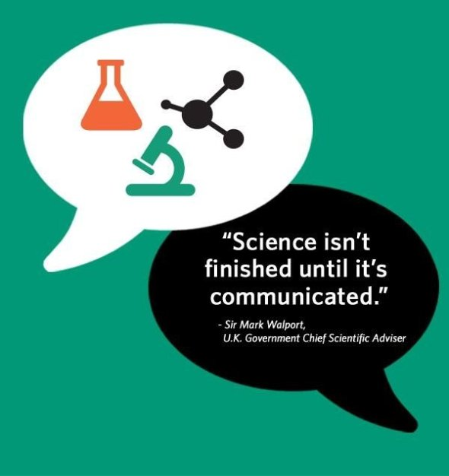
FRANCESCA SCIANITTI, INFN Communications – XXXII International Seminar of Nuclear and Subnuclear Physics – June 7-11, 2021

Slide 4
How researchers face the challenge of science communication?

Slide 5
1. Communicating science | Level of engagement
To inform and inspire the public | To consult and listen to public views | To collaborate with the public
Researchers informing and inspiring the public about their research | To better inform researchers on the publics’ views and concerns about their research, and also an opportunity to hear fresh perspectives and insights | Whereby researchers and the public work together on particular projects or help define future research direction, policy or implementation of research outcomes
participation in festivals; talks and presentations; digital engagement | public debates; online consultations; panels and user-groups | citizen science; co-production of knowledge; Patient and Public Involvement.
© University of Oxford – Public Engagement strategic plan

Slide 6
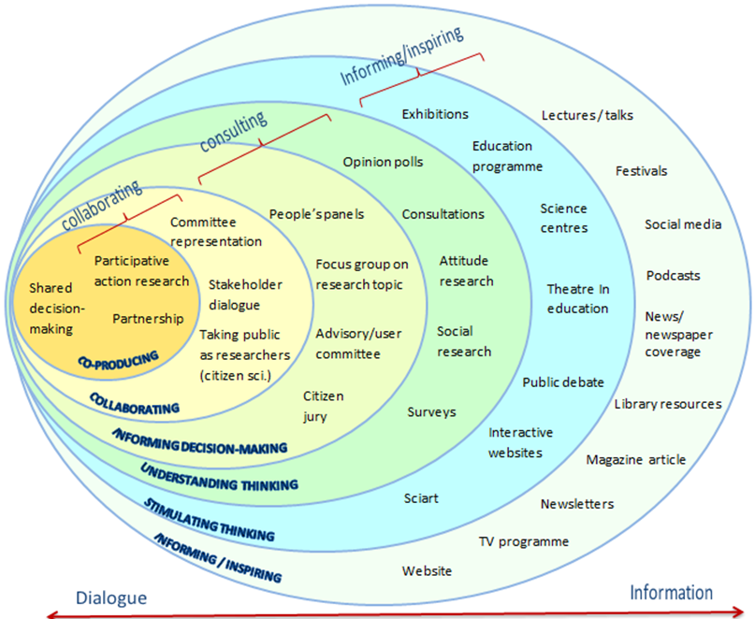
1. Communicating science | activities vs. engagement

Slide 7
2. Formats of Public Engagements I examples
Open Day (visit or lab activity) Researchers' Night presentation
Researchers involvement in long-term educational projects
Exhibition Science Café Demonstrative lab for schools Seminar/lecture for non-expert/expert audiences Public event at scientific conferences
Posters exhibition

Slide 8
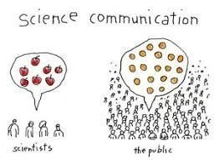
2. Publics| and others involved
SCIENTISTS - active researchers
PUBLICS - individuals outside of the practice of science
PRACTITIONERS - experts in designing and conducting PE activities
“General Public” doesn’t mean anything.
We have to ask ourselves:
who is our public
their expectations
their will to participate
their possibility to understand our words and actions
FRANCESCA SCIANITTI, INFN Communications – XXXII International Seminar of Nuclear and Subnuclear Physics – June 7-11, 2021

Slide 9
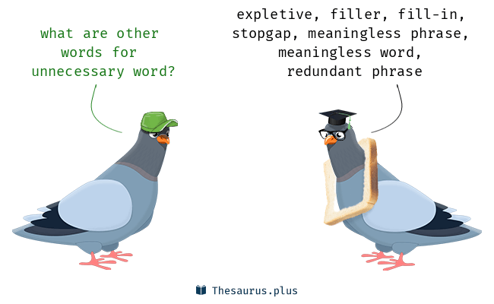
3. The language| the style of the communication
First question:
Who I’m talking to?
Any audience has a specific attitude to understand/to be engaged/to appreciate
The use of words, technical terms, concepts has to be weighted on the target
The style of the “conversation” can run from the institutional to the very informal one and should be chosen properly

Slide 10
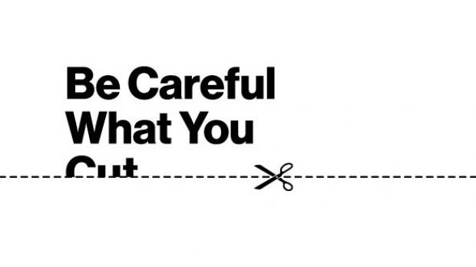
4. Stories| talking about your project
Your story is based on the five W’s you have in mind … thus you have in mind the story
Why | you do what you do
What | is the plan, the scheduled process
Where| will you conduct your research
When| do you expect to gather results
Who | is financing your project
Three elements have to be added to build a good story:
The storyboard (a logical sequence)
The non-storyboard (what would be illogical in the sequence)
The language (words to use or to not use)
FRANCESCA SCIANITTI, INFN Communications – XXXII International Seminar of Nuclear and Subnuclear Physics – June 7-11, 2021

Slide 11
4. Stories| the message
A story is something YOU tell to OTHERS to engage them with a content that is usually NEW for them and WELL KNOWN to you.
The science story must be:
True
Personal or correctly reported
Comprehensible
Interesting
Narratively complete
Short (some questions will remain without an answer)
“Complete in its structure” doesn’t mean exhaustive!

Slide 12
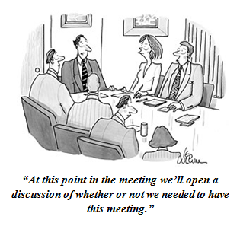
4. Stories| the non-storyboard
… even if you find them fascinating:
Deep or unnecessary details
Very technical aspects
Difficult concepts
Autoreferential issues
(merits should come out from the story)
The non-storyboard is made of what is
essential and interesting FOR YOU but not FOR OTHERS and not for your story
FRANCESCA SCIANITTI, INFN Communications – XXXII International Seminar of Nuclear and Subnuclear Physics – June 7-11, 2021

Slide 13
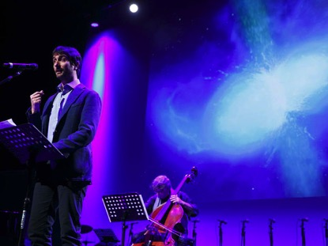
4. Stories| why not a simple speech
Following the psychologist and education scientist Jerome Seymour Bruner:
Human beings organize and manage their knowledge of the world following two main ways of thinking:
1_ The narrative thinking is the way people use to structure their own immediate experience.
2_The logical-scientific thinking: is the way in which human beings aim to clarify their knowledge to remove ambiguities.
When the two coexist, they mutually reinforce their capability to facilitate the process of meaning making.

Slide 14
4. Stories| a “story science” to communicate science
What do we mean with “STORIES”?
The «science of stories» can be used to produce persuasive and coherent science stories
the interplay between storytelling and culture, perceptions and science
→ emotional connection between scientists and their publics should.
The "story science” can help us to define our narrative framework and the key elements for a good story:
structure and setting
characters
plot and “moral”
FRANCESCA SCIANITTI, INFN Communications – XXXII International Seminar of Nuclear and Subnuclear Physics – June 7-11, 2021

Slide 15
4. Stories| the storyboard
The storyboard is made of:
Structure
the sequence is not improvised and include narrative key elements
Logic line
one concept logically follows the other (a good rule is: “never anticipate”)
Time line
The quantity and complexity of contents respect the time window at your disposal
FRANCESCA SCIANITTI, INFN Communications – XXXII International Seminar of Nuclear and Subnuclear Physics – June 7-11, 2021

Slide 16
Building a good story Independently from the PE format you choose
Understandable, engaging and persuasive
FRANCESCA SCIANITTI, INFN Communications – XXXII International Seminar of Nuclear and Subnuclear Physics – June 7-11, 2021

Slide 17
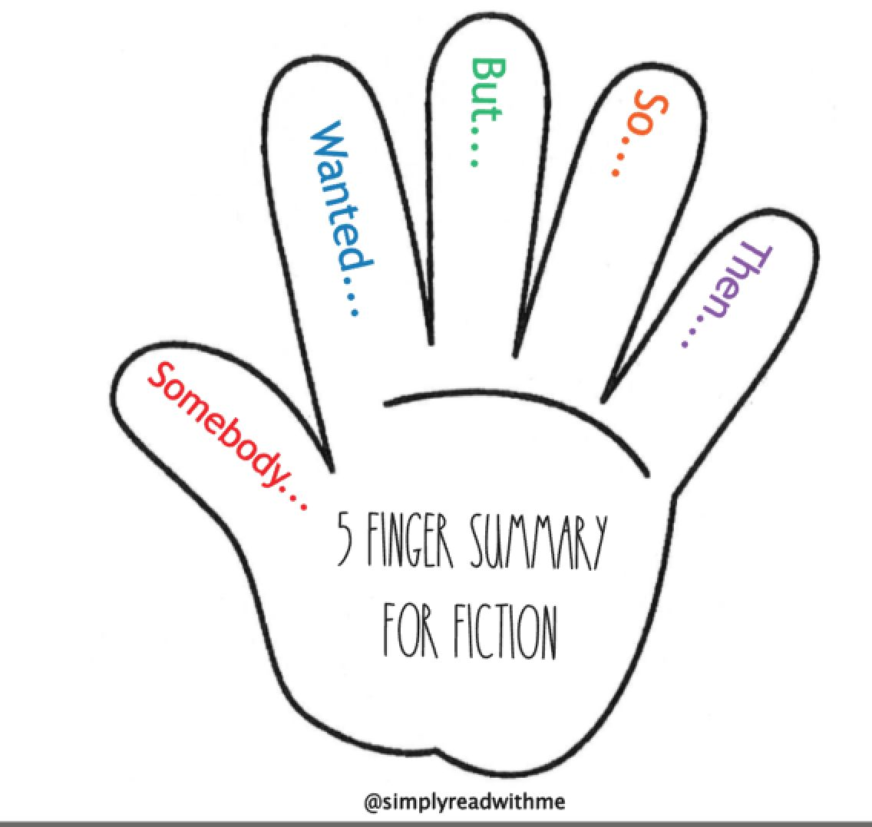
5. Structure of a story| key elements
Who is/are the characters: people/ideas/experiments/Physics objects/entities (gluons, neutrinos)
What is the setting made of: Infrastructure/laboratory/Space/ physics context (early universe, atomic nucleus)
Which is the problem to solve: Expected discovery/ nature of something/unexplained behaviours
Solution: discovery/explanation/New experiment/New Physics
Mood changing: long term experiment, very near discovery, epical discovery, deep uncertainty but big enthusiasm.

Slide 18
The Shapes of Stories Kurt Vonnegut
FRANCESCA SCIANITTI, INFN Communications – XXXII International Seminar of Nuclear and Subnuclear Physics – June 7-11, 2021

Slide 19
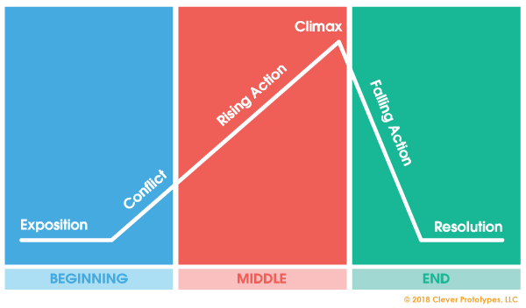
5. Structure of a story| … three acts?
The narrative arc:
Equlibrium
Disruption
New Equilibrium

Slide 20
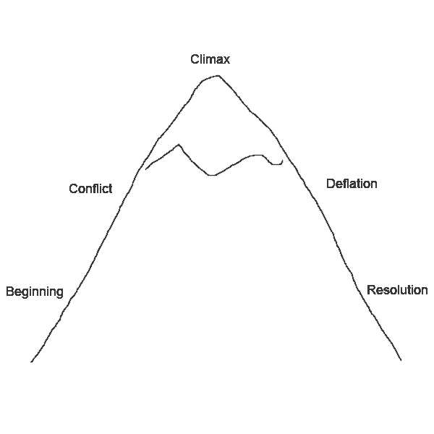
6. Examples of structures | … the Mountain
Useful to:
Telling how some challenges have been addressed Gradually increase the tension Ending the story satisfactorily
Examples:
The evolution of a past discovery/ The establishment of an idea, a shared paradigm An ongoing research adventure, a wait for discovery A positive progression: from research costs to innovation and societal benefits

Slide 21
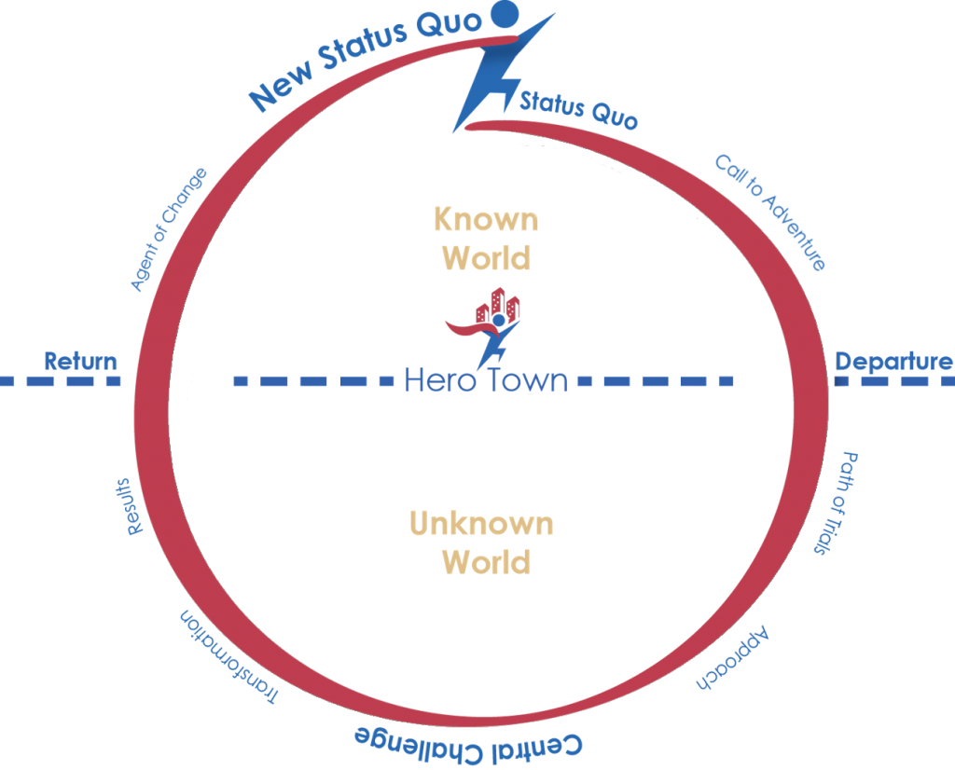
6. Examples of structures | … the Hero Journey
It involves:
A Hero (a person, a community, a team)
An initial scenario and a modified end scenario A "heroic" journey with overcoming obstacles The acquirement of new knowledge
Useful to:
Tell about a journey, an adventure, an experiment story Highlight the positives of exploring Describe the phases of a scenario change (new paradigm, someone’s theory)

Slide 22
6. Examples of structures | … the sparklines
Useful to:
Keeping the public's attention Generate wait and suspense Give rhythm without losing the thread of a sequence
Examples:
Time Travels: Possibility vs. Impossibility What is dark matter: Hypotheses and evidence vs. experiments/Known vs. unknown LHC history: from initial strategies/expectations to path changes (rigid timeline).

Slide 23
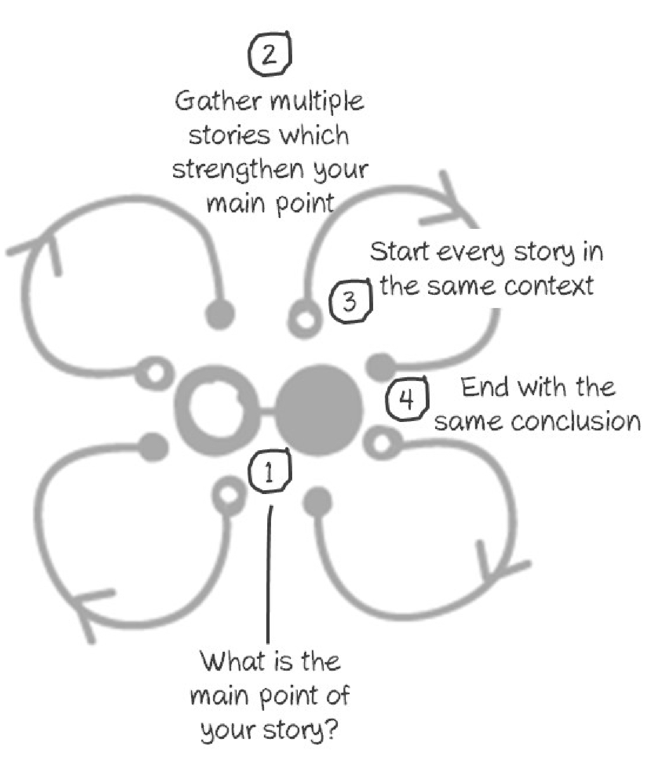
6. Examples of structures | … the Petal structure
Useful to:
Describe connections between threads in a story or process Show how different scenarios relate to a single idea Allow multiple speakers to talk around a guiding theme
Examples:
Innovation and research: physics and medicine/cultural heritage/computing/new materials Contemporary astronomy: different approaches. GW/neutrinos/gamma/optical Dark Universe: Dialogue between INFN, ASI and INAF rapresentatives

Slide 24
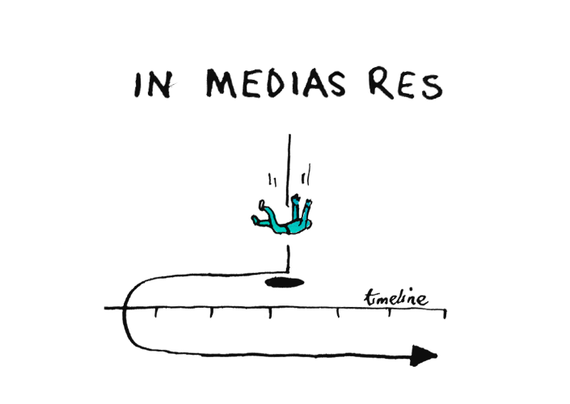
6. Examples of structures | … in Media Res
Useful when the story has a well-defined development to:
Capturing attention from the first moment Keep the audience suspended while waiting for an explanation Focus on a crucial moment in your story
Examples:
LHC is the coldest place in the universe Einstein is the unwitting inventor of GPS The 2015 gravitational wave was emitted at a distance of more than a billion light years

Slide 25
Why using narratives to talk about science - bibliography
Jones M.D., Crow D.A. (2017), How can we use the ‘science of stories’ to produce persuasive scientific stories?, Palmgrave Commuications, 3:53, Nature
Shanahan E., Jones M.D., McBeth M.K., Radaelli C.M. (2017) The Narrative Policy Framework. In: Weible C, Sabatier P (eds) Theories of the Policy Process. 4th edn, Westview Press, p 173–213
Herman D. (2003) Narrative theory and the cognitive sciences: Stanford Univ Center for the Study.
Dahlstrom, Michael F. Using narratives and storytelling to communicate science with non expert audiences, PNAS vol 111 suppl. 4 September 16, 2014 [www.pnas.org/cgi/doi/10.1073/pnas. 1320645111]
Irwin, A. The Politics of Talk: Coming to Terms with the ‘New’ Scientific Governance, Social Studies of Science 36(2): 299–320
Bruner, J. S. Actual minds. Possible words, Harvard University Press, Cambridge, 1986.
Bruner, J. (1992). La ricerca del significato. Bollati Boringhieri.
Bruner, J. (2004). Narratives of science. In Reconsidering science learning, (pp. 90-98). Routledge Farme
FRANCESCA SCIANITTI, INFN Communications – XXXII International Seminar of Nuclear and Subnuclear Physics – June 7-11, 2021

Slide 26
Around your PE activity
Communication, Budget, evaluation
FRANCESCA SCIANITTI, INFN Communications – XXXII International Seminar of Nuclear and Subnuclear Physics – June 7-11, 2021

Slide 27
7.Communication| how choosing a title
EVOQUES through images, irony, ideas, literary quotes, puns TELLS what the event is about INVITE the public DEFINE the style
THE SUBTITLE (always useful whenever possible) it reveals the content and the style
FRANCESCA SCIANITTI, INFN Communications – XXXII International Seminar of Nuclear and Subnuclear Physics – June 7-11, 2021

Slide 28
7. Communication| The event in a few lines
CONFERENCE-SHOW
LIGHTS AND WAVES RHAPSODY. A THREE-VOICE MUSIC STORY
an event by the National Institute of Nuclear Physics, the Italian space agency, with the contribution of the National Institute of Astrophysics
(SUBJECT→) The story is that of the most extraordinary discovery in physics of the last 100 years: the first detection of gravitational waves emitted by the fusion of neutron stars, which took place in perfect synergy between very different instruments. A discovery that changed the image of our universe. (STYLE →) In a non-random alternation of words and music, the two-act narrative is entrusted to the protagonists of discovery: (PROTAGONISTS →) exceptional physicists who, thanks to different tools, technologies and knowledge, have rassembled the image (CONTENUTS →) of an extraordinary cosmic event, describing in detail its characteristics and opening the new era of multi-messaging astronomy. (ARTISTS →) The musical contribution to the narrative participates in the choral message. Alternating with the voice of scientists, the music of the jazz trio and the Open Orchestra, returns the image of the specific and at the same time synergistic contribution of three ways of investigating the universe: (CONTENTS →) that of fundamental physics, with gravitational wave detectors, astrophysics, electromagnetic signal detectors from cosmic sources, and instruments orbiting space. (1100 types)

Slide 29
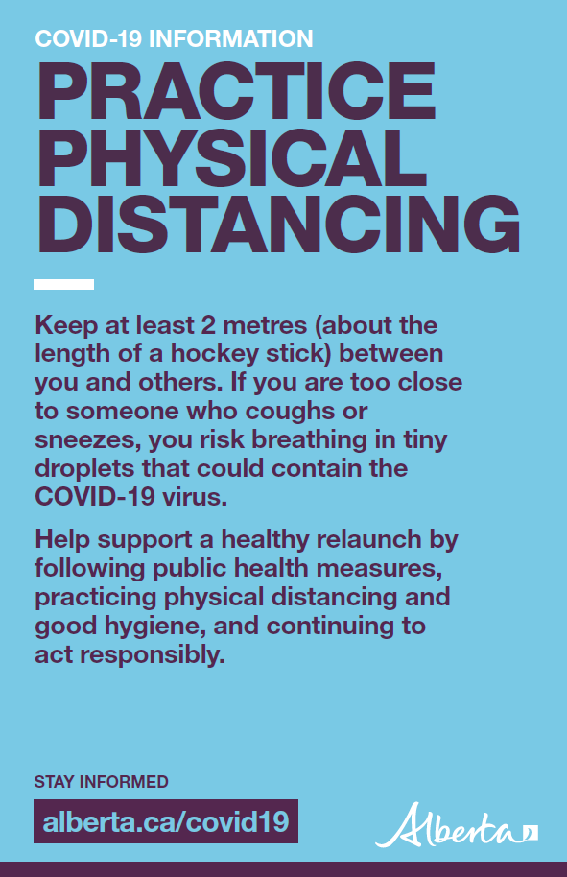
7. Visual communication| the importance of a clear and direct communication

Slide 30
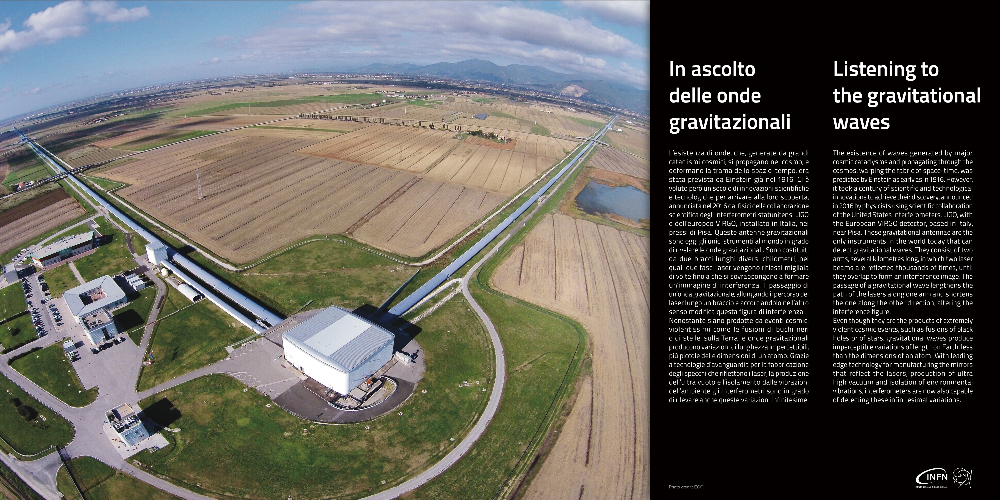
7. Visual communication| A good example of poster

Slide 31
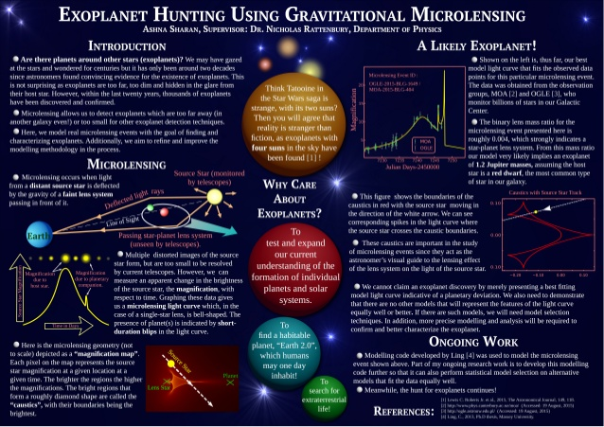
7. Visual communication| A bad example of poster

Slide 32
8. How … much | Budget
Some budget could be necessary:
To buy objects for demonstrations
To buy materials to build an exhibit
To pay the SIAE for copyright on videos, readings, music
To pay travel and stay for your invited speakers/contributors
To pay a professional moderator/an artist/a performer
To rent technical material for your public event: screen, projector, lights,
microphones, streaming system, simultaneous translation …
To rent the place where staging your activity (theatre, auditorium…)
To pay professionals to create multimedia installations or a videos
To pay professionals to design an exhibition (architect, stand builder …)
50 euro
50 keuro

Slide 33
9. Evaluation| impact and appreciation of a single event
 | General Appreciation | Knowledge | Interest | Image&brand
Narration | Entertainment | Language | Research | INFN
Contents | Story | Contents (before and after) | Physics/Science | Fundamental research
People | Main Actors | Research policy | Career | Profession
Towards a quantitative and goals-based evaluation of PE projects →
FRANCESCA SCIANITTI, INFN Communications – XXXII International Seminar of Nuclear and Subnuclear Physics – June 7-11, 2021

Slide 34
 | Objective | Metric | How measured |  | When
Goal 1. | Inform and motivate people on fundamental (or a specific field) research benefits
 | Reach a number of people with specific contents including research benefits; get % of them to follow up within Y weeks of outreach | N. of people reached Increase in the newsletter or the mailing list subscriptions, socials or website hits as a result of the outreach activity. | Track people attending the event/events and those linking to that remotely. Ask socials and websites visitors how they get there. | Start tracking within X weeks of outreach Tally ongoing results periodically | Start tracking within X weeks of outreach Tally ongoing results periodically
Goal 2. | Build credibility for the research program and its benefits through partners the community trusts | Inform and motivate people on fundamental research benefits
 | Recruit partner organizations (local or national) to actively promote the research program - or support specific outreach events (festivals or campaigns) | N. of partners committed to join Response rate on materials distributed by partners Leads generated by partner events | Sum of organizations that have agreed to partner Sum of organizations that fulfilled agreement Rate of return on partner materials or follow-up from partner outreach efforts | Assess periodically After any partner outreach effort or event | Assess periodically After any partner outreach effort or event
Goal 3. | Demonstrate the benefits of research to generate interest and self motivated political decisions.
 | Hold a N. of events with a call to action to sign up for a second step of deeper information/or subscribe for a newsletter/magazine/website. | N. of satisfied individuals in your public N. of event attendee N. of participants signing up for an assessment after events Conversation rate of assessment | Sum of attendees per event Dimension of the satisfied public resulting from event referrals (questionnaire). Sum of requested assessments resulting from event referrals (questionnaire) | Assess after each event Monitor periodically | Assess after each event Monitor periodically
Fonte: U.S. Departement of Energy

Slide 35
Practical Module
Designing your PE activity
FRANCESCA SCIANITTI, GIORGIO CHIARELLI – XXXII International Seminar of Nuclear and Subnuclear Physics – June 7-11, 2021

Slide 36
Practical Module| Design your PE activity

Slide 37
Practical Module| Design your PE activity

Slide 38
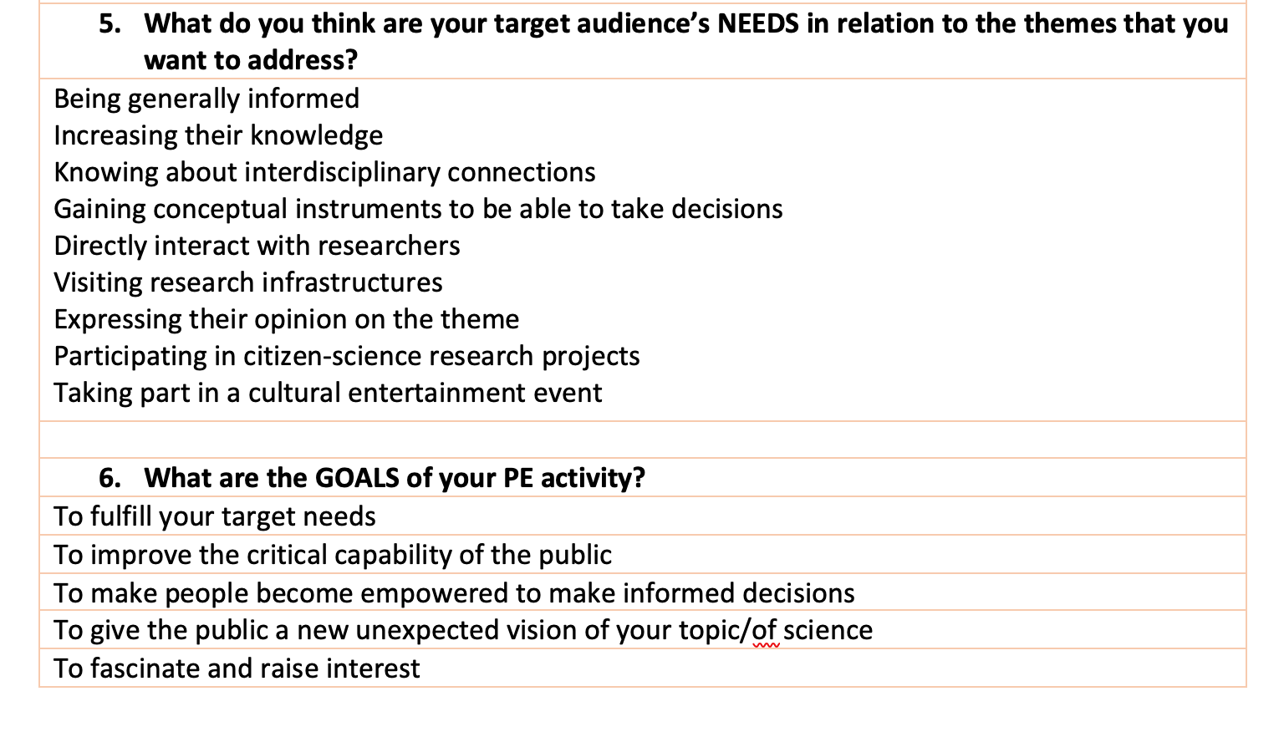
Practical Module| Design your PE activity

Slide 39
Practical Module| Design your PE activity
FRANCESCA SCIANITTI, INFN Communications – XXXII International Seminar of Nuclear and Subnuclear Physics – June 7-11, 2021

Slide 40
Practical Module| Design your PE activity

Slide 42
