Slide 1



The iTHEPHY project and its software platform
Enhancing remote teacher-student collaboration
Notes:
Hi everyone, my name is Gianluca Peco and I collaborate with IT team of the Bologna INFN department. I'm used to be sysadmin dealing with security and networks but in this context I'm going to present the iTHEPHY project and my contribution to it, wich was focused on the software platform integration.

Slide 2
Agenda
01
iTHEPHY EU funded Project
Originating idea and project development
02
ISHEP Cargese school and TANDEM Project
Practical implementation
03
IaaS ICT e-learning platform
ICT infrastructure
04
PaaS migration and software maintenance
New ideas for next steps
Notes:
The presentation will be divided in four parts. In the first one, I will illustrate the features of the master degree E-learning project iTHEPHY. In the second part I will focus on the two main educational activities that have been carried out as part of the project. In the third part I will illustrate the existing IaaS platform and in the last one the first steps toward the evolution of the platform to a microservices-based PaaS.

Slide 3

Project funded by the European Community / AGENZIA NAZIONALE INDIRE
Budget: 368990 euro - Coordinator: UNIBO - PI: Angelo Carbone
Who is funded?
  universities
  research Institutions
  industries
Aim?
improve the teaching quality
increase the collaboration among European institutions
promote the usage of information technologies tools
ensure education and research are mutually reinforcing
promote internationalization and mobility
KA2 - Cooperation for Innovation and the Exchange of Good Practices
KA203 - Strategic Partnerships for Higher Education
Notes:
The iTHEPHY project was funded by the European community. Entities allowed to apply are Universities, research institutes and industries. What are the purposes of this funding? Mainly:
improve the teaching quality
increase the collaboration among European institutions
promote the usage of information technologies tools
ensure education and research are mutually reinforcing
and
promote internationalization and mobility

Slide 4

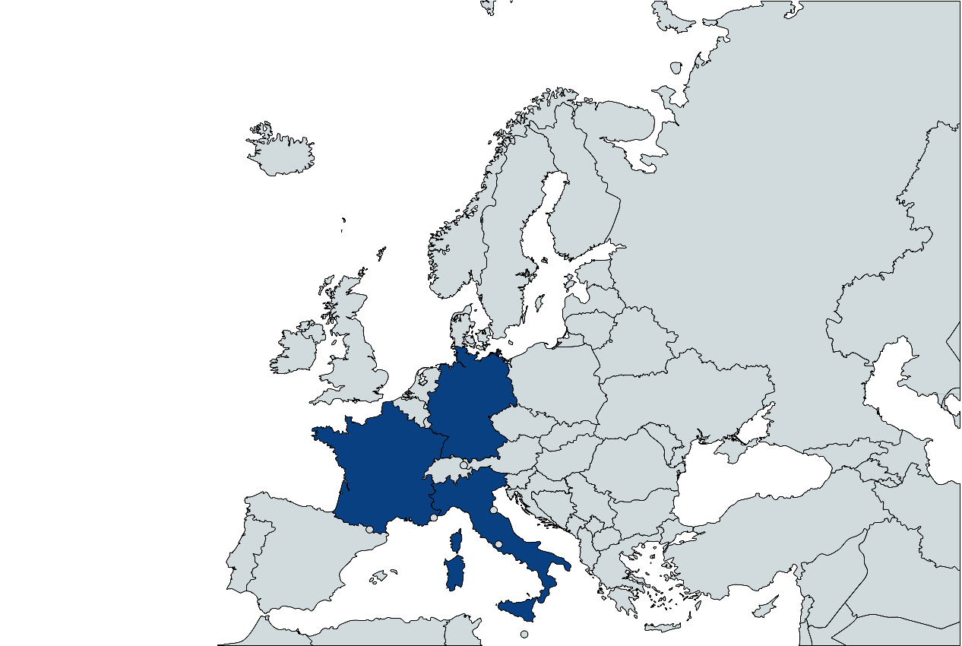
The idea to apply for this project started after 3 years of collaboration between Bologna, the University of Dortmund and the University of Clermont-Auvergne
Three editions (2015/16/17) of the ISHEP spring school (Cargese, Corsica) for students enrolled in the master degree of the three universities (and PhD students)
We also received funding for 15k euro from the Franco-German University for the Spring School and for the 2017 and 2018 editions
The project is also co-funded (about 20k euro) by the University of Bologna to include non-EU students
The consortium: a synergy between
Universities and research institutions
Notes:
Three is the perfect number. The general idea comes from the three-year collaboration of three European universities and as many research institutes. It represents the evolution of the participation in the realization of three editions of the Cargese school that had already been financed in the past by the participating universities

Slide 5
iTHEPHY project
Main idea:
  Team of students (2nd year of master degree) from each university to work
  together to a real research project
  Each team will be supervised by a teacher/researcher from the
  consortium
Goal:
  Increase the internationalization level of the master degree
  Give to the students team-work skills
  Promote international mobility
The project foresees 3 Intellectual Outputs:
  Guided exercises with solution to be implemented on e-learning platform
    exercise with full and partial solutions
  A web-based platform to support the team during the project
    Video web-conference plugin
    Chat room
    Shared area
    Scheduler/agenda for planning meetings between teachers and students and between students
    A project management tool for tracking projects, assigning sub-tasks and tracking their progress…
  A final document that reports the experience with the aim of replicability of the project in other master
  degrees (not only in physics)
Notes:
The basic idea is: groups of students in the second year of the master degree, coming from all the involved universities, work together on a real research project. The groups are supervised by researchers and teachers from the participating universities.
The objective is multiple-folded, it aims to increase the internationalization of the master degree, to engage studens in team work research activities and to promote their mobility inside Europe.
Three intellectual outputs have to be produced: the first one is a web-based platform to assist the teams with collaborations tools; the second intellectual output is a series of exercises with solutions to be included in the platform; the third one is a final document that reports the experiences and supports replicability in other master degrees, even in different disciplines

Slide 6
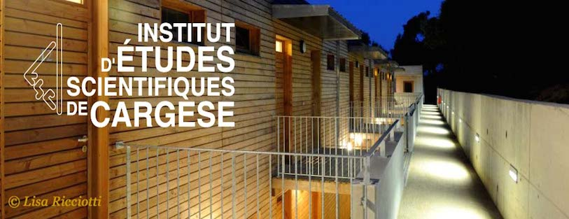
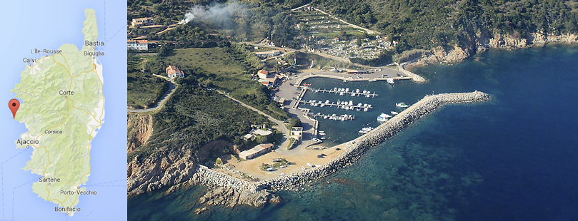
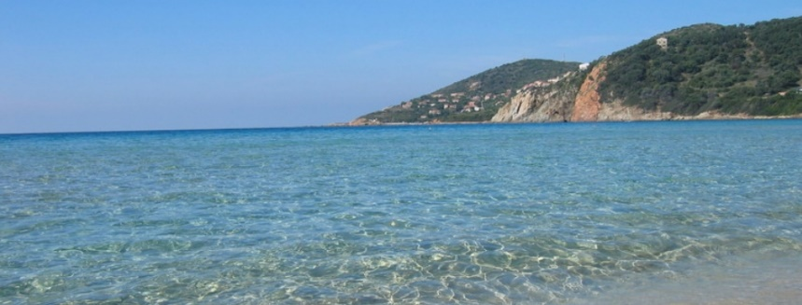
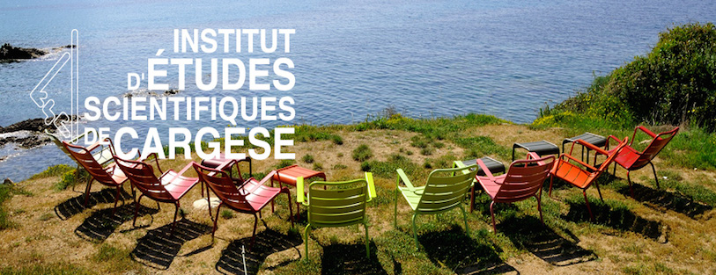
Summer/Spring Schools
(Cargese, Corsica)
We received funds for the orgaizazion of two editions of the International School of High Energy Physics (ISHEP)
  2018-edition focused on testing the new e-learning materials developed
  and the new web-based platform
  2019-edition dedicated to present results of the teams (tandem). Students and supervisor meet in person to develop the project
Both schools included lectures and seminars
Notes:
We received funds for two school editions: 2018 and 2019 the first one focused on testing the e-learning material and the platform. The second one dedicated to present the results of teams (tandem projects). Both editions included lectures and seminars

Slide 7
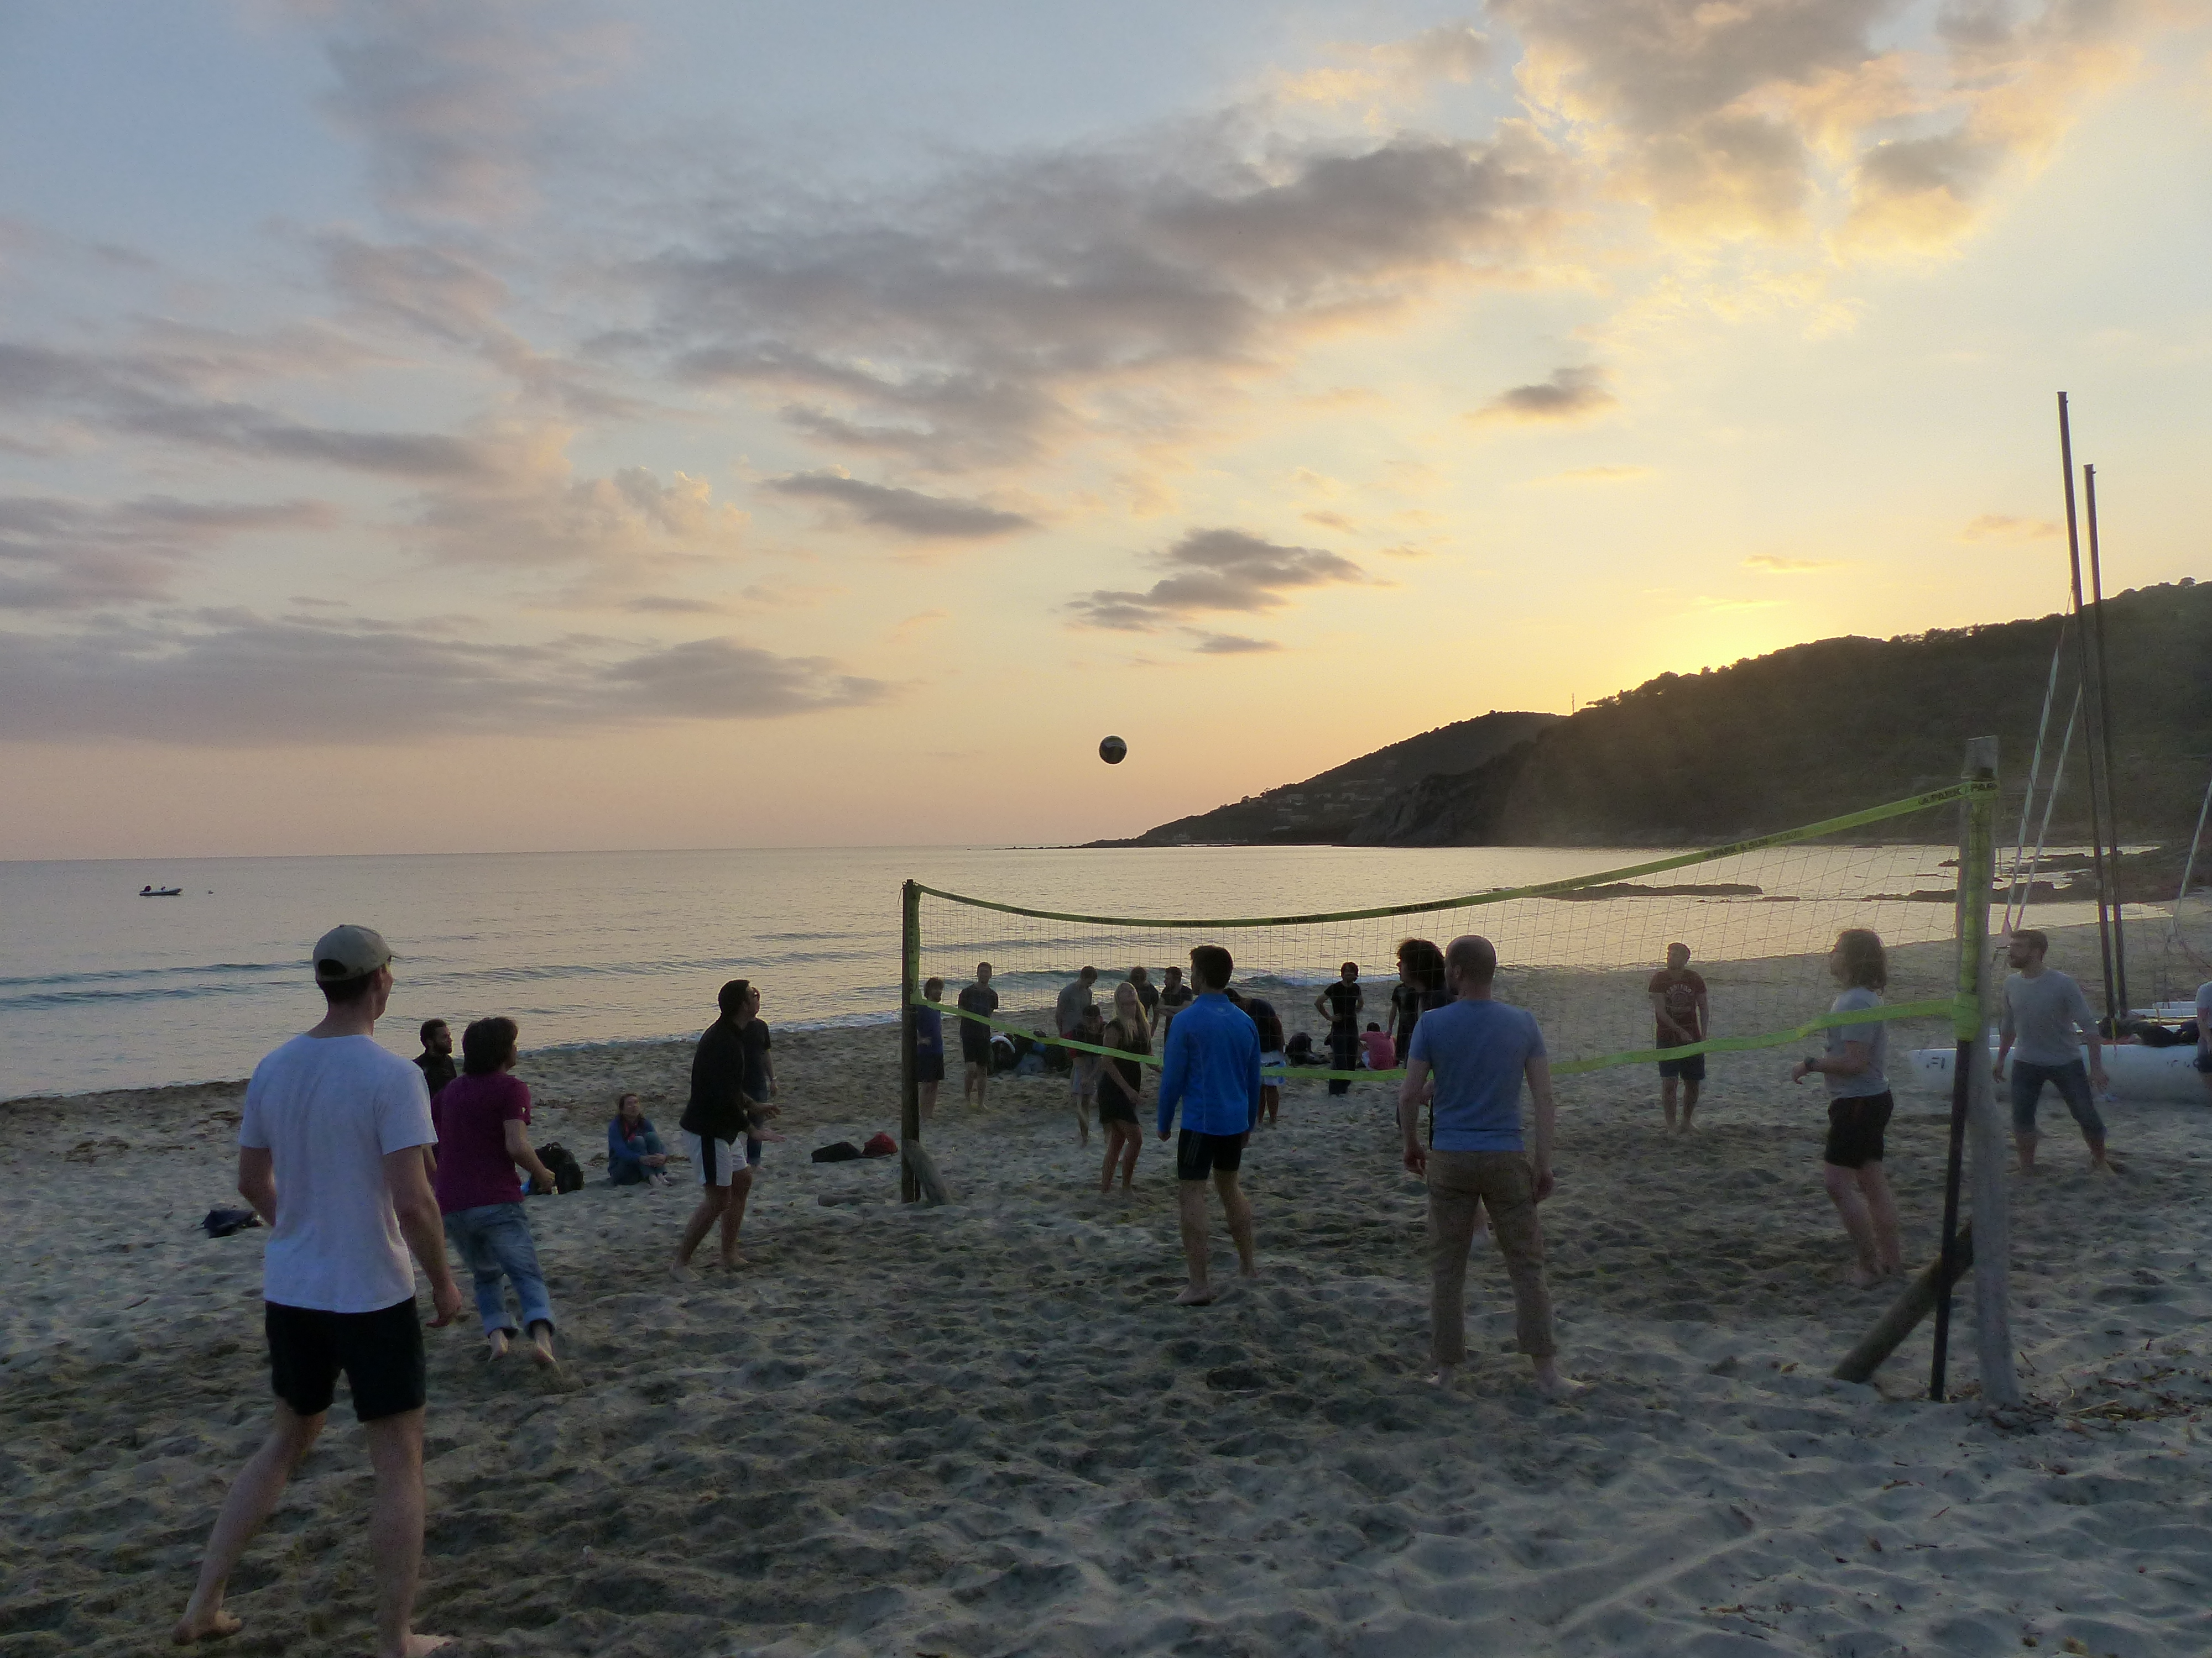

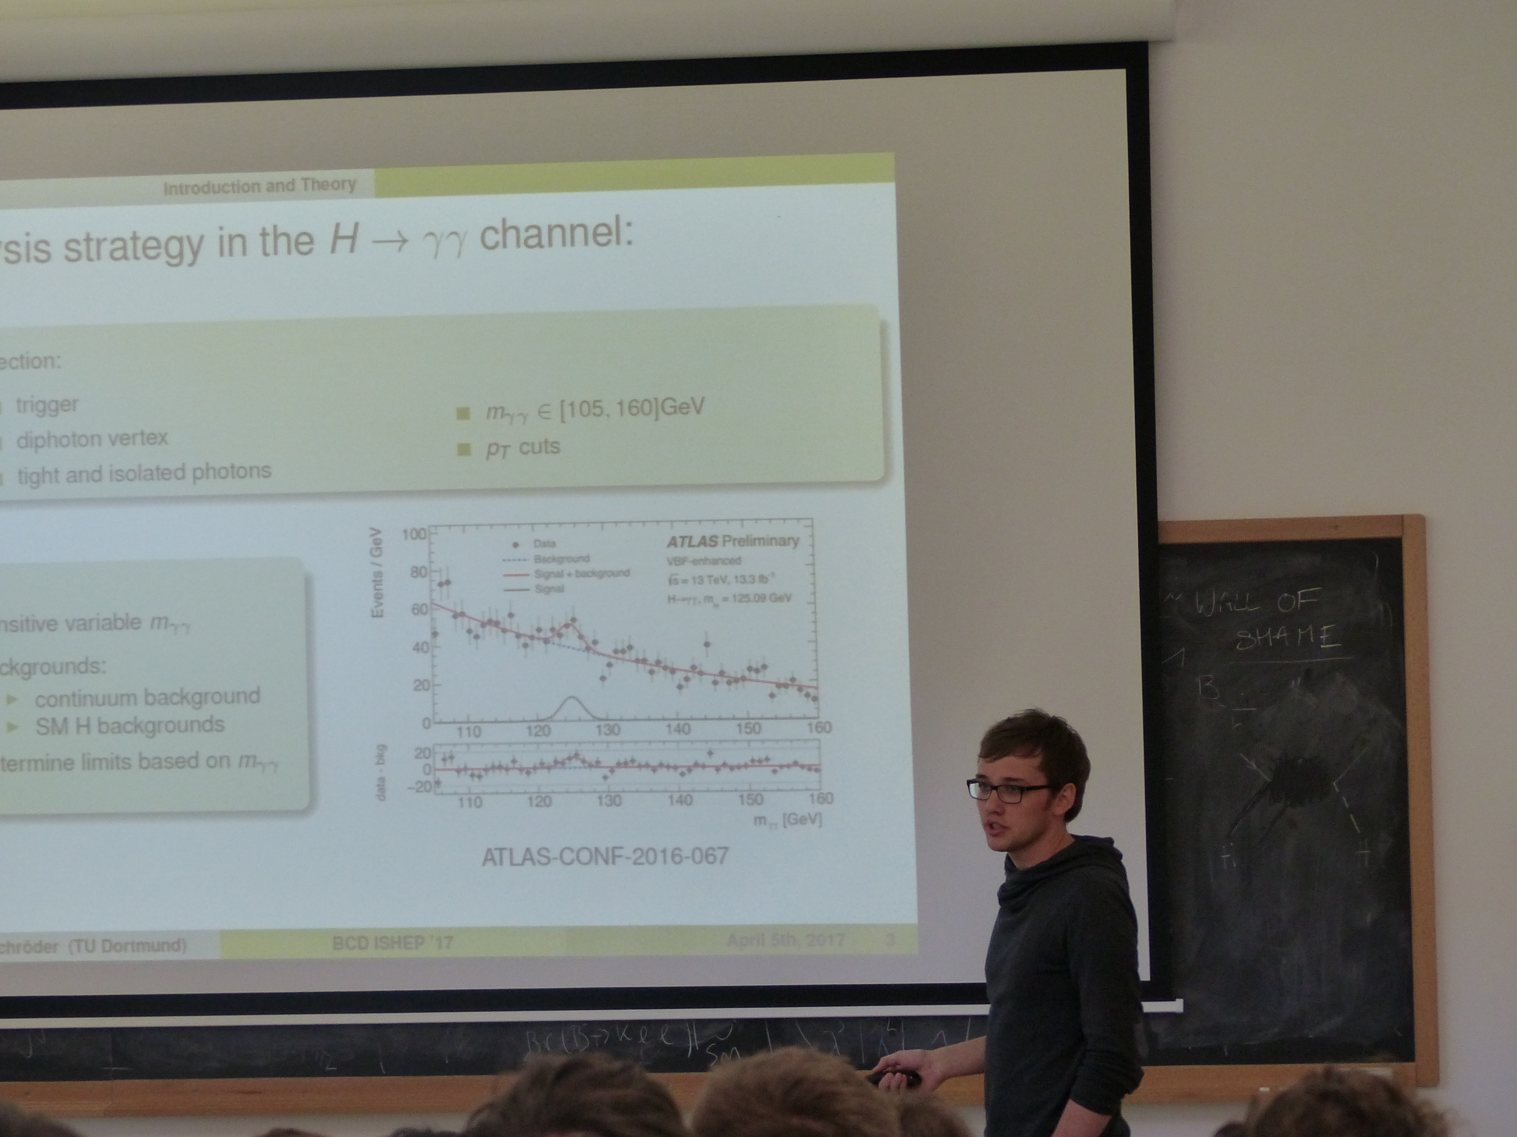
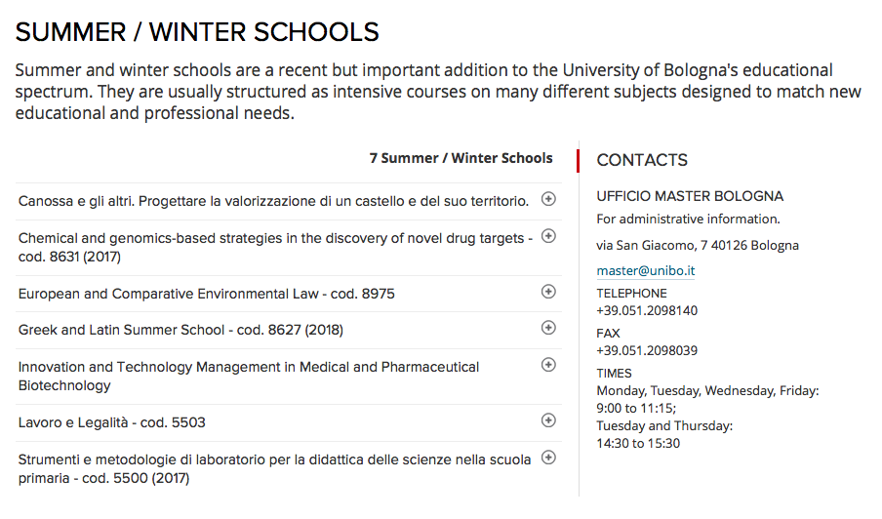
Summer/Spring Schools: new models for physics teaching
Official summer school of UNIBO
Possibility to deliver 6-ECTS (CFU)
For the future (after 2020) the
School + the project activities can be
recognize as one of the activities
inside the Master Degree,
corresponding to 6 ECTS
We will be able to deliver credits to
European students
Notes:
In the future (after 2020) the School and the project activities will be recognized as one of the activities inside the Master Degree in physics, corresponding to 6 ECTS.
We will be able to deliver credits to European students
At the Cargese school there are essentially two ways to learn physics, the first is more classic, the second quite innovative...

Slide 8

TANDEM: What’s all this about?
The idea of the whole project is to allow students to “emulate” what researchers do in their activity in an international context
What are the ingredients to perform a research program?
  Project: an idea which will be developed and transformed in something “real”
  Target: a starting date and a completion date
  Timeline: organize a calendar, considering all the intermediate steps, indicating when it’s
  time to show preliminary results to other colleagues, to your supervisors etc
  Document: product where you describe the details of your method, what you did and what you obtained
  Present final results to an international conference: the students have this possibility.
  It will be the ISHEP school in Cargese…
Notes:
The second activity inside iTHEPHY is TANDEM. Essentially the idea is to allow students to emulate what researchers really do in an international context
What are the ingredient to perform a research activity ?
A project, an idea
A Target , an end line
A Timeline, a calendar
A Document, a product describing the work
Presentation of results

Slide 9
Tandem project in practice
But the students are not (yet) real researchers! They are (still)
students… and by the way this a teaching activity, not a real research, so they need:
  Supervisors, which will guide them in the various steps of the project
  Tools, which will allow them to communicate, exchange files, material, documents… ideas
  They will not see results published on Nature, but they will see results transformed in ECTS credits, after a formal examination
Last year 16+2 students were on board:
  10 from Unibo, 4 from CF, 2 from TUD
  1 from Colombia and 1 from Russia
2019/2020 is starting right now
Notes:
But as students are not yet researchers they need
Supervision and collaborative tools (Redmine, RoketChat and Jitsi).
They will not see their work published in Nature, but transformed into ECTS credits.
Last year 18 students participated in TANDEM
2019/2020 is starting right now

Slide 10
Section 3-4
IaaS and PaaS platform
Notes:
And now something more technical. I will try to explain the choices made both in relation to the type of application and the type of license (call requirement). I will try to illustrate the technical choices adopted for the IO1 also in infrastructural terms and the activity in progress (outside the project scope) to evolve the platform into a PaaS object

Slide 11
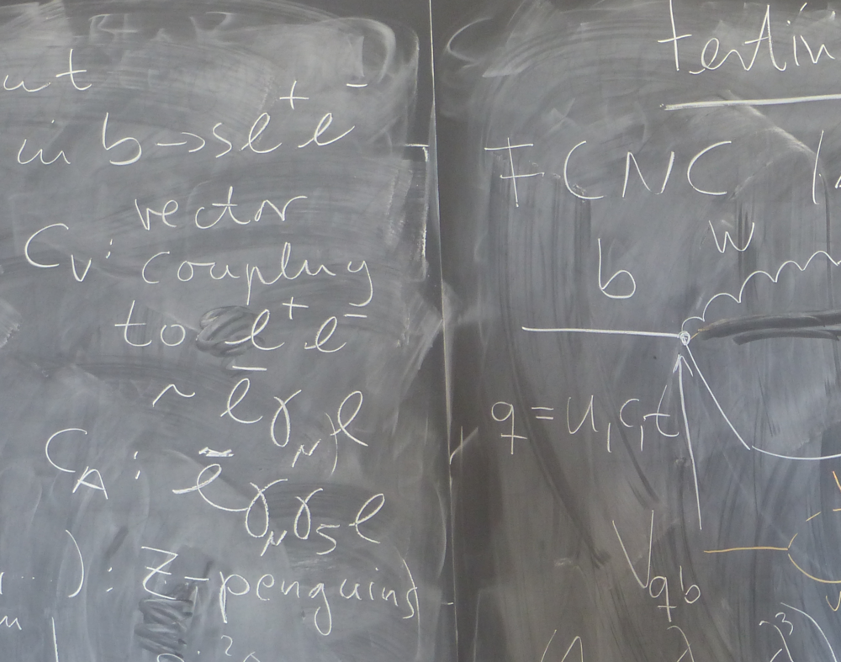
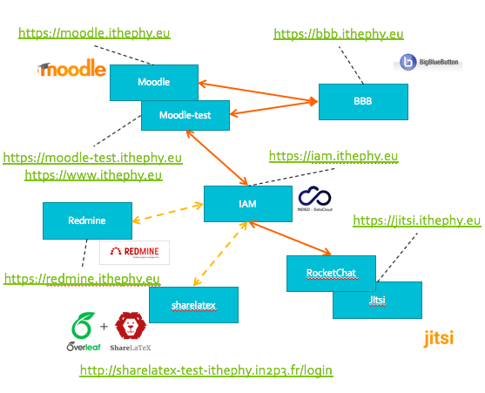
iTHEPHY platform
Made with FOSS software
Rocket.Chat
Chat portal with room and channel support
Integrated with Jitsi meet for audio/video
Moodle
Redmine
E-learning platform with a rich plugin marketplace
Project and management system with calendar,wiki and reporting system
Indigo
IAM
BigBlueButton
Sharelatex
Video lesson platform with recording option
Online realtime collaboration system on Latex document
Notes:
The building blocks put together in order to build the integrated platform are:
Moodle as LMS historically one of the most widely used e-leraning platforms
Bigbluebutton a non-default moodle plugin (now also stand-alone), that allows to create interactive video lessons and to record them (webinar, documentation, interactive learning)
Rocket.Chat: chat system with channel and room integrated with Jitsi (video conference) and Bigbluebutton
Redmine for project management, calendar, agenda and gantt charts
Sharelatex for real time shared latex editing
The front-end apps are authenticated by Indigo IAM using oauth2 protocol
The back-end apps are authenticated by the frontend ones via JWT API call.
Thanks to IAM teachers can take adavantage from a common authorization and user management system

Slide 12
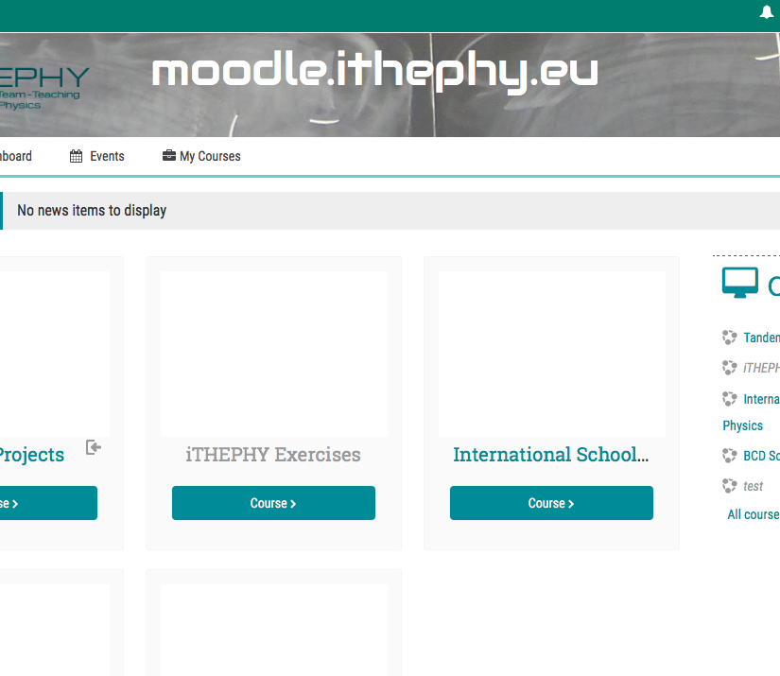
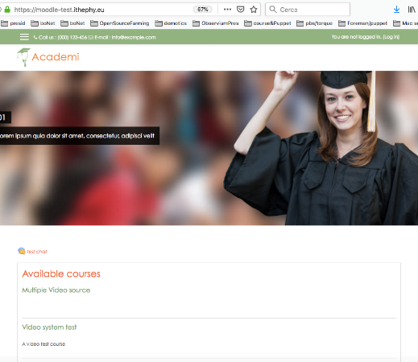
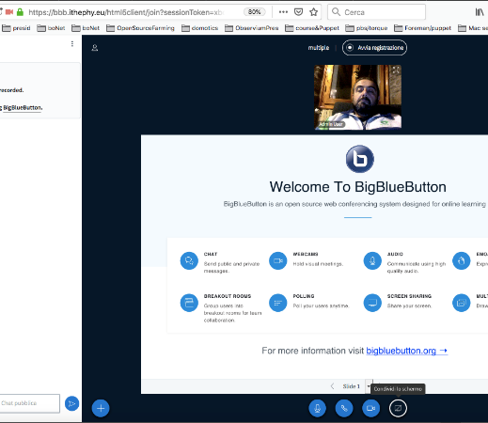
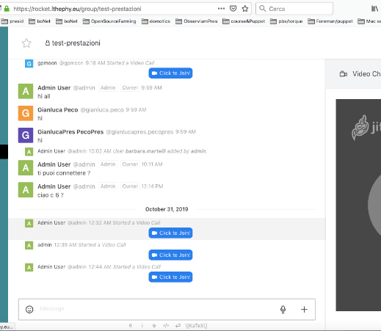
iTHEPHY IO1
e-learning and collaborative platform
moodle
moodle-test
BigBlueButton
Rocket.Chat
https://docs.moodle.org/35/en/Installation_quick_guide
https://docs.moodle.org/37/en/Installation_quick_guide
http://docs.bigbluebutton.org/2.2/install.html
https://rocket.chat/docs/installation/docker-containers/
Moodle is a free, online Learning Management System with a big community
Latest stable for developing and course testing purpose
New theme and innovative plugins
A video lesson tool with interactive collaboration whiteboard, online chat module and video recrding session
Chat,channel, room, bot, video, audio flexible app
Notes:
The choice regarding the e-learning platform that would comply with the project specifications was almost obliged by the fact that all the participating universities had a Moodle solution already in production as an institutional system. The platform is installed in two versions: one is a stable release for the production deployment, it si updated annually (except for security updates which are applied in a timely manner). The other platform version is the latest release and is deployed for testing and development
BigBlueButton has been chosen because it can be easily integrated into Moodle, it has interesting features such as the use of multi-platform html5 webrtc clients and the integration of Etherpads for shared notes together with a whiteboard integrated into the presentation
Rocket.Chat is a chat system chosen mainly because it is widely used at INFN as it is our institutional chat platform. It has all the requirements needed by the project such as integrability with Jitsi and BigBlueButton

Slide 13
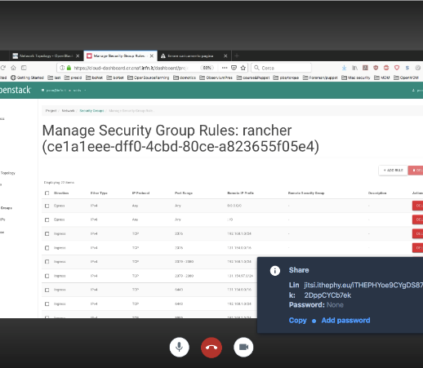
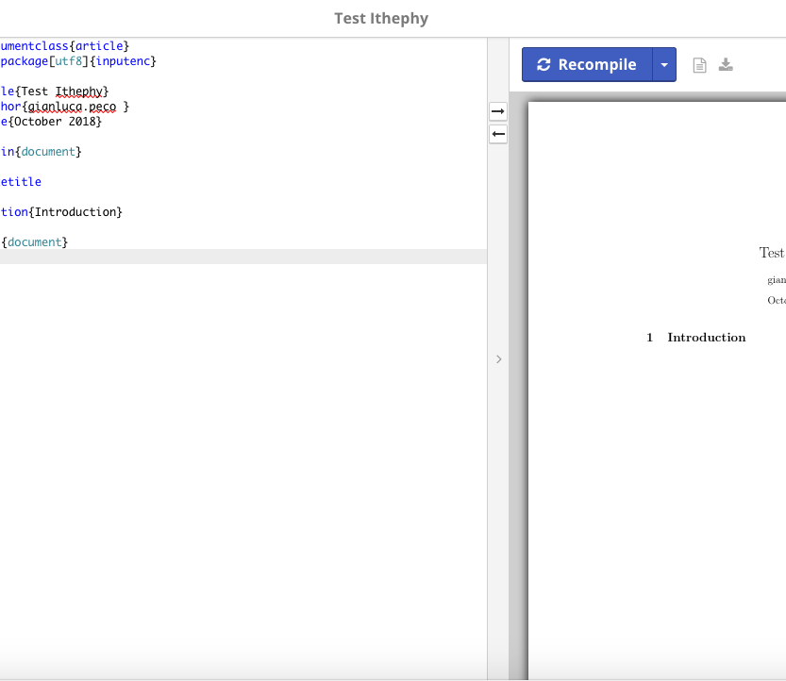
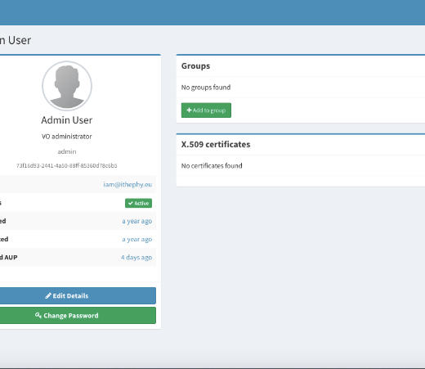
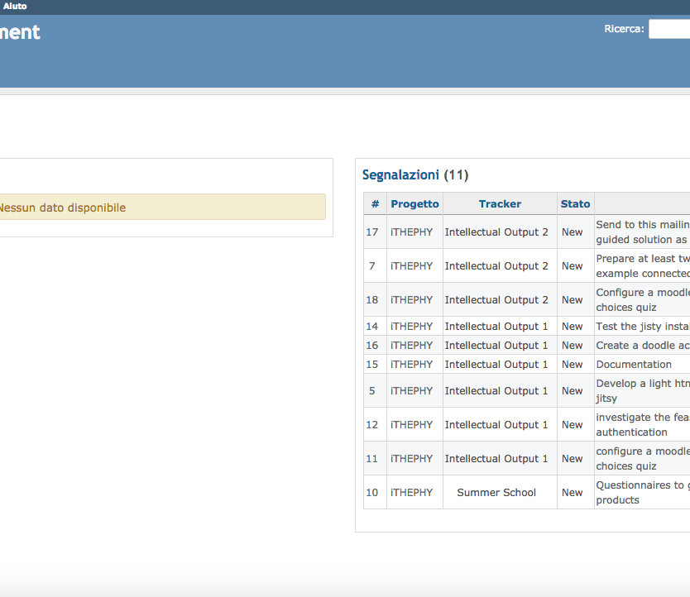
iTHEPHY IO1
e-learning and collaborative platform
JITSI-MEET
SHARELATEX
INDIGO IAM
REDMINE
https://github.com/jitsi/jitsi-meet/blob/master/doc/manual-install.md
https://github.com/overleaf/overleaf/wiki/Quick-Start-Guide
https://indigo-iam.github.io/docs/v/current/admin-guide/basic_conf.html
https://www.redmine.org/projects/redmine/wiki/RedmineInstall
Jitsi is a set of open-source projects that allows you to easily build and deploy secure videoconferencing solutions
Now overleaf is an online latex collaborative suite. Edit and compile directly on your web browser
A layer where identities, enrollment, group membership and authorization policies can be managed in an homogeneous way
Redmine is a flexible project management web application written using Ruby on Rails framework.
Notes:
Jitsi fully respects the platform requirements for audio / video conferencing, it is technologically advanced and widely supported. Not all features are supported by all browsers (Chrome is the suggested browser, Firefox is well supported, and desktop apps for other systems are available). A co-compatibility matrix is ​​available as well.
Sharelatex/Overleaf was the only solution for shared editing in latex at the time of platform deployment.
Indigo IAM allowed us to manage authorizations and authentications in an integrated and convenient way. It exploits oauth2/openID-connect for applications and provides a module for federation integration (idem / edugain)
Redmine, as a project management system had other competitors, we chose it mainly because it’s completely open source and provides all the required tools such as project management, calendar and agenda, in addition to traditional documentation tools (wiki, gantt charts, etc.)

Slide 14
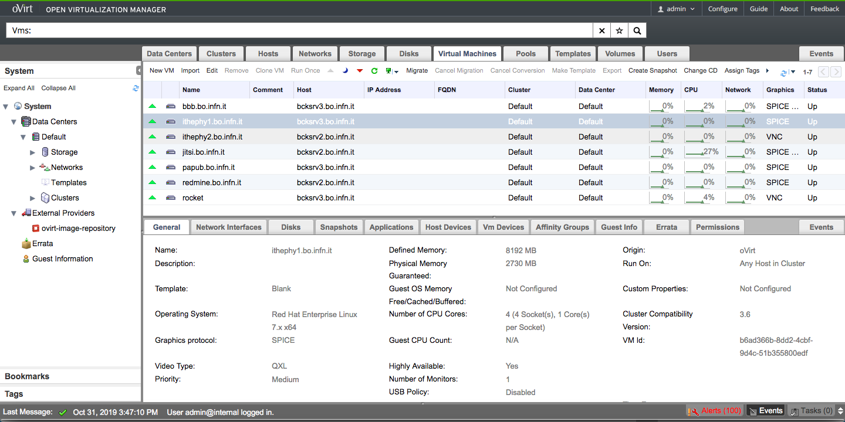
RedHat Ovirt on-premise HA
IaaS iTHEPHY infrastructure
Quite easy to deploy
The solidity of the past
Quite easy to maintain
Why not on bare-metal ???
Highly customizable
The System in production is based on the INFN-Bo IaaS service infrastructure based on an Ovirt cluster
Bi-processor Xeon multicore storage SAN Fiber channel
The provisioning of resources performed in manual mode with installation via PXE-boot linux distro and official guide of the application
Centos 7 - ubuntu 16.04 LTS - docker-compose
Hardening so guest with ufw / iptables app-armor selinux fail2ban
Ovirt native HighAvailability for Businness Continuity
Ovirt snapshot and cloning for Disaster Recovery
In stable production for 2 years
IO1 provides OVA files on a six-monthly basis
Based on consolidated platform
Almost dedicated physical resource
Necessity of underline fixed infrastructure
Difficult to export
Difficult to use in multi-institution scenario
Notes:
Il sistema in produzione si basa su risorse

Slide 15
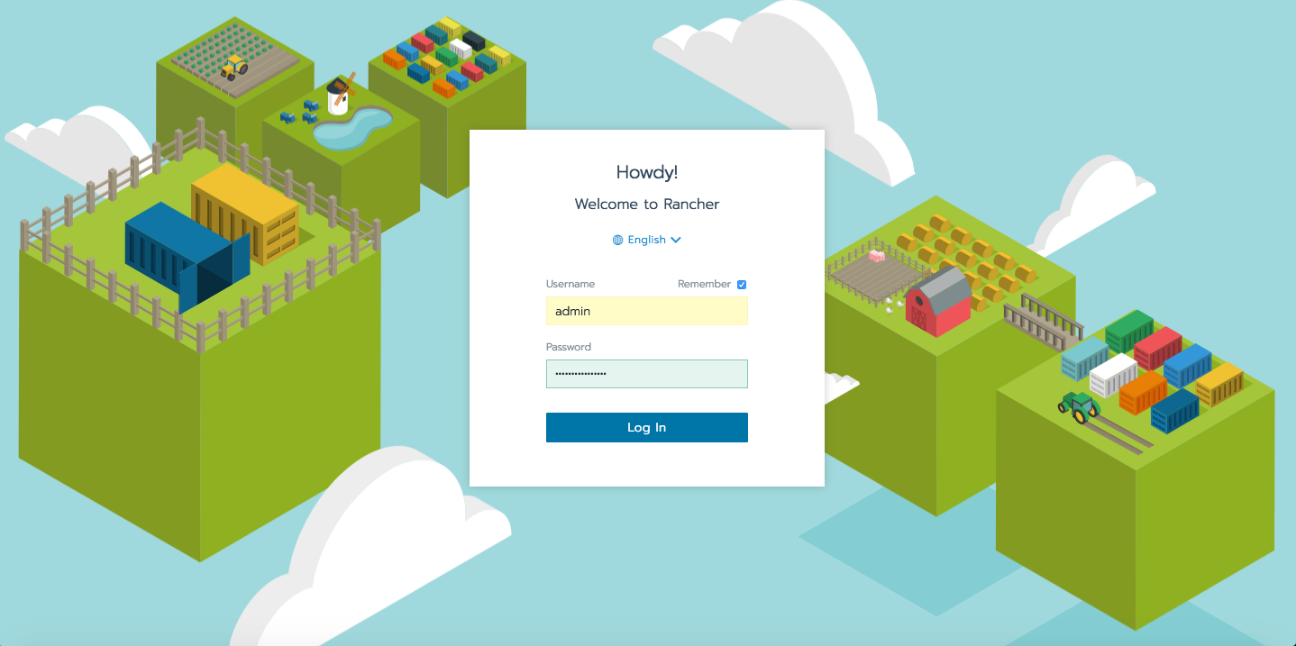
PaaS/KaaS click&play
PaaS iTHEPHY infrastructure
Easy to deploy ( catalog )
The convenience of the future
Easy to maintain ( catalog )
Distributed intelligence on various layer
Highly configurable
Openstack resource provisioning (CLOUD)
Containerization of every system (docker)
Orchestration and infrastructure configuration (k8s)
HELM Charts for fast deployment
Monitoring and logging
Load Balancer ingress
Automatic NGINX
Integrated Letsencrypt Certficate
Integrated resource provisioning with k8s provider
Another way to think security: RBAC
Based on new paradigm
Not so stable? maybe
Necessity of new way to think resource
Security at another level – all levels
https://containerjournal.com/topics/container-ecosystems/paas-vs-kaas-a-primer/
Notes:
The evolution in the Cloud resources offer (both private and public) and the need for teachers to have a fast, easy and highly flexible deployment system,led us to think about build up a microservices-based PaaS platform. The natural choice was Kubernetes and Rancher.
These tools allowed us to take advantage of HELM Charts for rapid deployment (a number of community recipes available online) and to exploit integrated monitoring an logging functionnalities provided by Kubernetes and Rancher.
Other useful features are Load Balancer ingress, Automatic NGINX, Integrated Certficate Letsencrypt, Integrated resource provisioning with k8s provider and RBAC (Role Based Access Control).This way of distributing software makes easier and agile the platform maintenance and distribution.

Slide 16
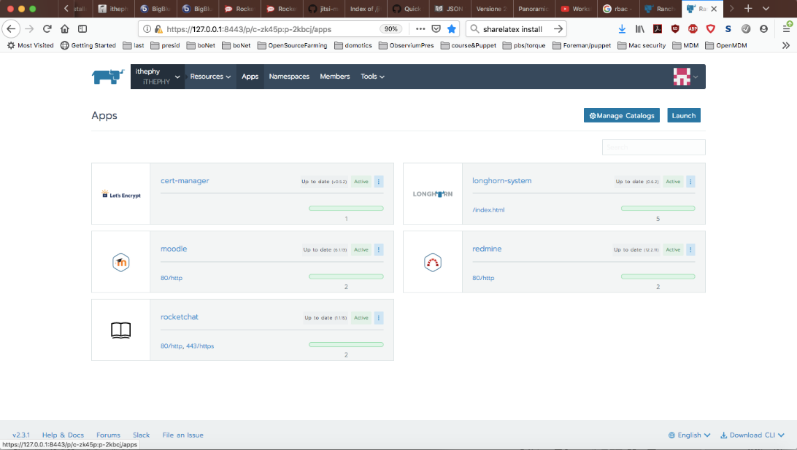
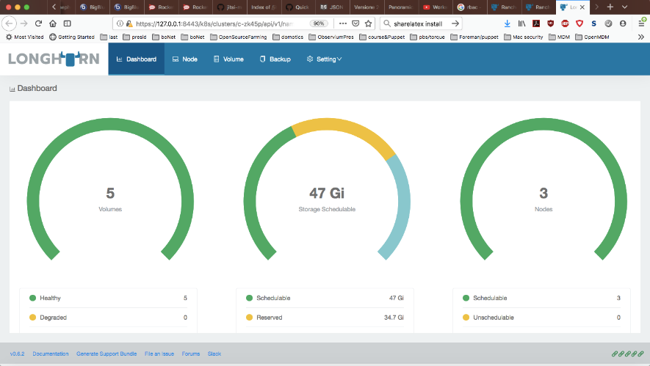
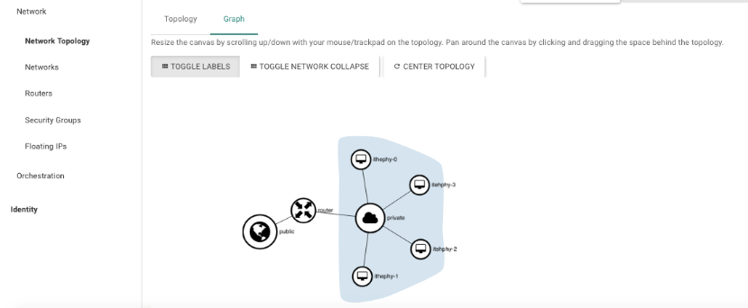
Rancher on Cloud@CNAF
Rancher 2.3.1
Openstack resources manually provisioned
Persistent storage with Longhorn software hyperconverged block device using hosts available resources. Necessity of manual configuration of L4 load balancer ad security groups on Openstack. Integration of moodle,redmine and rocket.chat with public jitsi. Rancher server run in a cluster node
Notes:
Solution for development on the cloud@cnaf (private infrastructure)
In this first tested solution (later converted into a development platform) the Openstack resources were manually instantiated and added to the Rancher cluster through the appropriate script
All the resources needed, from Floating IP to security groups ,up to L4 load balancers must be configured separately and supplied to Rancher from outside. In this version for the persistent storage have been used persistent volume provided by Longhorn.
Longhorn is a k8s application that manages local disk resources of the cluster nodes to provide replication-N block devices. It is in beta but has not shown any particular problem. The apps managed are moodle, redmine, rocket.chat, letsencrypt and longhorn.
We still need to add IAM, jitsi and bbb. These last ones are already available docker containers, but it is necessary to write the k8s/rancher recipe or to arrange an existing Helm chart

Slide 17
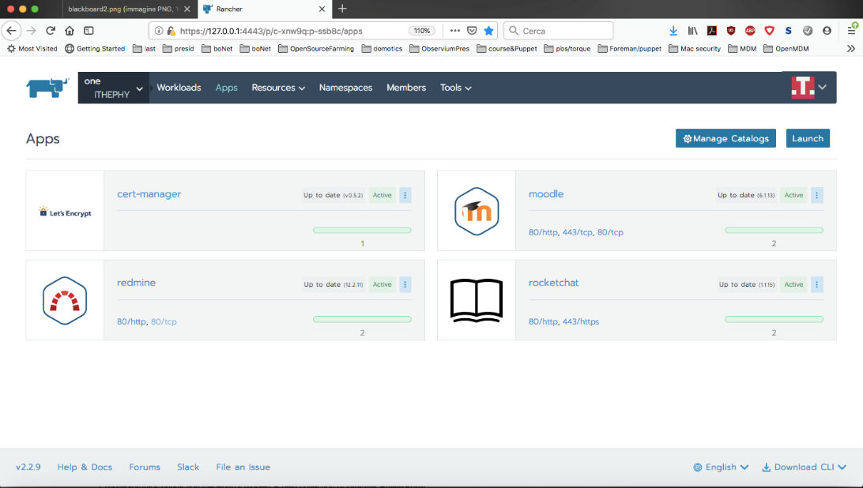
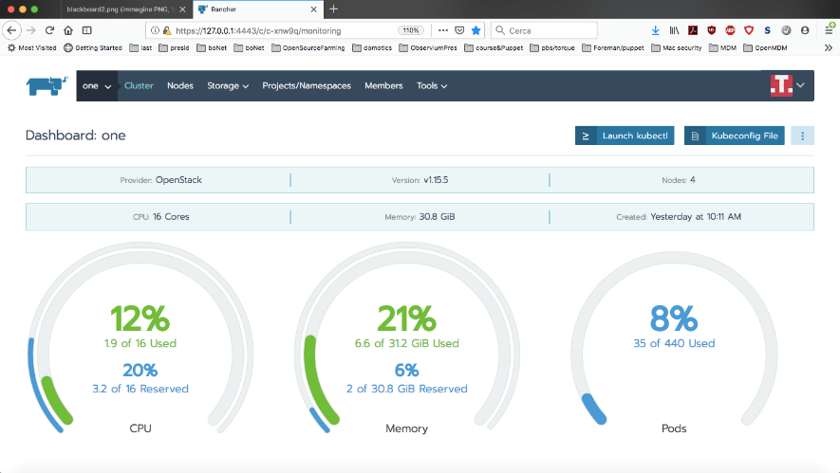
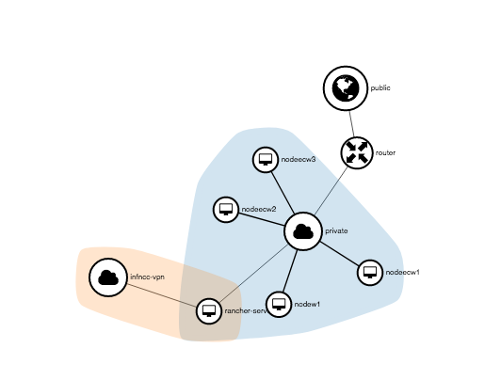
Rancher on INFN Corporate Cloud
Rancher 2.2.9
Openstack istance automatic provision
After the rancher plugin for openstack configuration, every necessary resource from compute node to L4 load balancer and persistent storage resource are automatically provisioned.Resource monitoring and application logging are enbedded in rancher resource and service configuration. Rancher server run in a dedicated node
Notes:
Pre-production solution in the INFN Corporate Cloud envirovment
All resources are automatically provisioned dependng on administrator resource allocation and/or application consumed resurce in dinamic mode.
Application installed using rancher catalog and HELM chart catalog. In this configuration application opened to the world via L4 ( by openstack ) and/or L7 (by rancher) load balancer and proxied by rancher nginx service.
All necessary security group configurations are made from application receipt.
Moodle, redmine, rocket.chat from official helm repository are installed and configured in this first version of preproduction iTHEPHY platform.
Also in this case, it is necessary to create,test and distribute a chart or a Kubernetes configuration starting from available docker-compose receipts for jitsi,bbb and IAM

Slide 18
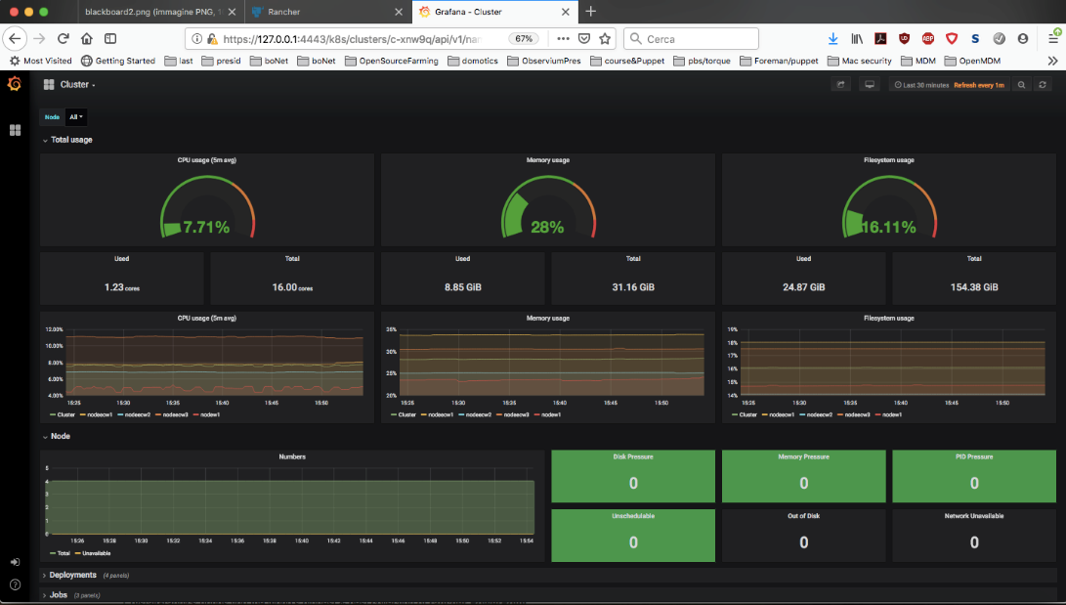
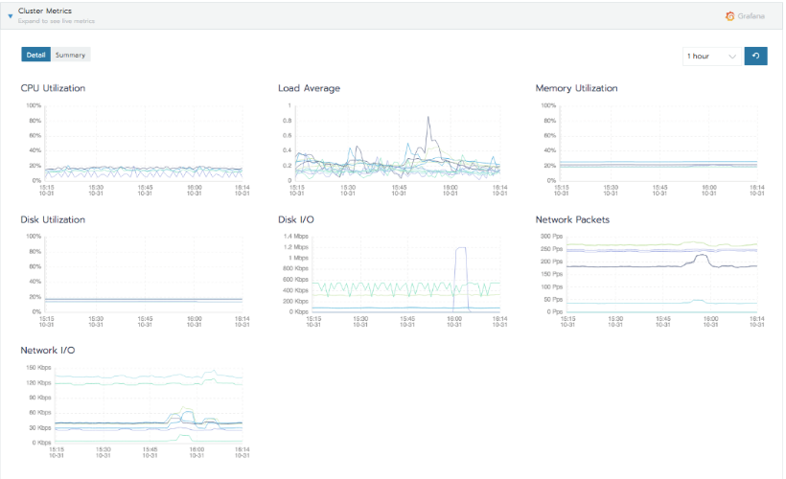
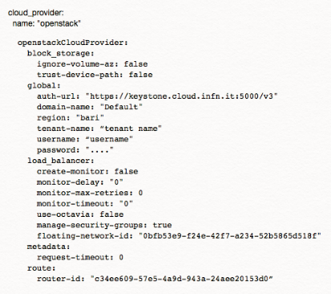
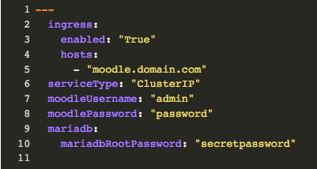
Rancher on INFN Corporate Cloud
Monitor & YAML conf
Enabled monitor with Prometheus and Grafana
Some configuration file necessary to plugin configuration
Notes:
Rancher k8s ecosystem allows to implement, monitor and log out-of-the-box, not only at the application level, but at every layer: form network to L4 resource. You can see here one of the YAML files we used for openstack integration and one of the YAML files customized for the moodle deployment

Slide 19
Next Steps (beyond the iTHEPHY IO1)
Develop and distribute a rancher (k8s too) receipt for every platform deployment
Consolidate a service for the automatic provisioning of iTHEPHY (iTHEPHY as a Service)
R&D of new functionalities based on FOSS software (interesting inputs form MALT experience)
R&D on the new security paradigm applied to k8s and Rancher PaaS/KaaS solution

Slide 20
Conclusions
The iTHEPHY project proposes an innovative and an unconventional approach to teaching
  Based on project-working teaching
  Complementary to frontal lectures
The iTHEPHY promotes internationalization
European and non-EU students are involved
FOSS software ecosystem
Structure IO1 based on virtualization easily to reproduce in house
Evolution based on containerization easily interoperable with various private/public provisioning from bare-metal to KaaS
If you are interested in replicating this activity in your institute feel free to contact us

Slide 21
https://www.facebook.com/Ithephy
https://twitter.com/IThephy
https://www.ithephy.eu/
https://iam.ithephy.eu/register
Thank you
And many thanks to:
Federico Zani for Rancher consulting
Cristina Duma and Stefano Stalio for INFN-CC and Cloud@cnaf support
Davide Salomoni and Andrea Ceccanti for IAM support

