Slide 1
EIC Instrumentation Challenges
David Gassner Sept 14, 2022
eeFACT22

Slide 2
Outline
EIC Overview
General instrumentation challenges
Selected instrumentation technical challenges
Individual bunch position measurements (short bunch spacing)
Electron Storage Ring injection
Strong Hadron Cooling ERL
Crabbing angle measurements
Electron crabbing angle measurements using synchrotron light monitor
Hadron crabbing angle measurement BPM near IP
Hadron residual crabbing angle monitor
Hadron Ring
New cryo-BPM pick-ups
Interaction Region
Cryo BPMs and large aperture BPMs
Strong Hadron Cooling
Relative longitudinal bunch alignment to ~ 1 micron
Summary

Slide 3
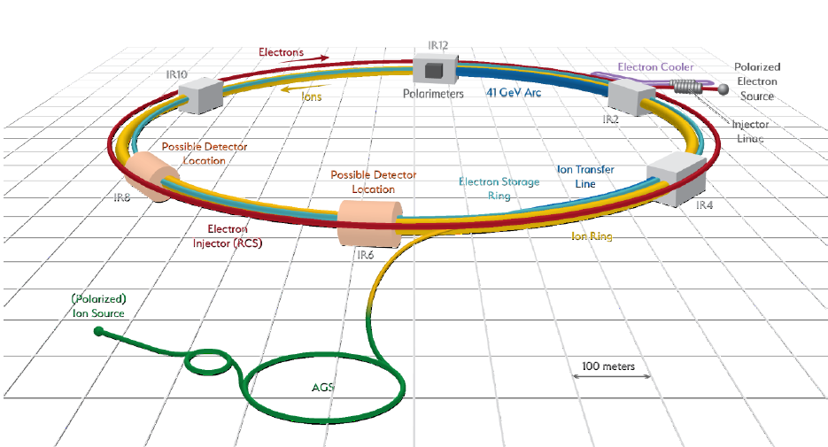
Electron Ion Collider Overview
Brief overview of EIC machines regions:
Pre-Injector (polarized electrons)
Turn-key 400 MeV Linac, 7 nC bunches
Photocathode electron gun, and beam transports provided by BNL
All beam instrumentation by BNL
Rapid Cycling Synchrotron (similarities to light source booster)
3.8 km, Inject at 400 MeV, accelerate to 5, 10 or 18 GeV, 100 ms acceleration ramp, 1 Hz rate. Bunch merging (7 to 14 to 28 nC)
Electron Storage Ring (similarities light source storage ring)
3.8 km, 5, 10 & 18 GeV, 2.5 Amps, 1,160 bunches, 10 ns bunch spacing, 28 nC, 7 mm RMS bunches, one bunch replaced each second
Hadron Ring Instrumentation Upgrade
3.8 km, 41 to 275 GeV store energies, 1 Amp, up to 1,160 bunches, 10 ns bunch spacing, 30 nC/bunch, 6 cm RMS bunch length
All established RHIC instrumentation systems will be upgraded for the shorter, higher intensity bunches, and the beam line components will be relocated to new locations in tunnel
New lower impedance beam line components
New electronics
Interaction Region
IP collision feedback systems, crabbing angle measurements, beam loss monitors
Strong Hadron Cooling
Single pass electron machine (~ 400 m of beam transport), 1 nC, 10 ps RMS bunches, 10 ns spacing, 100 mA average current, up to 150 MeV

Slide 4
EIC Instrumentation General Challenges
Challenges related to large scale accelerator projects
Largest System - Beam Position Monitors
7 machines regions, each with unique requirements
~ 1,660 BPMs
About 700 other new instruments throughout the facility, see next slide
Complications related to the pandemic
Supply chain delays & global chip shortages
At the present EIC preliminary design phase, very long delays in obtaining electronic components for prototype assembly and testing.
If these delays continue into the construction phase, can delay project completion schedule
Providing accurate materials cost estimates
Potential artificially inflated cost estimates due to inflation and other factors makes it difficult to provide accurate long term budgetary plans.
Maintaining adequate staffing
Elevated number of senior employees left or may be leaving soon
Challenging to find new hires with experience
Instrumentation staff is matrixed with with existing Collider-Accelerator department until 2025

Slide 5
EIC Instrumentation Scope
Electron Pre-Injector (400 MeV)
Instrument Quantity
BPMs 13
YAG/OTR Mon’s 13
Charge Mon’s 10
BLMs 4
Faraday Cup 2
Bunch Length 2
Emittance Mon 1
Mott Polarimeter 2
RCS to ESR Transport
Instrument Quantity
BPMs 22
Prof Mon's 7
Charge Mon’s 2
Pre-Inj Linac to RCS Transport
Instrument Quantity
BPMs 30
Prof Mon's 7
Charge Mon's 2
Electron Storage Ring
Instrument Quantity
BPMs 494
BLMs 50
DCCT/FCT 2
Synch Light Mon 2
X-Ray Pin-hole 1
Tune Monitor 1
Polarimeter 1
Trans BbB FB 1
Long BbB FB 1
Slow Orbit FB 1
BBA 1
Strong Hadron Cooling
Instrument Quantity
BPMs 110
BLMs 88
Beam Pipe Temp Mon's 70
Screen Prof Mon's 35
Current & Charge Mon's 18
Faraday Cups 12
Wire scanners 9
Emittance Mon’s 7
Halo Mon’s 4
Transverse Defl Cavity 1
Synch Light Mon's 4
Relative Bunch Alignment 1
Hadron Storage Ring
Instrument Quantity
BPMs 279
BLMs 220
IPM 2
Longi Prof Mon 1
Tune Monitors 2
DCCT 1
HF Schottky 1
LF Schottky 1
HT pick-up 1
Global Orb FB 1
Polarimeter 2
BbB Damper 1
HSR Injection Transport
Instrument Quantity
BPMs 41
BLMs 20
Profile Mon's 6
Charge Mon's 2
Rapid Cycling Synchrotron
Instrument Quantity
BPMs 576
BLMs 20
DCCT/FCT 2
Profile Mon's 7
Synch Light Mon 2
Tune Monitor 1
BBA 1
Interaction Region
Instrument Quantity
BPMs 78
BLMs 50
Orbit Corr at IP 2
Crab Tilt Monitor 1
Hadron Injection
from AGS

Slide 6
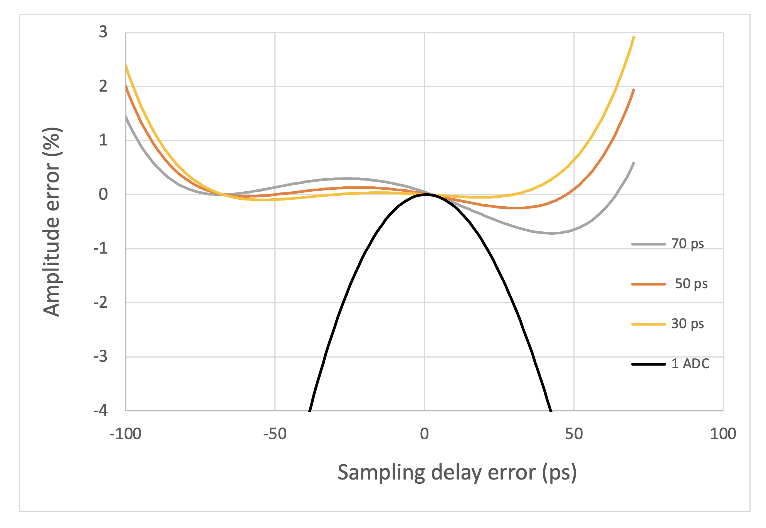
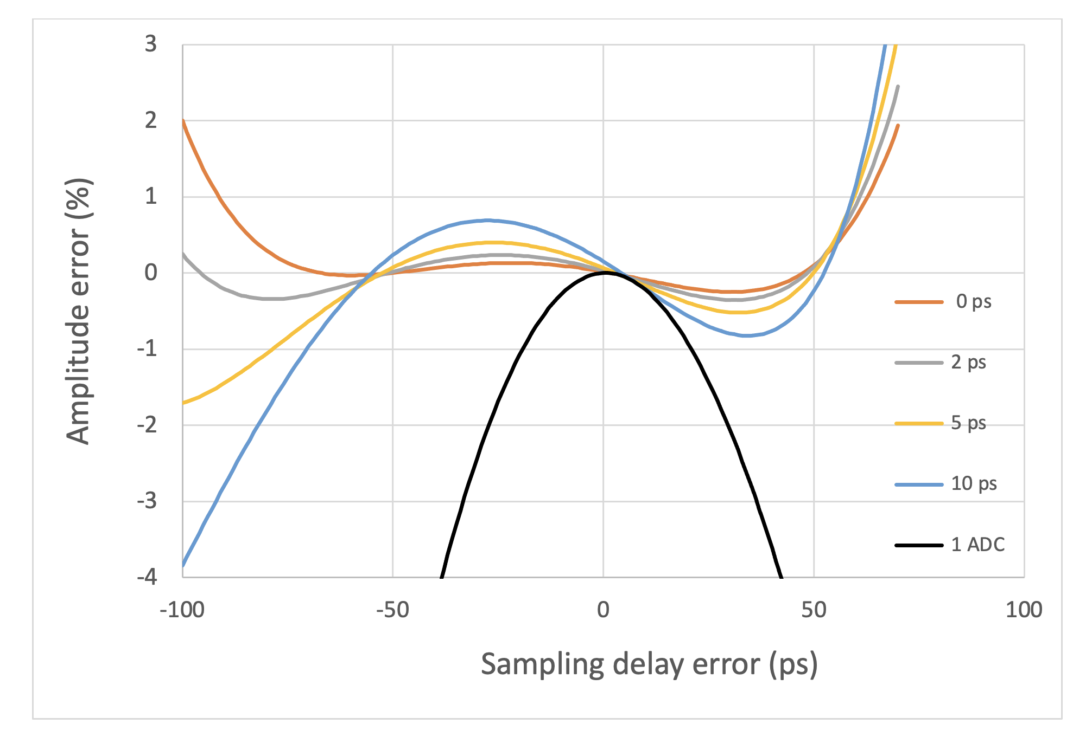
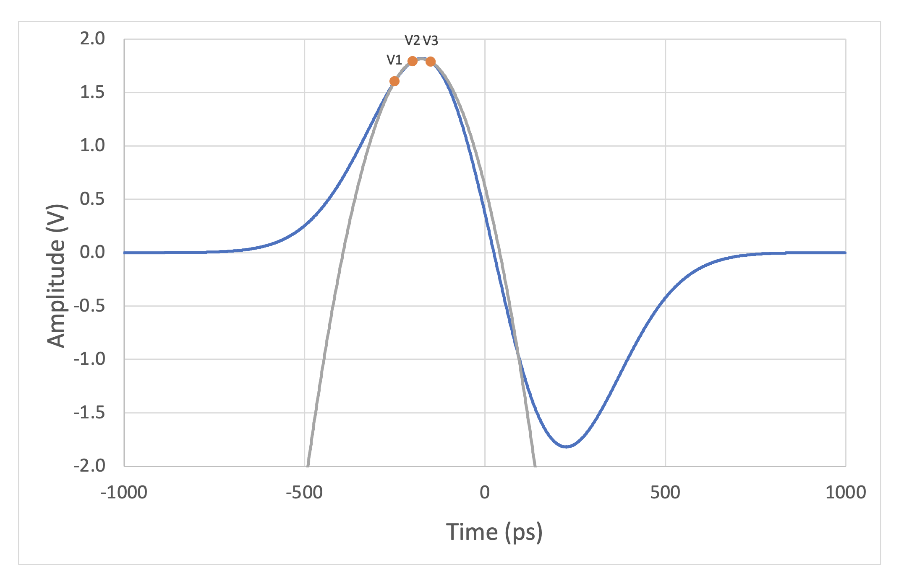
Individual bunch position measurement with short bunch spacing, 2 cases
At ESR Injection, bunch replacement at 1 Hz, with a ring filled with 1,160 bunches
Electron bunch spacing is 10 ns
Need to measure injected bunch position in the presence of adjacent stored bunches, only at the first 20 BPMs after injection
Ensure injected bunch trajectory is correct
Strong Hadron Cooling, Energy Recovery Linac
Electron bunch spacing is 5 ns
Alternating bunches are accelerating and decelerating, BPMs are located between Linac cavities.
Need to measure individual bunch positions in the presence of adjacent bunches
Considering using 3 digitizers each triggered at determined intervals, then use parabolic fit to reduce the measurement uncertainty due to ADC timing jitter.
The result of a simulated signal from a BPM traversed by an ultra-relativistic gaussian bunch with an RMS length of 200 ps (60 mm) is shown in Fig. 1. The parabola determined by the three voltages sampled at 50 ps intervals has an apex of 1.8153 V while the peak amplitude of the BPM signal is 1.8195, a 0.23% difference for a sampling delay error of 20 ps.
Performance comparison with three different sampling intervals: 30 ps, 50 ps and 70 ps
Black line is single ADC error
We explore the consequences of sampling interval errors of 2, 5 and 10 ps. In other words, while the first interval is kept constant at 50 ps, the second interval is stepped from 50 ps to 52 ps, 55 ps and 60 ps. The results are shown. We see that the amplitude errors caused by sampling interval errors increase significantly beyond 2 ps, but they are all more accurate than achievable with a single ADC.
P. Thieberger

Slide 7
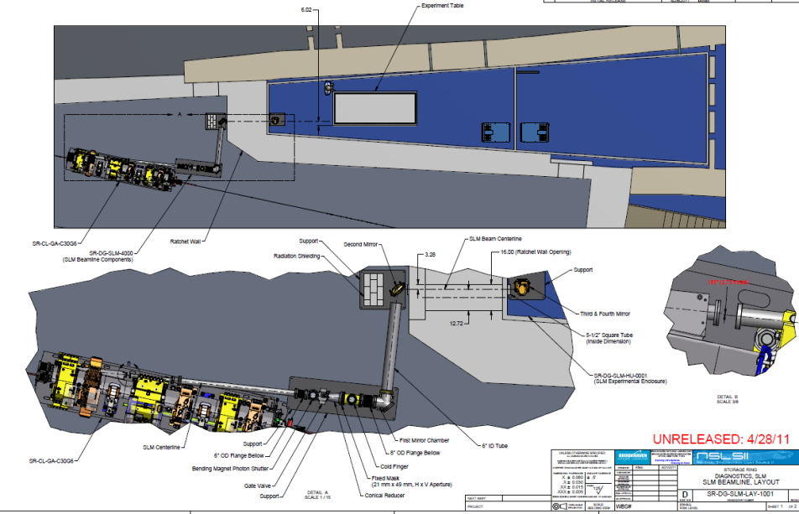
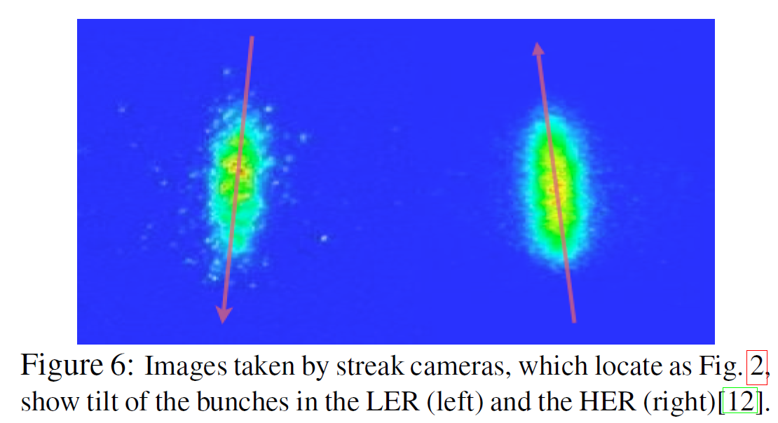
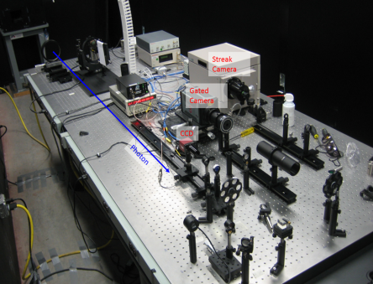
Electron Crabbing Angle Measurements
Electron Crabbing angle can be directly measured using a synchrotron light monitor with streak camera at a location TBD in the electron Storage Ring. Principle was demonstrated KEKB. Challenge is that this has not been done at BNL, different parameters at EIC.
A cooled mirror will direct the visible portion of synchrotron radiation to an enclosed light transport, then to an optical table in a service building.
Operational strategy for the measurement:
Since there is no room for an SLM in the IR, the electron crabbing angle cannot be directly measured in the IR during operations. It can be measured elsewhere in the ESR during a studies mode.
With the crabbing cavity turned on, and the decrabbing cavity turned off, the crab tilted beam will precess around the ring. A SLM will be located in the ESR lattice (away from the IR) at a location chosen with a large angle to optimize the measurement.
ESR synchrotron light monitor design
generally based on NSLS-II SLM
NSLS-II Synchrotron Light Monitor layout
When the decrabbing cavity is turned on (during normal operations), there should be no residual electron crabbing angle outside of the IR.
Plan to start working soon with NSLS-II colleagues to determine electron bunch crabbing angle measurement capability using ESR lattice and beam parameters.
Crab cavity bunch tilt angles measured at KEKB
NSLS-II Optical table with Streak camera
Longitudinal
Horizontal
Compensation of the Crossing Angle with Crab Cavities at KEKB, Abe et al, 2007
7

Slide 8
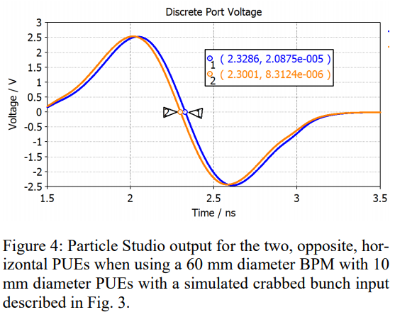
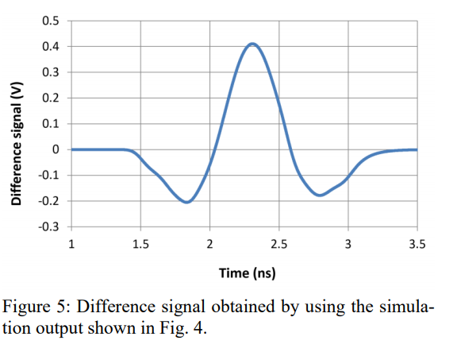
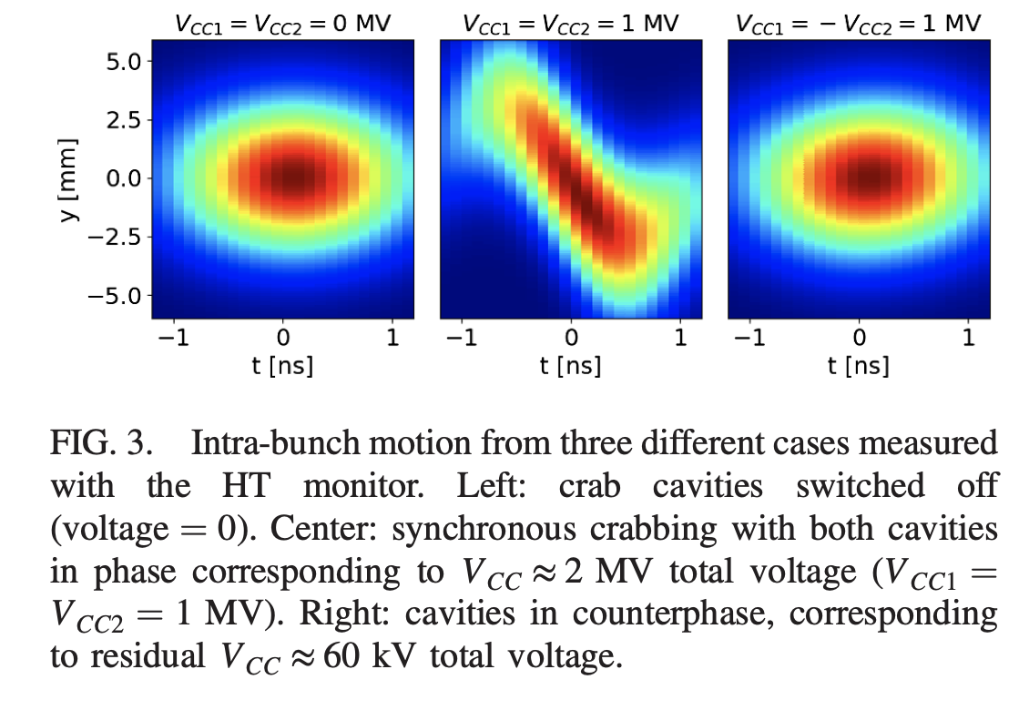
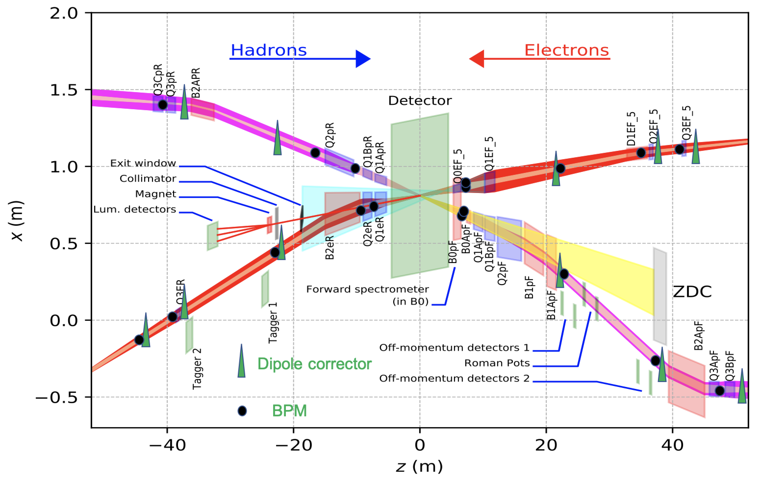
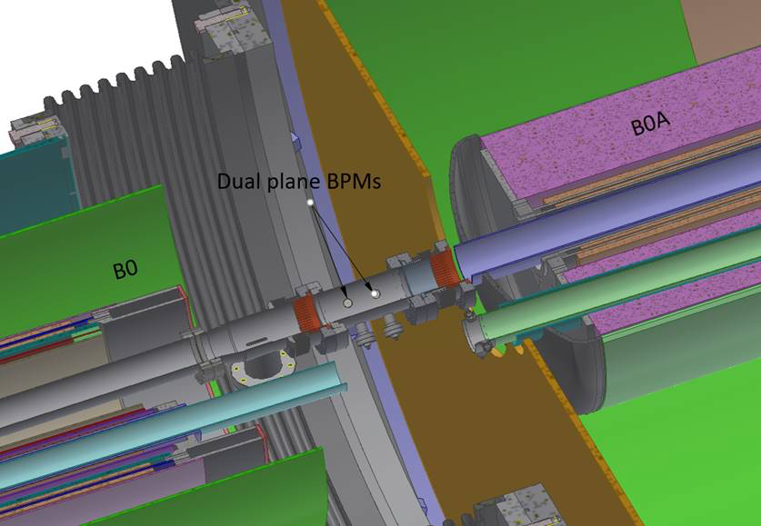
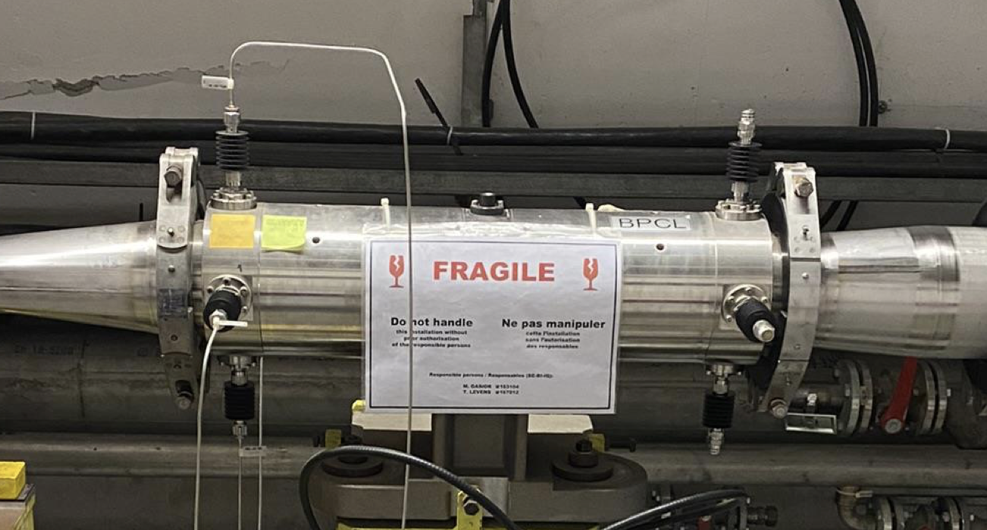
Hadron Crabbing Angle Measurements
et
Crabbing angle near IP determined by different degrees of BPM signal distortion depending on the tilt angle, the zero-crossing time difference is approximately proportional to the tilt angle.
A Head-tail monitor (stripline pick-up) will be installed in the HSR somewhere outside of the IR that can measure hadron bunch tilt angle with the de-crabbing cavity turned off.
Successful test at the SPS:
Concept by P. Thieberger
IPAC2018-WEPAF018
Concept has not demonstrated yet.
Due to sensitivity to long cable thermal effects, considering using a fast differential signal splitter in reverse, as combiner, close to the BPM
In the space between B0pF and B0ApF the horizontal BPM buttons should see the maximum tilting of the bunch, (crabbing angle 12.5 mrad.) Bending magnets and drifts behave alike with respect to crab rotations.
Proposed location between B0pF & B0ApF
SPS 60 cm strip-line
R. Calaga et al. PRAB 24 062001, June 2021

Slide 9
Hadron Crabbing Angle - Residual Measurement
Need crabbing angle residual (noise) measurement, located someplace away from the IR
Purpose is to reduce emittance growth
A dedicated feedback system could mitigate crab cavity noise effects. A similar system is planned for the HL-LHC.
The bunch head and tail position would be extracted from the pickup signal. The head/tail ∆ and Σ estimate the bunch tilt and offset (amplitude and phase noise respectively).
Themis Mastoridis has conducted simulations of such a system for the EIC HSR to study its potential performance and limitations.
The performance of the system will greatly depend on the pickup precision, location, and additional technical specifications (signal processing/equalization, longitudinal motion effect, etc).
The pick-up resolution needed for EIC HSR: TBD
Type of pick-up under discussion (electro-optical?), considering multiple pickups.
Potential collaboration topic with CERN.
T. Mastoridis, K. Smith, et al.

Slide 10
New Hadron Ring BPMs
To avoid heating of the cryogenic signal cables due to the shorter, more intense hadron bunches, the existing RHIC stripline BPMs will be shielded to minimize impedance.
279 new button type cryo-BPMs will be installed in the hadron ring adjacent to the shielded strip-line BPMs
Existing RHIC cryo-interconnect showing existing stripline BPM
Existing interconnect bellows removed, new flanges & cryo cooling bypass
New interconnect bellows with integrated button BPM and cryo-cooling bypass
Pictures & 3D models from C. Hetzel

Slide 11
New Hadron Ring BPMs - operations with large radial offset, why?
Hadrons and electrons must circulate in their respective storage rings with the same revolution period, 12.8 us.
The electron beam is highly relativistic over the entire energy range of 5 to 18 GeV, so the electron revolution period is practically constant.
In contrast, the hadron relativistic speed varies significantly over the proton energy range of 100 to 275 GeV.
To compensate for speed difference, a radial offset is used in the hadron storage ring to change the circumference path length.
Energy (GeV) | Circumference (m) | Change in circumference (mm) | Change in average radial offset (mm) | Change in maximum radial offset (mm)
100 | 3,833.7506 | -73.4 | -11.7 | -20
133 | 3,833.8240 | 0.0 | 0.0 | 0.0
275 | 3,833.8971 | 73.4 | 11.7 | 20
The radial shift will be greatest (~20 mm) near the cryo-BPMs (horizontal aperture radius of 32 mm) located near the horizontal focusing quads.
An alternative solution to operate without large radial offsets was to install a 164 m delay line in a warm region, with ~1.5 m displacement, and moveable magnets.
Determined to be not feasible
Not enough space in the existing RHIC tunnel
Overly expensive
IPAC2013 TUPFI079, N. Tsoupas

Slide 12
New Hadron Ring BPMs – button pick-up design
The new pick-up design considerations:
Operations with large radial offset at store
Power deposited in the buttons
Signal levels to meet performance requirements (20 um resolution, average over 1 second during store)
Dynamic range of ~ 85 dB;
long 125 cm RMS, 5 nC gold pilot bunches at injection
short 6 cm RMS, 30 nC bunches during store with large radial offset.
The latest HSR BPM pick-up design has 20 mm diameter buttons, located ~ 30 degrees rotated up and down from the horizontal plane, in a 64 x 50 mm aperture that matches the adjacent beam sleeve to minimize impedance.
HSR actively-cooled screen
69 mm horizontal aperture reduced to 65 mm; vertical aperture of 50 mm

Slide 13
New Hadron Ring BPMs – BPM pick-up design
Pincushion distortion, uncorrected:
Result of Particle Studio simulations carried out for 55 beam positions from X = 0 to 25 mm and Y = 0 to 10 mm in 2.5 mm steps, to determine the corresponding signal peak amplitudes.
Plotted are the positions calculated by using the linear terms only and adjusting the coefficients to provide correct coordinates for approximately centered beams.
The red dots correspond to X = ± 20 mm
beam positions showing the effect of the strong pincushion distortion
P. Thieberger

Slide 14
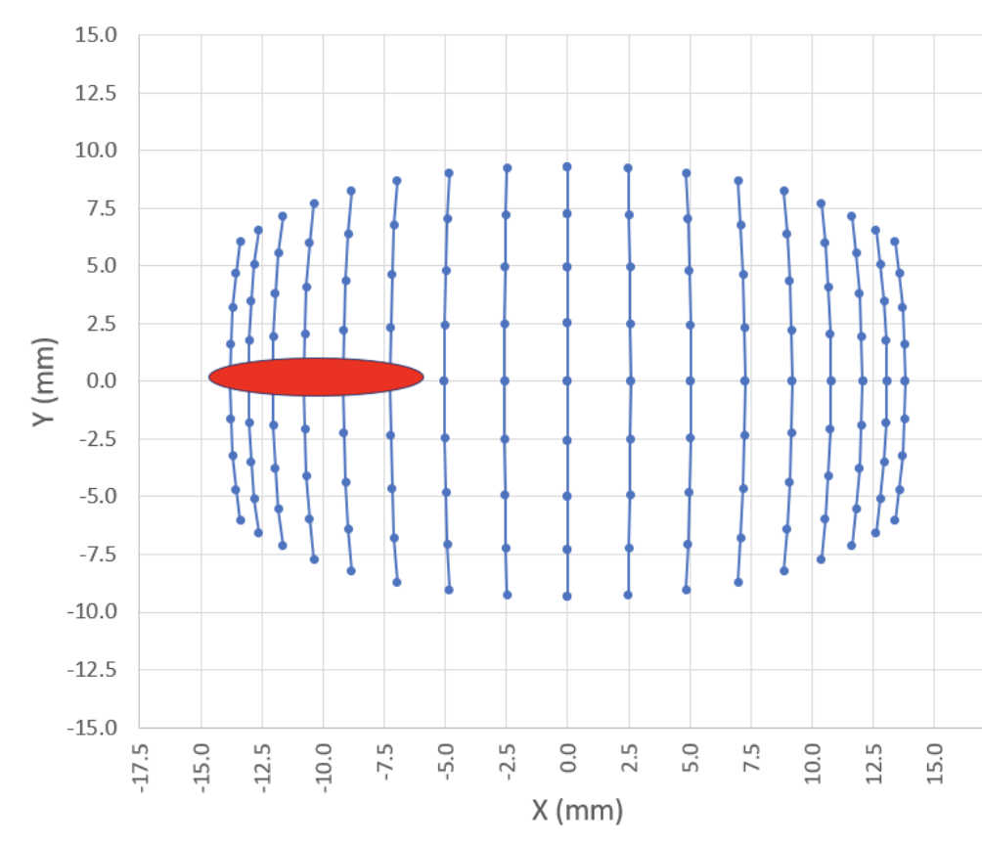
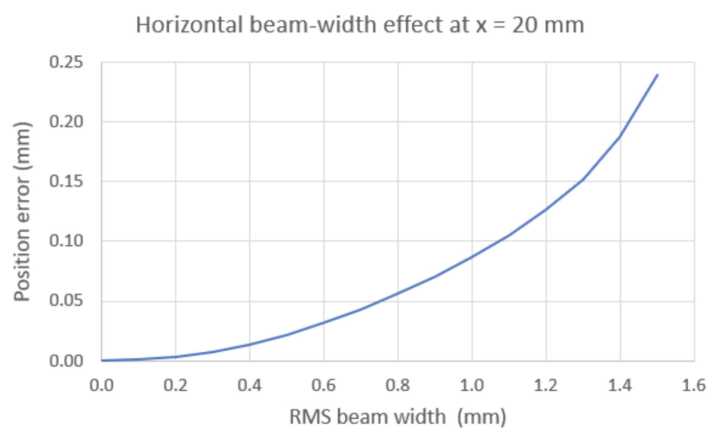
New Hadron Ring BPMs – BPM pick-up design
P. Thieberger
Corrected positions obtained by linearizing the data with fifth order polynomials. The points used in the least square procedure that determined the optimal coefficients are the ones inside the dotted line rectangle (+/- 23 mm horizontal, +/- 6 mm vertical)
Position measurement correction due to bunch shape
Example pincushion distortion
Due operations with large radial offsets
(~20 mm) near the horizontal focusing quads.
And to the relatively large transverse bunch size aspect ratio:
Tall bunch at the horizontally focusing quads
Wide at the vertically focusing quads
Will likely need to introduce an added correction factor based on transverse bunch shape
Consider using IPM transverse beam size measurement data in BPM correction algorithm.

Slide 15
Interaction Region BPM Pick-ups
Large diameter e-BPM pick-ups in the electron rear region present challenge for 1 um average resolution position measurements.
Relatively large radial offsets in the hadron BPMs near the IP also present challenge for quality measurements, performance requirements TBD.
Q1eR (~7.3 m from IP) 56 mm radius (4.4” diameter) in cryostat
Q2eR (~9.3 m from IP) 64 mm radius (5” diameter) in cryostat
DS of B2eR (22m from IP) 80 mm radius (6.3” diameter)
Q3eR (38 m from IP) 80 mm radius (6.3” diameter)
Q2eR
BPM
Q1eR
BPM

Slide 16
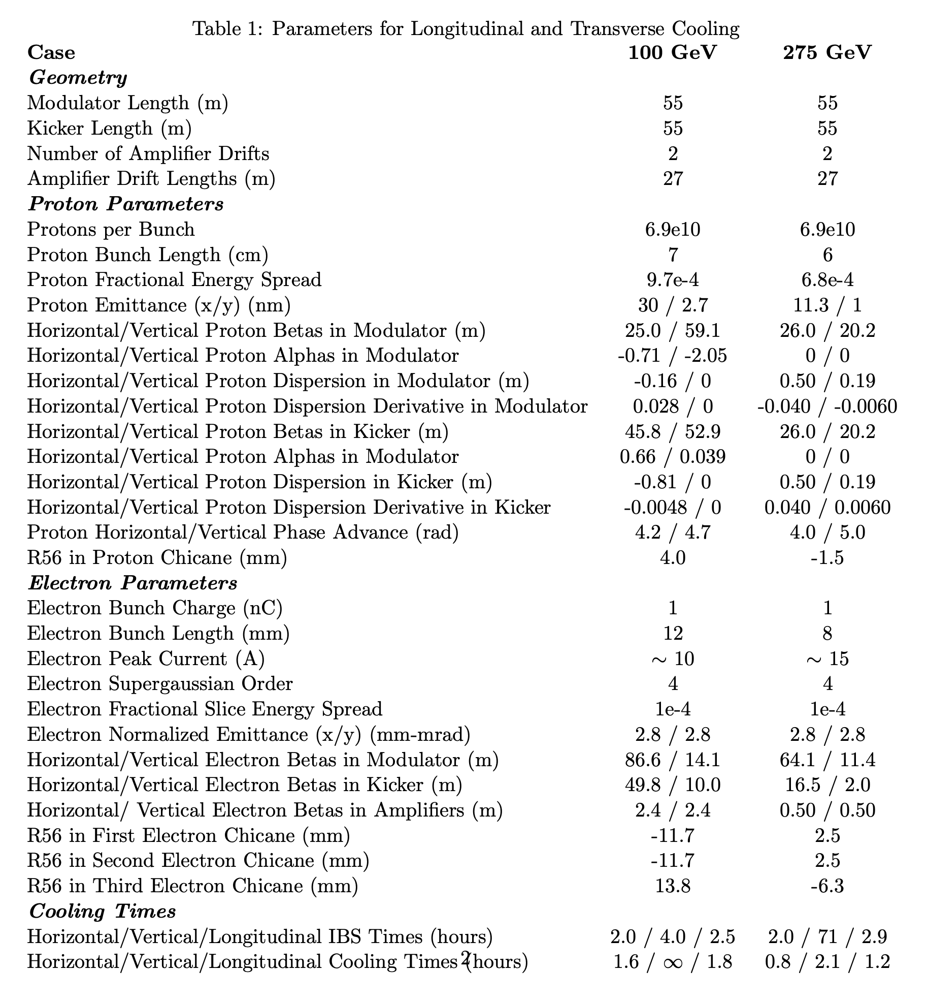
Strong Hadron Cooling – General overview
Basic cooling principle:
In the modulator, the proton bunch Schottky noise pattern is imprinted on the electron bunch
In the kicker, the amplified electron bunch pattern used to cool the same part of the proton bunch that was imprinted in the modulator.
SHC facility
cartoon layout
Hadron beam
Proton beam Energy (GeV) | Hadron bunch Length (cm) RMS | Electron bunch Length (mm) RMS
23.8 | 50 | 17
100 | 7 | 12
275 | 6 | 8

Slide 17
Strong Hadron Cooling - relative longitudinal alignment
W. Bergan, E. Wang
Instrumentation needed:
Co-propagate the protons and electrons (transverse & longitudinally) in the modulator and kicker
Need longitudinal electron-hadron alignment of ~1 um between modulator and kicker
Source of longitudinal alignment error can be caused by a change in path length difference due to magnet field ripple
Simulations are underway to find a relative longitudinal alignment measurement solution (W. Bergan, M. Blaskiewicz, G. Stupakov, et al.)
Latest approach:
Try to utilize the feature that the proton beam will have a Schottky signal which will get smaller during the cooling process.
Presently exploring this hadron Schottky “signal modification” measurement as a diagnostic.
There is small difference in the synchrotron light power emitted from the hadron beam after the kicker (downstream of a dipole) that may be able to be measured.
Simplified cooling diagram showing hadron synchrotron light radiation detector.

Slide 18
Strong Hadron Cooling - relative longitudinal alignment
Proposed strategy:
Integrate the hadron synchrotron light signal only during portion of the central hadron bunch being cooled.
For this simulation, integration over gated intervals for 1 second, with 11 ns bunch spacing.
100 GeV; central 12 mm of of 7 cm hadron bunch being cooled, need 40 ps integration time per bunch 275 GeV; central 8 mm of of 6 cm hadron bunch being cooled, need 27 ps integration time per bunch
Beam Energy (GeV) | Radiation from core nW/m² | For 10% measurement resolution nW/m² | Synch light wavelength + 10% BW (um) | Fractional change in Synch light intensity (%) | Number of signal photons e6 | Number of background photons e6 | Signal to Noise | Detector area mm² | Sensor thermal cooling: Type (temp), background
100 | 100 | 0.550 | 30 | 5.5 | 8.3 | 1500 | 210 | 100 | LH (4.2K), 2e-48W/m²
275 | 18,000 | 110 | 3 | 6 | 1.6 | 270 | 99 | 1 | LN2 (77K), 5e-22W/m²
Challenge:
Need to find cooled infrared detectors at with sensitivity at 3 and 30 microns that can be gated to measure only during hadron bunch core (10’s of ps)
Simulations of measurement configuration variations continue; we may be able to reduce the signal wavelength to make it easier to find sensors to measure these small variations in light power.
W. Bergan, E. Wang, et al.

Slide 19
Summary
There are a variety of instrumentation challenges at the EIC:
Those associated with a project with a relatively large and diverse scope
Pandemic related complications
Specific technical challenges
Other instrumentation challenges not mentioned include:
Electro-optic longitudinal bunch shape monitor design (plan to test prototype during next RHIC run)
Machine protection strategies with 3 rings running simultaneously & at the cooler
BPM measurement drift compensation due to thermal effects
and more….
There are a number of potential topics for collaborations with other institutes

Slide 20
Acknowledgements
EIC instrumentation team at BNL
Bel Bacha
Gabriele Bassi
Jonathan Bellon
Will Bergan
Mike Blaskiewicz
Alexei Beldnykh
Peter Braunius
Chris Degen
Lenny De Santo
Angelika Drees
Syed Hafeez
Charlie Hetzel
Doug Holmes
Rob Hulsart
Chuyu Liu
Frederic Micolon
Michiko Minty
Rob Michnoff
Christoph Montag
Peter Oddo
Danny Padrazo
Matt Paniccia
John Pomaro
Medani Sangroula
John Skaritka
Julio Renta
Peter Thieberger
Vadim Ptitsyn
Vahid Ranjbar
Matthieu Valette
Silvia Verdu Andres
Erdong Wang
Ferdinand Willeke
Holger Witte
Thank you for your attention!

