Slide 1
Development progress on TS MBK for FCC^{ee}
65th ICFA Advanced Beam Dynamics Workshop on High Luminosity Circular e-e+ Colliders (eeFACT2022), Sept. 12 – 16, 2022
Zaib Un Nisa (CERN)
Igor Syratchev (CERN), Jinchi Cai (UESTC), Graeme Burt (ULAN),
Anis Baig (ULAN, CERN)

Slide 2
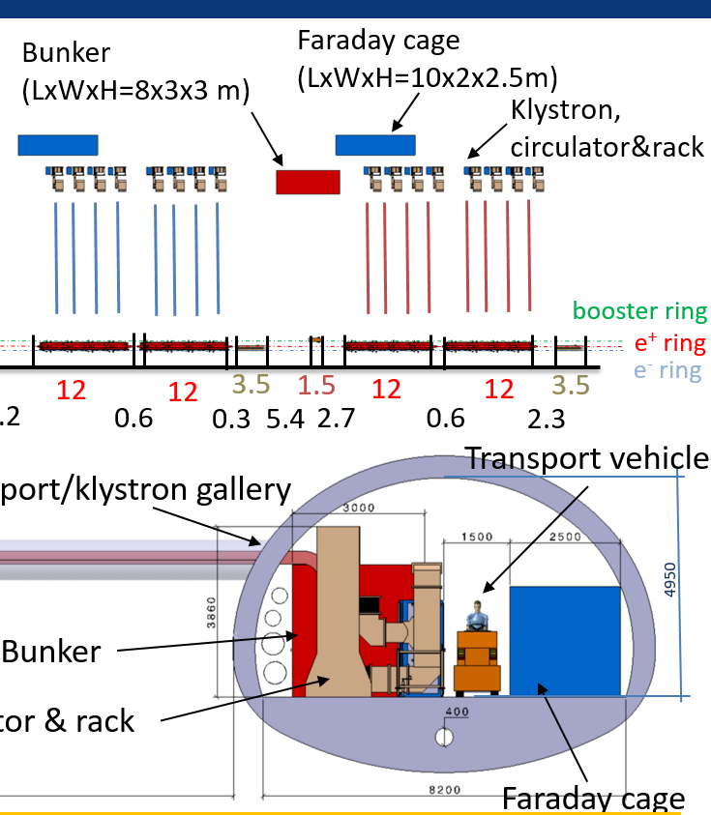
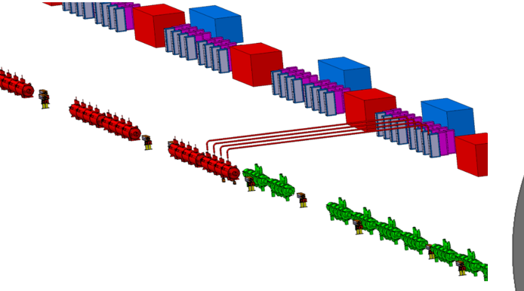
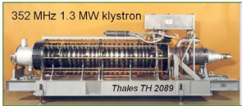
FCC_{ee} (Z) accelerator tunnel integration
Bunker:HV
Klystrons
1.3MW CW, 352MW, 100kV, 20A, eff.=63%.
5.5m
Each Klystron should deliver 1MW @ 400MHz.
Preferably, klystron should be placed vertically in the tunnel.
The total length of Klystron should be about 3m.
The efficiency of Klystron is targeted at 80%.

Slide 3
High efficiency klystrons projects at CERN
Task 1: HE Design and simulation
Task 2:HE LHC 400 MHz klystron
Task 3: HE-TS MBK L-band klystron
Validate the HE klystron technology (~70%) while upgrading and retro-fitting current LHC klystrons
The klystron design is accepted by Thales. Expected delivery of the prototype to CERN is in March 2023.
Task 4: HE 50MW X-band klystron with high rep-rate
Built a klystron, demonstrate >60% efficiency (cf. 38% in existing commercial tube) in collaboration with INFN and CPI
Reinforce synergies with CLIC, FLASH, Compact Light, Compton sources...
Klystron simulation code KlyC version 5 was released in May 2021. About 50 users worldwide.
Development and maintenance of the fast and accurate 2D klystron codes.
Demonstrate two-stage multibeam technology with 80%+ RF production efficiency
Complete design of TS MBK for CW FCC: 400 MHz, 1.2 MW
built demonstrator -> WP5 of the FCC SRF R&D Program
Promote this new technology towards CLIC, ILC, CEPC, by means of design and collaboration
New KlyC version 6 will include CGUN tracking module for the beam optics simulation (gun, solenoid and collector). Will be released in January 2021.
great showcase for CERN's technology. Contribution to the worldwide society.
Prepare the acceptance tests at CERN

Slide 4
Two-Stage Multi Beam Klystron (TS MBK) Technology
Commercial HE MBK
Efficiency 70%
Specific features:
Bunching at a low voltage (high perveance). Very compact RF bunching circuit.
Bunched beam acceleration and cooling (reducing Δp/p) along the short DC voltage post-accelerating gap.
Final power extraction from high voltage (low perveance) beam. High efficiency.
V
V₁+V₂
TS HE MBK
Efficiency ~85%
Additional advantages:
HV insulators
The second HV stage can be operated in DC mode. Thus simplifying the modulator topology (cost/volume) and increasing the modulator efficiency (in pulsed mode).
Simplified feedback for the first stage pulsed voltage. Improved klystron RF phase and amplitude stability.
Stage 1
V₁
V₂
Post accelerating gap
Stage 2

Slide 5
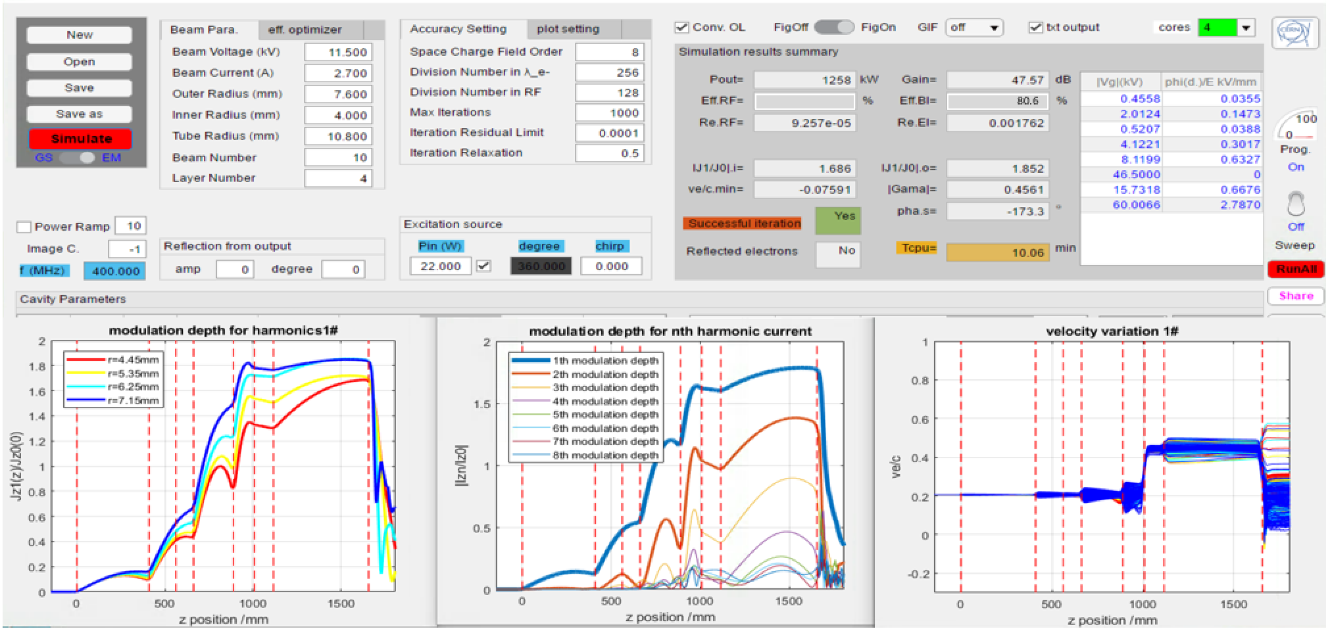
KlyC (CERN-made 1.5D klystron code) simulation results

Slide 6
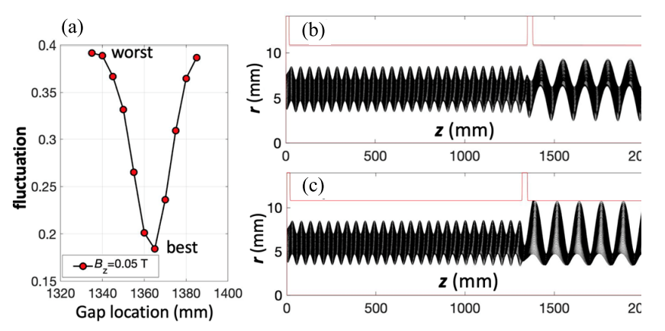
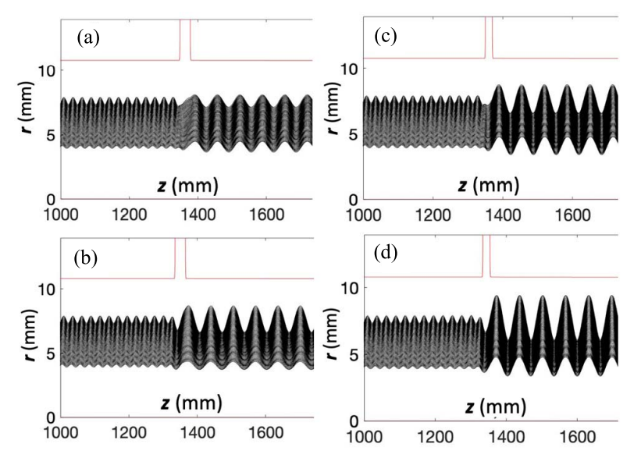
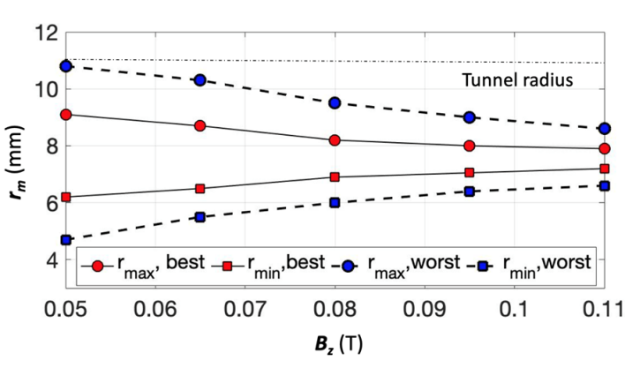
Beam Optics with PA Gap
PA Gap= 30 mm
PA Gap= 20 mm
Beam envelope in TS MBK with magnetic field of 0.05 T for gap length of 30 mm.
Beam optics with a magnetic field of 0.095 T.
Beam envelope in the second stage as a function of magnetic field.

Slide 7
TS MBK Solenoid Design
Bz field on axis
Beam tunnel radius= 10.8 mm
Bz/ T
Z/mm
Magnetic field: Bz=5.5XBrillouin (0.095 T) for non-convergent beam optic system.
Beam envelop along the beam tunnel. Gap length is optimized to minimize the beam scalloping before and after DC accelerating gap.

Slide 8
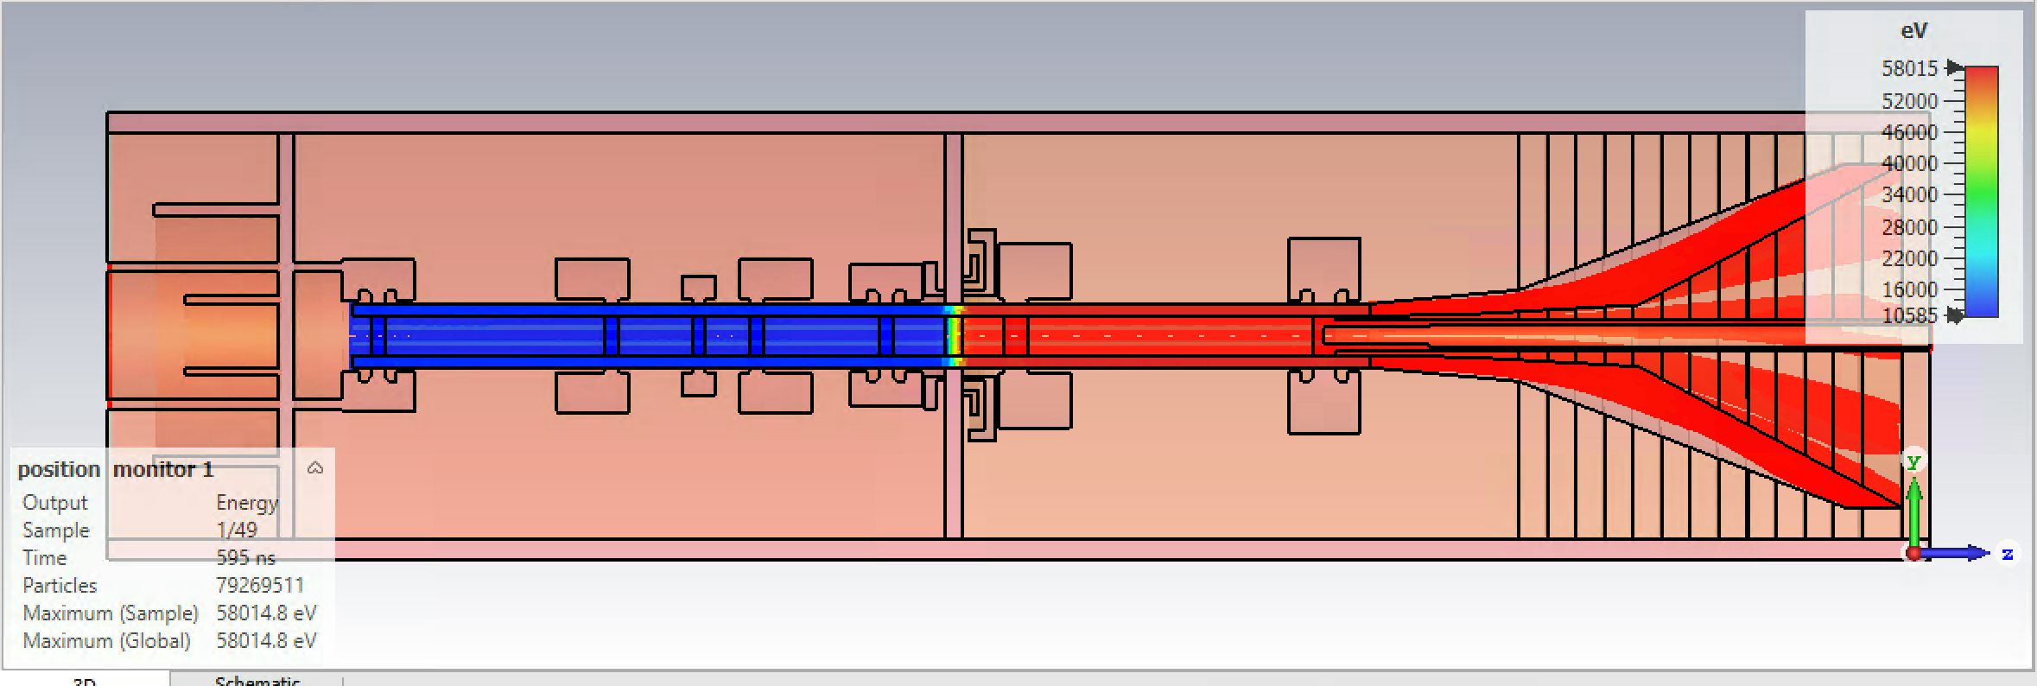
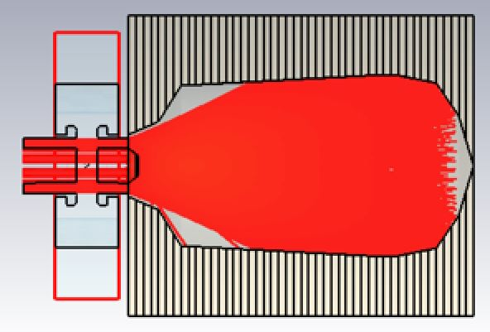
3D TRK & PIC (CST) beam optic simulations
3D Magnetic field is imported;
3D effects brought by the MB topology is fully considered
Tube is stable during 2000ns simulation time in PIC.
Peak surface power losses of 500W/cm² were set as a target following industrial data.
TRK
dP/dS, kW/cm²
PIC
Z/mm

Slide 9
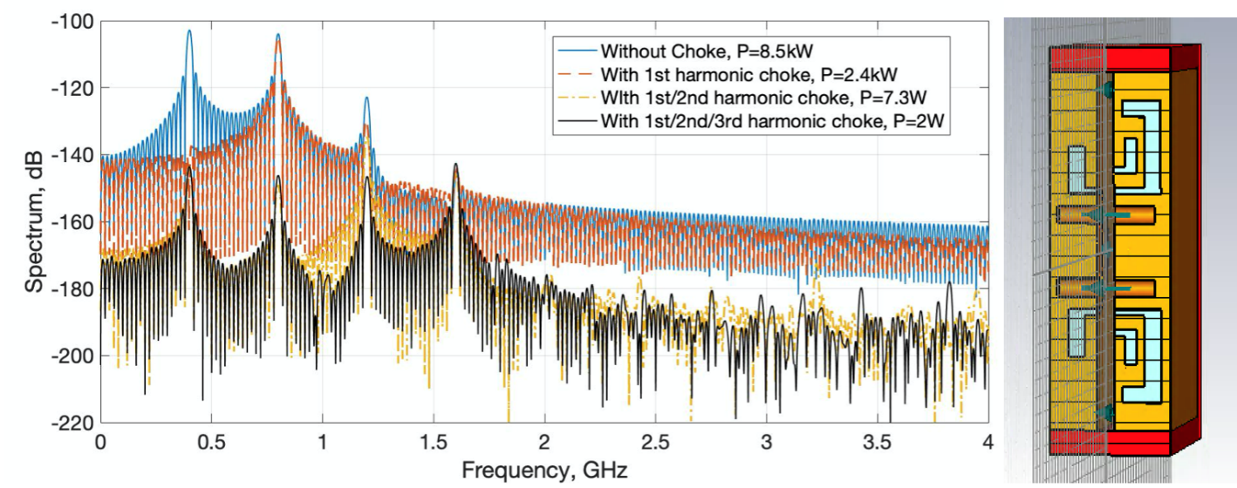
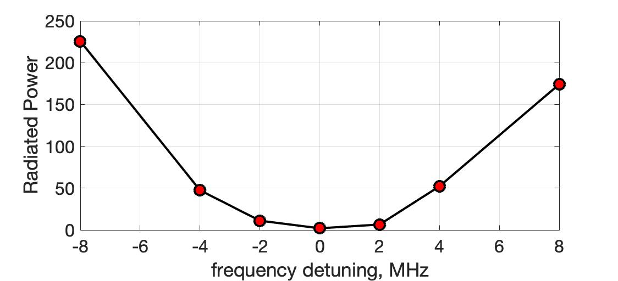
Parasitic RF power radiation into Post acceleration DC gap
Bunched beam passing through the open gap will partially radiate RF power into the gap (wakefield problem).
Radiation level is rather high: 8.5kW. The set of 3 frequencies (bunch harmonics) resonant rejecters reduces the radiation level by 36dB (down to 2W)

Slide 10
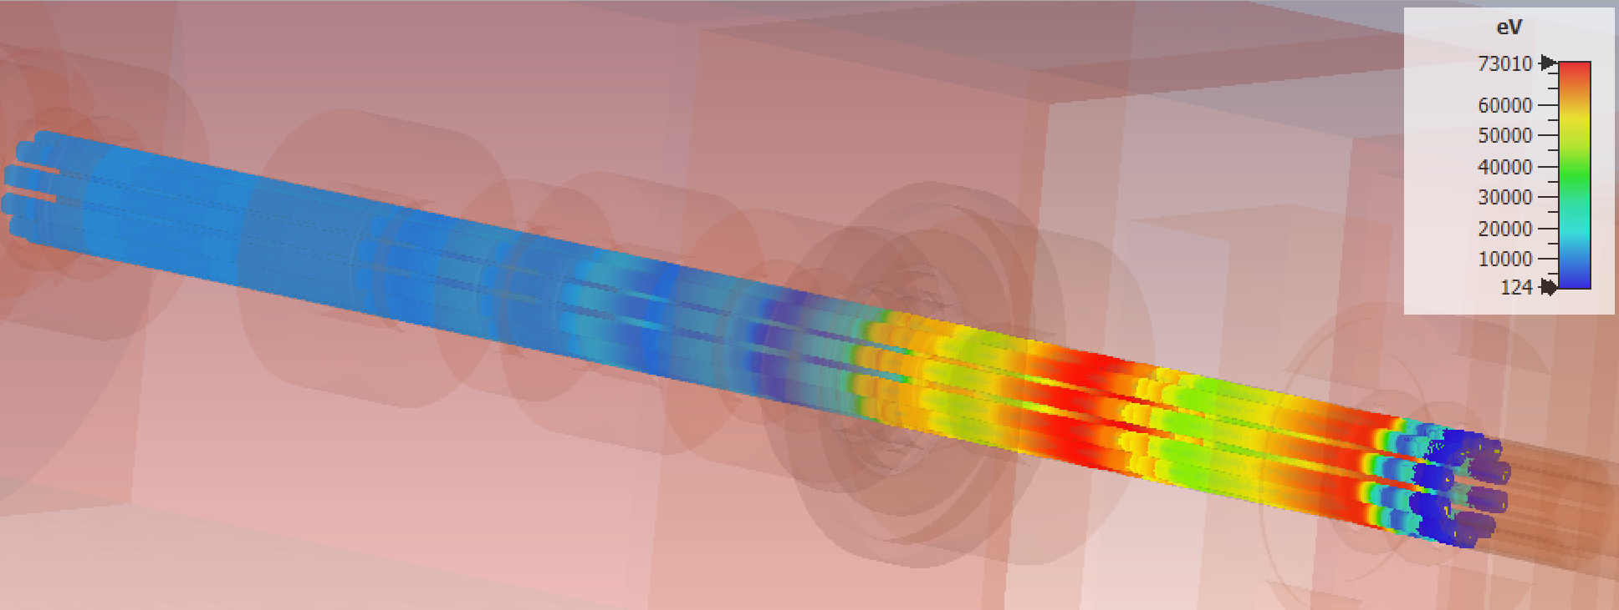
Full 3D PIC Simulation of TS MBK RF Circuit
Rendering of the particles’ velocity modulation in the steady state and saturation
Efficiency is 79% without reflected electrons in the output cavity.

Slide 11
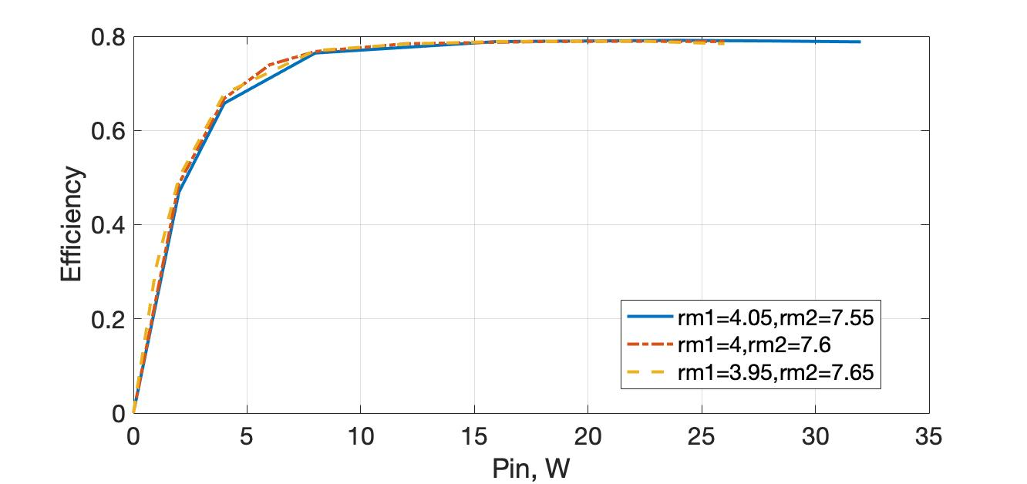
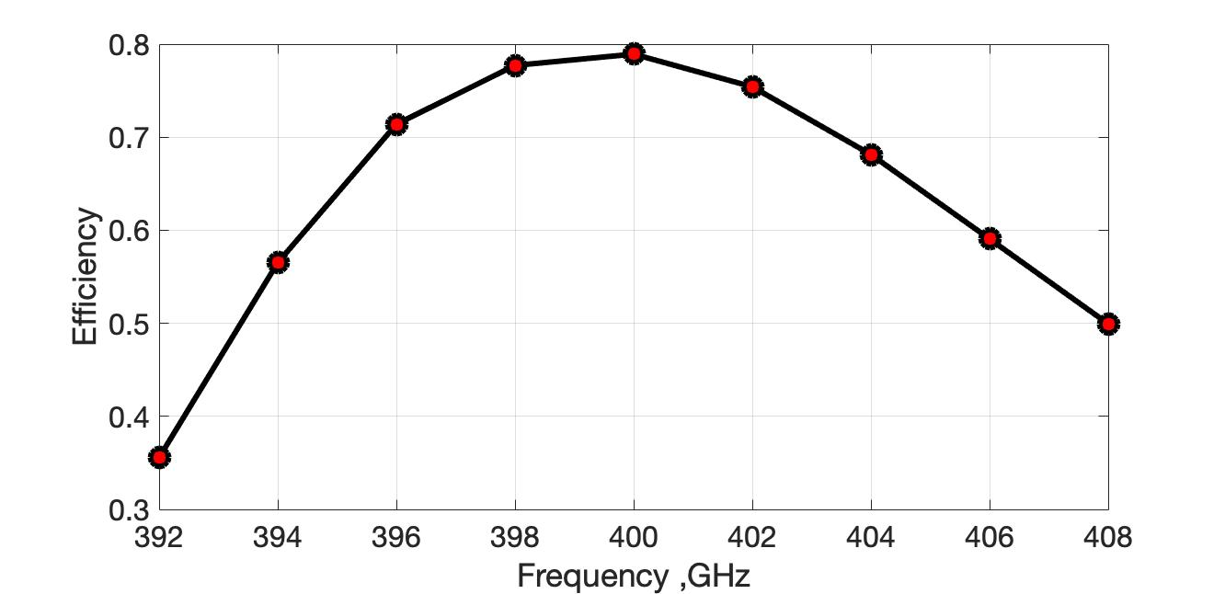
Power transfer and frequency band of TS MBK (CST PIC)
Hollow beam design makes tube less sensitive to beam parameter.
11.5 kV for the first stage, 58kV for the second stage, oil tank is not necessary for HV insulation.
-3dB bandwidth is over 16MHz.
Klystron could deliver 1.23MW output power at 400MHz, with circuit length of 1.6m. No instability in RF circuit were found.

Slide 12
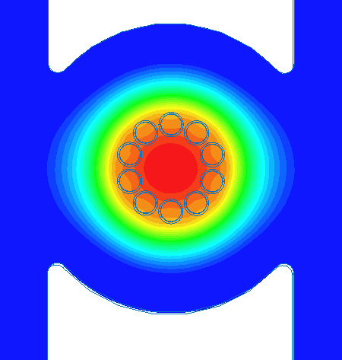
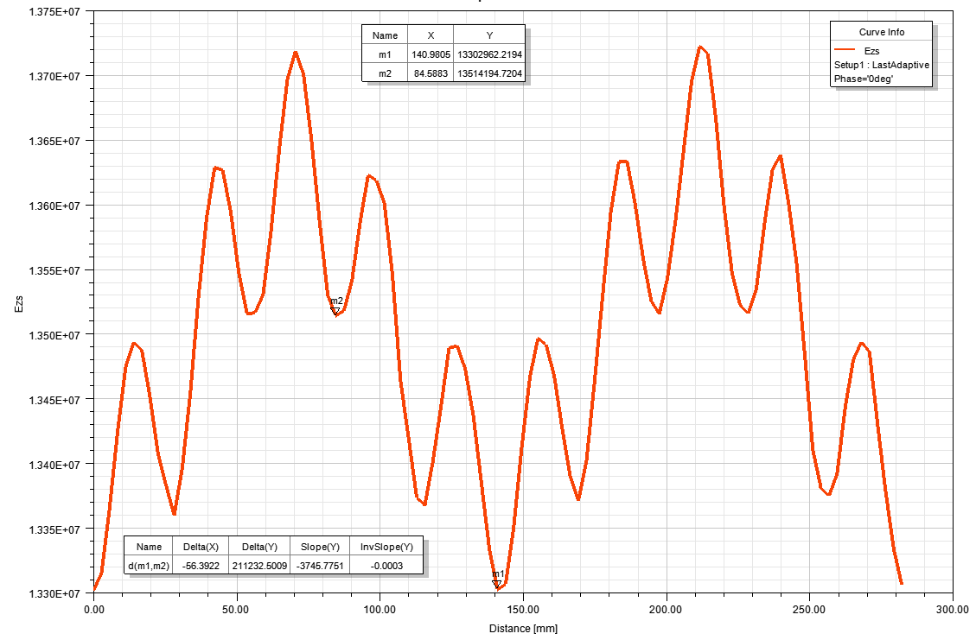
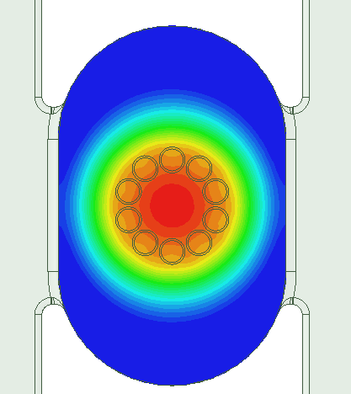
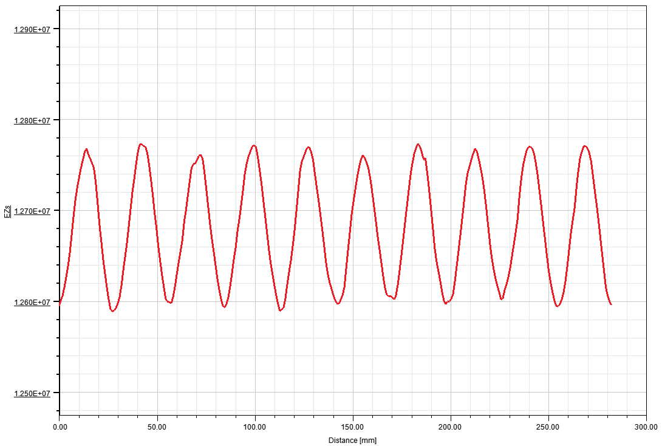
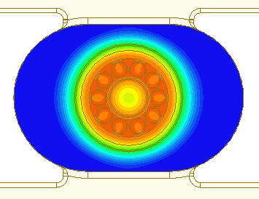
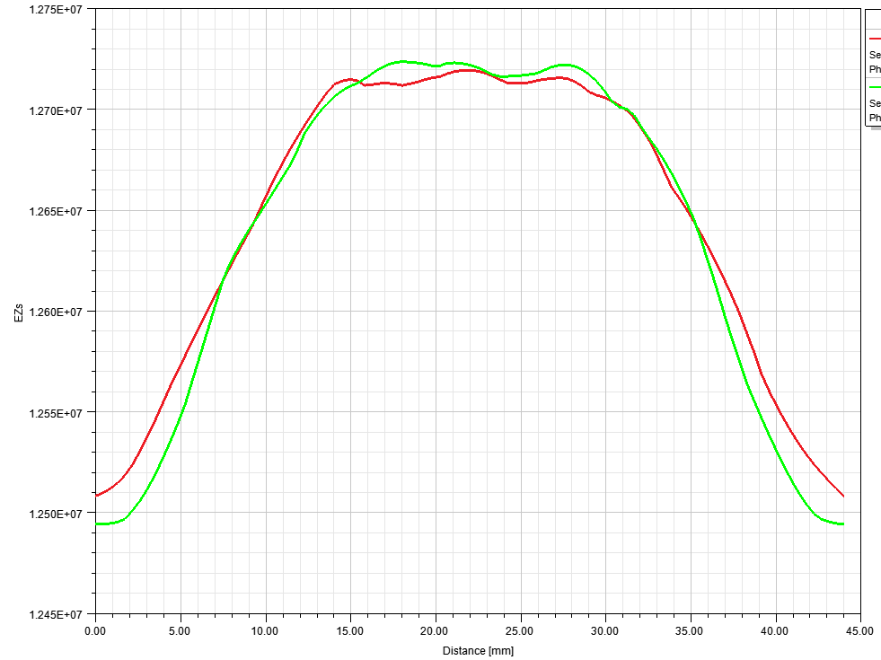
E_{z} at beams centers radius (middle of the gap)
Output cavity of the HE UHF (400 MHz) MBK.
1
TS technology will profit from the compact arrangement of RF cavities. TM01 reentrant cavities were selected and adopted to host 10x2.7A beams.
The original output cavity is coupled to two orthogonal waveguides. In this case we found that reflected electrons are originated not from every channel, but from the ones that have highest (azimuthally) impedance.
This effect was compensated by introducing racetrack shape of the cavity to compensate for the quadrupolar filed distortion. Then, reflected elections origin showed azimuthal dependence within the individual beamlet, that followed 6% dipolar distortion of the electric field.
This effect was compensated with L-C tuners, which reduced dipolar component down to about 1.5% and preserved compensation of the quadrupolar component.
2
3
E_{z} at single beams radius (middle of the gap)
#1
#4
#1
#4
With all these measures ‘reflected electrons free’ operation can be achieved with about 3%-5% higher RF power production efficiency.

Slide 13
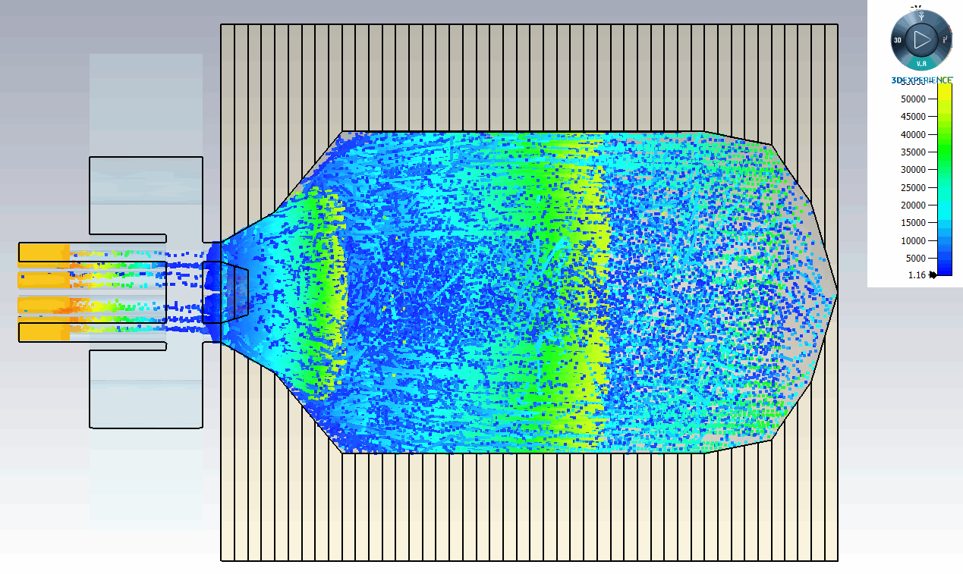
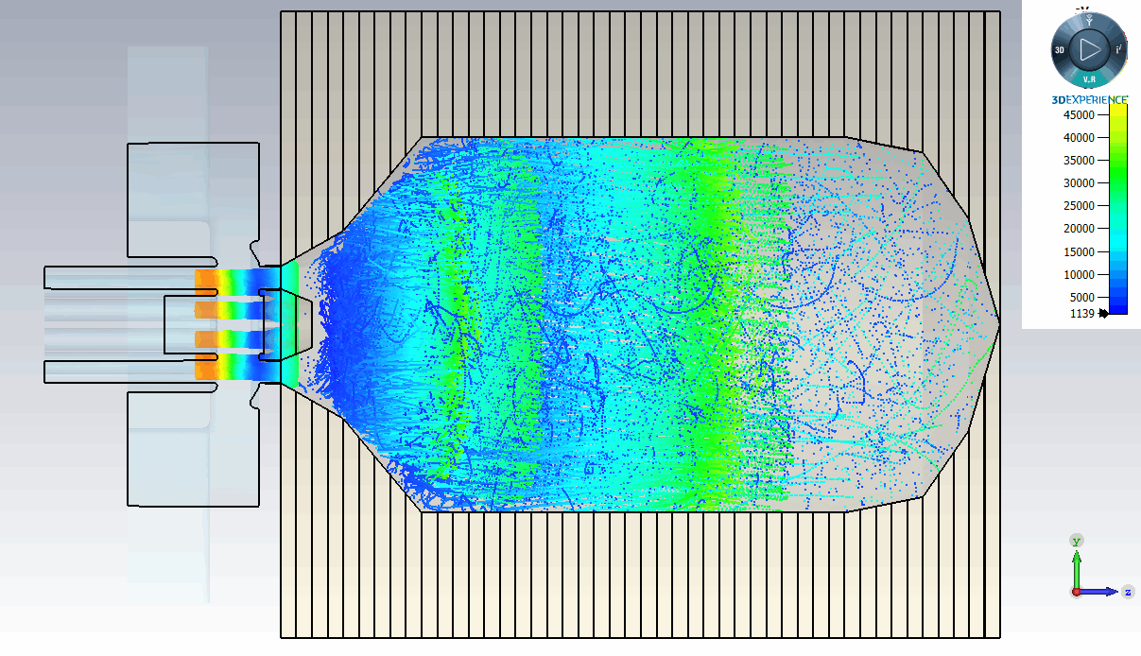
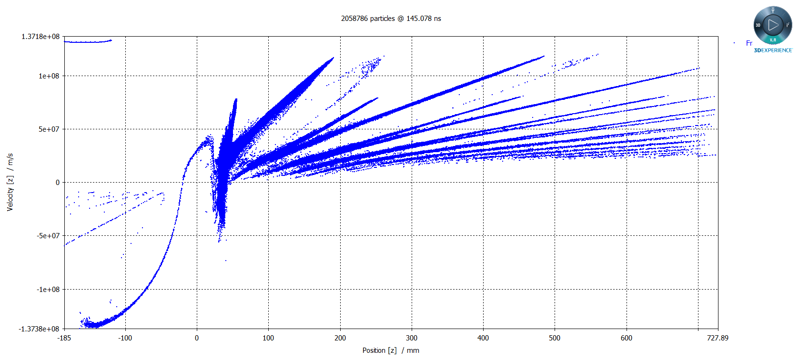
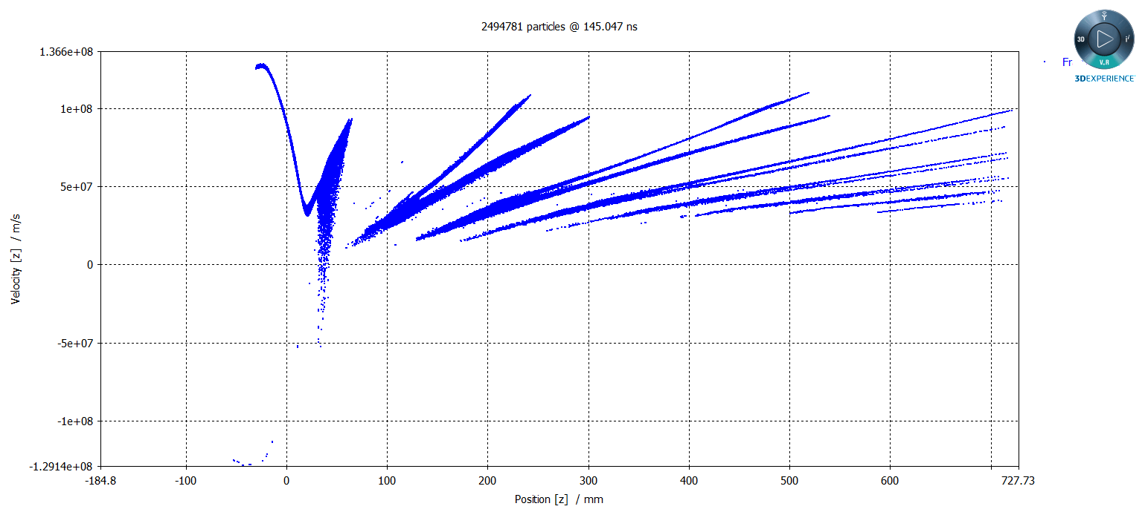
Output cavity of the HE UHF (400 MHz) MBK. 3D PIC Simulation
RF efficiency = 81 %
RF efficiency = 81 %
1
3

Slide 14
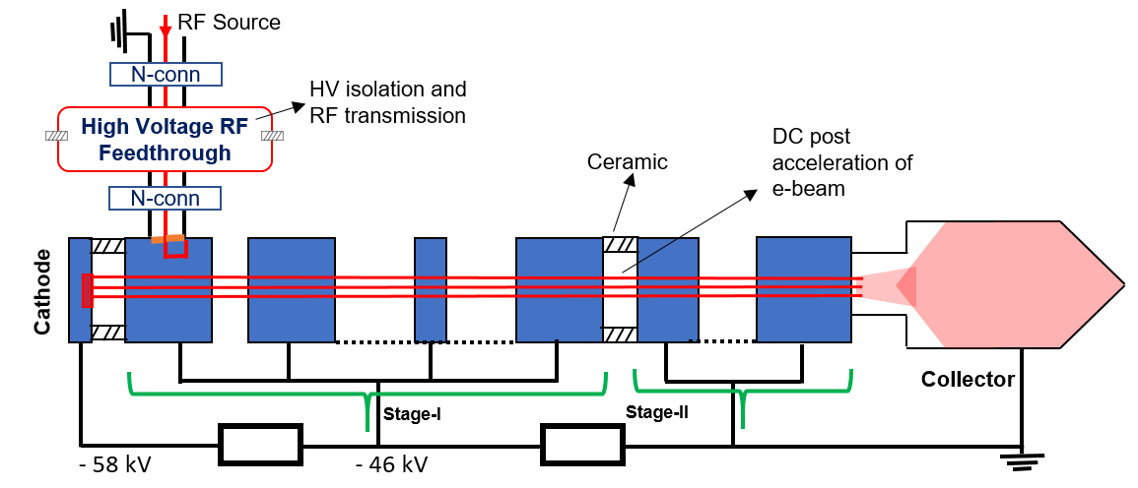
TS MBK High Voltage isolated RF Feed Through (HVRFT)
HVRFT is a special device which has to protect the klystron’s RF driver from the biasing voltage of the first stage (~50kV) and to enable efficient RF transmission of the driving RF signal (~100W) into the input cavity.

Slide 15
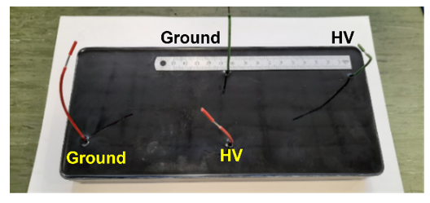
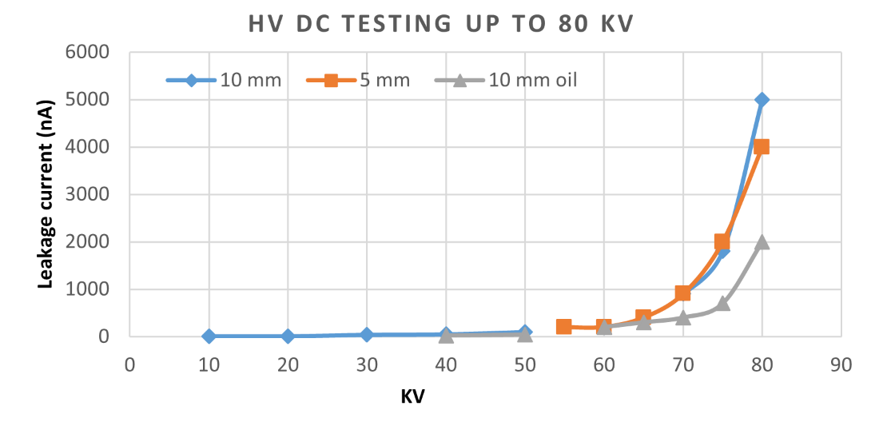
HVRFT design based on the strip-line topology
RF field map
High voltage tests of the stipeline electrodes imbedded into dielectric casing.
Strip-line topology allows for the compact solution. It provides HV isolation up to 65kV (measured) and efficient enough (60%) RF power transmission.
The full-scale prototype is now in fabrication and will be tested in September 2022.

Slide 16
1 m
Design Parameters for TS MBK for FCC^{ee}
Parameters | Design Target | KlyC | CST
Frequency (GHz) | 0.4 | 0.4 | 0.4
Voltage (kV) | 58 | 58 | 58
First stage (kV) | 10-20 | 11.5 | 11.5
N beams | 10 | 10 | 10
Total Current (A) | 27 | 27 | 27
Output Power (MW) | 1.2 | 1.28 | 1.2
Efficiency (%) | 80 | 80.6 | 79
Tube length (m) | <3 | -- | 2.8
2.8 m

Slide 17
FCC TS MBK Summary and outlook
The reduction of energy consumption in the future large scale accelerators, like FCC, is of a great importance.
Novel two-stage (TS) klystron technology was introduced recently. It enables compact solution in UHF band, with potential to increase the efficiency from 65% in existing commercial tubes up to 80%.
Such a 400 MHz, 1.2 MW TS MBK klystron for FCC is now under development at CERN as a part of the High Efficiency Klystrons project.
RF circuit, beam optics and special axillaries, like HVRFT and DC accelerating gap rejector, have been evaluated and confirmed in simulation the tube conceptual feasibility with potential to reach target efficiency of 80%.
The next step will be integration of beam optics and RF circuit, followed by technological development and prototype fabrication in collaboration with industrial partner.

Slide 18
Thanks for your attention!

