Slide 1

FCCee: from 200 MeV to 6 GeV linac-ee
Simona Bettoni¹, Andrea Latina²
A. Grudiev², P. Craievich¹, S. Doebert², H. W. Pommerenke², J.-Y. Raguin¹, M. Schaer¹, R. Zennaro¹, Y. Zhao²,
(WP1 FCCee Injector Study Group)
¹ Paul Scherrer Institut, Villigen (Switzerland)
² CERN, Meyrin (Switzerland)
65th ICFA Advanced Beam Dynamics Workshop on High Luminosity Circular e+e- Colliders (eeFACT2022)
12nd Sept-15th Sept 2022
Frascati (Italy)

Slide 2
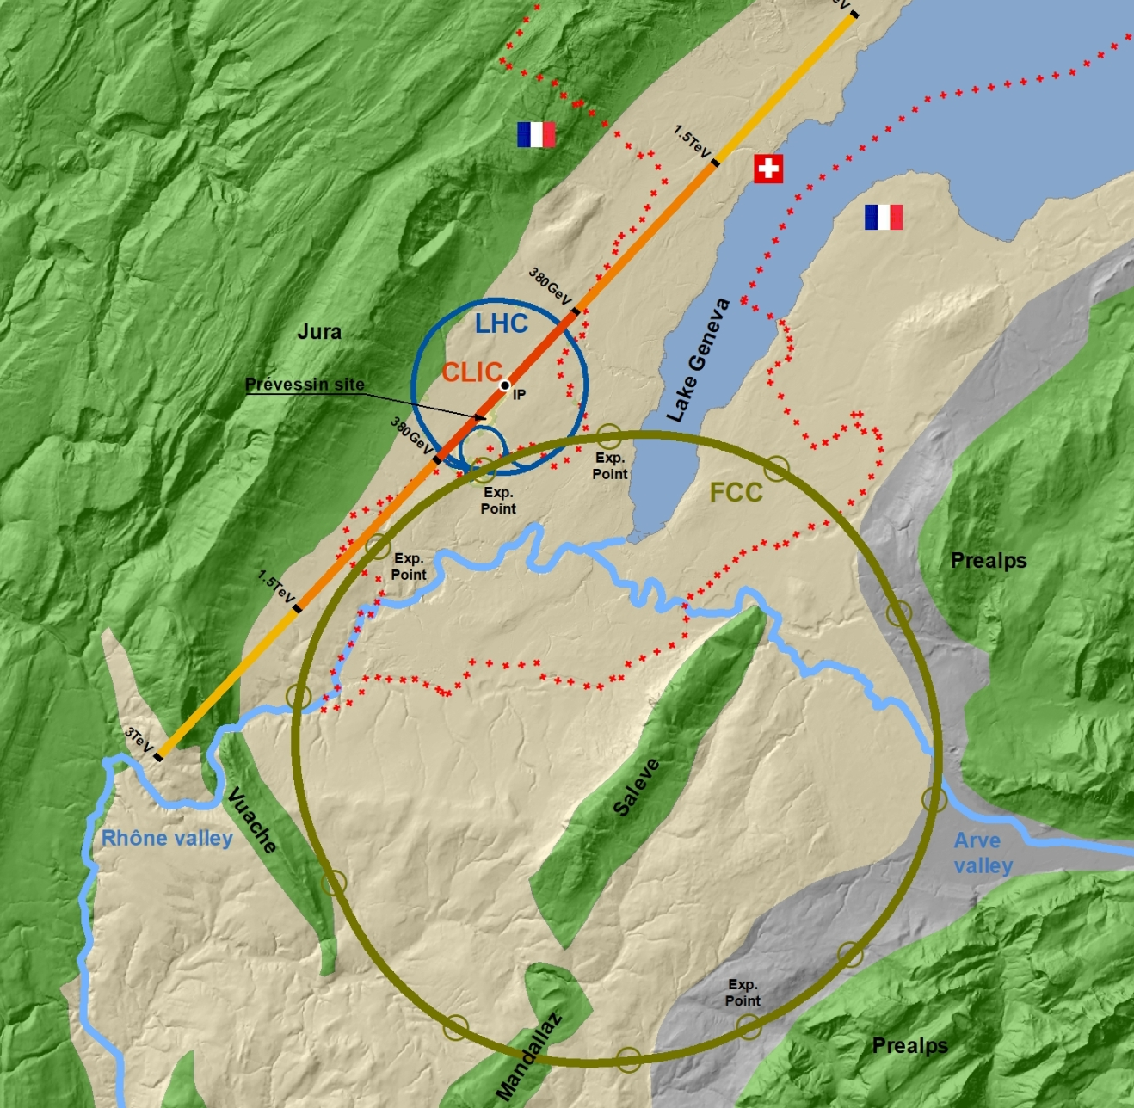
Outlook
Machine layout, inputs, and acceptance
Single bunch dynamics:
  Transverse: emittance preservation
  Longitudinal: energy spread and bunch length
Possible linac(s) layouts:
  Solutions which fulfill the requests
  Toward the most efficient design
  Further improvements
Multi-bunch dynamics
Summary and next steps

Slide 3
Layout, inputs, and acceptance
Final
200 MeV→1.54 GeV
1.54 GeV→6 GeV
~300 m
Initial*
*Optimizations by T. Brezina and S. Doebert

Slide 4
Layout, inputs, and acceptance
200 MeV→1.54 GeV
1.54 GeV→6 GeV
Parameter | Baseline |  | Alternative | Comments
Ring for injection | SPS (PBR) |  | HE Linac
Initial energy (MeV) | 200
Final energy (GeV) | 6 | 20
Charge (nC) | 5.5 | 5.0 |  | Changed from 4 nC to 5 nC during the linac optimization
Initial charge distribution | Gaussian/From tracking
Number of bunches | 2
Bunch spacing (ns) | 15-100 |  |  | From BD Linac point of view used to define LRW
Initial transverse rms emittance (um) | 3.3*, 6.1** |  |  | *at 4 nC-σ_{z} = 1.3 mm, **at 5 nC-σ_{z} = 0.65 mm
Final maximum transverse rms emittance (um) | 50
Initial rms bunch length (mm) | 1.3 (when starting the optimization) |  |  | Coming from the linac(s) optimization
Final bunch length (mm) | 1-1.5 |  |  | Optimizations ongoing
Final rms relative energy spread | 0.1-0.15% |  |  | Optimizations ongoing

Slide 5
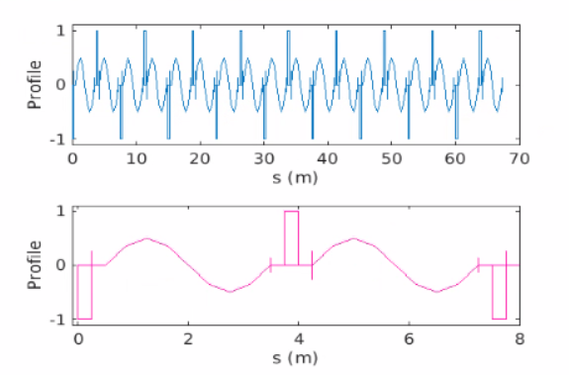
Linacs’ modeling
Lattice modeling:
    FODO lattice with 90 degs phase advance/cell
    One quadrupole/RF structure. Option with half of the quadrupoles investigated.
    RF structures’ wakefield: Bane model (a is the iris radius)
    90 degrees of the RF cavity corresponds to on-crest operation
Simulation codes:
    MAD-X for the optics matching
    Elegant for the single bunch tracking simulations
    RF Track for the single and multi-bunch tracking simulations
RF structure
Quadrupole
RF STRUCTURES | eLinac | Common Linac
Length (m) | 3 | 3
Frequency (GHz) | 2.8 | 2.8
Gradient (MV/m) | 25 | 25
Number of cavities | 18 | 60
Radius (a) over lambda | 0.1…0.2
QUADRUPOLES | e-Linac | Common Linac
Length (m) | 0.25
Gradient (T/m) | 7.75…30 | 1…8
Number | 18 | 60 (30)
Drift space (m) | 0.25

Slide 6
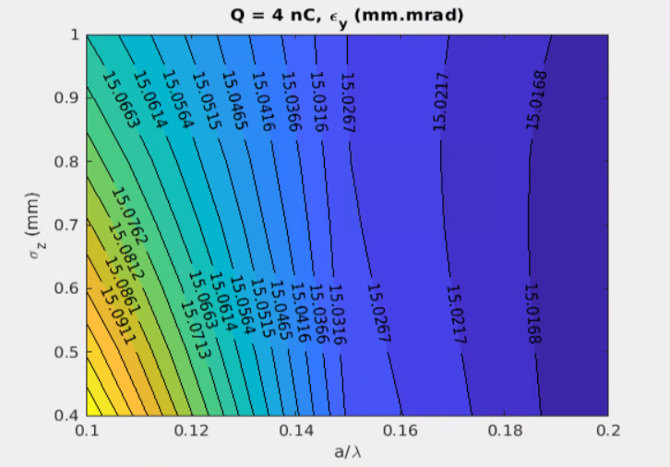
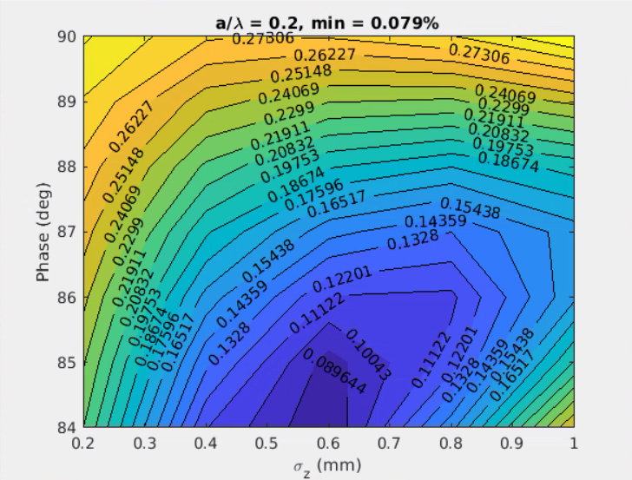
Single bunch effects
Single-bunch effects are dominated by short-range wakefield, elements misalignment, RF curvature, and incoming jitter
Emittance growth
Sources: off-axis orbit and/or random misalignments of several elements (RF structures and quadrupoles)
Possible cures: trajectory correction, optimization of the RF structures design
Projected energy spread
Sources: RF curvature and longitudinal wakefield vs bunch length
Possible cures: compensation of the RF curvature effect with the longitudinal wake potential
2D scans to determine the optimal working point
Transverse: emittance
Longitudinal: energy spread
Scan of the rms bunch length (σ_{z}) and the aperture of the RF structures (a/λ)
Scan of the bunch length (σ_{z}) and the RF phase (90 deg corresponds to on-crest phase)

Slide 7
Transverse plane single bunch: common Linac
1.54 GeV→6 GeV

Slide 8
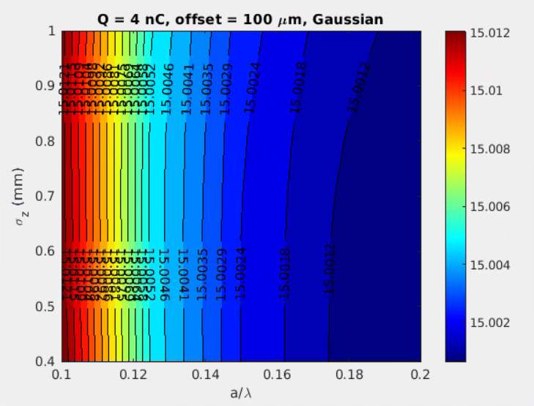
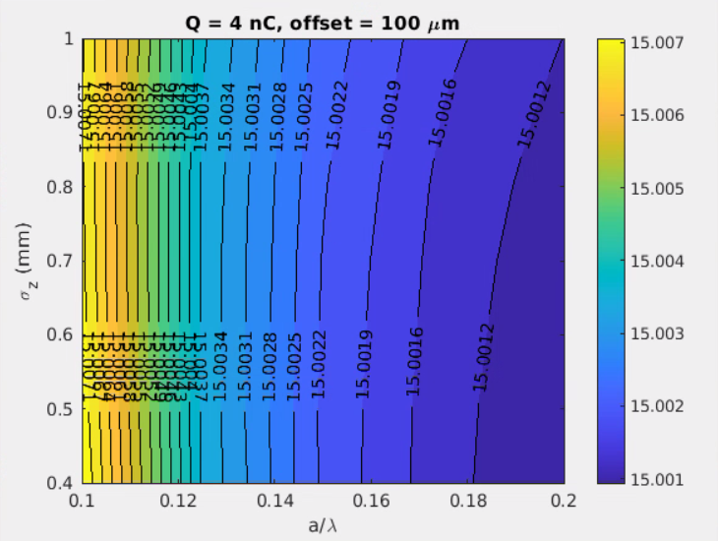
Sensitivity to RF structures misalignments
Imposed Gaussian distributed random offsets in both the transverse planes or a constant misalignments to all the RF structures along the Linac (BPM and quadrupoles aligned)
Offset x = 100 um rms
Offset y = 100 um rms
Gaussian distribution
Offset x = 100 um
Offset y = 100 um
All the same offset*
EMITTANCE
EMITTANCE
Negligible impact on the emittance ►no constraints on the RF design in the considered parameters space
*Same conclusion starting from smaller initial emittances: 5 mm.mrad and 10 mm.mrad

Slide 9
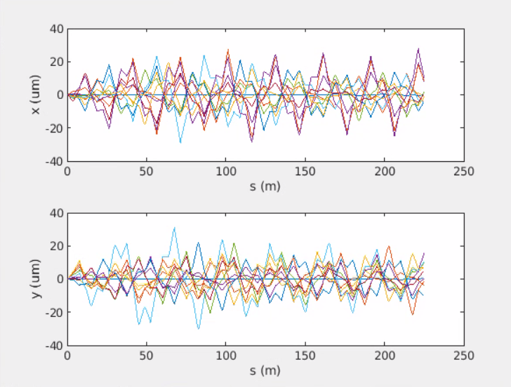
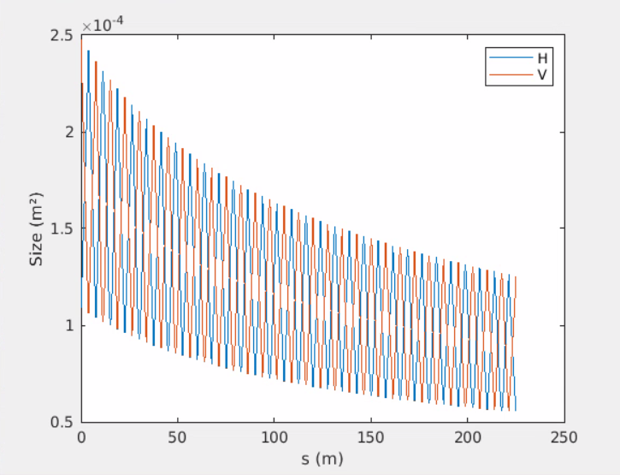
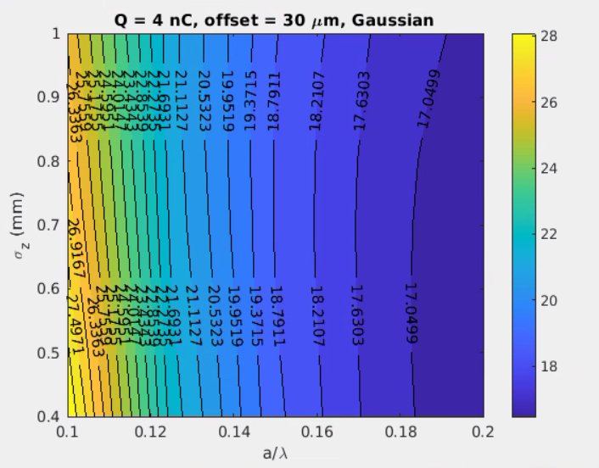
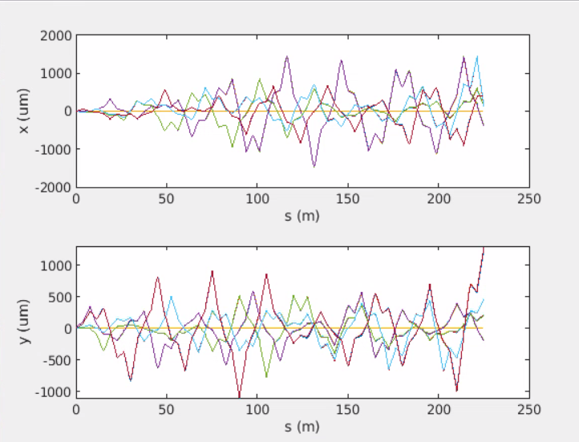
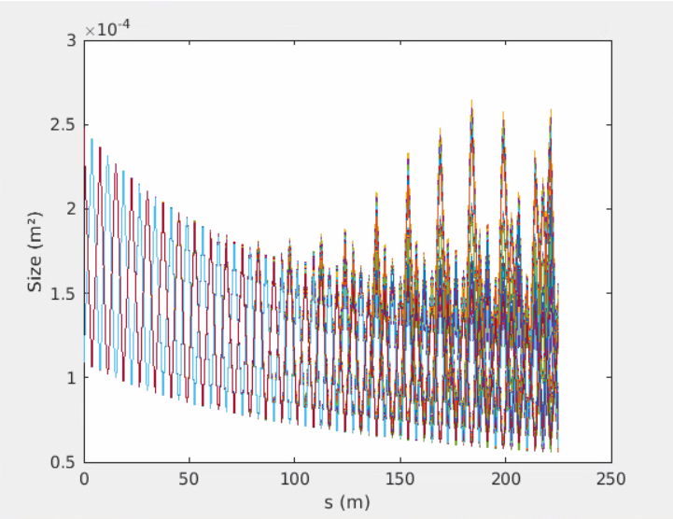
Sensitivity to quadrupoles misalignments
Imposed Gaussian distributed random offsets in both the transverse planes to all the quadrupoles along the Linac (BPM and RF structures aligned)
Offset x = 50 um rms
Offset y = 50 um rms
Gaussian distribution
Only RF structures misaligned
50
EMITTANCE
Quadrupoles (quadrupoles and RF structures) misaligned
Still below tolerance, but impact on the emittance (almost a factor 2 in the worst case)

Slide 10
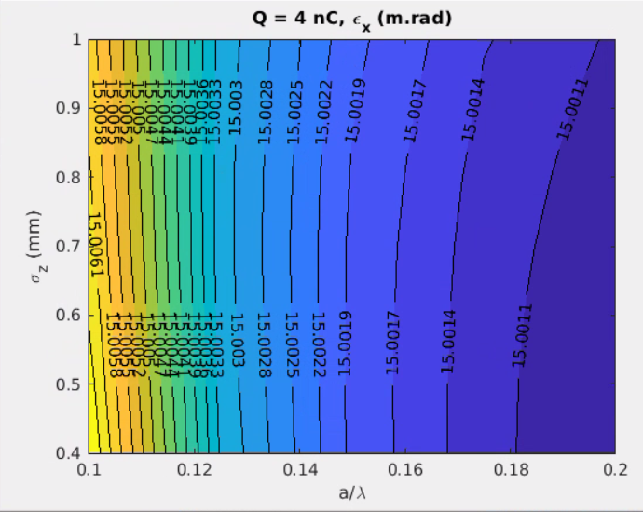
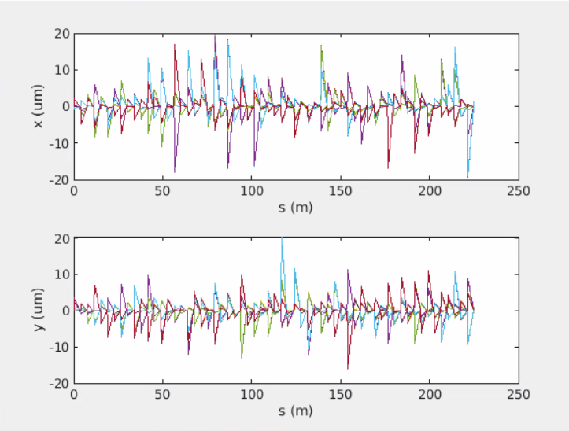
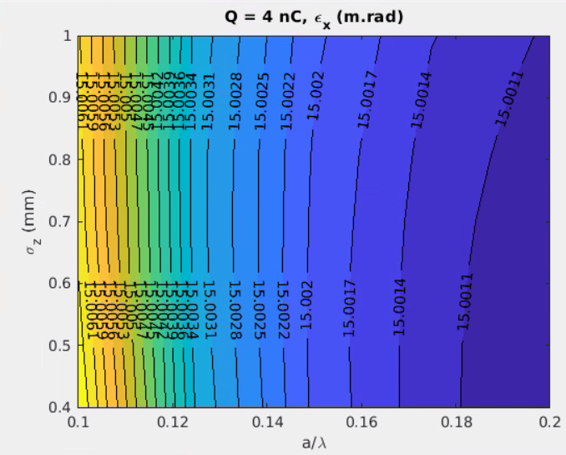
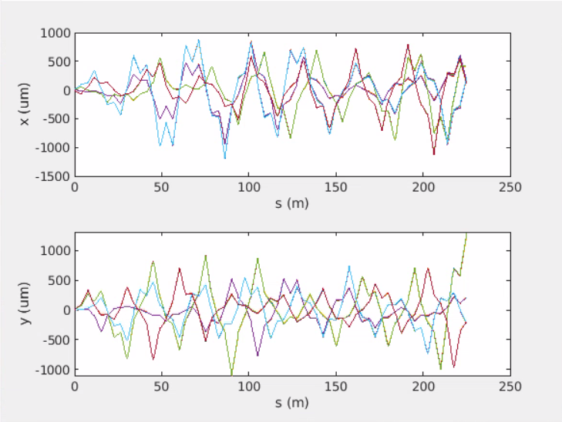
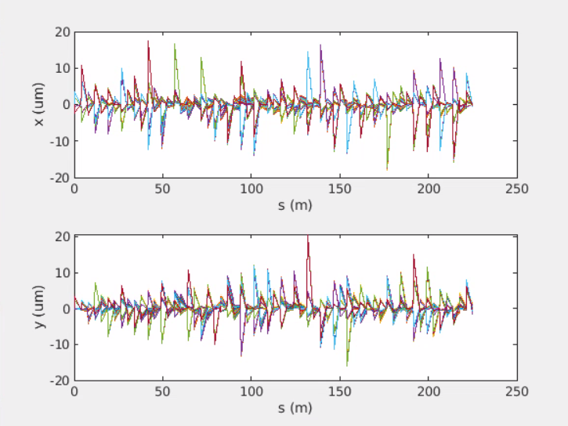
Orbit correction (one-to-one, 1/3 BPMs faulty) applied
w/o correction
with correction
(mm.mrad)
Quadrupoles
Offset x = 50 um rms
Offset y = 50 um rms
Gaussian distribution
EMITTANCE
w/o correction
with correction
(mm.mrad)
Quadrupoles
Offset x, y = 50 um rms
RF cavities
Offset x, y = 100 um rms
Gaussian distribution
EMITTANCE
Emittance increase under control for the considered cases, but orbit steering is essential for electrons (and positrons) sharing the same Linac

Slide 11
Transverse plane single bunch: e- Linac
200 MeV→1.54 GeV
~300 m

Slide 12
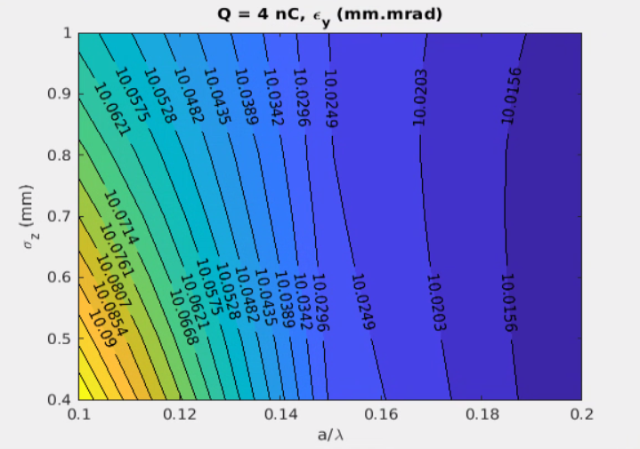
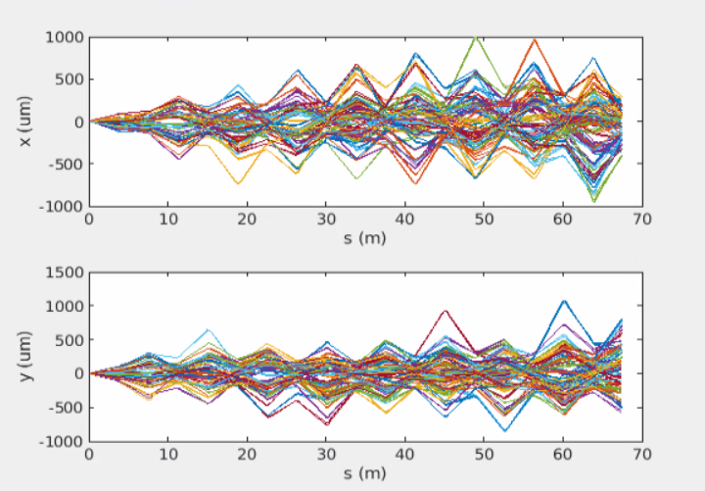
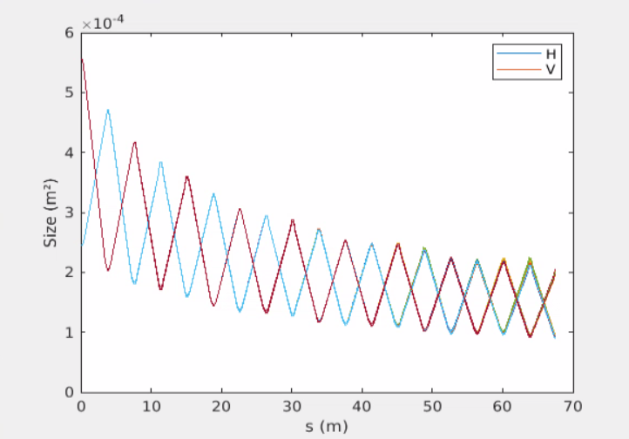
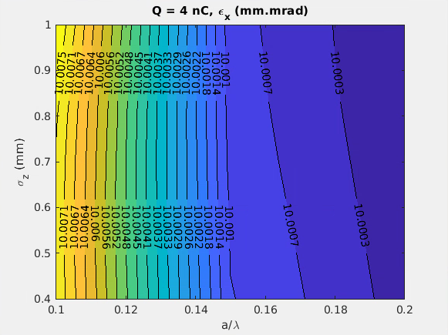
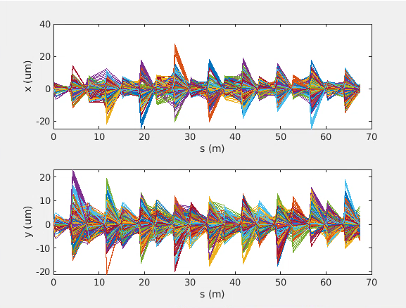
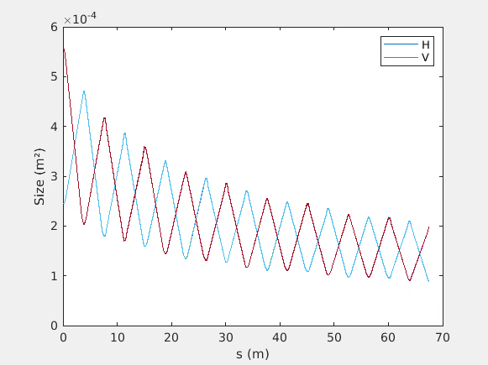
Sensitivity to misalignments and orbit correction
w/o correction*
EMITTANCE
Quadrupoles
Offset x, y = 50 um rms
RF cavities
Offset x, y = 100 um rms
Gaussian distribution
EMITTANCE
with correction*
Negligible impact on the emittance for RF and Quads misalignments ►no constraints on the RF design in the considered parameters space
*Same conclusion starting from smaller initial emittance: 3 mm.mrad and 5 mm.mrad

Slide 13
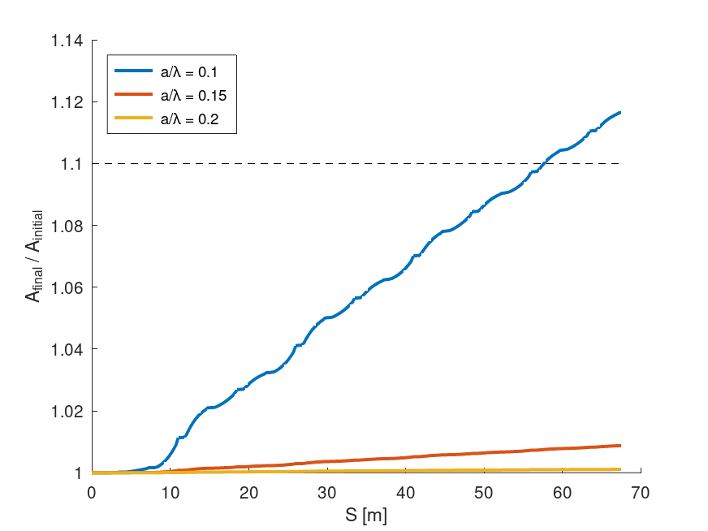
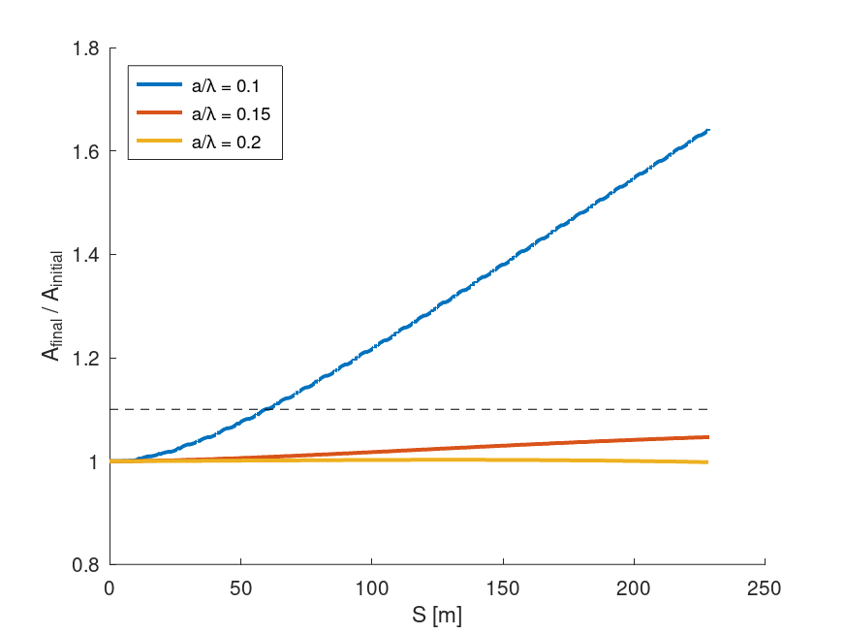
Incoming jitters
Possible incoming jitter sources:
    Arrival time: negligible
    Mean energy: to be verified, but not expected to be critical
    Charge: covered in a precedent presentation*
    Orbit:
e- Linac
Common Linac
Action* increase
Measurement of the incoming jitter amplification along the lattice due to orbit jitter
No large impact in e-Linac, and significant degradation along the common Linac for more extreme geometries
* A. Latina in FCC Injector review meeting: https://indico.cern.ch/event/1025852/contributions/4307595/attachments/2228176/3776428

Slide 14
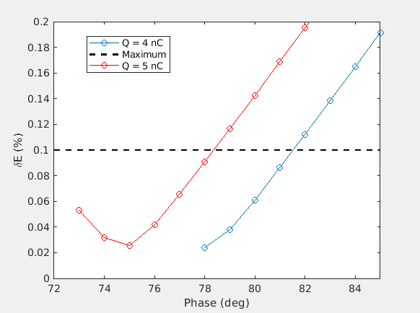
Dependence on bunch charge
To the spare
Possible incoming jitter sources:
    Arrival time: negligible
    Mean energy: to be verified, but not expected to be critical
    Charge: covered in a precedent presentation, and verified for one of the possible configurations
    Orbit
No modifications of the machine setup: jitter
Modifications of the machine setup : different working point
δE/E (%)
Without changing the machine setting δE/E changes by 0.008% (0.092% and 0.108% instead of 0.1%) for 2% charge jitter
If a larger variation of the beam charge is foreseen the optimal δE/E is achieved varying the operation point: 3 deg/nC (more in the spares)

Slide 15
Longitudinal plane single bunch: common Linac
1.54 GeV→6 GeV

Slide 16
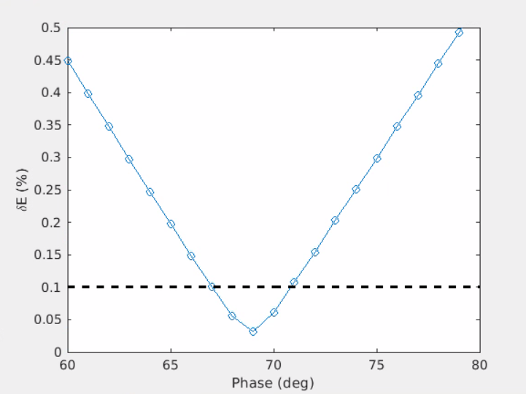
Energy spread optimization
Goal: bring the projected energy spread below 0.1%* at the SPS injection.
Considered scenarios:
Shorter bunch from the gun (before this work it was 1.3 mm)
  Possible emittance degradation
  Possible longitudinal space charge effect
  No CSR
Bunch compressor at the exit of e- Linac
  Energy loss due to the off-crest operation along the e-Linac
  Extra hardware necessary: linearizing cavities and bunch compressor
  Possible emittance degradation due to CSR
  Solution depends on the arrival time jitter and RF stability
  Very small values of energy spread possible
Shorter bunch from the gun and linearization
  Some extra hardware necessary: linearizing cavities
  Small values of energy spread possible
  No CSR effects
Considered parameters:
Phase extent: phase range where the final energy spread fulfils is inside the acceptance → stability
Minimum Target energy spread
Bunch length range → machine layout and beam specifications
* More comments in few slides

Slide 17
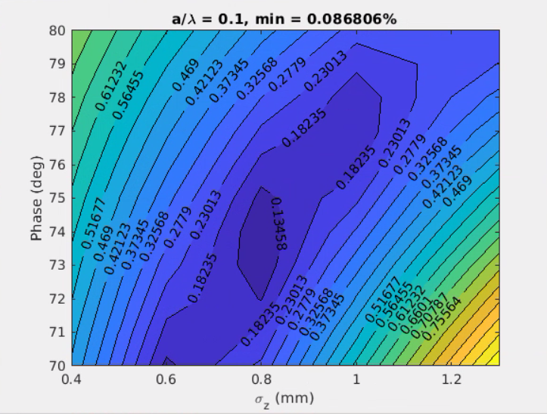
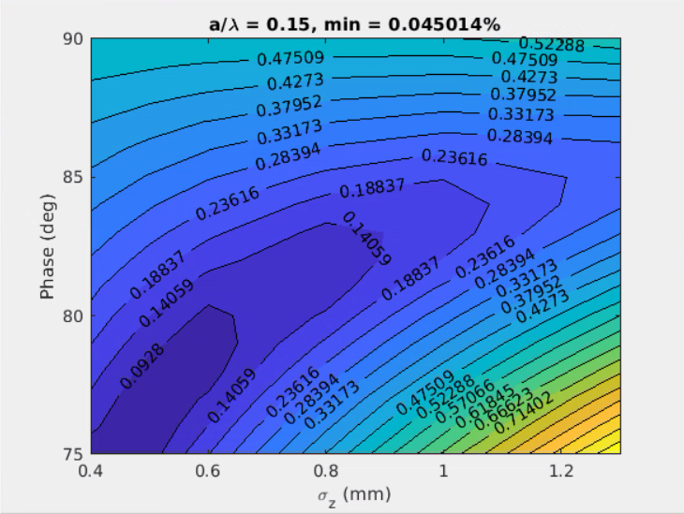
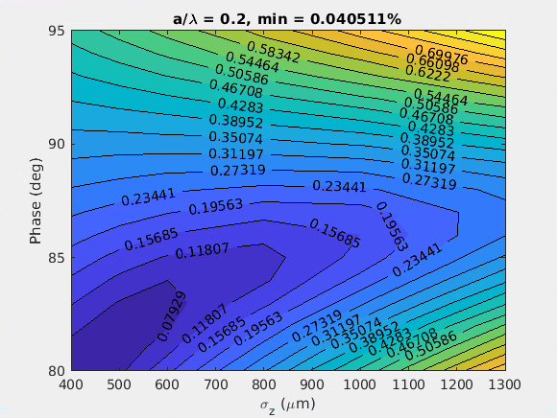
1. Shorter bunch from the gun
a/λ = 0.10
a/λ = 0.15
a/λ = 0.20
δE/E
δE/E
δE/E
 | a/λ = 0.10 | a/λ = 0.15 | a/λ = 0.20
Phase range (deg) | 73…74 | <75…81 | <80…85
Min δE/E | 1e-3 | 5e-4 | 4e-4
Rms bunch length (mm) | 0.8 | 0.4…0.65 | <0.4…0.7

Slide 18
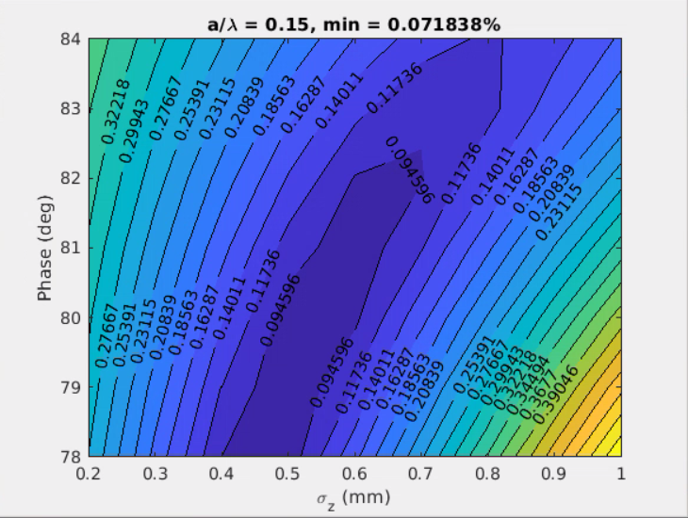
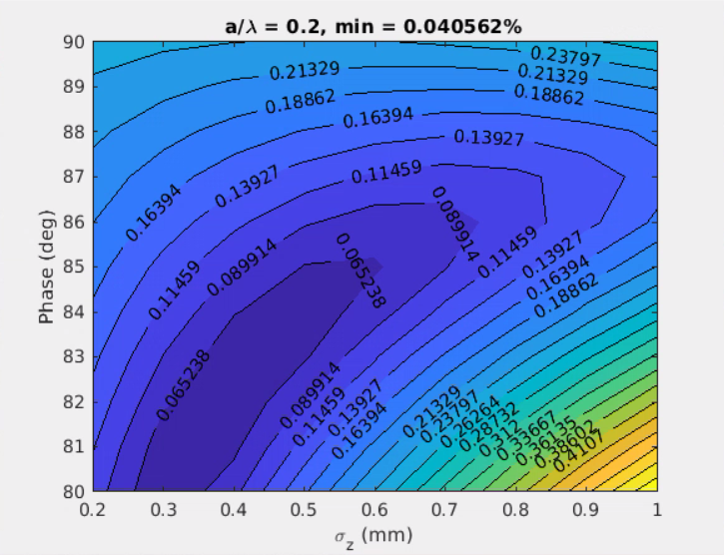
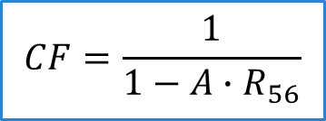
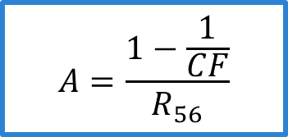
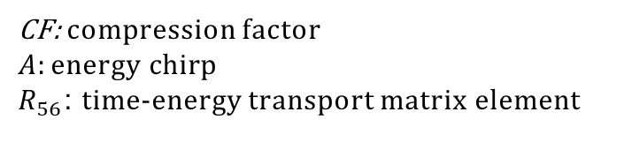
2. Compression at e-Linac: starting parameters
$$CF=\frac{1}{1−A∙R_{56}}$$
CF: compression factor
$$A:energy chirp$$
$R_{56}$: time-energy transport matrix element
$$A=\frac{1−\frac{1}{CF}}{R_{56}}$$
Simulations setup:
    Constant bunch length along e-Linac
    Varied the bunch length at the end of e-Linac
    Final energy chirp and slice energy spread scaled with the compression factor and R56, respectively
δE/E
δE/E
Optimal bunch length in the range of 0.3…0.7 mm depending on the RF geometry and RF operation phase

Slide 19
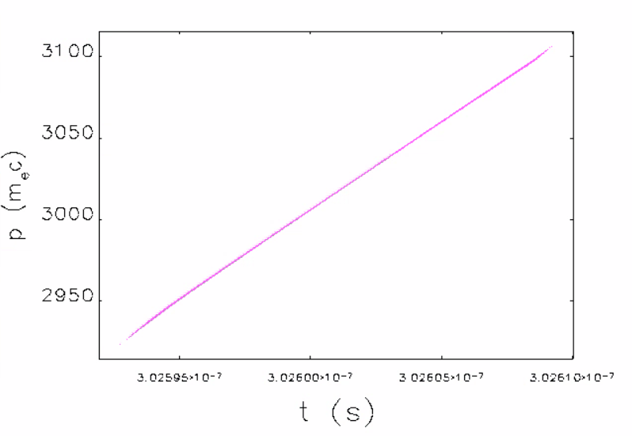
2. Compression at e-Linac: modeling
Bunch compressor
Dipole length (m) | 0.25
Dipole angle (deg) | 3.82
Linearizer f (GHz) | 4*2.8 = 11.2
Phase linearizer (deg) | 270
Linac as shown before
Linearizer
Frequency (GHz) | 2.8
Linac 1 phase (deg) | 75 | 72 | 73
Initial bunch length (mm) | 1.3
Final bunch length (um) | 457 | 238 | 312
Bend angle (deg) | 3.82
R56 (mm) | 63.4
Linearizer (11.2 GHz) voltage (MV) | 100
Linac length (m) | 90
Initial energy (MeV) | 202
Final energy (GeV) | 1.54
At the end of e- Linac (457 um case)

Slide 20
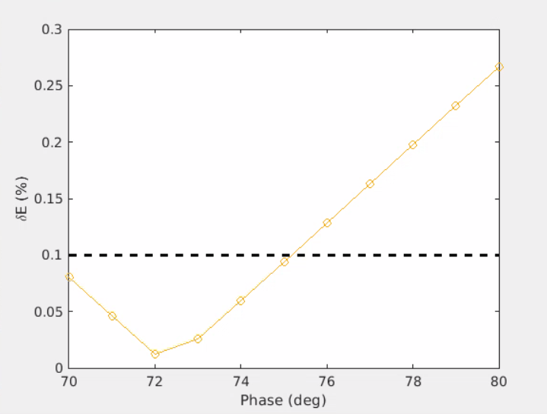
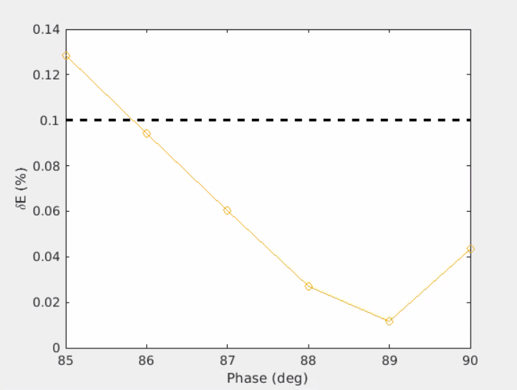
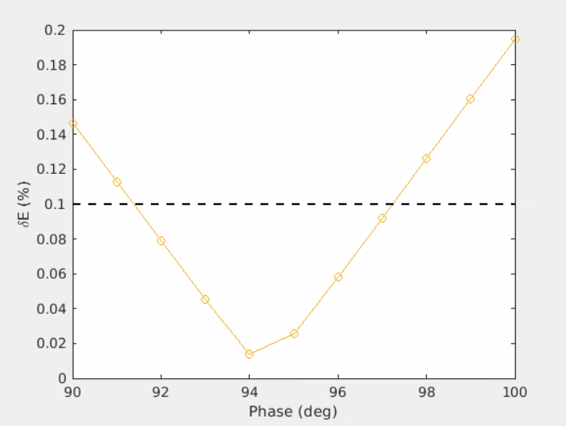
2. Compression at e-Linac: results
a/λ = 0.10
a/λ = 0.15
a/λ = 0.20
 | a/λ = 0.10 | a/λ = 0.15 | a/λ = 0.20
Phase range (deg) | <70…75 | 86…>90 | <80…85
Min δE/E | 1e-4 | 1e-4 | 1e-4
Rms bunch length (mm) | 0.457
For all the geometries the final energy spread << 0.1%
The solution at a/λ = 0.15 corresponds to the e- Linac close to on-crest operation region (the most energy efficient)

Slide 21
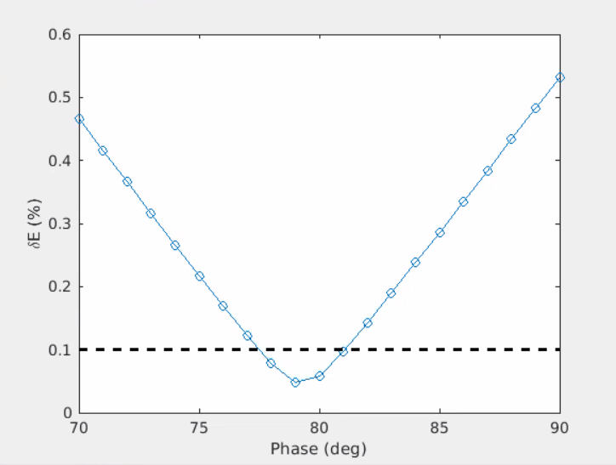
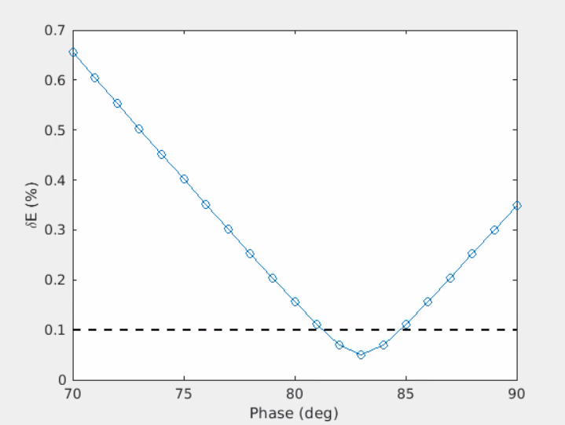
3. Shorter bunch from the gun and linearization
Intermediate solution:
  Moderately shorter rms pulse length: possible emittance degradation at the low energy section
  Linearizing cavity
  No bunch compression: no further emittance degradation due to CSR
a/λ = 0.10
a/λ = 0.15
a/λ = 0.20
 | a/λ = 0.10 | a/λ = 0.15 | a/λ = 0.20
Phase range (deg) | 66…70 | 77…81 | 81…85
Min δE/E | 2e-4 | 3e-4 | 3e-4
Rms bunch length (mm) | 0.650
Smaller values of energy spread reachable compared to the configuration 1

Slide 22
Comments at the 2022 FCC week (June 2022)
Several solutions satisfy the present requirements
 | a/λ = 0.10 | a/λ = 0.15 | a/λ = 0.20
Phase range (deg) | 73…74 | <75…81 | <80…85
Min δE/E | 1e-3 | 5e-4 | 4e-4
Rms bunch length (mm) | 0.8 | 0.4…0.65 | <0.4…0.7
Shorter from the gun
1.
How to choose the best one?
  The ring energy acceptance: is much less than 0.1% beneficial?
  Ease of operation, cost, and possible emittance degradation mechanisms
  Tolerance: “good phase region” extension, more or less critical the arrival time jitter (compression), …
  RF efficiency: smaller aperture still beneficial also if the optimum working point is off-crest? Up to which extent?
 | a/λ = 0.10 | a/λ = 0.15 | a/λ = 0.20
Phase range (deg) | <70…75 | 86…>90 | <80…85
Min δE/E | 1e-4 | 1e-4 | 1e-4
Rms bunch length (mm) | 0.457
Bunch compression
2.
 | a/λ = 0.10 | a/λ = 0.15 | a/λ = 0.20
Phase range (deg) | 66…70 | 77…81 | 81…85
Min δE/E | 2e-4 | 3e-4 | 3e-4
Rms bunch length (mm) | 0.650
linearization
3.

Slide 23
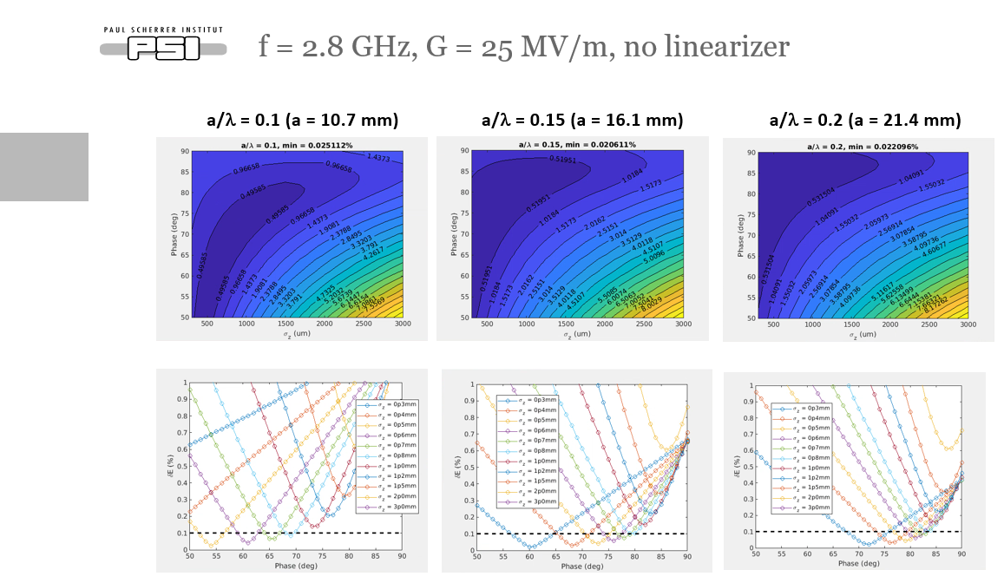
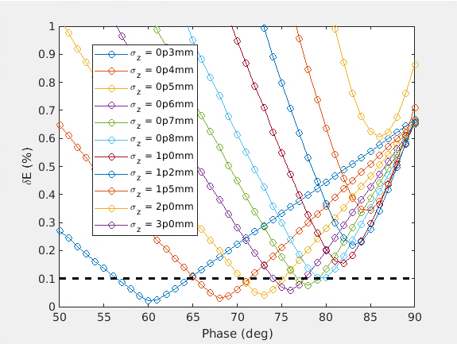
Which is the most efficient design?
To the spare
RF parameters: which ones and the considered range:
  Frequency: 2 GHz, 2.8 GHz, 5.6 GHz
  Gradient: 25 MV/m, 40 MV/m (maximum value based on H. Pommerenke’s RF design)
  Geometry (a/λ): 0.1, 0.15, 0.2, corresponding to apertures from 5.4 mm to 30 mm
More plots in the spares

Slide 24
RF structure geometry, frequency, and operation phase
RF design by H. Pommerenke
RF structure shape and frequency
How much do we loose when we lower the frequency (better for RF curvature)?
  Selected the shape of the structure
  The assumed 3 m length good also for the RF design
  Quantified the shunt impedance reduction vs RF frequency
RF shape, aperture, and operation phase
How much is convenient to go to larger aperture RF structure to stay closer to on-crest operation?
2.8 GHz
  In the considered phase range more convenient to shrink the aperture than going toward on-crest operation

Slide 25
Scenario 1: parameters scan
For each case the maximum bunch length and the corresponding phase giving the target energy spread are selected (see later)
f (GHz) | G (MV/m) | a/λ | a (mm) | Maximum σ_{z} (mm) |  | Maximum phase (deg)
 |  |  |  | δ_{E} = 0.1 % | δ_{E} = 0.15 % | δ_{E} = 0.1 % | δ_{E} = 0.15 %
2.8** | 25 | 0.1 | 10.7 | 0.8 | 1.2 | 69 | 89
2.8** | 25 | 0.15 | 16.1 | 0.8 | 1 | 79 | 81
2.8** | 25 | 0.2 | 21.4 | 0.7 | 0.8 | 82 | 81
2.8** | 40 | 0.1 | 10.7 | 0.8 | 0.8 | 77 | 85
2.8** | 40 | 0.15 | 16.1 | 0.7 | 1 | 82 | 79
2.8** | 40 | 0.2 | 21.4 | 0.7 | 0.8 | 85 | 84
5.6** | 25 | 0.1 | 5.4 | No solution | No solution | No solution | No solution
5.6** | 25 | 0.15 | 8.0 | 0.5 | 0.6 | 61 | 66
5.6** | 25 | 0.2 | 10.7 | 0.5 | 0.6 | 74 | 66
5.6** | 40 | 0.1 | 5.4 | 0.4 | 0.5 | 81 | 73
5.6** | 40 | 0.15 | 8.0 | 0.5 | 0.5 | 71 | 72
5.6** | 40 | 0.2 | 10.7 | 0.4 | 0.5 | 67 | 72
2.0* | 25 | 0.1 | 15 | 1 | 1.2 | 78 | 81
2.0* | 25 | 0.15 | 22.5 | 1 | 1.2 | 85 | 85
2.0* | 25 | 0.2 | 30 | 1 | 1.2 | 84 | 86
2.0* | 40 | 0.1 | 15 | 1 | 1.2 | 87 | 88
2.0* | 40 | 0.15 | 22.5 | 1 | 1.2 | 86 | 84
2.0* | 40 | 0.2 | 30 | 1 | 1.2 | 88 | 87
Outcome:
Bunch length slightly greater than 1 mm and operating phase relative close to on crest for
2 GHz
About a factor 2 shorter bunch and operating phase relatively far from the on crest for
5.6 GHz
Bunch length slightly smaller than 1 mm and phase more or less close to on crest for 2.8 GHz
** Electron linac at 2.8 GHz
* Electron linac at 2 GHz

Slide 26
Possible schematic layouts composing the scenario 1 cases
Several design are under consideration to fulfil the requests coming from the downstream section
σ_{z0}
f1
f1
σ_{z0}
e- linac
Common linac
Max σz = 1-1.2 mm
2.0 GHz, a/λ = 0.15
2.0 GHz, a/λ = 0.15
Max σz = 1-1.2 mm
Max σz = 0.7-1 mm
2.8 GHz, a/λ = 0.15
2.8 GHz, a/λ = 0.15
Max σz = 0.7-1 mm
Max σz ~ 0.5 mm
2.8 GHz, a/λ = 0.15
5.6 GHz, a/λ = 0.15
Max σz ~ 0.5 mm
σ_{z0}
σ_{z0}
e- linac
Common linac
f1
f1
n*f1
Max σz = 3.0 mm
2.0 GHz, a/λ = 0.15
2.0 GHz, a/λ = 0.15
12.0 GHz (n = 6)
Max σz = 3.0 mm
Max σz = 1.7 mm
2.8 GHz, a/λ = 0.15
2.8 GHz, a/λ = 0.15
11.2 GHz (n = 4)
Max σz = 1.7 mm
σ_{z0}
σ_{z1}
σ_{z1}
e- linac
Common linac
f1
n*f1
f2
Max σz = 3.0 mm
2.0 GHz, a/λ = 0.10
12.0 GHz
σz ~ 0.5 mm
5.6 GHz, a/λ = 0.15-0.2
Max σz ~ 0.5 mm
Max σz = 1.7 mm
2.8 GHz, a/λ = 0.15
11.2 GHz

Slide 27
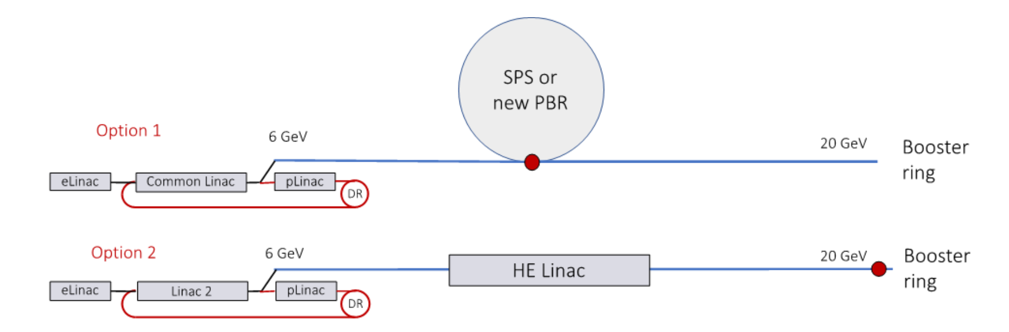
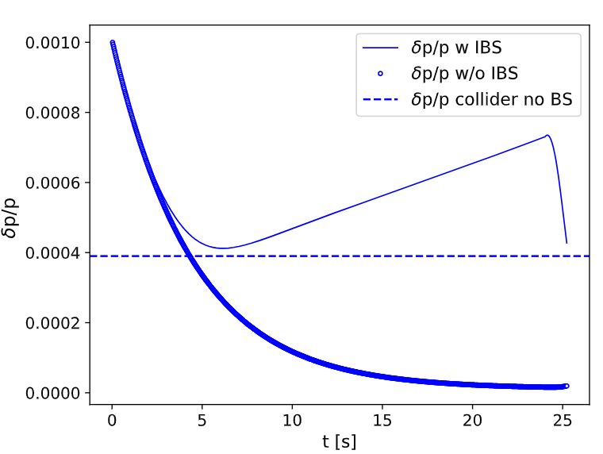
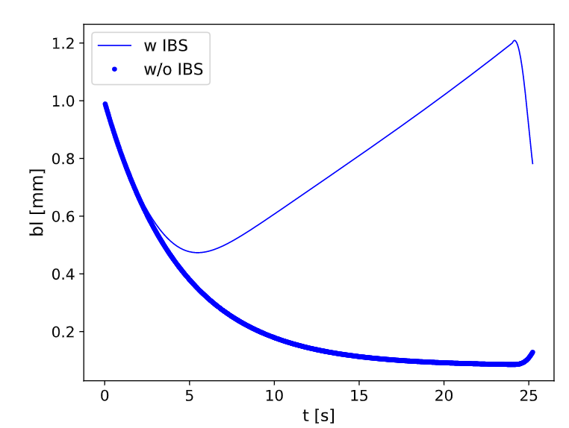
Requests from the booster ring
Baseline
Alternative
Booster simulations and discussions
(thanks to B. Dalena, M. Migliorati, and A. Chance)
Impact on the linac(s) design
Assumed energy spread at the injection = 0.1%
5.6 GHz, 0.15, 40 MV/m
Low energy spread: better for dynamic aperture, worse for instabilities
Long bunch length: better for instabilities, but under investigation coupling transverse-longitudinal plane
Bunch length~1-1.5 mm
Energy spread~0.1-0.15%
(ongoing optimization)
Marginal modification of the optimum working point (phase and bunch length) stopping the linac at 6 GeV or at 20 GeV
Strong impact on the linearizing cavity amplitude: alternative solutions under consideration

Slide 28
Most promising designs for different machine layouts
Target σ_{z} = 1-1.5 mm, δE/E = 0.1-0.15%
Same frequency as the positron linac
Sources are expected to be available at both frequencies
Higher harmonic possible with existing sources: energy efficient
σ_{z0} ~ 1-1.2 mm
e- linac
Common linac
σ_{z0}
f1 = 2-2.8 GHz
f1 = 2-2.8 GHz
6 GeV
σ_{z0} = 1.7-3 mm
e- linac
Common linac
σ_{z0}
f1 = 2-2.8 GHz
f1 = 2-2.8 GHz
6-4*f1
Length of the second section of the linac(s) determined by the minimum acceptable bunch length at the gun
Linearizing cavity at the highest energy: advantageous for beam quality
The RF phase is more on crest to elongate the bunch assuming the natural R56 of a chicane: energy efficient
σ_{z0} = 1.7-3 mm
σ_{z1} = 0.5 mm
σ_{z2}
f1 = 2-2.8 GHz
M*f1ª
f2 = 5.6 GHz
20 GeV
σ_{z0} = 0.7 mm (<1.7-3 mm)
σ_{z2}
f1 = 2-2.8 GHz
f2 = 5.6 GHz
M*f1ª
ª SuperKEKB “energy compressor” scheme and passive linearizer under consideration

Slide 29
Multi-bunch

Slide 30
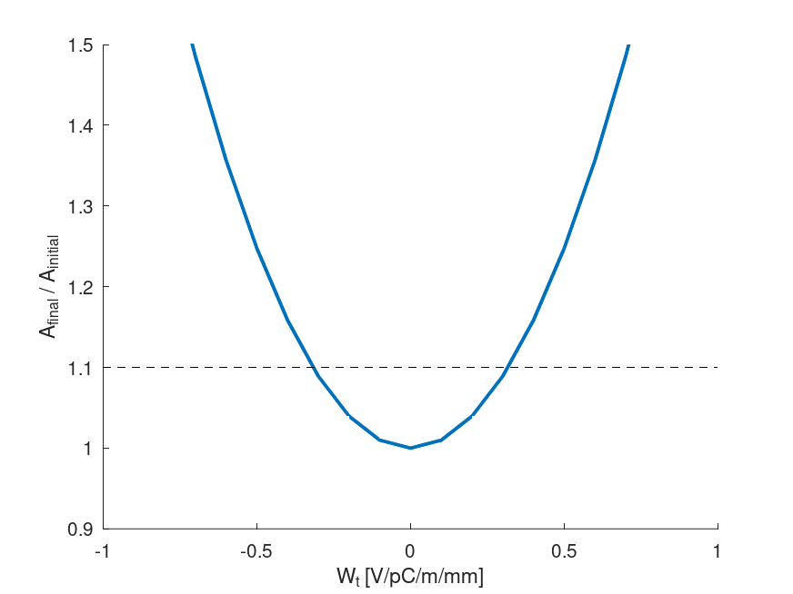
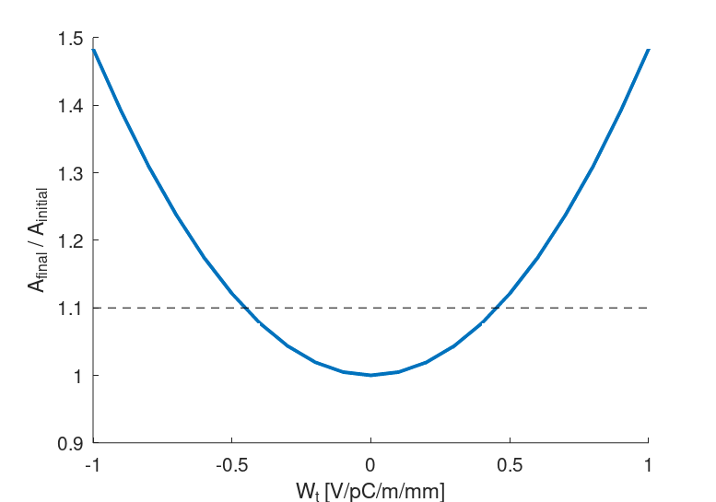
Jitter amplification: simulation strategy
Simulations’ strategy: provide specifications for the RF design
    Imposed a kick to the second bunch to simulate the long range wakefield generated by the first bunch to the following one: independent on the bunch time separation
    Determined the tolerable kick to maintain the action increase below a threshold (10% increase)
    RF design aims to produce transverse wakefield below this value. This contributes to determine the minimum bunch separation
e-Linac
Common Linac
RF structures optimized to produce a maximum kick~0.2 V/pC/mm at 17.5 ns time separation.
Done for 2.8 GHz, but no problems foreseen at 5.6 GHz.
(H. W. Pommerenke)
0.32 V/pC/m/mm at 4 nC
(0.256 V/pC/mm at 5 nC)
0.45 V/pC/m/mm at 4 nC
(0.36 V/pC/mm at 5 nC)

Slide 31
Conclusions
Several designs fulfill the specifications
Longitudinal and transverse beam dynamics studies:
    Single bunch (RF structures and quadrupoles misalignment): orbit correction
    allows preserving the emittance in the specifications (tbc for the final design)
    Jitter amplification due to multi-bunch effect: maximum tolerated kick due to long range
    wakefield provided as input for the RF design: RF optimizations done for the lower
    frequency case
Next steps and possible improvements:
    Selection of the most efficient design (ongoing)
    Implement the “energy compressor” or another system (passive linearizer) to avoid or reduce the use of the harmonic cavity
    Perform a full campaign of tolerance studies, optimize the lattice, and the RF structures for the baseline case
    Design the independent matching and orbit control for the electrons and positrons “merging” sections (not covered here)
    Possibly the design will undergo to a revision once the beam charge will be fixed

Slide 32


A swiss “thank you”…
Questions?
Comments?
…to CHART* and to you for your attention
*This work was done under the auspices of CHART (Swiss Accelerator Research and Technology Collaboration, https://chart.ch
FCCIS: 'This project has received funding from the European Union's Horizon 2020 research and innovation programme under the European Union's Horizon 2020 research and innovation programme under grant agreement No 951754.'

Slide 33
Spare slides

Slide 34
More parameters scans

Slide 35
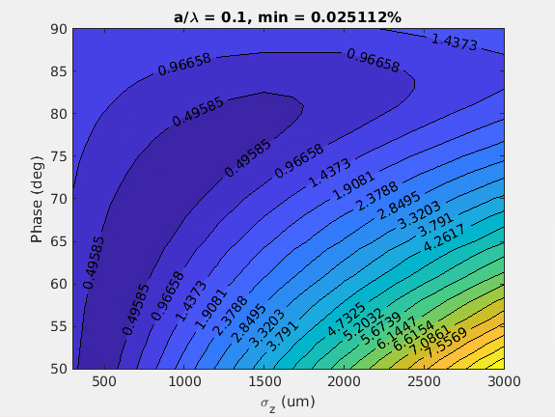
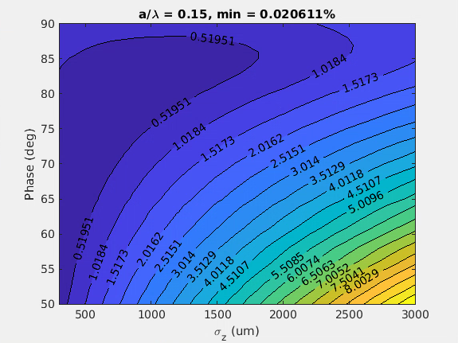
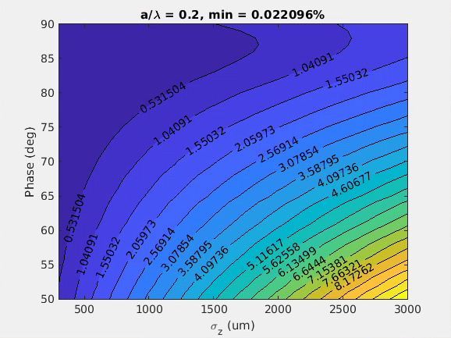


f = 2.8 GHz, G = 25 MV/m, no linearizer
Back
a/λ = 0.1 (a = 10.7 mm)
a/λ = 0.15 (a = 16.1 mm)
a/λ = 0.2 (a = 21.4 mm)

Slide 36






f = 2.8 GHz, G = 40 MV/m, no linearizer
Back
a/λ = 0.1 (a = 10.7 mm)
a/λ = 0.15 (a = 16.1 mm)
a/λ = 0.2 (a = 21.4 mm)

Slide 37






f = 5.6 GHz, G = 25 MV/m, no linearizer
/psi/home/bettoni_s/Matlab_works/Scan_FCC
Back
a/λ = 0.1 (a = 5.4 mm)
a/λ = 0.15 (a = 8 mm)
a/λ = 0.2 (a = 10.7 mm)
f_5p6GHz_G_25MVm_al_0p1.fig
f_5p6GHz_G_25MVm_al_0p15.fig
f_5p6GHz_G_25MVm_al_0p2.fig

Slide 38






f = 5.6 GHz, G = 40 MV/m, no linearizer
Back
a/λ = 0.1 (a = 5.4 mm)
a/λ = 0.15 (a = 8 mm)
a/λ = 0.2 (a = 10.7 mm)

Slide 39






f = 2.0 GHz, G = 25 MV/m, no linearizer
Back
Electron linac run at 2 GHz. To be consistent with the previous a/λ = 0.2 (~3 deg difference expected)
a/λ = 0.1 (a = 15 mm)
a/λ = 0.15 (a = 22.5 mm)
a/λ = 0.2 (a = 30 mm)
f_2p0GHz_G_25MVm_al_0p1.fig
f_2p0GHz_G_25MVm_al_0p15.fig
f_2p0GHz_G_25MVm_al_0p2.fig

Slide 40






f = 2.0 GHz, G = 40 MV/m, no linearizer
Back
Electron linac run at 2 GHz. To be consistent with the previous a/λ = 0.2 (~3 deg difference expected)
a/λ = 0.1 (a = 15 mm)
a/λ = 0.15 (a = 22.5 mm)
a/λ = 0.2 (a = 30 mm)
RUNNING …
SAVE ALSO .FIG
f_2p0GHz_G_40MVm_al_0p1.fig
f_2p0GHz_G_40MVm_al_0p15.fig
f_2p0GHz_G_40MVm_al_0p2.fig

Slide 41
Charge and geometry dependence

Slide 42

Q = 5 nC-start2end
Newly optimized shorter distribution
The distribution is a bit shorter than expected, but fine tuning

Slide 43

To keep in mind
Start-to-end fits with expectations, also if the newly optimized initial distribution seems to be a bit shorter than 650 um
From 0.15 to 0.2 a/lambda in e-Linac moves the optimal phase by 2 degrees
From 4 to 5 nC moves the optimal phase by 3 degrees
All this at this bunch length
It can be partially recovered by elongating the bunch length, but the maximum bunch length to stay below 0.1% final energy spread is 800 um, as expected from previous simulations (otherwise RF curvature starts to make impossible to stay below 0.1% final energy spread)

Slide 44



Dependence on the bunch charge (single bunch)
The machine will run at 4 nC down to 1 nC bunch charge
Checked the solution for 1 nC compared to 4 nC case
Back
Shorter (650 um) from the gun and linearization
a/λ = 0.20
a/λ = 0.15
a/λ = 0.10
Q = 4 nC
Q = 1 nC

Slide 45
RF structures design

Slide 46




RF structures gradient
7D Sweep range:
  rf phase advance ψ = 2π/3 … 9π/10
  frequency f = 2.0 GHz … 5.6 GHz
  aperture a_{entr} , a_{exit} = 0.08 λ … 0.34 λ
  iris thickness d_{entr} , d_{exit} = 0.02 λ … 0.19 λ
  structure length L = 0.5 m … 5.0 m
Courtesy of H. Pommerenke

Slide 47
Linearizing cavity(ies)

Slide 48

With the linearization
Without linearization
With linearization (using 12 GHz cavities)
f (GHz) | G (MV/m) | a/λ | a (mm) | Maximum σ_{z} (mm) | Maximum phase (deg)
 |  |  |  | δ_{E} = 0.1 %
2.0* | 40 | 0.1 | 15 | 3 | 89
Much longer bunch lengths possible
Less efficient for 5.6 GHz (2nd harmonic) except we compress and we can neglect the RF curvature downstream the compression

Slide 49
Low frequency design case: 2 GHz case
Without longitudinal phase space (LPS) linearization
Max σz = 1-1.2 mm
Max σz = 1-1.2 mm
e- linac
Common linac
2.0 GHz, a/λ = 0.1
2.0 GHz, a/λ = 0.1
With LPS linearization
Max σz = 3 mm
e- linac
Common linac
Max σz = 3 mm
2.0 GHz, a/λ = 0.1
2.0 GHz, a/λ = 0.1
12 GHz, a/λ
Max σz= 3 mm
e- linac
Common linac
σz tunable
2.0 GHz, a/λ = 0.1
2.0 GHz, a/λ = 0.1
12 GHz, a/λ
(RF structures off or slightly shorter bunch upstream and rest of the linac powered or dechirper)
  The beam quality is the best (longest bunch length) → transverse beam dynamics
  Operation phase close to 90 degrees
  Linearization quite efficient (6th harmonic)
  Possible to go toward small apertures and longer bunch lengths in case LPS is applied
  Linearization is more demanding higher the final beam energy is → “energy compressor” à la SuperEK-B attracting

Slide 50
Future further improvements
Back
Tuning of the final bunch length downstream of the linac(s):
  Possible to maximize the beam quality from the gun (long bunch)
Alternative to the high harmonic cavity: “energy compressor” à la SuperKEKB very attractive
  Maximize the bunch length over the f_{RF} relative “harmonic” order increasing the bunch length compatibly with BD
  This is more crucial for the higher frequency design option, and for the HE linac!
  In alternative or in addition a passive linearizer may be considered
R56<0
σ_{z0}
Tunable σ_{z}
Linac
Linac
f
n*f
Passive removal of the residual chirp (RF structures off or Dechirper)
σ_{z0} < max σ_{z}
Linac
Linac
Tunable σ_{z}
f
n*f
f
Active removal of the residual chirp (RF structures on, chicane shifted)
σ_{z1} > σ_{z0}
σ_{z2} << σ_{z1}
σ_{z1} = Ν∗σ_{z0}
R56<0
σ_{z0}
σ_{z2}
Linac
f₁
R56>0
f₁
f₁ or f₂

Slide 51
Others

Slide 52

Time structure
From P. Craievich, FCC Week 2022

Slide 53
“Minimalistic” schematic layout: a closer look
e- Linac a
(Match)
(BC)
(Match)
e- Linac b
Match
Common Linac
e+ Linac
Match
DR
Match
Schematic layout must include:
  Matching sections to and after the compression chicanes (if present)
  Independent matching sections to the common Linac (swap of βx and βy for electrons and positrons)
  Independent launch orbit for electrons and positrons at the entrance of the common Linac
Bend

Slide 54


Multi-bunch effects
Example: SwissFEL C-band cavities (f = 5.712 GHz)
Long-range transverse wakefield
(Causes transverse jitter amplification)
Long-range longitudinal wakefield
(Causes multi-bunch beam loading)

Slide 55
LSP linearization without harmonic cavity: the options
Could we linearize with this layout using the harmonic cavity?
  Linearization is more demanding higher the final beam energy is:
    Energy compressor à la SuperEK-B looks very appealing
    Passive linearizer
    Compression (enough to reduce the impact of the RF curvature effect) and subsequent decompression of the bunch
R56<0
R56>0
e- linac
Common linac
Common linac
Common linac
2.8 GHz, a/λ = 0.15
2.8 GHz, a/λ = 0.15
5.6 GHz, a/λ = 0.15
R56<0
5.6 GHz, a/λ = 0.15
1 mm < max σz < 2 mm
max σz < 1 mm
Max σz tunable
Linearized not with high harmonic cavity
R56>0
e- linac
Common linac
Common linac
2.8 GHz, a/λ = 0.15
2.8 GHz, a/λ = 0.15
11.8 GHz, a/λ
R56<0
5.6 GHz, a/λ = 0.15
1 mm < max σz < 2 mm
max σz < 1 mm
Max σz tunable

Slide 56

Some considerations (valid for all the layouts)
Bunch length tuning and operation point:
  We select R56 to run at 90 degrees to generate the desired chirp for the compression: maximize the RF efficiency
  The same argument is valid to elongate the beam swapping the sign of R56
R56>0
E
T
H
No chirp (off-crest)
Chirp (phase = 90 deg)
$$CF=\frac{1}{1−A∙R_{56}}$$
t
E
E
H
R56<0
H
T
E
H
T
T
t
t
t
Energy spread tuning:
  We may use not powered structures (not tunable) or dedicated structures, like a dechirper (tunable)
Longitudinal phase space linearization (alternative to the harmonic cavity), like in SuperKEKB:
  Accelerate the bunch using stations with frequency f
  Elongate the bunch by a factor N
  Decelerate the beam with stations at frequency f (equivalent to Nth harmonic with the short bunch)
  Compress the beam

Slide 57



Orbit correction
Built-in algorithms for our case (Elegant):
    One-to-one: pairing one corrector with the next downstream BPM
    One-to-best: attempts to find a BPM with a large response to each corrector
    Global: uses the global response matrix
Simulated scenarios:
    One-to-one with 2 corrector and 2 BPM each 3 quadrupoles
    One-to-one with 1 corrector and 1 BPM each 3 quadrupoles (max kick<100 urad). Considered in the following.
No orbit correction
Case 1
Case 2

Slide 58

Different lattices
Case with one quadrupole each two structures
e-common, low number of quads
e-Linac, large number of quads

Slide 59





Best working point?
a/λ = 0.20
a/λ = 0.15
a/λ = 0.10
We may run some structures off-crest, and some others on crest. More off-crest gives a more linear dechirp, but also more energy jitter due to arrival time jitter and RF timing jitter.
Several combination of phases along the Linac
Many more solutions are possible.
I would pick up one with the beginning as much as possible on crest, and after off-crest: better for transverse and we use the more linear part of the RF, but jitter?

Slide 60
Other effects to be considered
Beam loading
    Energy loss induced by the first bunch due to long range longitudinal wakefield
Charge jitter
    Energy loss induced by the first bunch due to long range longitudinal
To be compensated with different energy gain for the two bunches

Slide 61
Most promising designs for different machine layouts
Target σ_{z} = 1-1.5 mm, δE/E = 0.1-0.15%
σ_{z0} ~ 1-1.2 mm
σ_{z0}
e- linac
Common linac
f1 = 2 GHz
f1 = 2 GHz
6 GeV
σ_{z0} = 1.7-3 mm
e- linac
Common linac
σ_{z0}
f1 = 2-2.8 GHz
f1 = 2-2.8 GHz
M*f1
σ_{z0} = 1.7-3 mm
σ_{z1} = 0.5 mm
σ_{z2}
f1 = 2-2.8 GHz
M*f1
f2 = 5.6 GHz
20 GeV
*
σ_{z0} ~ 1-1.2 mm
σ_{z0} <1.7 mm
σ_{z1} = Ν∗σ_{z0}
σ_{z2}
f1 = 2.8 GHz
f1
f2 = 5.6 GHz
*SuperKEKB “energy compressor” scheme

Slide 62


Several harmonics

Slide 63



2. Compression at e-Linac: possible improvement
Goal: reduce the amplitude of the linearizing cavity
*
R56 = 63.4e-3 %m, T566 = -3/2*R56
lambda_RF = c/f_RF, lambda_linearizer = lambda_RF/4 %m
Considered working point in this presentation (457 um)
Parameters “available” for the optimization:
Compressor chicane energy: less for smaller linearizing cavity voltage, more for emittance preservation
Compression factor: smaller for emittance preservation, larger to have a negligible RF curvature downstream of the compressor
*https://www.slac.stanford.edu/pubs/slactns/tn04/slac-tn-05-004.pdf

