Slide 1


Progress in EIC Polarization Studies for the Injectors and Storage Ring
Vahid Ranjbar, BNL
eeFACT2022
12–15 Sep 2022
Frascati

Slide 2
Outline
Polarization Requirements in the ESR (work by Eliana Gianfelice)
  Radiative polarization and asymptotic polarization
  Optics and Misalignments
  Matching e/p emittance
Injector Polarization
  Concept Overview and Design
    Geometry
    Spin resonance strengths
  Polarization Performance
    Tolerances for vertical misalignments
    vertical orbit
    Spin imperfection correction scheme
Summary

Slide 3
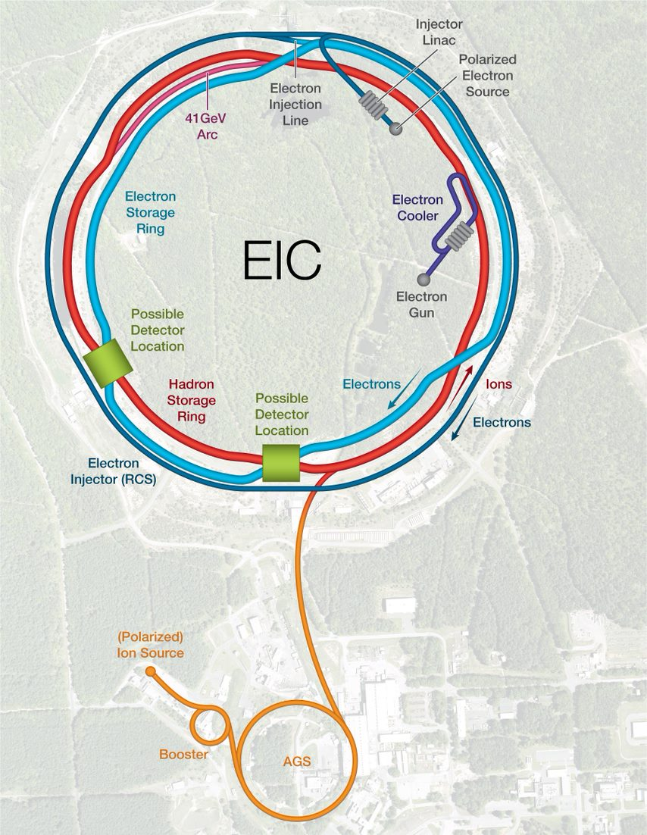
EIC Complex Layout

Slide 4
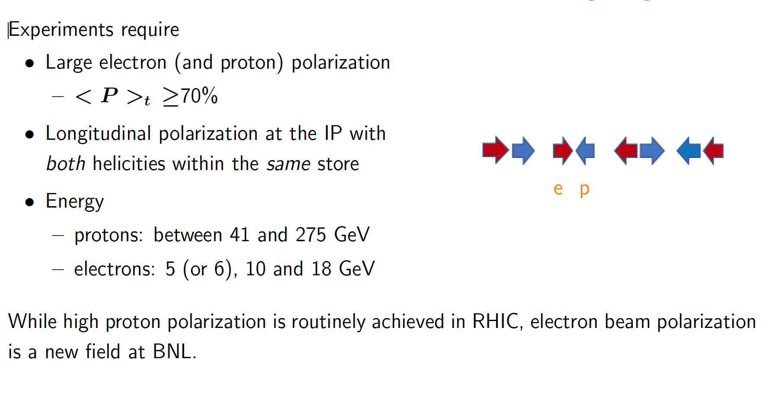
Radiative polarization and the EIC electron storage ring
Thanks: Eliana GIANFELICE

Slide 5
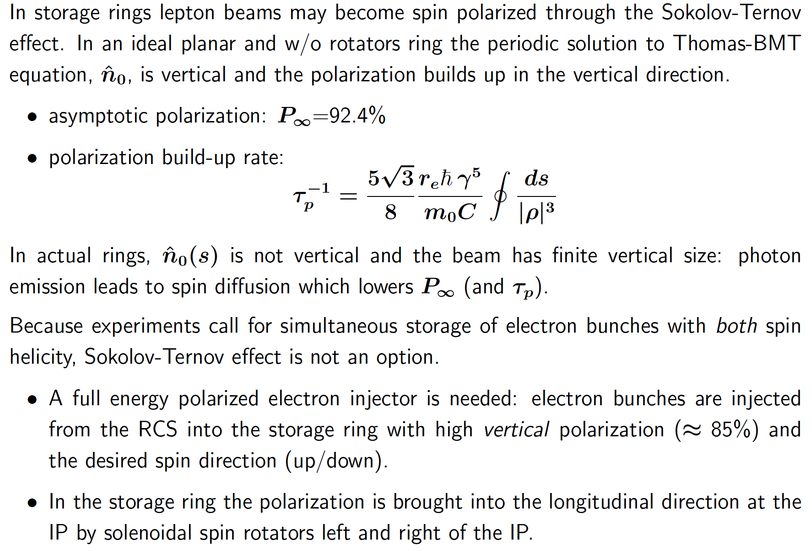
Thanks: Eliana GIANFELICE

Slide 6
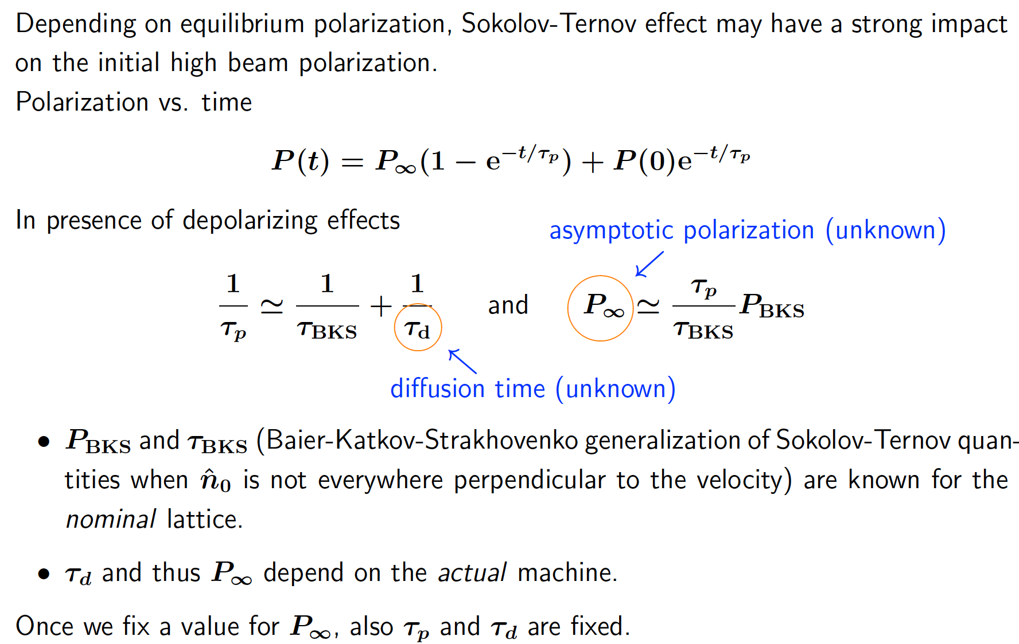
Assessing the needed asymptotic polarization
Thanks: Eliana GIANFELICE

Slide 7
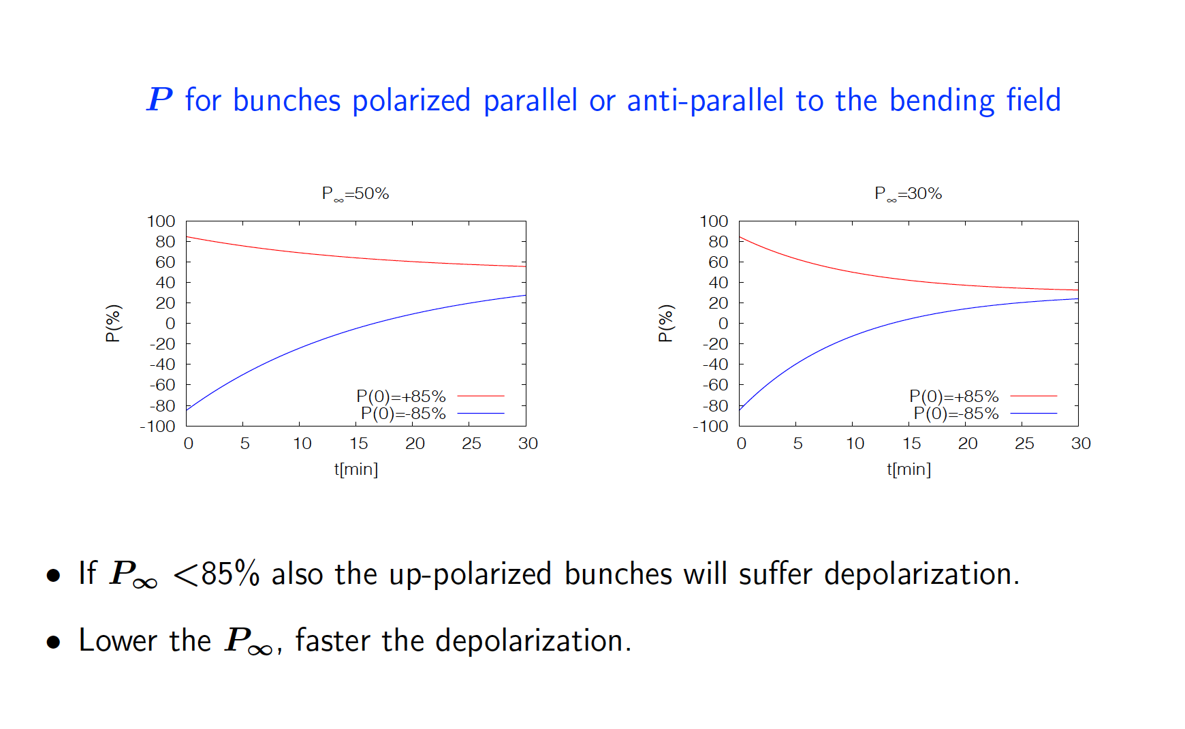
Thanks: Eliana GIANFELICE

Slide 8
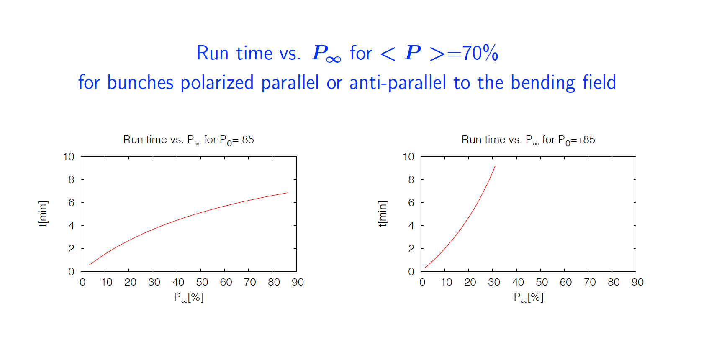
Thanks: Eliana GIANFELICE

Slide 9
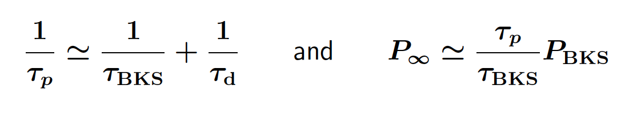
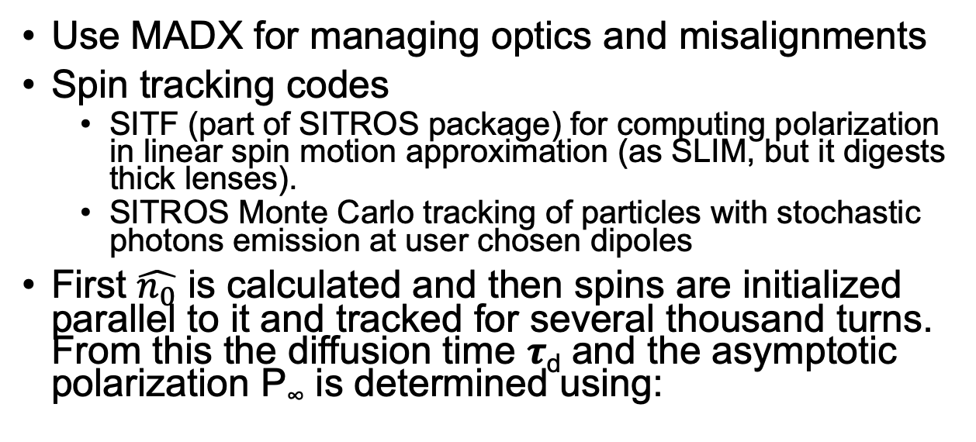
Simulation Approach
Thanks: Eliana GIANFELICE
Use MADX for managing optics and misalignments
Spin tracking codes
  SITF (part of SITROS package) for computing polarization in linear spin motion approximation (as SLIM, but it digests thick lenses).
  SITROS Monte Carlo tracking of particles with stochastic photons emission at user chosen dipoles
First $\hat{n_{0}}$ is calculated and then spins are initialized parallel to it and tracked for several thousand turns. From this the diffusion time 𝝉_{d} and the asymptotic polarization P∞ is determined using:

Slide 10
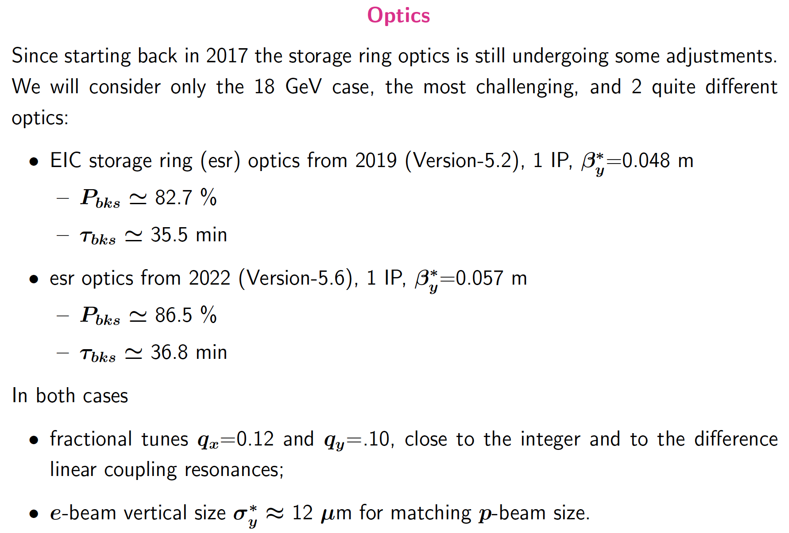
Thanks: Eliana GIANFELICE

Slide 11
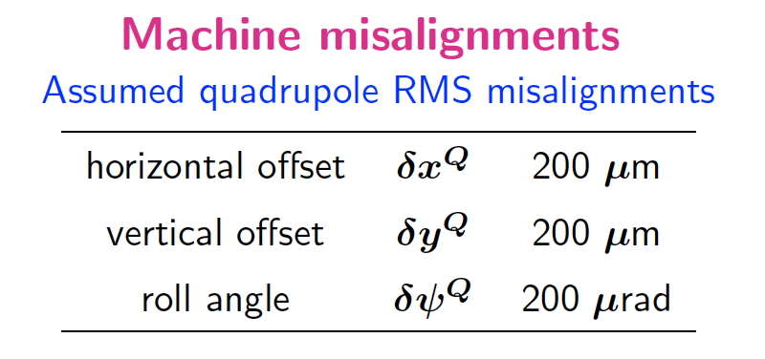
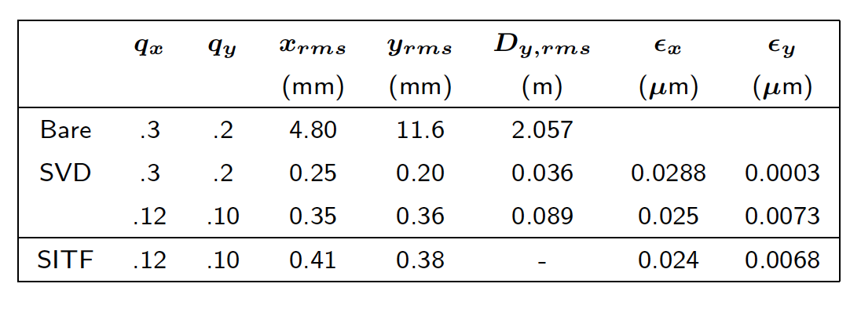
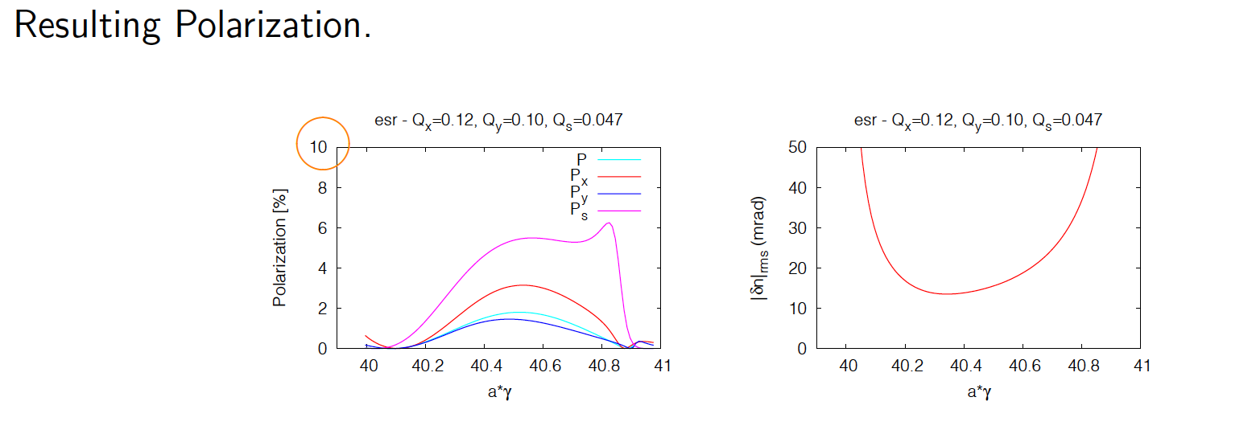
Misalignment and Correction Studies for Lattice v5.2
Thanks: Eliana GIANFELICE
Correcting to ~ 0.4 mm rms
P_{x,y,s} → Polarization with x,y and s orbital motion only
P → Polarization including all orbital motion.

Slide 12
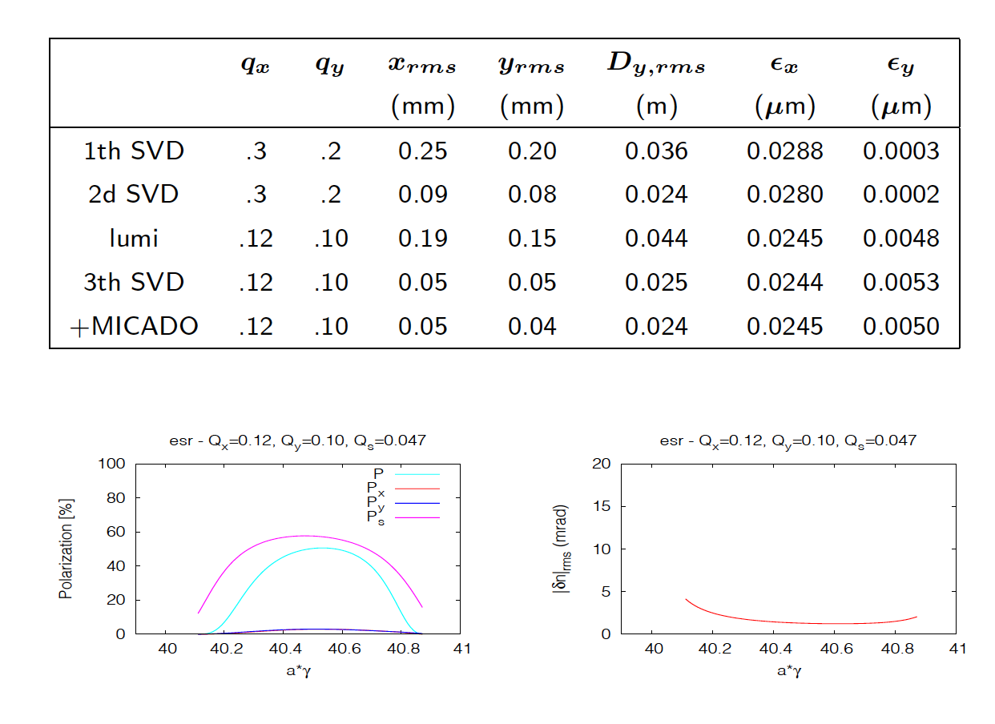
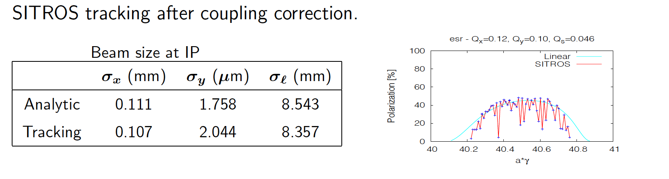
Correcting lattice 5.2v to 0.04 mm rms
  The small Px and Py may be a consequence of strong higher order resonances
  Including Betatron coupling correction restored the 40% polarization level
  But the beam size is about 6 times too small for matching proton beam.
Thanks: Eliana GIANFELICE

Slide 13
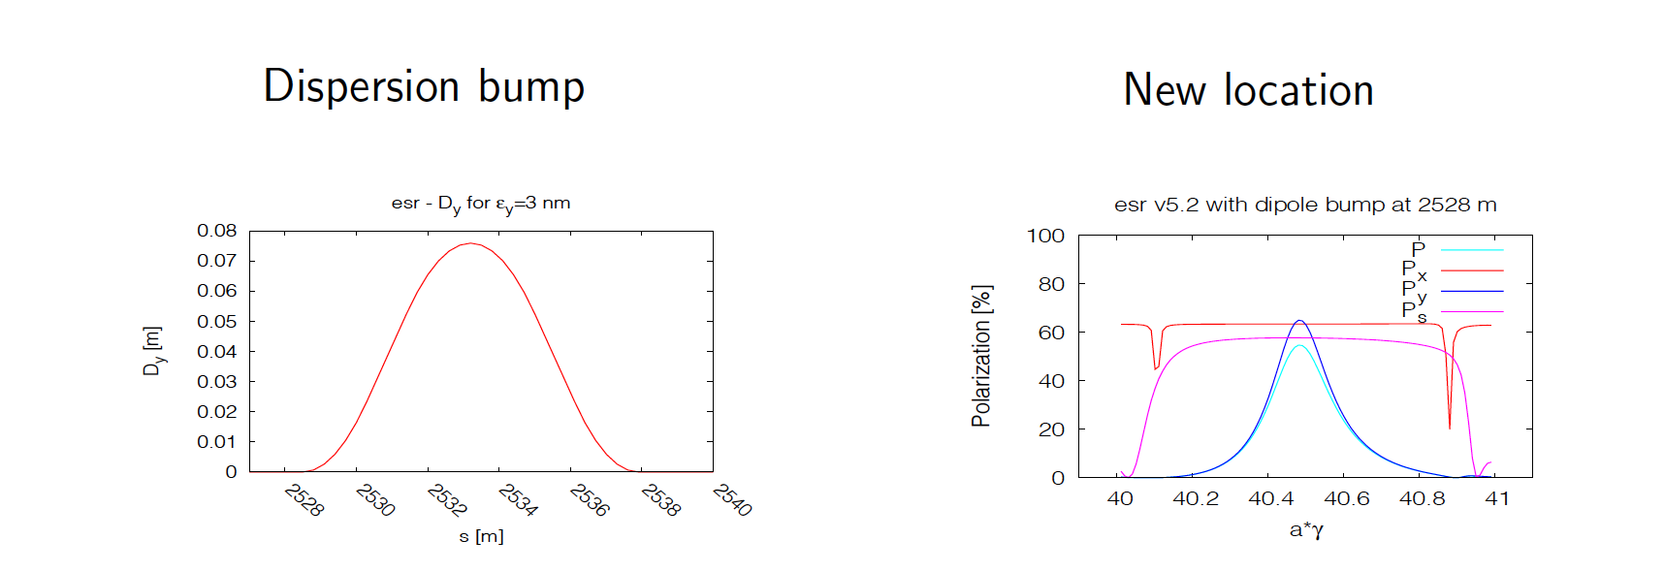
Approaches to match beam size at IP
Thanks: Eliana GIANFELICE
Introducing local coupling at the IP by 2 pairs of skew quads:
  ruled out by beam-beam simulations.
Increasing vertical emittance by adding
  a long vertical bump trough the arc sextupoles
    Ruled out due to poor polarization performance
  a vertical orbit bump in a straight section without quadrupoles.
    Possible if dispersion knob placed in “correct” location in lattice. Using location at 2528 m in the lattice increased vertical emittance to 3nm

Slide 14
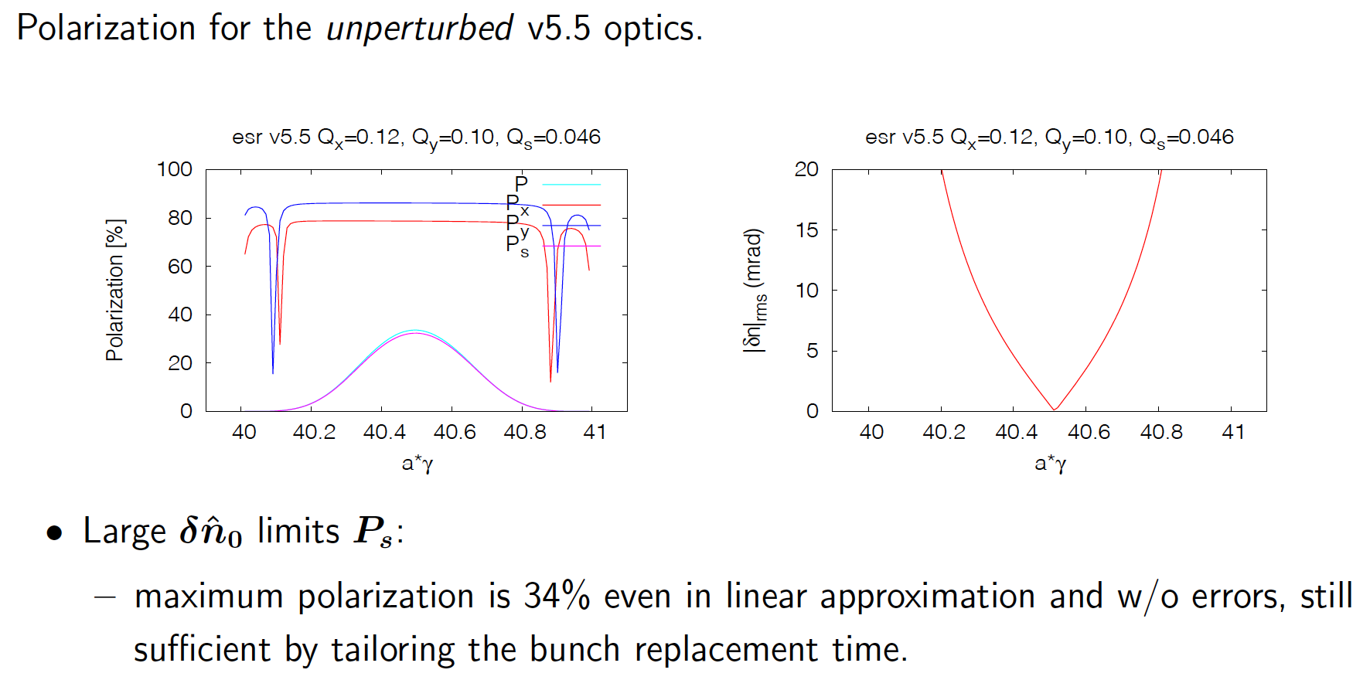
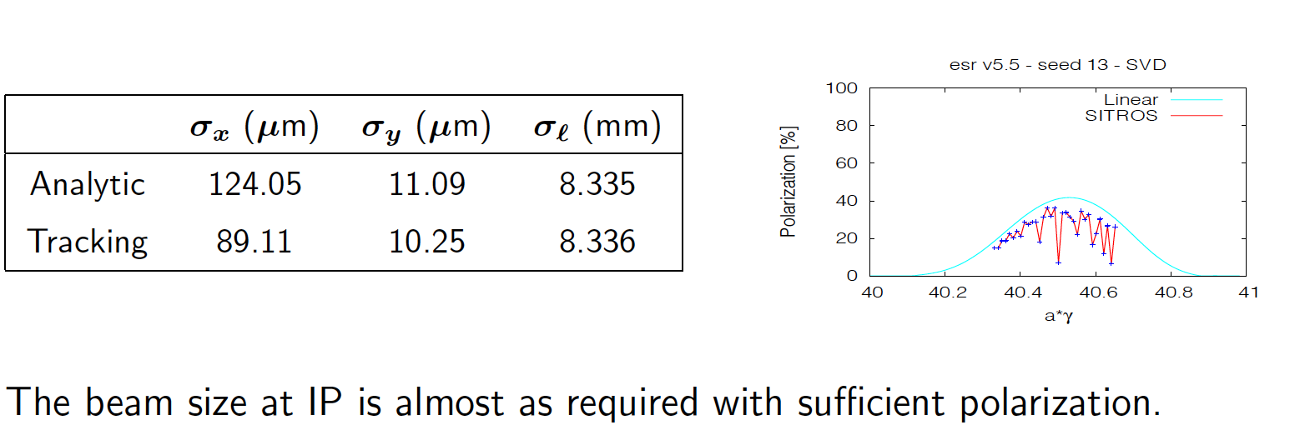
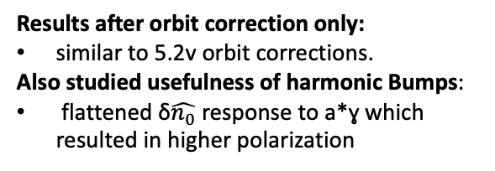
Studies of lattice v5.5
Thanks: Eliana GIANFELICE
Results after orbit correction only:
similar to 5.2v orbit corrections.
Also studied usefulness of harmonic Bumps:
flattened δ$\hat{n_{0}}$ response to a*ɣ which resulted in higher polarization

Slide 15
EIC Injector Requirements
To meet the ESR requirements a polarized injector delivering electrons polarized to at least 85%
To achieve the average polarization and luminosity requirements. The injector will need to inject two 28nC bunches once a second for energies of 5 and 10 GeV. At 18 GeV the intensity drops to two bunches at 11nC.

Slide 16
The EIC’s Rapid Cycling Synchrotron (RCS)
Will receive 7nC electrons polarized to ~90% from pre-injector at 400 MeV.
The RCS Requirements:
  needs to merge these bunches into two 28nC bunches for 5 and 10 GeV operations and 11nC for 18 GeV.
  Preserve polarization during acceleration from 400 MeV to extraction at 5, 10 and 18 GeV. With losses less < 5%.

Slide 17
Concept Overview: Spin Resonance Free Lattice
Both the strong intrinsic and imperfection resonances occur at:
  K = nP +/- Qy
  K = nP +/- [Qy] (integer part of tune)
To accelerate from 400 MeV to 18 GeV requires the spin tune ramping from
  0.907 < Gϒ < 41.
If we use a periodicity of P=96 and a tune with an integer value of 50 then our first two intrinsic resonances will occur outside of the range of our spin tunes
  K1 = 50+ν_{y} (ν_{y} is the fractional part of the tune)
  K2 = 96 – (50+ν_{y} ) =46-ν_{y}
  Also our imperfection will follow suit with the first major one occurring at K2 = 96 – 50 = 46

Slide 18
How to make this work in the RHIC tunnel?
It is easy to accomplish this with a perfectly circular ring. Just construct a series of FODO cells with bending magnets so that we have total periodicity of 96.
The problem is that the RHIC tunnel is not circular and has an inherent six fold symmetry.
The solution make the spin resonances integrals over the straight sections equal to zero.

Slide 19
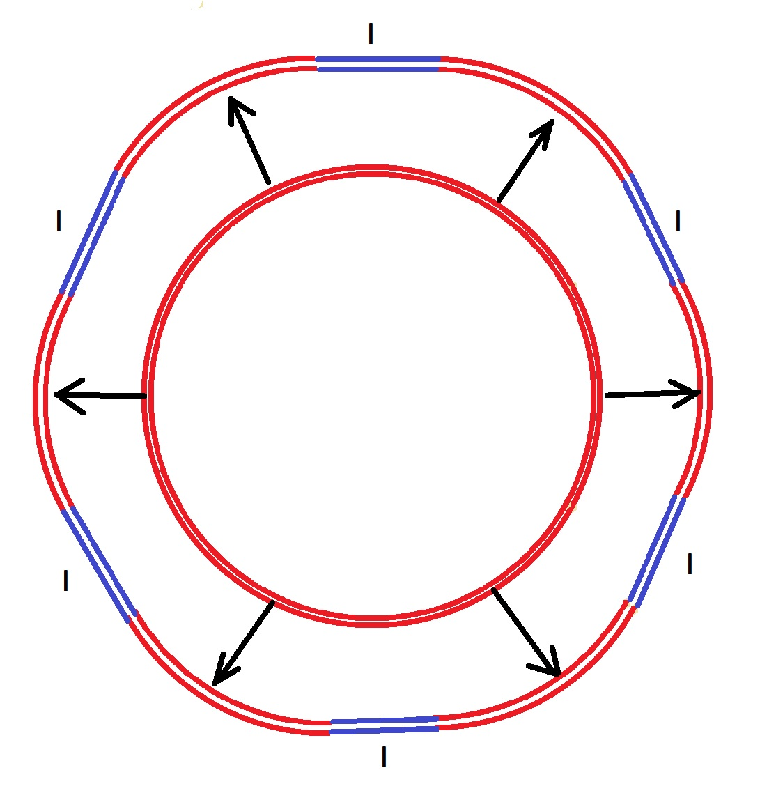
Project onto the RHIC tunnel
RHIC Tunnel

Slide 20
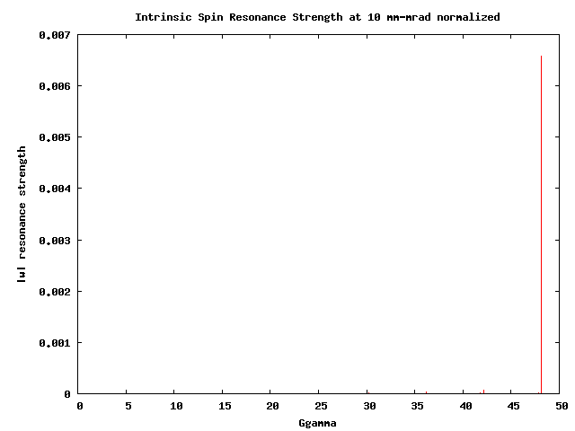
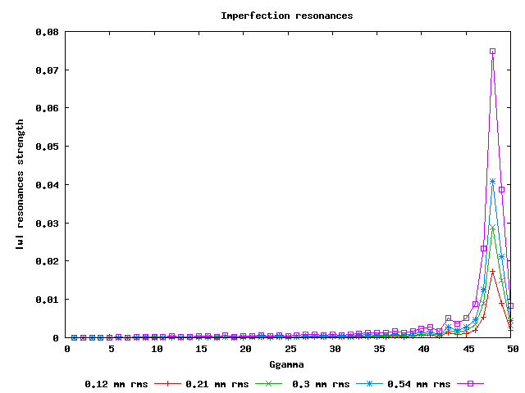
Calculating Spin Resonances
Extraction
Extraction
No polarization loss from cumulative effective of intrinsic spin resonances for distributions over 100 msec ramp.
Issue to control: Imperfection spin resonances ~ vertical rms orbit 0.5 mm to keep losses < 5%.

Slide 21
RCS Design Parameters
Current Design accommodates detector bypasses and RF physical needs
Two connecting arc designs
  Detector→ IP6, IP8
  RF, Extraction, Injection
    IP10→ RF
    IP12→ Extraction/injection
    IP2
    IP4
Achieved 3-4 meter bypass at the IP.
Impacts symmetry of lattice.
  However by optimizing the quad strengths in the bypass region we can recover low intrinsic losses.
  Spin resonance free electron ring injector Phys. Rev. Accel. Beams 21, 111003 – Published 27 November 2018

Slide 22
RCS lattice changes
Since original design RCS lattice has undergone two major revisions
  Avoid obstructions of walls and other beamlines
  Remove all RCS magnets from the detector hall
  Maximum beta functions increased from 70m to 120m
  Maintained zero polarization losses on ramp due to intrinsic spin resonances.
  Improved off-momentum DA from 1% to 1.5%

Slide 23
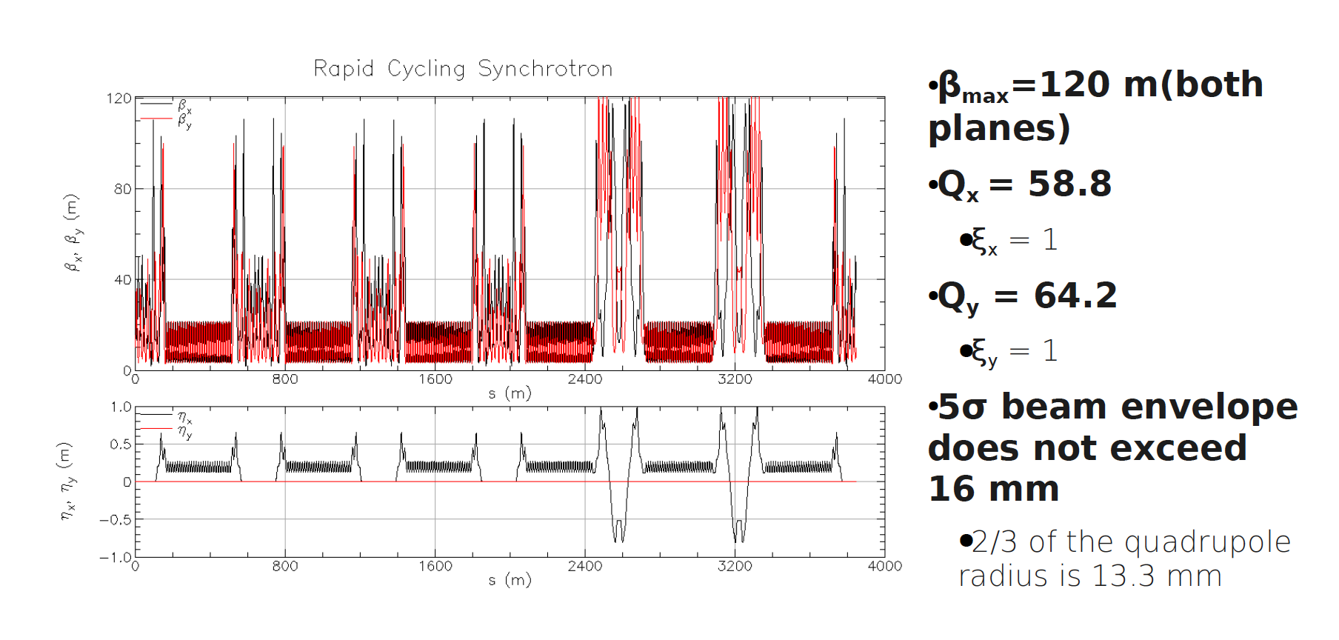
Baseline RCS optics
Thanks: Henry Lovelace III

Slide 24
Lattice response to orbit errors
Effect on Imperfections from Intrinsic suppression
Comparison of polarization transmission due to imperfection spin resonances as function of RMS orbit distortion. Lattice 1, was our first RCS optics attempt with 15% intrinsic resonance induced losses at RMS emittance of 1000 mm-mrad. Lattice 2 was our second and last RCS optics configuration with 8% losses at the same RMS emittance. This reduced imperfection spin resonance sensitivity as can be seen in the plot.
Lattice 2: 13 particle tracking with 0.6 mm RMS vertical and 0.3 mm RMS horizontal closed orbit distortion.

Slide 25
Polarization Performance
Intrinsic resonance as calculated by DEPOL yield no cumulative depolarization loss for a beam with a vertical emittance of 40 mm-mrad rms normalized emittance (RCS’s emittance at injection which falls to near zero by 18 GeV).
Imperfections could however potentially cause greater than 5% losses during ramp.
Due primarily to quadrupole misalignment and dipole rolls.
  But these effects can be controlled to bring our losses below 5% on ramp.→ Orbit Smoothing and Imperfection bumps.

Slide 26
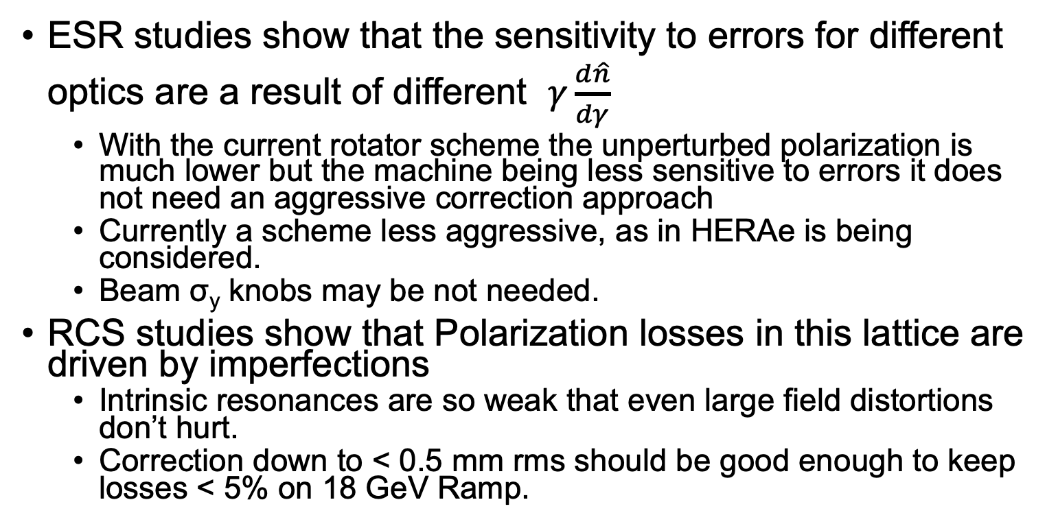
Summary
ESR studies show that the sensitivity to errors for different optics are a result of different $γ\frac{d\hat{n}}{dγ}$
  With the current rotator scheme the unperturbed polarization is much lower but the machine being less sensitive to errors it does not need an aggressive correction approach
  Currently a scheme less aggressive, as in HERAe is being considered.
  Beam σ_{y} knobs may be not needed.
RCS studies show that Polarization losses in this lattice are driven by imperfections
  Intrinsic resonances are so weak that even large field distortions don’t hurt.
  Correction down to < 0.5 mm rms should be good enough to keep losses < 5% on 18 GeV Ramp.

Slide 27
Backup Slides

Slide 28
Analysis of Imperfections:
  Survey estimates are 0.2 mm rms with a 2 sigma cut off and +/- 1 mrad rolls. This yields an estimated rms orbit distortion of between 3-6 mm rms.
  Extracting at 10 GeV RCS can handle > 3 mm RMS orbit with < 5% pol. Loss and 2 mrad uncorrected rolls.
  With appropriate BPM and corrector pairs this can be corrected down to below 0.5 mm rms and push our polarization losses below 5% extracting at 18 GeV.
  Once corrected, dynamical changes of the relative field strength in the quads and dipoles of greater than 0.5% can be tolerated with little effect on polarization transmission.
  Orthogonal imperfection bump scheme to fix any remaining losses beyond SVD orbit smoothing.

