Slide 1
IR Optics design for the FCC-ee
s-channel monochromatization scheme
H. Jiang A. Faus-Golfe, F. Zimmermann, K. Oide, Z. Zhang
15 September, 2022
IJCLAB IN2P3-CNRS

Slide 2
Outline
Introductions
The trade-off between energy spread and luminosity
The standard FCC-ee IR Optics design
The IR optics for the monochromatization scheme
The continuing optimization of the mono-scheme

Slide 3
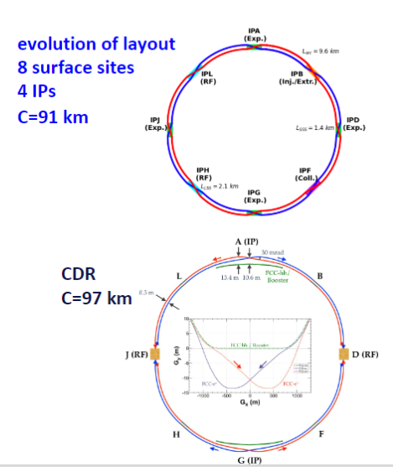
Introduction: FCC-ee collider
FCC-ee modes:
The FCC-ee standard modes:
Four different energy operation modes:
Z, WW,H(ZH) and ttbar
The optional fifth mode: s-channel Higgs production mode
The measurement of the electron Yukawa coupling, in dedicated runs at 125 GeV with center-of-mass (CM) energy spread(5-10 MeV). But the natural collision energy spread, due to the synchrotron radiation, is about 50MeV.
Requirements:
reduce the CM energy spread from 50MeV to 5MeV, which is comparable to the resonant width of the standard model Higgs Boson itself (4.2MeV) ^{[1]}
[1]Abada, A., Abbrescia, M., AbdusSalam, S.S. et al. FCC-ee: The Lepton Collider.
2 IPS

Slide 4
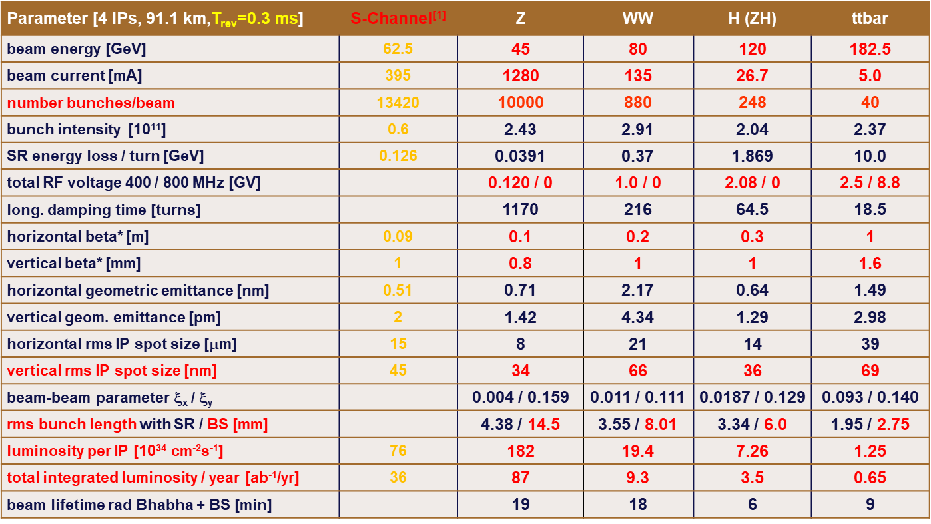
FCC-ee Parameters (including s channel mode)
FCCWEEK22, K. Oide, D. Shatilov

Slide 5
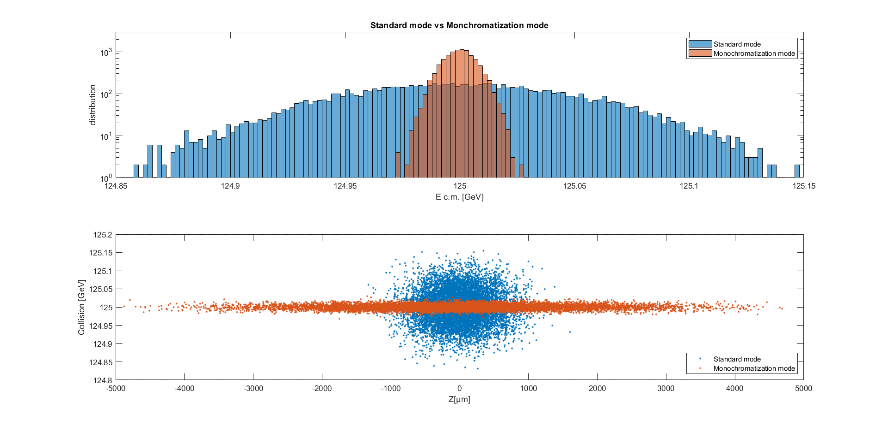
The transverse monochromatic scheme
The transverse monochromatic scheme(Guinea-Pig simulation results)
Monochromatization:
D*x=±0.2m
c.m. Energy spread
6.9MeV
Standard:
D*x=0
c.m. Energy spread
46MeV

Slide 6
Example IP parameters for monochromatization scenario for FCC-ee
The example IP parameters and performance for typical monochromatization scenario for FCC-ee $D_{x}^{∗}=±0.1m$
The monochromatization factor:
$$λ=\sqrt{1+\frac{D_{x}^{∗2}σ_{ε}^{2}}{ε_{x}β_{x}^{∗}}}$$
The correlation D*x and Mono-factor
$$D_{x}^{∗}$$ | ±0.1m | ±0.2m | ±0.3m | ±0.4m
$$λ$$ | 3.6 | 7.0 | 10.4 | 13.9

Slide 7
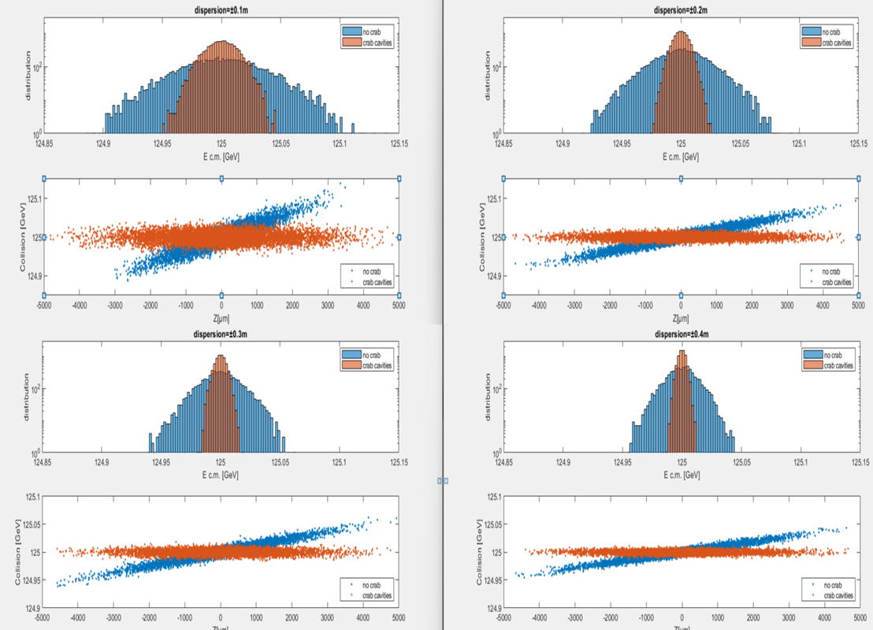
The trade-off between luminosity and center-of-mass energy spread
The monochromatic scheme reduces the c.m. energy spread but decreases the luminosity.
Guinea-pig simulations:
The relationship between luminosity and c.m. energy spread for different
D_{x}*= 0.1, 0.2, 0.3, 0.4m
The initial beam distribution:
Generated by mathematica with parameters shown in FCC-ee parameters table and different D_{x}*

Slide 8
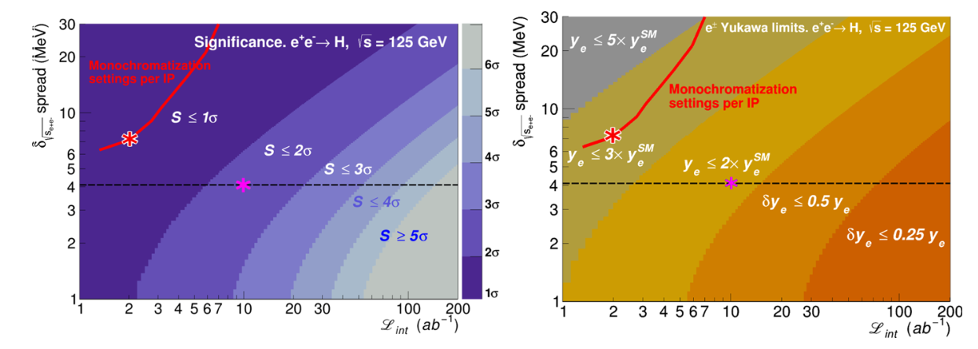
The trade-off between luminosity and center-of-mass energy spread
The relationship between dispersion and luminosity and c.m. energy spread
Dispersion | 0.1m | 0.2m | 0.3m | 0.4m
RMS energy spread with crab cavities | 12.8 MeV | 6.9 MeV | 4.6MeV | 3.6 MeV
RMS energy spread without crab cavities | 30.6 MeV | 21.1MeV | 14.8MeV | 11.6MeV
Luminosity(10³⁵cm⁻²s⁻¹) | 2.6 | 1.25 | 0.84 | 0.63
Monochromatization factor | 3.3 | 6.1 | 9.1 | 12
Significance(left) and associated upper limits contours on the electron Yukawa ye. (Right) in the c.m. energy spread vs. integrated luminosity^{[1]}

Slide 9
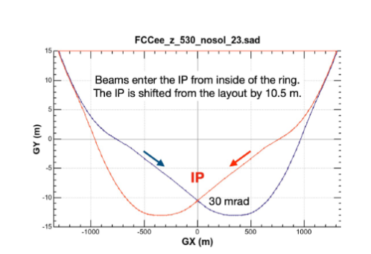
FCC-ee Standard IR optics design
FCC-ee IR geometry
Crossing angle:30mrad

Slide 10
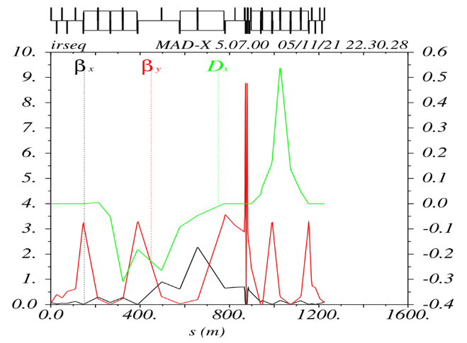
The baseline S-channel standard IR Optics
The asymmetric Standard mode IR Optics (from dispersion-free to dispersion-free region)

Slide 11
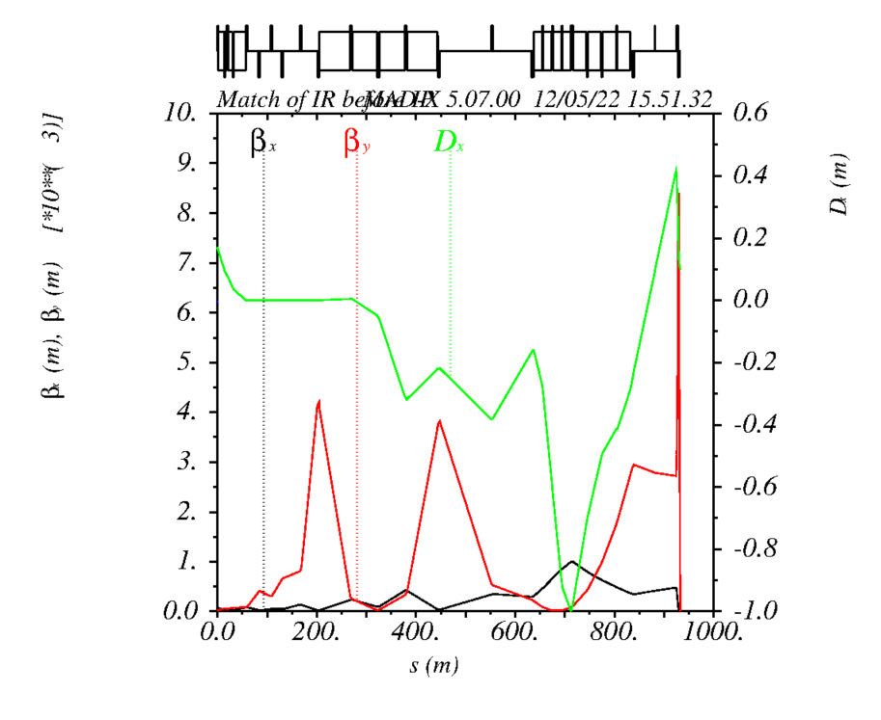
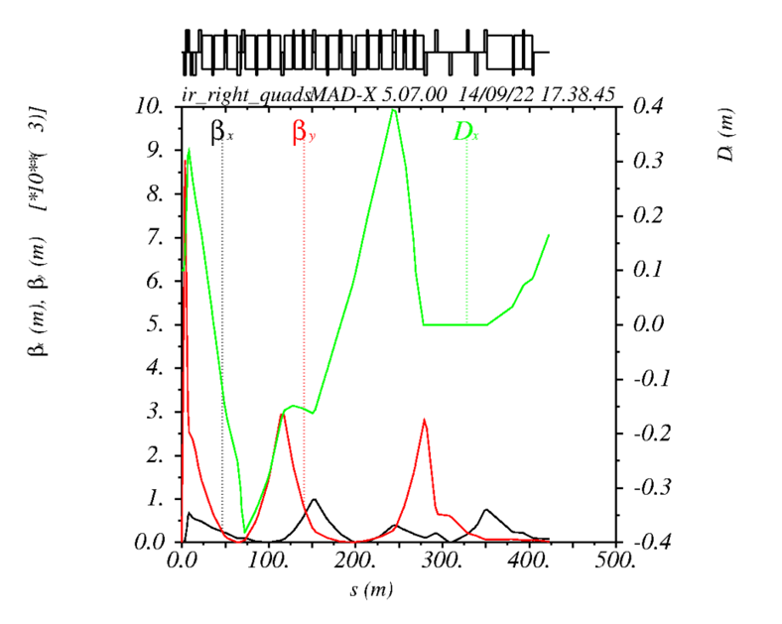
The Preliminary IR Optics for transversal mono-schemes
Before the Interaction Point: D*x=±0.1m After the Interaction Point:

Slide 12
Next steps
D_{x}* scanning and limits
Redesign and Correction of local chromaticity correction (LCC system)
Beam dynamic aperture (DA) analysis
Beam-beam effects

Slide 13
Thanks for your attention!
e⁺
e⁻
Bled lake, Slovenia

