Slide 1
Beam Instrumentation Challenges for FCC-ee
eeFACT22 – Frascati, Italy
14th September 2022
Manfred Wendt (CERN)
with contributions from
Emanuela Carideo, Ubaldo Iriso Áriz, Gaku Mitsuka, Toshiyuki Mitsuhashi, Gudrun Niehues, Micha Reißig, Mirko Siano,
Thibaut Lefevre, Stefano Mazzoni, Andreas Schlögelhofer
and many other colleagues

Slide 2
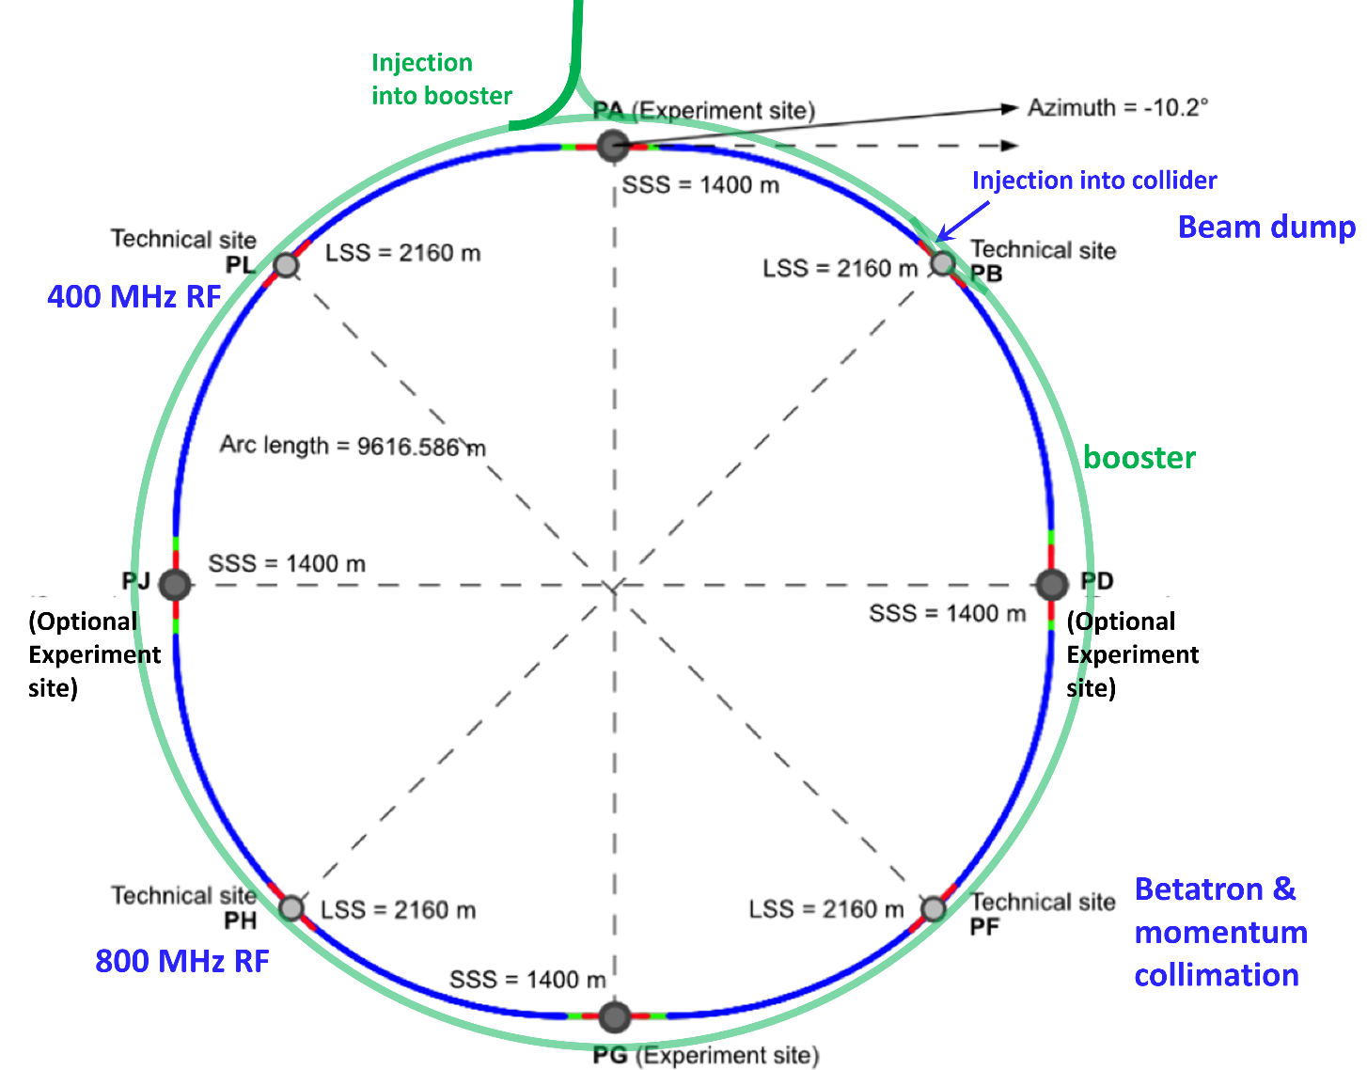
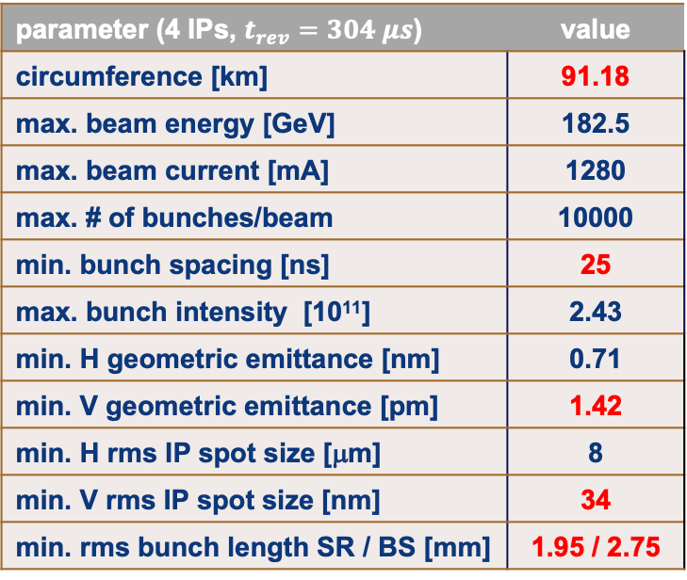
FCC-ee in a nutshell (from a BI perspective)
parameter (4 IPs, $t_{rev}=304 μs$) | value
circumference [km] | 91.18
max. beam energy [GeV] | 182.5
max. beam current [mA] | 1280
max. # of bunches/beam | 10000
min. bunch spacing [ns] | 25
max. bunch intensity [10¹¹] | 2.43
min. H geometric emittance [nm] | 0.71
min. V geometric emittance [pm] | 1.42
min. H rms IP spot size [μm] | 8
min. V rms IP spot size [nm] | 34
min. rms bunch length SR / BS [mm] | 1.95 / 2.75
+ injectors
and positron source
K. Oide, J. Gutleber

Slide 3
Outline
FCC-ee Beam Instrumentation Challenges
    Some general remarks
Beam Position Measurement
Beam Loss Measurement
Beam Size Measurement
Bunch Length Measurement
Other Challenges

Slide 4
FCC-ee Beam Instrumentation Challenges
Technical / scientific challenges
    Large size / footprint
      makes distributed BPM / BLM systems complex, expensive and difficult to maintain, and causes unwanted signal delays for FB applications.
      High SR power in the tunnel arcs requires radiation tolerant signal processing electronics and X-ray shielding efforts.
    Ambitious beam parameters,
    similar to 4th generation light sources requirements
      state-of-the-art beam instruments for beam size and bunch length / profiles
      excellent alignment, long term stability, etc. of the BPM system components
      low beam-coupling impedance for EM beam pickups
Managerial, manpower and budget challenges
    Require good communication between all teams and collaborators
    Specify and tailor limited resources to the most critical R&D activities

Slide 5
Beam Position Monitors (BPM)
A total of ~6000 BPMs in the 92 km tunnel
    2000+2000 BPMs for the main rings, 2000 BPMs for the booster ring
    Orbit, turn-by-turn, and bunch-by-bunch operating modes, 25 ns signal processing time
BPMs and BPM pickups also will be used for various non-orbit applications
    Tune measurement, orbit and bunch FB, timing electrodes, instability monitor, etc.
Some of the many challenges
    Large scale system: infrastructure, segmentation, cost optimization
    Signal latency (for FB apps), synchronization of turn and bunch data, large data throughput (probably >20 GSPS for each BPM plane) and decimation
    Radiation tolerant tunnel hardware
    Low beam-coupling impedance of the BPM pickups (wakefields)
    Alignment and stabilization (temperature variation) of the BPM pickups
    Accuracy (non-linearities), resolution (orbit, TxT, BxB), precision (drifts, aging) requirements, which are similar or even more tight then last gen SL sources.

Slide 6
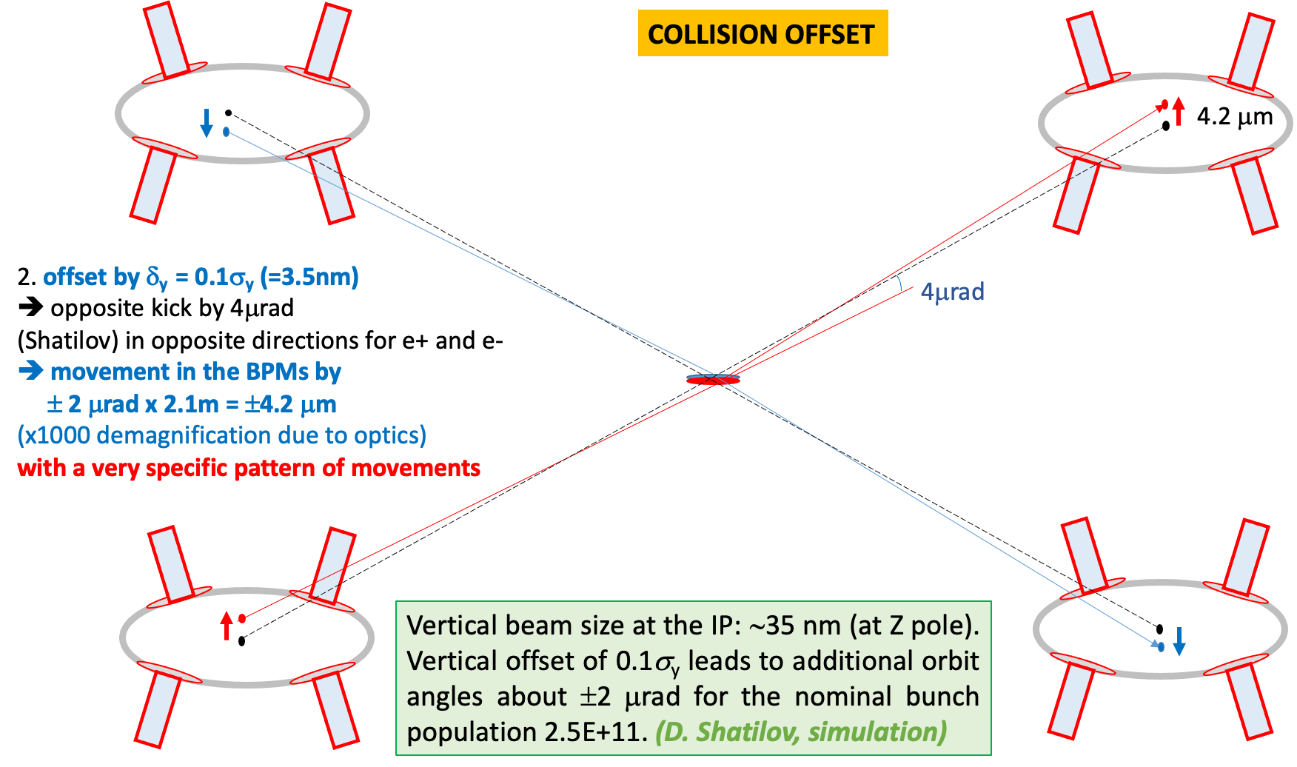
Some BPM Requirements
Rogelio
Alain
Eliana
Tessa
Resolution: <1 μm (orbit), <10 μm (TxT)
    However, in a very large beam pipe 70 mm dia. (FCC-ee arcs)
Alignment & accuracy 1-10 μm
    Movers? Pre-alignment accuracy?
    Stretched-wire BPM-quad electromagnetic pre-alignment?
Roll errors 10-30 μrad, calibration errors ~1 %
Long term stability & drifts?
Need to draft a BPM requirements document!
Jacqueline

Slide 7
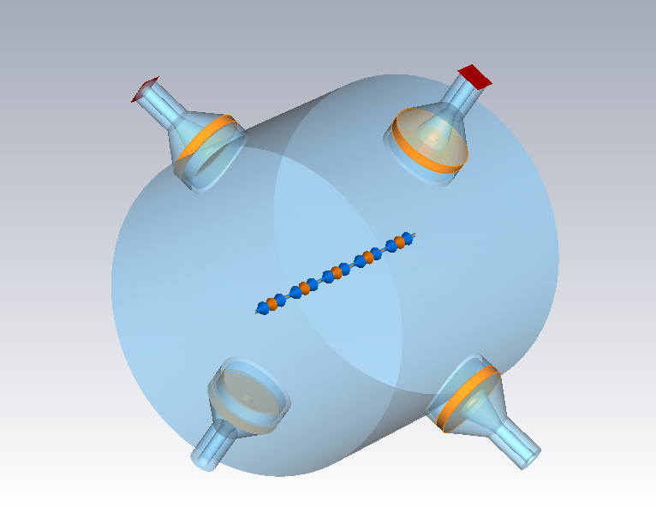
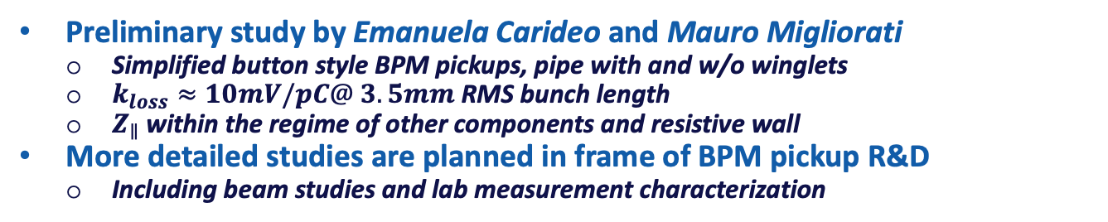
BPM Pickup R&D: Wakefields
Emanuela
& Mauro
Preliminary study by Emanuela Carideo and Mauro Migliorati
    Simplified button style BPM pickups, pipe with and w/o winglets
    $k_{loss}≈10mV/pC@ 3.5mm$ RMS bunch length
    $Z_{∥}$ within the regime of other components and resistive wall
More detailed studies are planned in frame of BPM pickup R&D
    Including beam studies and lab measurement characterization

Slide 8
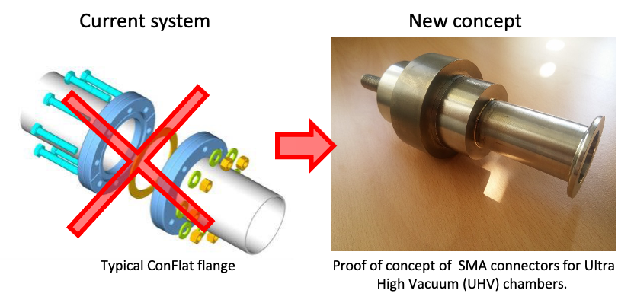
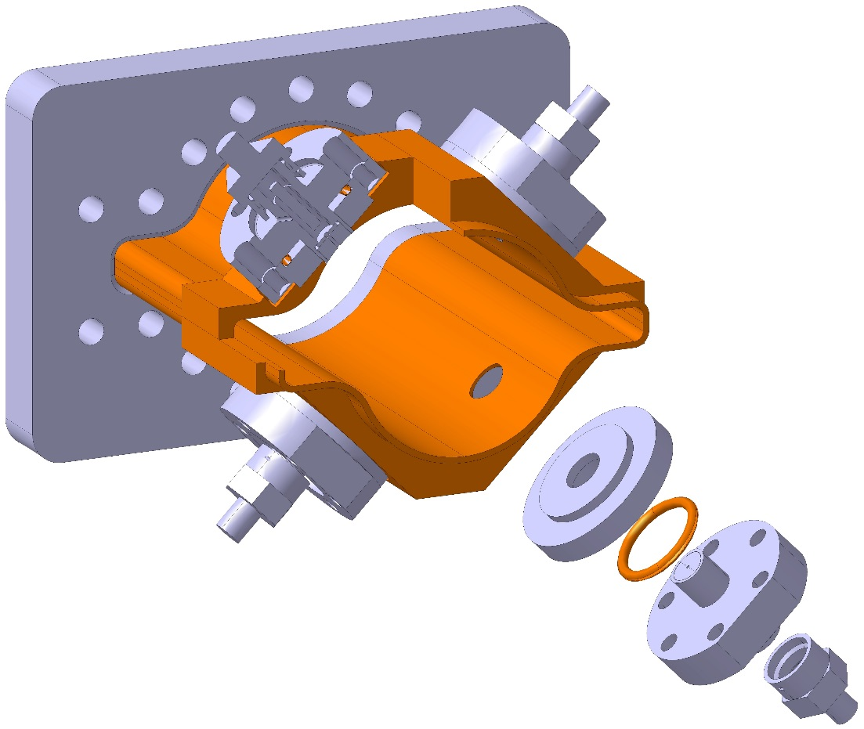
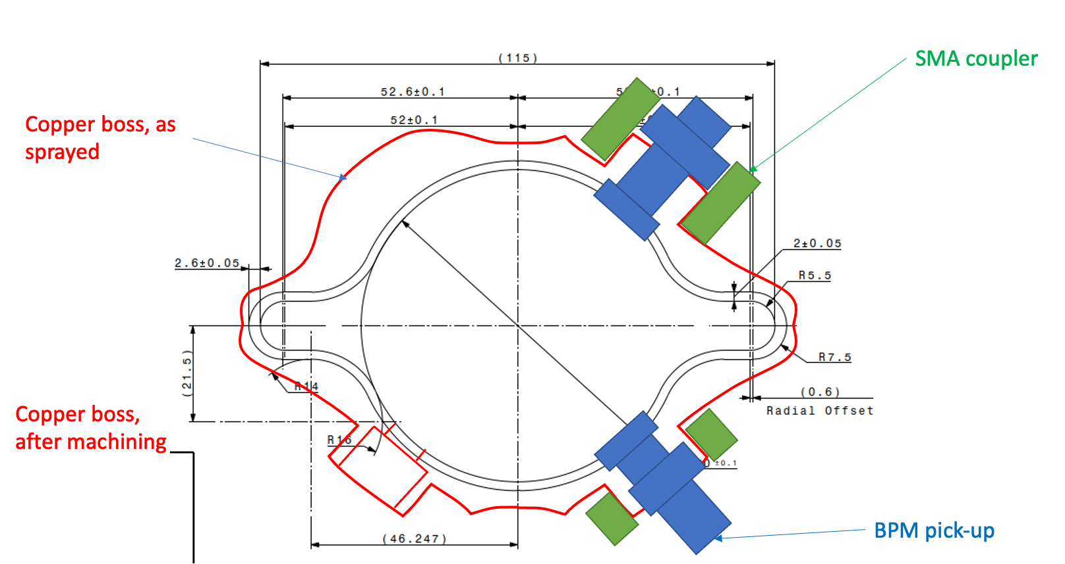
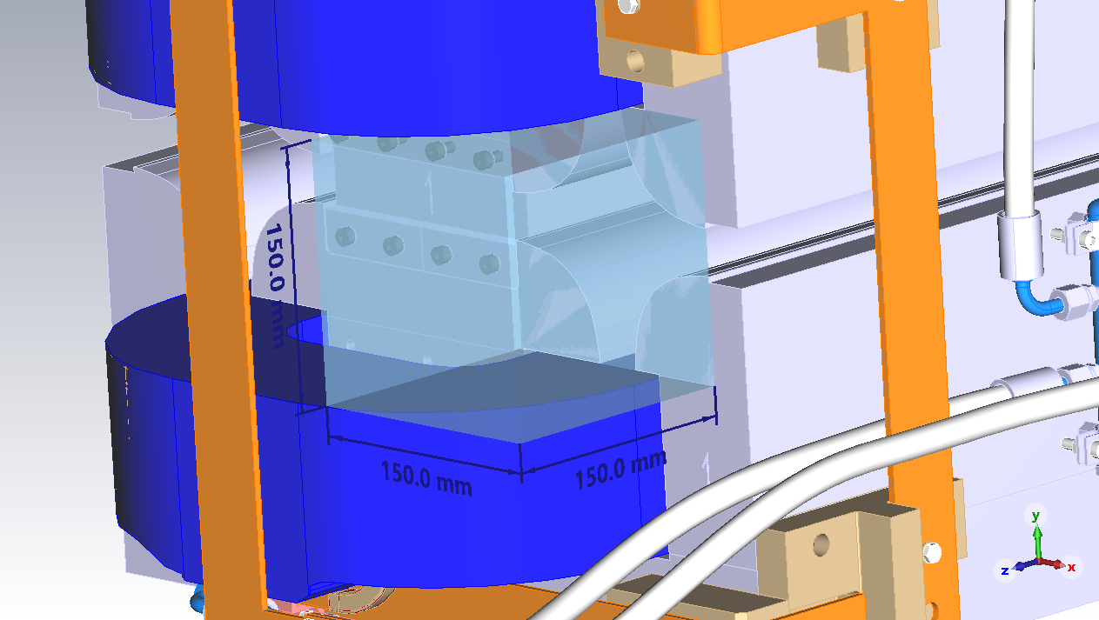
BPM Pickup R&D: Integration
Cedric
CERN vacuum team (Cerdic Garion) R&D on additive manufacturing
    Cost effective method to integrate
    the UHV BPM button feedthroughts into the vacuum chamber
    Requires more communication and studies
      Feedthrough RF properties, button size and mechanical details, pickup position non-linearities, EM alignment with quad, maintenance, etc.
Real estate at the quad
    Preliminary study hints no “extra” space is required for the BPM pickup
available
BPM pickup
real estate

Slide 9
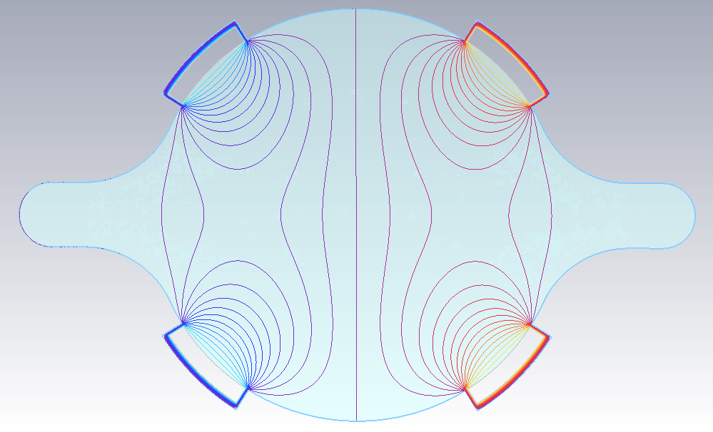
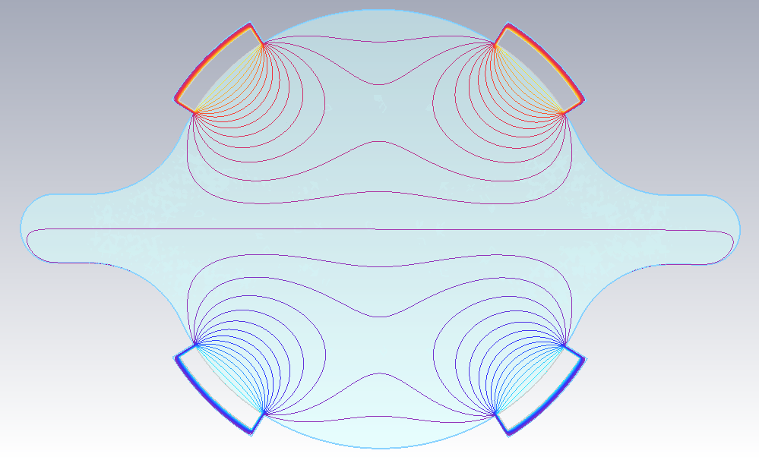
BPM System: Read-out, DAQ, Infrastructure
Too early to call
    With >25 years until installation
    better wait for technology updates!
    LHC BPM system (1100 BPMs, all BxB)
    operates almost unchanged since 15 years
      …and probably another 15 years
But…
    Follow technology advances
    which meets FCC-ee BPM requirements!
      Low latency read-out system to meet FB purposes
        What kind of DAQ segmentation do we need?
      Radiation tolerant hardware for tunnel installation
        Data decimation and pre-processing (e.g. correction of position non-linearities) in the tunnel?!
    Cost optimization and estimation!
BPM position behaviour: horizontal
BPM position behaviour: vertical

Slide 10
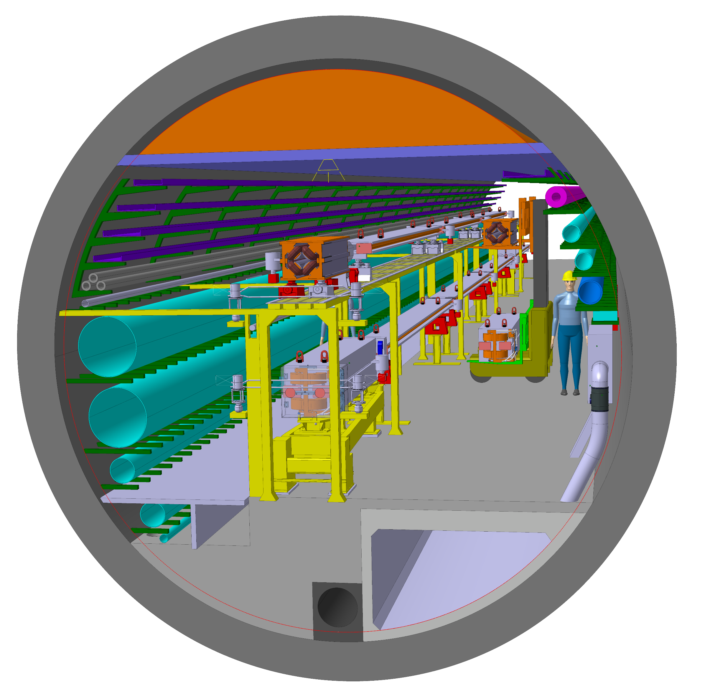
Beam Loss Monitors (BLM)
Large energy stored in both, main rings and booster ring require a machine protection system (MPS), supported by beam loss monitors (BLM)
    BLMs in the arcs need to be
    insensitive to X-rays!
    Identifying losses from the individual rings in the tunnel is difficult!
      Between main rings:
      BLMs with beam directivity
      Between main and booster rings:
      staged localization of the quads

Slide 11
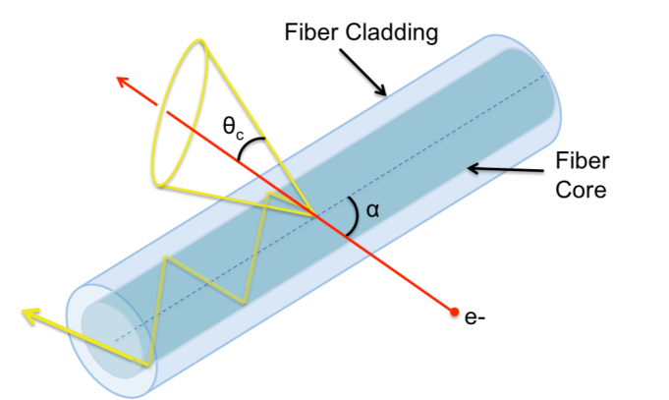
BLM R&D
Dedicated FCC-ee BLM R&D has not started, but…
Optical BLM system based on Cherenkov fibers offer
    High directivity
    Only measures charged particles
    Successful beam studies at CLEAR
Many experimental investigations initiated within the Linear Collider study
    Crosstalk between beam losses from CLIC Drive and Main beams:
    M. Kastriotou et al, “BLM crosstalk studies on the CLIC two-beam module”, IBIC, Melbourne, Australia (2015) pp. 148
    Position resolution of a distributed oBLM system:
    E. Nebot del busto et al, “Position resolution of optical fibre-based beam loss monitors using long electron pulses”, IBIC, Melbourne, Australia (2015) pp. 580
    RF studies (Breakdown and Dark current):
    M. Kastriotou et al., “A versatile beam loss monitoring system for CLIC”, IPAC, Busan, Korea, 2016, pp. 286

Slide 12
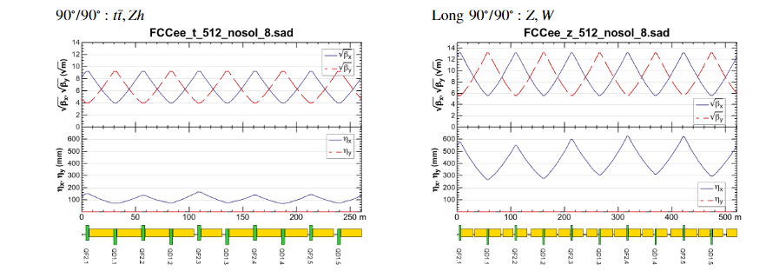
Beam Size Measurement
Parameter [4 IPs, 91.2 km] | Z | WW | H (ZH) | ttbar
beam energy [GeV] | 45 | 80 | 120 | 182.5
horizontal beta* [m] | 0.1 | 0.2 | 0.3 | 1
vertical beta* [mm] | 0.8 | 1 | 1 | 1.6
horizontal geometric emittance [nm] | 0.71 | 2.17 | 0.64 | 1.49
vertical geom. emittance [pm] | 1.42 | 4.34 | 1.29 | 2.98
horizontal rms IP spot size [μm] | 8 | 21 | 14 | 39
vertical rms IP spot size [nm] | 34 | 66 | 36 | 69
FCC-ee beam size is small!
    In the arcs (Zh):
    horizontal: ~100 μm
    vertical: ~7 μm

Slide 13
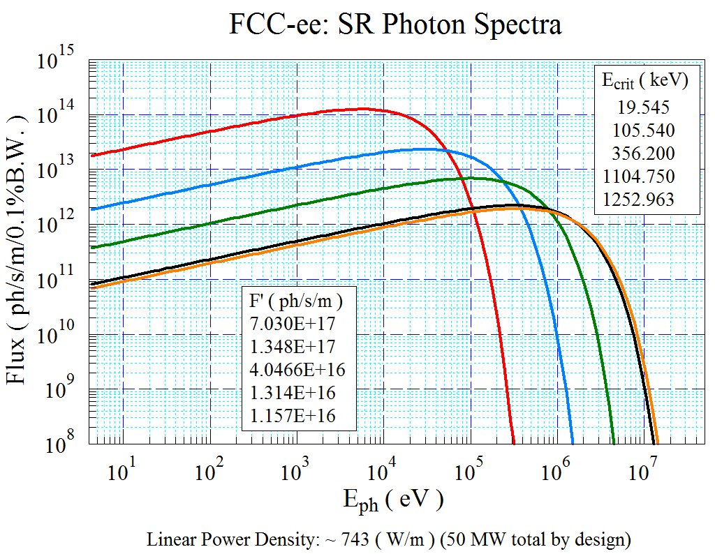

Beam Size Measurement based on SR
Use of synchrotron radiation at high beam energies
suffer from diffraction effects!
    Requires X-ray interferometric techniques
$$σ_{diff}=\frac{1.22λ}{4σ_{y}^{′}}≈0.43γλ$$
Diffraction limit:
~15 μm @ 0.1 nm (182.5 GeV)
FCC-ee challenge:
Large arc radius requires very long, extended SR extraction lines
    Also difficult for numerical simulations

Slide 14
Beam Size R&D: X-Ray Interferometer
Beam size given by the Fourier transform of the
spatial coherence measured by an interferometer
    Long light extraction line with critical alignment
    Single plane
    Does not provide the beam profile
Toshi & Gaku

Slide 15
Beam Size R&D: 2D X-Ray HNFS
Heterodyne Near Field Speckles (HNFS)
    Interference between the beam’s X-ray SR and scattered spherical waves from a colloidal suspension
      e.g., nano particle / water mix
    2D beam size measurement,
    few μm resolution
Mirko & Co

Slide 16
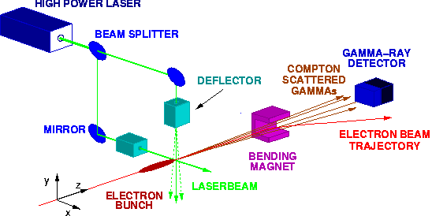
Beam Size R&D: Laser Wire Scanner (1)
Laser wire scanner technology developed for linear colliders
    Based on Compton scattering using high power laser light

Slide 17
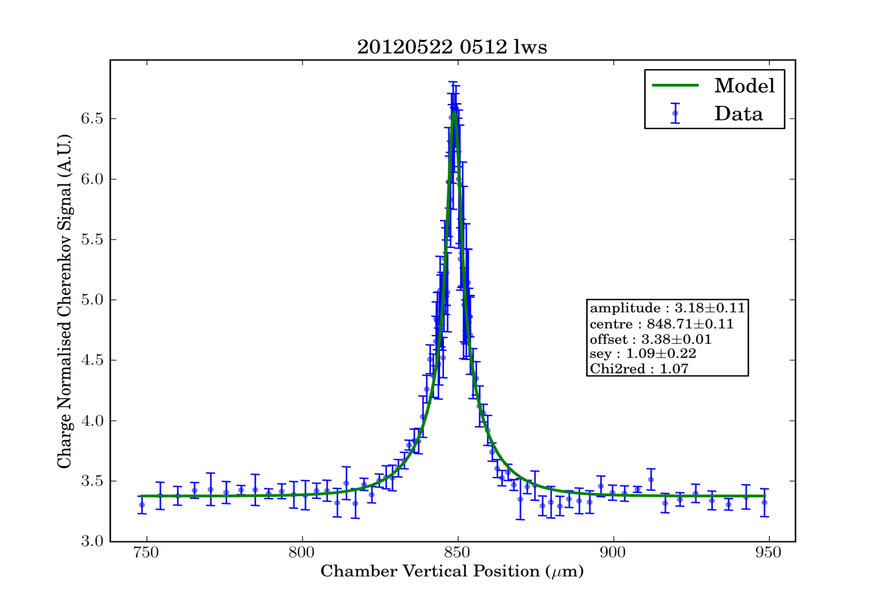
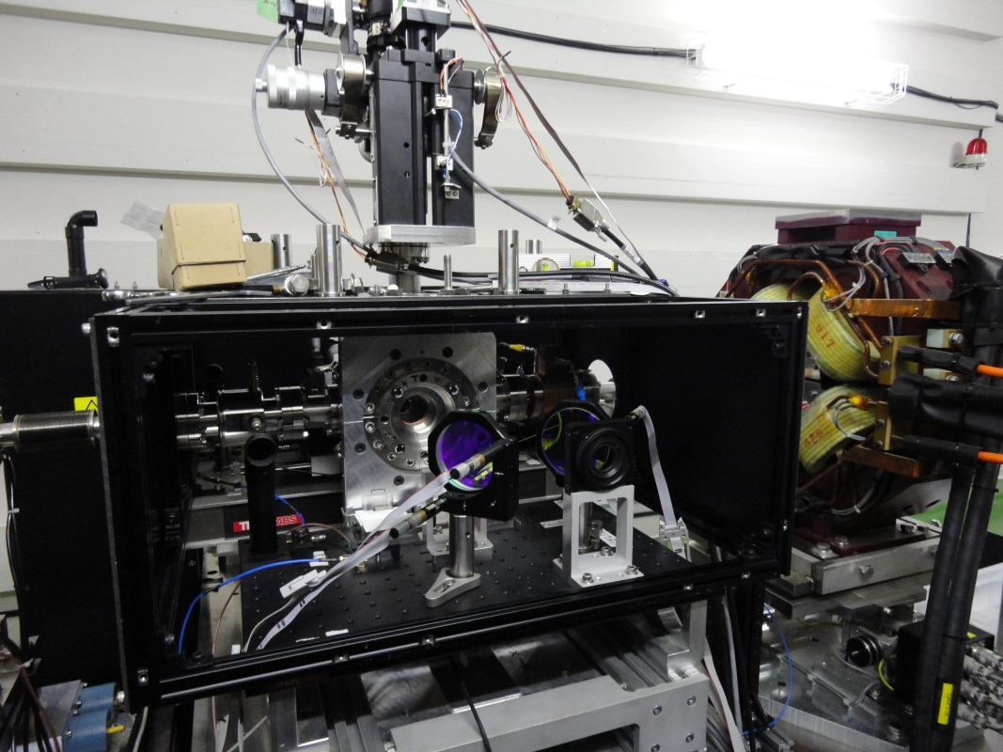
Beam Size R&D: Laser Wire Scanner (2)
    Demonstrated 1 μm measurement resolution!
      using a high-power fiber laser
    Shares laser technology with the Compton polarimeter
    Not cheap!
  15 years on R&D on ATF2 ring and extraction line
  H. Sakai et al, Physical Review ST AB 4 (2001) 022801 & ST AB 6 (2003) 092802
  S. T. Boogert et al., PRSTAB 13, 122801 (2010)
  L. Corner et al., IPAC, Kyoto, Japan (2010) pp3227

Slide 18
Bunch Length Measurement
Parameter [4 IPs, 91.1 km] | Z | WW | H (ZH) | ttbar
beam energy [GeV] | 45 | 80 | 120 | 182.5
rms bunch length with SR / BS [mm] | 4.38 / 14.5 | 3.55 / 8.01 | 3.34 / 6.0 | 1.95 / 2.75
“Reasonable” long bunches
    2 – 3 mm RMS, or longer
Need a bunch-by-bunch measurement system with picosecond resolution to monitor the impact of the Beamstrahlung.
Need a resolution in the 100 fs regime to estimate the energy spread, required for the energy calibration using the spin depolarization technique

Slide 19
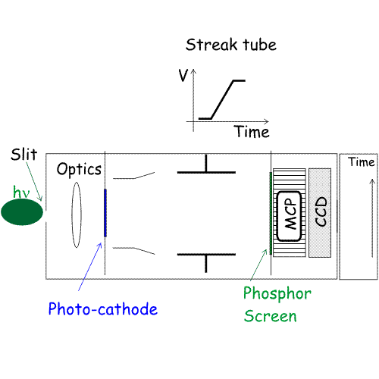
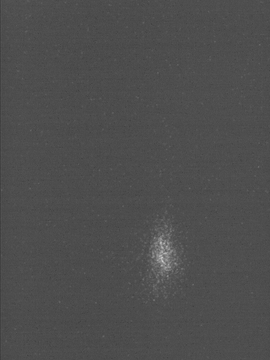
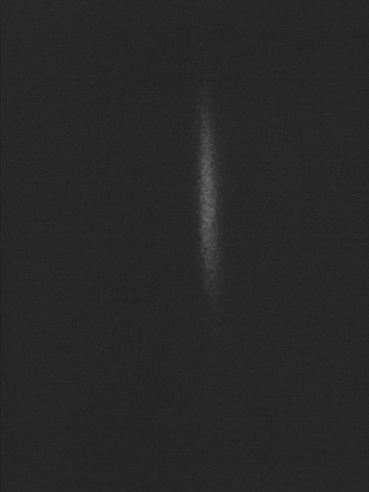
Bunch Length: Streak Camera
σ = 8.9ps (2.7 mm)
σ = 4.5ps (1.4 mm)
200 fs time resolution obtained using reflective optics,
a 12.5 nm BW optical BPF (800 nm) and the Hamamatsu FESCA200
        M. Uesaka, et.al., NIMA 406 (1998) 371
Does not provide bunch-by-bunch online monitoring

Slide 20

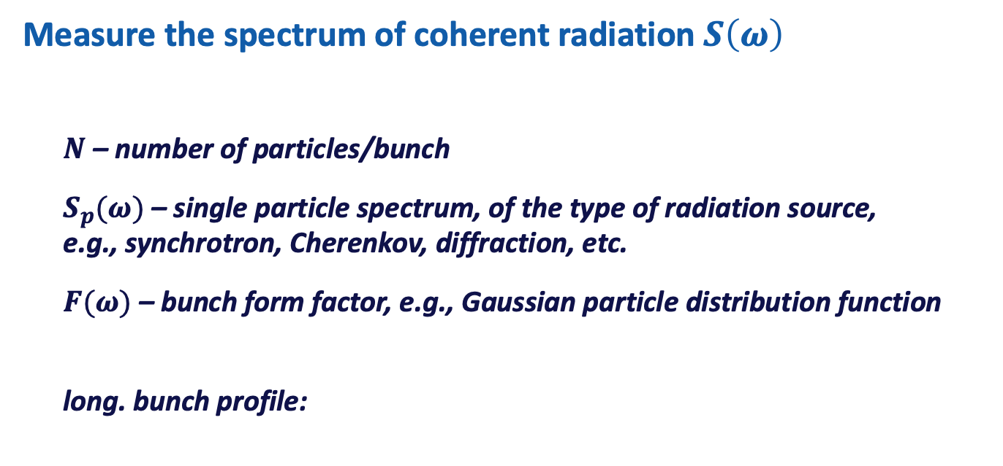
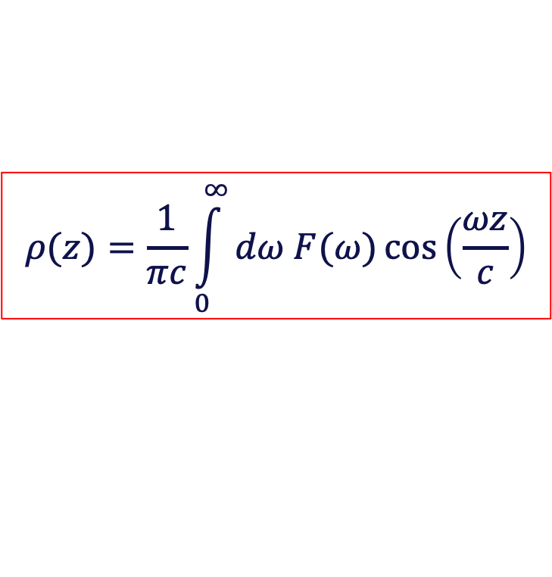
Bunch Length: Radiation-based
Measure the spectrum of coherent radiation $S\left(ω\right)$
    $N$ – number of particles/bunch
    $S_{p}(ω)$ – single particle spectrum, of the type of radiation source,
    e.g., synchrotron, Cherenkov, diffraction, etc.
    $F(ω)$ – bunch form factor, e.g., Gaussian particle distribution function
    long. bunch profile:
$$S\left(ω\right)≈N^{2}S_{p}\left(ω\right)F(ω)$$
$$ρ(z)=\frac{1}{πc}\int_{0}^{∞}{dω F(ω)\cos\left(\frac{ωz}{c}\right)}$$

Slide 21
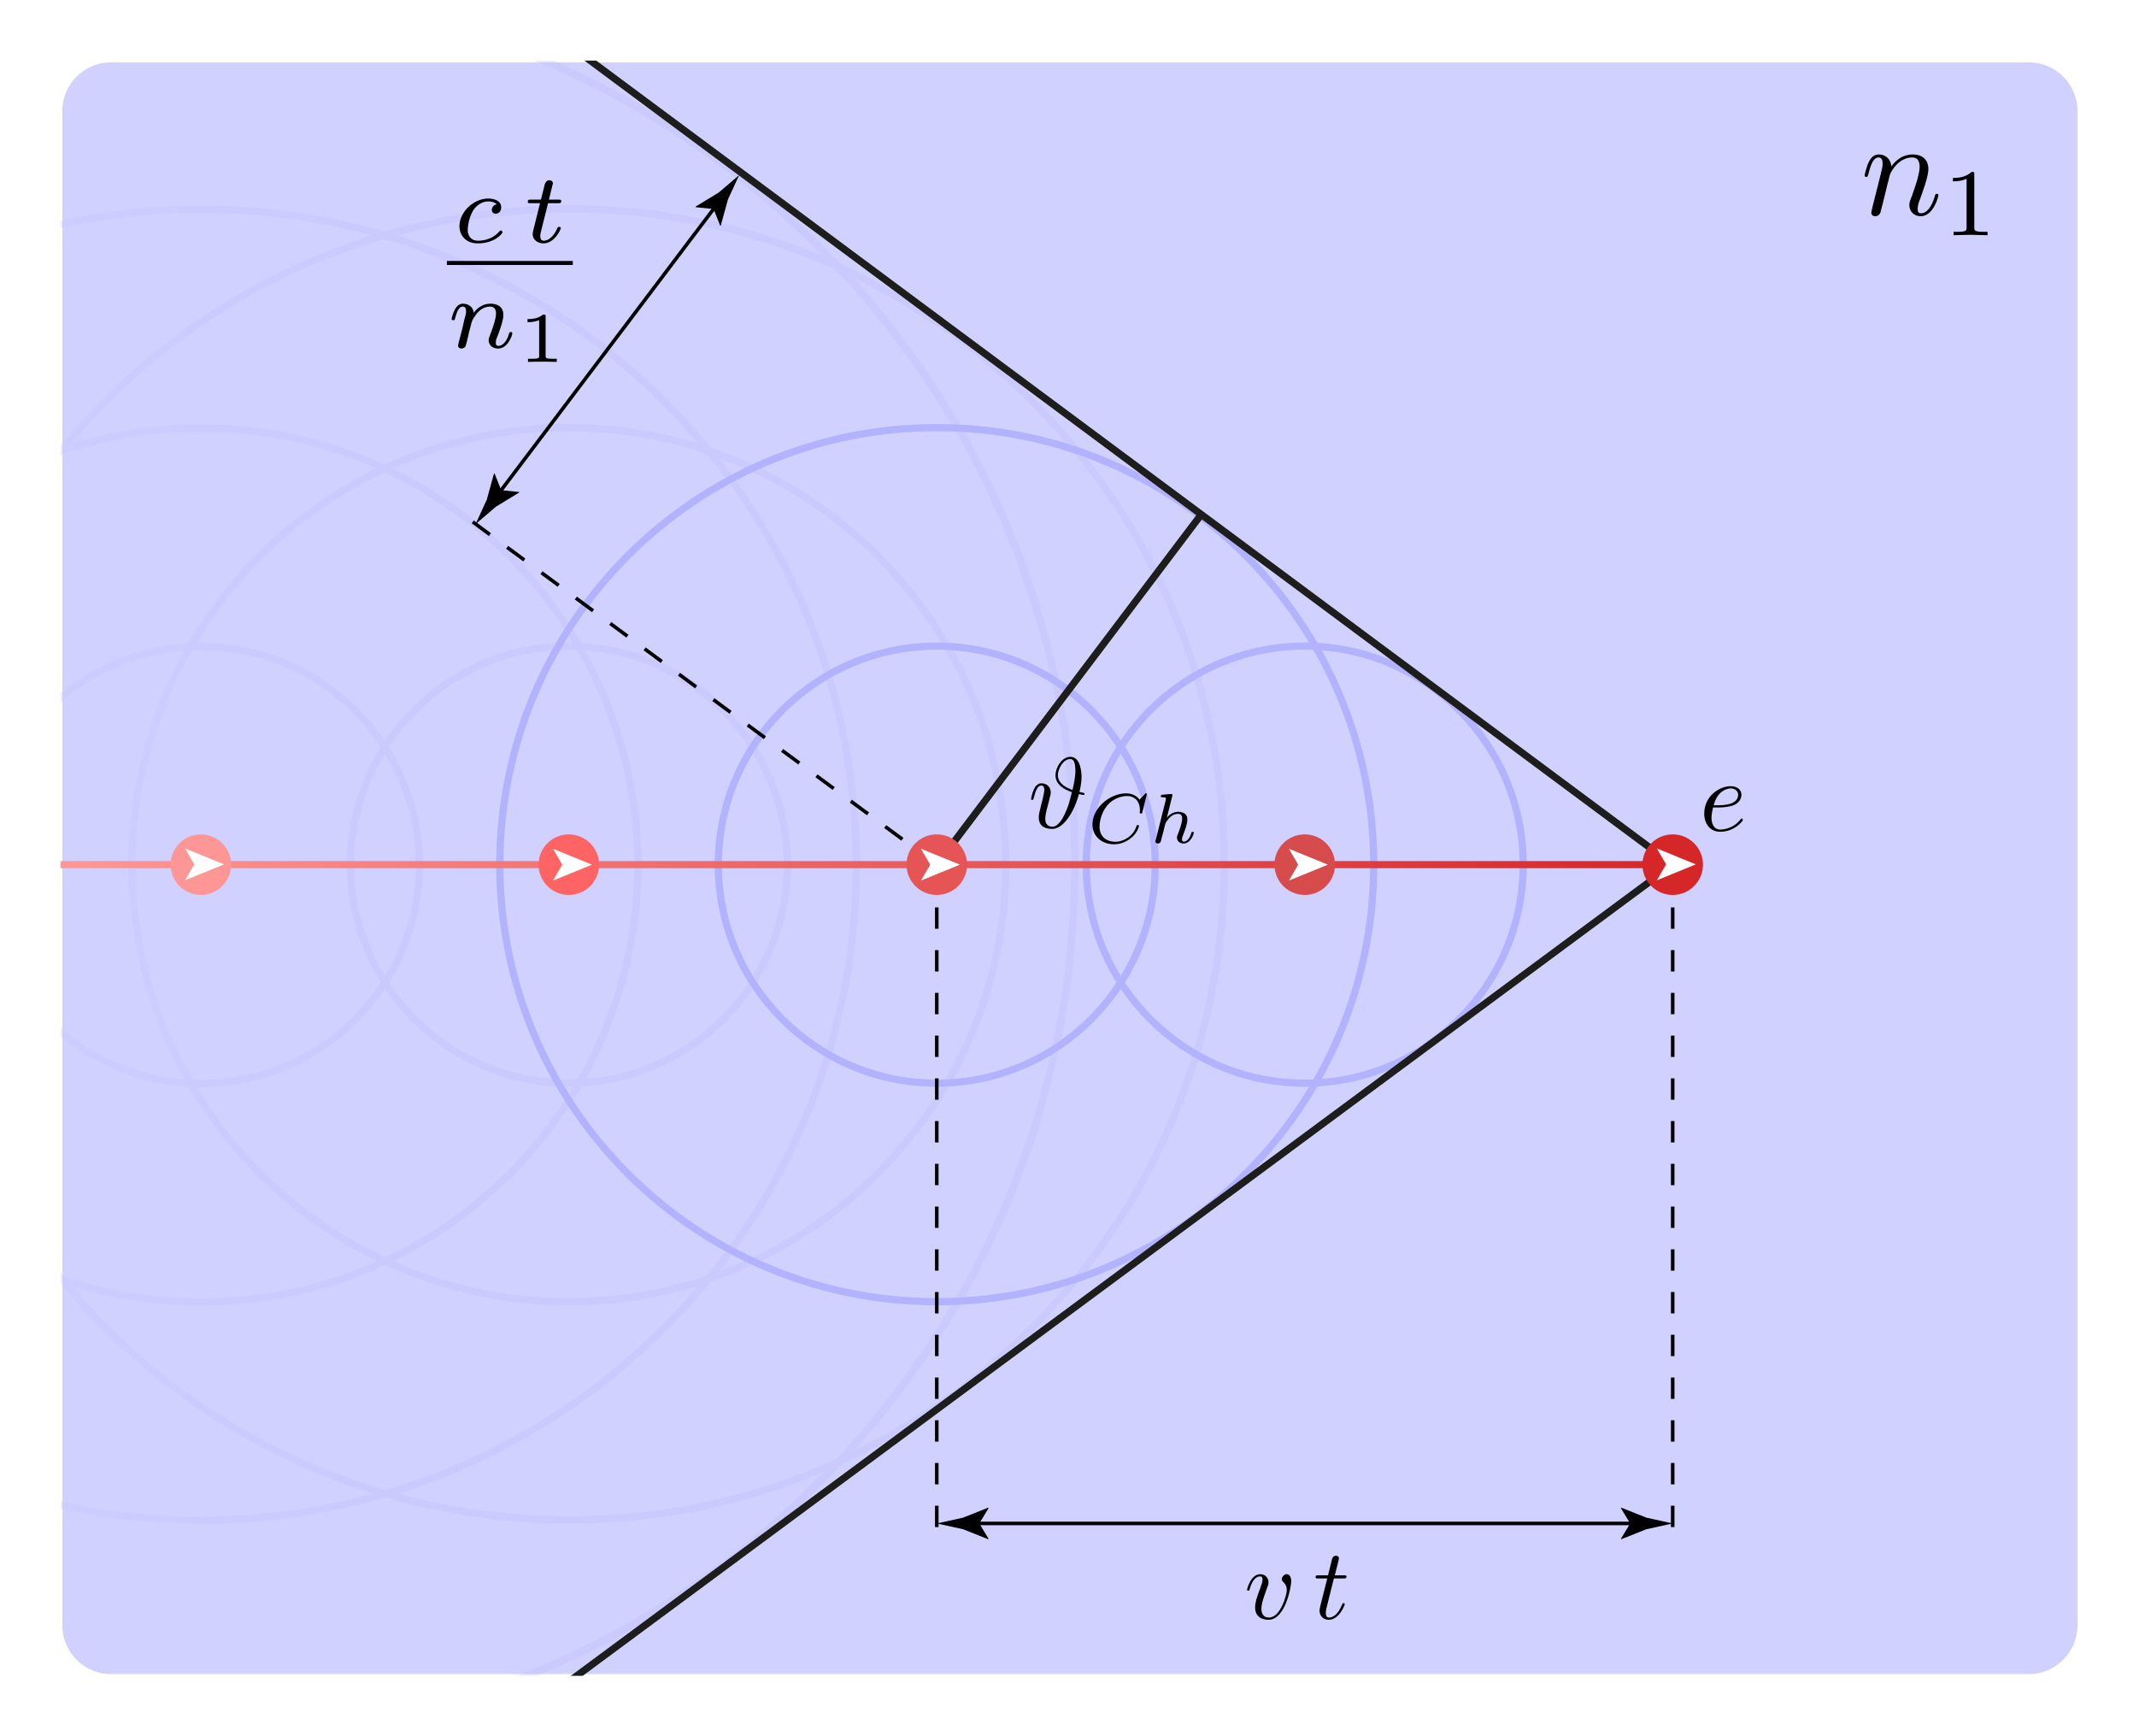
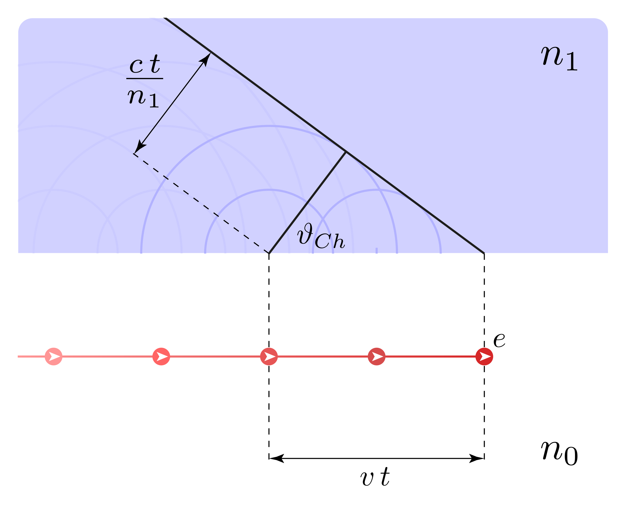
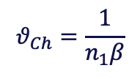
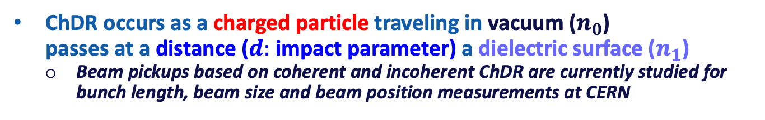


Bunch Length: Cherenkov Diffraction
Cherenkov Radiation
Cherenkov Diffraction Radiation (ChDR)
$$v>v_{p}=\frac{c}{\sqrt{n_{1}}}$$
$$θ_{Ch}=\frac{1}{n_{1}β}$$
$$d$$
Andreas
ChDR occurs as a charged particle traveling in vacuum ($n_{0}$)
passes at a distance ($d:$ impact parameter) a dielectric surface ($n_{1}$)
    Beam pickups based on coherent and incoherent ChDR are currently studied for
    bunch length, beam size and beam position measurements at CERN

Slide 22
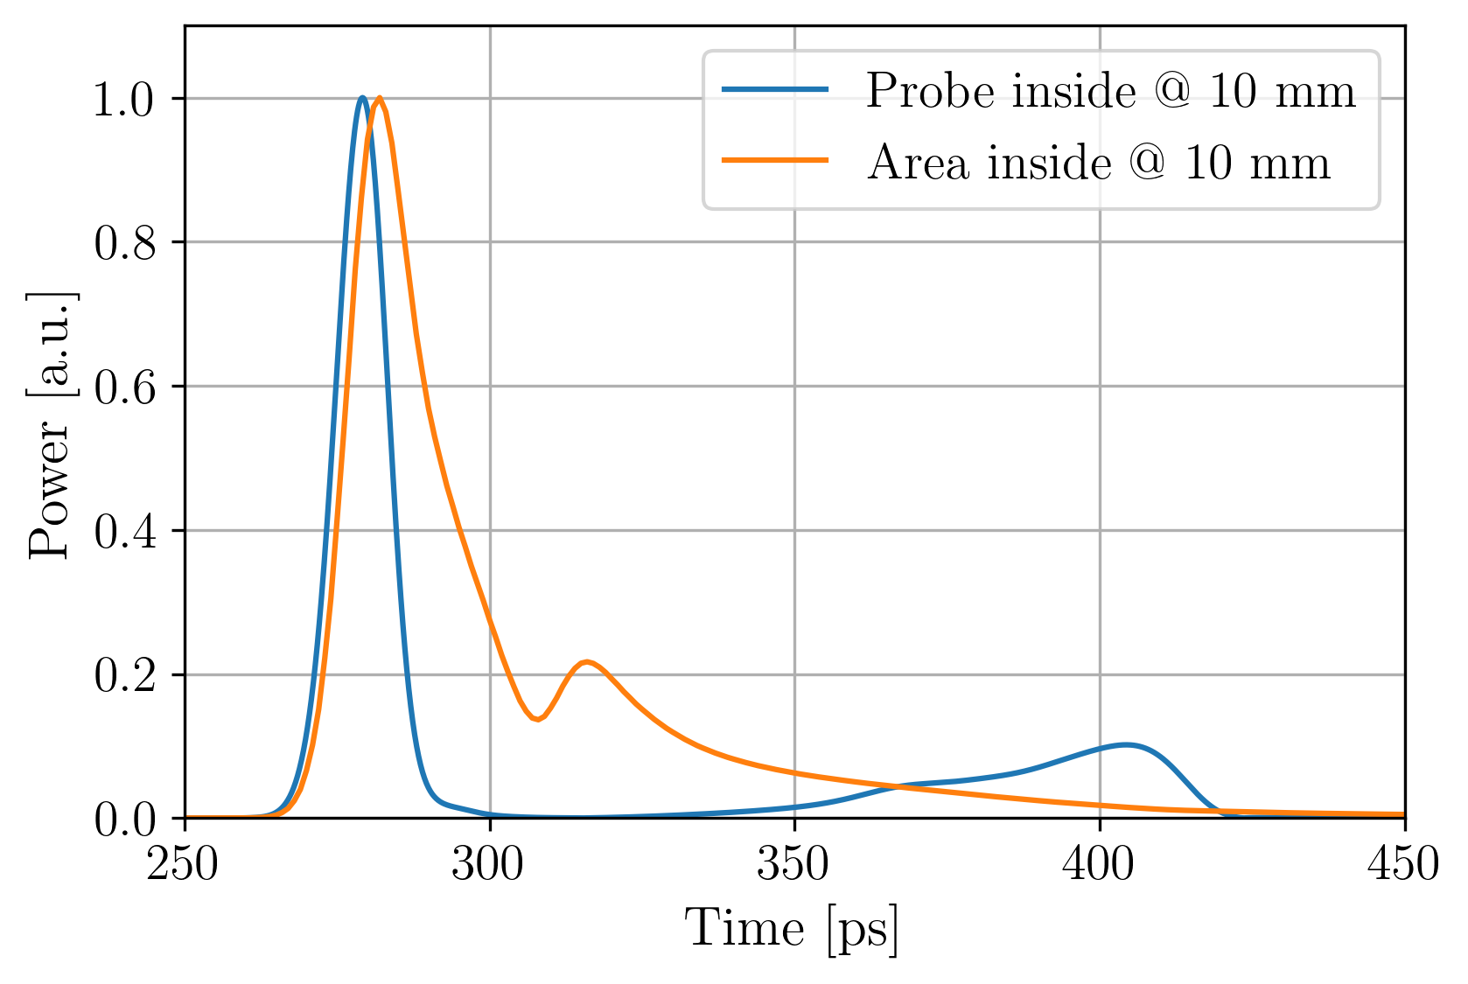
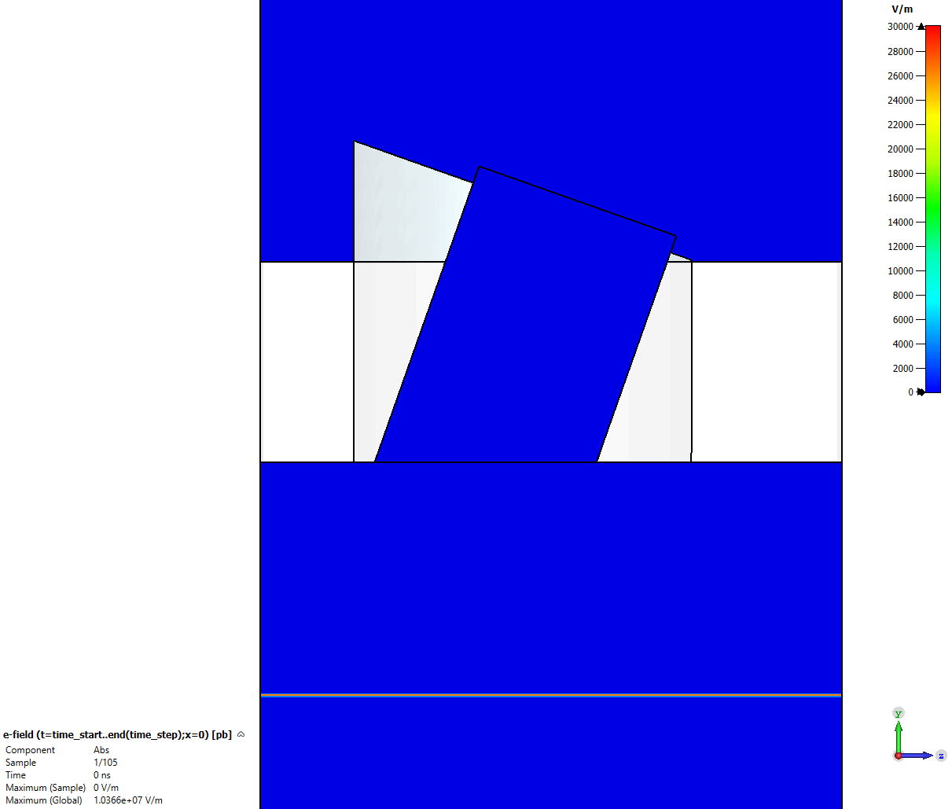
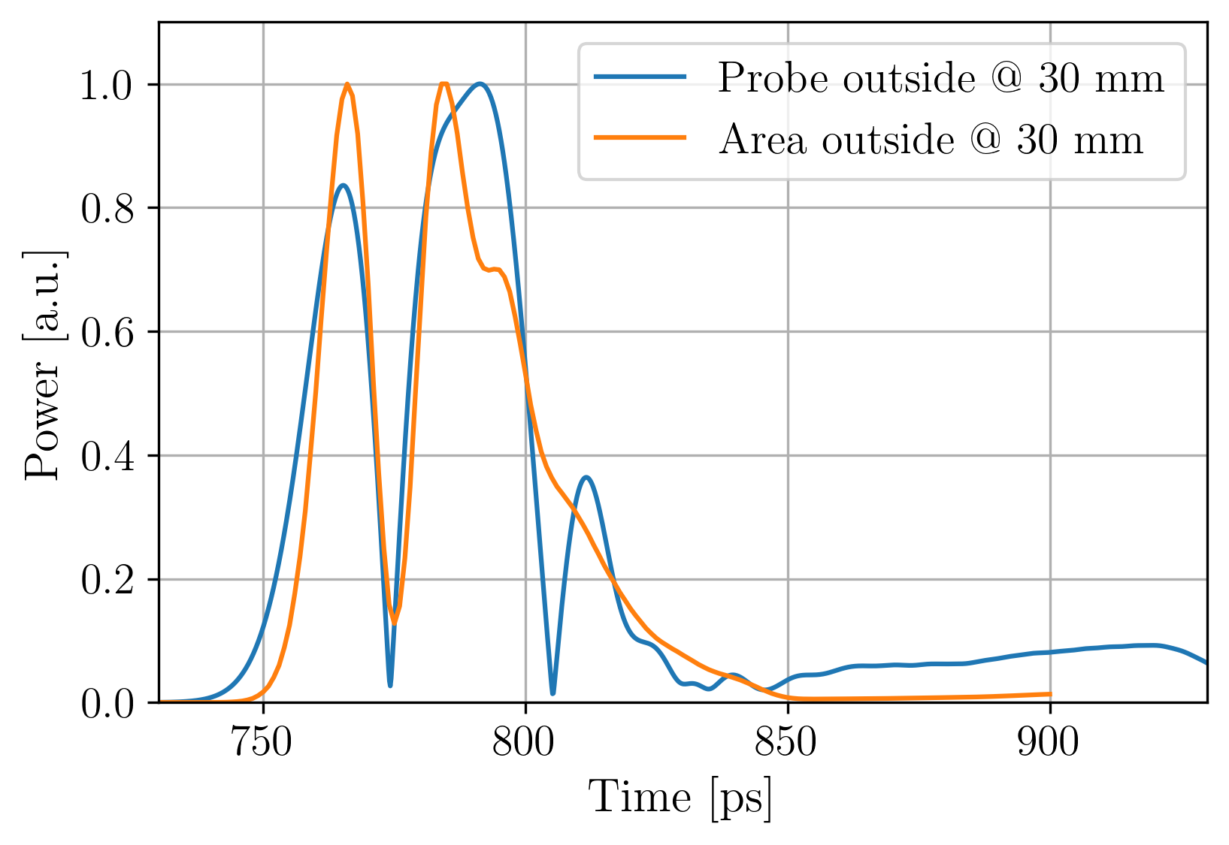
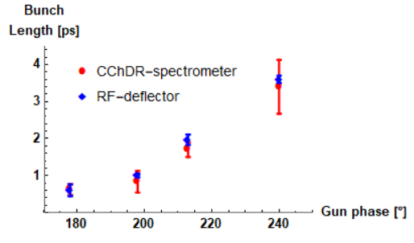
Bunch Length R&D: ChDR BI at CLEAR
Numerical analysis with CST Studio
ChDR bunch length measurements at CLEAR
    Utilizing the radiation at
    3 bands, 60 – 90 – 110 GHz
Andreas
E-field, Median plane (yz-plane)
2
1
1
2
A. Curcio
Electron bunch
5 ps Gaussian,
300 pC, 200 MeV

Slide 23
Bunch Length Measurement: EOS
Electro-optical sampling (EOS)
    Encode the bunch EM field onto the laser light,
    using a non-linear bi-refringent crystal (e.g., ZnTe, GaP)
    The beam EM field changes the polarization of the laser beam
    Different EOS methods exist, all of them offer a high time resolution <1 ps
Probing
laser pulse
EO crystal
Coulomb field
e beam

Slide 24
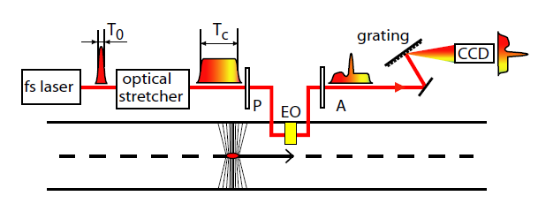
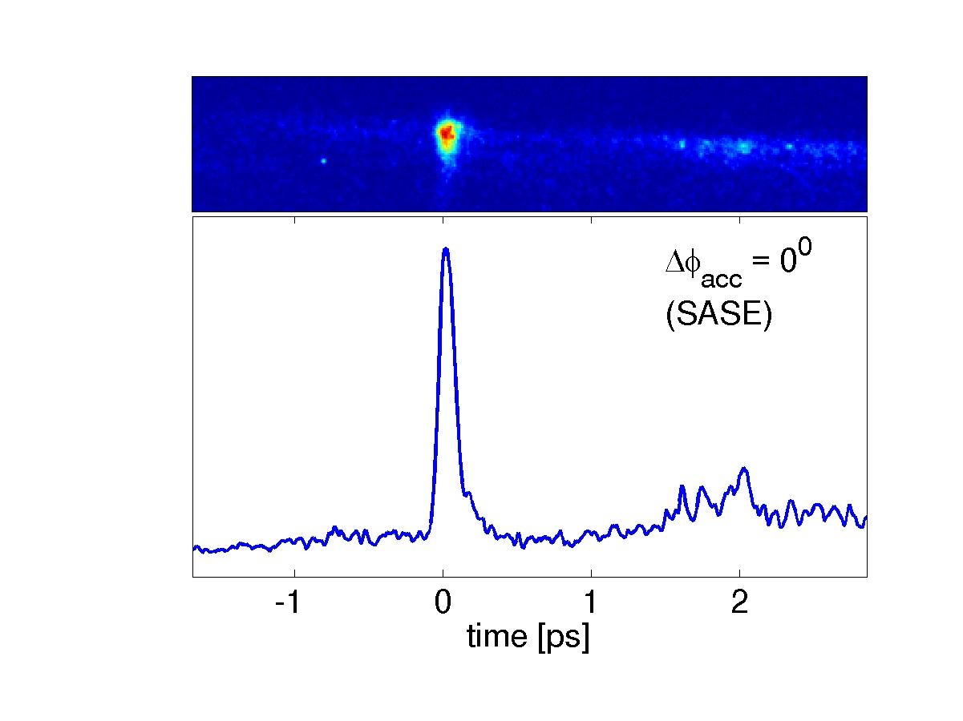
Bunch Length: EOS Spectral Encoding
Single-shot bunch profile measurement
    by detection the wavelength spectrum in a spectrometer (position vs. wavelength) of a chirped laser pulse (time vs. wavelength)
Measurement result FLASH (DESY)
110fs
Berden, et.al., Phys Rev Lett. 99 (2007)

Slide 25
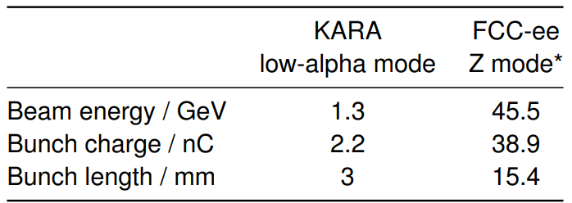
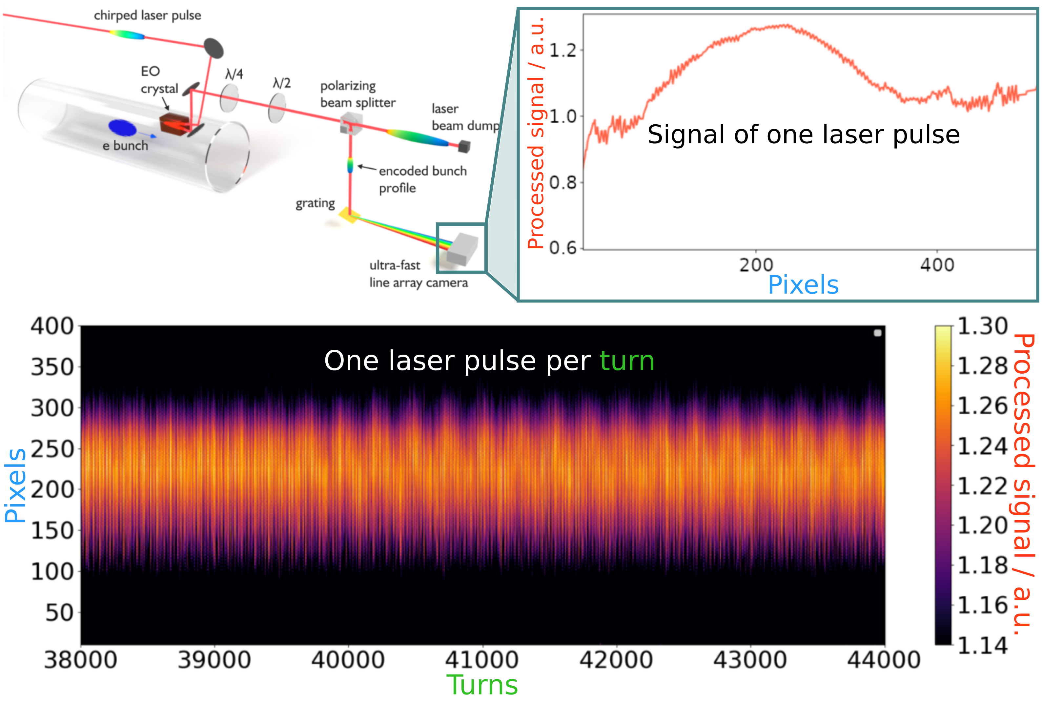
Bunch Length R&D: EOS@KIT (1)
  EOS Near-Field at KARA
    Turn-by-turn single bunch profile measurements
  Challenges for FCC-ee
* K. Oide 2022,151st FCC-ee Optics Design Meeting
Bunch-by-bunch measurement necessary
Higher bunch charge
Longer bunches
Monitor design needs to be adapted
Gudrun, Micha & Co.

Slide 26
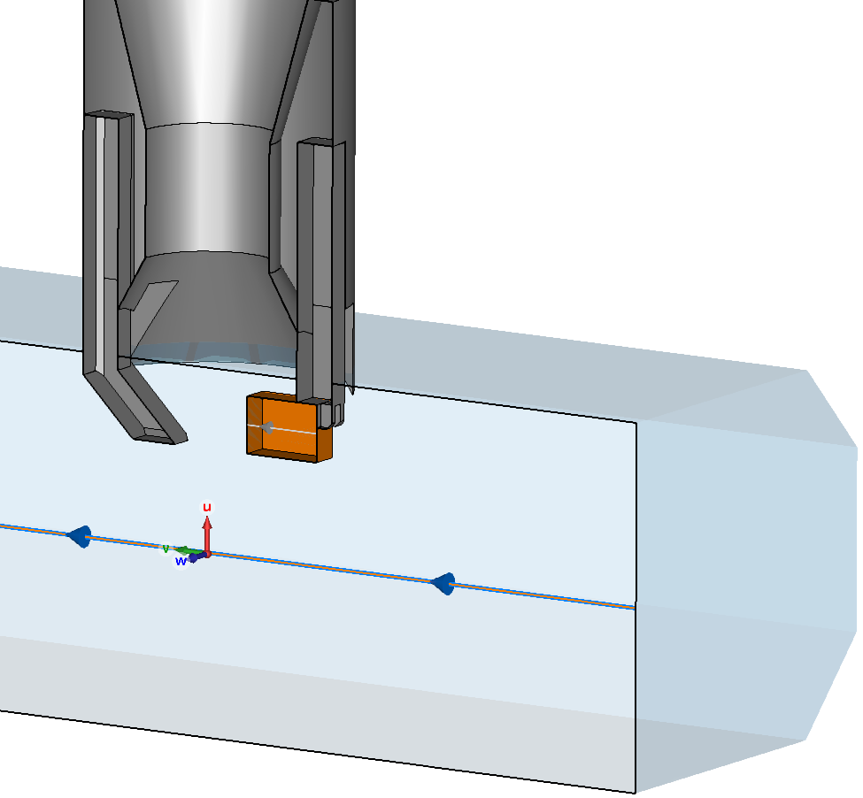
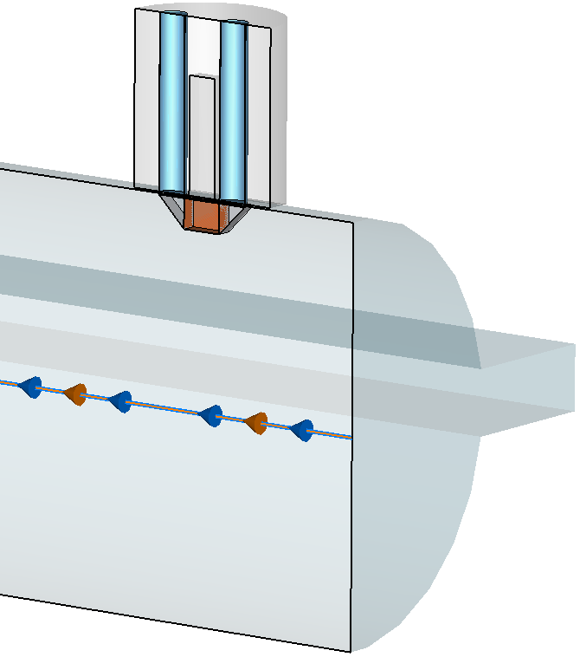
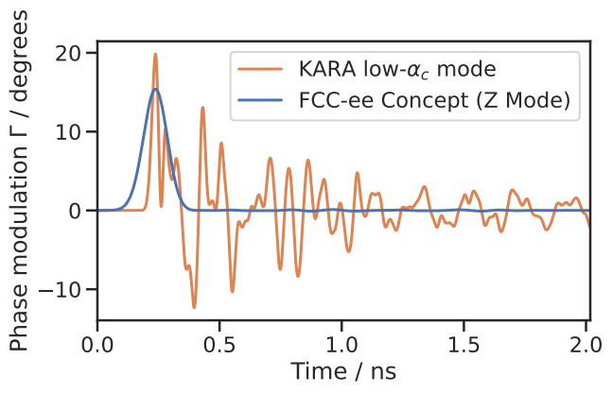
Bunch Length R&D: EOS@KIT (2)
  EO Bunch Profile Monitor for FCC-ee
EO Near-Field at KARA
Concept for FCC-ee
Comparison in Simulations
The concept design for FCC-ee achieves a similar signal strength as the monitor at KARA
M. Reissig, et.al., IPAC’22 MOPOPT025
M. Reissig, et.al., IBIC’22 WEP26 (unpublished)

Slide 27
Other Challenges
Communication
    Many R&D contributions inside and outside CERN
    Sometimes difficult to follow up, therefore:
    FCC-ee Beam Instrumentation Mini-Workshop
    Time: 21. – 22. November 2022, Location: CERN – Meyrin
    Contact: Stefano Mazzoni (stefano.mazzoni@cern.ch)
      Indico link TBD
Manpower
    CERN BI resources are shared between many activities
      Maintenance / overhaul of operating CERN beam instruments
      Various R&D activities and studies, like AWAKE, CLEAR, CLIC, FCC, MC, PBC
Budget
    The FCC-ee BI budget 2023-25 limits our R&D opportunities at CERN
      PhD on BPM pickup, ChDR & HNFS beam size, ChDR & EOS bunch length

Slide 28
Thank you for your attention.
eeFACT22 – Frascati, Italy
14th September 2022
Beam Instrumentation Challenges for FCC-ee
Manfred Wendt (CERN)
28

