Slide 1
Beam Physics Frontier Problems in 25 minutes
Frank Zimmermann
eeFACT’22 ICFA Workshop
13 September 2022
many thanks to Prof. Jie Gao and the Program Committee

Slide 2
major beam frontier challenges
synchrotron radiation
bending magnetic field
accelerating gradient
(rare) particle production – e⁺ and μ
cost and sustainability
exploring novel directions

Slide 3
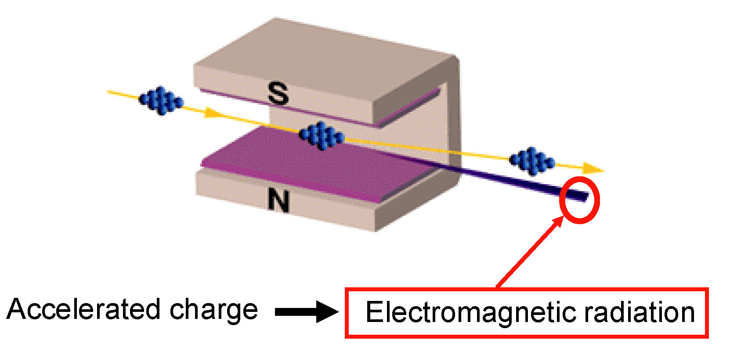
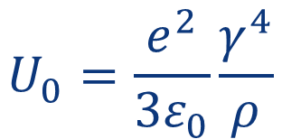
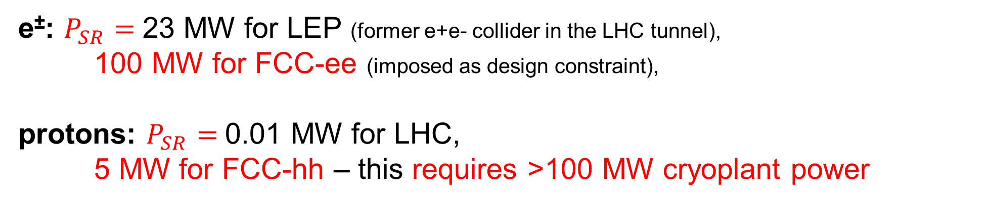
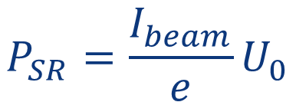
challenge #1: synchrotron radiation (SR)
circular colliders
$$U_{0}=\frac{e^{2}}{3ε_{0}}\frac{γ^{4}}{ρ}$$
energy loss per
particle per turn
$$P_{SR}=\frac{I_{beam}}{e}U_{0}$$
L. Rivkin
SR power
e±: $P_{SR}=$23 MW for LEP (former e+e- collider in the LHC tunnel),
100 MW for FCC-ee (imposed as design constraint),
protons: $P_{SR}=$0.01 MW for LHC,
5 MW for FCC-hh – this requires >100 MW cryoplant power

Slide 4
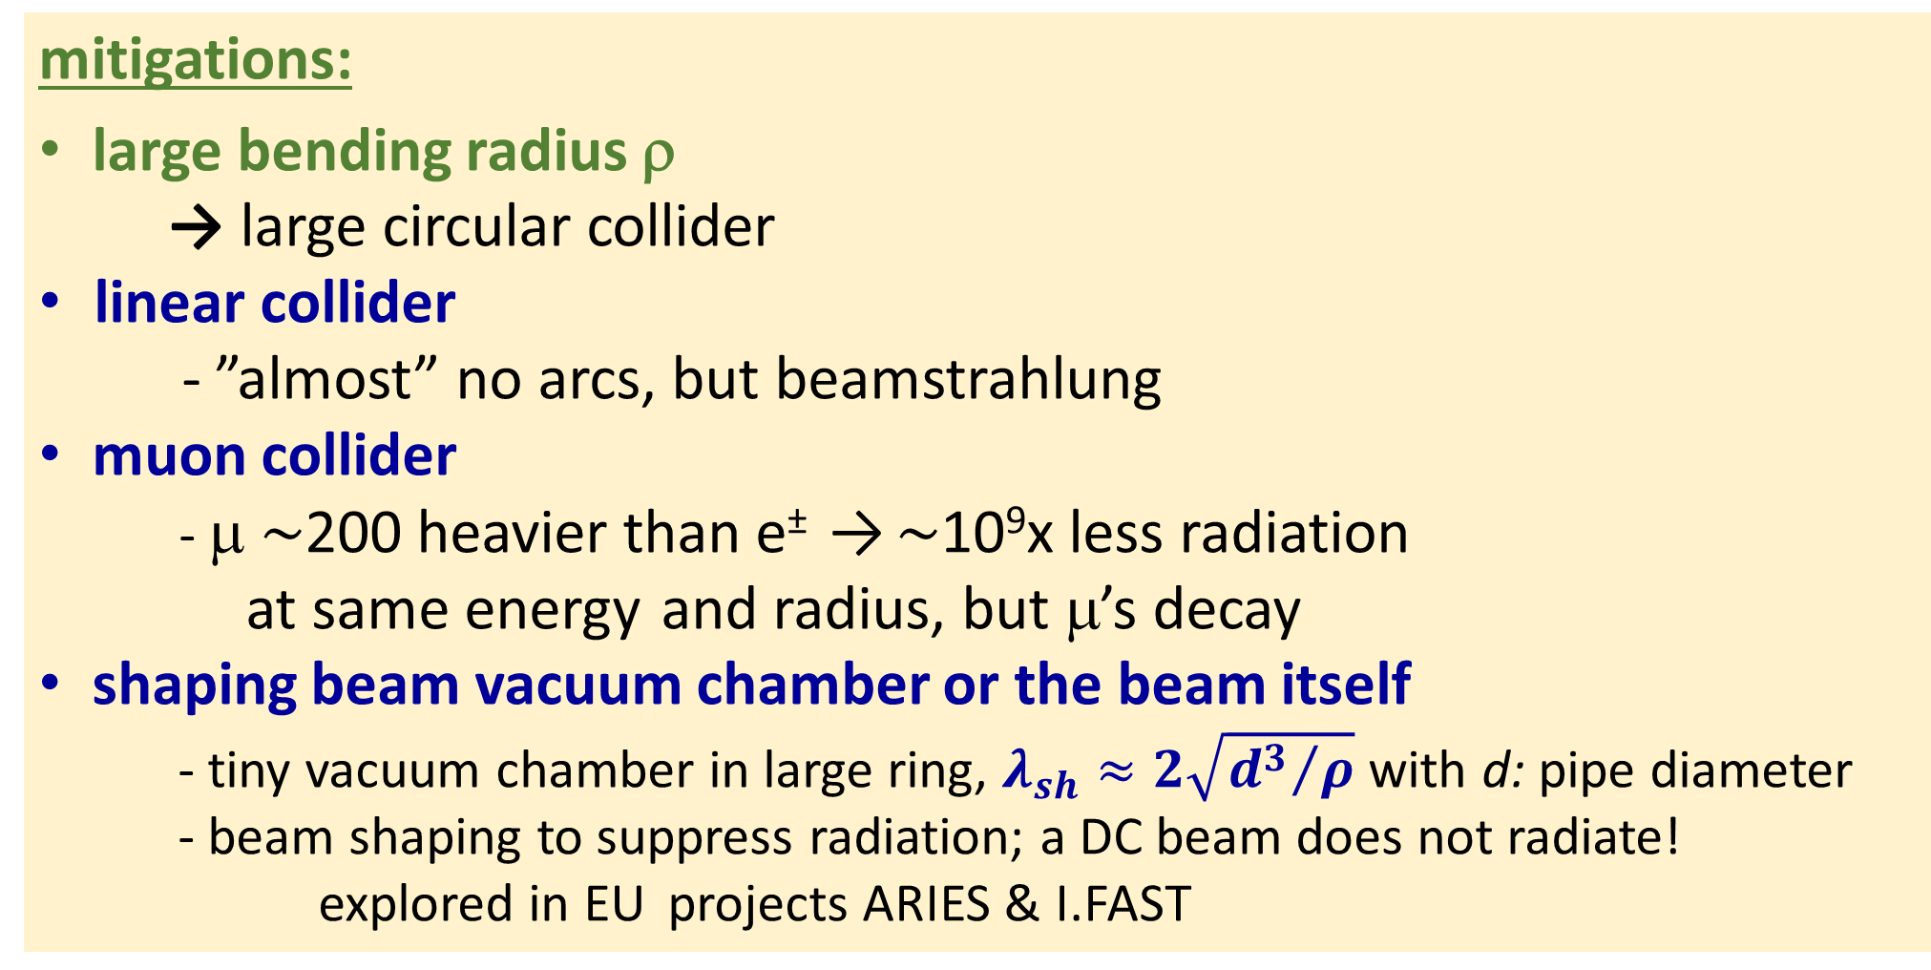
SR in the arcs: possible mitigations (challenge #1)
mitigations:
large bending radius ρ
  → large circular collider
linear collider
  - ”almost” no arcs, but beamstrahlung
muon collider
- μ $\sim$200 heavier than e± → $\sim$10⁹x less radiation
at same energy and radius, but μ’s decay
shaping beam vacuum chamber or the beam itself
- tiny vacuum chamber in large ring, $λ_{sh}≈2\sqrt{{d^{3}}/ρ}$ with d: pipe diameter
- beam shaping to suppress radiation; a DC beam does not radiate!
explored in EU projects ARIES & I.FAST
→ next slide
→ next next slides
→ later
→ later

Slide 5
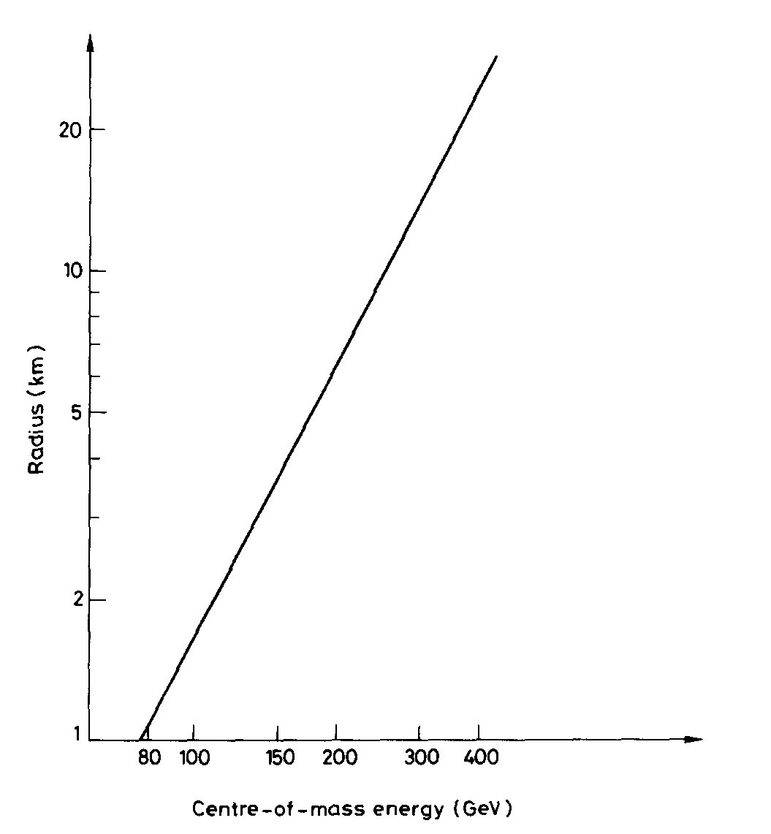
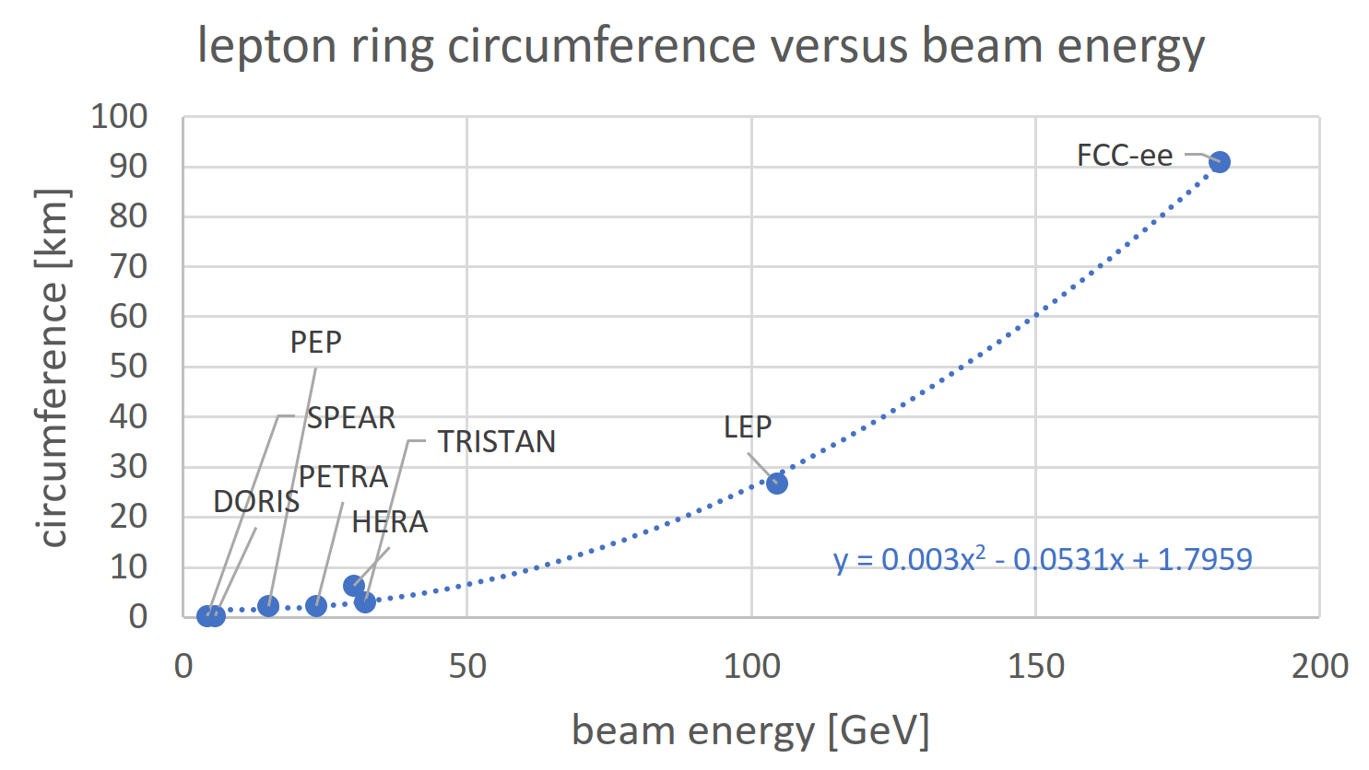

SR → size of circular e⁺e⁻ colliders (challenge #1)
365 GeV c.m.
↔
$\sim$100 km
cost-optimized
circumference
Data points from
S. Myers, “FCC - Building on the Shoulders of Giants”,
submitted to EPJ+ (2021)
Serendipitously, 90-100 km is exactly the size required for a 100 TeV hadron collider and optimum tunnel size in the Lake Geneva basin !
B. Richter, “Very High Energy Electron-Positron Colliding Beams for the Study of Weak Interactions”, NIM 136 (1976) 47-60
circular colliders

Slide 6
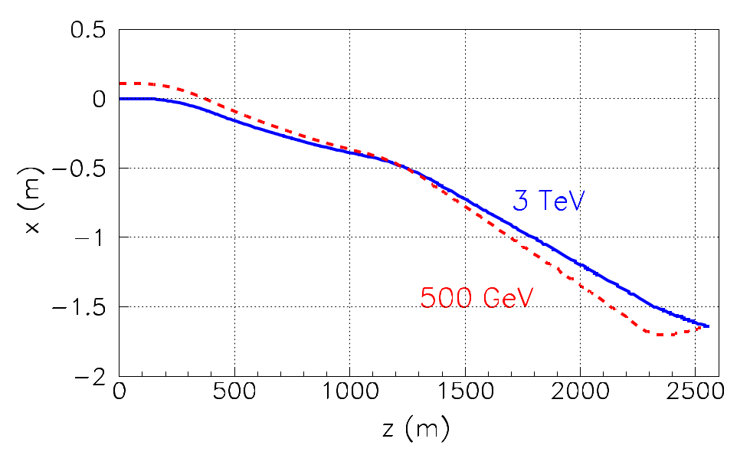
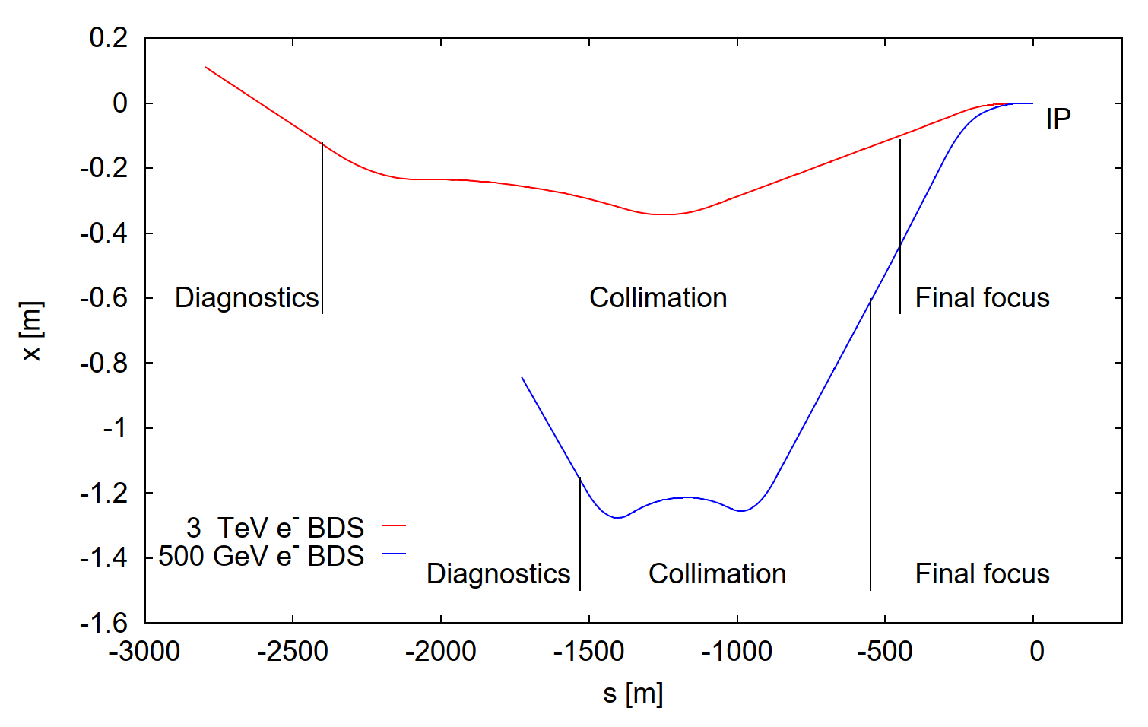
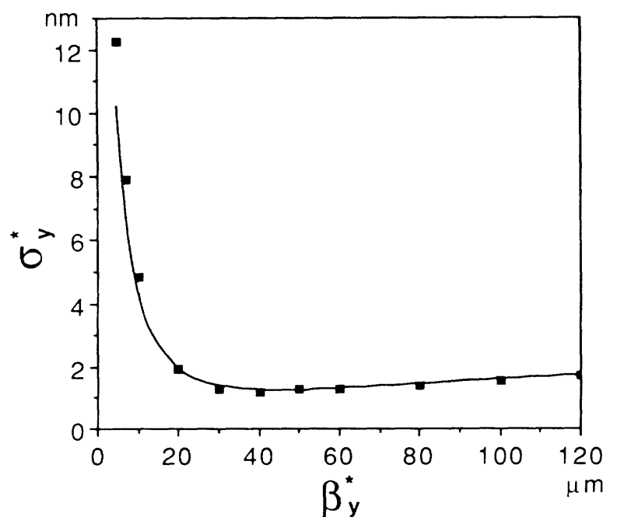
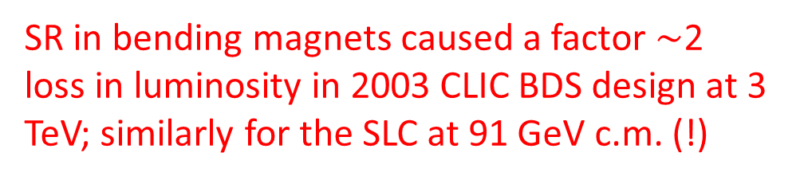
SR → linear collider beam delivery (challenge #1)
linear colliders
SR in bending magnets of the beam-delivery system
Other footprints of CLIC 3-TeV and 500-GeV beam delivery systems (G. Zamudio, R. Tomas, 2011, CLIC-Note-882 )
beam delivery tunnel should be compatible w. future beam energies
SR in final quadrupole magnet
(“Oide effect”) limits collision spot size
K. Oide, Phys. Rev. Lett. 61, 1713 (1988)
γ
Historical footprints of CLIC 3-TeV and 500-GeV beam delivery systems (M. Aleksa et al., 2003, CLIC-Note-551 )
e⁻
SR in bending magnets caused a factor $\sim$2 loss in luminosity in 2003 CLIC BDS design at 3 TeV; similarly for the SLC at 91 GeV c.m. (!)
e⁻
final quadrupole lens

Slide 7
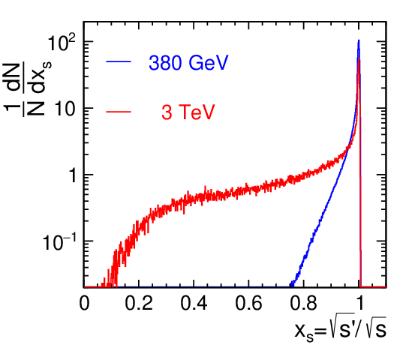
challenge #1: synchrotron radiation - cont’d
linear colliders
synchrotron radiation in the strong field of the opposing beam (=“beamstrahlung”) degrades the luminosity spectrum
CLIC at 380 GeV: 60% of total luminosity within 1% of target energy
CLIC at 3 TeV: only 33% of total luminosity within 1% of target
e⁺e⁻ collisions in linear colliders lose their distinct energy precision
D. Schulte
H. Abramowicz, et al
- arXiv:1807.02441

Slide 8
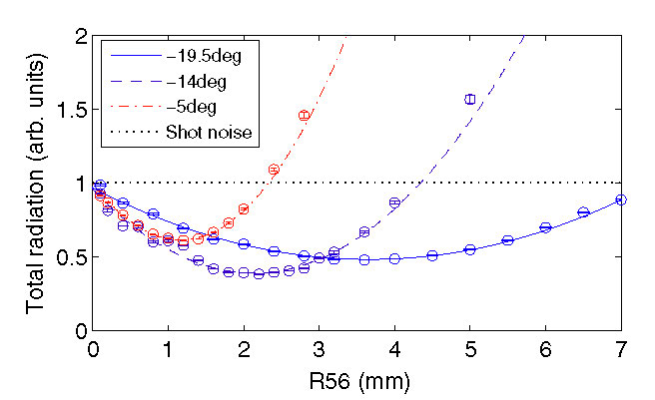
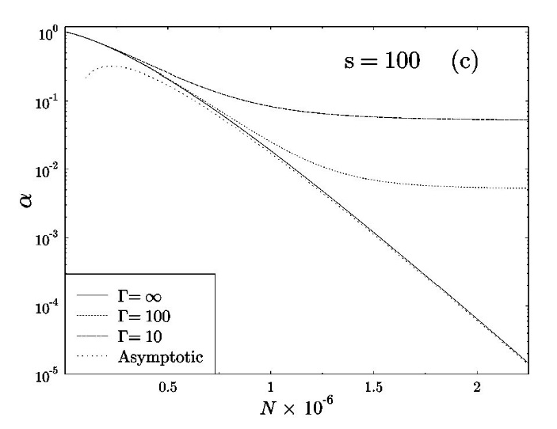
suppressing synchrotron radiation: shaping the beam?
DC beam does not radiate
suppression of shot noise and reduced radiation demonstrated at SLAC NLCTA, D. Ratner et al., PRST-AB 18, 050703 (2015)
1 D crystalline beam (acceleration by induction acceleration)?
N~10⁶
particles uniformly
distributed
→
factor 50 reduction
in total SR power
Synchrotron radiation of crystallized beams, Harel Primack and Reinhold Blümel, Phys. Rev. E 60, 957 (1999)

Slide 9
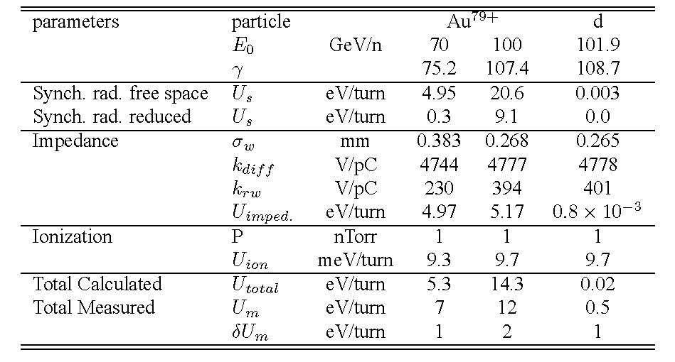
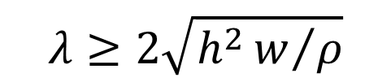
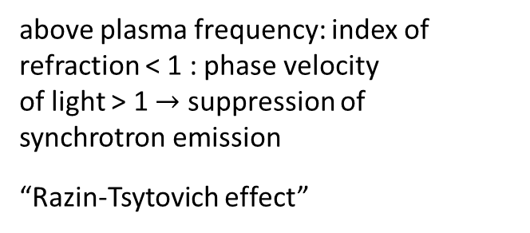
suppressing synchrotron radiation: tailoring boundary?
tailoring the boundary
large bending radius + small chamber size provide shielding
  - effect seen at RHIC
HTS coating for small (mm/micro/nano-) chamber?
hollow channel shield?
$$λ≥2\sqrt{h^{2}w/ρ}$$
h: full chamber height
w: full chamber width
ρ: bending radius
Examples:
h=w=1 cm, ρ=1 km → λ >600 nm (2 eV)
h=w=1 mm, ρ=10 km → λ >0.6 nm (2 keV )
h=w=0.1 mm, ρ=10 km → λ >2 pm (600 keV )
SR suppression in plasma
first experimental evidence for suppression
of incoherent synchrotron radiation,
above plasma frequency: index of refraction < 1 : phase velocity
of light > 1 $→$ suppression of
synchrotron emission
“Razin-Tsytovich effect”
N. P. Abreu et al.,
EPAC’08

Slide 10
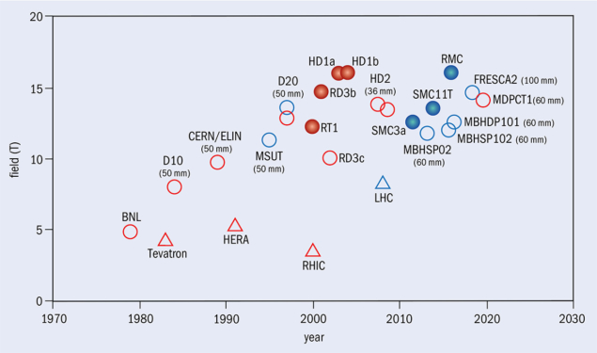
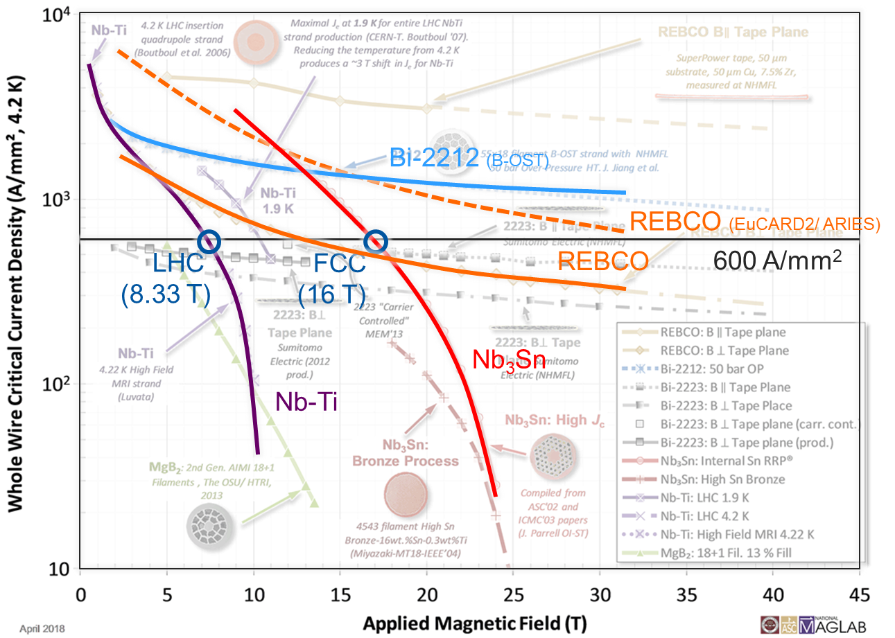
challenge #2: bending magnetic field
→ hadron collider energy reach
Nb₃Sn
Superconducting wire critical current density versus magnetic field.
P. Lee
Nb-Ti
HTS
L. Bottura
Nb₃Sn
Record fields attained with dipole magnets of various configurations and dimensions, and either at liquid (4.2 K, red) or superfluid (1.9 K, blue) helium temperature.
Nb-Ti

Slide 11
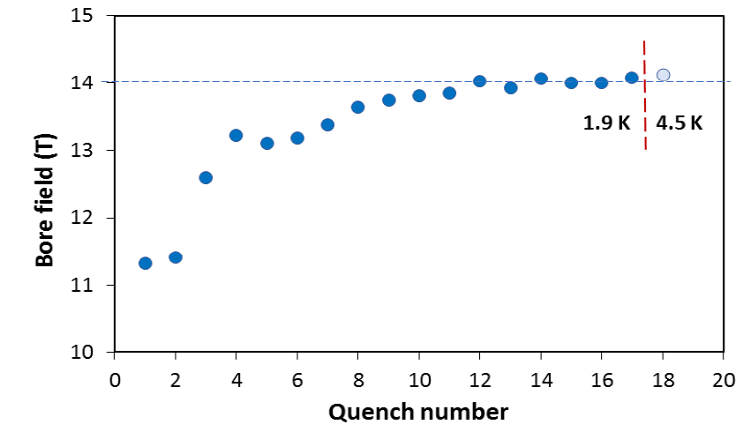
US – MDP: 14.5 T magnet tested at FNAL
84% on the laodline at 1.9 K
92% on the loadline at 4.2 K
60-mm aperture
4-layer graded coil
15 T dipole demonstrator
Staged approach: In first step pre-stressed for 14 T
Second test in June 2020 with additional pre-stress reached 14.5 T
cosθ dipole

Slide 12
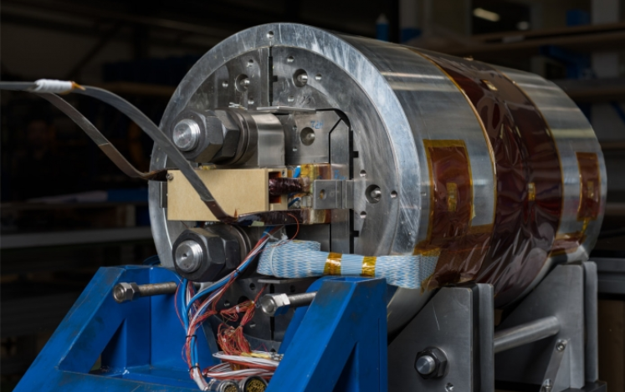
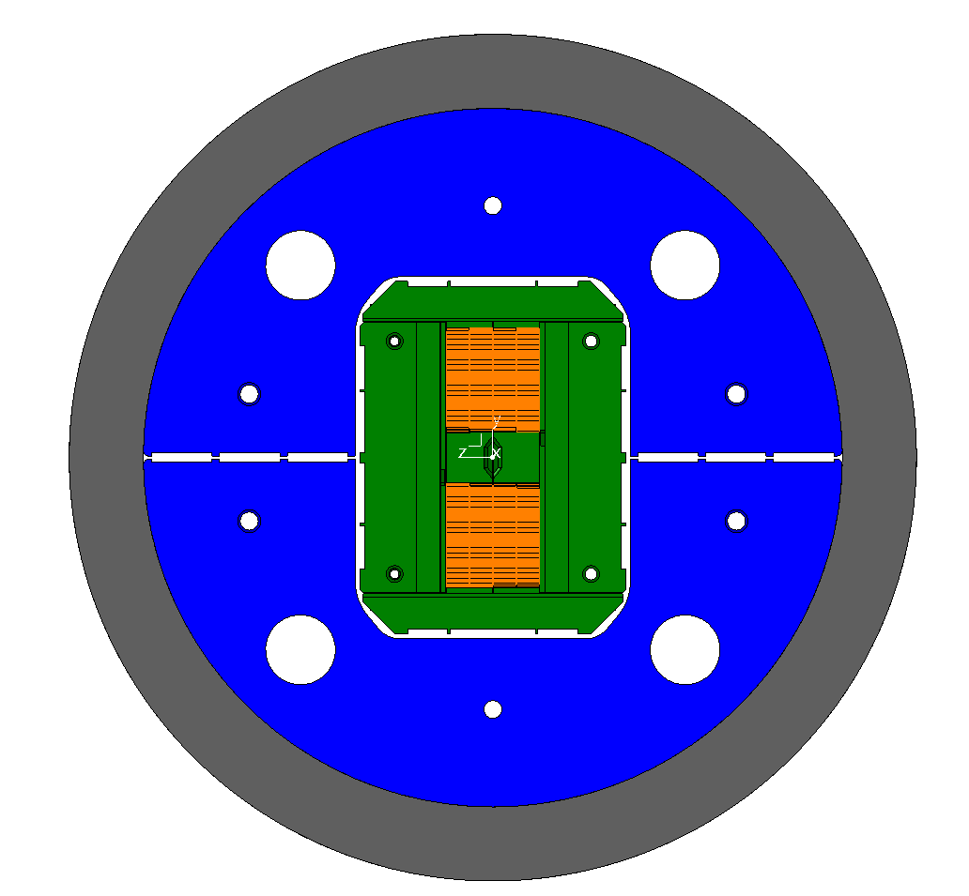
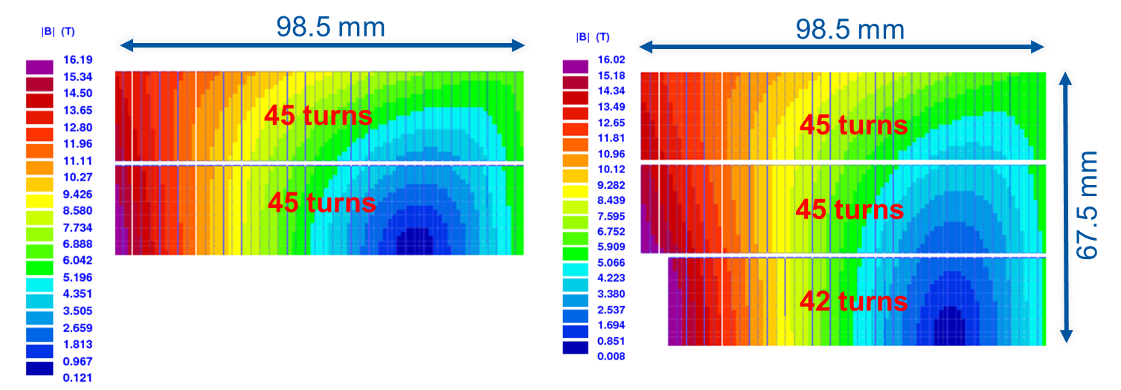
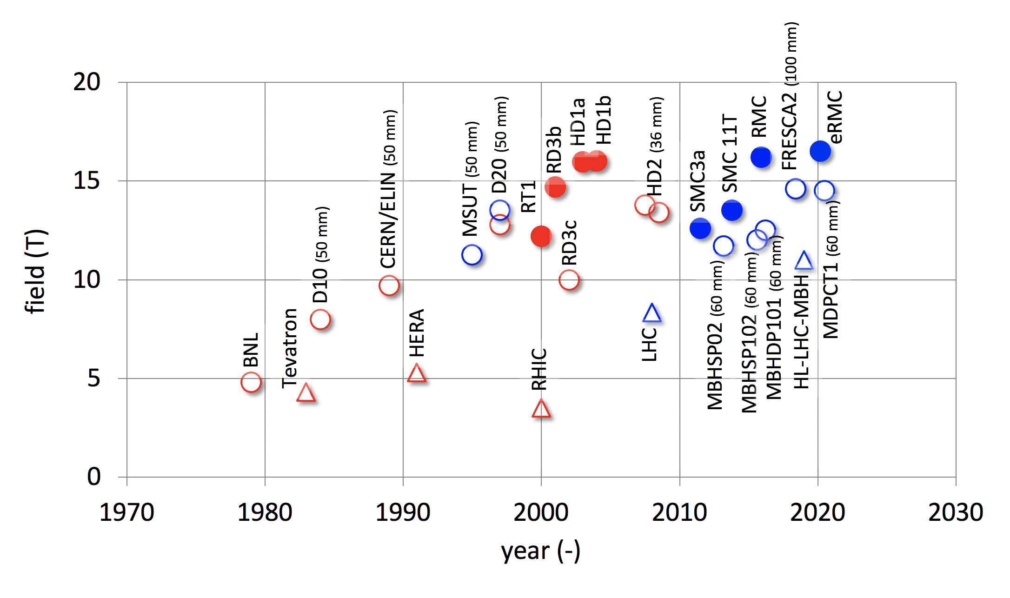
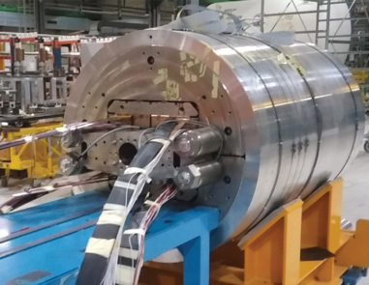
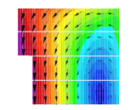
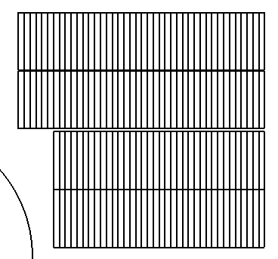
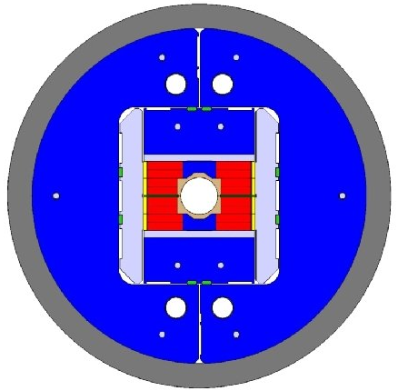
CERN Nb₃Sn progress: FRESCA2 & eRMC
RMC/eRMC (2-decks, no aperture), 16.5 T
Block dipoles
Luca Bottura
FRESCA2 (4-decks, 100 mm), 14.6 T

Slide 13
High-Field Magnets - R&D Program Goals
Development of robust and cost-efficient processes
LHC
Robust Nb₃Sn
HL-LHC QXF
Logical step for a next phase (2027-2034)
HL-LHC 11T
D20
Ultimate Nb₃Sn
Fresca2
MDPCT1
Exploration of new concepts and technologies
HTS
Luca Bottura

Slide 14
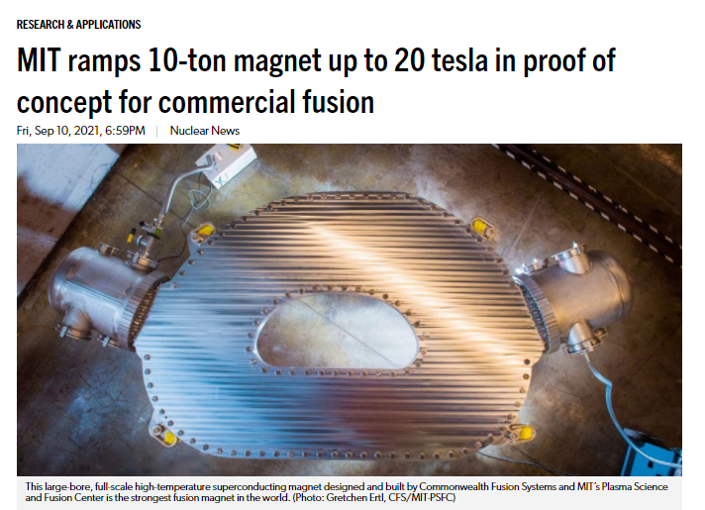
Nuclear Fusion Magnet R&D Progress
September 2021
toroidal model coil
HTS material:
REBCO
important synergies with magnet development for fusion projects

Slide 15
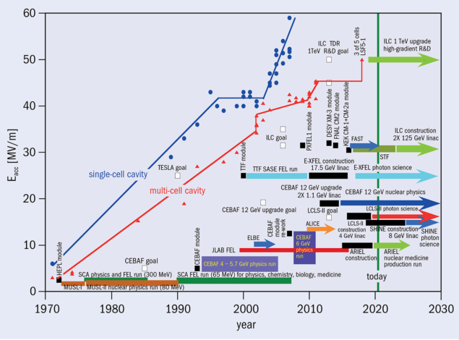

challenge #3: accelerating gradient
Gradient growth Superconducting RF linac accelerating gradient achievements and applications since 1970. CERN Courier 2020
R. Aßmann
RF Accelerators
> 30,000 operational – many serve for Health
30 million Volt per meter
RF: 90 years of success story for society
Plasma Accelerators
first user facility to be realized
100,000 million Volt per meter
Added value
new RI’s due to compactness and cost-efficiency
bringing new capabilities to science, institutes, hospitals, universities, industry, developing countries.
400 m
60* m
R. Geng
*realistic design including all required infrastructure for powering, shielding, …

Slide 16
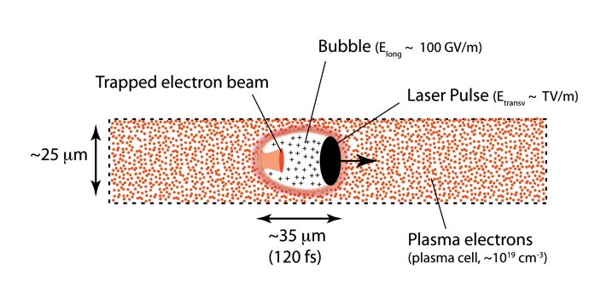
High-Gradient Acceleration (Plasma/Laser)
R. Assmann

Slide 17
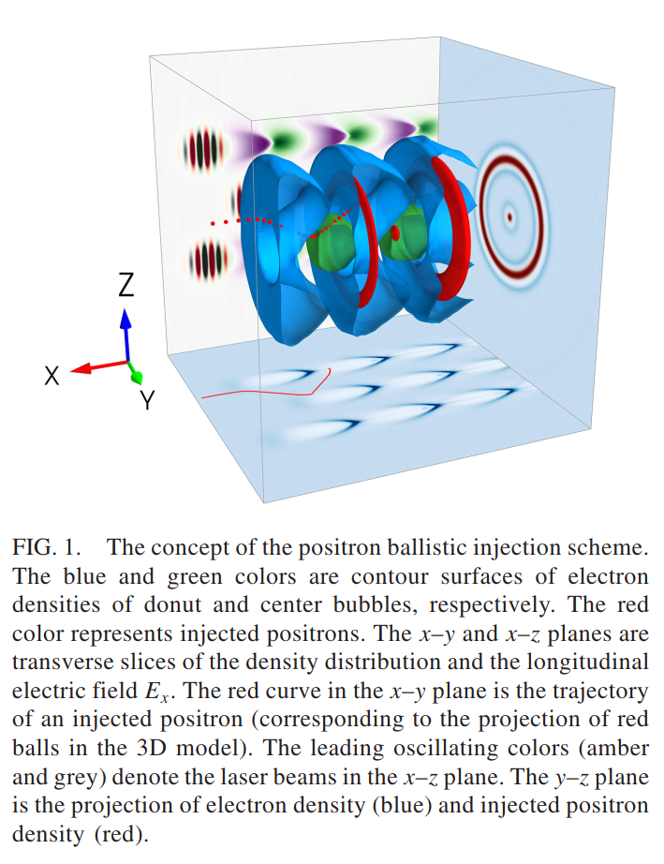
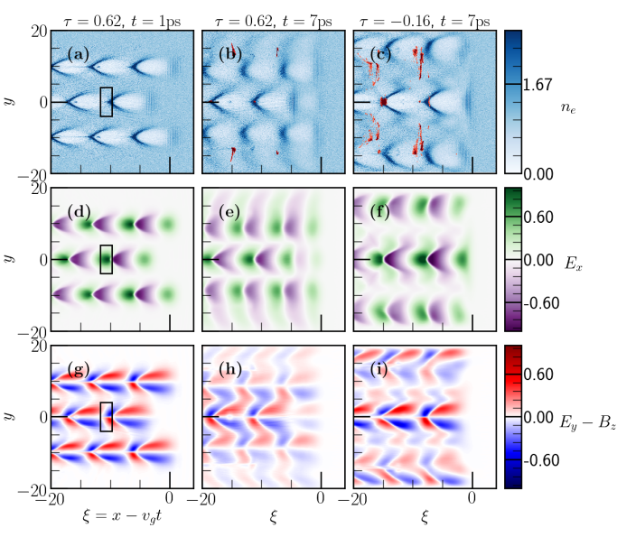
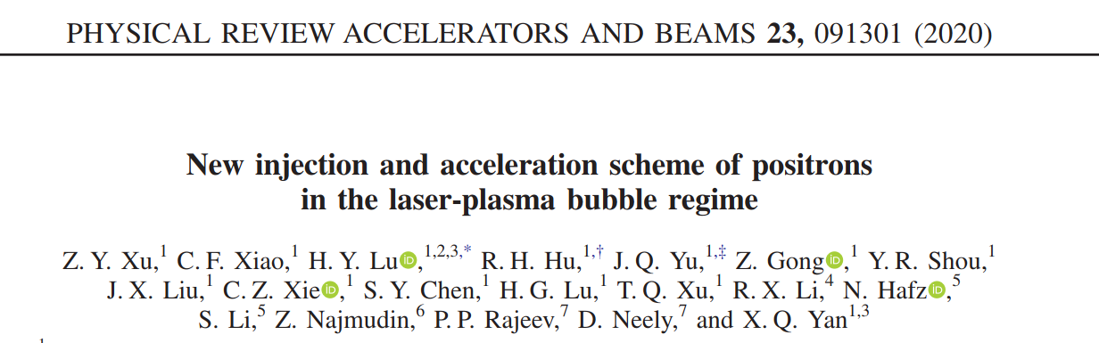
plasma acceleration of positrons ? (required for e⁺e⁻ collider)
“ballistic injection”: a ring-shaped laser beam and a coaxially propagating Gaussian laser beam are employed to create donut and center bubbles in the plasma, resp.
Z.Y. Xu

Slide 18
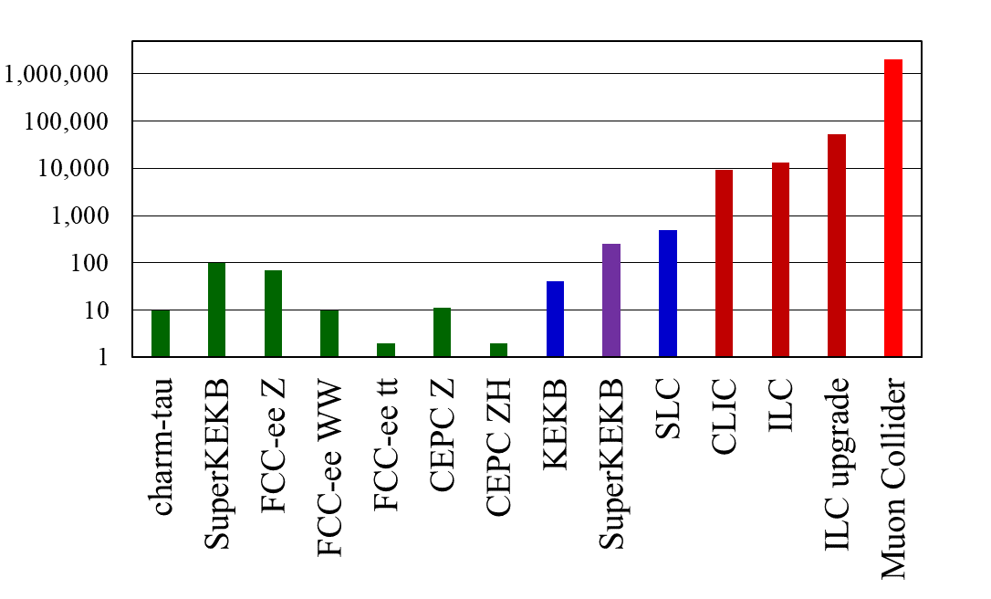
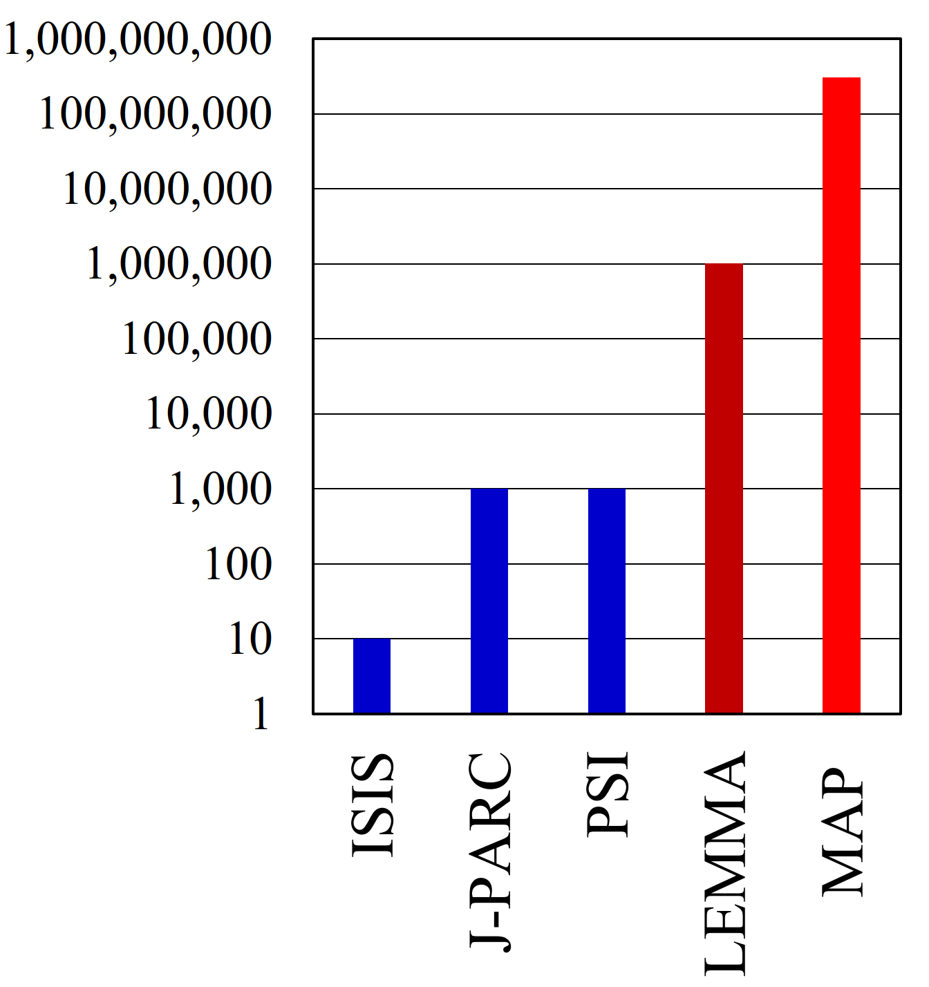
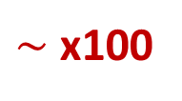
challenge #4: particle production – e⁺, μ
positron rates [10¹⁰e⁺/s]
muon rates [10⁵μ/s]
>10¹⁶ e⁺/s
required for
μ collider
required at IP
routinely
achieved
required for top up
existing
being
commis-
sioned
Lemma scheme
$\sim$ x100
x1000
x10,000
> x100,000

Slide 19
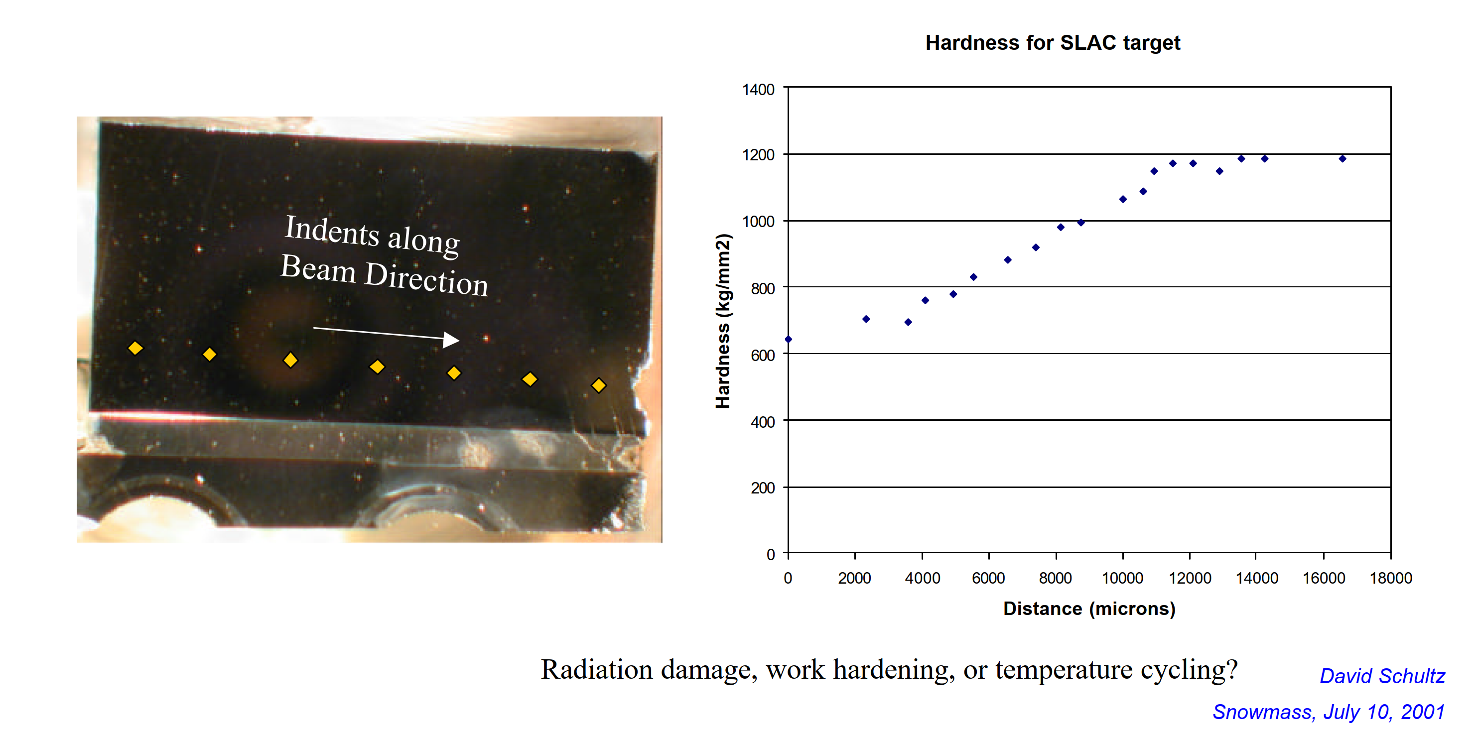
failure of SLC e⁺ target after 5 years of operation (challenge #4)
SLC target analysis at LANL: Failed SLC positron target was cut into pieces and metallographic studies were carried out to examine level of deterioration of material properties due to radiation exposure.
even achieving SLC e⁺ rate is not trivial

Slide 20

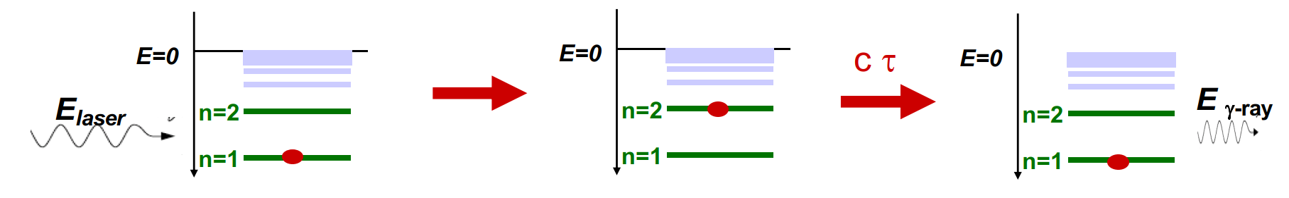
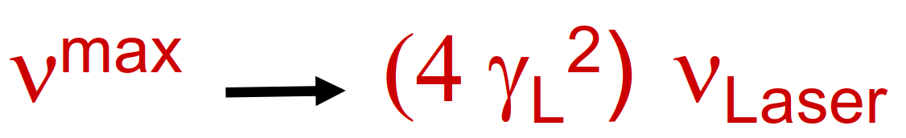
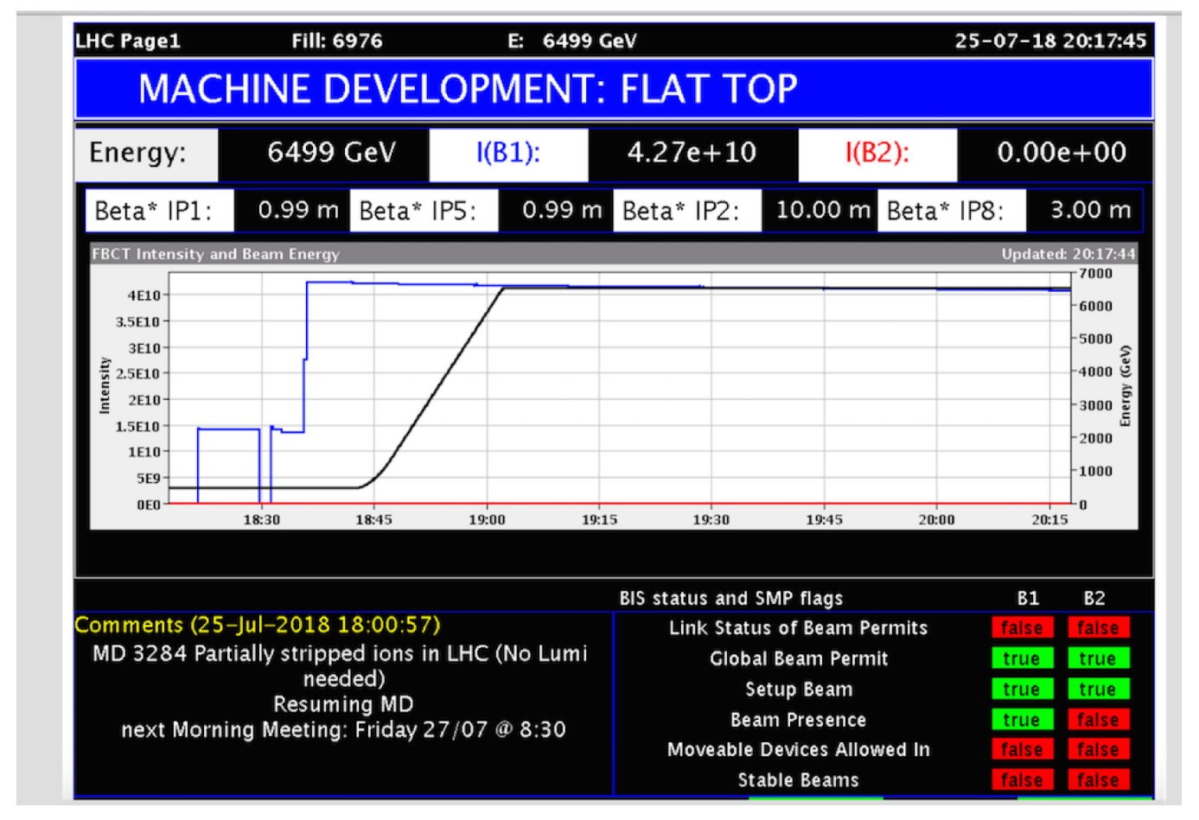
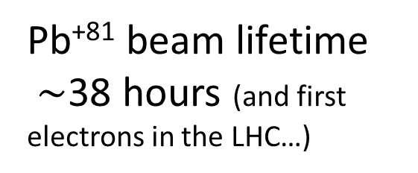
particle production: Gamma factory (challenge #4)
resonant scattering of laser photons off partially stripped heavy-ion beam in LHC (or FCC): high-stability laser-light-frequency converter
Gamma Factory could provide e⁺ rate required for LEMMA μ collider
proposed applications:
intense source of e⁺ (10¹⁶-10¹⁷/s) , μ (10¹¹-10¹²/s), π, etc. – sufficient for LEMMA type μ collider
doppler laser cooling of high-energy beams
HL-LHC w. laser-cooled isocalar ion beams
Pb⁺⁸¹ beam lifetime
$\sim$38 hours (and first electrons in the LHC…)
W. Krasny

Slide 21
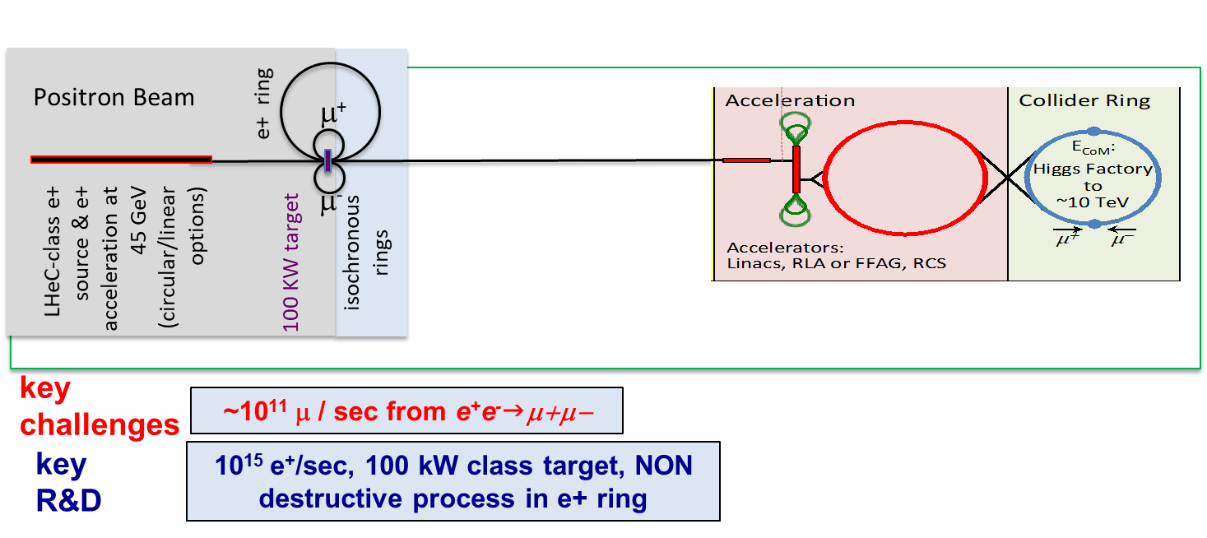
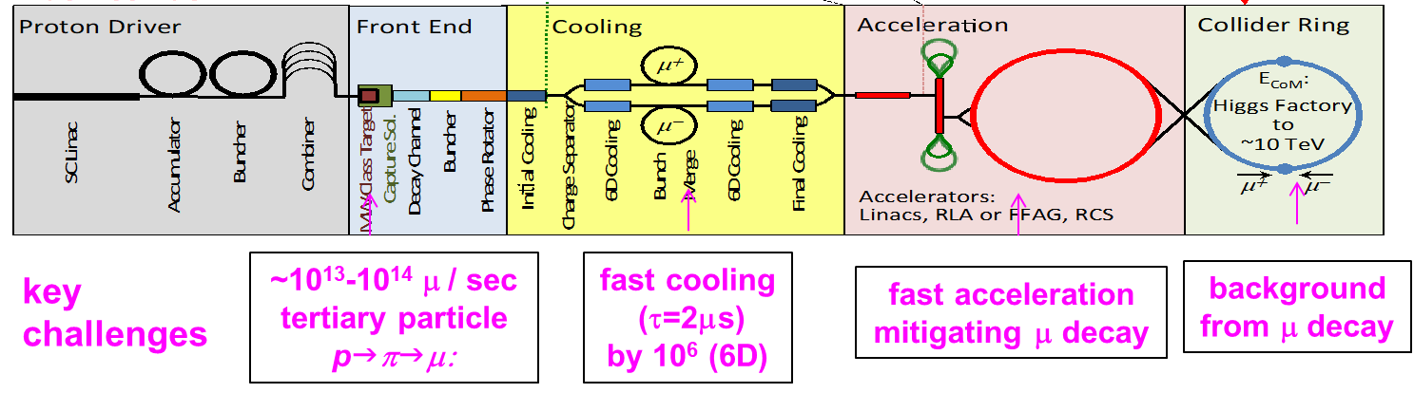
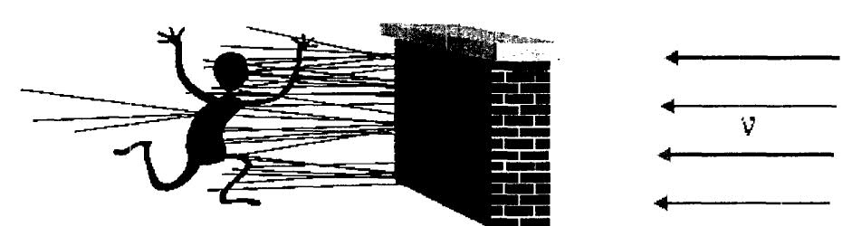

Muon Collider schemes & challenges
$\sim$1.6x10⁹ x less SR than e⁺e⁻, no beamstrahlung problem
two production schemes proposed
US-MAP (2015) p-driven
Italian LEMMA (2017) e⁺-annihilation
needs large 45 GeV e⁺ ring like FCC-ee, possible upgrade path to FCC-μμ
μ‘s decay within a few 100 - 1000 turns:
→ rapid acceleration
(perhaps plasma?)
→ ν radiation hazard
(limits maximum μ energy)
Bruce King 1999
$$σ_{ν}∝E, flux ∝E^{2} (Lorentz boost)$$
solution beyond 10 TeV unclear

Slide 22
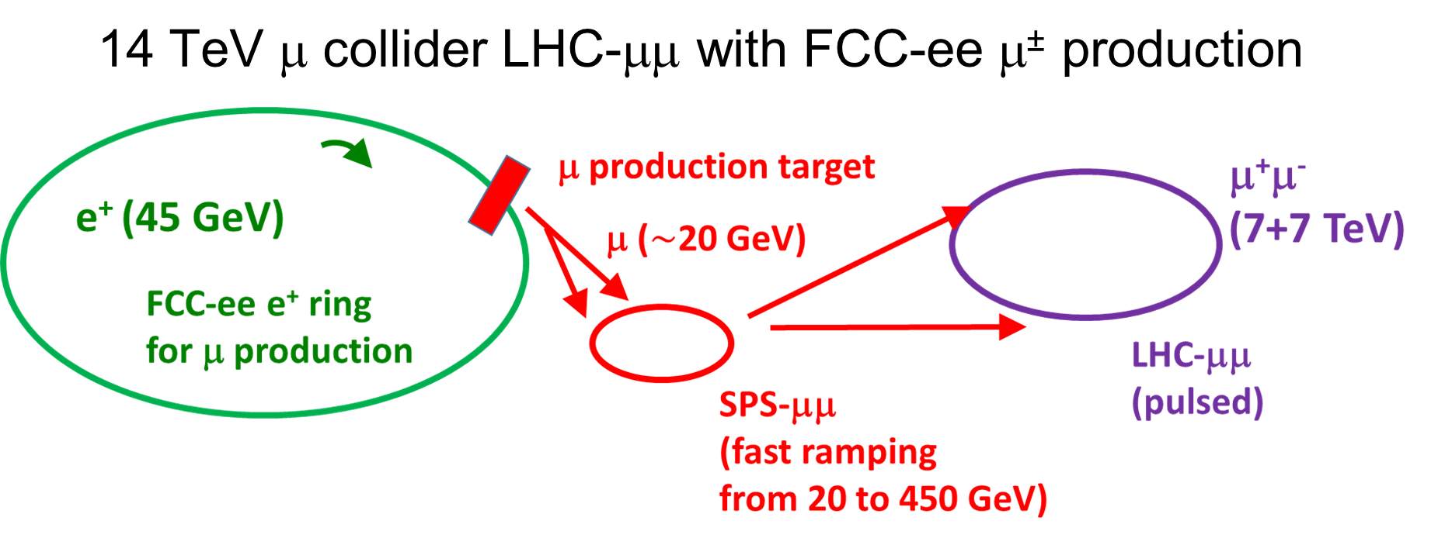
post FCC-ee option: feeding 14 TeV μ collider
P. Raimondi, M. Antonelli, M. Boscolo.
M. Antonelli, et al., NIM A 807, 101 (2016)
M. Boscolo et al., PRAB 23, 051001 (2020)
F. Zimmermann 2018 J. Phys.: Conf. Ser. 1067 022017

Slide 23
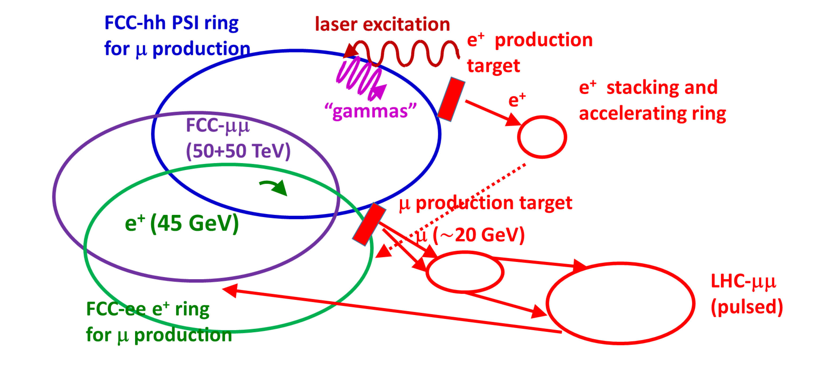
after FCC-hh: FCC-μμ, a 100 TeV μ collider?
W. Krasny,
https://arxiv.org/abs/1511.07794
F. Zimmermann 2018 J. Phys.: Conf. Ser. 1067 022017
PSI: partially stripped ion (“Gamma Factory”)

Slide 24
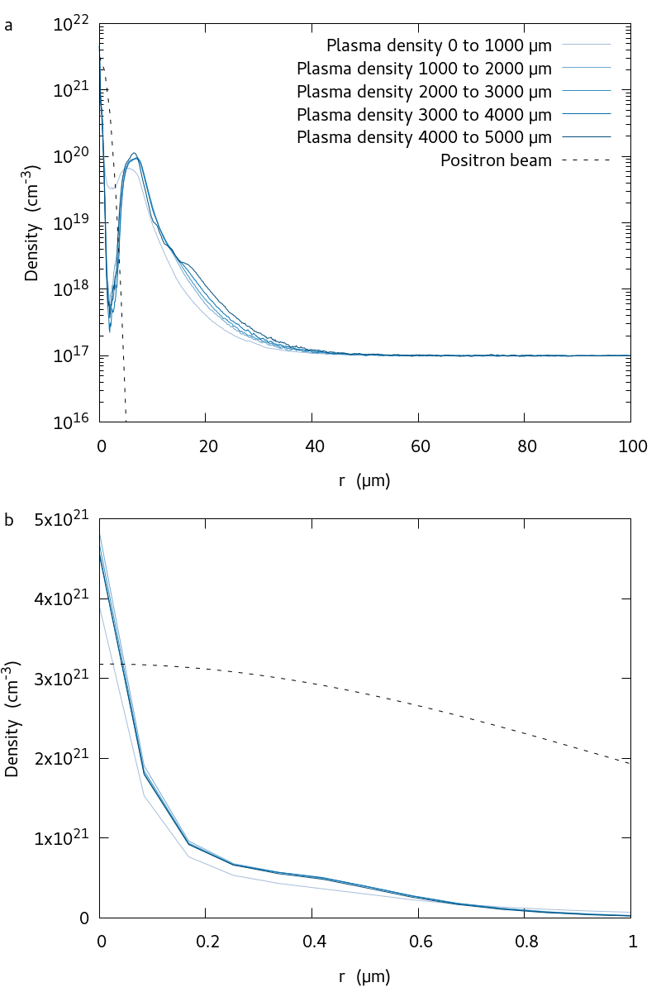
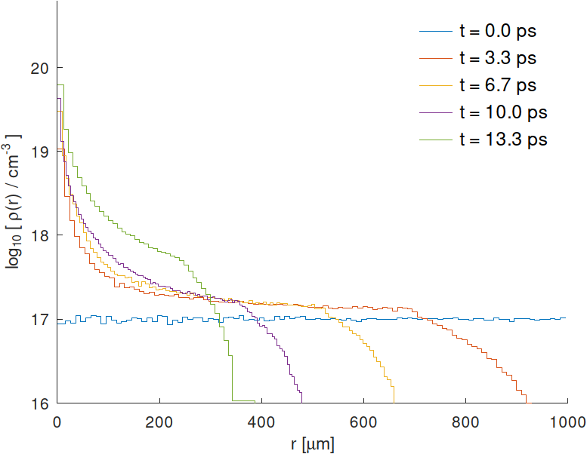
simulated of plasma target response for FCC-μμ
Transverse profiles of the plasma electron density as the positron bunch passes through the plasma, simulated with LCODE (K.V. Lotov) for the initial bunch distribution. The mean density over different distances behind the head of the beam are shown over a radial distance of up to 100 𝜇m from the beam (a) and a zoom over 1 𝜇m around the beam (b).
A. Latina
Electron density at the entrance of the plasma as a function of radial position for different time steps, simulated by RFTRACK, with only positron fields acting on electrons; during 3.3 ps the positron bunch advances by 1 mm.
F. Zimmermann et al., Proc. IPAC’22, p. 1691
energy loss mechanisms inside the plasma ?
J. Farmer

Slide 25

challenge #5: cost / sustainability
P. Lebrun, RFTech 2013
1959
total cost $∝$E_{cm}^{0.28}
new
concepts
and
new
technologies
1971
2008
cost per collision energy greatly reduced

Slide 26







“green” energy efficient technologies
more efficient RF power sources
more efficient SC cavities
A. Grasselino
I. Syratchev
twin aperture dipoles for FCC-ee
M. Koratzinos
CCT HTS quadrupoles & sextupoles for FCC-ee
A. Milanese

Slide 27



Energy Recovery Linacs (ERLs) – Landscape
V. Litvinenko, T. Roser, M. Chamizo
test Facility PERLE at IJClab
(high current, multi-turn)
would complement MESA, CBETA,
bERLinPRO and EIC cooler
M. Klein, A. Hutton, et al.
ERL Panel

Slide 28

Possible Future Colliders based on ERLs
cost, power & feasibility of ERLC & CERC
being analysed by expert sub-panel
A. Hutton, M. Klein

Slide 29


reappraisal of historical ERL collider proposals
early linear-collider proposals
1-6 GeV c.m.
Maury Tigner, “A Possible Apparatus for Clashing-Beam Experiments”, Nuovo Cimento 37, 1228 (1965)
these early proposal always
recovered the energy of the spent beam!
Ugo Amaldi, “A possible scheme to obtain e-e- and e+e- collisions at energies of hundreds of GeV”, Physics Letters B61, 313 (1976)
300 GeV c.m.

Slide 30



efficiency and upgrade of super-beam facilities
power efficiency challenge
Fermilab & J-PARC Power Upgrades
protons per pulse
challenge
V. Shiltsev

Slide 31




challenge #6: exploring novel directions
Very large hadron collider on the Moon (CCM), $C\sim$11 Mm, E_{c.m.}$\sim$14 PeV (1000x LHC’s), 6x10⁵ dipoles with 20 T field, either ReBCO, requiring ~7-13 k tons rare-earth elements, or IBS, requiring $\sim$a million tons of IBS. Many of the raw materials required to construct machine, injector complex, detectors, and facilities can potentially be sourced directly on the Moon. 11000-km tunnel a few 10 to 100 m under lunar surface to avoid lunary day-night temperature variations, cosmic radiation damage, and meteoroid strikes. Dyson band or belt to continuously collect sun power. Required: <0.1% sun power incident on Moon surface.
J. Beacham, F. Zimmermann, 2022 New J. Phys., https://doi.org/10.1088/1367-2630/ac4921

Slide 32


storage rings as tools to detect or generate gravitational waves
ARIES workshop 2021
challenging, but maybe not hopeless -
note: earlier studies in 1980’s and 90’s, e.g.
G. Diambrini Palazzi, D. Fargion, P. Chen, D. Zer-Zion,
J. Van Holten, H. Schmickler, A. Jansson, M. Lindroos,...
Accelerators meet gravitational waves – CERN Courier
J. Ellis et al (2021), https://arxiv.org/abs/2105.00992
Sources and sensitivities GW sources (shaded) and detector sensitivities (lines), incl. space-based interferometer LISA, ground-based LIGO and Einstein Telescope. Accelerator-based detection methods and sources are superimposed based on optimistic assumptions.

Slide 33


This is the place to make progress !
Marcus Tullius Cicero,
106-43 BC
Tusculanae Disputationes, 45 BC: series of dialogues that take place during five days at Cicero’s villa at Tusculum (now the town of Frascati near Rome) – Might the Frascati eeFACT’22 proceedings (5 days of talks!) become equally famous?!

