Slide 1
EIC MDI & IR Magnet Design
Holger Witte
Head Magnet Systems, L3 IR
eeFACT 2022
September 13th 2022

Slide 2
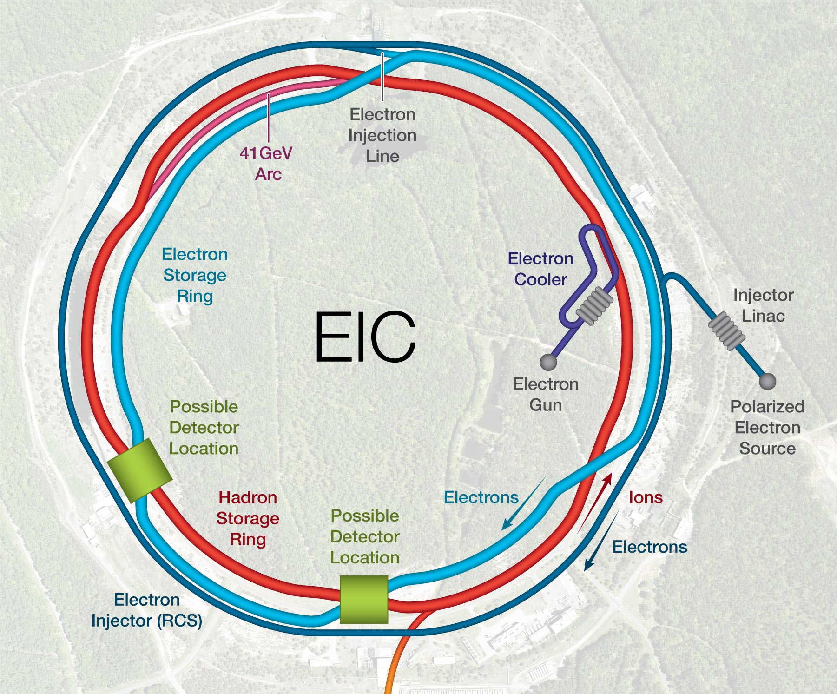
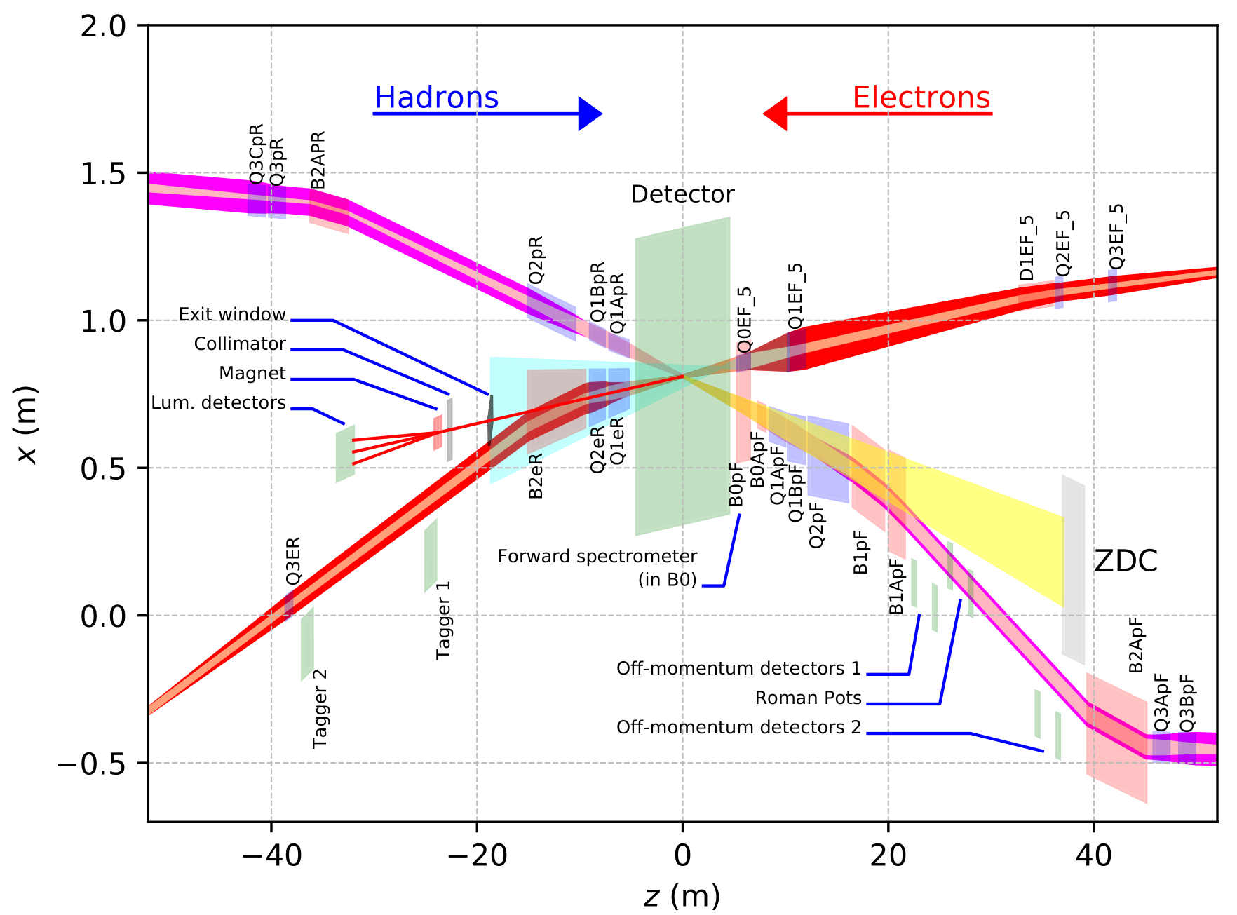
EIC IR: Overview
Rear
Forward
Hadron storage ring (HSR): 4 yellow and 2 blue RHIC arcs
Add electron storage ring (ESR) in existing tunnel (and the RCS)
IR location: IR6

Slide 3
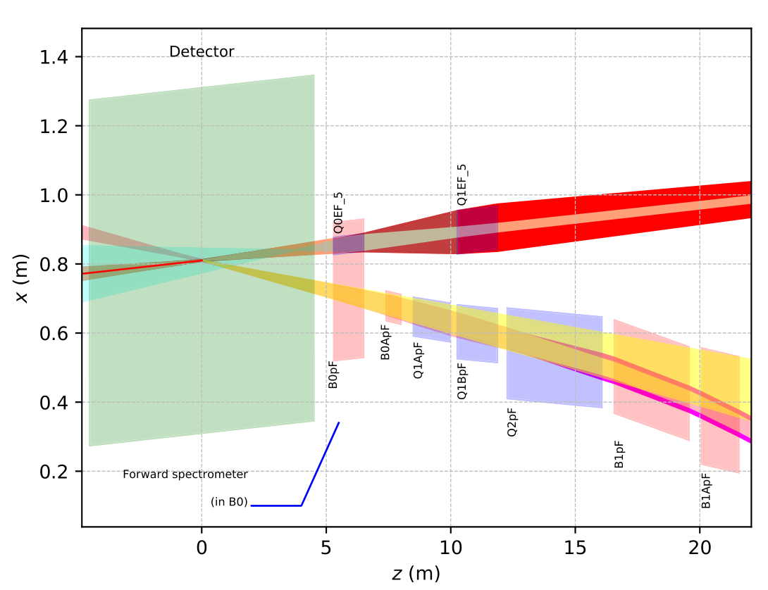
EIC IR: Forward Direction
Cryostats
Electrons
Interleaved magnet scheme
  Adding magnets is challenging
Why are these magnets difficult?
  Required field
  Aperture
  Geometric constraints
Hadron forward magnets: collared magnets
  Large apertures: physics
Electron forward magnets/B0pF: direct wind magnet
All magnets NbTi, 2K (Q0eF: 4K)
Two cryostats
IP
Hadrons
Name | R1 | length | B | grad | B pole
 | [m] | [m] | [T] | [T/m] | [T]
B0ApF | 0.043 | 0.6 | -3.3 | 0 | -3.3
Q1ApF | 0.056 | 1.46 | 0 | -72.608 | -4.066
Q1BpF | 0.078 | 1.61 | 0 | -66.18 | -5.162
Q2pF | 0.131 | 3.8 | 0 | 40.737 | 5.357
B1pF | 0.135 | 3 | -3.4 | 0 | -3.4
Name | R1 | length | B | grad | B pole
 | [m] | [m] | [T] | [T/m] | [T]
Q0eF | 0.025 | 1.2 | 0 | 13.5 | 0.4
Q1eF | 0.063 | 1.61 | 0 | 8.1 | 0.5

Slide 4
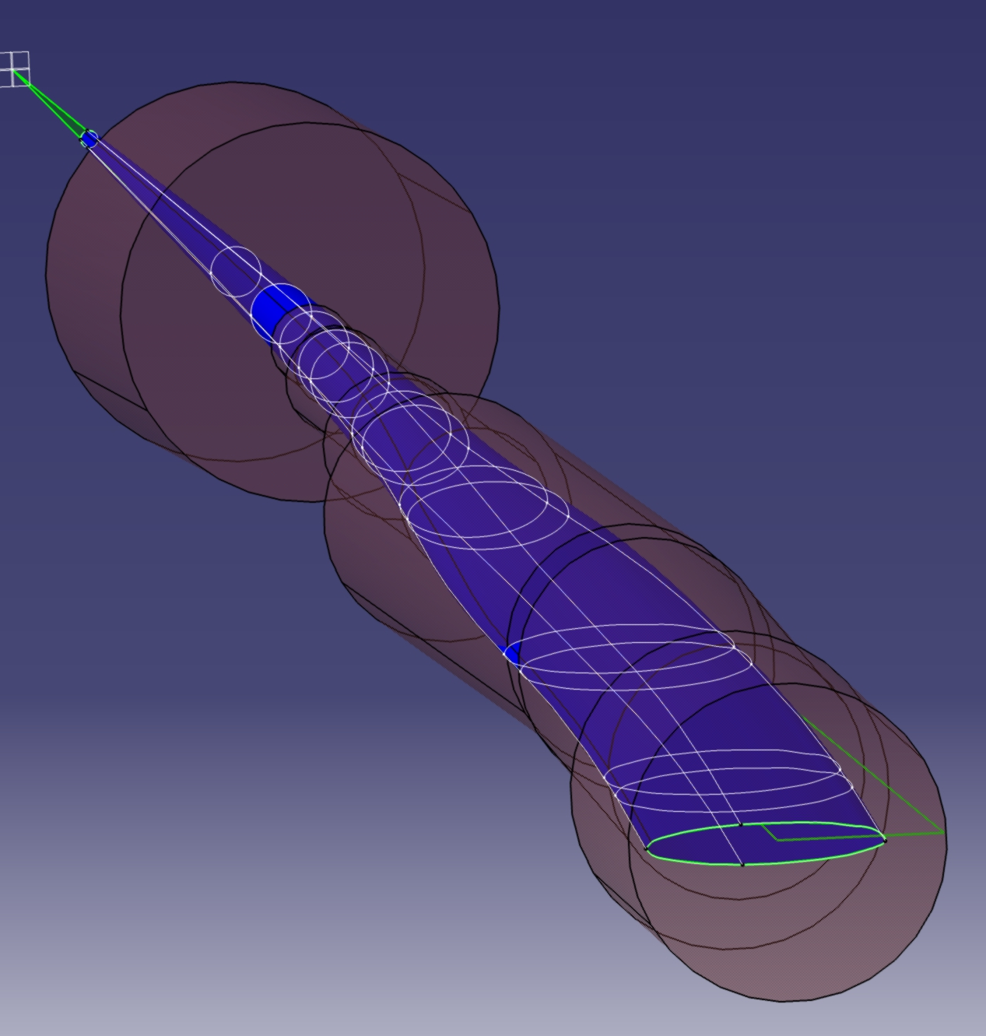
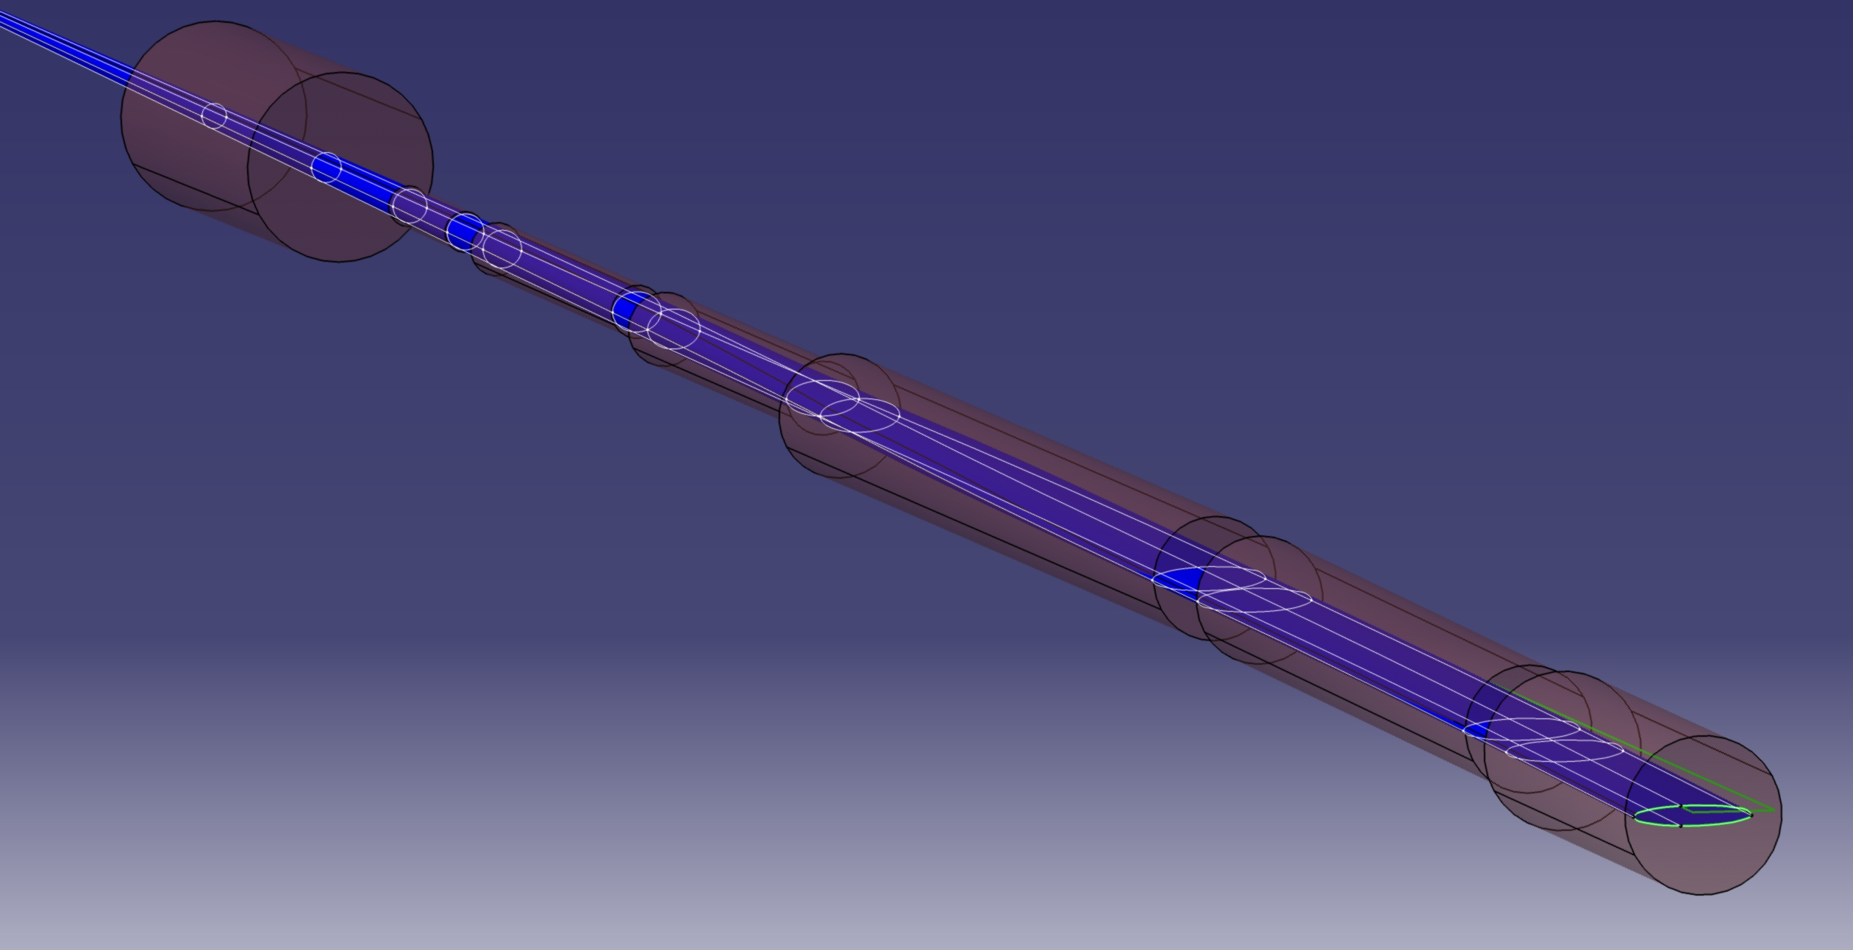
Hadron Forward - Apertures
To optimize aperture: magnets tilted and displaced
Verified with two codes
  BMAD – general purpose tracking code
  Geant4 (friends from Physics)
B0pF
Neutron cone
B1ApF
p_{t}=1.3GeV
Generate cone for particles with p_{t}=1.3GeV
Rendered in CAD program with magnet apertures

Slide 5
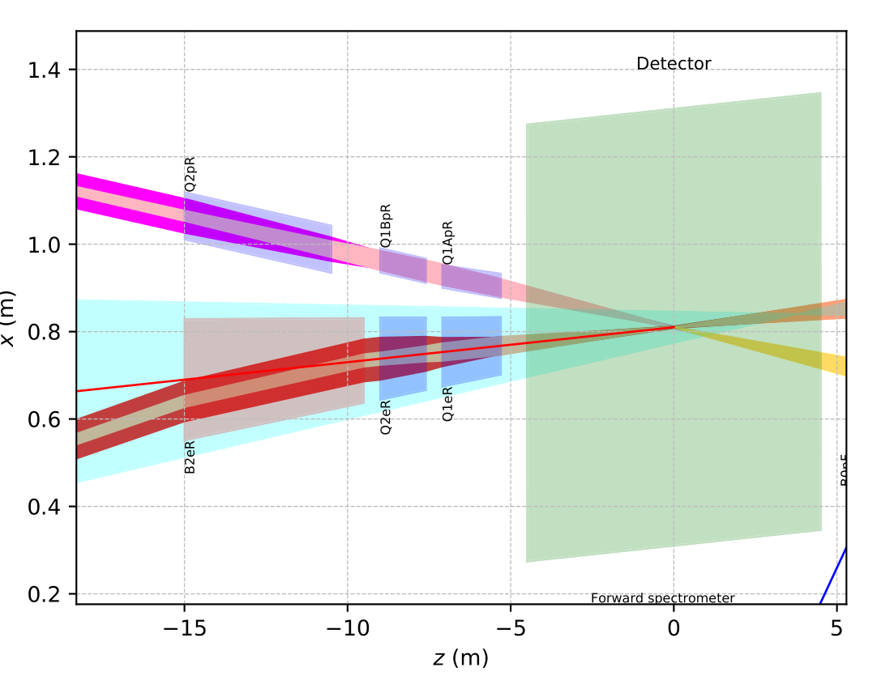
EIC IR: Rear Direction
Hadrons
2-in-1 magnets
  Common yokes
Main issue: space between magnets
  Crossing angle
Large aperture due to synrad fan
  Comes from low-beta quads
All magnets NbTi, 4.2K
All magnets direct wind
Three cryostats
Cryostats
IP
Electrons
Name | R1 | R2 | length | B | grad | B pole
 | [mm] | [mm] | [m] | [T] | [T/m] | [T]
Q1eR | 66 | 79 | 1.8 | 0 | 14 | -1.1
Q2eR | 83 | 94 | 1.4 | 0 | 14.1 | 1.3
(B2eR) | 97 | 139 | 5.5 | 0.2 | 0 | 0.2
B2AeR | 90.45 | 90.45 | 2.0 | 0.192 | 0 | 0.192
B2BeR | 111.45 | 111.45 | 3.45 | 0.238 | 0 | 0.238
Name | R1 | R2 | length | grad | B pole
 | [mm] | [mm] | [m] | [T/m] | [T]
Q1ApR | 20 | 26 | 1.8 | 78.4 | 2.0
Q1BpR | 28 | 28 | 1.4 | 78.4 | 2.2
Q2pR | 54 | 54 | 4.5 | 33.8 | 1.8
B2eR: split into two magnets, not shown in figure

Slide 6
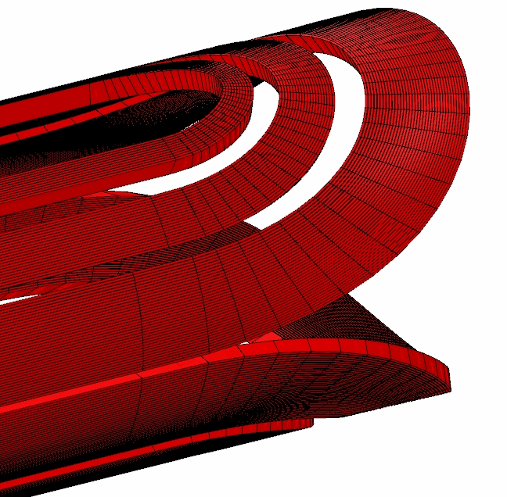
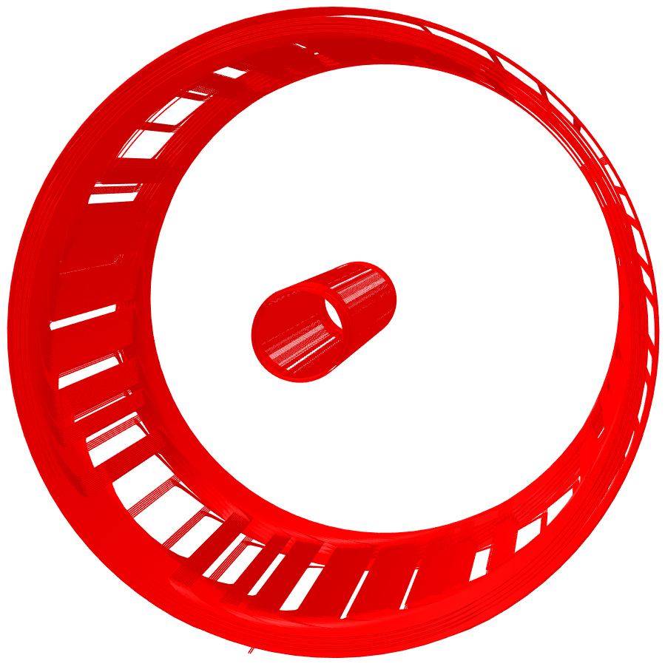
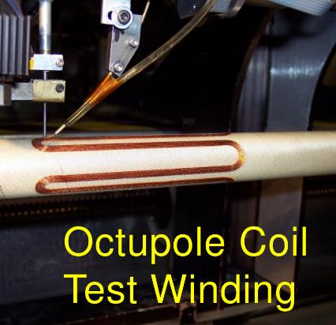
IR Magnets – Fabrication Techniques
Three groups of superconducting magnets
  All NbTi
10 Direct Wind Magnets
(S-MD)
Patterns: serpentine and CCT
5 Collared Magnets
1 Special Magnet
(also direct wind)

Slide 7
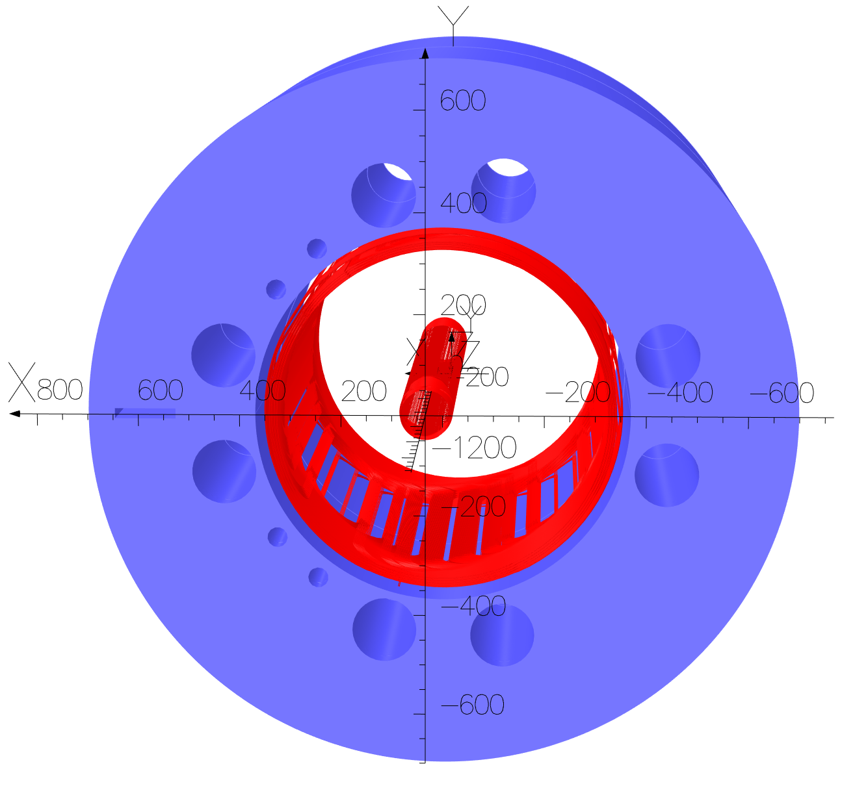
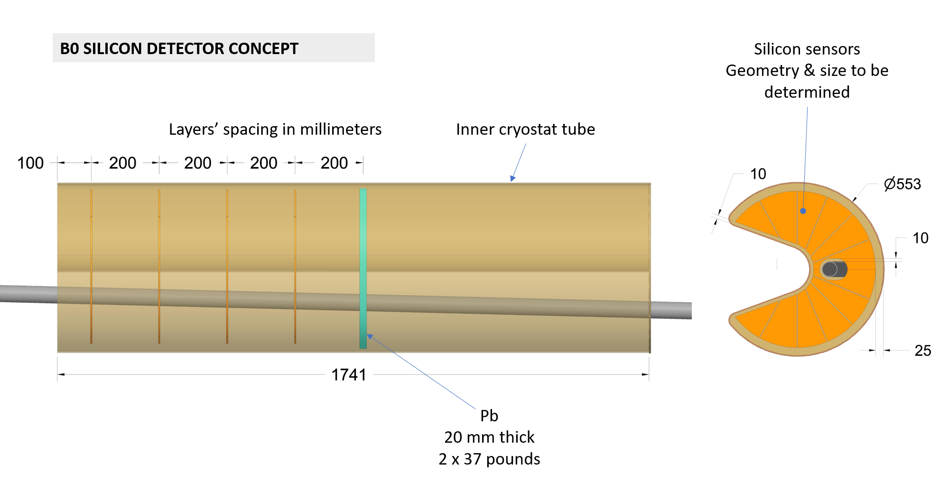
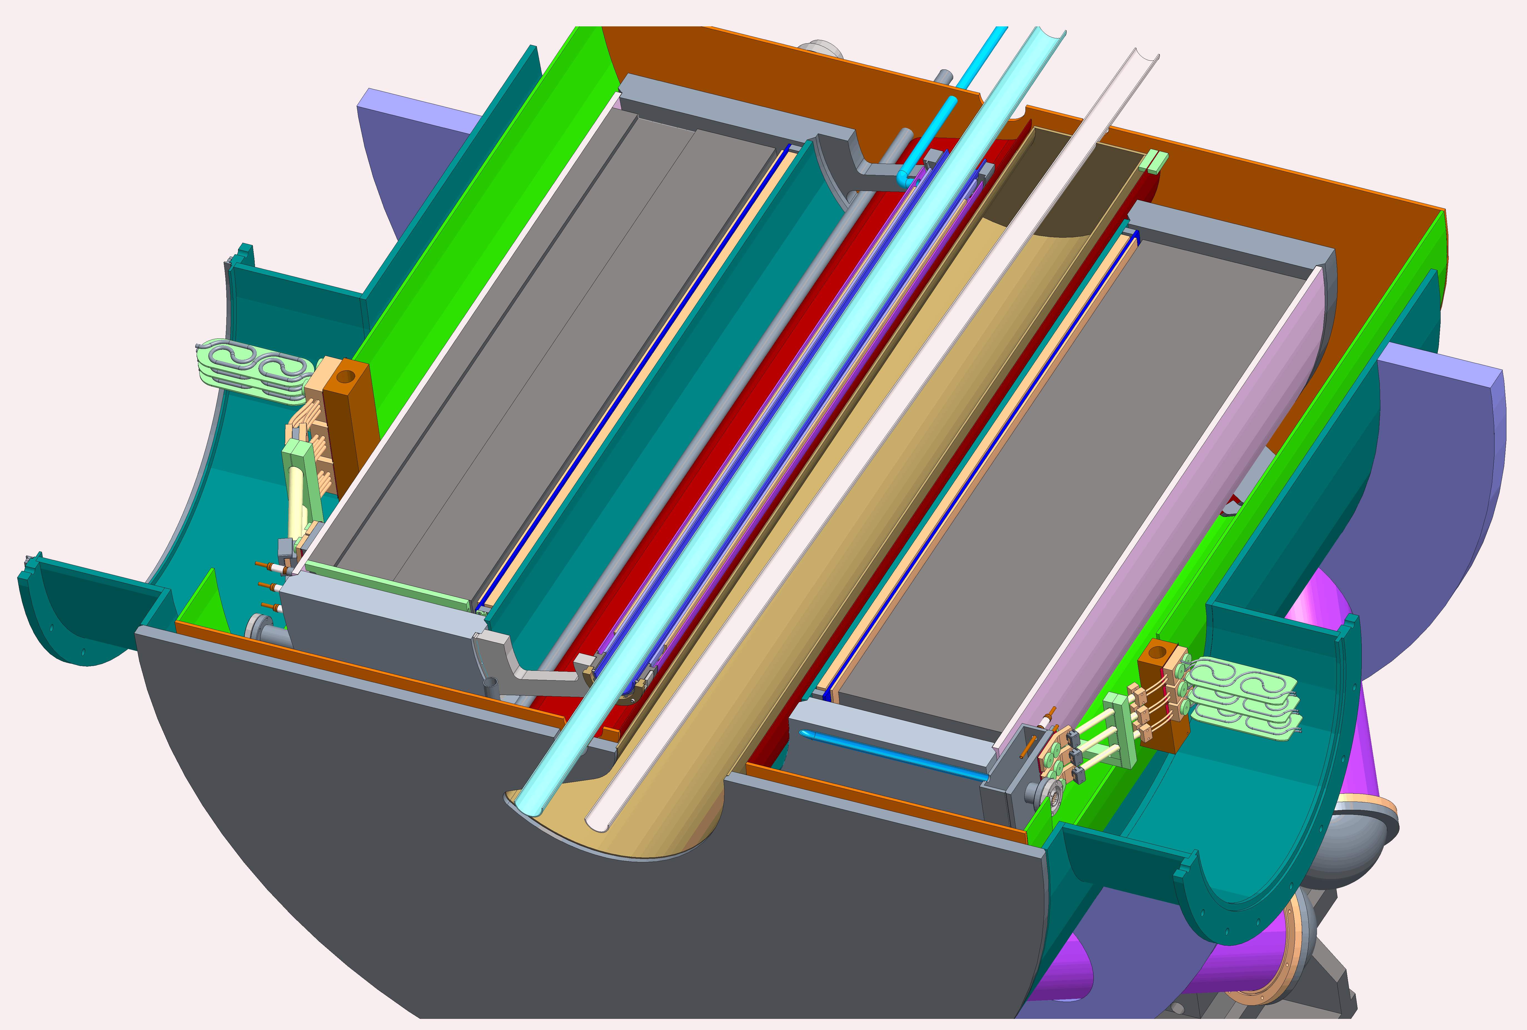
B0pF Forward Spectrometer
Beams share magnet aperture
  Hadrons: 1.3T field
  Electrons: 14T/m gradient
Implementation: combined function magnet
  Large aperture quadrupole; zero field axis shifted with dipole
Space constraints/large aperture
  Requires 2K
Courtesy of B. Parker (BNL)
Hadron Coils
Electron Coils
Common Yoke
Courtesy of
K. Hamdi (BNL)

Slide 8
Hadron Forward Cable Magnets Status
Re-design for 2K
  4K did not converge
  Better margins
  Risk reduction
New cable geometry:
LHC style, 15mm wide
  Two keystones
  Similar to LHC cable
  28 strands
2D work complete
  3D work ongoing
  Structural analysis
1.816mm
1.984mm
15.1mm
1.79mm
2.01mm
15.1mm

Slide 9
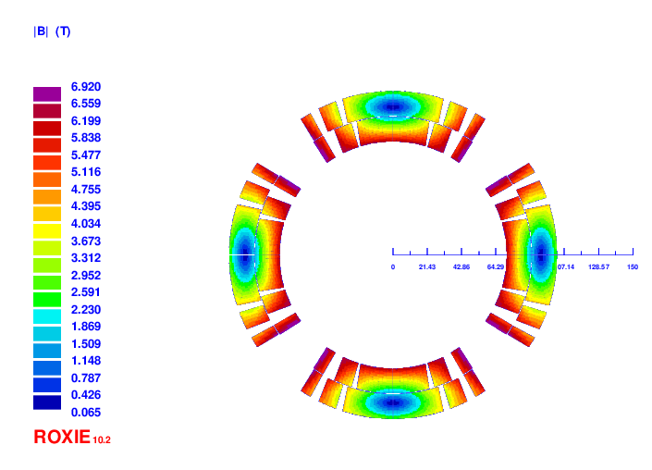
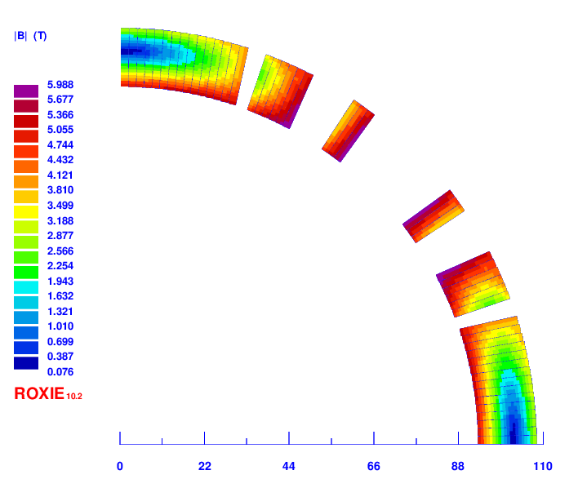
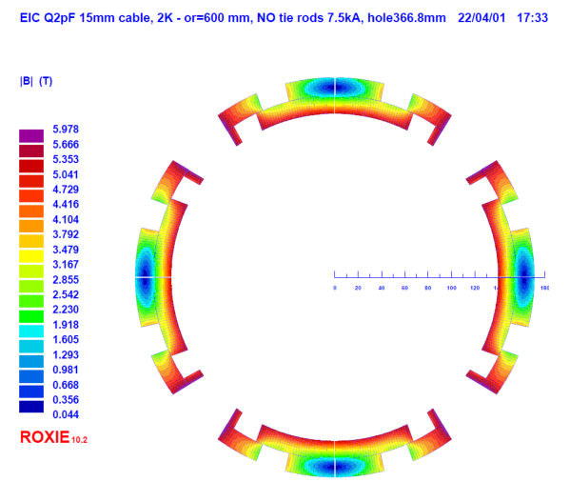
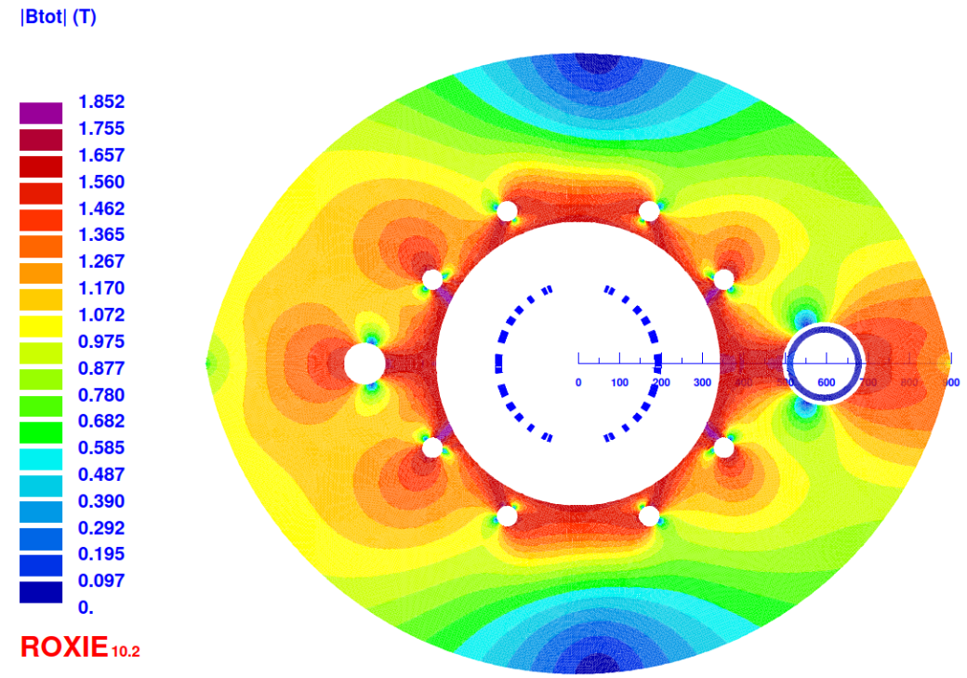
2D Cross-Sections
2D cross-sections for all collared magnets
Sufficient field quality and temperature margin at 2K
Iron yoke – magnetization management
Q1ApF
Q1BpF
Q2pF
B1ApF
B1pF
Courtesy of BNL SMD

Slide 10
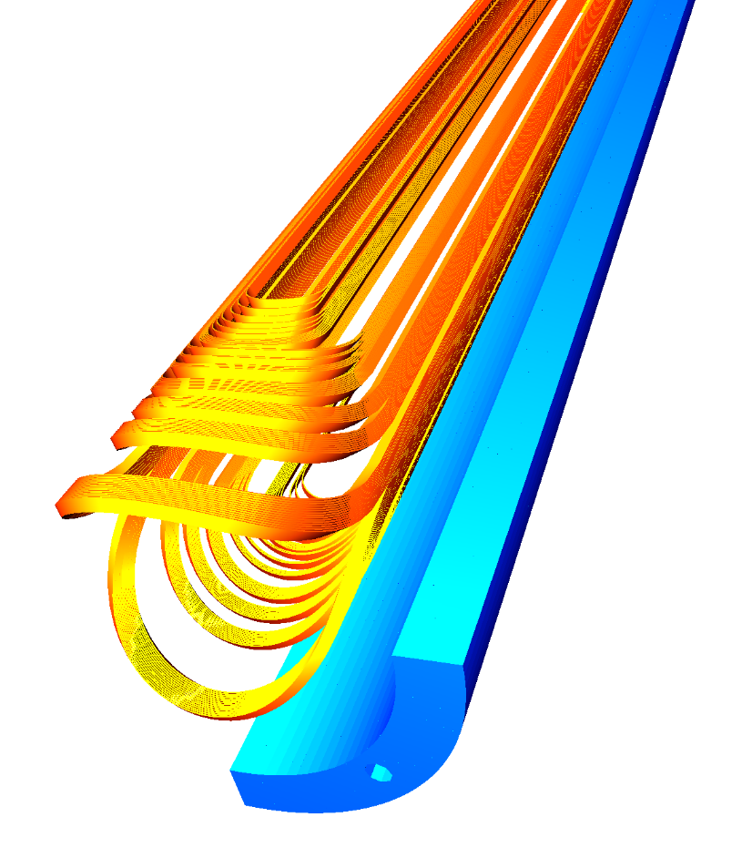
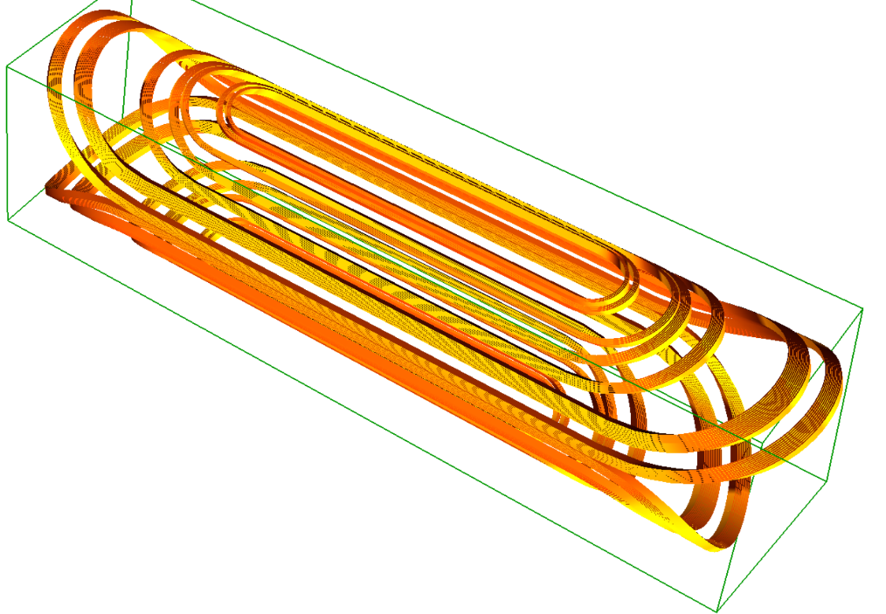
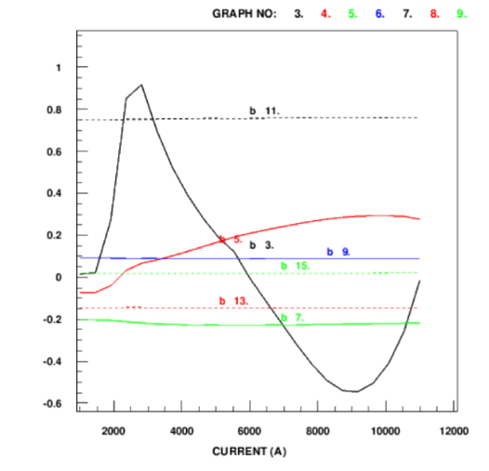
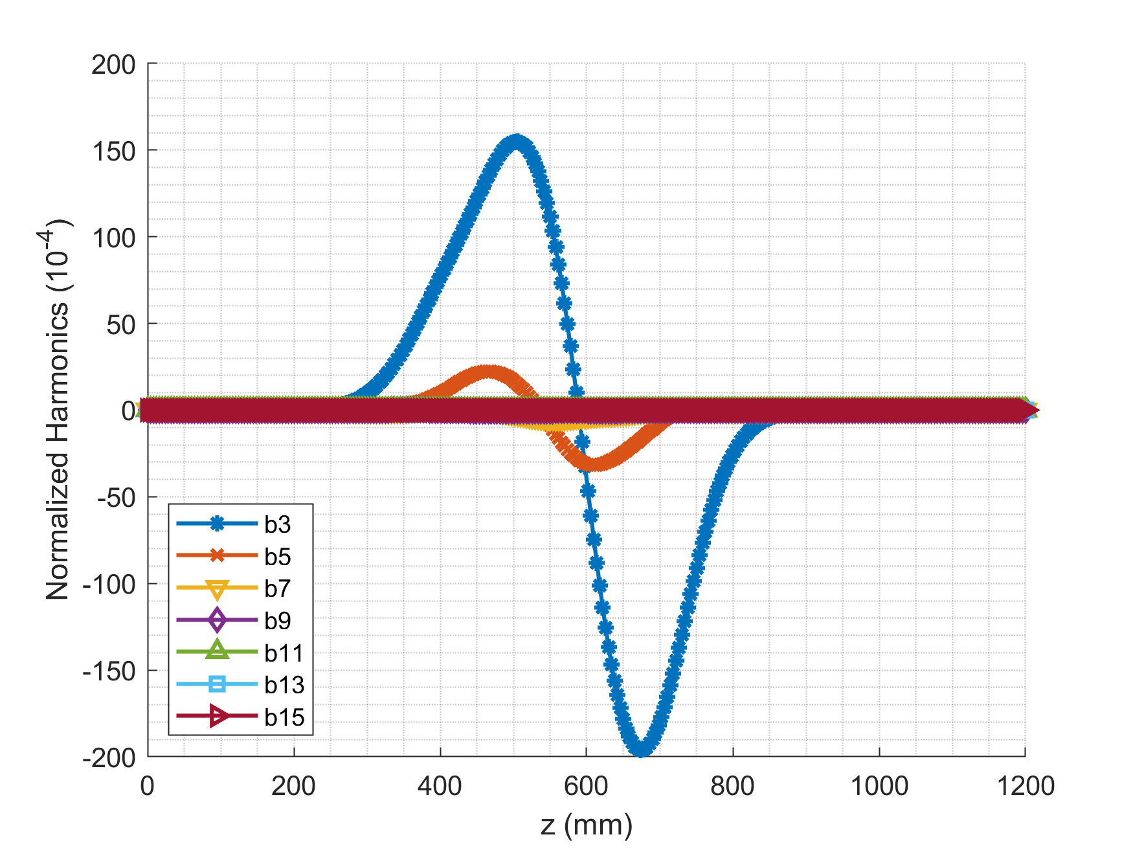
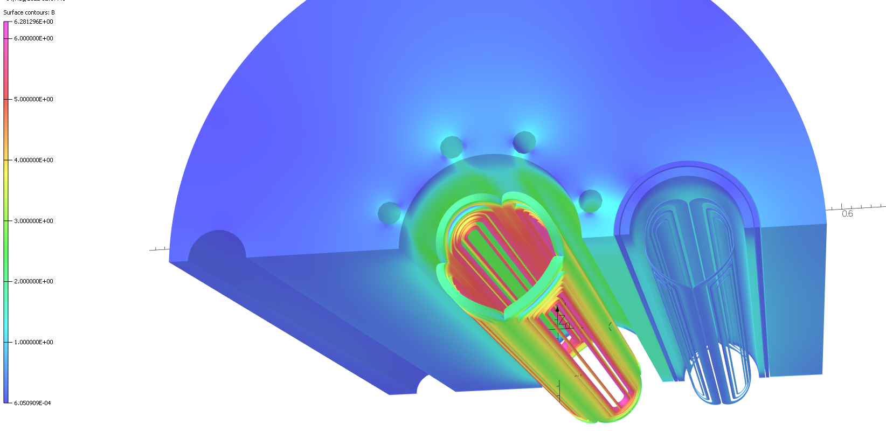
3D Designs
Preliminary designs for all magnets
  Minimized peak field in ends
  Good harmonics
Sufficient margin (>30%)
B1ApF
B1pF
Q1BpF
Courtesy of BNL SMD

Slide 11
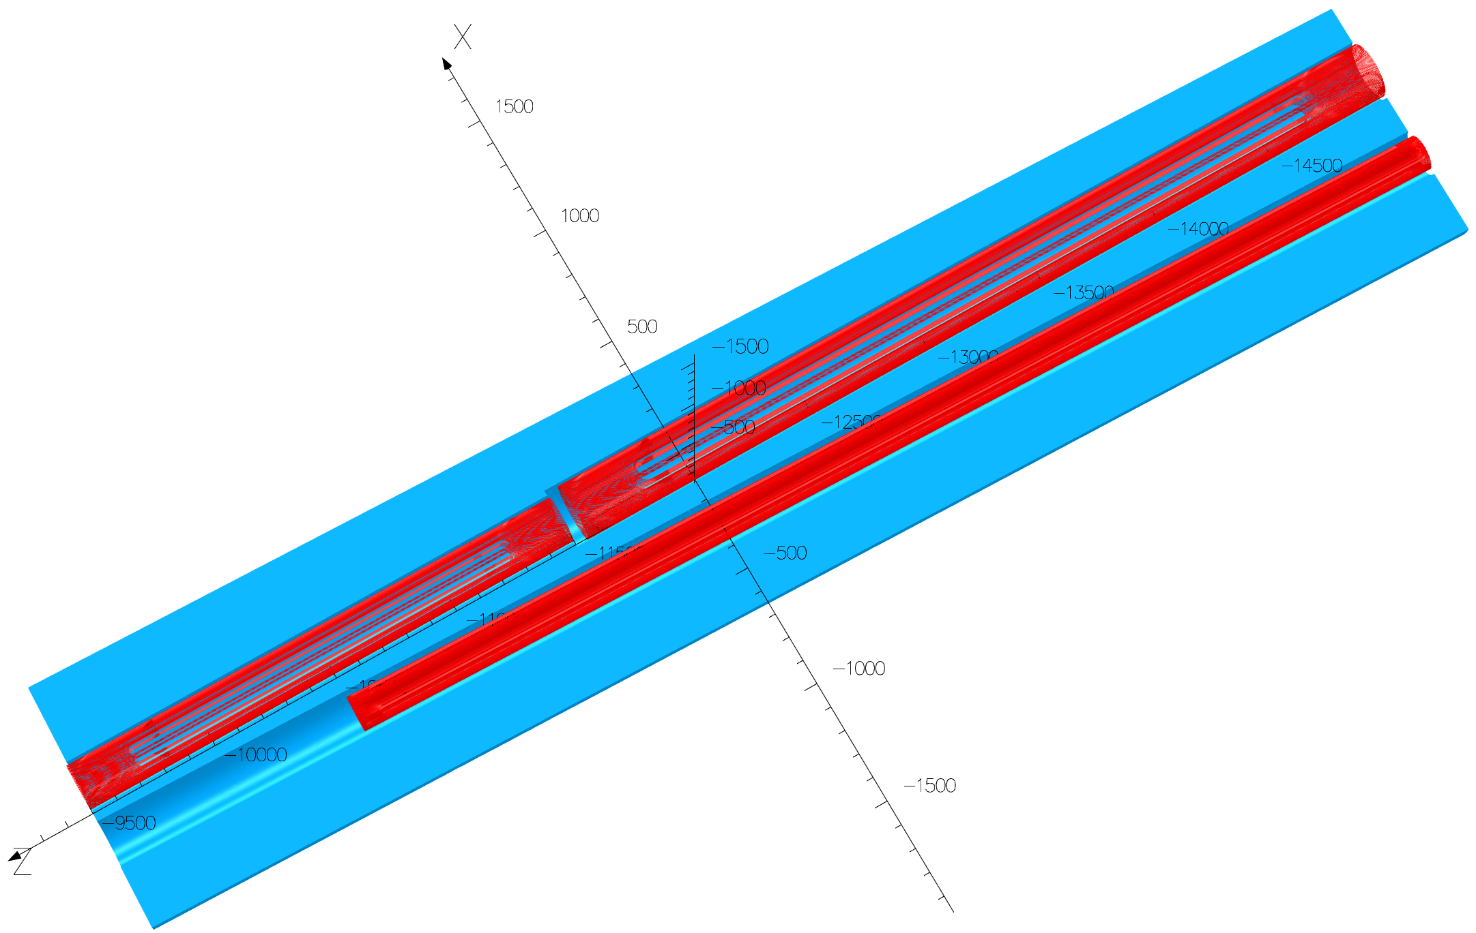
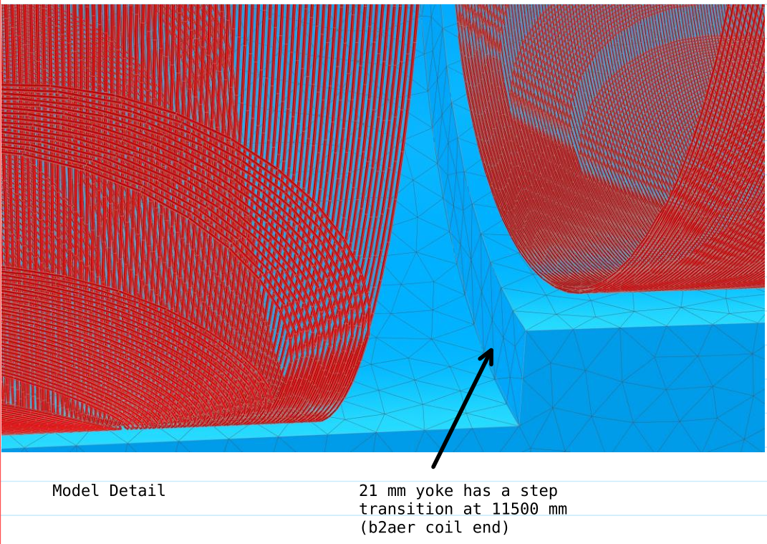
Direct Wind Magnets - Status
Preliminary magnet designs complete
Recent changes
  B2eR split into two magnets to optimize magnet aperture/cost
  B0pF length reduction
Implementation of correctors
B2BeR
3.45m
B2AeR
2m
Q2pR
Courtesy of B. Parker (BNL)

Slide 12
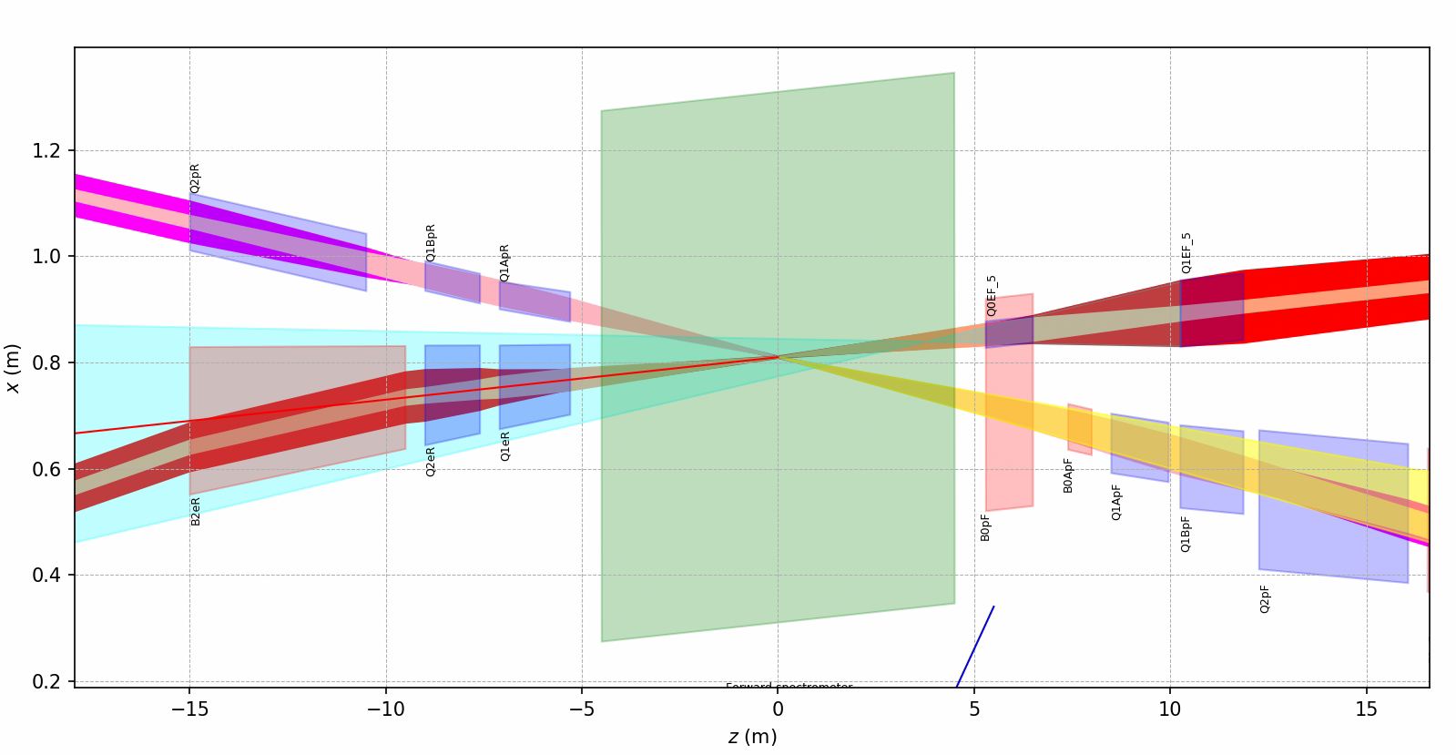
Detector Solenoid Compensation
Need four skew quadrupole magnets
  0.6T/m over 1.8m (assuming 3T solenoid)
Possible locations
  Hadrons: B0ApF, Q1ApR
  Electrons: Q1eF, Q1eR
    Q0eF: technically possible, but cuts into acceptance

Slide 13
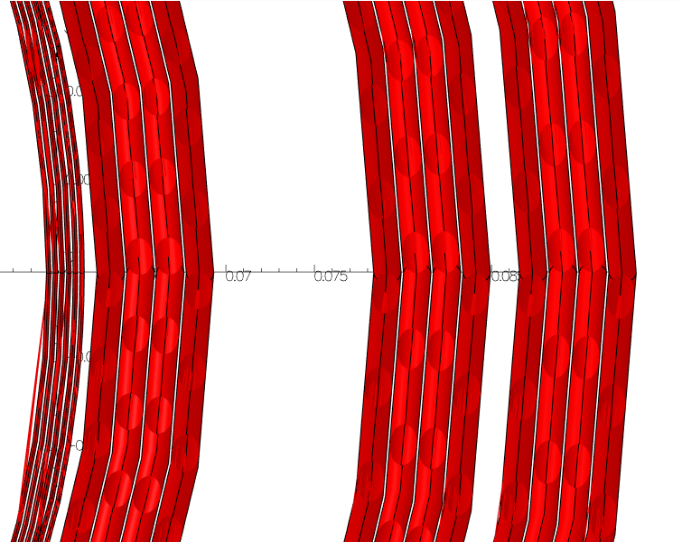
B0ApF – Corrector Dipole
Normal dipole
Horizontal corrector, 3.3T, 0.6m long
  Reason: B0pF is fixed field magnet
  Different energies: different orbits
  B0ApF and B1(A)pF: same orbit
Also: vertical corrector
  Detector solenoid compensation
Also: possible location for skew quadrupole
He space
4 layers skew dipole
2 layers skew quadrupole
Wire dia: 0.25mm
B0ApF: 1.55mm dia

Slide 14
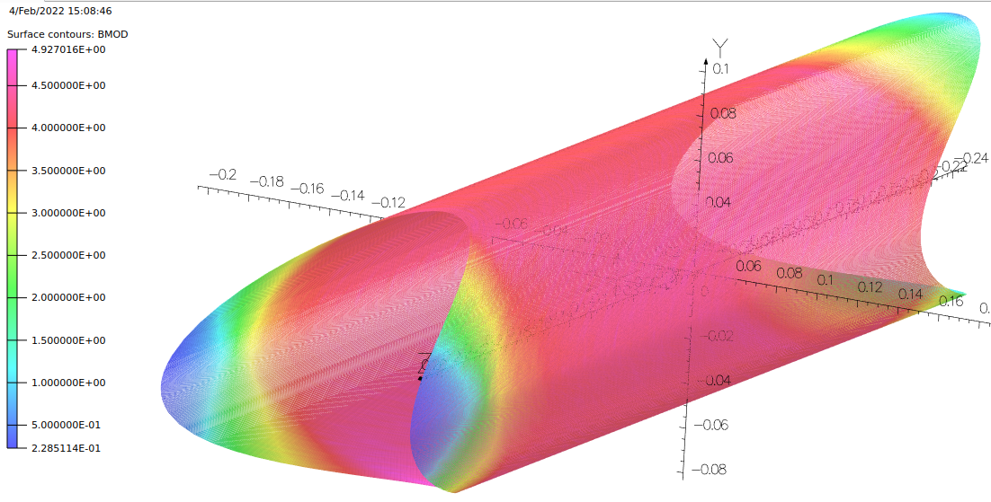
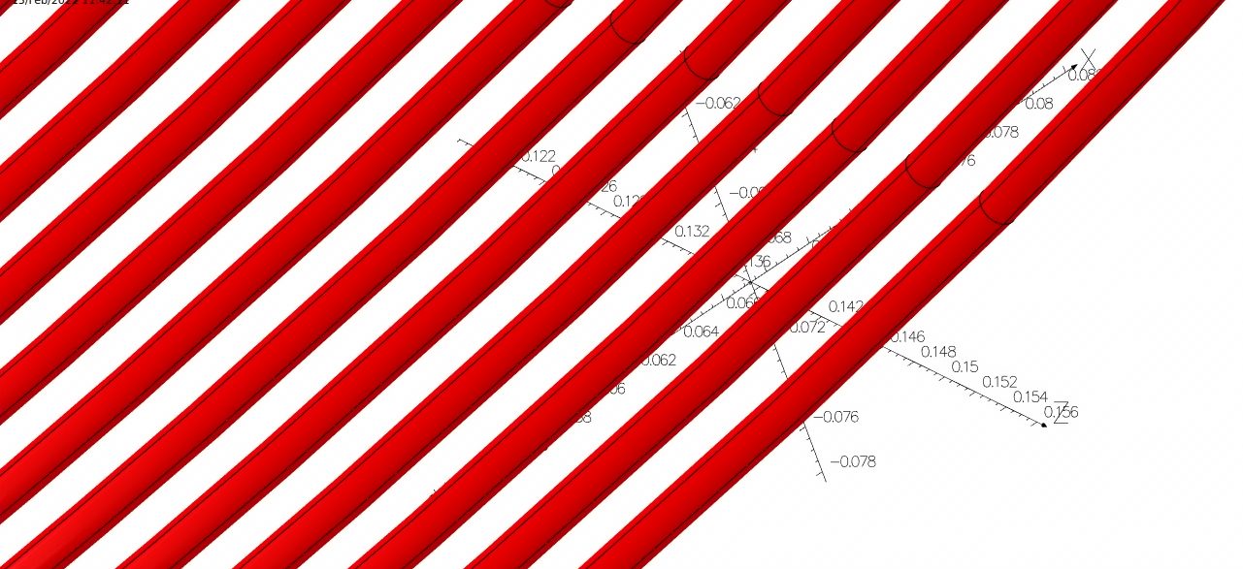
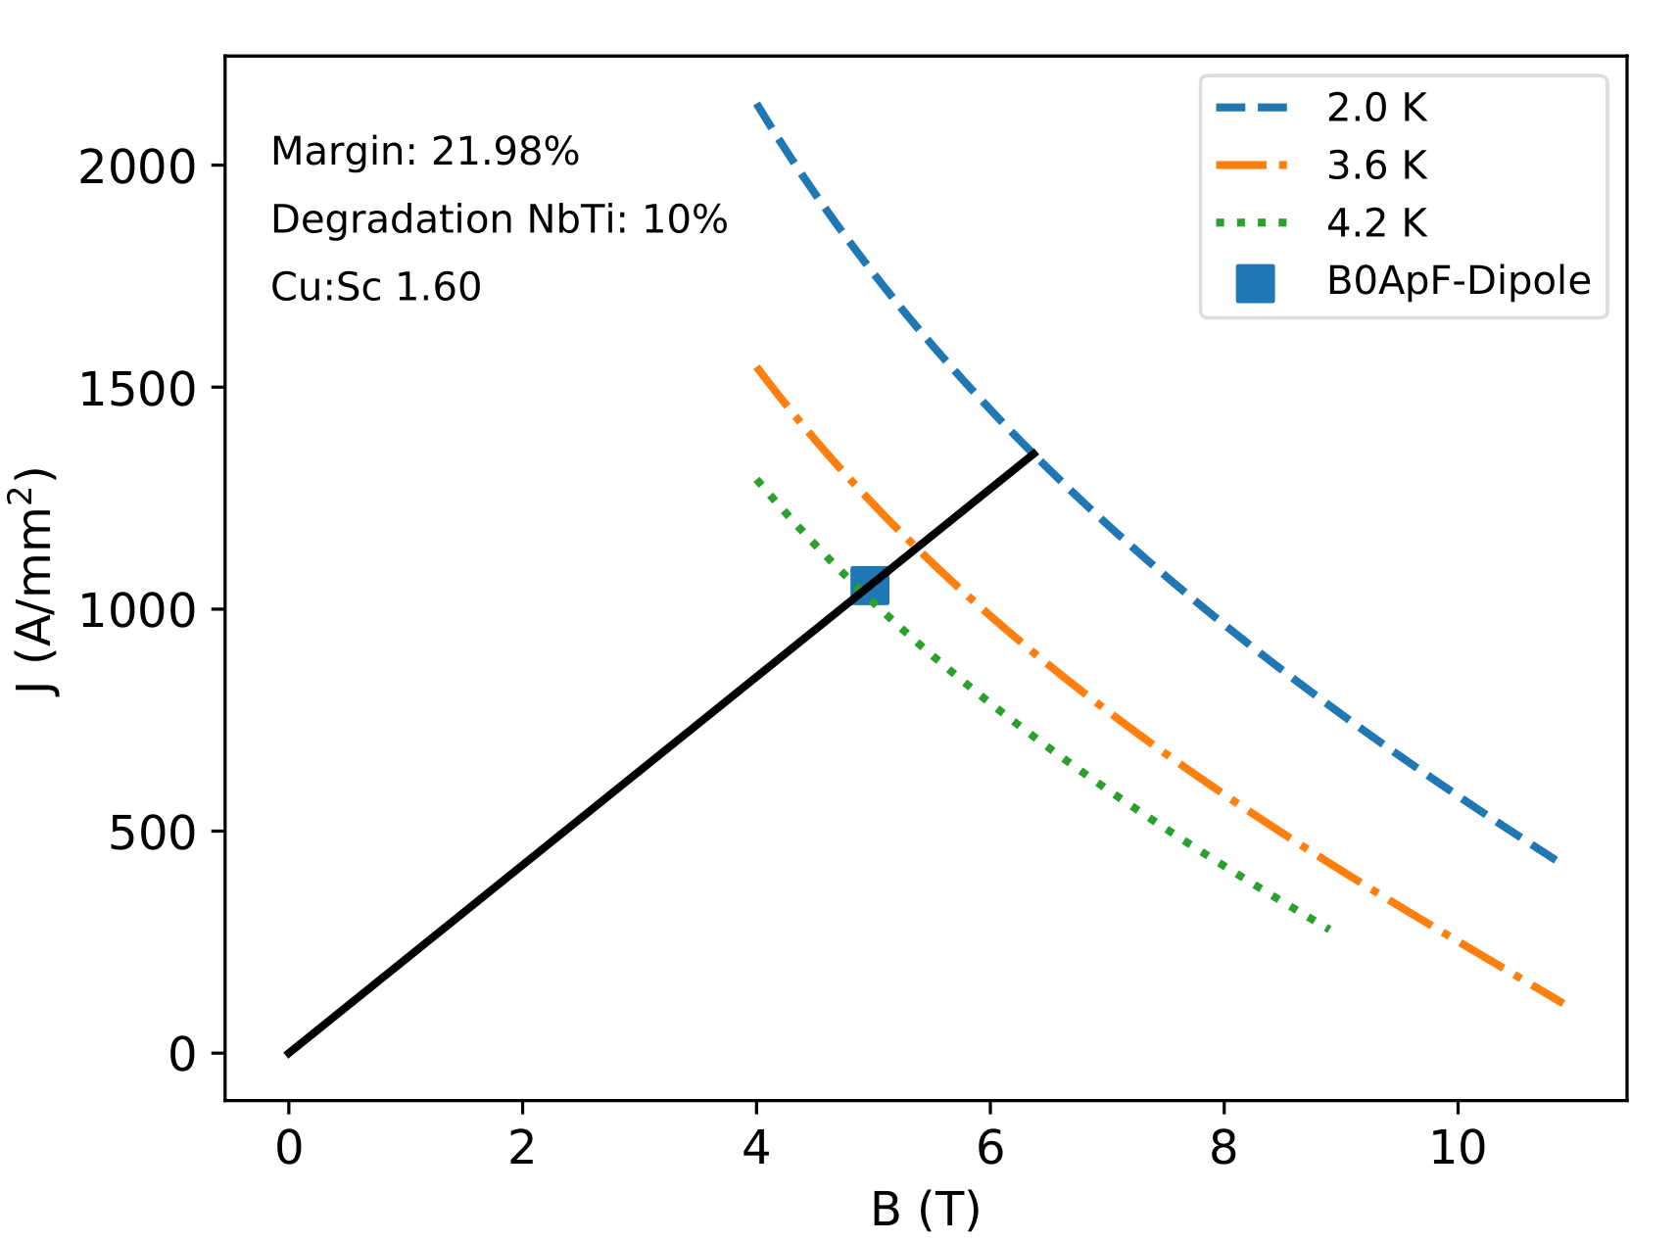
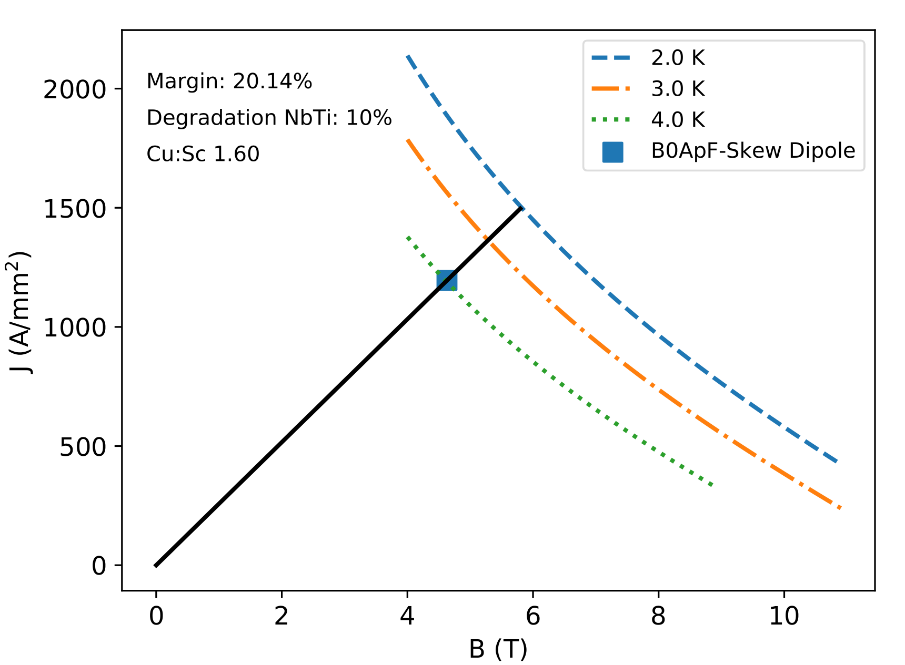
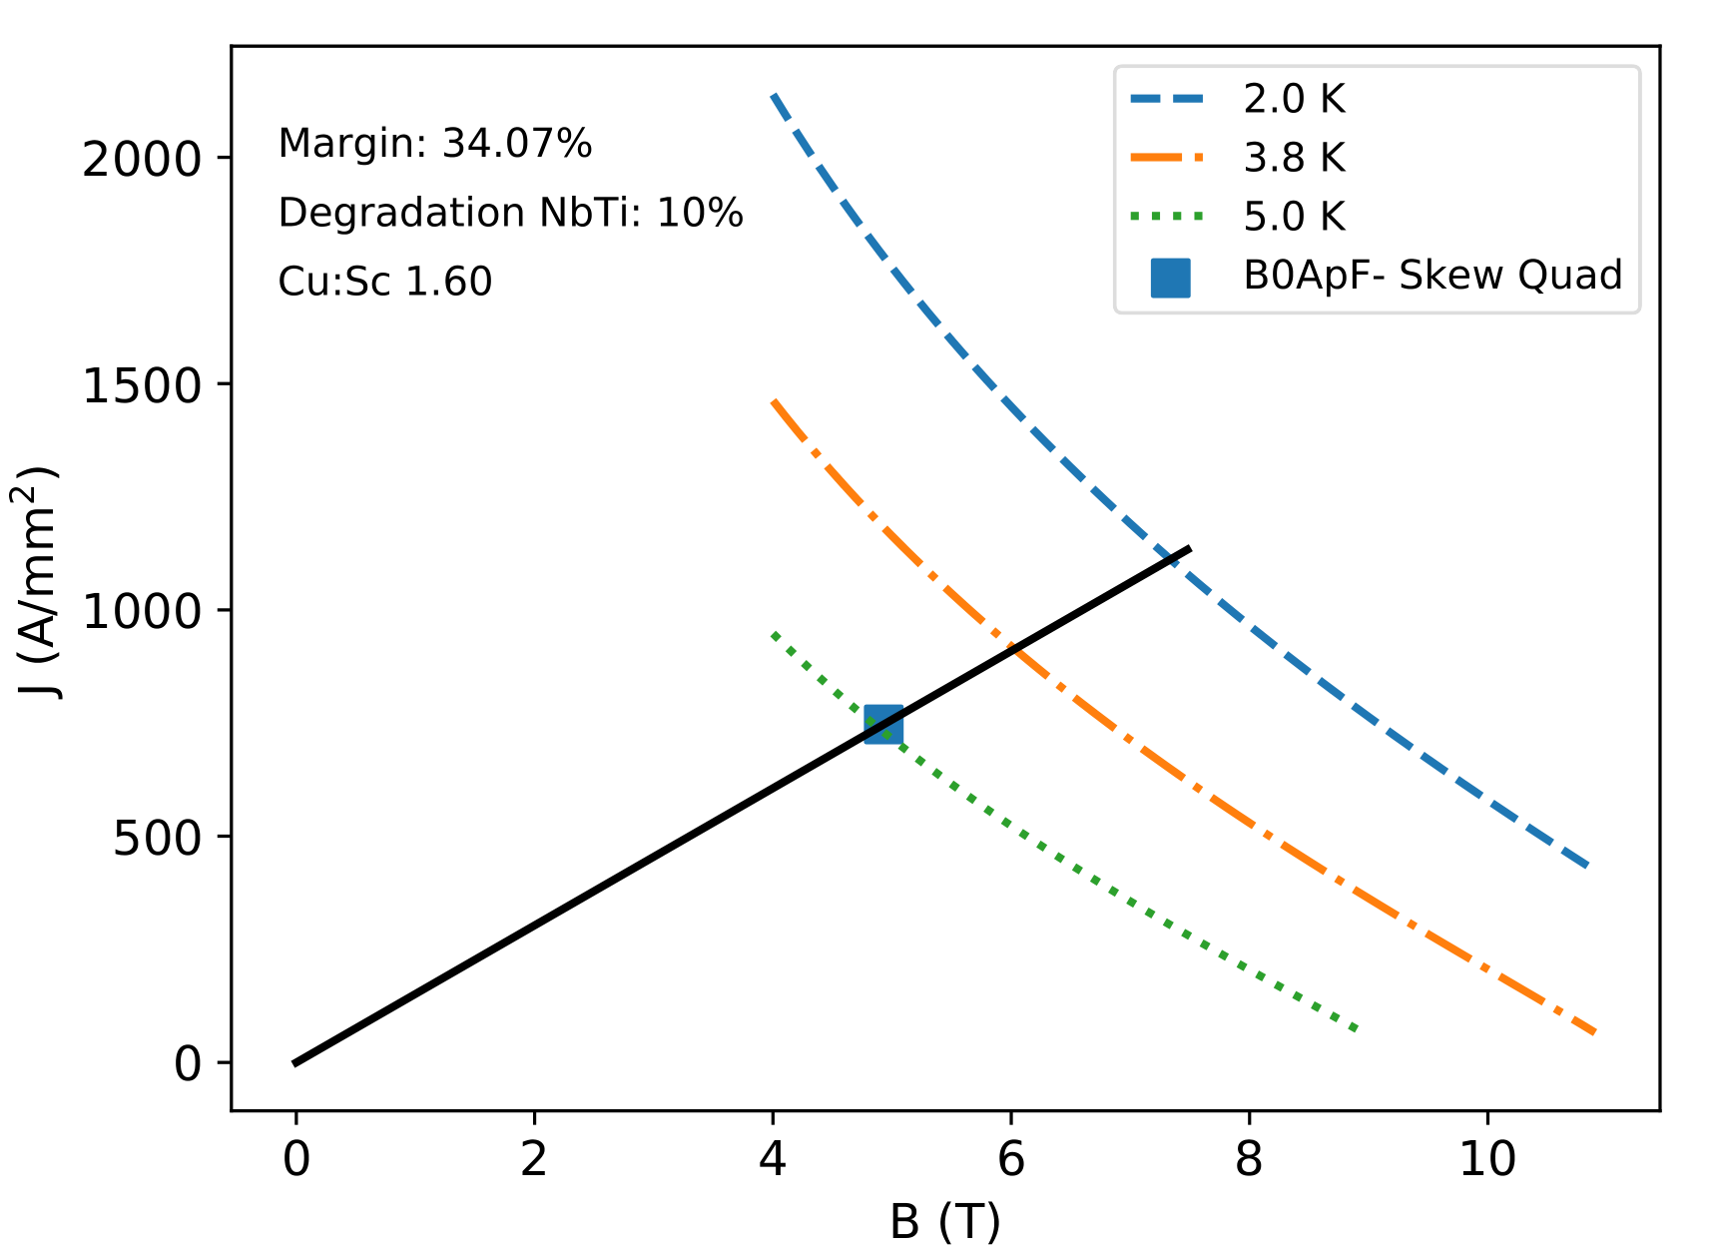
Skew Quad, Hadron Forward
Implementation: CCT
  Serpentine pattern could be more efficient
Sufficient margin for all multipoles at 2K
Lower detector solenoid field: margins will increase
Normal dipole
Skew dipole
Skew quad

Slide 15
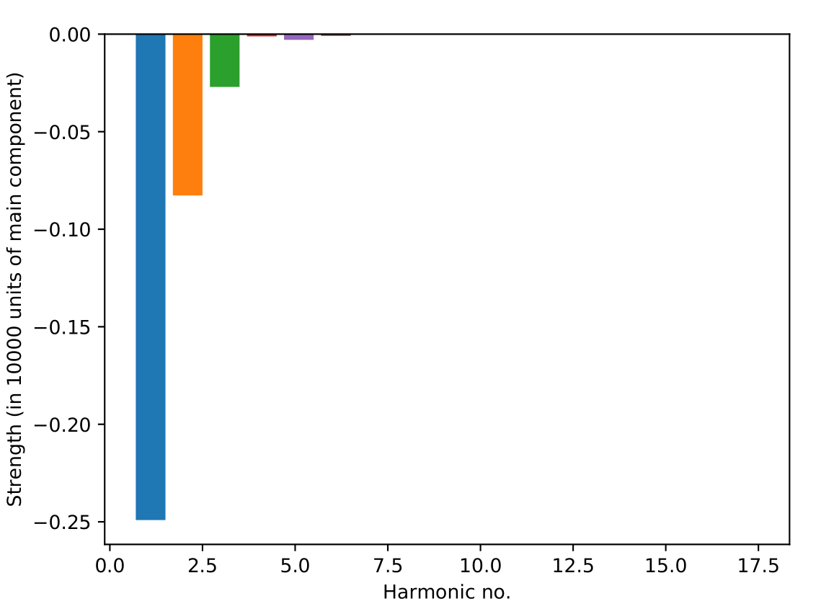
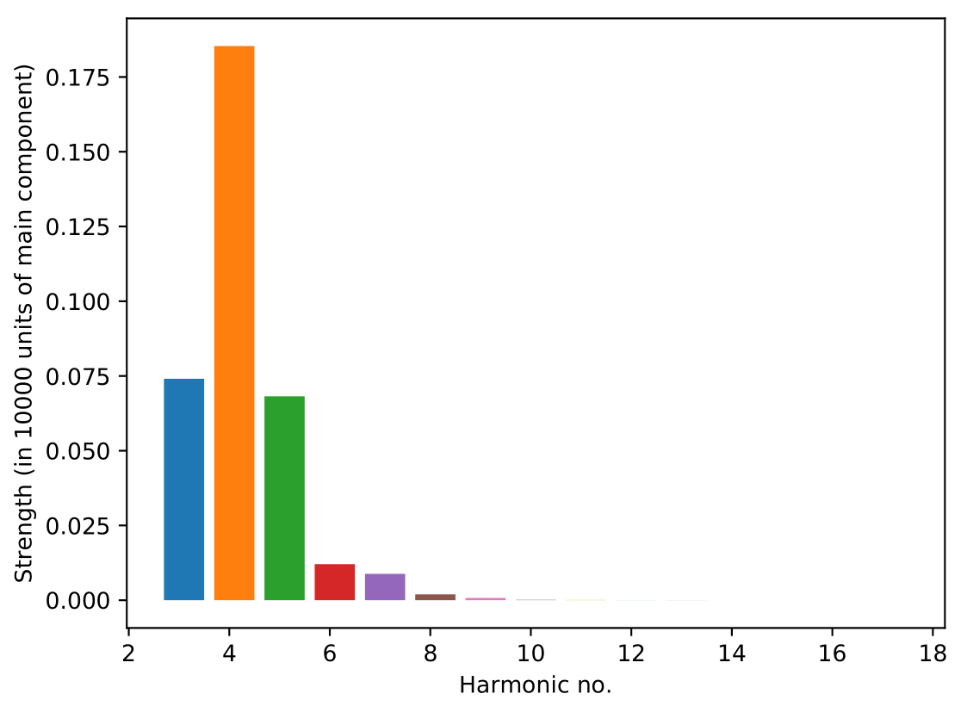
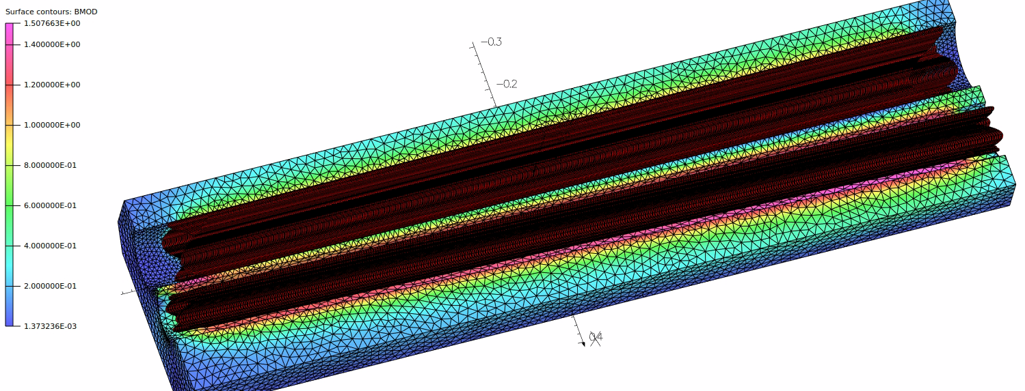
Q1ApR/Q1eR Tapered Quads
Q1eR
Normal harmonics
Tapered CCT FF quadrupole magnets
Clear apertures
  Q1eR: IR 47.6... 55.7 mm
  Q1ApR: IR 20…26 mm
Gradient
  Q1ApR: 78T/m
  Q1eR: 14T/m
Harmonics: <0.25 units
Q1eR
Skew harmonics
Q1eR
Q1ApR

Slide 16
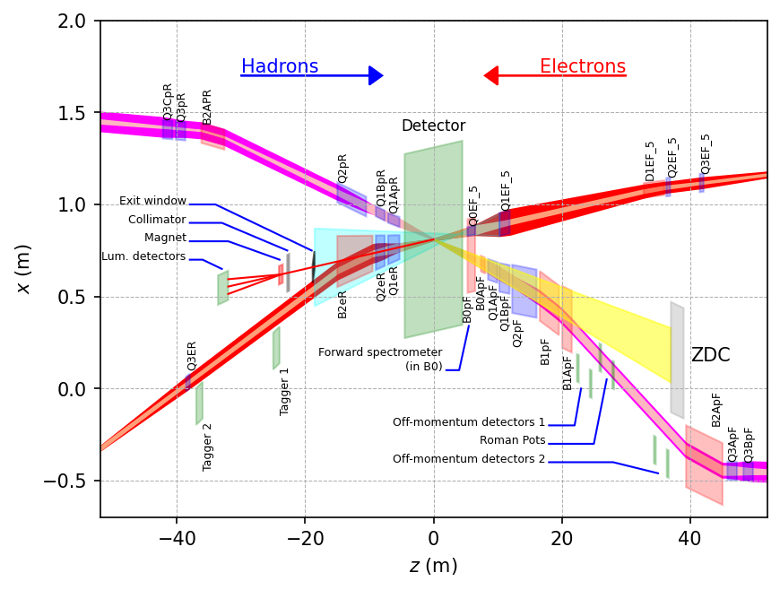
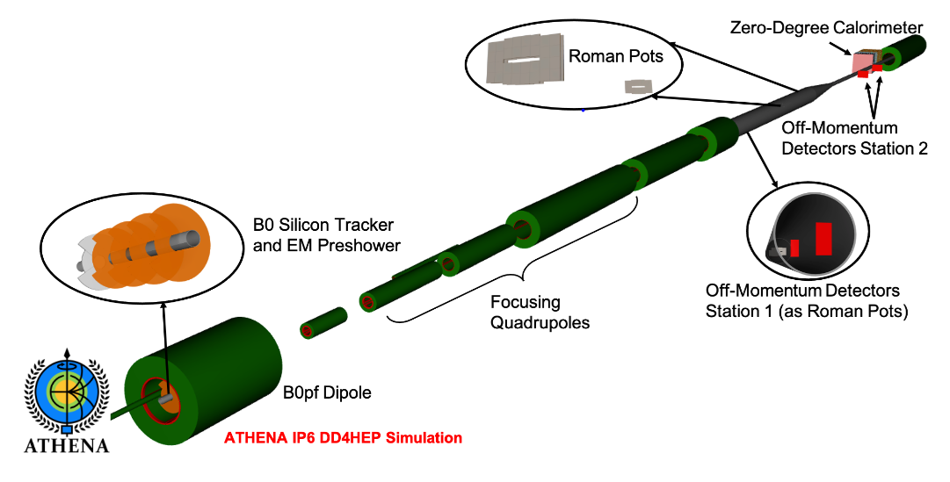
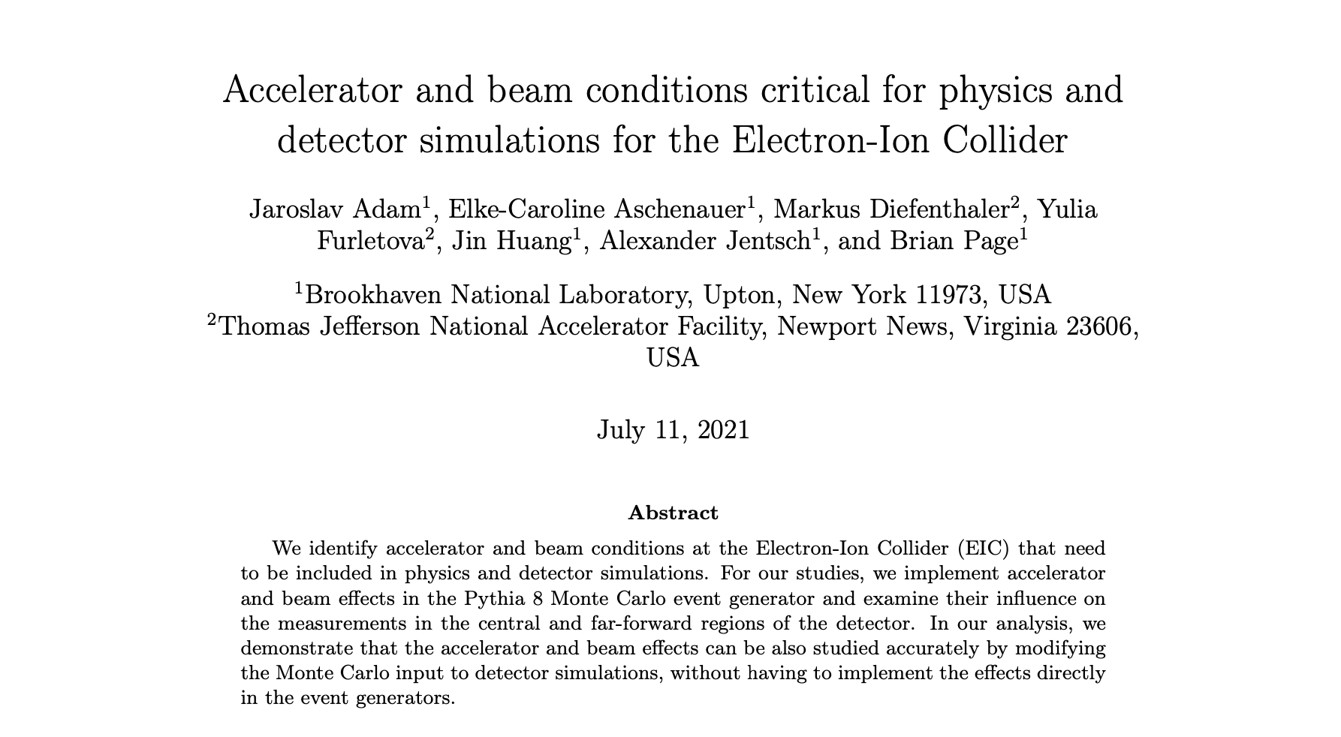
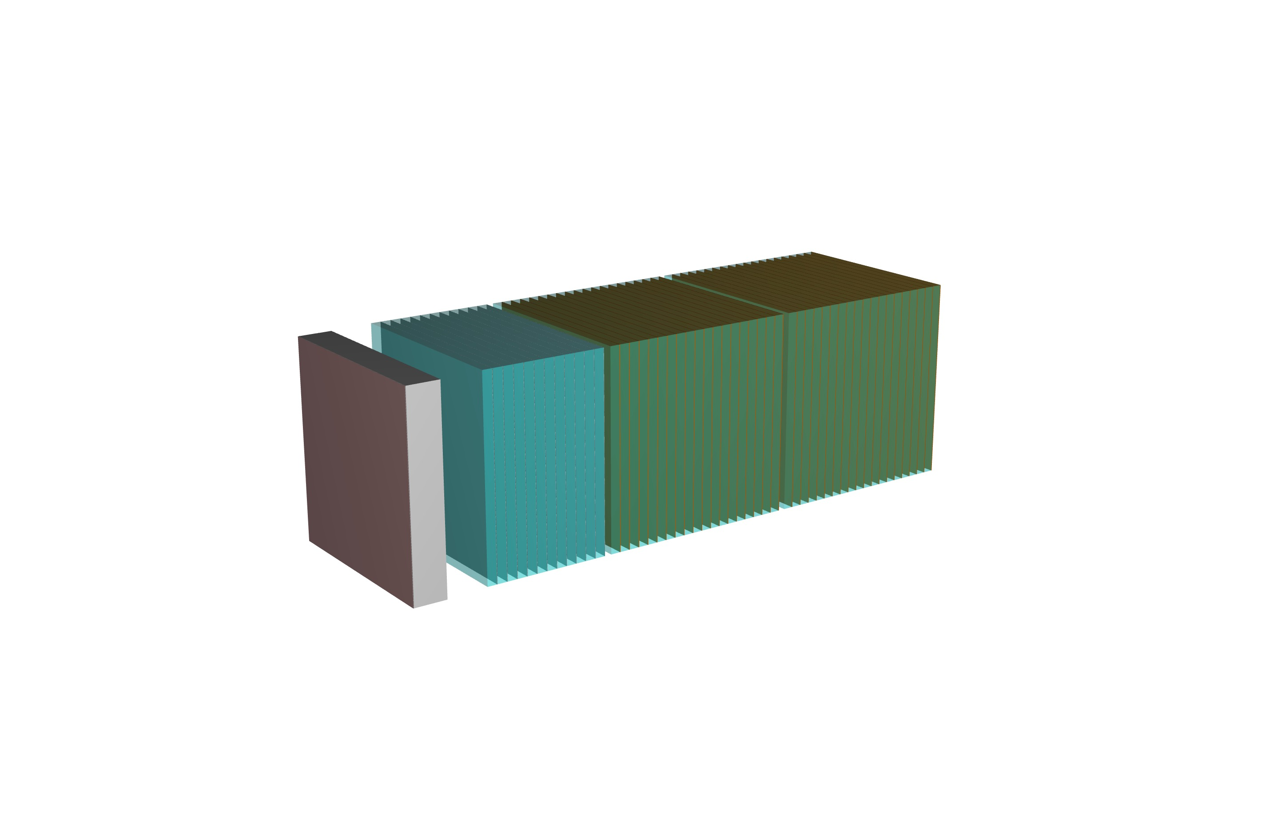
Progress – Integration to IR
IP magnets & ancillary detectors fully simulated in GEANT including all beam effects
developed software for proto-collaborations to account for crossing angle and other beam effects in MC
to be published http://www.eicug.org/web/sites/default/files/Accelerator_and_beam_conditions_critical_for_EIC_simulations.pdf
Courtesy of
E. Aschenauer & group (BNL)
PbScint
PbSi
PbWO4
HCAL
ECAL

Slide 17
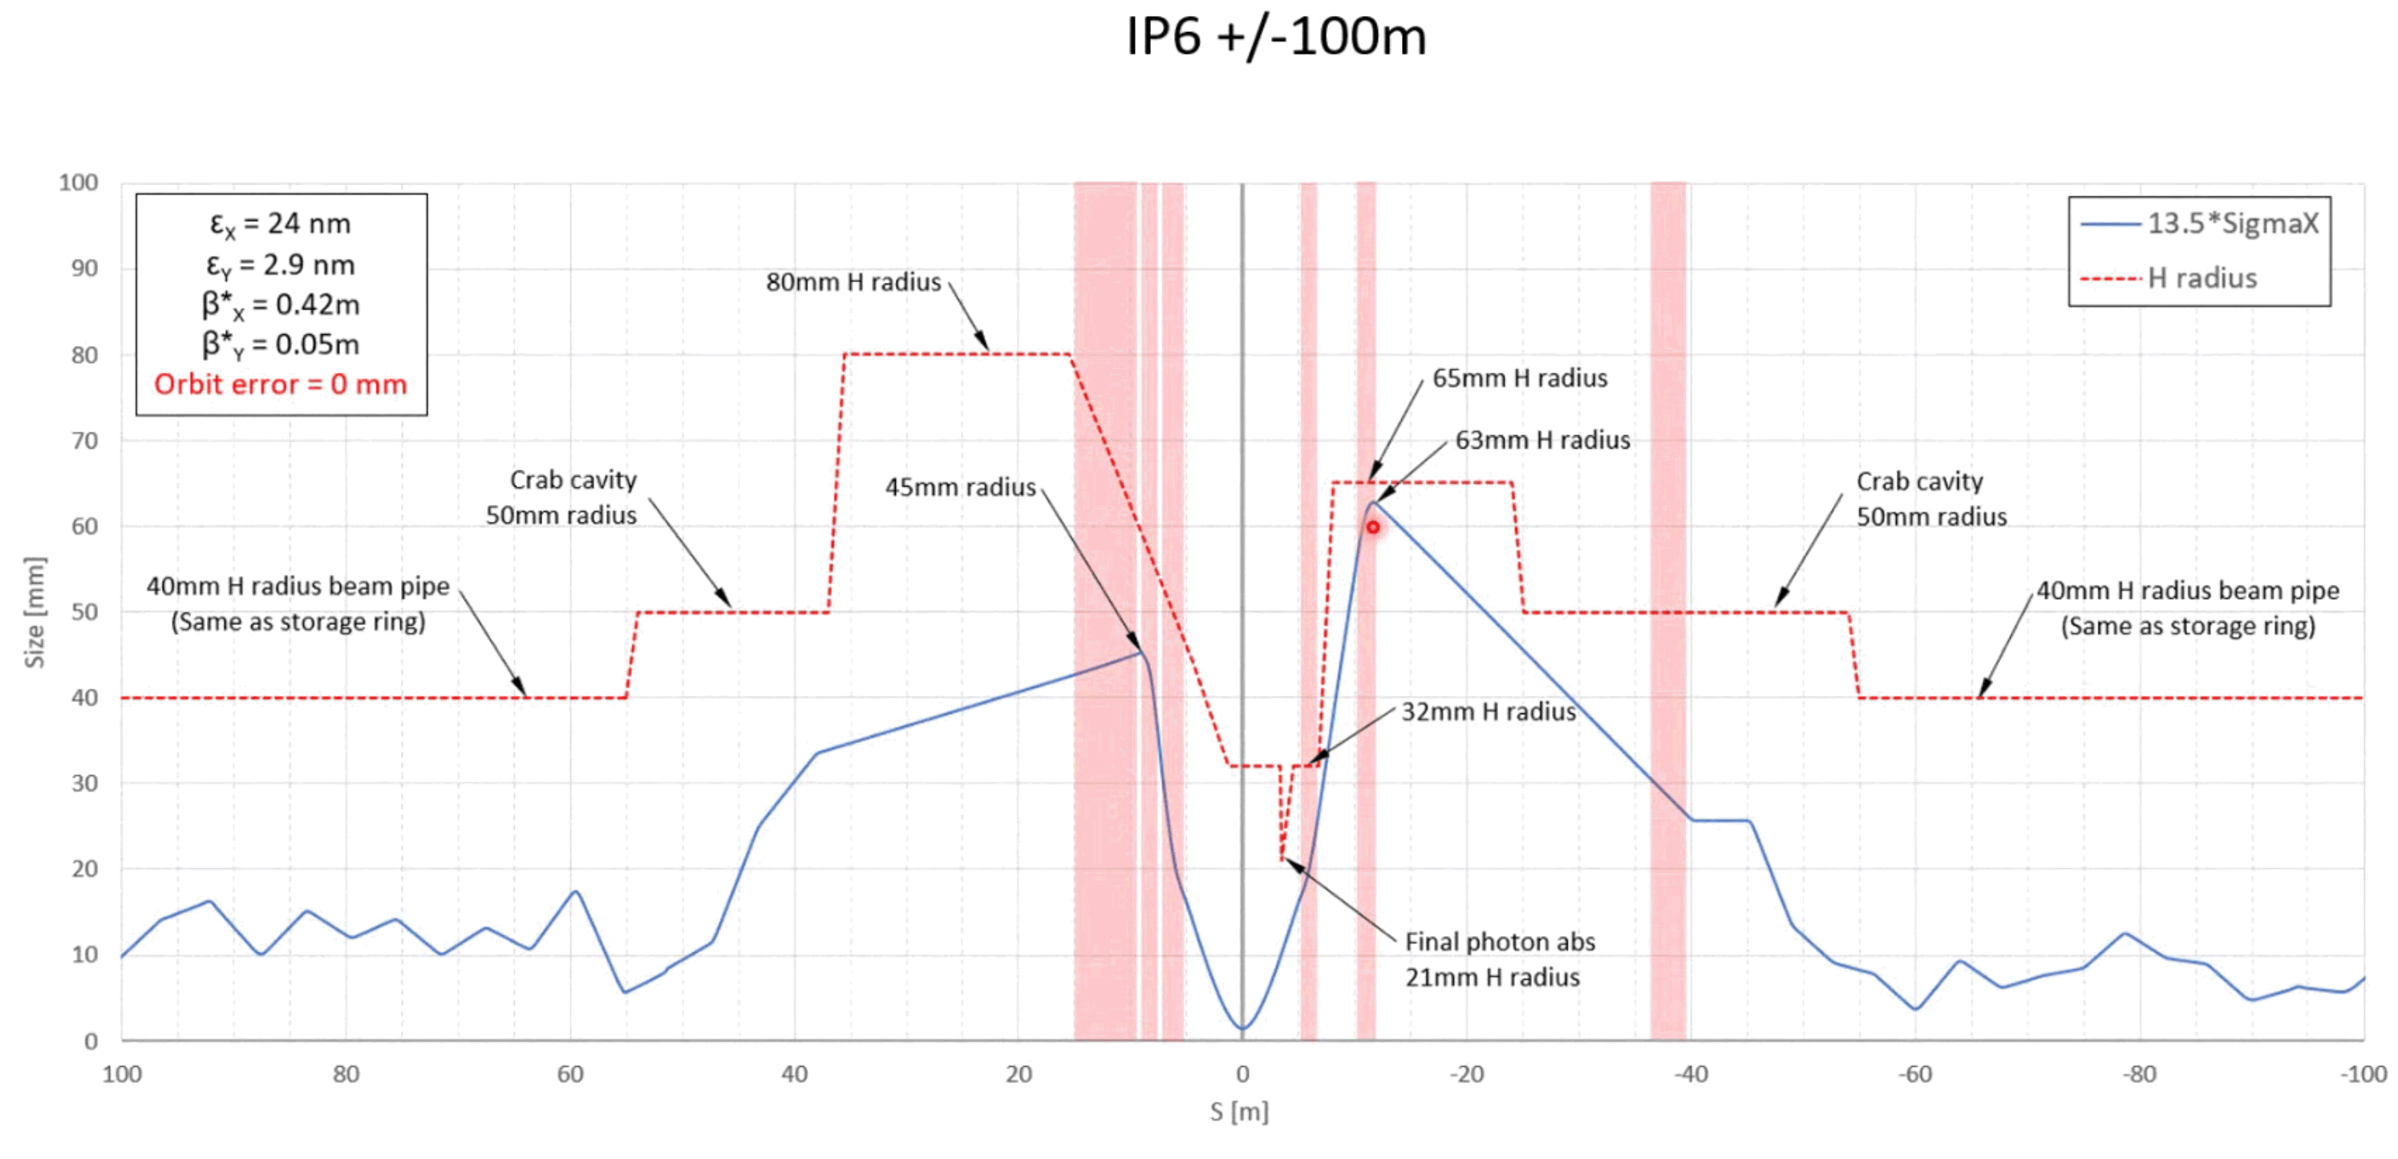
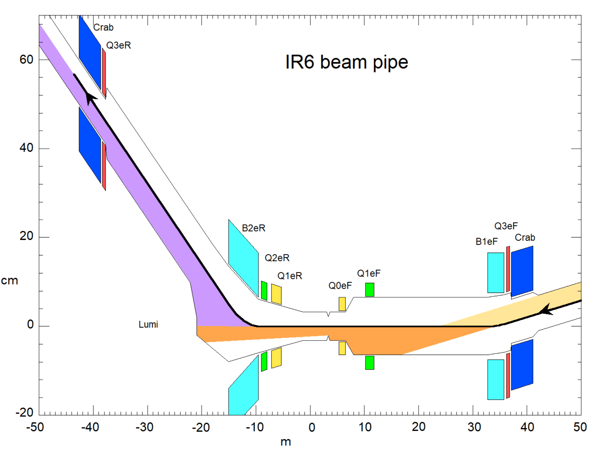
Synchrotron Radiation
Extensive simulations of SR by dedicated working group
  Including photo desorption
  SR photon spectrum provided to collaborations
Two separate codes with good agreement
  Synrad3D
  SYNC_BKG (Mike Sullivan)
Focus on
  Central chamber
  Lumi window
  Polarimeter
  Heat loads inner IR
  Spin rotators/crab cavities
Courtesy of C. Hetzel (BNL) / M. Sullivan (SLAC)

Slide 18
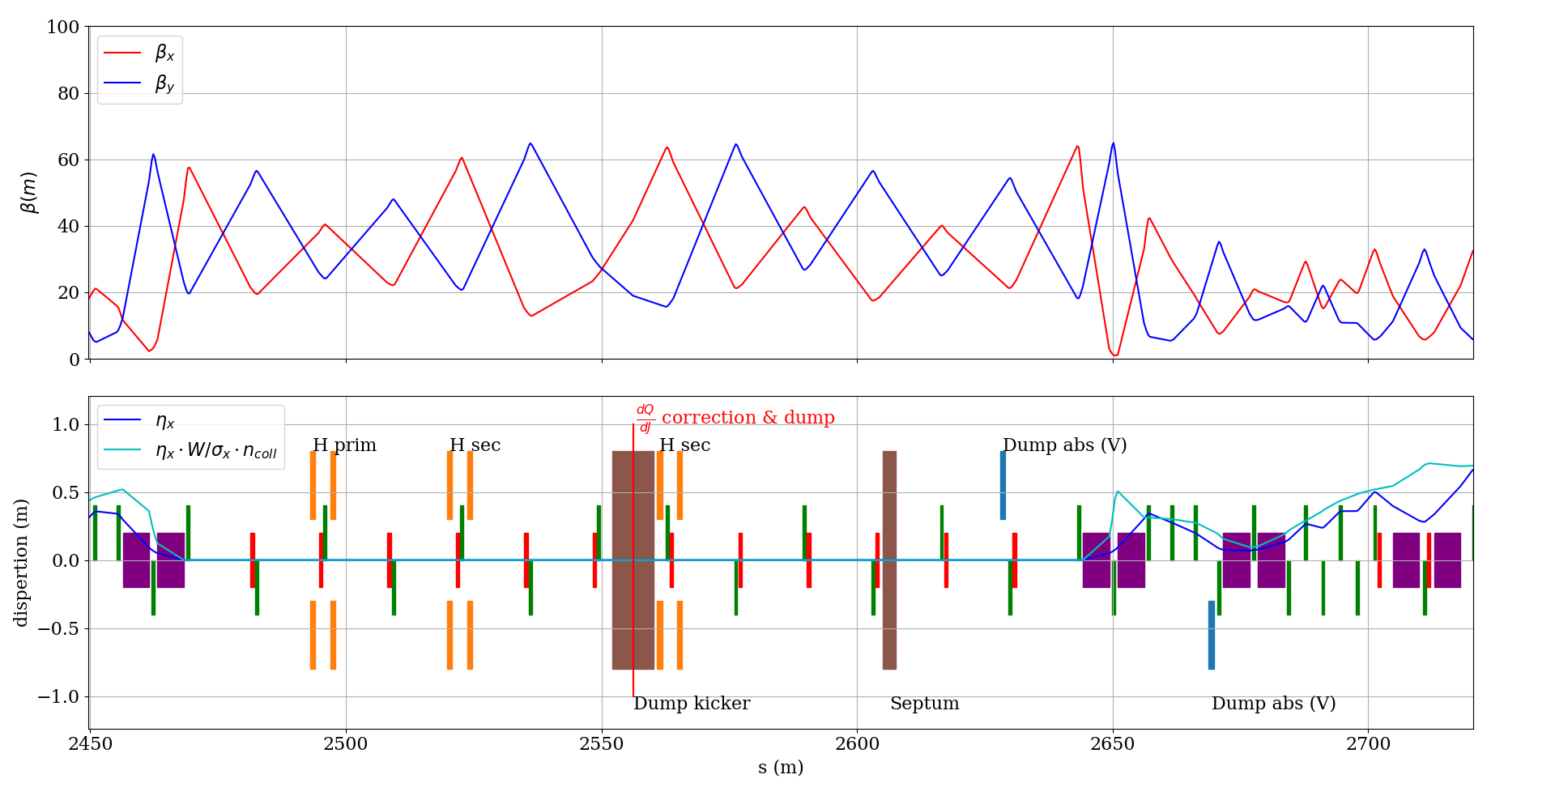
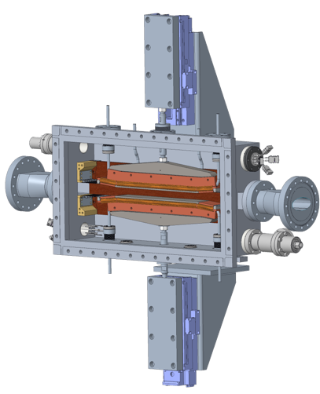
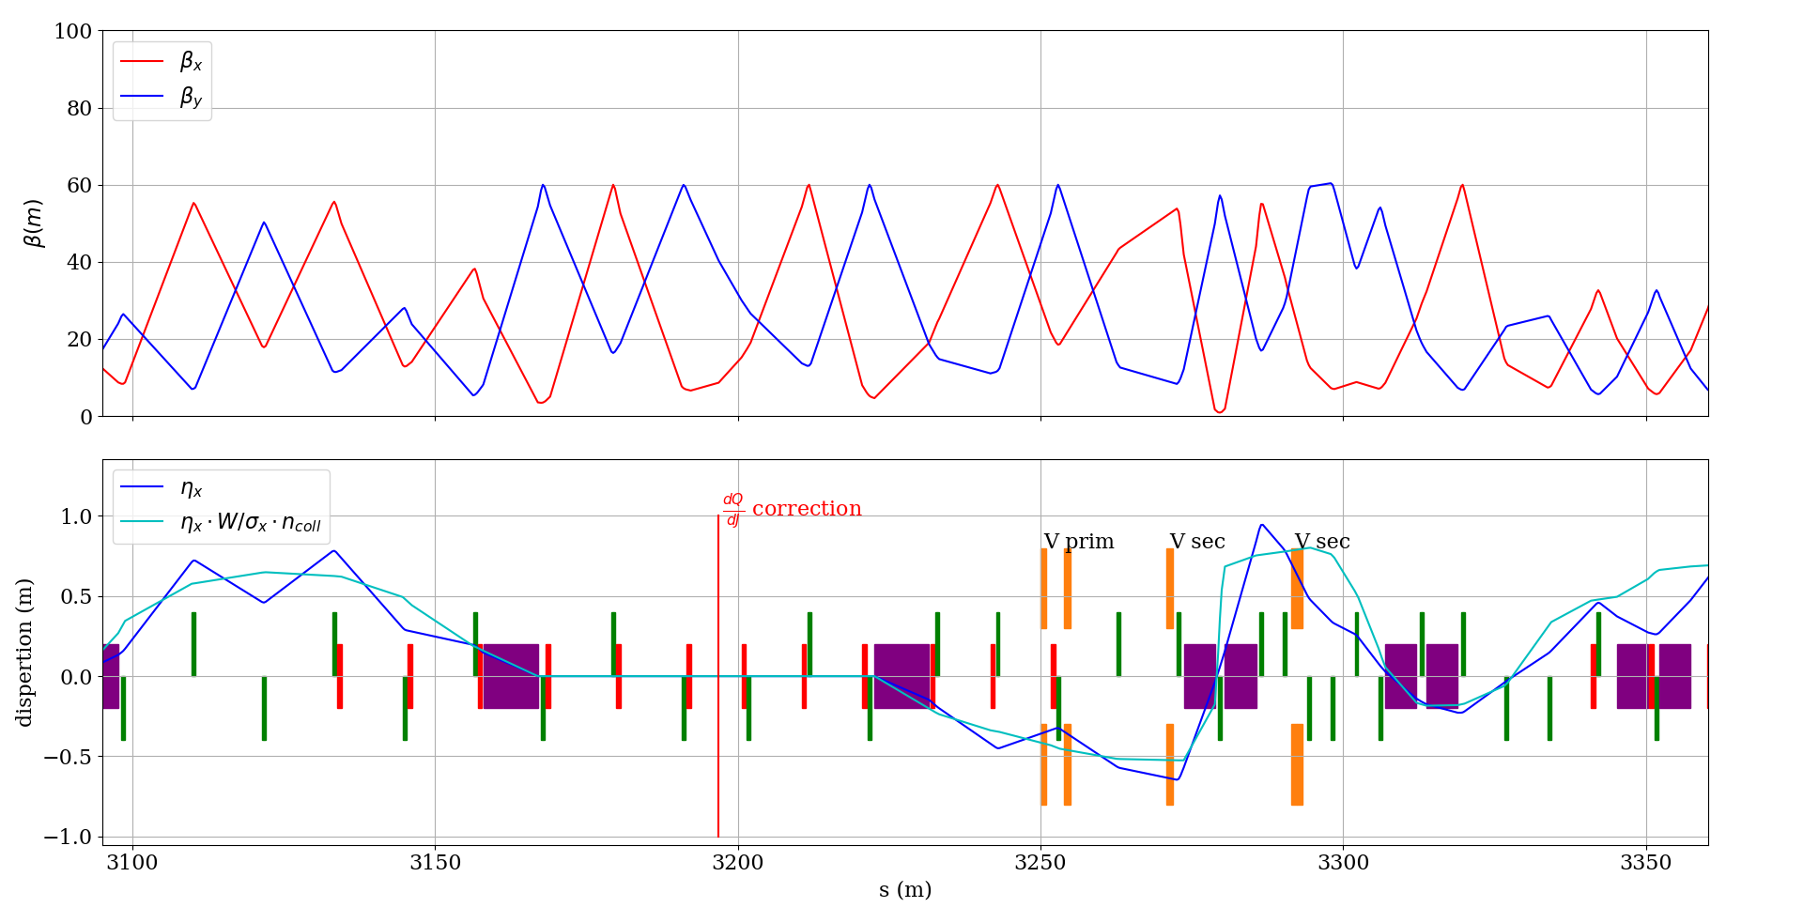
Collimators
IR2 - Horizontal
ESR
  Planned in IR2 & 4
  2-sided prim. + 2 sec. for cleaning and flexibility with phase advances and optics
IR4 – Vertical
Courtesy of A. Drees (et. al.)

Slide 19
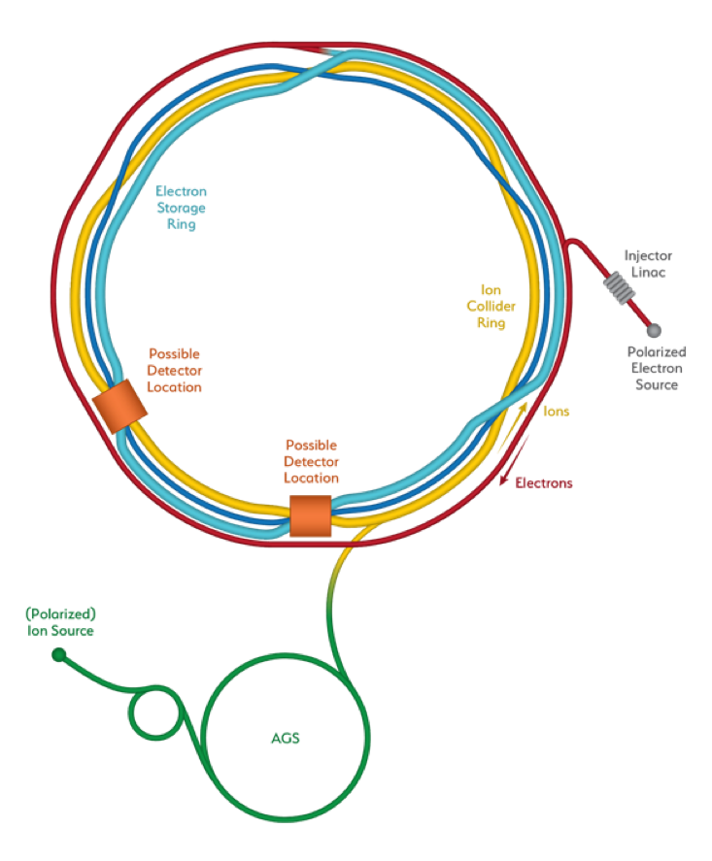
Overview
Sector 12 H Betatron Collimation (both planes)
electron : 6+1 collimators
Hadrons : 6+1 collimators
+absorbers and masks
Sector 12 H Momentum Collimation (D7 ‘dummy’)
IR2 e Horizontal Collimation
& Abort System
Hadron Abort System (already there)
IR12 e Injection absorbers
Masks
IR4 e Vertical + Momentum Collimation
H Injection protection
(note: not actual inj. location)
Collimator efficiency tracking studies ongoing

Slide 20
Summary
IR design is mature
Collared magnets: preliminary design complete
  2D/3D
  2K operation
Most magnets: direct wind manufacturing technique
  Preliminary designs complete
  Including corrector magnets into designs
Synchrotron radiation
Detector integration
Collimator design progressing

Slide 21
Acknowledgements
BNL
J. Adam, M. D. Anerella, E.C. Aschenauer, J. Avronsart, A. Ben-Yahia, J.S. Berg, M. Blaskiewicz, A. Blednykh, W. Christie, J. Cozzolino, A. Drees, D. Gassner, K. Hamdi, C. Hetzel, H.M. Hocker, D. Holmes, A. Jentsch, A. Kiselev, P. Kovach, M. Kumar, F. Kurian, H. Lovelace III, Y. Luo, G. Mahler, A. Marone, G. McIntyre, C. Montag, R.B. Palmer, B. Parker, S. Peggs, S. Plate, V. Ptitsyn, G. Robert-Demolaize, J. Rochford, C. Runyan, J. Schmalzle, K.S. Smith, S. Tepikian, R. Than, P. Thieberger, J. Tuozzolo, F.J. Willeke, H. Witte, Q. Wu, Z. Zhang
JLAB
M. Stutzman, R. Gamage, P. Ghoshal, T. Michalski, W. Wittmer
SLAC
M. Sullivan, Y. Nosochkov, A. Novokhatski
ORNL
V. Morozov
… and many more!

Slide 22

Additional Slides

Slide 23
Forward Hadron Magnets
 | Length | IR1 | Pole tip field R1 | Dipole Field | Gradient
 | m | cm | T | T | T/m
B0pF | 1.2 | 17 |  | -1.3
B0ApF | 0.6 | 4.3 |  | 3.3
Q1ApF | 1.46 | 5.6 | 4.07 | 0 | -77.903
Q1BpF | 1.61 | 7.8 | 5.16 | 0 | -63.028
Q2pF | 3.6 | 11.3 | 5.36 | 0 | 39.736
B1pF | 3 | 13.5 |  | 3.4
B1ApF | 1.5 | 16.8 |  | 2.7
IR1: inner radius (= clear aperture) at coil beginning
Pole tip field R1: IR1*gradient
Collared coils, apart from B0pF and B0ApF (direct wind)

Slide 24
Forward Electron Magnets
 | Length | IR1 | IR2 | Pole tip field R1 | Pole tip field R2 | Gradient
 | m | cm | cm | T | T | T/m
Q0eF | 1.2 | 2.5 | 2.5 | 0.4 | 0.4 | 13.5
Q1eF | 1.61 | 6.3 | 6.3 | 0.5 | 0.5 | 8.1
IR1: inner radius (= clear aperture) at coil beginning
IR2: inner radius (= clear aperture) at coil end
Pole tip field R1: IR1*gradient
Pole tip field R2: IR2*gradient
All direct wind coils

Slide 25
Rear Hadron Magnets
 | Length | IR1 | IR2 | Pole tip field R1 | Pole tip field R2 | Gradient
 | m | cm | cm | T | T | T/m
Q1ApR | 1.8 | 2.0 | 2.56 | 1.56 | 2. | 78
Q1BpR | 1.4 | 2.8 | 2.8 | 2.184 | 2.184 | 78
Q2pR | 4.5 | 5.4 | 5.4 | 1.84 | 1.84 | 34
IR1: inner radius (= clear aperture) at coil beginning
IR2: inner radius (= clear aperture) at coil end
Pole tip field R1: IR1*gradient
Pole tip field R2: IR2*gradient
All direct wind coils
Q1ApR: tapered

Slide 26
Rear Electron Magnets
 | Length | IR1 | IR2 | Pole tip field R1 | Pole tip field R2 | Dipole Field | Gradient
 | m | cm | cm | T | T | T | T/m
Q1eR | 1.8 | 4.76 | 5.57 | 0.67 | 0.78 | 0 | 14
Q2eR | 1.4 | 6.43 | 6.43 | 0.91 | 0.91 | 0 | 14.1
B2AeR | 2.0 | 90.45 | 90.45 | 0.192 | 0.192 | 0.192 | 0
B2BeR | 3.45 | 111.45 | 111.45 | 0.238 | 0.238 | 0.238 | 0
IR1: inner radius (= clear aperture) at coil beginning
IR2: inner radius (= clear aperture) at coil end
Pole tip field R1: IR1*gradient
Pole tip field R2: IR2*gradient
All direct wind coils
Q1eR: tapered double-helix coil

Slide 27
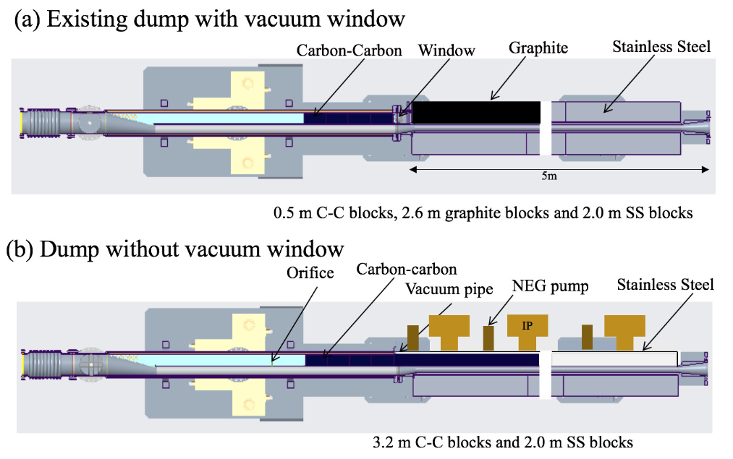
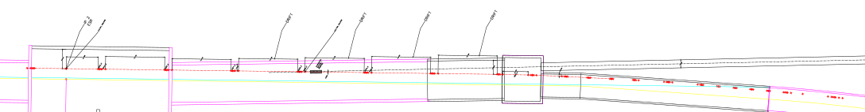
Abort systems: HSR & ESR
HSR:
The plan is to keep the current RHIC system w. necessary upgrades
ESR:
Plan to use an unused spectrometer tunnel in IR2 which will allow extracting the 300-kJ beam away from other IR2 users. It features 6 x 2-mrad vertical kickers, a 2° Lamberton magnet & a 50m-long transfer line with 6 warm quads.
kickers
Lambertson magnet
Top view
dump
27
27

Slide 28
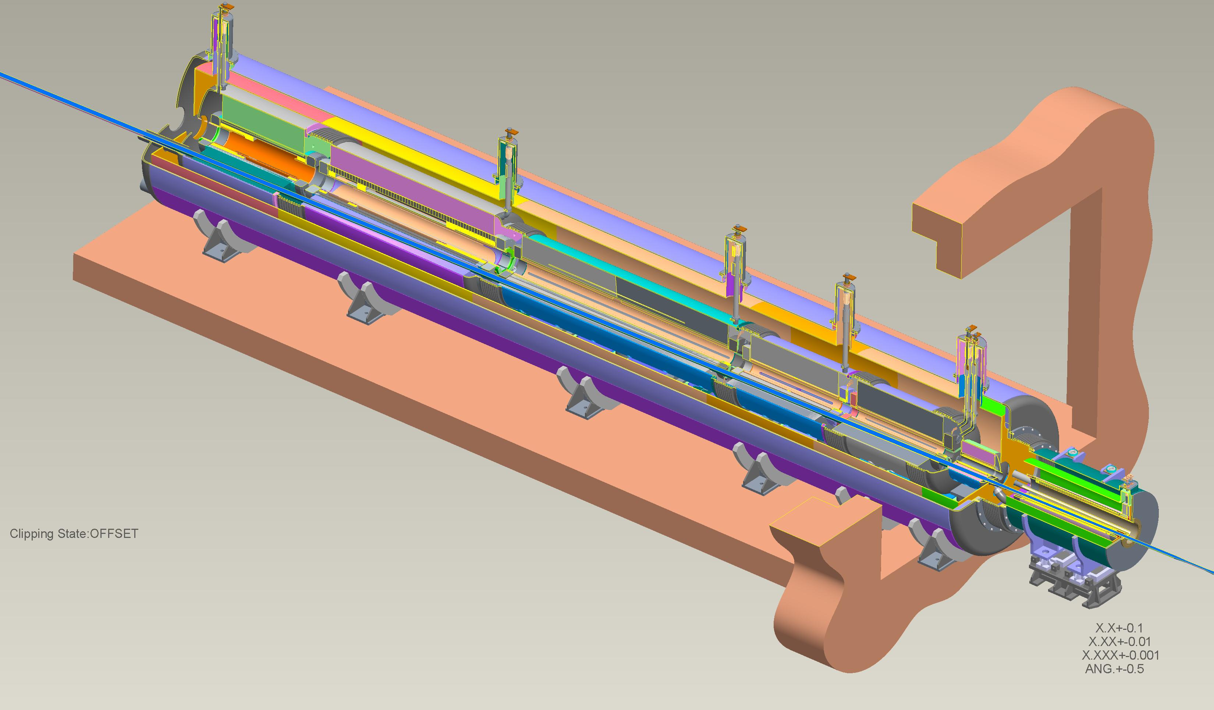
Forward Side, Two Cryostat Layout
Forward Cryostat Inside Tunnel
B0 Cryostat Inside Detector Hall

Slide 29
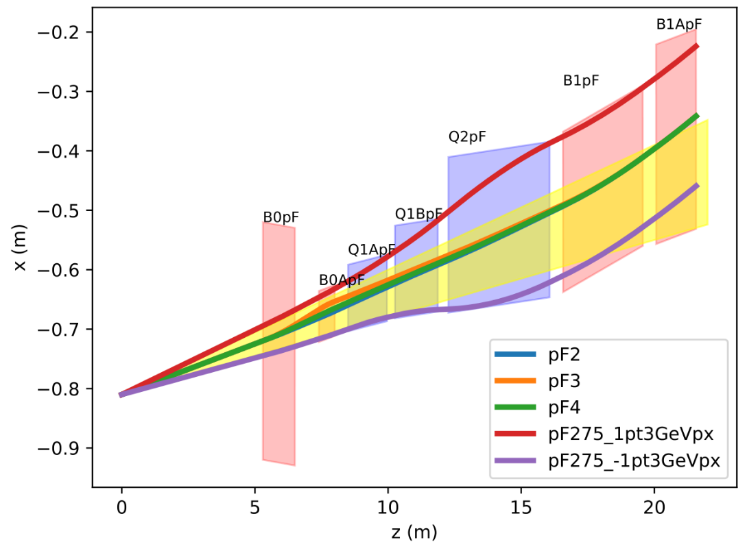
Hadron Forward - Apertures
Magnet aperture optimization:
Magnets tilted and displaced
Magnets split in two (e.g. Q1A and Q1B)
275 GeV
41 GeV
100 GeV
275 GeV
41 GeV
100 GeV
275 GeV +1.3 GeV p_{x}
275 GeV -1.3 GeV p_{x}

Slide 30
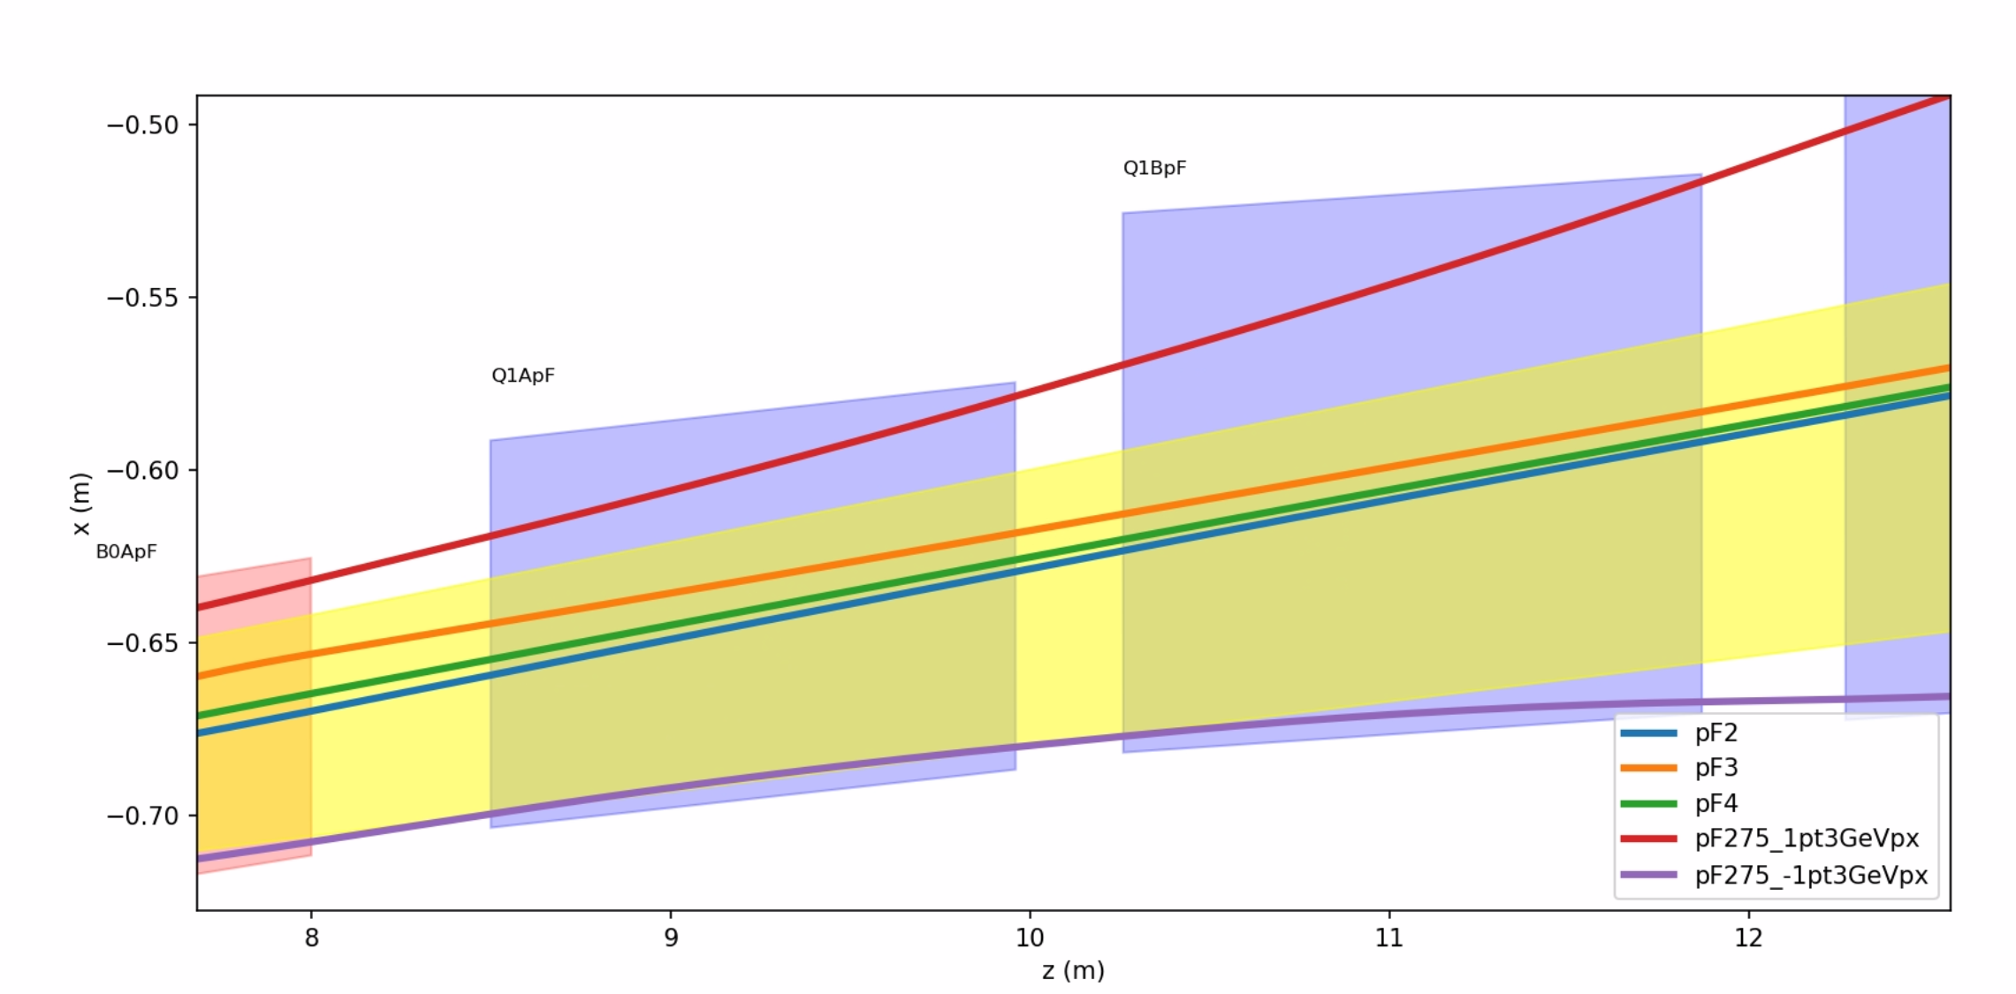
Q1ABpF – New Magnet Concept
Recombining Q1ApF and Q1BpF
275 GeV
41 GeV
100 GeV
275 GeV +1.3 GeV p_{x}
275 GeV -1.3 GeV p_{x}
New magnet – Q1ABpF
Advantages: No end plates, making use of additional space between magnets
Smaller aperture at IP side

Slide 31
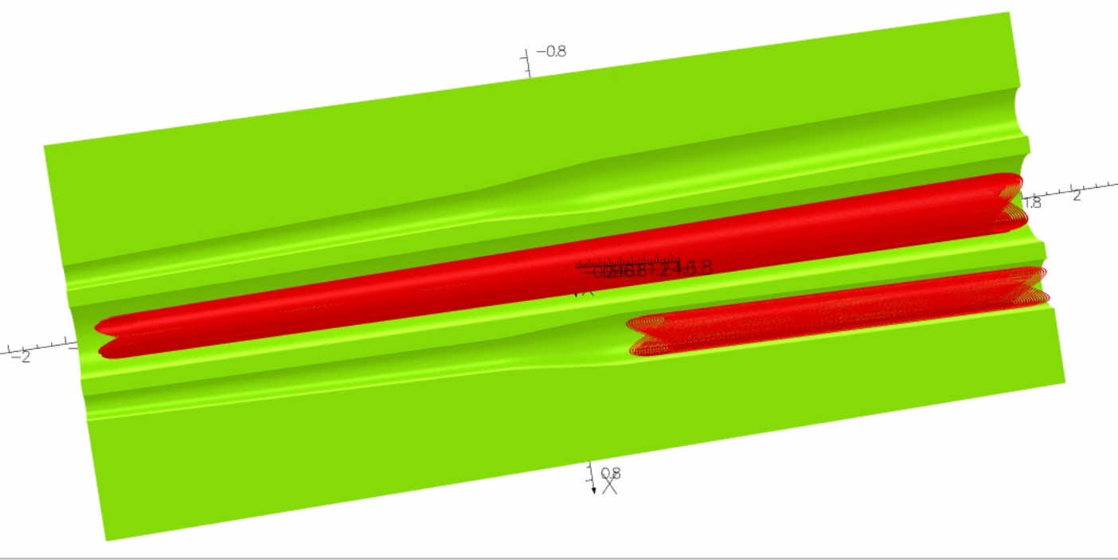
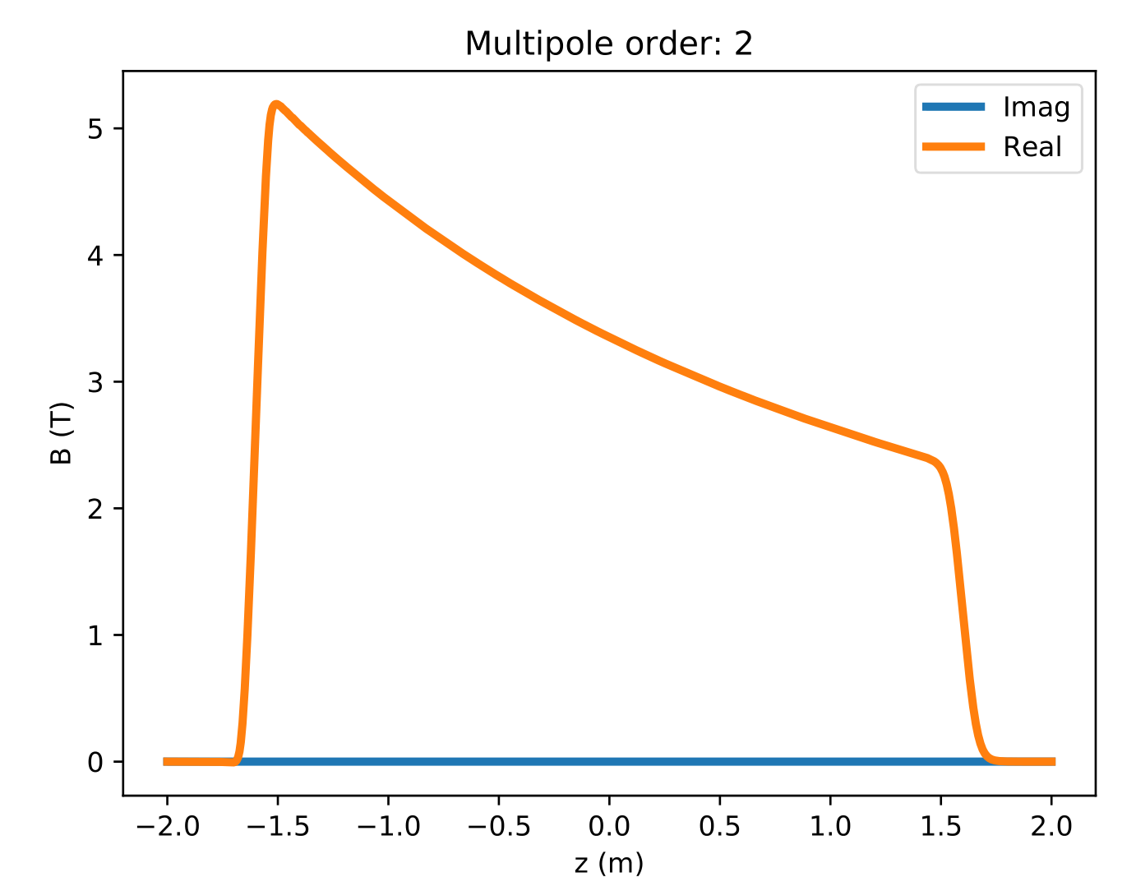

Q1ABpF: Implementation
CCT
  Allows to cancel unwanted harmonics
  Modulation of gradient
Frontloading of gradient
Helps crosstalk / field quality
  Better utilization of space
  Can tailor maximum gradient
Challenges
  Need to prove that this works mechanically
  No collar
Q1ABpF
Q1eF
J_{Σ}
100 → 50 T/m
J₁
J₂
R=50mm

Slide 32



Mechanical Analysis
Ongoing work
  2D/3D
Modeling details 3D
  Opera 3D: Forces
  CATIA: Geometry and fill
  COMSOL: Structural analysis
  Complexity: 1TB RAM
COMSOL 2D
  Contact elements
  Pre-stress, cooldown and Lorentz force

Slide 33



Tapered Double Helix Magnet
Tapered double helix demonstrator
4 layer coil, NbTi, 4.2K
  Aperture: 60..80mm
  L=0.4m
Tested successfully 7/16/2020
  40 T/m, no quench up to short sample
Constant gradient despite taper
H. Witte et al. http://dx.doi.org/10.1109/TASC.2019.2902982
940A/0.6mm²=1567A/mm²

Slide 34


HSR Collimators
Different constraints:
  Different loss behavior for protons/ions
  Cold ring requires good cleaning efficiency in the arcs
  More flexibility on the optics
We can benefit from RHIC and LHC experience.
Planned in IR12 :
  issues with other users due to radiation
  switchyard doubles the second secondary
  Real estate
Momentum collimators are planned for the sector 12 ”D7” dummy.
  Requires cryo-bypass!
Courtesy of G. Robert-Demolaize

