Slide 1


CEPC MDI
Sha Bai
On behalf of CEPC MDI group
65th ICFA Advanced Beam Dynamics Workshop
on High Luminosity Circular e⁺e⁻ Colliders
(eeFACT2022)
2022-09-13

Slide 2
Outline
Introduction
IR beam pipe structure
Background estimation
Mitigation design efforts
  Masks
  Collimators
  Shielding
Thermal Analysis
  HOM heating
  Synchrotron radiation
  Beam loss backgrounds
  Beam pipe thermal analysis
Mechanical Design and Optimization
  Remote vacuum connector
  SC magnet supports
Detector simulation
Summary

Slide 3
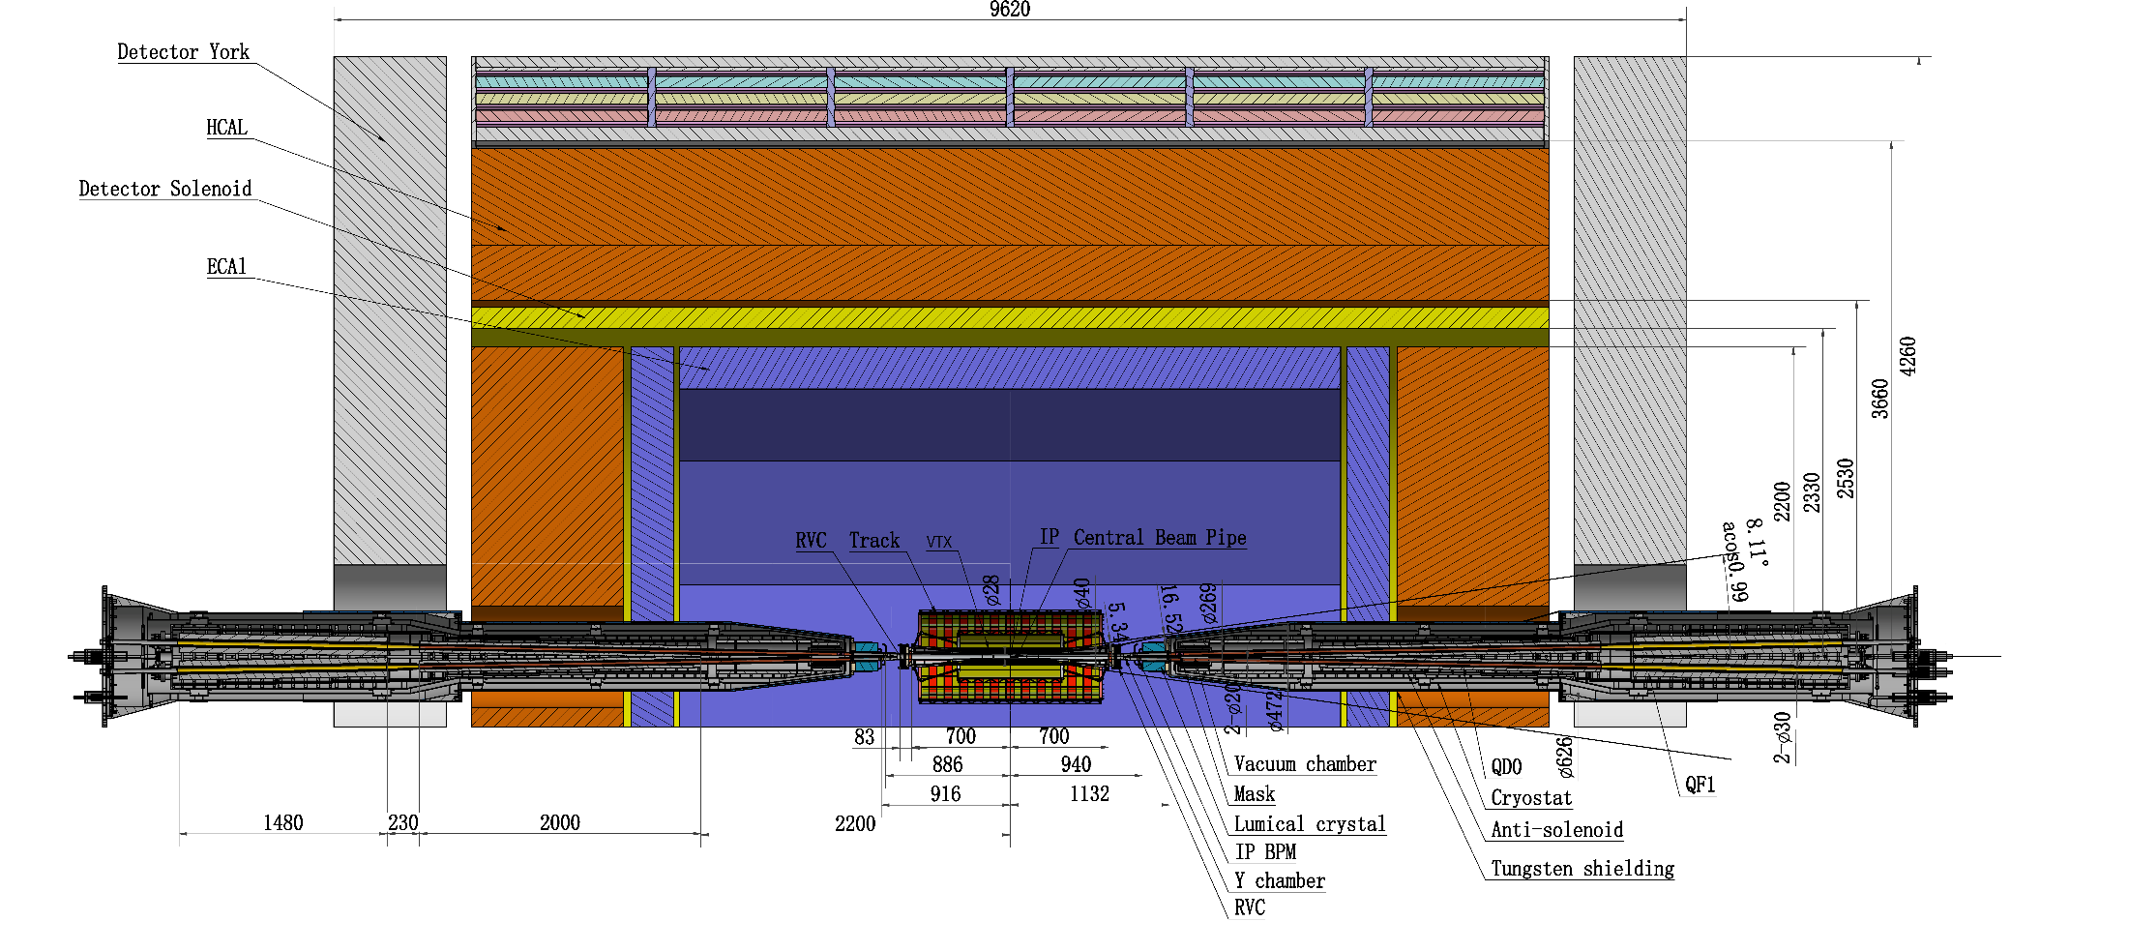
MDI layout and IR design
The Machine Detector Interface (MDI) of CEPC double ring scheme is about ±7m long from the IP.
The CEPC detector superconducting solenoid with 3T magnetic field（2T in Z）and the length of 7.3m.
The accelerator components inside the detector without shielding are within a conical space with an opening angle of cosθ=0.993. Detective angle: acos0.99
The e+e- beams collide at the IP with a horizontal angle of 33mrad and the final focusing length is to 1.9m.

Slide 4
MDI parameters
 | range | Peak filed in coil | Central filed gradient | Bending angle | length | Beam stay clear region | Minimal distance between two aperture | Inner diameter | Outer diameter | Critical energy (Horizontal) | Critical energy (Vertical) | SR power (Horizontal) | SR power (Vertical)
L* | 0~1.9m |  |  |  | 1.9m
Crossing angle | 33mrad
MDI length | ±7m
Detector requirement of accelerator components in opening angle | 8.11˚
QDa/QDb |  | 3.2/2.8T | 141/84.7T/m |  | 1.21m | 15.2/17.9mm | 62.71/105.28mm | 48mm | 59mm | 724.7/663.1keV | 396.3/263keV | 212.2/239.23W | 99.9/42.8W
QF1 |  | 3.3T | 94.8T/m |  | 1.5m | 24.14mm | 155.11mm | 56mm | 69mm | 675.2keV | 499.4keV | 472.9W | 135.1W
Lumical | 0.95~1.11m |  |  |  | 0.16m |  |  | 57mm | 200mm
Anti-solenoid before QD0 |  | 8.2T |  |  | 1.1m |  |  | 120mm | 390mm
Anti-solenoid QD0 |  | 3T |  |  | 2.5m |  |  | 120mm | 390mm
Anti-solenoid QF1 |  | 3T |  |  | 1.5m |  |  | 120mm | 390mm
Beryllium pipe |  |  |  |  | ±120mm |  |  | 28mm
Last B upstream | 64.97~153.5m |  |  | 0.77mrad | 88.5m |  |  |  |  | 33.3keV
First B downstream | 44.4~102m |  |  | 1.17mrad | 57.6m |  |  |  |  | 77.9keV
Beampipe within QDa/QDb |  |  |  |  | 1.21m |  |  |  |  |  |  | 1.19/1.31W
Beampipe within QF1 |  |  |  |  | 1.5m |  |  |  |  |  |  | 2.39W
Beampipe between QD0/QF1 |  |  |  |  | 0.3m |  |  |  |  |  |  | 26.5W

Slide 5
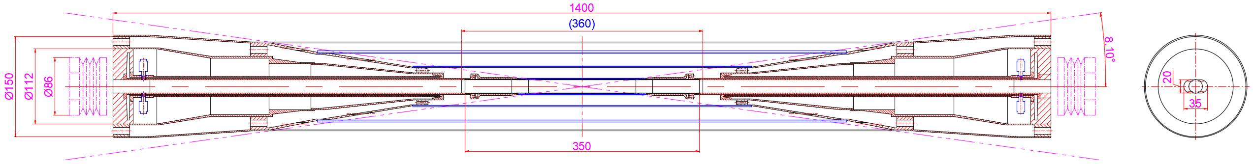
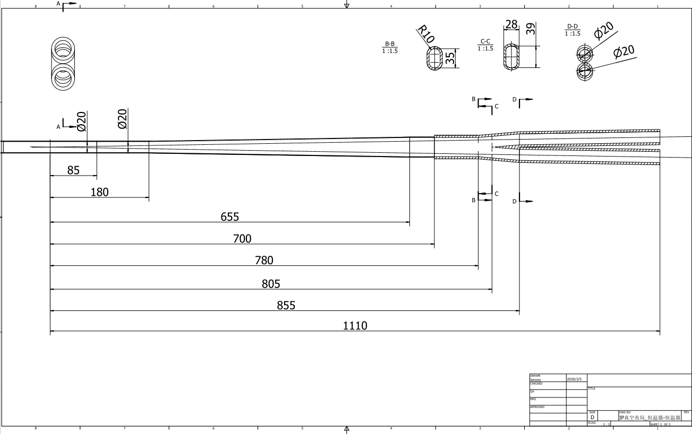
The new central beampipe design
From IP(mm) | Shape | Inner diameter(mm) | Material | Marker
0-85 | Circular | 20 | Be
85~180 | Circular | 20 | Al
180~655 | Cone | 20~35 | Al | Taper: 1:70
655~700 | Circular | 35 | Al
700~780 | Circular | 35 | Cu
780~805 | Cone | 35~39 | Cu
805~855 | Race-track | 39~20 double pipe | Cu
Crotch point at 805mm，with slope，breeches pipe starting point at 855mm，cone，interface point at 700mm

Slide 6
Background estimation
Background sources
  Photon backgrounds: SR, Pair production
  Beam loss backgrounds
    Radiative Bhabha scattering
    Beam Gas scattering
    Beam Thermal photon scattering
  Injection background
Real beam
  Errors
  Beam-beam effect
  Beam tail
  Solenoid
Multi-turn tracking
  Using built-in LOSSMAP with one step ahead output
  SR emitting on
  RF on
  Radtapper on
A. Natochii
Beam loss BG
A. Natochii
Photon BG
Injection BG

Slide 7
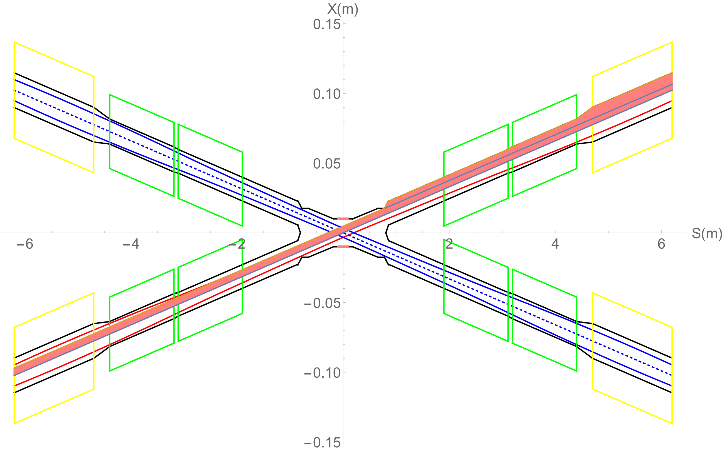
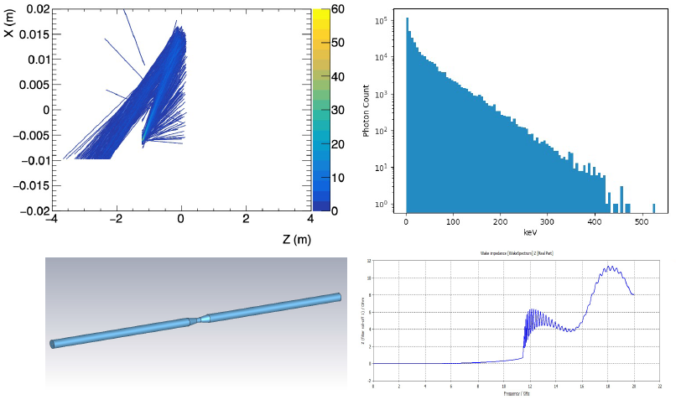
Synchrotron radiation
No SR photons hitting the central beam pipe directly in normal conditions, which is generated from the last bending magnet in the upstream of IP
However, some secondaries generated within the beam pipe of QD would hit the detector beampipe, even the beryllium part. Therefore, the mitigation methods must be studied.
SR photons generated from the FD magnets will hit downstream of the IR beam pipe, and the once-scattering photons will not go into the detector beam pipe but goes to even far away from the IP region.

Slide 8
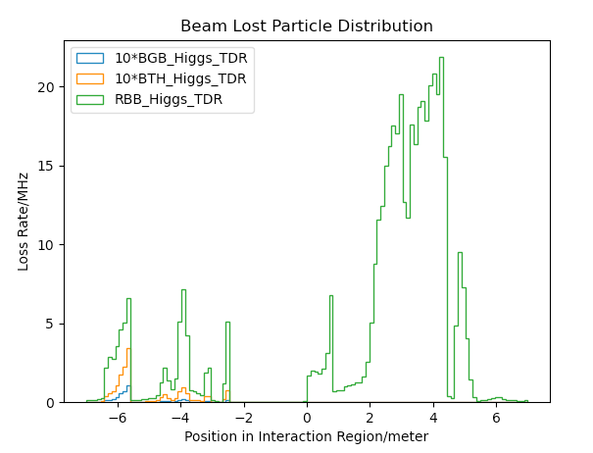
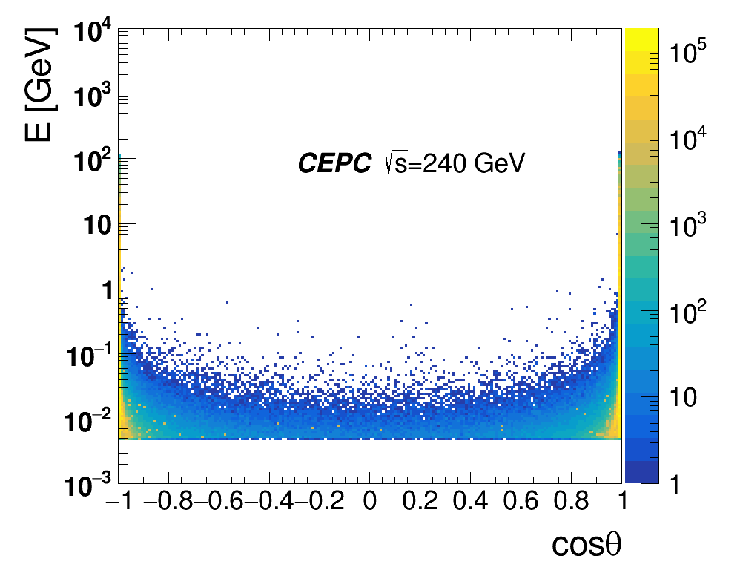
Radiation background
Including Radiative Bhabha scattering, Beam-Gas scattering, Beam Thermal Photon scattering.
Beam loss background from Beamstrahlung almost no in upstream IP, but mainly from pair-production distribution.
name | Position | Distance to IP/m | Beta function/m | Horizontal Dispersion/m | Phase | BSC/2/m | Range of half width allowed/mm
APTX1 | D1I.785 | 44611 | 20.7 | 0.12 | 164.00 | 0.006 | 1~6
APTX2 | D1I.788 | 44680 | 20.7 | 0.12 | 164.25 | 0.006 | 1~6
APTY1 | D1I.791 | 44745 | 105.37 | 0.12 | 165.18 | 0.0036 | 0.156~3.6
APTY2 | D1I.794 | 44817 | 113.83 | 0.12 | 165.43 | 0.0036 | 0.156~3.6
APTX3 | D1O.5 | 1729.66 | 20.7 | 0.06 | 6.85 | 0.00182 | 1~6
APTX4 | D1O.8 | 1798.24 | 20.7 | 0.12 | 7.10 | 0.00182 | 1~6
APTY3 | D1O.10 | 1832.52 | 20.7 | 0.25 | 7.22 | 0.00182 | 0.069~3.3
APTY4 | D1O.14 | 1901.1 | 20.7 | 0.25 | 7.47 | 0.00182 | 0.069~3.3
APTX5 | DMBV01IRU0 | 56.3 | 196.59 | 0 | 362.86 | 0.01178 | 2.9~11.78
Pair-Production Distribution
Beam loss particle distribution with collimator design.
Collimator design meet requirements of beam-stay-clear region, impedance, phase etc on.
4 sets of collimators were implemented per IP per Ring(16 in total)
  2 sets are horizontal(4mm radius), 2 sets are vertical(3mm radius).
One more upstream horizontal collimator sets were implemented to mitigate the Beam-Gas background

Slide 9
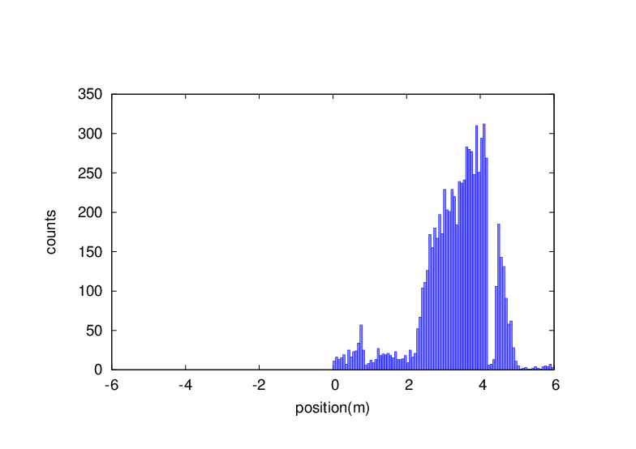
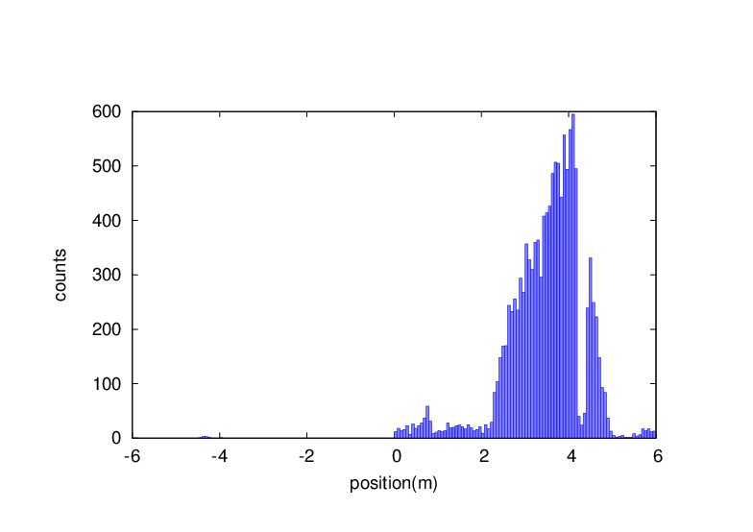
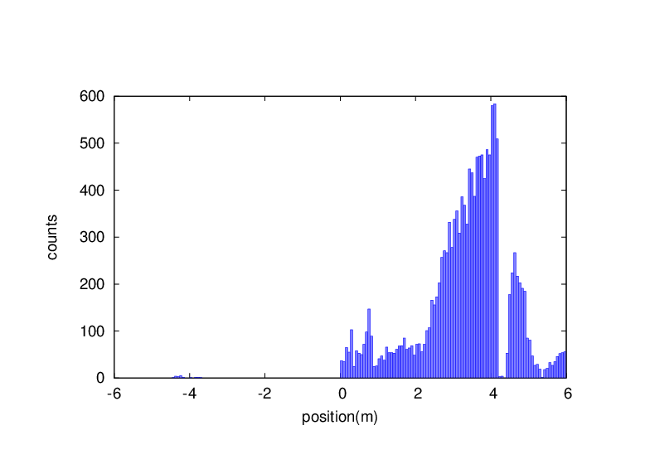
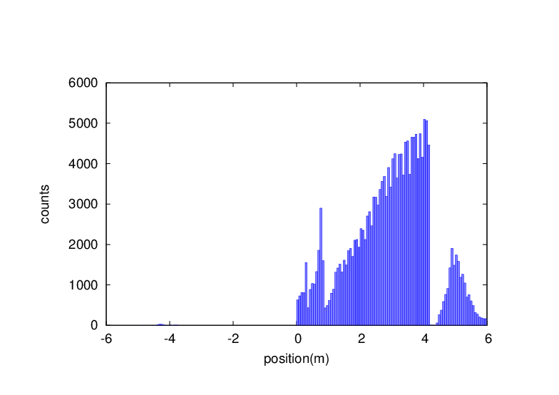

Injection background
RBB is taken into account in all cases
A simplified model of top-up injection beam
Tails from imperfectly corrected X-Y coupling after the injection point
some tolerances to imperfect beams from the booster (e.g. too large emittances)
non-Gaussian distributions existing/building up in the booster and being injected into the main rings
Injection beam parameters
Mode | tt | Higgs | W | Z
Bunch Number | 37 | 240 | 1230 | 3840
Bunch Charge | 0.96 nC | 0.7 nC | 0.73 nC | 0.8 nC
Beam Current(mA) | 0.11 mA | 0.51 mA | 2.69mA | 9.2 mA
Beta_func (x/y) | 200/55 | 200/55 | 200/55 | 200/55
Emittance (nm) | 2.83 | 1.26 | 0.56 | 0.19
Bunch Length (mm) | 2.0 | 2.0 | 1.7 | 0.96
Circular beam
Injection beam
Gaussian beam with 3sigma
Almost no beam loss background in the upstream of the IP, while significantly increased downstream
The existed collimation system can well cope
No effect on the inner layer detector but may damage the outer layer or the endcap detector
BG downstream may damage the SC magnet coils and cause quench.
Tungsten shielding demanded in the IR.
Since the very tight space in the IP region, a tungsten-alloy beam pipe is under design in the CEPC TDR stage.
Gaussian beam with 40sigma
Large emittance ~10times
Large emittance ~1000times
Double gaussian beam
Uniform beam

Slide 10
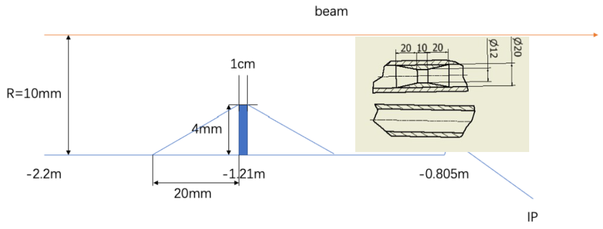
SR mitigation – mask and Au shielding
Methods | Photon hitting number on Be/BX | Deposition power on Be(W)
No mask | 39400.0 | 30.57*e-5
1.21-mask-Cu | 1736.0 | 1.45*e-5
1.21-mask-W | 1698.0 | 1.36*e-5
2.2-mask-Cu | 1147.0 | 0.94*e-5
1.21-mask-Cu-5㎛Au | 216.0 | 0.273*e-5
Masks design(two masks/IP/ring) :
  Tungsten
  One locates at -1.21m with 4mm height and 10mm long
  The other at -4.2m with 0.6mm height
Lots of photons are secondaries, generated within QD0
Photons hitting number on Be/BX reduced by two orders of magnitude
~216 photons/BX could hit Be
  ~2.73x10⁻⁶ W deposition power on Be beampipe

Slide 11
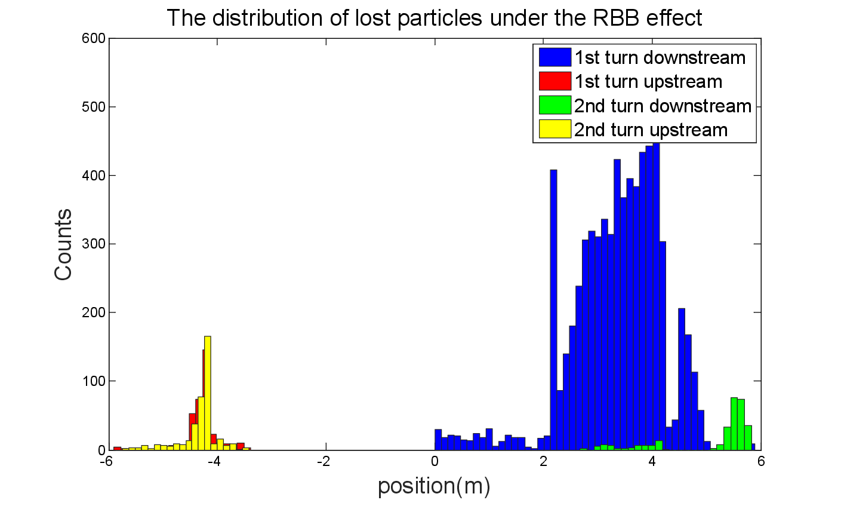
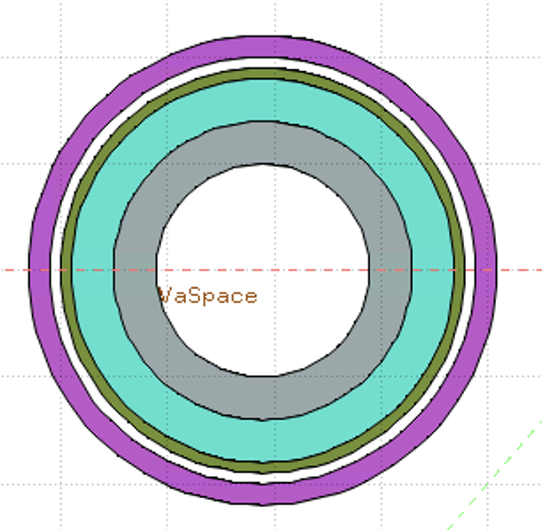
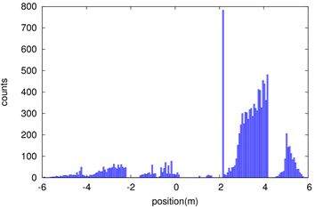
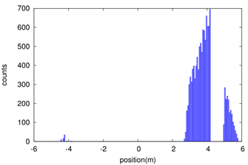
Shielding
Beam loss in the downstream IR with a large amount, due to the process of radiative bhabha scattering, beamstrahlung, beam-gas scattering, beam thermal photon scattering.
Radiation dose may damage the SC magnet coil and the detector.
solution
1. Tungsten IR beam pipe,
2. Combined iron and tungsten yoke of SC magnet
Key Issues on Calculation and Simplification of Beam pipe model
Pure tungsten IR beam pipe with 4mm thickness without cooling taken into account, simulate the Absorbed Dose on Coil (Region)
Only Beam-Gas beam loss is taken into account until now
Take the loss rate calculated by SAD into account:
  ~0.00166 Gy/s(0.166rad/s)
  ~14.35 Gy/day
  ~36662.49 Gy/lifetime(Higgs plans to run 7 years)
  Limit is 100000 Gy/lifetime
White: Vacuum
Gray: Tungsten Pipe
Light Green: Helium
Heavy Green: Stainless Steel Vassel
Pink: Coil

Slide 12
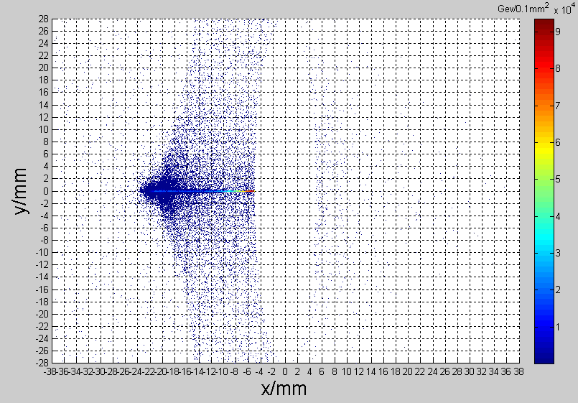
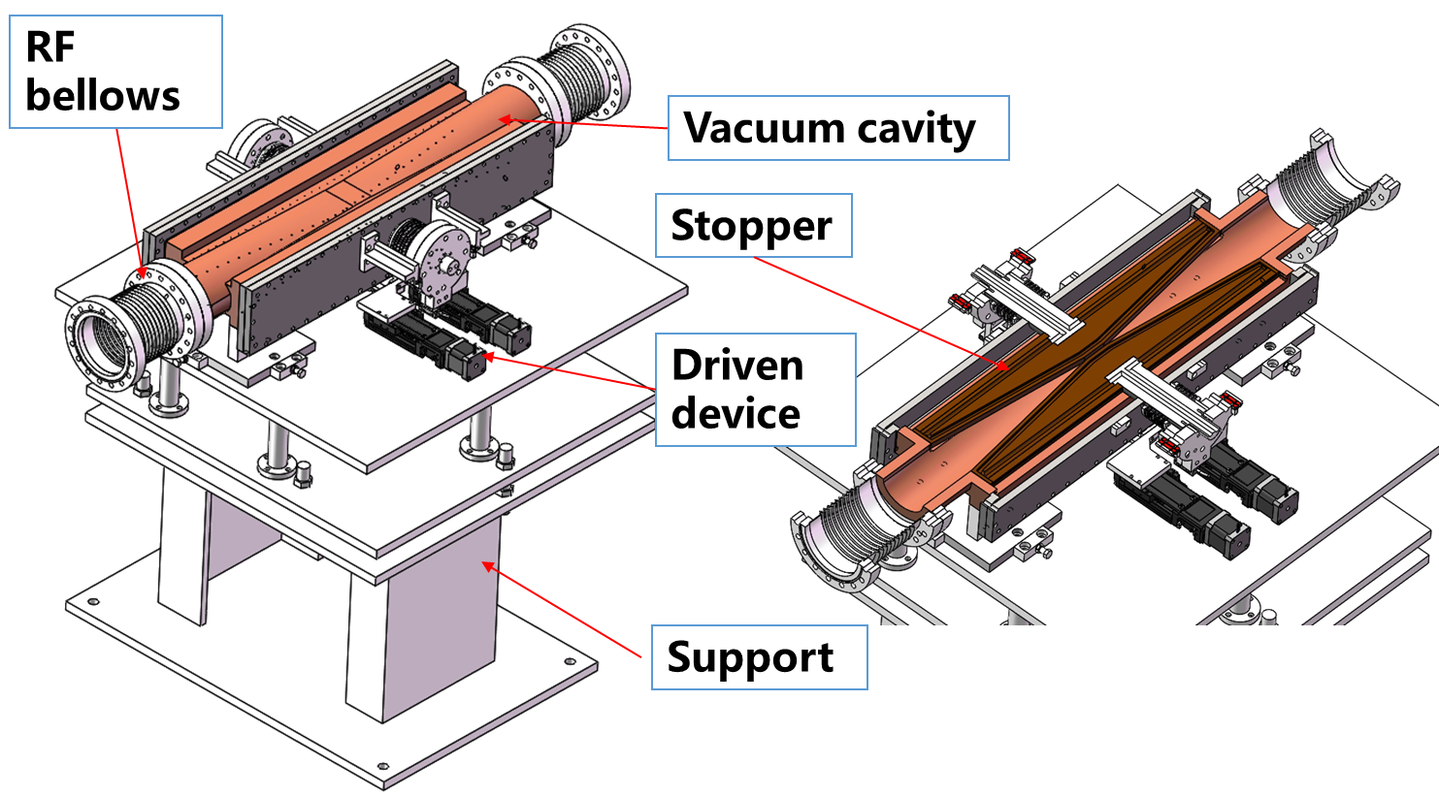
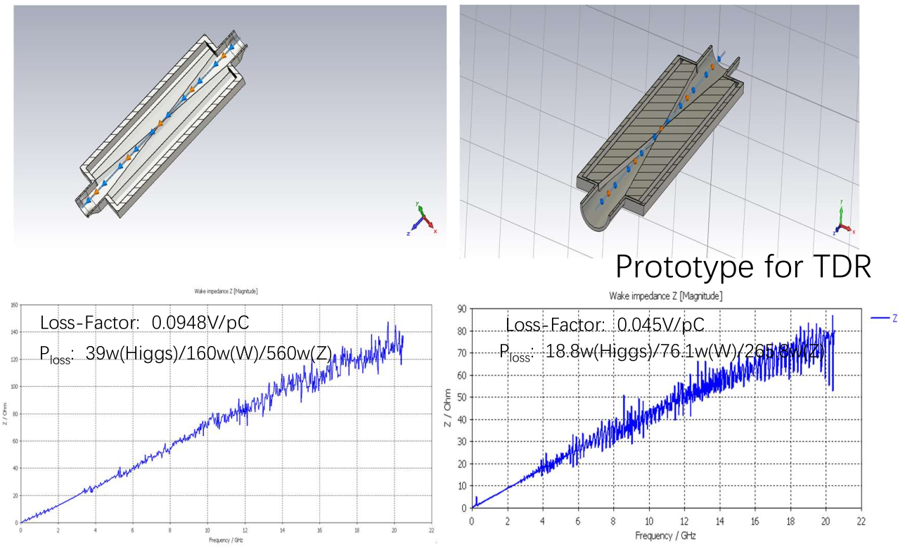
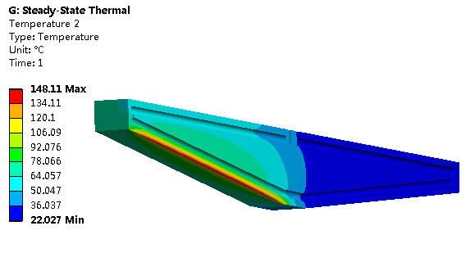
Movable collimators
Located in straight section between two dipoles, the length is 800 mm.
SR power: 9.3kW @Higgs, 30MW
  Particle deposition:
  Jaw material: Cu
  Total heat generation: 91.6 W
  Maximum temperature raise by particle-material reaction: 2℃
Highest temperature: 148 ℃

Slide 13
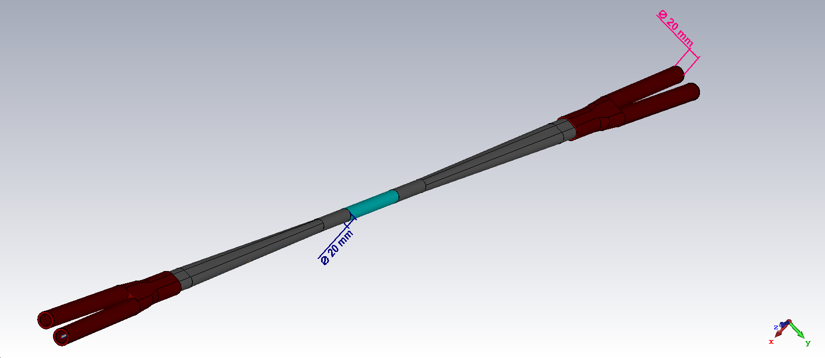
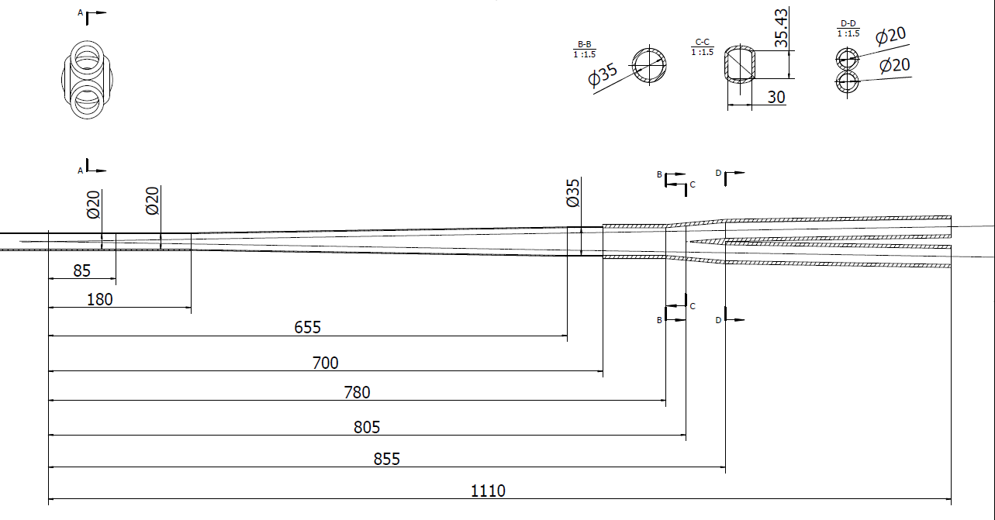
HOM power distribution
results for MDI 20mm-20mm
Transition region: Racetrack (including materials)
σ_{z}=5mm: Two beam in the IR
Loss factor Trap in IR @k_trap: 0.032v/pc
P_{trap}: H/W/Z/tt: 24.0w/117.1w/1160.8w/6.67w
Position | Position Start-end（mm） | material | Length (mm) | Higgs(w) & (w/cm²) | W (w) & (w/cm²) | Z(w) & (w/cm²) | ttbar（w） & (w/cm²)
Be pipe (w) | 0-85 | Be | 85 | 1.13 & 0.021 | 5.587 & 0.105 | 55.295 & 1.35 | 0.31 & 0.005
Be pipe transition(w) | 85-180 | Al | 95 | 0.61 & 0.01 | 2.950 & 0.049 | 29.280 & 0.491 | 0.172 & 0.007
Transition pipe (w) | 180-655 | Al | 475 | 6.99 & 0.017 | 34.48 & 0.085 | 341.562 & 0.83 | 1.958 & 0.005
Transition （w） | 655-700 | Al | 45 | 0.62 & 0.015 | 2.95 & 0.071 | 29.28 & 0.701 | 0.172 & 0.004
RVC bellow（w） | 700-780 | Cu | 80 | 0.52 & 0.007 | 2.532 & 0.034 | 25.002 & 0.337 | 0.14 & 0.002
Transition on Y-crotch | 780-805 | Cu | 25 | 0.16 & 0.007 | 0.785 & 0.032 | 7.822 & 0.316 | 0.05 & 0.002
Y- crotch (w) | 805-855 | Cu | 50 | 0.33 & 0.005 | 1.572 & 0.024 | 15.626 & 0.241 | 0.091 & 0.002
Quadrupole pipe(w) | 855-1100 | Cu | 245 | 1.58 & 0.005 | 7.735 & 0.024 | 75.594& 0.24 | 0.434 & 0.002
Total | 0-1100 | - | 1100 | 12.0 &0.011 | 58.594 &0.056 | 580.46 & 0.56 | 3.331 & 0.003

Slide 14
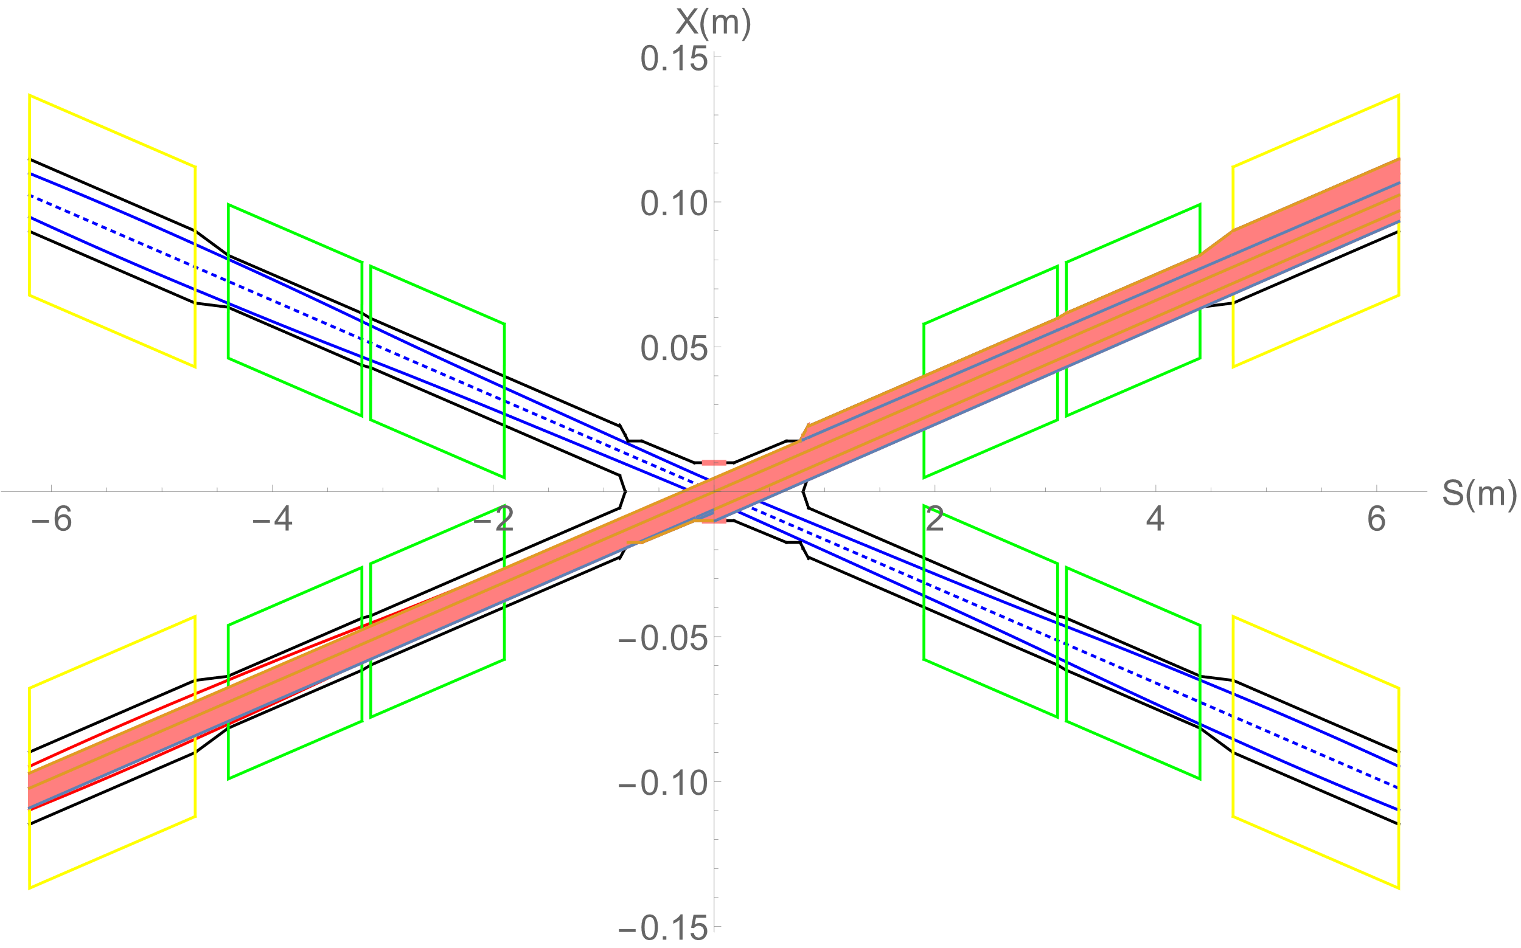
Heat load from SR
In normal conditions, there is no SR photons hitting the central beam pipe.
Single layer beam pipe with water cooling, SR heat load is not a problem.
In abnormal conditions, SR photons hitting the bellows (no cooling) and berrylium pipe under the extreme beam conditions , since it is a transient effect, heat load is not a problem.
Region | SR heat load | SR average power density
0~780mm | 0 | 0
780mm~805mm | 23.04W | 256W/cm²
805mm~855mm | 53.39W | 296.6W/cm²
855mm~1.9m(QDa entrance） | 4.32W | 1.15W/cm²
QDa | 3.28W | 0.75W/cm²
QDa~QDb | 22.92W | 79.58W/cm²
QDb | 3.96W | 0.91W/cm²
QDb~QF1 | 71.04W | 65.8W/cm²
QF1 | 7.26W | 1.34W/cm²
In extreme cases ~ at least 10 times per day. The beam will be stopped within 0.5ms when abnormal.
The background of the detector and radiation dose should be considered under abnormal conditions.

Slide 15
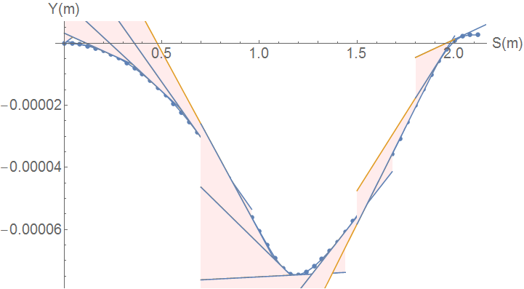
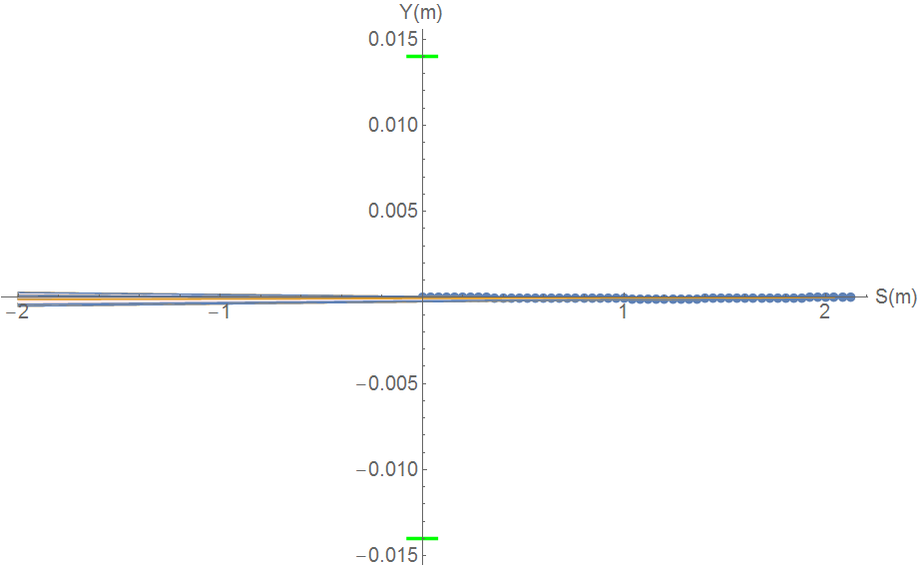
SR from solenoid combined field
Horizontal trajectory will couple to the vertical
Due to the sol+anti-sol field strength quite high, maximum~4.24T, transverse magnetic field component is quite high.
SR from vertical trajectory in sol+anti-sol combined field should be taken into account.
SR fan is focused in a very narrow angle from
-116urad to 131urad
SR will not hit Berryllium pipe, and no background to detector.
SR will hit the beam pipe ~213.5m downstream from IP
Water cooling is needed.
Maximum: 670keV
Maximum: 31W

Slide 16
Heat load in IR from beam loss background
Region | RBB | Beamstrahlung | Beam-Gas | BTH
Berryllium pipe | 6.7mW | 0 | 0 | 0
Detector beam pipe | 0.024W | 0 | 4.8uW | 1.2uW
Accelerator beam pipe before QDa | 0.17W | 0 | 4.2uW | 1.2uW
QDa~QDb | 2.13W | 3.8uW | 5.9uW | 1.8uW
QDb~QF1 | 0.01W | 3.8uW | 0.5uW | 0.6uW
QF1 | 0.26mW | 0 | 3.7uW | 0.66uW
Beam loss particles from the process of radiative Bhabha scattering, Beamstrahlung, Beam-Gas scattering, and beam-thermal photon scattering hitting the IR beam pipe
Heat load in IR from beam loss background is so small, compared to synchrotron radiation and HOM.
The photons generated from the process of radiative Bhabha scattering, Beamstrahlung, and Beam-Gas scattering with small angle and large energy, still under analysis.

Slide 17
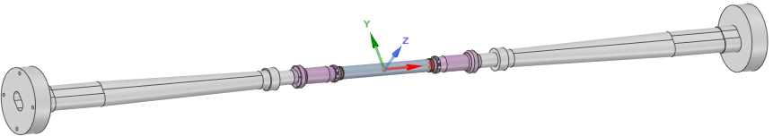
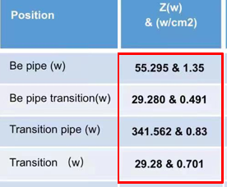
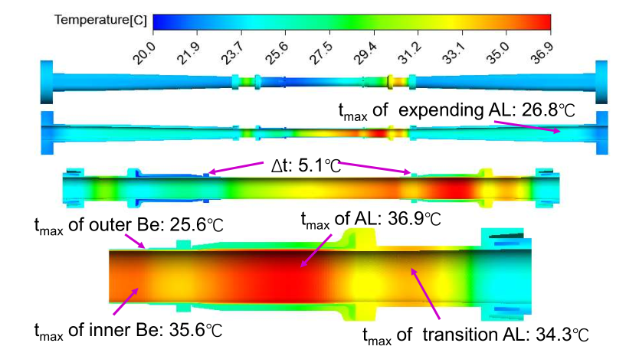
Beam pipe thermal analysis
Calculation model and condition
Heat source distribution
Extending pipe:
2 inlet pipe, 2 outlet pipe
Coolant: water
Inlet temperature: 20℃
Inlet velocity: 0.5m/s（1.7L/min）
Be pipe:
4 inlet pipe, 4 outlet pipe
Coolant: paraffin
Inlet temperature: 20℃
Inlet velocity: 0.5m/s（0.8L/min）
Extending pipe:
2 inlet pipe, 2 outlet pipe
Coolant: water
Inlet temperature: 20℃
Inlet velocity: 0.5m/s（1.7L/min）
Calculation results:
Temperature difference ~5.1⁰C between two sides of the first layer detector
Temperature low, temperature difference small, meet the requirement

Slide 18
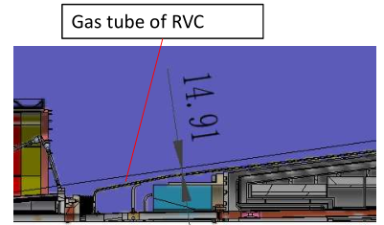
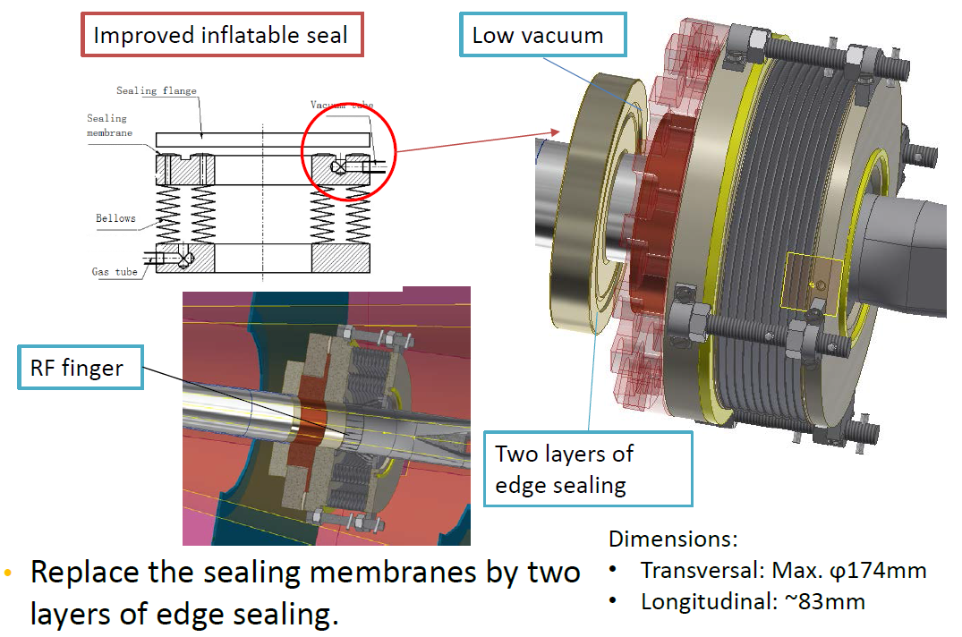
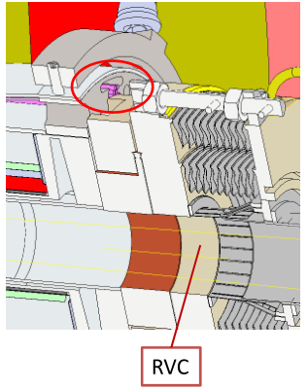
Remote vacuum connector
RVC distance to detective angle : 14.91mm (gas tube)
No interference for this design!

Slide 19
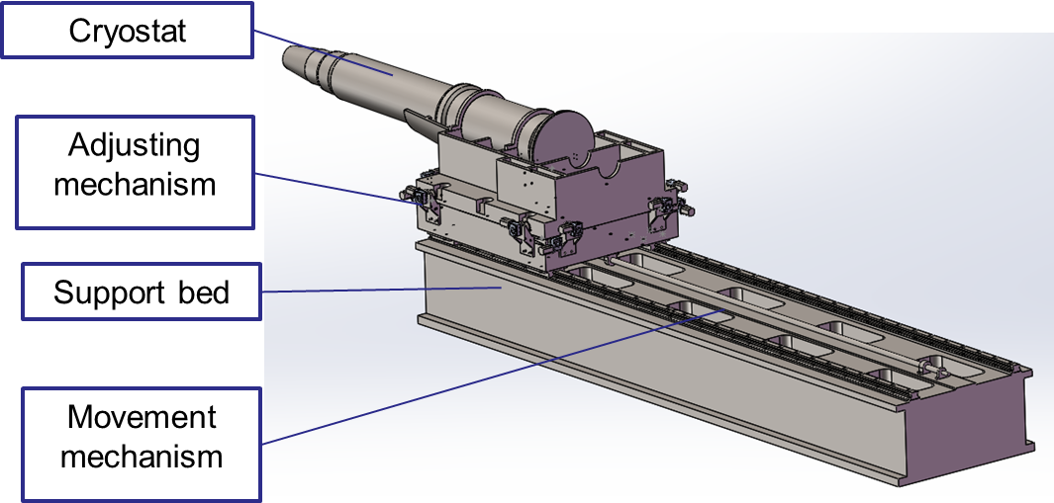
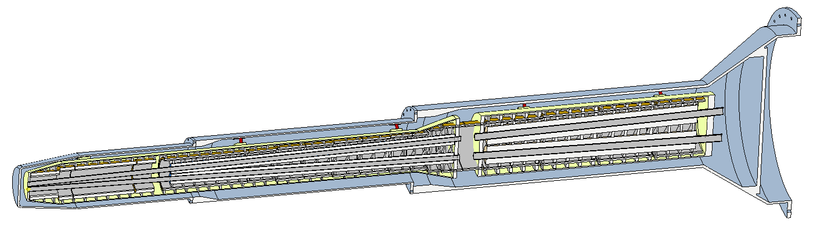
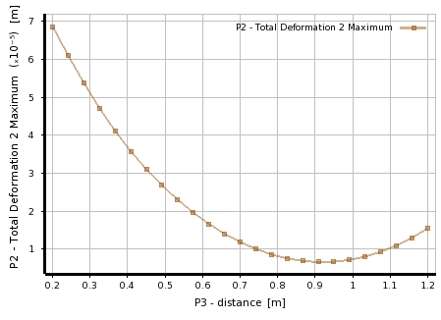
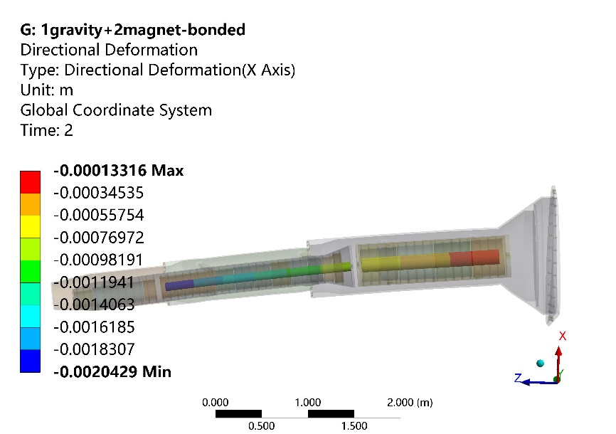
SC magnet supports
The cryostat is about 5.5 m long. The cantilever length is 3.6~5.5 m.
Vacuum vessel
Helium vessel
QF1
QD0
Anti-solenoid
Support rods
Magnet | Support | Optimized uneven deformation (um)
QD0 | Skeleton | 2.1
 | Solid | 3.2
QF1 | skeleton | 0.8
The cryostat was 5 meters long with18 mm thick stainless wall. The maximum deformation was 190 um.
The uneven deformation reduced significantly with structure optimization within the cryostat

Slide 20
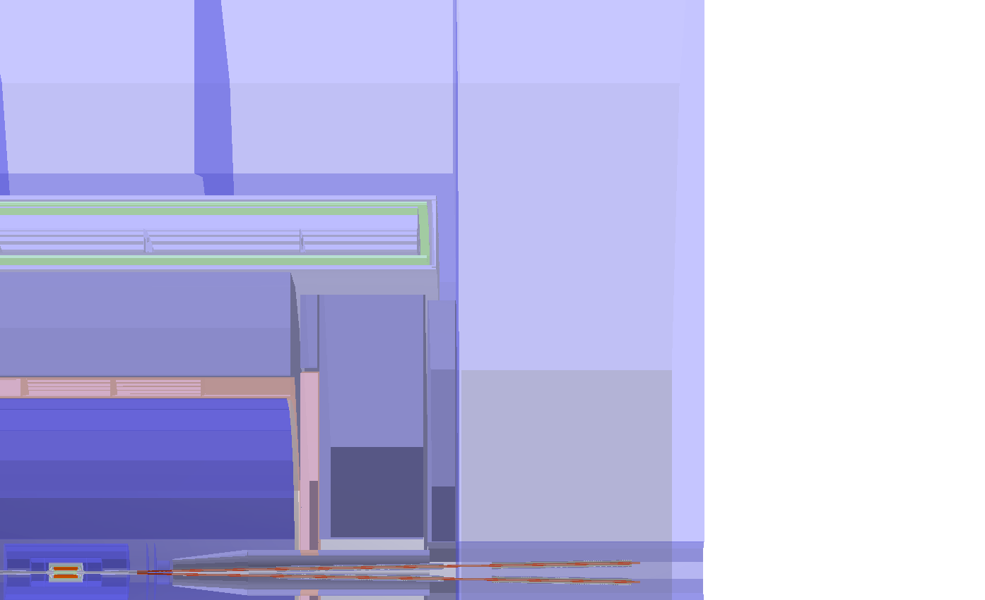
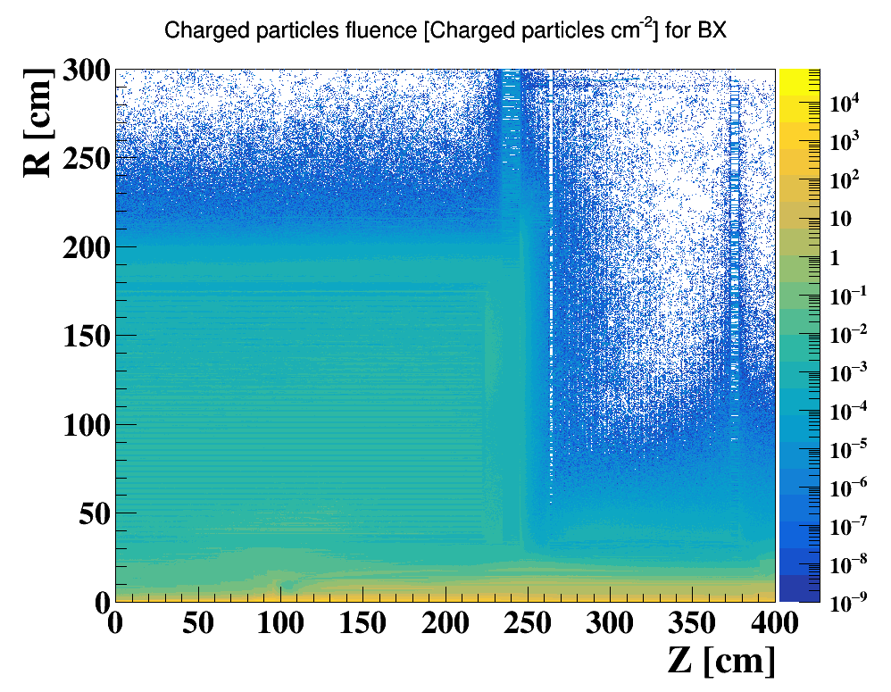
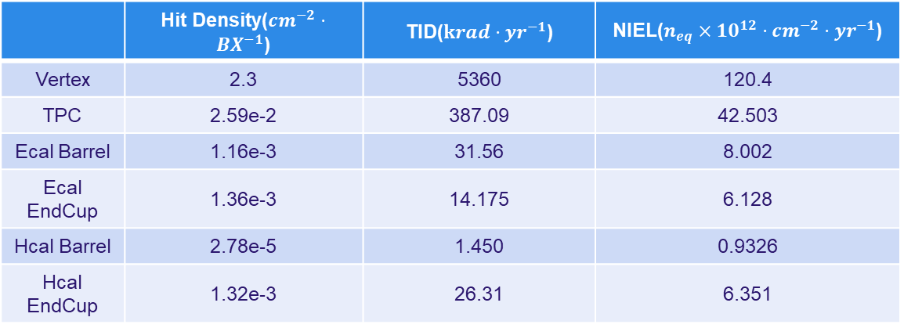
Full Detector Simulation
Two Main Concern has been taken for detector impacts:
  Detecting Efficiency(Occupancy): The ratio of Data/Noise
  Detector Safety: Radiation Tolerance/Cooling Issues
Three quantities has been scored:
  Charged Particle Fluence(Hit Density)
  Total Ionizing Dose(TID)
  1 MeV Silicon Equivalent Fluence(NIEL)
  A Safety of 10 is always applied to all results
Could reach Ecal and outside
Characterized by Hit Density, TID and NIEL
Yoke(barrel)
300cm
Solenoid
Yoke(Endcap)
HCal
200cm
HCal
TPC
End cap ring
400 cm
Higgs ~ 50MW
EMC
Yoke plugin
 | Hit Density($cm^{−2}⋅BX^{−1}$) | TID($krad⋅yr^{−1}$) | NIEL($n_{eq}×{10}^{12}⋅cm^{−2}⋅yr^{−1}$)
Vertex | 2.3 | 5360 | 120.4
TPC | 2.59e-2 | 387.09 | 42.503
Ecal Barrel | 1.16e-3 | 31.56 | 8.002
Ecal EndCup | 1.36e-3 | 14.175 | 6.128
Hcal Barrel | 2.78e-5 | 1.450 | 0.9326
Hcal EndCup | 1.32e-3 | 26.31 | 6.351

Slide 21
Summary
The MDI layout has been renewed. Compatible and no interference for the design.
New Φ20mm IR beam pipe is designed and renewed.
The estimation of the radiative background from photon background, beam loss background and injection background has been updated.
The mitigation efforts of every kinds of background dedicated to the mask, collimator and shielding has been designed.
The thermal analysis including HOM heating, synchrotron radiation, beam loss background and beam pipe thermal analysis meet the requirement.
Some key devices such as remote vacuum connector and SC magnet supports are designed. The uneven deformation reduced significantly with structure optimization within the cryostat.
The full detector simulation shows the impact on detector small enough.

Slide 22
Thanks

