Slide 1
Realization, Timeline, Challenges and Ultimate Limits of Future Colliders
Vladimir Shiltsev (Fermilab)
eeFACT’22 – 65th ICFA BD Workshop (INFN Frascati, Sep 12-15, 2022)
12 September 2022

Slide 2
Content (Plan)
Snowmass’21 Accel. Frontier (4 slides)
Implementation Task Force (7 slides)
On Limits of Colliders (17 slides)

Slide 3
https://www.snowmass21.org/
Snowmass’21 Discussions (incl. colliders)
“Snowmass is a particle physics community study”
Organized by APS DPF, DPB, et al
Snowmass provides input to P5 (Particle Physics Project Prioritization Panel)
which develops
a 10-20 yrs strategy for
the US HEP program
1.5-2 yrs
Snowmass
~7 yrs of
hard work
P5
~ 1 yr
Particle Physics
Project Prioritization Panel
DOE/NSF
Particle Physics is global
Particle Physics is not isolated

Slide 4
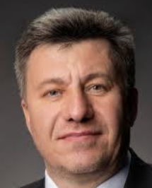
Snowmass’21 Accelerator Frontier Conveners
Steve Gourlay (LBNL)
Tor Raubenheimer (SLAC)
Vladimir Shiltsev (FNAL)
Topical Group |  | Topical Group co-Conveners
AF01 | Beam Phys & Accel. Education | Z. Huang (Stanford) | M. Bai (SLAC) | S. Lund (MSU)
AF02 | Accelerators for Neutrinos | J. Galambos (ORNL) | B. Zwaska (FNAL) | G. Arduini (CERN)
AF03 | Accelerators for EW/Higgs | F. Zimmermann (CERN) | Q. Qin (ESRF) | G.Hoffstaetter (Cornell) A.Faus-Golfe (IN2P3)
AF04 | Multi-TeV Colliders | M. Palmer (BNL) | A. Valishev (FNAL) | N. Pastrone (INFN) J.Tang (IHEP)
AF05 | Accelerators for PBC and Rare Processes | E. Prebys (UC Davis) | M. Lamont (CERN) | Richard Milner (MIT)
AF06 | Advanced Accelerator Concepts | C. Geddes (LBNL) | M. Hogan (SLAC) | P. Musumeci (UCLA) | R. Assmann (DESY)
AF07 | Accelerator Technology R&D
 | Sub-Group RF | E. Nanni (LBNL) | H.Weise (DESY) | S. Belomestnykh (FNAL)
 | Sub-Group Magnets | G. Sabbi (LBNL) | S. Zlobin (FNAL) | S. Izquierdo Bermudez (CERN)
 | Sub-Group Targets/Sources | C. Barbier (ORNL) | Y. Sun (ANL) | Frederique Pellemoine (FNAL)

Slide 5
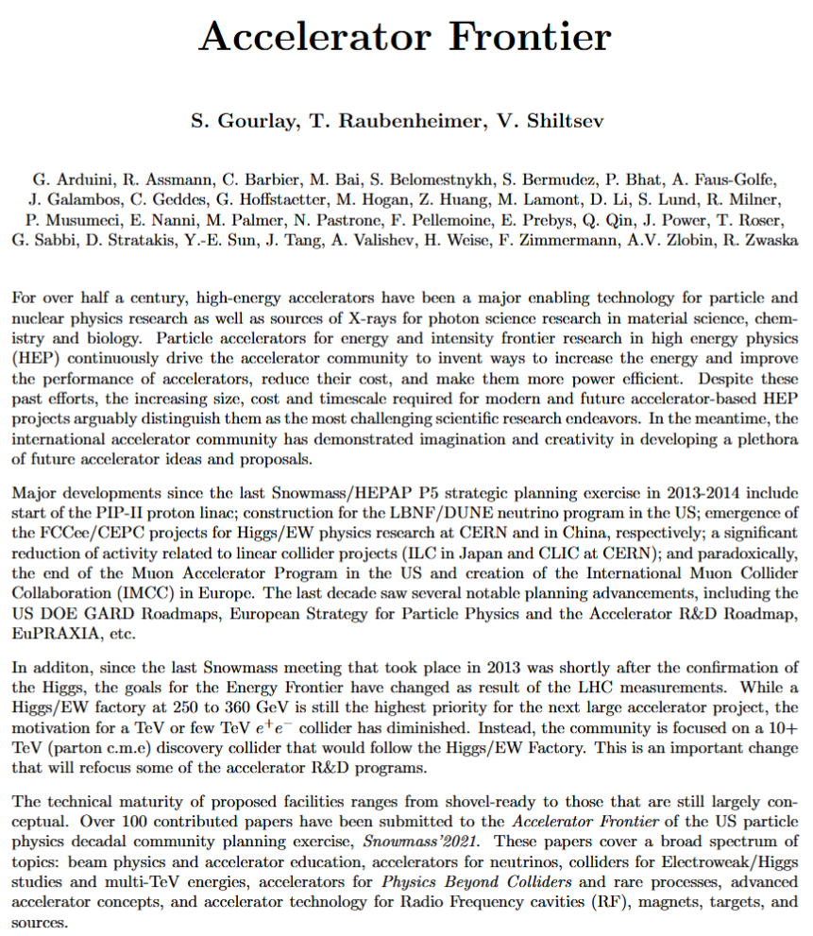
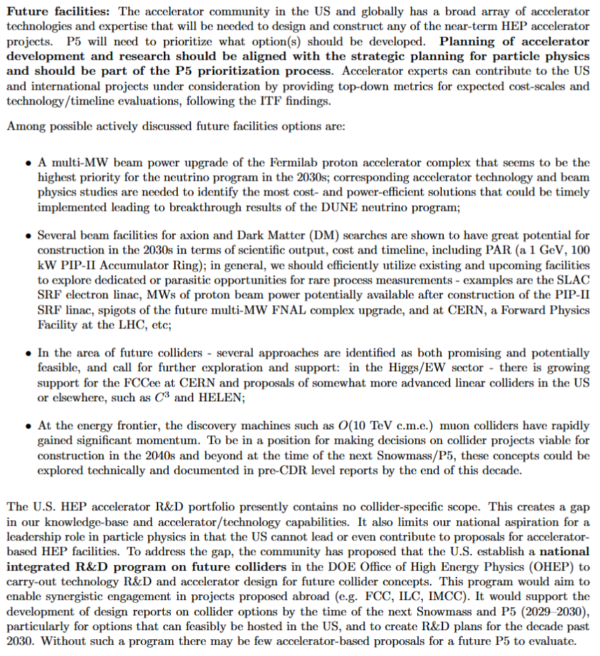
AF Report: Exec. Summary
“Intro”:
Since last P5, this Snowmass’21 process
“Future Facilities”:
TBD by P5 – accelerator/people need to be part of P5; ITF analysis can greatly help
Multi-MW FNAL complex upgrade will be priority for NF in 2030 (AF ready)
Many opportunities for Rare Processes (AF ready), incl. PAR and utilize what we have
Several Higgs/EW factories are feasible: FCCee, C3 and HELEN to be explored
O(10 TeV/parton) needed for >2040’s, muon colliders to be explored/ pre-CDR by 2030
Need an Integrated Future Colliders R&D program in OHEP to provide design reports by next Snowmass/P5’2030 and engage internationally (FCC, ILC, IMCC)

Slide 6
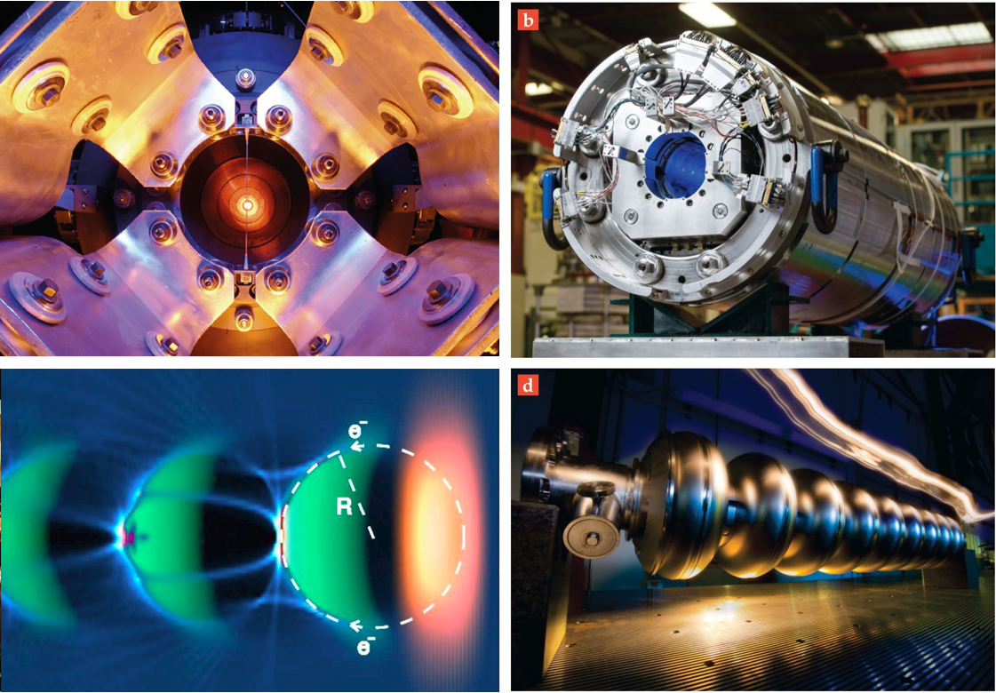
Multi-MW targets: - 2.4 MW for PIP-III - 4-8 MW for muon collider
Accelerator R&D: Next Decade
Magnets for
colliders and RCSs: - 16T dipoles
- 40T solenoids - 1000 T/s fast
cycling ones
…coordinated
with US MDP
Accelerator & Beam Physics
High intensity/brightness beams acceleration and control
High performance computer modeling and AI/ML approaches
Design integration and optimization, incl energy efficiency
Wakefields: - collider quality beams
- efficient drivers and staging
- close coordination with Int’l (Euro Roadmap, EUPRAXIA,..)
SC/NC RF: - 70-120 MV/m C³
- 70 MV/m TW SRF
new materials, high Q₀
efficient RF sources
Full AF “final draft” report available and via https://snowmass21.org/accelerator/start

Slide 7
Part II
Collider Implementation Task Force
(Snowmass’21 Accelerator Frontier)

Slide 8
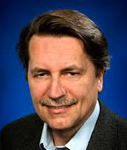
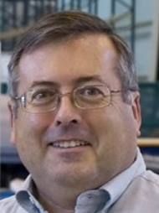
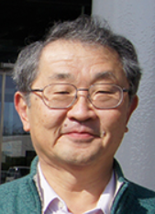
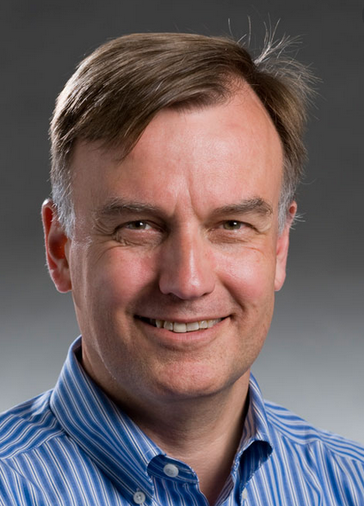
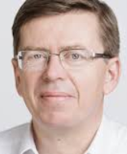
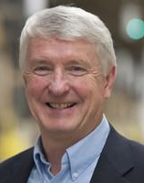
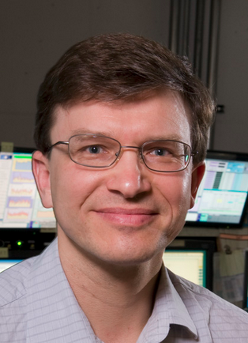
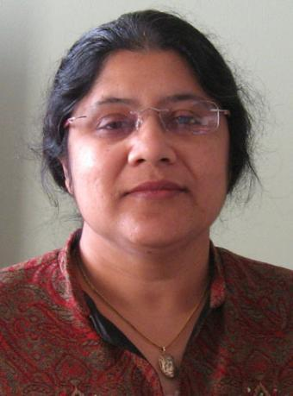
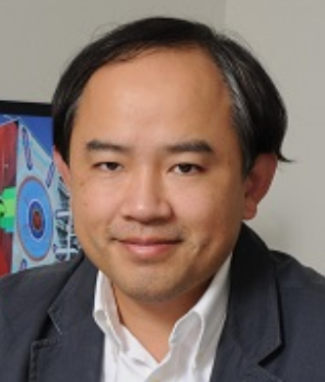
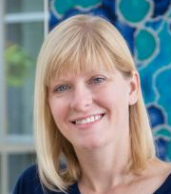
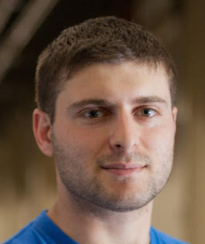
Implementation Task Force
https://arxiv.org/abs/2208.06030
The Accelerator Frontier Implementation Task Force (ITF) is charged with developing metrics and processes to facilitate a comparison between collider projects:
Higgs/EW factories (focus of slides below)
Lepton colliders with 3 TeV cme
Lepton and hh colliders 10+ TeV cme
FNAL site-fillers and eh colliders
ITF addressed (four subgroups):
Physics reach (impact), beam parameters
Size, complexity, power, environment
Technical risk, readiness, and R&D required
Cost and schedule
Thomas Roser (BNL, Chair)
Philippe Lebrun (CERN)
Steve Gourlay (LBNL)
Tor Raubenheimer (SLAC)
Katsunobu Oide (KEK)
Jim Strait (FNAL)
Vladimir Shiltsev (FNAL)
Reinhard Brinkmann
(DESY)
John Seeman (SLAC)
REPORT
Dmitry Denisov (BNL)
Meenakshi Narain (Brown U.)
Liantao Wang (U.Chicago)
Sarah Cousineau (ORNL)
Marlene Turner (LBNL)
Spencer Gessner (SLAC)
Below I mostly follow T.Roser presentation in Seattle

Slide 9
Proposals – Higgs/EW Physics

Slide 10
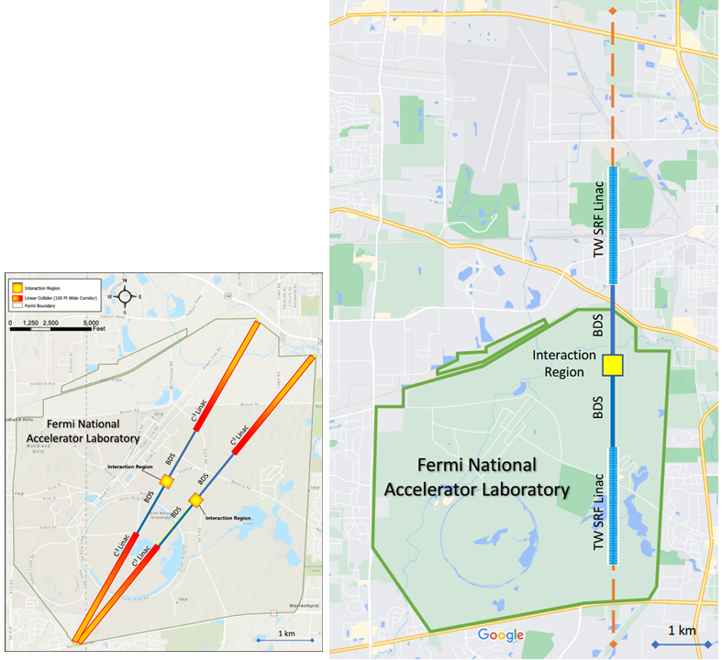
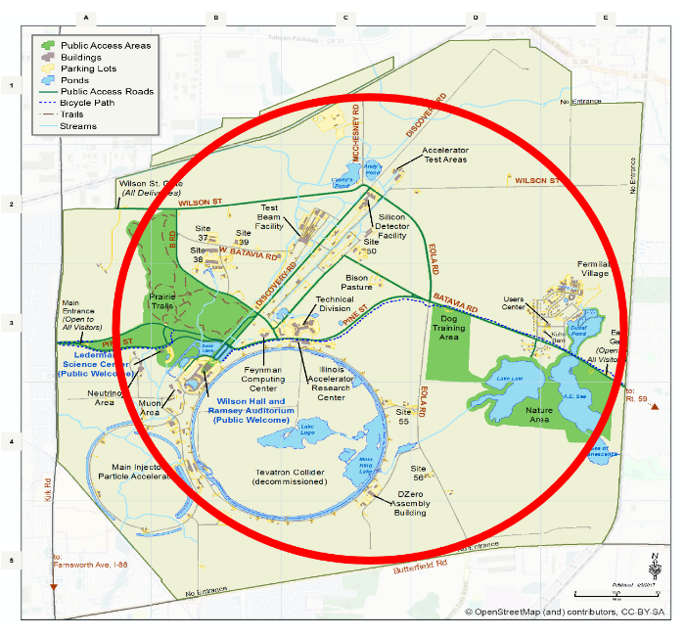
250 GeV cme Fermilab Site-Fillers
CCC
HELEN
16-km collider e+e- ring
cool- or SC-RF e+e- linear colliders
7-km for 250 GeV, 12-km 0.5+ TeV
https://arxiv.org/abs/2203.08088
https://arxiv.org/abs/2203.08211
https://arxiv.org/abs/2110.15800

Slide 11
Fermilab
site-fillers
ITF Report – T.Roser, et al, arXiv:2208.06030

Slide 12
Cost Estimates for Higgs Factories
ITF Report – T.Roser, et al, arXiv:2208.06030

Slide 13
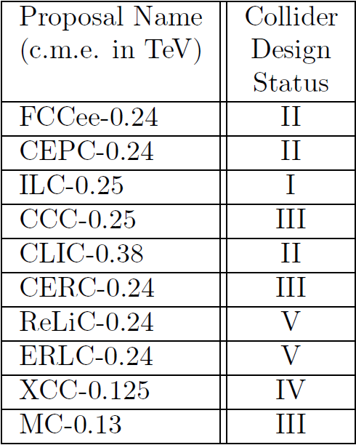
ITF Technical Risk Registry
ITF Table 14: "Design Status": I - TDR complete, II - CDR complete, III - substantial documentation; IV - limited documentation and parameter table; V - parameter table. Overall risk tier category ranging from Tier 1 (lower overall technical risk) to Tier 4 (multiple technologies that require further R&D).
ITF Report – T.Roser, et al, arXiv:2208.06030

Slide 14
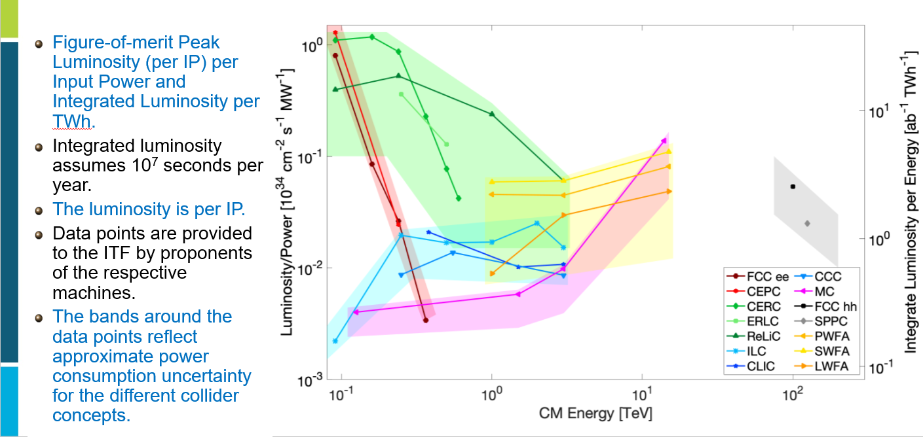
Luminosity per Power
Circular ee
ERL based ee
Linear ee
Muon coll
Wakefield
Hadron pp
Once again: luminosity and power consumption values have not been reviewed by ITF - we used proponents’ numbers.
ITF Report – T.Roser, et al, arXiv:2208.06030

Slide 15
Part III
Limits of Colliders
(as discussed at the Snowmass’21 Accelerator Frontier Topical Group 1 Workshop “Physics Limits of Ultimate Beams”, Jan. 2022;
mostly following
V.Shiltsev, Proc. IPAC’21, WEPAB017)

Slide 16
How ultimate colliders might look like?
BASED ON EXISTING TECHNOLOGIES ?
Circular ee
Linear ee/γγ
Circular pp
Circular μμ
BASED ON EMERGING TECHNOLOGIES ?
ERL ee/γγ
Plasma ee/γγ
Linear μμ / Plasma μμ
EXOTIC SCHEMES ?
Crystal linear μμ/ττ
Crystal linear ττ
Crystal circular pp

Slide 17
ITF’s Look Beyond Higgs Factories
 | CME (TeV) | Lumi per IP (10^34) | Years, pre-project R&D | Years to 1st Physics | Cost Range (2021 B$) | Electric Power (MW)
FCCee-0.24 | 0.24 | 8.5 | 0-2 | 13-18 | 12-18 | 280
ILC-0.25 | 0.25 | 2.7 | 0-2 | <12 | 7-12 | 140
CLIC-0.38 | 0.38 | 2.3 | 0-2 | 13-18 | 7-12 | 110
HELEN-0.25 | 0.25 | 1.4 | 5-10 | 13-18 | 7-12 | 110
CCC-0.25 | 0.25 | 1.3 | 3-5 | 13-18 | 7-12 | 150
CERC(ERL) | 0.24 | 78 | 5-10 | 19-24 | 12-30 | 90
CLIC-3 | 3 | 5.9 | 3-5 | 19-24 | 18-30 | ~550
ILC-3 | 3 | 6.1 | 5-10 | 19-24 | 18-30 | ~400
MC-3 | 3 | 2.3 | >10 | 19-24 | 7-12 | ~230
MC-10-IMCC | 10-14 | 20 | >10 | >25 | 12-18 | O(300)
FCChh-100 | 100 | 30 | >10 | >25 | 30-50 | ~560
Collider-in-Sea | 500 | 50 | >10 | >25 | >80 | »1000
ITF Report – T.Roser, et al, arXiv:2208.06030
17

Slide 18
Factors and Limits
Main factors to consider feasibility of future colliders used to be
Feasibility of Energy
Feasibility of Luminosity
Feasibility of Cost
The European Strategy (2019) and Snowmass’21 discussions revealed additional limits:
Time to construct and commission
Societal limits: # of experts, size of facility, radiation, etc
Environmental impacts: power consumption, carbon footprints, scarcity of resources (He, Nb, W, etc), excavated materials, etc
Here we will only briefly touch some important points

Slide 19
Limits on Energy
for e-/e+: $E_{cm}≤500 GeV{\left(\frac{ρ}{10km}\right)}^{\frac{1}{3}}$
for muons: $E_{cm}≤600 TeV{\left(\frac{ρ}{10km}\right)}^{\frac{1}{3}}$
for protons: $E_{cm}≤10 PeV{\left(\frac{ρ}{10km}\right)}^{\frac{1}{3}}$
Synchrotron radiation defines linear vs circular if U_{SR} < E
$$U_{SR}=C_{γ}\frac{E^{4}}{ρ}=88.46\frac{r_{0}}{r_{e}}{\left(\frac{m_{e}}{m_{0}}\right)}^{3}\frac{E^{4}\left[GeV\right]}{ρ\left[m\right]}$$
Production and survival: unstable particles such as muons
$\frac{dN}{dt}=−\frac{N}{γτ_{0}}$; $γ=γ_{i}+z\frac{dγ}{dz}$
where $τ_{0}$ is the lifetime, $τ_{0}∼2.2μs$ for muons…
requires fast acceleration
for muons
for τ-leptons
Staging efficiency (losses) per stage for M stages ≥
Circumference 100 km , B<16 T , E <50 TeV
Circumference 40,000 km, B=1 T, E <1.3 PeV
Length 50 km , G<0.1 GV/m, E <5 TeV
Length 10 km, G<1 TV/m, E <10 PeV
Technology within limited space /area:

Slide 20
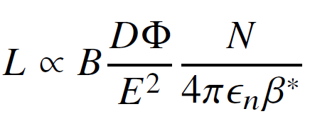
Limits on Luminosity (some)
General Equation
sheer beam power
e/p SR rad. power
μ→ν radiation dose
LC power, BS, jitter
flux dilution factor

Slide 21
αβγ vs ITF 30-parameter cost model
Higher energy → usually bigger size, more power and higher costs:
Where is the societal limit on the cost of colliders?
Cost ranges estimates – detailed vs parametric models
ITF Report – T.Roser, et al, arXiv:2208.06030
The αβγ cost model (2014): Cost(TPC)= α L^{1/2} + β E^{1/2} + γ P^{1/2}
α≈ 2B$/sqrt(L/10 km) for tunnel/civil
β ≈ 10B$/sqrt(E/TeV) for SC/NC RF
β ≈ 2B$ /sqrt(E/TeV) for SC magnets
β ≈ 1B$ /sqrt(E/TeV) for NC magnets
γ≈ 2B$/sqrt(P/100 MW) for site power
ITF Report - Figure 7: Ratio of the estimates of the three-parameters αβγ Model (#2) and Model 3 to the 30-parameter cost Model 1 for future collider projects vs ECM.
αβγ model – V.Shiltsev, JINST 9 T07002 (2014).

Slide 22
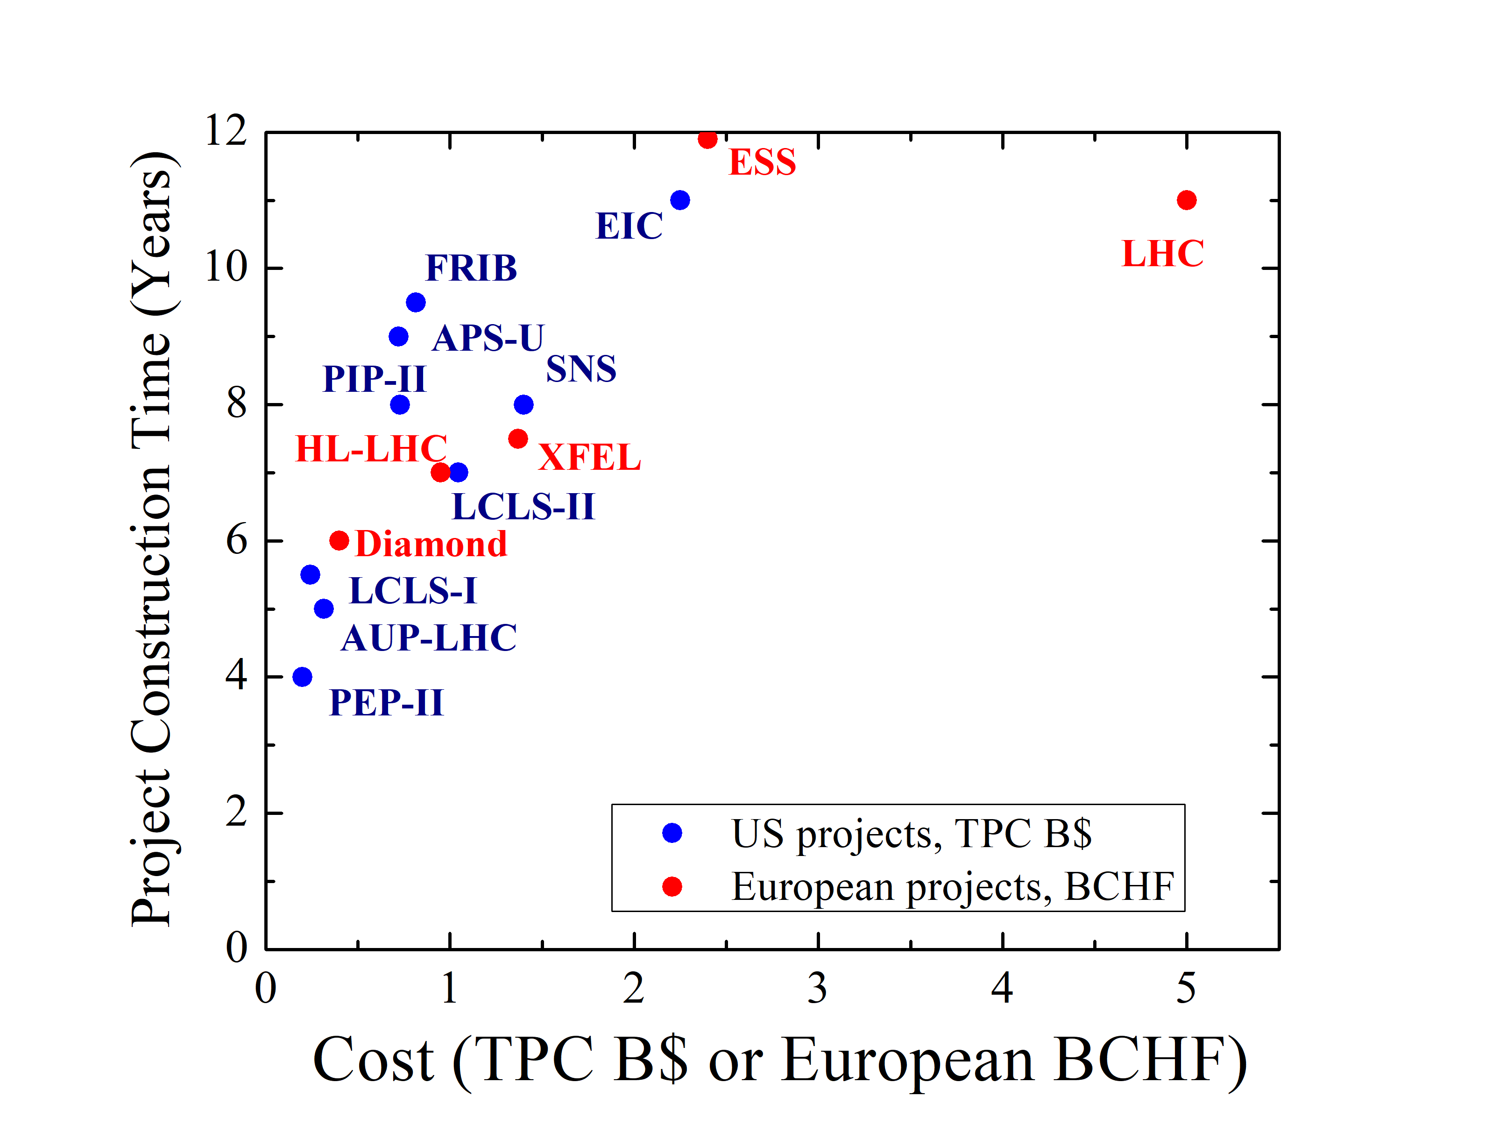
Accelerators Timeline X+Y+Z ≤ ?
Bigger size and cost → longer:
Pre-project R&D X years
Depends on novelty
Construction project Y years
Annual peak <0.5B$/year ?
“Oide law”: need ~1 expert to spend (intelligently) 1 M$/year
NB: <4500 experts worldwide
Commissioning Z years
Depends on complexity
Past large colliders:
5 yrs
Katsunobu Oide - KEK
~SQRT(Cost)?
+4 (SLC, DAFNE, BEPCII)
-3 (PEP-II, Tevatron-I, LEP-II)

Slide 23
Construction Time… ~SQRT(Cost)?
ITF Report - Figure 11: Construction time for recent large accelerator projects in the US and Europe.
Peak spending rate depends on $$/yr limit and on # of available
experts …currently, btw 0.2 to 0.5 B$/yr (total World’s HEP ~4B$)

Slide 24
Circular e+e- Colliders
Let’s skip them… dead end… SR power
E.g. >0.5 TeV ring will be
Big (>200-300 km?)
Low luminosity O(10 fb-1/yr)
A lot of RF → expensive >1.5-2 LHCU

Slide 25
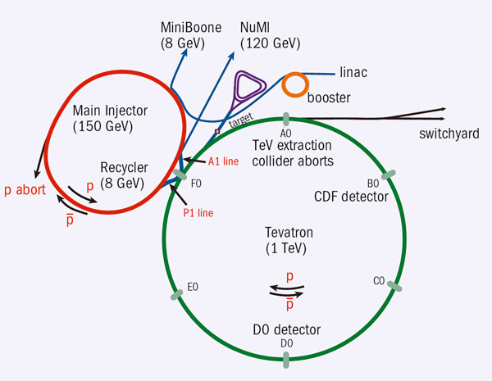
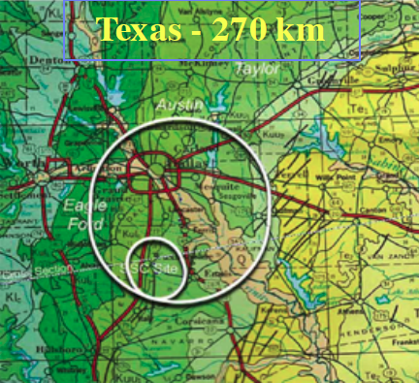
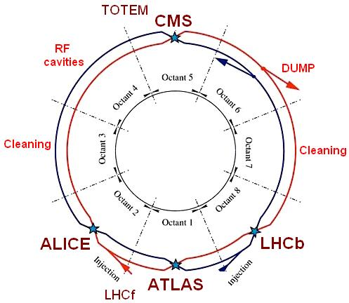
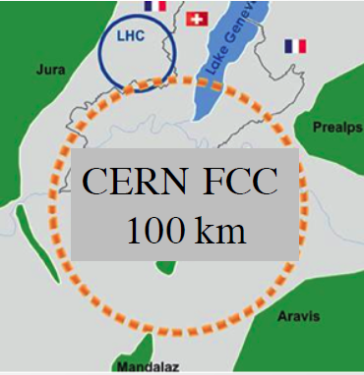
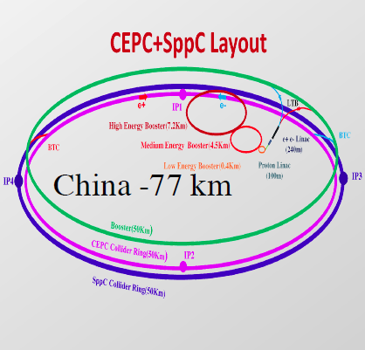
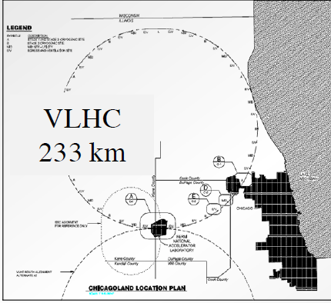
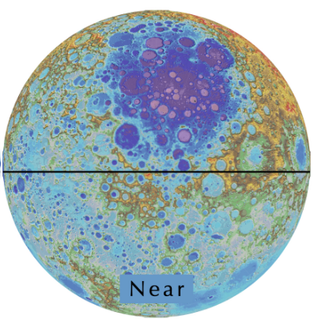
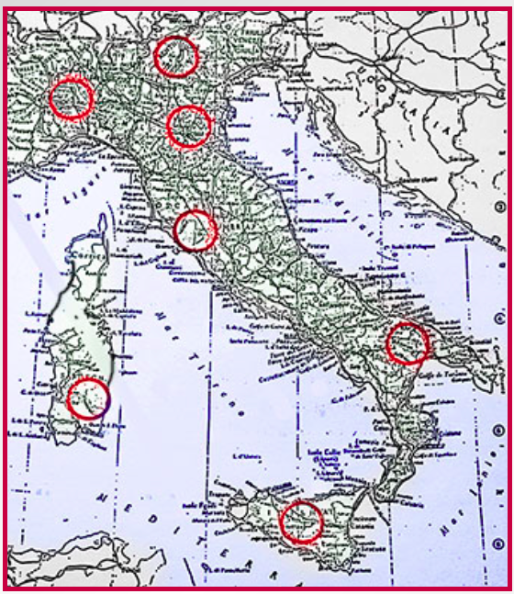
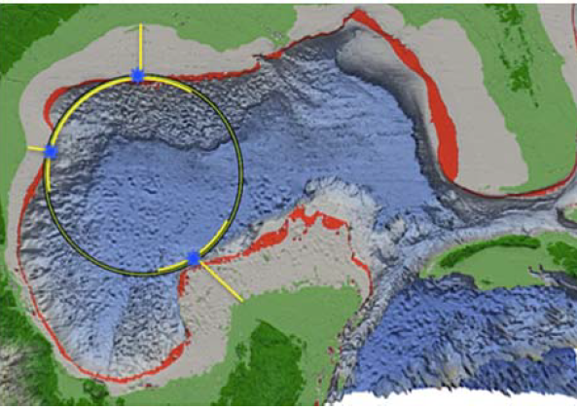
Circular pp Colliders
Texas 90 km
Can use Tevatron and LHC as reference point
Parameter sets exist for SSC, FCC-hh, SppC, VLHC, Coll-Sea, Eloisatron, CCMoon
Major advantages:
known technology and physics
good power efficiency ab⁻¹/TWh
Major limitations:
Size (magnetic field B)
Power
Beam-beam, burn-off, instabilities
Synchrotron radiation
Cost
China 100 km

Slide 26
pp Colliders: Lumi and Cost vs Energy
Circular pp
B=10T, 300 km
P=2-3 TWh
Cost=3-5 LHCU
B=16T, 100 km, P=2.5-3 TWh
Cost=3-5 LHCU
10 ab⁻¹/yr
B=3.2T, 1900 km P=>5 TWh
Cost>8 LHCU
FCC
ELN
1 ab⁻¹/yr
Sea
B=20T, 1600 km, P=10? TWh
Cost > 6 LHCU
LHC
UELN
VLHC
0.1 ab⁻¹/yr
B=8 T, 27 km, P=1.1 TWh
Cost=1 LHCU
Globe
B=1T, 40000 km, P> 30 TWh
Cost> 30 LHCU
B=10T, 233 km, P=1.5-3 TWh
Cost= 3.8? LHCU
0.01 ab⁻¹/yr
Collider on Moon
Tevatron
B=20T, 11000 km, P> >10 TWh
Cost> 40 LHCU
1 fb⁻¹/yr
B=4.5 T, 6 km, P=0.3 TWh
Cost=~0.5 LHCU
7 TeV
70 TeV
700 TeV
7 PeV
70 PeV

Slide 27
MC: Lumi and Cost vs Energy
Circular μμ
B=10 T, Ф=1
27(14) km
P=1.5-2TWh
Cost=1-2 LHCU
B=10 T, Ф=10
27 km
P=2 TWh
Cost=1.6-2.5 LHCU
10 ab⁻¹/yr
MC-14
MC-6
B=10 T, Ф=100
100 km
P=3.5? TWh
Cost=3-5 LHCU
1 ab⁻¹/yr
B=10 T
6 km, Ф=1
P=1.3 TWh
Cost=0.7-1 LHCU
MC-1.5
0.1 ab⁻¹/yr
B=10 T, 2.5 km, Ф=1
P=1 TWh
Cost=0.5 LHCU
B=10 T, Ф=100
300 km
P=5 ? TWh
Cost=>5 LHCU
0.01 ab⁻¹/yr
B=10 T, Ф=100
1000 km
P=9 ?TWh
Cost=>8 LHCU
1 fb⁻¹/yr
1 TeV
10 TeV
100 TeV
1 PeV
10 PeV

Slide 28
Linear RF and Plasma: Lumi and Cost vs Energy
Linear ee/γγ
20-50 km
P=6-15? TWh
Cost=4-8 LHCU
18 km
P=3-4 TWh
Cost=2-5 LHCU
LWFA-30
10 ab⁻¹/yr
DLA-30
ILC-1
CLIC-3
PWFA-10
1 ab⁻¹/yr
30-100 km
P=2.5 TWh
Cost=5-10 LHCU
40 km
P=1.5 TWh
Cost=1.5-2 LHCU
Ult.Plasma-0.1
0.1 ab⁻¹/yr
50 km
P=3 TWh
Cost=2-3 LHCU
Ult.Plasma-1
0.01 ab⁻¹/yr
~200-500 km
P=2.5 TWh
Cost=15-30 LHCU
1 fb⁻¹/yr
1 TeV
10 TeV
100 TeV
1 PeV
10 PeV

Slide 29
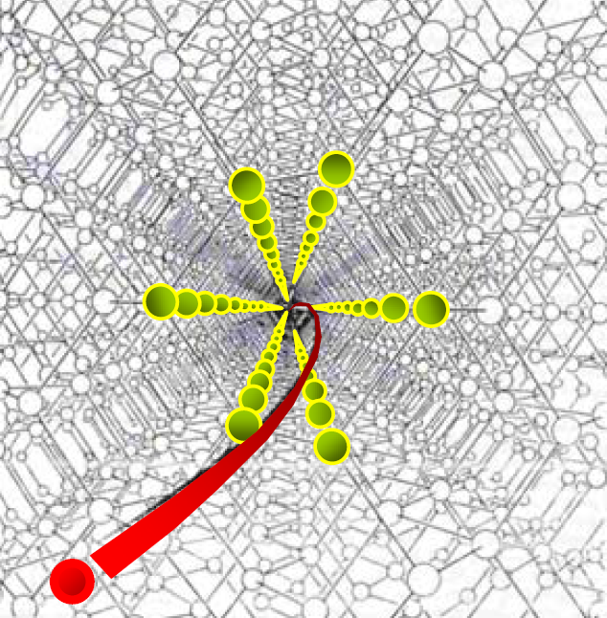
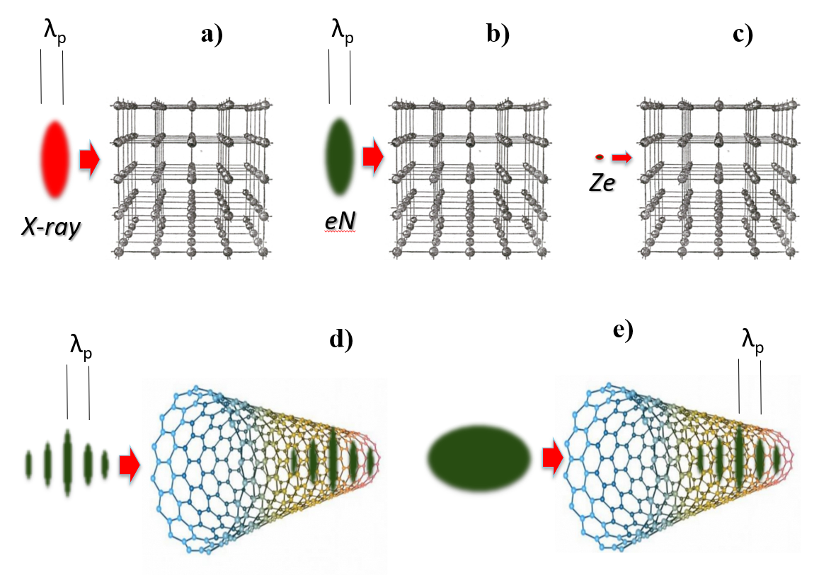
Exotic Colliders
Acceleration in structured media, eg CNTs or crystals ( only muons!!! )
Major advantages:
solid density → 1-10 TV/m gradients
continuous focusing and acceleration (no cells, one long channel, particles get strongly cooled betatron radiation)
small size promises low cost
Major limitations:
“blue sky”, O(10) papers, plans for proof-of-principle experiment E336 @FACET-II (S.Corde, T.Tajima, et al)
how to drive Xtals? lasers, beams?
Cost is unknown, power is unknown, luminosity - (how low?)
Acceleration in Xtals book (T.Tajima, et al 2020)

Slide 30
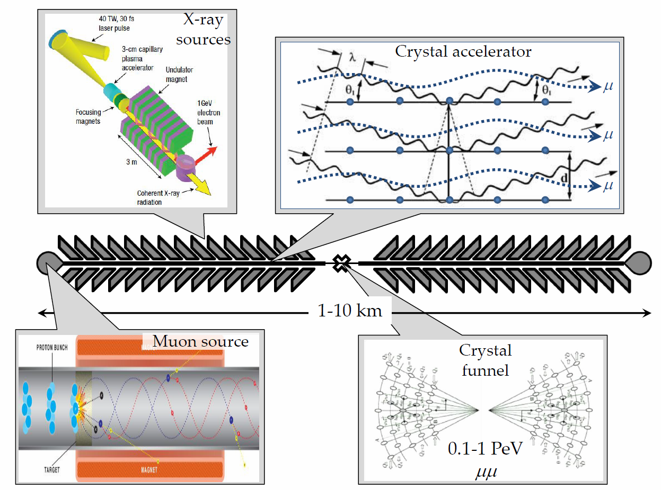
Xtal Collider
n~10²² cm⁻³, 10 TeV/m →
1 PeV = 1000 TeV
n_{μ} ~1000, n_{B} ~100, f_{rep} ~10⁶ L ~10³⁰⁻³²
V.Shiltsev, Phys. Uspekhy 55 965 (2012)

Slide 31
XtalC Luminosity
Considerations :
Angstrom size at IP
Muons/bunch < Xtal electrons excited
Employ many channels
Limit beam power O(10MW)
Combine n_channels to gain L
via crystal funnel (? Is it possible)

Slide 32
Xtal Colliders: Lumi and Cost vs Energy
Linear Xtal μμ
XC-0.1
G=1-10 TV/m
0.1-1 km
P=< 1TWh
Cost=<3 LHCU?
10 ab⁻¹/yr
G=1 TV/m
0.1-1 km
P=< 1TWh
Cost=<1 LHCU?
1 ab⁻¹/yr
XC-1
0.1 ab⁻¹/yr
0.01 ab⁻¹/yr
G=1-10 TV/m
1-10 km
P=< 2TWh
Cost=<10 LHCU?
1 fb⁻¹/yr
XC-10
1 TeV
10 TeV
100 TeV
1 PeV
10 PeV

Slide 33
Main Conclusions:
For ultimate high energy colliders:
Major thrust is Energy
Major concern/limit is Cost
Main focus is Luminosity and Power
There are other important factors (CO₂ footprint, etc)
Cost:
Critically dependent on core acceleration technology
Existing injectors and infrastructure greatly help
High Energy means low Luminosity :
Don’t expect more than 0.1-1 ab⁻¹/yr at 30TeV - 1 PeV
Assume Power limited to 1-3 TWh/yr (1-3 x LHC)

Slide 34
Main Conclusions (2):
For considered collider types:
Circular pp – limit is ~100 TeV (14 TeV cme per parton)
Circular ee – limit is ~0.4-0.5 TeV
Circular μμ – limit is between 30 and 100 TeV
Linear RF ee/γγ – limit is between 3 and 10 TeV
Plasma ee/γγ
Exotic crystal μμ – promise of 0.1-1 PeV, low Luminosity
Muons are particles of the future
Helpful/cited references (next slide)

Slide 35
(Some Useful) References:
ITF Report – T.Roser, et al, arXiv:2208.06030
RMP Colliders – V.Shiltsev, F.Zimmermann, Rev.Mod.Phys. 93, 015006 (2021); see also arxiv
αβγ model – V.Shiltsev, JINST 9 T07002 (2014).
Ultimate Limits of Colliders – V.Shiltsev, Proc. IPAC’21, WEPAB017 (2021).
Nature Physics MC – K.Long, et al, Nature Physics (2021), see also arxiv
Eloisatron – W.Barletta, in AIP Conference Proceedings, vol. 351, no. 1, pp. 56-67(1996).
Xtal collider – V.Shiltsev, Physics Uspekhi, v.55 (10), p.1033 (2012).
F.Zimmermann – NIMA 909 (2018): 33-37; see also ARIES Workshops summary
T.Raubenheimer - Phys. Rev. ST Accel. Beams 3, 121002 (2000).
D.Schulte Plasma Colliders – Rev.Accel.Sci.Tech. 9 (2016): 209-233.
2019 Crystal Workshop - eds. T.Tajima, et al, Beam Acceleration in Crystals and Nanostructures (World Scientific, 2020)
CPT-theorem – V.Shiltsev, Mod. Phys. Lett. A, vol. 26, No. 11 (2011) pp. 761-772.

Slide 36
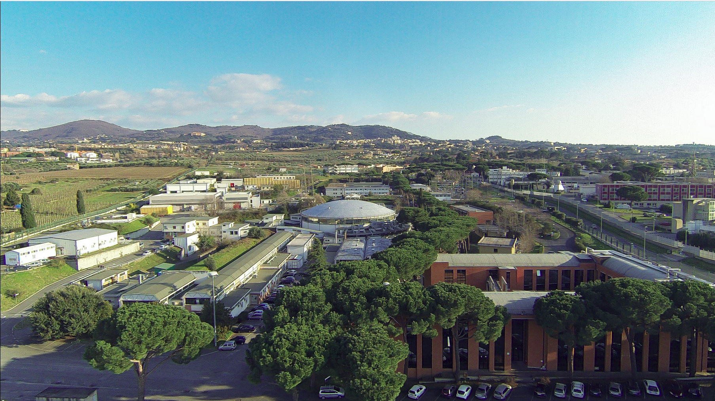
Thanks for your attention!
Special thanks to
My AF co-conveners S.Gourlay and T.Raubenheimer, and AF3 conveners - Angeles, Qing Qin, Frank Z and Georg H.
Marica and Organizers of the eeFACT’22 Workshop
… as final note, tons of material (all reports, etc) available at:
https://snowmass21.org/accelerator/start

Slide 37
Back up slides

