Slide 1
Algoritmi di denoising innovativi basati su deep learning per la riduzione del rumore in immagini NMR in Fluoro 19
Alessandro Sbandi

Slide 2
Objective and strategy
Testing denoising algorithms based on deep learning.
Compare results with traditional methods.
Three different neural network architectures:
-Denoising Autoencoder (DAE)
-Variational Autoencoder (VAE)
-Denoising Convolutional Neural Network (DnCNN)

Slide 3
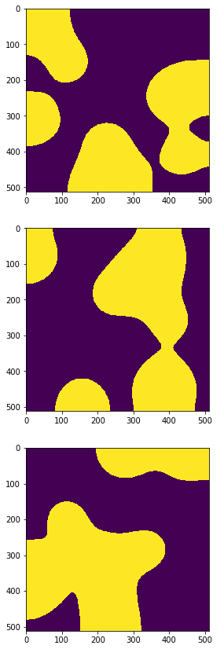
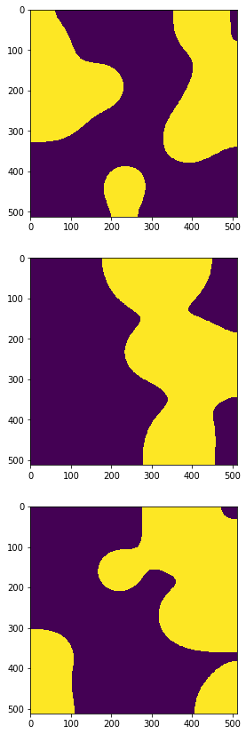
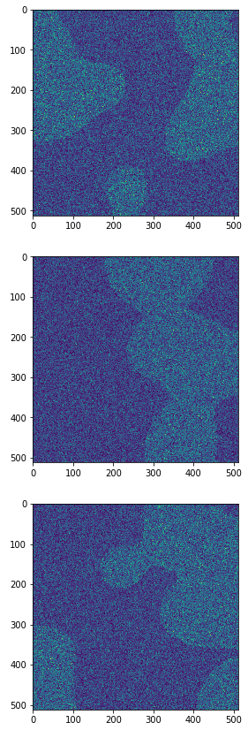
Dataset 1
Generation parameters:
Signal Signal+Rician Noise
Signal = 1000
Sigma = 700
Image Size = 512x512
Blobsize = 10.
Nseeds = 3

Slide 4
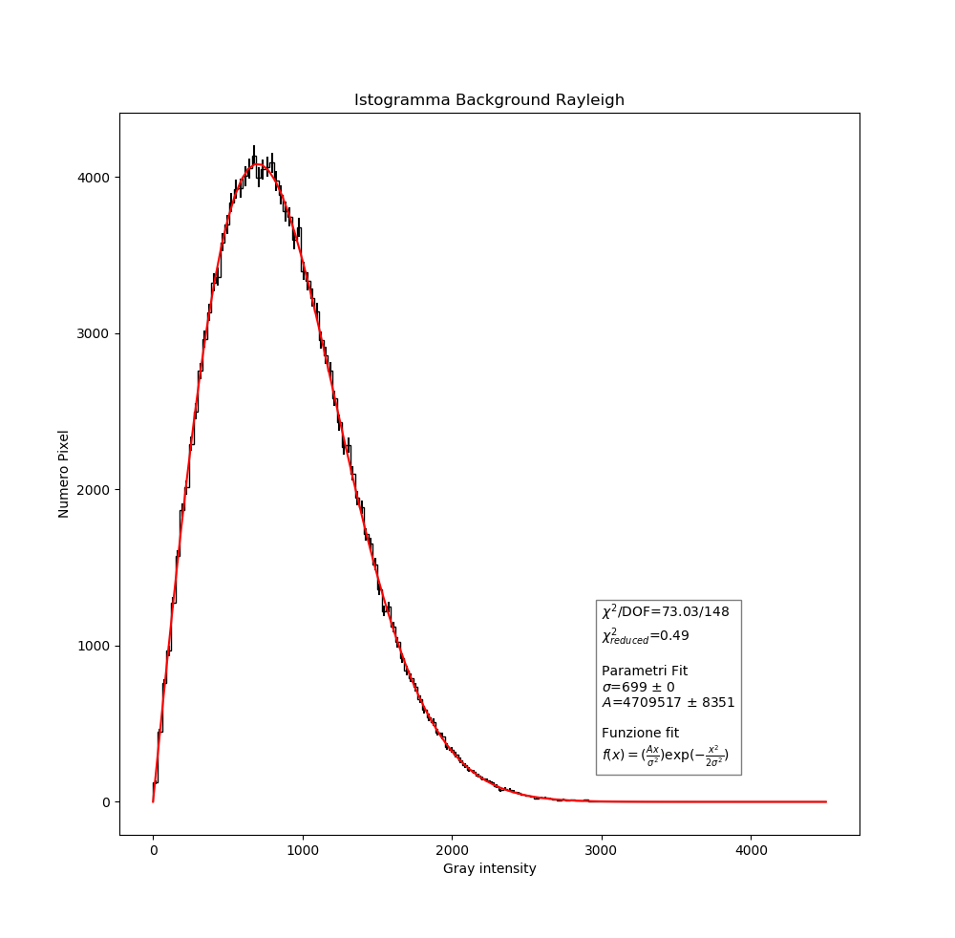
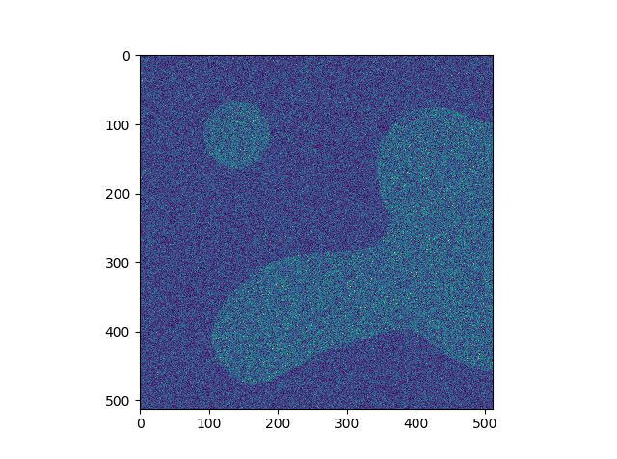
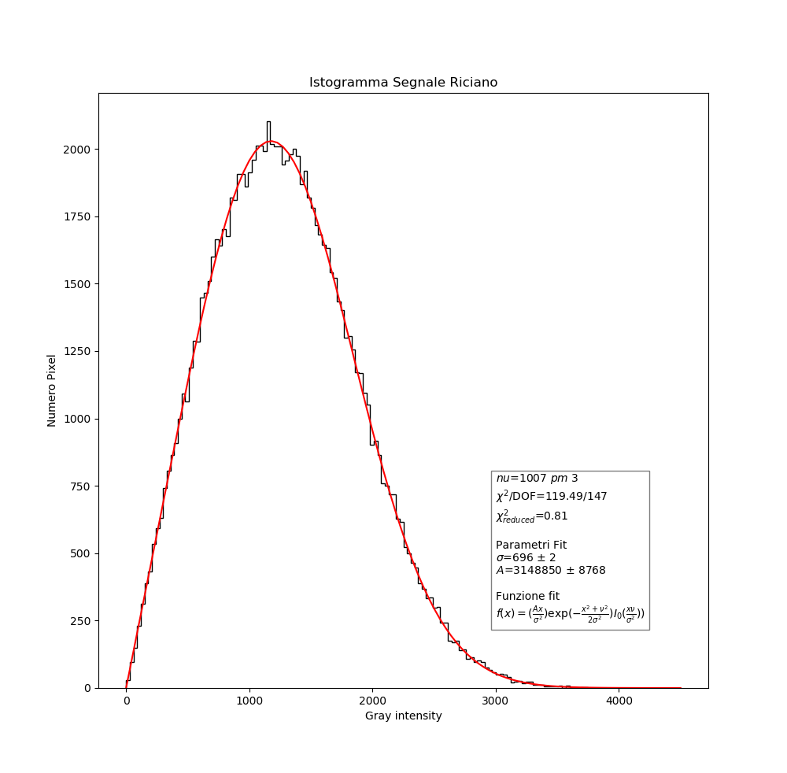
First analysis
$$Rayleigh: f\left(x,σ\right)=\frac{x}{σ^{2}}ⅇ^{−\frac{x^{2}}{2σ^{2}}}$$
Background
$$Rice: f\left(\left.x\right|ν,σ\right)=\frac{x}{σ^{2}}\exp\left[\frac{−\left(x^{2}+ν^{2}\right)}{2σ^{2}}\right]I_{0}\left(\frac{xν}{σ^{2}}\right)$$
Signal

Slide 5
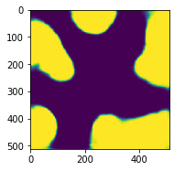
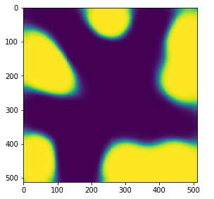
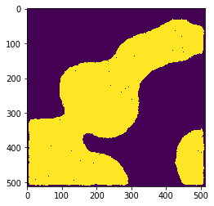
Results dataset 1
 | PSNR (dB) | Dice coefficient
Noised Images | 5.863 ± 0.332 | 0.334 ± 0.008
Denoising autoencoder | 17.039 ± 1.433 | 0.959 ± 0.010
Variational autoencoder | 13.989 ± 1.101 | 0.905 ± 0.018
Wiener filter | 16.701 ± 0.875 | 0.973 ± 0.006
DAE VAE WIENER+OFFSET

Slide 6
Results dataset 1
 | PSNR (dB) | Dice coefficient
Noised Images | 5.863 ± 0.332 | 0.334 ± 0.008
Denoising autoencoder | 17.039 ± 1.433 | 0.959 ± 0.010
Variational autoencoder | 13.989 ± 1.101 | 0.905 ± 0.018
Wiener filter | 16.701 ± 0.875 | 0.973 ± 0.006
Best performance
DAE VAE WIENER+OFFSET

Slide 7
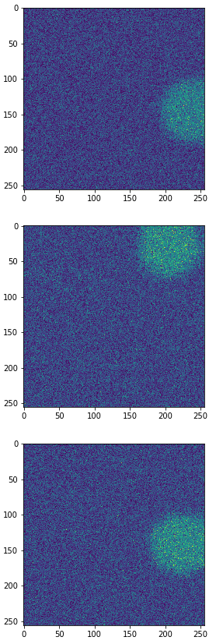
Dataset 2
Fixed shape and Rician noise
Can DAE denoise it? Like a Wiener filter?
Can a generative model (VAE) do the ‘‘same’’ task?
Signal Signal+Rician Noise
Generation parameters:
Signal = 1000
Sigma = 700
Image Size = 256x256
Blobsize = 1
Nseeds = 1
Gaussian Filter
10000 images:
7200 train set
1800 validation set
1000 test set
Using the same architectures used for dataset 1

Slide 8
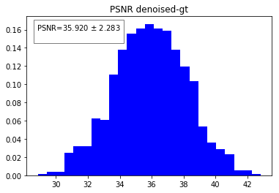
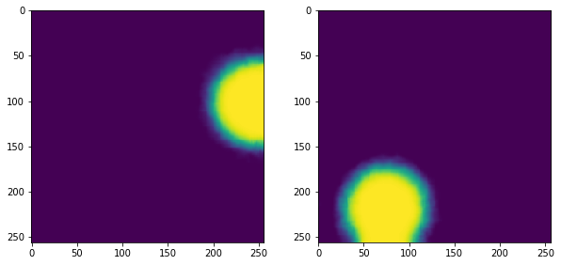
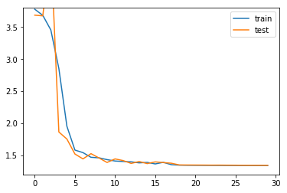
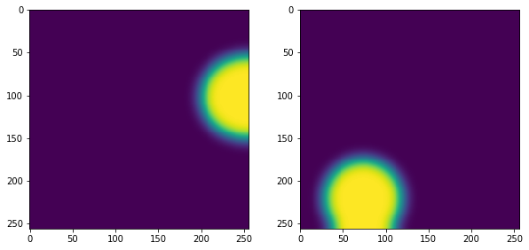
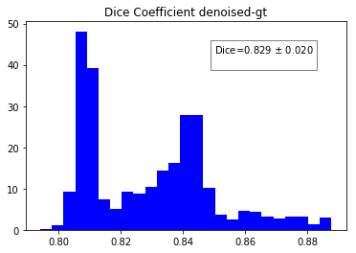
Denoising autoencoder results
Loss
Epochs
 | PSNR (dB) | Dice Coeff.
DAE | 35.920 ± 2.283 | 0.829 ± 0.020

Slide 9
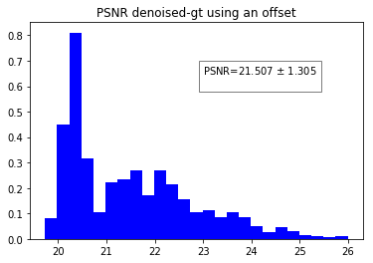
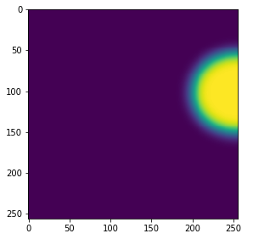
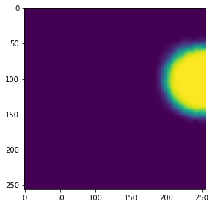
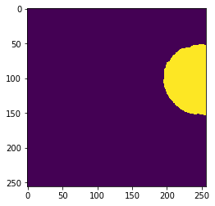
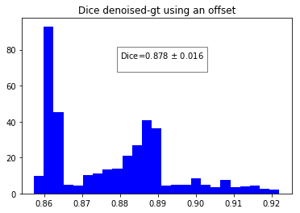
Denoising autoencoder results with an offset
 | PSNR (dB) | Dice Coeff.
DAE | 35.920 ± 2.283 | 0.829 ± 0.020
DAE with offset | 21.507 ± 1.305 | 0.878 ± 0.016
GT PREDICT PREDICT+OFFSET

Slide 10
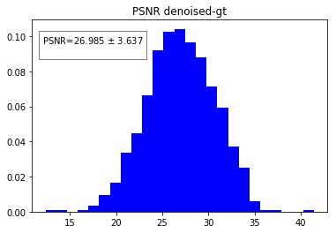
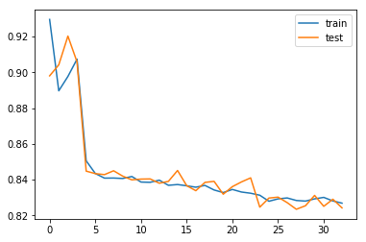
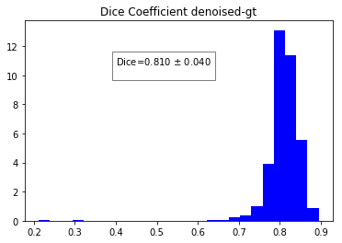
Variational autoencoder results
Loss
Epochs
 | PSNR (dB) | Dice Coeff.
VAE | 26.985 ± 3.637 | 0.810 ± 0.040

Slide 11
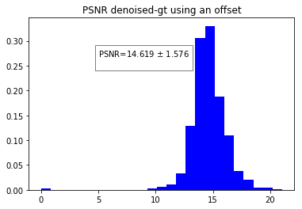
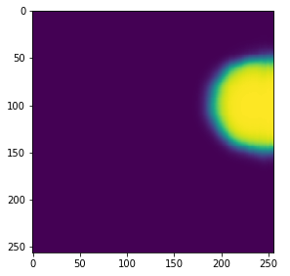
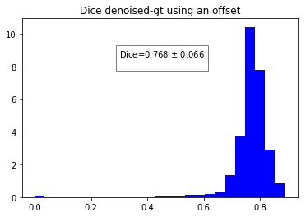
Variational autoencoder results with an offset
 | PSNR (dB) | Dice Coeff.
VAE | 26.985 ± 3.637 | 0.810 ± 0.040
VAE with offset | 14.619 ± 1.576 | 0.768 ± 0.066
GT PREDICT PREDICT+OFFSET

Slide 12
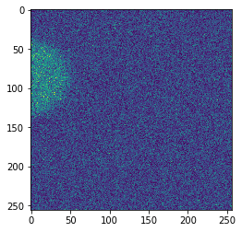
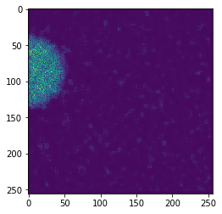
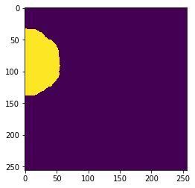
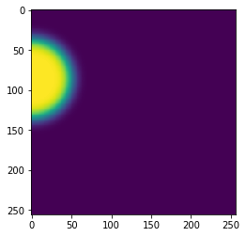
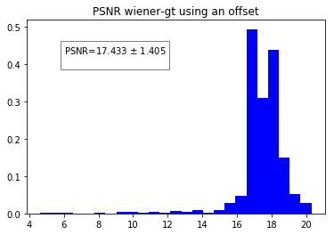
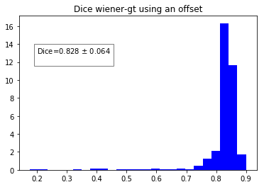
Using Wiener filter+offset+median filter
TEST WIENER FILTER MEDIAN FILTER GT
 | PSNR (dB) | Dice Coeff.
Wiener filter | 17.433 ± 1.405 | 0.828 ± 0.064

Slide 13
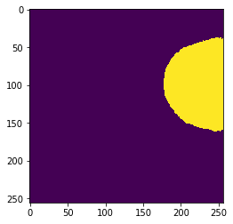
Results dataset 2
 | PSNR (dB) | Dice coefficient
Noised Images | 5.863 ± 0.332 | 0.334 ± 0.008
DAE | 35.920 ± 2.283 | 0.829 ± 0.020
DAE with offset | 21.507 ± 1.305 | 0.878 ± 0.016
VAE | 26.985 ± 3.637 | 0.810 ± 0.040
VAE with offset | 14.619 ± 1.576 | 0.768 ± 0.066
Wiener filter with offset | 17.433 ± 1.405 | 0.828 ± 0.064
The denoise is good as a Wiener filter ✓
For a generative model performance are lower as expected ✓
DAE VAE WIENER+OFFSET

Slide 14
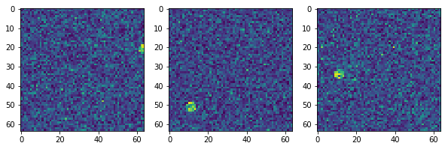
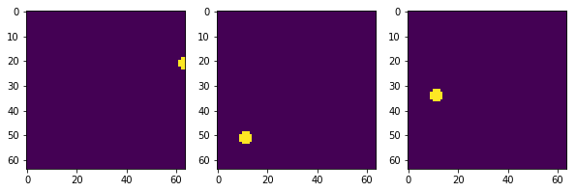
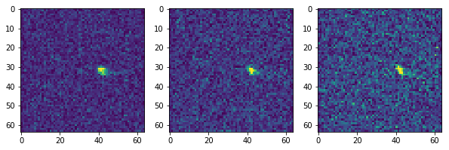
Dataset 3
Test the reconstruction: do DAE and VAE generalize the reconstruction of signals with different shapes?
Generation parameters:
10003 images:
7000 train set
3000 validation set
3 test set
Signal = 1500
Sigma = 900
Image Size = 64x64
Blobsize = 0.3
Nseeds = 1

Slide 15
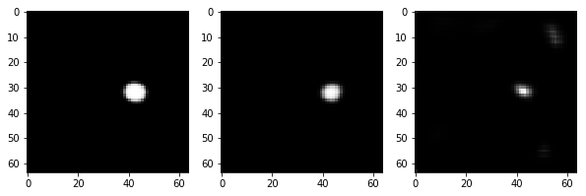
Results dataset 3
DAE/VAE don’t generalize in reconstruction ✗
Two possible strategies:
a) DAE/VAE trained with deformed signals shapes.
b) try with a different network DnCNN.

Slide 16
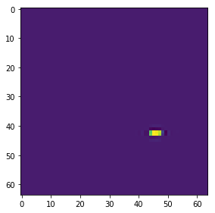
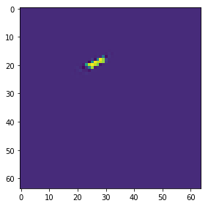
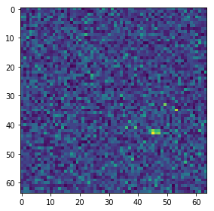
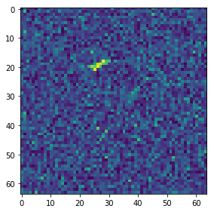
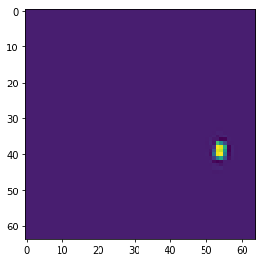
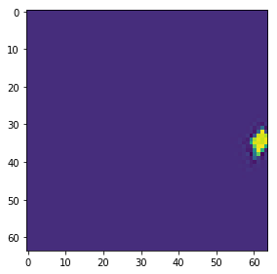
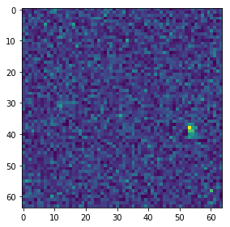
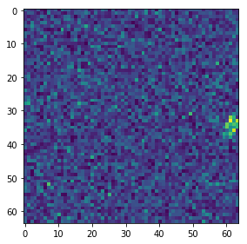
Dataset 4
Generation parameters:
Signal Signal+Rician Noise
Signal = 1500
Sigma = 900
Image Size = 64x64
Blobsize = 0.2/0.5
Nseeds = 1
Gaussian filter
Elastic deformation
10003 images:
7000 train set
3000 validation set
3 test set

Slide 17
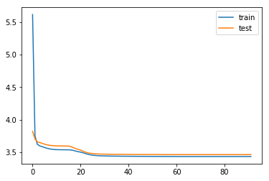
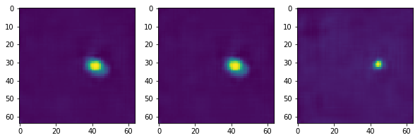
Denoising autoencoder results
Loss
Epochs
 | Shannon Entropy
MRI 1 | 11.996
MRI 2 | 11.995
MRI 3 | 11.997

Slide 18
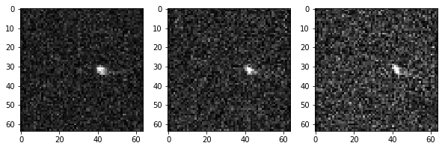
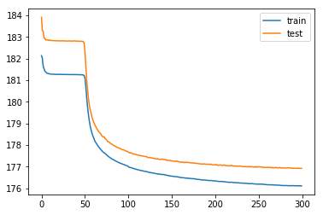
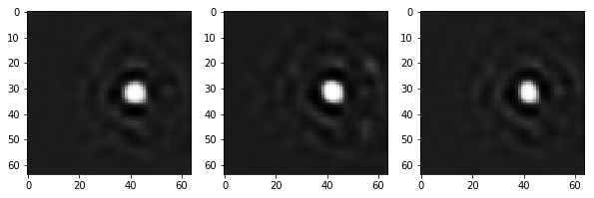
Variational autoencoder results
Loss
Epochs
 | Shannon Entropy
MRI 1 | 11.982
MRI 2 | 11.981
MRI 3 | 11. 988

Slide 19
Results dataset 4: A plan
Reconstructions are a little bit better then before ✓
But not so good, I need greater dataset for an appropriate generalization ✗

Slide 20
Dataset 4: B plan
Try with a different network, DnCNN.
DnCNN needs fewer data then AE to generalize.
Used as denoiser with residual learning configuration.
Input Layer (64, 64, 1)
Conv2D(64)
Conv_block
Conv_block
…
Conv2D(64, (3,3))
x15
BatchNormalization((2,2))
Conv2D(1)
Forces to learn noise
Output=Input-Conv2D(1)

Slide 21
Results of DnCNN
Loss
Epochs
 | Shannon Entropy
MRI 1 | 11.996
MRI 2 | 11.995
MRI 3 | 11.999
DnCNN results are good as the best DAE (the one with infinite power generalization) and of the Wiener filter ✓
DnCNN generalizes better with different shapes ✓

Slide 22
Results dataset 4
Shannon Entropy | MRI 1 | MRI 2 | MRI 3
DAE | 11.996 | 11.995 | 11.997
VAE | 11.982 | 11.981 | 11. 988
DnCNN | 11.996 | 11.995 | 11.999
Wiener | 11.999 | 11.999 | 11.999
MRI
DAE
VAE
Wiener
DnCNN

Slide 23
Conclusions...
Denoising is good, but DnCNN and Wiener work better then DAE/VAE.
Wiener eliminates the noise, but produces artifacts. Maybe others non-Rician noise sources.
DnCNN produces really good results in 2/3 MRI. Statistic is too low, but could be different acquisition conditions or problematics.
Tested three different deep neural network architectures for denoising:
- DAE: works well in recognizing and removing the noise, needs large data- augmented samples in order to not learn shapes in the training set.
- VAE: as expected underperform with the DAE but can be used to produce large samples for training of the DAE/DnCNN.
- DnCNN: best results, same level as Wiener filter, in terms of noise removal and good generalization to different shape (need to be quantitatively assessed).

Slide 24
...and further steps
Try to add a residual layer in DAE/VAE.
Improve plots and quantitative measures between different methods.
High statistic test with simulated data with different shape (to quantify generalization power).
High statistic test with simulated data adding Rician noise + other noise components.
Completing the study and wrapping up for the thesis (deadline for submission end of december).

