Slide 1
CALOCUBE READ-OUT SYSTEM
G. Martinez, J. Casaus, J. Marin
CIEMAT

Slide 2
Calocube read-out
Fast serial ad hoc
1 to 1
PC
T+ROC 1
HIDRA2
FE BOARD
HIDRA2
FE BOARD
HIDRA2
FE BOARD
HIDRA2
FE BOARD
T+ROC 2
T+ROC 2
T+ROC 2
T+ROC2
T+ROC 2
64 FE CH
T+ROC2
T+ROC2
T+ROC2
USB 2.0
1 to 1
COMMAND DISTRIBUTION
DATA COLLECTION

Slide 3
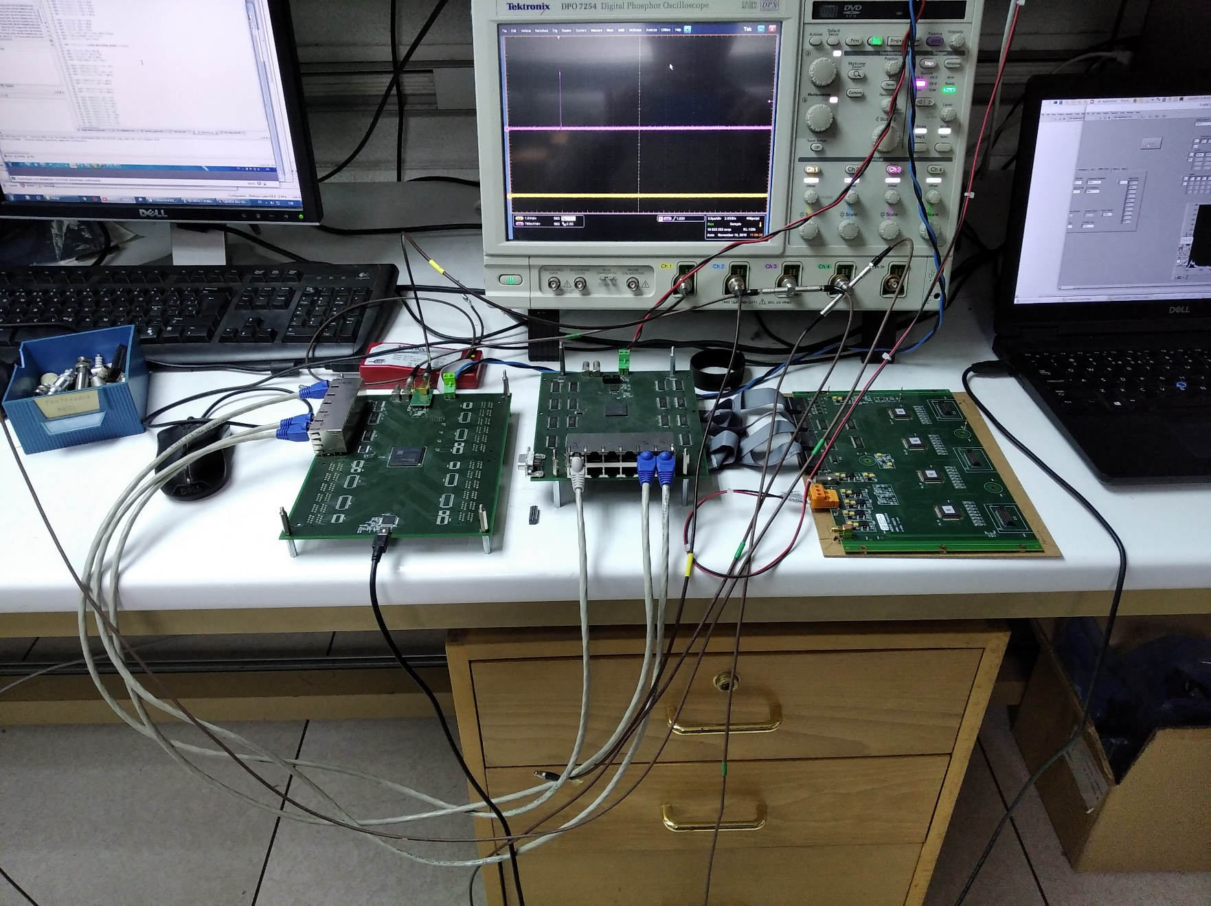
Calocube read-out
T+ROC1
T+ROC2
HIDRA2 BOARD
PC

Slide 4
Read-out summary
System Characteristic:
4 ASIC (CSA + CDS + ST) / Hidra2 Front End Board
3 Scalopendra Kaptom cables / Hidra2 FEB
Up to 4 Hidra2 FEB/ T+ROC2.
Up to 8 T+ROC2 / T+ROC1.
LVDS interface between boards.
Common acquisition sequence to all 4 Hidra2 FEB.
Single digital read-out (ADC) output per Hidra2 FEB.
Trigger & calibration masks Daisy-Chained inside each Hidra2 FEB.

Slide 5
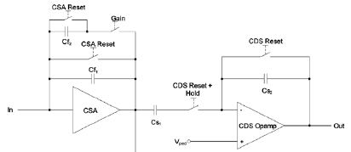
HiDRA2 Chip
Charge Sensitive Amplifier (CSA)
Correlated Doubled Sampling (CDS)
Self Trigger Stage (ST)
https://drive.google.com/drive/folders/1O9lQHOBpgZ2vuzyTFjxDppKAs4-0ZpYH?usp=sharing

Slide 6
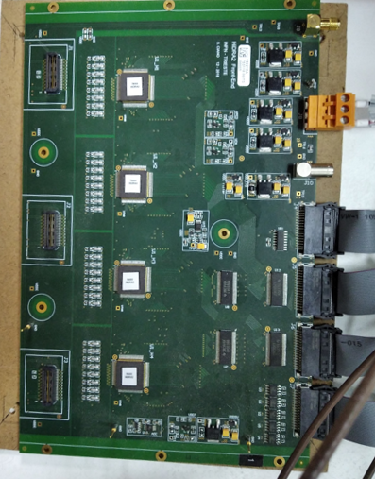
Hidra2 Description
T+ROC2 Interface
ADC
FE CONN.
Hidra ASIC
Hidra ASIC
FE CONN.
Hidra ASIC
FE CONN.
Hidra ASIC
POWER

Slide 7
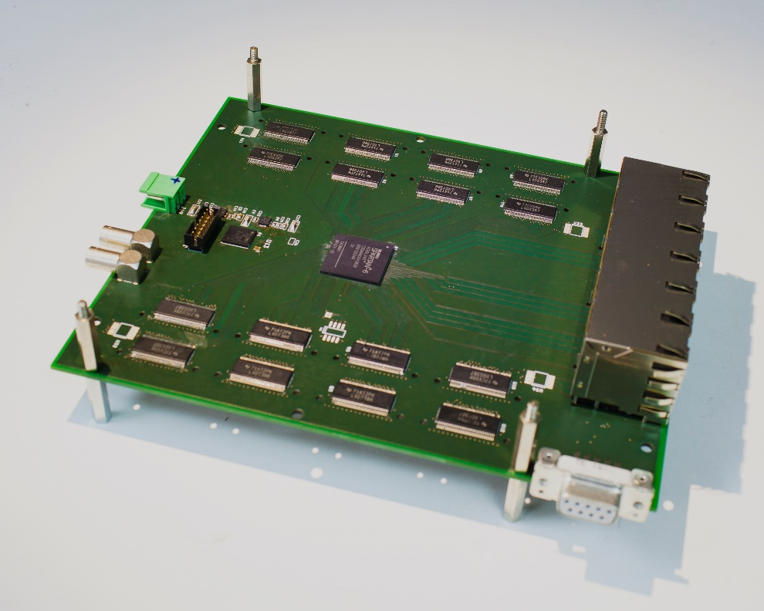
T+ROC2 Description
15cm x 17cm.
6 Layers.
PCB layout cross-checked with Hidra2 board design.
XC6S45 Xilinx FPGA.
Fast Serial link connection to T+ROC 1.
LVDS connections to HIDRA2 & T+ROC1.
XC6S
FPGA
HIDRA 2 INTF.
T+ROC 1 INTF.
POWER
https://drive.google.com/drive/folders/1O9lQHOBpgZ2vuzyTFjxDppKAs4-0ZpYH?usp=sharing

Slide 8
T+ROC2 CONTROL SEQUENCE GENERATION + DATA ADQUISITION
4K
FPGA
FPGA functions:
HIDRA control sequence generation
Physical levels of the comunication protocol
Acquisition
Dual port RAM
HIDRA 2 INTF.
16 (12 + 4)
n
PL add. counter
FastLink 750KB/s
Register
External Trigger
T+ROC 1 INTF.
MUX
FastLink 750KB/s
DATA
Buffer
ADC + GAIN Buffer
n = 4
FastLink 750KB/s
FastLink 750KB/s
MUX
MUX
MUX
TRG Buffer
n = 4
FL up 2 30MB/s
TRG Buffer
MUX

Slide 9
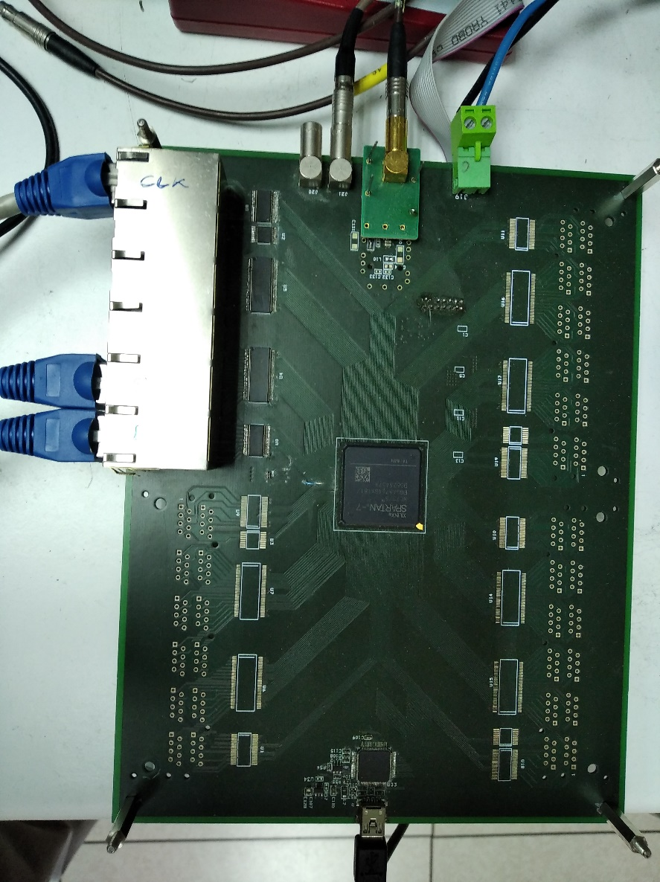
T+ROC1 description
20cm x 17cm
6 Layers
Fast Serial link connection to T+ROC 2.
LVDS connections to HIDRA2 & T+ROC2.
XC7S Xilinx FPGA
USB 2.0 Interface (FTDI chip)
USB 2.0
XC7S Family
FPGA
T-ROC 2
POWER
https://drive.google.com/drive/folders/1O9lQHOBpgZ2vuzyTFjxDppKAs4-0ZpYH?usp=sharing

Slide 10
T+ROC1 EVENT BUILDING + CONFIGURATION
n = 8
FPGA
n = 32
T-ROC 2 INTERFACE
FastLink 750KB/s
T-ROC 2 INTERFACE
ADC + GAIN Buffer 32Kx1B
FastLink 750KB/s
T+ROC 2 INTERFACE
FastLink 750KB/s
BUSY
Busy LOGIC
EXT. TRG
n = 8
USB 2.0
TRG Buffer
8Kx1B
FastLink 750KB/s
FastLink 750KB/s
TRG
FastLink 750KB/s
Event builder Buffer 8Kx1B
MUX
Time Buffer
Trigger Logic
FPGA functions:
Event builder
Busy managment
Comunication protocol
Trigger logic
Configuration
n = 8
FastLink 750KB/s
Register
FastLink 750KB/s
Configuration 8Kx1B TX
1Kx1B RX

Slide 11
SOFTWARE
LabView programs:
Configuration => Set the working conditions
Data taking => For test debugging purposes.
LINUX:
Data taking => Normal data taking.
https://drive.google.com/drive/folders/1O9lQHOBpgZ2vuzyTFjxDppKAs4-0ZpYH?usp=sharing

Slide 12
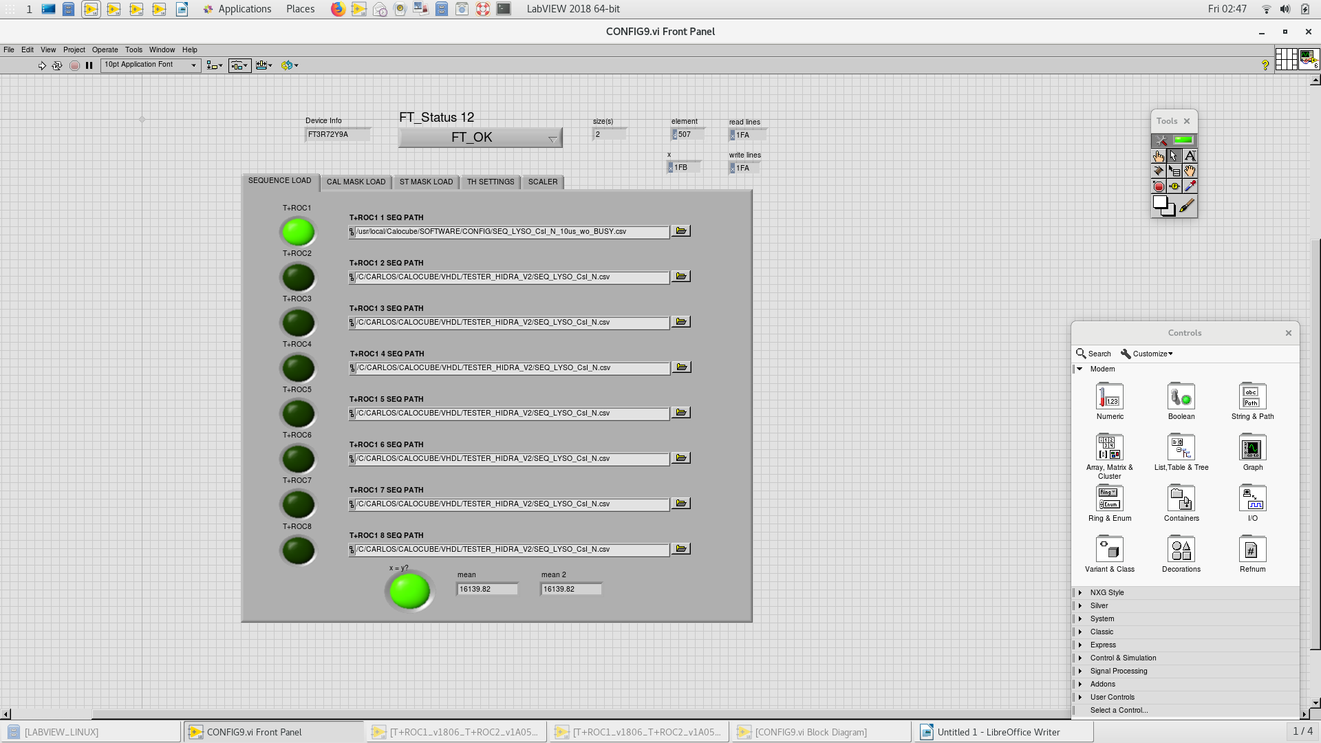
SOFTWARE: CONFIGURATION

Slide 13
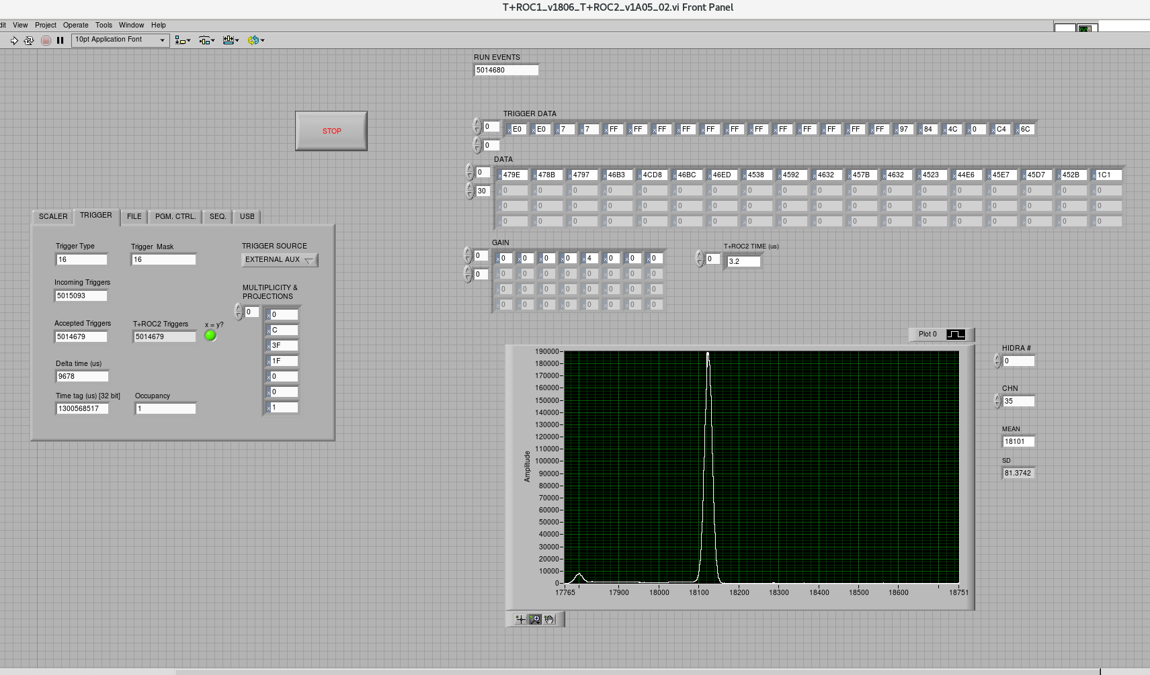
SOFTWARE: DAQ
https://drive.google.com/drive/folders/1O9lQHOBpgZ2vuzyTFjxDppKAs4-0ZpYH?usp=sharing

Slide 14
USEFUL LINK
https://drive.google.com/drive/folders/1O9lQHOBpgZ2vuzyTFjxDppKAs4-ZpYH?usp=sharing
BEIJING CALOCUBE SET-UP
T+ROC1
T+ROC2
SOFTWARE
TROC1_1B0C.mcs
TROC1_manual.docx
CALOCUBE_ROC_1_01.pdf
T+ROC2_v4.pdf
T+ROC2_v4.docx
T+ROC2_v1A11.mcs
CALOCUBE_ROC_2_01.pdf
THRESHOLD_0.csv
ST_MASK_all.csv
SEQ_LYSO_CsI_N_10us_wo_BUSY.csv
CALL_MASK.csv
CONFIG_9.vi
INSTALL_LINUX.tgz
T+ROC1_v1806_T+ROC2_V1A05_2.vi
HIDRA2
HIDRA2_datasheet.pdf
Cabling.pdf

