Slide 1
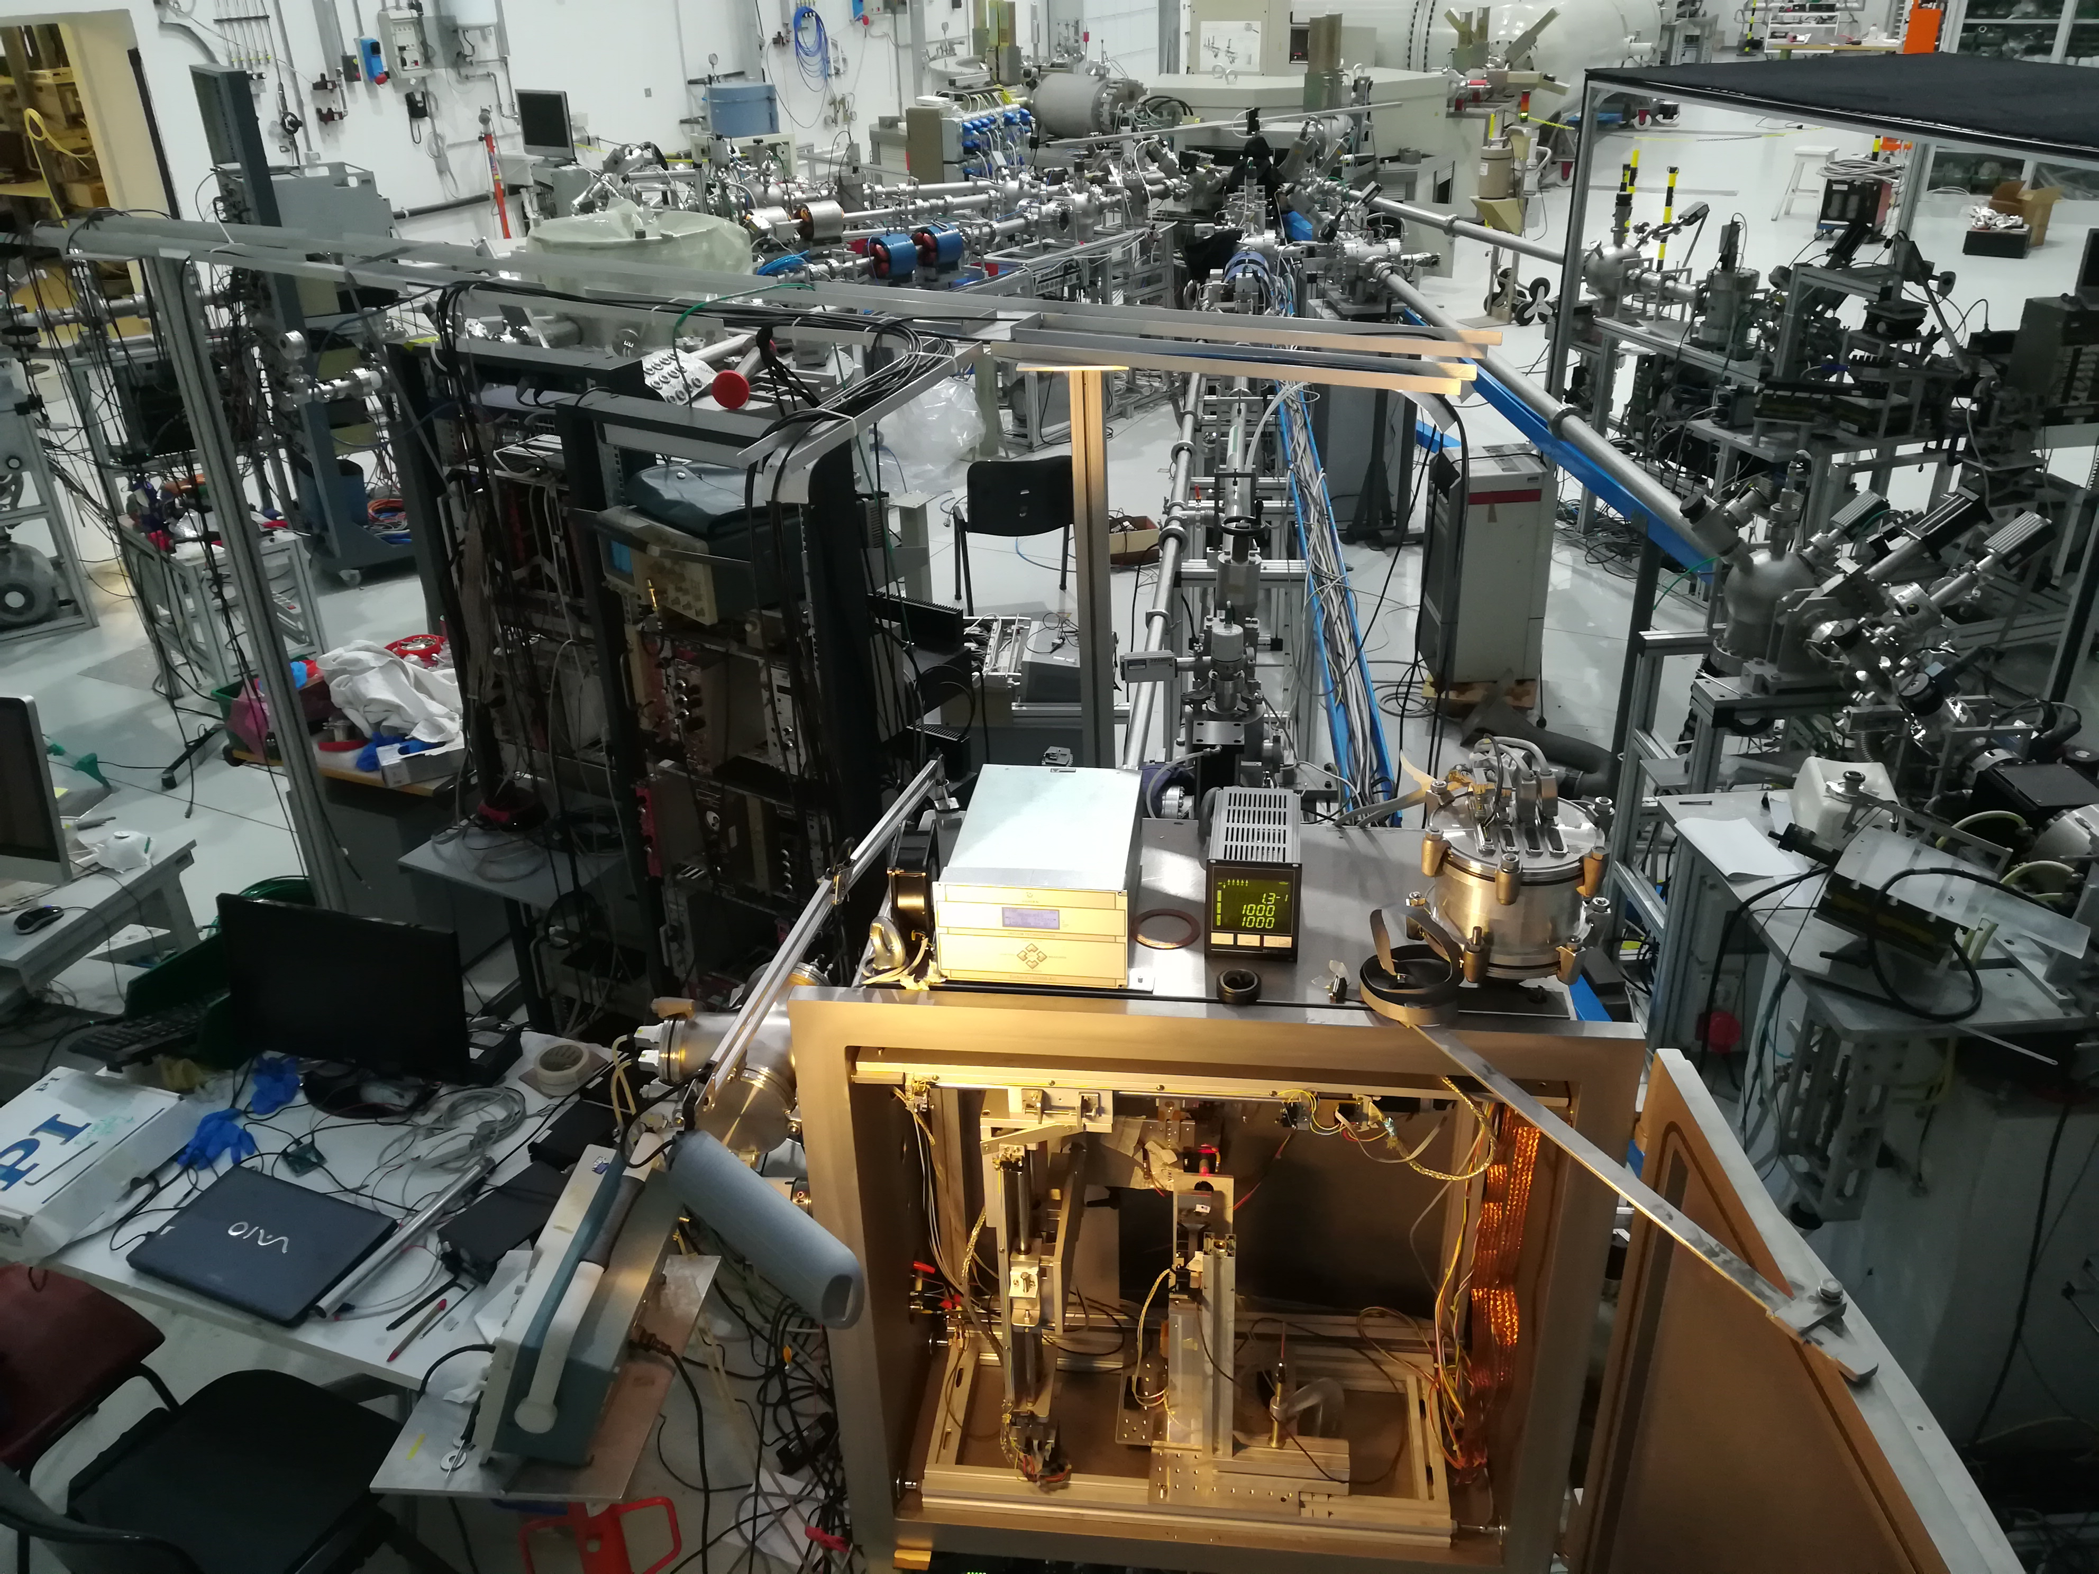
Implantation of silicon-vacancy single-photon emitters at the Tandetron accelerator of INFN Florence for application in quantum technologies.
Stefano Lagomarsino, Silvio Sciortino,
Nicla Gelli,
Lorenzo Giuntini, Massimo Chiari, Francesco Taccetti, Mirko Massi,
Lukas Hunold,
Florian Sledz,
Haritha Kambalathmana, Assegid M. Flatae, Marco Bellini,
Chiara Corsi,
Mario Santoro,
and Mario Agio

Slide 2
SiV color centers implantation for QA
Implantation of color centers at INFN-FI
Characterization and post-processing at LENS and CNR-INO Florence
Optical studies and device development with Lab. Of Nano-optics Siegen Univ. - Germany

Slide 3
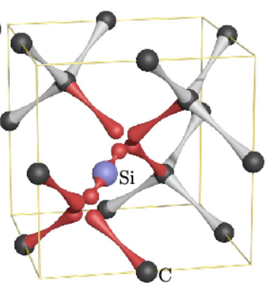
Diamond color centers implantation for QA
The interest for (negative) Silicon-Vacancy centers arises from
Strong brightness at room temperature
Emission concentrated in ZPL within down to 0.7 nm at room temperature
Single photon emission
Short lifetime of excited state (1ns) ⇒high emission rate
Quantum information storage and manipulation
Doublet spin state of the gr. state
Possibility to increase the (yet short) coherence time of the spin state (e.g. embedding in a phononic crystal)

Slide 4
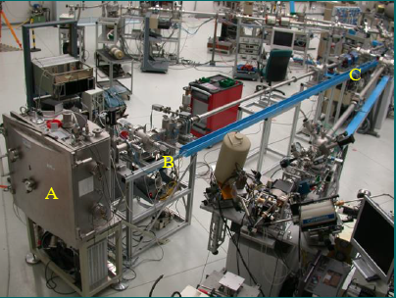
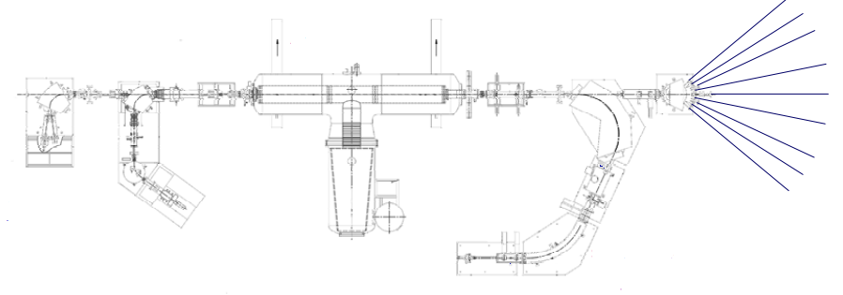
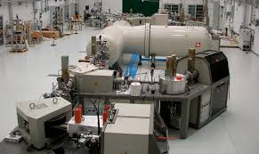
Tandetron accelerator facility of LABEC (Florence)*
Electrostatic deflector line
Si3+
Choosing appropriate term. Voltage and charge state, we work on the 0.1 <E<15 MeV range of energies
DC: ∼10 nA/mm²
(fluence 10¹¹÷10¹⁶ cm⁻²)
switching magnet
Si+
Pulsed: duty cicle≤0.05%:
down to 10⁶ cm⁻²
Si2+
Si3+
We can generate and accelerate a great amount of on species either atomic (Si, Ge-, Sn- ecc.) or in convenient molecular form (CN- ecc.)
Si4+
0.1 MeV - 70±20 nm (FWHM)
Prob.dens/ion (μm⁻¹)
3MV tandem accelerator
Ar stripper
15 MeV – 3.16±0.08μm
Depth (μm)
Si-
* The center for production of single-photon emitters at the electrostatic-deflector line of the Tandem accelerator of LABEC (Florence) NIMB 422, 31-40
Solid state sputtering neg. Ion source
Es. Si-, CN-

Slide 5
Implantation of color centers at INFN-FI
def+
predef.
predef. only
no-def.
Irradiation time (s)
10⁻⁸
10⁻⁷
10⁻⁶
10⁻⁵
10⁻⁴
10⁻³
10⁻²
10⁻¹
10⁻⁰
10¹
10²
10³
10⁴
Fluence (cm⁻²)
10⁴
10⁶
10⁶
10¹¹
10¹¹
10¹⁶
Single shot on a 1μm pin-hole
Heavy implantation, strong damage
Single shot on a 1 cm target
Well separated centers light implantation
Heavy implantation, low damage
1 s
(1Hz)
50 s
(10Hz)
1 s
(1Hz)
10²s
(100Hz)
1 s
Cont.
10⁴ s
Cont.
Process time (s)

Slide 6
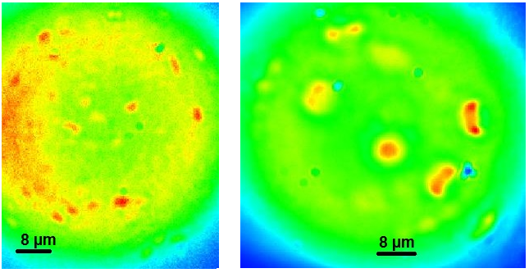
Implantation of color centers at INFN-FI
Single emitter characterization performed at Laboratory of Nano-Optics, Siegen Univ. (Ge)
Single centers (after proper annealing) were searched for by wide field microscopy and addressed for further measurements*.
647 Kr-Ar cw laser
10 ion/μm²
1 ion/μm²
10X Obj.
wide-field-ill.
60X oil-imm. Obj.
1.5 mm w-dist.
*Optical properties of silicon-vacancy color centers in diamond created by ion implantation and post-annealing Diamond and Related Materials 84, 196-203

Slide 7
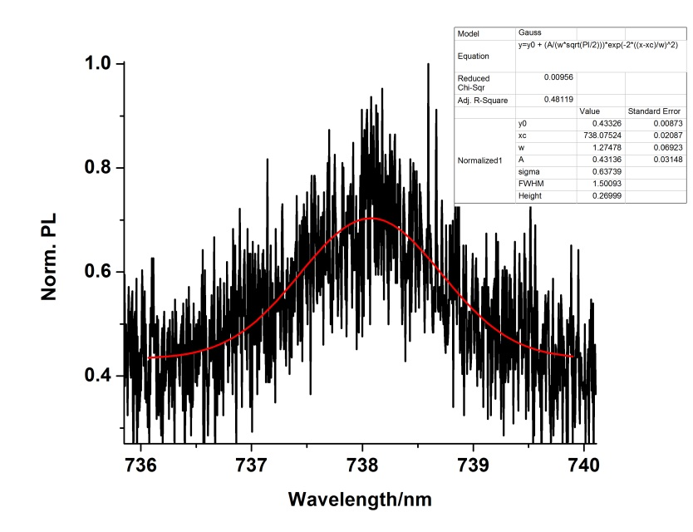
Implantation of color centers at INFN-FI
Single emitter characterization performed at Laboratory of Nano-Optics, Siegen Univ. (Ge)
FWHM = (1.6±0.1) nm
Then, their spectra has been analysed, revealing a very sharp luminescent peak at 738 nm with an inhomogeneous dispersion of order tenth of nm.
647 Kr-Ar cw laser
10 ion/μm²
1 ion/μm²
10X Obj.
wide-field-ill.
60X oil-imm. Obj.
1.5 mm w-dist.
647 Kr-Ar cw laser
to spectrometer

Slide 8
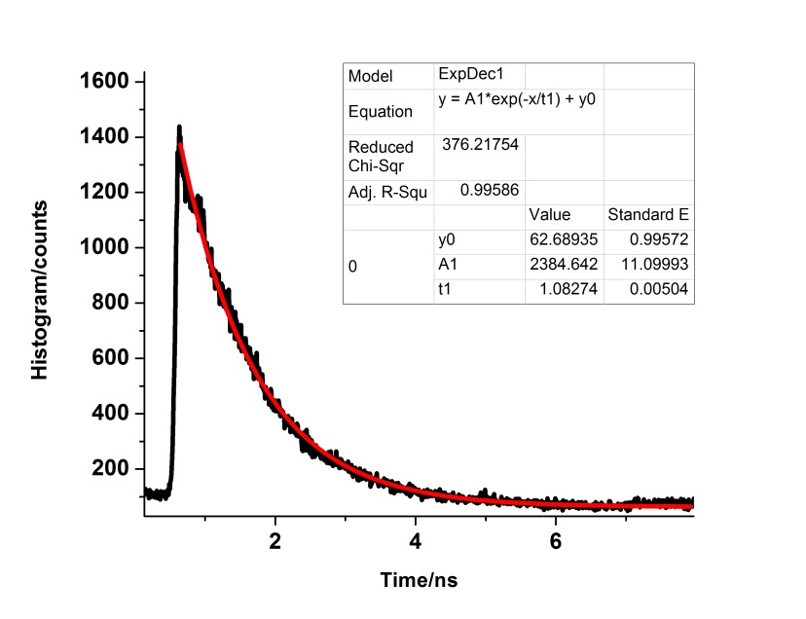
Implantation of color centers at INFN-FI
Single emitter characterization performed at Laboratory of Nano-Optics, Siegen Univ. (Ge)
Time-dependent measurements of excited state lifetime gave ∼ 1ns, with a theoretical limit to the emission rate of order 50 MHz (with 5% of Q-efficiency)
τ = (1.07±0.01) ns
(ns)
10 ion/μm²
1 ion/μm²
60X oil-imm. Obj.
1.5 mm w-dist.
50 ns
45 ps
656 pulsed laser-diode
647 Kr-Ar cw laser
to spectrometer

Slide 9
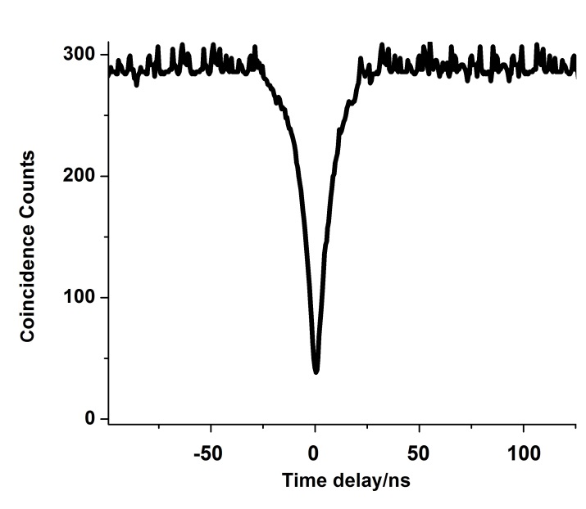
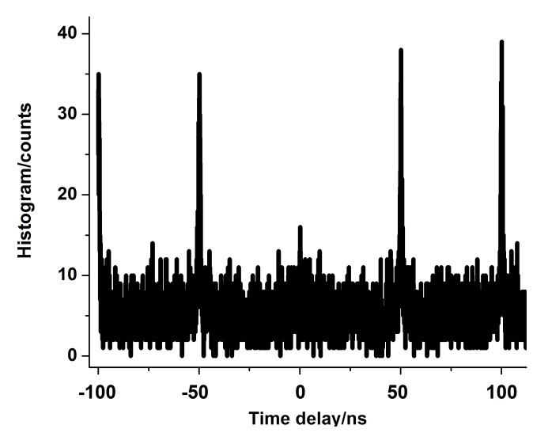
Implantation of color centers at INFN-FI
Antibunching in pulsed excitation
cw excitation
g² meas.
10 ion/μm²
1 ion/μm²
Possibility to produce and address single emitting centers confirmed
60X oil-imm. Obj.
1.5 mm w-dist.
50 ns
45 ps
656 pulsed laser-diode
start
delay
stop

Slide 10
Implantation of color centers at INFN-FI
Two kinds of implantation are performed:
Statistically uniform over large areas (1-10 mm²)
Wide field images of implanted areas
Color centers are randomly implanted at a low fluence and then searched for and addressed for measurements, or locally activated by pulsed laser irradiation

Slide 11
Implantation of color centers at INFN-FI
Two kinds of implantation are performed:
Implanted over matrices with micrometric resolution
«hot spots» 10⁶ Si implanted
10³
±30
10²
±10
10
±3
1
±1
1
±1
photoluminescence map (scan. 1μm res.)

Slide 12


Implantation of color centers at INFN-FI
Two points 10 μm apart, each with ∼100 col. centers
Confocal micro-fluorescence scan
1.5 μm
FWHM
Single center
Thus, the dispersion of the ion distribution is about
$$\sqrt{{1.5}^{2}−{0.6}^{2}}μm ≈ 1.4 μm$$
0.6 μm
FWHM
Due to the pin-hole dimensions (possibility to improve to fractions of μm)

Slide 13
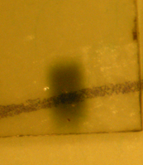
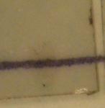
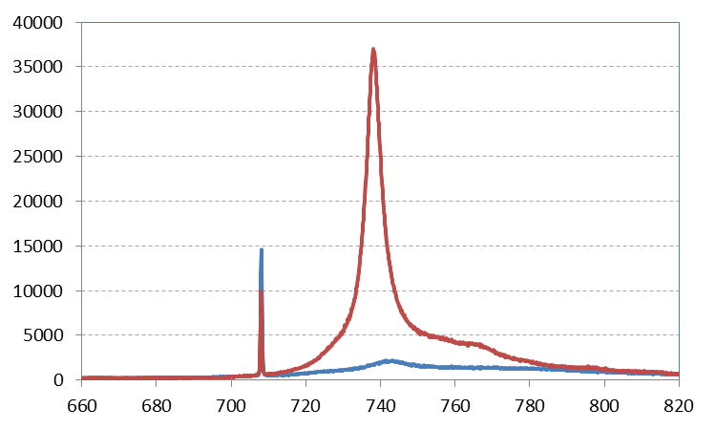
Implantation of color centers at INFN-FI
After proper annealing at 1150°C
1150°C
20°C
2h
3h
t
Before annealing
Annealed 1150°C
Transparency recovers
(defect annealing)
- x20 increase of luminescence signal (738 nm ZPL of SiV, negligible sidebands)

Slide 14
Characterization and post-processing at Lens and INO-CNR Florence
Recently, a new kind of activation procedure has been employed for Nitrogen-Vacancy centers, based on the effect of localised femtosecond, high intensity laser irradiation of diamond with native Nitrogen impurity level of order ppb.

Slide 15
Characterization and post-processing at Lens and INO-CNR Florence
If succesfull, it would permit to locally address the activation of individual SiV centers (res ∼ 1 μm) by laser irradiation after diffuse silicon irradiation.
At the XUV-lab of INO-CNR Florence we are employing a similar procedure for activation experiments of SiV centers after implantation of Si ions.
Ti-Sapphire, 800 nm, 300 mJ, 30 fs pulses
F
NF
Weel F
BS
SF
∼ 10 nJ pulses
Spectr.
entr. slit
Dicr. M.
BPF
He-Ne excitation laser beam
Dicr. M.
Beam exp.
TV camera
Sample

Slide 16

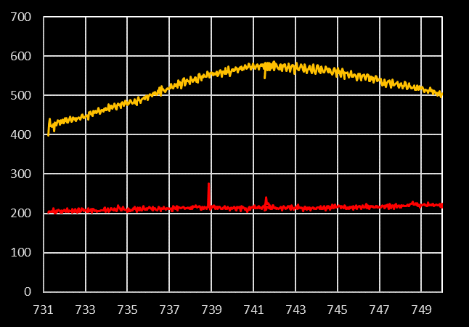
Where irradiated with Ti-Sapphire for some minutes, the diamond surface partially recovers transparence, indication of vacancy-interstitial recombination
after
before
during
before
λ_{max} = 741.5 nm
FWHM = 9 nm
after
The identification of the feature at 741 nm is not trivial. It will require measurement of the excited state lifetime
before

Slide 17
Characterization and post-processing at Lens and INO-CNR Florence
Luminescence is quenched at high temperatures, but still strong at 500K, and recovers at RT
Peak wavelength is a reproducible indicator of temperature, with good sensitivity especially at HT
*Robust luminescence of the silicon-vacancy center in diamond at high temperatures AIP Advances 5 (12), 127117

Slide 18
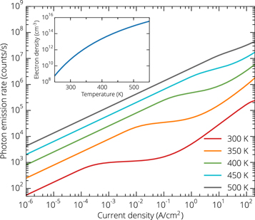
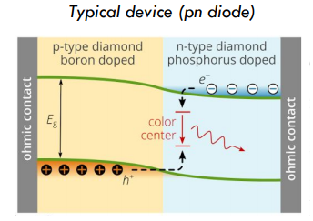
Device development with Lab. Of Nano-optics Siegen Univ. - Germany
We are working to the fabrication of single photon light-emitting Schottky diodes based on the implantation of recombination SiV centers in an n-doped diamond
Their emission rate would take advantage of the high temperature robustness of these color centers

Slide 19
Device development with Lab. Of Nano-optics Siegen Univ. - Germany
The work is in progress trying to explore the issue of electrical excitation and detection of single photon emission in the depletion zone of Schottky diodes.
Anticoincidence measurements shows difinitely single-photon emission conditions.
The first assessment of such a behavior in n-doped diamond.
Low fluence (∼10⁷ cm⁻²) implantation in Phosphorus doped diamond (grown at 5000 ppm of PH₃/CH₄)
results in well separated luminescent centers…
… exhibiting 738 nm luminescence with 7.6 nm FWHM, over a background which is separable from signal below saturation.
Saturation of
single emitter
background
arXiv:1912.09352

Slide 20
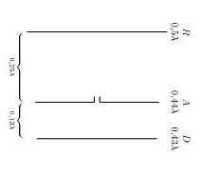
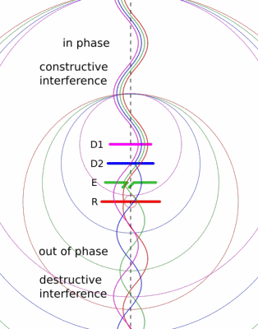
Device development with Lab. Of Nano-optics Siegen Univ. - Germany
SiV centers embedded in a nano-layered antenna have shown increased directionality.
We are working also on Si-implantation in polycr. diamond membranes (∼100 nm thickness)*.
Composite diamond-silica-metal layered structures (Yagi-Uda antenna-like) are capable to increment directionality and efficiency of color centers (two patents, US and EU)
Work is in progress to improve superficial characteristics of diamond films and optimize optical characteristics of SiV centers.
*Highly efficient light extraction and directional emission from diamond color centers using planar Yagi-Uda antennas arXiv:1905.03363

Slide 21
Silicon-vacancy color centers in phosphorus-doped diamond Assegid Mengistu Flatae, Stefano Lagomarsino, Florian Sledz, Navid Soltani, Shannon S Nicley, Ken Haenen, Robert Rechenberg, Michael F Becker, Silvio Sciortino, Nicla Gelli, Lorenzo Giuntini, Francesco Taccetti, Mario Agio arXiv preprint arXiv:1912.09352
Exploring ultrafast single-photon emission of silicon-vacancy color centers in diamond nano-membranes coupled with gold nano-cones
H Kambalathmana, AM Flatae, S Lagomarsino, H Galal, F Tantussi, GC Messina, E Wörner, C Wild, N Gelli, S Sciortino, L Giuntini, F De Angelis, M Agio Quantum Nanophotonic Materials, Devices, and Systems 2019 11091, 1109108
Highly efficient light extraction and directional emission from diamond color centers using planar Yagi-Uda antennas Hossam Galal, Assegid M Flatae, Stefano Lagomarsino, Gregor Schulte, Christoph Wild, Eckhard Wörner, Nicla Gelli, Silvio Sciortino, Holger Schönherr, Lorenzo Giuntini, Mario Agio arXiv preprint arXiv:1905.03363
Optical properties of silicon-vacancy color centers in diamond created by ion implantation and post-annealing Stefano Lagomarsino, Assegid M Flatae, Silvio Sciortino, Federico Gorelli, Mario Santoro, Francesco Tantussi, Francesco De Angelis, Nicla Gelli, Francesco Taccetti, Lorenzo Giuntini, Mario Agio Diamond and Related Materials 84, 196-203
The center for production of single-photon emitters at the electrostatic-deflector line of the Tandem accelerator of LABEC (Florence) Stefano Lagomarsino, Silvio Sciortino, Nicla Gelli, Assegid M Flatae, Federico Gorelli, Mario Santoro, Massimo Chiari, Caroline Czelusniac, Mirko Massi, Francesco Taccetti, Mario Agio, Lorenzo Giuntini Nuclear Instruments and Methods in Physics Research Section B: Beam Interactions with Materials and Atoms 422, 31-40
Robust luminescence of the silicon-vacancy center in diamond at high temperaturesS Stefano Lagomarsino, Federico Gorelli, Mario Santoro, Nicole Fabbri, Ahmed Hajeb, Silvio Sciortino, Lara Palla, Caroline Czelusniak, Mirko Massi, Francesco Taccetti, Lorenzo Giuntini, Nicla Gelli, Dmitry Yu Fedyanin, Francesco Saverio Cataliotti, Costanza Toninelli, Mario Agio AIP Advances 5 (12), 127117

Slide 22
Implantation of silicon-vacancy single-photon emitters at the Tandetron accelerator of INFN Florence for application in quantum technologies.
Stefano Lagomarsino, Silvio Sciortino,
Nicla Gelli,
Lorenzo Giuntini, Massimo Chiari, Francesco Taccetti, Mirko Massi,
Lukas Hunold,
Florian Sledz,
Haritha Kambalathmana, Assegid M. Flatae, Marco Bellini,
Chiara Corsi,
Mario Santoro,
and Mario Agio

