Slide 1
Nanowires quantum detector
Vittorio Bellani
INFN & Pavia University
Andrea Marini
INFN & l’Aquila University
Francesco Rossella
INFN & NEST Pisa
Quantum Technologies within INFN: status and perspectives
20-21 January 2020, Padova

Slide 2
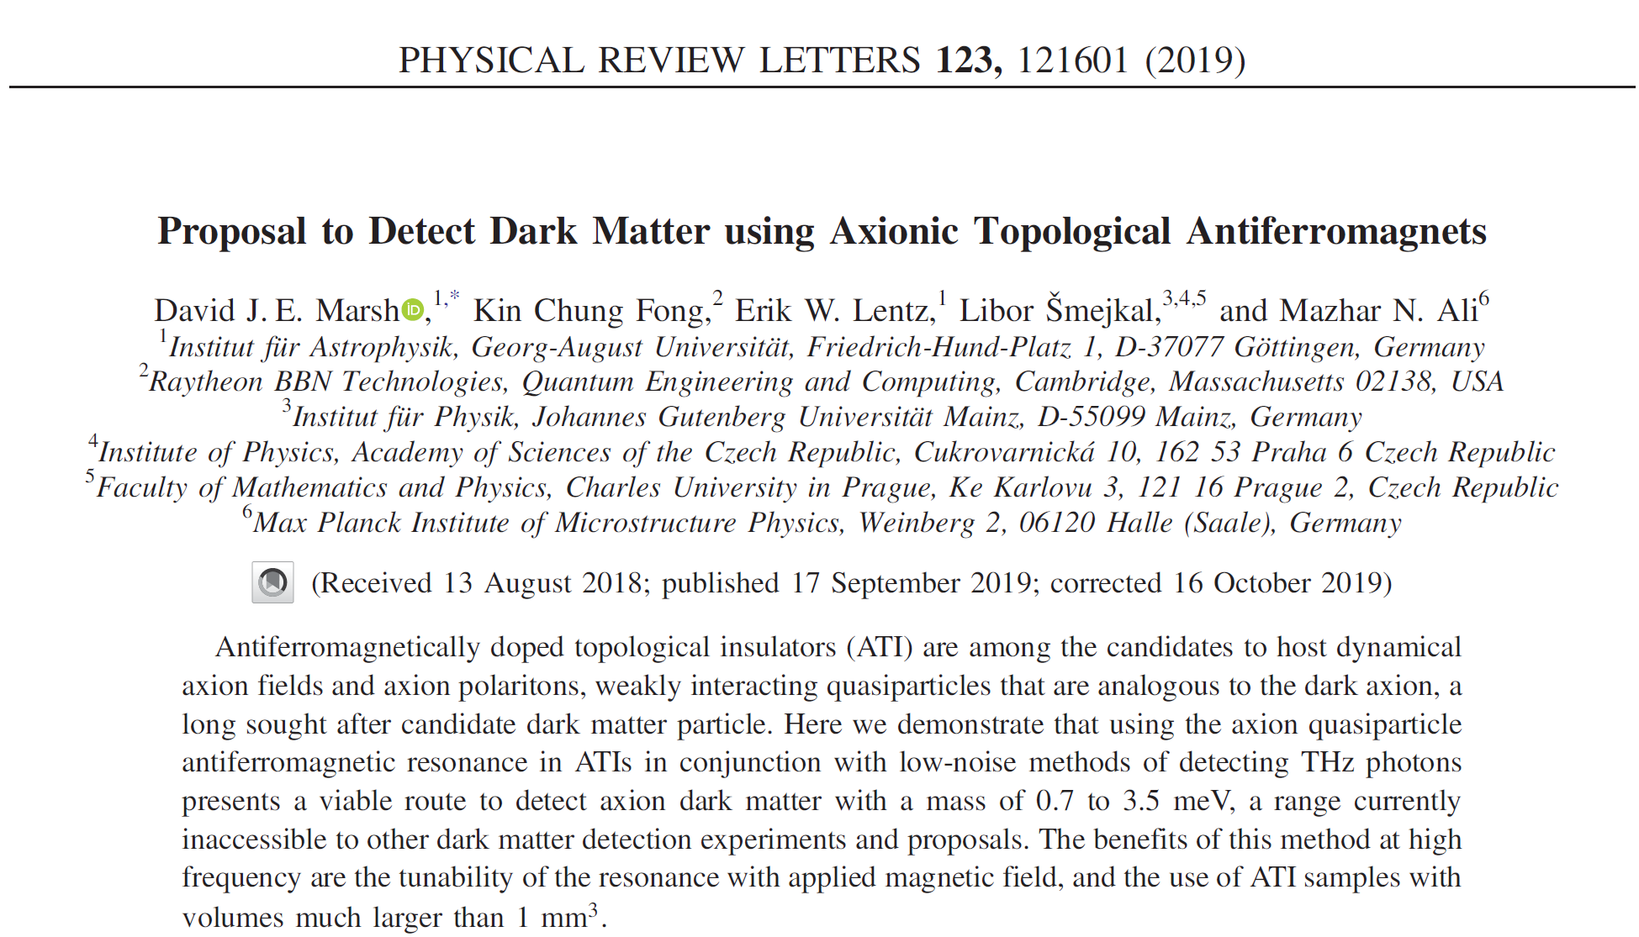
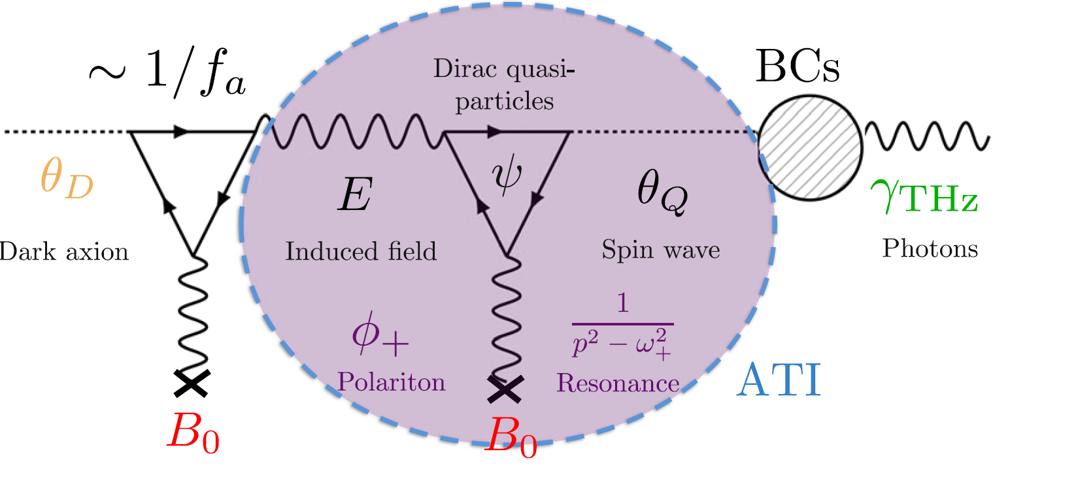

Slide 3
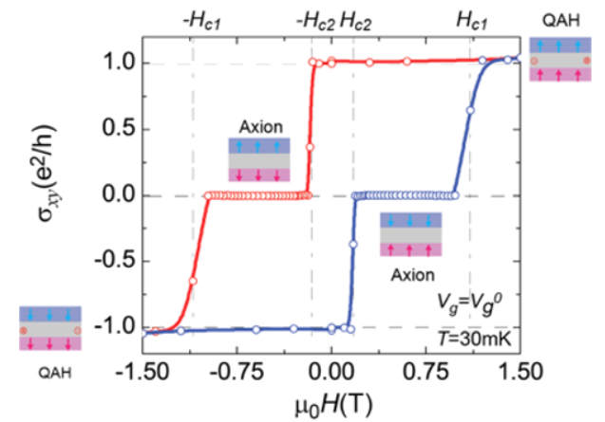

Slide 4
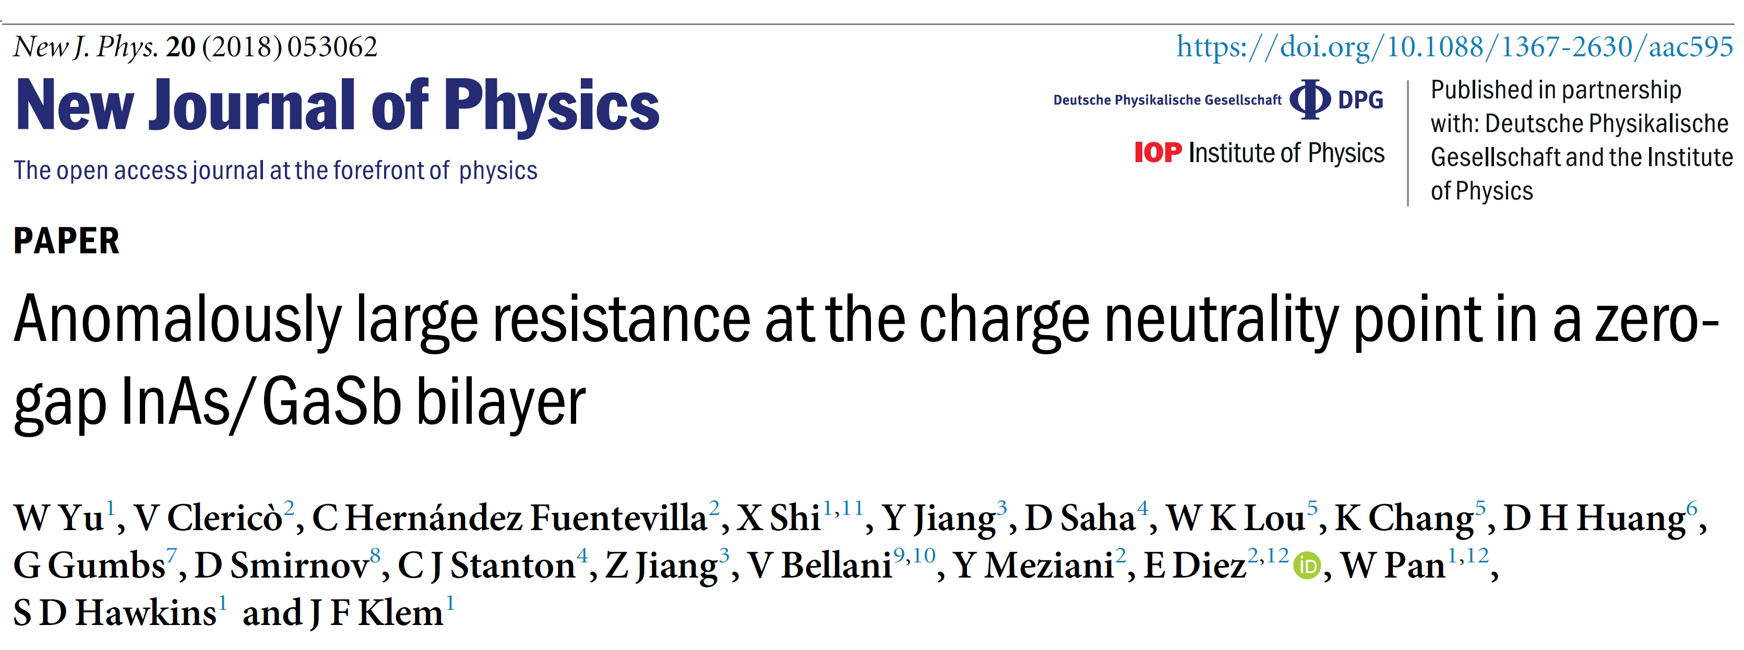
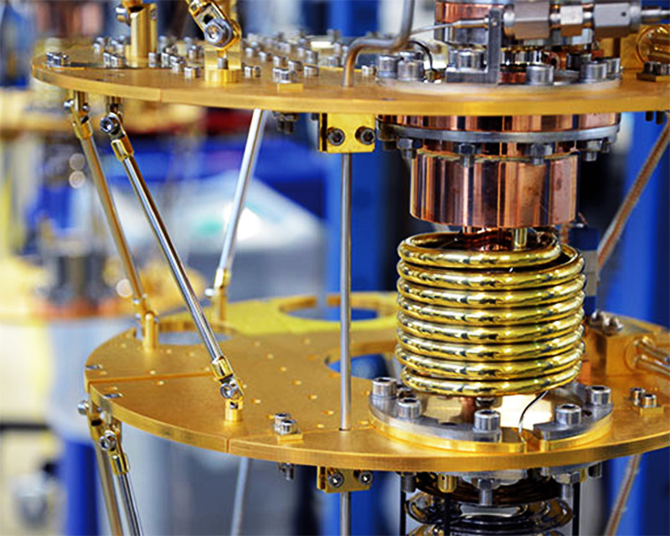
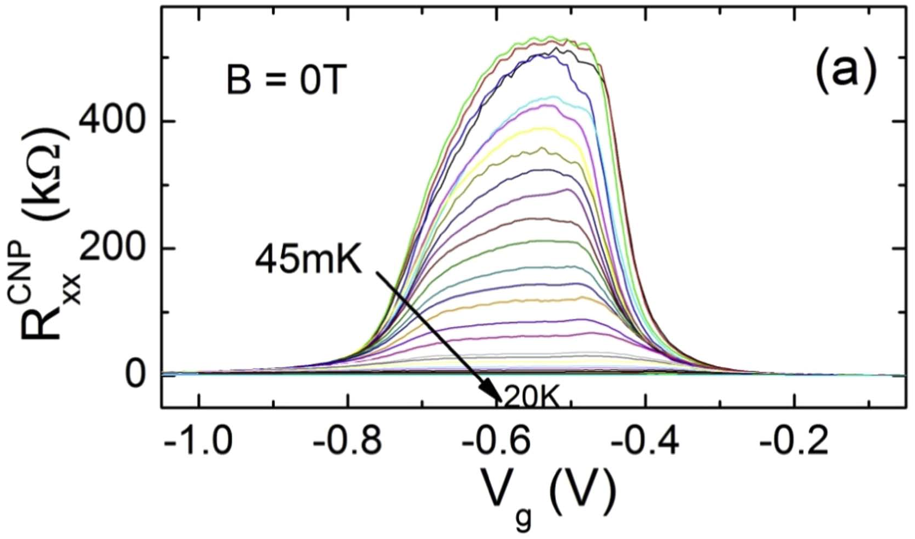
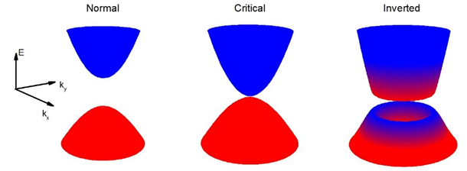
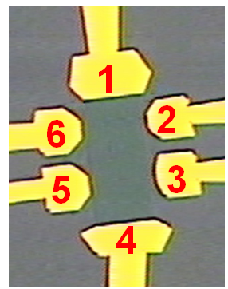
Band structures of the InAs/GaSb DQWs calculated using the eight-band k·p method.
Longitudinal resistance Rxx as a function of gate voltage Vg for increasing
Temperatures.

Slide 5
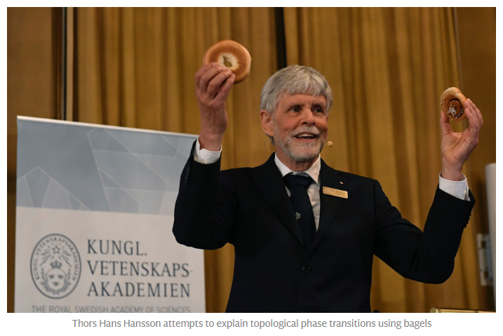

Slide 6
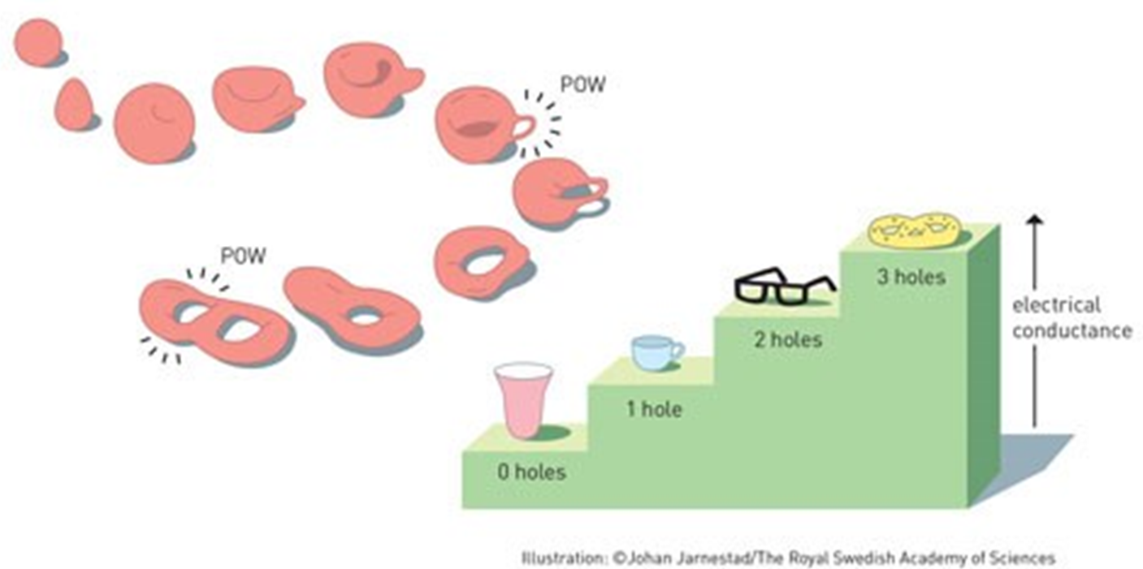

Slide 7
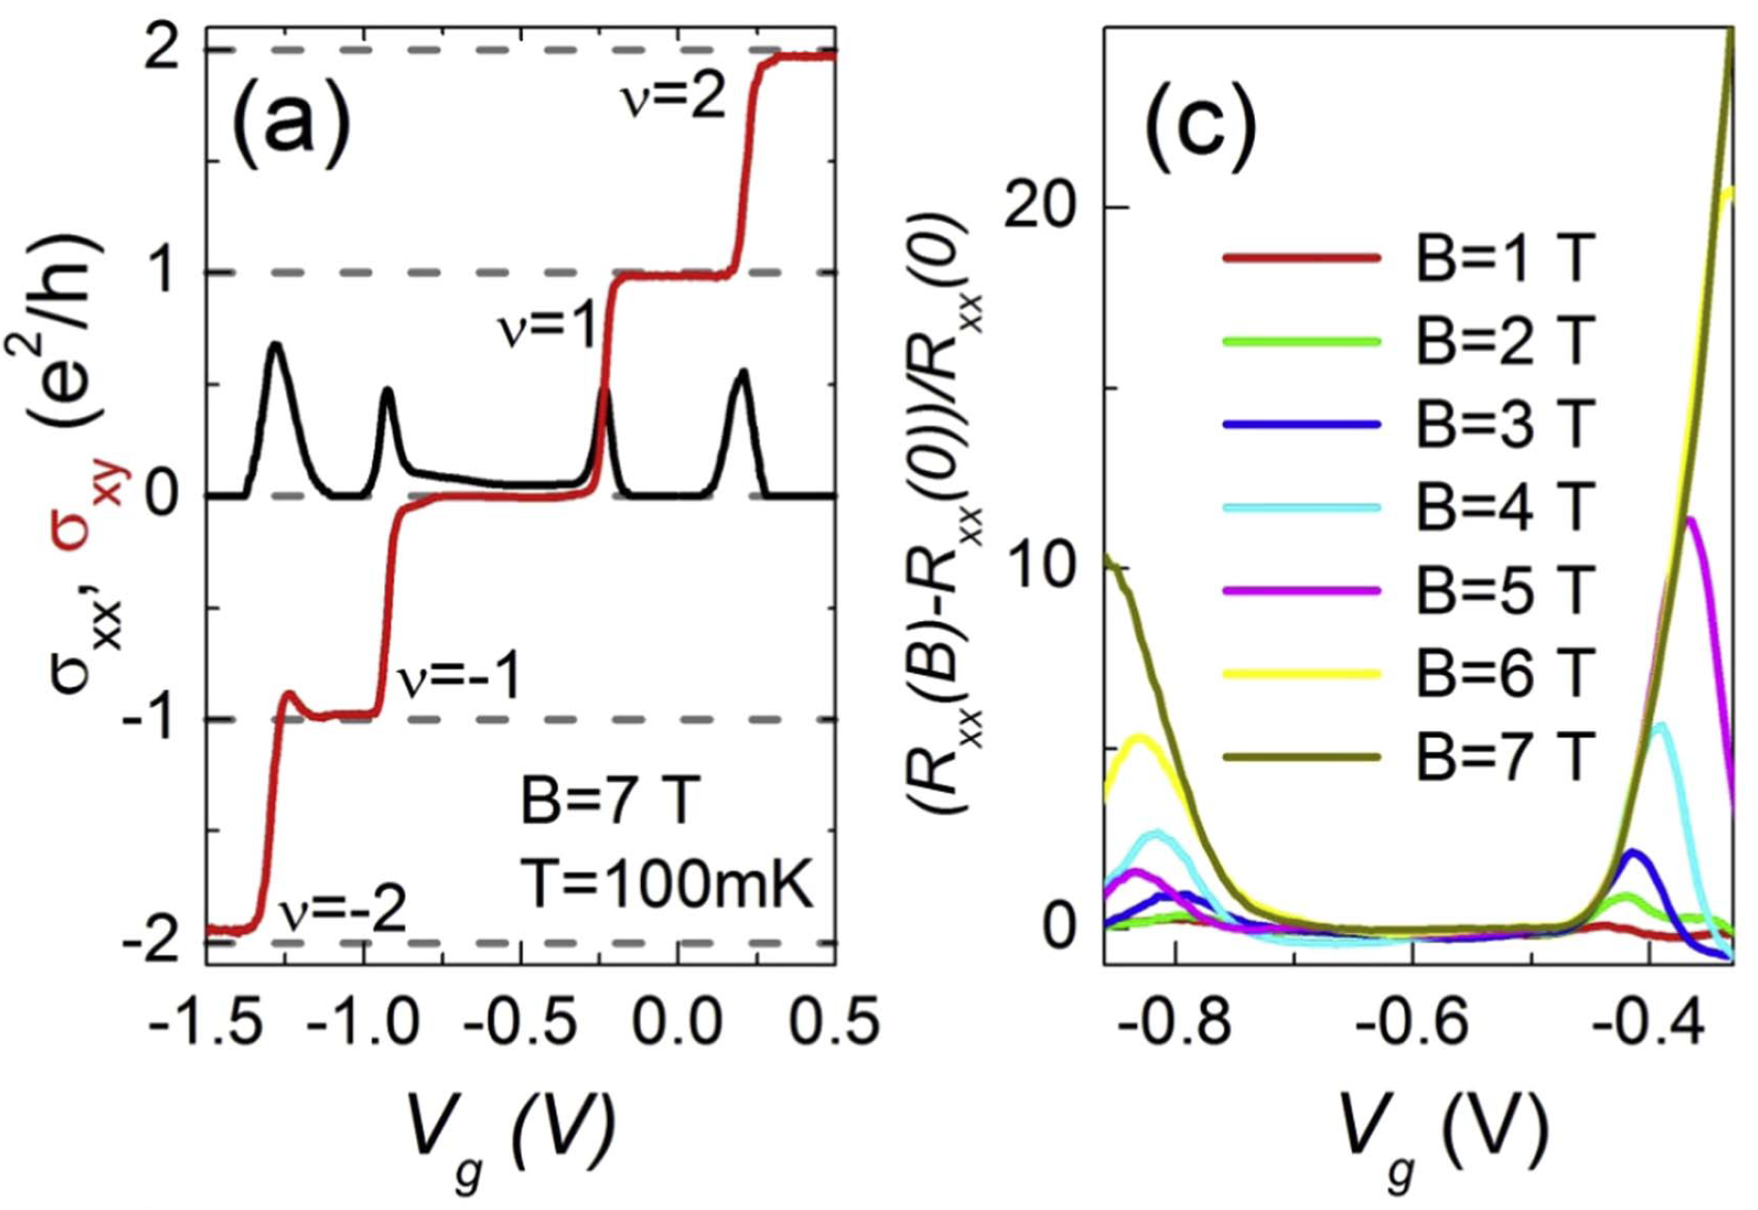
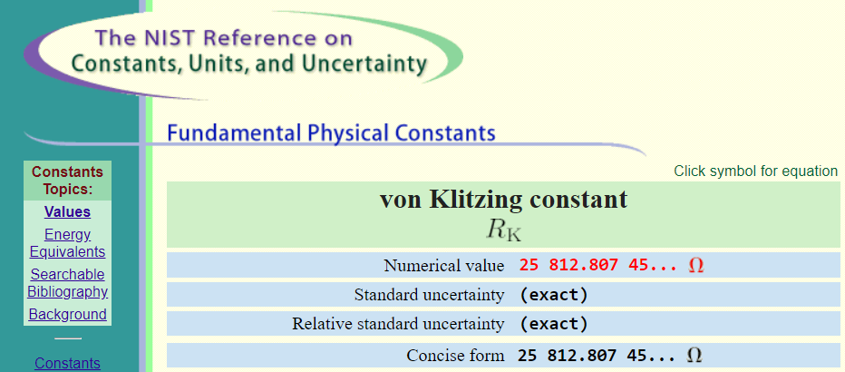
Magnetotransport properties of the critical sample. (a) Longitudinal (s_{xx}) and Hall (s_{xy}) conductivities as a function of V_{g}, measured at B = 7 T. (c) Normalized magnetoresistance (R_{xx}(B) - R_{xx}(0))/R_{xx}(0) in the charge neutrality point, for increasing magnetic fields.

Slide 8
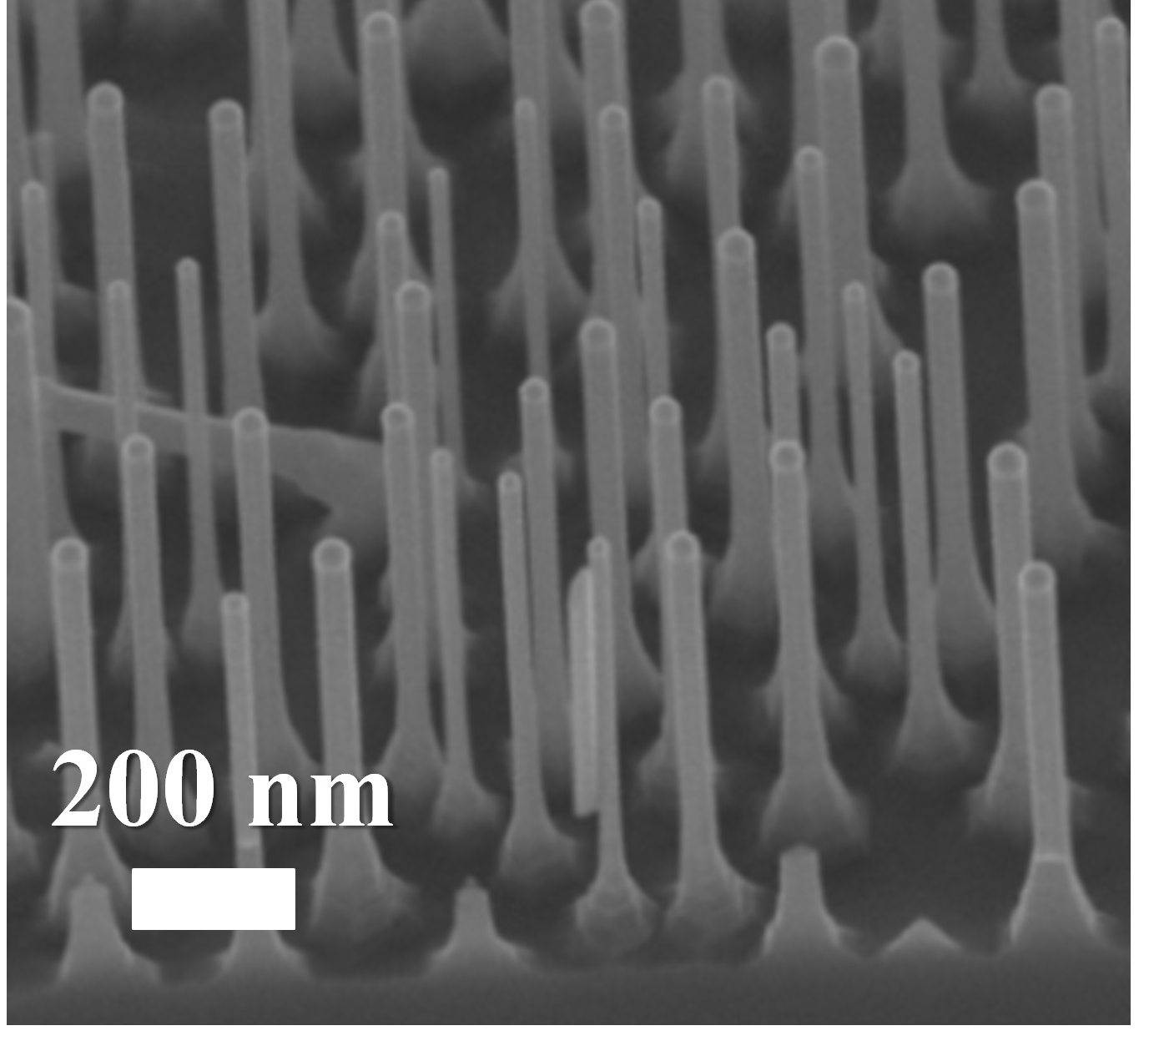
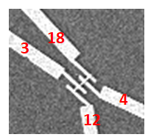
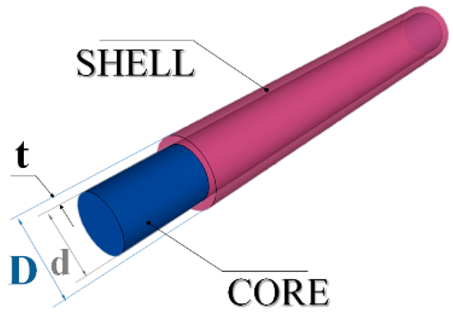
SEM of a core–shell nanowires array.
Schematic structure of the single NW

Slide 9
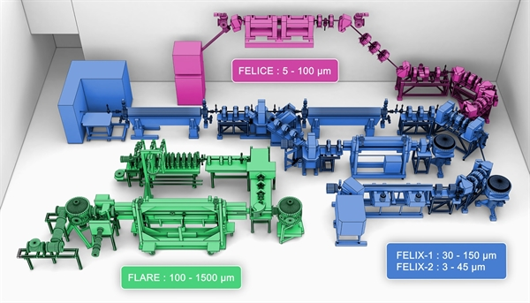
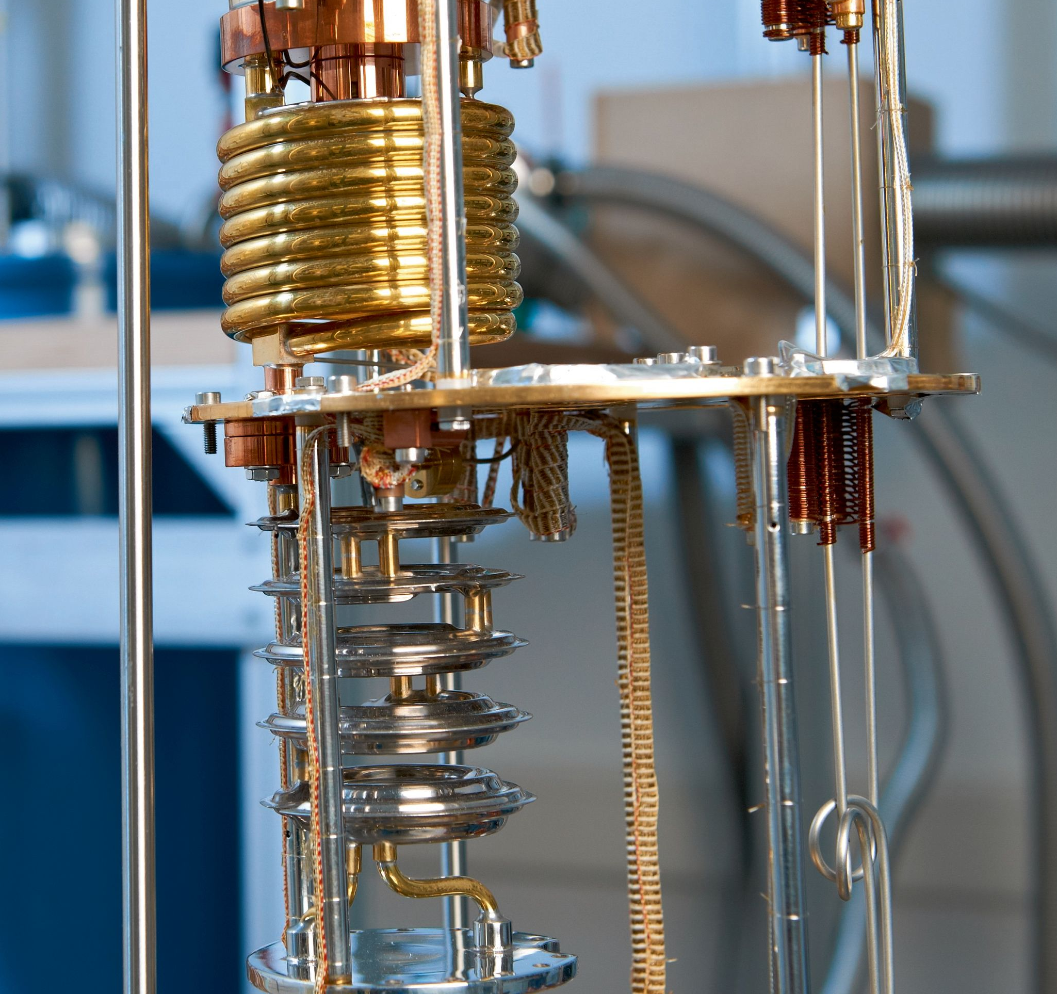

Slide 10
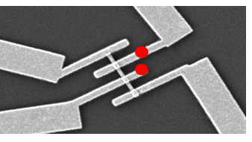
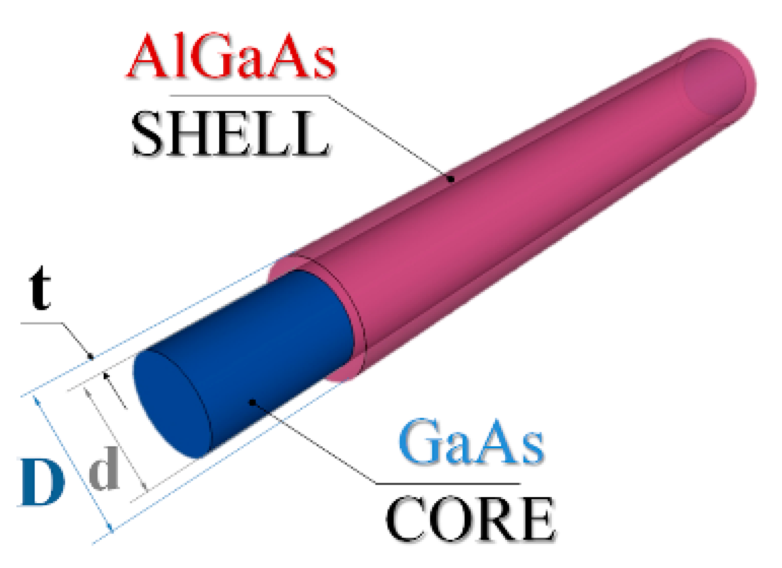
I-V charateristics of the NW detector versus magnetic field
at T = 2 K.

Slide 11
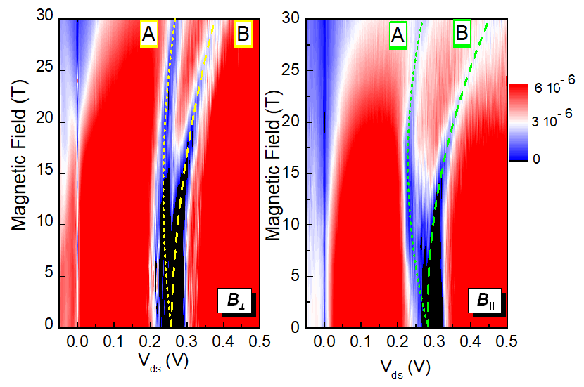
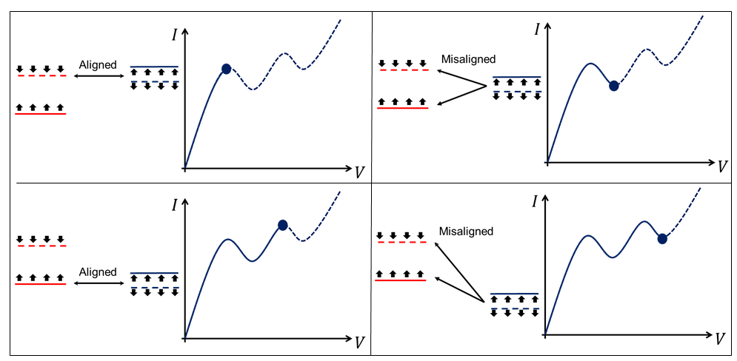
Schematic description of the evolution of the I/V characteristics, and of the corresponding spin split e and h levels alignment, with the magnetic field; in this figure the e and h spin alignment in the split levels.
dI/dV versus V_{db} and B, for magnetic field applied perpendicularly and parallel to the NWs. The NDC simultaneously hand linear landau shift, Zeeman splitting and quadratic diamagnetic shift.

Slide 12
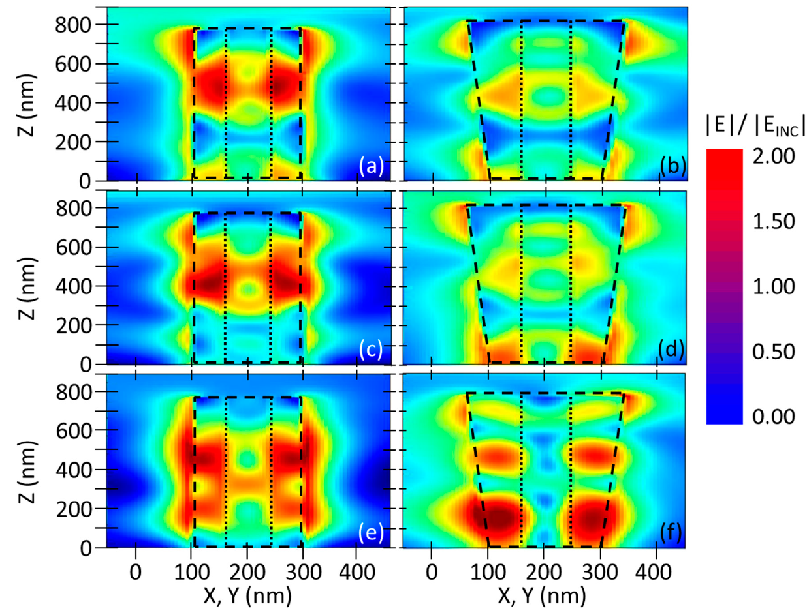
Longitudinal electric field distribution around a NW. Near-field normalized electric field expansion for the non-tapered C–S geometry, (a) θ = 0 °, λ = 925 nm; (c) θ = 40°, λ = 800 nm and (e) θ = 70, λ = 735 nm. Near-field normalized electric field expansion for the tapered C–S geometry, (b) θ = 0 ° and a λ = 925 nm, (d) θ = 40 and a λ 820 nm (f) θ = 70°, λ = 690 nm.
F. Floris et al., Materials 12, 3572 (2019).

Slide 13
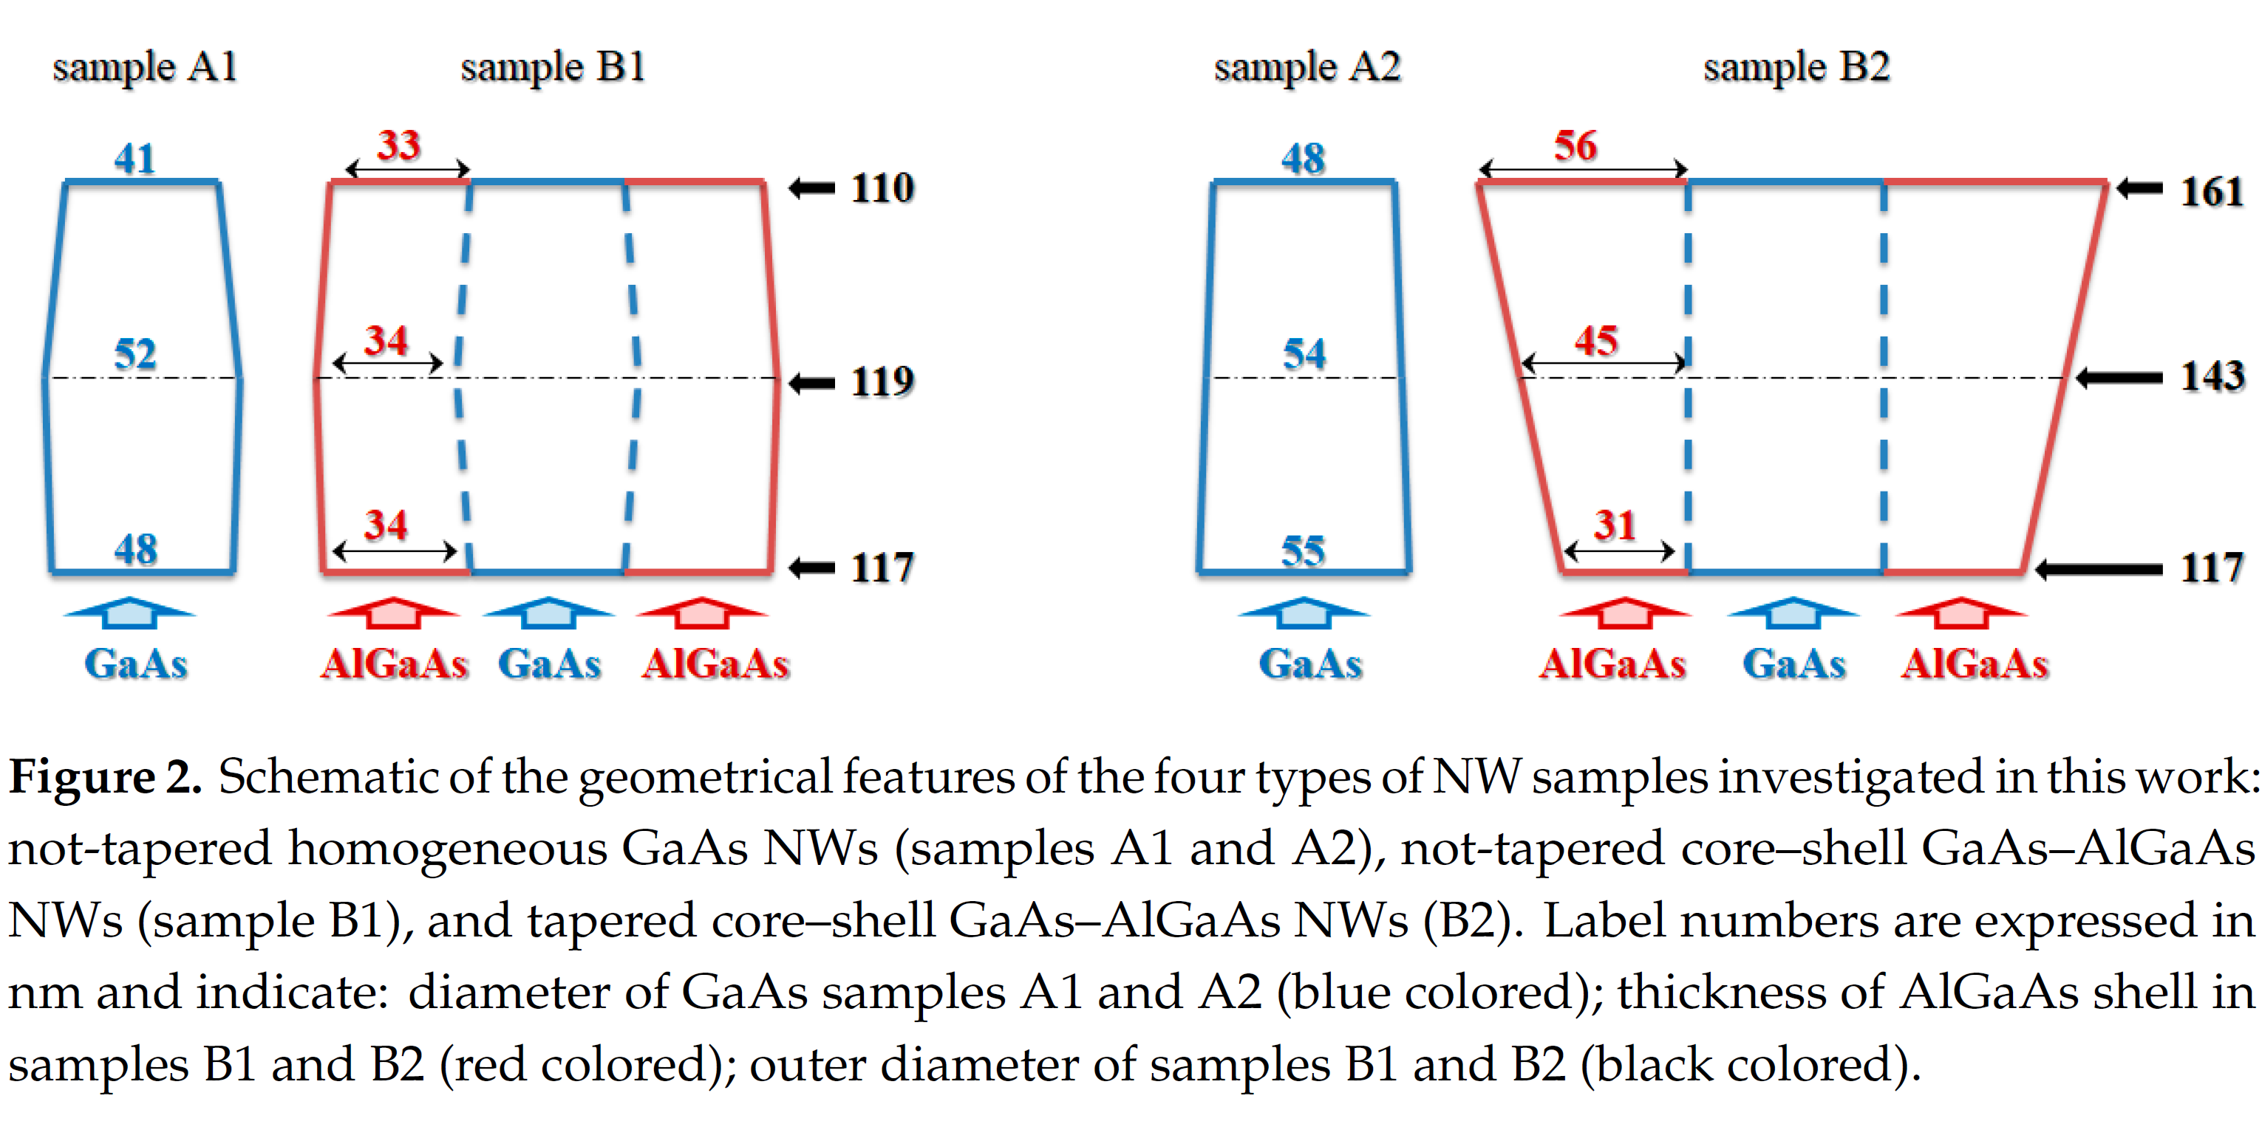
F. Floris et al., Materials 12, 3572 (2019).

Slide 14
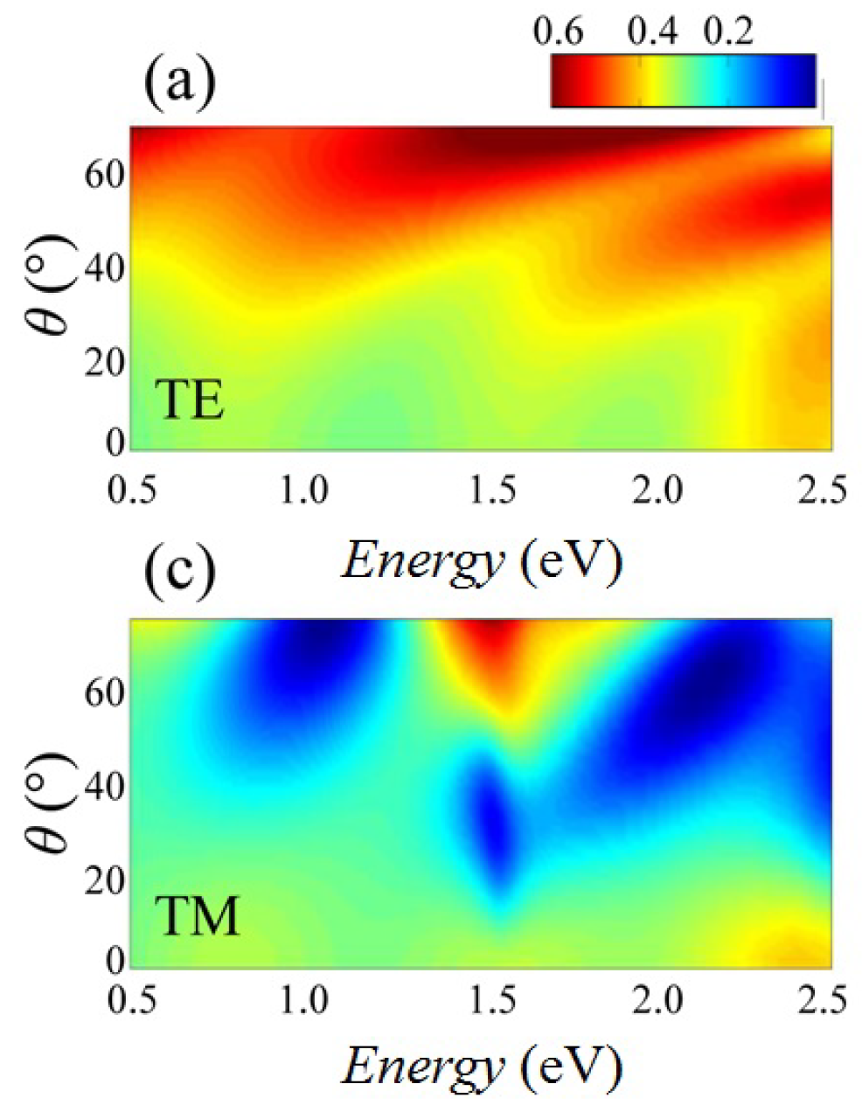
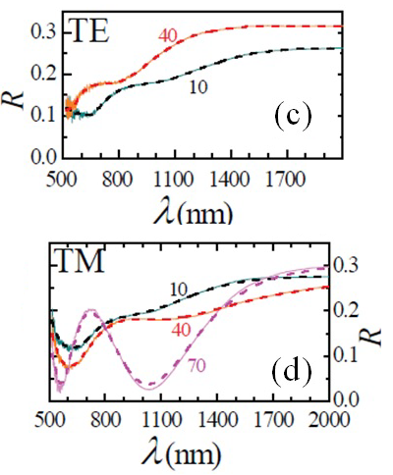
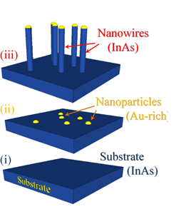
Schematics of a set of samples (ii) InAs substrate with Au catalyst nanoparticles; (iii) NW assembly (c) optical measurement configuration.
Logarithmic color plot of the angle and energy-resolved calculated reflectence.
(c,d) Calculated (dashed line) and measured (solid line) reflectance for the two polarizations.

Slide 15
Conclusions
Semiconductor nanowires detectors using topological insulator (TI) may allow the measurement of axions.
Numerical simulations allowed for identifying the geometrical features of the core–shell nanowires leading to the design of optimal structures for the detectors.
The self-assembled NW technology enables fast and cost-effective realization of detectors. NWs are relevant in view of sensitive detection, thanks to the exceptional surface-to-volume ratio due to the high aspect ratio of the NWs.
Owing to their large surface-to-volume ratio, NWs and NW-based systems bear great potential for sensing applications. They powerful detection platform for a broad range of radiation detection for astro-particle physics.

