Slide 1


Le attività di Fisica Sperimentale delle Alte Energie
Alessia Tricomi (alessia.tricomi@ct.infn.it)
Dipartimento di Fisica e Astronomia «E. Majorana»
Università degli Studi di Catania
Incontro con l’EAB del DFA, Catania, 12 dicembre 2019

Slide 2



Outline – Alias… «CERN sotto il Vulcano»
Outline
Alice @LHC
CMS @LHC
LHCf @LHC
And?

Slide 3
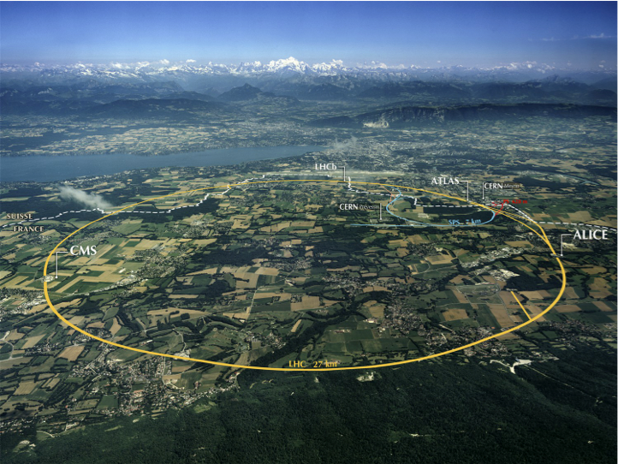
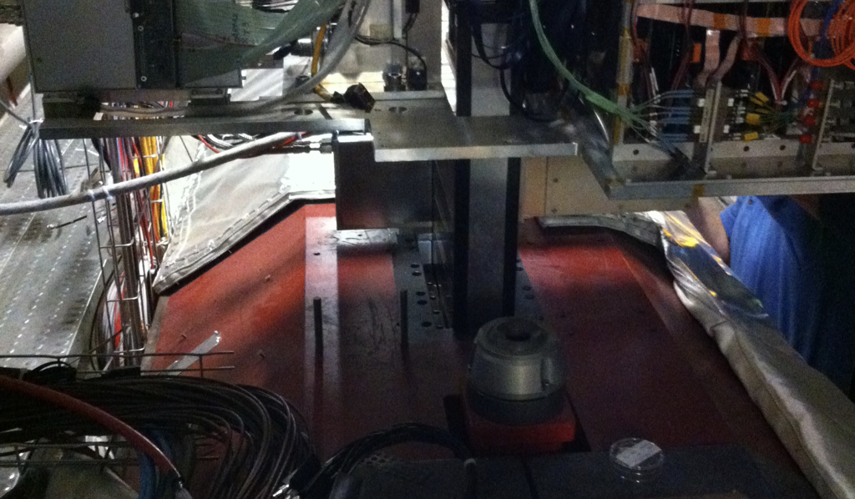
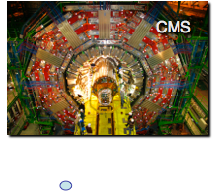
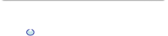
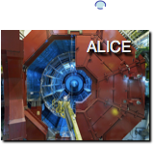
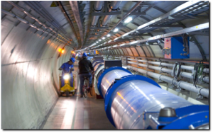
DFA(&INFN-CT)@Large Hadron Collider
LHCf
Esplorando nuove frontiere

Slide 4
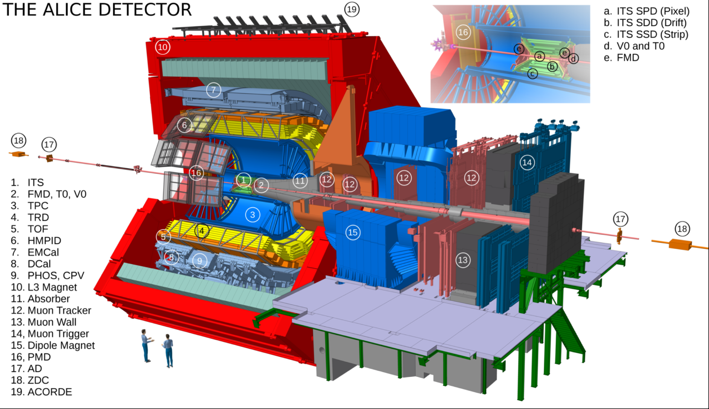
LEI
International collaboration of more than 1500 physicists, engineers and technicians, including around 350 graduate students, from 154 physics institutes in 37 countries across the world.

Slide 5
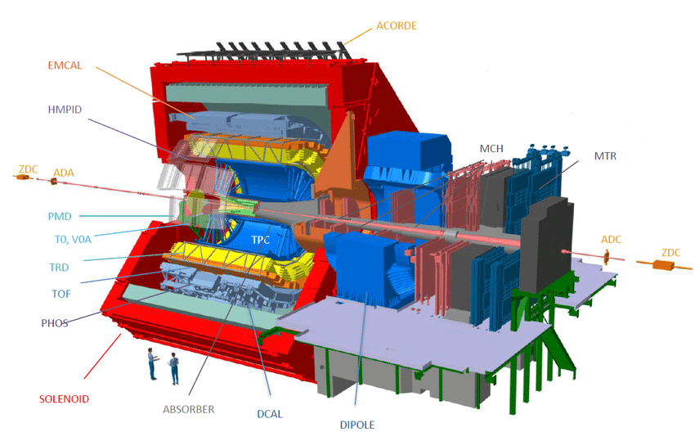


ALICE: A Large Ion Collider Experiment
ALICE is the experiment at the LHC devoted to the study of ultra-relativistic heavy-ion collisions (+ a broad p-p and p-A program)
GOAL: investigate the strongly interacting QCD matter created under extreme conditions of temperature and energy density
Understand confinement, producing and studying in the lab a deconfined plasma of quark and gluons (QGP)
Understand evolution of matter from the hot and dense deconfined phase towards ordinary hadrons (analogous to the early Universe evolution)
OBSERVABLES: hadrons, leptons and photons in a high multiplicity environment over a wide transverse momentum range

Slide 6
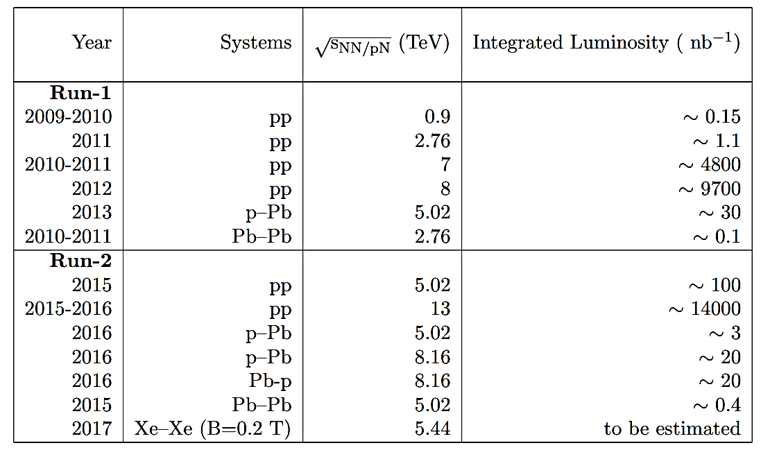
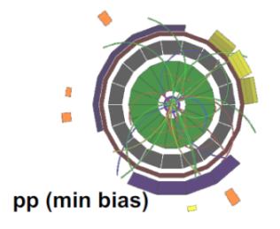


ALICE data taking and main results
DETECTOR PERFORMANCE:
robust tracking → central barrel with low material budget in a wide p_{T} range
particle identification over a large momentum range
excellent muon identification down to low p_{T} at forward rapidity
STRIKING RESULTS:
QCD matter at extreme temperature and energy density behaves as an almost perfect fluid
Similarities between ‘‘small systems’’ (pp, p-Pb) and Pb-Pb collisions

Slide 7
ALICE group in Catania
Member of the ALICE Collaboration since almost the very beginning (∼ 2000)
Composition (2020):
  Researcher University personnel (UniCT + UniME): 3 + 3
  Researcher INFN personnel: 4
  3 PhD students
  Technicians from various services (electronics, detector and mechanical workshop)
Summary of research activities:
  Construction of several subdetectors
  Commissioning and data taking
  Data analysis
  Computing
150 Papers in the last 5 years
~10 talks at Conference

Slide 8
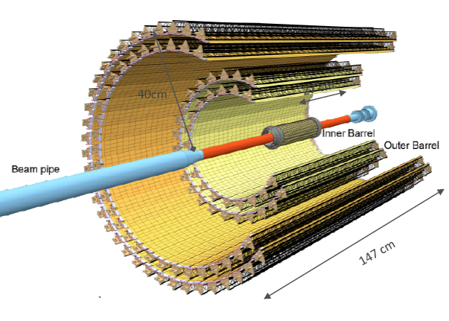
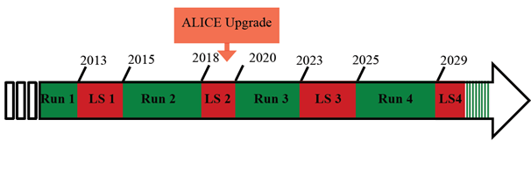
Experimental activities
Past:
SPD (Silicon Pixel Detector) – test of RO chips and ladders in clean room + R&D
EMCal and DCal (Electromagnetic Calorimeters):
  Tower assembly
  R&D on photosensors + APD characterization
Present/Future:
New ITS (Inner Tracking System):
  R&D on monolithic sensors
  FPC (Flexible Printed Circuit) tests in clean room
New ITS Commissioning and Installation (physicists
and technicians)
ALICE Upgrade (2019-2020)
New Inner Tracking System (ITS)
7 layers of Monolitic Active Pixel Sensors

Slide 9
Data analysis activities
Past:
Contribution to performance study
Primary vertex reconstruction
Tracking and Identification based on neural networks
Present/Future:
Study of short-lived resonances
Study of light (anti-) nuclei production

Slide 10
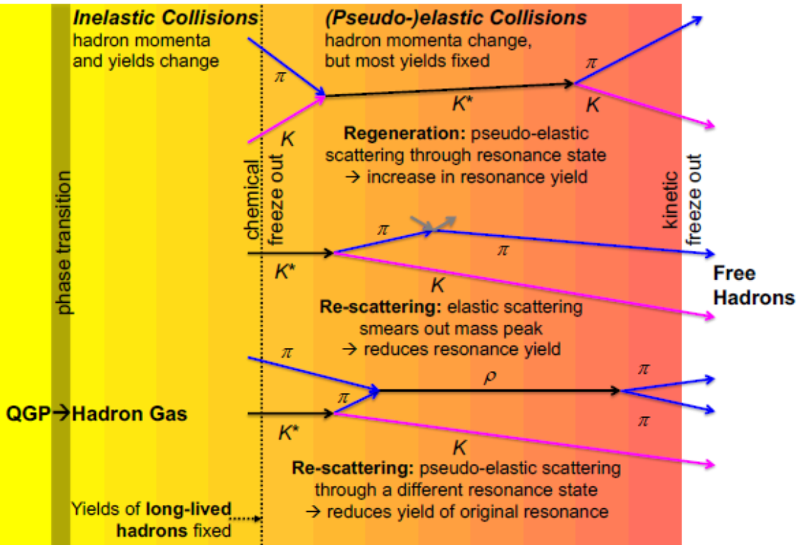
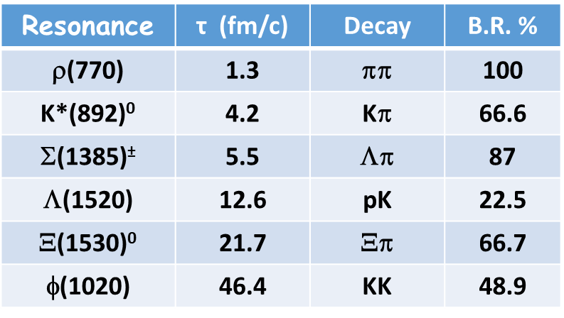
Production of hadronic resonances
Hadronic resonances have a lifetime of the same order of the lifetime of the fireball formed in ultrarelativistic heavy-ion collisions
Regeneration and re-scattering change resonance yields
Hadronic resonances in heavy-ion collisions can be used to study:
Properties of the hadronic phase (yields depend on chemical freeze out temperature, hadronic phase lifetime, resonance lifetimes, and hadronic scattering cross-sections)
Strangeness production (enhancement, canonical suppression), in-medium energy loss, elliptic flow, effects that shape pT spectrum (as hydrodynamics), modification of lineshape ( e.g. chiral symmetry restoration)…

Slide 11
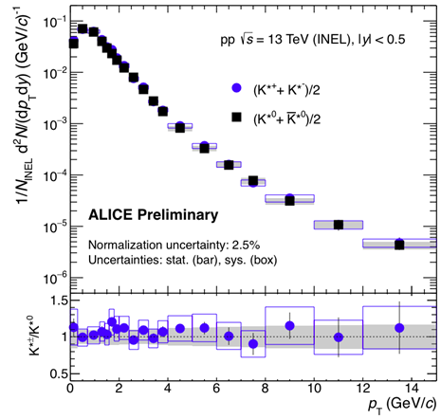
Short-lived resonances in CT
ALICE has measured a comprehensive set of resonance particles
Short-lived resonance are suppressed in most central collisions compared to small collision systems, while no suppression is present for long-lived resonances
Hint of suppression for short-lived resonances in high multiplicity pp and pA (small systems)
Current analyses in Catania:
Charged K*(892) production in pp collisions at 13 TeV as a function of multiplicity
Use of machine learning technique for the resonance identification

Slide 12
Short-lived resonances in CT
RESPONSABILITES: leading role of ALICE Catania team in this topic
Conveners of the first Resonance PAG (Physics Analysis Group): Alberto Pulvirenti (2006-2011) and Angela Badala’ (2006-2013)
Organization of the international Group and preparation of the official code for resonance analysis in AliRoot (official ALICE code)
Members of Paper Committee of papers about resonance production with ALICE at LHC
Members of Internal Review Committee of papers about resonance production with ALICE at LHC
Internal referees of many resonance analyses in pp, pPb, PbPb at different collision energies

Slide 13
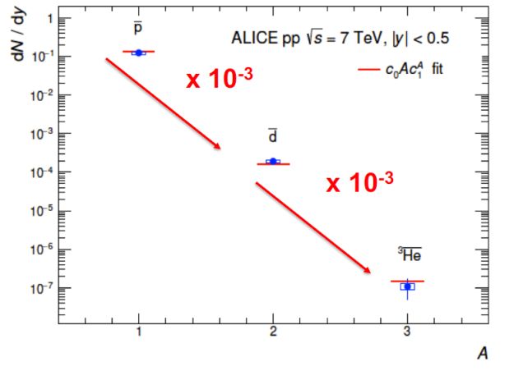
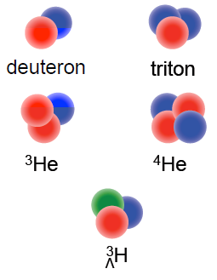
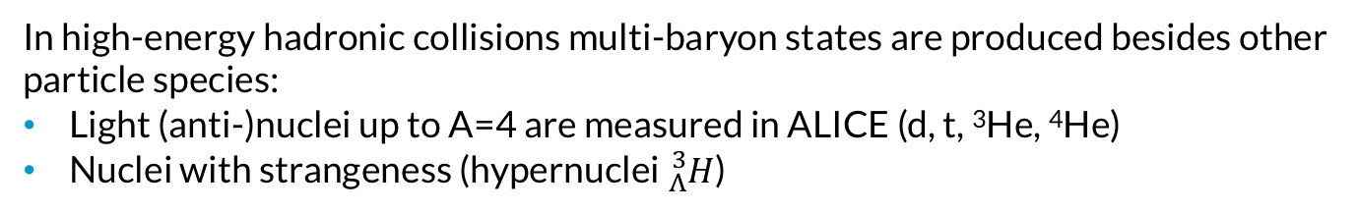
Production of light (anti-) nuclei
In high-energy hadronic collisions multi-baryon states are produced besides other particle species:
Light (anti-)nuclei up to A=4 are measured in ALICE (d, t, ³He, ⁴He)
Nuclei with strangeness (hypernuclei ${}_{Λ}^{3}H$)
Light (anti-)nuclei can give information on:
Hadronization models (coalescence and statistical)
CPT invariance
Background for Dark Matter searches (AMS)
“Penalty factor” for increasing the mass number by adding one nucleon:
~10³ in pp
600 in p-Pb
350 in Pb-Pb

Slide 14
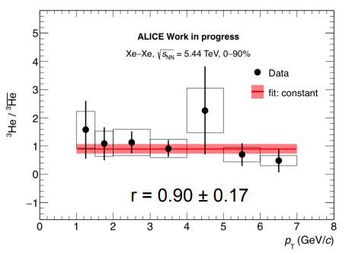
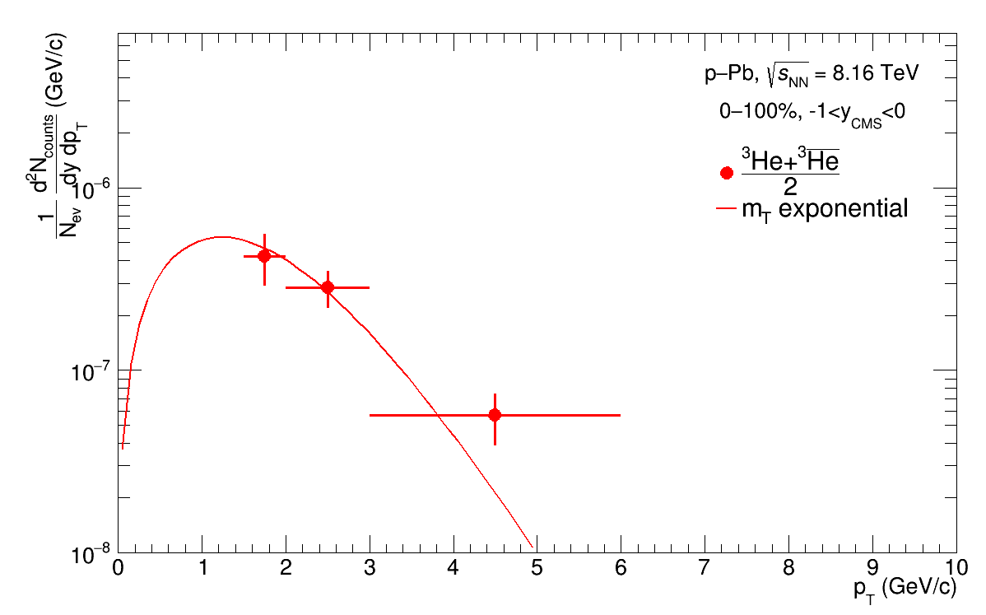
Analysis of light (anti-) nuclei in Catania
Done: Study of (anti) ³He in Xe-Xe collisions at 5.44 TeV
Current analysis:
Study of (anti) ³He, (anti-) ³H e (anti-)d in p-Pb collisions at 8 TeV, centrality 0-100%
Collaboration with GSI (Darmstadt)
Official agreement between
UniCT – GSI ready to be signed

Slide 15
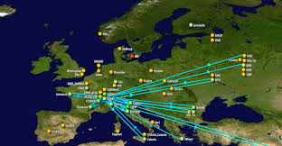
ALICE Computing in CT
Catania is one of the 155 Tier2 centers in the world. In Italy:
  Tier1 (CNAF – BO)
  Tier2 (CT, BA, PD-LNL, TO)
ALICE-CT Tier2 resources:
  Core: 1528 - HS06: 15125
  Disk space: ~1.5 PB
  Network Connection (Gb/s): 80 (2 x 40 etherchannel)
CT takes part to IBISCO PON (to strengthen the current southern computing infrastructure and to constitute the ﬁrst real and concrete step towards the Italian Computing and Data Infrastructure)
ALICE-CT people involved in research activities on machine learning algorithms

Slide 16
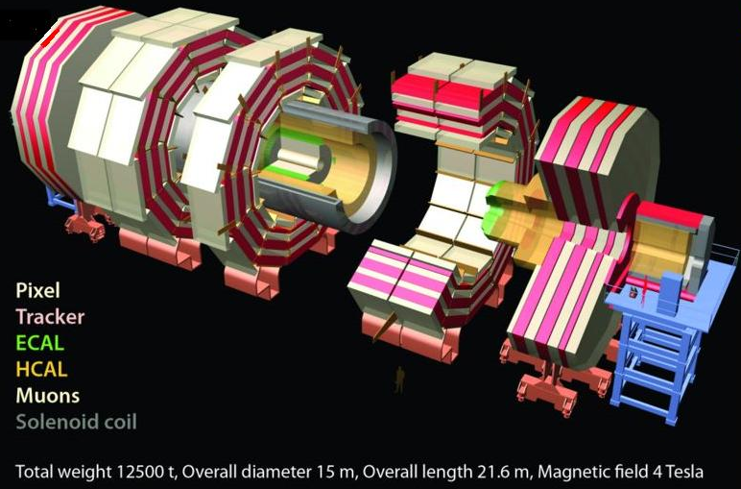
LUI
The CMS experiment is one of the largest international scientific collaborations in history, involving more than 4000 scientists, engineers, and students from 203 institutes in 47 countries.

Slide 17
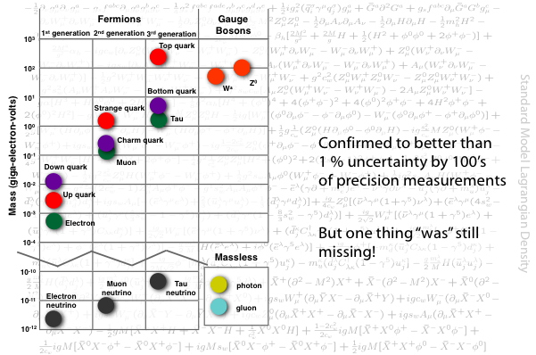
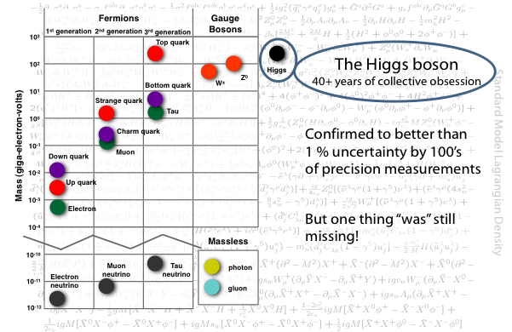
Compact Muon Solenoid
The Compact Muon Solenoid (or CMS) detector sits at one of these four LHC collision points. It is a general-purpose detector designed to observe any new physics phenomena that the LHC might reveal.
The Standard Model and the search for New Physics
Confirmed to better than 1% uncertainties by 100’s of precision measurements

Slide 18
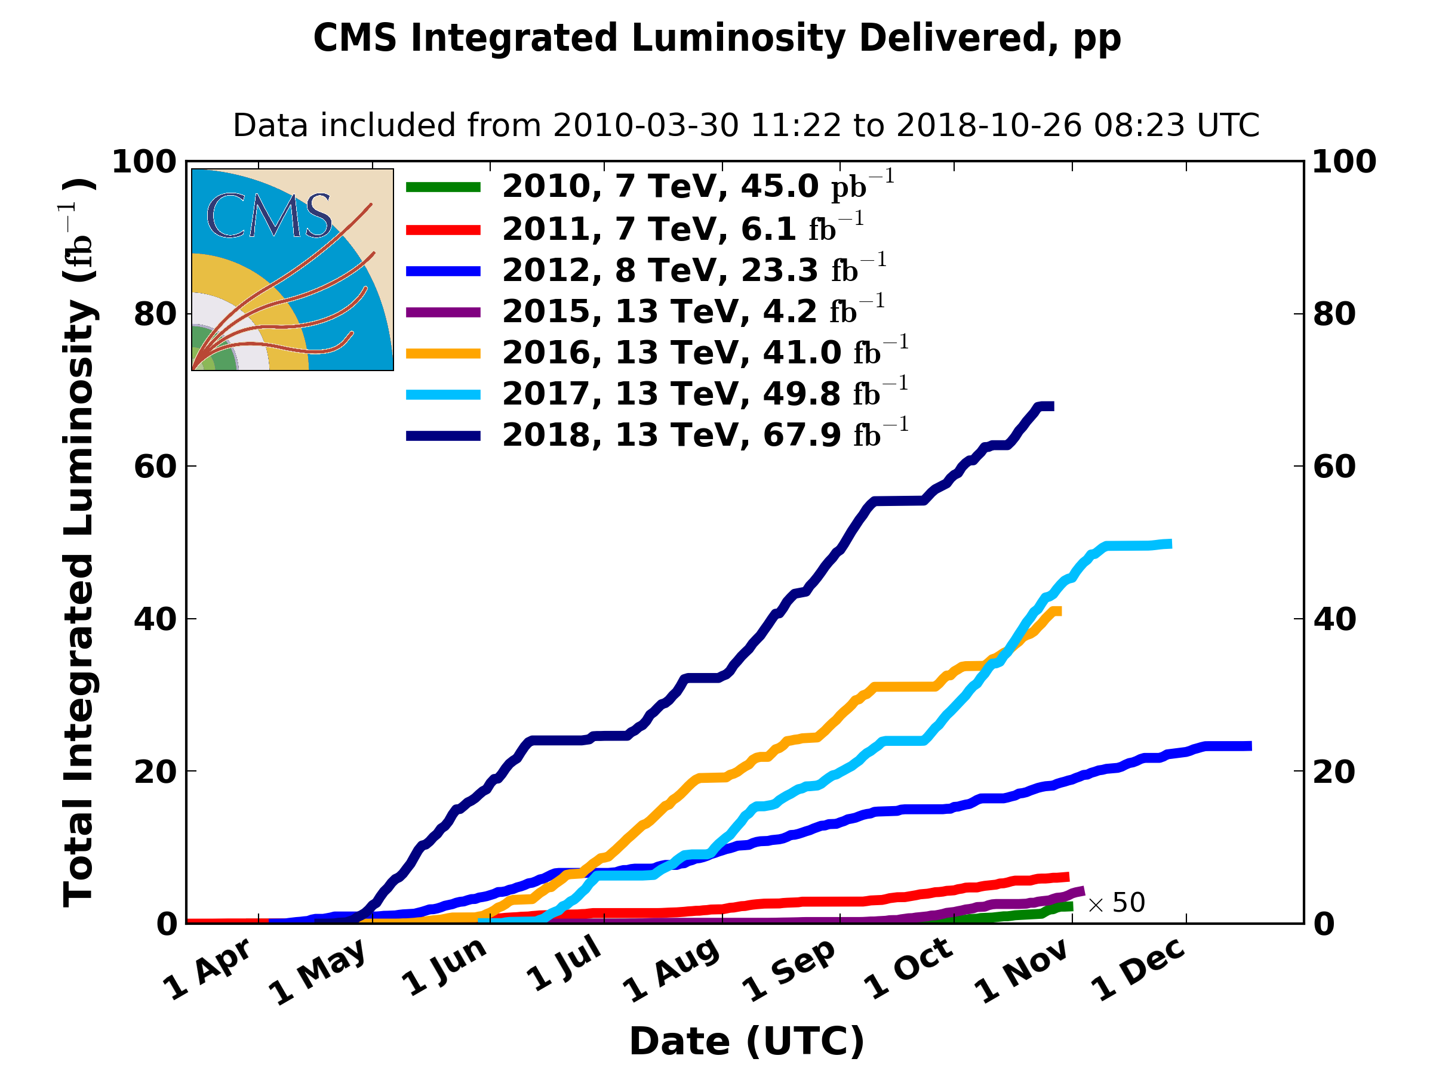
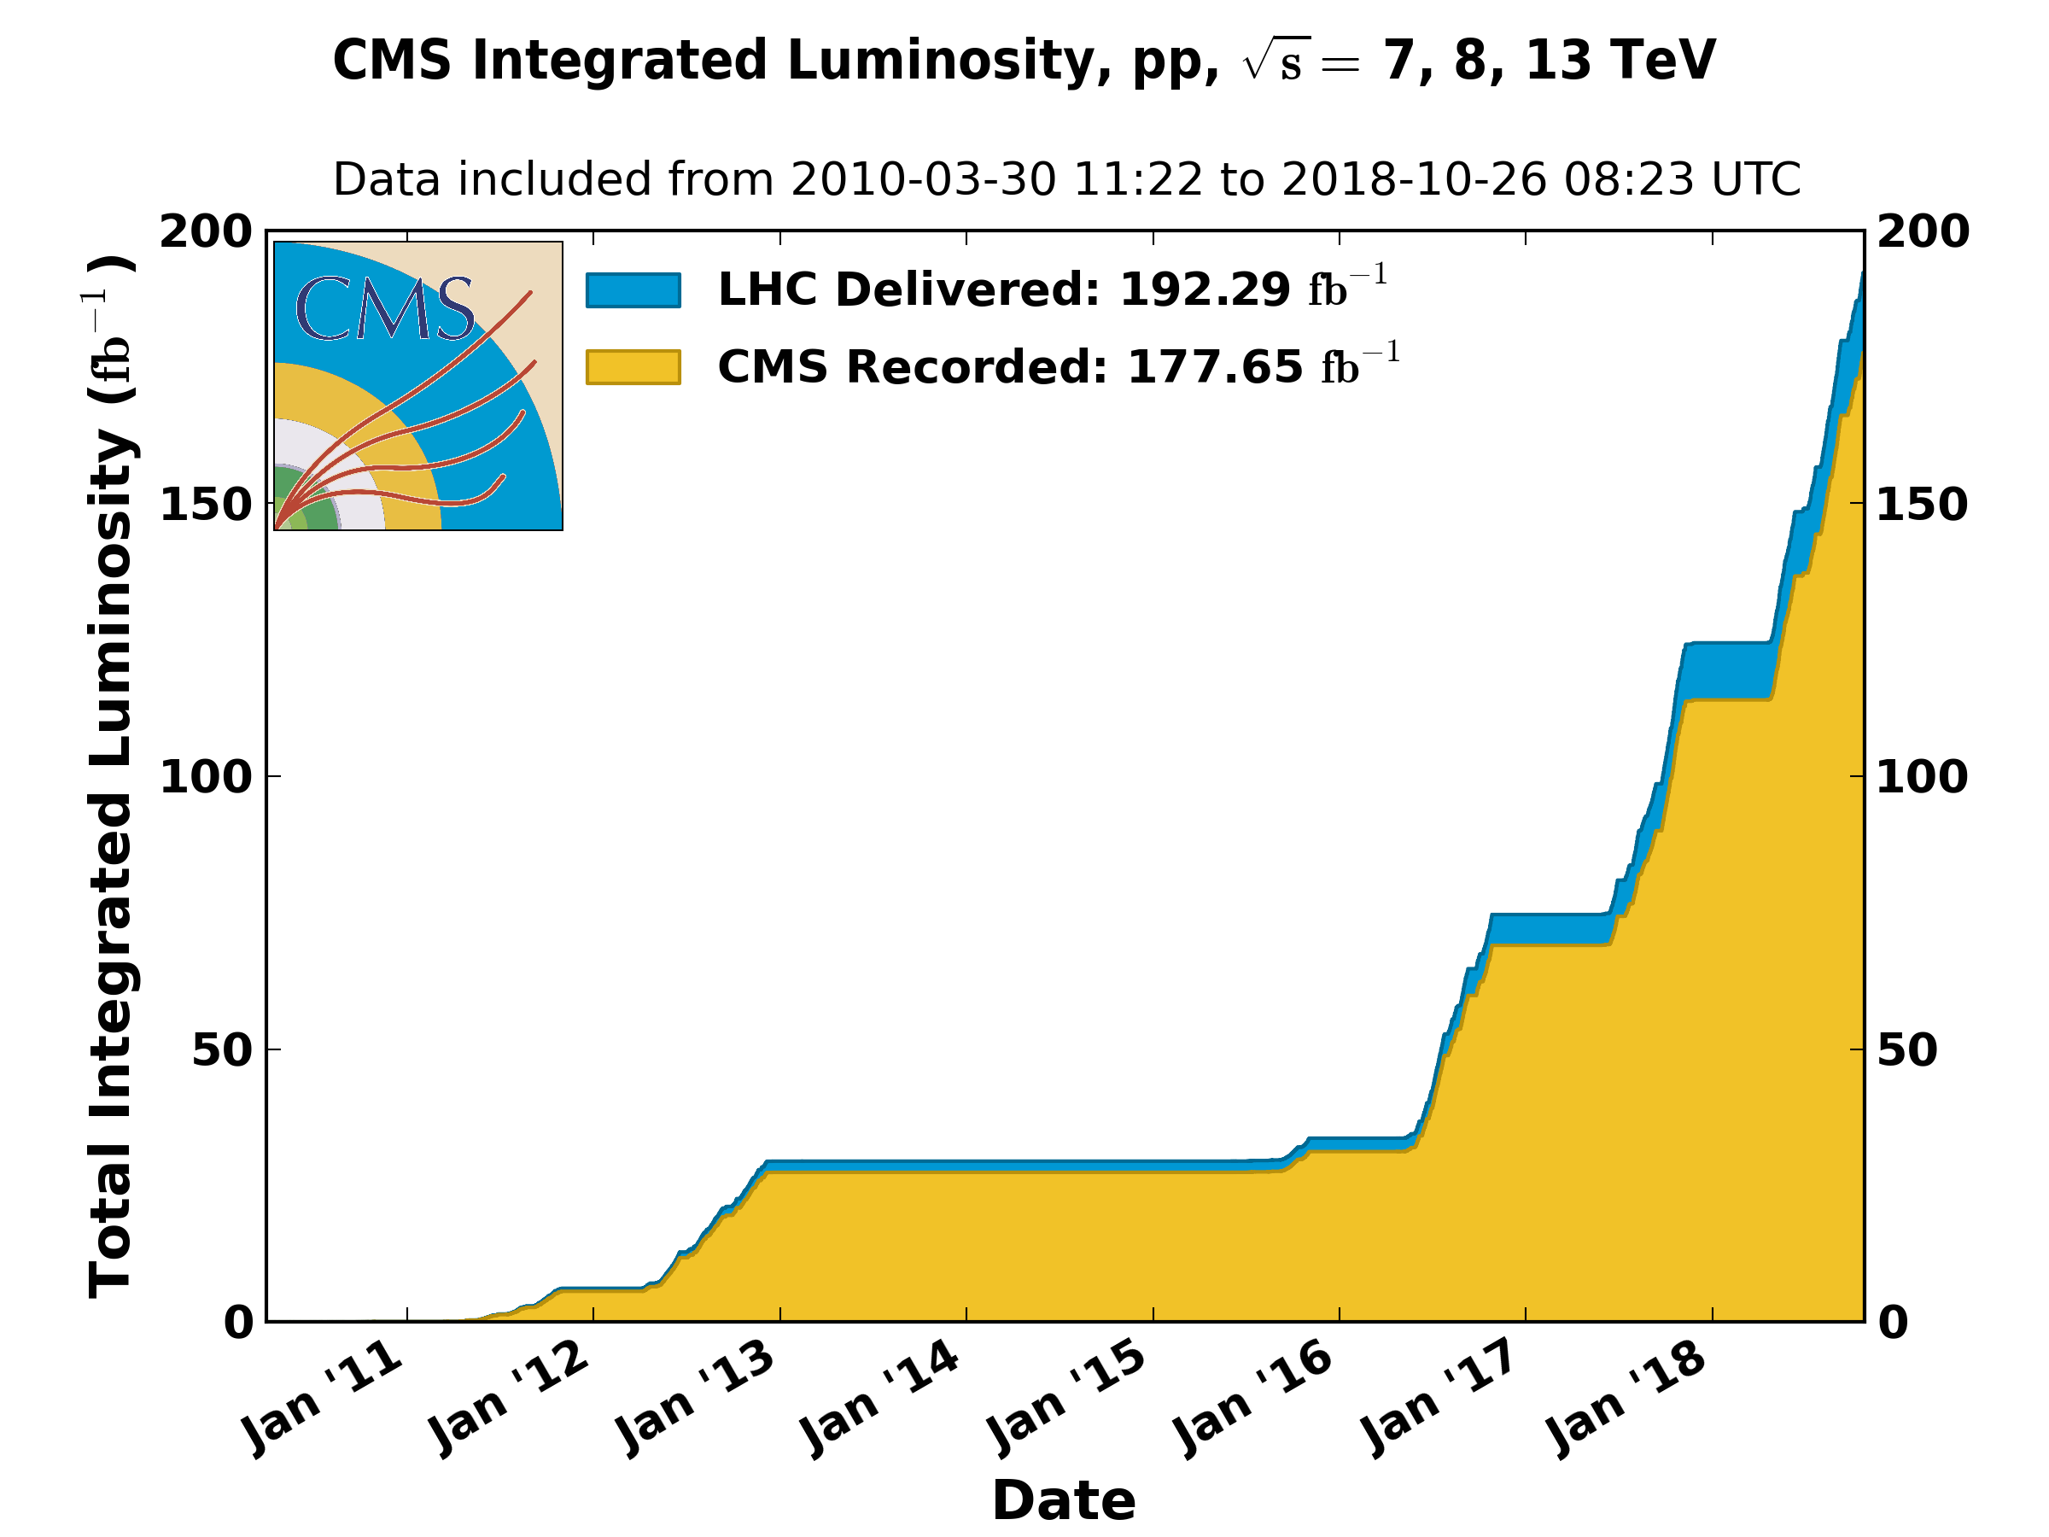
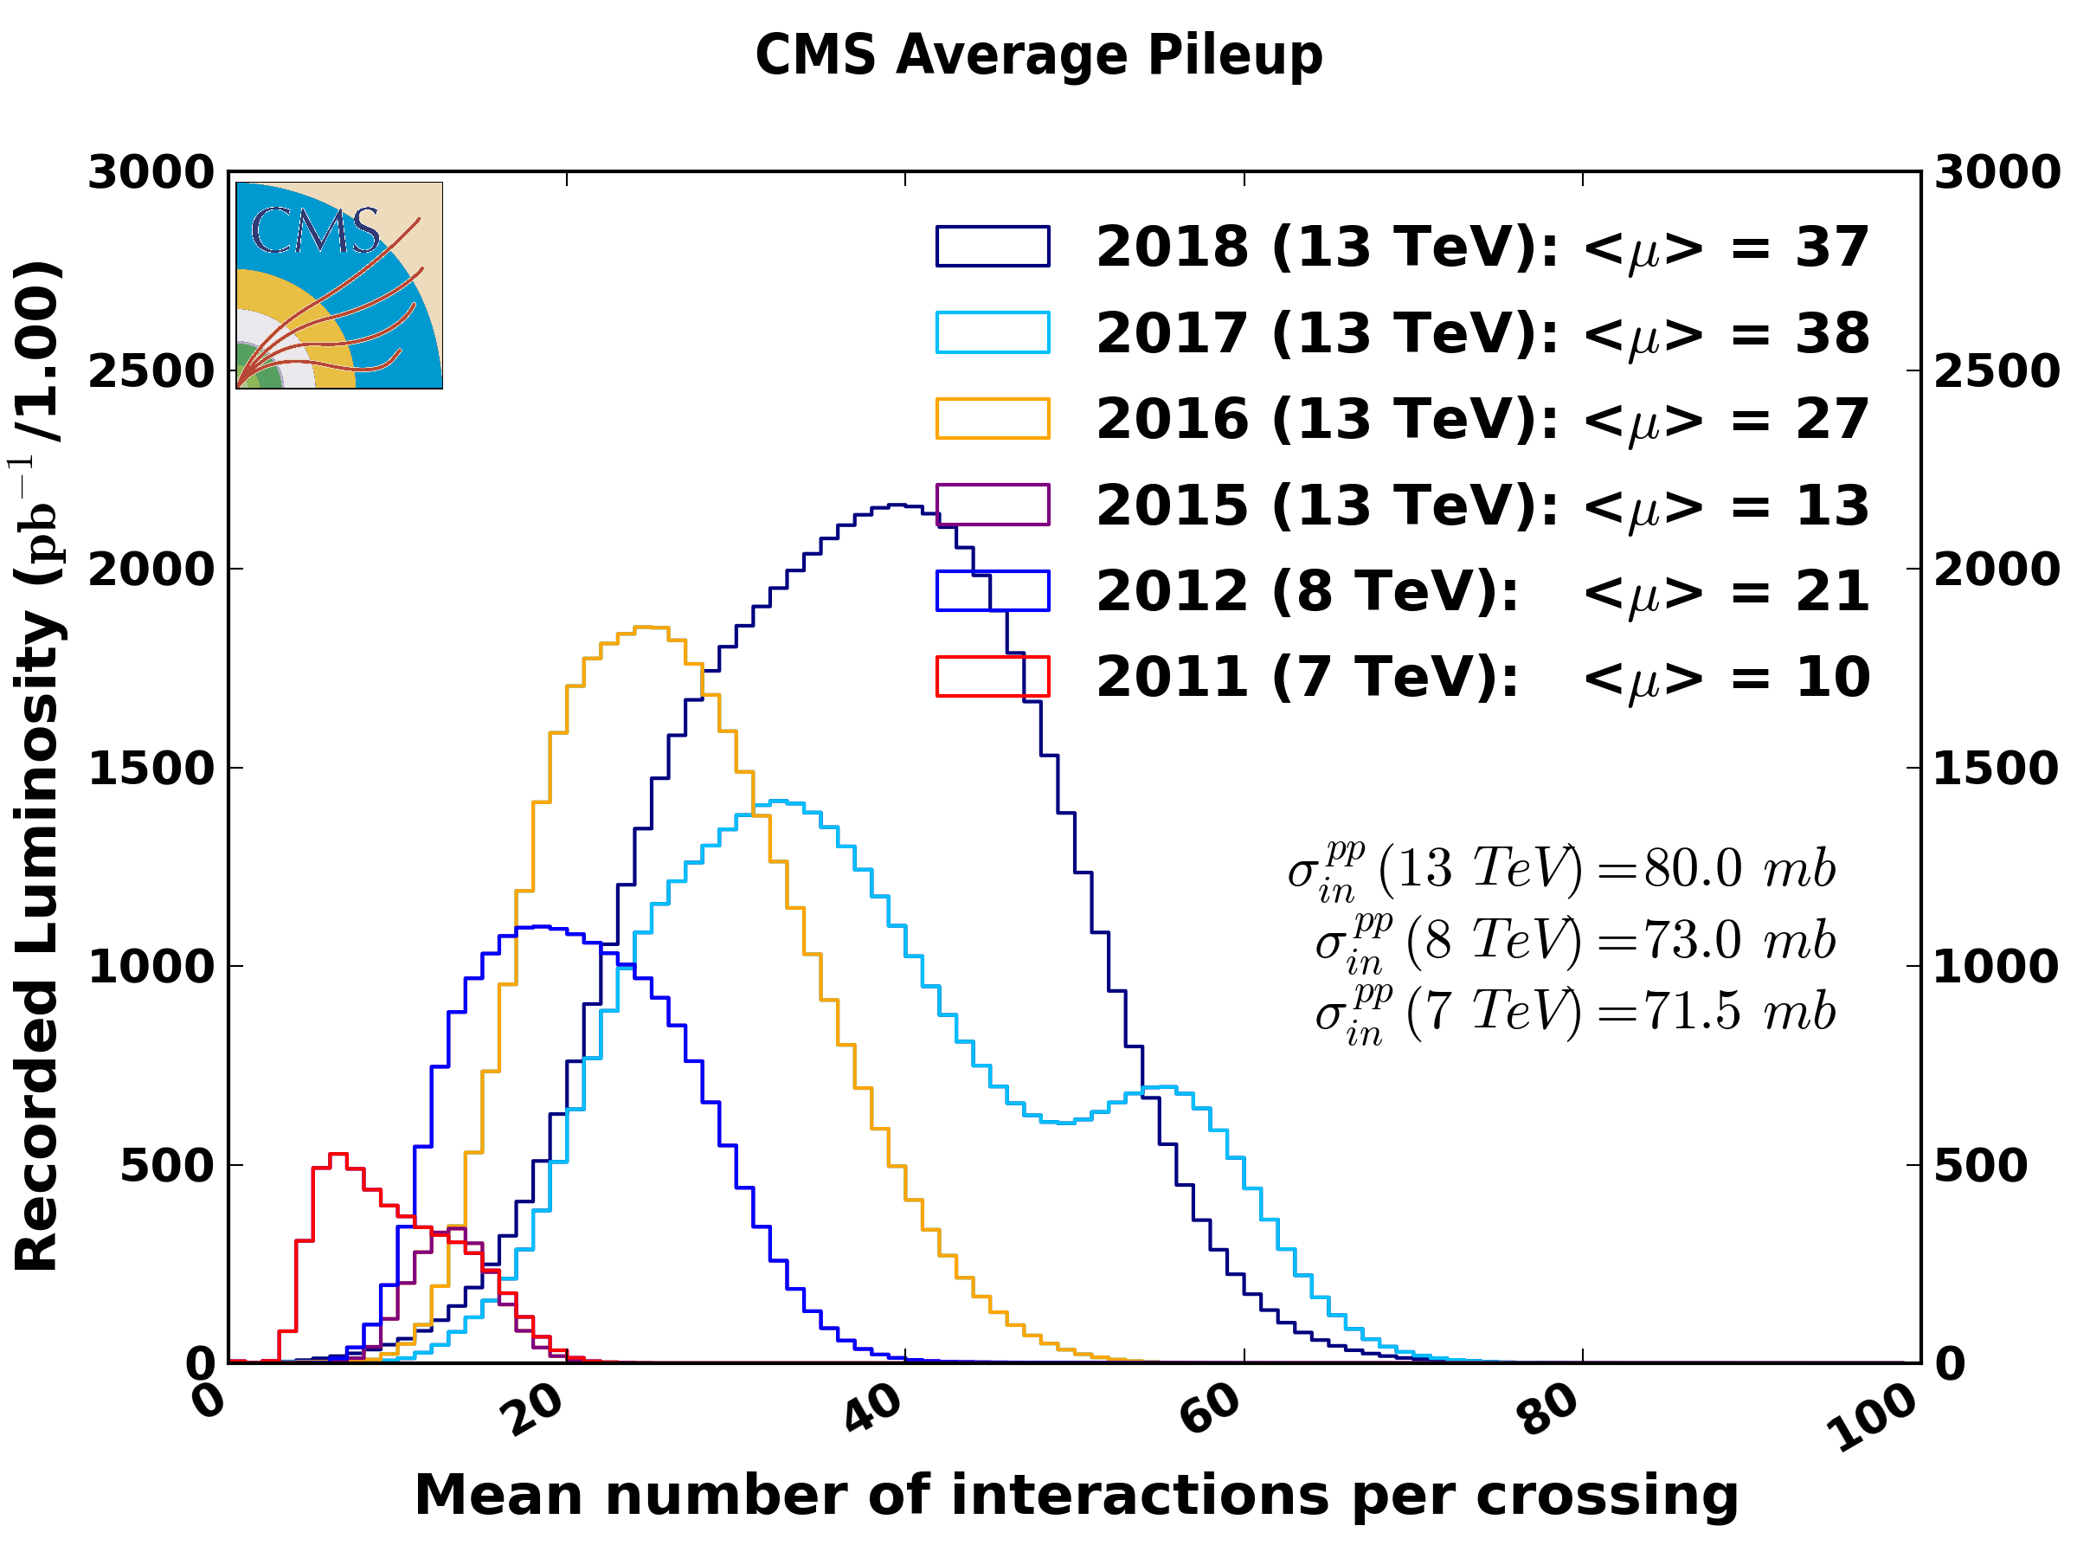
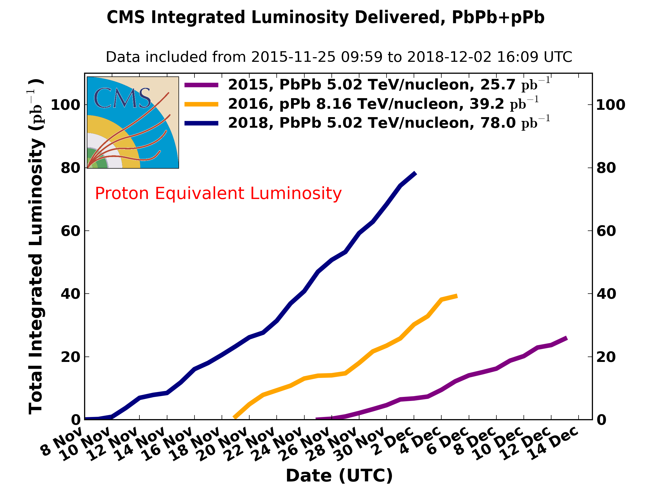
CMS data taking and performance
Excellent performance
Efficiency >92% in p-p run
Excellent performance also in p-Pb and Pb-Pb run
with a very reach Physics program

Slide 19
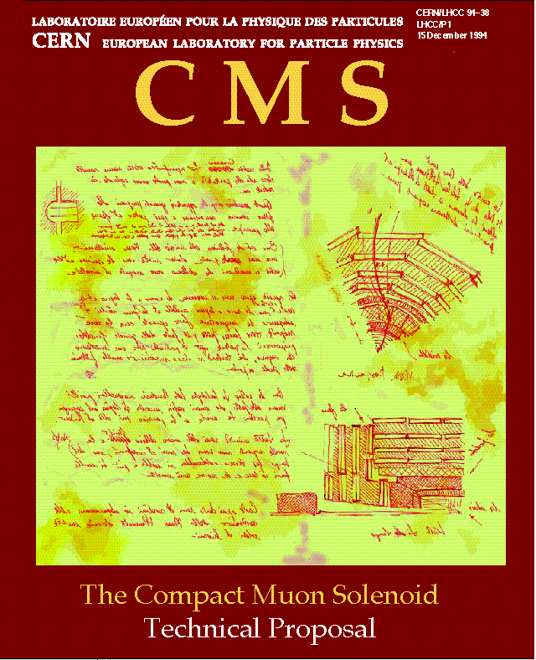
CMS group in Catania
La prima pubblicazione in CMS
15 Dicembre 1994!

Slide 20
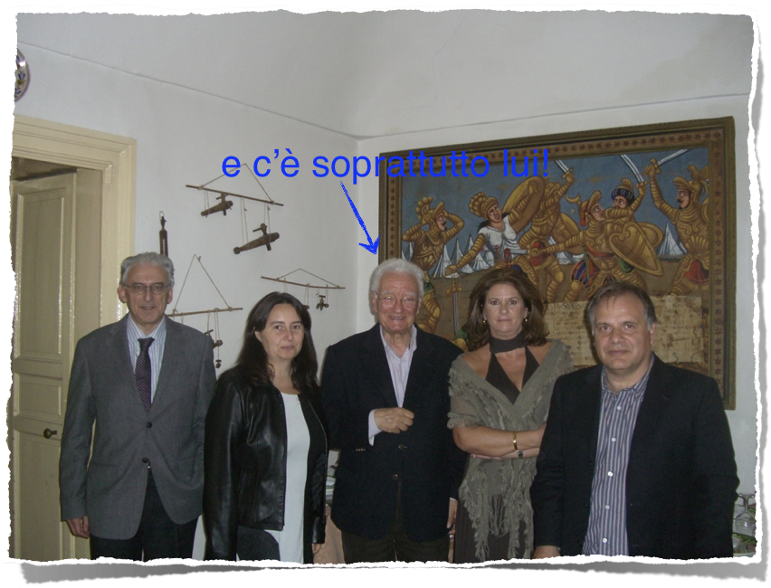
Particle Physics group in Catania
1998: First PhD thesis in Experimental Particle Physics “b and c forward-backward asymmetry with the ALEPH experiment at LEP”, the world most precise measurement of sin²θ- Tutor: Renato Potenza
1999: the first course of Experimental Particle Physics in the Physics Master Degree and the first Master Degree Theses in Physics in the ALEPH experiment
Particle Physics in Catania is a reality!

Slide 21
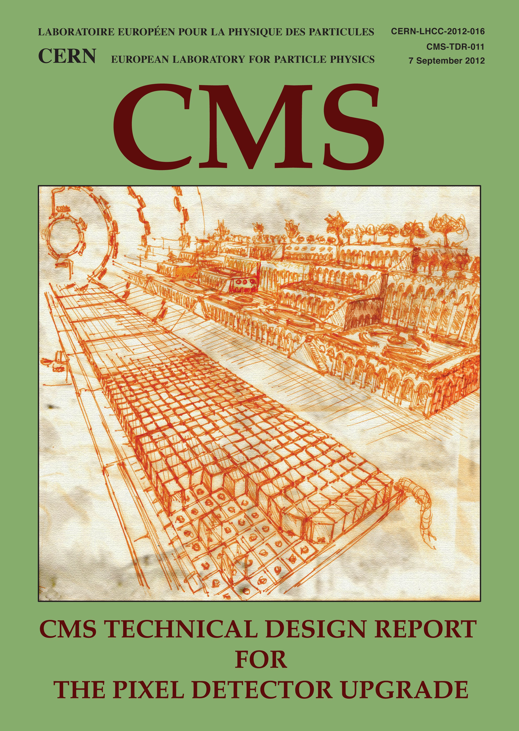
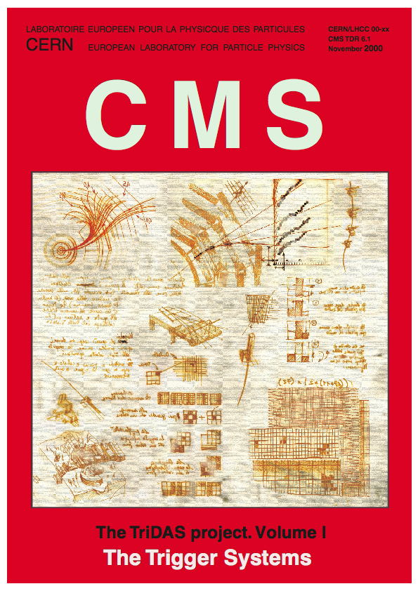
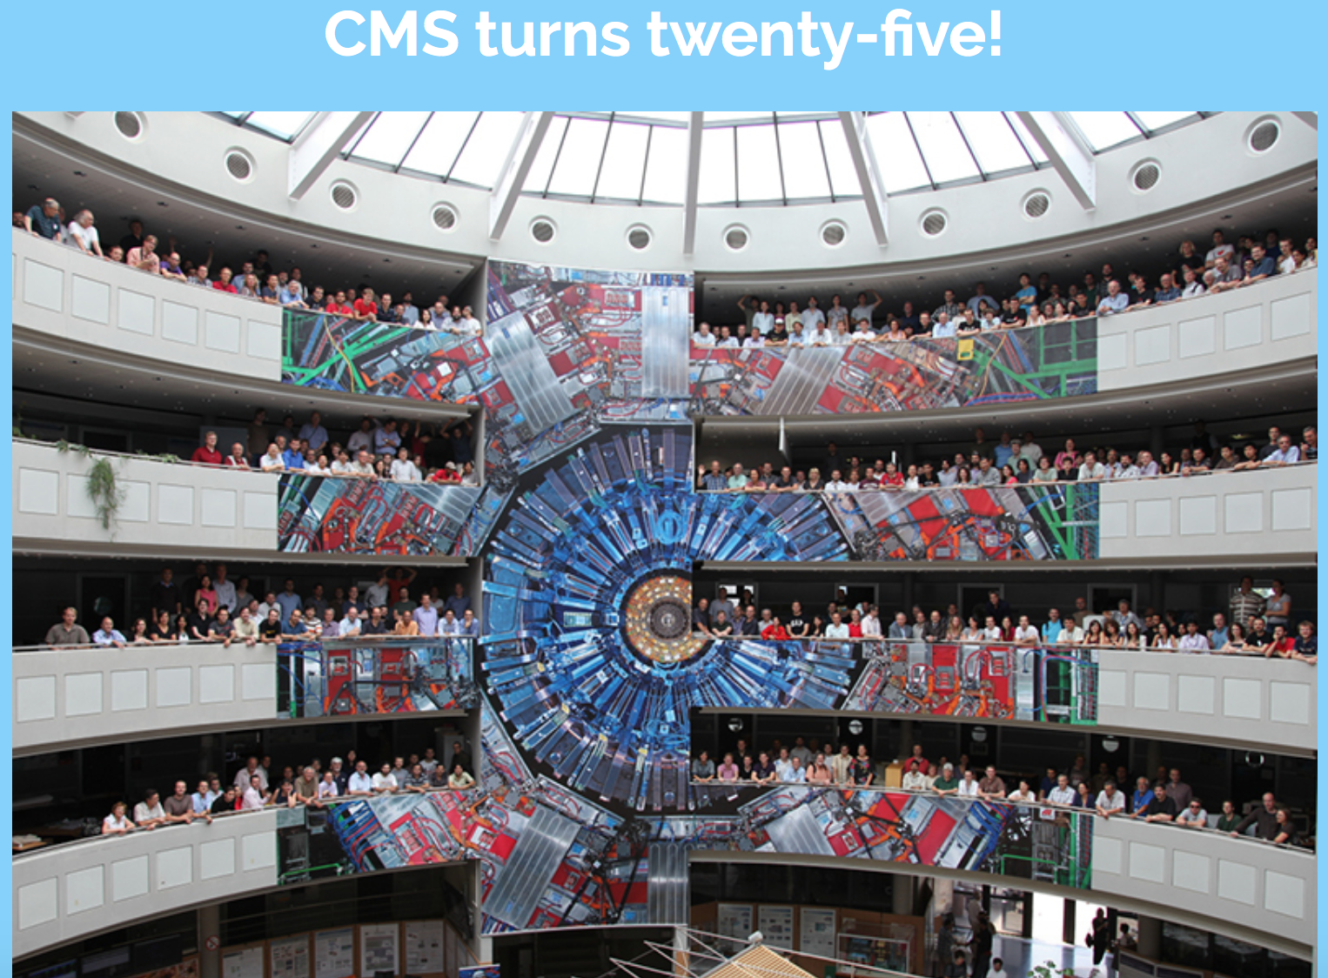


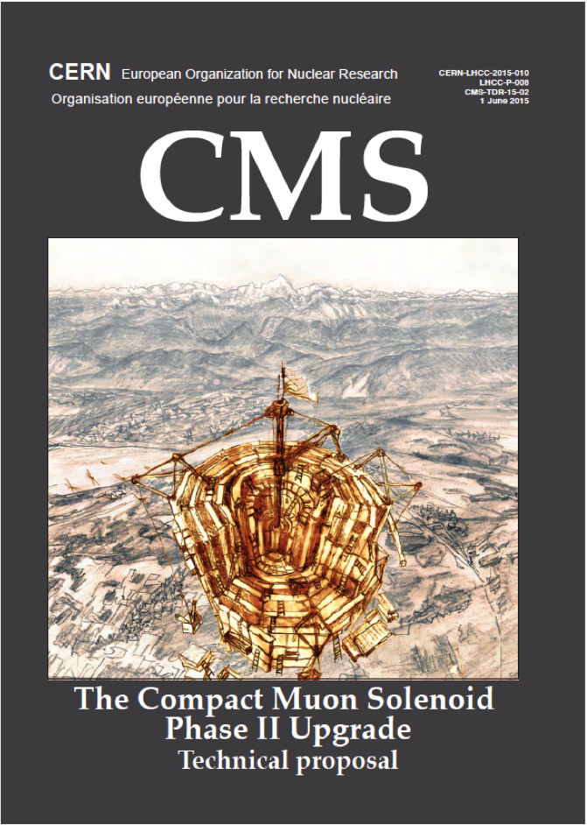
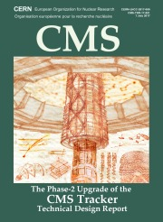
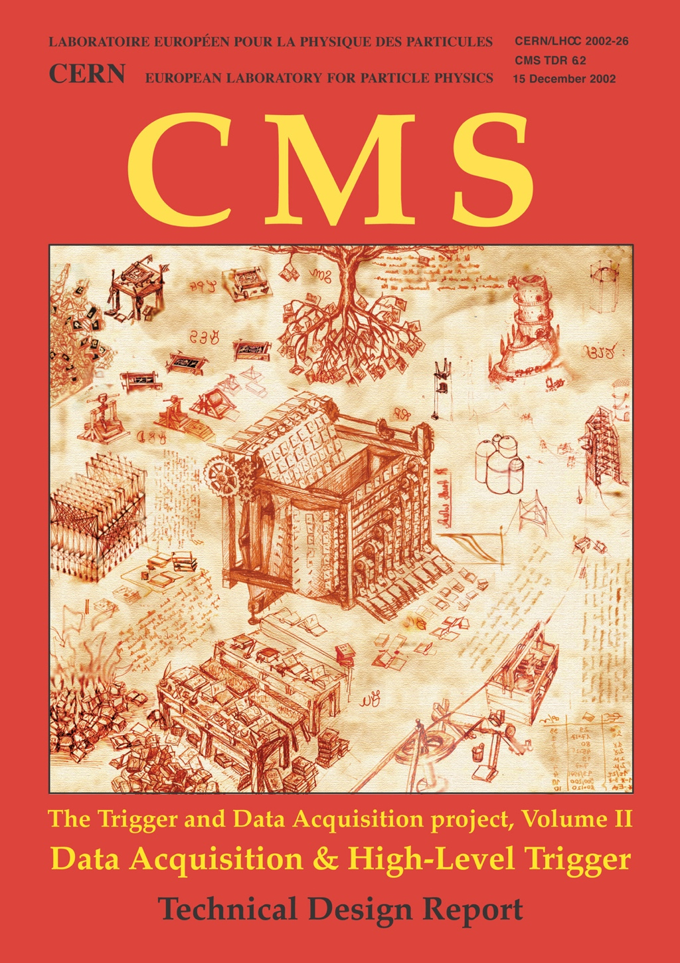

CMS group in Catania
Passando per...
La prima pubblicazione in CMS
15 Dicembre 1994!

Slide 22
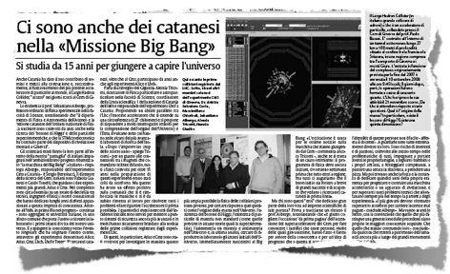
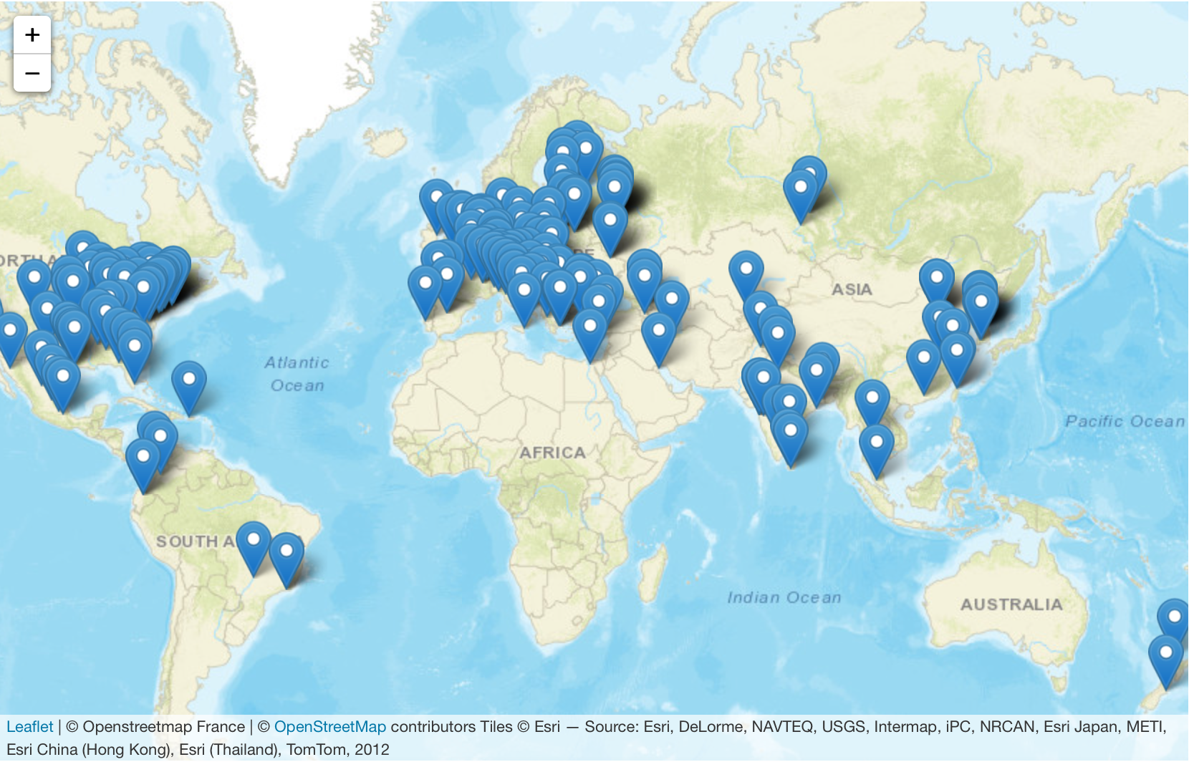

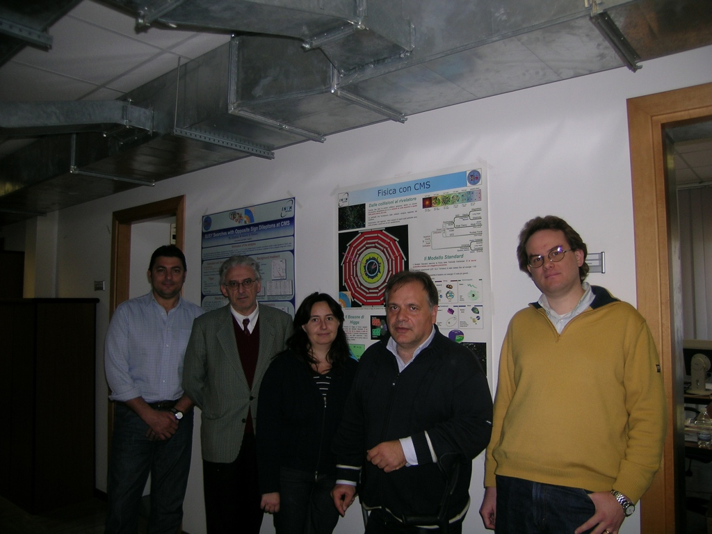
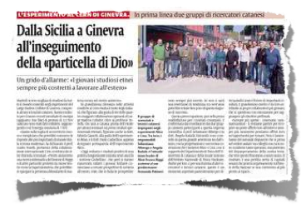
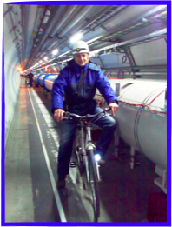
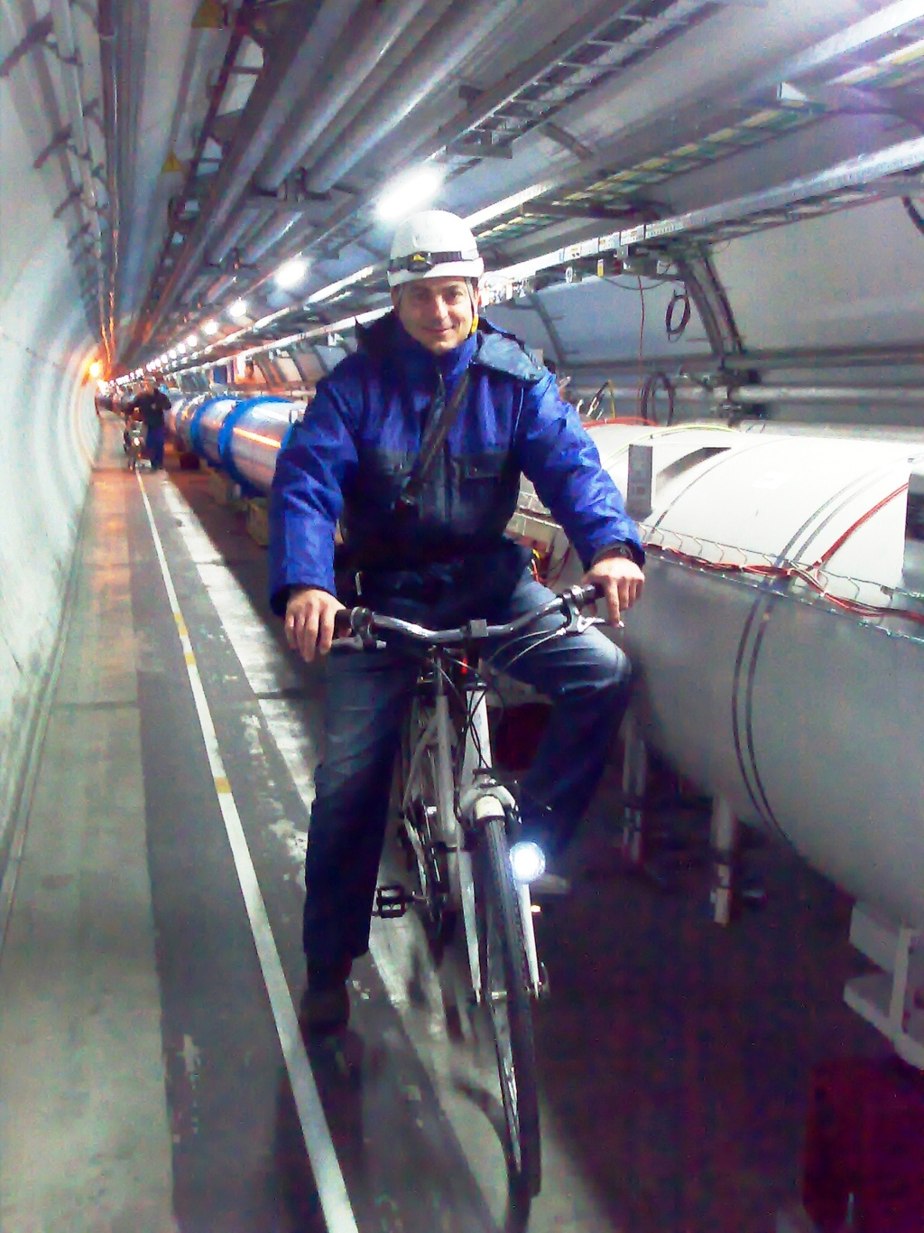
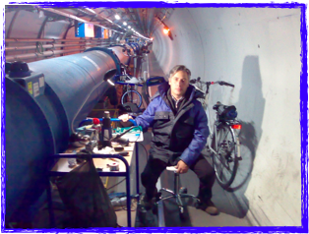
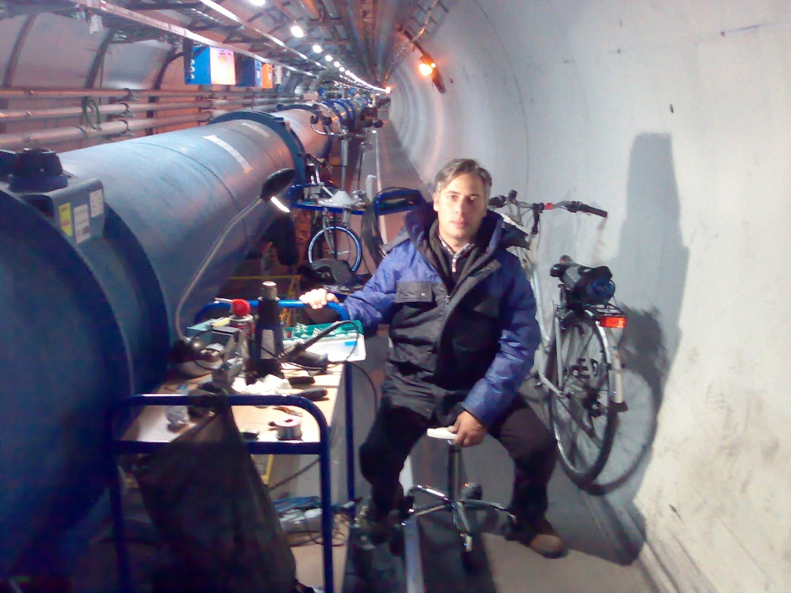
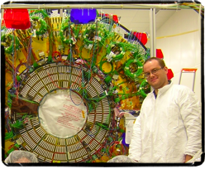
CMS nel mondo e a Catania…

Slide 23

CMS@Catania
CMS Silicon Tracker

Slide 24
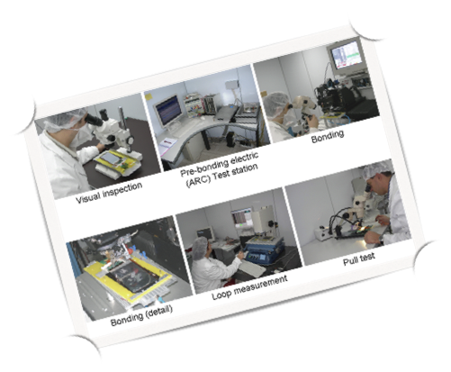
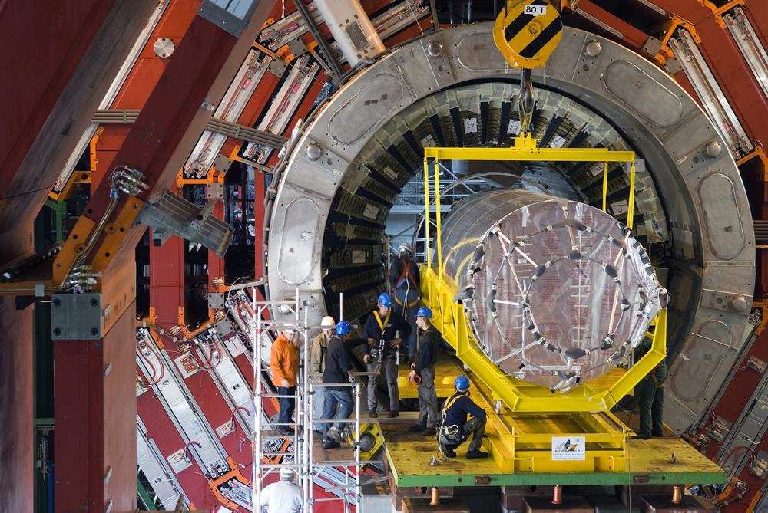
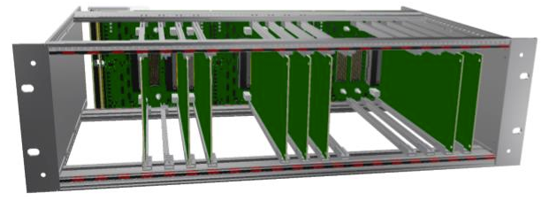
CMS@Catania: experimental activities
Tracker design, construction, integration, running and manteinance is the light motiv of all experimental activities
Past:
Catania has been one of the Tracker production center
  Module bonding and Testing (>500 silicon
  microstrip modules assembled and tested
  Power Supply test and maintenance → huge effort
  from DFA Technicians
Tracker Commissioning and Installation
Magnet Test and Cosmic Challenge responsibility
Tracker Run Coordination
Present/Future:
New Tracker Detector
  Catania is the test center for the Outer Tracker front-end hybrid
    ~ 4000 circuits to be tested
  Significant contribution to the development of the test set-up
  Participation to R&D activities and test beam
  Development of the construction DB

Slide 25
CMS@Catania: software activities
Recent/Future:
Design of the new Tracker
  Layout simulation and performance studies for Phase1 and Phase2 Tracker
Past:
Catania has significantly contributed to the Tracking software development
  Performance studies during the first years of data taking
  Development of b-tagging algorithms
  Development of the computing model
    Participation to INFN-GRID and EU-DataGRID project
    Development of the middleware and of the HEP-grid tool
  MC production center
  Fast simulation development and maintenance

Slide 26
Discovery of a new particle

Slide 27
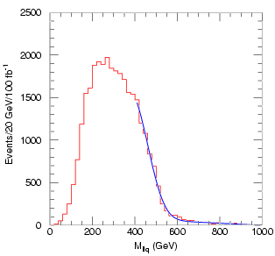
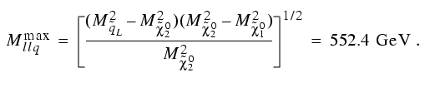
CMS@Catania: Physics and analysis
Catania has significantly contributed to Higgs boson and SUSY searches
  Leading role in the ttbar background studies
  Development of a new method to search for and reconstruct SUSY particles (if any! 😜)
  Expertise in the leptonic channels
  Squark and gluino searches
llq edge
1% error
(100 fb⁻¹)
p
p
~
~
~
~
χ⁰₁
~
q
χ⁰₂
l
g
q
q
l
l

Slide 28
CMS: Highlights on Physics

Slide 29
CMS Catania group and responsibility
Composition: S. Albergo (signing author), M. Consoli (INFN), S. Costa, A. Di Mattia (INFN), R. Potenza (Emeritus), A. Tricomi, C. Tuvè
Many responsibility on Tracker & Physics
WP8-HEP Application EU-DataGrid: - A. Tricomi (2001-2004)
L3 manager for Tracker construction: -S. Costa (bonding), A. Tricomi (module test), C. Tuvè (gantry) (2001-2006)
B-tagging italian coordinator - A. Tricomi (2001-2005)
CMS representative in CNAF-T1 - A. Tricomi (2002-2005)
Bonding WG convener - S. Costa (2003-2006)
CMS representative SUSY-BSM Les Houches Workshop – A. Tricomi (2005)
MTCC – TIB - A. Tricomi (2005-2006)
Convener Sqaurk WG @Flavour in the Era of LHC Workshop (2005-2007) – A. Tricomi
Tracker Run Coordinator - A. Tricomi (2006)
SLHC Tracker Layout and Performance WG Convener - A. Tricomi (2007-2017)
Tracker Upgrade Steering Group - A. Tricomi (2007-2010)
SUSY leptonic WG - A. Tricomi (2008)
SLHC Offline project coordinator - A. Tricomi (2008-2011)
SLHC Management Board - A. Tricomi (2008-2011)
Tracker Resource Manager - S. Costa (2009-2017)
Convener Tracker Finance Board - S. Costa (2009-2017)
Member if CMS FB, TPO, TMB, Phase1 MB, Phase2 MB – S. Costa (2009-2017)
Phase2 Tracker Upgrade Steering Group – A. Tricomi (2010-2017)
Tracker Institution Board Chair – S. Costa (2020-2023)
National Responsibility:
CMS INFN leader - R. Potenza,
S. Albergo, S. Costa, A. Tricomi
GR1 coordinator - R. Potenza, S. Albergo, A. Tricomi, S. Costa
Italian Upgrade Office – S. Costa

Slide 30



CMS@Catania: Physics and Papers
119 Papers on SUSY
>60 2015-2019
h-index >90
Cit. > 50k
939 Paper CMS Collaboration+Tracker paper
~ 600 Papers in the last 5 years
More than 15 invited talks on SUSY and Tracker (A.T.)

Slide 31

L’ALTRO
LHCf is the smallest of the LHC experiment with only 30 scientists mainly from Japan and Italy. Four Nations and 10 Institute are involved.
In italy: University and INFN Catania & University and INFN Florence

Slide 32

LHCf: Astroparticle Physics @LHC

Slide 33





Ultra High Energy Cosmic Rays
Studying the properties of primary High Energy Cosmic Rays based on observation of EAS
X_{max} : depth of air shower maximum in the atmosphere
RMS(X_{max}): fluctuations in the position of the shower maximum
N_{μ}: number of muons in the shower at the detector level
+
MC Simulation to describe hadronic interaction with atmosphere
Energy, mass composition, direction
—> source of primary cosmic rays
—> origin of the universe (final goal)

Slide 34
Imperfect knowledge in hadronic interaction
18.8< log(E/eV) < 19.2
2000m<R<4000m
Auger: different <lnA> with different analysis, different model,…
PRD 96, 122003 (2017)
Telescope Array: expected muon purity vs. N_{data}/N_{MC}
Muon excess as Auger pointed out
PhD thesis of R.Takeishi (2017)

Slide 35





HECR Physics at LHC: LHCf Physics
Model-originated uncertainties or even discrepancies
p-p + p-Pb
p-Pb
Energy
– E_{SD} > E_{FD} :
discrepancy
– missing energy (μ,ν) in FD : uncertainty
Mass
– Mass vs. X_{max} in FD:
uncertainty
– Mass vs. e/μ or μ excess in SD :
discrepancy
① Inelastic cross section
④ secondary interactions
nucleon, π
If large σ: rapid development
If small σ: deep penetrating
② Forward energy spectrum
nNuclear effects
If softer shallow development
If harder deep penetrating
Inelasticity k=1-E_{lead}/E_{avail}
If large k (π⁰s carry more energy)
rapid development
If small k (baryons carry more energy) deep penetrating
LHCf —>use LHC
6.5 TeV+6.5 TeV⇒Elab=9*10¹⁶ eV
3.5 TeV+3.5 TeV⇒Elab=2.6*10¹⁶ eV
450 GeV+450 GeV⇒Elab=2*10¹⁴ eV
to calibrate MCs
In addition: p-Pb collision at 5.02&8TeV to study nuclear effect

Slide 36

First models tuning after the first LHC data
(EPOS, QGSJET and SIBYLL)
From D. D’Enterria
Significant reduction of differences btw different hadronic interaction models!!!
But still a lot to be done….

Slide 37



LHCf: location and detector layout
44X₀,
1.6 λ_{int}
Energy resolution:
< 5% for photons
30% for neutrons
Position resolution:
< 200μm (Arm#1)
40μm (Arm#2)
Pseudo-rapidity range:
η > 8.7 @ zero Xing angle
η > 8.4 @ 140urad
Arm#1 Detector
20mmx20mm+40mmx40mm
4 X-Y GSO Bars tracking layers
Arm#2 Detector
25mmx25mm+32mmx32mm
4 X-Y Silicon strip tracking layers

Slide 38




A brief photo-history
November 2016
8 Tev p-Pb
June 2017 @RHIC
510 GeV p-p

Slide 39






Event category in LHCf
Responsible for air shower core (elasticity)
Responsible for EM air shower component (inelasticity)

Slide 40
LHCf Data Taking and Analysis matrix
RUN | Proton E_{LAB} (eV) | γ | n | π⁰ limited acceptance | π⁰ full acceptance | LHCf - ATLAS | Performance
SPS test beam |  | NIM A 671 (2012) 129 | JINST 9 (2014) P03016
p+p 900 GeV | 4.3x10¹⁴ | PLB 715 (2012) 298-303 |  | Not accessible. |  |  | IJIMPA 28 (2013) 1330036
p+p 7 TeV | 2.6x10¹⁶ | PLB 703 (2011) 128-134 | PLB 750 (2015) 360-366 | PRD 86 (2012) 092001 | PRD 94 (2016) 032007
p+p 2.76 TeV | 4.1x10¹⁵ |  |  | PRC 89 (2014) 065209
p+Pb 5 TeV | 1.4x10¹⁶
p+p 13 TeV | 9.0x10¹⁶ | PLB 780 (2018) 233–239 On-going: ATLAS-LHCf | Arm1: on-going Arm2: JHEP11 (2018) 073 | Preliminary |  | Conf. Note: ATLAS-CONF-2017-075
p+Pb 8.1 TeV | 3.6x10¹⁶ | Prelim.

Slide 41



γ energy spectra 7 vs 13 TeV
PLB, 780 (2018) 233-239
PLB, 780 (2018) 233-239
13 TeV
7 TeV
High energy data covers up to larger pT
Similar trend in 7TeV and 13TeV, but differences look enhanced in 13TeV results

Slide 42


ARM2 unfolded neutron spectra
Unfolding is very important (40% energy resolution)
1
2
JHEP 1811 (2018) 073
3

Slide 43



From the LHC to RHIC
√s scaling, or breaking?
Schematic view of the RHICf installation
LHCf Arm2 detector in the LHC tunnel
ZDC
18m
Acceptance in E-p_{T} phase space
1.2GeV

Slide 44
LHCf and the future
Low luminosity run for p+p at 14 TeV (2021?)
Low luminosity p+O (or O+O) run or other light ions at the highest achievable energy (2023?)
Physics cases and related upgrade of the DAQ system are
summarized in a detailed Technical Report submitted this year to LHCC
(CERN-LHCC-2019-008 ) → Accepted!
Physics cases and related upgrade of the DAQ system are
summarized in a Tech. Report (CERN-LHCC-2019-008 )
Physics cases and related upgrade of the DAQ system are
summarized in a Tech. Report (CERN-LHCC-2019-008 )

Slide 45
LHCf @ Catania
1 DFA Unit
Contribution to detector construction, software development and data analysis
Many responsibility role:
  Since 2006 Catania INFN leader
  Since 2010 LHCf representative in the Minimum Bias and Underlying event WG
  Since 2012 LHCf representative in the LHC Cosmic Ray WG
  Since 2013 LHC INFN Leader
Almost 70 papers produced with huge Catania contribution of which about 25 in the last five years
More than 10 invited talks in the last 5 years
Physics cases and related upgrade of the DAQ system are
summarized in a Tech. Report (CERN-LHCC-2019-008 )
Physics cases and related upgrade of the DAQ system are
summarized in a Tech. Report (CERN-LHCC-2019-008 )

Slide 46


Slide 47

Research&Development for Future accelerators (RD-FA)
European Strategy for Particle Physics
RD-FA INFN
DFA participation: S.Albergo, G.Cappello, A.Tricomi
UV SiC photodetectors R&D and SiPM for dual-readout calorimetry
IEEE SENSORS JOURNAL:
VOL. 17, NO. 14, JULY 15, 2017
VOL. 19, NO. 8, APRIL 15, 2019
Eur.Phys.J.ST 228 (2019) no.2, 261-623
Eur.Phys.J.ST 228 (2019) no.4, 755-1107
Eur.Phys.J.ST 228 (2019) no.5, 1109-1382
Eur.Phys.J. C79 (2019) no.6, 474
IDEA: International Detector for Electron-Positron Accelerators

Slide 48
Grazie !

