Slide 1

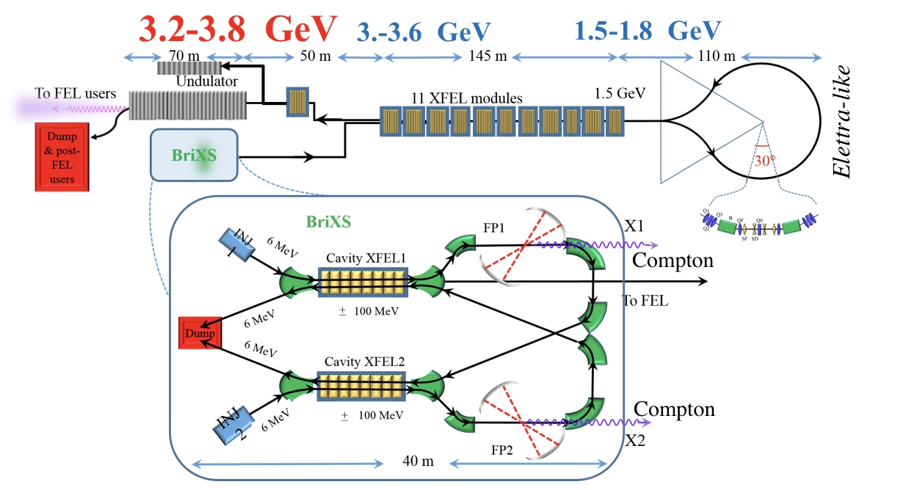
MariX: Conceptual Design Report of a Multi-disciplinary Advanced Research Infrastructure for the generation and application of X-rays
Luca Serafini – INFN-Milan and University of Milan –
on behalf of MariX-C.D.R. Collaboration
The Challenge: sustainable CW coherent X-ray FEL & ICS
multi MW electron beams with
recovery/recirculation to keep
power consumption / radio-protection
below 100 kW
MariX Seminar – Laboratori Naz. Frascati - INFN - Dec. 2nd, 2019

Slide 2

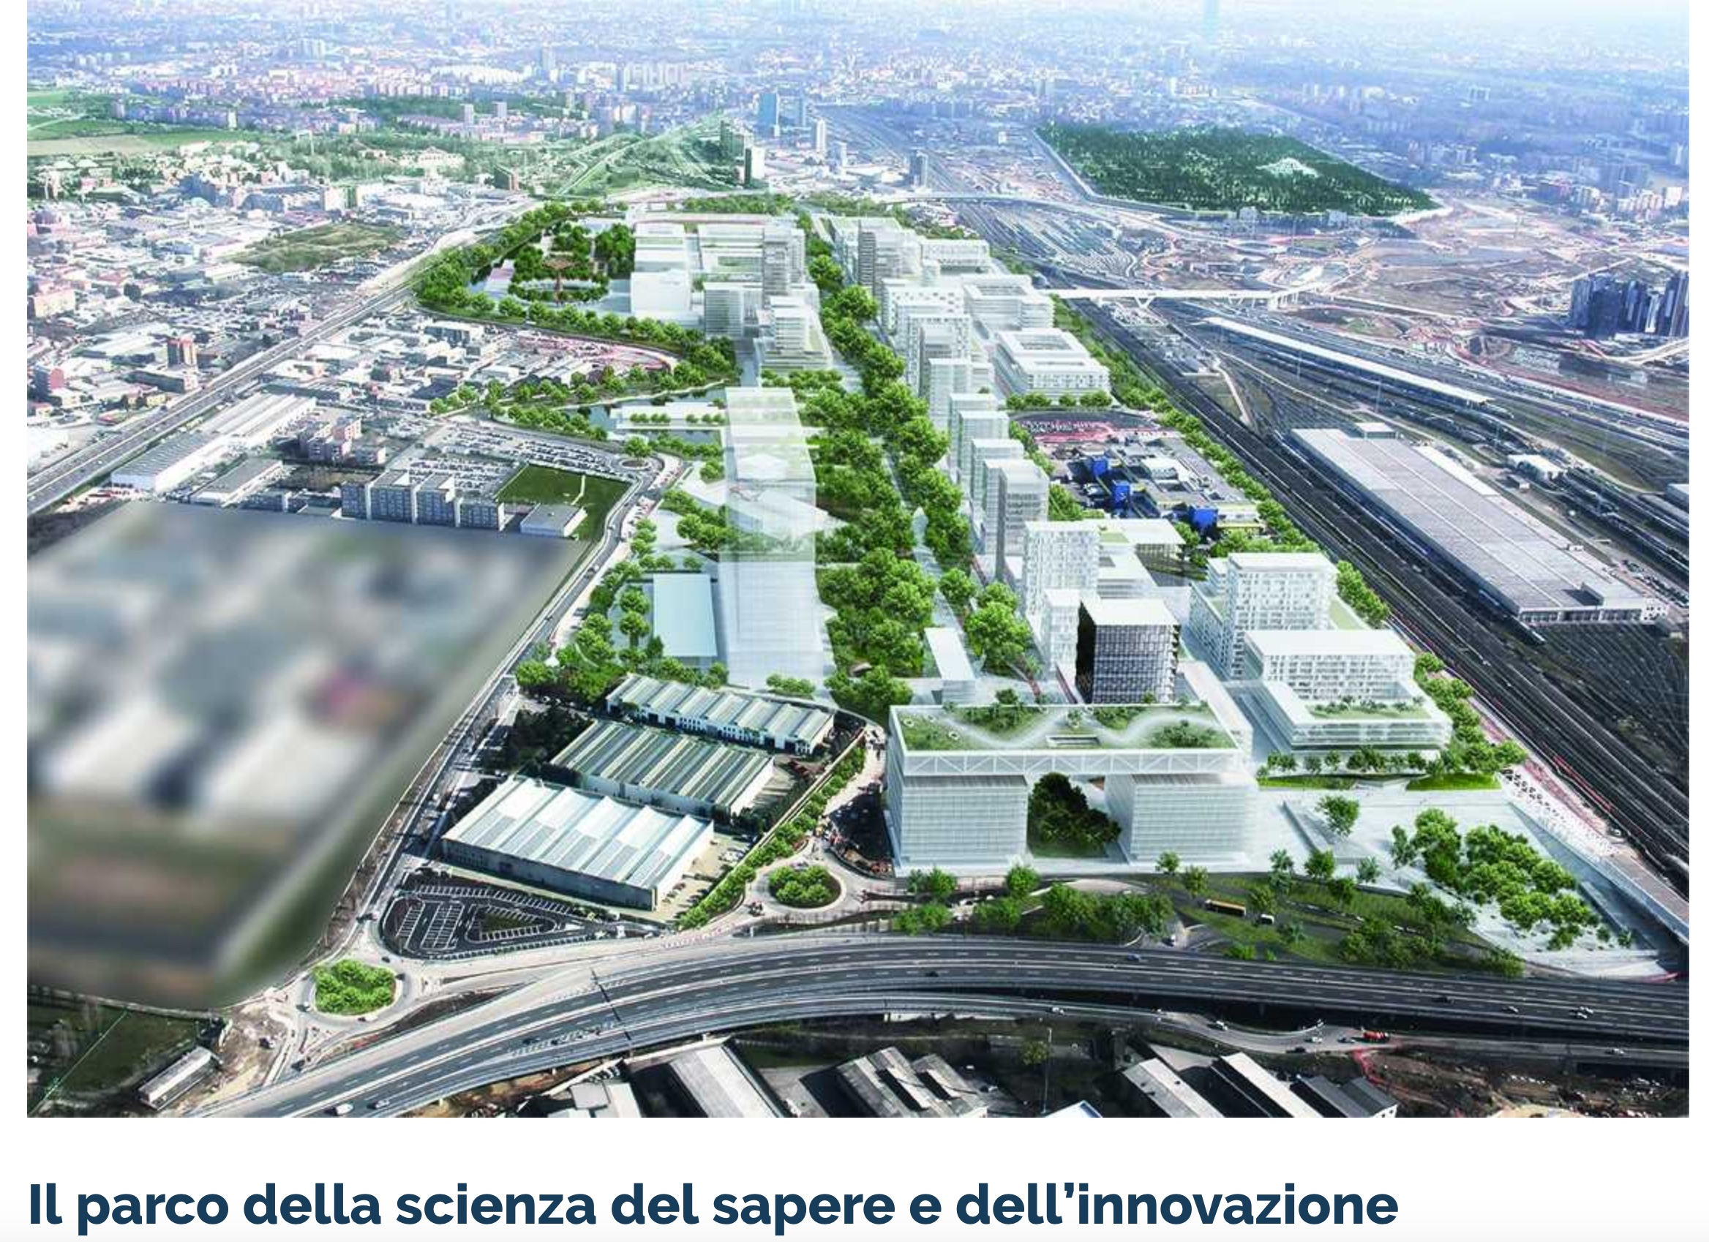


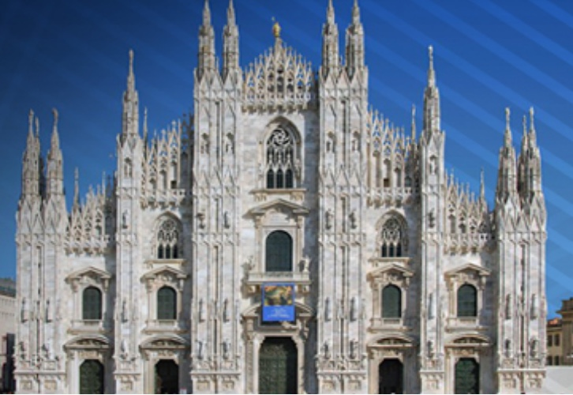
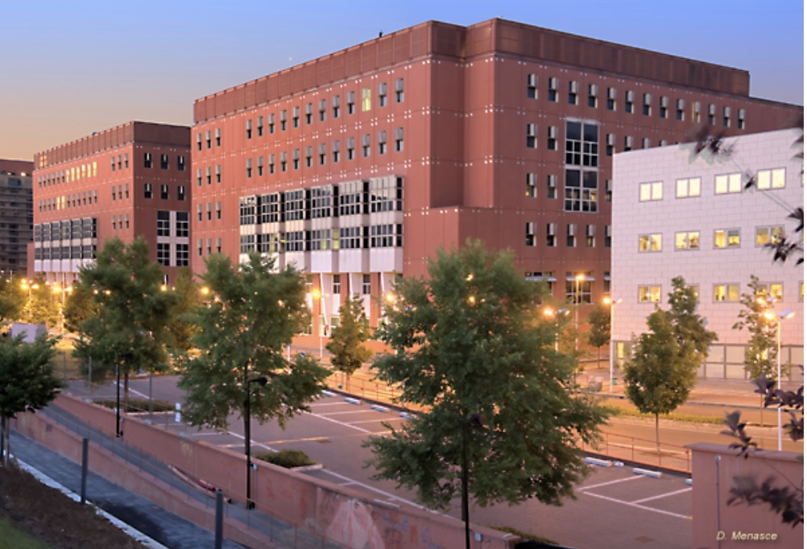

Autostrada A7 Como-Varese
MIND : Milan INnovation District
Linea ferroviaria Mi-Torino
A Multi-disciplinary Advanced Research Infrastructure for the Milan metropolitan area

Slide 3
Multi-disciplinary Advanced Research Infrastructure
for the generation and application of X-rays: MariX C.D.R.
Scientific Case for a low jitter CW FEL was conceived by Giorgio Rossi, Giacomo Ghiringhelli, Ezio Puppin, Francesco Stellato/Silvia Morante, Bruno Paroli, Martino Bolognesi: Linear Spectroscopy in 0.2-8 keV at femtosecond time scale
Clinical Case for ICS monochromatic X-ray Source delineated by metropolitan Milan Hospitals: San Raffaele, Niguarda, Istituto Naz. dei Tumori, in collaboration with Ferrara and Naples Univ.
Design of a High Sustainability CW combined FEL & ICS X-ray Source for UniMi Scientific Campus spanning 0.2-180 keV (delivering 200kW to 2 MW sustainable beam power to client, cfr. Fermi 100 W, EupraXia 30 W, LCLS 2 kW )

Slide 4
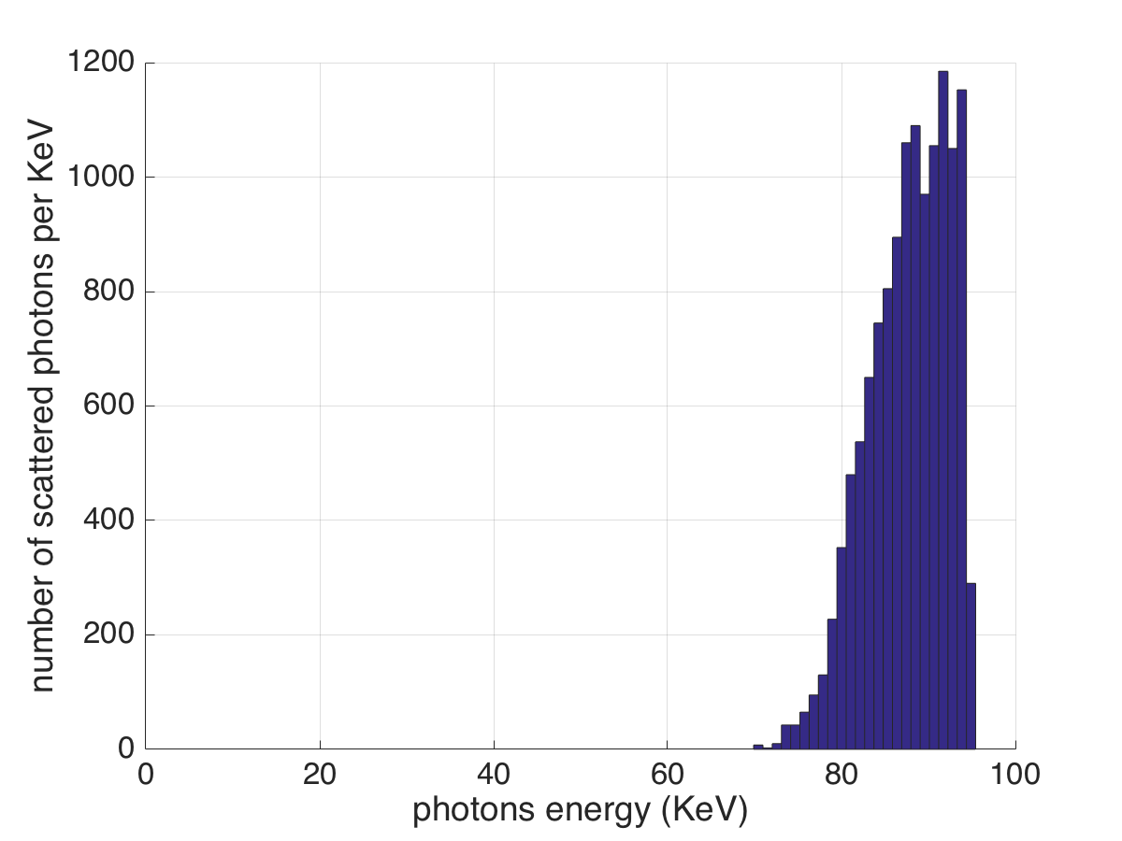
The Mission: coherent femto-second X-rays @ (0.2-8) keV, and ultra-high brilliance hard X-rays @ 20-180 keV
FEL fully coherent diffraction limited X-ray photon beam: 10⁸⁻¹⁰ hν/pulse @ 1 MHz
in 0.05% Δν/ν, 0.2-8 keV, σ_{t} < 50 fsec, 10¹⁶ hν/s
FEL Spectrum
2.5 GeV, λ_{w}=12 mm
LCLS, 1 Angstrom
15 GeV, λ_{w}=2.5 cm
Compton X-ray photon beam: 10¹² - 10¹³ hν/s (@ 100 MHz) in 5% Δν/ν, 20-180 keV, tunable, polarized, σ_{t} = 2 psec, 10 μm round source spot size, mrad divergence
Compton spectrum
FP @ 400 kW, 10 mA,
e⁻ beam 1 MW
2.6.10¹² photons/s

Slide 5

The Product: Conceptual Design Report
After 1 year of hard work...
CDR has been published and
available for download at
www.marix.eu

Slide 6
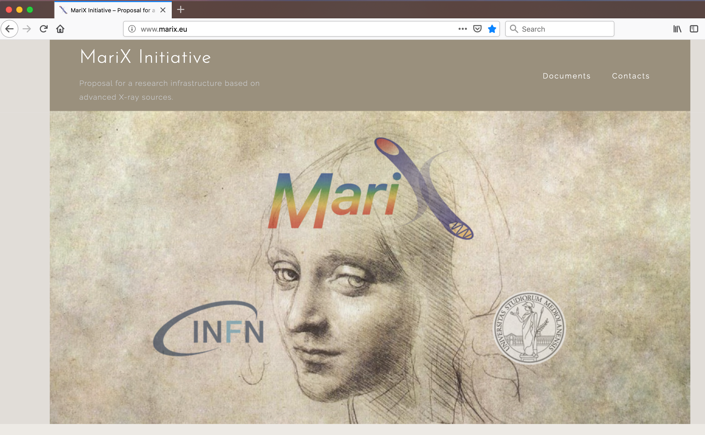
MariX Seminar – Laboratori Naz. Frascati - INFN - Dec. 2nd, 2019

Slide 7
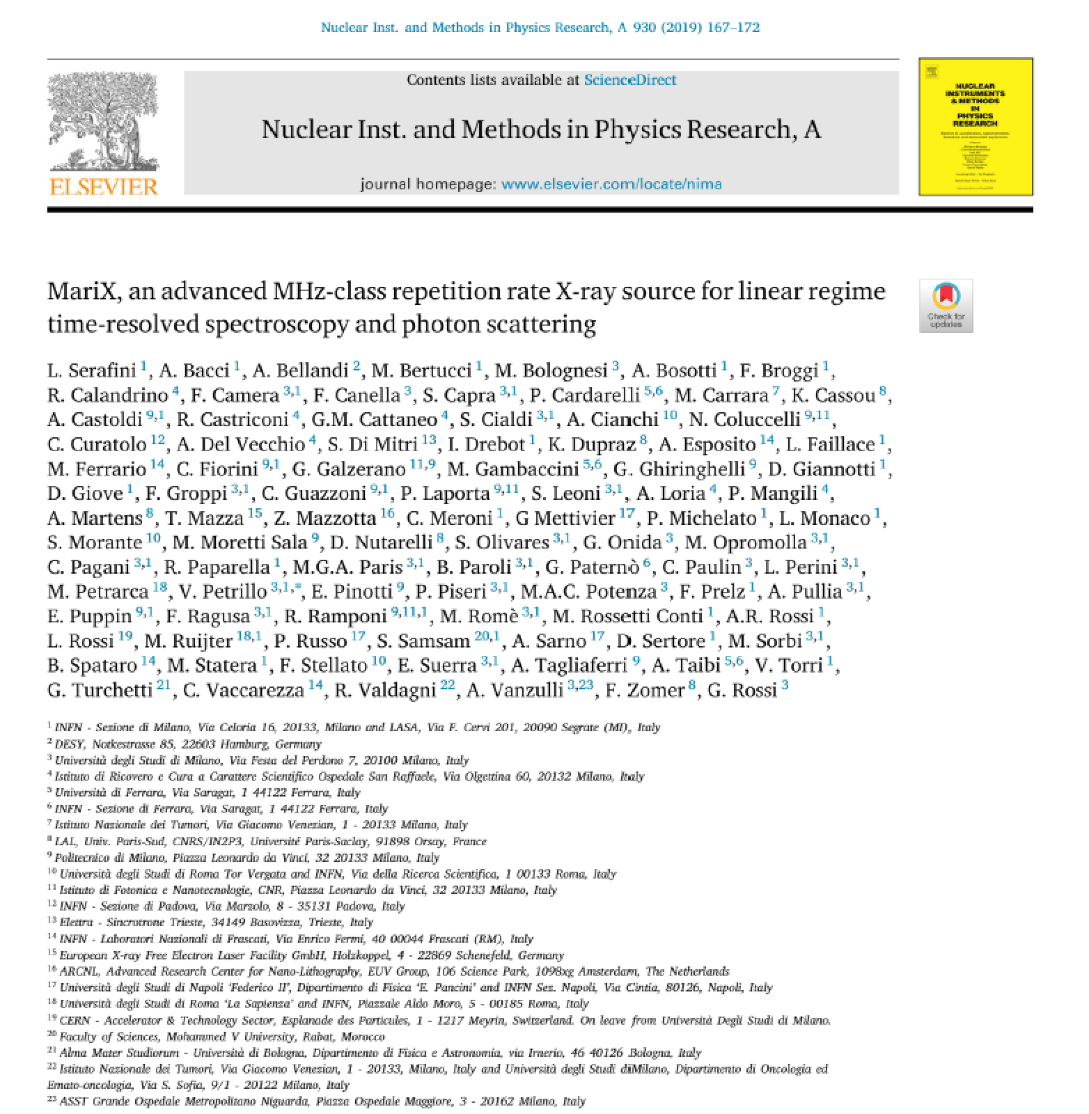
Executive Summary
published on NIM-A

Slide 8
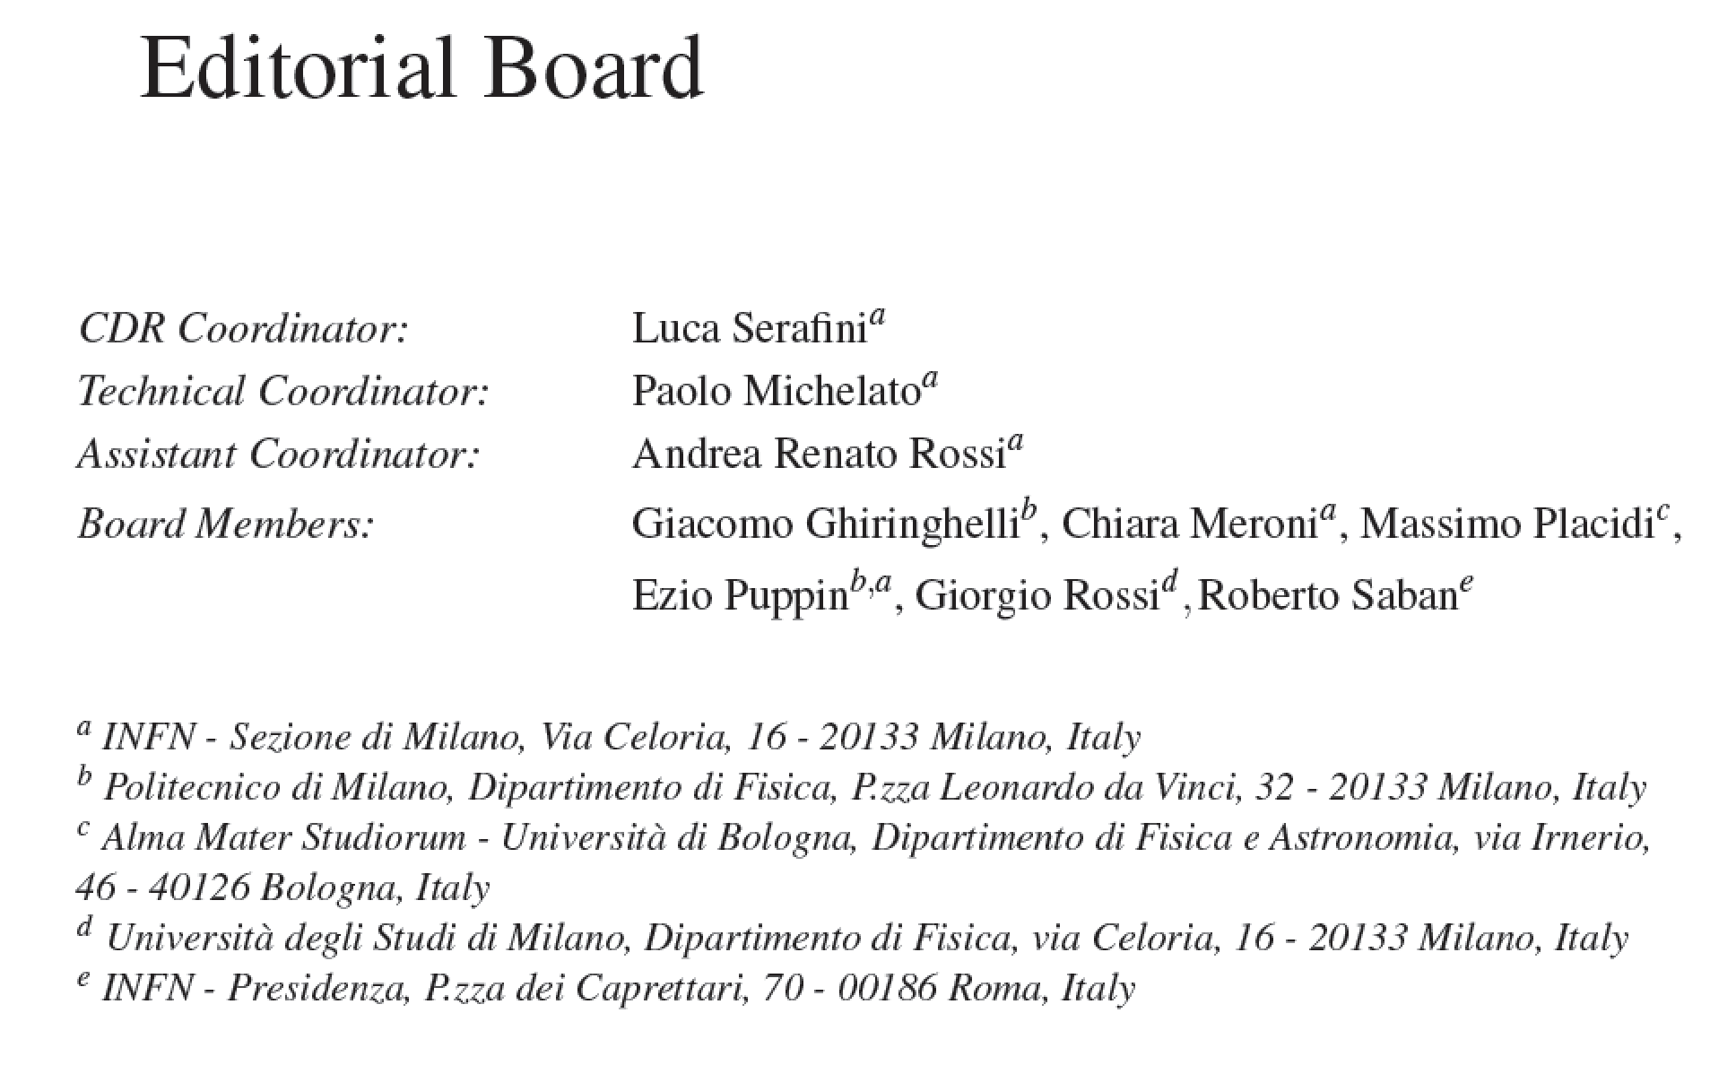
Machine Team: A. Bacci, A. Bosotti, F. Broggi, S. Cialdi, C. Curatolo (INFN-PD), S. DiMitri (ST),
I. Drebot, A. Esposito (LNF), D. Giove, G. Galzerano (PoliMi/CNR), P. Michelato, L. Monaco,
R. Paparella, V. Petrillo, F. Prelz, E. Pinotti (PoliMi), M. Placidi (Univ. BO), E. Puppin (PoliMi),
A.R. Rossi, D. Sertore, V. Torri
Fellows: D. Giannotti^{INFN}, L. Faillace^{INFN}, M. Rossetti Conti^{INFN}, S. Capra^{UniMi}
PhD/Master Students: F. Canella, M. Opromolla, C. Paulin, M. Ruijter^{INFN},
S. Samsam^{ICTP}, E. Suerra

Slide 9
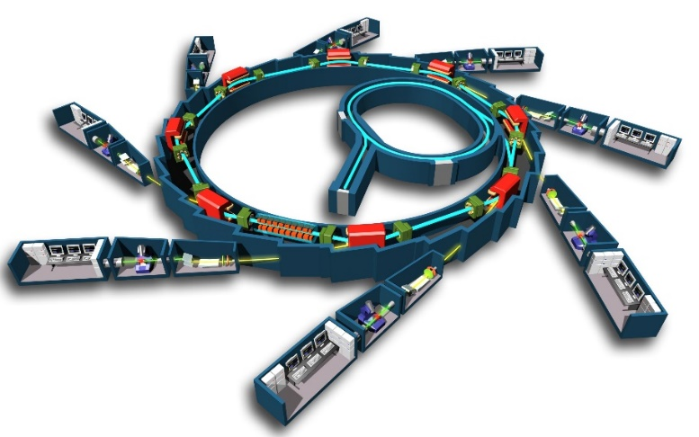
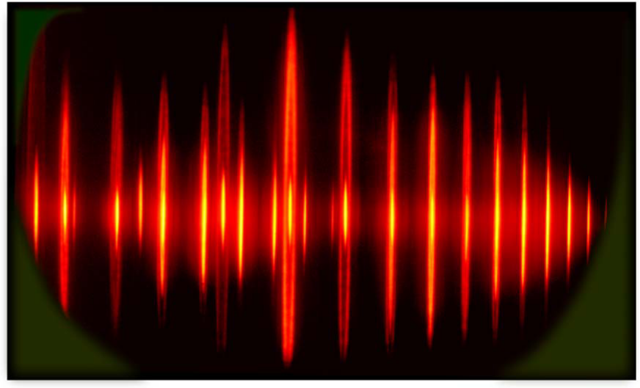
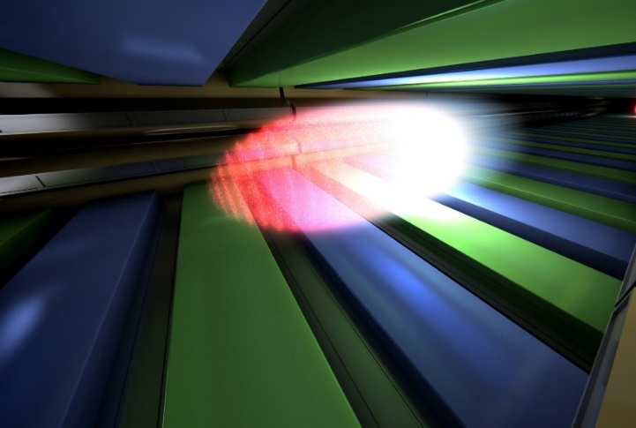

Laser-HHG UV-Soft X
Synchrotron Radiation sources
Free Electron Laser sources
500 MHz repetition
nJ pulse energy; ≈50ps
10⁵⁻⁶ photons x (5)x10⁸pulses
^{Linear response} ^{regime:}
^{Imaging} and spectroscopy (perturbation theory)
10Hz-27kHz repetition
mJ pulse energy; ≈50fs
10¹²⁻¹³ photons x
10¹⁻³⁻⁽⁶⁾pulses
Ultrafast Non-linear response regime
Imaging, flash+destroy
MARIX+FEL (10 keV)
1 MHz repetition
100nJ pulse energy; ≈50fs
10⁸⁻¹¹ photons x 10⁶pulses
Ultrafast Linear response
DLSR: vertical emittance 2-8 picorad,
horizontal emittance 200-300 picorad
MariX: vertical/horizontal
emittance 45 picorad
⇒ Round vs. Flat beams
Courtesy Giorgio Rossi

Slide 10
Scientific/Clinical Case: 2 Research Fields
enabled by MariX originality (Compton+FEL in CW)
High resolution low dose Radio-logical Imaging (<100 μm) with mono-chromatic X-rays up to 150 keV: mammography, 2 color angiography, radio-therapy with auger electrons on cis-platine, CAT 3D imaging of Cult.Herit./Archeological/Paleontological samples
Time resolved spectroscopy with fs coherent X-rays up to 8 keV @ 1 MHz rep rate: catalisys and chemistry in solvents, structure of nano-objects from coherent diffraction, bio-chemistry @ atomic and fs scale, pump&probe spectroscopy of strongly correlated materials, magnetism, superconductivity, topological materials, materials under strong spin-orbit interaction. Protein Crystallography with single-shot imaging (flash-and-destroy)

Slide 11
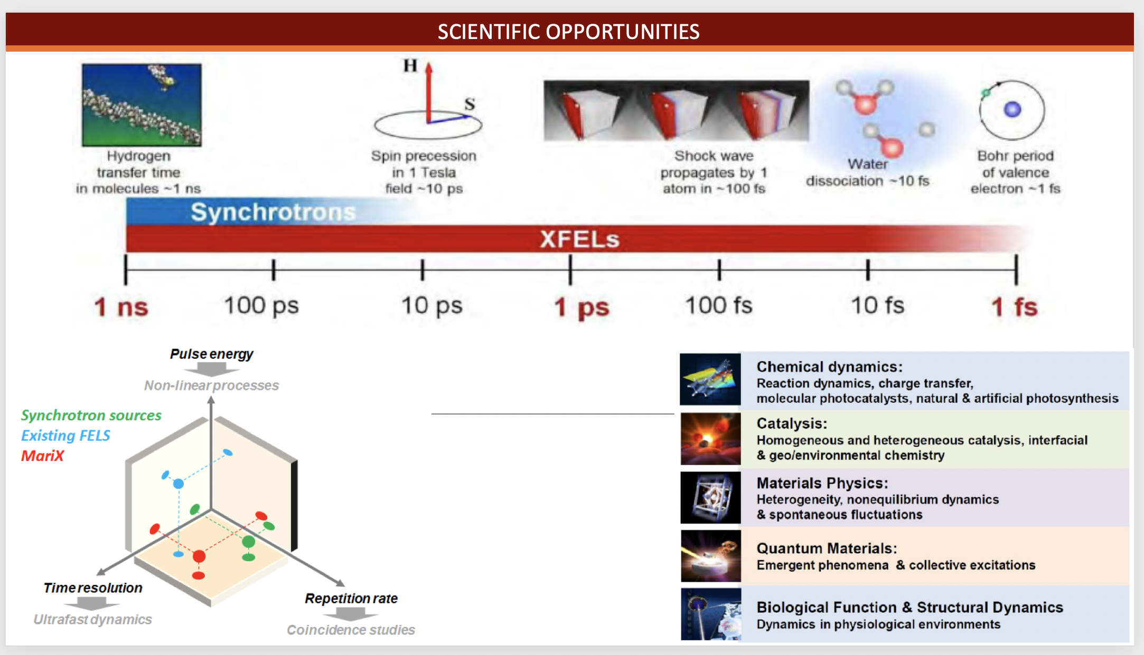
MariX Seminar – Laboratori Naz. Frascati - INFN - Dec. 2nd, 2019
Courtesy Giorgio Rossi

Slide 12
Comparison between X-FELs
Electron Beam Energy to radiate at ~ Angstrom
λ_{R} = λ_{w} (1+a_{w}²)/ 2γ² , λ_{w} ÷ 1.2-3 cm
FEL | Radiation Wavelength (A) | Electron Beam Energy (GeV) | Linac Length (m)
LCLS | 0.5 | 14.3 | 1000.
PSI | 1.0 | 5.8 | 500.
EuXFEL | 0.15 | 17.5 | 1700.
LCLS II | 2.4 | 4.0 | 650.
MariX | 1.5 | 3.8 | ???? < 200
MariX Seminar – Laboratori Naz. Frascati - INFN - Dec. 2nd, 2019

Slide 13
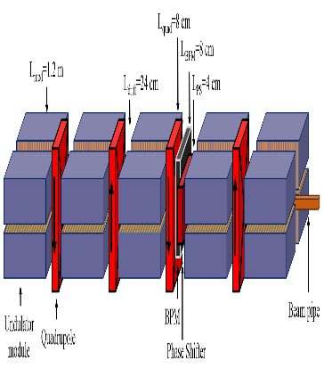
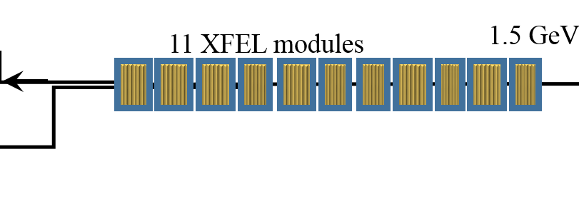

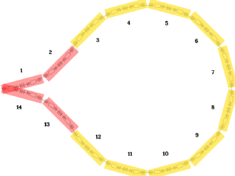
In quest of High Sustainability we had to conceive a new kind of machine:
the Two-Way Linac (TWL)
All Accelerators are one way – the beam propagates in one direction (ERL too)
MariX uses the CW Linac twice – forward and backward
Superconductiong Linac: 13 XFEL crio-modules Compr Undulator
Traditional
FEL layout
Injector
dV/dz=17 MV/m
100 MeV 1.6-1.8 GeV
λ=7 Ang
0
100m
200m
300m
400m
500m
Linac2
Linac1: 11 XFEL crio-modules
Arc
compr
MariX
layout
λ=1.5 Ang
Injector
3.4-3.8 GeV 2.8-3.2 GeV 1.4- 1.6 GeV
Only Standing Wave RF Cavities can accelerate particles in both directions!

Slide 14
Acceleration in opposite directions through a Linac
(two-way acceleration)
is possible if:
RF fields can accelerate in both directions
(Standing Waves can do it)
2) Focusing effective in both directions and weakly energy dependent
(RF focusing and/or solenoids)
3) No bunch crossing –> Twice the Linac Length < Bunch separation
4) RF fields must be on for a time longer than
bunch back-and-forth travel time (CW recommended)
5) Orbit position must not be dependent on magnetic rigidity
(no two-way through dipoles, except bifurcations)
MariX Seminar – Laboratori Naz. Frascati - INFN - Dec. 2nd, 2019

Slide 15
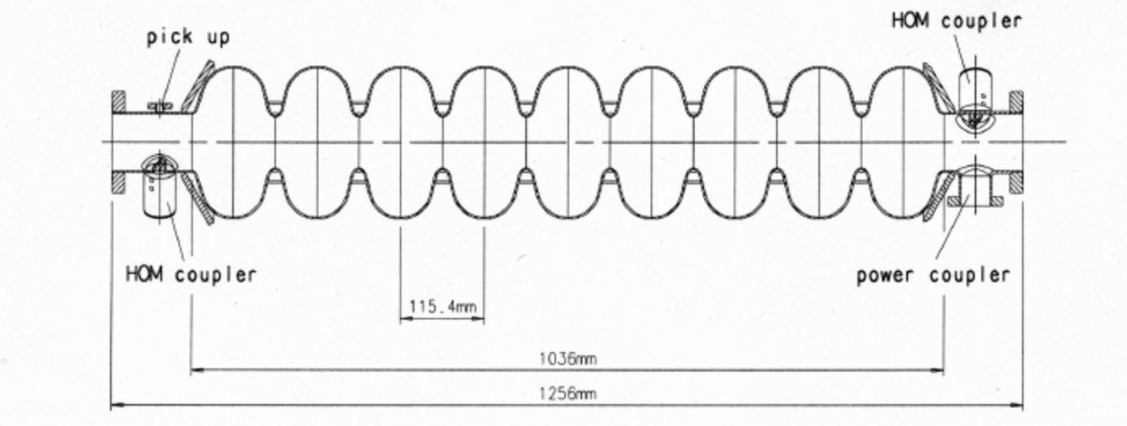
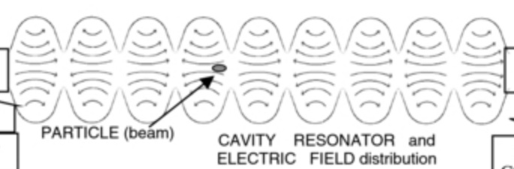
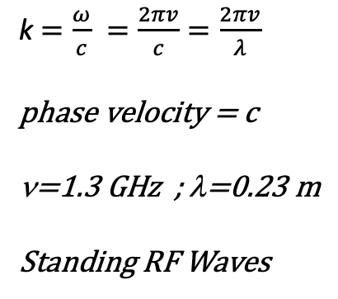
Modo risonante TM_{010-π} ad Onda Stazionaria
k$=\frac{ω}{c} =\frac{2πv}{c}=\frac{2πv}{λ}$
phase velocity = c
ν=1.3 GHz ; λ=0.23 m
Standing RF Waves
9 celle = 4.5 λ = 1.04 m
MariX Seminar – Laboratori Naz. Frascati - INFN - Dec. 2nd, 2019

Slide 16
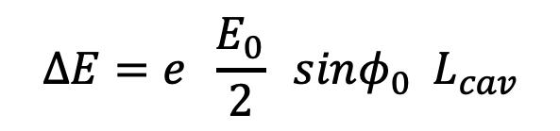
standing wave
E₀ sin(kz)cos(ωt-φ₀) =
(1/2) E₀ sin(kz-ωt+φ₀) + (1/2) E₀ sin(kz+ωt-φ₀)
forward traveling wave,
synchronous to z = ct
backward traveling wave,
synchronous to z = -ct
ampiezza della componente
di onda viaggiante sincrona
rispetto all’elettrone
$$ΔE=e \frac{E_{0}}{2} sinφ_{0}{ L}_{cav}$$
MariX Seminar – Laboratori Naz. Frascati - INFN - Dec. 2nd, 2019

Slide 17
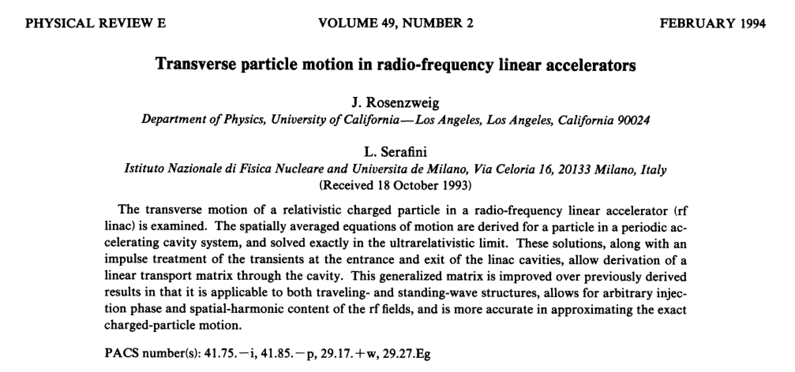
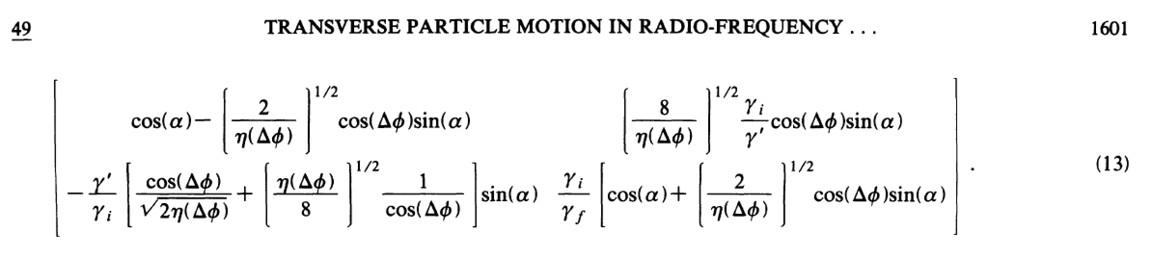
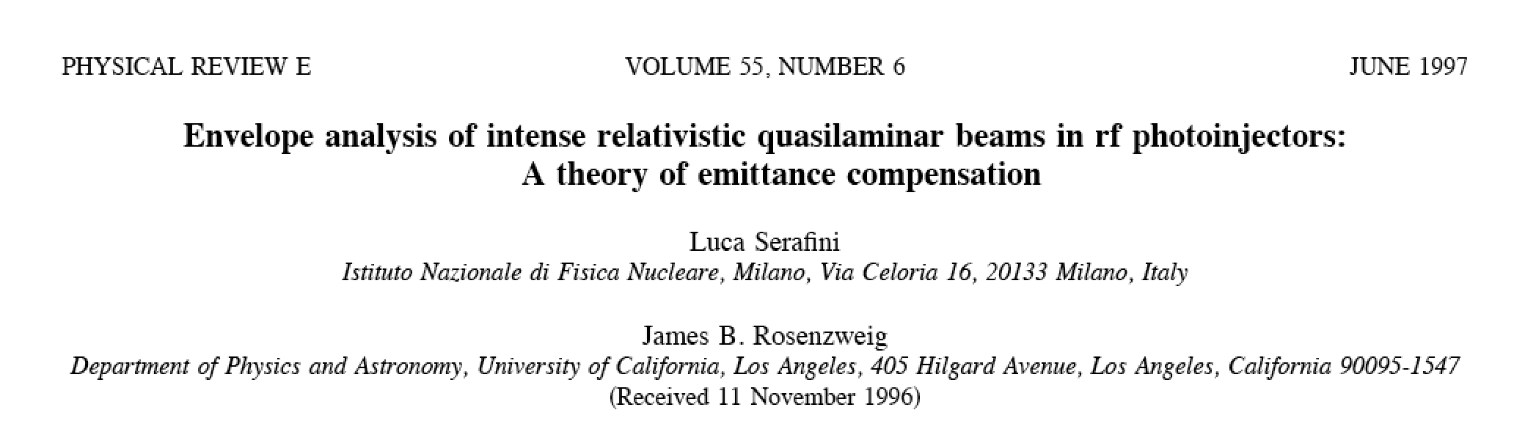
RF Focusing effective only in Standing Wave RF Cavities
a lesson we learned long time ago
RF transport matrix

Slide 18
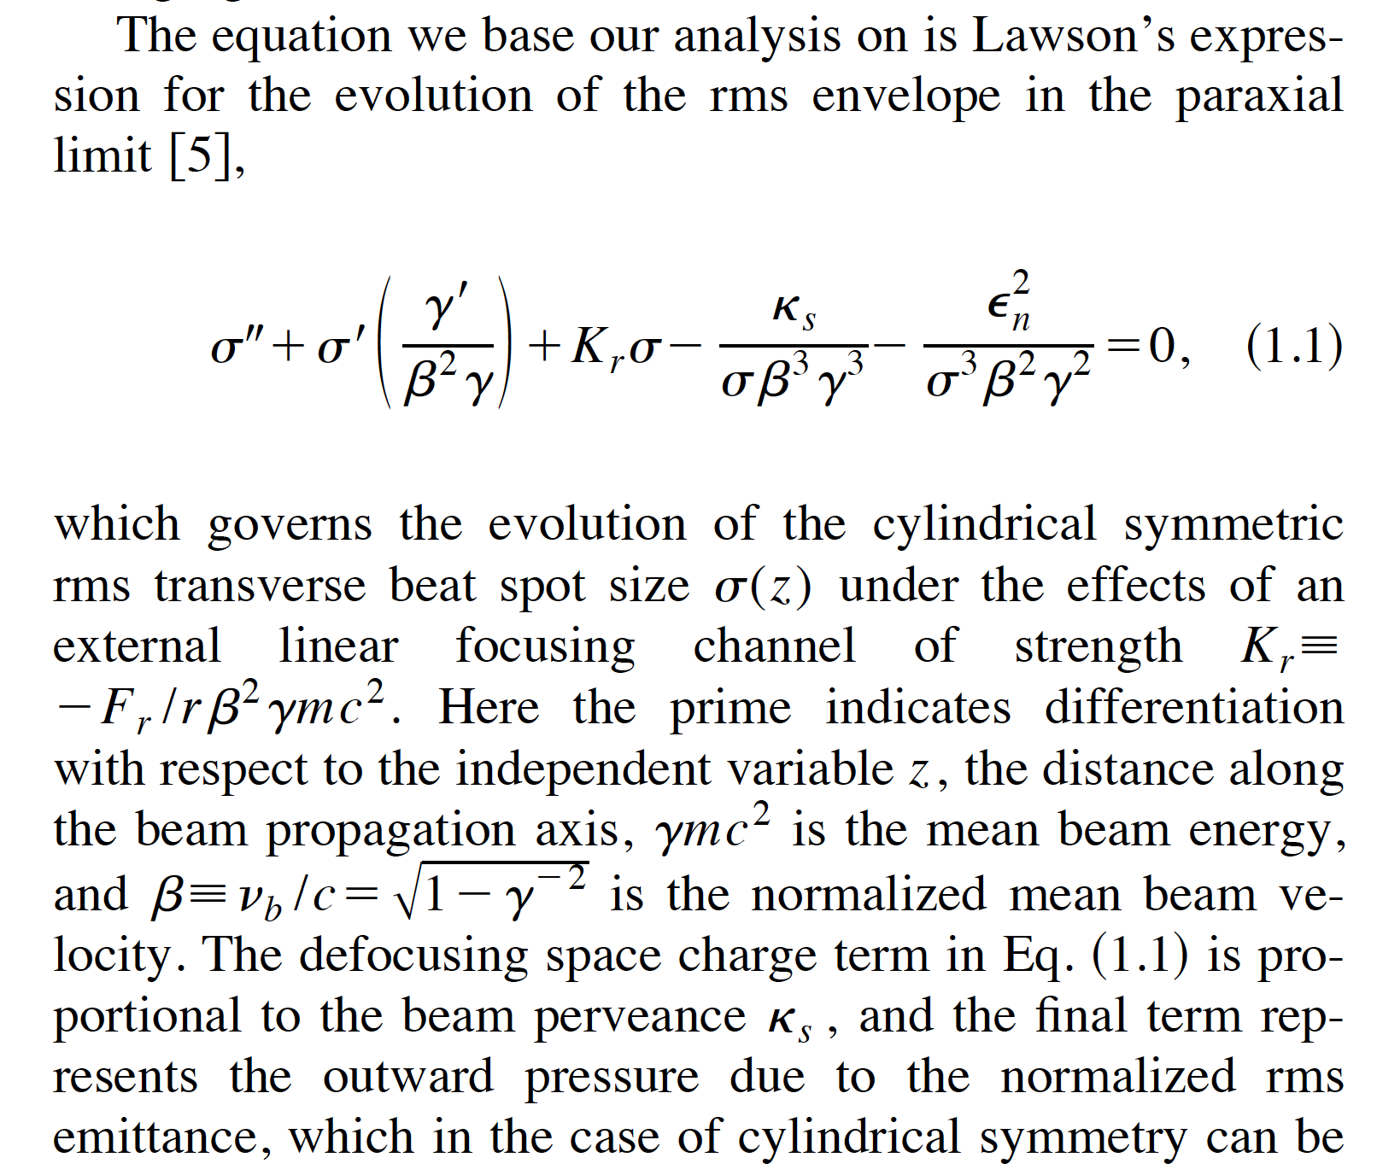
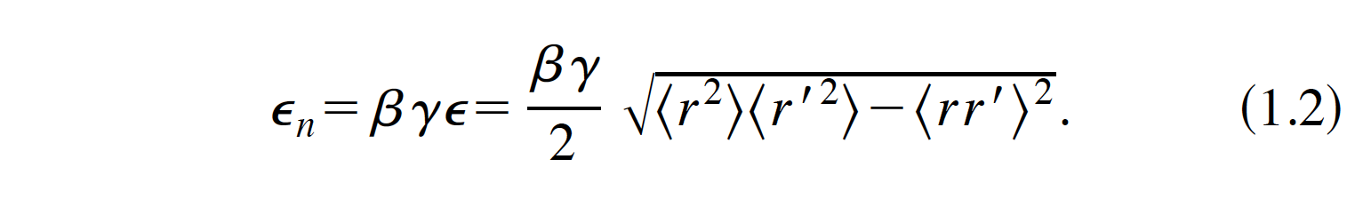
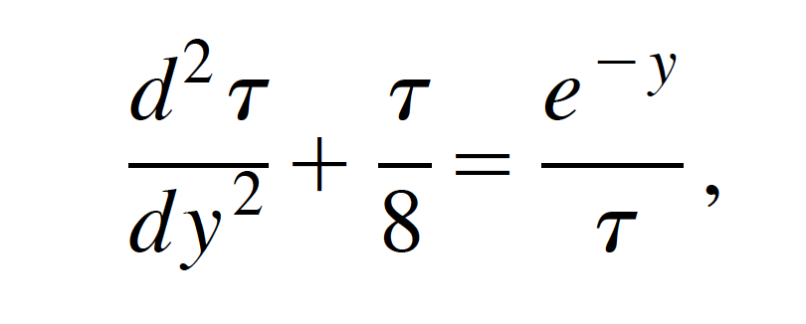
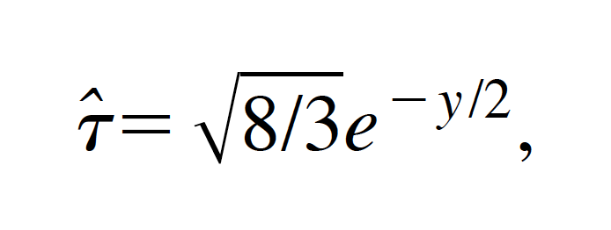
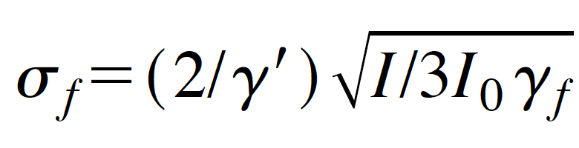
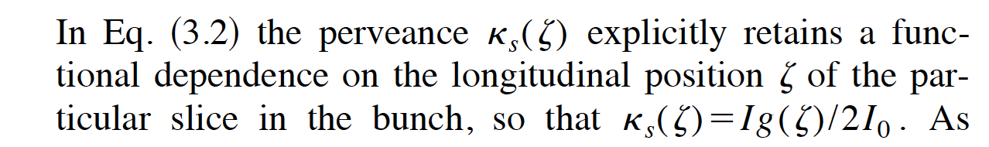
RMS Envelope Equation for laminar beams: a path towards the Invariant
Envelope Theory for High Brightness el. beams (1997, L.S and J.Rosenzweig)
Cauchy
1.1

Slide 19
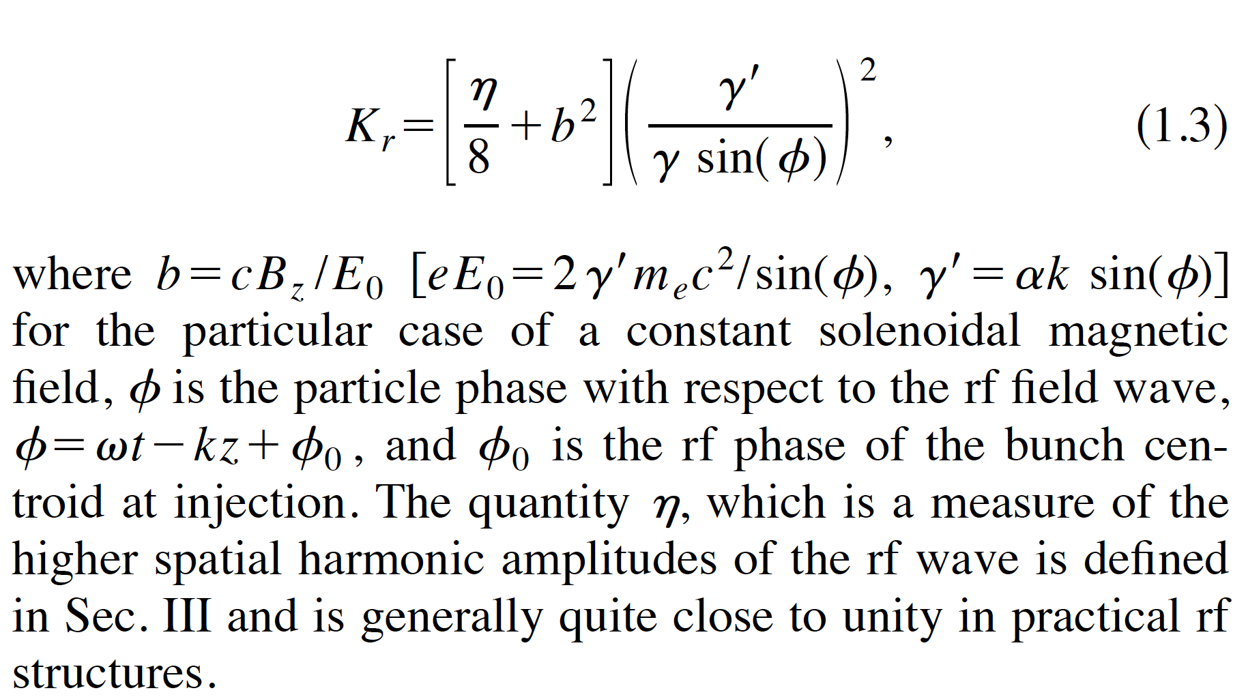
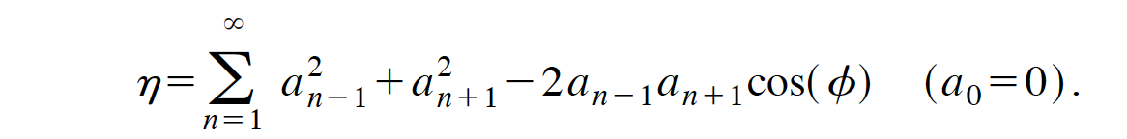
RF (ponderomotive) Focusing
~ 1 Standing
~ 0 Traveling

Slide 20
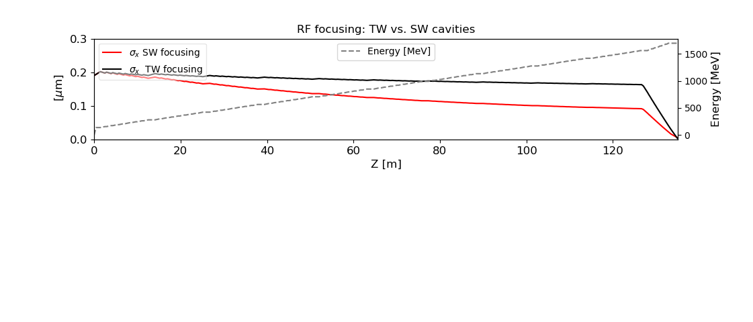

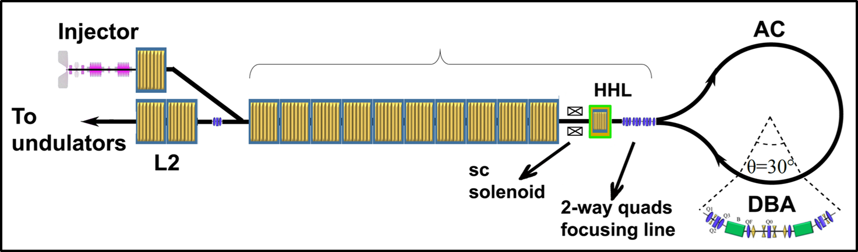
The Super Conductive Main Linac
Ten Tesla like cryomodules: max grad 16 MV/m, 8 cavity per cryomodules
Chirp for AC-compression is given injecting @ + 6° from RF crest.
We rely only on second order focusing, symmetric back-and-forth: Rf focusing and solenoid foc.
5 T solenoid
Two-pass 2-way region
Notes:
Adiabatic focsing

Slide 21
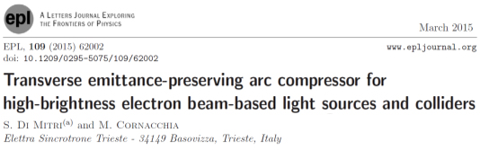
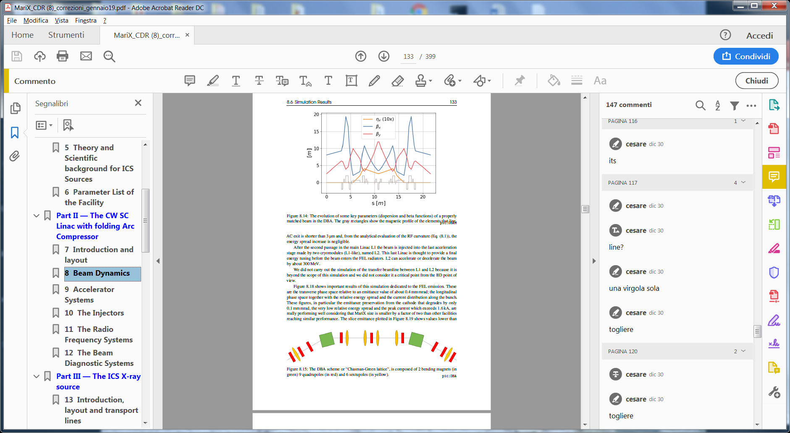
Source layout 5:
The arc compressor
14 Double Bending Achromats Elettra-like
dipole
One DBA
quad
R₅₆=35 mm
30°
sextupole
R=41 m
Study of the arc compressor done by
M. Rossetti Conti
MariX Seminar – Laboratori Naz. Frascati - INFN - Dec. 2nd, 2019

Slide 22
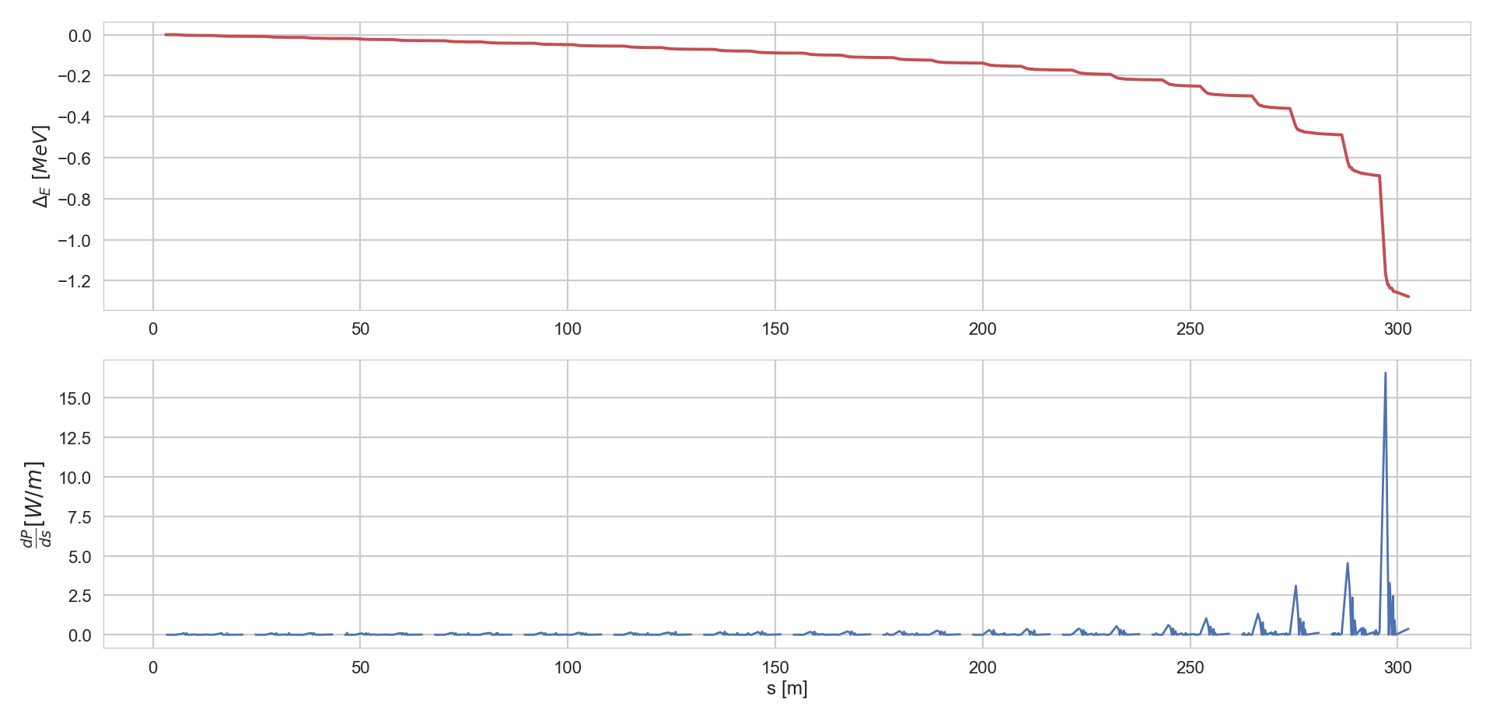
ISR and CSR through Arc Compressor
MariX Seminar – Laboratori Naz. Frascati - INFN - Dec. 2nd, 2019

Slide 23
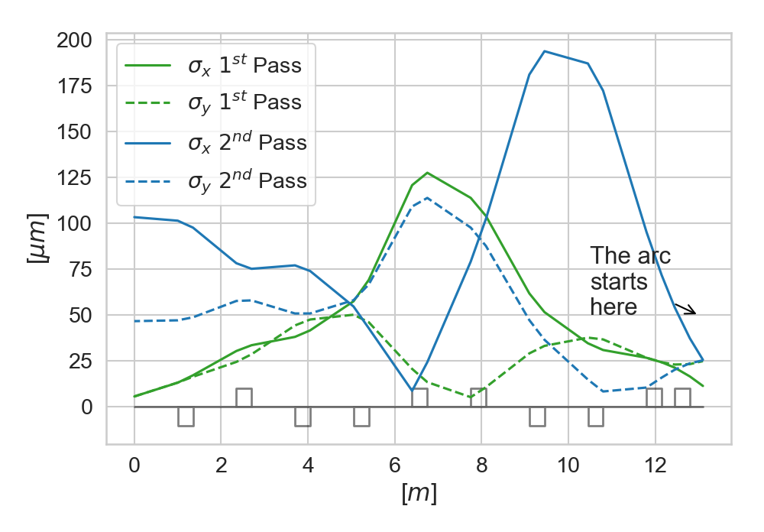

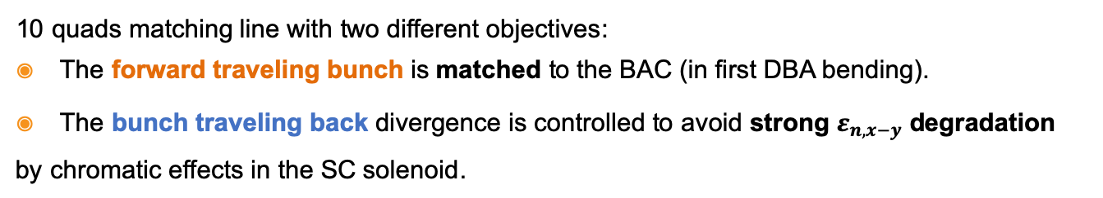
Bubble Arc matching line
10 quads matching line with two different objectives:
The forward traveling bunch is matched to the BAC (in first DBA bending).
The bunch traveling back divergence is controlled to avoid strong $ε_{n,x−y}$ degradation by chromatic effects in the SC solenoid.
Forward
Backward
Notes:
The matching line is composed by 10 Quads and its design is complicated since this line have two objectives.
the forward…
The divergence of the backward have to be controlled To avoid emittance deg. By chromatic effects that can occur in the SC solenoid if the bunch tranverse dimensions are too high.

Slide 24
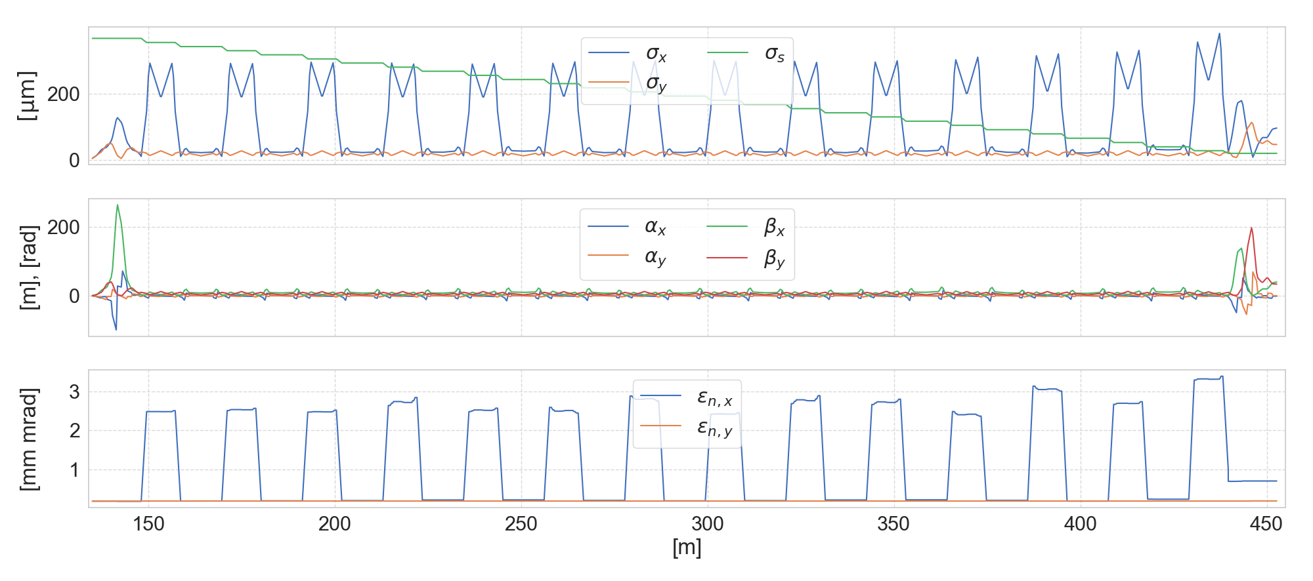
Beam parameters in BAC
CSR and LSC: on
I_{peak} x 100
Projected ε_{n,x} increase by CSR
Notes:
The main parameters of the bunch in the BAC are shown In this picture, looking at the green line in the upper plot we can clearly see the linear compression of the bunch. At the end of the line the peak current is multiplied by a factor of 1 hundred.
The effects of the CSR kick on the bunch slices are visible at the end of the line in the increase of the projected emittance.
However, this effect is not strong as it may seem, in fact we will see that the slice emittance is low. In all the bunch

Slide 25
Beam dynamics 1: before the arc, Q=50 pC
here
Beam dynamic study made by A. Bacci
I_{peak}=16 A
σ_{x}=6 μm
σ_{z}=360 μm
<E>=1.5 GeV
ε_{nx,y}=0.2 μm
ΔE/<E>=7 10⁻⁴
Longitudinal phase space
Transverse phase space
MariX Seminar – Laboratori Naz. Frascati - INFN - Dec. 2nd, 2019

Slide 26
Beam dynamics 2: after the arc, Q=50 pC
here
I_{peak}=1600 A
σ_{x}=52μm
σ_{z}=20 μm
ΔE/<E>=3.6 10⁻⁴
ε_{n,x}=1 μm
σ_{y}=14.5 μm
Longitudinal phase space
Transverse phase space
ε_{n,y}=0.2 μm
Centro Brasileiro de Pesquisas Fisicas, Rio de Janeiro, May 2nd, 2019

Slide 27
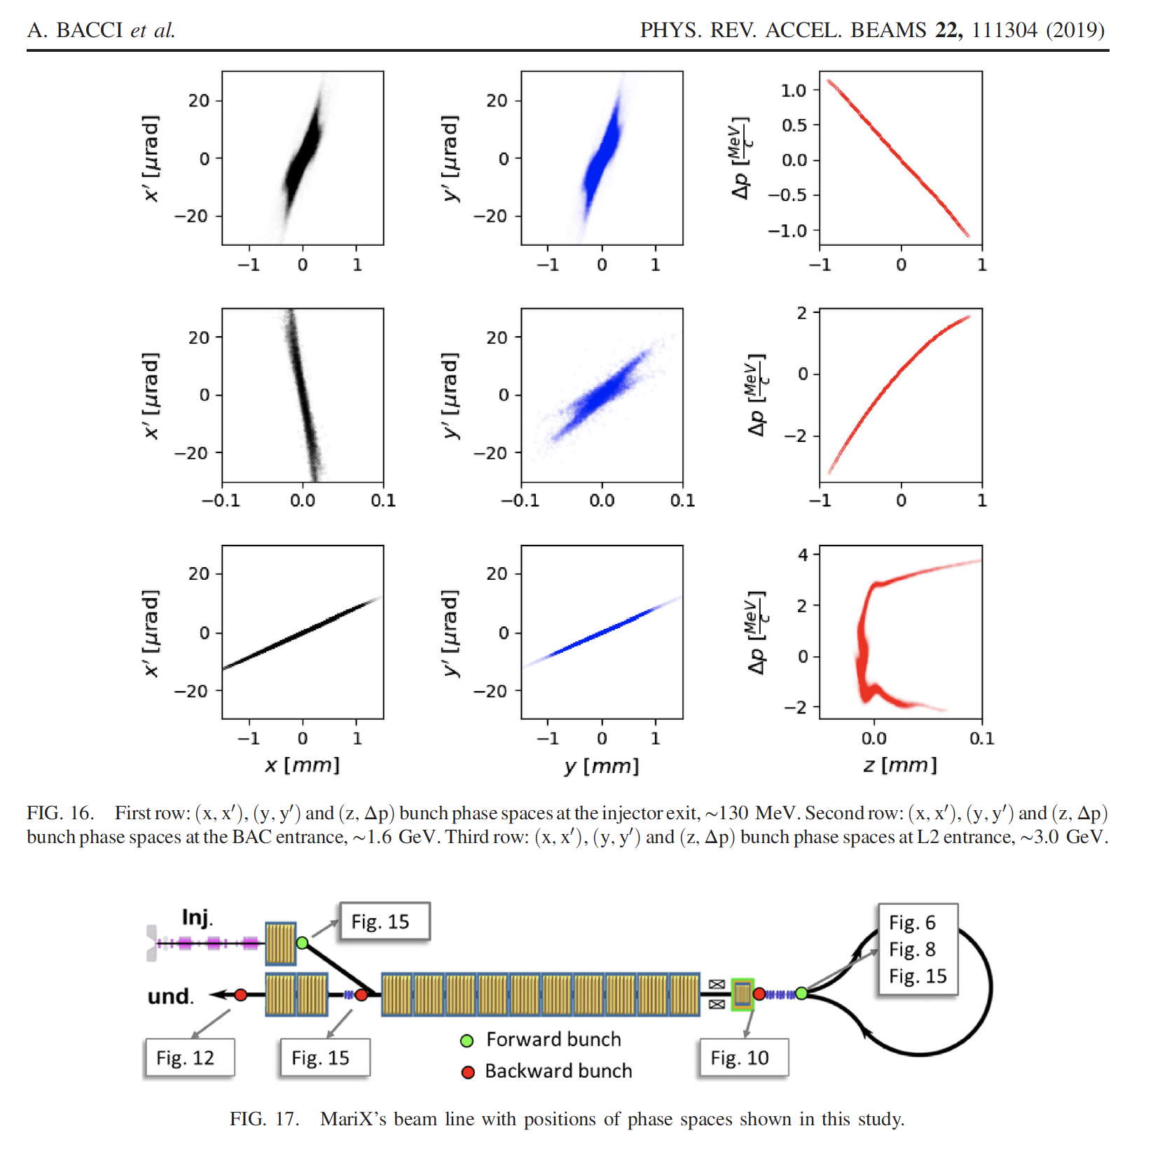
MariX Seminar – Laboratori Naz. del Sud - INFN - Nov. 13th, 2019

Slide 28
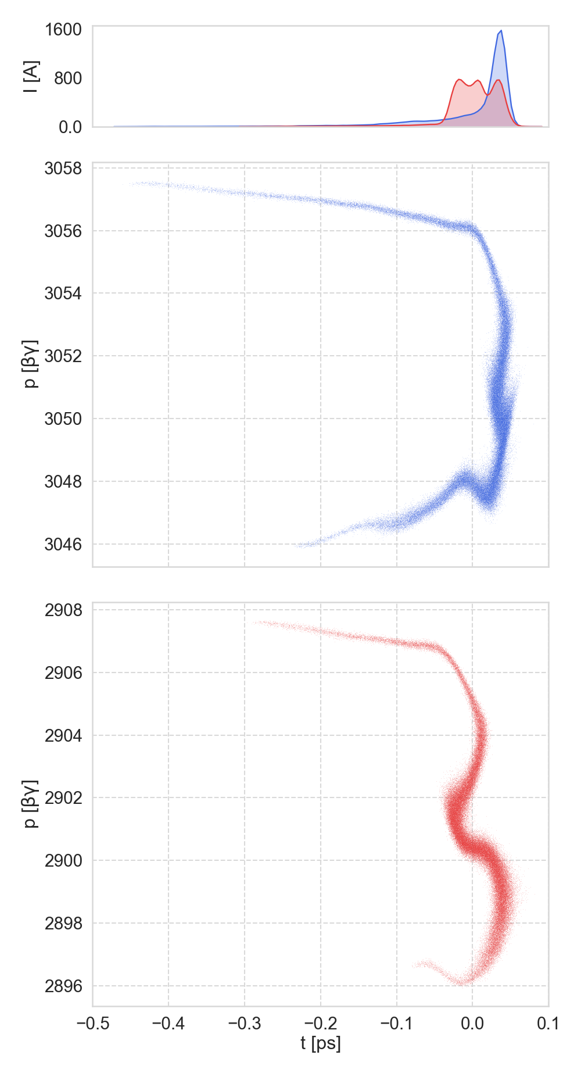
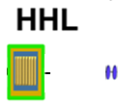
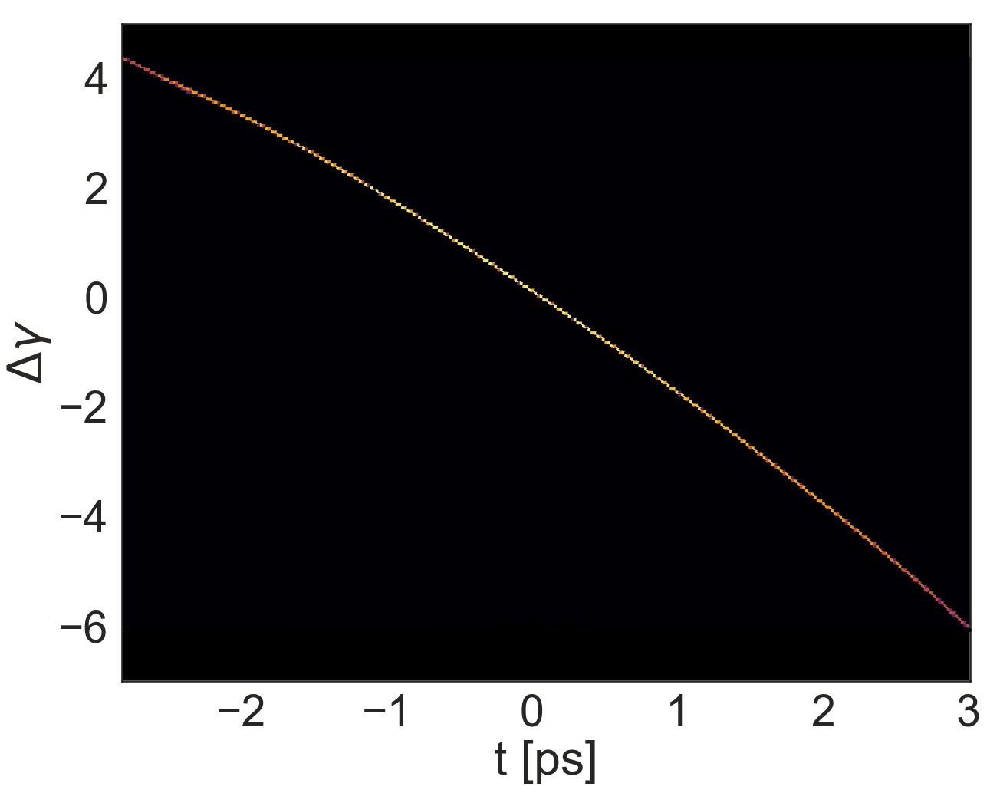
CSR compensation
Two main factors contribute in CSR compensation:
Current profile shaping (injector) reduce CSR kick.
The HHL in acc. phase (+100 MeV) increases LPS curvature compensating the distorsion induced by CSR.
Forward
HHL
Backward
Notes:
The preservation of the slices quality is achieved thanks to two factors
1- the current shaping performed in the injector reduce the CSR kick at maximum compression.
2- the HHL positioned before the matching line is used to increase the curvature of the beam as can be seen in the picture in the bottom left.
This is done to compensate the distortion induced by the CSR emission, the effect is clearly seen comparing the shape of the final LPS with the cavity turned off (in red) and on (in blue). This increase significantly the peak current the distribution

Slide 29
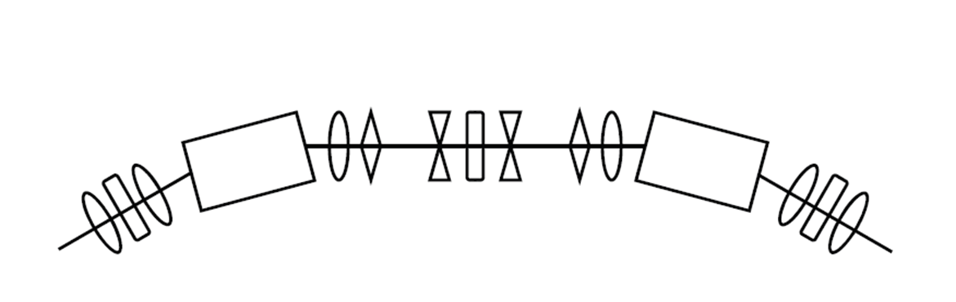


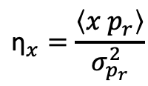
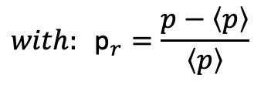

Beam dispersion damping
$${\text{η}}_{x}=\frac{\left\langle x p_{r}\right\rangle }{σ_{p_{r}}^{2}}$$
$${\text{η}\text{′}}_{x}=\frac{\left\langle x′ p_{r}\right\rangle }{σ_{p_{r}}^{2}}$$
The CSR kick induces dispersive effects on the beam:
Increase η and η’, <x> and <x’> and spoils FEL emission
$$with: {\text{p}}_{r}=\frac{p−\left\langle p\right\rangle }{\left\langle p\right\rangle }$$
Modified last DBA
Projected ε_{n,x} decreased by 30%
STEERINGS
Beam centered on axis
QUADS
Notes:
Another effect of the CSR kick is the induction of residual dispersion on the beam.
This can be quantified using the eta and eta’ parameters or looking at the centroids displacement.
To compensate this effect we modified the last DBA adding 2 Quads and a couple of steering magnets, we used these parameters to minimize eta and eta’ nda the centroids displacements from the axis.
As result we obtained a decrease in the projected emittance by 30% and centered back the beam on axis.

Slide 30
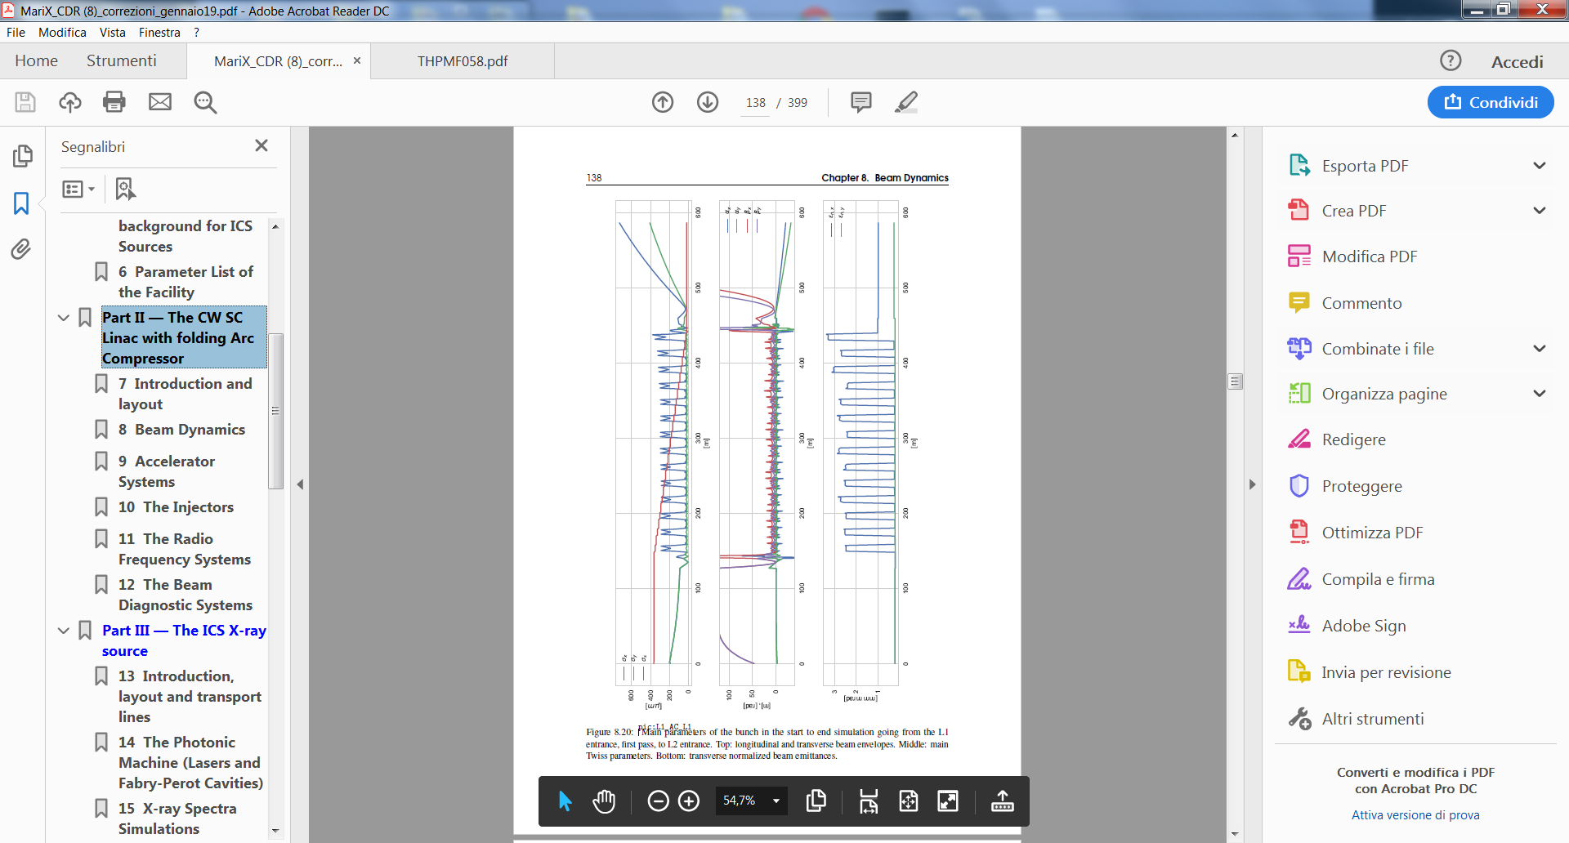
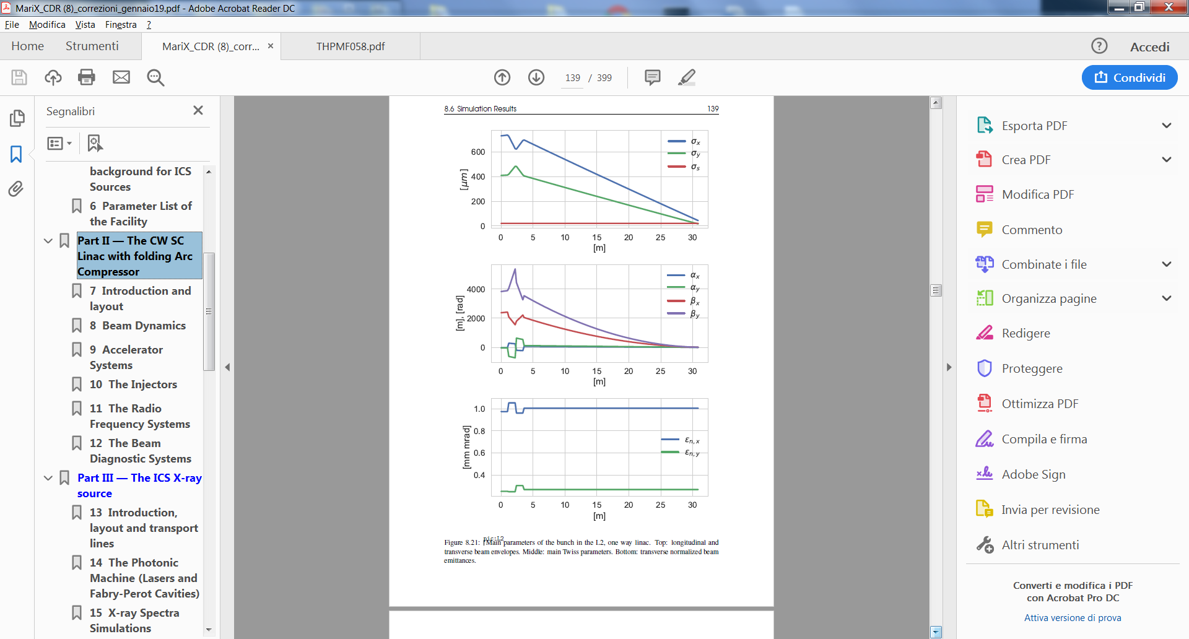
beam dynamics w/o optimization in last DBA with special lay-out
All the beam dynamics simulations have been done with ELEGANT by
Alberto Bacci and Marcello Rossetti Conti
Envelopes
Linac 1 1st pass TL Arc compressor TL Linac 1 2nd pass Linac2
Emittances
MariX Seminar – Laboratori Naz. Frascati - INFN - Dec. 2nd, 2019

Slide 31
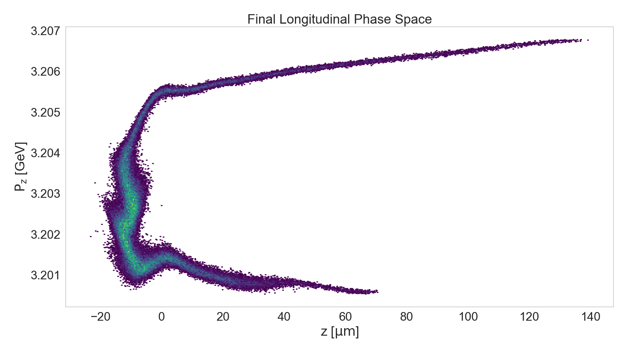
The Bunch
Beam Propagation
Notes:
This is the final LPS of the beam, it is interesting to note that the beam tail is the most populated part of the bunch.
Looking at this PS we see a really weak gain of the MBI induced by CSR.

Slide 32
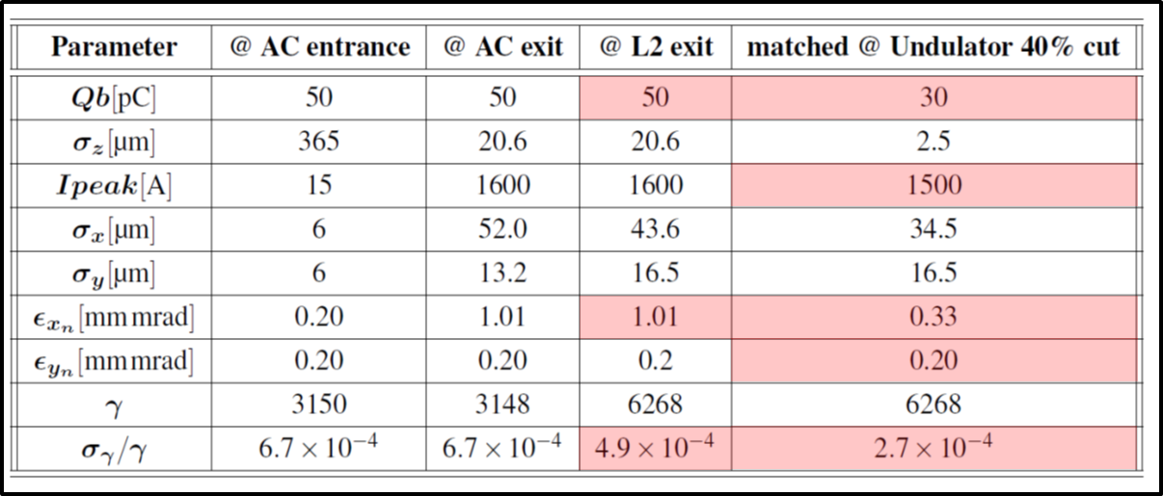



The Bunch
Par. | Full Beam | Cut
Q_{tot} | 50 pC | 30 pC
I_{peak} | 1580 A | 1500 A
σ_{E} | 1.6 MeV | 750 keV
σ_{E}/E | 1.0 10⁻³ | 4.7 10⁻⁴
ε_{n,x} | 1.01 µm | 0.29 µm
0.71
0.71
0.24
$$∆γ$$
Desired Max Slice ε_{n,x} = 0.5 mm mrad
T [s]
Notes:
This is the slice analysis of the bunch, that shows a peak current of 1.6 kA .
It’s interesting to note that the minimum of the emittance is in the position of the maximum of the current -→ really high peak brightness 9 10^16
The main beam parameters are shown in this table, a beam cut of the portion that we expect will contribute more to the FEL emission shows 30 pC charge, really low emittance and energy spread and high current

Slide 33


Slide 34


MAC-INFN LASA, Giugno 2019
estratto dal report:
MariX Seminar – Laboratori Naz. Frascati - INFN - Dec. 2nd, 2019

Slide 35

MariX Seminar – Laboratori Naz. del Sud - INFN - Nov. 13th, 2019

Slide 36

MariX Seminar – Laboratori Naz. Frascati - INFN - Dec. 2nd, 2019

Slide 37

500 m
Next generation CW FELs like LCLS-II are km-long: not enough space in new UniMi Campus

Slide 38


100
200
300
400
m
MariX Seminar – Laboratori Naz. Frascati - INFN - Dec. 2nd, 2019

Slide 39

Ezio Puppin – CDR convener for Civil Engineering and
Infrastructure Systems
MariX Seminar – Laboratori Naz. Frascati - INFN - Dec. 2nd, 2019

Slide 40

200 kW underground beam dump @ 3.8 GeV
MariX Seminar – Laboratori Naz. Frascati - INFN - Dec. 2nd, 2019

Slide 41


Slide 42



General considerations on MariX FEL
1) For emitting with continuity from 100 eV to 8 KeV:
Nominal electron beam
L_{quad}=20 cm
L_{mod}=2.8 m
L_{drift}=56 cm
Undulator
module
Quadrupole
BPM
Beam
pipe
Phase Shifter
ULIX1
UliX1 λ=2.8 cm a_{w}<2.5
from 100 eV to 4KeV
L_{mod}=1.2 m
L_{drift}=24 cm
L_{quad}=8 cm
ULIX2
UliX2 λ=1.2 cm a_{w}<0.8
from 2 KeV to 8 KeV
Undulator
module
BPM
Beam pipe
Quadrupole
Phase Shifter
MariX Seminar – Laboratori Naz. Frascati - INFN - Dec. 2nd, 2019

Slide 43



SASE3: single shot imaging (1.5 Å), ULIX2, 1.2 cm
e-En (GeV) | 3.8
Und (cm,m) | 1.2 60
Ph-en (keV) | 9.25
Rep rate | 1 MHz
Energy | 3.3 uJ
Numb per shot | 2.5 10⁹
Bandwidth (%) | 0.3
N/ s (s-1) | 2.5 10 ¹⁵
Spectral dens(N/shot/1%bw) | 0.8 10⁹
Radiation size mm | 0.1
Divergence mrad | 15 10⁻³
Tot. spect dens. (N/s/1%bw) | 8 10^14
Coherence | SASE
Q=50 pC, SASE
I=1.5 kA
emit=0.35 um
ΔE/E=3.6 10⁻⁴
a_{w}=0.64
dt=10 fs
Growth
Power
60 m
Spectrum
60 m
SASE spikes undersampled
in the graph (but not in the calculus)
MariX Seminar – Laboratori Naz. Frascati - INFN - Dec. 2nd, 2019

Slide 44


SASE1: water window (2.77 nm) ULIX1, λ_{w}=2.8 cm
 | 16pC | 50 pC
e-En (GeV) | 3.2 | 3.2
Und l_w, L(cm,m) | 3 , 25 | 5, 25
Ph-en (keV) | 0.45 (2.8nm) | 0.45 (2.8nm)
Rep rate | 1 MHz | 1 MHz
Energy | 21 μJ | 156 μJ
Numb per shot | 3 10¹¹ | 2.2 10¹²
Bandwidth (%) | 0.1 | 0.15
Pulse duration (fs) | 3 | 10
N/ s (s⁻¹) | 3 10¹⁷ | 2.2 10¹⁸
S dens(N/shot/%bw) | 1.7 10¹² | 1.5 10¹³
Radiation size mm | 0.15 | 0.07
Divergence mrad | 2.5 10⁻² | 1.810⁻²
Tot. S. d. (N/s/%bw) | 1.7 10¹⁸ | 1.5 10¹⁹
Coherence | Single Spike | SASE
Growth
I=1.5 kA
emit=0.35 um
ΔE/E=3.6 10⁻⁴
a_{w}=2.5
dt=10-3 fs
Q=50 pC
Q=16 pC
Q=50 pC
SASE
Power
30 m
Spectrum
30 m
Q=16 pC
Single Spike
MariX Seminar – Laboratori Naz. Frascati - INFN - Dec. 2nd, 2019

Slide 45


FEL simulations
With ELEGANT simulations we obtained
an electron beam with parameters very
similar to the nominal ones
0.5-0.35
Sirius like, ESRF-upgrade like

Slide 46



Seeded pulses for linear spectroscopy (3-6 Ang):
three options
Multi-Cascade Seeded by HHG in gas at 13 nm
Possible only at low repetition rate
Multi-Cascade seesed by a FEL Oscillator at 13 nm, MoSi mirrors
Possible at 0.5 MHz
Regenerative Amplifier with diamond mirrors
1 MHz, Optical line by Alberto Tagliaferri
MariX Seminar – Laboratori Naz. Frascati - INFN - Dec. 2nd, 2019

Slide 47




3° option: Regenerative amplifier at 4 Ang with Diamond mirrors
SASE
Reg. amplifier
Spectrum
λ(nm)
Temp. distr.
s(μm)
Round trip number
Round trip number
MariX Seminar – Laboratori Naz. Frascati - INFN - Dec. 2nd, 2019

Slide 48

λ_{R} = λ_{u} / 2γ²
Comparison between X FELs, photons per second,
Electron Beam Energy to radiate at ~ Angstrom
FEL | Pulse per second
LCLS | 120 Hz
SACLA | 30-60 Hz
FERMI | 10-50 Hz
PAL | 30-60 Hz
PSI | 100 Hz
EuXFEL | 27 kHz
LCLS II | 1 MHz
MariX | 1MHz
MariX Seminar – Laboratori Naz. Frascati - INFN - Dec. 2nd, 2019

Slide 49


Slide 50

BriXS: an example of high sustainability. High power 2 MW beam delivered to user with only 200 kW power consumption/dissipation with outstanding beam quality (larger than storage rings, same current)
Great advantage of BriXS ERL vs. storage ring based ICS: we do not care about electron beam quality preservation after collision (tighter focusing, round beam) – we just need to recover its kinetic energy by deceleration

Slide 51



4th order variational expansion over rms phase space distribution of e-hν colliding beams

Slide 52


Slide 53

Inverse Compton Sources rivaling in Average Brightness with Synchrotron Light Sources at photon energies above 80-100 keV
ELI-NP-GBS
STAR
I.C.S.

Slide 54






BriXS Compton Source
Clinical/Scientific Case
enrolling
Ercolano’s
papyri
Fonte dei grafici: SwissFEL Science Case

Slide 55


Slide 56

MariX-RAD CSN5-INFN (FE, MI, NA)
Resp. Naz. Paolo Cardarelli - Univ. di Ferrara and INFN-FE

Slide 57




Slide 58

20 mA, 100 MHz, 10 MeV
> 60% energy recovery
≈ 6 M€, TDR preparation approved by INFN within mid 2020

Slide 59

MariX 2-Phases (M€)
BriXS 82.5
MariX-FEL 685.3
cmp. LCLS-II > 1 G€
XFEL > 1 G€
MariX Seminar – Laboratori Naz. Frascati - INFN - Dec. 2nd, 2019

Slide 60
Operational Costs (M€/year) Footprint (m²) (€/kwh)
MariX 45.5 (18 A/C) 35.000 0.234
LCLS 110
XFEL 120
SIRIUS 35 68.000 0.11
MariX Seminar – Laboratori Naz. Frascati - INFN - Dec. 2nd, 2019

Slide 61
conclusions
MariX/BriXS/BriXSino – the Italian way towards sustainable high power e⁻ (e⁺) accelerators (MW and multi-MW class)
A new genetic line in accelerator zoology (2-way 2-pass)
Both are strategic motivations for INFN (BriXSino aims at filling an Italian void in this field)
Why Milano: unique overlap among expertise in accelerator & laser physics and technology, like High Brightness Beams/FEL/ICS Physics - SC/RF technology - High QE photocathodes - High Power Optical FP cavities, and a qualified User Community in Synchro-tron Light and FELs, with the endorsement in MariX-CDR and BriXS-EoI from IRCCS San Raffaele, Niguarda, Istituto Nazionale dei Tumori
MariX Seminar – Laboratori Naz. Frascati - INFN - Dec. 2nd, 2019

Slide 62

An Arc Compressor at Eupraxia@SPARC-Lab?
A better footprint sustainability, additional space for a 60 m long undulator
Courtesy Andrea R. Rossi
MariX Seminar – Laboratori Naz. Frascati - INFN - Dec. 2nd, 2019

Slide 63
MariX Seminar – Laboratori Naz. del Sud - INFN - Nov. 13th, 2019

