Slide 1
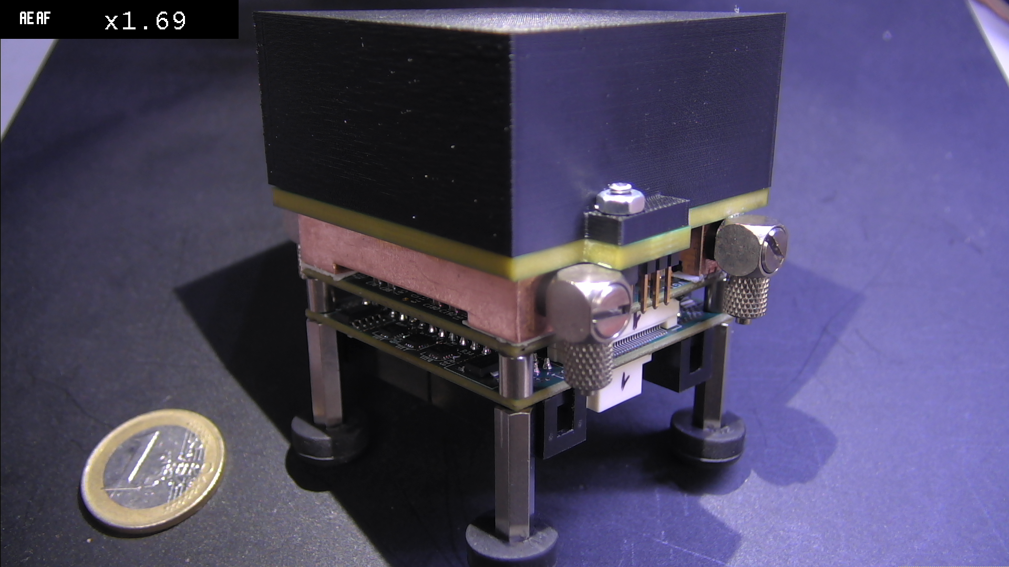
Practical Issues in PET instrumentation
SiPM coupled to crystals
- single crystal
- PET configuration
Piergiorgio Cerello

Slide 2
Range Monitoring / INSIDE
Time-resolved image reconstruction
day 1
day 2
Measured activity
V. Ferrero et al., “Online proton therapy monitoring: clinical test of a Silicon-photodetector-based in-beam PET”
Scientific Reports, (2018) 8:4100 | DOI:10.1038/s41598-018-22325-6

Slide 3
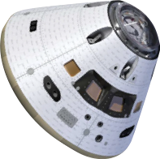
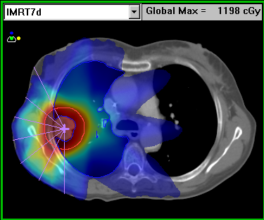
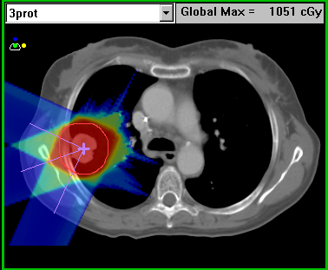
Target Fragmentation / FOOT
Particle therapy
Spacecraft shielding
BEAM

Slide 4
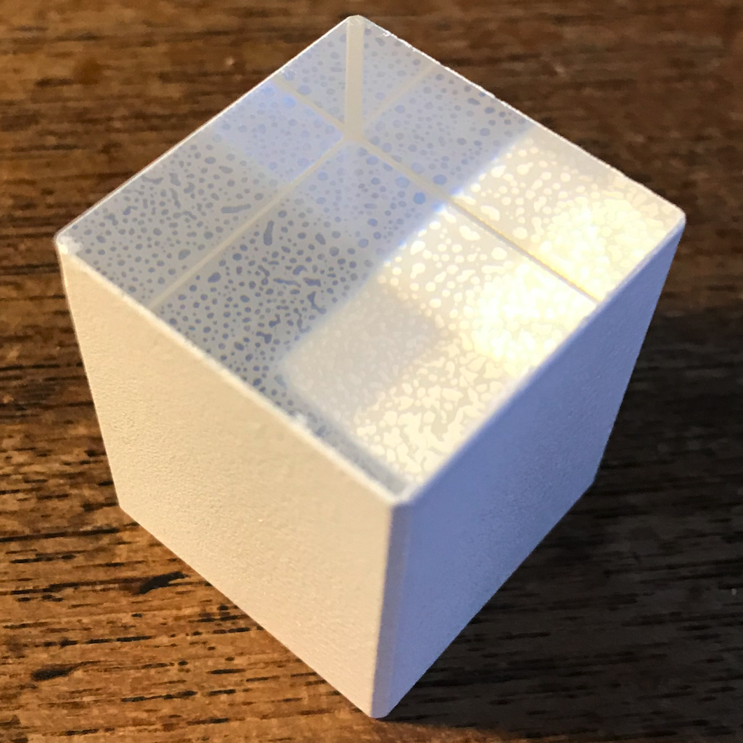
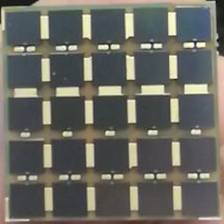
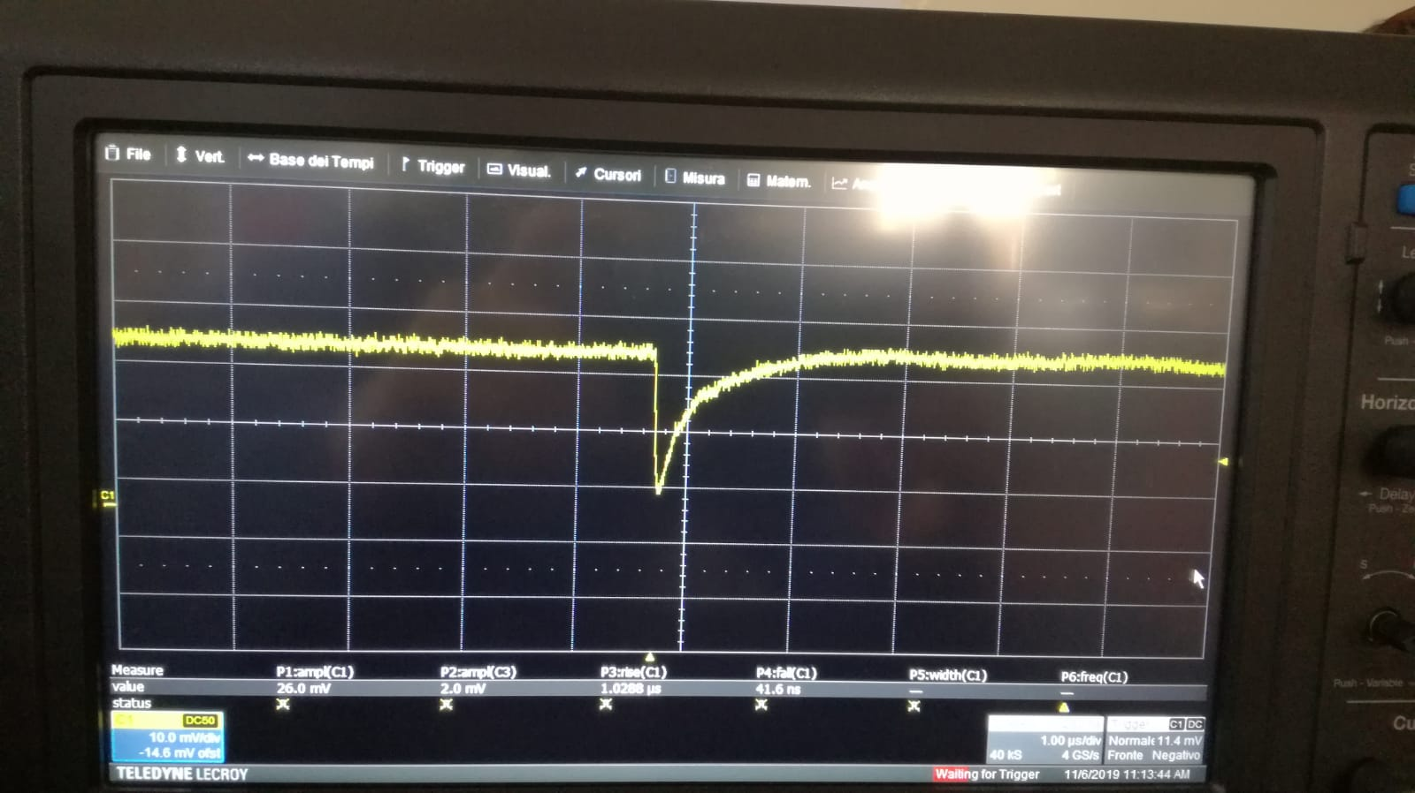
Single Crystal
Objectives
SiPM concept and basic parameters
A simple setup for cosmic rays detection
Notes:
4

Slide 5
Single Crystal
BGO Crystal
SiPM tile + front-end board
CAEN V1742 digitizer
DAQ system
Oscilloscope
Notes:
5

Slide 6
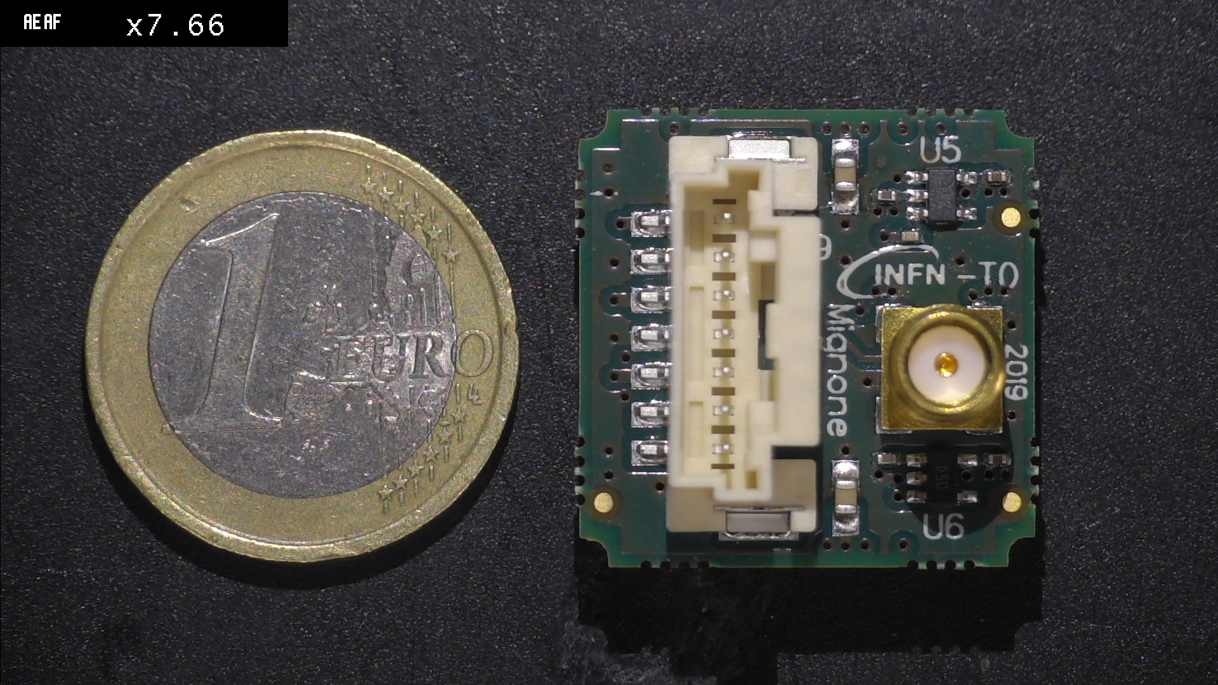
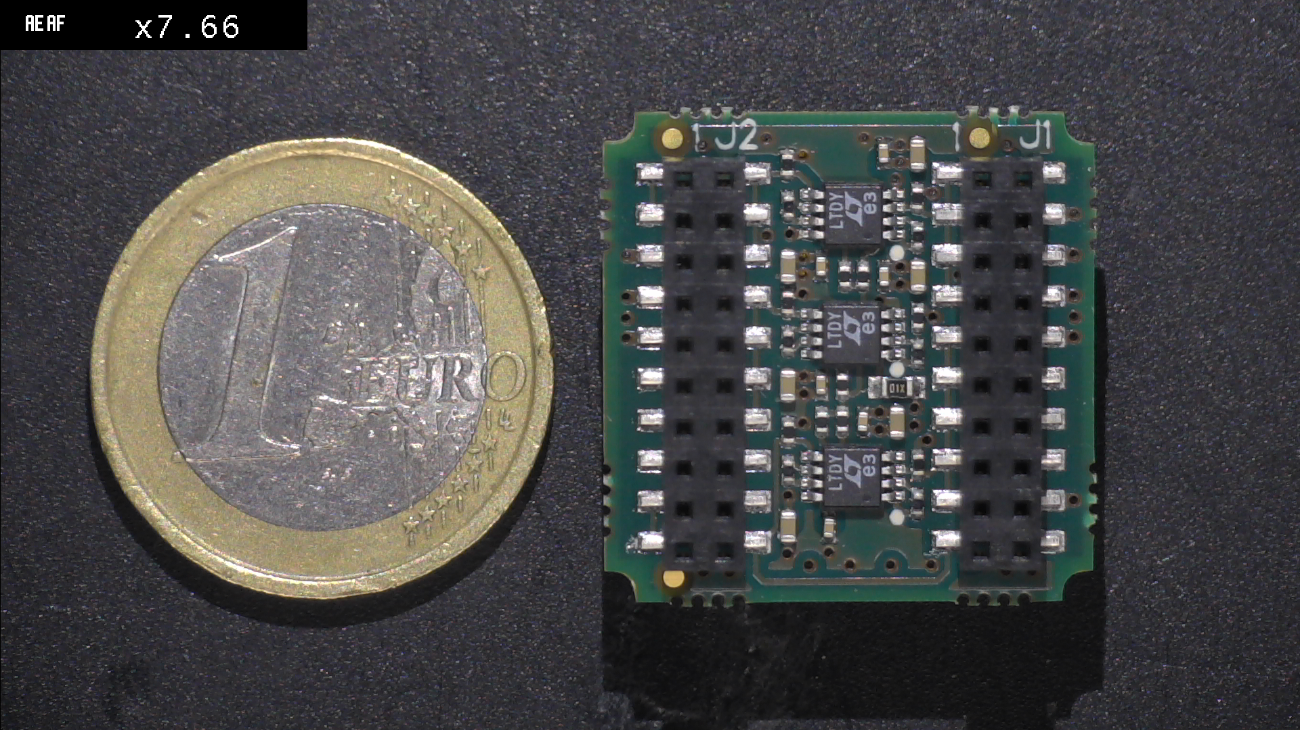
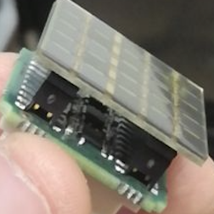
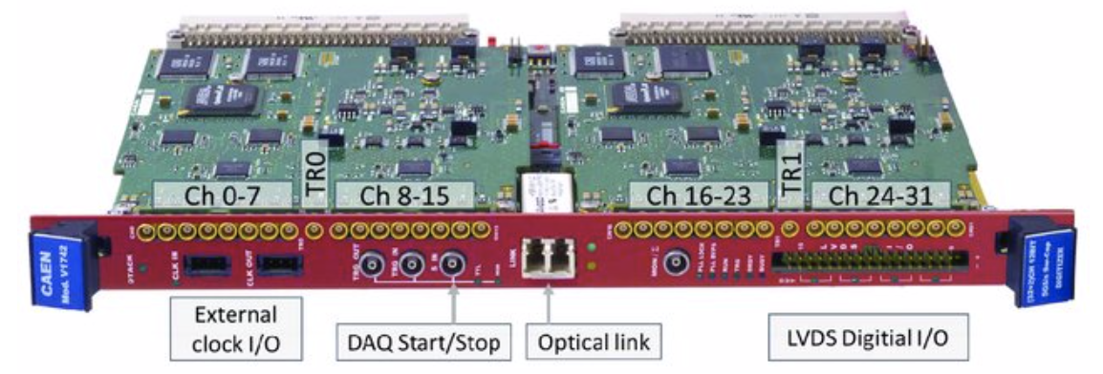
Single Crystal
Program: from the crystal to the signal
Notes:
6

Slide 7
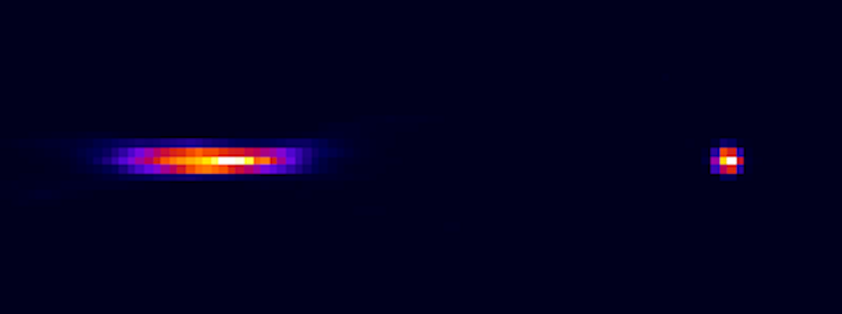
PET configuration
Objectives
e⁺e⁻ annihilation detection
energy spectrum, reconstruction
effect of Depth Of Interaction
Notes:
7

Slide 8
PET configuration
²²Na source
2 PET modules + front-end boards
FPGA
DAQ system
PC for image reconstruction
Notes:
8

Slide 9
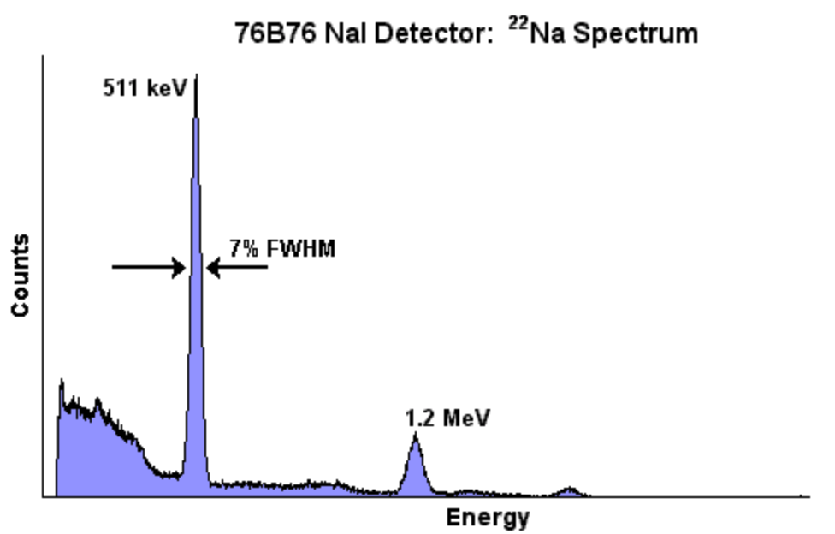
PET configuration
Program: PET detection and reconstruction
Notes:
9

Slide 10
People
Stefano Argiro’
Nazar Bartosik (Post-doc)
Piergiorgio Cerello
Elisa Fiorina
Francesco Pennazio
Lorenzo Scavarda (Ph.D.)
Notes:
10

