Slide 1
The coating thermal noise R&D for the 3rd generation: a multitechnique investigation
E. Cesarini^{1,2)}, M.Prato³⁾, M. Lorenzini²⁾
Università di Urbino
INFN Firenze
INFN Genova
on behalf of CoaCh collaboration

Slide 2
The CoaCh project
Single layer
sample set
Substrate with a single layer of Ta₂O₅ , crafted to enhance the layer characteristics and to be easily handled
Characterization
Modeling
Hints for
Production/
Post-production
Mechanical, bulk, optical, surface and interface properties
Modification/ alteration
Global alterations :
Thermal processing/annealing in vacuum or controlled atmosphere
EM radiation exposure (X-rays, UV)
Local alterations :
Laser heating/damaging
Ion implantation
New samples

Slide 3
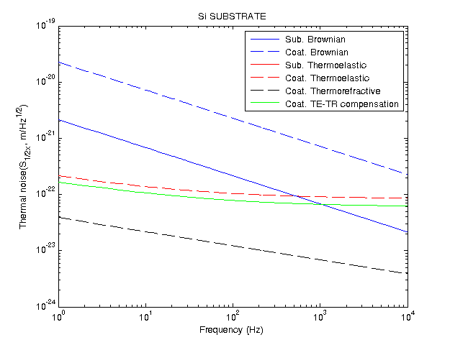
The CoaCh for the 3rd generation
Higher Brownian Noise
Simulation at 18K
see talk J. Franc or ET-021-09
High Brownian Coating Noise

Slide 4
Facilities
Properties |  | Description | Facility
Chemical | Bonding state | To evaluate the presence of dangling bonds or the oxidation state | XPS in Genova
Structural | Short range ordering | To quantify the degree of amorphousness | SEM (Modena/Pisa)
 |  |  | XRD in Pisa
Tribological | Roughness | Nano and micro scale | AFM in Genova
Optical | Index of refraction | 245-1700 nm | SE in Genova
Thermal | Conductivity | Thermal conductivity 4 K | Firenze
Mechanical | Young’s modulus and density | Measured through the effects on mode frequencies | Q measurement setup/AFM
 | Mechanical loss | Loss angle measurements | Q measurement in FI PG & PD (Low & Cryo T)

Slide 5
Preliminary results on 200 nm Ta₂O₅ mono-layer
Q-measurements facility in Firenze
Annealing treatment in vacuum
SE analysis in Genova
XPS analysis in Genova
Future upgrades

Slide 6
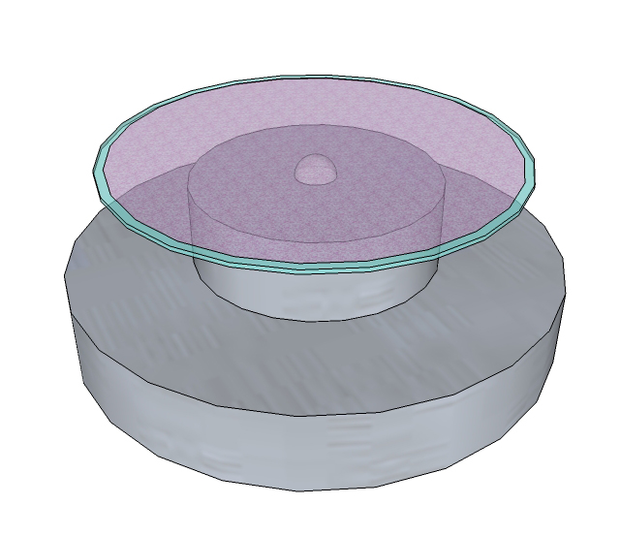
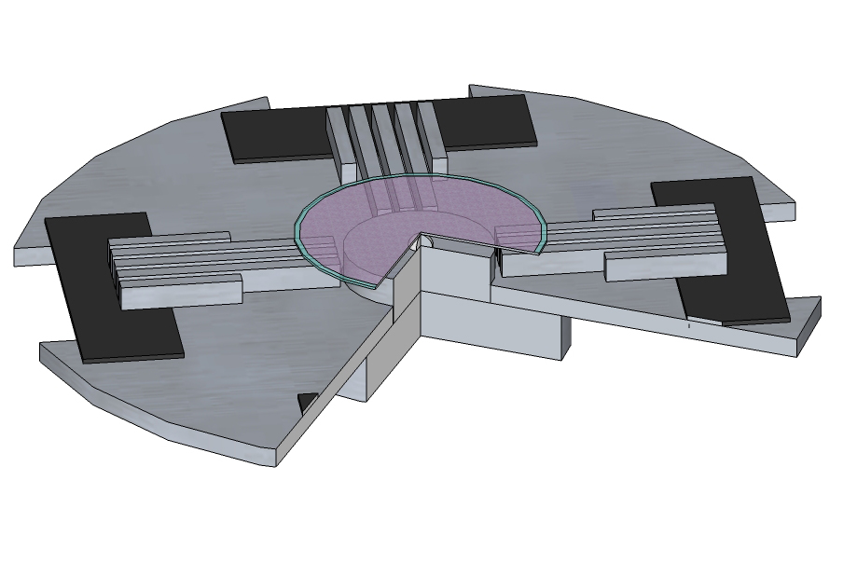
Q measurements with GeNS
equilibrium condition:
D>t
GeNS (INFN FI) Q measurements at room temperature with a nodal suspension controlled in temperature
The reproducibility between two different suspensions is within 20%
Q value is not depending on suspension point
The deposited coating is preserved
Maximum measured Q value for a thin disk is about 20∙10⁶
E. Cesarini et al. REVIEW OF SCIENTIFIC INSTRUMENTS 80, 053904 (2009)

Slide 7
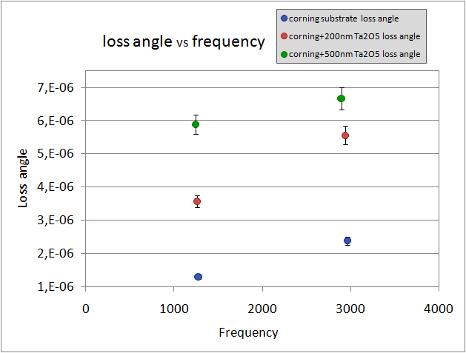
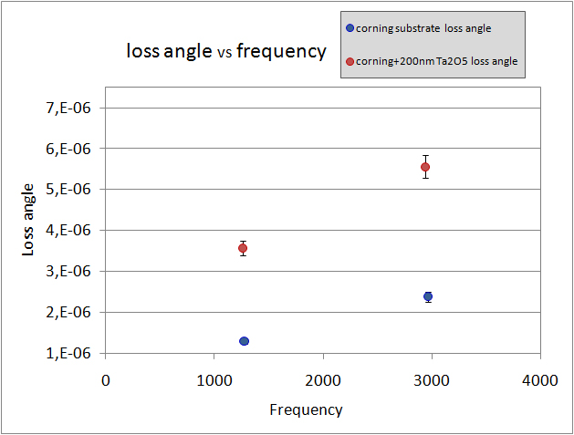
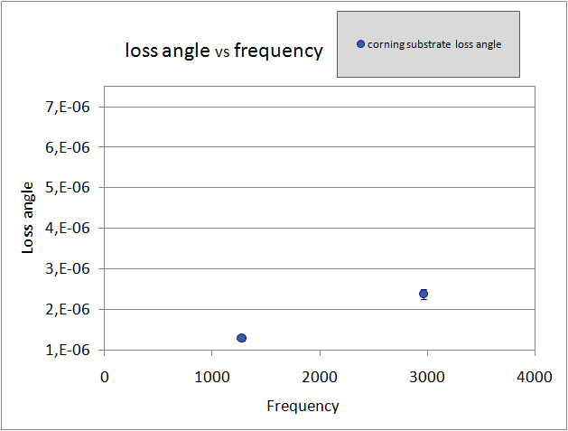
Q measurements with GeNS
CORNING substrate
+
Ta2O5 mono-layer ion beam sputtered by ATFilms
Substrate+500nm
Ta2O5 loss angle
Substrate+200nm Ta2O5 loss angle
Substrate loss angle

Slide 8
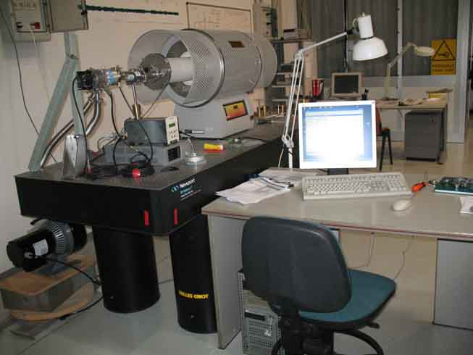
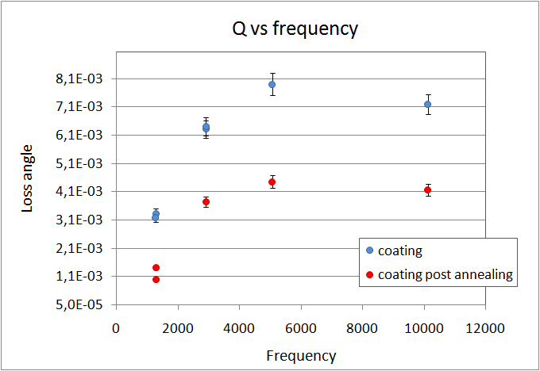
Annealing treatment in vacuum
TUBE
FURNACE
Loss angle vs Frequency
VACUUM
SYSTEM
ANNEALING CURVE
500 °C
for 1 h
SLOW COOLING
HEATING
WHY 500°C ?
From literature amorphous Ta2O5 crystallised at ≈650°C so we made a conservative choice
Martin et al. Class. Quantum Grav. 26 (2009) 155012
Martin et al. Class. Quantum Grav. 25 (2008) 055005
NATURAL
COOLING

Slide 9
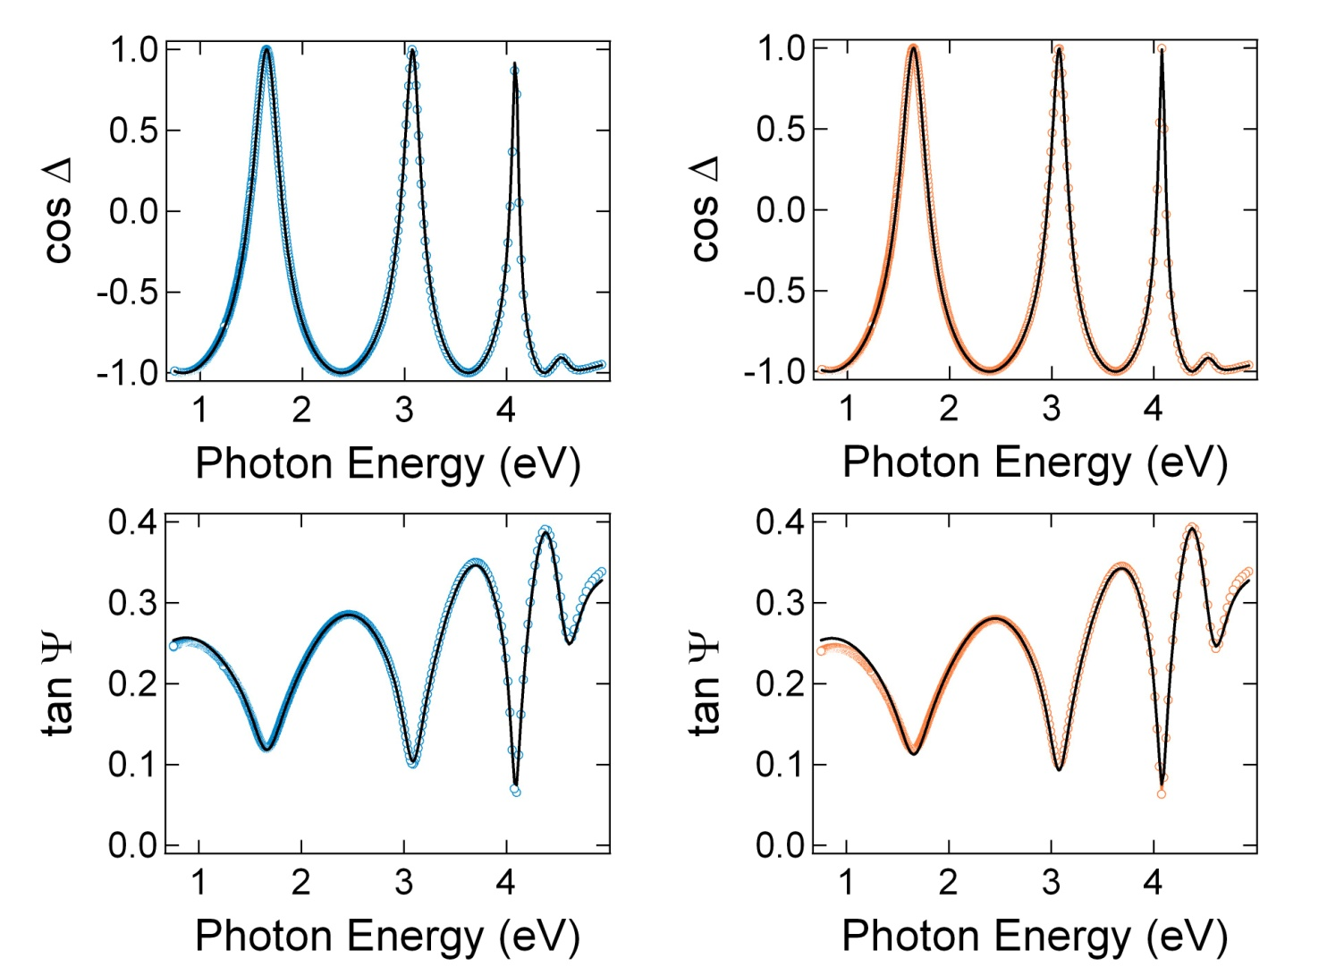
SE analysis
OPTICAL MODEL FITTED
not annealed disk:
annealed disk:
BEFORE ANNEALING AFTER ANNEALING
SE studies the polarization of the beam reflected by the specimen
Surface roughness d = 1.6 nm
Ta₂O₅ – thickness = 196 nm (20÷40 nm 1-2% voids layer)
Corning substrate
Surface roughness d = 0.9 nm
Ta₂O₅ – thickness = 196 nm (20÷40 nm 1-2% voids layer)
Corning substrate
Fresnel reflection coefficients

Slide 10
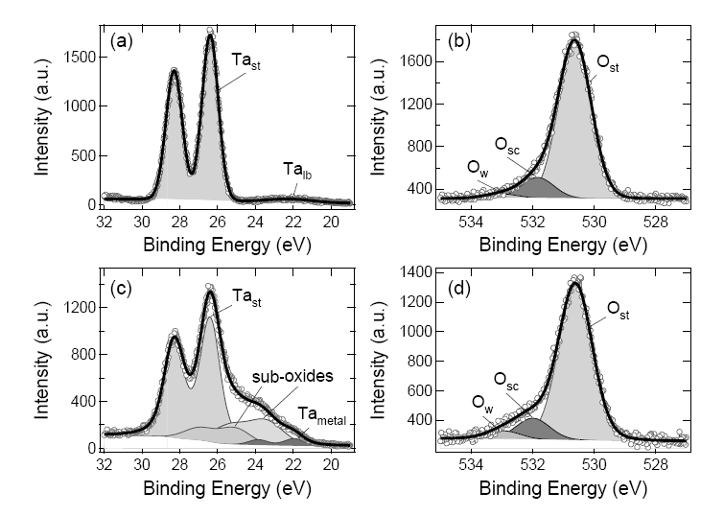
XPS analysis
X-Rays Photo-electron Spectroscopy (XPS) used to study the chemical composition of the surface
High resolution image of Ta4f and O1s peak
metallic Tantalium
Ta₂O₅ 200 nm amorphous layer
NO CHANGING AFTER THE ANNEALING
Ta₂O₅ amorphous powder

Slide 11
further possible investigation
Control of the structural properties XRD (Pisa, M. Tonelli)
Direct measurement of the layers thickness to fit the optical properties (Modena, Pisa SEM)
Changing of the Annealing procedure:
Annealing temperature
Quick cooling rate to preserve amorphous structure

Slide 12
Upgrades
GENS at cryogenic temperatures (see talk by M. Lorenzini), silicon substrates
Furnace chamber to connect to XPS machine, to control any chemical structure changes during the heat treatment
Possibility to introduce a small cryostat to cool the sample during SE analysis to investigate optical properties at low temperature
Introduction of the possibility to do annealing in a controlled atmosphere (e.g. N2)
Correlation with structural properties

Slide 13
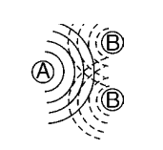
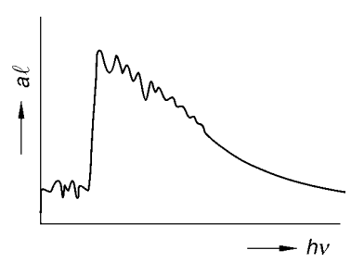
EXAFS
Extended X-ray absorption ﬁne structure spectroscopy
This powerful technique for probing the local structure . It gives information on the number and chemical identities of near neighbours and the average interatomic distances up to 5-6 Å
interference between scattered photons and photons reflected by neighbouring sites
The X-ray source is synchrotron radiation, allowing the EXAFS technique to be used for atoms in any aggregation state (solid,
liquid or gas) in all kinds of environment: crystalline solids, glasses, amorphous phases, liquids and solutions.
ABSORPTION
Threshold behaviour

Slide 14
Conclusion
A multi-technique approach (CoaCh project) on coating thermal noise problem is on-going for 2nd and 3rd generation of GW detectors
First preliminary results can be useful to understand which properties to correlate and which analyses are needed
Upgrades of set up are beginning

