Slide 1
Optimization of thermal noise
for ET-LF sensitivity
Keiko Kokeyama
University of Birmingham
ET meeting @ Jena, Germany, 1-3 March 2010

Slide 2
Contents
Thermal Noise (TN) Estimation
1. Suspension TN
Thermal conductivity of silicon fiber
Including the coating TN, optimization of temperature and fiber diameter
Optimization of suspension length
2. Thermoelastic Noise
arm cavity power
Summary
0/13

Slide 3
Suspension TN estimation
Mathematical formula of suspension TN
d: fiber diameter
T: temperature of the test mass
lsus: suspension length
d (suspension fiber diameter) appears as a cross section area
d has to be enough strong
Fibers have to take away the heats due to the arm power
Heat flow depends on d, T
Heat flow
20 mW
Arm power 20kW
Coating absorption
1ppm
1/13
Notes:
n, E wire , lsus, πηι wire are the number of wire, Young‘s modulus, suspension length, loss angle.
E.g., when the arm cavity of 20 kW and the absorption of the coating is 1ppm, the fibers must bring 20 mW
Thermal flow of the fiver depends on thermal conductivity, etc.

Slide 4
To choose fiber diameter
We need thermal conductivity κ of silicon
Heat flow:
κ should depend on a fiber diameter, as well as the temperature, and it has not been measured experimentally yet (Experimental data of κ is available only for bulk silicon)
We drive thermal conductivity κ analytically using Debye model
c.f.) experimental data of sapphire is available
2/13
Notes:
K is the thermal flow
How much K required is determined by the arm power and the coating absorption as I showed in the last page
K depends on d square and the thermal conductivity, and the thermal conductivity also depends on d.
Experimental data is not available yet
We derive kappa from debye model

Slide 5
Thermal conductivity by Debye model
Debye Model
Phonons of crystal get scattered by several reasons and the scatterings disturb the thermal propagation inside the material
When scatterings are big, heat propagation is prevented
Thermal conductivity
[1]
In this model, mean free times are shorten by…
Phonon scattering (high temperature)
Impurity scattering (low temperature)
Boundary Scattering
[1] D. Morelli et al, Phys. Rev. B, 66, 195304 (2002)
3/13
Notes:
τ_{C}, τ_{N}, … are the mean free times. This relaxation time is affected by scattering between phonons of silicon crystal. (Heat can propagate when phonon scatterings are low) Mean free times are shorten by various scattering source
1. Normal Scattering … phonons are collide with low kinetic momentum
2. Umklapp Scattering … phonons collisions with high kinetic momentum
3. Isotope Scattering … isotope atoms occurs scattering
4. Boundary Scattering … phonons are scattered by the walls of fiber. When the low temperature and other scattering are small, the boundary scattering comes to be dominant. It fiber diameter dependence

Slide 6
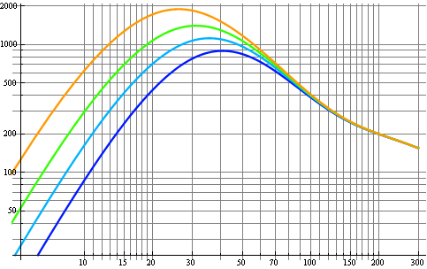
Scatterings and κ
2000
This is a theoretical model. It will be replaced by experimental data.
1000
Thermal conductivity [W/K/m]
100
500 um
1 mm
2 mm
5 mm
10
10 20 30 100 200
Temperature [K]
4/13
Notes:
is Glasgow doing?
Assuming 1.2mm and 12K lower mass temperature, th hermal flow of 20mW is accomplish -> 1ppm

Slide 7
Scatterings and κ
2000
This is a theoretical model. It will be replaced by experimental data.
1000
Thermal conductivity [W/K/m]
100
500 um
1 mm
2 mm
5 mm
10
10 20 30 100 200
Heat flow
Temperature [K]
e.g. 12K, 2mm → 20mW extraction
We start the parameter optimization.
4/13

Slide 8
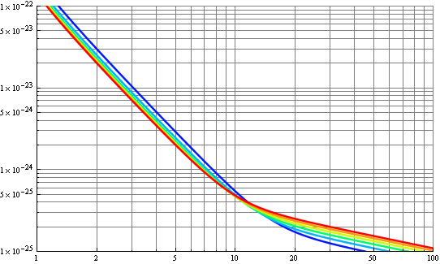
Optimization – temperature
Parameter tradeoff:
When T is increased, K becomes larger – d can become smaller – suspension TN is decreased
On the other hand, the coating TN is increased by temperature increasing
20kW, 1m suspension TN + coating TN
10⁻²²
suspension TN
10⁻²³
Sensitivity [1/sqrtHz]
12K
16K
20K
24K
28K
32K
10⁻²⁴
coating TN
10⁻²⁵
1 10 100
Frequency [Hz]
5/13

Slide 9
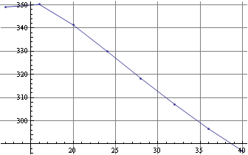
Optimization scale
We used a range for 200-solarmass black hole binary as a scale
When lsus=1m
Inspiral Range [Gpc]
15 20 25 30 35 40
Temperature [K]
16K is the best
6/13
Notes:
20 kW

Slide 10
Optimization scale
We determine the temperature by a range for 200-solarmass black hole binary
When lsus=1m
Inspiral Range [Gpc]
15 20 25 30 35 40
Temperature [K]
16K is the best
smallest d is chosen
6/13
Notes:
20 kW

Slide 11
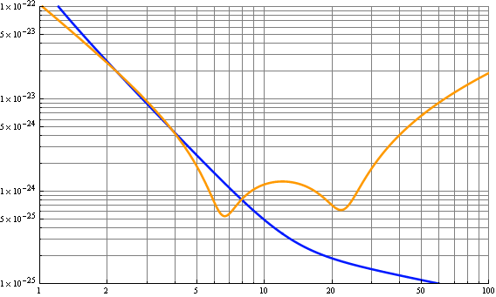
Optimization – Length
20kW, 16K
10⁻²²
16K, 1.44mm, 1m
10⁻²³
QN
Sensitivity [1/sqrtHz]
10⁻²⁴
coatingTN
10⁻²⁵
1 10 100
Frequency [Hz]
Suspension length should be changed
7/13

Slide 12
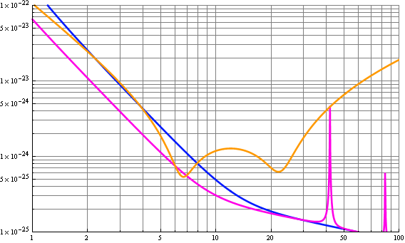
Optimization – Length
20kW
10⁻²²
16K, 1.44mm, 1m
10⁻²³
QN
Sensitivity [1/sqrtHz]
lsus=3m
10⁻²⁴
16K, 2.14mm
10⁻²⁵
1 10 100
Frequency [Hz]
3m suspension is ok compared with QN
8/13

Slide 13
Small summary and a next step
Procedure to choose suspension + coating TN parameters
Optimal temperature for best inspiral range considering suspension and coating TN
smallest fiber diameter is chosen
Suspension length not to disturb QN
Thermoelastic noise
has to be taken into account
9/13
Notes:
because when you increase the arm power, the heat flow to be extracted will become bigger – higher temperature may be employed -> thermo elastic noise may become high

Slide 14
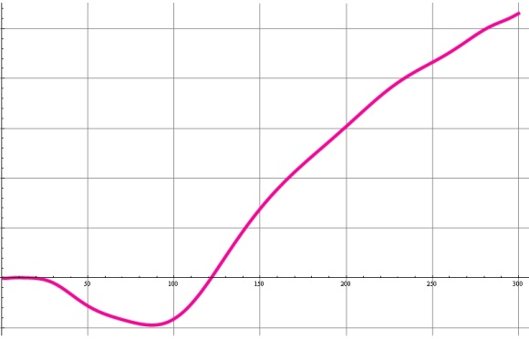
Thermo Elastic Noise
Thermoelastic noise formula [2]
Thermal expansion rate
Thermal expansion data
2.5 10⁻⁶
2.0 10⁻⁶
1.5 10⁻⁶
1.0 10⁻⁶
5.0 10⁻⁷
0
-5.0 10⁻⁷
0 50 100 150 200 250 300
Tenperature [K]
[2] M. Cerdonio et al, Phys. Rev. D, 63, 082003 (2001)
10/13

Slide 15
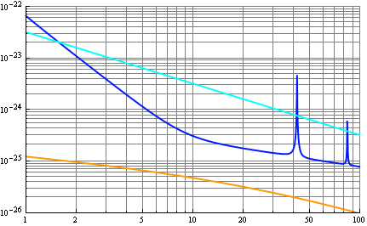
Sensitivity Curves
10⁻²²
20 kW
10⁻²³
SQL
10⁻²⁴
Sensitivity [1/sqrtHz]
S+C TN 3m 16K
TEN 16K
10⁻²⁵
10⁻²⁶
1 10 100
Due to the small thermal expansion rate,
thermoelastic noise is good at 16 K
Different an arm cavity power?
11/13

Slide 16
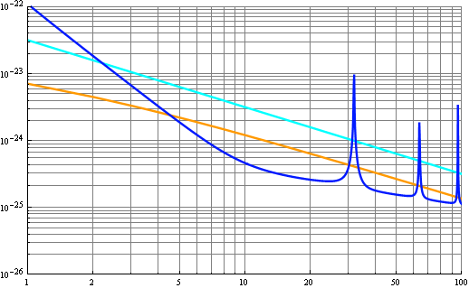
Sensitivity Curves
10⁻²²
20 kW
10⁻²³
SQL
10⁻²⁴
Sensitivity [1/sqrtHz]
S+C TN 3m 16K
TEN 16K
10⁻²⁵
10⁻²⁶
1 10 100
10⁻²²
200 kW
10⁻²³
SQL
Arm cavity power
should be optimized
considering QN
10⁻²⁴
Sensitivity [1/sqrtHz]
S+C TN 3m 32K
TEN 32K
10⁻²⁵
10⁻²⁶
1 10 100
Frequency [Hz]
12/13

Slide 17
Summary
For ET-LF
We discussed how to choose the optimal TN parameters for d, T, lsus
200 MS BH binary inspiral range as a scale to choose T
d was optimized for the chosen T
lsus was chosen not to disturb QN
Arm cavity power has to be chosen including QN
Other aspect
Ribbon suspension can be an alternative as it can have a lager cross section area the more heat flow may be accomplish
13/13
Notes:
3m monolithic fiber may not be available

Slide 18
Thank you.

Slide 19
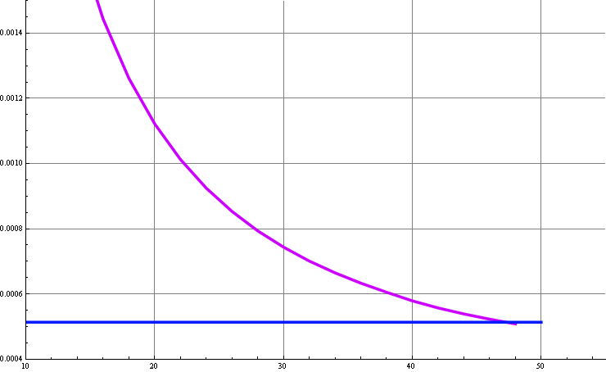
1.4
a
20 kW
1.2
Strength limit
Wire diameter from
thermal flow requirement
1.0
Fiber diameter requirement satisfying a thermal flow for 20 kW arm power and strength requirement
Fibediameter [mm]
0.8
0.6
0.4
10 20 30 40 50
Temperature [K]

Slide 20
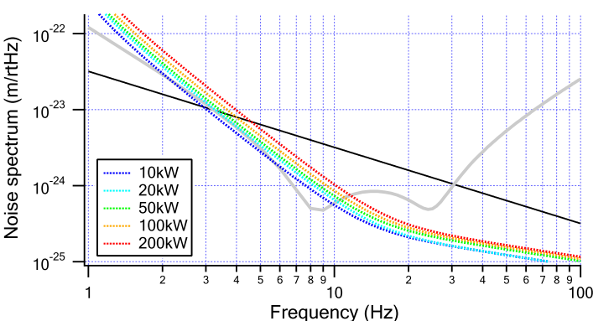
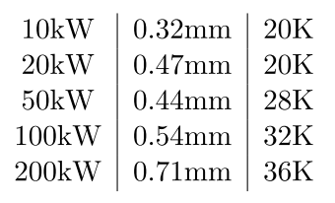
Ribbon

Slide 21
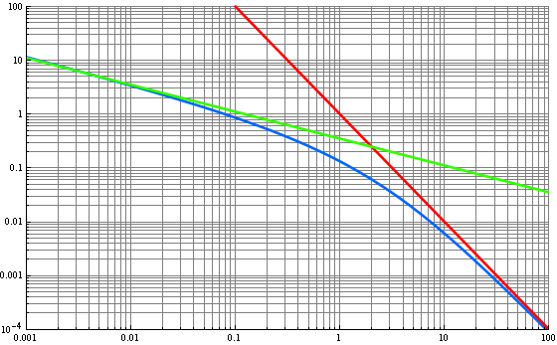
Thermo Elastic Noise
Thermoelastic noise Formula [1]
J(Ωc) can be approximated;
J(Ωc)
Ωc
[1] M. Cerdonio et al, Phys. Rev. D, 63, 082003 (2001)
11/14

