Slide 1
Cygno PubComm update
Depositing in OA archives prior to publication
E.Baracchini, S.Bianco, E. Di Marco, G. Maccarrone
2020.04.23

Slide 2
Lots of good reasons to follow the principles of Open Access to the results of publicly funded research
  Ethics
  Subscription expenses (now market is oligopolistic)
  EU recommendations
  Italian laws
  Research Evaluation (VQR)
  Plan S (signed by INFN)
  INFN at the forefront of OA movement (SCOAP3, Plan S, etc)
    Info ? INFN OA Working Group R.Barbera, S.Bianco, M.Maggi, D.Menasce, L.Patrizii
      http://home.infn.it/it/open-access

Slide 3
Green Open Access
“Subscription” MODEL
  Publish preprint to OA repository
  Submit to subscription journal, get it accepted
  Wait 0/6/12 months before submitting post-peer review version “postprint/AAM” to OA repository
  Pay Article Processing Costs (APC) and publish OA
  Buy subscription…
  …and also pay APC
Gold Open Access
“Article Processing Costs” MODEL
Hybrid with Double Dipping
Notes:
qualche parola sul gergo usato

Slide 4
Impact Factor
New journals has IF=0 for two years
IF Index is subject to problems (self citations, negative citations etc.)
Notes:
e’ il momento quindi di introdurre la bibliometria, fonte di parecchi mali. Indici creati con buone intezioni, ma poi messi a punto in maniera spesso surrettizia per millantare autorevolezza
l’IF ad esempio e’ zero per ogni nuova rivvitsa che volesse entrare nel mercato, cosa che rende il dominio degli oligopolisti nmolto difficile da scalfire. e’ numero adatto inoltre ad essere manipolato con una serie di tecnihe.
per la valutazione del singolo venne proposto invece l’h factor che viebe definito qui e vengono dati esempi di fisici famosi e meno famosi

Slide 5
Plan S Principles (simplified)
We are not going to pay to publish on double dipping journals
We support self archiving and zero-embargo green OA
We are not going to use Impact Factor for evaluation of research
We are going to apply the Plan S principles on new projects starting after January 1st, 2021

Slide 6
May 31st, 2019
Plan S – Implementation Guidance
The Three Roads
Open Access publishing venues (journals or platforms)
Subscription venues (repository route)
Transition of subscription venues (transformative arrangements)
Authors publish in a subscription journal and make either the final published version (Version of Record (VoR)) or the Author's Accepted Manuscript (AAM) openly available in a repository.
Authors publish Open Access in a subscription journal under a transformative arrangement.
Authors publish in an Open Access journal or on an Open Access platform.
cOAlition S funders will financially support publication fees.
cOAlition S funders will not financially support ‘hybrid’ Open Access publication fees in subscription venues.
cOAlition S funders can contribute financially to Open Access publishing under transformative arrangements.
1
2
3
gold OA
green OA
hybrid in transition
Notes:
So what is the main difficulty in outreaching researchers on plan s ? They do not have time to read. Implementation guidelines ae very clear,plan s is not only gold OA, is not author pays. There are three conformal routes…

Slide 7
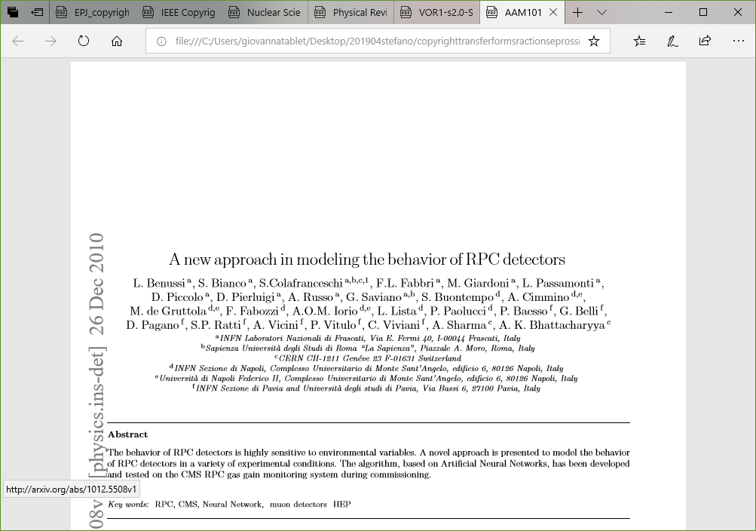
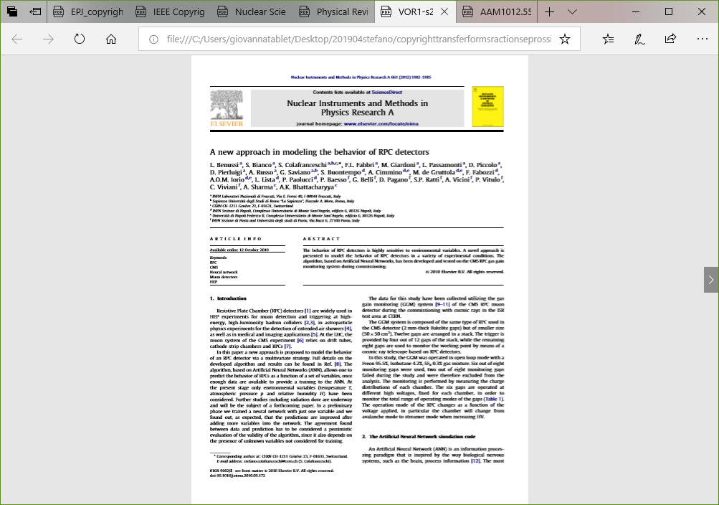
Author’s Accepted Manuscript
AAM also called «postprint»
Version Of Record

Slide 8
Openaccessrepository.it
Try it, free DOI when depositing your content
PILOT

Slide 9
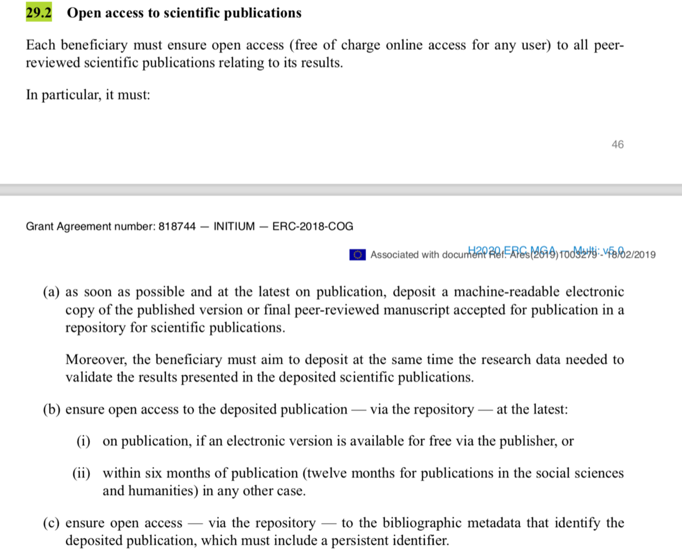
ERC request

Slide 10
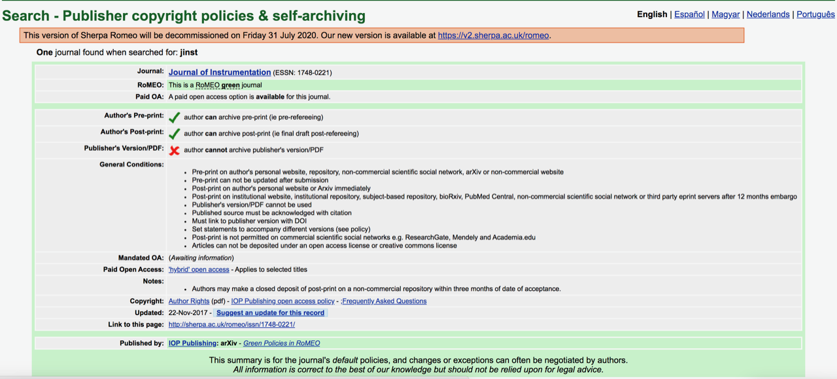
Sherpa-romeo database

Slide 11
But, JINST (IOP) Copyright Transfer Agreement https://jinst.sissa.it/jinst/help/JINST/JINST_copyrightlocked.pdf
3.3.3 Include the Article (all or part) on web sites of the
Institution (including its repository) where a
Named Author worked when research for the Article was carried out; and
3.3.4 No sooner than 12 months after publication to include the
Article (all or part) on third party web sites including e-print
servers, but not on other publisher’s web sites.
Contacts in progress to understand
this discrepancy

Slide 12
Conclusions
ERC happy if AAM immediately deposited on arXiv or openaccessrepository.it
Immediate deposit of AAM on Openaccessrepository.it always allowed
Immediate deposit of AAM on arXiv allowed by NIM/Elsevier (sherpa-romeo and CTA agree)
Immediate deposit of AAM on arXiv allowed by JINST/IOP ? (probably yes, but discrepancy sherpa-romeo vs CTA to be solved)
  If impossible, we deposit immediately AAM on openaccessrepository.it and insert a comment in the arXiv deposit (but I think this is an unlikely scenario)

Slide 13
On Plan S
S.Bianco, L.Patrizii Plan S e le società scientifiche – una rivoluzione per l'Open Access? doi 10.15161/oar.it/23537 in openaccessrepository.it

Slide 14
more

Slide 15
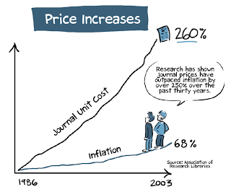
Notes:
quale e’ la crisi che ha portato al movimento Open Access ? Questione di soldi. Non ci possiamo piu’ permettere l’acquisto delle riviste scientifiche, e dipendiamo dagli stessi editori oligopolisti per valutare la nostra stessa ricerca

Slide 16
Top 5 commercial publishers
Large Revenues
No royalties paid to authors
No compensation to peer reviewers
Low cost of editing / formatting

Slide 17

Rsearch assessment, TODAY
Research assessment based on IF_{y,5} and Citations
Authors publish on journals with high IF
Peer review provided by (unpaid) scientists
ANVUR (Research assessment govern. agency) considers only journals indexed on WOS and SCOPUS
New, quality journals cannot have an IF before 2/5 years
Restrictive law on copyright will not guarantee free posting of AAM/postprint unless contractual.
Minimal editing is provided by publishers
Notes:
insomma questo e’ il circolo vizioso attuale:

Slide 18
Infn e Open Access
2007 joins SCOAP3
2013 signs MedOAnet position paper in Rome
2014 signs Messina declaration 2.0
2008 signs Berlin declaration
2010 signs Granada declaration
2018 joins Plan-S
2018 joins OA2020

Slide 19
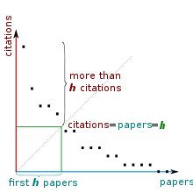
h-index
 | h-index
A.Einstein (1906) | 4
P.Higgs | 7
P.A.M.Dirac | 19
S.Bianco | 98
fonte: wikipedia
Notes:
nonperdo tempo a spiegare come funziona, perche’ e’ chiaro che non funziona
e’ chiaro a tutti che l’h non funziona ?
qualcuno ha ancora dubbi ?
no ?
bene possiamo continuare e spiegare quale e’ il processo di scrittura e valutazione dei risultati

Slide 20
Ref: S.Mele JCDL Toronto 2016
Gli utenti di arXiv sostituiscono
la versione più recente con la AAM
appena ricevuta notizia dell’accettazione
da parte della rivista

