Slide 1
LABORATORI NAZIONALI DI FRASCATI
Report on research activities for the PhD in “Accelerator Physics” (32nd cycle)
Studies and Measurements on Cavity Beam Position Monitors for Novel Electron Linacs
Student: Giovanni Franzini
Advisor: Prof. Luigi Palumbo
Co-Advisor: Prof. Andrea Mostacci
Referee: Fabio Marcellini (PSI), Ubaldo Iriso (ALBA)
12 November 2019

Slide 2
Agenda
ELI-NP GBS review
Cavity Beam Position Monitor basic concepts
Test bench design and measurements at LNF-INFN
Beam Measurements at DESY
Test bench design at SPARC
Conclusions

Slide 3
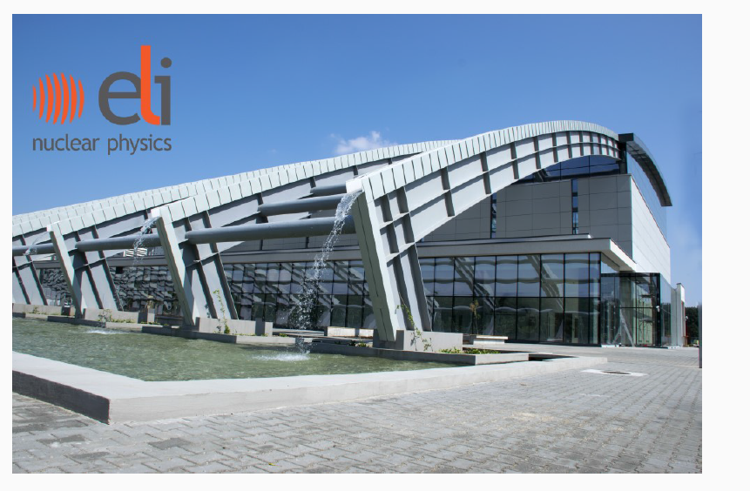
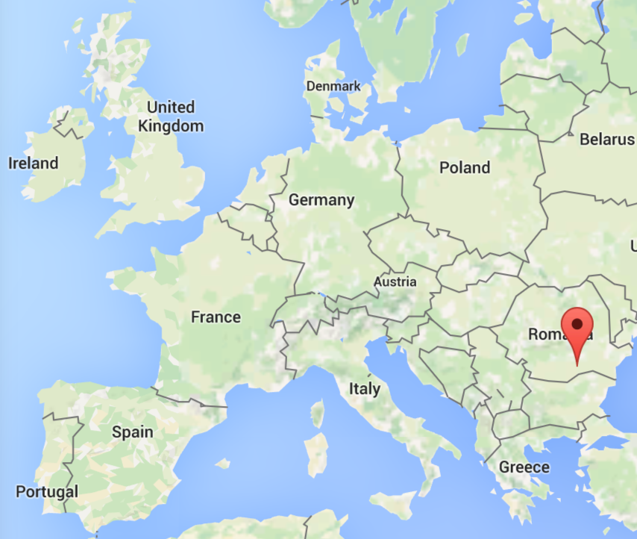
ELI-NP Gamma Beam System
ELI-NP GBS (Extreme Light infrastructure – Nuclear Physics, Gamma Beam System) is an Advanced Gamma Source for studies in new nuclear spectroscopy and new photonuclear physics.
It is a Compton back-scattering machine with a tunable energy of the gamma photons between 0.2 and 19.5 MeV, a narrow bandwidth (0.5%) and a high spectral density (>10⁴ photons/sec/eV).
The EuroGammaS consortium, led by INFN, is responsible for its development and delivery. The machine installation is halted due to a contract dispute.

Slide 4
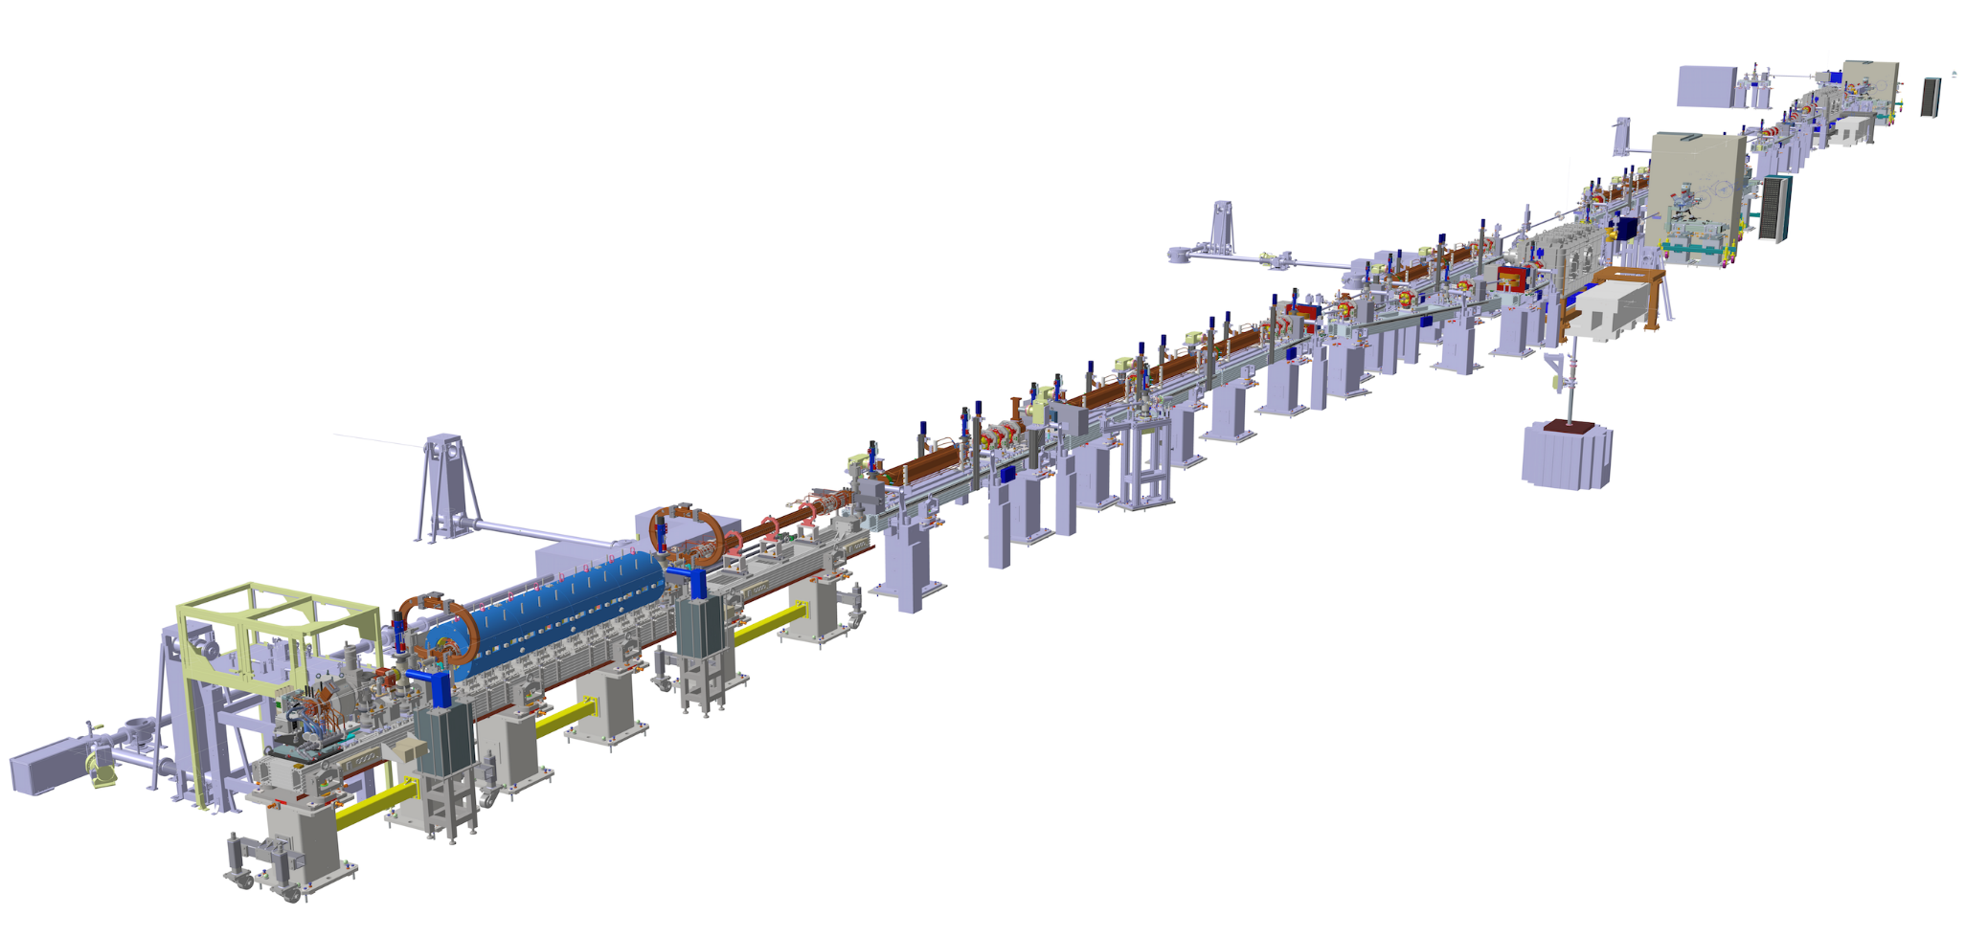
ELI-NP Layout
IP
electrons
C-Band damped structures (5.712GHz)
S-Band structures (2.856GHz)
courtesy A. Mostacci

Slide 5
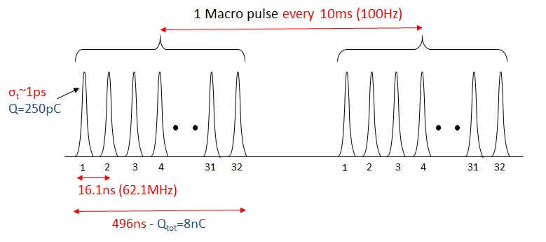
Beam Parameters and structure
Electron Beam Specifications
Parameter | Value
Max. Energy at IP [MeV] | 280 – 720
Macro Pulse rep. Rate [Hz] | 100
Number of bunches | up to 32
Bunch spacing [ns] | 16.1
Bunch length [ps] | 0.91
Bunch charge [pC] | 25-250
Bunch Energy Spread | < 0.1%

Slide 6
Interaction Point Module
Gamma Beam Specifications
Parameter | Value
Energy [MeV] | 0.2 – 19.5
Spectral Density [ph/(s·eV)] | 0.8 – 4·10⁴
Bandwidth rms [%] | ≤ 0.5
Peak brilliance [Nph/(s·mm²·mrad²·0.1%)] | 10²⁰ – 10²³
By using an optical re-circulator, a single laser pulse will collide with a multi-bunch (32) electron beam at the interaction point, generating the gamma beam by Compton back-scattering.

Slide 7
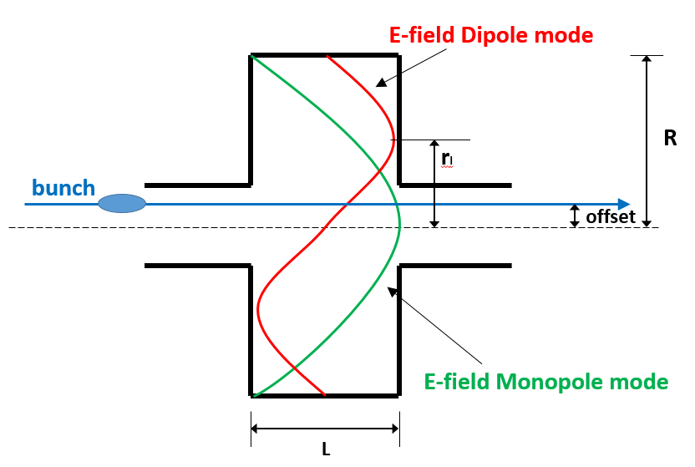
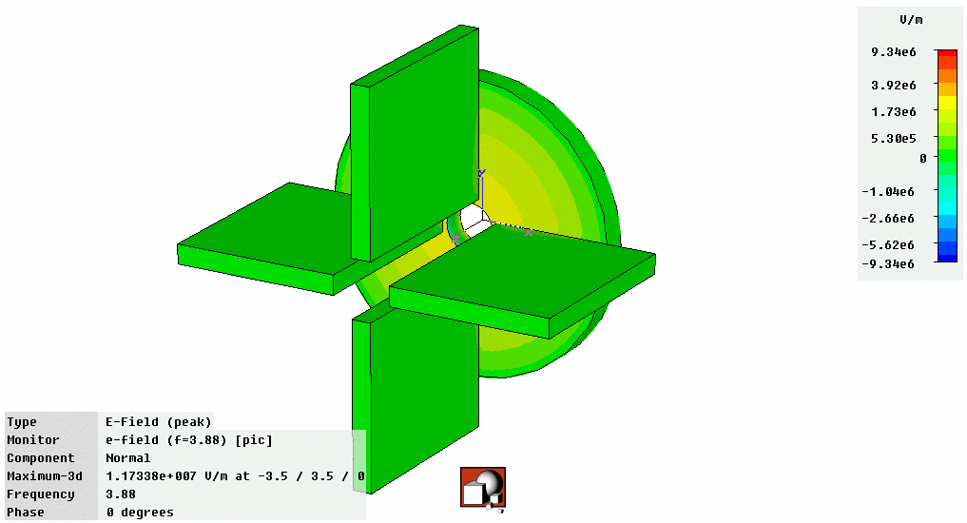
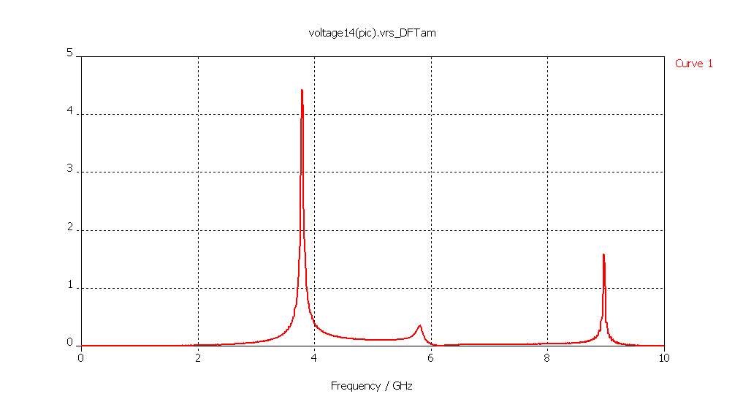
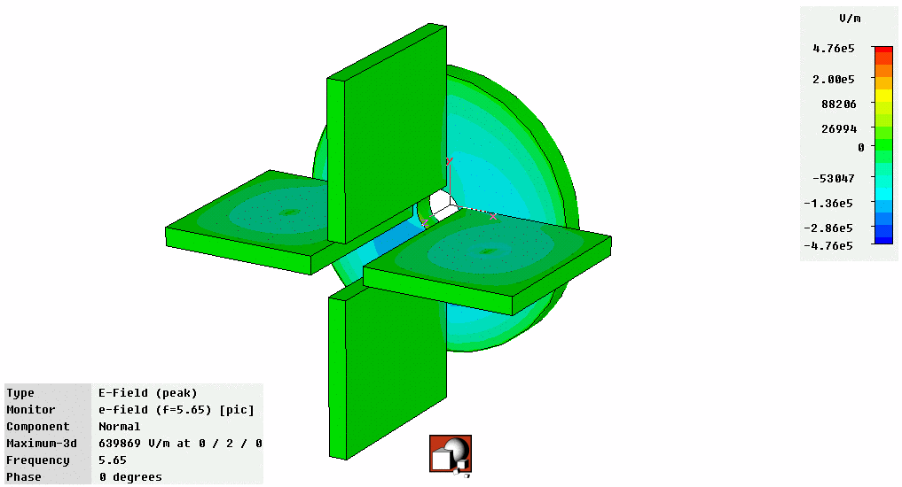
Cavity BPM (pillbox resonator)
monopole mode
dipole mode
TM010
(monopole)
TM110
(dipole)
$$v_{sig}∝i_{beam}$$
$$v_{sig}∝i_{beam}∙r$$
courtesy D. Lipka

Slide 8
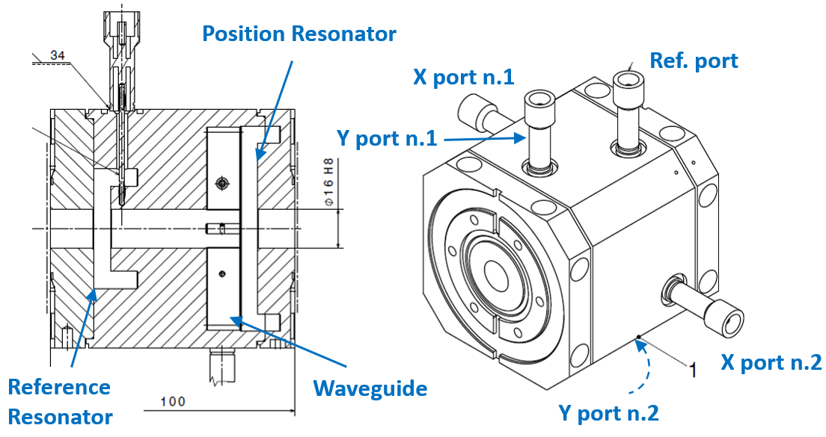
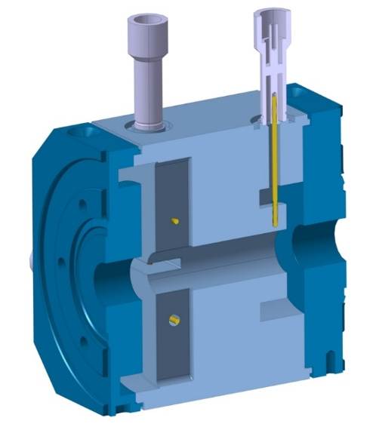
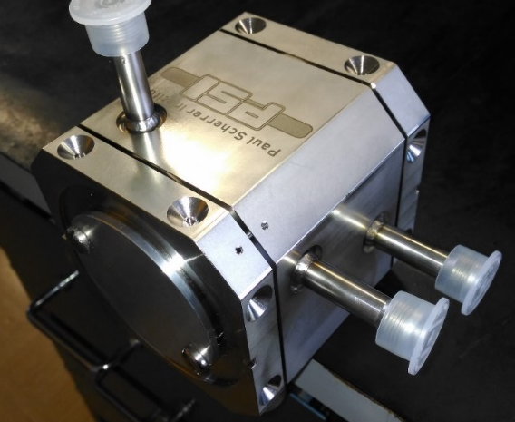
Cavity BPM (PSI BPM16 Design)
General Pickup Parameters
Parameter | Value
Material | Stainless Steel 316LN
Length [mm] | 100
Inner Aperture [mm] | 16
Distance from Pos. To Ref. Resonator [mm] | 60
Position Cavity Resonator
Parameter | Value
Gap between res. walls [mm] | 7
QL | 40
TM110 Frequency [GHz] | 3.284
TM010 Frequency [GHz] | 2.252
Position Signal [V/mm/nC] | 7.07
Angle Signal [µm/mrad] | 4.3
Reference Cavity Resonator
Parameter | Value
Gap between res. walls [mm] | 7
QL | 40
TM010 Frequency [GHz] | 3.284
Charge Signal [V/nC] | 135
Angle Signal [µm/mrad] | 4.3

Slide 9
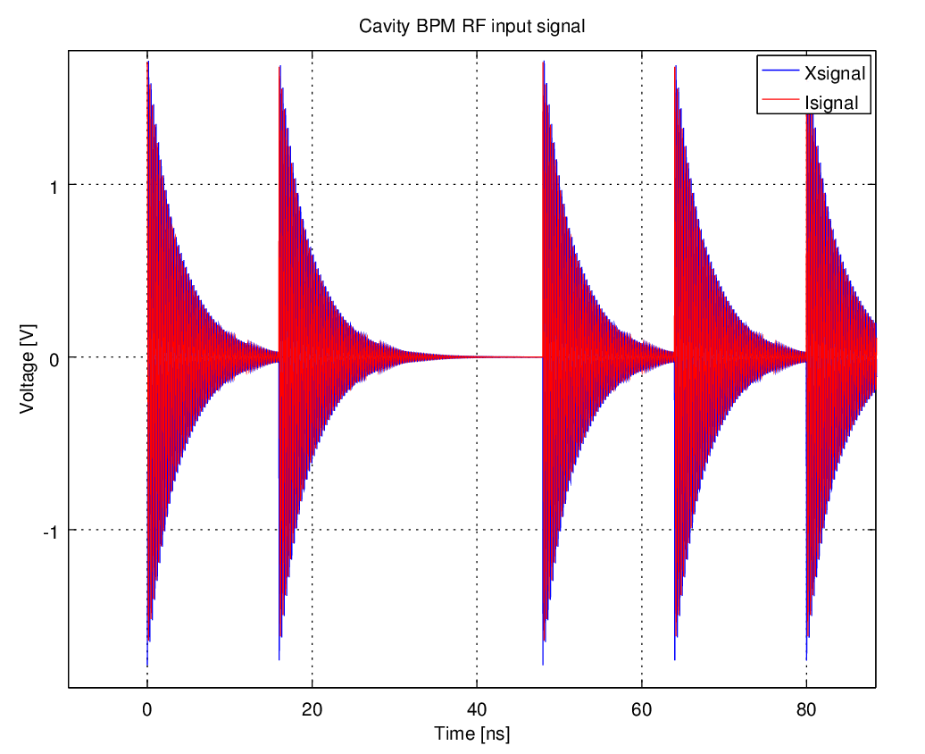
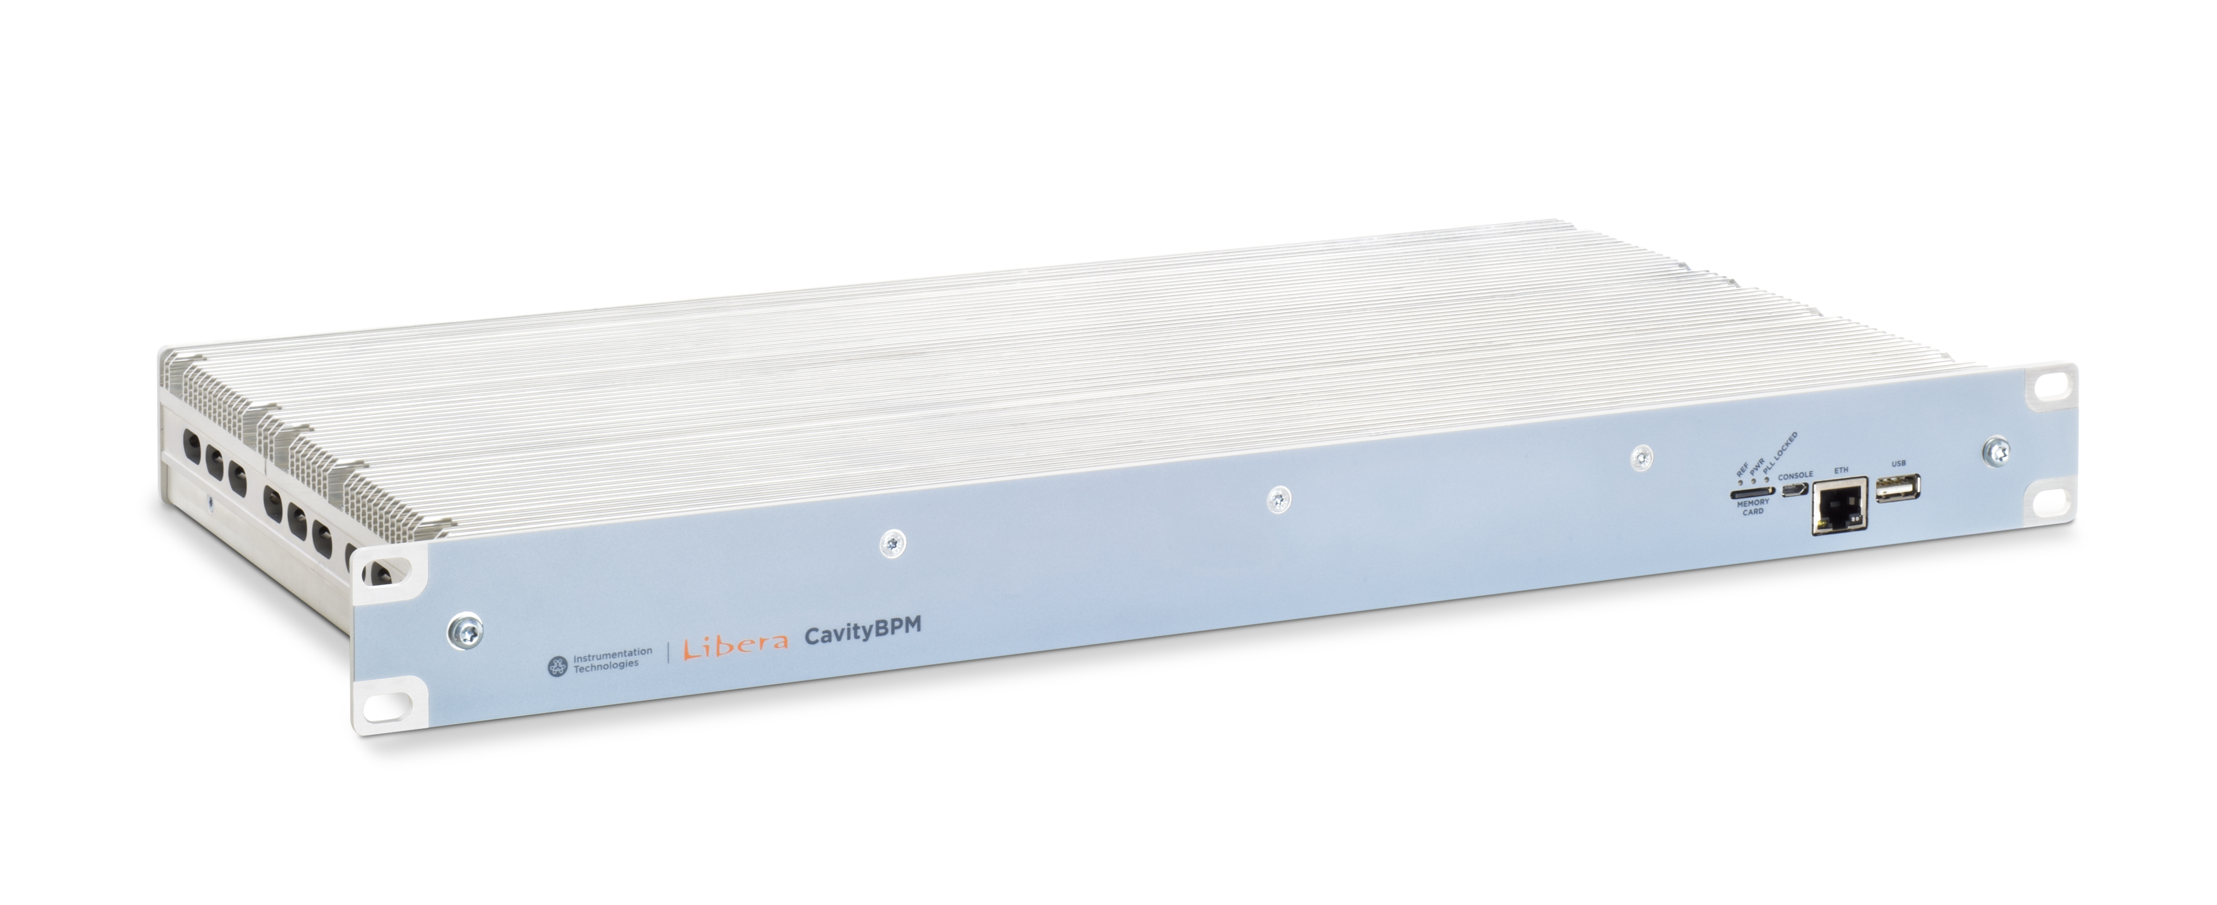
Cavity BPM
Cavity BPM
Output Signal
overlap
Libera for Cavity (Instrumentation Tech.)
ADC | 4 channels, 500MS/s, 14bit
SoC | ZYNQ 7035 / ARM Cortex A9
ADC buffer | 4kS/channel (~8us)
Variable attenuation | 31dB, channel-independent
Input signal freq. | C-band, S-band
Ref. signal freq. | Up to 250MHz
16.1 ns
…
1st bunch
2nd bunch
4th bunch
5th bunch
6th bunch
Goal: 1 μm resolution over a range of ±1 mm

Slide 10
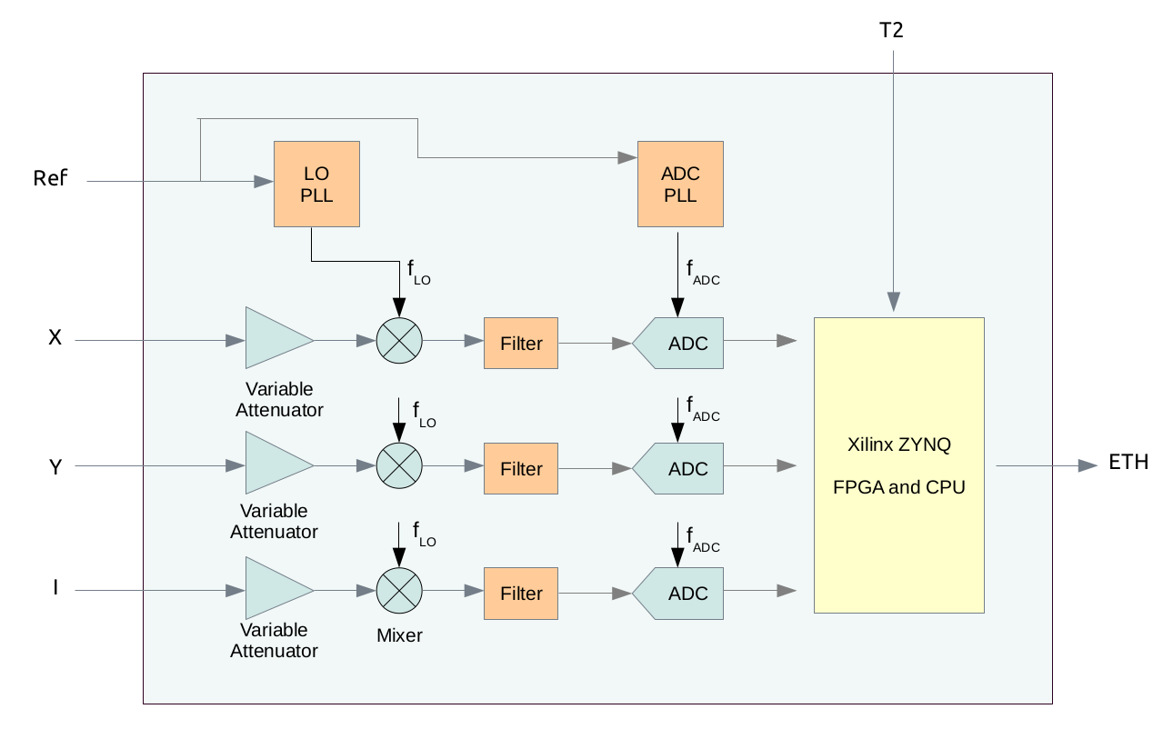
Signal processing (1/2)

Slide 11
Signal processing (2/2)
$${V_{X}}_{b}=\sqrt{\sum_{bth bunch window}{{x_{n}}^{2}}}$$
$${V_{Y}}_{b}=\sqrt{\sum_{bth bunch window}{{y_{n}}^{2}}}$$
$${V_{I}}_{b}=\sqrt{\sum_{bth bunch window}{{i_{n}}^{2}}}$$
$$X_{b}=K_{x}\frac{{V_{X}}_{b}}{{V_{I}}_{b}} Y_{b}=K_{y}\frac{{V_{Y}}_{b}}{{V_{I}}_{b}}$$

Slide 12
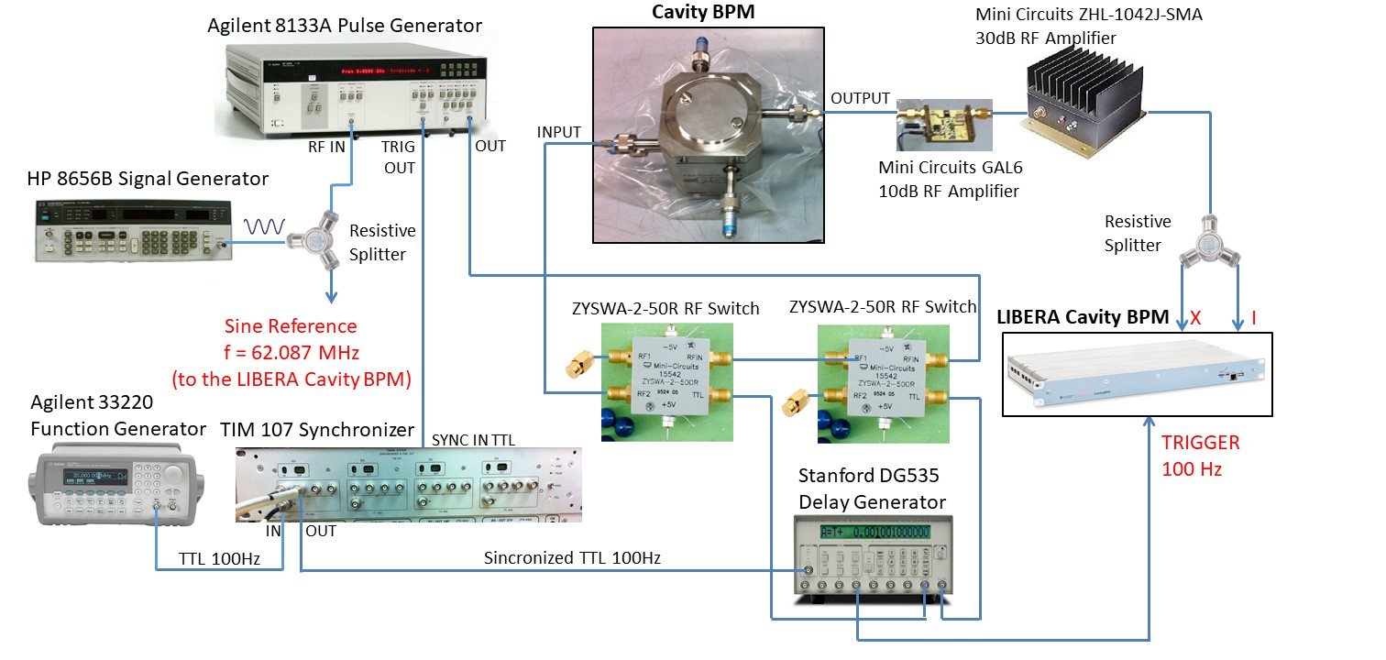
Test Bench at LNF-INFN for Cavity BPM
A pulse generator excites the “position resonator” of the cavity BPM (mimicking the passage of a beam bunch). The output signal is then split and provided to the input channels of the readout electronics.
The test bench offers the possibility to perform measurements with train of pulses, which are synchronized with the reference signal and the trigger provided to the readout electronics.

Slide 13
Some of the measurements performed
Calibration of the variable attenuators:
Results obtained: if not performed, the variable attenuators could lead to variation of amplitudes of 1dB (~12%)
Resolution measurements with sinewave signals.
Results obtained: relative standard deviation of 0.4·10⁻³ (0.4 µm over ­±1 mm)
Resolution measurements with single pulses
Results obtained: relative standard deviation of 3·10⁻³ (3 µm over ­±1 mm). The resolution is worse than the sinewave case, mainly due to the fact that we were not exploiting all the input available range of the readout electronics.
Resolution measurements with trains of pulses
Results obtained: similar values of relative standard deviation as the single pulse case. Bad synchronization between the ADC clock and the bunches could lead to accuracy problems.
Stability over time
Results obtained: temperature could lead to amplitude variation of the signals in the order of 5%. Nevertheless the effects on the signals ratio is negligible.
CONCLUSIONS: Resolution of 1 µm over ­±1 mm can be achieved, but measurements in presence of the beam are required.

Slide 14
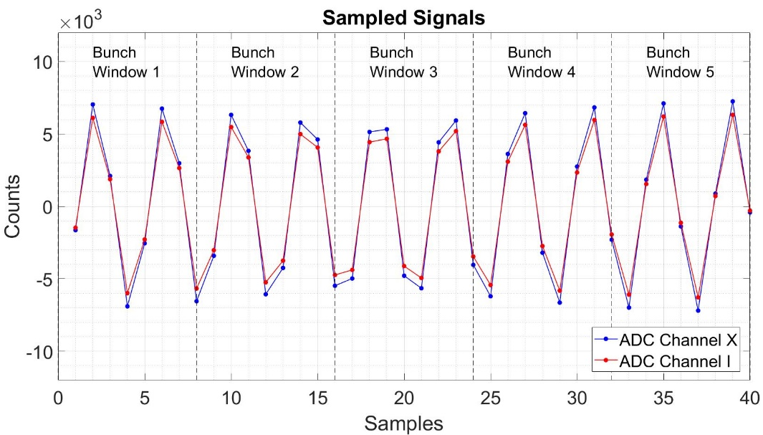
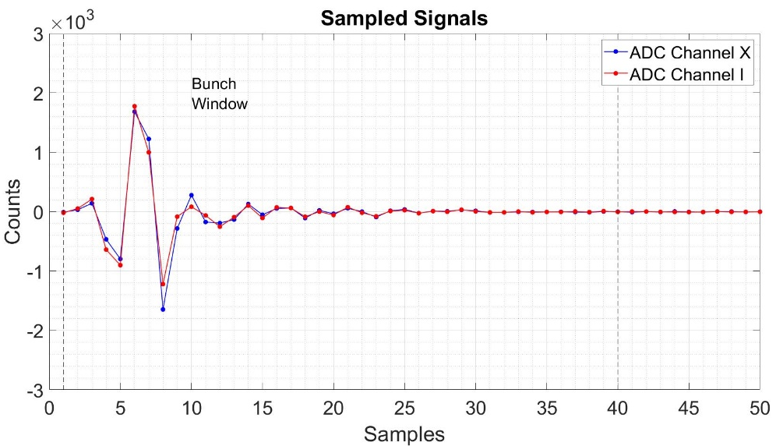
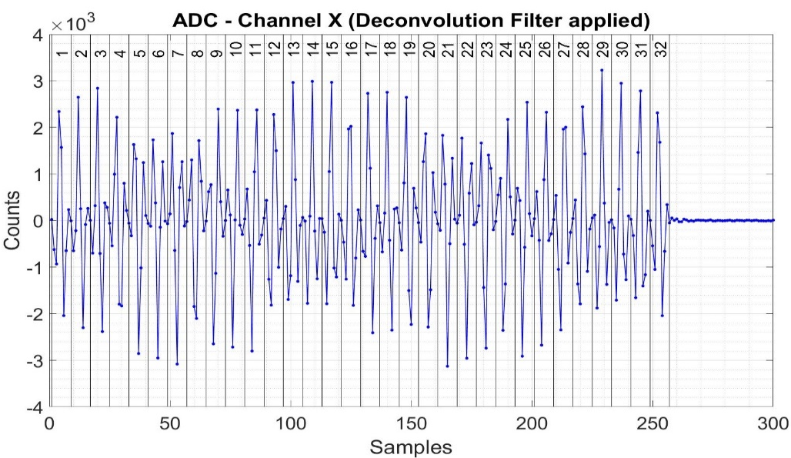
An example of the measurements performed
Sinewave measurements
Single pulse measurements
Train of pulses measurements

Slide 15
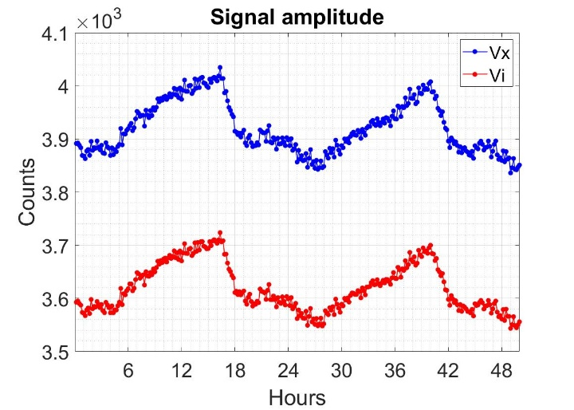
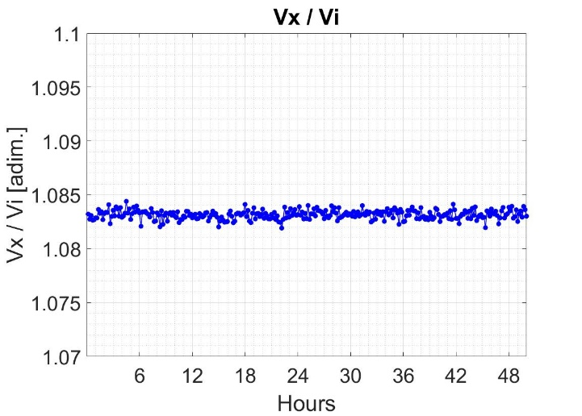
Stability over time
Maximum excursion of ~5% on the signal amplitudes, due to temperature variations. Nevertheless…
…there are negligible effects on the ratio Vx/Vi (position)

Slide 16
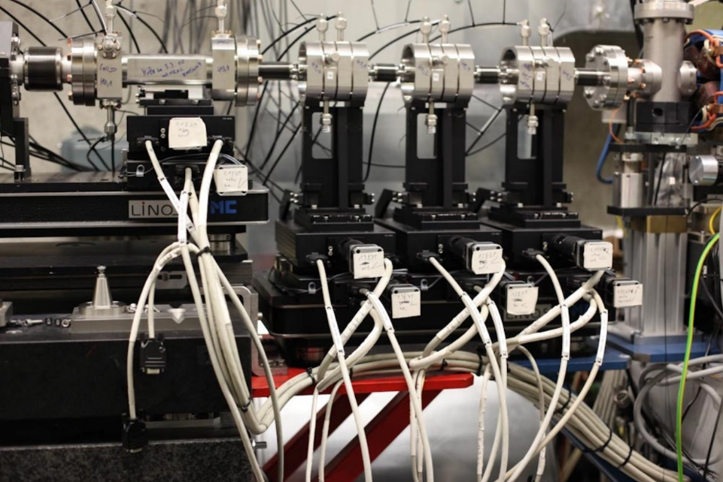
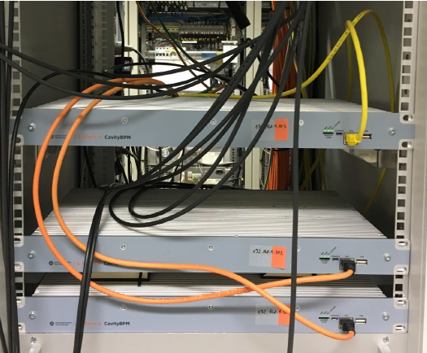
Measurements at FLASH (DESY)
Cavity BPM | FLASH | ELI-NP
Parameter | Value | Value
QL | 70 | 40
Dipole Res. frequency [GHz] | 3.3 | 3.284
Reference Res. Frequency [GHz] | 3.3 | 3.284
Dipole Sensitivity [V/mm/nC] | 3 | 7.07
Reference Sensitivity [V/nC] | 60 | 135

Slide 17
Resolution Measurements
cBPM1
cBPM2
cBPM3
Beam
expected
measured (X3)
Residual
measured (X1)
measured (X2)
$$σ_{{ResX}_{2}}=\sqrt{{σ_{X2}}^{2}+\frac{{σ_{X1}}^{2}+{σ_{X3}}^{2}}{4}}= \sqrt{ \frac{3}{2} }∗σ_{X}$$
$${ResX}_{2}=X_{2}−\frac{X_{1}+X_{3}}{2}$$
Position resolution measurements was performed with three cBPMs
The resolution of the device under test (cBPM2) is calculated by measuring the residual for cBPM2 (the difference between the position measured by the cBPM2 and the expected position calculated with the measurements of cBPM1 and cBPM3).

Slide 18
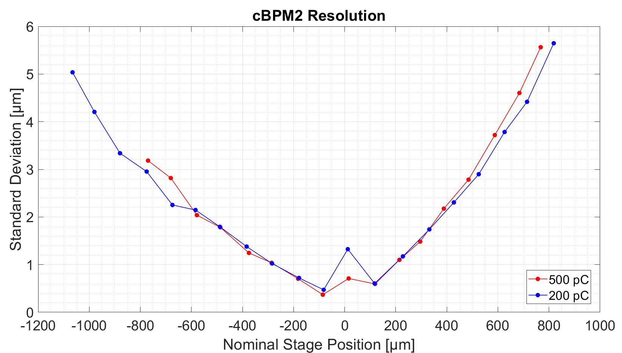
Resolution Measurements
Resolution measurements at FLASH show two main issues:
The resolution depends on the position of the beam. We believe that this depends on a high jitter (3ps) of the external reference signal at FLASH (i.e. FLASH setup problem).
The resolution at the center get worse. We believe that this is related to the digital signal analysis performed by the instruments (i.e. read-out electronics problem).

Slide 19
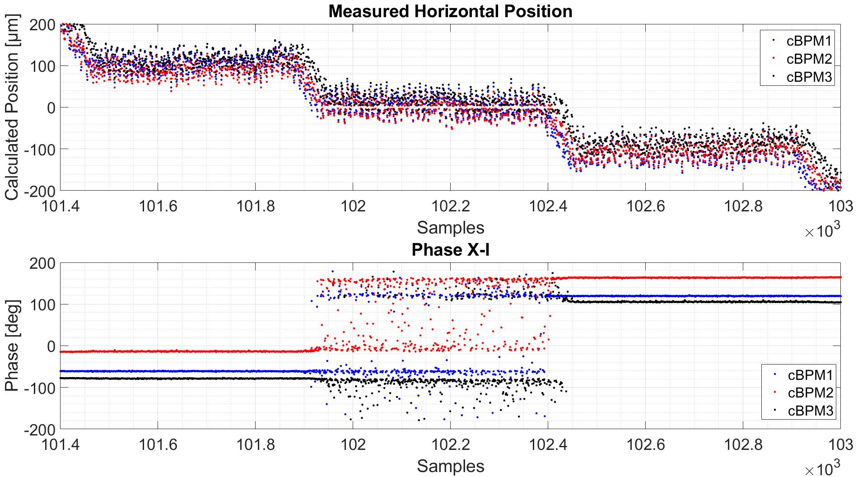
Measurements at the e.m. center of the cBPM
Electronic noise and offset are sampled, adding an always positive contribution to the signal amplitude, making impossible to measure “0 µm” of beam position.
Solution: implementation of an algorithm that measure the noise without the signal and compensate its amplitude contribution.
Phase difference between “X” and “I” signals is not properly calculated when the signals are too low, leading to erratic measurements of the beam position sign (left/right, up/down).

Slide 20
Conclusions on the beam measurements
A resolution as low as 0.37 µm over a range of ±1.3 mm was obtained for beam bunch of 200 pC and 500 pC.
Resolution depends on the beam position, which could be justified by taking into accounts jitter / phase noise. The problem is probably related to the reference signal provided to the system and can be addressed with a low jitter reference signal.
Measurements for beam at the e.m. center of the cBPM are problematic. This issue can be partially compensated with the implementation of an algorithm that compensate the noise contribution on the signal amplitude.
Other measurements (linearity, crosstalk between channels, frequency analysis of the signals,…) were performed and reported on the thesis, showing good results for ELI-NP GBS applications.
Further measurements are ongoing at SPARC-LAB, to complete the characterization and to provide a starting point for the design of the diagnostics of the EUPRAXIA linac.

Slide 21
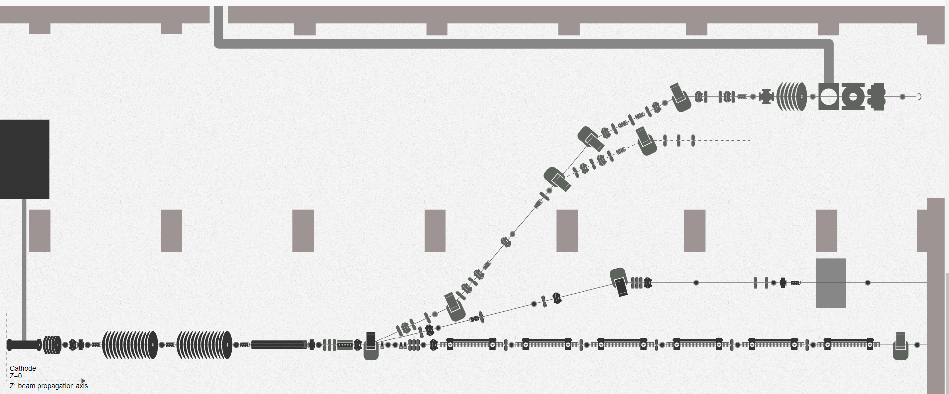
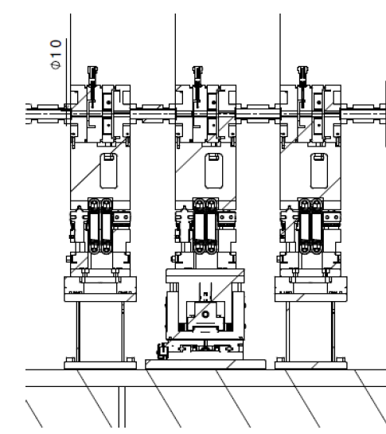
Test Bench at SPARC

Slide 22
Thank you for your attention!

Slide 23
Spares

Slide 24
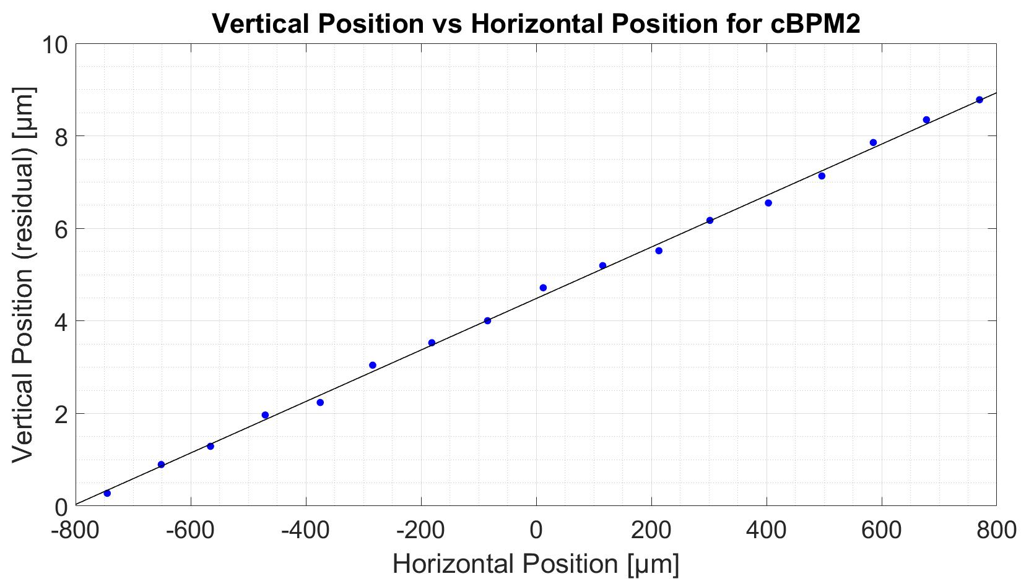
Crosstalk
Correlation coefficient between the vertical plane and the horizontal plane is -45 dB (0.0056)

