Slide 1



Design of a novel linear accelerator for carbon ion therapy
Vittorio bencini

Slide 2
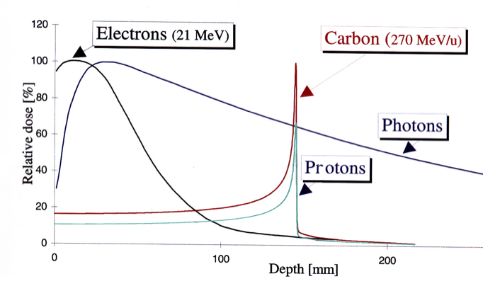
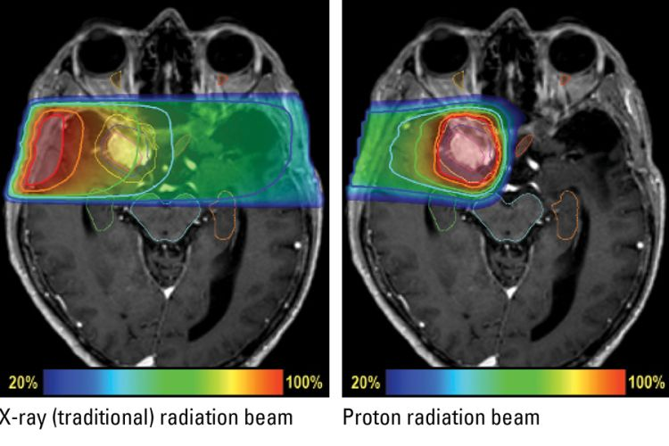
Hadron therapy
Carbon ions:
Higher Radio Biological Effect
Suited to treat radioresistant tumors

Slide 3
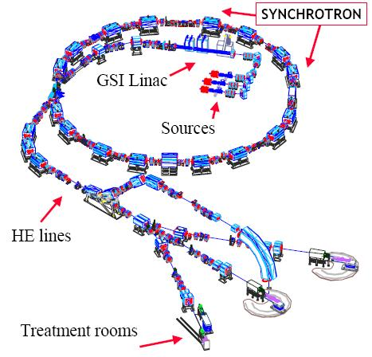
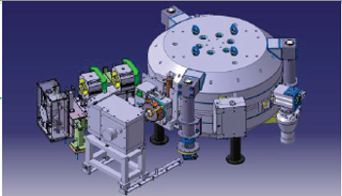
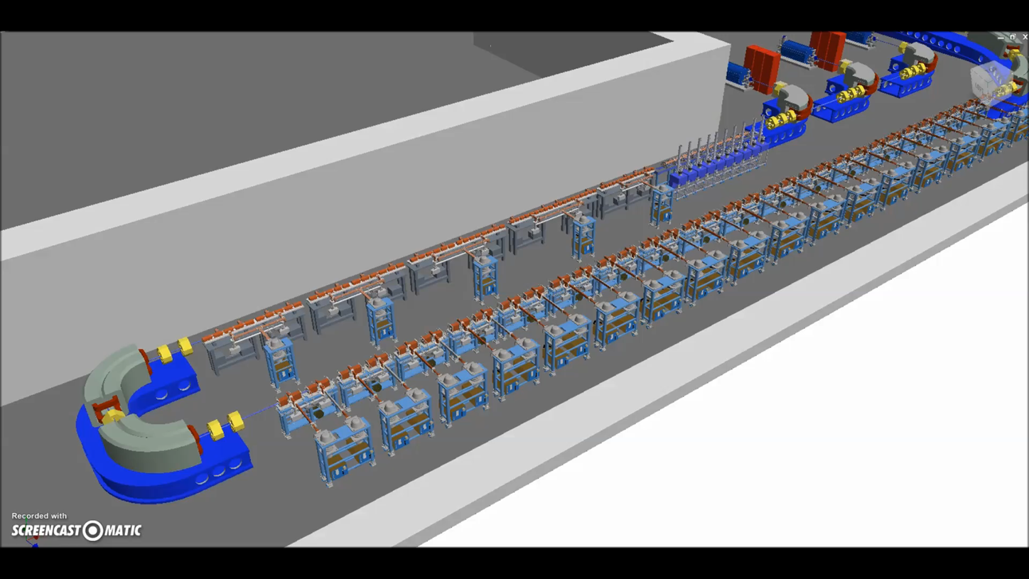
Accelerators for hadron-therapy
Cyclotrons
Linacs
Features
Small footprint
Drawbacks
Passive energy modulation
Big emittance
Slow energy modulation
Only for protons
Features
Active energy modulation
Fast energy modulation
Excellent beam quality
Drawbacks
‘linear’ footprint
Features
Active energy modulation
Both protons and carbon ions
Drawbacks
Slow energy change
Big footprint
Big emittance
Synchrotrons

Slide 4
Accelerators for hadron-therapy
Cyclotrons
Linacs
Features
Small footprint
Drawbacks
Passive energy modulation
Big emittance
Slow energy modulation
Only for protons
Features
Active energy modulation
Fast energy modulation
Excellent beam quality
Drawbacks
‘linear’ footprint
Features
Active energy modulation
Both protons and carbon ions
Drawbacks
Slow energy change
Big footprint
Big emittance
Synchrotrons

Slide 5
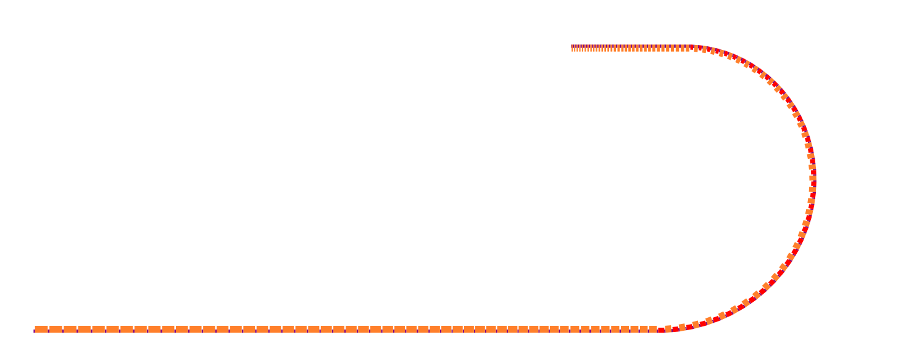
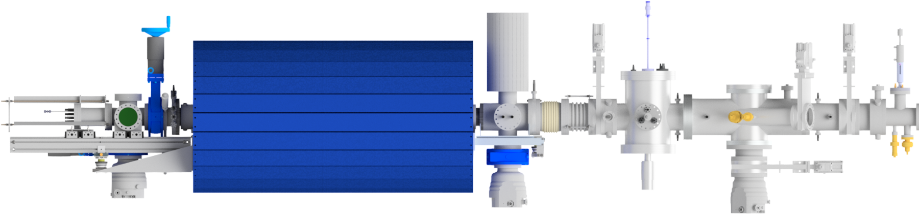

The bent linac
Parameter | Value
Frequency | 750 MHz/3 GHz
Species | ¹²C⁶⁺
Final energy | 100-430 MeV/u
Repetition rate | 200 (400) Hz
TwinEBIS
LEBT
RFQ
Fixed energy
section
Bent section
12 m
Energy modulated section
33 m

Slide 6
The bent linac
Parameter | Value
Frequency | 750 MHz/3 GHz
Species | ¹²C⁶⁺
Final energy | 100-430 MeV/u
Repetition rate | 200 (400) Hz
TwinEBIS
Fixed energy
section
LEBT
RFQ
MEDeGUN commissioning
LEBT beam matching
Bent section
Bent linac design
750 MHz RFQ design
12 m
Energy modulated section
33 m

Slide 7
MEDeGUN commissioning

Slide 8
MEDeGUN commissioning
Solenoid
TwinEBIS
Collector
MEDeGUN
Drift tubes
Ion Extractor
Suppressor
Design parameter | Value
Test site | TwinEBIS, CERN
Main magnet | 2 (*5) T
Trap length | 0.25 (*0.5) m
Electron current | 1 A
Current density | 3 kA/cm²
Electron energy | 6.5-8.5 keV
Capacity C⁶⁺ | 1·10⁹ Ions per pulse
Repetition rate | 200 (*400) Hz
Pulse length | 5 μs

Slide 9
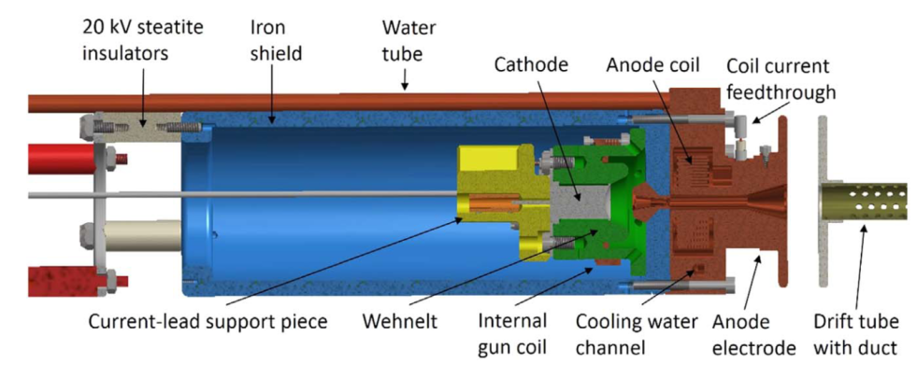
MEDeGUN commissioning
Solenoid
MEDeGUN
Collector
MEDeGUN
Drift tubes
Ion Extractor
Suppressor
Design parameter | Value
Test site | TwinEBIS, CERN
Main magnet | 2 (*5) T
Trap length | 0.25 (*0.5) m
Electron current | 1 A
Current density | 3 kA/cm²
Electron energy | 6.5-8.5 keV
Capacity C⁶⁺ | 1·10⁹ Ions per pulse
Repetition rate | 200 (*400) Hz
Pulse length | 5 μs
Commissioning main goals
Extract electrons with nominal parameters
Minimize beam losses
Reduce electron beam energy

Slide 10
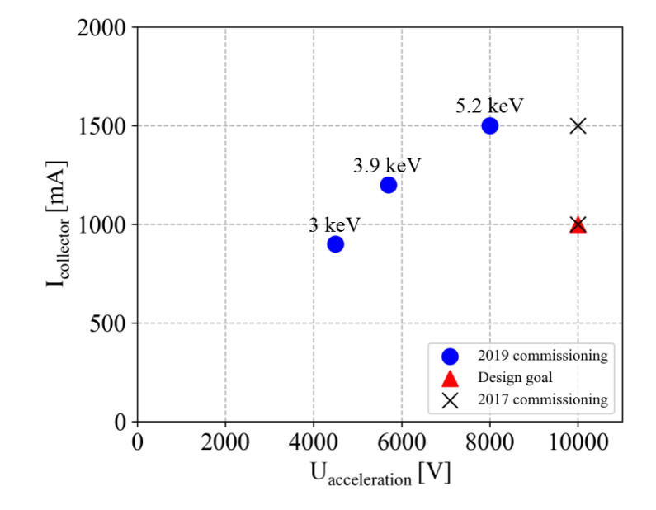
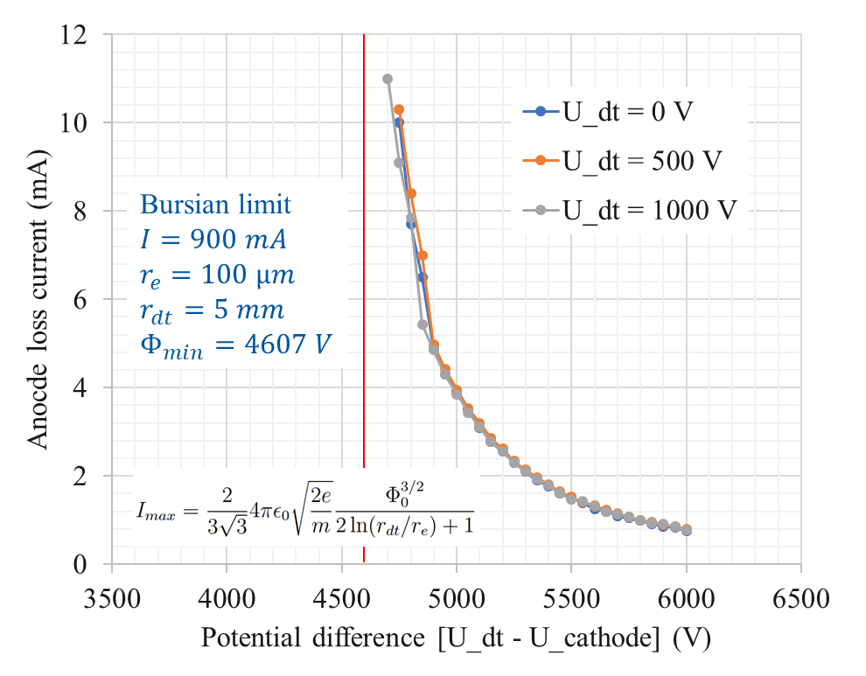
MEDeGUN commissioning
Achievements
Collector
Stable reproducible operation above nominal current
Energy decreased to the lower theoretical limit
Minimized losses (<1.5 mA)
Better understanding of beam behavior at low energy
Calculation of expected ion current
U_cathode
U_dt
Ion Extractor
Suppressor
Current measurements
Bursian limit
8 keV

Slide 11
LEBT beam matching

Slide 12
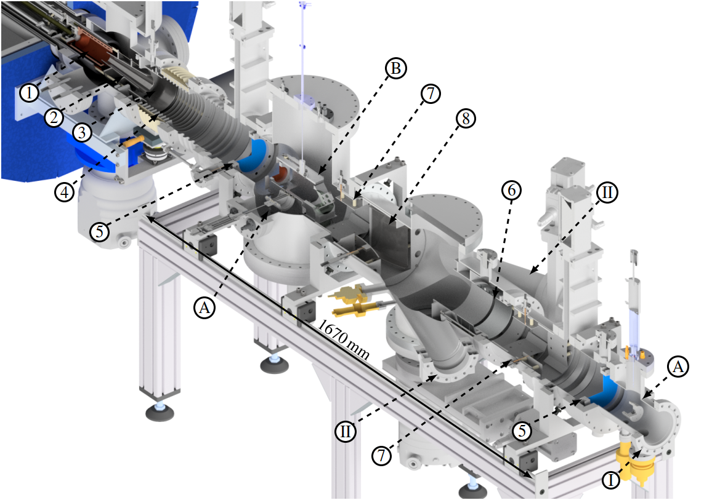
LEBT beam matching
Collector
Extractor
Adaptor
Rings
Gridded lens
Einzel lens
Switchyard
Deflector

Slide 13
LEBT beam matching
Matching elements
Collector
Extractor
Adaptor
Rings
Gridded lens
Einzel lens
Switchyard
Deflector
Main goals
Simulate beam dynamics in the LEBT
Beam matching to the RFQ
Assess flexibility of the system

Slide 14
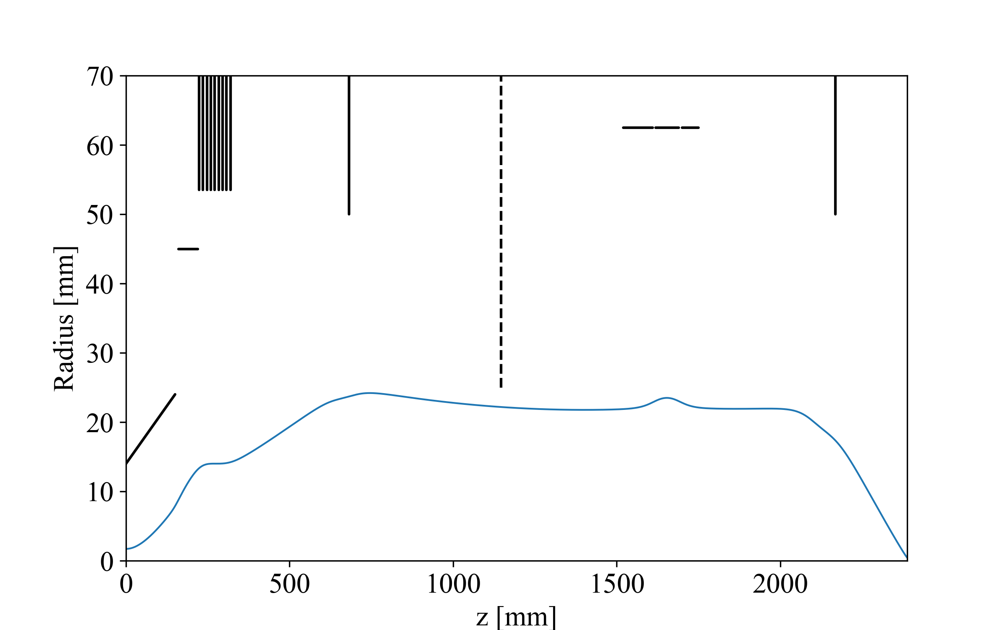




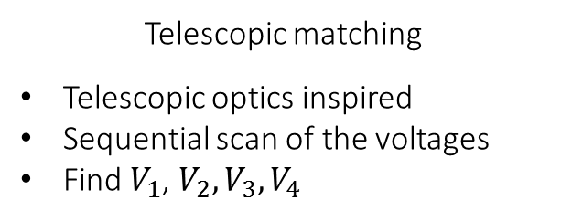
LEBT beam matching
Matching carried out in two steps:
Telescopic matching
Telescopic optics inspired
Sequential scan of the voltages
Find $V_{1}$, $V_{2},V_{3},V_{4}$
Min emittance
α=0
α=0
Max transm.
Gaps
$$V_{2}$$
$$V_{3}$$
$$V_{4}$$
Einzel lens
Adaptor
Gridded lens
Gridded lens
$$V_{1}$$
Extractor

Slide 15
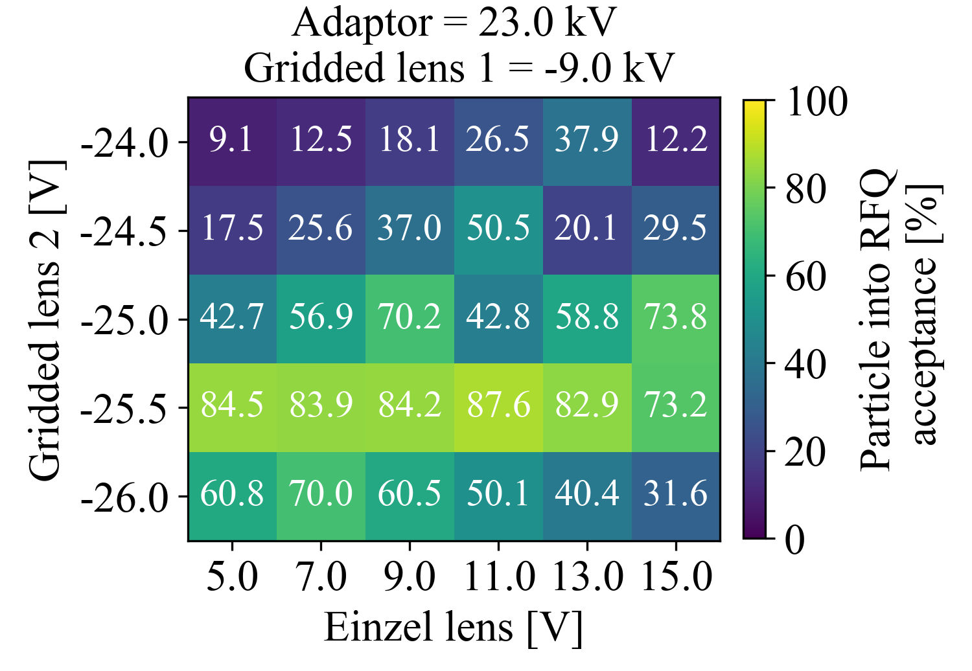
LEBT beam matching
Matching carried out in two steps:
Telescopic matching
Telescopic optics inspired
Sequential scan of the voltages
Find $V_{1}$, $V_{2},V_{3},V_{4}$
Full scan
Start with telescopic matching results
Optimization algorithm to find the maximum transmission
Finer scan on last lens to adjust the matching conditions
Min emittance
α=0
α=0
Max transm.
Gaps
$$V_{2}$$
$$V_{3}$$
$$V_{4}$$
Einzel lens
Adaptor
Gridded lens
Gridded lens
$$V_{1}$$
Extractor

Slide 16

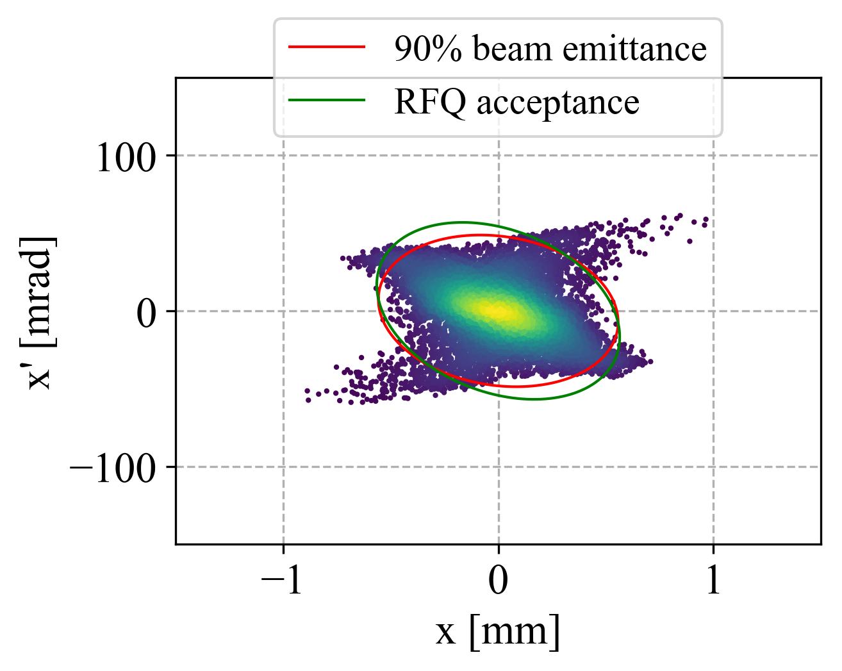
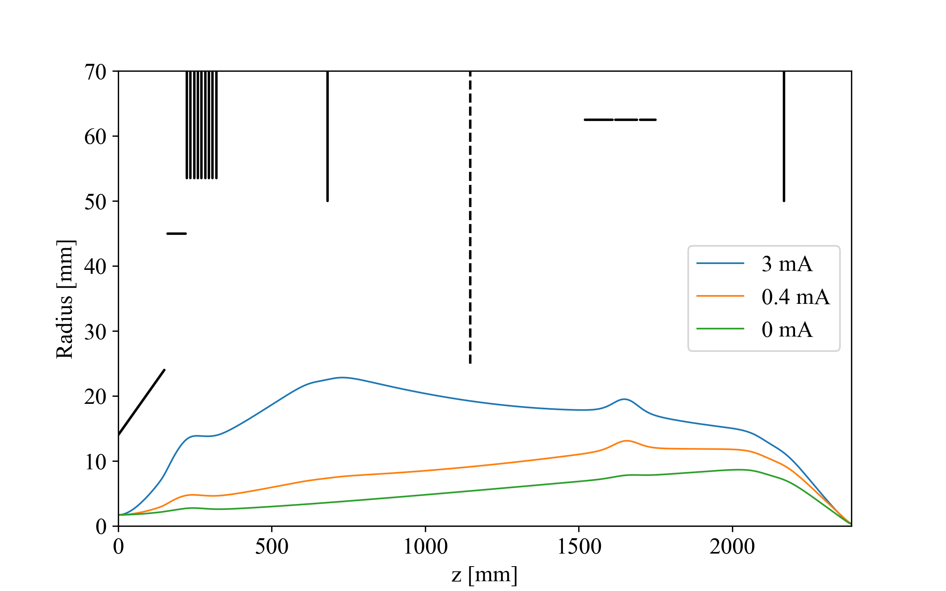
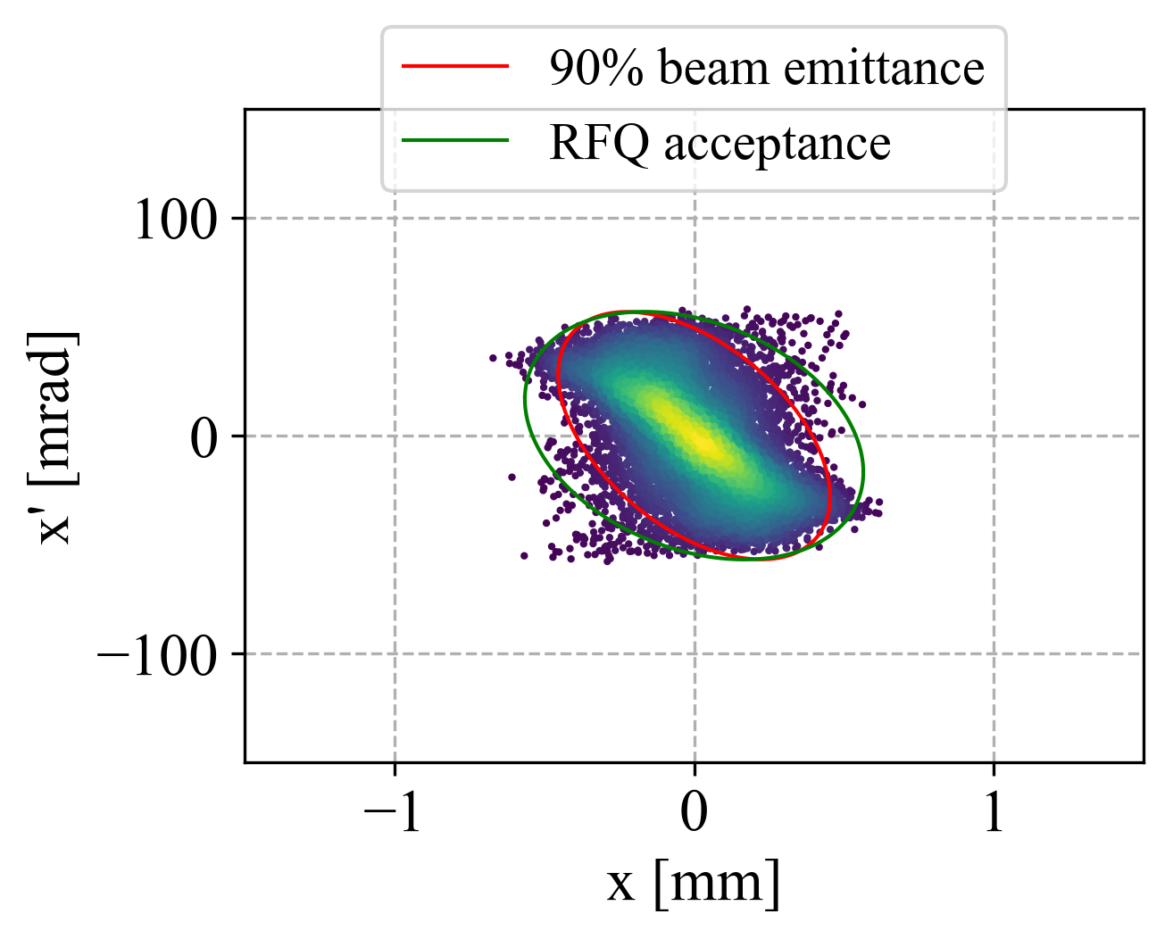
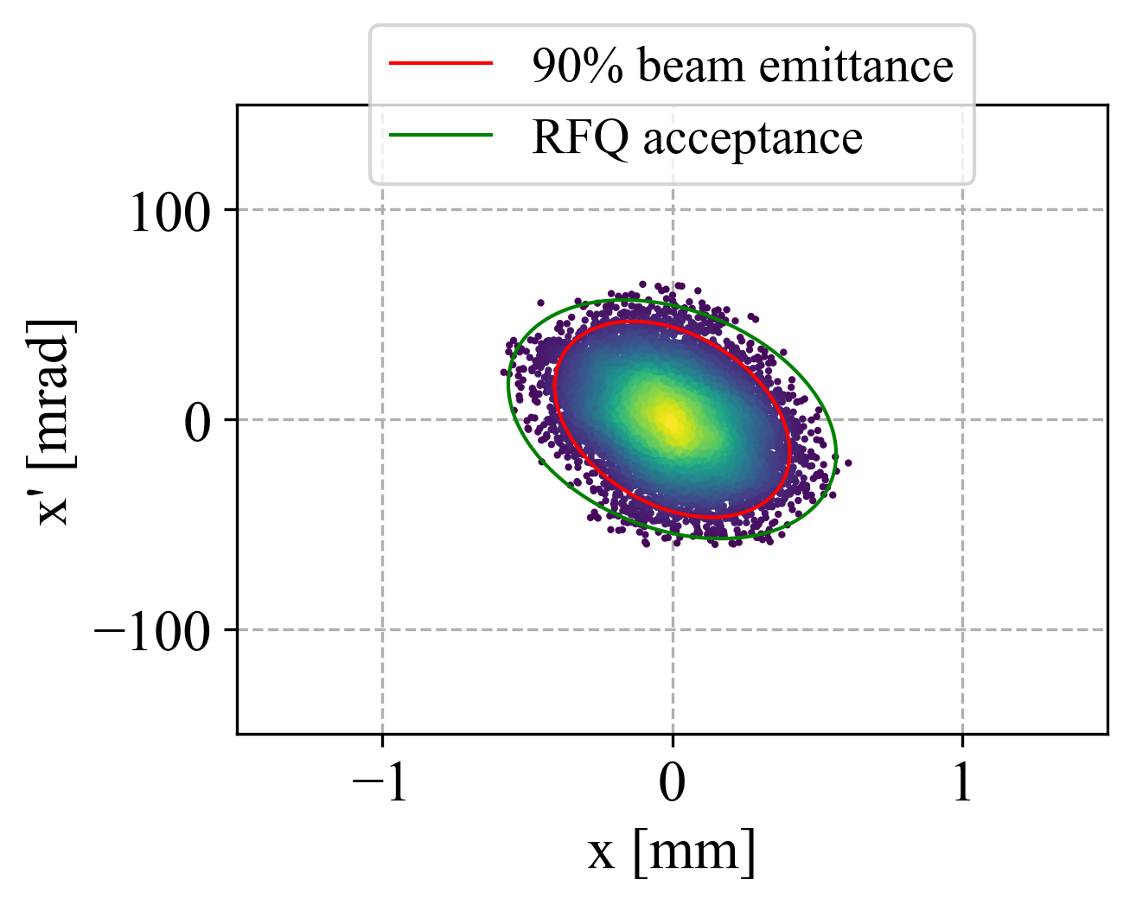
LEBT beam matching
Matching at different currents
0 mA – no space charge case
0.4 mA – nominal current case
3 mA – Maximum theoretical current from TwinEBIS (after upgrade)
For higher current the beam aberrations become more relevant increasing the losses
Combination of space charge and electric field non linearity

Slide 17
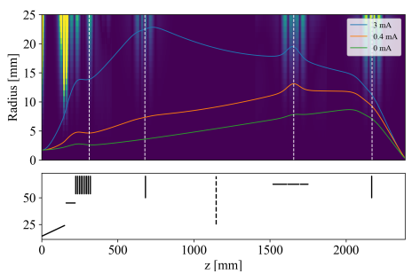

LEBT beam matching
Non linearities
Non linear field can induce aberrations and emittance growth
Introduce a Non Linearity Index to quantify the deviance between linear and real field
Useful to understand if the beam interacts with non linear fields

Slide 18
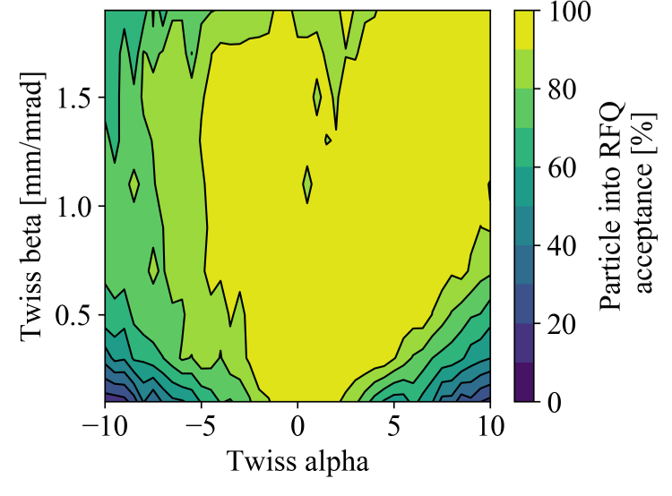
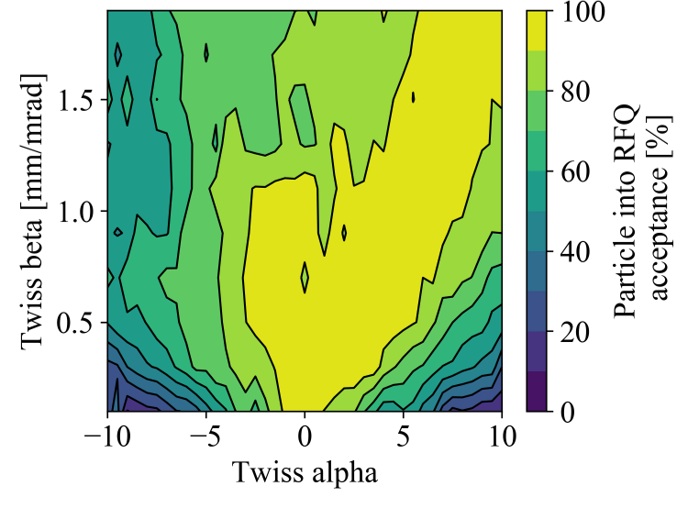
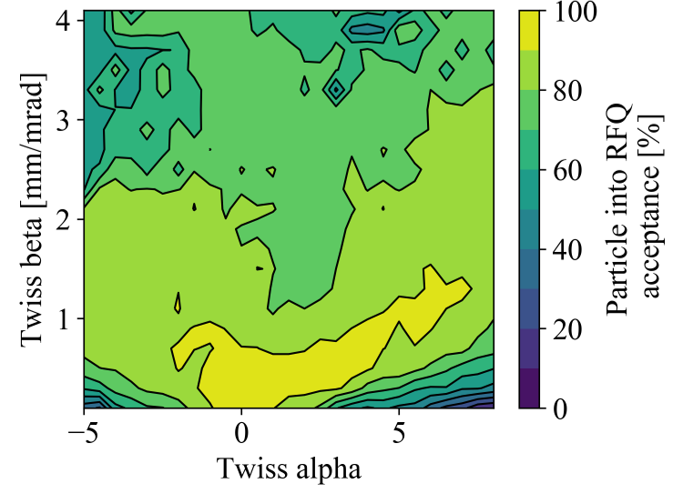
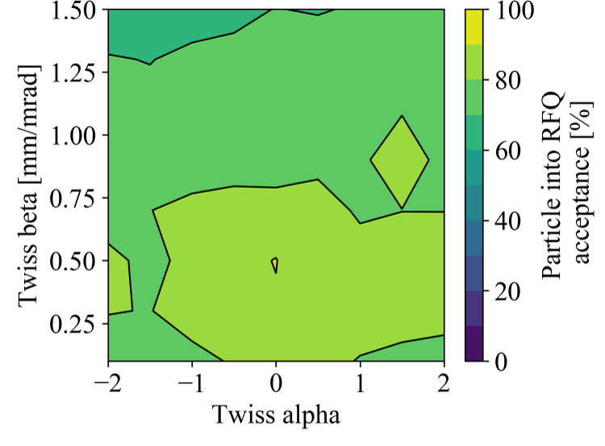
LEBT beam matching
Sensitivity study to different beam currents and Twiss parameters

Slide 19
750 MHz RFQ

Slide 20
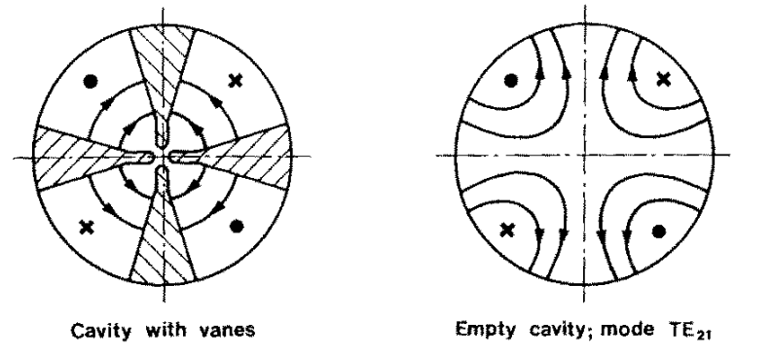
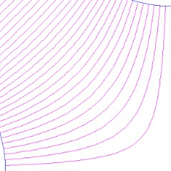
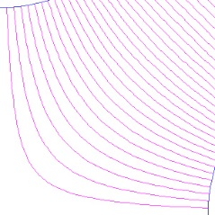
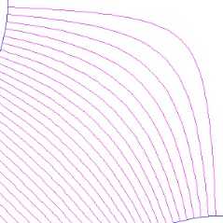
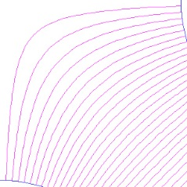
RFQ design
What is a radio frequency quadrupole?
It is an RF cavity where the TE₂₁ mode is excited.
Four electrodes are installed into the cavity
The electrodes are connected to an RF source
They alternate their polarity with the RF frequency
+
-
-
+

Slide 21
RFQ design
What is a radio frequency quadrupole?
It is an RF cavity where the TE₂₁ mode is excited.
Four electrodes are installed into the cavity
The electrodes are connected to an RF source
They alternate their polarity with the RF frequency
-
(Bunching)
+
+
-
Focusing
Acceleration

Slide 22
RFQ design
Different designs can be optimized depending on the application and final energies
 | High transmission | Compact
Length m | 4.6 m | 2.7
Emax MV/m | 53 MV/m | 51 MV/m
Vane voltage KV | 50kV | 50kV
r0 | 1.4mm | 1.4 mm
rho | 1.3 mm | 1.3
Transmission | 99% | 54%
Input Nominal tr. emittance rms norm | 0.02 | 0.02
Win/u | 0.015 MeV | 0.015 MeV
Wout/u | 2.5/5 MeV | 2.5/5 MeV
q/A | 1/2 | 1/2
Power consumption | 470 kW | 280 kW

Slide 23
RFQ design
Different designs can be optimized depending on the application and final energies
 | High transmission | Compact
Length m | 4.6 m | 2.7
Emax MV/m | 53 MV/m | 51 MV/m
Vane voltage KV | 50kV | 50kV
r0 | 1.4mm | 1.4 mm
rho | 1.3 mm | 1.3
Transmission | 99% | 54%
Input Nominal tr. emittance rms norm | 0.02 | 0.02
Win/u | 0.015 MeV | 0.015 MeV
Wout/u | 2.5/5 MeV | 2.5/5 MeV
q/A | 1/2 | 1/2
Power consumption | 470 kW | 280 kW

Slide 24
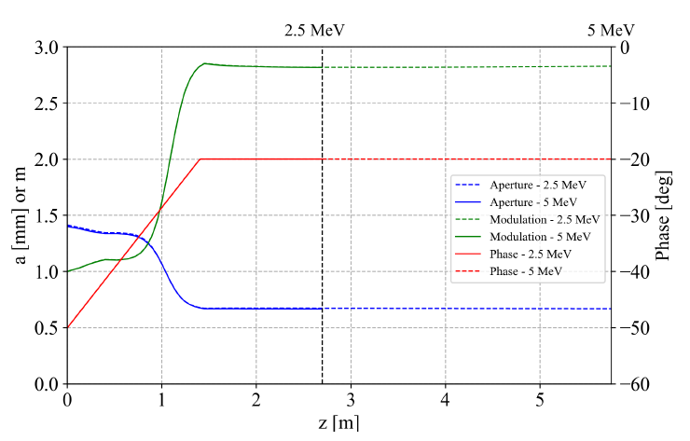
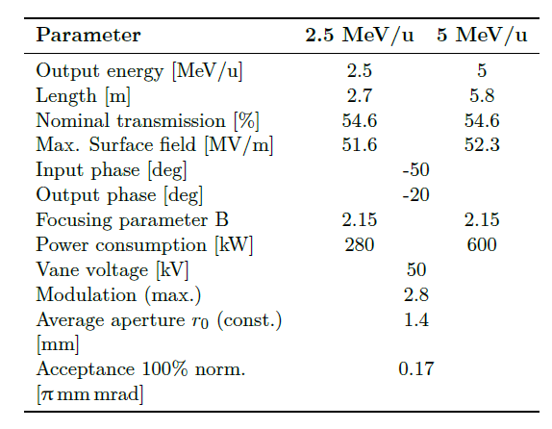
RFQ design
Compact design

Slide 25
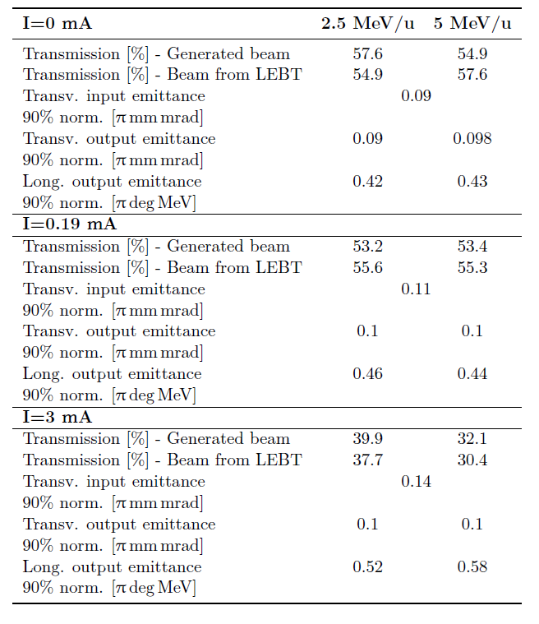
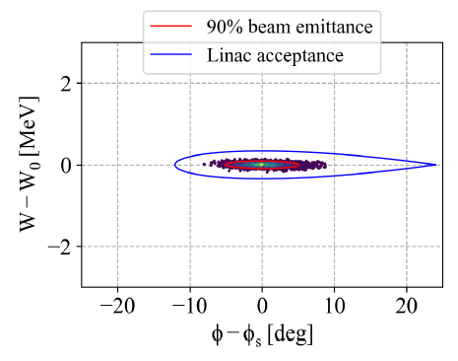
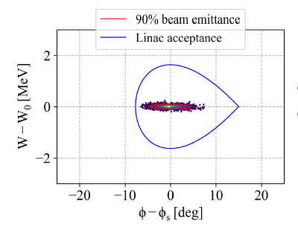
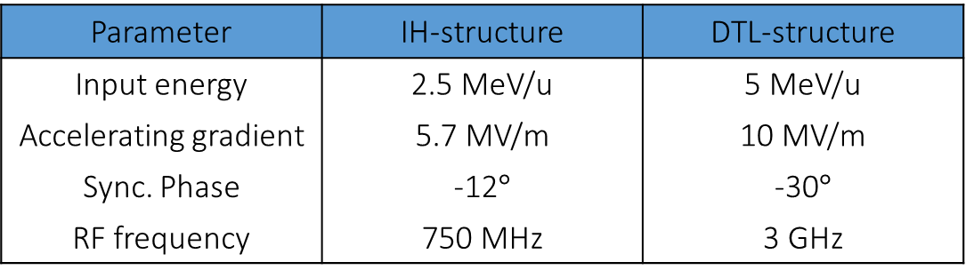
RFQ design
Two structure could follow the RFQ (two different longitudinal acceptances)
Parameter | IH-structure | DTL-structure
Input energy | 2.5 MeV/u | 5 MeV/u
Accelerating gradient | 5.7 MV/m | 10 MV/m
Sync. Phase | -12$°$ | -30$°$
RF frequency | 750 MHz | 3 GHz
1.5

Slide 26
Bent linac design

Slide 27
The bent linac
Parameter | Value
Frequency | 750 MHz/3 GHz
Species | ¹²C⁶⁺
Final energy | 100-430 MeV/u
Repetition rate | 200 (400) Hz
TwinEBIS
LEBT
RFQ
Fixed energy
section
Bent section
12 m
Energy modulated section
33 m

Slide 28
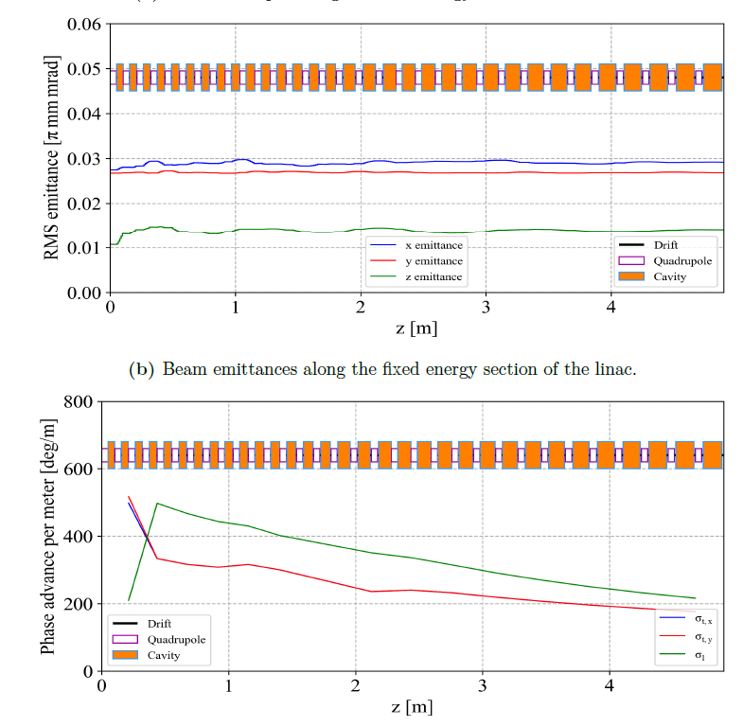
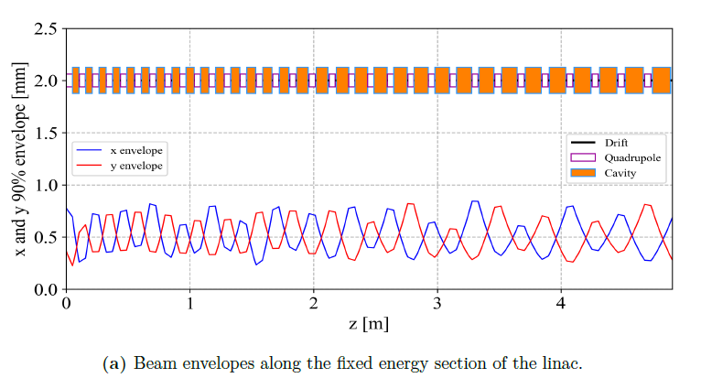
Fixed energy section
Parameter | Value
Frequency | 3 GHz
Energy | 5-30 MeV/u
Length | 5 m

Slide 29
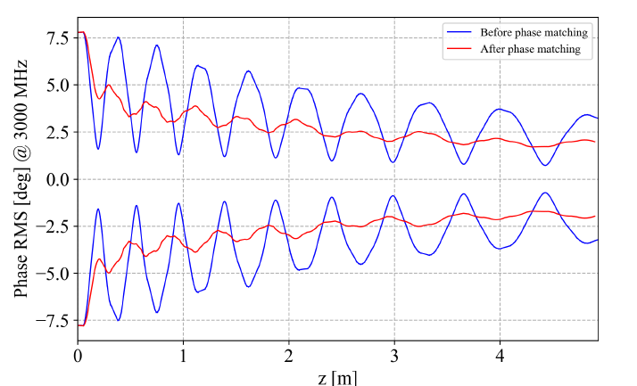
Fixed energy section
Matching between RFQ and Fixed energy section is very delicate
The jump in frequency reduces the longitudinal acceptance by a factor 4
Redesign the first two tanks (match the phase) to smooth the mismatch

Slide 30
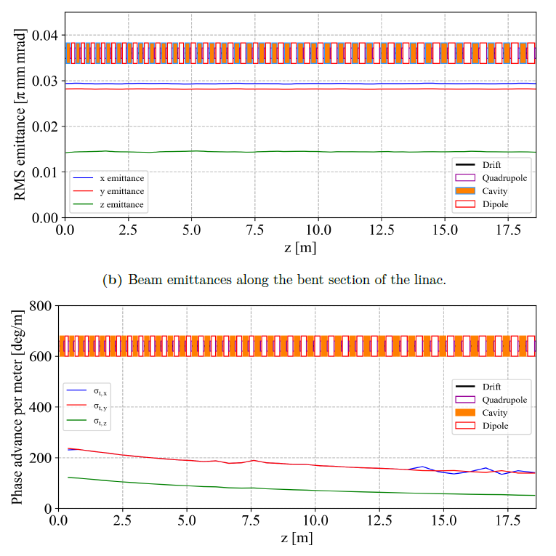
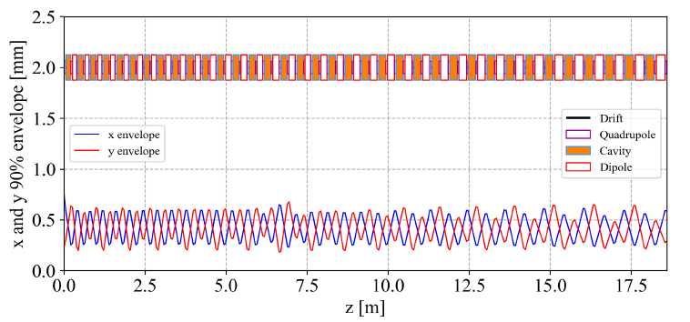
Bent section
Parameter | Value
Frequency | 3 GHz
Energy | 30-100 MeV/u
Length | 18 m
Dipole field (permanent) | 1 T

Slide 31
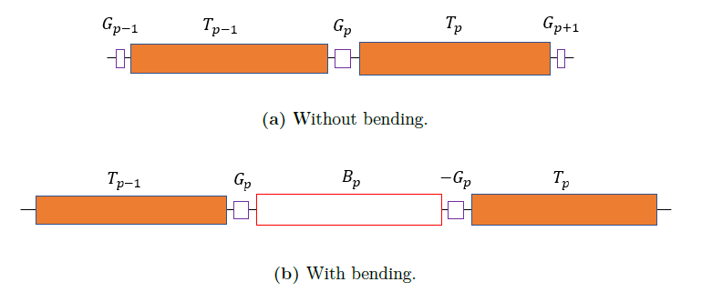

Bent section
Bent section designed to maximize beam stability
Interlaced accelerating cavities and dipoles
Length of the dipoles chosen to keep canstant transverse phase advance
The tank-bend-tank system is described by the matrix:
Ld is changed until the stability condition is matched

Slide 32
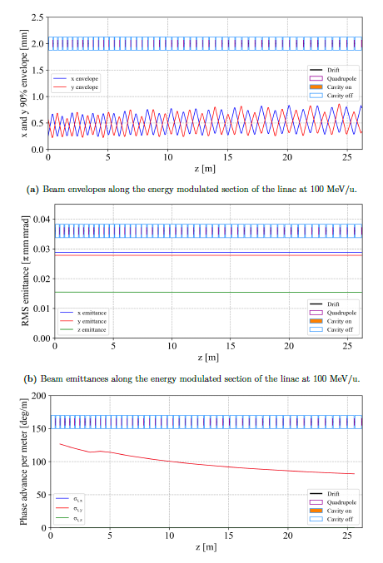
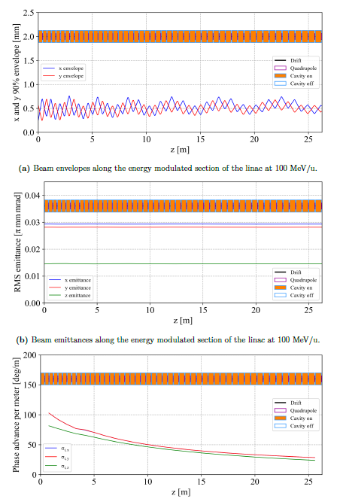
Energy modulated section
100 MeV/u
430 MeV/u
Parameter | Value
Frequency | 3 GHz
Energy | 100-430 MeV/u
Length | 26 m
Energy modulation accompished by switching on and off the cavities
The quads are permanent, so the optics cannot be adjusted to the energy
Challange is to find optics configuration that maximize transmission at all energies
Two cases at max and min energy

Slide 33
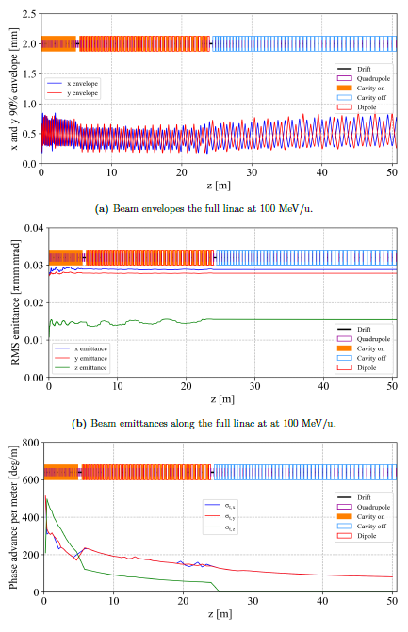
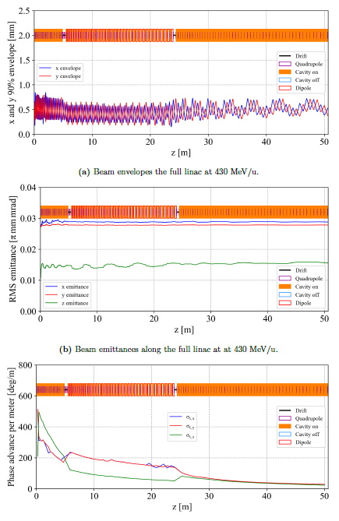
Full linac tracking
100 MeV/u
430 MeV/u

Slide 34
Conclusions
Successfull MEDeGUN commissioning allowed to calculate amount of ions out of TwinEBIS source
The beam dynamics simulations on the LEBT allowed to assess the flexibility of the system and estimate the current transmitted into the RFQ
Four versions of the 750 MHz RFQ were presented to offer a wide range of options. The compact design at 5 MeV/u was selected
The concept of bent linac was introduced and the beam dynamics was studied
An end to end tracking demontrated the capability of the machine of providing small emittance beams at different energies with a current orders of magnitudes higher than the required one

Slide 35
Thank you for your attention!

Slide 36
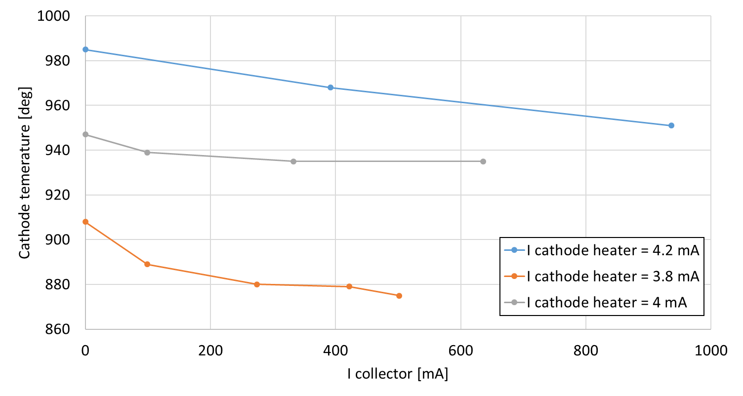
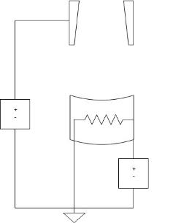
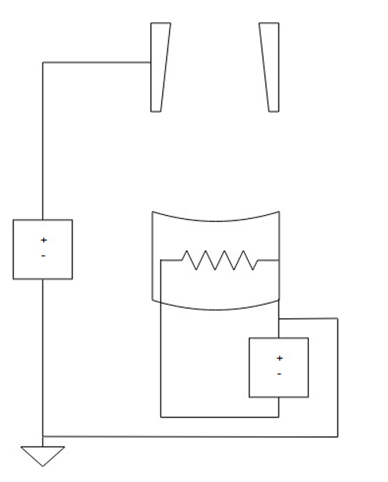


MEDeGUN commissioning
Dec 2018:
Cathode temperature increases with extracted current
Extracted beam should cool cathode due to work function
→ Unstable, cathode at risk of overheating
$$Collector$$
$$Collector$$
$$e^{−}$$
$$e^{−}$$
$$U_{coll}$$
$$U_{coll}$$
$$Filament$$
$$Filament$$
$$U_{\begin{aligned}cath. \\ heat\end{aligned}}$$
$$U_{\begin{aligned}cath. \\ heat\end{aligned}}$$

Slide 37
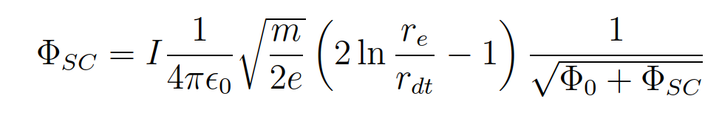
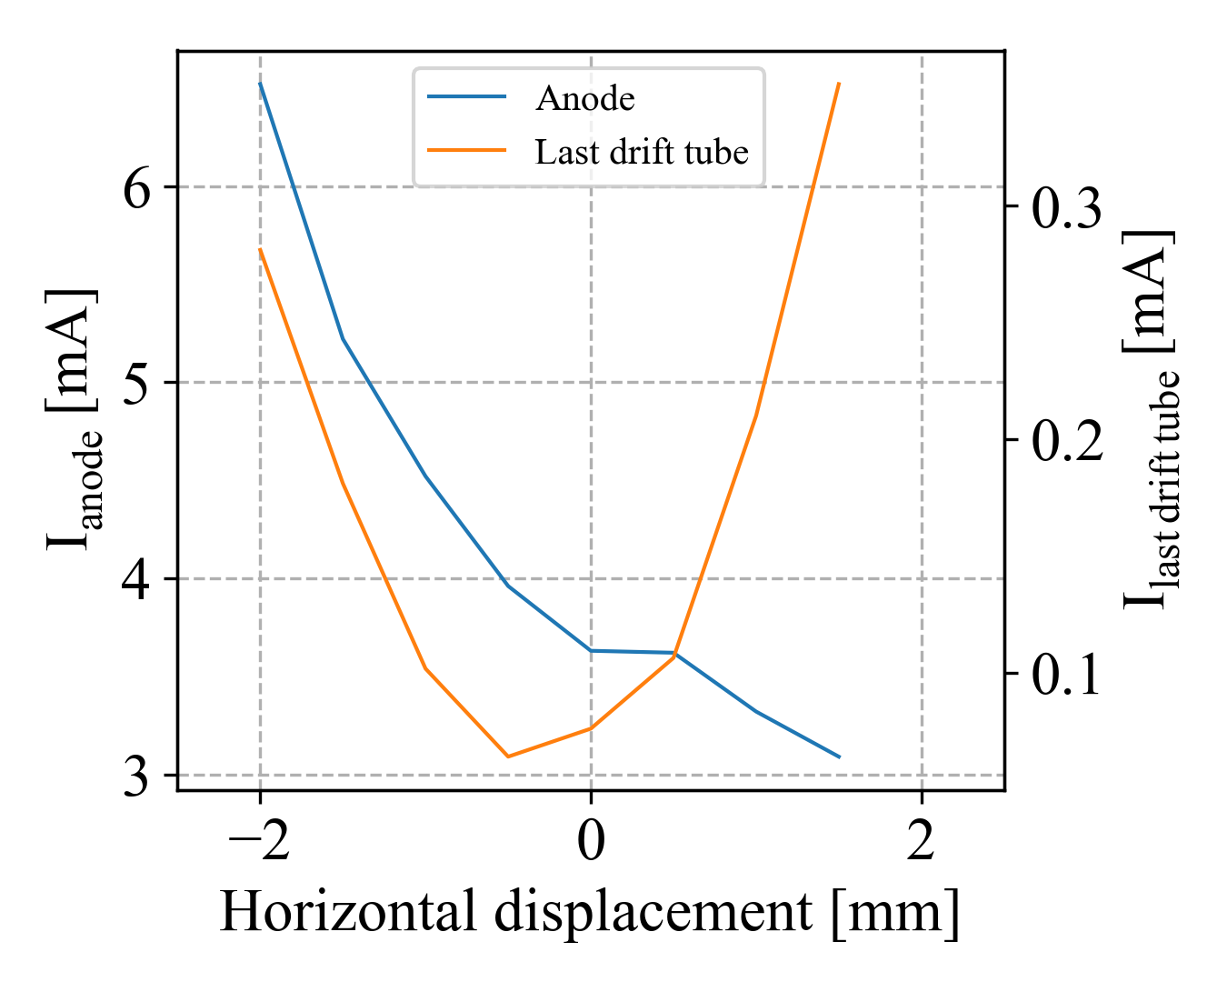
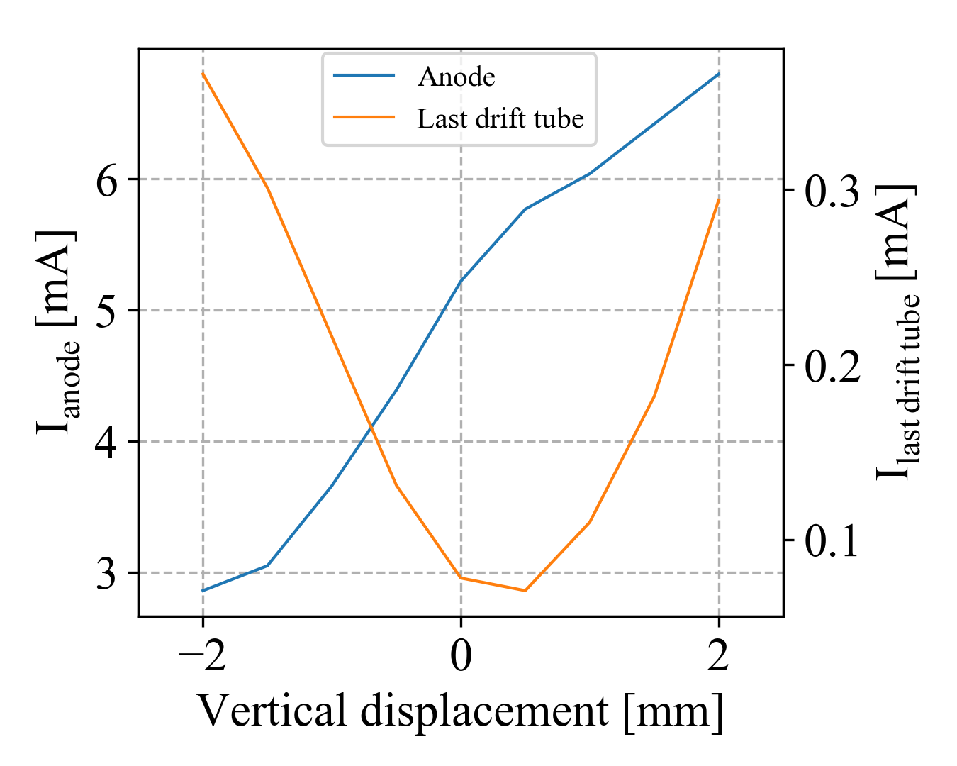
MEDeGUN commissioning

Slide 38

LEBT matching
Input distribution
Calculated from electron beam parameters
Tracked to ectraction with TRAK code
Telescopic matching principle

Slide 39



LEBT matching
Telescopic matching scan results

Slide 40


RFQ design
Changing the input synchronous phase, the longitudinal emittance of the output beam can be controlled
The losses occur at injection energy preventing activation issues

