Slide 1
A Thermomechanical-Electromagnetic Approach For The Design Of New Accelerator Components
Presentation for the Admission to the The Final Dissertation for the PhD school in Particle Accelerators Physics
Candidate: Lorenzo Teofili
Academic Supervisor: Mauro Migliorati (Sapienza Universita’ di Roma)
CERN Supervisor: Iñigo Lamas García (CERN)
1/19

Slide 2
Scope of the Presentation
Introduction
The HL-LHC and LIU Projects
Beam Intercepting Devices (BIDs)
Motivation of the Work
Impedance Reduction Guidelines and Example of Application for LIU Devices (The Proton Synchrotron Booster Absorber Scraper) [1][2][3]
Impedance Analysis, simulations and measurements, of the HL-LHC Devices (The Target Collimator Low Dispersion)
Conclusions
2/19

Slide 3
The HL-LHC and LIU Projects
3/19

Slide 4
Beam Intercepting Devices
Dumps

Slide 5
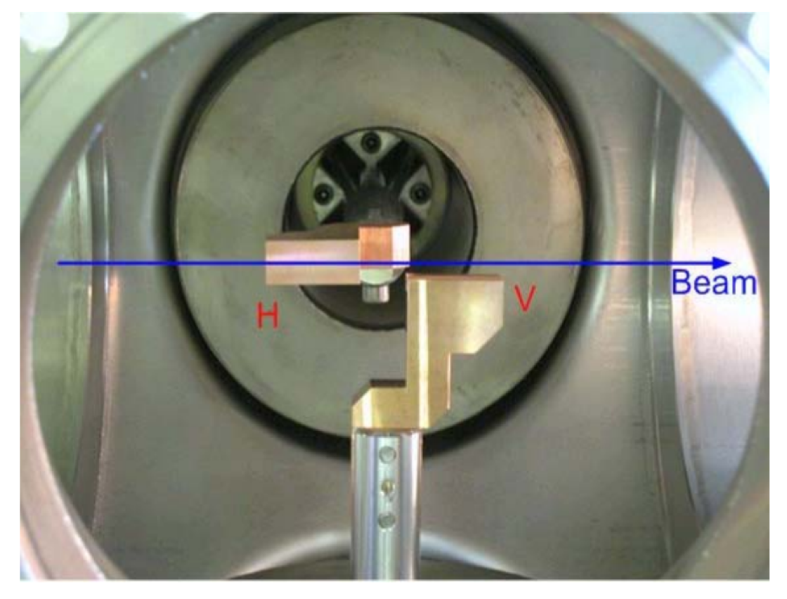
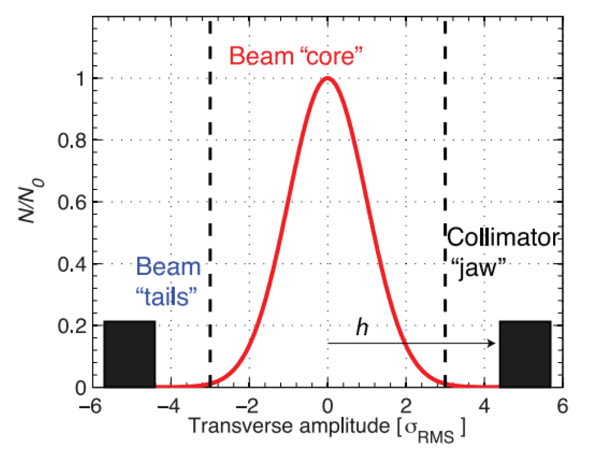
Beam Intercepting Devices
Collimators
Absorbers/Scrapers
4/19

Slide 6
Nuclei Matter Interactions
5/19

Slide 7
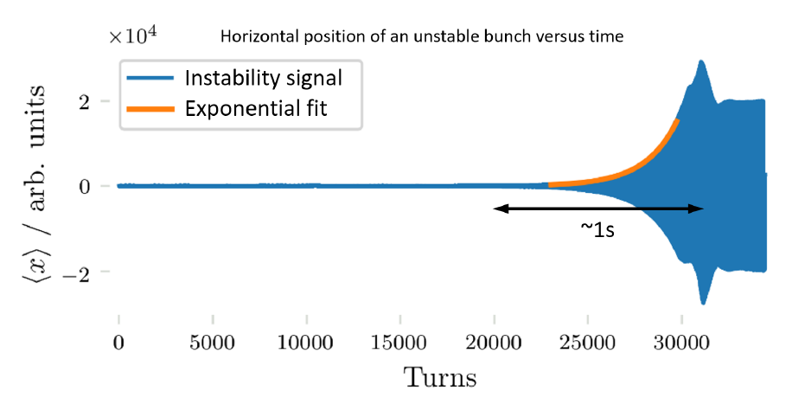
BID and Electromagnetic Interactions
6/19

Slide 8
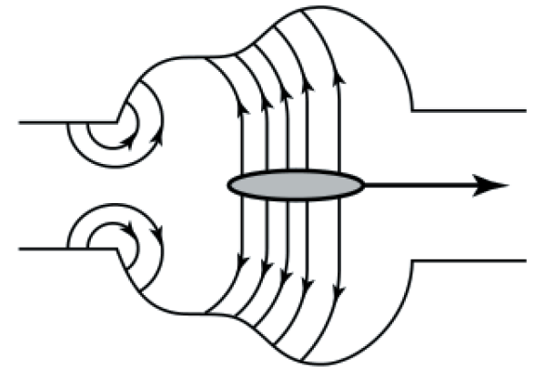
Wakefield And Impedance
is the Electric Field experienced by the Test particle due to the reflected and diffracted electric field.
Longitudinal Wakefunction
Longitudinal Impedance
FT
Transverse Wakefunction
Transverse Impedance
7/19

Slide 9
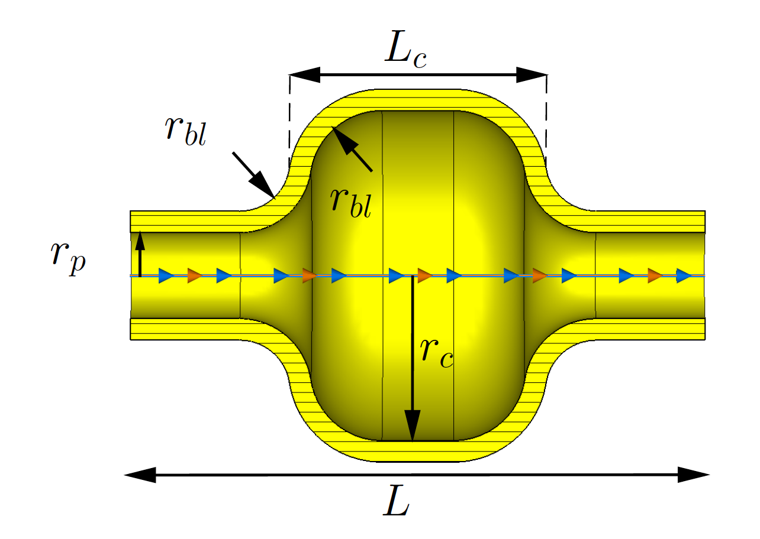
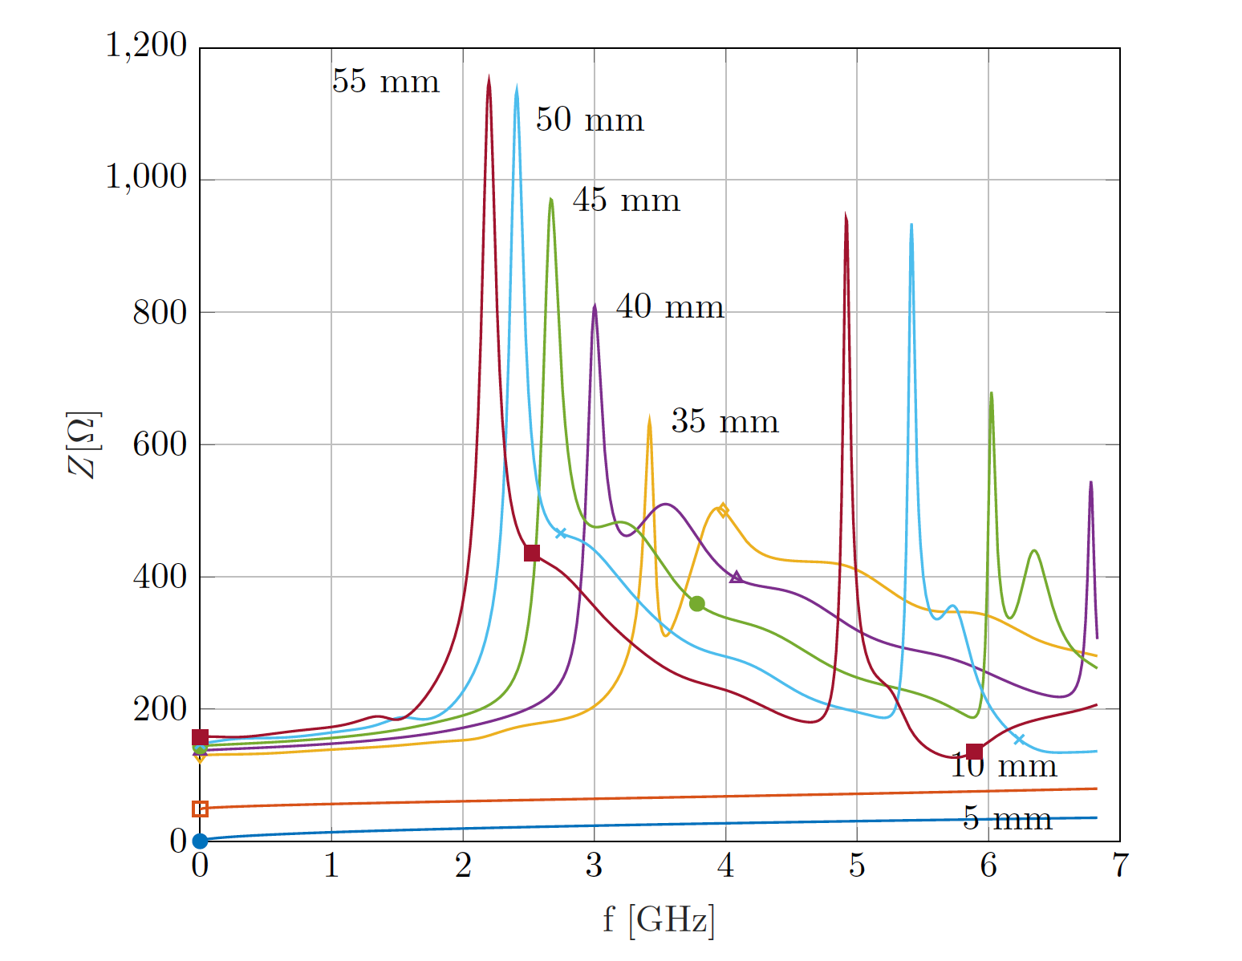
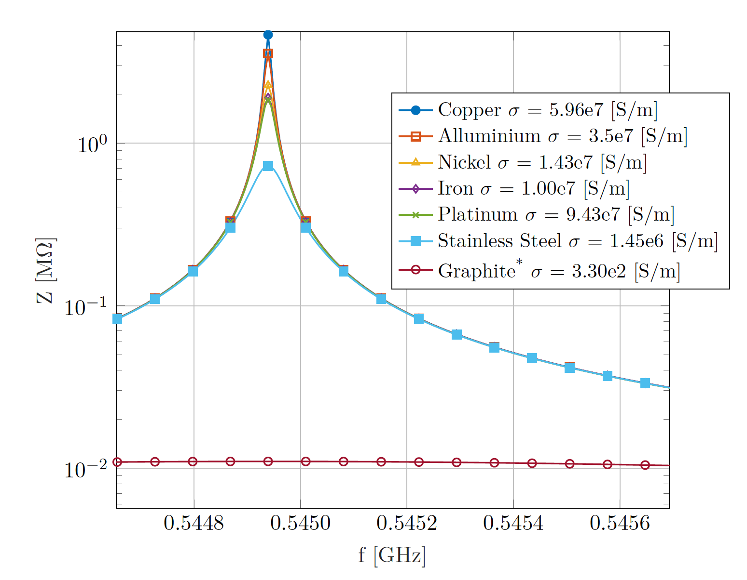
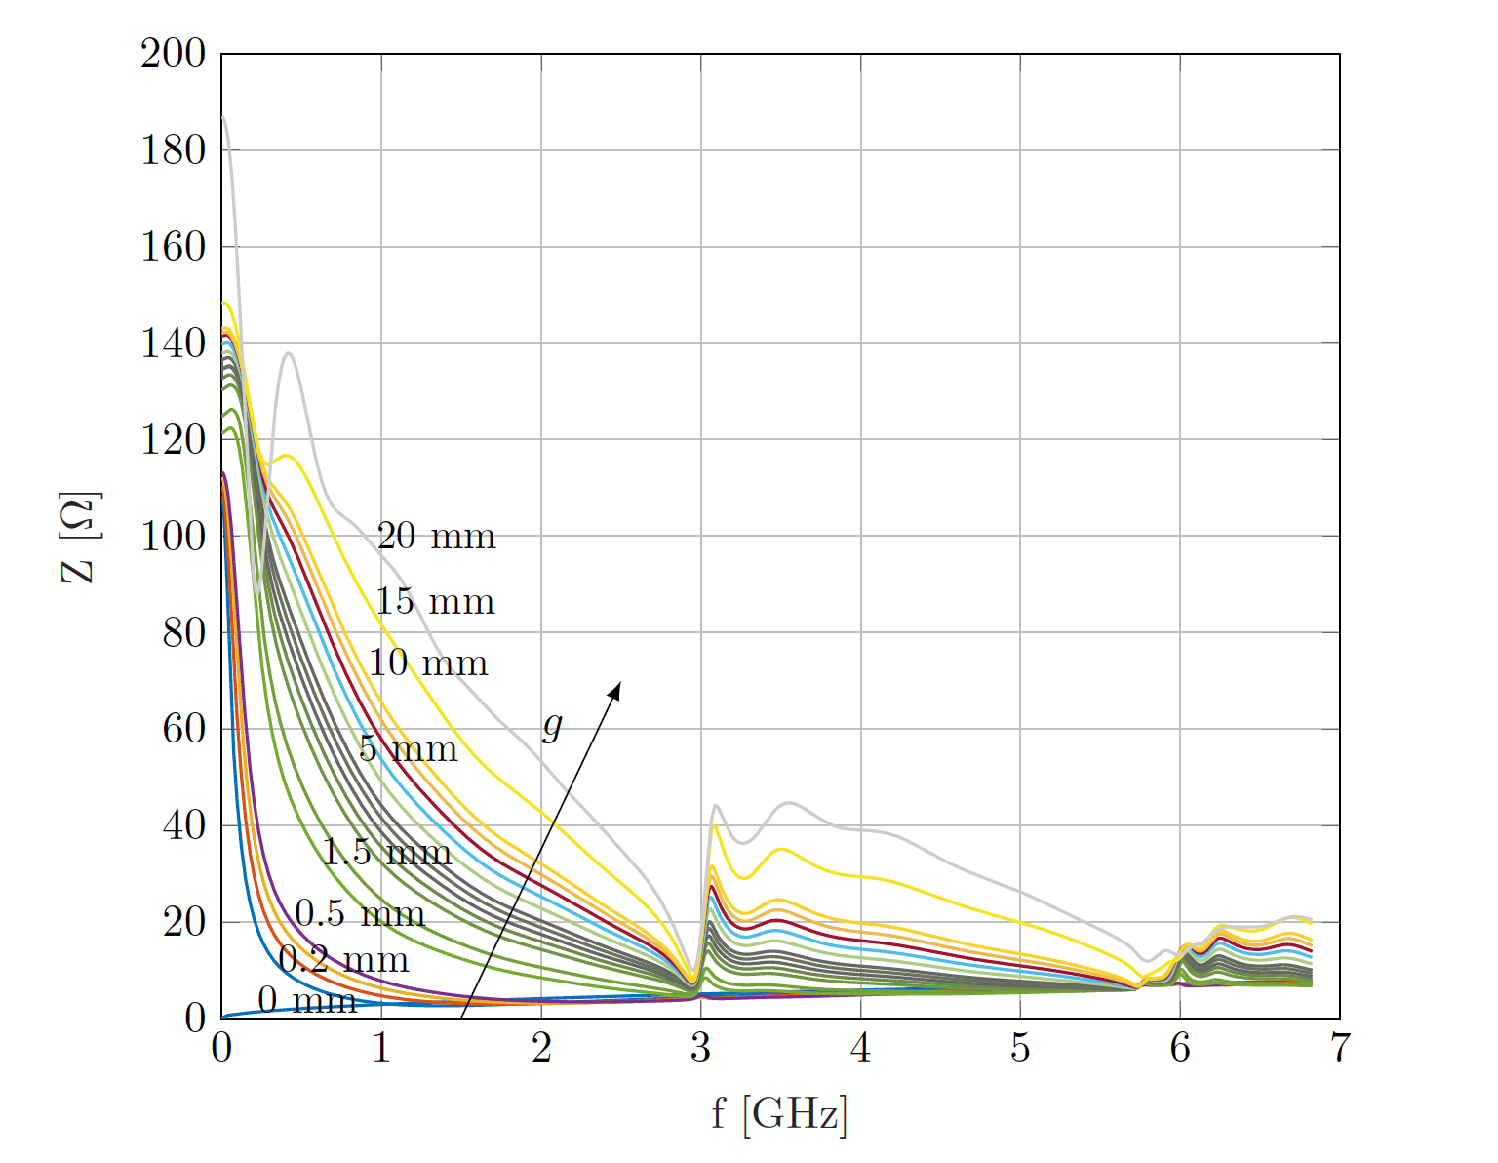
Low Impedance Guidelines (1/2)
8/19

Slide 10
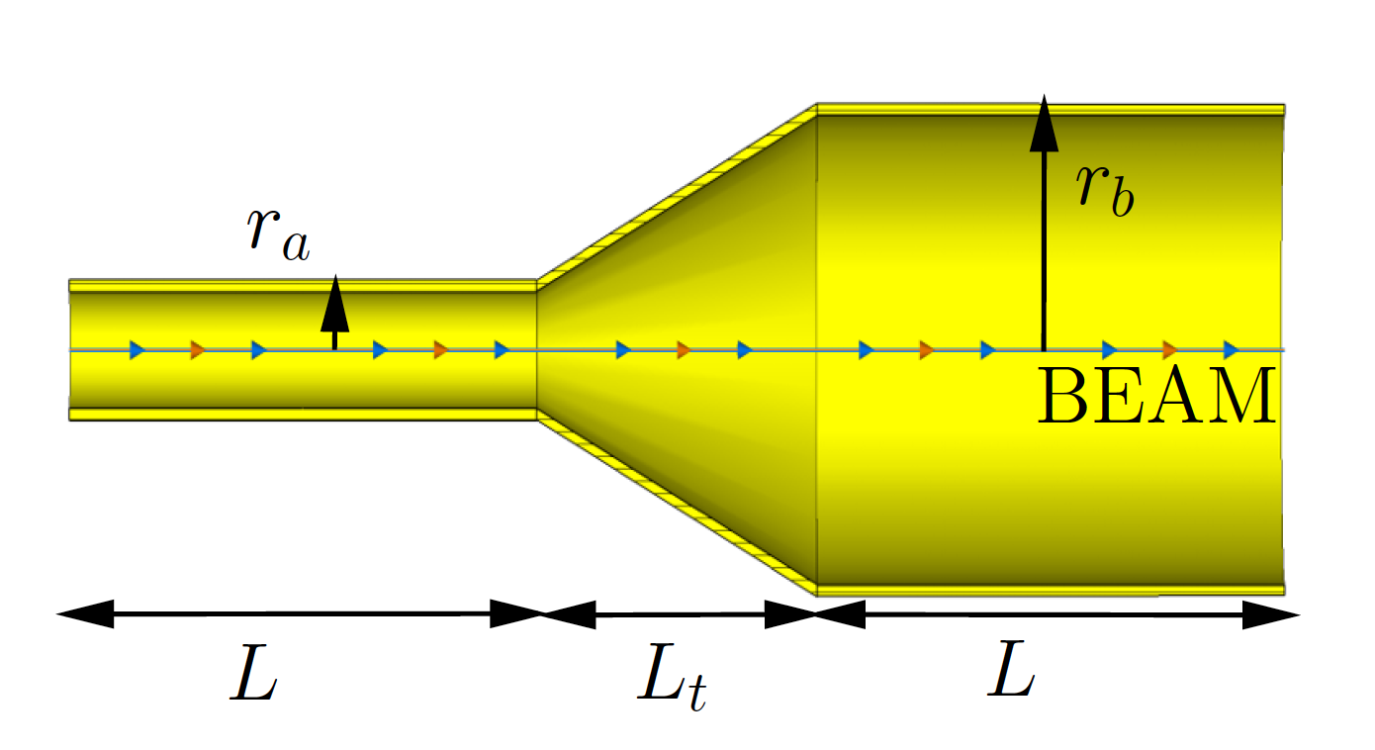
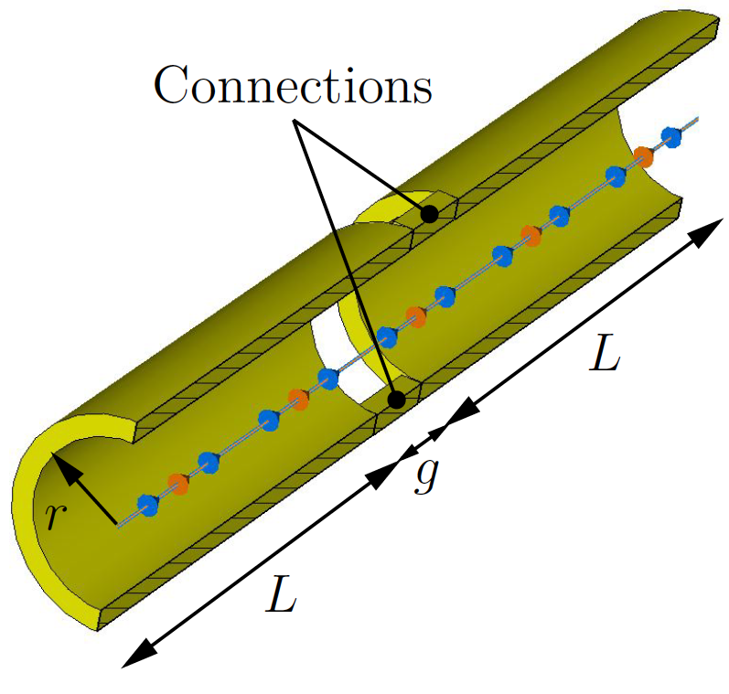
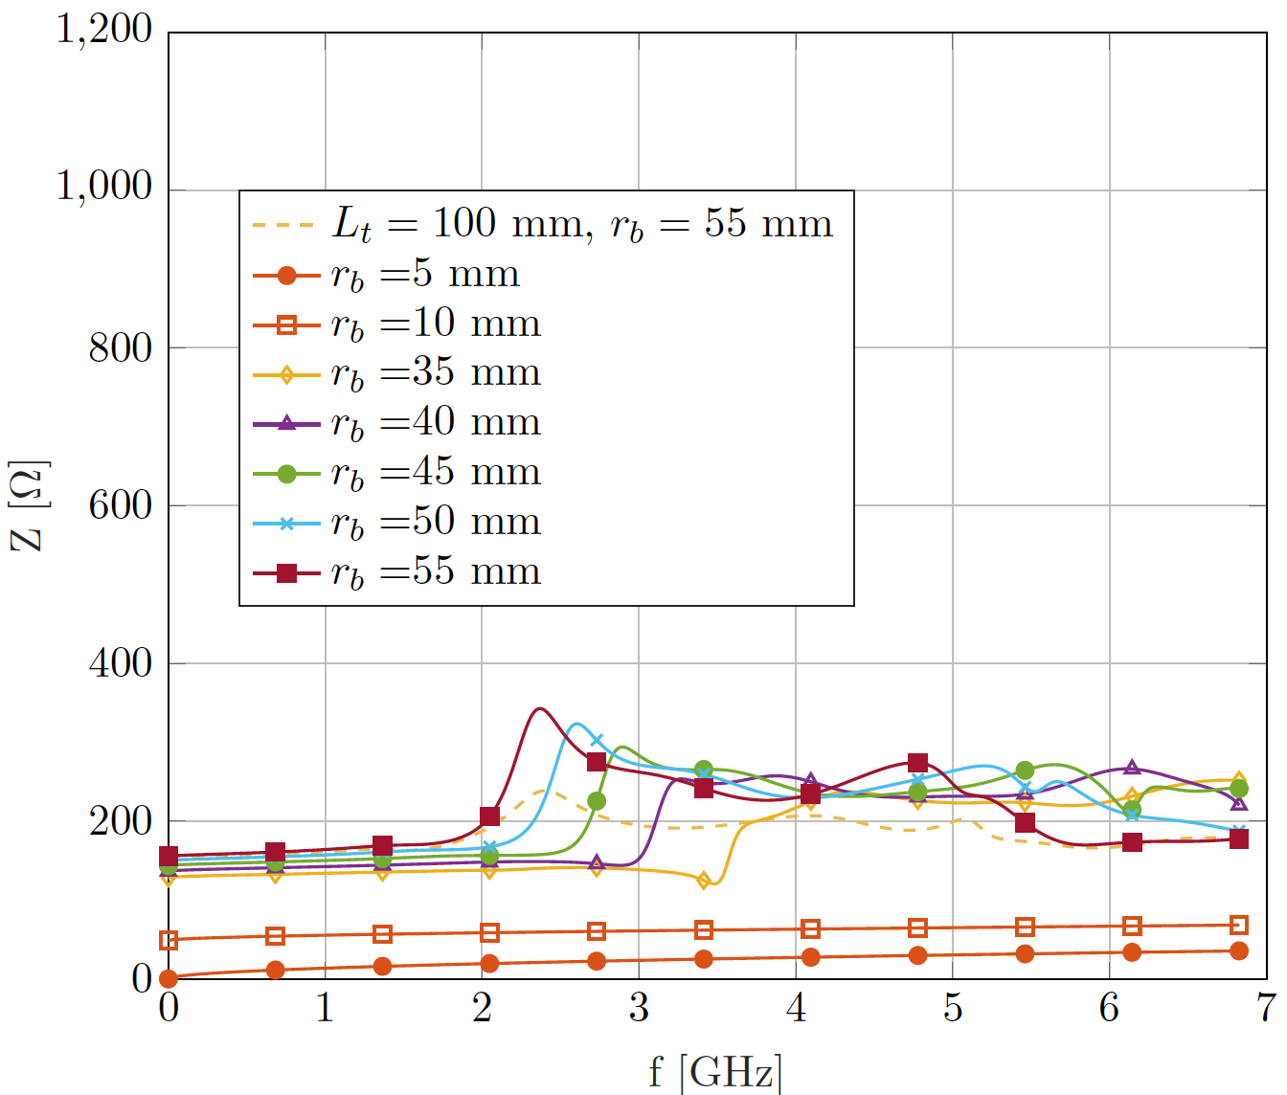
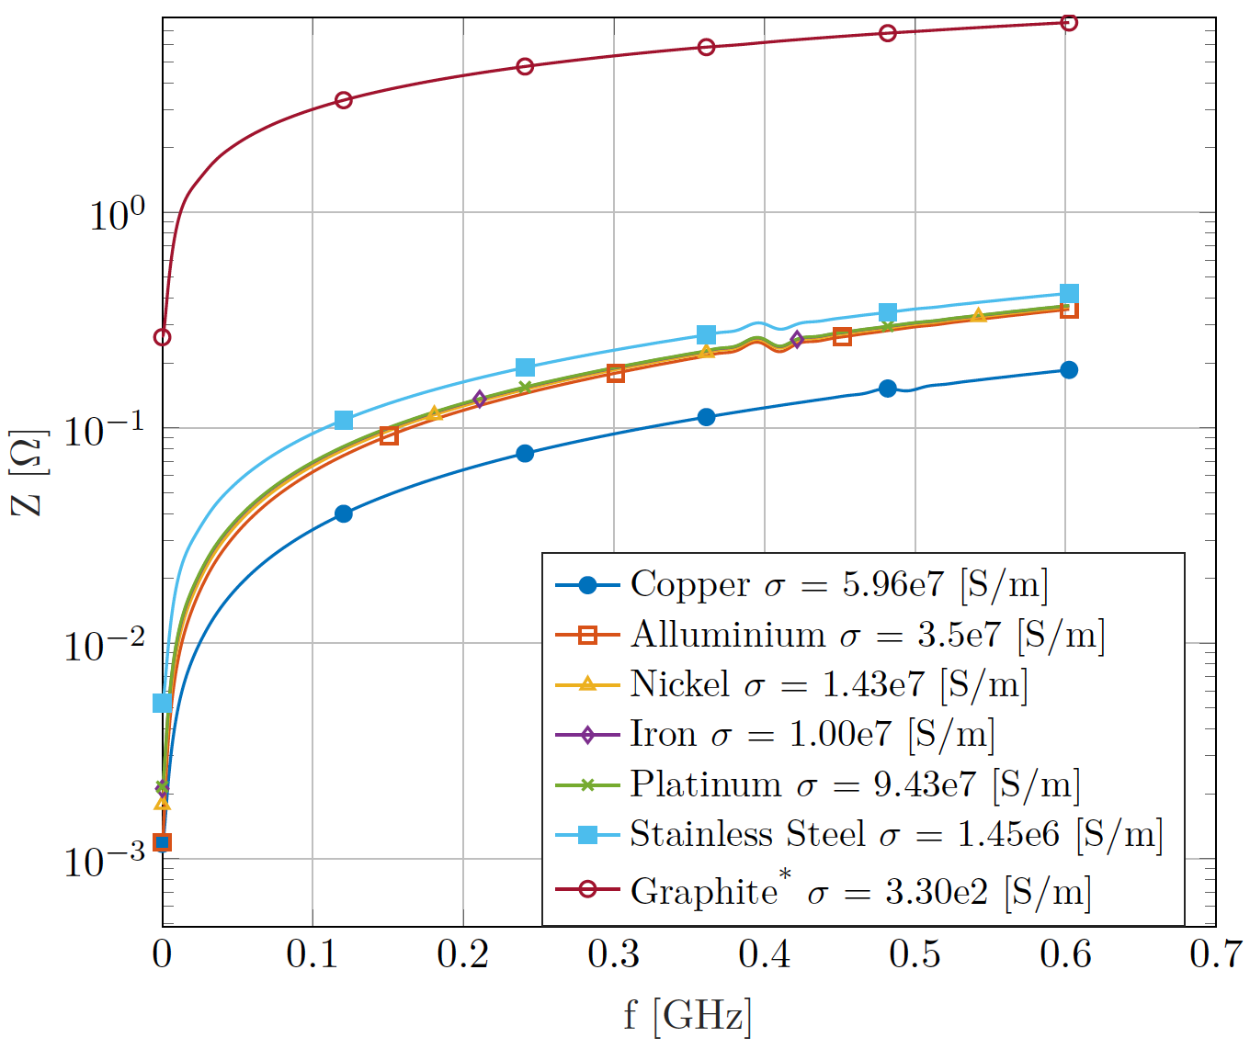
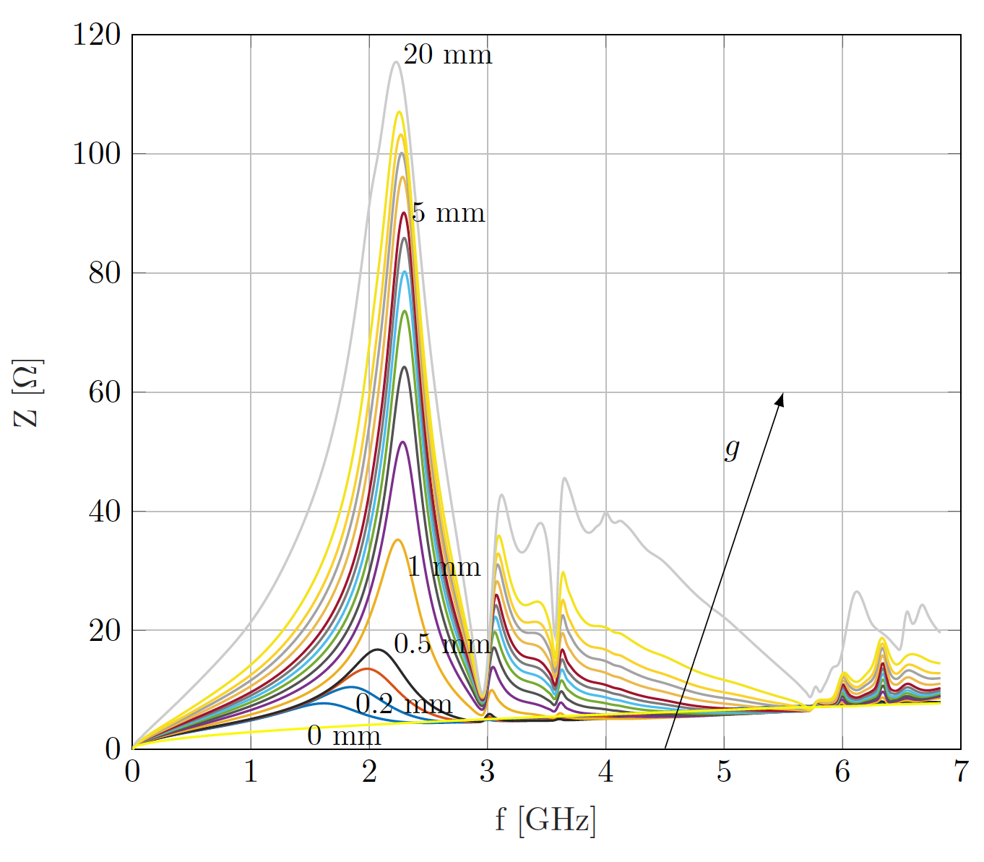
Low Impedance Guidelines (2/2)
9/19

Slide 11
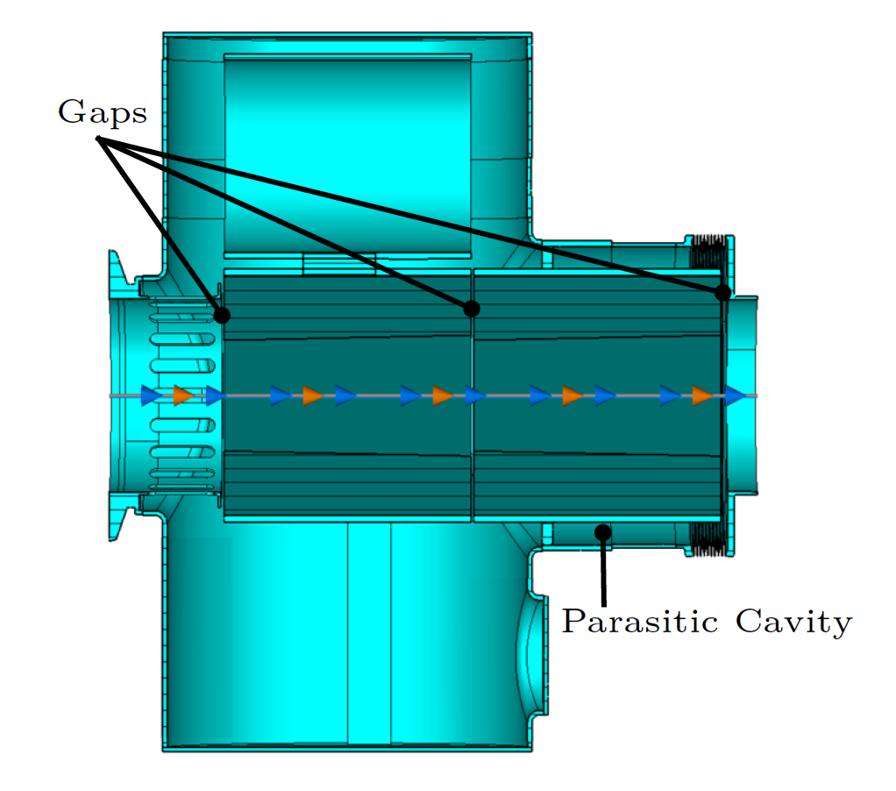
Examples of Application for LIU Devices: The PSB Absorber/Scraper Preliminary Design
Nominal Operation
Commissioning
10/19

Slide 12
Examples of Application for LIU Devices: The PSB Absorber/Scraper Final Design
11/19

Slide 13
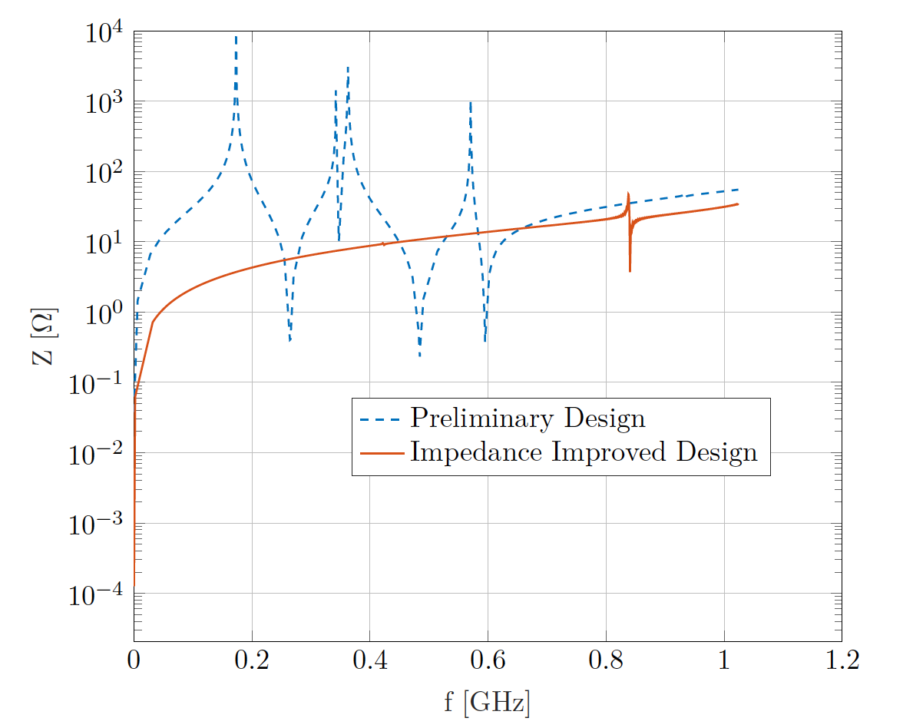
The PSB Absorber/Scraper Final and Preliminary Design Comparison
Preliminary Design
Impedance Improved Design
12/19

Slide 14
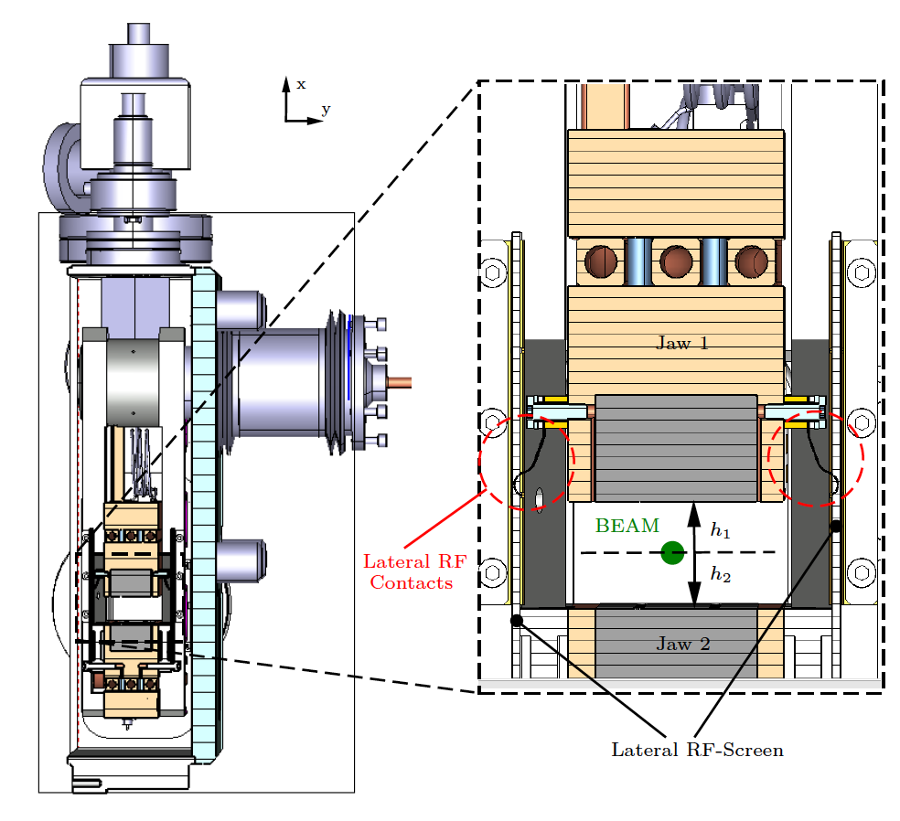
Impedance Analysis of the HL-LHC Devices (The Target Collimator Low Dispersion)
/19
13/19

Slide 15
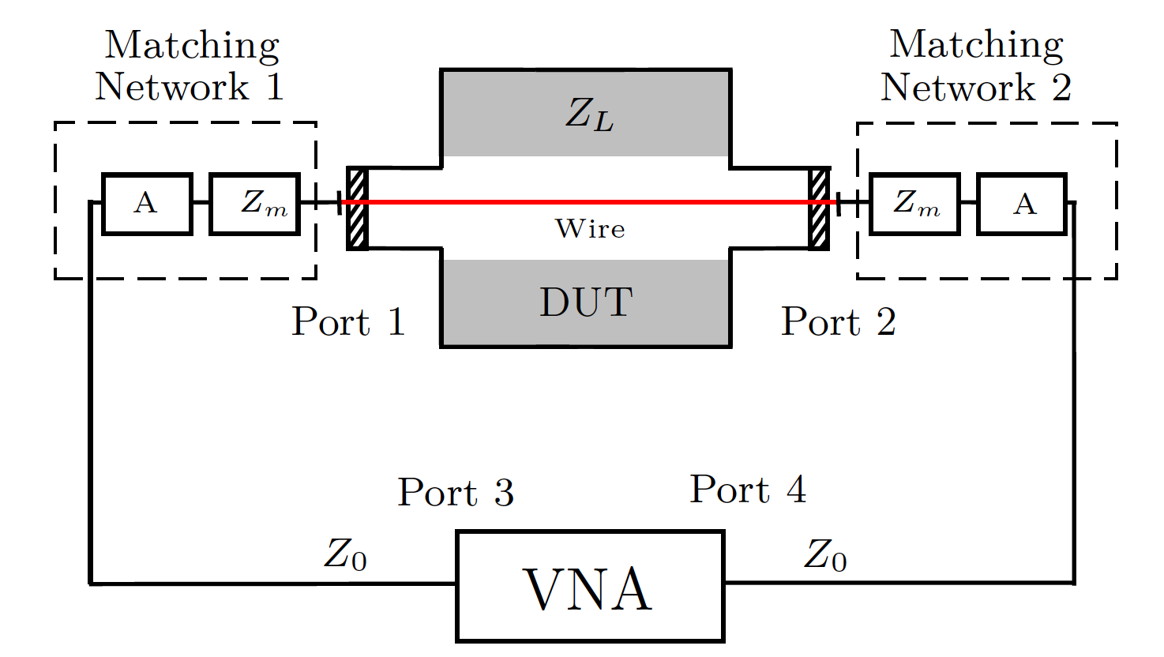
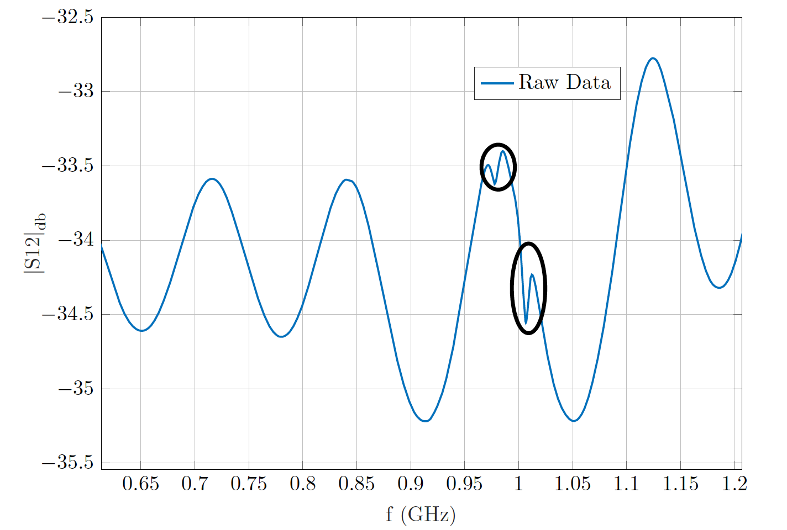
The Target Collimator Low Dispersion Impedance Measurements
14/19

Slide 16
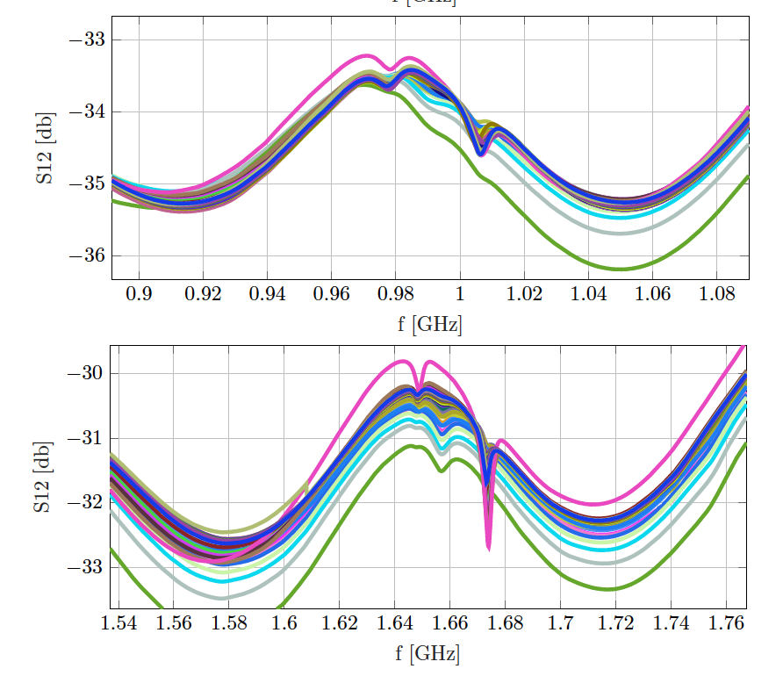
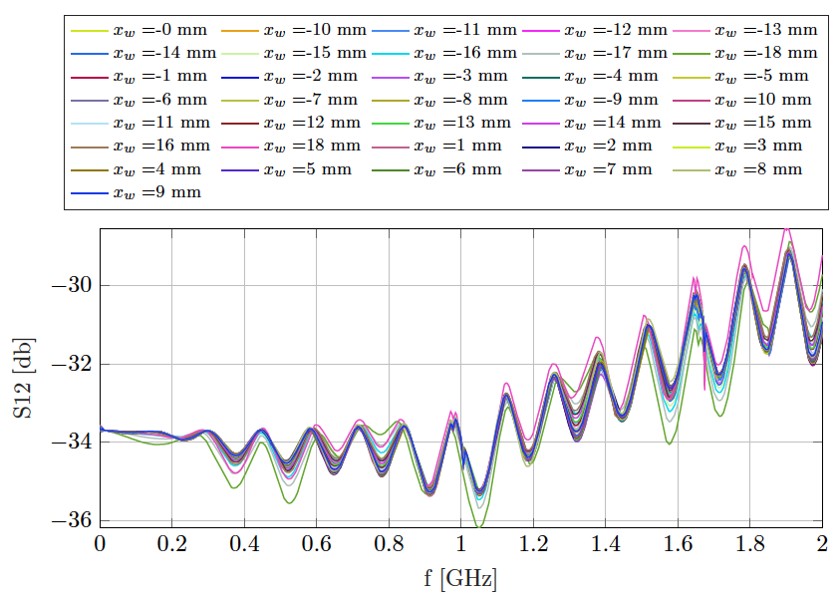
The Target Collimator Low Dispersion Measurements
15/19

Slide 17
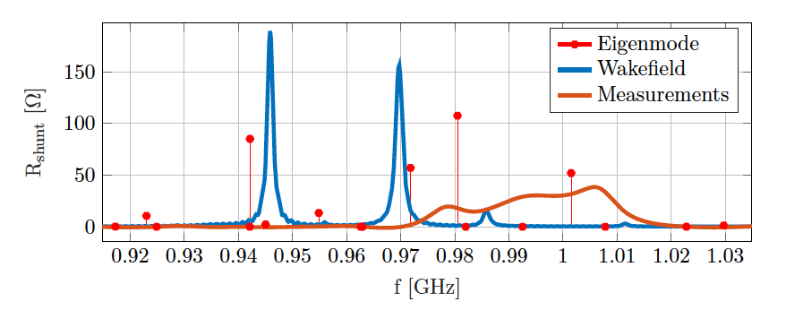
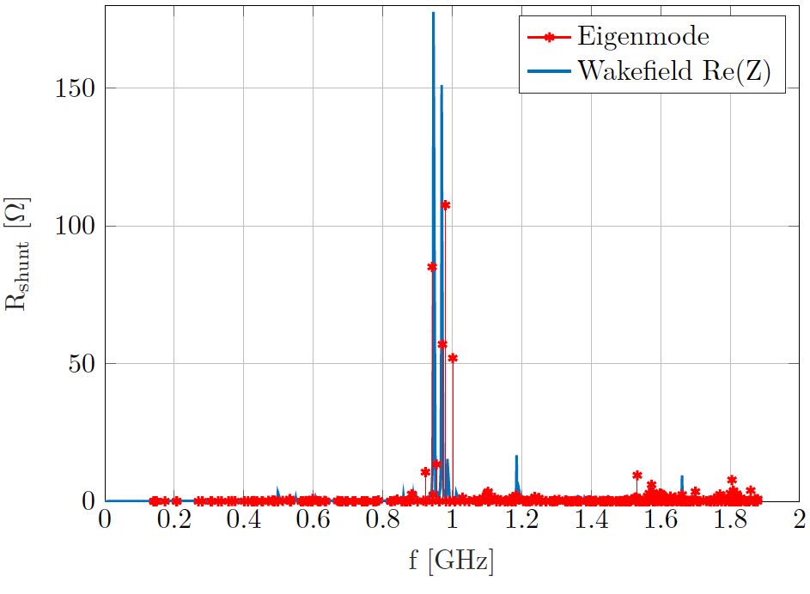
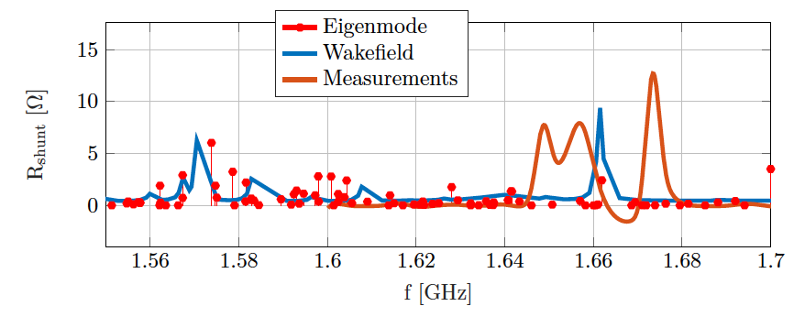
The Target Collimator Low Dispersion Simulations and Measurements Comparison
16/19

Slide 18
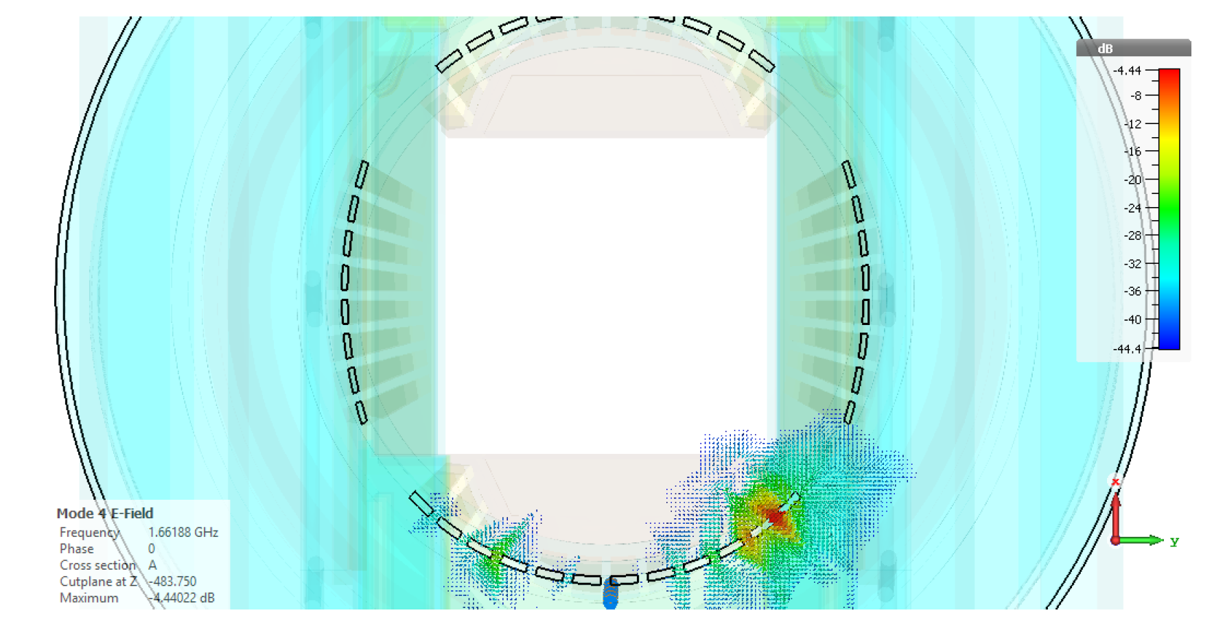
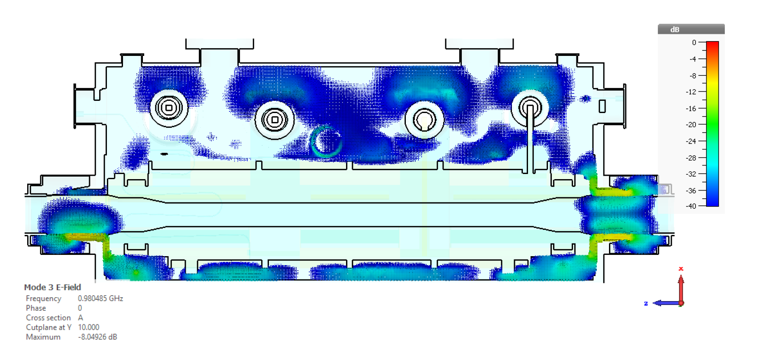
The Target Collimator Low Dispersion Simulations and Measurements Comparison
17/19

Slide 19
Conclusions
The HL-LHC and LIU were presented
In the context of these two projects the intensity of the beams running in the CERN accelerator complex is plan to be doubled
Most devices have to be redesigned to cope with the new demanding situations, especially the beam intercepting devices
In the redesign of the beam intercepting devices the minimization of the electromagnetic beam-equipment interaction (quantified by the impedance) is a crucial design driver
In this presentation some minimization techniques has been reviewed
An example of their application have been shown, using them the impedance of the Proton Synchrotron Booster Absorber Scraper have been reduced of three order of magnitude (studies done by simulations)
The impedance of the PSBAS final design does not lead to beam instabilities or RF-Heating issues
The results for an impedance measurements campaign for a collimator have been presented.
The wire measurements technique was described and its results were compared with the performed simulations, there is agreement between measurements and simulations but there are also some discrepancies
The discrepancies could be caused by the difficulty to model correctly the RF-fingers in the device
18/19

Slide 20
References
[1] Teofili, L., et al. Design of the new proton synchrotron booster absorber scraper (PSBAS) in the framework of the large hadron collider injection upgrade (LIU) project. In Journal of Physics: Conference Series, vol. 1067 (2018). Doi:10.1088/1742-6596/1067/8/082027.
[2] Teofili, L., Lamas, I., and Rijoff, T. L. DESIGN OF LOW IMPACT IMPEDANCE DEVICES : THE NEW PROTON SYNCHROTRON BOOSTER ABSORBER SCRAPER ( PSBAS ). In CERN Yellow Rep. Conf. Proc., vol. 1, pp. 18–22. CERN, Geneva (2018). Available from: https: //cds.cern.ch/record/2674111, doi:10.23732/CYRCP-2018-001.111.
[3] Teofili, L., Migliorati, M., and Lamas, I. a Multi-Physics Approach To Simulate the Rf-Heating 3D Power Map Induced By the Proton Beam in a Beam Intercepting Device *. J. Phys.: Conf. Ser., 1067 (2018). Available from: http://iopscience.iop.org/article/10.1088/1742-6596/1067/6/062012/pdf.
19/19

Slide 21
Thank You For Your Attention

Slide 22
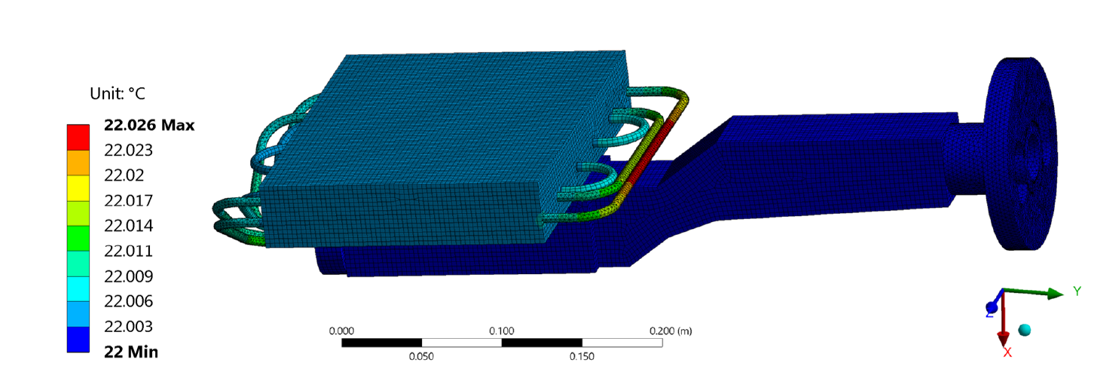
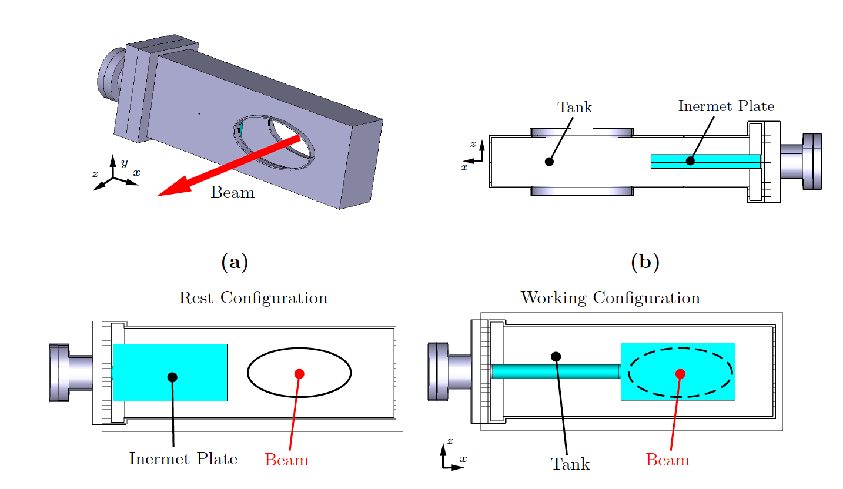
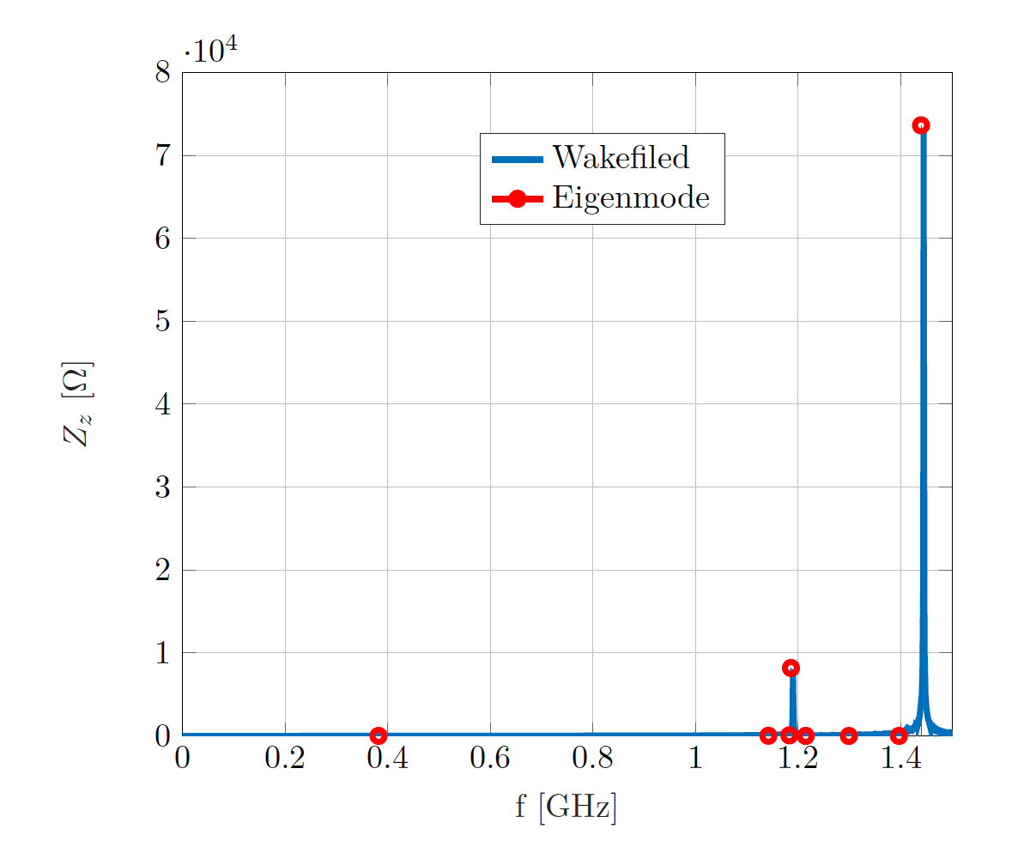
Thesis Work Not Discussed In this Presentation
PSDUMP [4,5]
PS Rallentisseur

Slide 23
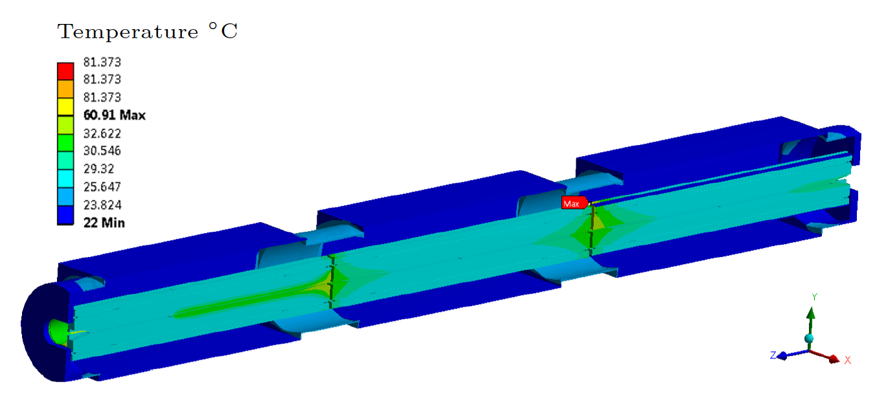
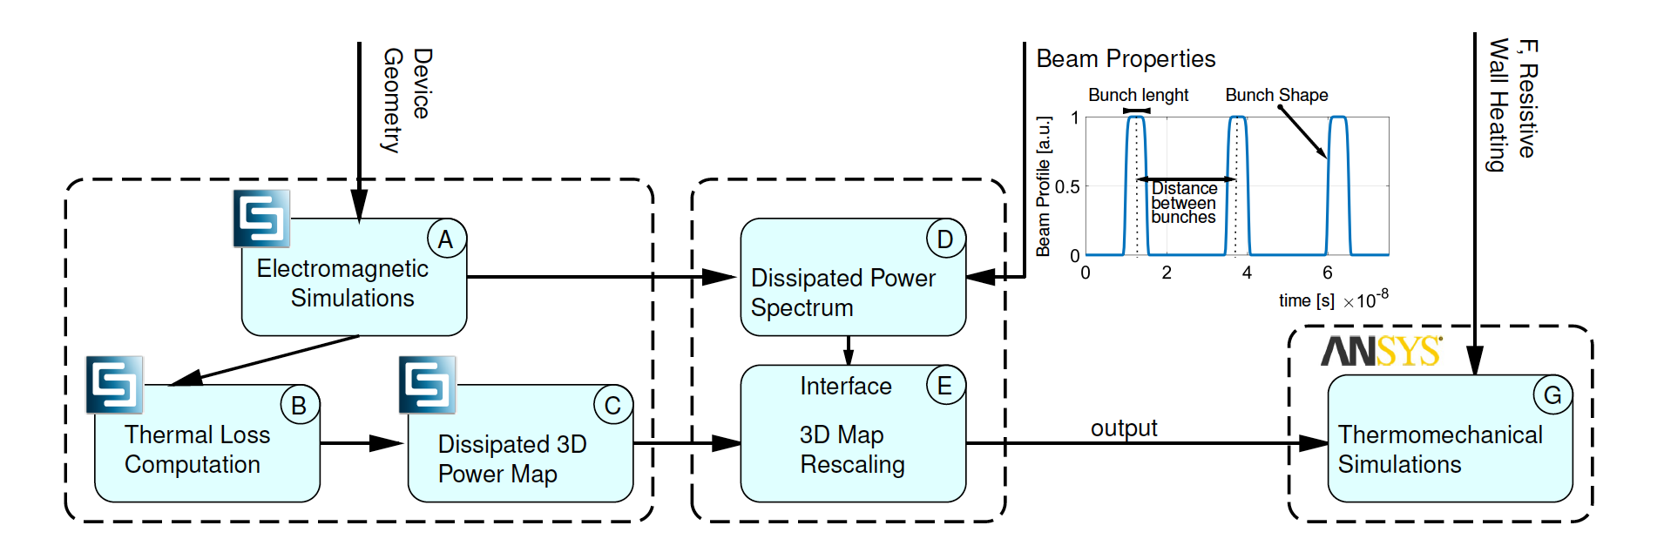
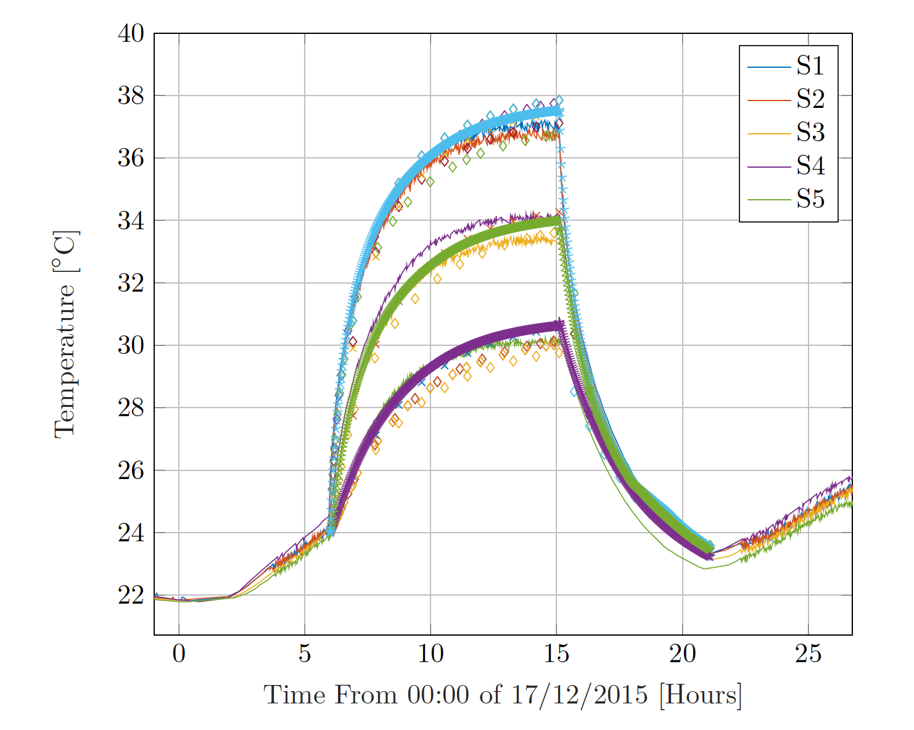
Thesis Work Not Discussed In this Presentation
TDIS [6,7]
A new Simulations Method for Impedance Induced Thermo-mechanical effects [3]

Slide 24
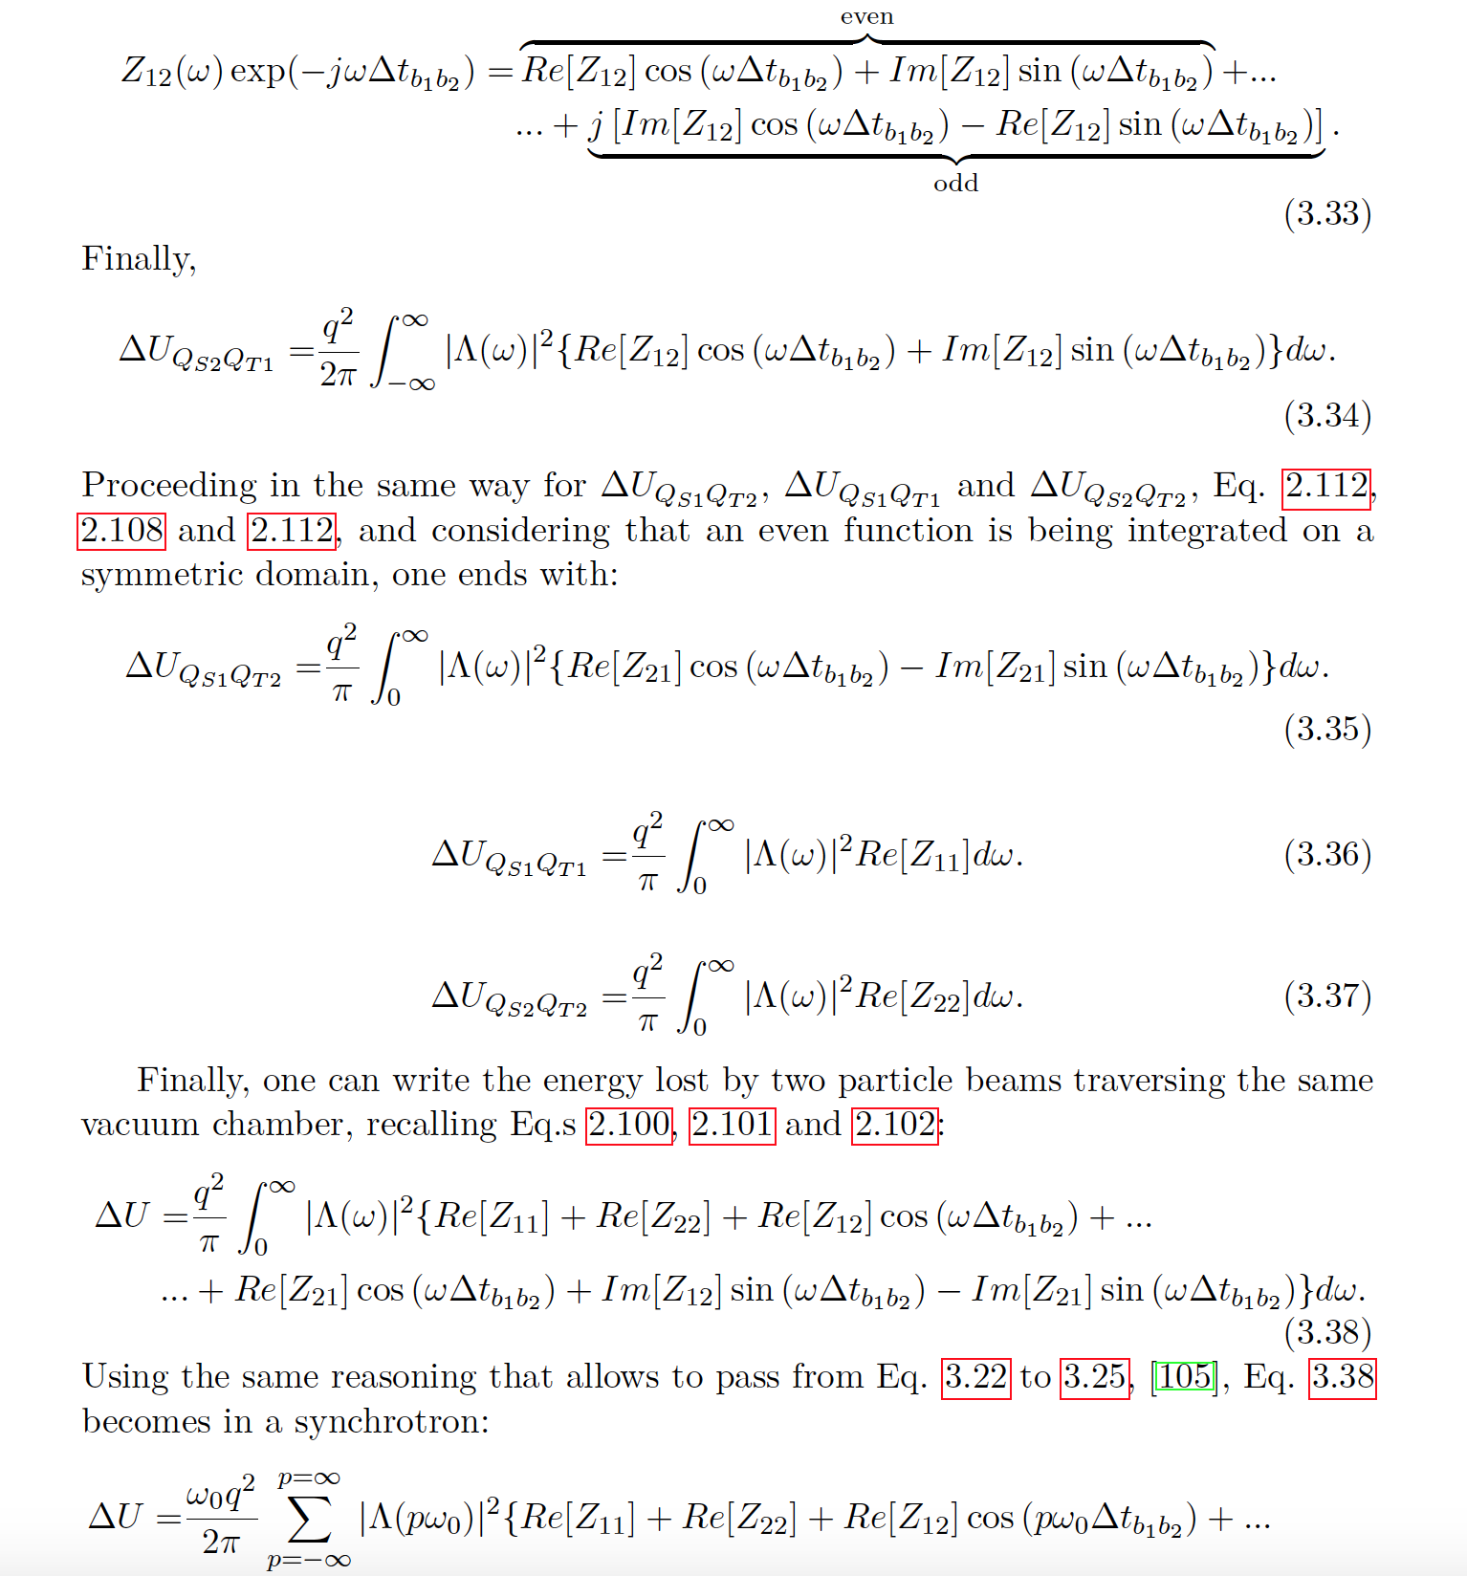
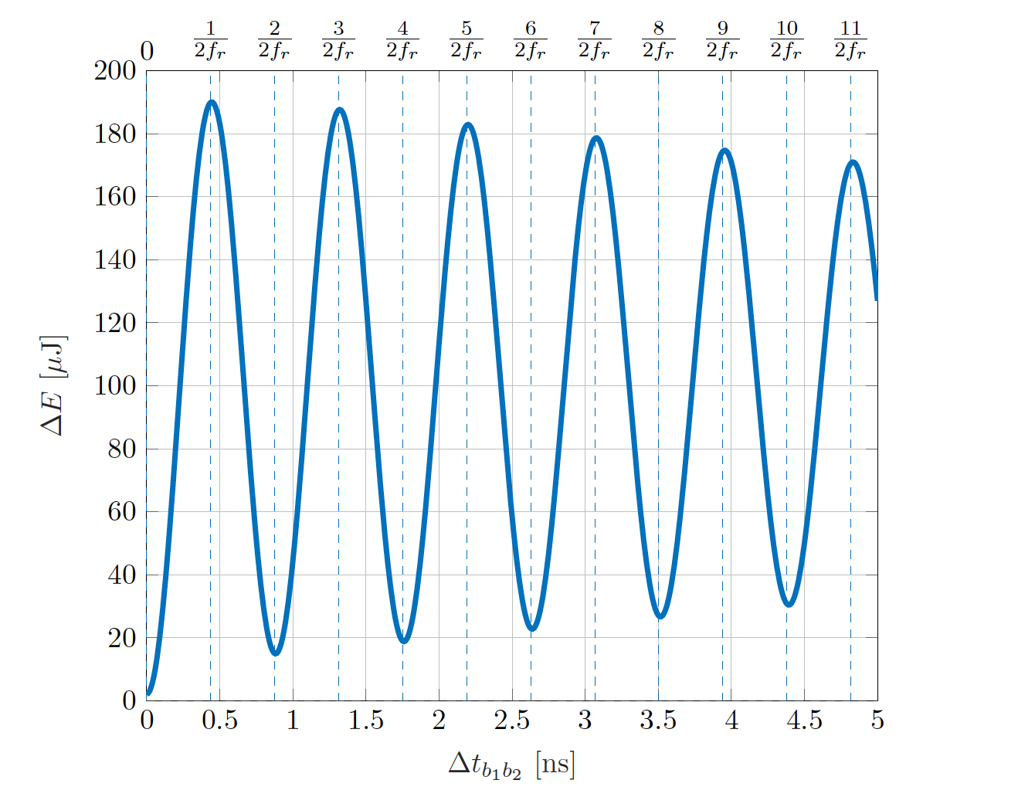
Thesis Work Not Discussed In this Presentation
Counter Rotating Impedance

Slide 25
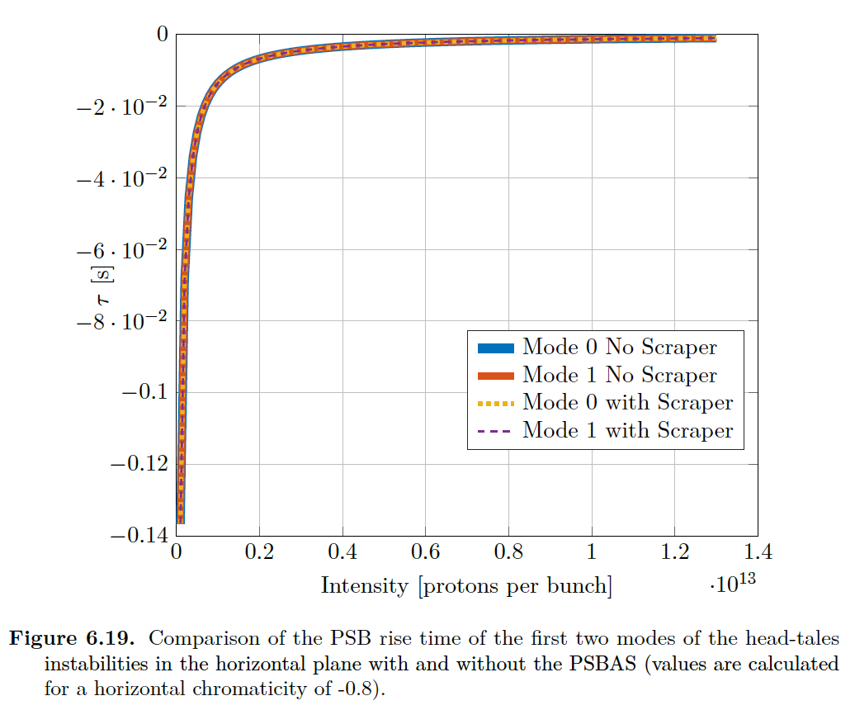
Impact of the PSBAS Impedance Improved Design on Beam Instabilities and RF-Heating
Beam Instabilities
RF-Heating Map
Total Dissipated RF-Power 0.43 W
Courtesy Of T. Rijoof

Slide 26
Extra References
[4] B. K. Popovic, L. Teofili, and C. Vollinger, “Impedance Analysis of New PS Internal Dump Design”, in Proc. 9th Int. Particle Accelerator Conf. (IPAC'18), Vancouver, Canada, Apr.-May 2018, pp. 3083-3086. doi:10.18429/JACoW-IPAC2018-THPAF052
[5] L. Teofili et al., “Analysis on the Thermal Response to Beam Impedance Heating of the Post Ls2 Proton Synchrotron Beam Dump”, in Proc. 10th Int. Particle Accelerator Conf. (IPAC'19), Melbourne, Australia, May 2019, pp. 4260-4263. doi:10.18429/JACoW-IPAC2019-THPTS065
[6] Teofili, L., Migliorati, M., Calviani, M., Carbajo, D., Gilardoni, S., Giordano, F., Lamas, I., Mazzacano, G., and Perillo, A. Analysis on the mechanical effects induced by beam impedance heating on the HL-LHC target dump injection segmented (TDIS) absorber. In Journal of Physics: Conference Series, vol. 1067 (2018). doi:10.1088/1742-6596/1067/6/062011.
[7] Teofili, L., Migliorati, M., Carbajo, D., Lamas, I., and Perillo, A. DESIGN OF THE TARGET DUMP INJECTION SEGMENTED (TDIS ) IN THE FRAMEWORK OF THE HIGH LUMINOSITY LARGE HADRON COLLIDER ( HL-LHC ) PROJECT. (2015), 122. doi:10.18429/JACoW-HB2018-TUP2WE04.

