Slide 1
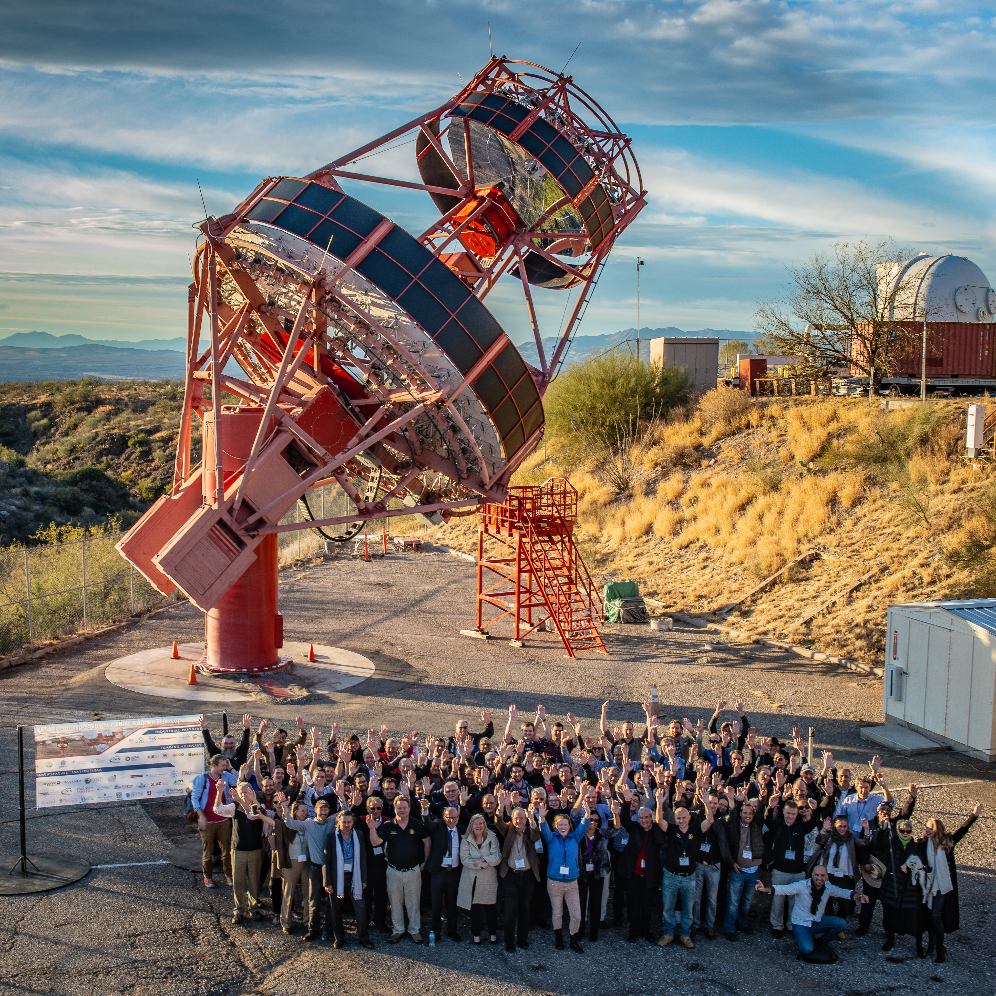
Status of the pSCT camera and its upgrade
pSCT project
  Camera performance progress
Updates since the Lugano meeting
  SiPM technology transfer
  Preamplifier ASIC: SMART
  Front-end electronics modules
Next steps

Slide 2
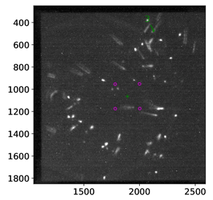
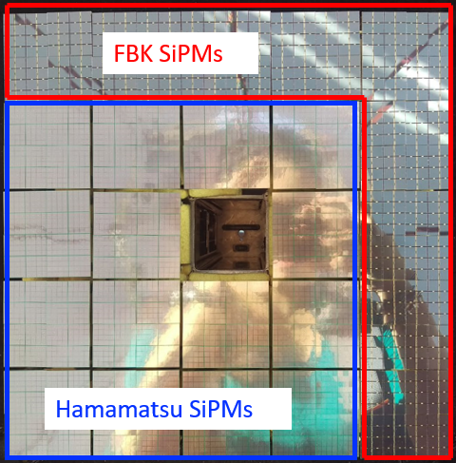
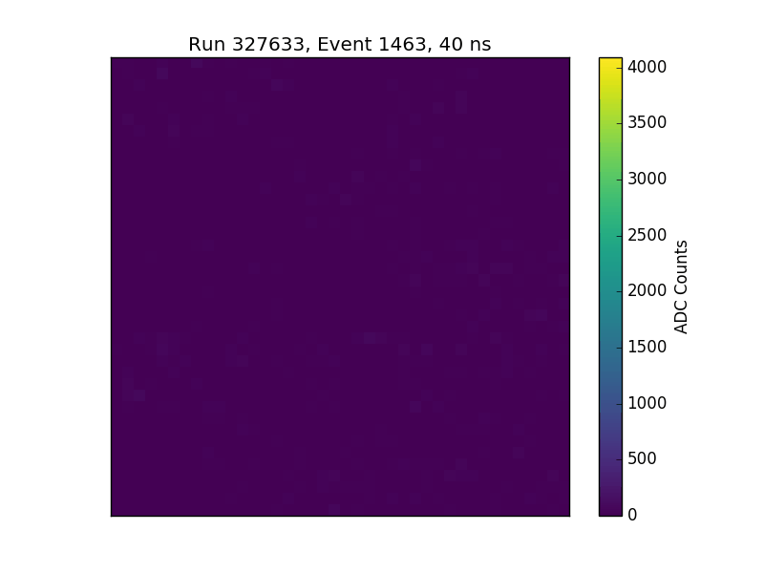
pSCT Camera
All modules (US and INFN) have TARGET 7 front-end electronics modules
Central module position used for global alignment system
Improvements made in the mirror alignment
  Vega star
  Showers now resolved into compact regions (corresponding to the improved alignment shown in Vega images)
More progress on the
  Optimized ASICs initialization sequence, properly configured at all temperatures
  noise stable when chiller is running.

Slide 3
Optimization for low temperature issues
Not fixed
Fixed

Slide 4
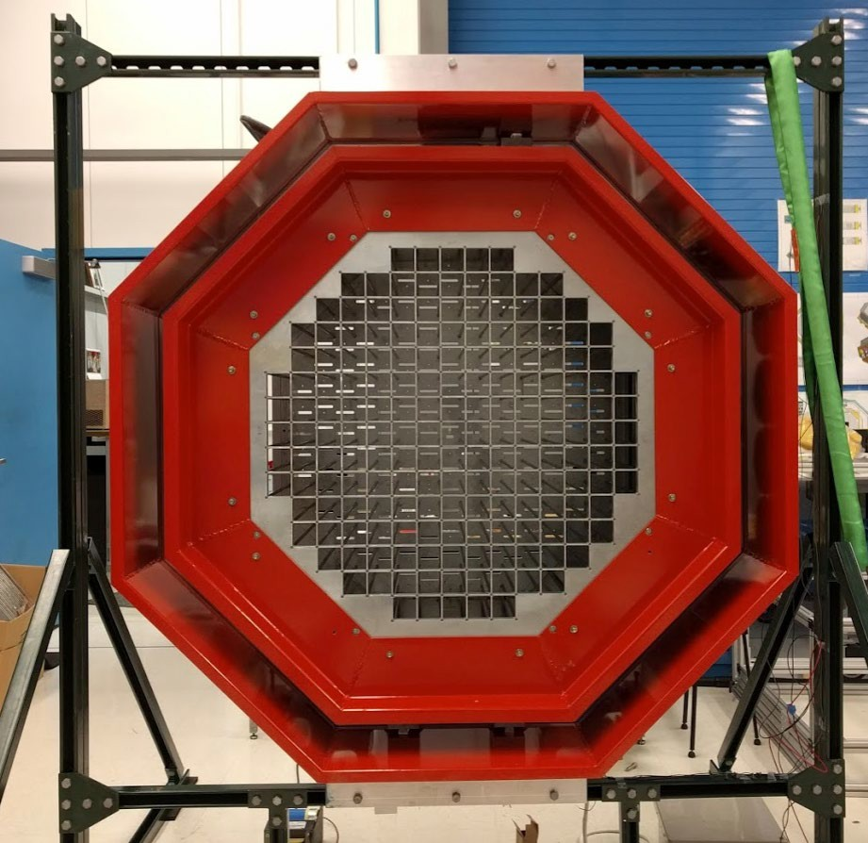
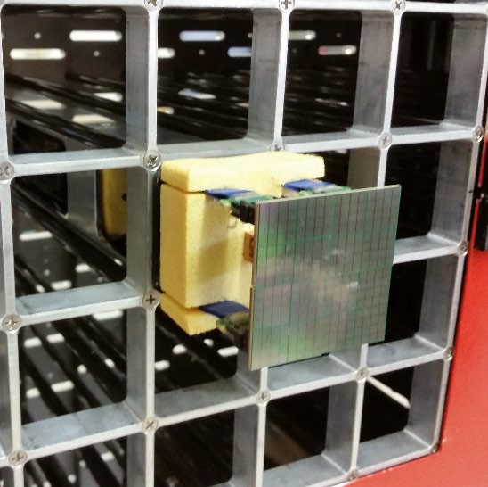
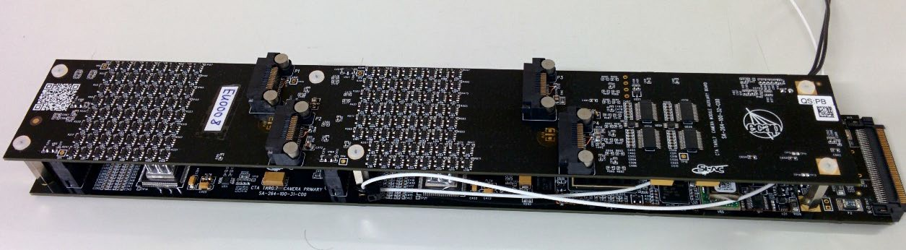
pSCT camera upgrade
Goal: Populate the full camera (11328 channels, 177 modules)
NUV-HD by FBK as SiPM sensor
Design a preamplifier ASIC and remove discrete components
Re-design the readout module with TARGET family ASICs
  T5TEA for trigger
  TARGET-C for analog sampling
Pre-amplifier stage
pulse shaping
pole zero cancellation

Slide 5
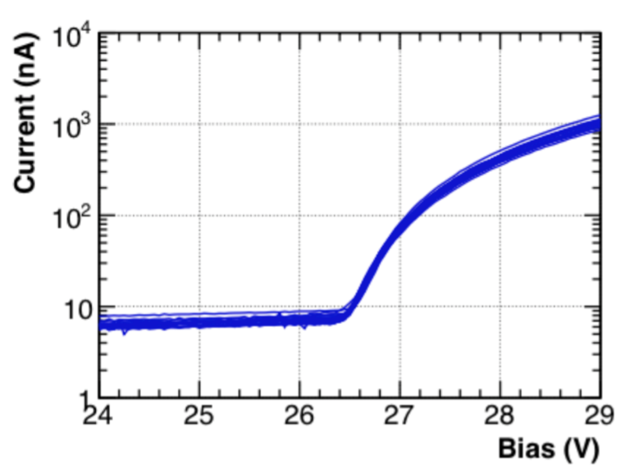
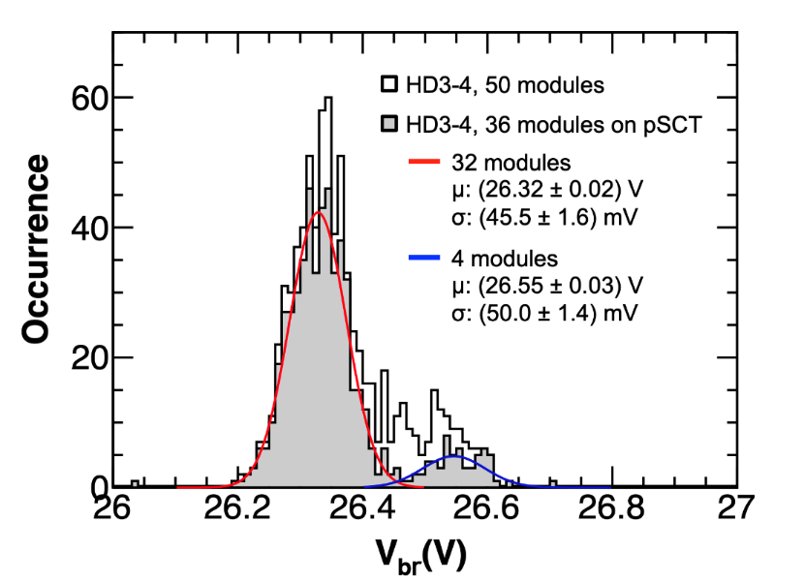
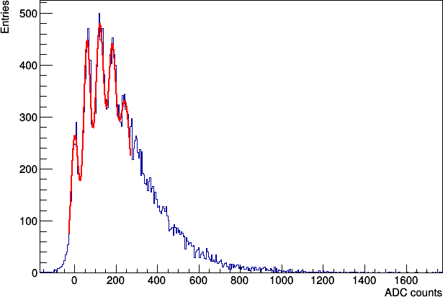
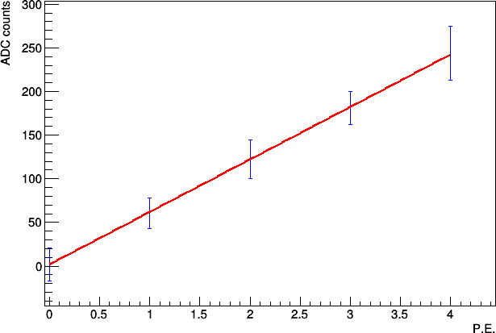
FBK Silicon Photomultipliers
iV measured on all channels after assembly
  Breakdown voltage V_{bd} evaluated
  Uniform V_{bd} : σ/μ = 0.17%
Gain measurement and pulse amplitude
  4x4 NUV-HD3 matrix (Vbias = 33 V), one SiPM illuminated
  SMART & Target-C (sampling) + T5TEA (trigger)
  Picosecond pulsed laser
IV characteristics for a 16-channel matrix
V_{bd} distribution for all SiPMs

Slide 6
FBK Silicon Photomultipliers
Technology transfer to LFoundry started in 2019
  SiPMs to be delivered in early 2020
FBK NUV-HD3 with Through-Silicon-Via technology (TSV)
  No wire bonds → damage reduced
  New possibilities
    protective quartz glass
    larger fill factor
    assembly of SiPMs as for components
Assembly and tests of new optical modules foreseen in mid 2020

Slide 7
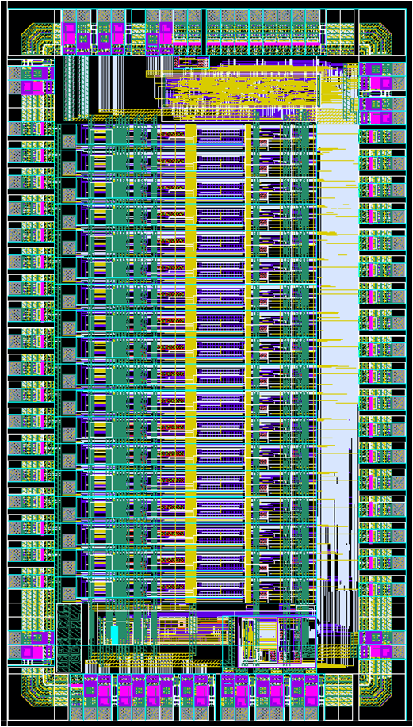
SMART preamplifier ASIC
SMART v2
Designed by F. Licciulli , INFN Bari
  16-channel preamplifier
  SiPM bias fine tuning (8-bit DAC)
  Configurable gain stage (2-6 mV/p.e.)
  Tail suppression stage with programmable filtering
  frequency
  SiPM mean current measurement with a 10-bit ADC
  Digital control via SPI link
SMART v2 improvements
  14-bit programmable trans-impedance (8 bit R, 6 bit C)
  6 bits for pole-zero compensation
  Increase of linear dynamic range
  Digital lines for CHIP select
  Improvement of layout to further reduce noise and analog cross-talk
ASIC delivered in Bari last July :
  Evaluation board just produced and mounted
  Validation tests in next few weeks

Slide 8
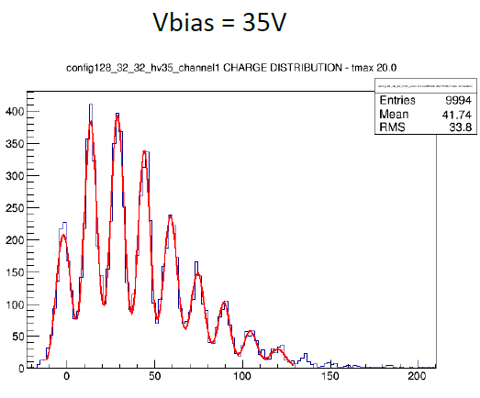
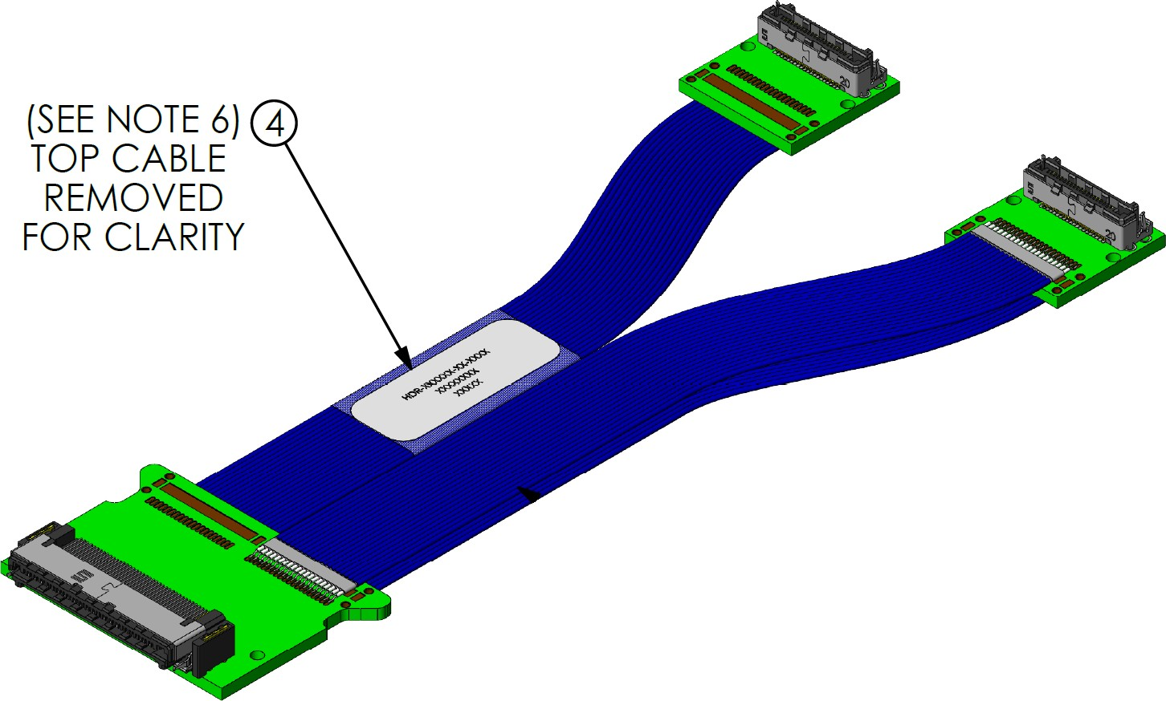
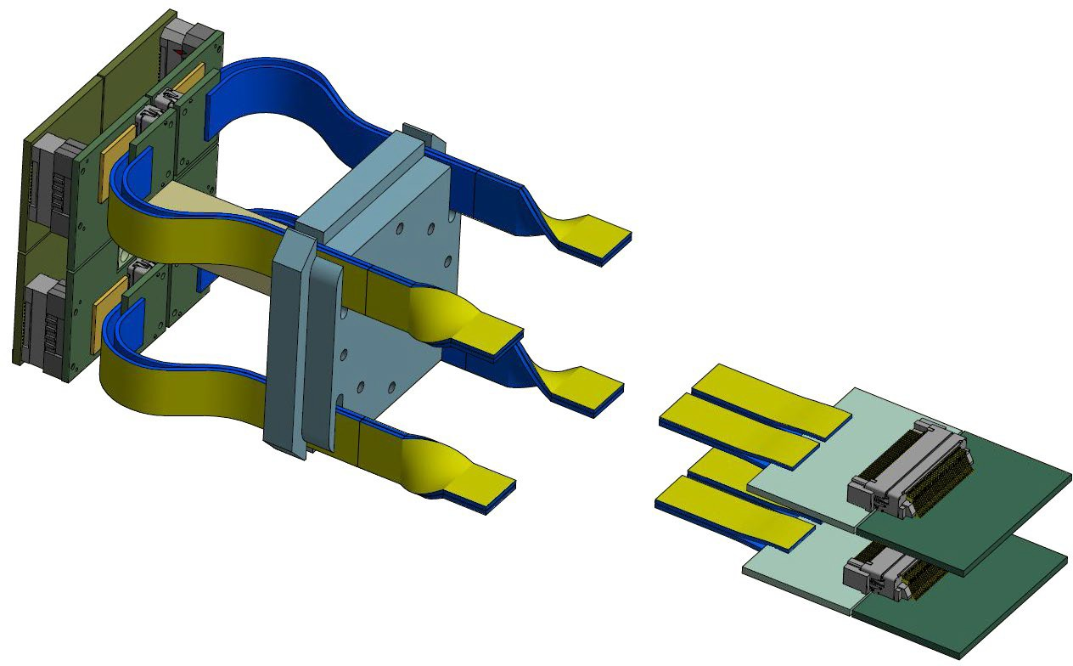
SMART preamplifier ASIC
SMART on a small PCB (1 per matrix) plugged on the SiPM matrix
PCBs connected to the FEE modules with a custom cable (from 80-pin connector to 2x40-pin connectors)
Custom cables to be produced in early 2020
New SMART version foreseen in 2020 aimed to full production
SiGe 0.35um technology no more available in AMS
v3 version in new Lfoundry:
  Software, design kit available
  Design already started
  Production & tests in mid 2020

Slide 9
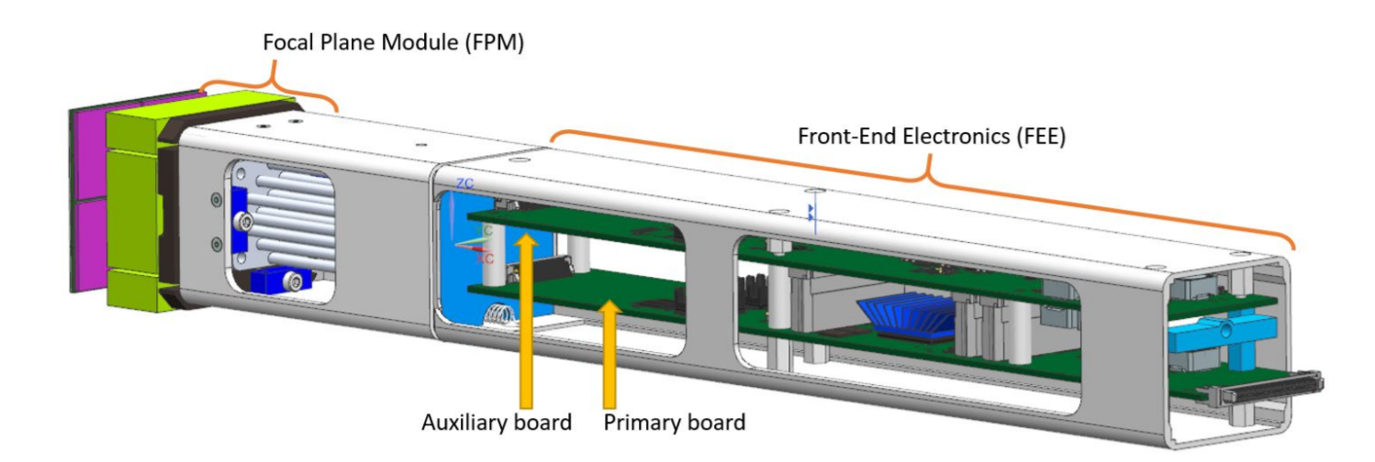
FEE design history
SCT and CHEC share a lot
  SiPM camera
  Near sensor preamplifier needs
  Low noise electronics
  Single photo electron trigger capability
SCT and CHEC have a long history of cooperation, starting back in 2011
Initial contacts with Leicester group in may 2018, at the CTA consortium meeting in Paris
Considering each expertise and needs
it was natural to come to an agreement on cooperating on the FEE module design
Main issue with Target7 electronics was the cross talk on the ASIC and on the PCB
Initial approach to split the analog and digital processing between the top and bottom boards (following CHEC approach) was adopted in order to avoid cross talk effects on the PCB
After some iterations between the SCT and CHEC groups we have come to a satisfactory design for the pSCT prototype FEE module

Slide 10
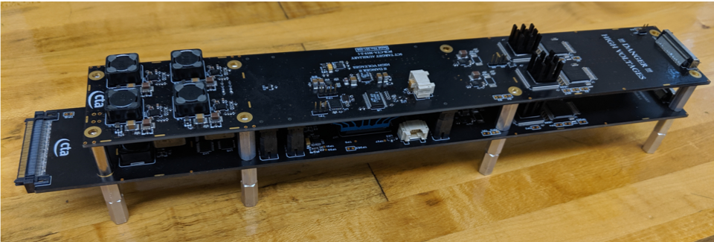
FEE module prototypes
New FEE modules based on new TARGET ASICs
  TargetC : sampling and digitization
  T5TEA : trigger
4 prototypes of the new FEE modules have been produced
Performance tests in 4 labs:
  Atlanta
  Erlangen
  Madison
  Pisa
Preliminary results
  Pedestal noise
  Signal x-talk
  Trigger noise

Slide 11
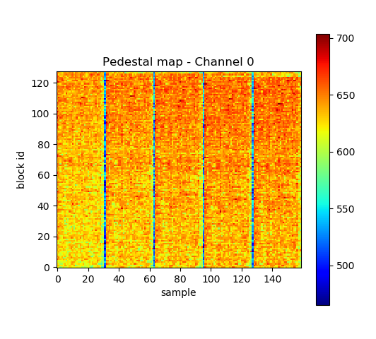
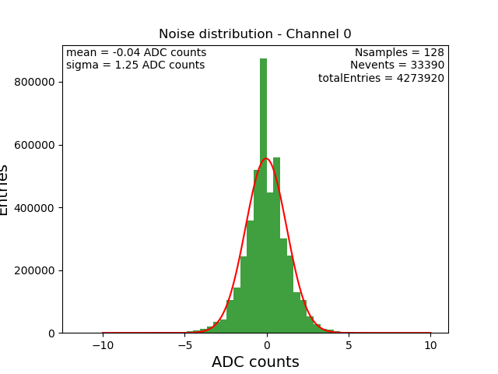
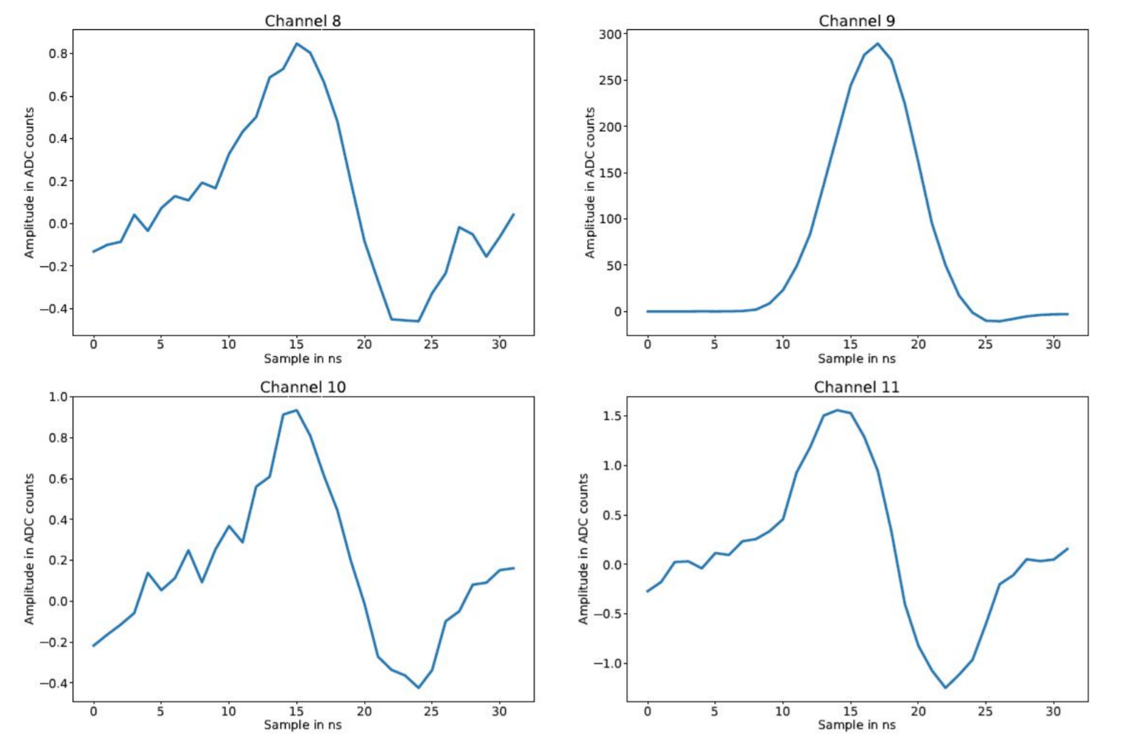
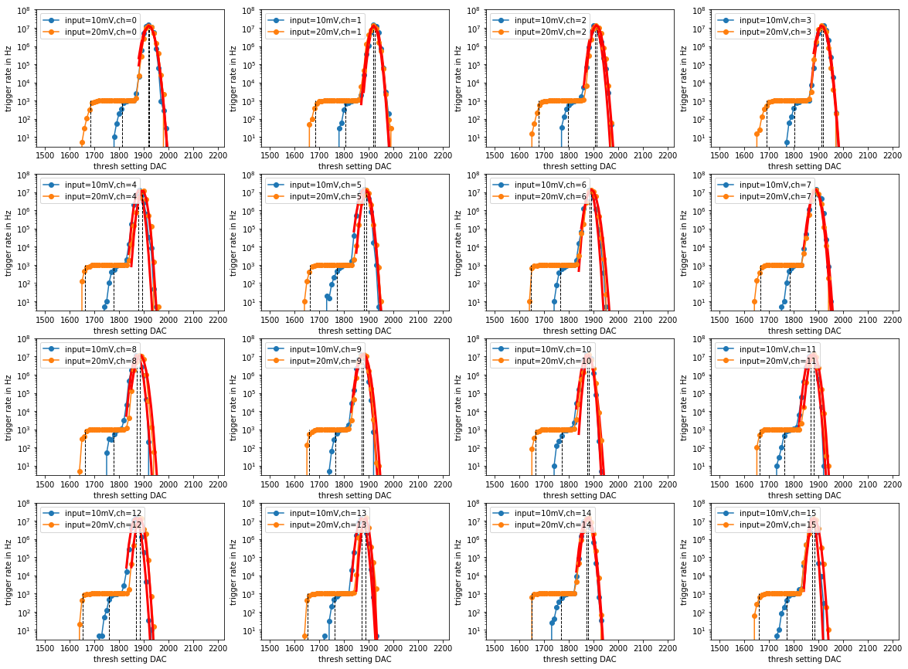
FEE performance
Performance of the FEE modules is satisfactory so far, aim at «1-1-1»
  Pedestal noise is around 1.25 ADC counts
  Signal cross talk:
  less than 1% cross talk on
  adiacent lines
  Trigger chain noise:
  less than 1 mV noise
Input=6mV
Input=12mV

Slide 12
Next steps
FEE Design review scheduled for october 30th, 2019
Documentation available
  Board schematics
  Layout files
  SCT requirements
  Prototype test extended documentation, huge effort by:
  T. Meures, M. Bitossi, N. Otte, B. Mode, A. Rugliancich, L. Di Venere
8 people in the review committee
Accepted

Slide 13




Schedule
10 / 2019
9 / 2020
9 / 2020
9 / 2021
Year 1
Year 2
Year 3
Completed:
FEE design Backplane revision
SiPM testing / production
Ongoing:
FEE testing
SMART testing Shutter design
Camera cooling evaluation
FEE production batch#1
SMART preamp boards
Testing one full sector Purchasing
FEE production batch#2
Integration / Commissioning

Slide 14
Conclusions
The pSCT camera performance installed at FLWO is progressing:
  Commissioning is still ongoing, not a surprise considering the system complexity
  Mirror alignment brings better performance in current camera shower images
  Lot of progress on ASIC initialization sequence and temperature calibration
Camera upgrade already started and present status is on schedule
  Full camera with SiPMs produced in LFoundry with TSV technology
  New FEE designed (cooperation with CHEC people) and under test
  → FEE design review on October 30th 2019
  → tender for full production of FEE modules to be published by end of the year
  Pre-amplifier ASIC (SMART v2) tests in the next few months
  → New version foreseen in 2020 (SMART v3)
First milestone in 2020 is the full chain (SiPM-preamplifier-FEE)
Upgraded camera installation foreseen for end 2021

