Slide 1
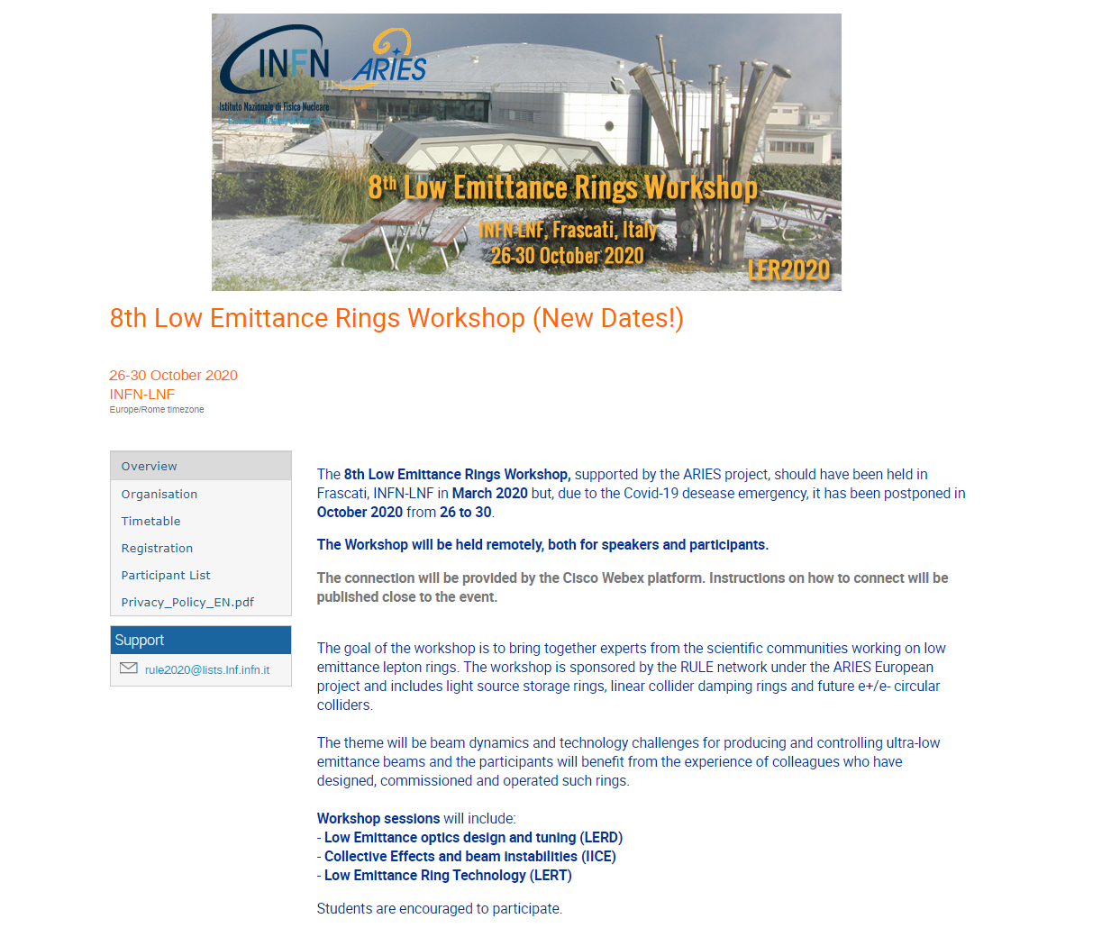
8th Low Emittance Ring Workshop

Slide 2
ARIES WP7 RULε: milestones and deliverables
 |  | Year 1 |  |  |  | Year 2 |  |  |  | Year 3 |  |  |  | Year 4
Task | Description | Q1 | Q2 | Q3 | Q4 | Q1 | Q2 | Q3 | Q4 | Q1 | Q2 | Q3 | Q4 | Q1 | Q2 | Q3 | Q4
1 | Coordination and Communication |  |  | M |  |  |  |  |  |  |  | M |  |  |  |  | D
2 | Injection systems for ultra-low emittance ring |  |  |  | M |  |  |  | M | D
3 | Beam dynamics and technology for low-emittance rings |  |  |  |  | M |  |  |  | M |  |  | D
4 | Beam tests and commissioning of low emittance rings |  |  |  |  |  |  | D
1st General WS
2nd General WS
1st Injection WS
2nd Injection WS
Diagnostics WS
Technology WS
Beam test WS
commissioning WS
This is the last general workshop of this funding cycle with ARIES (end Apr 21)
The next project I-FAST (Innovation Fostering in Accelerators Science and Technology) submitted in March 2020 is under evaluation at the EU a decision is expected soon to start in May 2021 (see my talk on Friday)

Slide 3
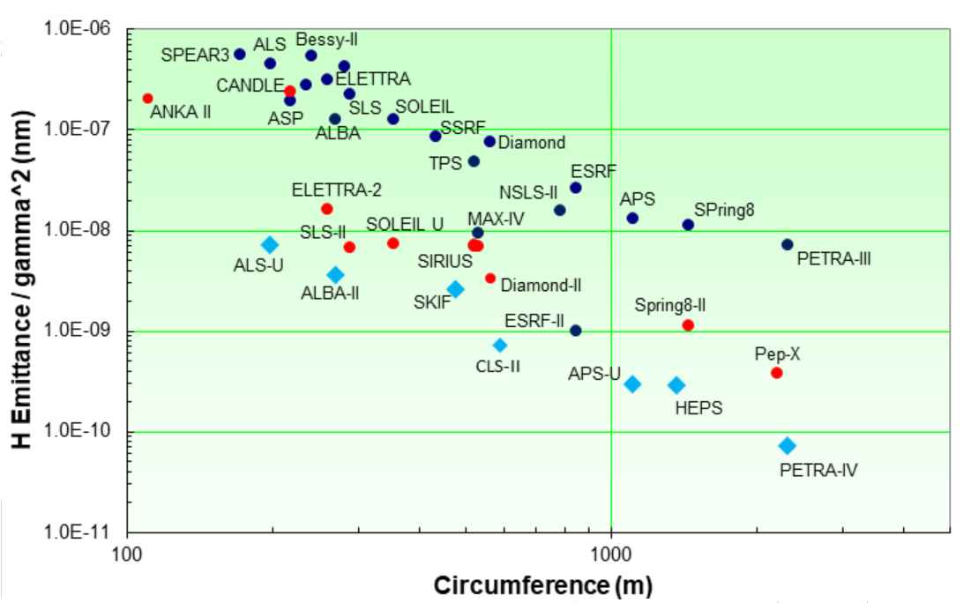
The field is thriving
operating
light sources
mostly DBA-TBA
MBA
on-axis
injection

Slide 4
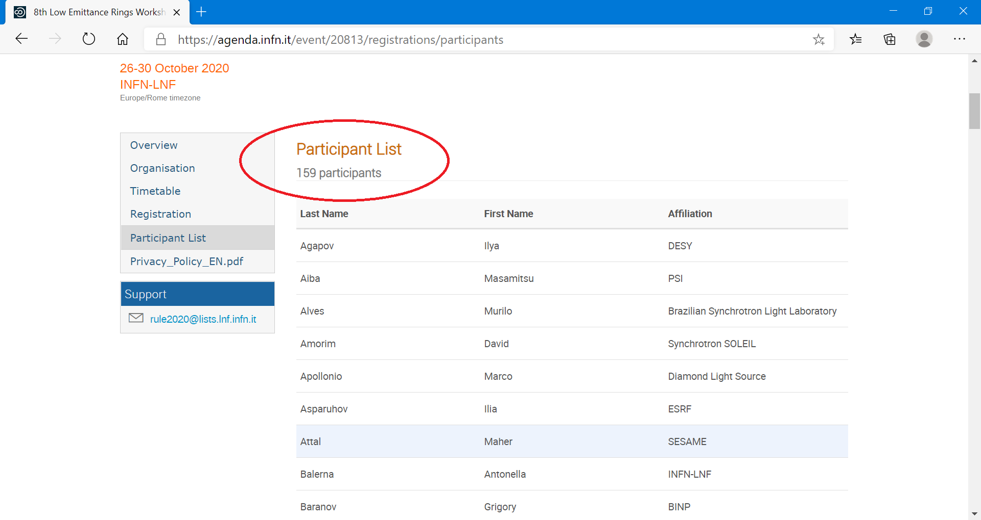
The field is thriving

Slide 5
A special thank…
to
Marica Biagini
and the Frascati LOC

