Slide 1
The HTS undulator and wiggler development
Daniel Schoerling
On behalf of the HTS team & the undulator collaboration (KIT-CERN)
Special thanks to Sebastian Richter (CERN/KIT), Axel Bernhard (KIT), Paolo Ferracin (LBNL) and Laura Garcia Fajardo (LBNL)
30th of October 2020

Slide 2
Outlook
The CLIC damping rings
The collaboration for undulators and wigglers
CERN’s HTS program
The HTS undulator development
Conclusion

Slide 3
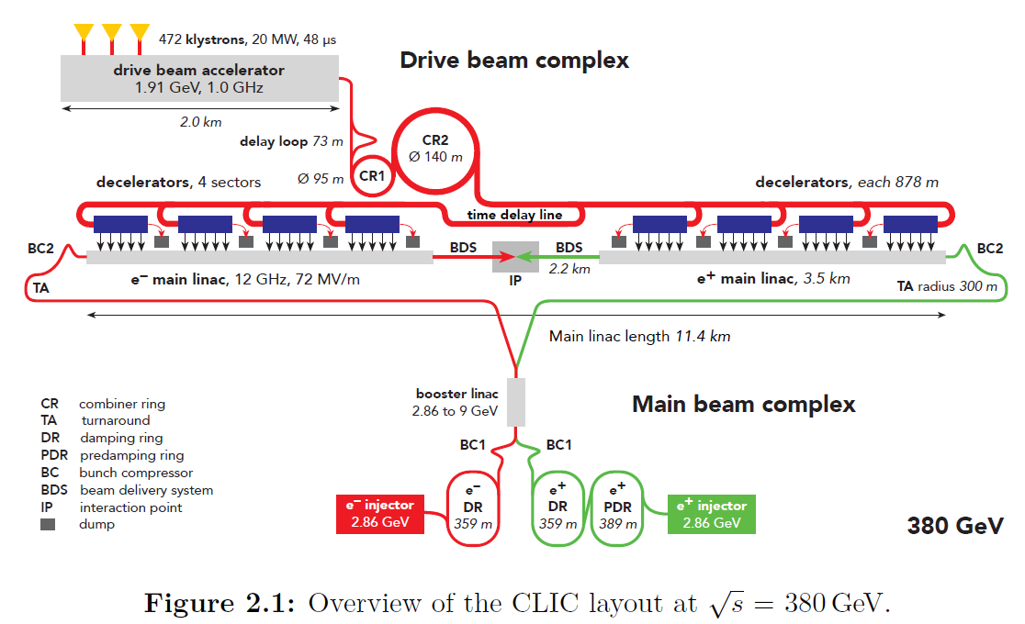
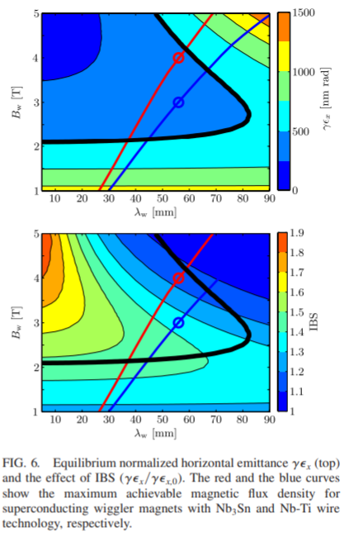

The CLIC collaboration

Slide 4
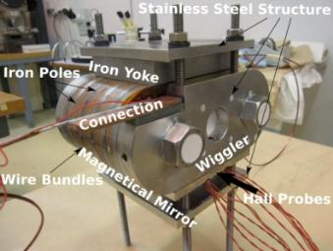
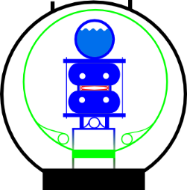
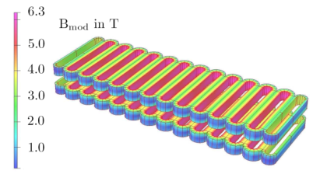
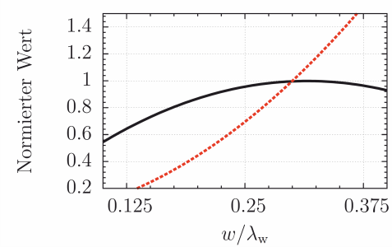
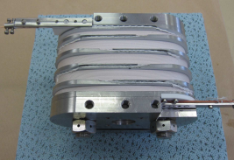
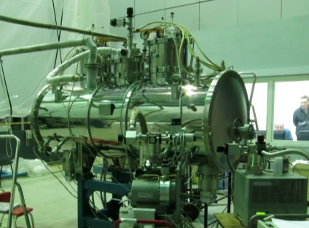






The CLIC collaboration
Designing
damping wiggler magnets with analytical equations and FE software
Manufacturing
Nb-Ti and Nb₃Sn short models for proof-of-principal
Developing
a technical concept for the SC CLIC damping wigglers
Amount of conductor
Normalized value
Maximum field
w
A
Coil width / period length
Collaborations

Slide 5
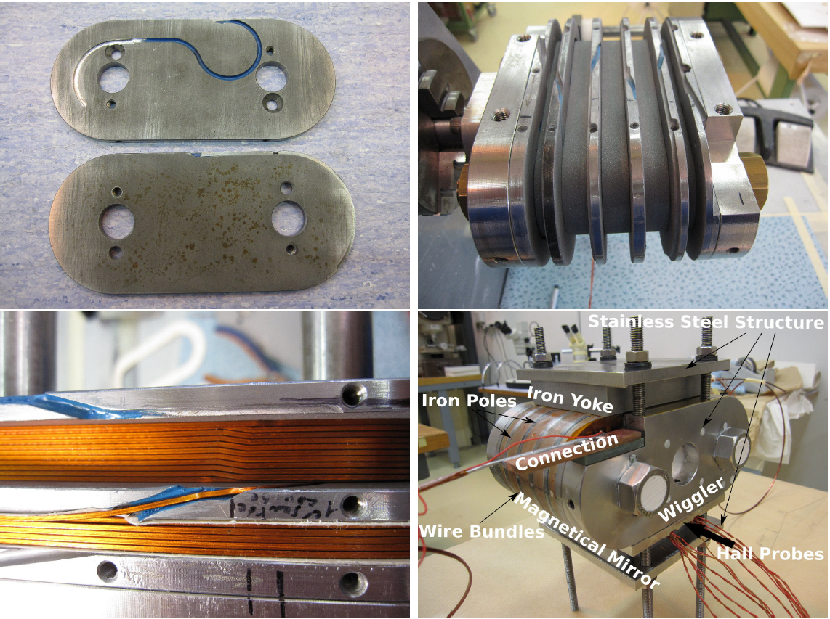
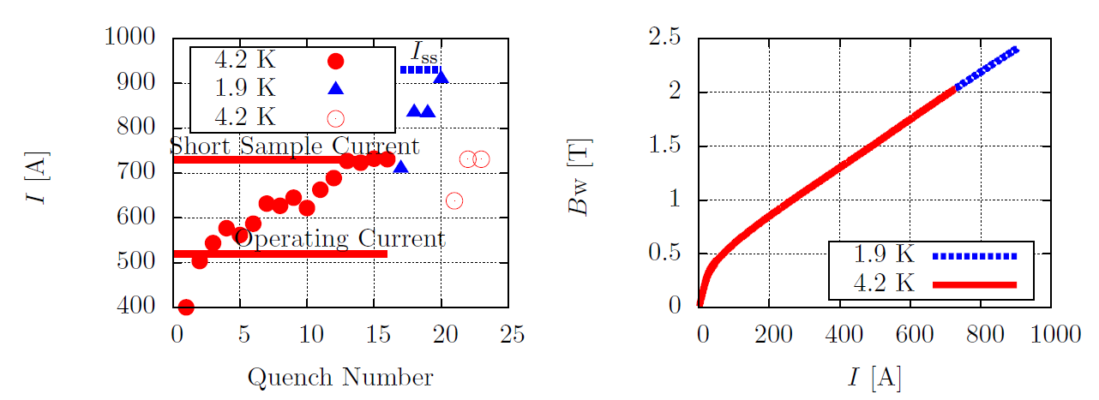
The first steps, now more than 10 years ago
This Nb-Ti superconducting wiggler has reached only 60% of the critical current, that is, a maximum mid-plane flux of 1.6T instead of 2.5T (Courtesy BINP)

Slide 6
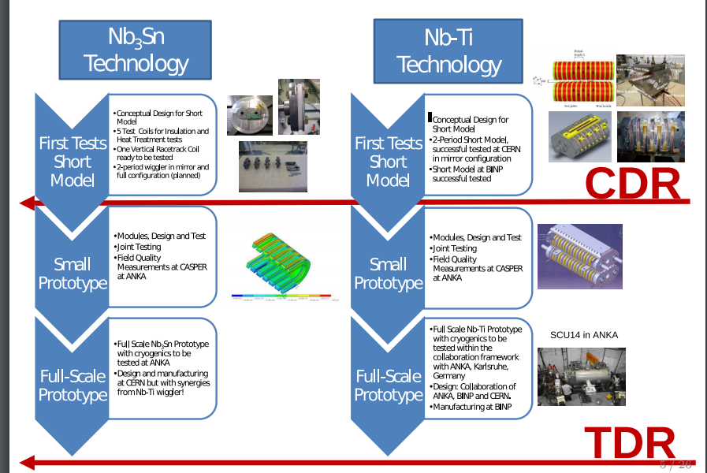
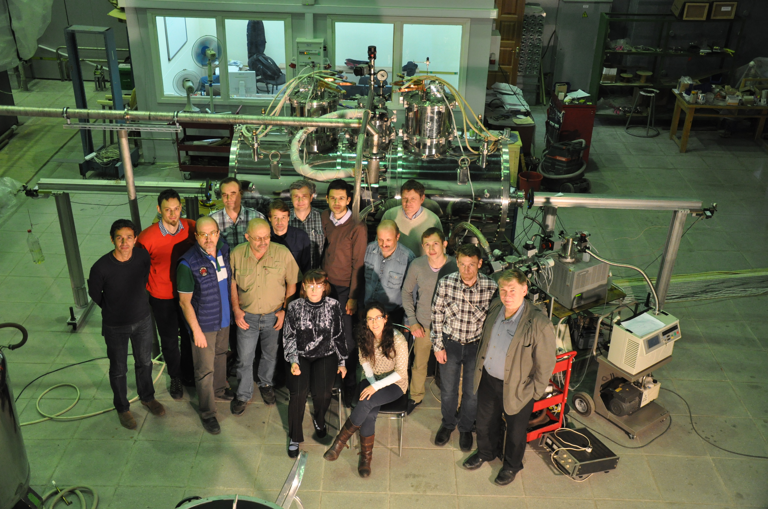
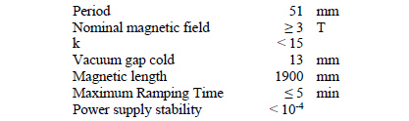
Moving from VR to HR
Roadmap
Workshop at CERN on 3rd December 2010 [1] and following discussions:
  HR or VR wiggler?
  Prepare KIT to test after the Nb-Ti a Nb₃Sn wiggler: cryostat is build such that coils can be relatively easily be exchanged
  A second cryostat was seriously discussed but never built/financed
After many discussions and technical work, only 4 years later a CLIC damping wiggler was successfully built and tested.
We had agreed on a conduction cooled Nb-Ti HR wiggler with graded coils:
The magnet was successfully tested and is used in KARA, KIT
CLIC damping wiggler FAT, 21.05.2014
[1] https://indico.cern.ch/event/111714/

Slide 7
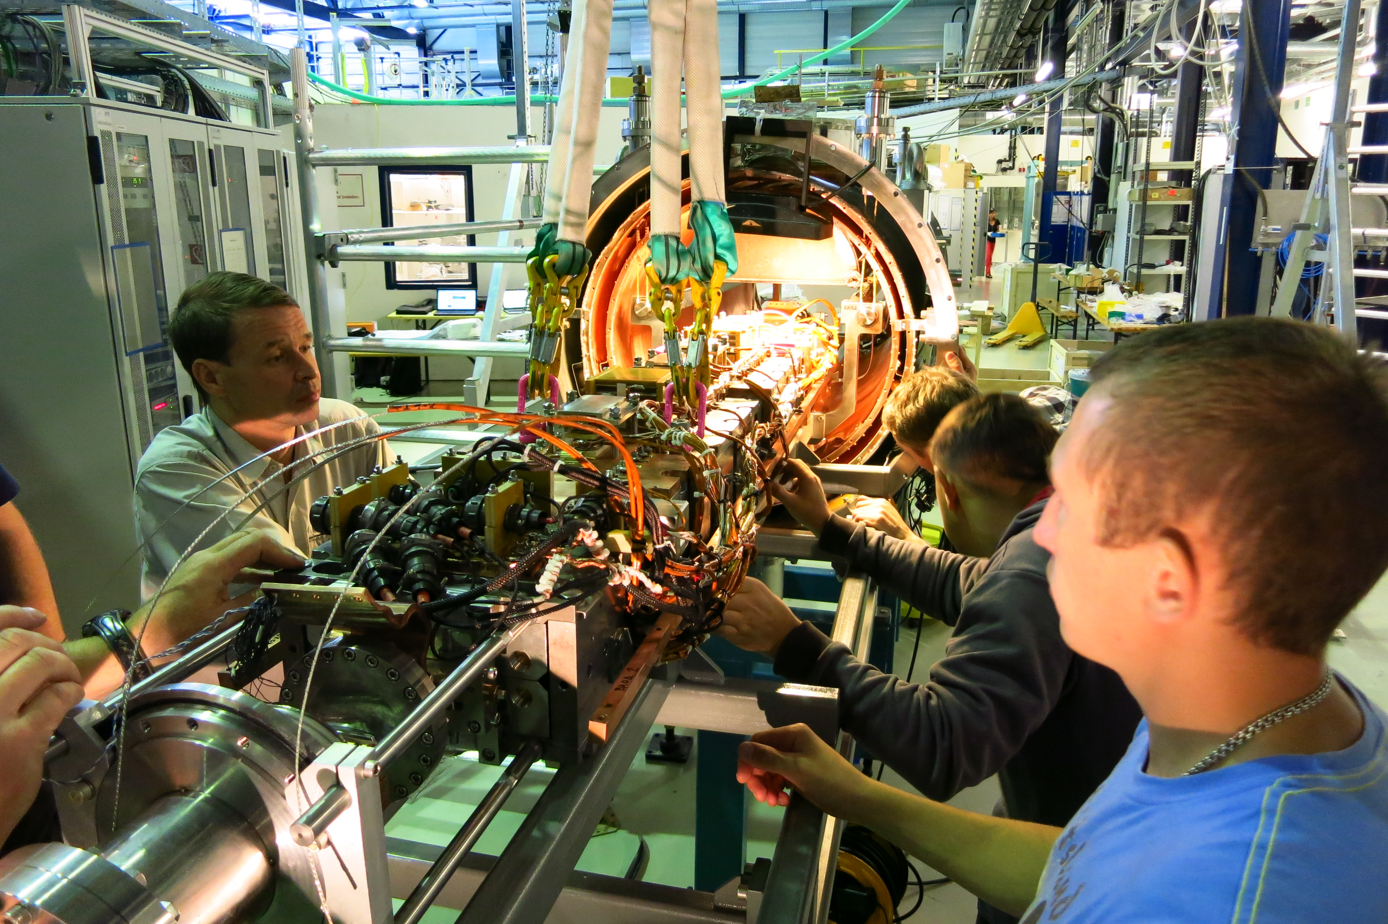
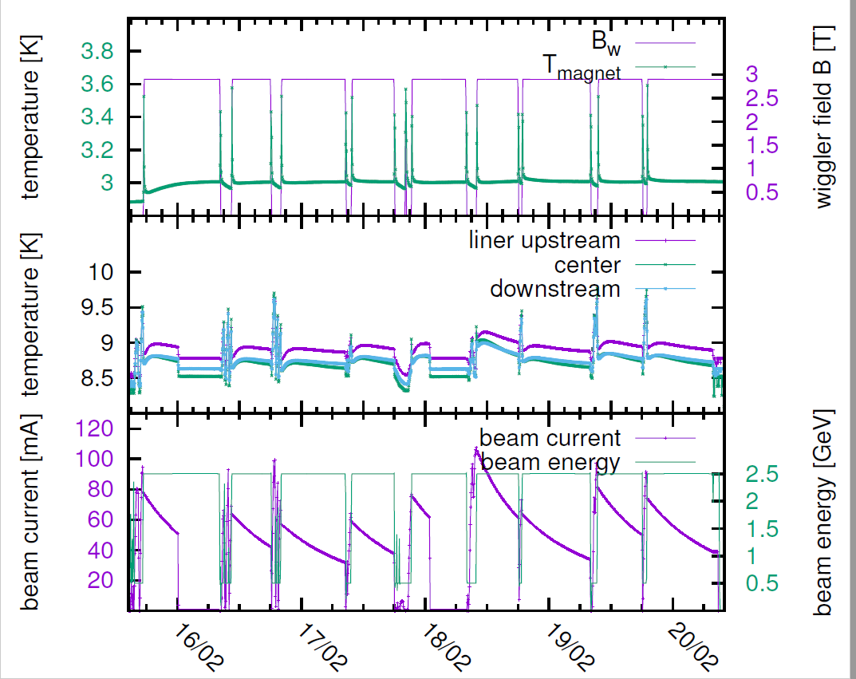
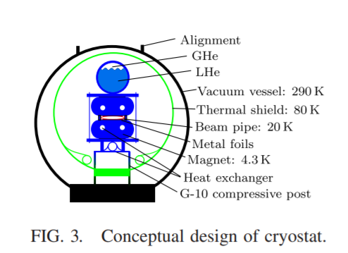
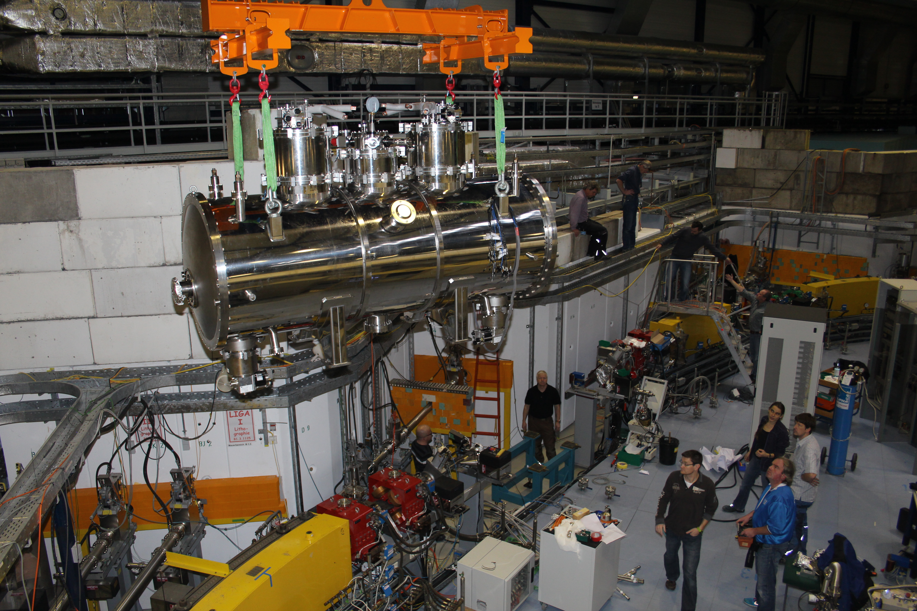
The Nb-Ti prototype wiggler
The cryogenic performance of the conduction cooled system was excellent reaching around 3 K
In the case of indirect cooling, however, holding quenches occur after periods of seconds to several hours in the outer, high current coil sections for fields above 2.9 T. These holding quenches are basically uncorrelated with the magnet temperature.
D. Schoerling et al. Phys Rev STAB 15, 042401 (2012) & A. Bernhard et al., IPAC 2016, Paper WEPMB002

Slide 8
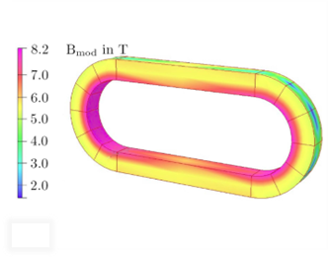
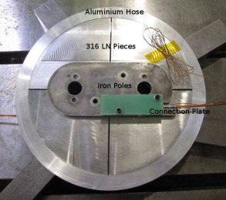
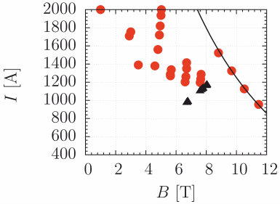
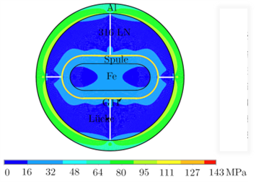
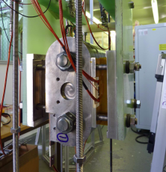
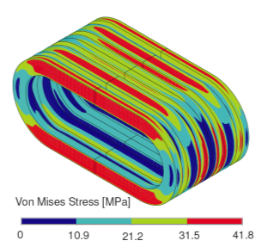

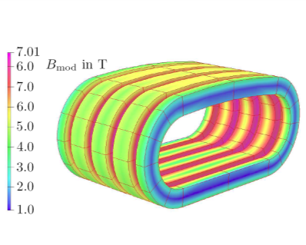
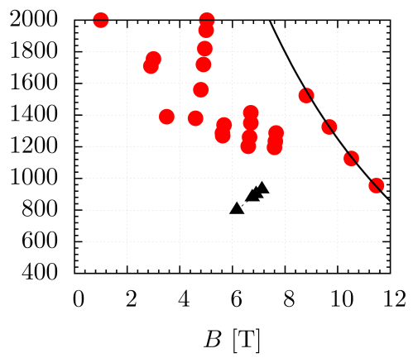
Nb₃Sn wiggler 1/2
EM Design
Mechanical Design
Prototype
Test Results
Coil 1
Short Sample
For the first time, Nb₃Sn damping wigglers have been built and successfully tested
A fully fledged technical concept for CLIC damping wigglers has been developed (PhysRev STAB, Vol. 15:4, 04/2012) and is tested in ANKA
Achievements

Slide 9
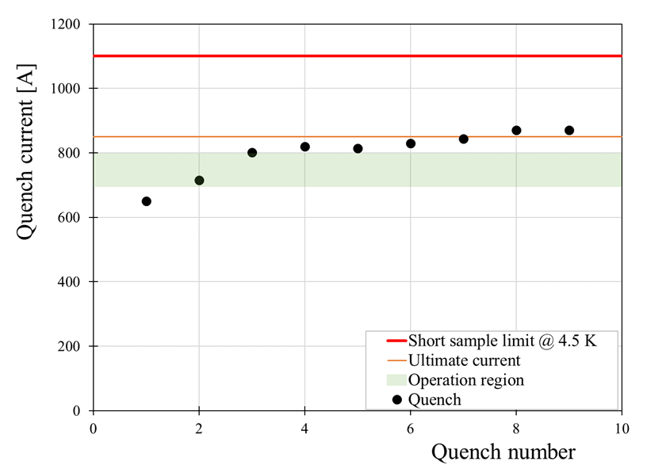
Nb₃Sn wiggler 2/2
During first test (November 2017):
No quench up to 600 A (limit of power supply at that time)
During second test (limited to 900 A due to rod strength, October 2018):
First quench at 650 A, 60% SS
Reached beyond operation region (690-800 A) after 2 quenches
Ultimate current (850 A) after 7 quenches
Two last quenches at 871 A, 79% SS
Performance within expectations
Period length 49.5 mm
Max field on axis 4.3 T
Gap 15 mm
Laura Garcia Fajardo et al.

Slide 10
Summary history
A Nb-Ti prototype magnet was built and successfully tested in KARA at KIT
Nb₃Sn wiggler magnets: VR magnets to reduce the number of joints. One HR test coil was built
The Nb₃Sn short model wigglers are built from single strands, which are difficult to insulate and prone to breakage after heat treatment
The second prototype Nb₃Sn magnet reached its operating region after the second quench! However, both wiggler models were plagued with technical issues: the first one had performance issues and both models had insulation issues.
In conclusion a working Nb-Ti CLIC damping wiggler prototype was built. On the other hand, the use of Nb₃Sn for wigglers is considered complicated and thanks to the impressive progress of ReBCO tape conductors interest in this technology for wigglers diminished over the years
In 2018/2019 the activity was refocused on HTS (with a focus on undulators for CompactLight, a free electron laser design study)
This activity was now integrated into the HTS magnet development program of CERN

Slide 11
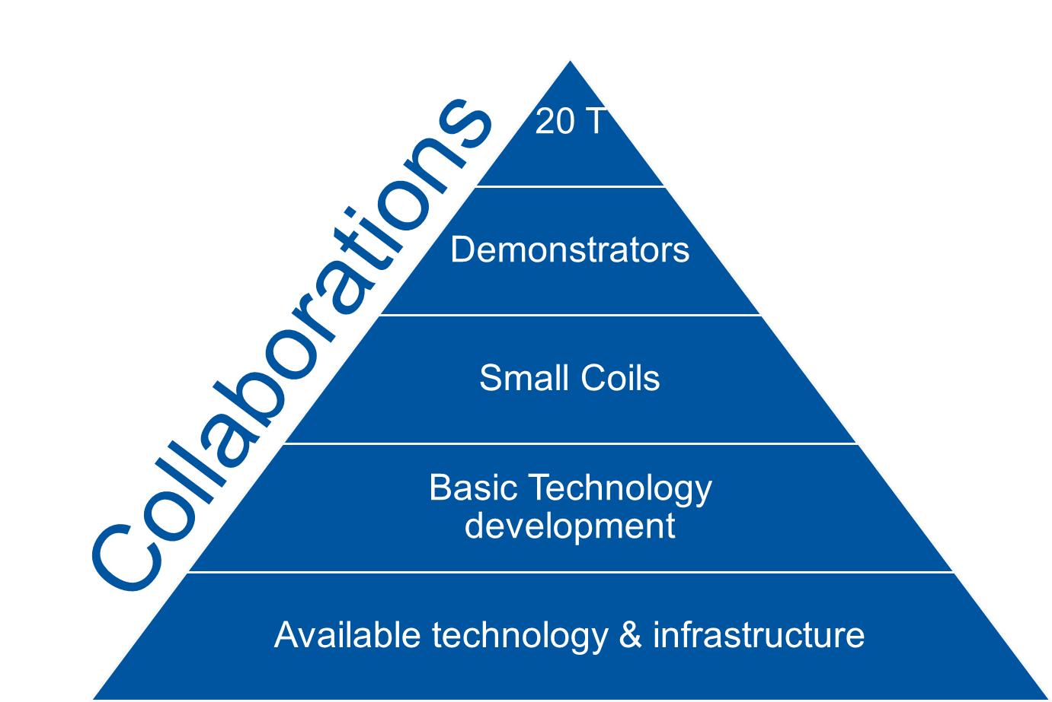
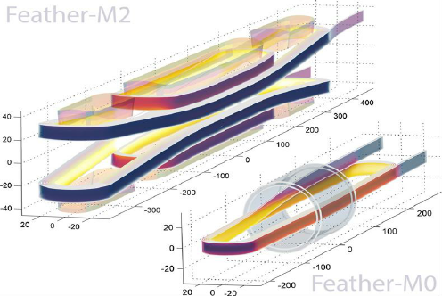
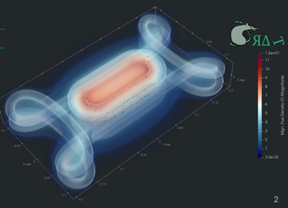
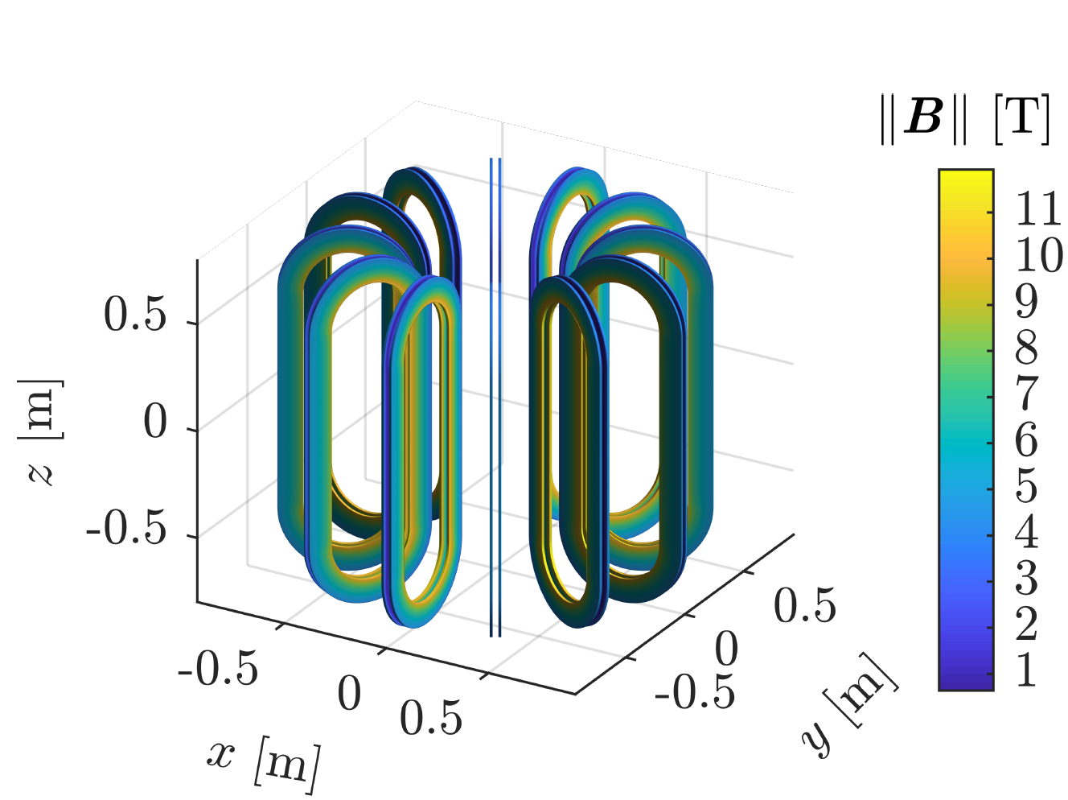
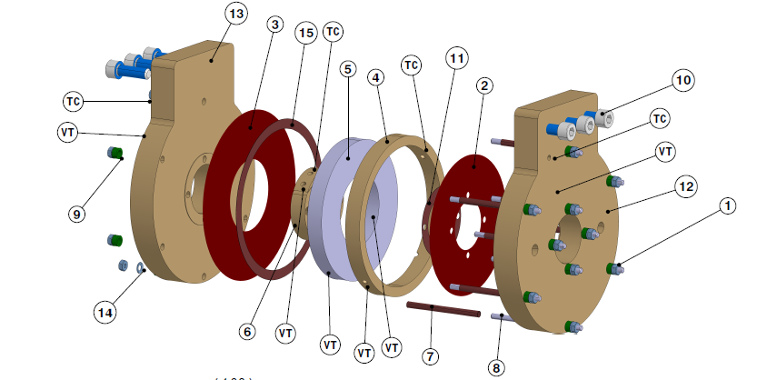
CERN’s HTS program: A snapshot
CERN’s HTS magnet program serves the potential future machines: hadron, electron/positron, muons and physics beyond colliders
The focus is on the development of HTS high-field dipole magnets for future (hadron) colliders
The aim is to build in the next 10 years an ‘accelerator-like’ short model magnet reaching around 20 T for a future circular collider (hadron or muons), which shows that
  these field levels can be reliably reached, managing effectively the mechanical stress
  ramps in the order of 10 min to nominal field are feasible
  protection, if powered in series, is feasible
  reasonable field quality level is within reach, acceptable for next-generation colliders (beyond FCC)

Slide 12
High-field accelerator magnets for hadron colliders:
Flowchart
EuCard1∗
EuCard1 in Fresca2
EuCard2∗
EuCard2 in Fresca2
FULLY INSULATED
F-2 ∗
F-0∗
F-0 in
Sultan
F-2 in
Fresca2
F-3 ∗
F-3 in
new, 20 T
#1-#5
#1-#5
#1-#7
#1-#7
#1-#n
#1-#n
S-C #1
20 T stand-alone magnet
S-C #2
…
CLF, 8 T
New∗
New in ?, 20 T
NON OR PARTIALLY INSULATED
S-C #n
#1-#n
#1-#n
#n-1-#m
CLF1, 3 T
ESPP
ESPP
2022
2025
2028
2030
∗ Stand-alone test of insert magnets

Slide 13
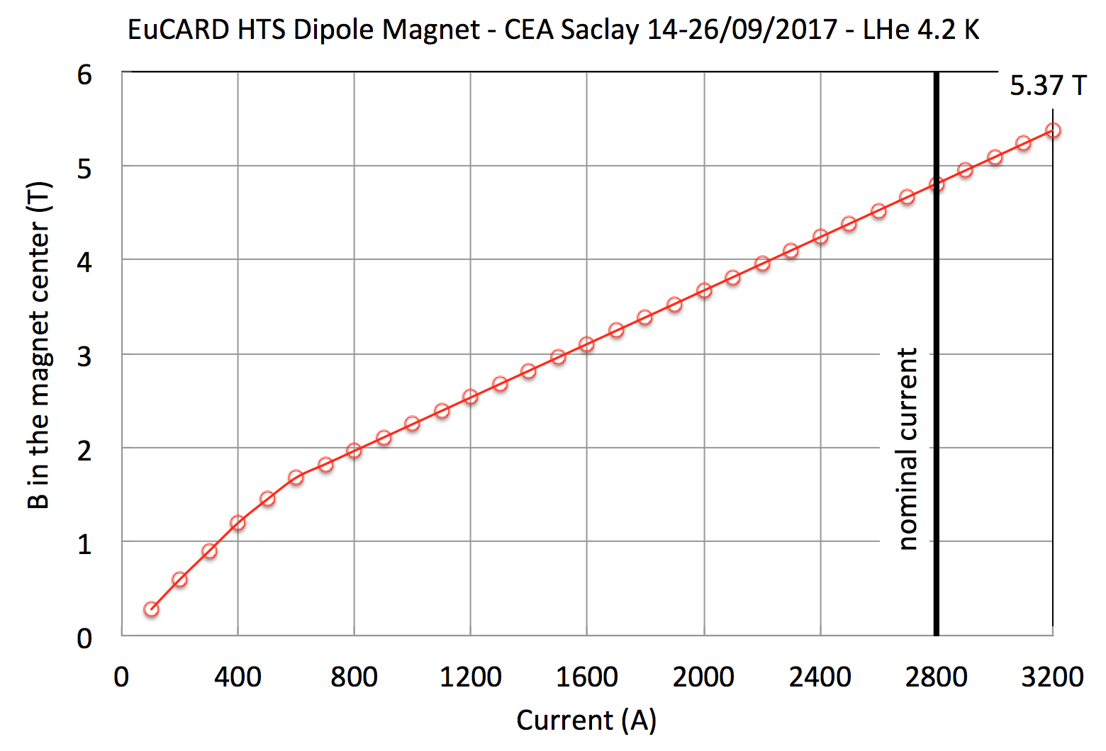

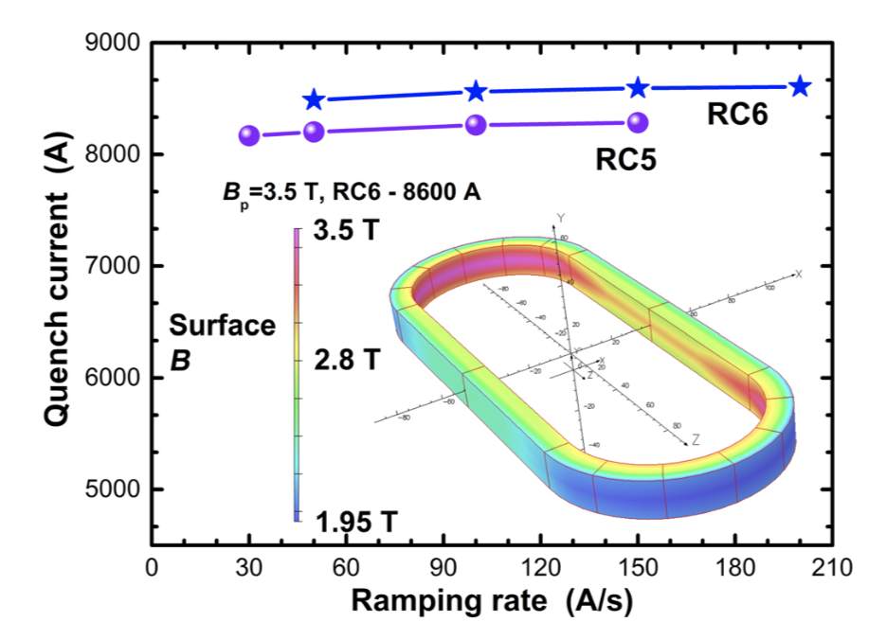
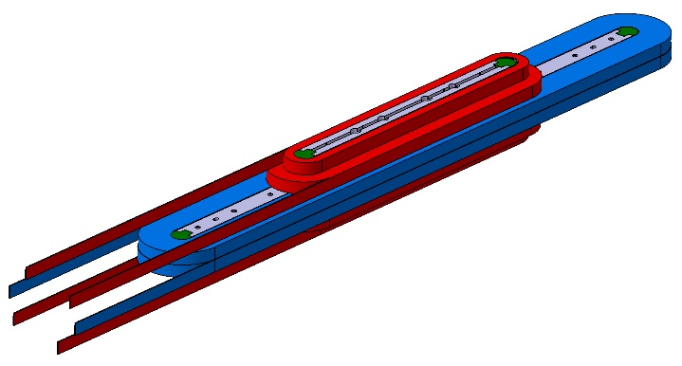


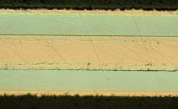
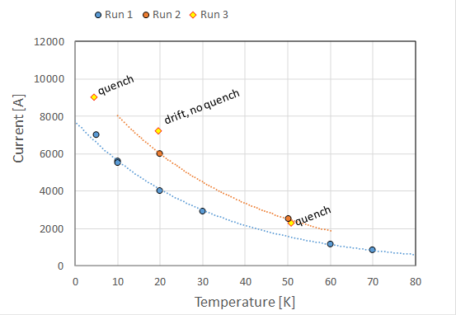


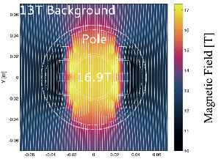
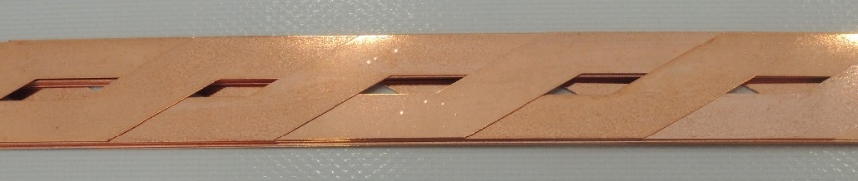
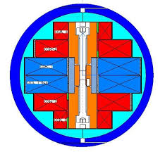
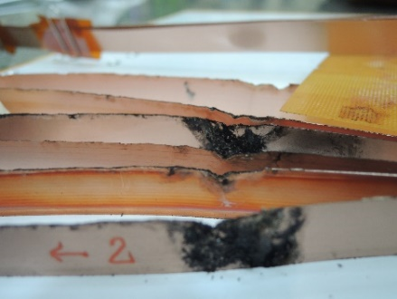
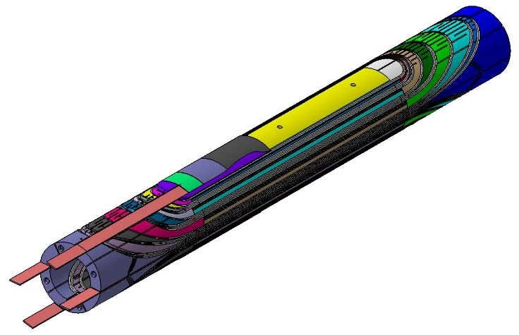
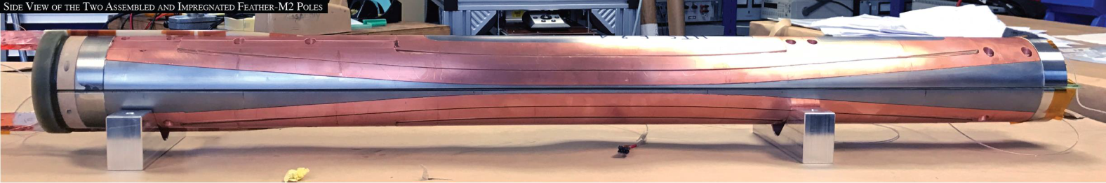
HTS dipole magnets
5.37 T
4.7 T
Many open questions:
Degradation, how to avoid?
Transposition needed up to which level?
BSCCO vs ReBCO?
REBCO tapes
4.2 T
REBCO Roebel
Feather2
EuCard2

Slide 14
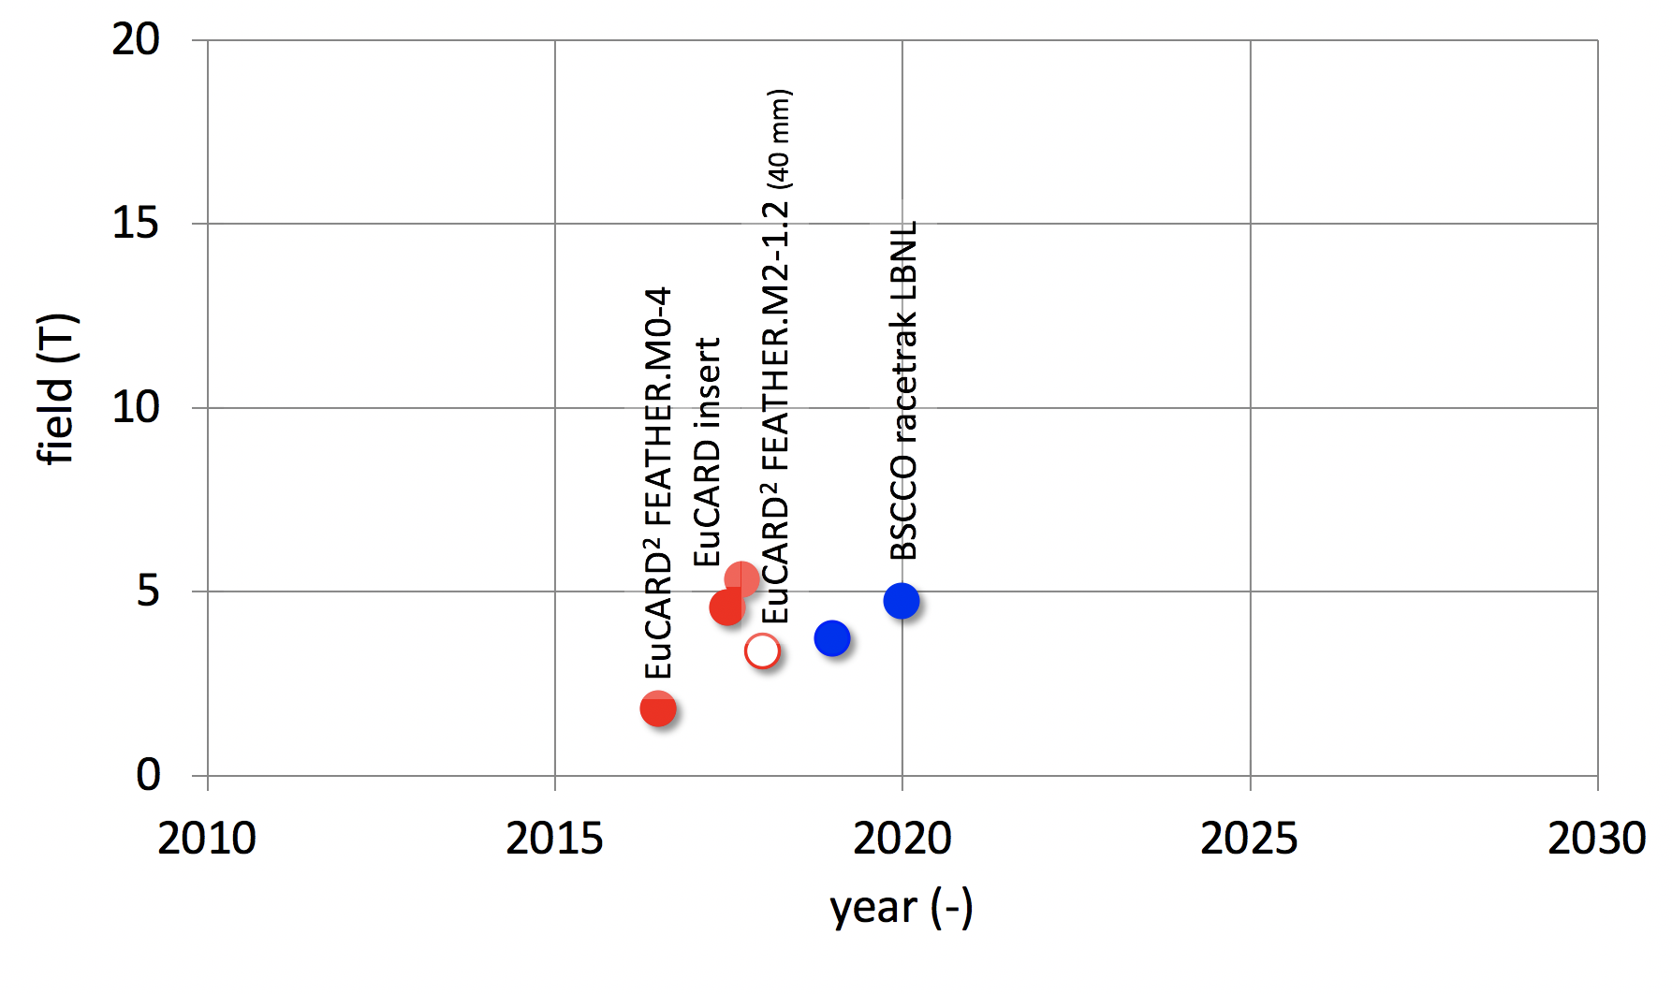
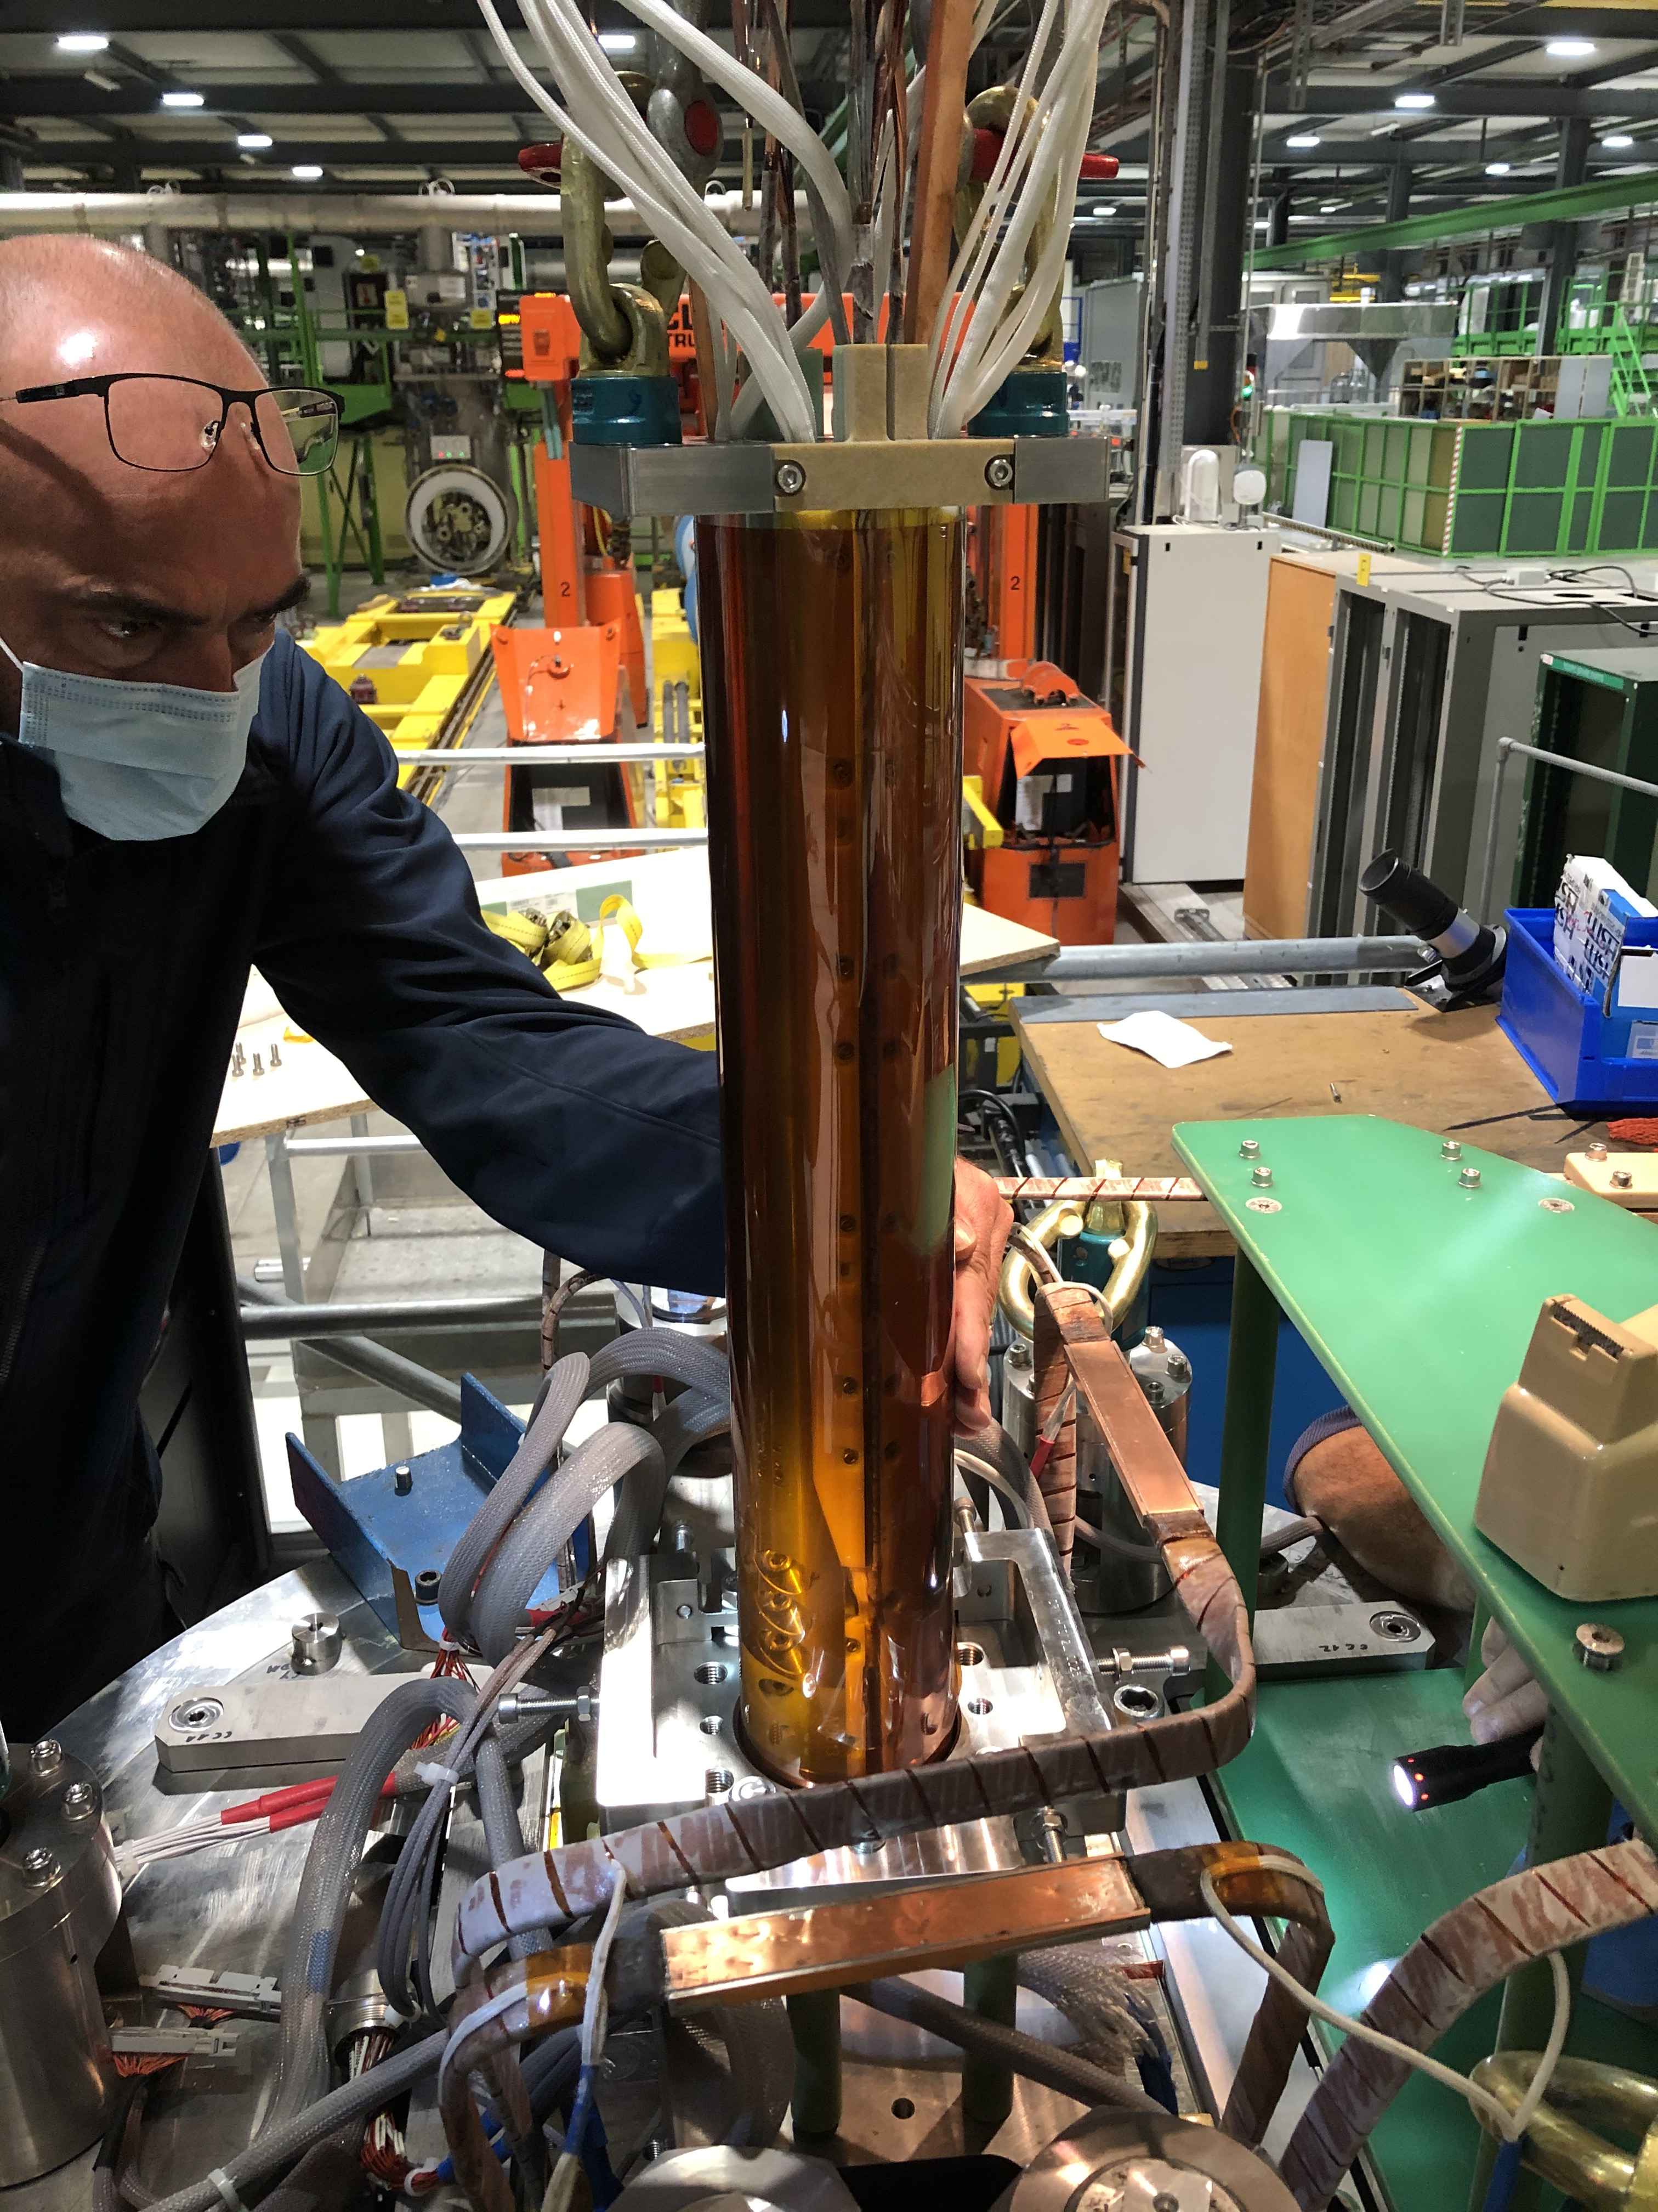
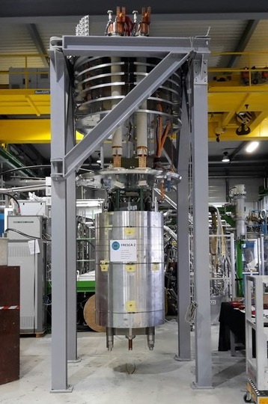
HTS dipole magnets
Hybrid: Feather2 & Fresca2, test will start in a few days
Courtesy: L. Bottura

Slide 15
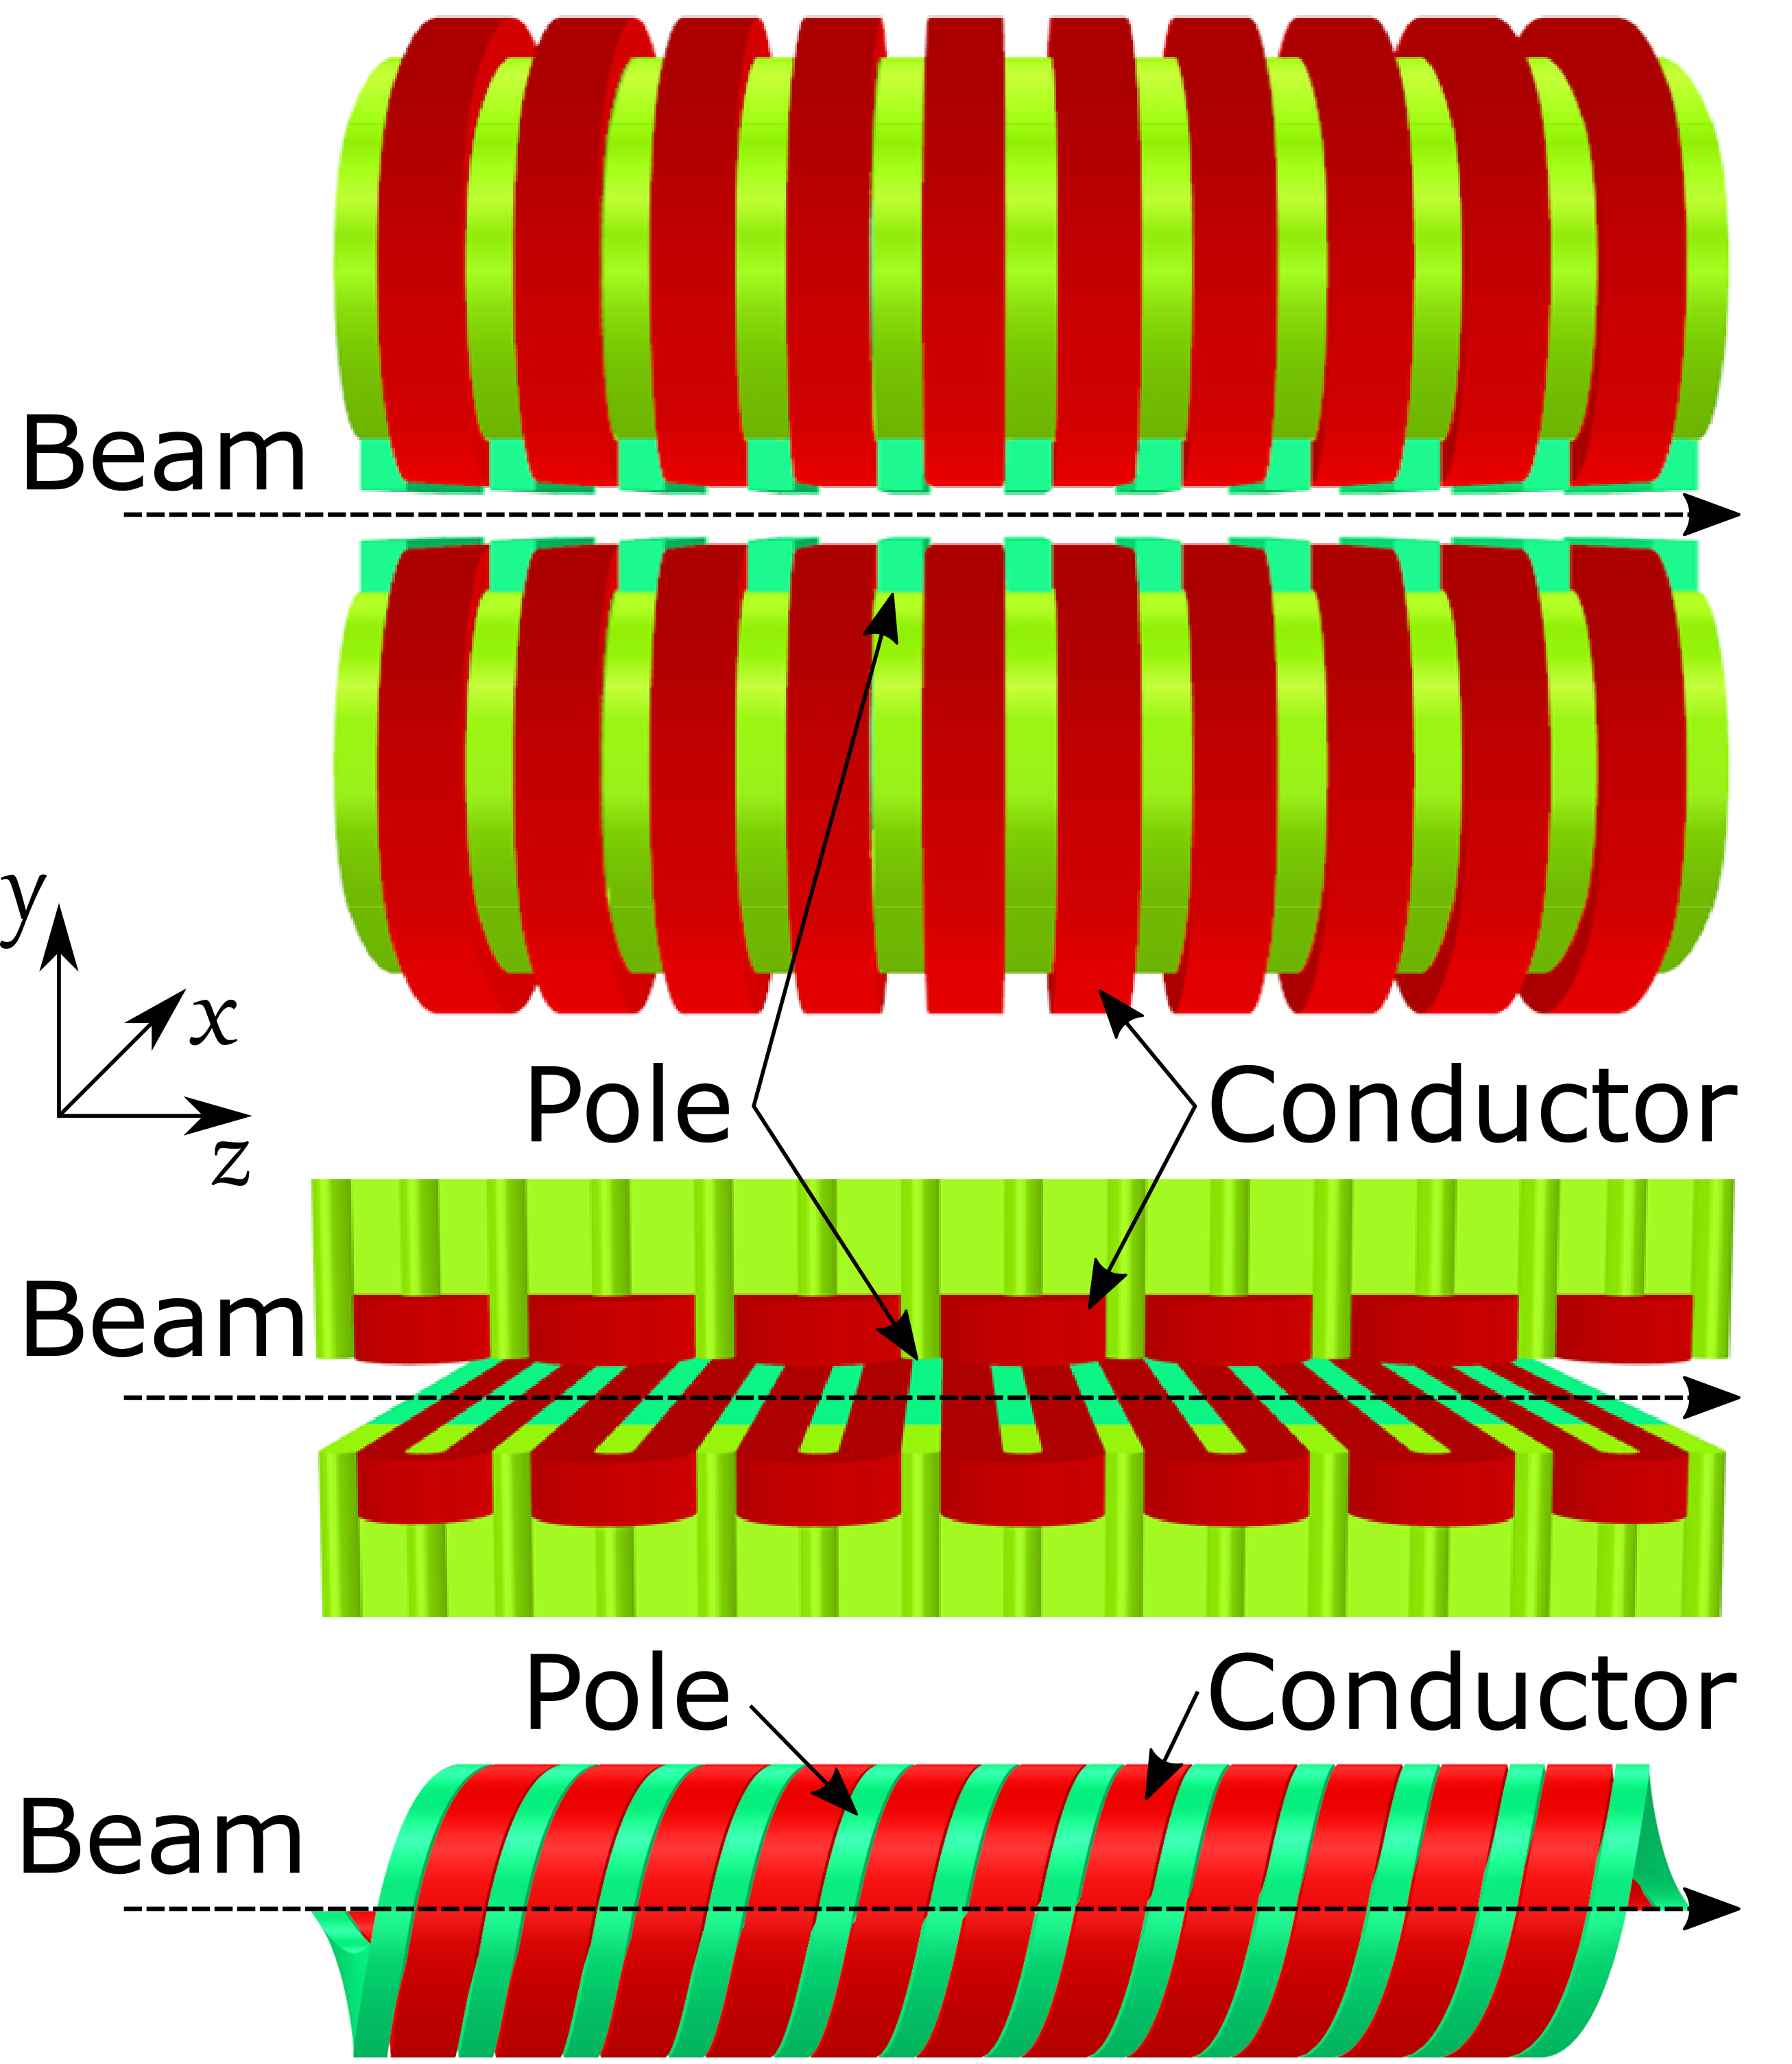
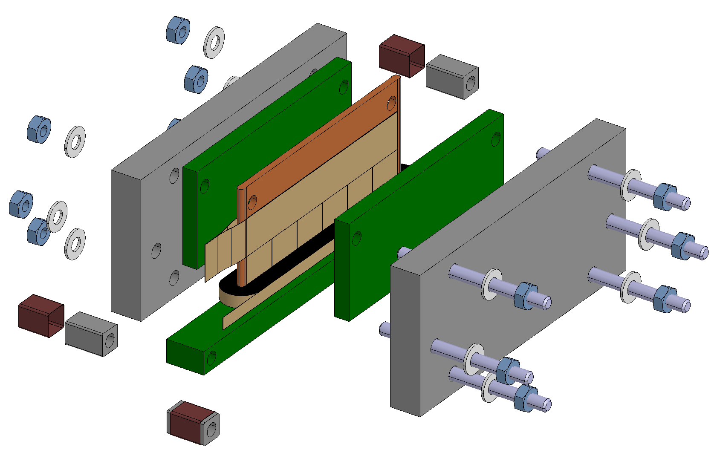
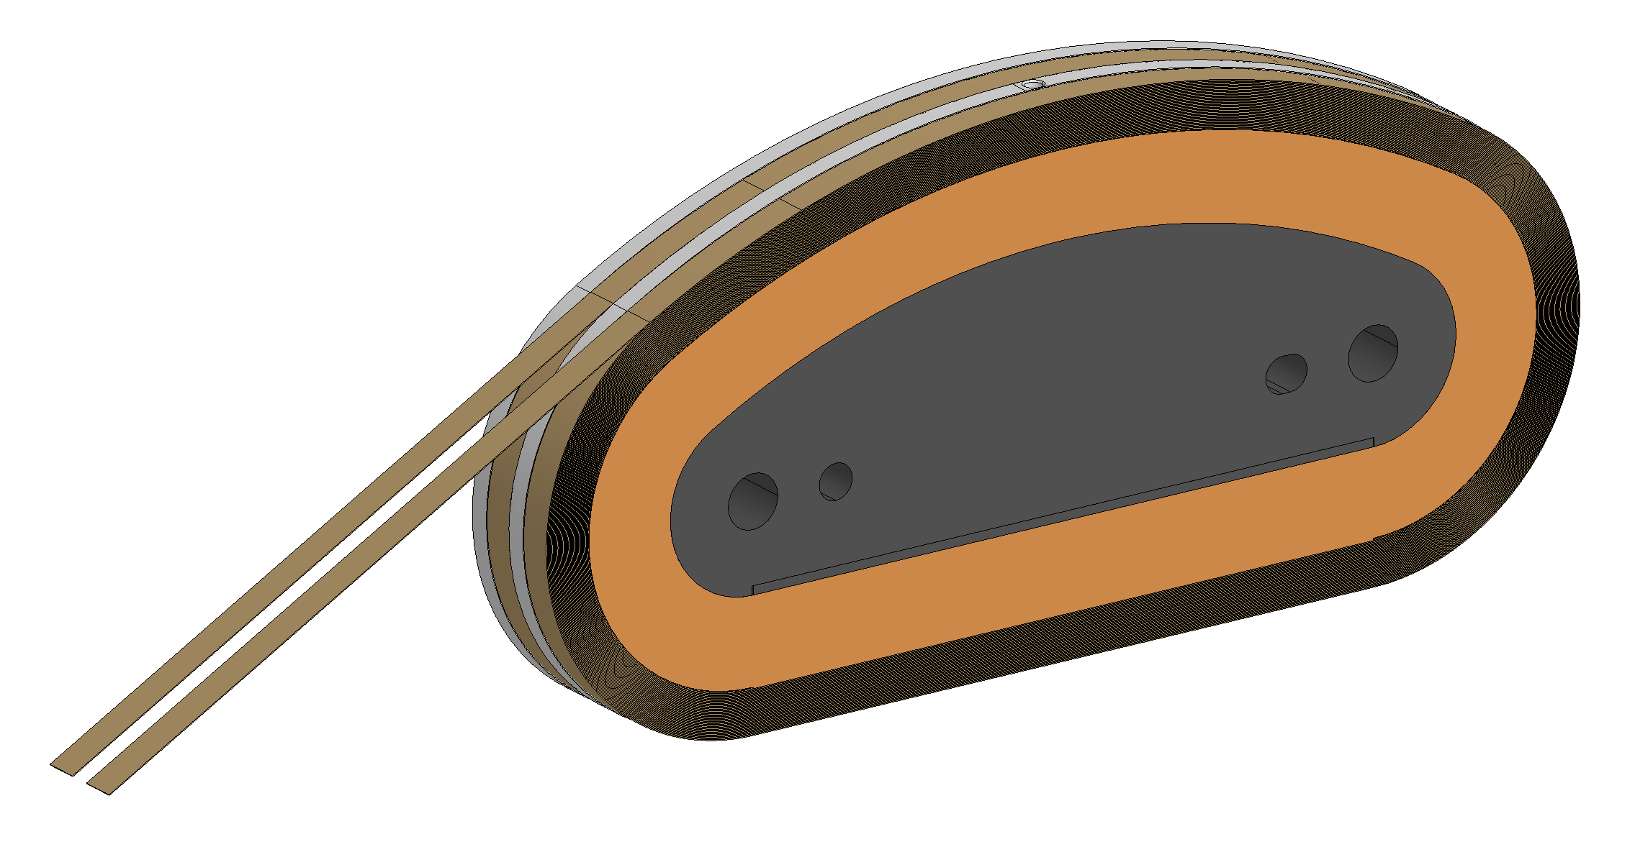
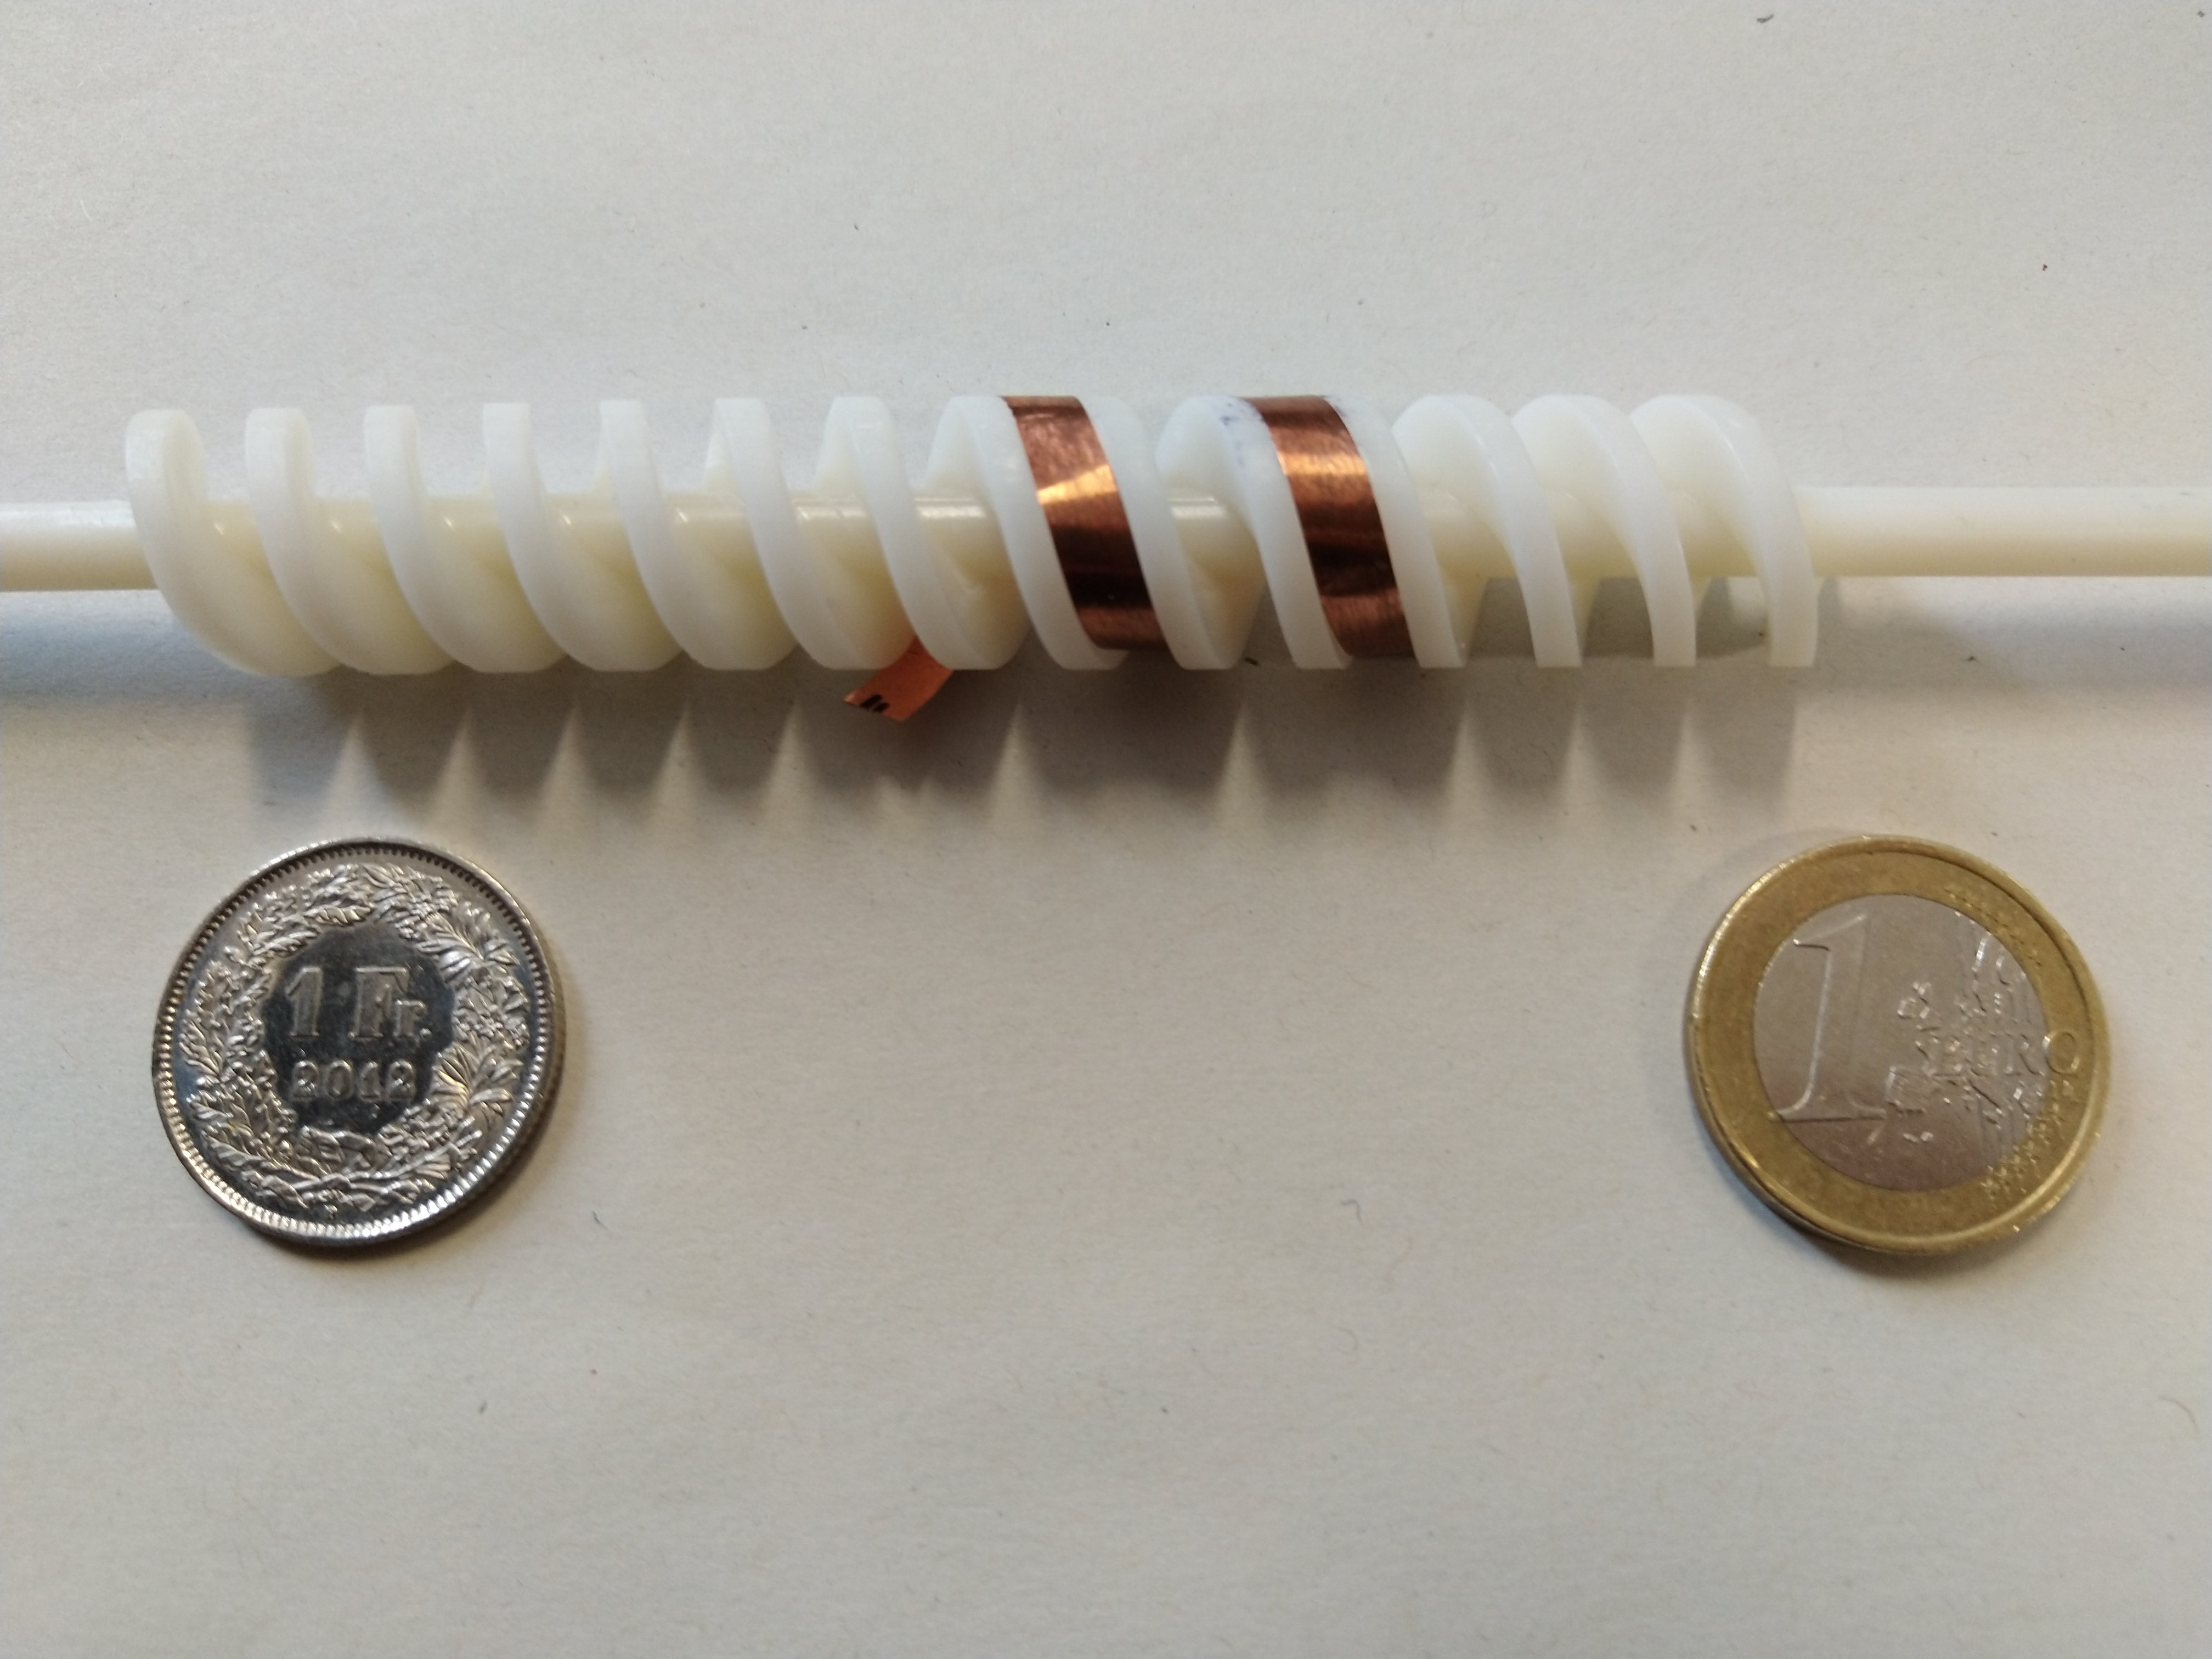
High-field accelerator magnets for leptons: Wiggler/Undulator
Horizontal planar undulator
  Advantages: High tape efficiency, relatively easy to repair in case of problems
  Disadvantages: Large number of joints (~250 joints/m), very small bending radius of tape (1.25-6 mm)
Vertical planar undulator
  Standard design for undulators, bending radius adjustable
  Large number of joints for tape probably unavoidable
Helical undulator
  √2 more efficient than a planar undulator, very compact magnet design
  No feasible winding scheme yet developed
The aim is to build a short 4-5 prototype magnet and prove that the predicted fields can be reached, the magnet can be protected. Moreover, the field quality shall be predicted and measured.
Small prototype program is funded from FCC, CLIC, and TE

Slide 16

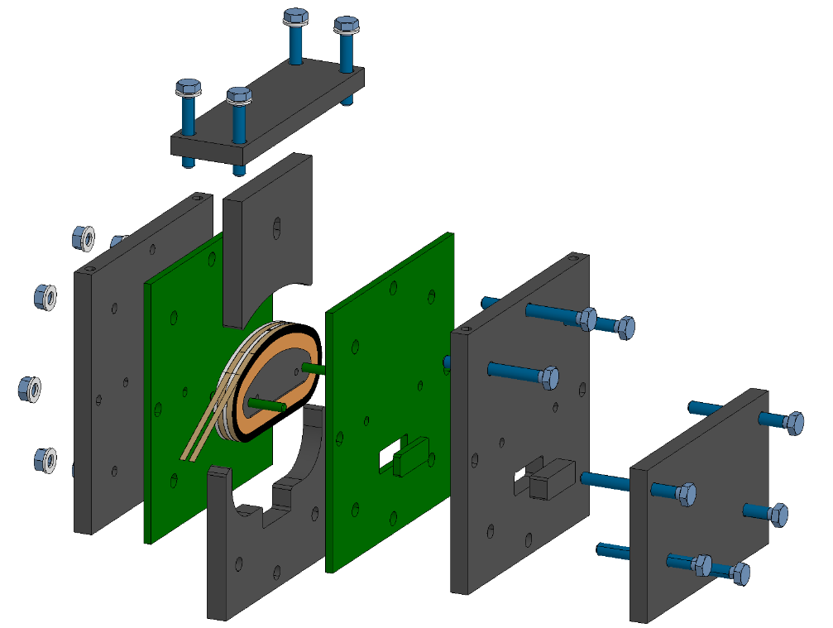










Prototype coils
Horizontal planar undulator
Helical undulator
Horizontal vertical undulator
Sebastian Richter et al.

Slide 17




Potential field reach of HTS undulators
period length λ_{u} / mm | HTS (VR) B / T | HTS(HR) B / T | HTS(hel.) B / T | HTS(hel.*) B / T | Nb-Ti B / T | Ratio HTS(VR+HR) / 2 x Nb-Ti
13 | 1.8 | 2.3 | 2.3 | 1.0 | 1.2 | 1.67
15 | 2.3 | 3.0 | 2.8 | 1.5 | 1.5 | 1.77
Similar increase in field is expected for non-insulated HTS damping wiggler magnets [1]
[1] S. Richter et al., HTS undulator development, CLIC workshop 2019

Slide 18
The HTS program: Undulators/Wigglers
Flowchart
Small coil program
Horizontal Wiggler, Test coil
Coil 1-#n
Vertical Wiggler, Test coil
Wiggler/undulator, short model (0.1 m)
Wiggler/undulator, long model (0.5 m)
Coil 1-#n
Helical Wiggler, Test coil(s)
Coil 1-#n
Funding not yet secured
2022
2027

Slide 19
Conclusion
Since more than 10 years we are developing in a collaboration between CERN and KIT and with other partners SC wiggler and undulator magnets
We have built several prototypes and with BINP a full scale Nb-Ti wiggler installed and operated in KARA
Recently, we started to refocus our activities towards HTS undulators and wigglers
We plan to build in the next year test coils, and two short 5-period prototypes and, if funding & resources permits, a 0.5-1 m long prototype
This program is part of the HTS magnet development program of CERN and profits from the main line development towards a 20+ T magnet

