Slide 1
Detuning impedance effect on coasting beams and aspects of fast-slow mode coupling instability
N.Biancacci, E.Métral, M.Migliorati
LER2020 – 27th October 2020
Notes:
https://agenda.infn.it/event/20813/timetable/#all.detailed

Slide 2
Outline
Introduction
Coasting beams fast and slow waves
Effect of driving impedance
Effect of detuning impedance
Effect of driving + detuning impedance
(Un-)Coupled fast and slow modes
The fast-slow mode coupling instability
Conclusions

Slide 3
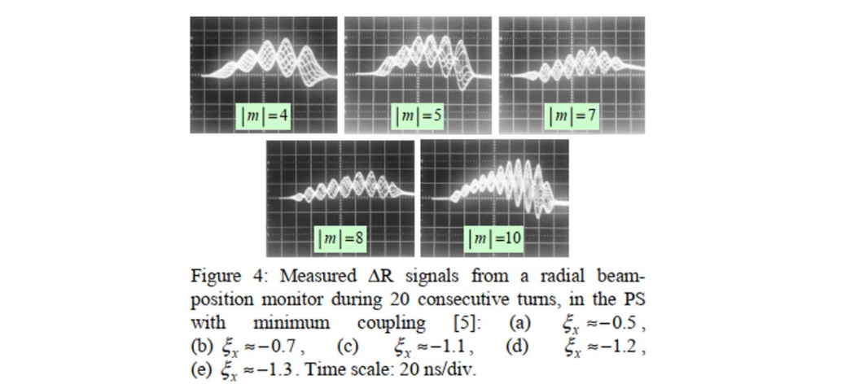
Introduction
Collective headtail horizontal instabilities have been measured and characterized versus chromaticity in the past at injection in the PS.
HeadTail simulations were performed in [1] and could reproduce the expected behavior versus chromaticity.
[1]: E.Métral et al. “Simulation study of the horizontal head-tail instability observed at injection of the CERN Proton Synchrotron”,
22nd Particle Accelerator Conference, Albuquerque, NM, USA, 25 - 29 Jun 2007, pp.4210

Slide 4
Introduction
Collective headtail horizontal instabilities have been measured and characterized versus chromaticity in the past at injection in the PS.
HeadTail simulations were performed in [1] and could reproduce the expected behavior versus chromaticity.
Few questions remained:
What is the effect of space charge?
Which impedance is driving the instability?
Why the horizontal plane is more critical than the vertical one?

Slide 5
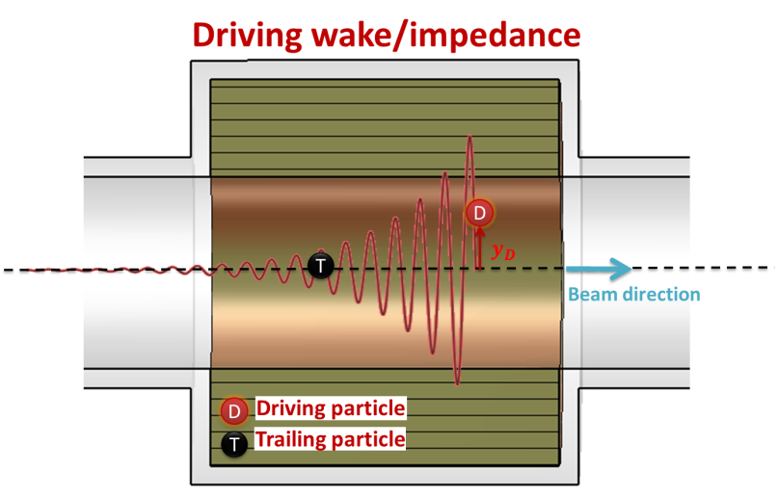
Introduction
A dedicated study was done in 2019 with M.Migliorati from the University of Rome “La Sapienza”.
PyHeadTail simulations were performed accounting for the impedance of a flat beam pipe with PS bunched beam parameters.
Results when accounting for: driving impedance
$$z$$

Slide 6
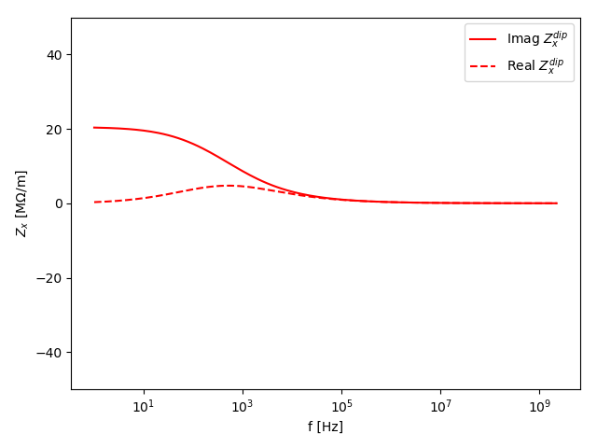
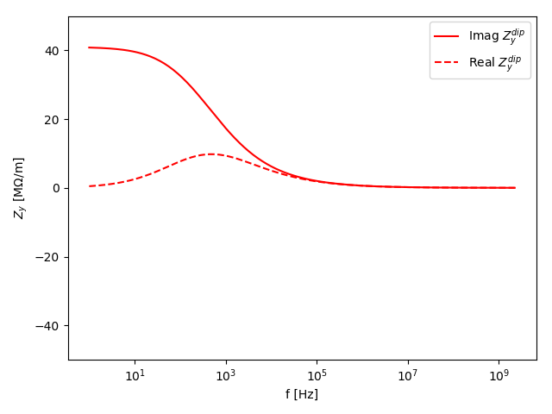
Introduction
A dedicated study was done in 2019 with M.Migliorati from the University of Rome “La Sapienza”.
PyHeadTail simulations were performed accounting for the impedance of a flat beam pipe with PS bunched beam parameters.
Results when accounting for: driving impedance
X plane
Y plane
“Inductive bypass” regime
Classical “thick-wall“ regime

Slide 7
Introduction
A dedicated study was done in 2019 with M.Migliorati from the University of Rome “La Sapienza”.
PyHeadTail simulations were performed accounting for the impedance of a flat beam pipe with PS bunched beam parameters.
Results when accounting for: driving impedance
X plane
Y plane
No instability observed
Instability observed

Slide 8
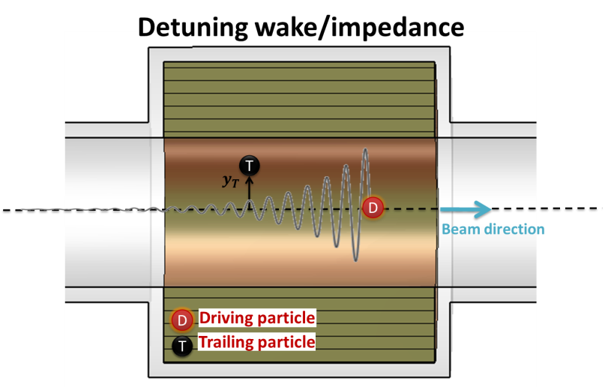
Introduction
A dedicated study was done in 2019 with M.Migliorati from the University of Rome “La Sapienza”.
PyHeadTail simulations were performed accounting for the impedance of a flat beam pipe with PS bunched beam parameters.
Results when accounting for: driving and detuning impedance
+
$$z$$
$$z$$

Slide 9
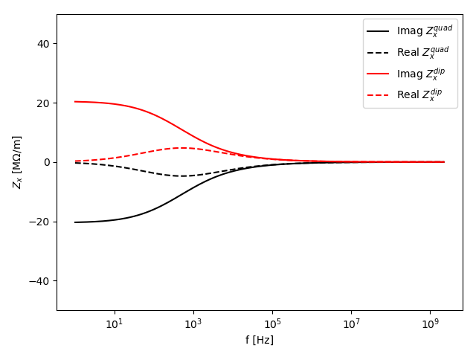
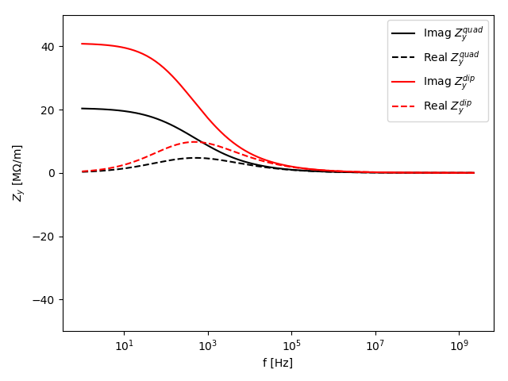
Introduction
A dedicated study was done in 2019 with M.Migliorati from the University of Rome “La Sapienza”.
PyHeadTail simulations were performed accounting for the impedance of a flat beam pipe with PS bunched beam parameters.
Results when accounting for: driving and detuning impedance
X plane
Y plane

Slide 10
Introduction
A dedicated study was done in 2019 with M.Migliorati from the University of Rome “La Sapienza”.
PyHeadTail simulations were performed accounting for the impedance of a flat beam pipe with PS bunched beam parameters.
Results when accounting for: driving and detuning impedance
X plane
Y plane
Instability observed
No instability observed

Slide 11
Introduction
The detuning impedance was found to have a destabilising effect in the horizontal plane (see [2] for more details).
A theory accounting for the detuning impedance effect on bunched beam instabilities is being developed (see e.g. EDELPHI developed in [3])
Objective: understand the detuning impedance effect on “simpler” cases:
Two particle model for $Q^{′}=0$ (G.Rumolo’s next talk)
Two (and more than two) modes approach (E.Métral previous talk and [4])
Coasting beam theory and simulations $→$ here!
[2] M.Migliorati, “Short update of the PS instability studies at injection”, 180th HSC meeting, 17-06-2019
[3] G.Iadarola, et al. “Linearized method for the study of transverse instabilities driven by electron clouds” PRAB23, 081002
[4] E.Métral, et al. “Transverse mode coupling instability in the presence of detuning impedance”, CERN-ACC-NOTE-2020-0019

Slide 12
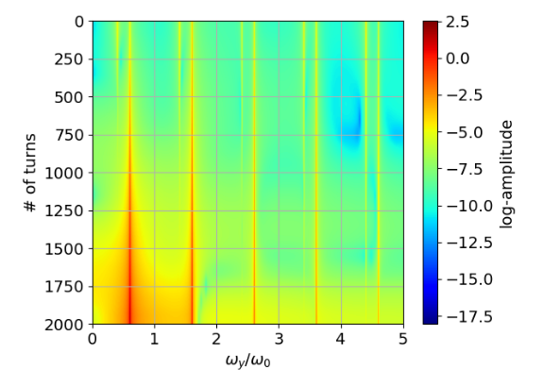
Coasting beam simulations: slow/fast waves
PyHeadTail was adapted to simulate coasting beams [5]
PS scenario: driving impedance, ${10}^{13}$ protons, PS-like parameters (injection)
y-plane, $Q_{y}=6.4$
[5] N.Biancacci, “pyHEADTAIL for coasting beams”, 178th HSC meeting, 27-05-2019

Slide 13
Coasting beam simulations: slow/fast waves
PyHeadTail was adapted to simulate coasting beams [5]
PS scenario: driving impedance, ${10}^{13}$ protons, PS-like parameters (injection)
y-plane, $Q_{y}=6.4$
Fast waves $→$ $n+Q>0$stable
$$n=$$
$$−6$$
$$−5$$
$$−4$$
$$−3$$
$$−2$$

Slide 14
Coasting beam simulations: slow/fast waves
PyHeadTail was adapted to simulate coasting beams [5]
PS scenario: driving impedance, ${10}^{13}$ protons, PS-like parameters (injection)
y-plane, $Q_{y}=6.4$
Fast waves $→$ $n+Q>0$ stable
Slow waves $→$ $n−Q>0$ unstable
$$n=$$
$$7$$
$$8$$
$$9$$
$$10$$
$$11$$
$$n=$$
$$−6$$
$$−5$$
$$−4$$
$$−3$$
$$−2$$

Slide 15
Coasting beam simulations: slow/fast waves
PyHeadTail was adapted to simulate coasting beams [5]
PS scenario: driving impedance, ${10}^{13}$ protons, PS-like parameters (injection)
y-plane, $Q_{y}=6.4$
Fast waves $→$ $n+Q>0$ stable
Slow waves $→$ $n−Q>0$ unstable
The lowest slow wave is the most unstable wave (resistive wall)
$$n=$$
$$7$$
$$8$$
$$9$$
$$10$$
$$11$$
$$n=$$
$$−6$$
$$−5$$
$$−4$$
$$−3$$
$$−2$$

Slide 16
Effect of driving impedance: theory
Let’s consider a transverse perturbation [6,7]
$$y\left(s,t\right)=Δe^{j(Ωt−ns/R)}$$
with $R$, radius of the machine, $n$ integer number, $Ω$ angular perturbation frequency and $Δ$ maximum excursion at time $t=0$.
The overall driving force induced by the driving wake $W_{y}^{driv}(z)$ is:
$$\left\langle F_{y}^{driv}\left(s,t\right)\right\rangle =−\frac{qv}{C}ρ\left(s\right)y\left(s,t\right)\int_{0}^{∞}{W_{y}^{driv}\left(z\right)}e^{\frac{jΩz}{v}}dz/v=−\frac{qv}{C}ρ\left(s\right)y\left(s,t\right)Z_{y}^{driv}(Ω)$$
with $ρ\left(s\right)=qN/C$ longitudinal line density ($q$ elementary charge, $N$ beam population, $C = 2πR$), beam velocity $v.$
The complex frequency shift can be found as
$$ΔΩ_{n}^{driv}=−\frac{q^{2}vN}{2γm_{0}C^{2}ω_{β}}jZ_{y}^{driv}(\left(n−Q_{y}\right)ω_{0})$$
with $γm_{0}$ relativist mass and $ω_{β}=Q_{y}ω_{0}$.
[6] A.W.Chao, “Physics of Collective Beam Instabilities in High Energy Accelerators”
[7] J.L.Laclare, “Coasting beam transverse coherent instabilities”, 5th General Accelerator Physics Course

Slide 17
Effect of driving impedance: theory vs simulations
PS scenario: driving impedance, intensity scan, PS-like parameters
V plane x2 more critical (flat chamber)
Very good agreement with the available theory!

Slide 18
Effect of detuning impedance: theory
Let’s consider the contribution of the detuning impedance force:
$$\left\langle F_{y}^{det}\left(s,t\right)\right\rangle =−\frac{q}{C}y\left(s,t\right)\int_{t}^{∞}{W_{y}^{det}\left(vt^{′}−vt\right)}ρ(s,t′)vdt′$$
When the longitudinal distribution is constant we have
$$\left\langle F_{y}^{det}\left(s,t\right)\right\rangle =−\frac{q^{2}vN}{C^{2}}y\left(s,t\right)jZ_{y}^{det}(0)$$
i.e. the detuning impedance is sampled at DC $→$ see importance of inductive bypass effect!
The complex frequency shift can be found as:
$$ΔΩ_{n}^{det}=−\frac{q^{2}vN}{2γm_{0}C^{2}ω_{β}}jZ_{y}^{det}(0)$$

Slide 19
Effect of driving + detuning impedance: theory
Let’s consider the overall contribution of the driving and detuning force.
Superimposing the effects we have:
$$\ddot{y}\left(s,t\right)+ω_{β}^{2}y\left(s,t\right)=2ω_{β}ΔΩ_{n}^{tot}y(s,t)$$
with $ΔΩ_{n}^{tot}= ΔΩ_{n}^{driv}+ΔΩ_{n}^{det}$, and $\ddot{y}$ meaning derivation over time.
As the detuning impedance effect can be rather large we investigate also the possibility of fast-slow waves couplings.
Considering ${n=n}_{1}$ and $n=n_{2}$ respectively as a slow and fast wave index, we have:
(slow wave)
$$\ddot{y_{1}}+ω_{β}^{2}y_{1}=2ω_{β}{ΔΩ}_{y,n_{1}}^{tot}y_{1}+2ω_{β}{ΔΩ}_{y,n_{2}}^{tot}y_{2}$$
(fast wave)
$\ddot{y_{2}}+ω_{β}^{2}y_{2}=2ω_{β}{ΔΩ}_{y,n_{2}}^{tot}y_{2}$ $+2ω_{β}{ΔΩ}_{y,n_{1}}^{tot}y_{1}$
The non-trivial solution of the system will represent stable/unstable coupled modes.

Slide 20
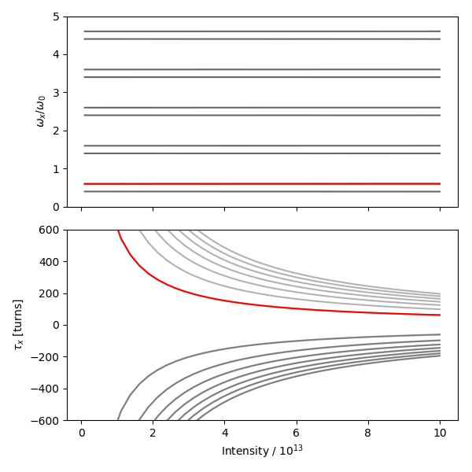
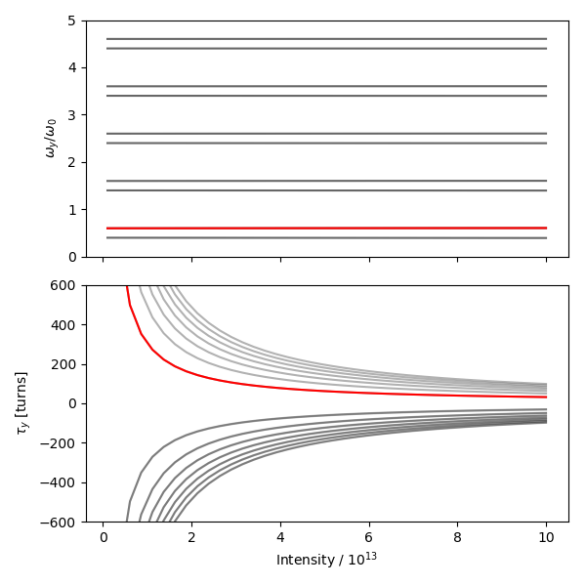
Example with classical theory: uncoupled waves
X plane
Y plane
(slow wave)
(fast wave)
(slow wave)
$$\ddot{y_{1}}+ω_{β}^{2}y_{1}=2ω_{β}{ΔΩ}_{y,n_{1}}^{driv}y_{1}$$
$${ΔΩ}_{y }^{driv}∝Z_{y}^{driv}(n Q_{y})$$
with
$$+$$
(fast wave)
$\ddot{y_{2}}+ω_{β}^{2}y_{2}=2ω_{β}{ΔΩ}_{y,n_{2}}^{driv}y_{2}$
$$−$$

Slide 21
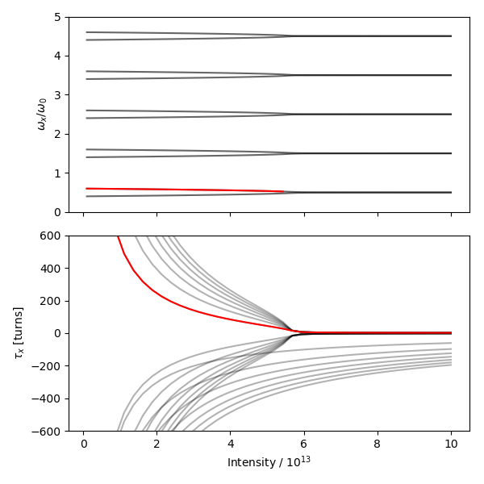
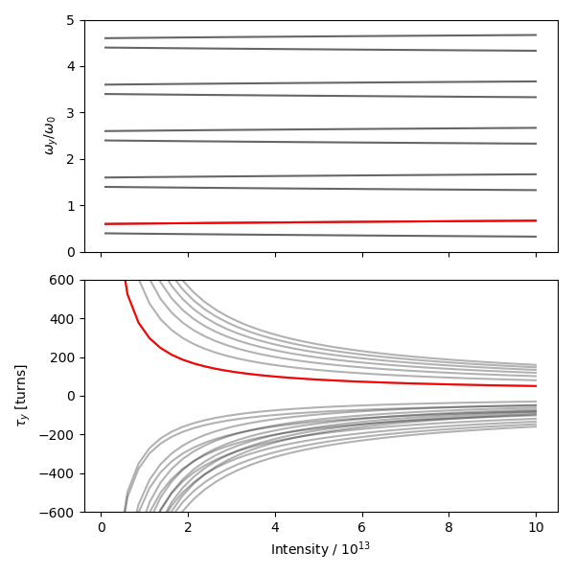
Example with extended theory: coupled waves
X plane
Y plane
Coupling(s)!
(slow wave)
$$\ddot{y_{1}}+ω_{β}^{2}y_{1}=2ω_{β}{ΔΩ}_{y,n_{1}}^{tot}y_{1}+2ω_{β}{ΔΩ}_{y,n_{2}}^{tot}y_{2}$$
$${ΔΩ}_{y }^{tot}∝Z_{y}^{driv}\left(n Q_{y}\right)+Z_{y}^{det}(0)$$
with
$$+$$
$\ddot{y_{2}}+ω_{β}^{2}y_{2}=2ω_{β}{ΔΩ}_{y,n_{2}}^{tot}y_{2}$ $+2ω_{β}{ΔΩ}_{y,n_{1}}^{tot}y_{1}$
with
$$−$$
(fast wave)

Slide 22
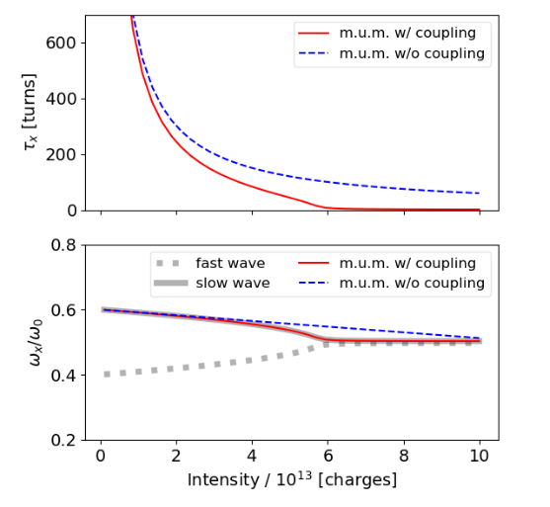
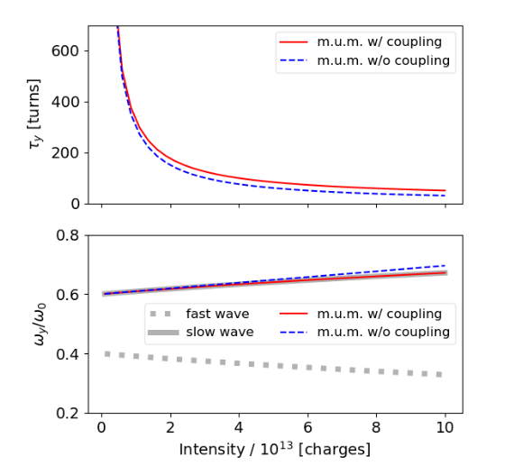
Effect on the most unstable mode
Accounting for the fast-slow mode coupling theory in presence of detuning impedance, the plane of the most unstable mode is exchanged!
This effect cannot be observed w/o accounting for the fast-slow mode couplings.

Slide 23
Fast-slow mode coupling instability
PyHeadtail simulations were performed with both driving and detuning impedances.
We notice:
Very good agreement with the developed theory.
The plane inversion happens slightly below $N=4⋅{10}^{13}$.
When the intensity is too high ($N>6⋅{10}^{13}$) we fall on the half integer.

Slide 24
Conclusions
A significantly destabilising effect of the detuning impedance has been observed in the frame of the study of the PS instability at injection.
Problem attacked with a “simpler” case: coasting beams.
Main outcome:
A destabilising effect of the detuning on the horizontal plane was observed also in coasting beam simulations.
The inductive bypass effect is essential to extrapolate the effect of detuning impedance (until now, the inductive bypass effect was found to be important at CERN only for the LHC collimators).
A new theory was developed accounting for coupling of slow and fast waves in presence of detuning impedance.
A new instability mechanism, the fast-slow mode coupling, was predicted and simulated.
Future work:
Investigate effect of longitudinal coasting beam distributions, chromaticity and momentum spread (both with simulations and Vlasov’s formalism)

Slide 25
Thank you for your bandwidth! Any questions?

Slide 26
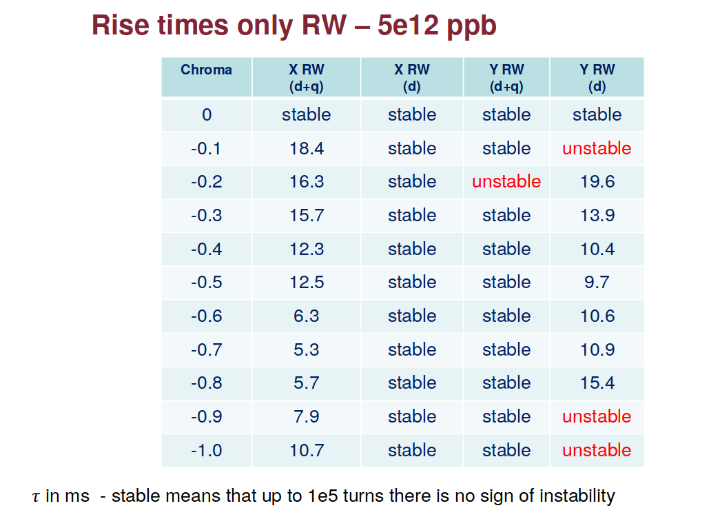
M.Migliorati’s simulations
A destabilising effect of the detuning impedance has been observed in simulations by M.Migliorati (see e.g. https://indico.cern.ch/event/824835/)
The instability is observed for the PS parameters at injection energy.
We set-up the same simulations in coasting beams to try to understand the mechanism in a simpler physical context.

