Slide 1

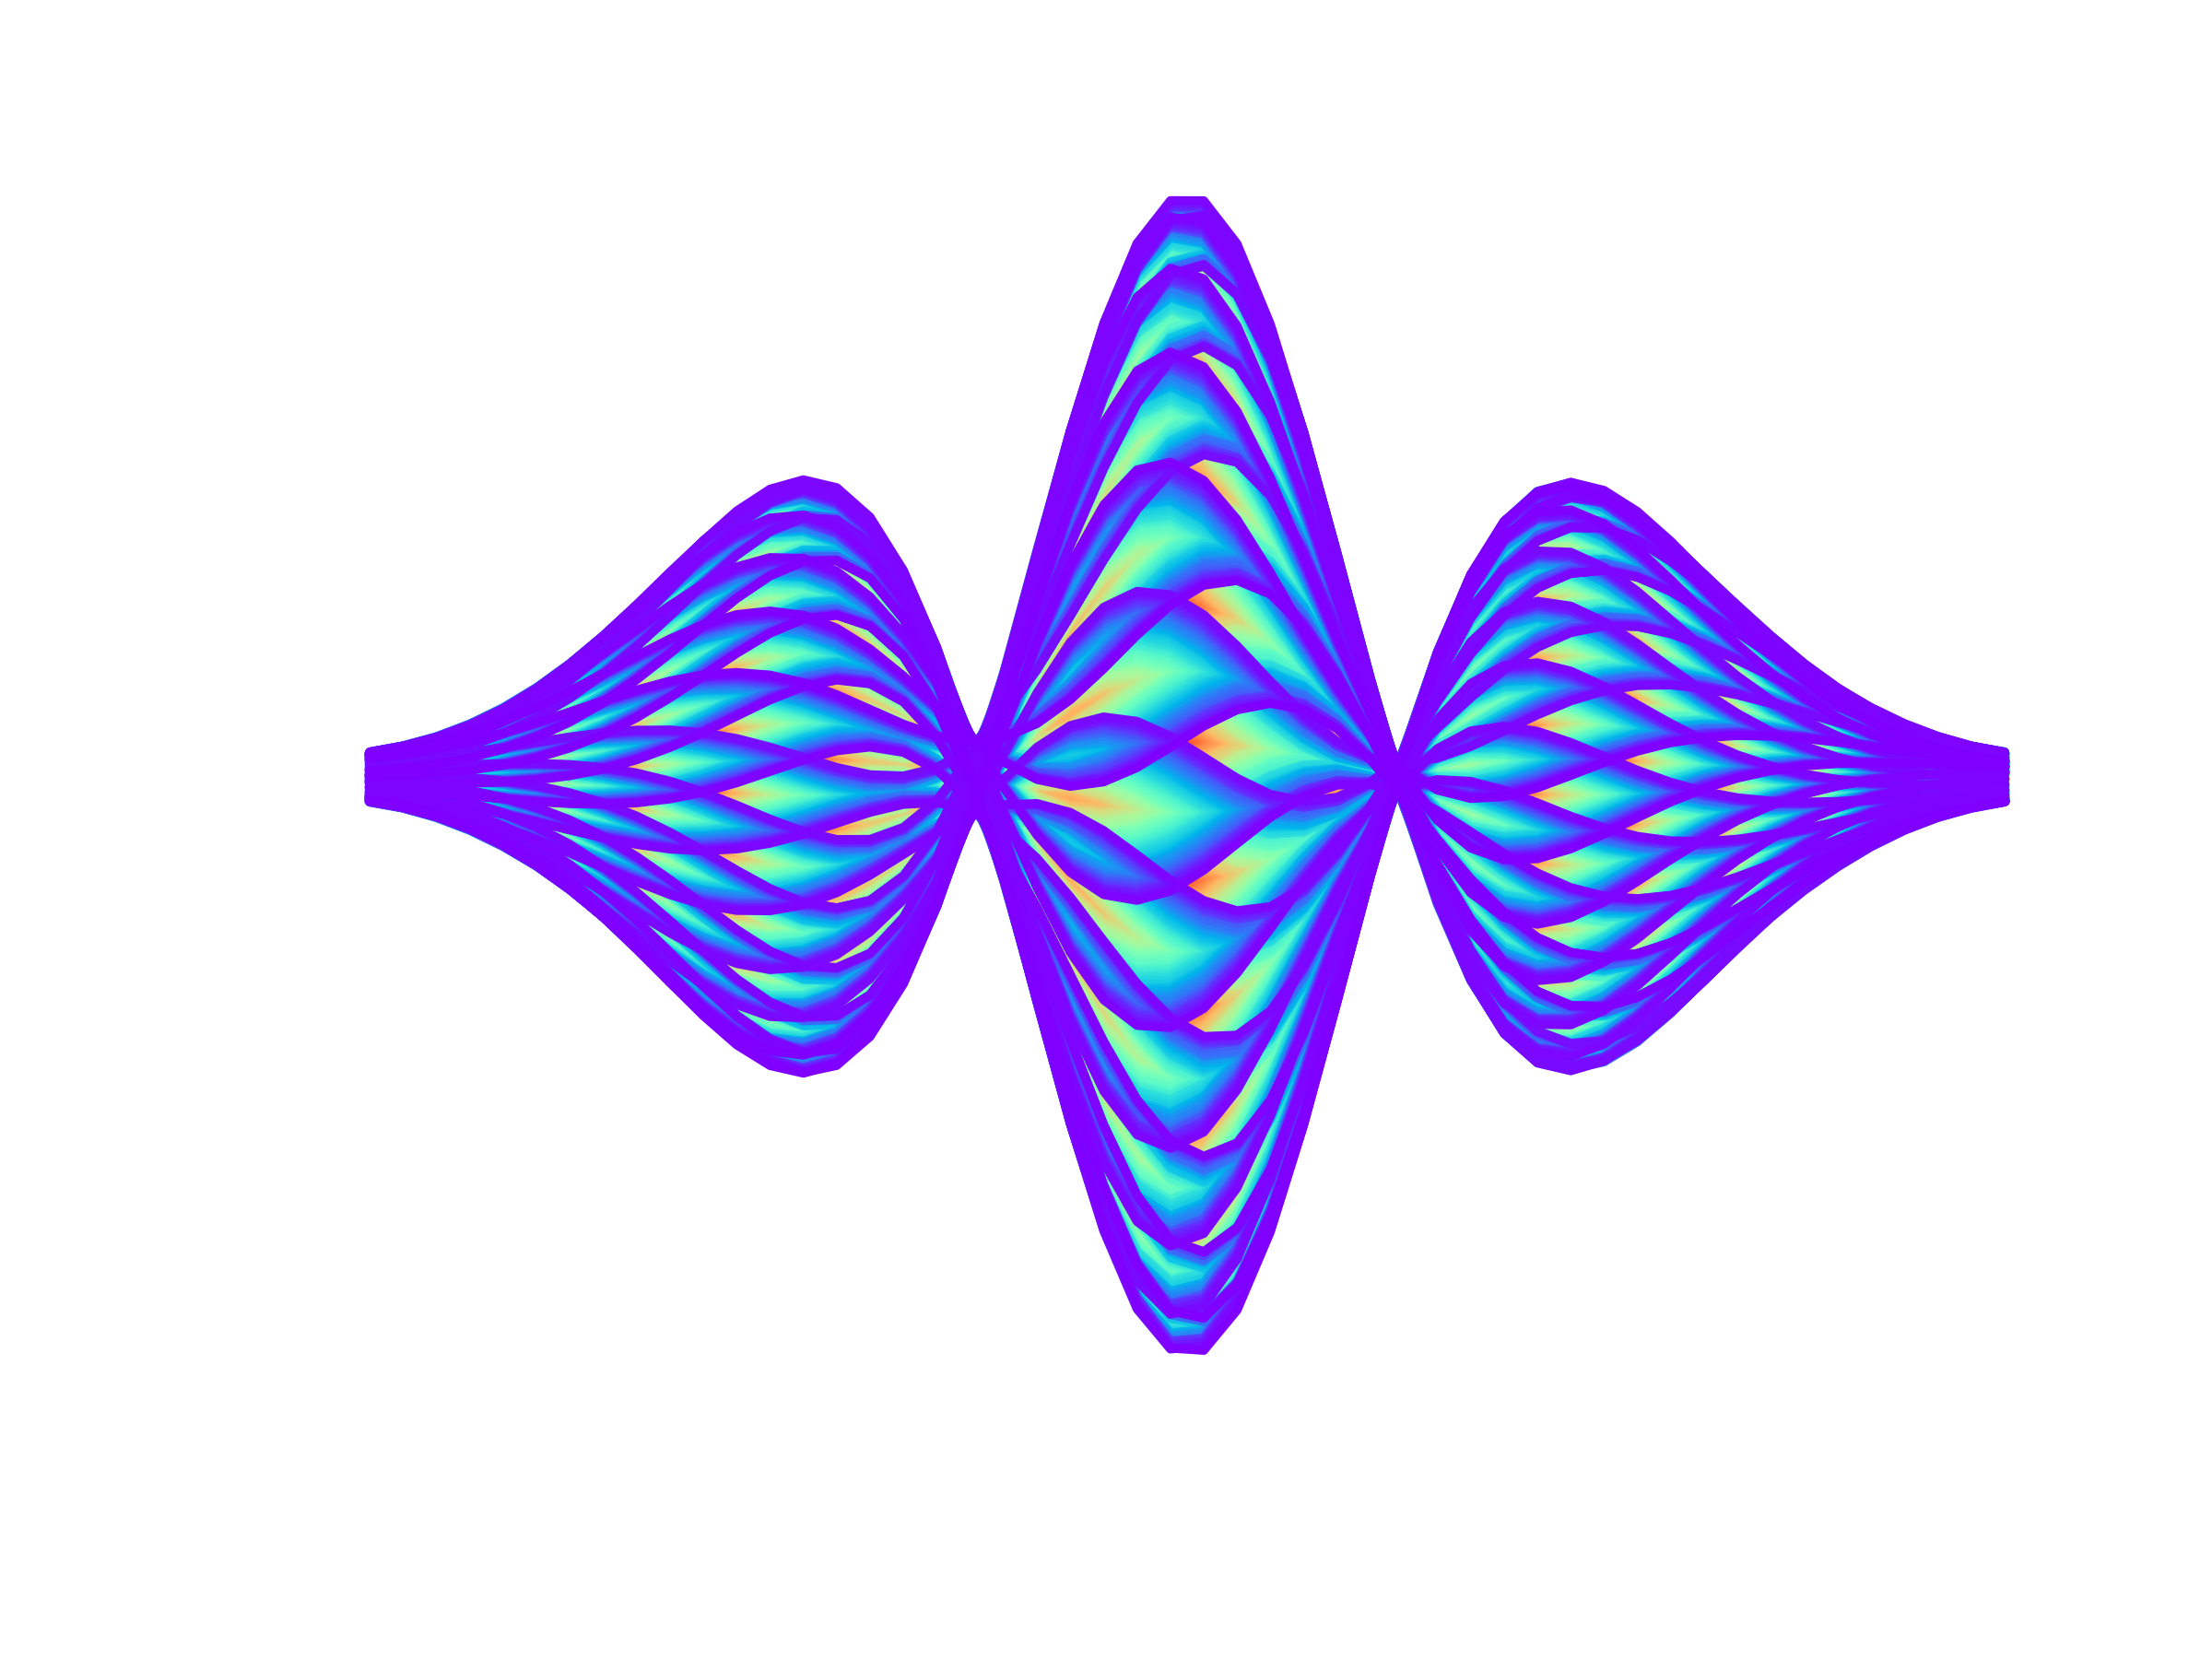
TMCI in the presence of detuning impedance
E. Métral, X. Buffat and G. Rumolo

Slide 2
TMCI in the presence of detuning impedance
E. Métral, X. Buffat and G. Rumolo
Motivation: recent pyHEADTAIL simulations for the CERN PS (by
M. Migliorati, 2019) revealed that the detuning impedance can have a destabilising effect

Slide 3
TMCI in the presence of detuning impedance
E. Métral, X. Buffat and G. Rumolo
Motivation: recent pyHEADTAIL simulations for the CERN PS (by
M. Migliorati, 2019) revealed that the detuning impedance can have a destabilising effect
=> Started to review in detail the theory of all transverse instabilities with detuning impedance
(see https://cds.cern.ch/record/2714848/files/CERN-ACC-NOTE-2020-0019.pdf)

Slide 4

Contents
Introduction
TMCI for a single bunch ($Q^{′}=0$)
  Theory with 2-particle model => See next talk by G. Rumolo with all the detailed computations
  Theory of circulant matrix formalism with 2 or more azimuthal modes but still 1 radial mode
  Comparison with simulation of circulant matrix formalism with many azimuthal modes but still 1 radial mode (from BimBim code)
  Full BimBim simulation of circulant matrix formalism with many azimuthal modes and many radial modes
Coasting-beams => See next talk by N. Biancacci with a new instability mechanism identified
Conclusion and outlook

Slide 5
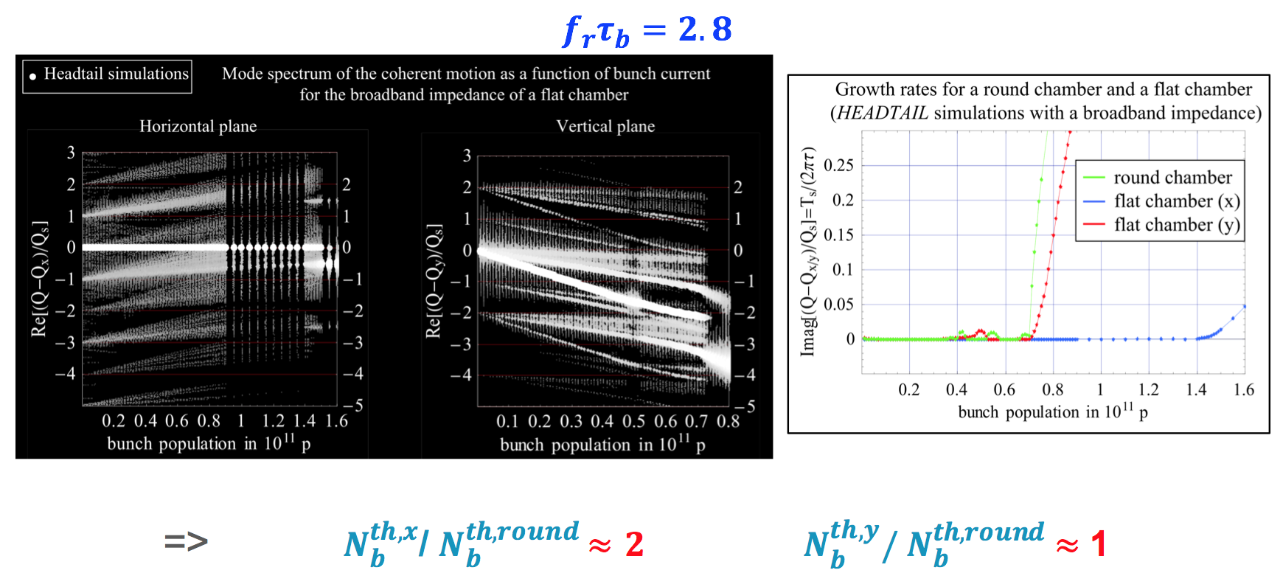
Intro: Past simulations for SPS TMCI
B. Salvant
=> Can we fully understand them?

Slide 6
Intro: Past simulations for SPS TMCI
As we will see, it is important to differentiate between the “short-bunch” regime (TMCI between modes 0 and -1) and the “long-bunch” regime (TMCI between higher-order modes)

Slide 7
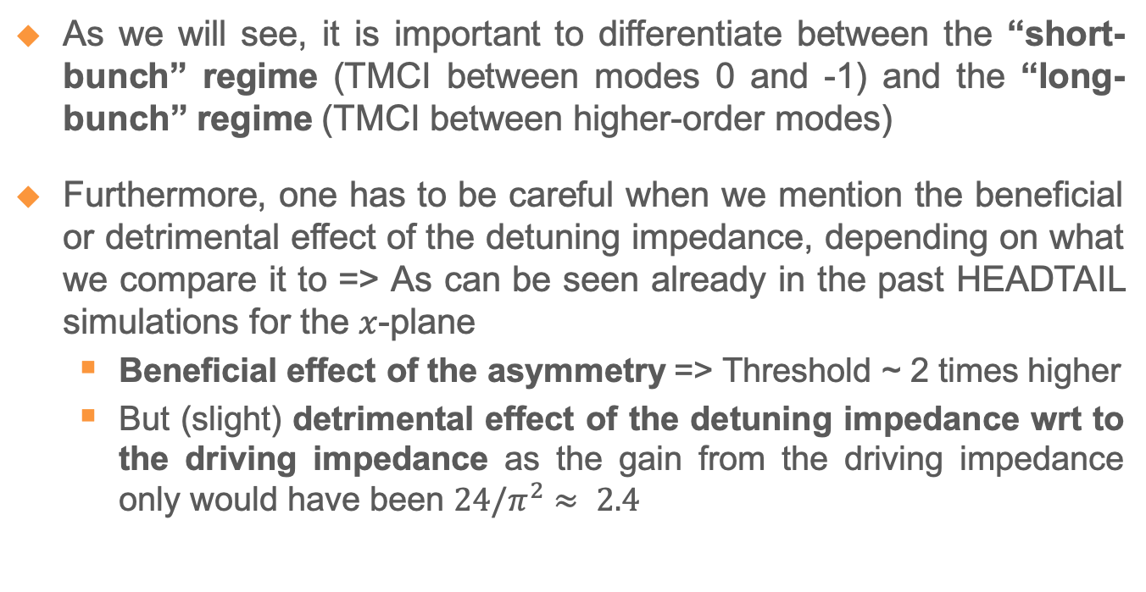
Intro: Past simulations for SPS TMCI
As we will see, it is important to differentiate between the “short-bunch” regime (TMCI between modes 0 and -1) and the “long-bunch” regime (TMCI between higher-order modes)
Furthermore, one has to be careful when we mention the beneficial or detrimental effect of the detuning impedance, depending on what we compare it to => As can be seen already in the past HEADTAIL simulations for the $x$-plane
  Beneficial effect of the asymmetry => Threshold ~ 2 times higher
  But (slight) detrimental effect of the detuning impedance wrt to the driving impedance as the gain from the driving impedance only would have been $24/π^{2}≈ 2.4$

Slide 8
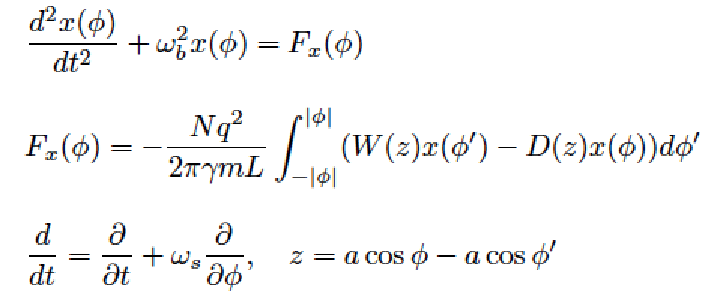
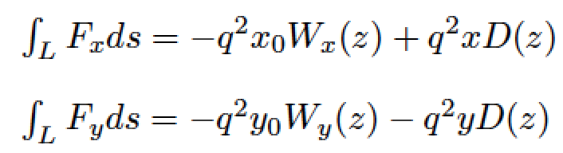
Circulant matrix formalism (1 radial mode)
See A. Burov and V. Danilov, “Suppression of transverse bunch instabilities by asymmetries in the chamber geometry”, Phys. Rev. Lett. 82, 2286 (1999) => Followed the formalism from Danilov-Perevedentsev_1997 (Feedback system for elimination of the TMCI, Nucl. Instr. and Methods, A391, 77)

Slide 9
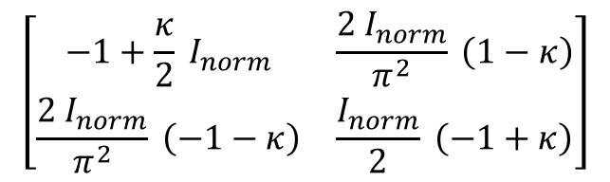
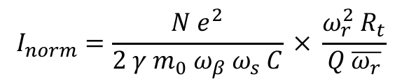


Circulant matrix formalism (1 radial mode)
Using the “air-bag” model with a constant wake (given below as the constant term of a resonator wake, which will be used after) and considering first only 2 modes (0 and -1), the system is fully described by the following matrix to be diagonalized
$$\left[\begin{matrix}−1+\frac{κ}{2} I_{norm} & \frac{2 I_{norm}}{π^{2}} \left(1−κ\right) \\ \frac{2 I_{norm}}{π^{2}} \left(−1−κ\right) & \frac{I_{norm}}{2} \left(−1+κ\right)\end{matrix}\right]$$
$$I_{norm}=\frac{N e^{2}}{2 γ{ m}_{0} ω_{β} ω_{s} C} × \frac{ω_{r}^{2} R_{t}}{Q \overline{ω_{r}}}$$
$$κ=\frac{D\left(z\right)}{W_{x }\left(z\right)}$$
+ 1 in $x$ for CRW flat chamber
- 1/2 in $y$ for CRW flat chamber

Slide 10
$$κ=0.0$$
Circulant matrix formalism (1 radial mode)
See aslo G. Rumolo’s talk (similar results)

Slide 11
$$κ=0.1$$
Circulant matrix formalism (1 radial mode)

Slide 12
$$κ=0.2$$
Circulant matrix formalism (1 radial mode)

Slide 13
$$κ=0.3$$
Circulant matrix formalism (1 radial mode)

Slide 14
$$κ=0.4$$
Circulant matrix formalism (1 radial mode)

Slide 15
$$κ=0.5$$
Circulant matrix formalism (1 radial mode)

Slide 16
$$κ=0.6$$
Circulant matrix formalism (1 radial mode)

Slide 17
$$κ=0.7$$
Circulant matrix formalism (1 radial mode)

Slide 18
$$κ=0.8$$
Circulant matrix formalism (1 radial mode)

Slide 19
$$κ=0.9$$
Circulant matrix formalism (1 radial mode)

Slide 20
$$κ=1.0$$
Circulant matrix formalism (1 radial mode)

Slide 21
$$κ=1.1$$
Circulant matrix formalism (1 radial mode)

Slide 22
$$κ=0.0$$
Circulant matrix formalism (1 radial mode)

Slide 23
$$κ=−0.1$$
Circulant matrix formalism (1 radial mode)

Slide 24
$$κ=−0.2$$
Circulant matrix formalism (1 radial mode)

Slide 25
$$κ=−0.3$$
Circulant matrix formalism (1 radial mode)

Slide 26
$$κ=−0.4$$
Circulant matrix formalism (1 radial mode)

Slide 27
$$κ=−0.5$$
Circulant matrix formalism (1 radial mode)

Slide 28
$$κ=−0.6$$
Circulant matrix formalism (1 radial mode)

Slide 29
$$κ=−0.7$$
Circulant matrix formalism (1 radial mode)

Slide 30
$$κ=−0.8$$
Circulant matrix formalism (1 radial mode)

Slide 31
$$κ=−0.9$$
Circulant matrix formalism (1 radial mode)

Slide 32
$$κ=−1.0$$
Circulant matrix formalism (1 radial mode)

Slide 33
$$κ=−1.1$$
Circulant matrix formalism (1 radial mode)

Slide 34
Circulant matrix formalism (1 radial mode)
See aslo G. Rumolo’s talk (similar results)

Slide 35


Circulant matrix formalism (1 radial mode)
- 1/2 in $y$ for CRW flat chamber
+ 1 in $x$ for CRW flat chamber

Slide 36
Circulant matrix formalism (1 radial mode)
=> Only beneficial effect of the detuning impedance wrt to the driving impedance for the “short-bunch” regime

Slide 37
Circulant matrix formalism (1 radial mode)
Considering now a BBR impedance and many azimuthal modes (but still 1 radial mode), an excellent agreement is obtained between theory and simulation (vs. the bunch length)

Slide 38



Circulant matrix formalism (1 radial mode)
Considering now a BBR impedance and many azimuthal modes (but still 1 radial mode), an excellent agreement is obtained between theory and simulation (vs. the bunch length)
Theory
BimBim simulation (X. Buffat)
$$I_{norm}^{th}$$
$$I_{norm}^{th}$$
$$f_{r}τ_{b}$$
$$f_{r}τ_{b}$$

Slide 39
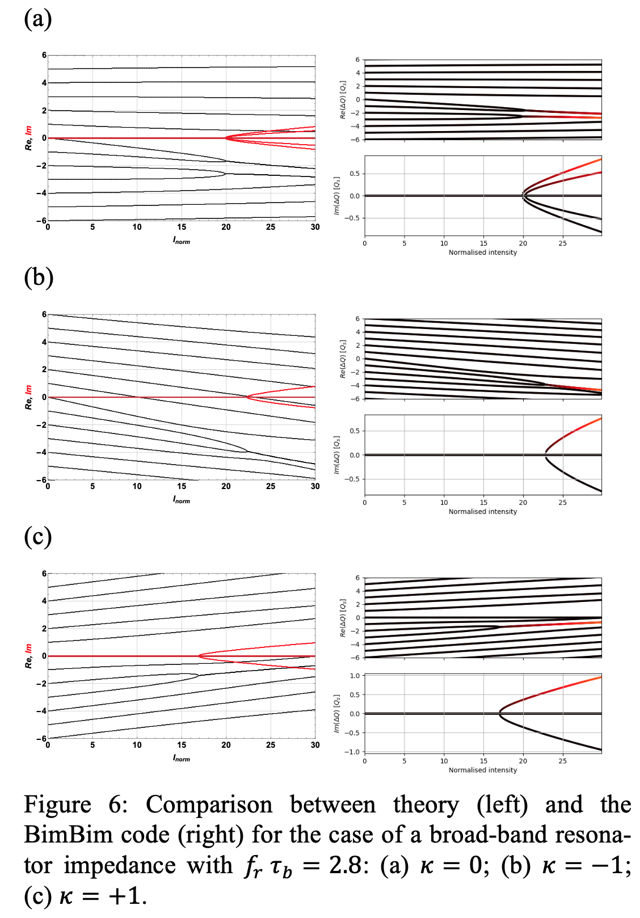
“Long-bunch” regime

Slide 40
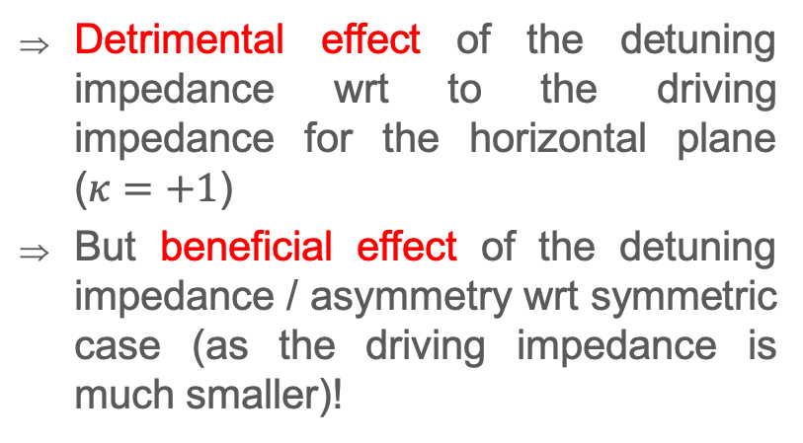
“Long-bunch” regime
Detrimental effect of the detuning impedance wrt to the driving impedance for the horizontal plane ($κ=+1$)
But beneficial effect of the detuning impedance / asymmetry wrt symmetric case (as the driving impedance is much smaller)!

Slide 41
“Long-bunch” regime
Detrimental effect of the detuning impedance wrt to the driving impedance for the horizontal plane ($κ=+1$)
But beneficial effect of the detuning impedance / asymmetry wrt symmetric case (as the driving impedance is much smaller)!

Slide 42
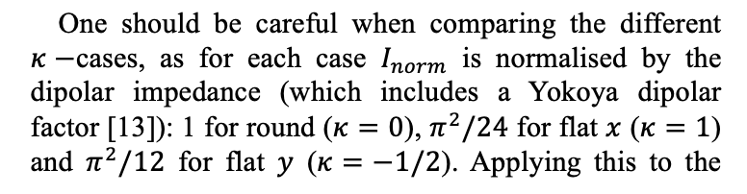
“Long-bunch” regime
Detrimental effect of the detuning impedance wrt to the driving impedance for the horizontal plane ($κ=+1$)
But beneficial effect of the detuning impedance / asymmetry wrt symmetric case (as the driving impedance is much smaller)!

Slide 43
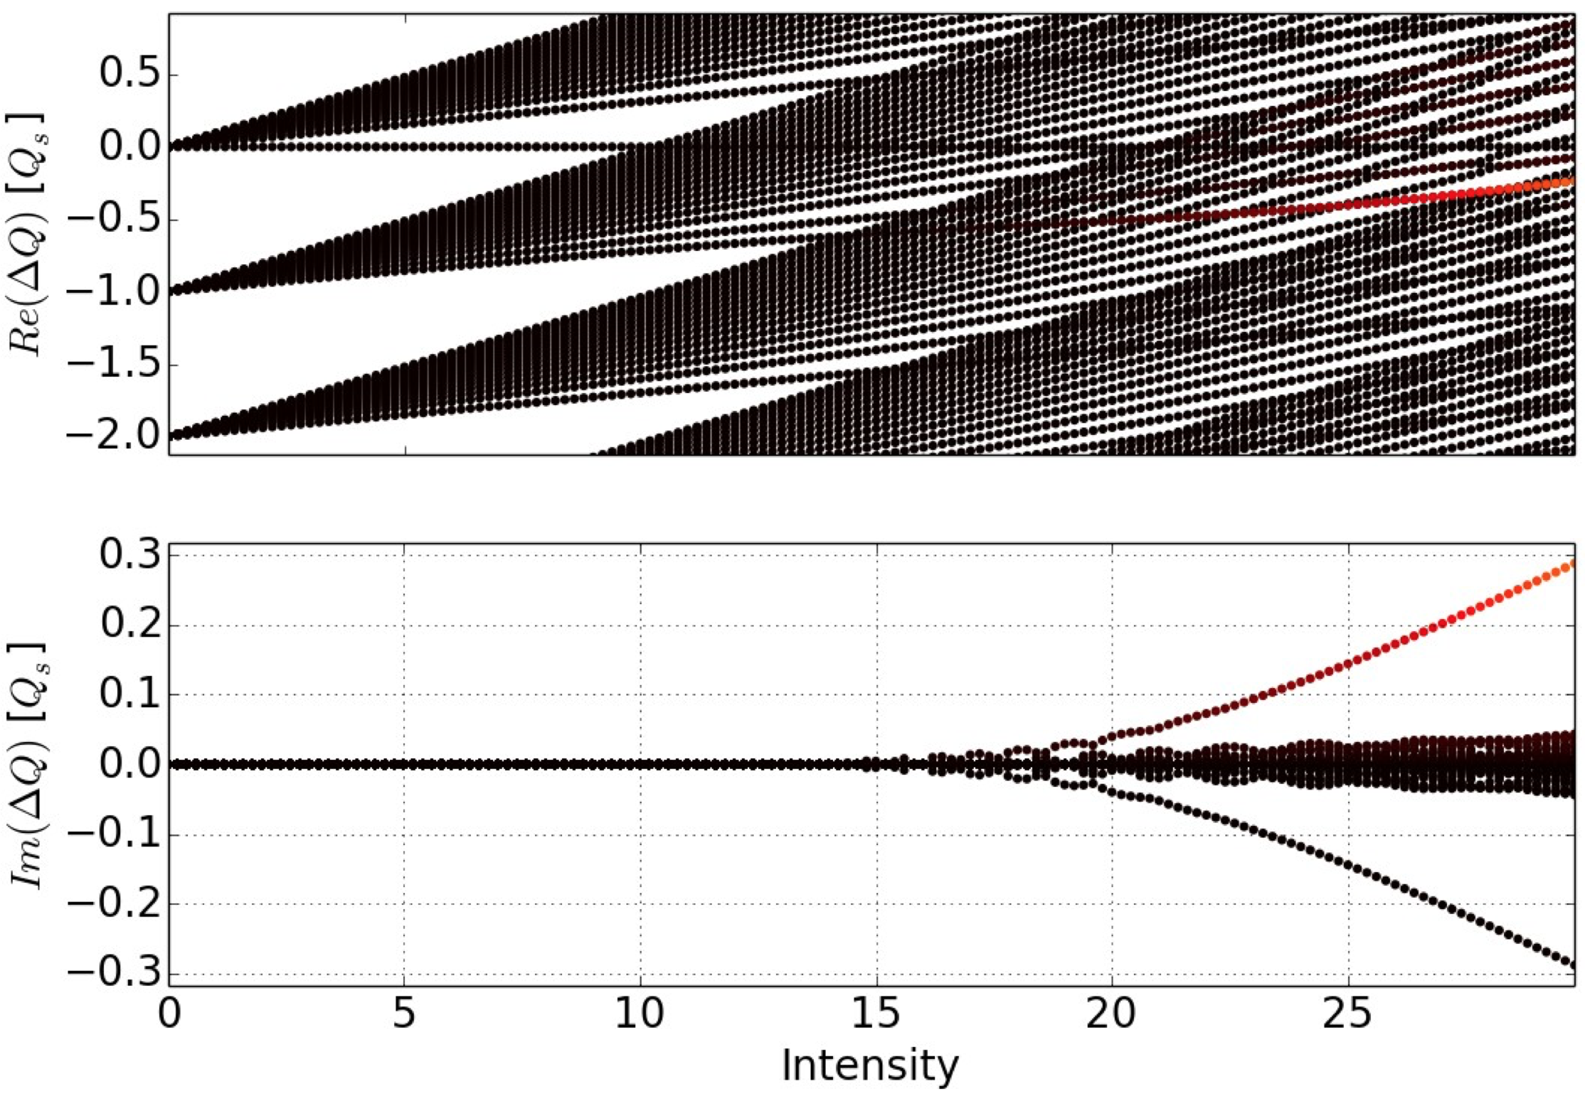
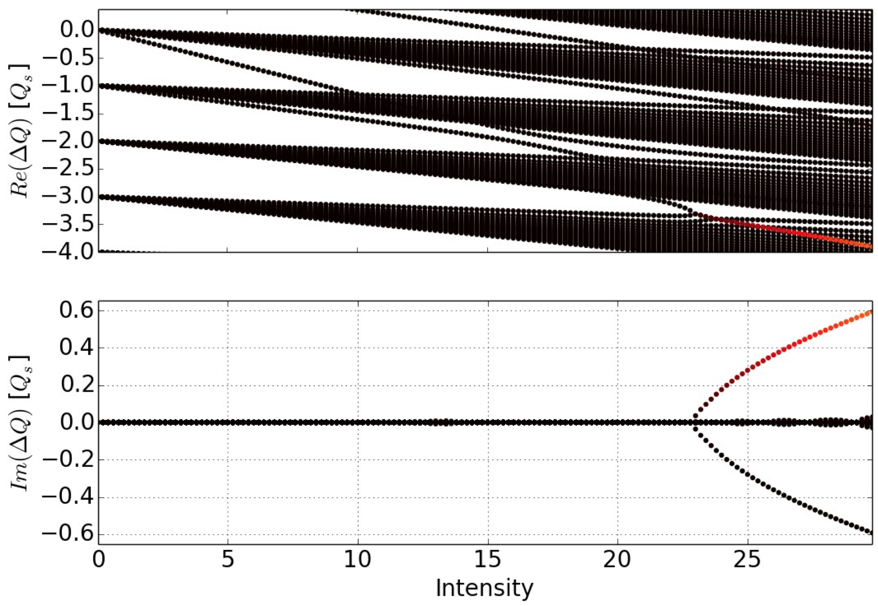
Circulant matrix formalism (>1 radial modes)
X. Buffat (BimBim code)
=> Similar intensity thresholds as before (with change of modes which couple), similar to past HEADTAIL simulations

Slide 44
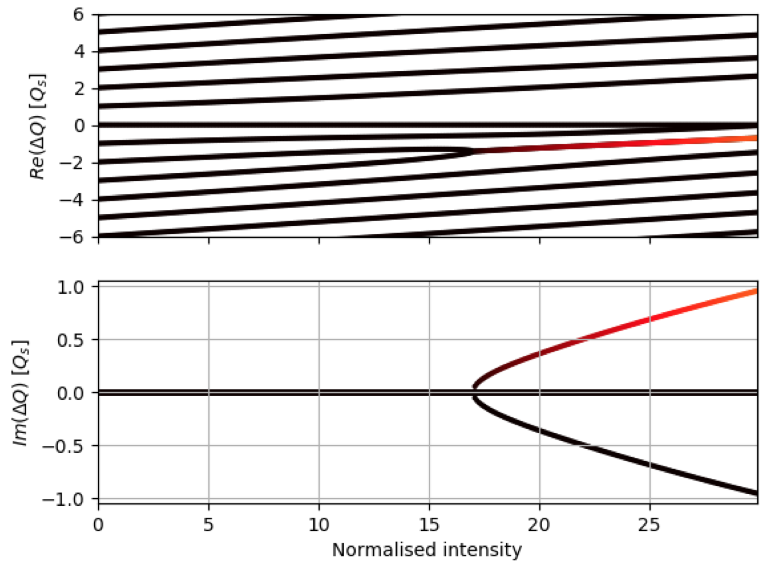
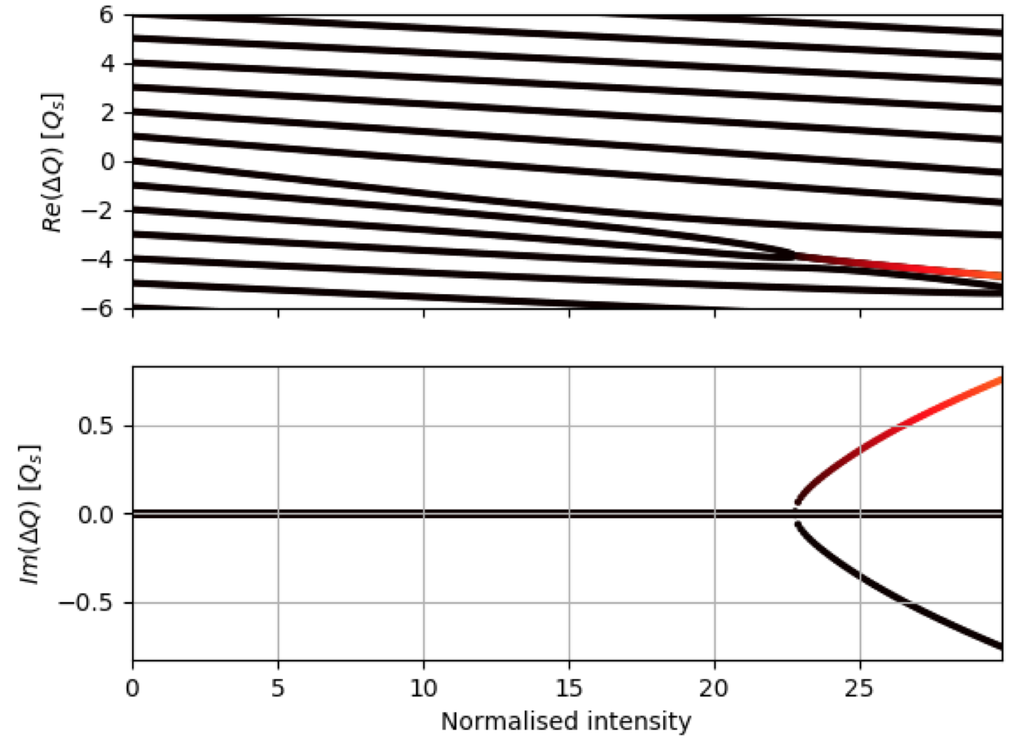
Circulant matrix formalism (>1 radial modes)
X. Buffat (BimBim code)

Slide 45
Conclusion and outlook
Huge effort started in the CERN HSC section since ~ 1 year to try and fully understand the effect of the detuning impedance on beam stability

Slide 46

Conclusion and outlook
Huge effort started in the CERN HSC section since ~ 1 year to try and fully understand the effect of the detuning impedance on beam stability
The case of the single-bunch TMCI (for $Q^{′}=0$) was discussed here

Slide 47

Conclusion and outlook
Huge effort started in the CERN HSC section since ~ 1 year to try and fully understand the effect of the detuning impedance on beam stability
The case of the single-bunch TMCI (for $Q^{′}=0$) was discussed here
  “Short-bunch” regime with a constant wake: Only a beneficial effect is predicted wrt to the driving impedance

Slide 48

Conclusion and outlook
Huge effort started in the CERN HSC section since ~ 1 year to try and fully understand the effect of the detuning impedance on beam stability
The case of the single-bunch TMCI (for $Q^{′}=0$) was discussed here
  “Short-bunch” regime with a constant wake: Only a beneficial effect is predicted wrt to the driving impedance
  “Long-bunch” regime with a BBR impedance: a detrimental effect is predicted wrt to the driving impedance (as it was in fact already observed in past HEADTAIL simulations)

Slide 49

Conclusion and outlook
Huge effort started in the CERN HSC section since ~ 1 year to try and fully understand the effect of the detuning impedance on beam stability
The case of the single-bunch TMCI (for $Q^{′}=0$) was discussed here
  “Short-bunch” regime with a constant wake: Only a beneficial effect is predicted wrt to the driving impedance
  “Long-bunch” regime with a BBR impedance: a detrimental effect is predicted wrt to the driving impedance (as it was in fact already observed in past HEADTAIL simulations)
Meanwhile, a general theory for bunched beams has been developed by G. Iadarola et al.: “Linearized method for the study of transverse instabilities driven by electron clouds”, PRAB 23, 081002, 2020 (https://journals.aps.org/prab/abstract/10.1103/PhysRevAccelBeams.23.081002)

