Slide 1
FCC-ee emittance tuning
Tessa Charles
University of Liverpool, The Cockcroft Institute
LHC
PS
SPS
FCC
photo: J. Wenninger
photo: J. Wenninger

Slide 2
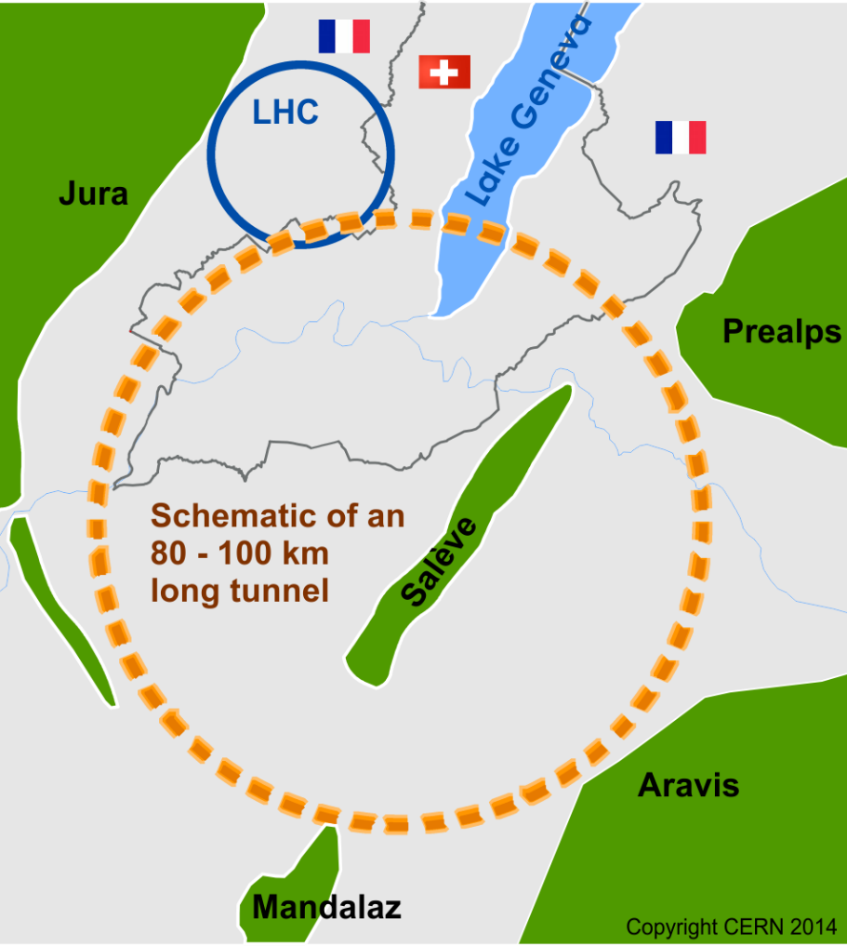
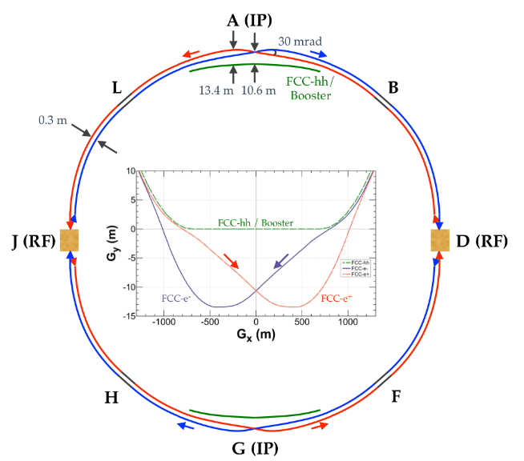
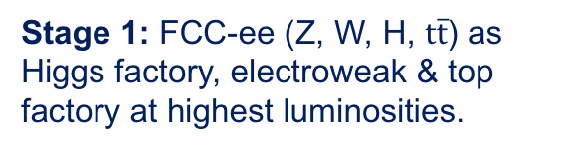
The FCC integrated program
Comprehensive cost-effective program maximizing physics opportunities.
Stage 1: FCC-ee (Z, W, H, $\text{t}\overline{\text{t}}$) as Higgs factory, electroweak & top factory at highest luminosities.
Stage 2: FCC-hh (~100 TeV) as natural continuation at energy frontier, with ion and eh options.
FCC-ee
FCC-hh
2
Notes:
Complementary physics
Common civil engineering and technical infrastructures
Building on and reusing CERN’s existing infrastructure
FCC integrated project allows seamless continuation of HEP after HL-LHC

Slide 3
2020 Update European Particle-Physics Strategy
2020 Update European Particle-Physics Strategy (CERN-ESU-013/014)
“An electron-positron Higgs factory is the highest-priority next collider. For the longer term, the European particle physics community has the ambition to operate a proton-proton collider at the highest achievable energy. Accomplishing these compelling goals will require innovation and cutting-edge technology:
“Europe, together with its international partners, should investigate the technical and financial feasibility of a future hadron collider at CERN with a c.o.m energy of at least 100 TeV and with an electron-positron Higgs and electroweak factory as a possible first stage. Such a feasibility study of the colliders and related infrastructure should be established as a global endeavour and be completed on the timescale of the next Strategy update.”
Plan for 2020–2025:
Financing strategy including in-kind contributions
Governance model for construction & operation
Host states / Civil-engineering preparation including site investigations
Technical design study for accelerator and infrastructure

Slide 4
2020 Update European Particle-Physics Strategy
2020 Update European Particle-Physics Strategy (CERN-ESU-013/014)
“Europe, together with its international partners, should investigate the technical and financial feasibility of a future hadron collider at CERN with a c.o.m energy of at least 100 TeV and with an electron-positron Higgs and electroweak factory as a possible first stage. Such a feasibility study of the colliders and related infrastructure should be established as a global endeavour and be completed on the timescale of the next Strategy update.”
Plan for 2020–2025:
Financing strategy including in-kind contributions
Governance model for construction & operation
Host states / Civil-engineering preparation including site investigations
Technical design study for accelerator and infrastructure

Slide 5

FCC-ee parameters
parameter | Z | WW | H (ZH) | ttbar
beam energy [GeV] | 45 | 80 | 120 | 182.5
beam current [mA] | 1390 | 147 | 29 | 5.4
no. bunches/beam | 16640 | 2000 | 393 | 48
bunch intensity [10¹¹] | 1.7 | 1.5 | 1.5 | 2.3
SR energy loss / turn [GeV] | 0.036 | 0.34 | 1.72 | 9.21
total RF voltage [GV] | 0.1 | 0.44 | 2.0 | 10.9
long. damping time [turns] | 1281 | 235 | 70 | 20
horizontal beta* [m] | 0.15 | 0.2 | 0.3 | 1
vertical beta* [mm] | 0.8 | 1 | 1 | 1.6
horiz. geometric emittance [nm] | 0.27 | 0.28 | 0.63 | 1.46
vert. geom. emittance [pm] | 1.0 | 1.7 | 1.3 | 2.9
bunch length with SR / BS [mm] | 3.5 / 12.1 | 3.0 / 6.0 | 3.3 / 5.3 | 2.0 / 2.5
luminosity per IP [10³⁴ cm⁻²s⁻¹] | 230 | 28 | 8.5 | 1.55
beam lifetime rad Bhabha / BS [min] | 68 / >200 | 49 / >1000 | 38 / 18 | 40 / 18
Tessa Charles, UK FCC meeting, September 2020

Slide 6
FCC-ee parameters
parameter | Z | WW | H (ZH) | ttbar
beam energy [GeV] | 45 | 80 | 120 | 182.5
beam current [mA] | 1390 | 147 | 29 | 5.4
no. bunches/beam | 16640 | 2000 | 393 | 48
bunch intensity [10¹¹] | 1.7 | 1.5 | 1.5 | 2.3
SR energy loss / turn [GeV] | 0.036 | 0.34 | 1.72 | 9.21
total RF voltage [GV] | 0.1 | 0.44 | 2.0 | 10.9
long. damping time [turns] | 1281 | 235 | 70 | 20
horizontal beta* [m] | 0.15 | 0.2 | 0.3 | 1
vertical beta* [mm] | 0.8 | 1 | 1 | 1.6
horiz. geometric emittance [nm] | 0.27 | 0.28 | 0.63 | 1.46
vert. geom. emittance [pm] | 1.0 | 1.7 | 1.3 | 2.9
bunch length with SR / BS [mm] | 3.5 / 12.1 | 3.0 / 6.0 | 3.3 / 5.3 | 2.0 / 2.5
luminosity per IP [10³⁴ cm⁻²s⁻¹] | 230 | 28 | 8.5 | 1.55
beam lifetime rad Bhabha / BS [min] | 68 / >200 | 49 / >1000 | 38 / 18 | 40 / 18
Tessa Charles, UK FCC meeting, September 2020

Slide 7
FCC-ee parameters
parameter | Z | WW | H (ZH) | ttbar
beam energy [GeV] | 45 | 80 | 120 | 182.5
beam current [mA] | 1390 | 147 | 29 | 5.4
no. bunches/beam | 16640 | 2000 | 393 | 48
bunch intensity [10¹¹] | 1.7 | 1.5 | 1.5 | 2.3
SR energy loss / turn [GeV] | 0.036 | 0.34 | 1.72 | 9.21
total RF voltage [GV] | 0.1 | 0.44 | 2.0 | 10.9
long. damping time [turns] | 1281 | 235 | 70 | 20
horizontal beta* [m] | 0.15 | 0.2 | 0.3 | 1
vertical beta* [mm] | 0.8 | 1 | 1 | 1.6
horiz. geometric emittance [nm] | 0.27 | 0.28 | 0.63 | 1.46
vert. geom. emittance [pm] | 1.0 | 1.7 | 1.3 | 2.9
bunch length with SR / BS [mm] | 3.5 / 12.1 | 3.0 / 6.0 | 3.3 / 5.3 | 2.0 / 2.5
luminosity per IP [10³⁴ cm⁻²s⁻¹] | 230 | 28 | 8.5 | 1.55
beam lifetime rad Bhabha / BS [min] | 68 / >200 | 49 / >1000 | 38 / 18 | 40 / 18
Tessa Charles, UK FCC meeting, September 2020

Slide 8
FCC-ee parameters
parameter | Z | WW | H (ZH) | ttbar
beam energy [GeV] | 45 | 80 | 120 | 182.5
beam current [mA] | 1390 | 147 | 29 | 5.4
no. bunches/beam | 16640 | 2000 | 393 | 48
bunch intensity [10¹¹] | 1.7 | 1.5 | 1.5 | 2.3
SR energy loss / turn [GeV] | 0.036 | 0.34 | 1.72 | 9.21
total RF voltage [GV] | 0.1 | 0.44 | 2.0 | 10.9
long. damping time [turns] | 1281 | 235 | 70 | 20
horizontal beta* [m] | 0.15 | 0.2 | 0.3 | 1
vertical beta* [mm] | 0.8 | 1 | 1 | 1.6
horiz. geometric emittance [nm] | 0.27 | 0.28 | 0.63 | 1.46
vert. geom. emittance [pm] | 1.0 | 1.7 | 1.3 | 2.9
bunch length with SR / BS [mm] | 3.5 / 12.1 | 3.0 / 6.0 | 3.3 / 5.3 | 2.0 / 2.5
luminosity per IP [10³⁴ cm⁻²s⁻¹] | 230 | 28 | 8.5 | 1.55
beam lifetime rad Bhabha / BS [min] | 68 / >200 | 49 / >1000 | 38 / 18 | 40 / 18
Tessa Charles, UK FCC meeting, September 2020

Slide 9
FCC-ee parameters
parameter | Z | WW | H (ZH) | ttbar
beam energy [GeV] | 45 | 80 | 120 | 182.5
beam current [mA] | 1390 | 147 | 29 | 5.4
no. bunches/beam | 16640 | 2000 | 393 | 48
bunch intensity [10¹¹] | 1.7 | 1.5 | 1.5 | 2.3
SR energy loss / turn [GeV] | 0.036 | 0.34 | 1.72 | 9.21
total RF voltage [GV] | 0.1 | 0.44 | 2.0 | 10.9
long. damping time [turns] | 1281 | 235 | 70 | 20
horizontal beta* [m] | 0.15 | 0.2 | 0.3 | 1
vertical beta* [mm] | 0.8 | 1 | 1 | 1.6
horiz. geometric emittance [nm] | 0.27 | 0.28 | 0.63 | 1.46
vert. geom. emittance [pm] | 1.0 | 1.7 | 1.3 | 2.9
bunch length with SR / BS [mm] | 3.5 / 12.1 | 3.0 / 6.0 | 3.3 / 5.3 | 2.0 / 2.5
luminosity per IP [10³⁴ cm⁻²s⁻¹] | 230 | 28 | 8.5 | 1.55
beam lifetime rad Bhabha / BS [min] | 68 / >200 | 49 / >1000 | 38 / 18 | 40 / 18
Tessa Charles, UK FCC meeting, September 2020

Slide 10
FCC-ee parameters
parameter | Z | WW | H (ZH) | ttbar
beam energy [GeV] | 45 | 80 | 120 | 182.5
beam current [mA] | 1390 | 147 | 29 | 5.4
no. bunches/beam | 16640 | 2000 | 393 | 48
bunch intensity [10¹¹] | 1.7 | 1.5 | 1.5 | 2.3
SR energy loss / turn [GeV] | 0.036 | 0.34 | 1.72 | 9.21
total RF voltage [GV] | 0.1 | 0.44 | 2.0 | 10.9
long. damping time [turns] | 1281 | 235 | 70 | 20
horizontal beta* [m] | 0.15 | 0.2 | 0.3 | 1
vertical beta* [mm] | 0.8 | 1 | 1 | 1.6
horiz. geometric emittance [nm] | 0.27 | 0.28 | 0.63 | 1.46
vert. geom. emittance [pm] | 1.0 | 1.7 | 1.3 | 2.9
bunch length with SR / BS [mm] | 3.5 / 12.1 | 3.0 / 6.0 | 3.3 / 5.3 | 2.0 / 2.5
luminosity per IP [10³⁴ cm⁻²s⁻¹] | 230 | 28 | 8.5 | 1.55
beam lifetime rad Bhabha / BS [min] | 68 / >200 | 49 / >1000 | 38 / 18 | 40 / 18
Tessa Charles, UK FCC meeting, September 2020

Slide 11
FCC-ee parameters
parameter | Z | WW | H (ZH) | ttbar
beam energy [GeV] | 45 | 80 | 120 | 182.5
beam current [mA] | 1390 | 147 | 29 | 5.4
no. bunches/beam | 16640 | 2000 | 393 | 48
bunch intensity [10¹¹] | 1.7 | 1.5 | 1.5 | 2.3
SR energy loss / turn [GeV] | 0.036 | 0.34 | 1.72 | 9.21
total RF voltage [GV] | 0.1 | 0.44 | 2.0 | 10.9
long. damping time [turns] | 1281 | 235 | 70 | 20
horizontal beta* [m] | 0.15 | 0.2 | 0.3 | 1
vertical beta* [mm] | 0.8 | 1 | 1 | 1.6
horiz. geometric emittance [nm] | 0.27 | 0.28 | 0.63 | 1.46
vert. geom. emittance [pm] | 1.0 | 1.7 | 1.3 | 2.9
bunch length with SR / BS [mm] | 3.5 / 12.1 | 3.0 / 6.0 | 3.3 / 5.3 | 2.0 / 2.5
luminosity per IP [10³⁴ cm⁻²s⁻¹] | 230 | 28 | 8.5 | 1.55
beam lifetime rad Bhabha / BS [min] | 68 / >200 | 49 / >1000 | 38 / 18 | 40 / 18
Tessa Charles, UK FCC meeting, September 2020

Slide 12
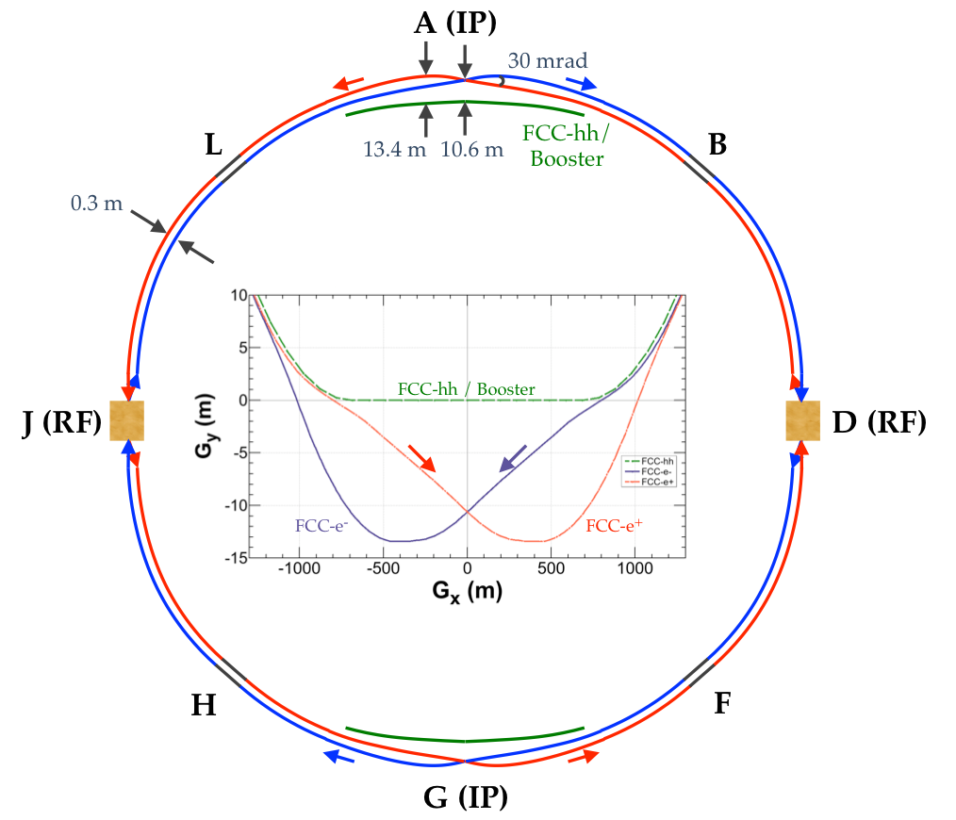
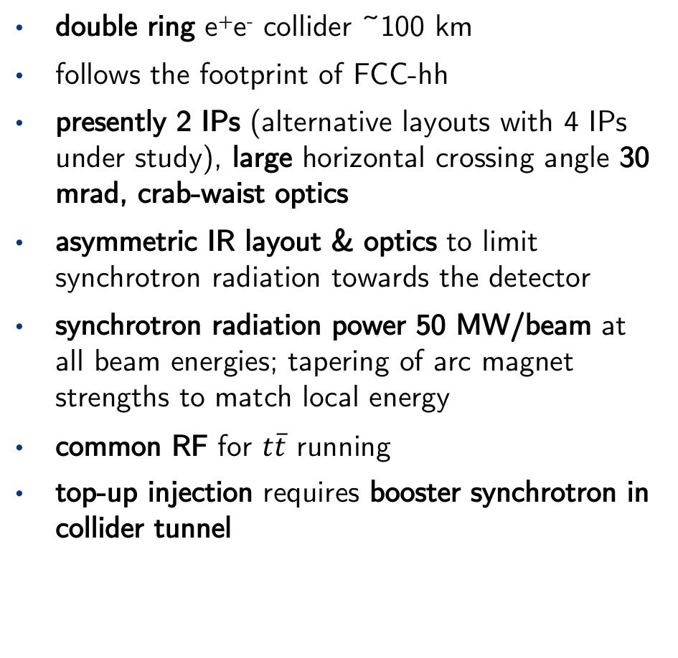
FCC-ee basic design choices
double ring e⁺e⁻ collider ~100 km
follows the footprint of FCC-hh
presently 2 IPs (alternative layouts with 4 IPs under study), large horizontal crossing angle 30 mrad, crab-waist optics
asymmetric IR layout & optics to limit synchrotron radiation towards the detector
synchrotron radiation power 50 MW/beam at all beam energies; tapering of arc magnet strengths to match local energy
common RF for $t\overline{t}$ running
top-up injection requires booster synchrotron in collider tunnel
FCC-ee: The Lepton Collider, Eur. Phys. J. Spec. Top. 228, 261–623 (2019)
K. Oide et al., Phys. Rev. Accel. Beams 19, 111005 (2016)
12

Slide 13
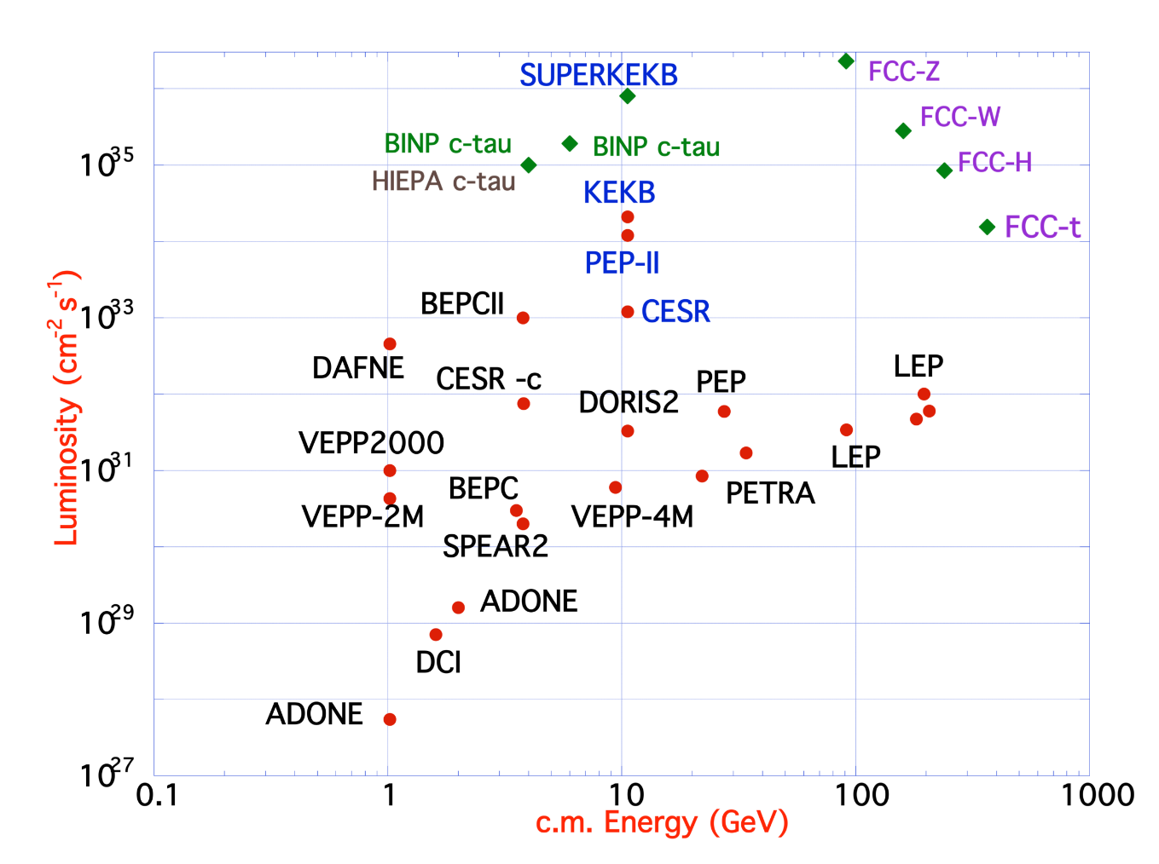
Design concept: using lessons and techniques from past colliders
B-factories: KEKB & PEP-II: double-ring lepton colliders, high beam currents, top-up injection
DAFNE: crab waist, double ring
LEP: high energy, SR effects
VEPP-4M, LEP: precision E calibration
KEKB: e⁺ source
HERA, LEP, RHIC: spin gymnastics
S-KEKB: low β_{y}*, crab waist
Marica Biagini
Marica Biagini
13
Notes:
combining successful ingredients of several recent colliders → highest luminosities & energies
Not to mention, we’ve also using techniques developed at synchrotrons light sources as low emittance lepton rings. So it’s not merely a bigger LEP, it’s an advanced modern low emittance synchrotron.

Slide 14
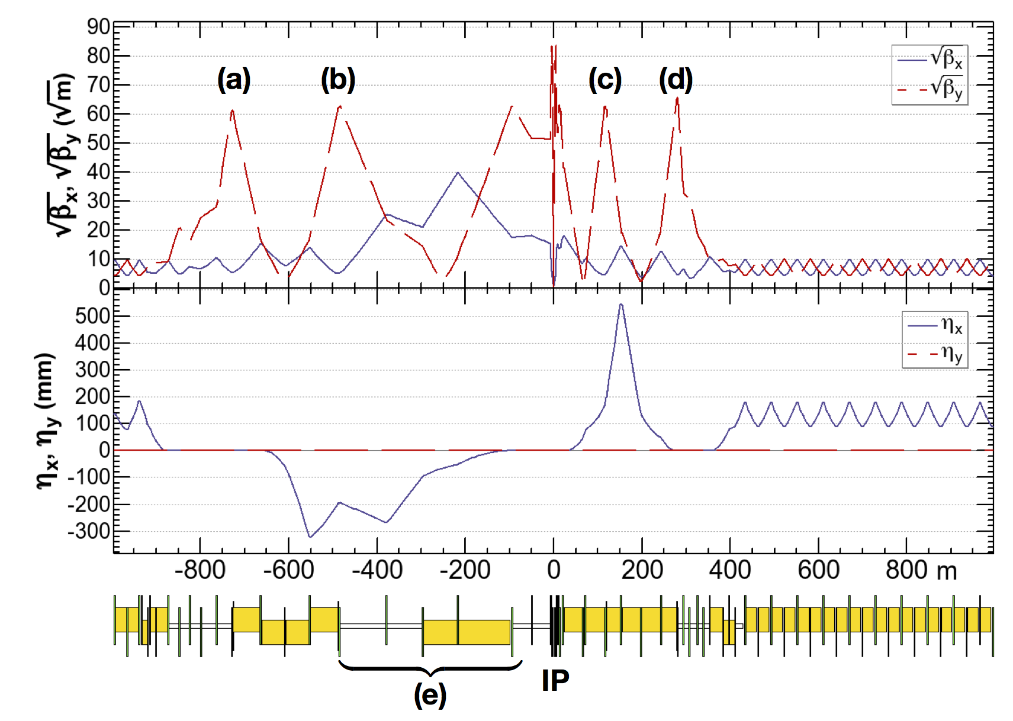
FCC-ee asymmetric crab-waist IR optics
Novel asymmetric IR optics to suppress synchrotron radiation toward the IP, E_{critical} <100 keV from 450 m from IP (lesson from LEP)
4 sextupoles (a–d) for local vertical chromaticity correction combined w. crab waist, optimized for each working point – novel “virtual crab waist”, (standard crab waist demonstrated at DAFNE)
ttbar 182.5 GeV
H. Burkhardt, A. Blondel, M. Koratzinos, K. Oide, et al.
K. Oide et al., Phys. Rev. Accel. Beams 19, 111005 (2016)
14

Slide 15
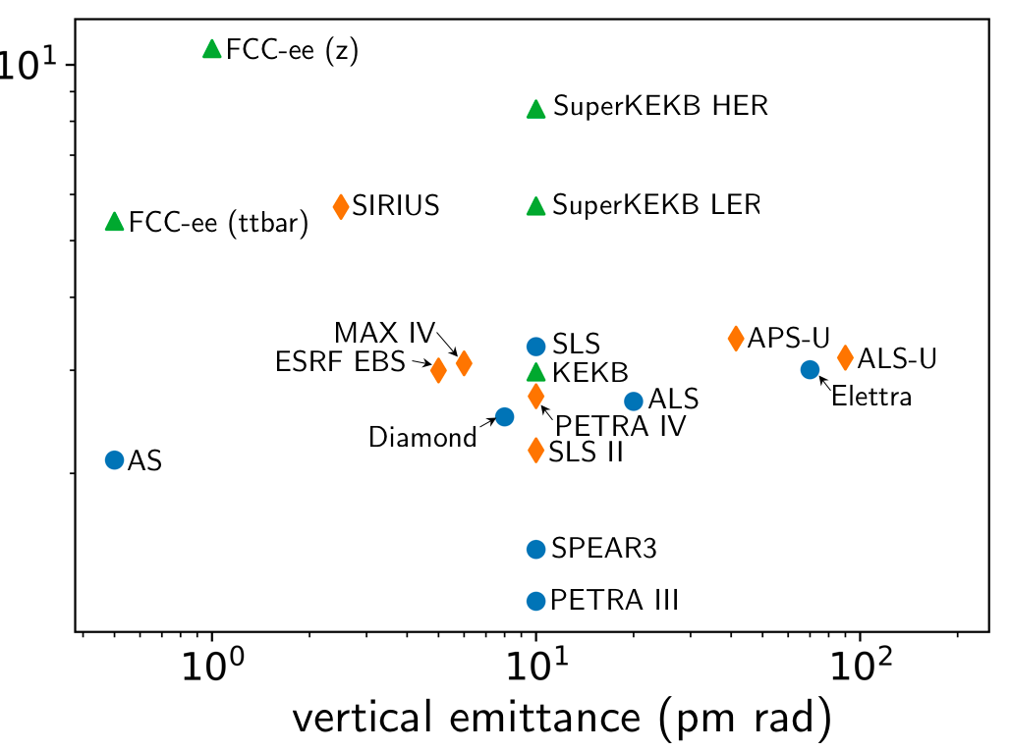
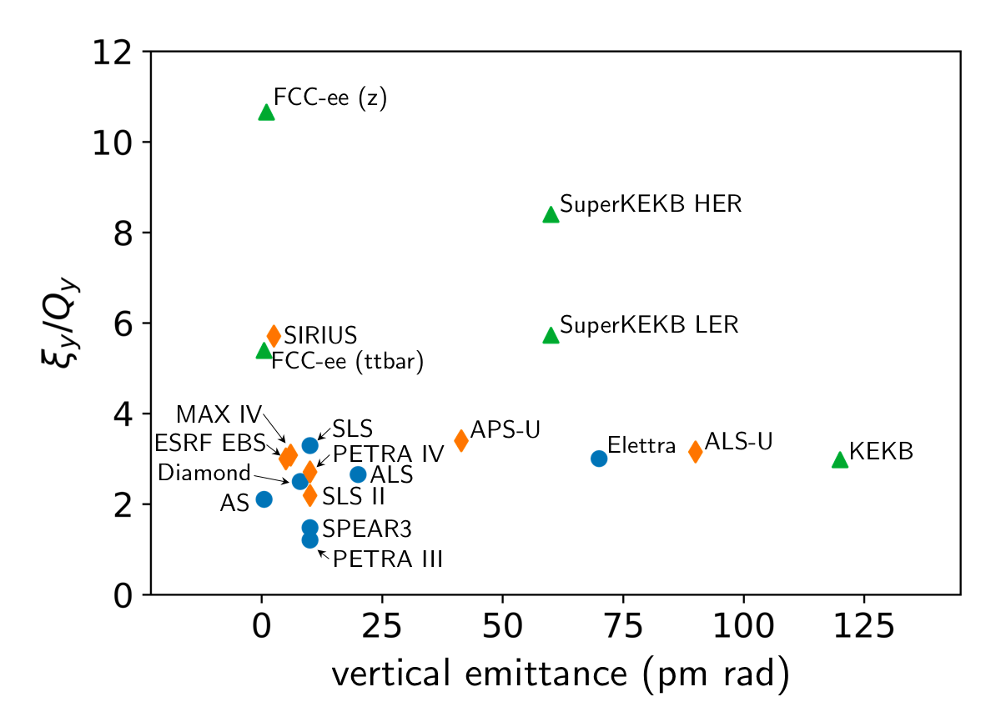
Natural chromaticities for a range of low emittance storage rings
(during collisions)
(during collisions)
Many thanks to:
Rohan Dowd (AS), Masamitsu Aiba (PSI), Katsunobu Oide (KEK), Thorsten Hellert (ALS), Ilya Agapov (DESY), Pedro Fernandes Tavares (MAX IV), Kent Wooton (APS), Bastian Härer (KEK), Liu Lin (LNLS), Simone Di Mitri (Elettra), Jeff Corbett (SLAC), Bernhard Holzer (CERN)
Many thanks to:
Rohan Dowd (AS), Masamitsu Aiba (PSI), Katsunobu Oide (KEK), Thorsten Hellert (ALS), Ilya Agapov (DESY), Pedro Fernandes Tavares (MAX IV), Kent Wooton (APS), Bastian Härer (KEK), Liu Lin (LNLS), Simone Di Mitri (Elettra), Jeff Corbett (SLAC), Bernhard Holzer (CERN)
15

Slide 16

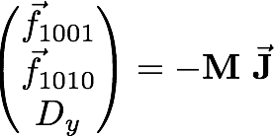
Correction Strategy
Orbit correction:
  MICADO & SVD from MADX
    Hor. corrector at each QF, Vert. corrector at each QD
  1598 vertical correctors / 1590 horizontal correctors
    BPM at each quadrupole
  1598 BPMs vertical / 1590 BPMs horizontal
Vertical dispersion and orbit:
  Orbit Dispersion Free Steering (DFS)
Linear coupling:
  Coupling resonant driving terms (RDT)
    1 skew at each sextupole + skews correctors at the IP
Beta beating correction & Horizontal dispersion via Response Matrix:
  Rematching of the phase advance at the BPMs
    1 trim quadrupole at each sextupole

Slide 17
Assigning misalignments
  - Misalignment randomly distributed via a Gaussian, truncated at 2.5 sigma.
  - 2 independent DX and DY misalignments for each end of the girder, and which are used to calculate DTHETA and DPHI.
17

Slide 18
Assigning girder misalignments
Arc quadrupoles and sextupoles are misaligned relative to a girder misalignment, incorporating misalignment due to ∆y_{girder} and ∆𝛳.
sextupoles/ quadrupoles
girder
girder
dipole
dipole
(not to scale)
18

Slide 19
Assigning girder misalignments
19
Notes:
\begin{table}[htb!]
\centering
\begin{tabular}{lccccc}
\hline
Type & $\Delta$X ($\mu$m) & $\Delta$Y ($\mu$m) & $\Delta$PSI ($\mu$rad) & $\Delta$S ($\mu$m) & Field Errors \vspace{.1cm} \\
\hline
Arc quadrupole* & 50 & 50 & 200 & 50 & $\Delta k/k = 2\times 10^{-4}$ \\
Arc sextupoles* & 50 & 50 & 200 & 50 & $\Delta k/k = 2\times 10^{-4}$ \\
Girders & 100 & 100 & - & 500 & - \\
\hline
Dipoles & 100 & 100 & 200 & 500 & $\Delta$B/B $= 1\times 10^{-4}$ \\
\hline
IR quadrupole & 75 & 75 & 100 & 75 & $\Delta k/k = 2\times 10^{-4}$ \\
IR sextupoles & 75 & 75 & 100 & 75 & $\Delta k/k = 2\times 10^{-4}$ \\
\hline
BPM** & 40 & 40 & 100 & - & - \\
\hline
\end{tabular}
\end{table}
\vspace{-.45cm}
* \ misalignments relative to girder placement
** misalignments relative to quadruple placement

Slide 20
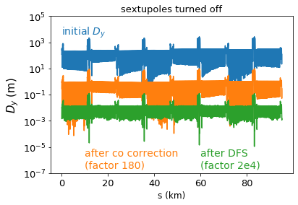
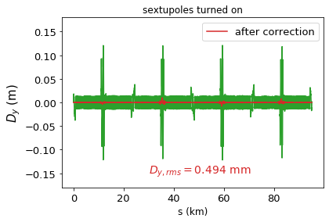
Starting situation
Orbit correction
+DFS (sextupoles off)
Dispersion and coupling correction (sextupoles on)
Switch on
sextupoles
20

Slide 21
Correction Strategy (1/2)
Sextupoles strengths set to 0
  Closed-orbit correction
  Rematch the tune
  Beat-beat correction
  1 step Dispersion Free Steering w/o sextupole
  +
  1 step coupling correction
  CHECK of tunes, orbit, β_{y, max}
  1 step Dispersion Free Steering w/o sextupole
  +
  1 step coupling correction
  CHECK of tunes, orbit, β_{y, max}
  Save x,x’,y,y’ at the beginning of the machine
Set sextupoles strength to 10% of their design current
(details on next slide)
Final correction
(details on next slide)
Sextupoles strengths set to zero.
  Gradient errors applied
    Weighted beta-beat correction was performed and tune re-matched.
    Sextupole and dipole field errors introduced.
    Weighted beta-beat correction was performed and tune re-matched.
  Misalignments applied to all magnets and girders.
    Tune re-matched to the nominal tune, and orbit correction performed.
    Beta-beat correction applied, and if needed orbit corrected and tune rematched.
    Coupling correction, followed by beta-beat correction and coupling correction.
Sextupoles set to 10% of their design strength
(details on next slide)
Final correction (at 100% sextupole strength)
(details on next slide)
21
21

Slide 22
Correction Strategy (2/2)
Sextupoles strengths set to 0
  Closed-orbit correction
  Rematch the tune
  Beat-beat correction
  1 step Dispersion Free Steering w/o sextupole
  +
  1 step coupling correction
  CHECK of tunes, orbit, β_{y, max}
  1 step Dispersion Free Steering w/o sextupole
  +
  1 step coupling correction
  CHECK of tunes, orbit, β_{y, max}
  Save x,x’,y,y’ at the beginning of the machine
Set sextupoles strength to 10% of their design current
(details on next slide)
Final correction
(details on next slide)
Sextupoles strengths set to zero.
  (details on previous slide)
Sextupoles set to 10% of their design strength
  Orbit correction
  Combined coupling and dispersion correction
  Beta-beating correction applied.
  Sextupole strengths increased by 10%
Final correction (at 100% sextupole strength)
  Additional coupling, dispersion and beta-beating correction was applied.
Constant checking of the tunes and orbit avoids running into resonances, or failure to find the closed orbit.
These two steps repeated ~12 times.
22
22

Slide 23
FCC-ee emittance tuning results
RMS misalignment and field errors tolerances:
ttbar (182.5 GeV) 4IP lattice, after correction strategy:
23

Slide 24
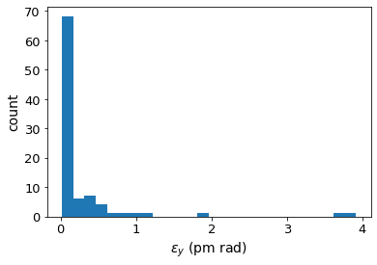
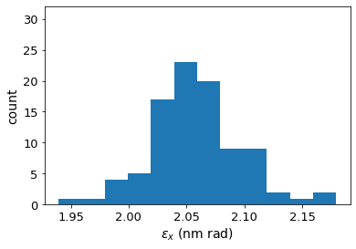
FCC-ee emittance tuning results
RMS misalignment and field errors tolerances:
ttbar (182.5 GeV) 4IP lattice, after correction strategy:
24
Notes:
%$\epsilon_{x, \textrm{rms}} = 1.685$ nm rad \\
%$\epsilon_{y, \textrm{rms}} = 0.871$ pm rad \\
$\frac{\epsilon_{y}}{\epsilon_{x}} = 0.0789$ $\%$ \\
\begin{table}[htb!]
\centering
\begin{tabular}{p{3cm}cccc}
\hline
Type & $\Delta$X & $\Delta$Y & $\Delta$PSI & $\Delta$S \\
& ($\mu$m) & ($\mu$m) & ($\mu$rad) & ($\mu$m)
\vspace{.1cm} \\
\hline
Arc quadrupole* & 50 & 50 & 200 & 50 \\
Arc sextupoles* & 50 & 50 & 200 & 50 \\
\hline
Dipoles & 100 & 100 & 200 & 500 \\
\hline
Girders & 100 & 100 & - & 500 \\
\hline
IR quadrupole & 75 & 75 & 100 & 75 \\
IR sextupoles & 75 & 75 & 100 & 75 \\
\hline
BPM** & 40 & 40 & 100 & - \\
\hline
\end{tabular}
\end{table}

Slide 25
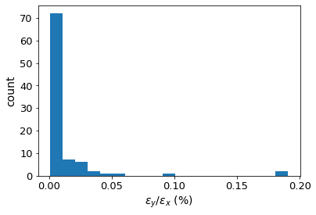
FCC-ee emittance tuning results
RMS misalignment and field errors tolerances:
ttbar (182.5 GeV) 4IP lattice, after correction strategy:
25
Notes:
%$\epsilon_{x, \textrm{rms}} = 1.685$ nm rad \\
%$\epsilon_{y, \textrm{rms}} = 0.871$ pm rad \\
$\frac{\epsilon_{y}}{\epsilon_{x}} = 0.0789$ $\%$ \\
\begin{table}[htb!]
\centering
\begin{tabular}{p{3cm}cccc}
\hline
Type & $\Delta$X & $\Delta$Y & $\Delta$PSI & $\Delta$S \\
& ($\mu$m) & ($\mu$m) & ($\mu$rad) & ($\mu$m)
\vspace{.1cm} \\
\hline
Arc quadrupole* & 50 & 50 & 200 & 50 \\
Arc sextupoles* & 50 & 50 & 200 & 50 \\
\hline
Dipoles & 100 & 100 & 200 & 500 \\
\hline
Girders & 100 & 100 & - & 500 \\
\hline
IR quadrupole & 75 & 75 & 100 & 75 \\
IR sextupoles & 75 & 75 & 100 & 75 \\
\hline
BPM** & 40 & 40 & 100 & - \\
\hline
\end{tabular}
\end{table}

Slide 26
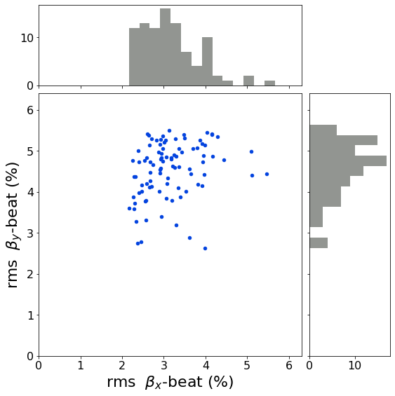
Beta-beating correction
RMS misalignment and field errors tolerances:

Slide 27
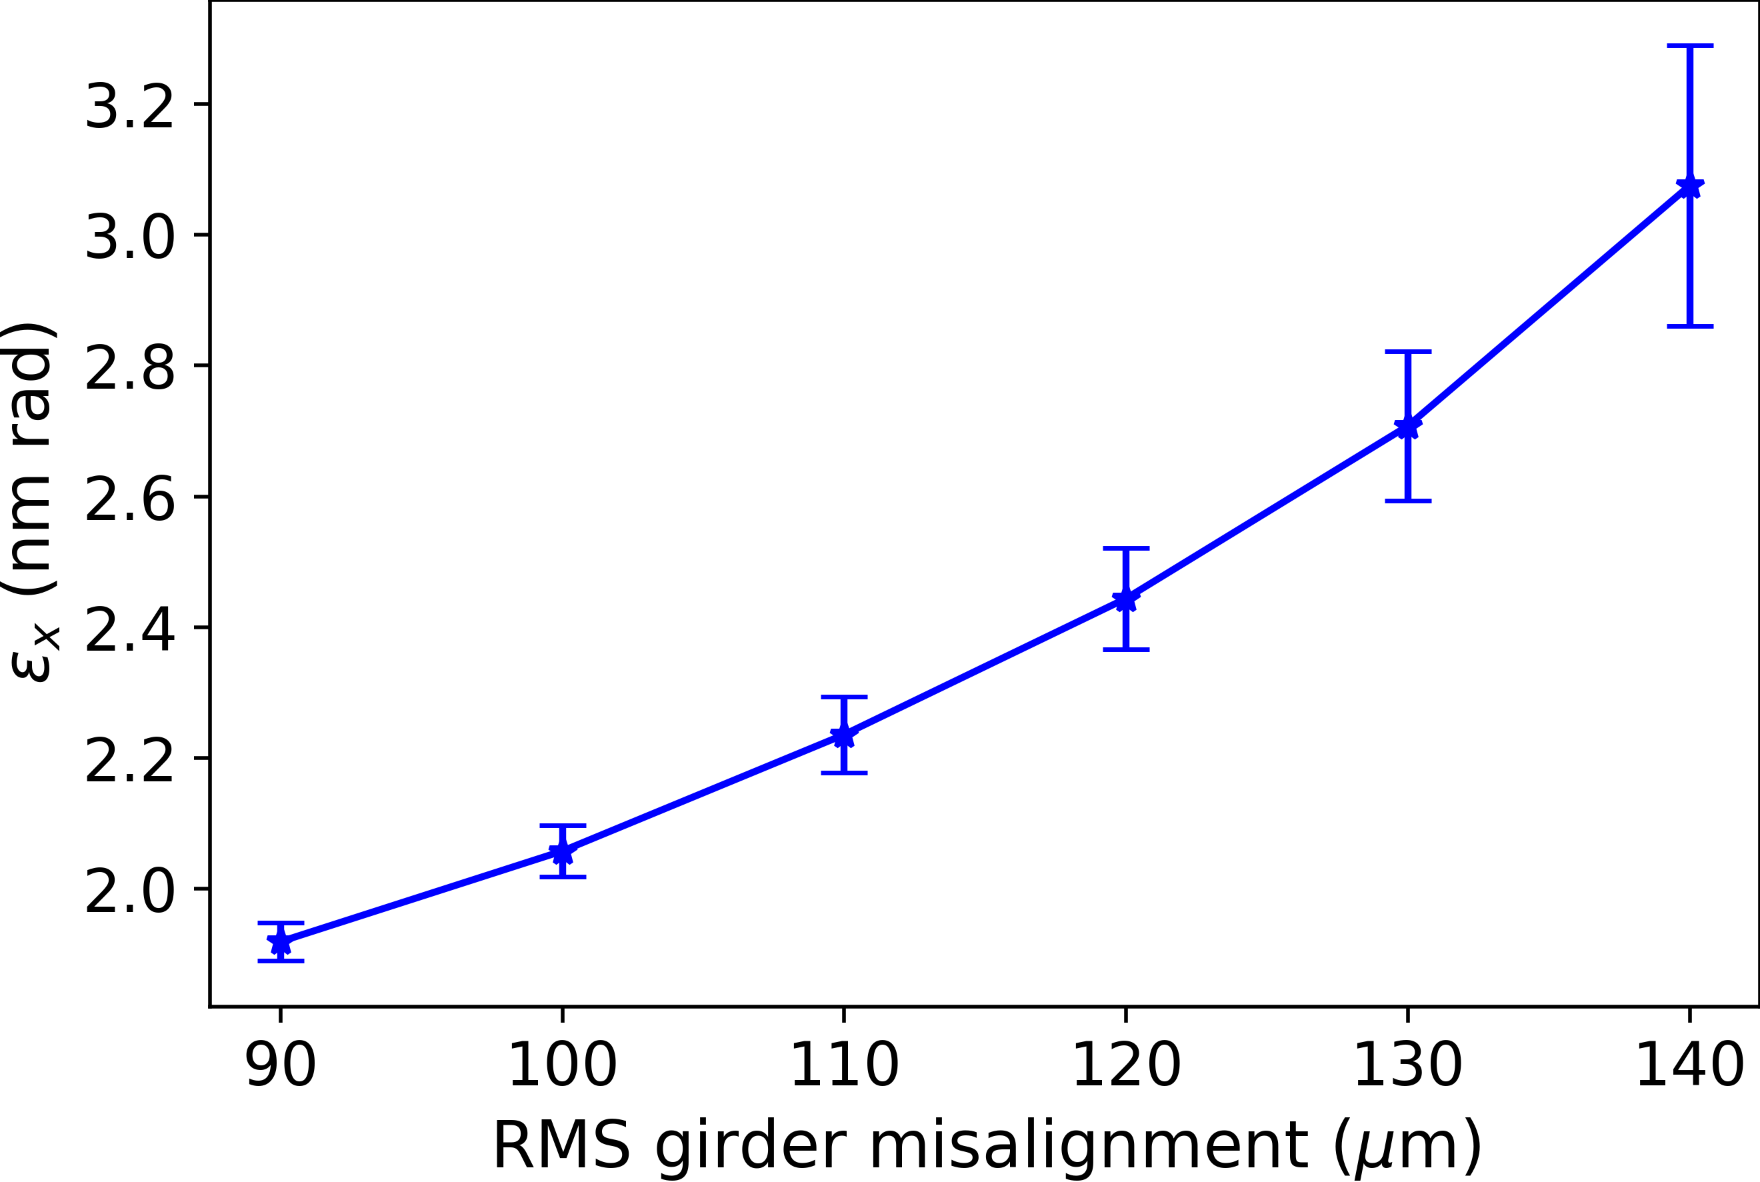
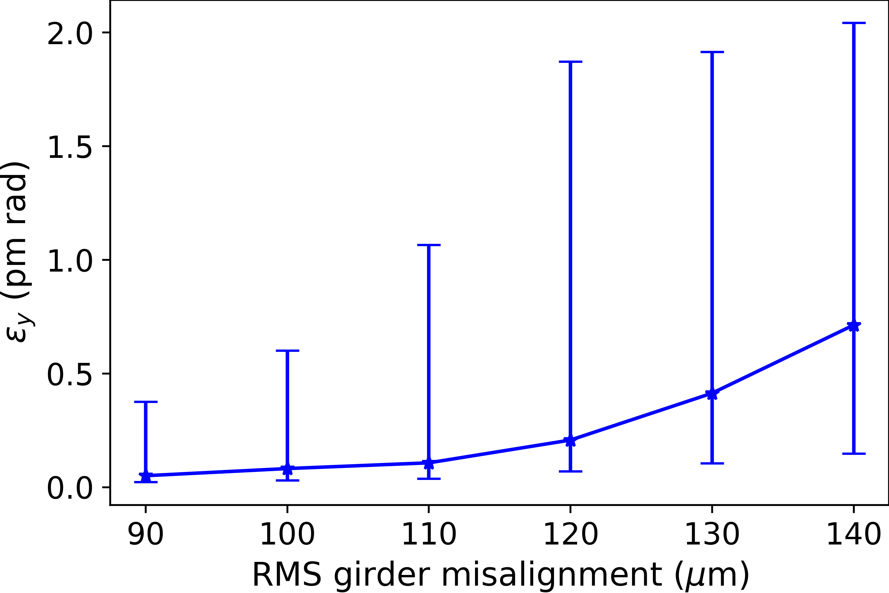
Girder misalignment
The girder misalignment has the strongest influence on horizontal emittance of all the parameters listed in the previous table.
27

Slide 28
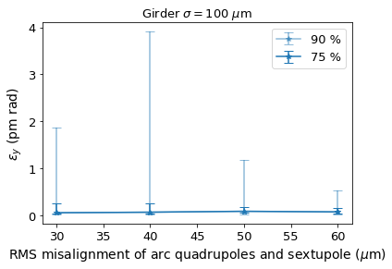
Arc magnet misalignments on girder
All other misalignments are as defined previously.
28

Slide 29
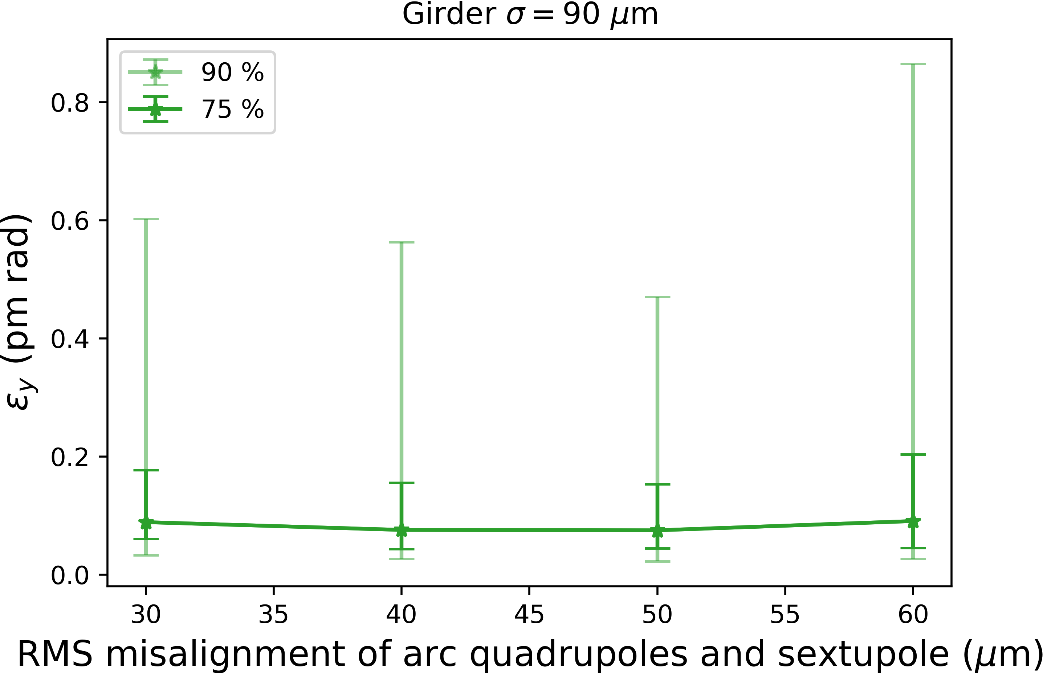
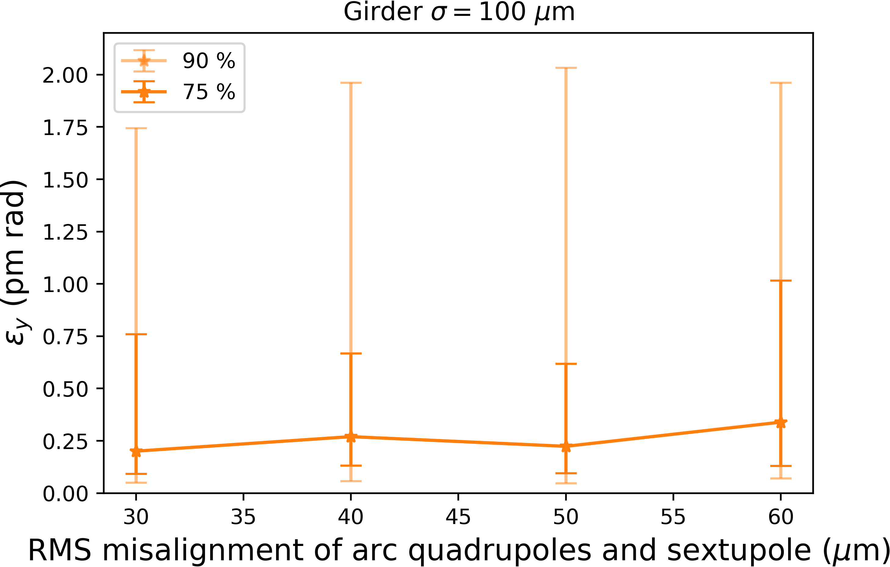
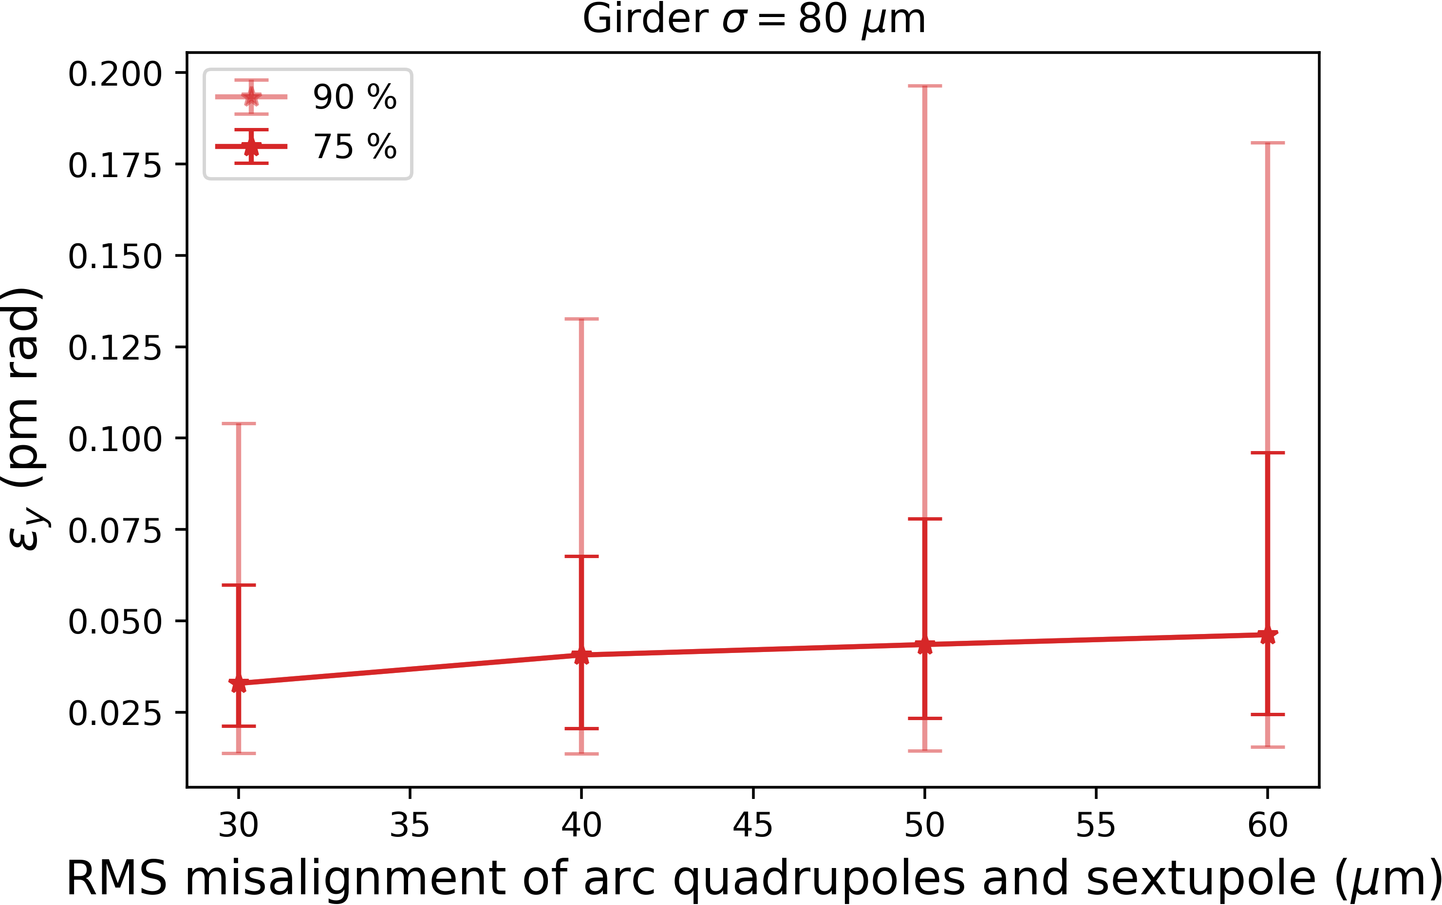
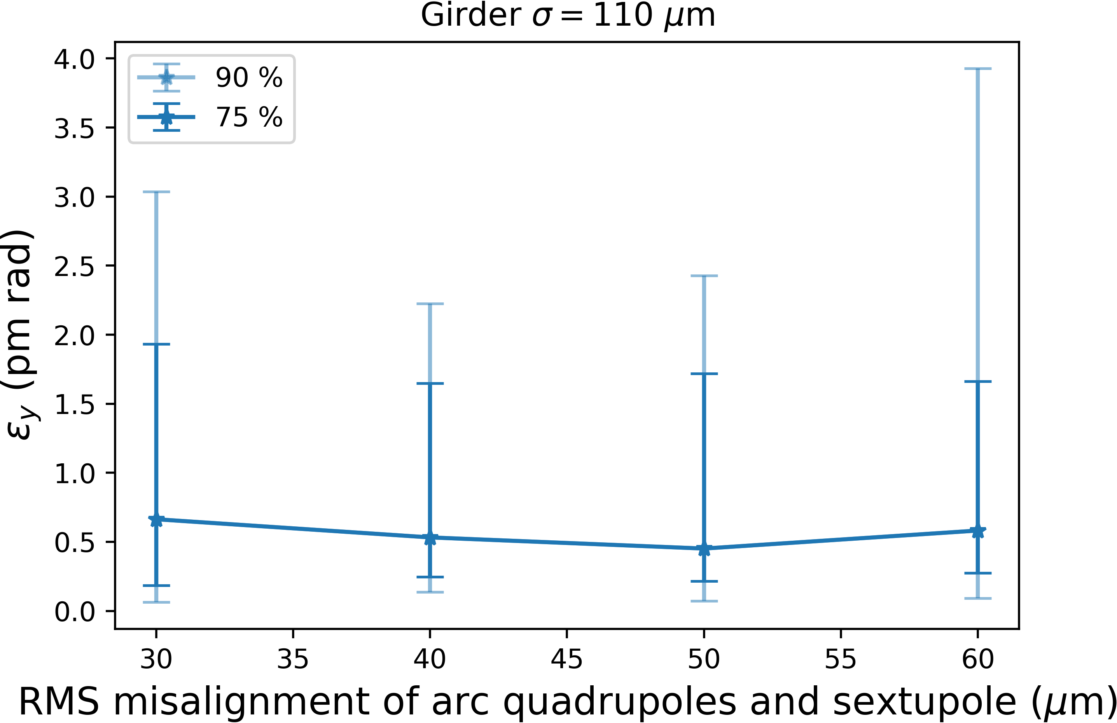
Girder misalignment
All other misalignments are as defined previously.
29

Slide 30
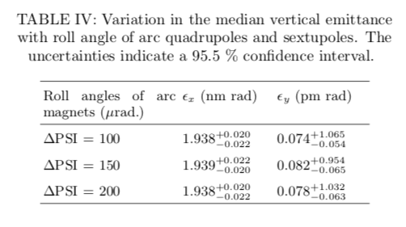
30

Slide 31
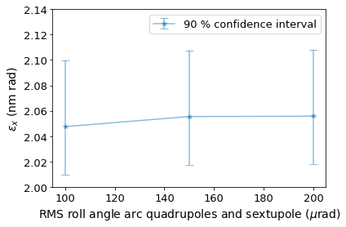
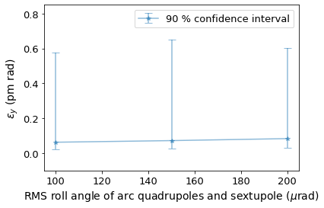
Arc magnet roll angles
All other misalignments are as defined previously.
31

Slide 32
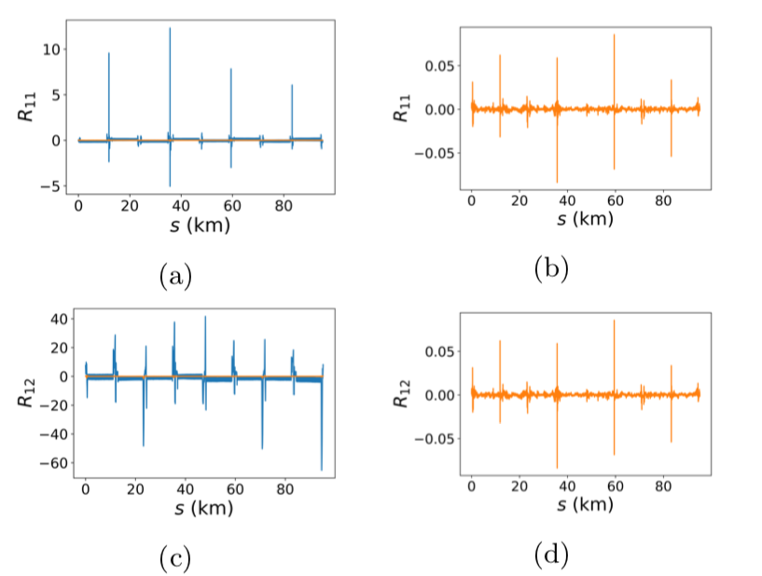
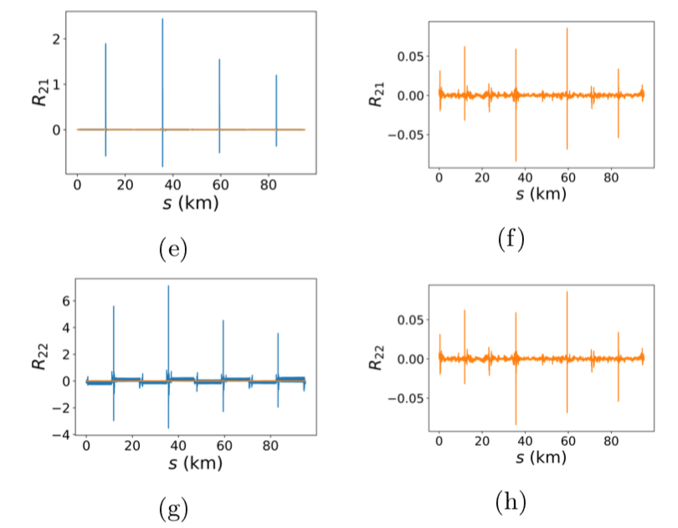
Coupling matrix elements
Before correction
(without sextupoles)
After correction
(with sextupoles)
Before correction
(without sextupoles)
After correction
(with sextupoles)
32

Slide 33
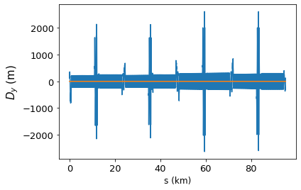
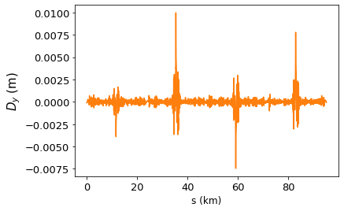
Vertical dispersion
Before correction
(without sextupoles)
After correction
(with sextupoles)
D_y, rms = 0.495 mm
33

Slide 34
Summary
FCC-ee is an efficient Higgs & electro-weak factory at c.m. energies from 90 to 365 GeV, with luminosities ranging from 1.55x10³⁴ cm⁻²s⁻¹ to 230 x 10³⁴ cm⁻²s⁻¹.
In the simulation campaign, we systematically studied a wide combination of magnet tolerances for field errors, alignment of individual magnets as well as girders and the settings of the BPMs.
The correction algorithms developed in this context represent a powerful correction tools and lead to successful convergence for a large majority of the applied errors seeds. And, most importantly, the lead to values of coupling and beam emittance that lie within the requirements of the machine design.
Emittance tuning studies for FCC-ee are ongoing, as we work towards a Technical Design.
Thank you
tessa.charles@liverpool.ac.uk

Slide 35
Back up slides …

Slide 36
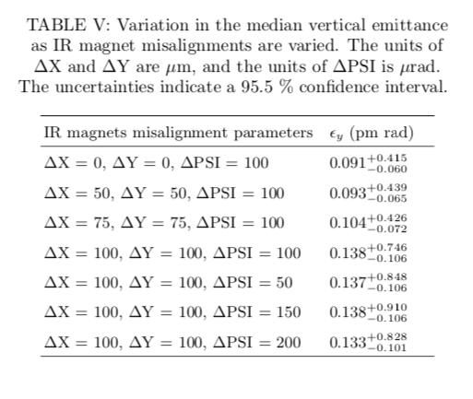
IR magnets
36

Slide 37
FCC integrated project technical schedule
1
2
3
4
5
6
7
8
9
10
11
12
13
14
15
16
17
18
15 years operation
34
35
36
37
38
39
40
41
42
43
~ 25 years operation
70
Project preparation &
administrative processes
Permis-sions
Update
Permissions
Funding strategy
Funding and
in-kind contribution agreements
Funding and
in-kind contribution agreements
Geological investigations, infrastructure detailed design and tendering preparation
Tunnel, site and technical infrastructure construction
FCC-ee dismantling, CE & infrastructure adaptations FCC-hh
FCC-ee accelerator R&D and technical design
FCC-ee accelerator construction, installation, commissioning
FCC-hh accelerator R&D and technical design
FCC-hh accelerator construction, installation, commissioning
Set up of international experiment collaborations, detector R&D and concept development
FCC-ee detector technical design
FCC-ee detector
construction, installation, commissioning
FCC-hh detector R&D,
technical design
FCC-hh detector
construction, installation, commissioning
Superconducting wire and magnet R&D, short models
Long model magnets, prototypes, preseries
16 T magnet industrialization and
series production

Slide 38

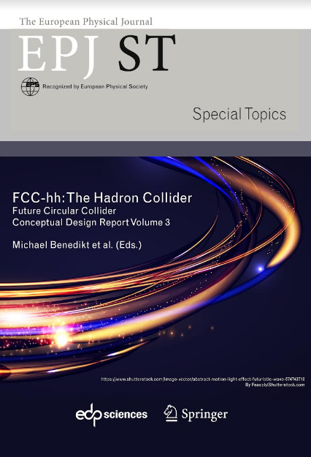
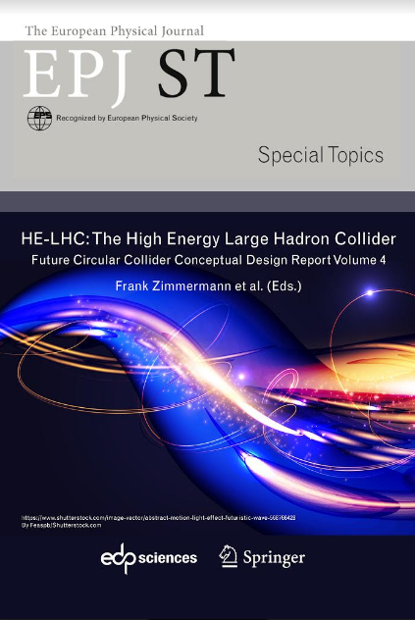
FCC CDR, Study Documentation, Snowmass LoI
FCC-Conceptual Design Reports:
  Vol 1 Physics, Vol 2 FCC-ee, Vol 3 FCC-hh, Vol 4 HE-LHC
  CDRs published in European Physical Journal C (Vol 1) and ST (Vol 2-4)
  EPJ C 79, 6 (2019) 474 , EPJ ST 228, 2 (2019) 261-623 ,
  EPJ ST 228, 4 (2019) 755-1107 , EPJ ST 228, 5 (2019) 1109-1382
Summary documents provided to EPPSU SG
  FCC-integral, FCC-ee, FCC-hh, HE-LHC
  Accessible on http://fcc-cdr.web.cern.ch/
Snowmass 2020 Letters of Interest
  https://snowmass21.org/loi
>1350 contributors from > 350 institutes,
a truly global effort as suggested by EPPSU 2013
Notes:
Published June 2020

Slide 39
2020 Update European Particle-Physics Strategy
2020 Update European Particle-Physics Strategy (CERN-ESU-013/014)
“An electron-positron Higgs factory is the highest-priority next collider. For the longer term, the European particle physics community has the ambition to operate a proton-proton collider at the highest achievable energy. Accomplishing these compelling goals will require innovation and cutting-edge technology:
“Europe, together with its international partners, should investigate the technical and financial feasibility of a future hadron collider at CERN with a c.o.m energy of at least 100 TeV and with an electron-positron Higgs and electroweak factory as a possible first stage. Such a feasibility study of the colliders and related infrastructure should be established as a global endeavour and be completed on the timescale of the next Strategy update.”
Plan for 2020–2025:
Financing strategy including in-kind contributions
Governance model for construction & operation
Host states / Civil-engineering preparation including site investigations
Technical design study for accelerator and infrastructure

Slide 40
2020 Update European Particle-Physics Strategy
2020 Update European Particle-Physics Strategy (CERN-ESU-013/014)
“Europe, together with its international partners, should investigate the technical and financial feasibility of a future hadron collider at CERN with a c.o.m energy of at least 100 TeV and with an electron-positron Higgs and electroweak factory as a possible first stage. Such a feasibility study of the colliders and related infrastructure should be established as a global endeavour and be completed on the timescale of the next Strategy update.”
Plan for 2020–2025:
Financing strategy including in-kind contributions
Governance model for construction & operation
Host states / Civil-engineering preparation including site investigations
Technical design study for accelerator and infrastructure

