Slide 1
Diamond Light Source Upgrade
Ian Martin,
on behalf of the Diamond-II design team
8th Low Emittance Rings Workshop
27/10/2020

Slide 2
Diamond-II Upgrade
Design goals for Diamond-II storage ring:
Improve quality of photon beams delivered to users:
  Increase spectral brightness
  Increase transverse coherence
  Reduced source size, line-width
  Optimise spectral range
Achieved via reduction in natural emittance, increase in beam energy, new IDs, (phase space matching - WIP)
  2) Increase number of straight sections:
  Space for new beamlines (up to nine)
  Choice of source for existing dipole beamlines (ID / wiggler / bespoke 3-pole wiggler)
  Space for ancillary components (RF cavities, diagnostics equipment, …)

Slide 3
Diamond-II Upgrade
Magnets
Long Straight
Standard Straight
Mid Straight
~11.3m
~8.3m
Diamond-I super-period
~7.5m
~2.9m
~5.2m
Diamond-II super-period
6 long straights, ~7.5 m long: IDs, injection elements
18 standard straights, ~5.2 m long: IDs
24 mid straights, ~2.9 m long: IDs, 3PW/dipole sources, RF, 3HC, diagnostics, stripline kickers
>35 % of the ring consists of insertion straights (quad to quad)

Slide 4
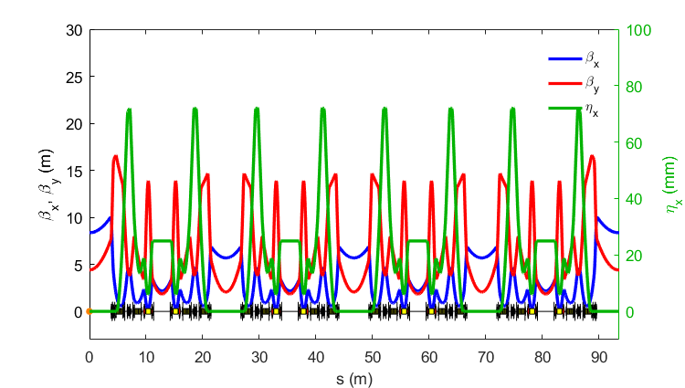
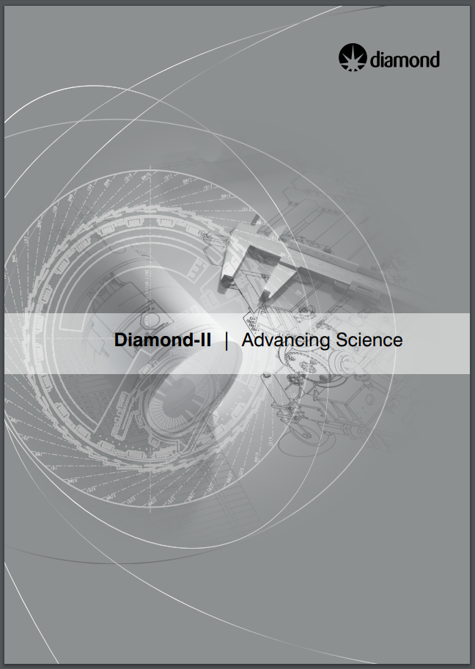
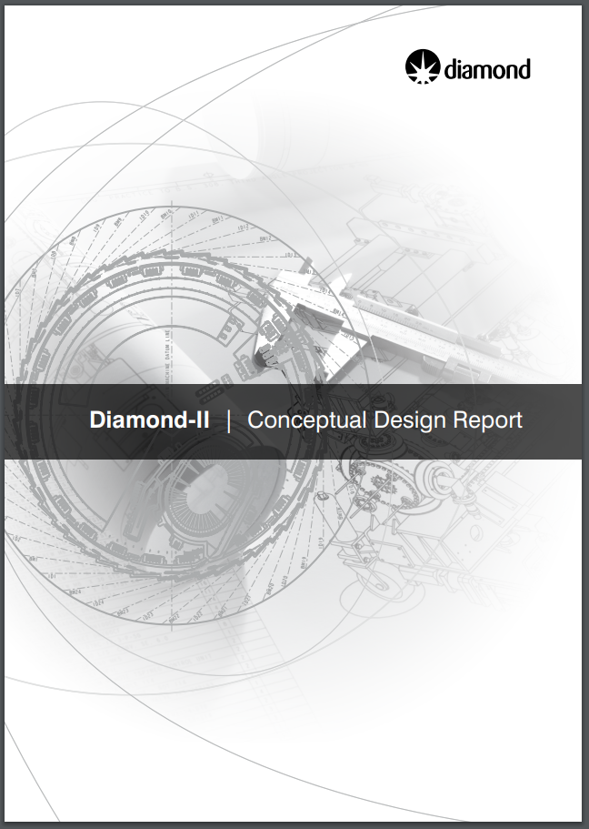
Diamond-II CDR Lattice
Lattice structure is a ‘Modified-Hybrid 6-Bend Achromat’, combining:
ESRF-EBS Hybrid 7BA cell
Mid-straights from Diamond Double-Double Bend Achromat
Each cell consists of:
4 longitudinally-varying dipoles
2 transverse gradient dipoles
16 (17) quadrupoles
12 sextupoles
2 octupoles
Emittance (bare lattice) 2.7 nm.rad (3 GeV) => 160 pm.rad (3.5 GeV)
Conceptual Design Report (May 2019):
https://www.diamond.ac.uk/Home/About/Vision/Diamond-II.html

Slide 5
Optimisation Strategy for CDR Lattice
Combination of ‘-I transformer’ and higher-order achromat
Phase advance between focussing chromatic sextupoles:
μ_{x} = ~3π
μ_{y} = ~π
Cell tunes chosen to cancel resonance driving terms over 8 cells:
μ_{x} = ~2π*19/8
μ_{y} = ~2π*7/8
Some detuning necessary:
ring tunes must avoid main resonances
-I transformer drives 2nd order chromaticity (Δμ/2π ~ 0.025)
tolerance of Δμ/2π ~ 0.01 for cell tunes
H-function in mid-straight minimised to avoid increase in emittance from IDs
-I transformer
higher-order achromat

Slide 6
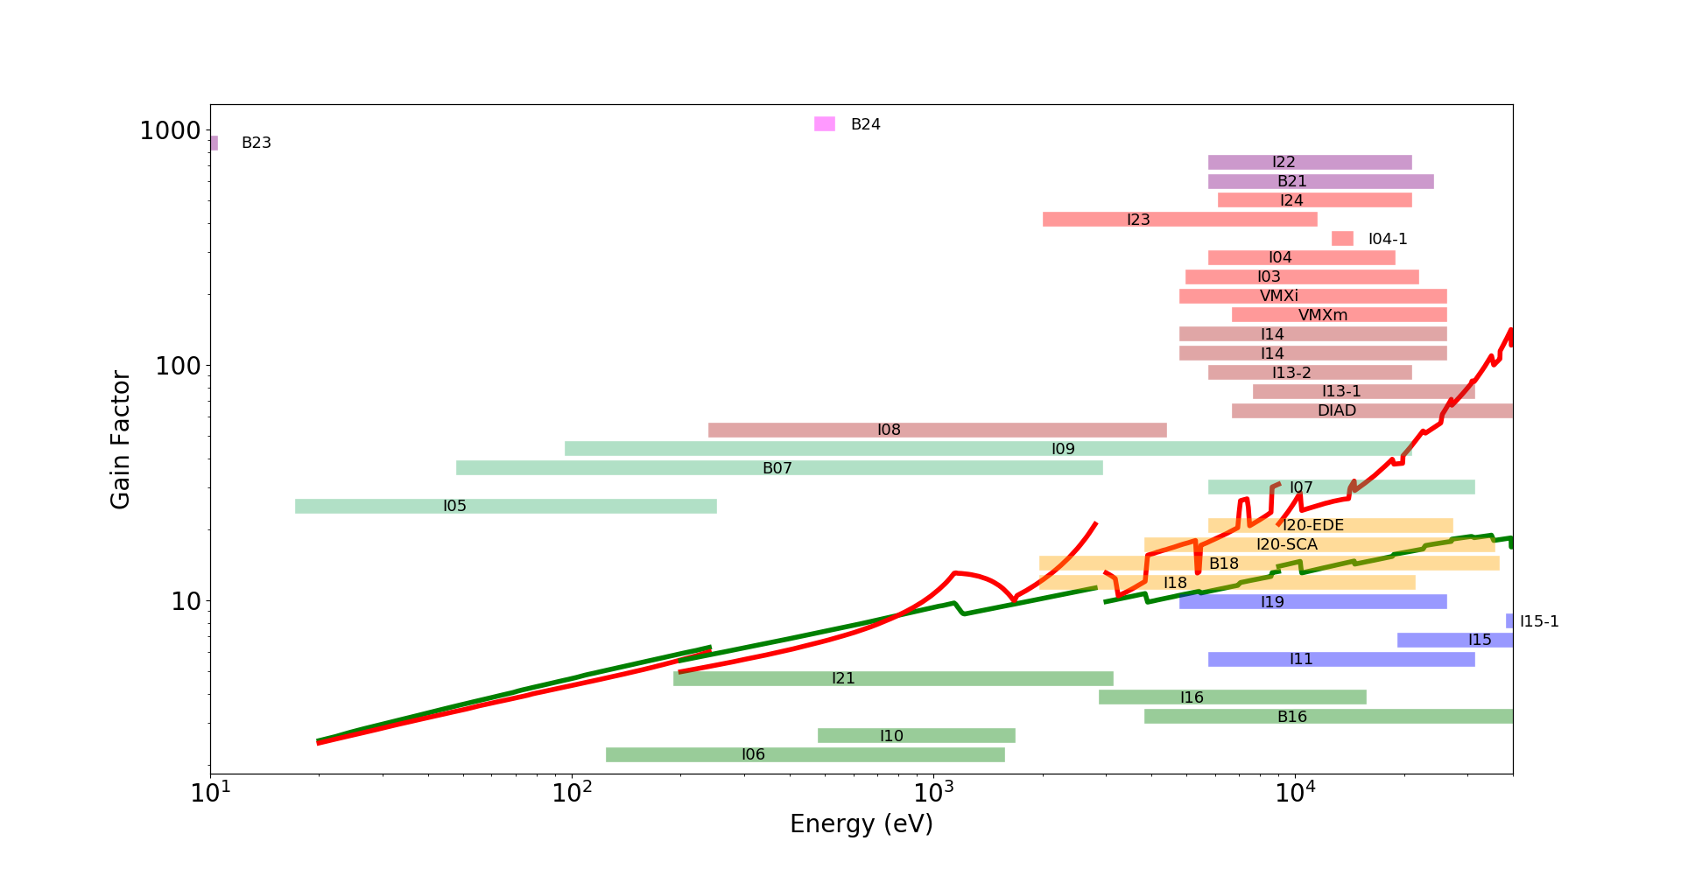
Brightness Gain for CDR Lattice
 | emittance (no IDs) | Ratio | emittance (IDs+IBS) | Ratio
Diamond | 2.7 nm | 17.2 | 3.1 nm | 18.4
Diamond-II | 157 pm |  | 147 pm
3.5 GeV, 157 pm†
3.0 GeV
115 pm†
† bare lattices

Slide 7
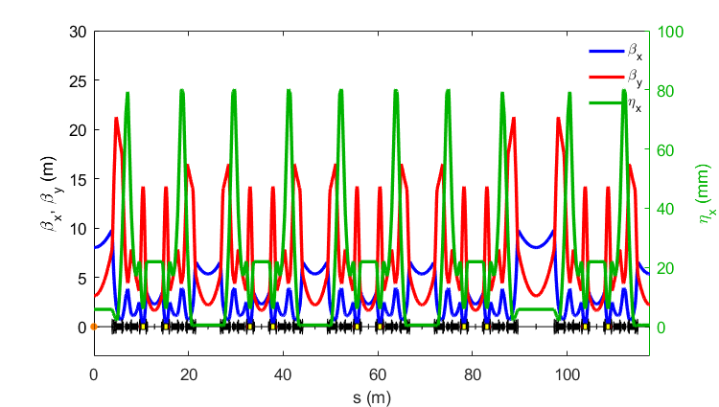
Lattice Developments Since CDR
Addition of reverse bend dipoles to control dispersion found to be beneficial, either to:
increase dispersion at chromatic sextupoles (lifetime gain)
reduce dispersion in dipoles (emittance reduction)
Further lines of investigation (WIP):
Better symmetrisation of the phase advance between chromatic sextupoles (μ_{x,y})
Adding transverse gradient / shaping of longitudinal bend profiles to match the dispersion
Tuning of H-function in mid-straights (improves emittance with IDs)
Allowing some dispersion leakage in long / standard straights
μ_{x,y}
μ_{x,y}
μ_{x,y}
μ_{x,y}
Reverse bend quadrupoles

Slide 8
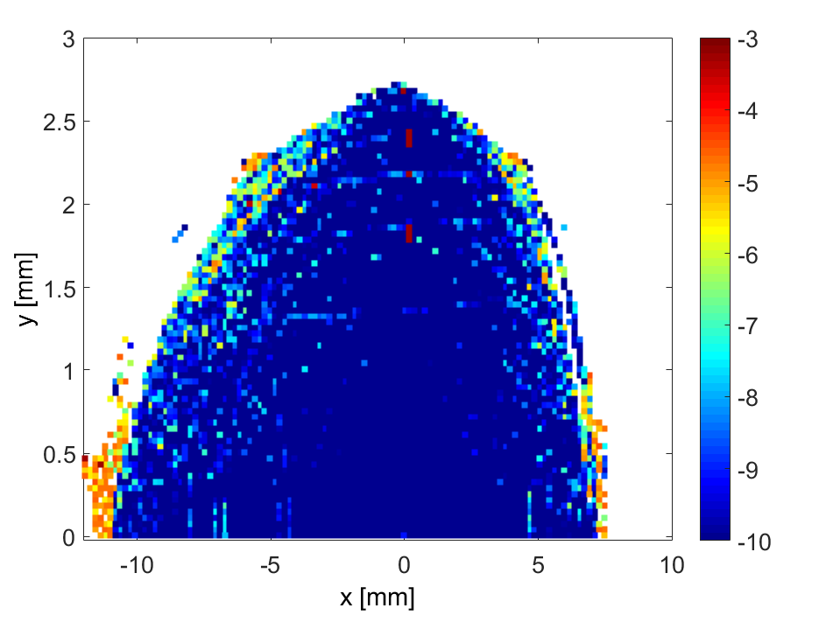
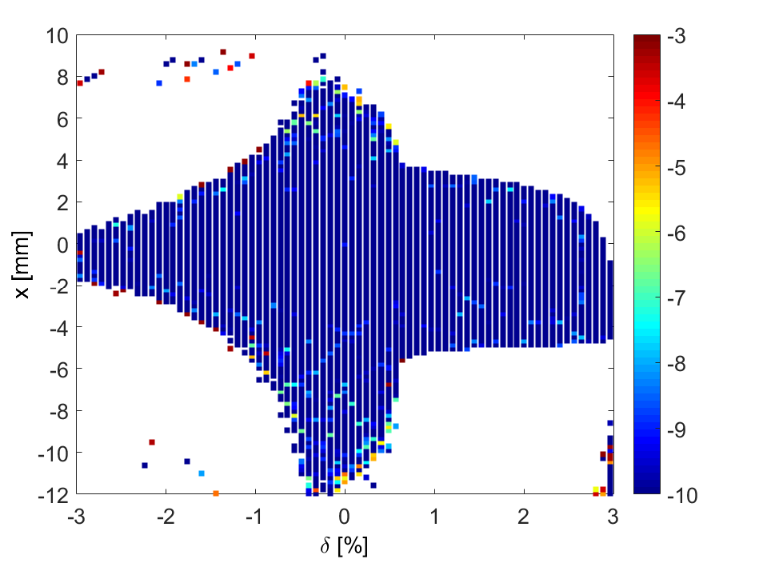
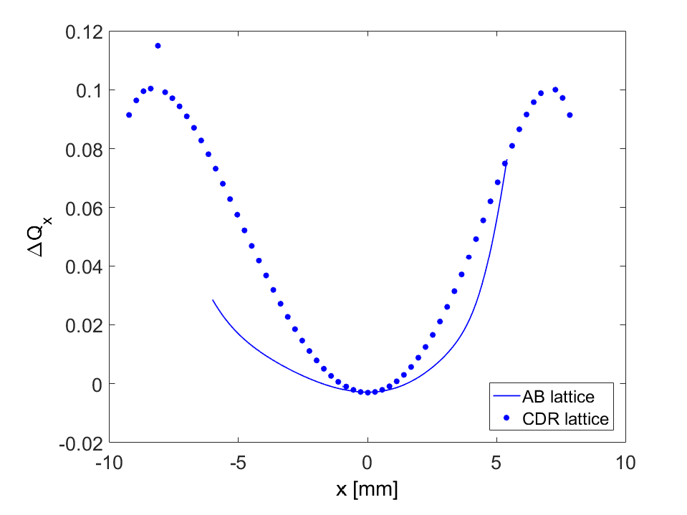
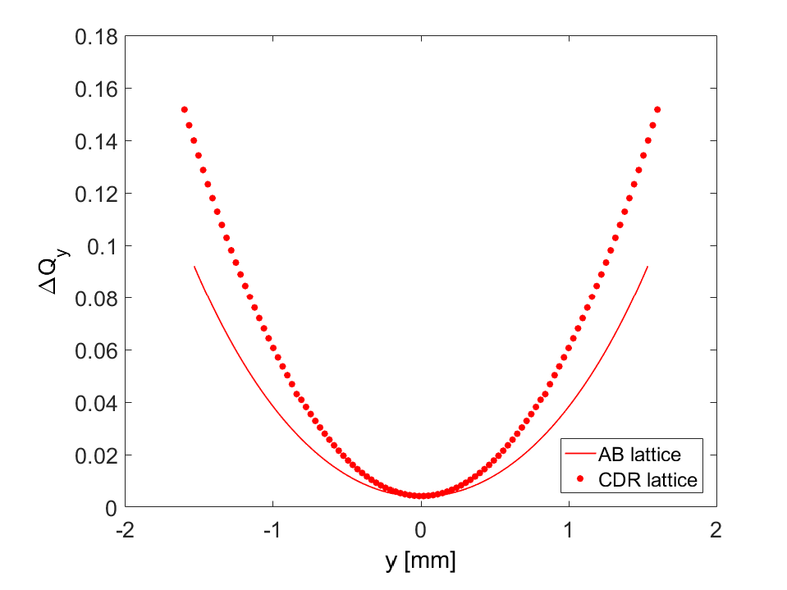
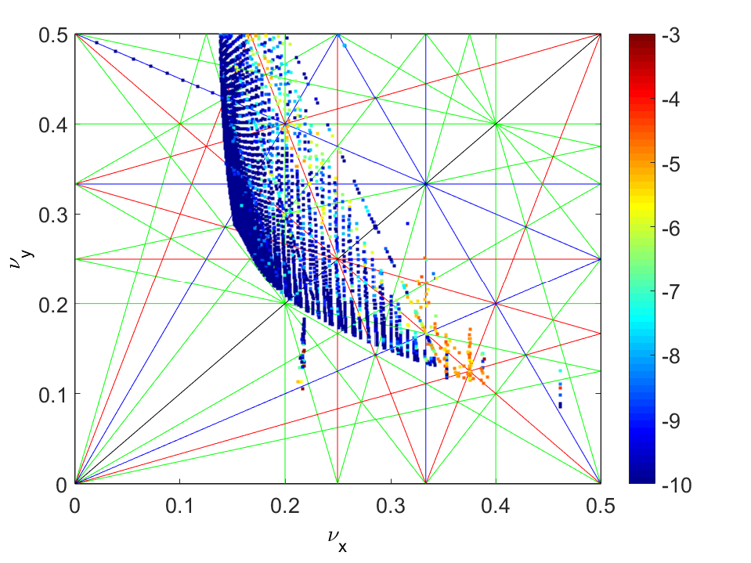
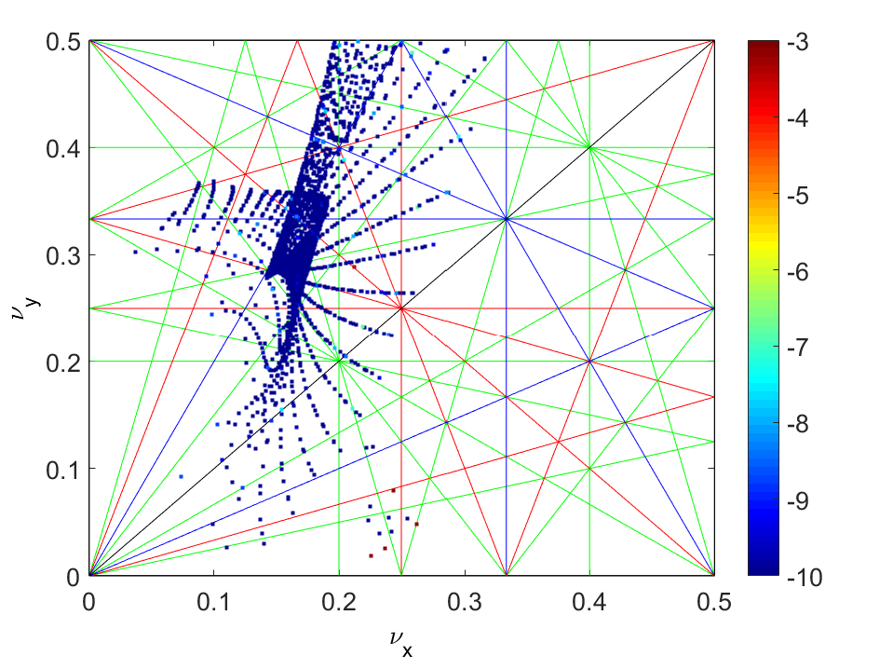
Dynamic Aperture with Reverse Bends
Combination of changes have improved performance:
Smaller tune shift with amplitude
Larger on/off momentum DA
Still some impact from strong resonances
Working to improve via tune scans and MOGA
Courtesy H. Ghasem

Slide 9
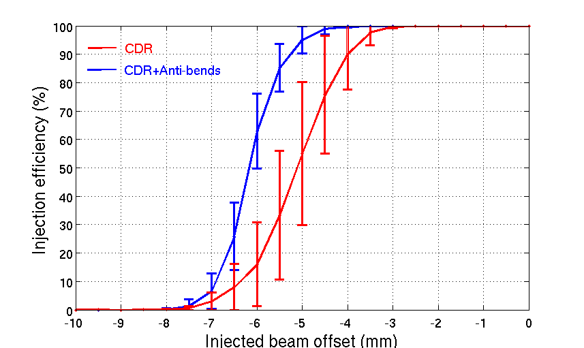
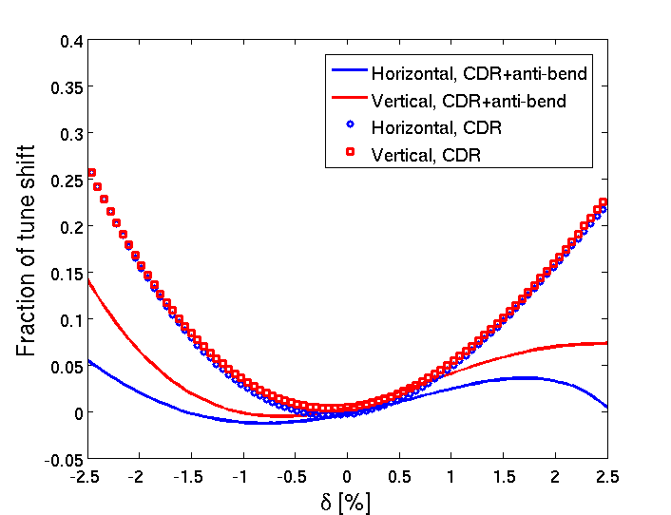
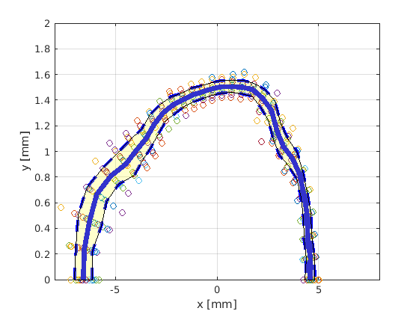
Injection Efficiency with Reverse bends
Off-axis accumulation looks feasible, however, maintaining high injection efficiency would require:
Injected beam emittance < 20-30 nm.rad
Injected beam bunch length < 40 ps
New booster forms part of the Diamond-II upgrade plan
(see later slides)
With these parameters, separation of stored / injected beams can be as high as 5 mm before injection efficiency starts to degrade.
RB lattice
CDR lattice

Slide 10
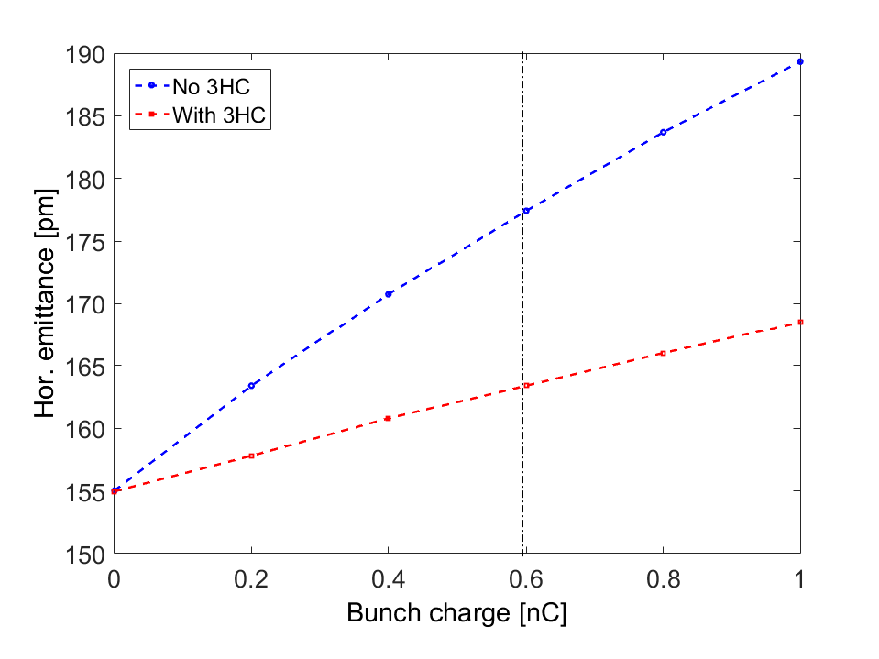
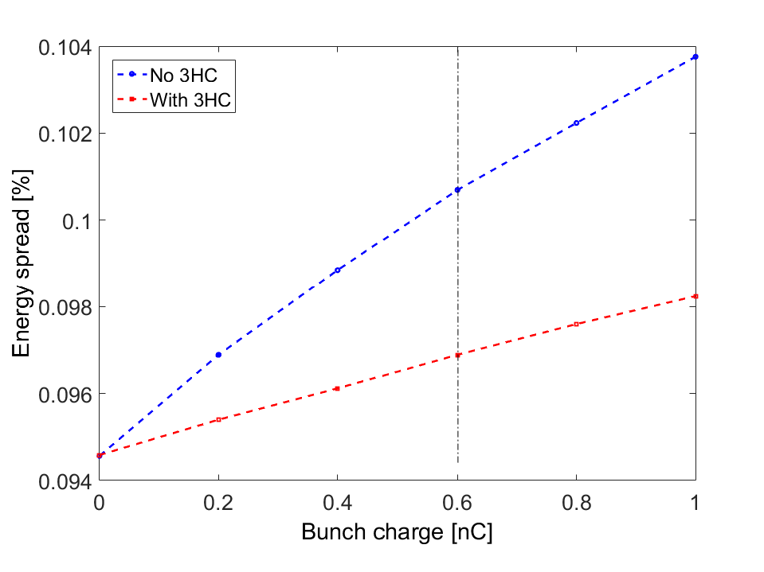
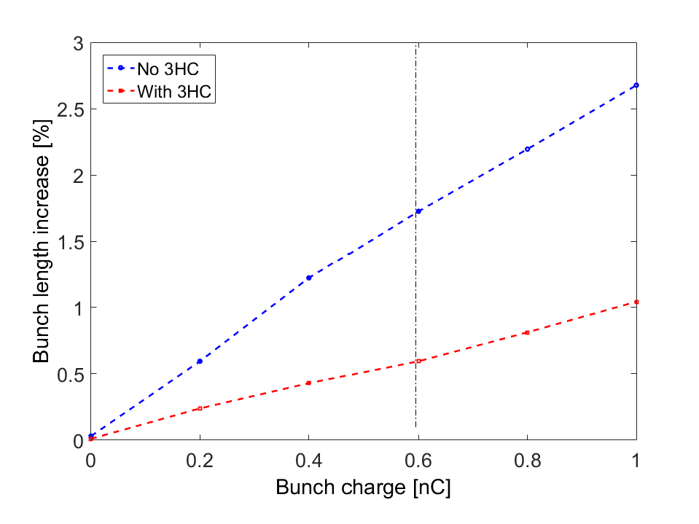
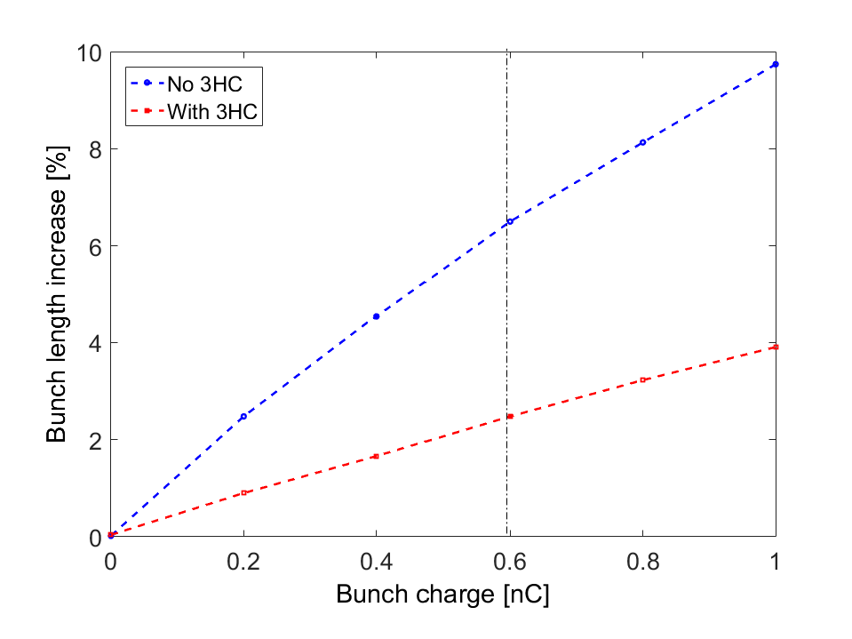
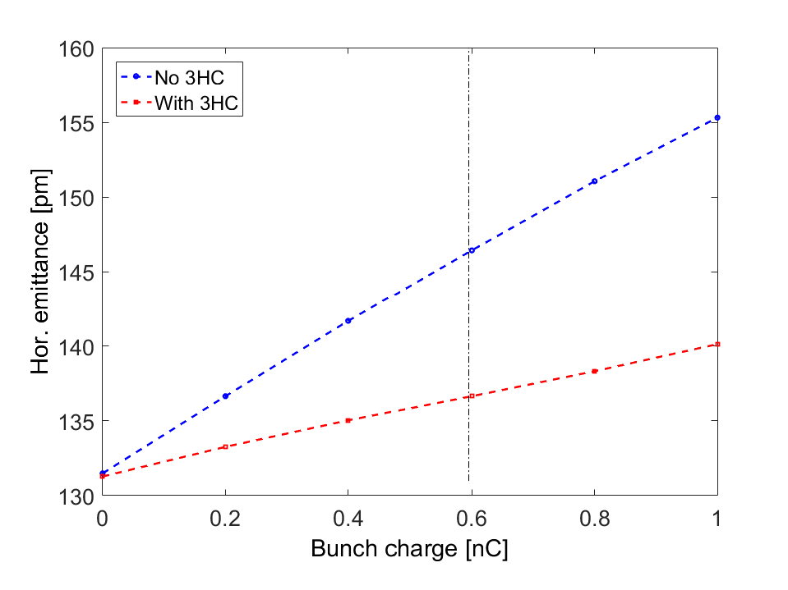
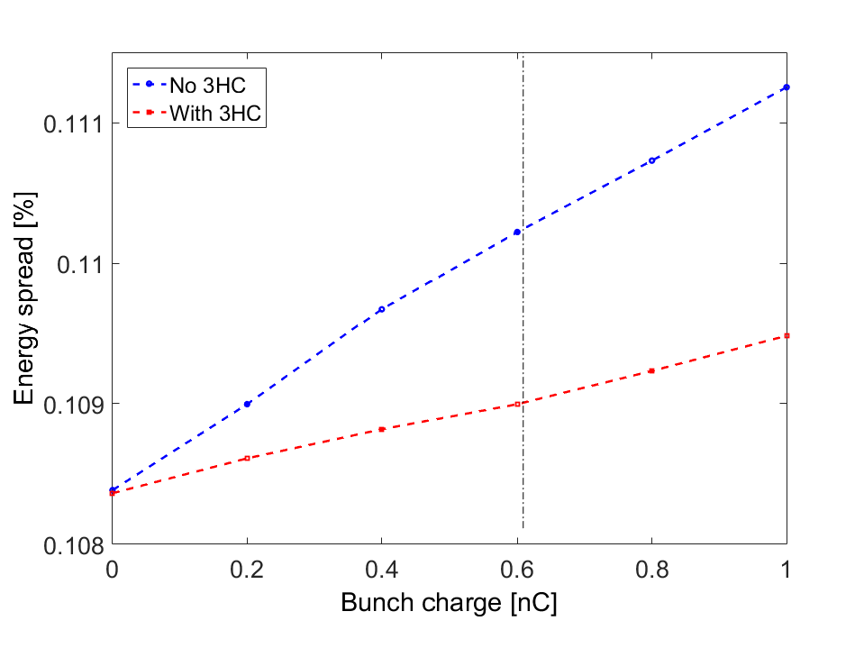
Intra-beam Scattering
Emittance
Energy Spread
Bunch Length
Without IDs:
With IDs:

Slide 11
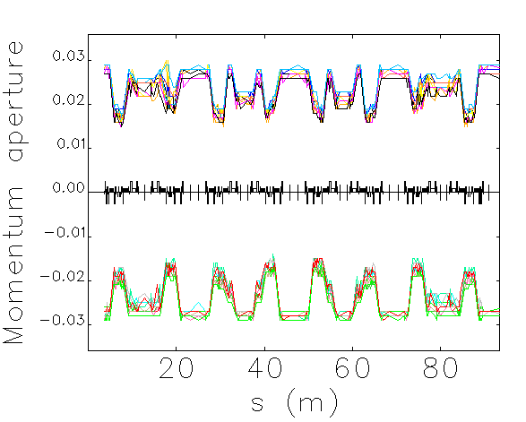
Lifetime with Reverse bends
Reverse bend lattice also has improved lifetime compared to CDR:
Reduced tune-shift with momentum avoids resonances
More robust to errors
(Momentum acceptance reduced in dispersion bumps)
Lifetime calculations assume 300 mA, 900 bunches, ε_{y} = 8 pm.rad
Gas lifetime assumes 100 % CO equivalent pressure of 10⁻⁹ mbar
ΔQ_{x}, RB lattice
ΔQ_{y}, RB lattice
ΔQ_{x}, CDR lattice
ΔQ_{y}, CDR lattice
Component | Lifetime (h)
Coulomb | 37.3
Bremsstrahlung | 72.8
Total gas | 24.7
Touschek (no IDs, no IBS, no 3HC) | 1.6
Touschek (with IDs, with IBS, with 3HC) | 4.8
Overall lifetime | 4.0
Courtesy H. Ghasem

Slide 12
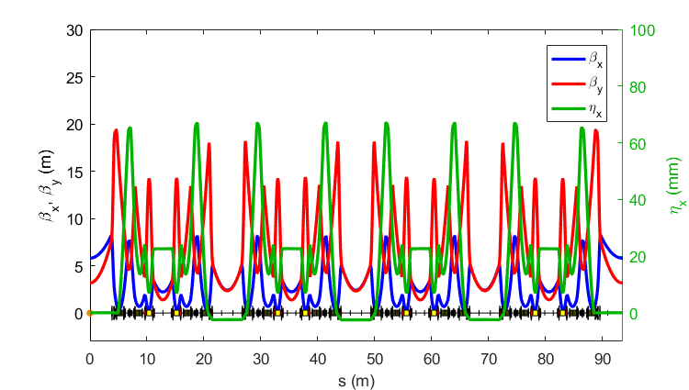
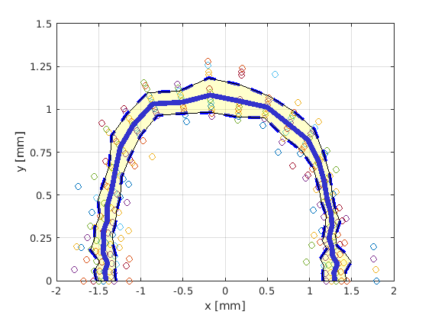
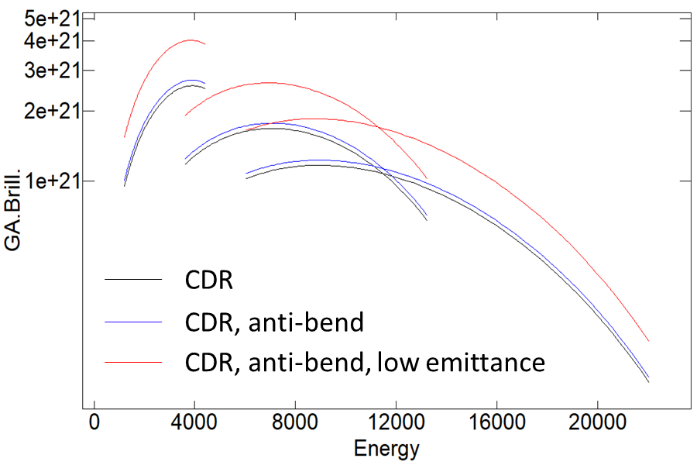
Diamond-II Alternative Optics?
Future ‘brightness-upgrade’ under consideration:
Use same basic hardware
Source points fixed
Increase horizontal tune to lower emittance
Better phase-space matching at IDs
Can be phased-in after initial commissioning
Storage ring / injector already commissioned
Challenges:
Would require on-axis injection (SB only)
Reverse bend quads need to be re-aligned
Shorter lifetime / frequent injection
Increased sensitivity to beam motion
1.5 m CPMU in MSS
(λ_{u} = 17.6 mm)
Brilliance [ph/s/mrad²/mm²/0.1%BW]
CDR Lattice
RB Lattice
RB Lattice (low emittance)
Energy [eV]
Courtesy H. Ghasem

Slide 13
Diamond-II Lattice Options
Parameter | Units | CDR Lattice | Off-axis RB Lattice | On-axis RB Lattice
Betatron tunes |  | [57.16, 20.25] | [54.16, 20.29] | [62.16, 20.31]
Natural chromaticity |  | [-75.7, -89.7] | [-67.8, -91.2] | [-89.3, -110.3]
Momentum compaction factor |  | 1.2×10⁻⁴ | 1.1×10⁻⁴ | 1.0×10⁻⁴
Energy Loss per turn (with/without IDs) | MeV | 0.67 / 1.71 | 0.72/1.76 | 0.72 / 1.76
τ_{x}, τ_{y}, τ_{E} (without IDs) | ms | 14.2, 19.5, 12.0 | 9.5, 18.1, 16.4 | 9.9, 18.1, 15.5
τ_{x}, τ_{y}, τ_{E} (with IDs) | ms | 6.7, 7.7, 4.1 | 5.4, 7.4, 4.6 | 5.5, 7.4, 4.8
β_{x}, β_{y}, η_{x} (long straights) | m, m, cm | 8.4, 4.4, 0 | 8.0, 3.1, 0.6 | 5.8, 3.2, 0
β_{x}, β_{y}, η_{x} (standard straights) | m, m, cm | 5.7, 2.1, 0 | 5.3,2.2,0.05 | 2.4, 2.4, 0
β_{x}, β_{y}, η_{x} (mid straights) | m, m, cm | 2.2, 1.9, 2.5 | 2.3, 1.6, 2.2 | 2.2, 1.4, 2.3
Emittance (bare lattice) | pm.rad | 157 | 159 | 111
Energy spread (bare lattice) | % | 0.08 | 0.09 | 0.09
Bunch length (bare lattice) | mm | 3.5 | 3.8 | 3.9
Emittance (with IDs, IBS, 3HC) | pm.rad | 147 | 136 | 110
Energy spread (with IDs, IBS, 3HC) | % | 0.10 | 0.11 | 0.11
Bunch length (with IDs, IBS, 3HC) | mm | 10.9 | 10.4 | 10.8
Total lifetime (with IDs, IBS, 3HC) | h | 2.9 | 4.0 | 1.7

Slide 14
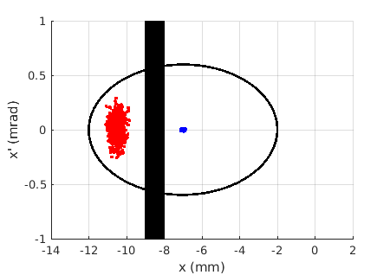
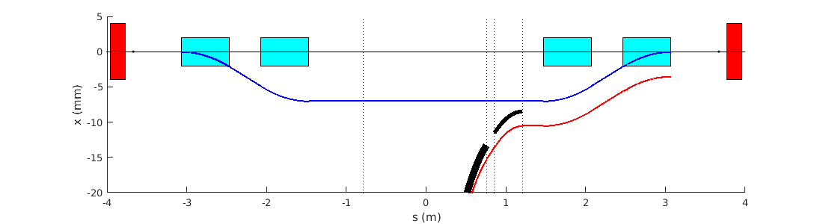
Diamond-II Injection
Baseline injection scheme:
standard 4 dipole kicker bump (6 μsec, half-sine pulses)
allows single-shot, on-axis injection for initial commissioning
off-axis accumulation possible by reducing amplitude of bump
compatible with both multi-bunch or single bunch injection
combination of thick (3 mm) / thin (1 mm) septum magnets
allows ~3.5 mm beam separation at injection point
3.5 mm beam separation
5 mm dynamic acceptance
Dipole kickers:
L = 0.6 m
θ = 7.0 mrad
B = 0.14 T
Main septum:
L = 0.155 m
θ = 7.5 deg
B = 0.98 T
Thin septum:
L = 0.35 m
θ = 1.0 deg
B = 0.58 T

Slide 15
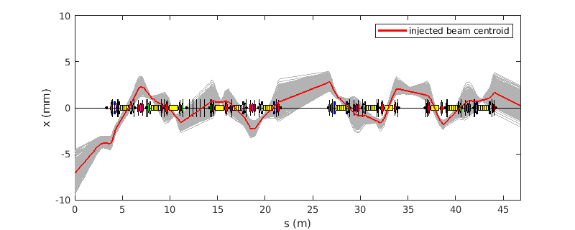
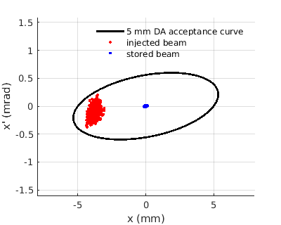
Diamond-II Injection
Alternative injection scheme under consideration (stage 2: off axis injection with nonlinear kicker):
Thick/thin septum magnets moved to upstream end of straight
Injected beam exits septum magnet at ~ -8.5 mm
One (or more) nonlinear kickers at downstream end (reduces disturbance during top-up)
Injected beam must be matched to slope of NLK field for high injection efficiency
Nonlinear kicker: θ_{NLK} ~ 1.0 to 1.5 mrad
x_{beam} ~ -3.5 to -4 mm

Slide 16
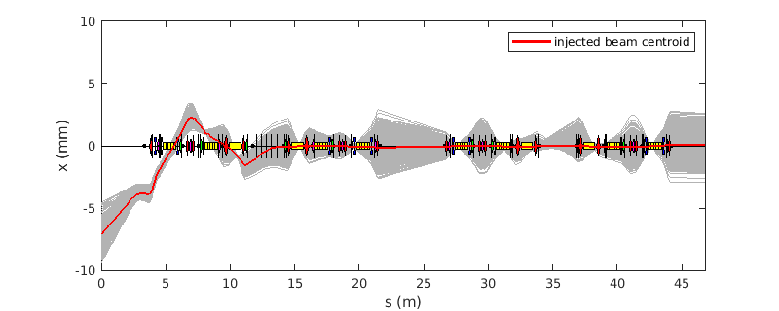
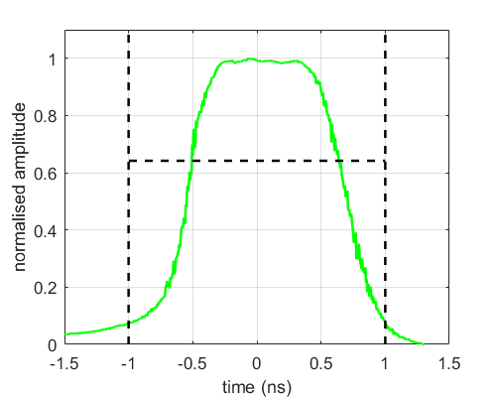
Diamond-II Injection
Alternative injection scheme under consideration (stage 3: on-axis injection):
Combination of thick/thin septum magnets and nonlinear kicker remain unchanged
Single bunch stripline kickers added in downstream mid-straight section
Could enable single-bunch swap out injection
Oscillations could be shared between stored / injected bunches to avoid losing stored bunch
±20 kV / 2 ns pulsers with 5×0.3 m long striplines (8 mm half-gap) looks sufficient
FID GmbH:
2 ns (0-0)
±20-30 kV
SB kickers: θ_{SBK} ~ 0.2 - 0.25 mrad

Slide 17
Diamond-II Vacuum Chamber
Requirement: Target average pressure ≤ 10⁻⁹ mbar at 300 mA after 100 A.h beam conditioning
Current solution (WIP)
Vessel cross-section: Mainly circular (20 mm inner diameter)
  Antechamber in those dipole vessels with photon beam extraction
Pumping: Non-evaporable getter (NEG) coated apart from antechamber vessels
  Plus discrete ion pumps and NEG cartridge pumps
  3D vacuum sims to confirm vacuum (Synrad+, Molflow+, Comsol Multiphysics®)
Heat load management: Mix of discrete and distributed absorbers
Materials/manufacturing: Most vessels copper; antechamber vessels aluminium
  CuCrZr discrete absorbers possibly with some additive manufacturing
  Fully RF-shielded gate valves, flanges and bellows
  NEG coating by industry
Assembly process: Ex-situ bakeout only
  Vacuum strings (~7m) built up, baked out and NEG activated on assembly trolleys
  Remain under vacuum during installation
Courtesy M. Cox

Slide 18
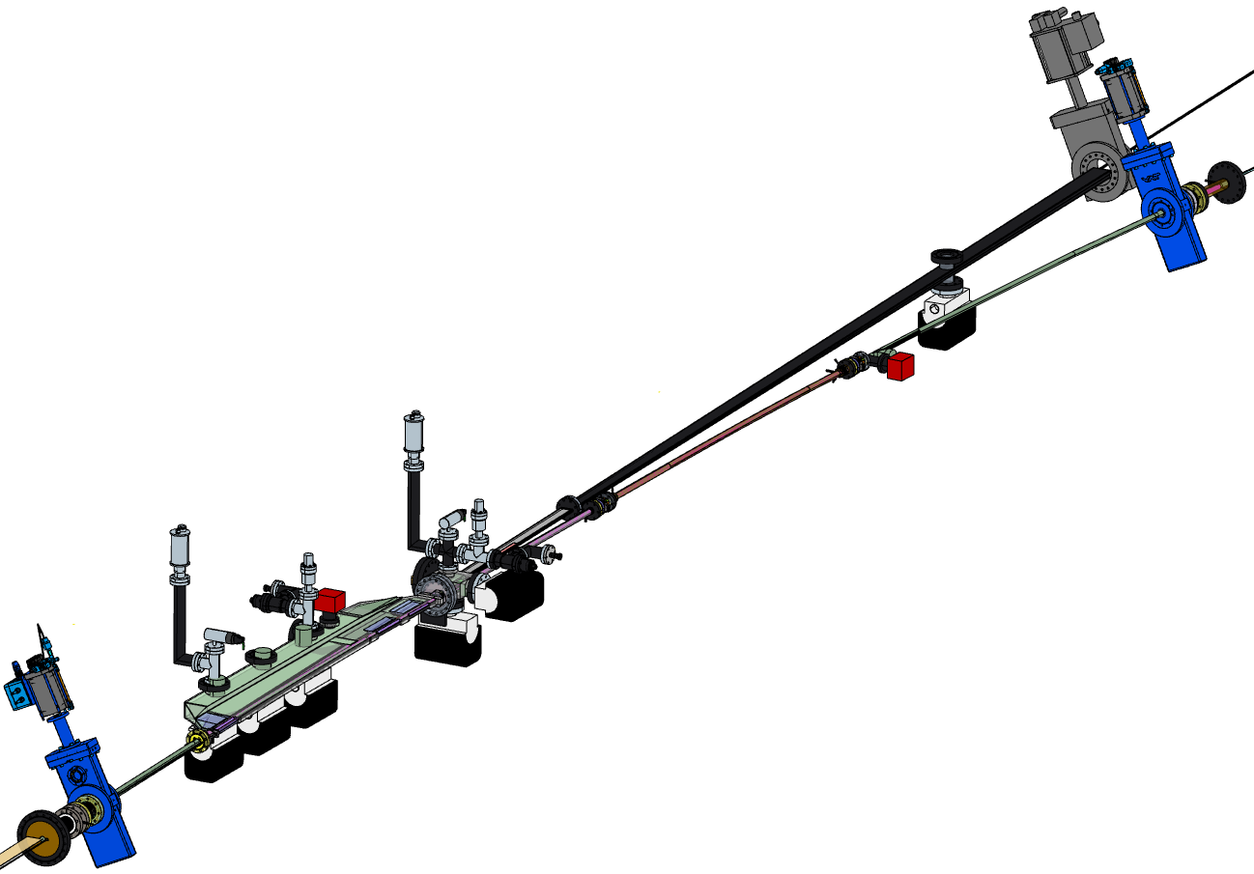
Diamond-II Vacuum Chamber
Four different girder types:
Long to Mid (LM)
Mid to Standard (MS)
Standard to Mid (SM)
Mid to Long (ML)
plus some special variants for particular beamlines
Electron beam exit
Photon beam exit
Dipole
3 vessel (Cu/NEG)
RF gate valve
Residual gas analyser (RGA) ports
Dipole
2 vessel (Cu/NEG)
Ion/NEG pumps (not all labelled in this diagram)
Crotch 1 vessel and absorber (Cu)
Beam direction →
Dipole 1 vessel (Al)
Courtesy M. Cox

Slide 19
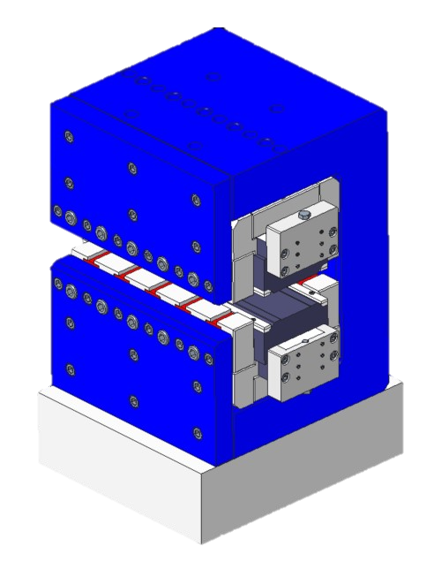
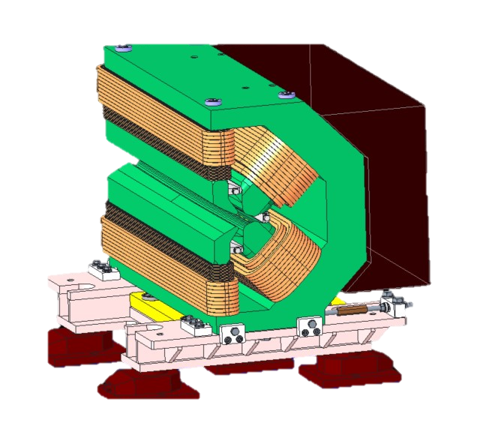
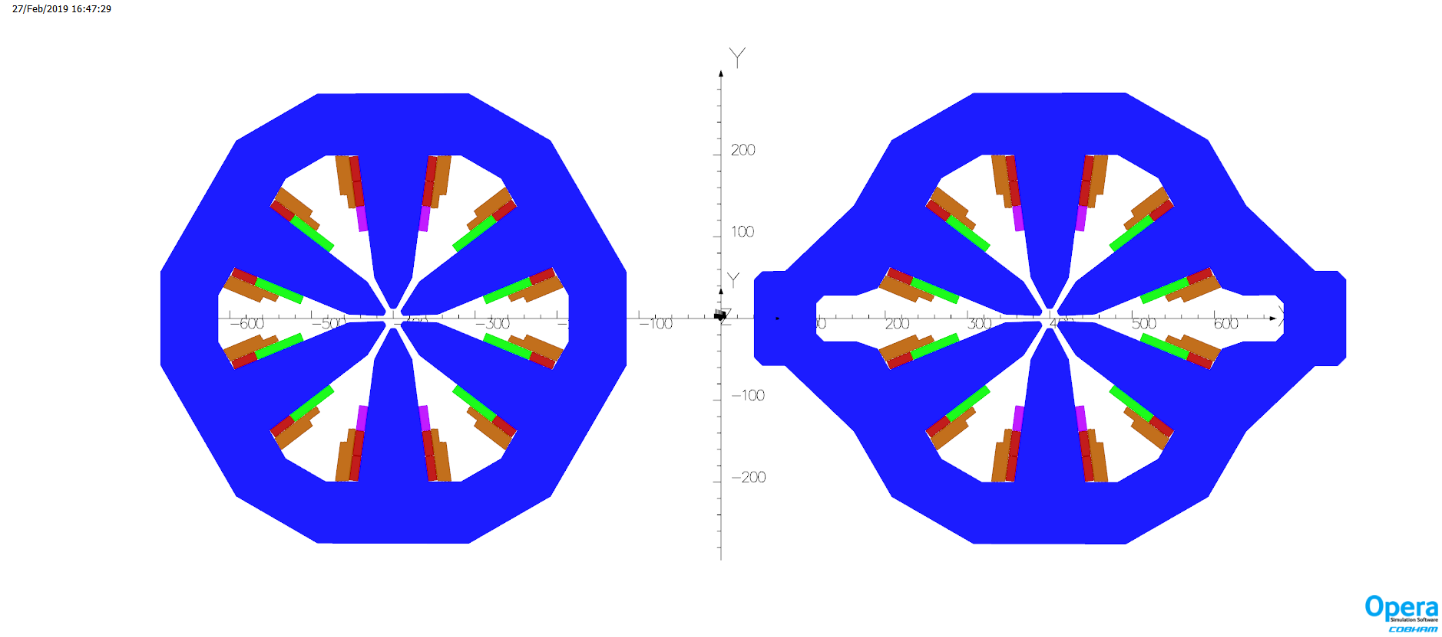
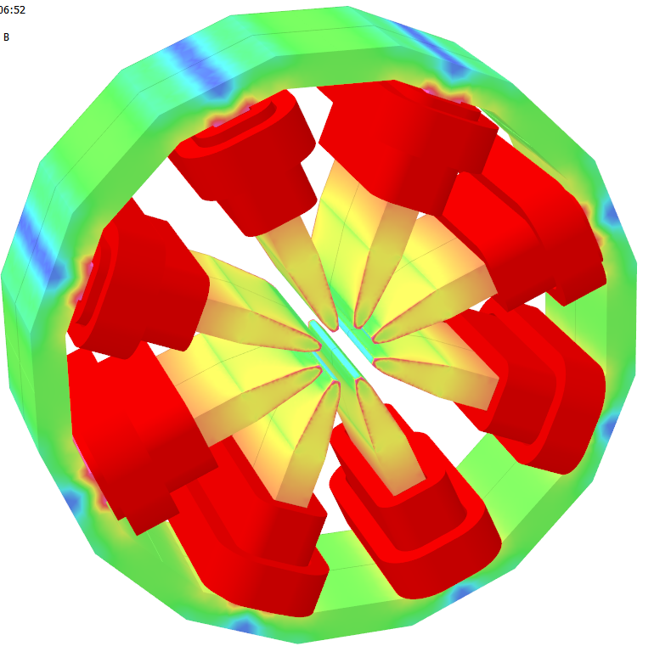
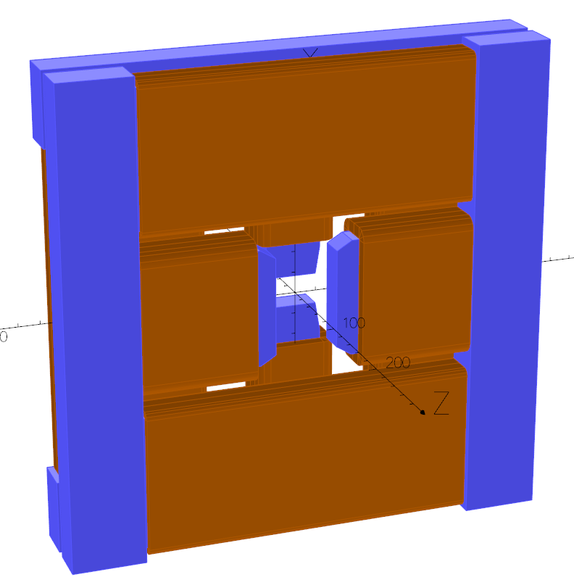
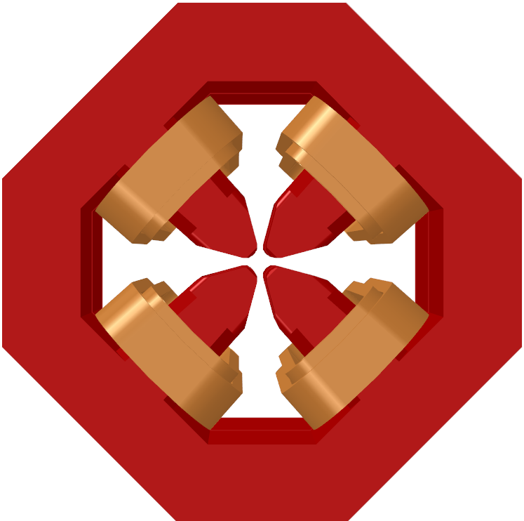
Diamond-II Magnets (CDR Lattice)
Magnet | Length | Max B₀ | Max G₀ | Max S₀ | Max O₀ | # Magnets | # Families | Type
 | [m] | [T] | [T/m] | [T/m²] | [T/m³]
DL dipole | 1 | 0.29 to 0.76 | - | - | - | 96 | 1 | Permanent Magnet
DQ dipole | 0.87 | 0.695 | -32.32 | - | - | 48 | 1 | Electro-Magnet
Quadrupole | 0.105-0.36 | - | 85 | - | - | 396 | 13 | Electro-Magnet
Sextupole* | 0.1-0.14 | - | - | 3850 | - | 288 | 6 | Electro-Magnet
Octupole | 0.09 | - | - | - | 110300 | 48 | 1 | Electro-Magnet
Slow Corrector | 0.08 | 0.15 | - | - | - | 12 | 1 | Electro-Magnet
Fast Corrector | 0.025 | 0.01 | - | - | - | 144 | 1 | Electro-Magnet
*Sextupoles contined additional horizonal/vertical corrector and skew quadrupole windings
DL Dipole
DQ Dipole
Quadrupole
Sextupole
Octupole
Slow corrector
Courtesy A. Shahveh

Slide 20
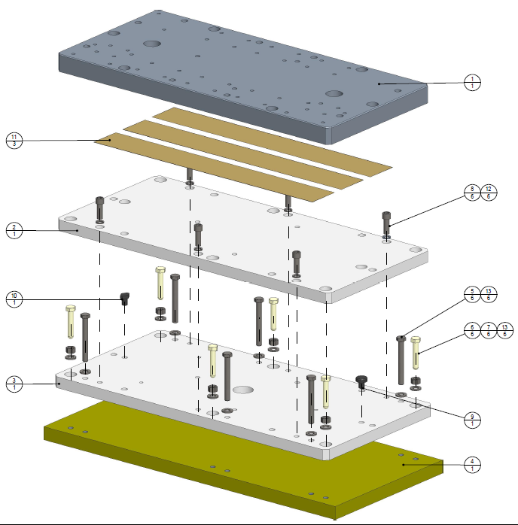
Diamond-II Girders
Girder design work is on-going.
Present solution:
Magnets to be supported on single girder per half-cell (~8 m long)
Manual adjustment system (screw-thread adjustment in each plane))
Aim to achieve overall transmissibility of ~1 in 1-100 Hz band
Electron beam is most sensitive to vertical girder motion
Use viscoelastic tape in baseplates
  stiff at high frequency to reduce transmissibility
  Soft at low frequencies to allow expansion and contraction
Choice of material from trial girders
  steel fabrication (same as existing girders, good stiffness)
  cast grey iron (better damping properties, easy to produce, cost-effective)
  carbon composite (lightweight, high natural frequency, expensive)
Test girders will inform final choice of material and support system (in progress).
Courtesy J. Dymoke Bradshaw

Slide 21
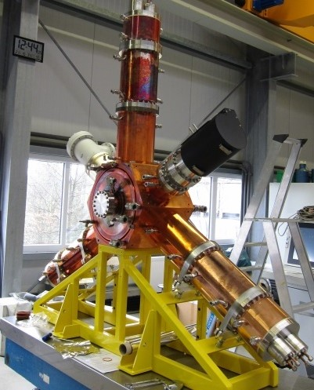
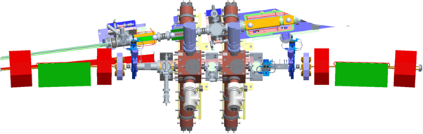
Diamond-II RF
Use HOM-damped normal-conducting cavities (500 MHz):
  More robust and more easily repaired than superconducting cavities
  Releases current long RF straight for a new flagship beamline ID
  Broader frequency tuning range allows Diamond-I NC cavities to be used in Diamond-II
  Latest iteration of cavities used in BESSY, ALBA and ESRF (scaled for frequency)
  Smaller footprint than superconducting cavities in cryostats
  Effective HOM-damping has been demonstrated in Diamond-I
Eight RF cavities arranged in pairs in mid-section straights:
  Multiple low-voltage cavities gives lower wall losses
  Use of multiple cavities introduces redundancy of operation
Courtesy C. Christou

Slide 22
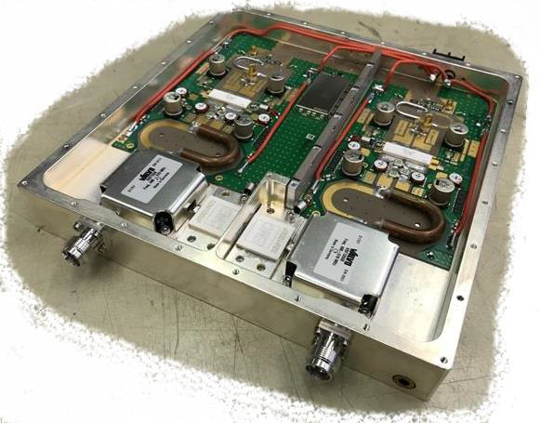
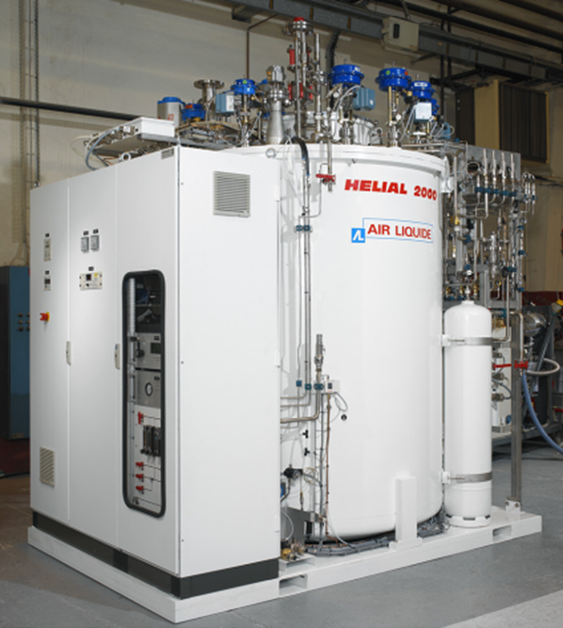
Diamond-II RF
Amplifiers
Each cavity powered by single solid state amplifier
  100 kW amplifier many 800 W power transistors
  Redundancy ensures continuity of operation
  Several commercial suppliers exist
Amplifier/cavity operation regulated by digital LLRF
  IQ or polar PI loops for cavity ampl./phase
  Based on the MicroTCA standard
  Digital (functionality can be added as required)
  Based on system developed at ALBA
Higher harmonic cavity
  Minimise storage ring heating
  Alleviate collective instabilities
  Maximise beam lifetime
Passive superconducting HHC
  Needs no new amplifier
  Operates across all beam currents
  Can fit in mid-section straight
  Available from industry (CEA design: SLS, Elettra)
Can use the existing Diamond-I cryogenic plant
Courtesy C. Christou

Slide 23
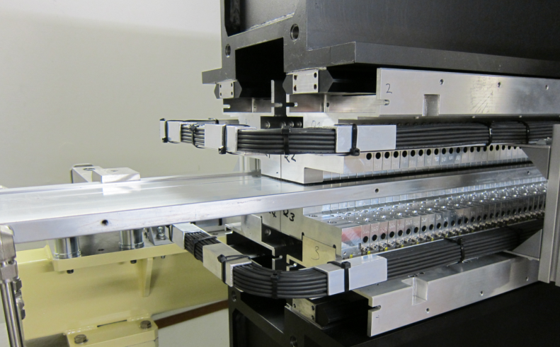
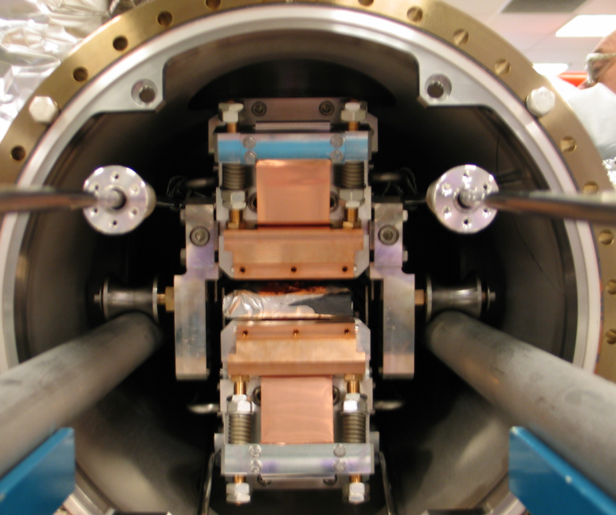
Diamond-II Insertion Devices
ID Upgrade Program:
9 IDs to be replaced as part of rolling upgrade program (mainly CPMUs, but also 1 APPLEII-KNOT, 1 HPMU and 1 SCU)
9 new IDs and 3×3PW required for Diamond-II operations (Day 1, relocation of BM sources / shorter straight lengths)
2 new IDs needed for Diamond-II to meet science objectives
9 IDs remain unchanged
ID Build Strategy:
Total of 11 (or more!) IDs to be built between 2022 and 2025
Mix of in-house and industry
CPMUs built in-house (in progress)
HPMUs and SCU out-sourced
Courtesy S. Milward

Slide 24
Diamond-II Injector Upgrade
Efficient injection into D-II storage ring requires an upgrade to the existing booster:
Increased extraction energy
Lower emittance
Shorter bunch length
Increased charge per shot (SB and MB)
Other considerations:
must fit in existing tunnel
high injection efficiency
low impedance for high-current bunches
long lifetime w.r.t. booster cycle
dynamic aperture larger than physical
long-term reliability
 | Target | Existing booster
Energy | 0.1 - 3.5 GeV | 0.1 - 3.0 GeV
Emittance | <30 nm.rad# | 134 nm.rad
Bunch length | <40 ps* | 100 ps
Max. SB charge | ~5 nC⁺ | ~0.2-0.4 nC
Max. MB charge | ~15 nC | ~1-2 nC
#defined by storage ring dynamic aperture
*defined by storage ring momentum aperture
⁺for 3 nC hybrid bunch in storage ring swap-out

Slide 25
Diamond-II Injector Upgrade
Replacement booster synchrotron:
Unit cells built from F/D combined-function magnets
Sextupole correction in dipole pole-face
Two long, dispersion-free straight sections
Distributed trim sextupoles for eddy-currents
Raising inj. energy from 100 MeV to 150 MeV under consideration
Parameter | Unit | Existing Booster | Booster-II
Energy Range | GeV | 0.1-3.0 | 0.1-3.5
Circumference | m | 158.4 | 163.264
Tunes |  | [7.18, 4.27] | [12.20, 5.36]
Natural Chromaticity |  | [-9.7, -6.3] | [-13.5, -11.9]
Mom. Comp. Factor |  | 2.5×10⁻² | 5.8×10⁻³
Emittance | nm.rad | 134 | 17.7
Energy Spread | % | 0.073 | 0.086
Bunch Length@2MV | ps | 60 | 39
Energy Loss Per Turn | keV | 580 | 947

Slide 26
Diamond-II Timeline
Event | Date
CDR Published | May 2019
1st MAC | Feb. 2020
UKRI International Accelerator Committee project review | Nov. 2020
2nd MAC | Jan. 2021
UKRI decision from Board | Jan. 2021
Decision from Wellcome Trust on grant application | Feb. 2021
Submit Outline Business Case to BEIS | Mar. 2021
Draft TDR reviewed by MAC and SAC | Dec. 2021
Final TDR published | Dec. 2021
CD-2 (UKRI) | Jan. 2022
Submit Final Business Case to BEIS | Feb. 2022
Start of funding and procurement | Apr. 2022
Start of shutdown | Dec. 2025
Resume full User Mode | Jun. 2027

Slide 27
Summary
Optimisation of the Diamond-II lattice is on-going, with the aim to freeze the hardware in next 2-3 months to allow finalisation of engineering, vacuum and magnet designs.
Staged upgrade looks attractive and feasible:
standard off-axis injection to allow injector and storage ring to be commissioned and characterised
injection with nonlinear kicker and single-bunch kickers for transparent injection
shift to high-brightness / on-axis injection lattice once performance established
Still some design choices to be made:
storage ring magnet parameters (DL dipoles with gradient, inclusion of reverse bends)
injection scheme
active vs. passive harmonic cavity
booster injection energy
Plus detailed vacuum chamber design, girder design, NLK/SB kicker parameters, transfer lines, sources for ex-bending magnet beamlines etc, etc, …

Slide 28
Extra Slides

Slide 29
Magnets for CDR Lattice
DL Magnet (Permanent magnet)
Magnet gap: 25.2 mm
Magnetic Field from 0.29 to 0.76 T
Yoke and Assembly
Same pole tip for all modules,
Gap between poles: 5 mm
Gap between yokes: 25 mm
Yoke size: 200(175)(W)x314(224)(H)
Yoke weight: 270 kg
PM Blocks
Br: 1.12 T (Max)
Material: Sm₂Co₁₇
108 block (~ 35 kg)
DQ Magnet (Electromagnet)
B=0.695 T, G=-32.32
Field Quality @ 7 mm : ΔB/B≤5.0E-04
Independent Quadrupole field tuning
Straight yoke and bent pole tips
Max deformation ≤ 5 um (using aluminium spacers)
Fringe field analysis shows ψ~20˚ (eff. pole-face angle)
No end chamfers
Courtesy A. Shahveh

Slide 30
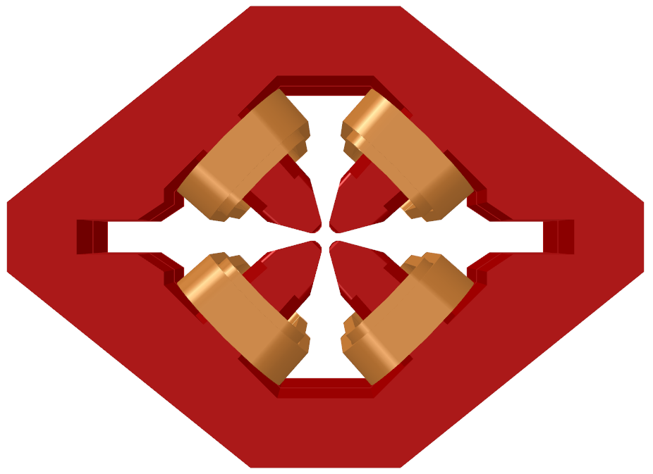
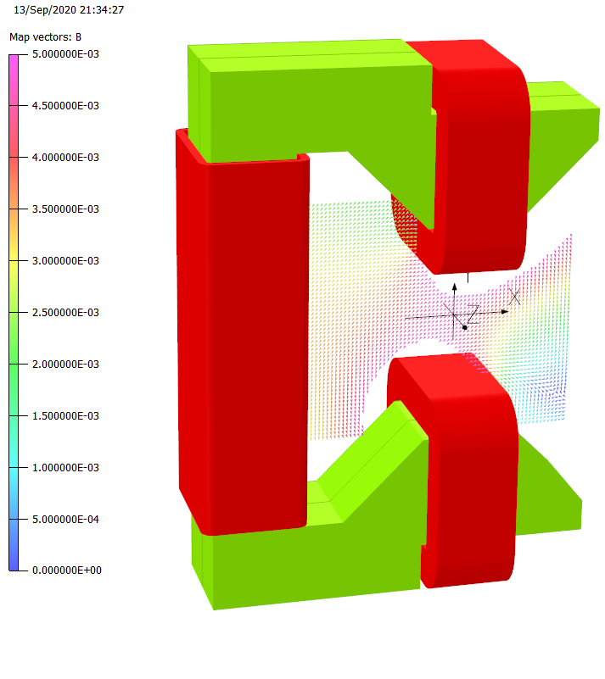
Magnets for CDR Lattice
Quadrupole magnets
G_{max}= 85 T/m
Segmented pole profile with iron yoke
R=12 mm, pole-pole gap is 10 mm (r=12.75 & 14.25 mm also exist)
No end chamfers.
Two different cross section and 5 different lengths
Overall size: 540x540(700)mm
Sextupole magnets
S_{max}= 3850 T/m²
Normal Iron pole
R=12/15 mm
Pole-pole gap 7.2/10 mm
No end chamfers.
Two different cross section, lengths, and radius (5 family in total)
Bx, By, Skew_Q trim coils
Overall size: 550x550(720)mm
Octupole magnets
Oct_S_{max}=110300 T/m³
R=13 mm, 7.2 mm pole-to-pole gap
Errors < 10% at 10 mm
Overall size: 140x140 mm
Corrector magnets
Def_{max}=1 mrad per component
Bx gap=59 mm
By gap=29 mm
Errors < 10% at 10 mm
Total length 80 mm
Overall size: 450x450 mm
Fast mini Correctors
Def_{max}=20 µrad per component
Errors < 40% at 10 mm
Total length 25 mm
Overall size: 110x220 mm
Courtesy A. Shahveh

Slide 31
Diamond-II Insertion Device Upgrades
ID |  | Period (mm) | N | L (m) | Gap (mm) | B (T) | K | Emin1 | Emin3 | Diamond-II energy range (keV) | Ptot (kW)
I24 | CPMU-1 | 17.6 | 113 | 2 | 4 | 1.4 | 2.30 | 1.81 | 5.44 | 5-30 | 9.06
I03 | CPMU-2 | 17.6 | 113 | 2 | 4 | 1.4 | 2.30 | 1.81 | 5.44 | 5-30 | 9.06
I11 | SCU-1 | 15.6 | 128 | 2 | 4 | 1.2 | 1.75 | 2.95 | 8.85 | 9-35 | 6.68
I14 | CPMU-3 | 17.6 | 113 | 2 | 4 | 1.36 | 2.24 | 1.89 | 5.67 | 5-25 | 8.55
I04 | CPMU-4 | 17.6 | 113 | 2 | 4 | 1.4 | 2.30 | 1.81 | 5.44 | 6-30 | 9.06
J02 (VMXm) | CPMU-5* | 17.6 | 113 | 2 | 4 | 1.4 | 2.30 | 1.81 | 5.44 | 5-30 | 9.06
K04 (I04.1) | HPMU-1 | 19.7 | 76 | 1.5 | 4 | 1.2 | 2.21 | 1.72 | 5.15 | 10-25 | 5.01
I05 | APPLEIIK-1 | 192 | 26 | 5 | 20 | 0.45 | 8.07 | 0.02 | 0.05 | 0.018-0.24 | 2.35
I13 | CPMU-6 | 20 | 100 | 2 | 6.4 | 1.04 | 1.94 | 2.01 | 6.04 | 5-25 | 5.03
K02 (VMXm) | HPMU-2 | 17.6 | 85 | 1.5 | 4 | 1.1 | 1.81 | 2.51 | 7.53 | 5-30 | 4.21
J13 | HPMU-3 | 22.6 | 119 | 2.7 | 5 | 0.97 | 2.05 | 1.66 | 4.99 | 6-38 | 5.88
I09 | HPMU-4 | 25.3 | 79 | 2 | 6.4 | 1.06 | 2.50 | 1.11 | 3.33 | 2.1-18 | 5.22
K21 | HPMU-5 | 18.7 | 80 | 1.5 | 4 | 1.17 | 2.05 | 2.00 | 6.00 | 6-14.5 | 4.80
K16 | HPMU-6 | 18.7 | 80 | 1.5 | 4 | 1.17 | 2.05 | 2.00 | 6.00 | 6-14.5 | 4.80
I06 | APPLEII-1 Segmented? | 56 | 29 | 3.5 | 12.5 | 0.73 | 3.82 | 0.25 | 0.75 | 0.25-2.1 | 2.01
I08 | APPLEII-2 | 56 | 62 | 3.5 | 12.5 | 0.73 | 3.82 | 0.25 | 0.75 | 0.25-4.2 | 4.30
I10 | APPLEII-3 | 48 | 73 | 3.5 | 13.2 | 0.93 | 4.17 | 0.25 | 0.75 | 0.25-1.6 | 7.04
K07 (B07-2) | APPLEII-4 | 80 | 22.5 | 1.8 | 12.5 | 1.09 | 8.14 | 0.04 | 0.13 | 0.25-5.0 | 4.97
I18 |  | 19.5 | 102 | 2 | 4 | 1.21 | 2.20 | 1.74 | 5.22 | 2-27 | 6.77
I19 |  | 18.7 | 106 | 2 | 4 | 1.17 | 2.04 | 2.01 | 6.04 | 6-35 | 6.31
I02 (VMXi) | CPMU-5* | 17.6 | 113 | 2 | 4 | 1.36 | 2.24 | 1.89 | 5.67 | 5-30 | 8.55
I22 | HPMU-7 | 18.7 | 106 | 2 | 4 | 1.17 | 2.04 | 2.01 | 6.04 | 6-30 | 6.31
D-I upgrade
D-II operations
D-II science
D-II future
Courtesy S. Milward

Slide 32
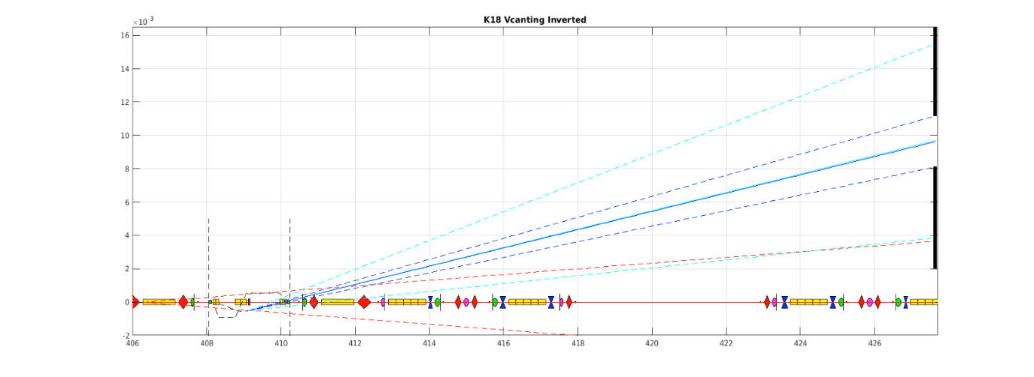
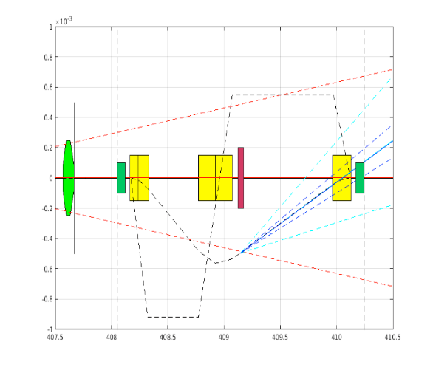
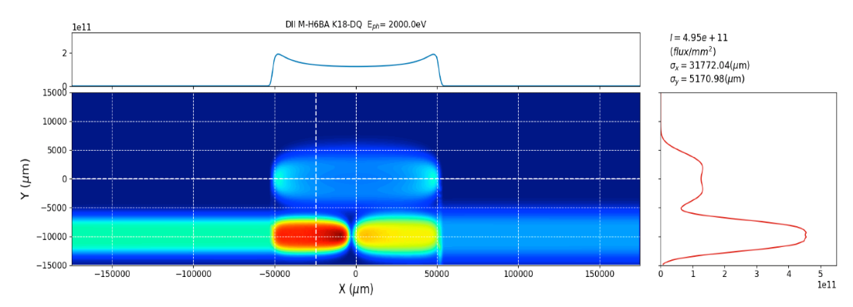
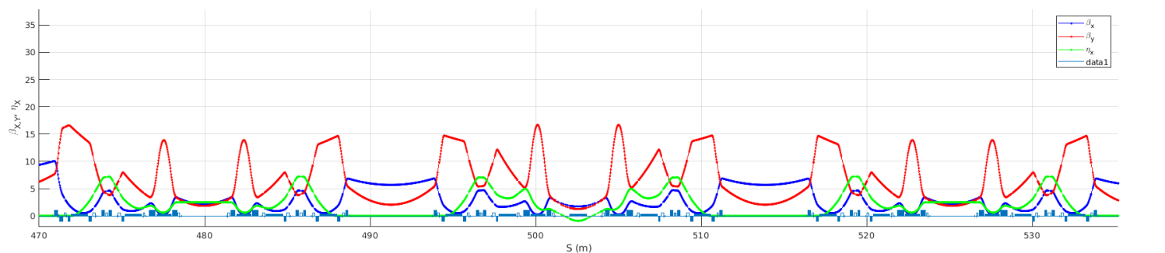
Diamond-II Dipole Sources
K18
  Steerer-Radiator-Steerer canted solution: SR transmission feasible
3K-bump: canting solution
Dy_max @ radiator = 0.49mm
Demi_y = 0.055pm (from V-bump)
Demi_x ~ 0 pm (from S-R-S)
[θ1, θ2, θ3]= [-0.91667, 1.4667, -0.55] mrad
E_{γ} = 2keV
R
K18 FE slit
0.165mrad
0.55mrad
K22
  Mid Straight Single Dipole studied:
    Complete NL-dynamics optimisation
  DQ dipole (reduced acceptance)
K23
  DQ dipole likely option
  Mid Straight Single Dipole also considered
3.75mm
DQ: L = 0.87m
θ = 51.8mrad
B_{y} = 0.6954T
Courtesy M. Apollonio

Slide 33



Diamond-II Brightness Comparison
2 m CPMU in SSS
(λ_{u} = 17.6 mm)
1.5 m CPMU in MSS
(λ_{u} = 17.6 mm)
Brilliance [ph/s/mrad²/mm²/0.1%BW]
Brilliance [ph/s/mrad²/mm²/0.1%BW]
CDR Lattice
RB Lattice
RB Lattice (low emittance)
CDR Lattice
RB Lattice
RB Lattice (low emittance)
Energy [eV]
Energy [eV]
5 m APPLE-II in LSS
(λ_{u} = 56 mm)
2.7 m HPMU in LSS
(λ_{u} = 22.6 mm)
Brilliance [ph/s/mrad²/mm²/0.1%BW]
Brilliance [ph/s/mrad²/mm²/0.1%BW]
CDR Lattice
RB Lattice
RB Lattice (low emittance)
CDR Lattice
RB Lattice
RB Lattice (low emittance)
Energy [eV]
Energy [eV]
Courtesy H. Ghasem

