Slide 1
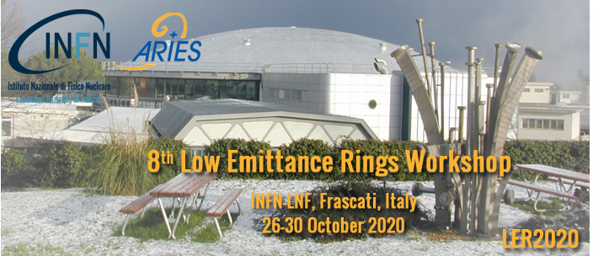
Status of SLS upgrade
Masamitsu Aiba, PSI
on behalf of SLS2.0 team

Slide 2
Contents
Upgrade outline
Lattice design
Plan and status of components
Summary

Slide 3
Upgrade outline
Objective: 40 times spectral brightness for ‘Hard X-ray’ (Promised in Letter of Intent, 2014)
Demand
  Very high energy photons, >50 keV
  Higher photon flux for soft and hard X-ray (spectroscopy) beamlines
  Higher coherent flux for ptychography beamline
  At low energy (VUV, ～20 eV), photon beam as of SLS
  Stable photon beam for all beamlines with top-up operation and fast orbit feedback
Constraint
  Reusing the SLS building and the injector chain
    Limited circumference, 288 m
    Storage ring geometry very close to the present ring to fit the ‘triangular’ tunnel (3 types of straights, Long, Medium and Short)
Funding period: 2021-2024

Slide 4
Lattice design (1)
SLS2 storage ring parameters
Parameters | Values | Remark
Circumference | 288 m | Total absolute bending angle of 430 degree with RB
Beam energy | 2.7 GeV | SLS operation at 2.4 GeV
Nominal beam current | 400 mA | As of SLS
Betatron tunes (H/V) | 39.35/19.22 | Uncorrected chromaticity -99.0 / -33.4
Momentum compaction factor | 1.04x10-4 | Negative alpha lattice abondoned
Natural energy spread | 1146 ppm | 1160 ppm with IBS, 1040 ppm with all IDs
Natural emittance | 157 pm | 161 pm with IBS, 135 pm with all IDs
Damping partition (H/V/L) | 1.82 / 1.0 / 1.18
Damping time | 4.1 / 7.5 / 6.4 ms | 3.6 / 5.8 / 4.3 ms with all IDs
Radiation loss per turn | 689 keV | 900 keV with all IDs
RF frequency | 500 MHz | Passive 3HC in addition to 500 MHz system
Nominal RF voltage | 1.44 MV | RF bucket height -6.2/+4.5%, 1.7 MV with all IDs
Beam lifetime | 11 hours | Ideal lattice with 3HC and 10-9 mbar CO
Number of Superbends | 4 | To be installed after commissioning
Superbend peak field | 5 / 3.5 / 2.1 T | 2.1 T bend with P.M., otherwise superconducting
Total length of straight for IDs | 50 m

Slide 5
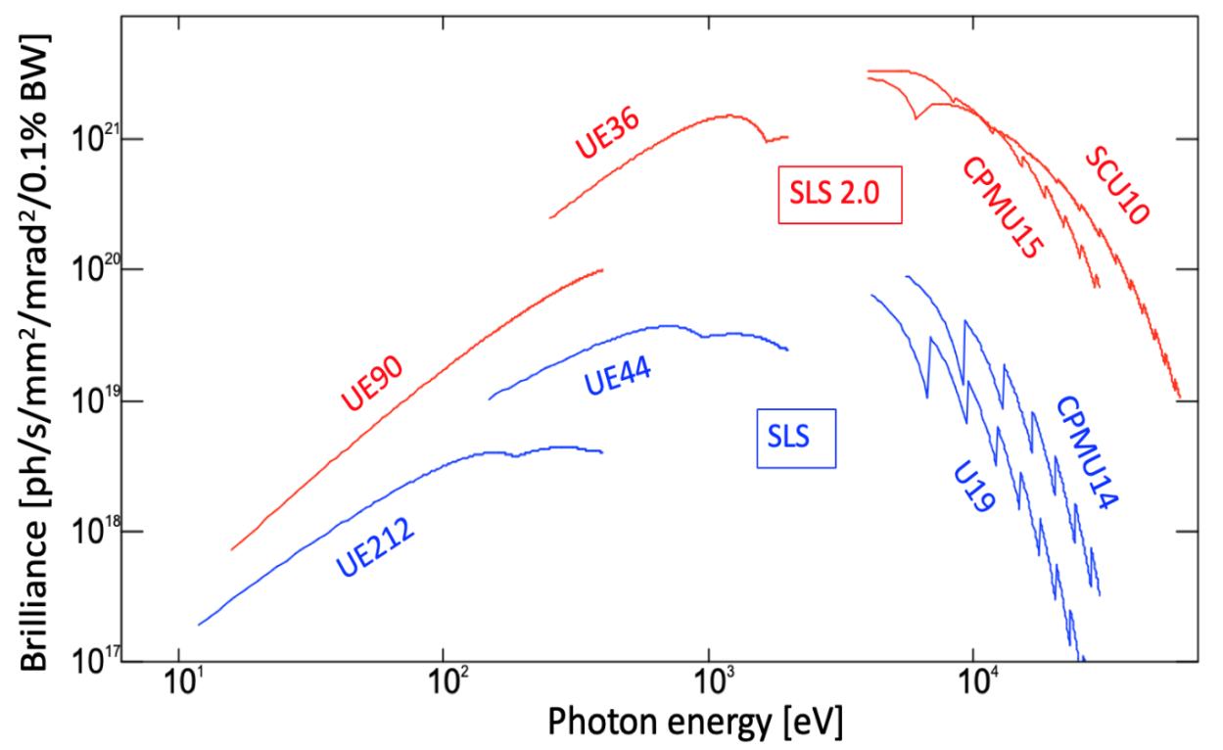
Lattice design (2)
Expected performance
Hard X-ray (10-20 keV) w.r.t. SLS:
About 60 times gain with smaller emittance and higher energy
Even more gain , 140/870 times (10/20 keV), with new undulator (CPMU15)

Slide 6
Lattice design (3)
Lattice concept
  MBA arc
    Unit cell with longitudinal gradient bend (LGB) and reverse bend (RB) → Low emittance for the given circumference
    Distributed chromaticity-correction sextupoles → Large-enough momentum aperture, and thus long-enough lifetime
    (Large number of sextupoles and also octupoles as a drawback)
    7BA is the best compromise among the emittance, nonlinearity and magnet feasibility
  Pseudo symmetry
    Phase advance between the sextupoles facing to straight section is constant over all straight sections
    → Super-periodicity = Number of arcs for on-energy
    beam, resulting in a large-enough dynamic aperture
    → Geometry close to the present ring with Long, Medium
    and Short straight sections
  Low betas at insertion device locations as much as possible
    Matching between the electron beam and photon beam

Slide 7
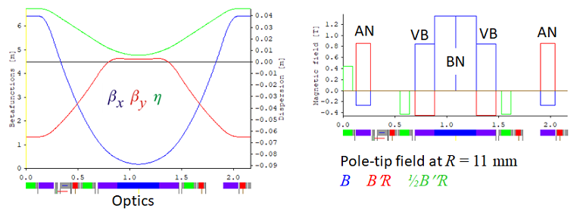
Lattice design (4)
Unit cell – LGB + Reverse bend
Actual unit cell layout
+ Reverse bend cell
LGB+RB:
LGB+RB cell can be up to ~5 times
better in terms of emittance
Simplified LGB “Victory stand”
Bending and combined function (No pure quadruople)
Absolute bending angle 5.48 deg / Net bending angle 5.0 deg

Slide 8
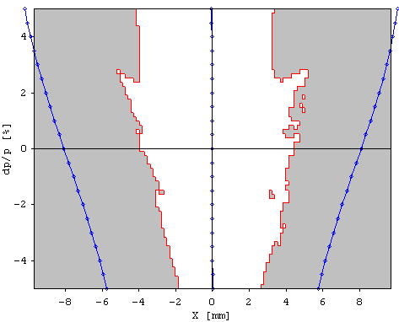
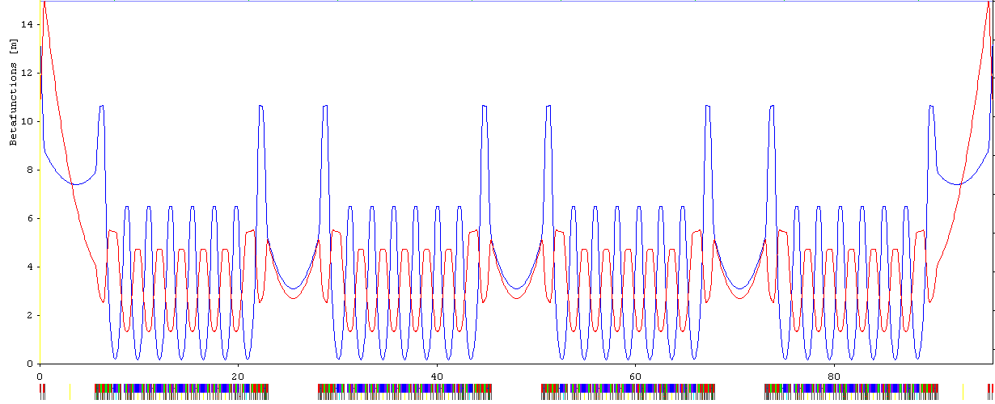
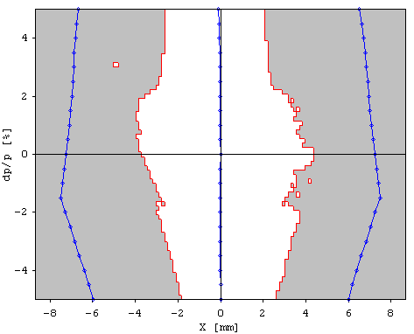
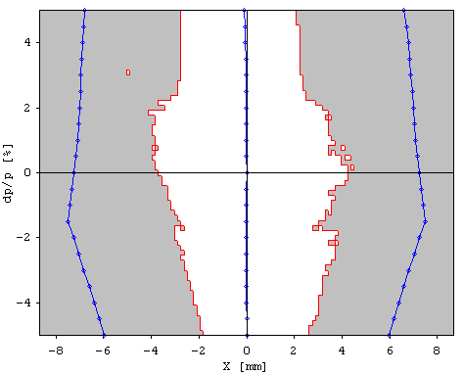
Lattice design (5)
Pseudo symmetry
DA vs dp/p ±5%
@ βx=2.95 m
Second half of
matching section
+ half straight section
Beta function, 1/3 of ring
Second half of
matching section
+ half straight section
2 x Second half of
matching section
+ straight section
2 x Second half of
matching section
+ straight section
2 x Second half of
matching section
+ straight section
S.P.=12
P.S.P.=12
S.P.=3
P.S.P.=12
Additional
quads
Additional
quads
Achromat +
2 x First half of
matching section
Achromat +
2 x First half of
matching section
Achromat +
2 x First half of
matching section
Achromat +
2 x First half of
matching section
S.P.=1
P.S.P.=12
Identical Achromat arc + First half of matching section
Second half of matching section (sextupole free) can be different but with the identical phase advance in H and V for 2x second matching section + straight section

Slide 9
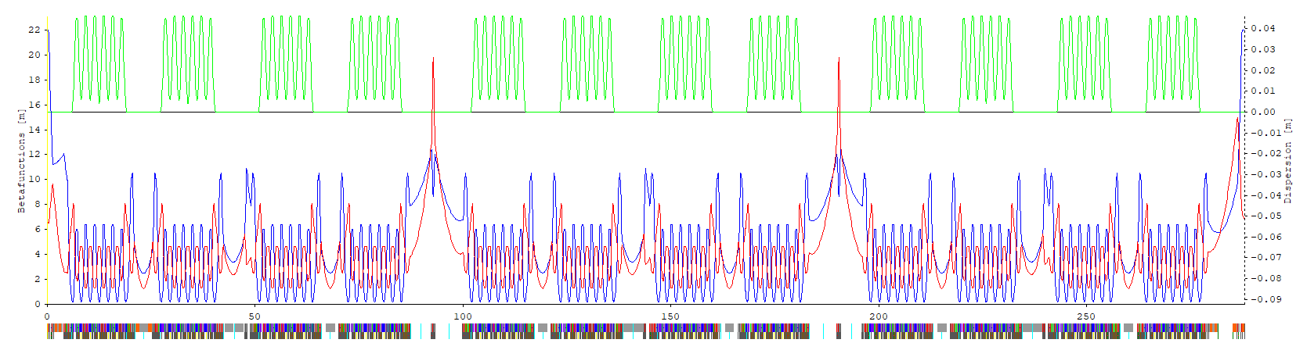
Lattice design (6)
Optical functions – Full ring
A large number of magnets, 1150, in this type of lattice
Flexibility in optics correction and vertical emittance control

Slide 10
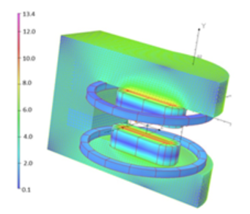

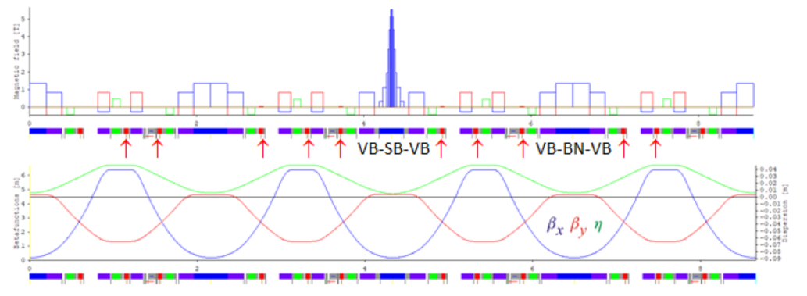
Lattice design (7)
Superbend integration
  Optics re-matching
  5 superbends to be integrated
    2 x 3.5 T and 5 T peak with SC magnet
    2.1 T peak with permanent magnet

Slide 11
Lattice design (8)
Vertical emittance control
  Set to 10 pm in operation
  Mainly excited by vertical dispersion
  No dispersion and no coupling at ID locations with many skew quads
Vertical dispersion (1/3 of ring)
η @ all elements
η @ BPMs

Slide 12
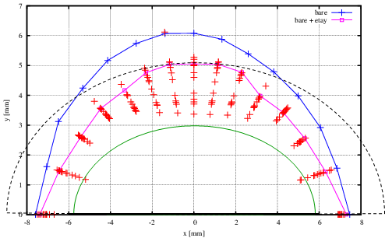
Lattice design (9)
Dynamic aperture (Error study)
DA of ideal lattice,
i.e. no errors
DA of ideal lattice with skew quads set for 10 pm of vertical emittance
DA with error settings and optics corrections, 12 seeds
Tracy-3 6D-tracking, 4096 turns
Silhouette of ∅ 18 mm beam pipe (approx.)
Silhouette of beam pipe including insertion devices
+ ++
β_{x} = 22 m
β_{y} = 6.7 m
+ ++
+ ++
Error setting and correction scenario
Misalignments: 60/20/30 μm, cut 2σ
girders/inter-girder/element-girder
Beam based alignment, 5 μm
Orbit correction
Optics correction, Δβ/β ∼ 0.5%
Tune correction
2 iterations
Systematic multipoles from magnet design
Dynamic aperture ~6 mm
Injection at <4 mm

Slide 13
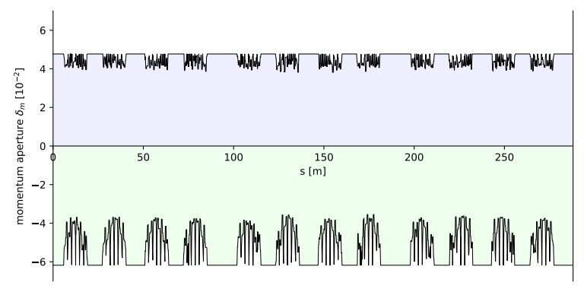
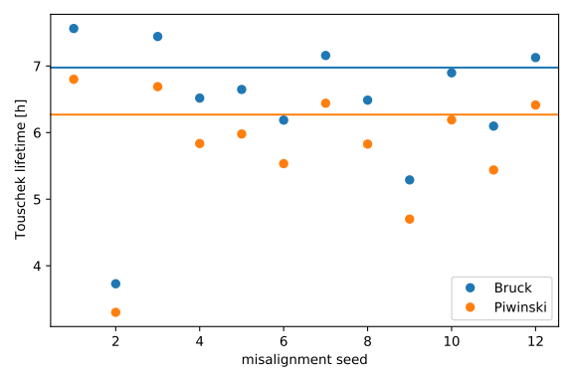
Lattice design (10)
Lifetime (Error study)
Touschek lifetime with
Bruck/Piwinski models (No 3HC)
Typical momentum acceptance
Solid lines = ideal & 10 pm v.e.
6.98 h
6.27 h
3.73 h
Total Lifetime with 3rd harmonic cavity
and 10⁻⁹ mbar residual gas (CO):
11 hrs (ideal & 10 pm), 7 hrs for the bad seed
3.30 h
Bad seed → recovery
by tune adjustment

Slide 14
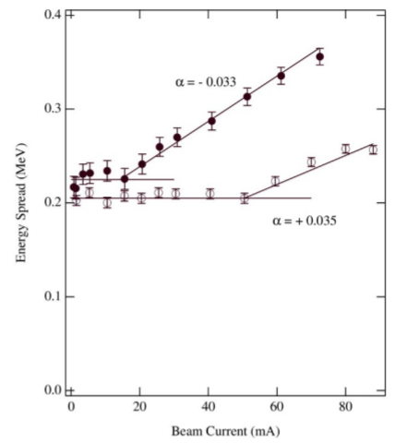
Lattice design (11)
Collective effect – Negative and positive α
  Long. MWI threshold is much higher with positive α
  Negative α lattice was considered for SLS2 but abandoned
    Emittance is smaller with negative alpha but not dramatically
    Not only due to instability but also for reducing total absolute bend angle (approximately -100 degree)
Threshold measurement
at UVSOR
M. Hosaka et al., Longitudinal Beam Dynamics on Electron Storage Ring with Negative Momentum Compaction Factor, proc. 1st APAC, pp. 426, 1998.

Slide 15
Lattice design (12)
Collective effect summary
 | Threshold | Remark
Ion instability | 10-bucket gap out of 480 | Nominal filling is 20-backet gap
Longitudinal MWI | 2.2 mA | 6.5 mA with 3HC cavity
Head-tail (TMCI) | 4 mA | With 3HC and chromaticity=1.5
Coupled bunch instability | Under study | HOM damped cavity may be required Betas larger than SLS at cavity location… Chromaticity lower than SLS (+5 both planes)…
Nominal filling: 400 mA for 460 bunches (0.87 mA/bunch)
Arc vacuum chamber diameter 18 mm

Slide 16
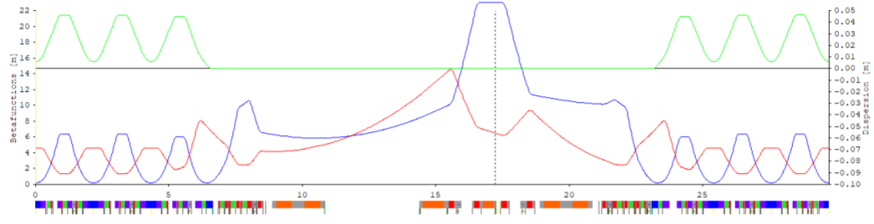
Lattice design (13)
Injection – Straight section layout/optics
  Some flexibility for straight section optics thanks to pseudo symmetry
  High hor. beta, 22 m, at thin septum to magnify DA
  Small injected beam oscillation at IDs (low beta) → Small aperture Apple-X to provide high flux photon beams
K1
K2
K3
K4
Thick septum
Thin septum

Slide 17
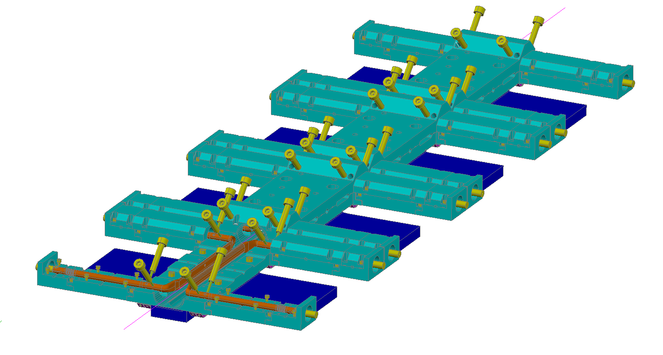
Lattice design (14)
Injection schemes
  2 stage septum: Thick and thin septa a la ALS
  Small horizontal emittance, 2~3 nm, from booster with emittance exchange
  Baseline: Kicker-bump injection (Left figure)
  Upgrade: Aperture sharing with short pulse kicker, ~ 500 μrad kick (Right figure)
  Design criterion: 100% injection efficiency
Horizontal phase space at thin (1 mm) septum – First 6 turns
Injection beam
Stored beam
Only few bunches
to be disturbed by
Short pulse kicker
with ~20 ns pulse
Future upgrade to
very fast kicker, 2~4 ns,
disturbing only 1 bunch
Short pulse kicker ~20 ns
may be installed and available
from Day-1

Slide 18
Plan and status of components (1)
Magnet
  Permanent magnet : Unit cell dipoles, combined function magnets and Superbend (2.1 T peak)
  Electromagnet: Dipole correctors, Quadrupoles, Sextupoles and Octupoles
  Additional windings at Octupoles as Quadrupole correctors and Skew quadrupoles
  Superconducting magnet: Superbends (3.5 and 5 T peak)
  Status
    Magnet design almost completed / under finalization (taking into account cross-talk)
    Proto-typing on-going

Slide 19
Plan and status of components (2)
RF system
  Main 500 MHz RF system
    4 stations to meet the power requirement, 276 (Lattice) + 85 (IDs) kW
    Various options under consideration from house-made to commercial products
  3HC
    Re-use SLS superconducting cavity with some upgrade
  Amplifiers
    Solid state amplifier – Higher initial cost but lower operation cost
  Low level RF
    New digital system, In-house development

Slide 20
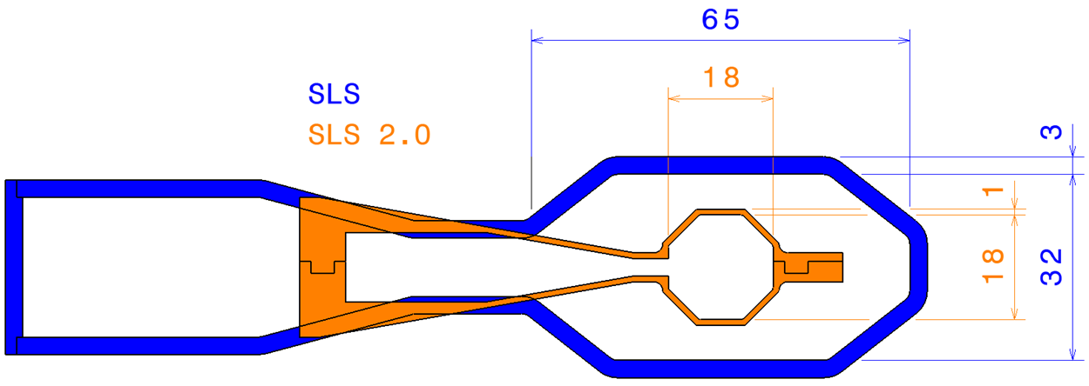
Plan and status of components (3)
Vacuum chamber
  Octagonal cross section, equivalent diameter 18 mm
  Cupper + NEG coating (Coating at PSI)
  10⁻⁹ mbar (CO equivalent) after 100 A.h
  Activation of 17 m long sector outside tunnel and transport into the tunnel, keeping vacuum
  Newly designed crotch absorber: 80 W/mm² → 30 W/mm²
SLS
SLS2

Slide 21
Plan and status of components (4)
BPM
  Orbit mode resolution spec: <50 nm rms
  SLS BPM upgrade on-going
    New system will be used in SLS2 (except for BPM pickups)
    System test at SLS will reduce SLS2 commissioning time
  SLS2 BPM pickup: design completed and under prototyping

Slide 22
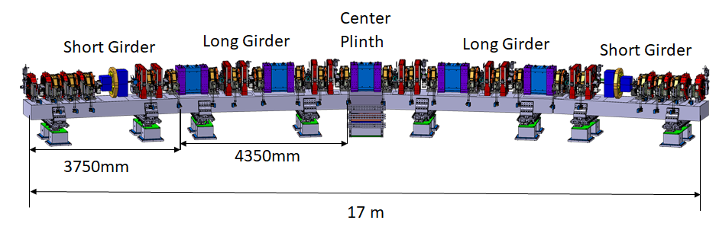
Plan and status of components (5)
Girder
  Lowest eigen-frequency spec: >50 Hz
  4 girder + 1 center plinth per arc
  Remotely movable girder as in SLS
  Design completed and under prototyping

Slide 23
Summary
Lattice design to meet the objective, demands and constraints is completed and achieved by
  LGB+RB unit cell
  Pseudo symmetry
Most components are designed and under prototyping
More technical details will be found in TDR to be published by end 2020

