Slide 1
Copper Cleaning Protocol for DarkSide Motherboards
4 Squared copper samples (100x100mm) previously measured (Krakow) before Cleaning
Reference sample: Standard CUORE Protocol (TECM) (E=100 µm)
Test Sample 1: TEC (E=100 µm)
Test Sample 2: C1EC (E=100 µm)
Test Sample 3: C1EC (E=50 µm)
T = Tumbling
E = Electro Polishing
C = Chemistry
M = Plasma Cleaning
C1 = Chemical Pre-Cleaning

Slide 2
Test of Copper Cleaning Protocol for DarkSide Motherboards
4 Squared copper samples (100x100mm) previously measured (Krakow) before Cleaning
Reference sample: Standard CUORE Protocol (TECM) (E=100 µm)
Test Sample 1: TEC (E=100 µm)
Test Sample 2: C1EC (E=100 µm)
Test Sample 3: C1EC (E=50 µm)
APPROVED
T = Tumbling
E = Electro Polishing
C = Chemistry
M = Plasma Cleaning
C1 = Chemical Pre-Cleaning

Slide 3
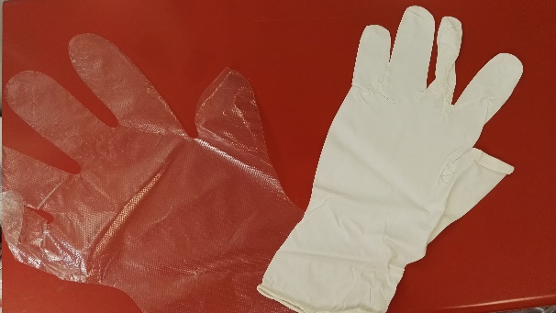
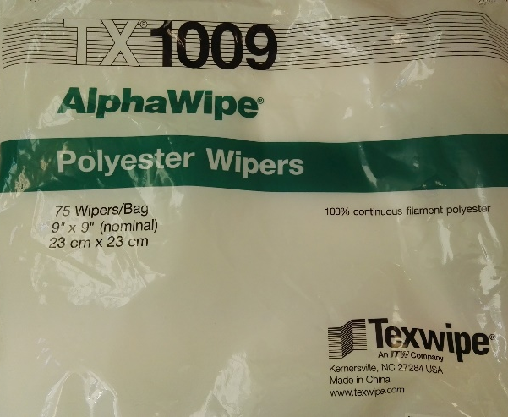
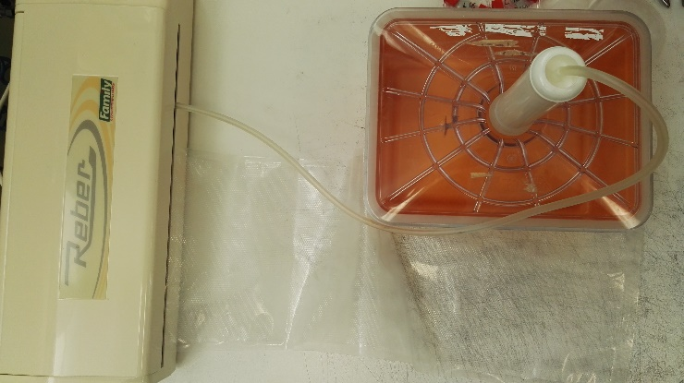
Copper Components Transport and Manipulation for DarkSide Motherboards
Prevention of Recontamination during the cleaning process:
1. Manipulation with double gloves (Class 100 clean room gloves + polyethylene gloves)
2. Manipulation with Alpha Wipe TX1009 tissue 100% continuous filament polyester
3. Storage in single PE-PA-PE bag under vacuum (during the intermediate steps of cleaning)
5. Final storage in double PE-PA-PE bags under vacuum
NB: The vacuum pump (Reber 9700N) for vacuum packaging is a commercial electrical appliance for food storage under vacuum but commissioned with the option oil and grease free. These appliances are frequently replaced due to the absence of lubrication on mechanic parts.

Slide 4
Copper Components Transport and Manipulation for DarkSide Motherboards
Prevention of Recontamination during the cleaning process:
1. Manipulation with double gloves (Class 100 clean room gloves + polyethylene gloves)
2. Manipulation with Alpha Wipe TX1009 tissue 100% continuous filament polyester
3. Storage in single PAPE bag under vacuum (during the intermediate steps of cleaning)
5. Final storage in double PAPE bags undervaccum
NB: The vacuum pump (Reber 9700N) for vacuum packaging is a commercial electrical appliance for food storage under vacuum but commissioned with the option oil and grease free. These appliances are frequently replaced due to the absence of lubrication on mechanic parts.
APPROVED

Slide 5
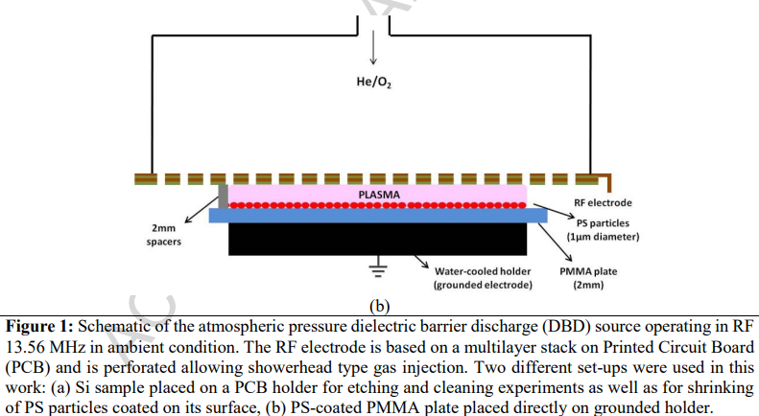
Possible Acrylic Cleaning Process: Reactive Atmospheric Plasma
Etching rate : 80-300 nm/min
Polymer film (on Si wafer) etching rate as a function of O2 content in the He/O2 gas feed: PMMA film (triangles) and AZ photoresitst (retangles).
Dimitrakellis, P., & Gogolides, E. (2018). Atmospheric plasma etching of polymers: A palette of applications in cleaning/ashing, pattern formation, nanotexturing and superhydrophobic surface fabrication. Microelectronic Engineering, 194, 109–115.

Slide 6
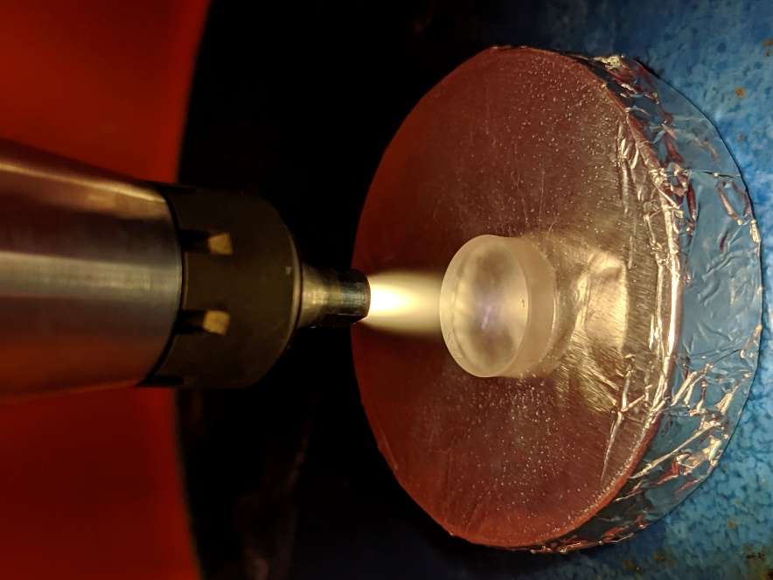
Weight loss
PMMA 27
PMMA 28
PMMA 29
Treatment distance:2,7cm
Weight loss: (67±1)x10⁻⁵ g
Treatment distance: 2 cm.
Weight loss: (90±1)x10⁻⁵ g
Treatment distance:1,5cm
Weight loss: (82±1)x10⁻⁵ g
Atmospheric pressure plasma treatment using compressed air

Slide 7
Thickness loss
PMMA 27
PMMA 28
PMMA 29
Treatment distance:2,7cm
Thickness loss: 19µm
Treatment distance: 2 cm.
Thickness loss: 26µm
Treatment distance:1,5cm
Thickness loss: 31µm
Erosion rate: 388 nm/s
Erosion rate: 238 nm/s
Erosion rate: 325 nm/s
17

Slide 8
Atmospheric Plasma Treatment for Veto DarkSide
Veto: 200 Components
Configuration suggested from IIS
Series of 20 plasma torches (each torch treats 30 mm) in linear combination
600 mm
70 kg
2000 mm
50 mm

Slide 9
Alternative treatments for Veto of Darkside
Flame Treatments
Propane or Butane Gases (faster that Plasma Treatments)
Atmospheric Plasma Treatments
Extra Pure Gases
Laser Ablation Treatments
Absence of gases (faster that Plasma Treatments

Slide 10
Atmospheric Plasma Treatment
Surface treatment tests using atmospheric plasma, carried out on acrylic samples measuring 50x50 mm 5 mm thick
Variables of the experiment:
Typology di gas (n.9 different technical gas)
- Synthetic Air(in cylinder)
- Ar
- He
- N2
- Ar-50%He
- Ar-5%O2
- Ar-5%H2
- N2-5%H2
70%Ar - 20%He - 8%CO2 - 2%O2
Feed speed (V):
For each gas, the tests will be performed at 3 different feed speeds (V1, V2, V3).
Nozzle distance (H):
for each gas value and speed, 2 different values ​​of the distance of the piece will be performed (H1, H2)
A total of 54 tests will be carried out.

Slide 11
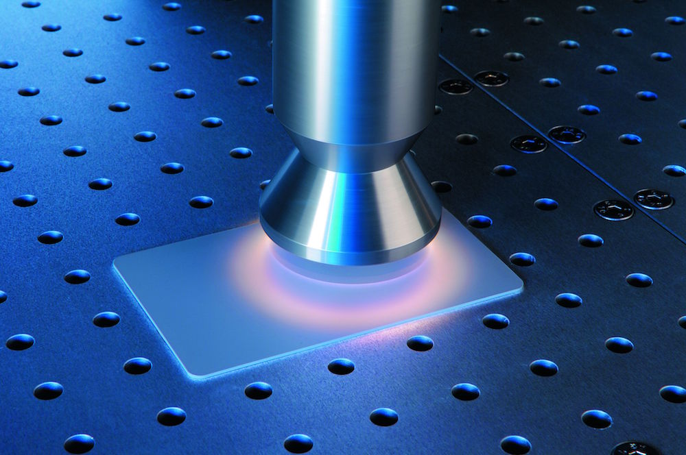
Future Projects: Does DarkSide need Atmospheric Plasma Cleaning?
www.plasmatreat.it

