Slide 1
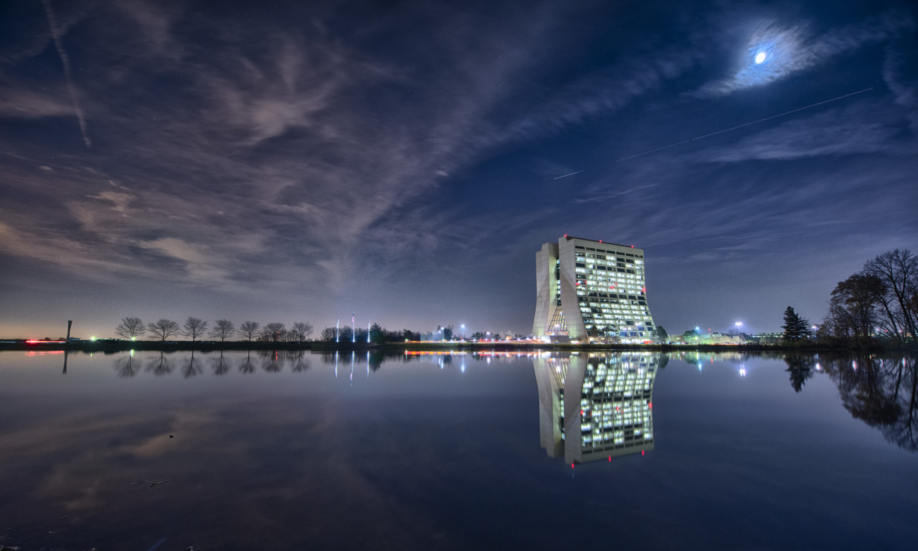

INTENSE
Particle physics experiments at the high intensity frontier, from new physics to spin-offs. A cooperative Europe-US–Japan effort
WP6
Dissemination and Outreach
Chiara Vignoli, Carmela Luongo
INTENSE Meeting, November 2019

Slide 2


WP6 - Main Objectives
O6.1: Disseminate the results to the scientific community through publication at conferences and in specialised journals.
O6.2: Promote communication between the scientific community and the general public and increase science awareness in society.
O6.3: Educate the general public about particle physics and related areas. Demonstrate how particle physics although perceived as very abstract, contributes to solving very concrete problems and has many practical applications in medicine, homeland security, industry, computing, and with muon radiography, in geology, geophysics and archaeology.

Slide 3
Tasks
T6.1: Workshop day (ALL): In coincidence with the annual general meeting, we will organize a one-day workshop. The target of the seminars and lectures given by the project researchers will be university students in physics, engineering, computing science and material science, and, possibly, technical high-school students in their last year. The laboratories will be open for demonstrations and events for non-specialized audiences will be organized.
T6.2: Open Day/Masterclasses (ALL): The project partners already take part in the “European Researchers Night” and “Night of Science”. To coincide with this event, all the laboratories will be open to the general public to show and discuss the results of our research. We will prepare posters and brief interactive computer simulations. Master classes will be organized for high-school students.
T6.3: Annual Physics Meeting at INFN-LNF (ALL): The target of this three-day event are high school teachers and the goal is to give information on the recent advancements in the field of sub-nuclear and nuclear physics and particle detector developments. A special effort will be made to prepare experiments which use the new detectors developed by the project participants.
T6.4: Summer School at FNAL and other US Laboratories (3M, ALL): Organize a three-day training on the project research activities for the students of the “Summer School at FNAL and other US Laboratories”. An effort will be made to give the students the opportunity to meet researchers of the non-academic partners and discuss the prospects of working on research and development in European private companies.
T6.5: Outreach web site (ALL): We will develop a public web site with a detailed INTENSE description serving several functions: introducing the concepts of particle physics and muon radiography for the general public, disseminating the results to both experts and the general public, facilitating communication and sharing data within the participants and a broad user community, including geophysicists, archaeologists. Videos related to particle physics and muon radiography will be produced and collected on the website and shared through YouTube and other freely accessible web services.

Slide 4
Description of Deliverables
D6.1 (M1/M9/21/33/45): Workshop day organized in coincidence with INTENSE Kick-Off and General Meetings.
D6.2 (M9/21/33/45): Open day/Masterclasses for high-school students.
D6.3 (M10/22/34/46): Annual Physics Meeting at INFN-LNF.
D6.4 (M8/20/32/44): Summer School at FNAL and other US Laboratories.

Slide 5
Web page
http://riseintense.df.unipi.it

Slide 6
Outreach Activity :
European Researchers’ Night – September 27, 2019
The event aims to bring researchers closer to the general public and to increase public awareness of research and innovation activities with a view to supporting the public recognition of research and innovation activities, creating an understanding of the impact of researchers’ work on citizens’ daily lives and encouraging young people to embark on research careers

Slide 7

Outreach Activity :
European Researchers’ Night – September 27, 2019
Presentation of INTENSE activities @ SHARPER

Slide 8

Outreach Activity:
European Researchers’ Night – September 27, 2019
Interviews on TV and radio
Shows on neutrino
Seminars to general public
Posters on neutrino
Games with kids
Games for general public
Experiments description
Particle models
Detector models
Physics research impact in life and technology
…... and more
@ SHARPER L’Aquila

Slide 9
Outreach Activity:
European Researchers’ Night – September 27, 2019
Posters on neutrino
@ SHARPER L’Aquila

Slide 10
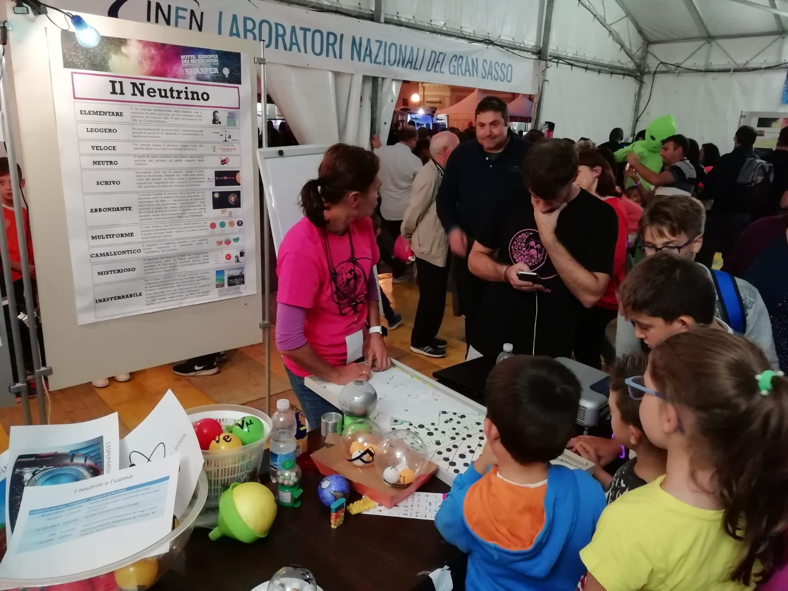
Outreach Activity:
European Researchers’ Night – September 27, 2019
Games with kids
@ SHARPER L’Aquila

Slide 11
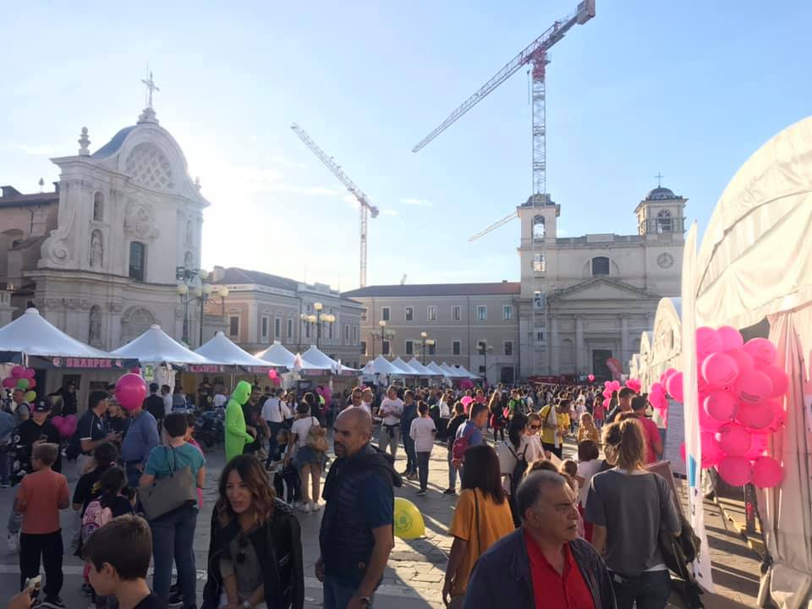
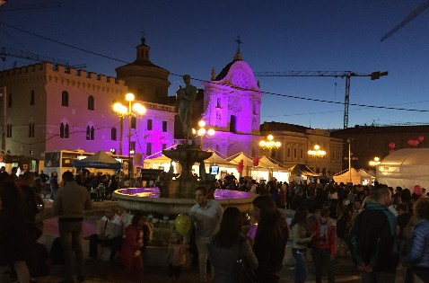
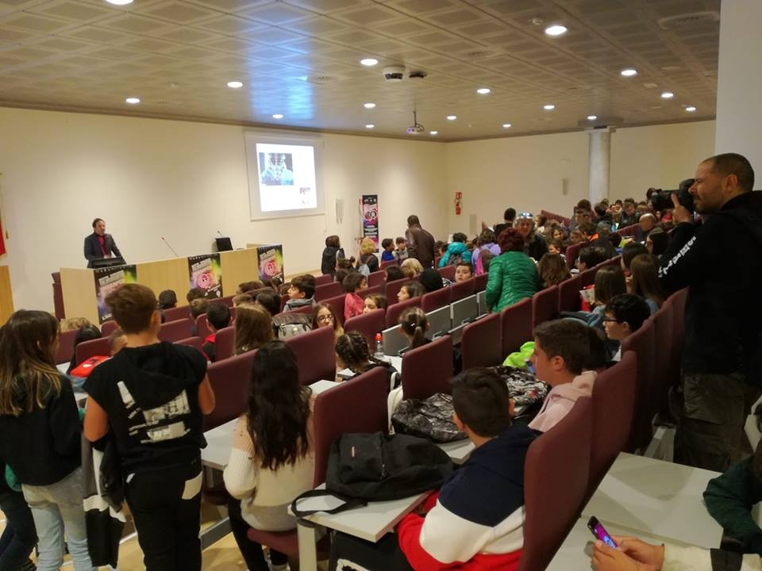
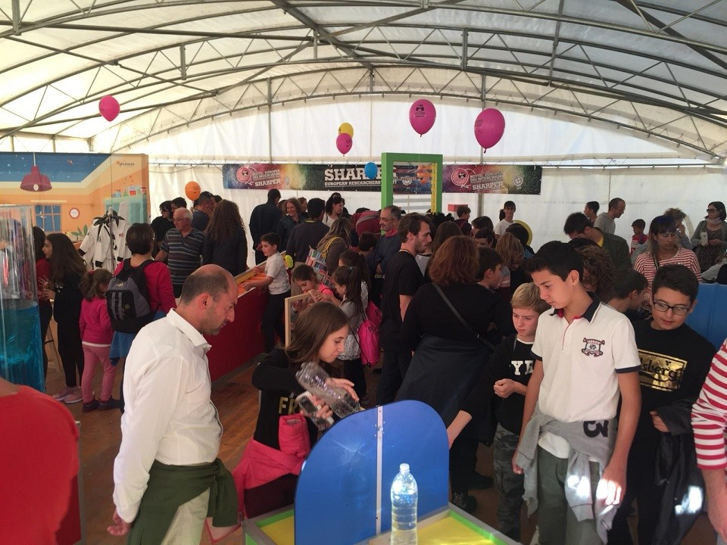
Games with kids

Slide 12
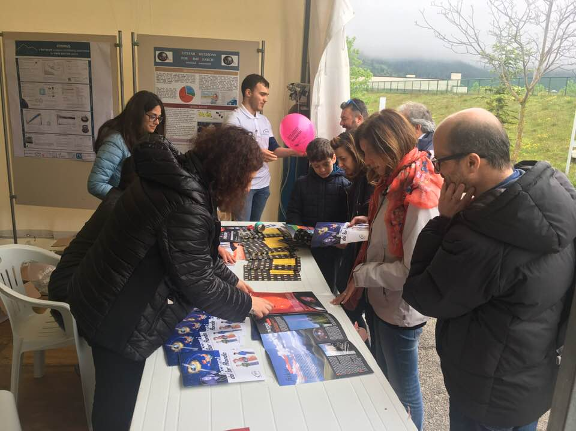

Outreach Activity:
LNGS Open Day
Communication and outreach activities with general public

Slide 13
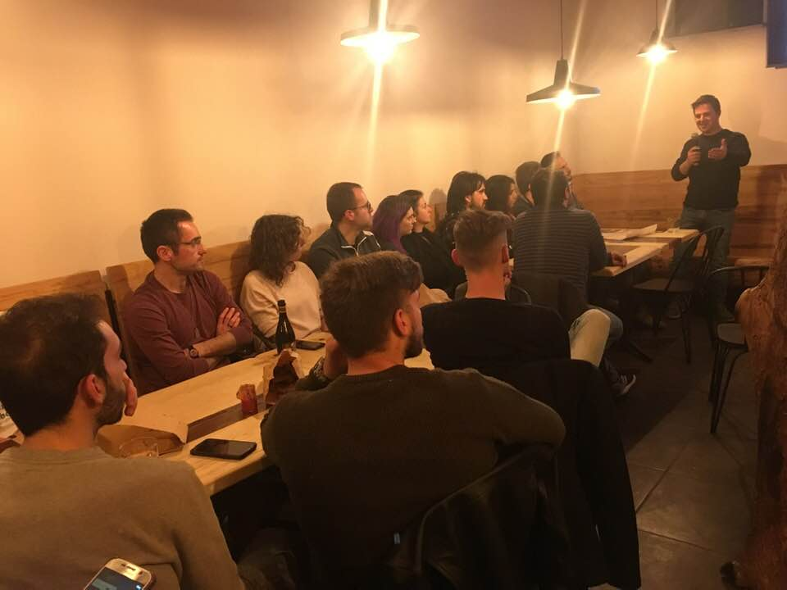

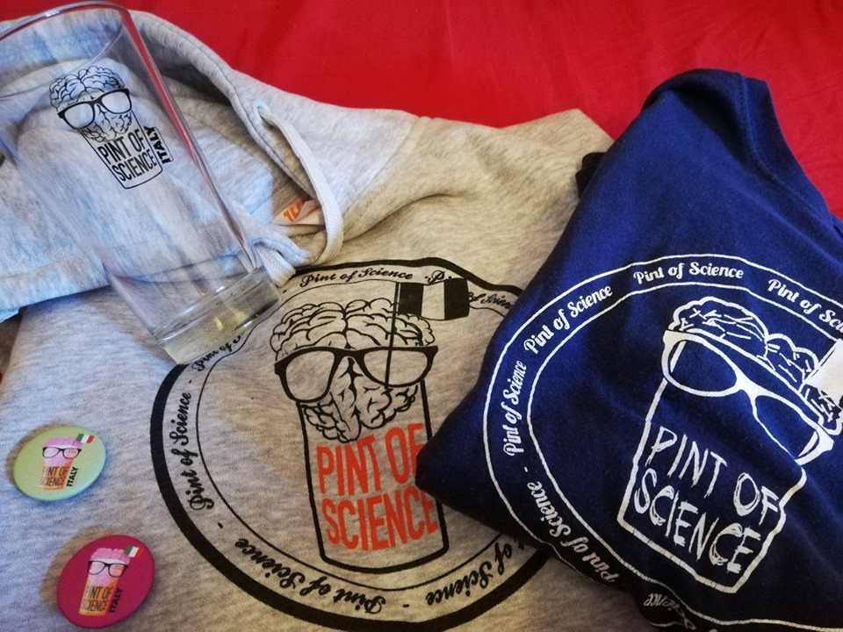
Outreach Activity:
Pint Of Science
Communication and outreach activities with general public

Slide 14
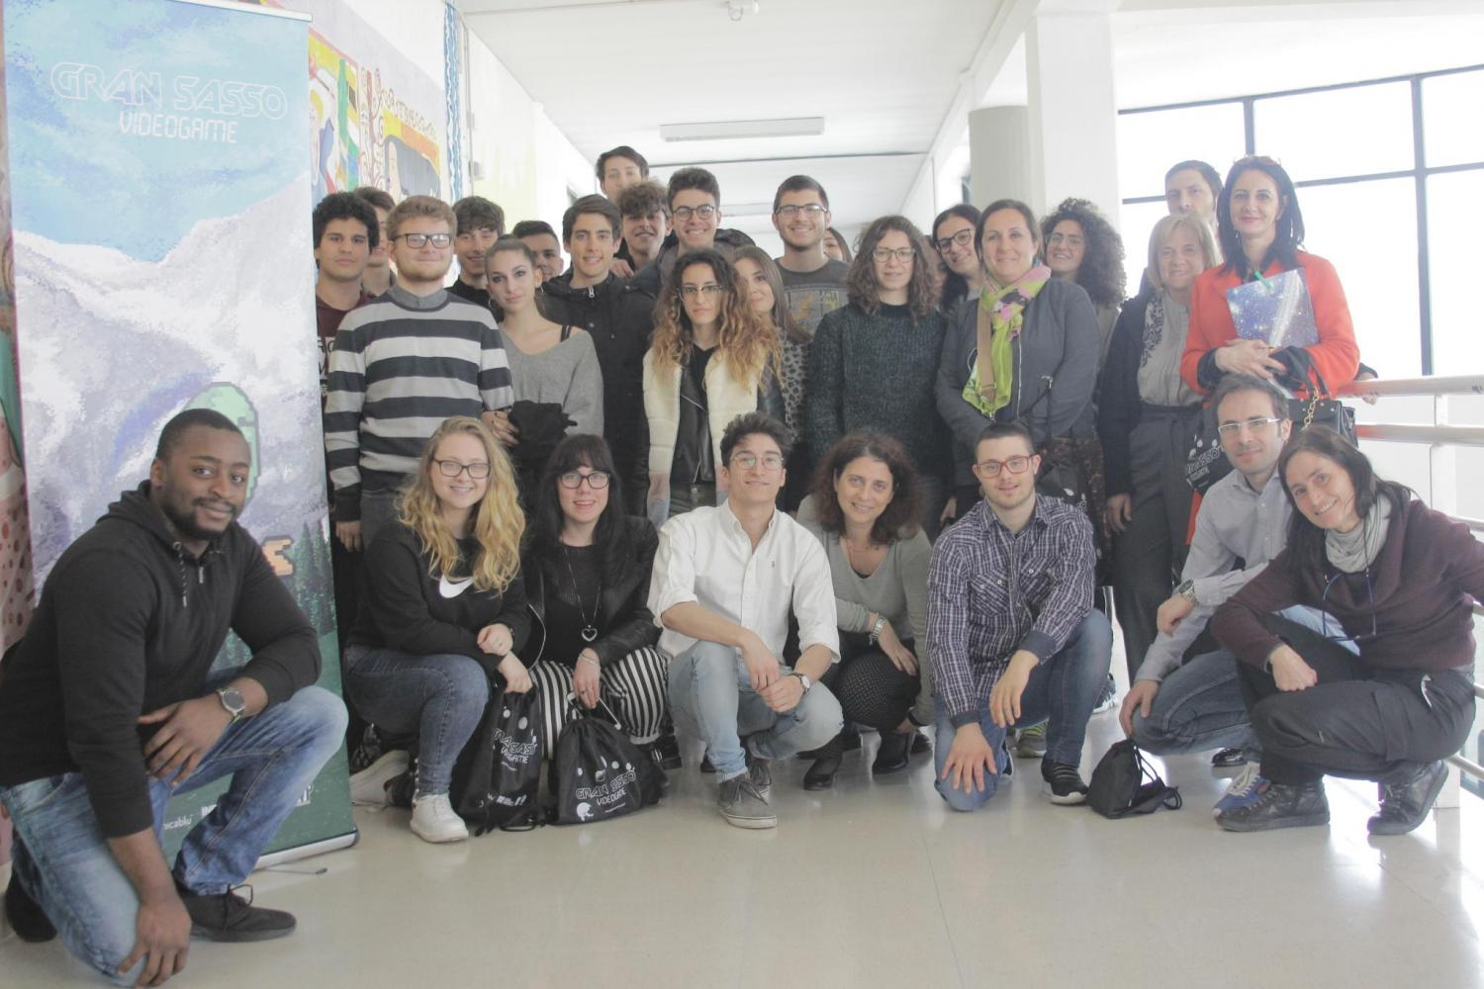
Outreach Activity:
Secondary School
Communication and outreach activities with schools

