Slide 1
H2020, M. Sklodowska-Curie
R&I No. 822185 INTENSE
Installation of the signal flanges
in the ICARUS T600 detector
Installation protocol
Guaranteeing the functional integrity of the cables
Results
Pictures, pictures, pictures…
A. Braggiotti, INTENSE – WP1
This task required a precisely coordinated collaboration among colleagues from Italy,
from FNAL, and from various institutions in the USA.
This has been made possible mostly thanks to INTENSE contribution.
INTENSE General Meeting November 6^{th –} 7th 2019
Notes:
1

Slide 2
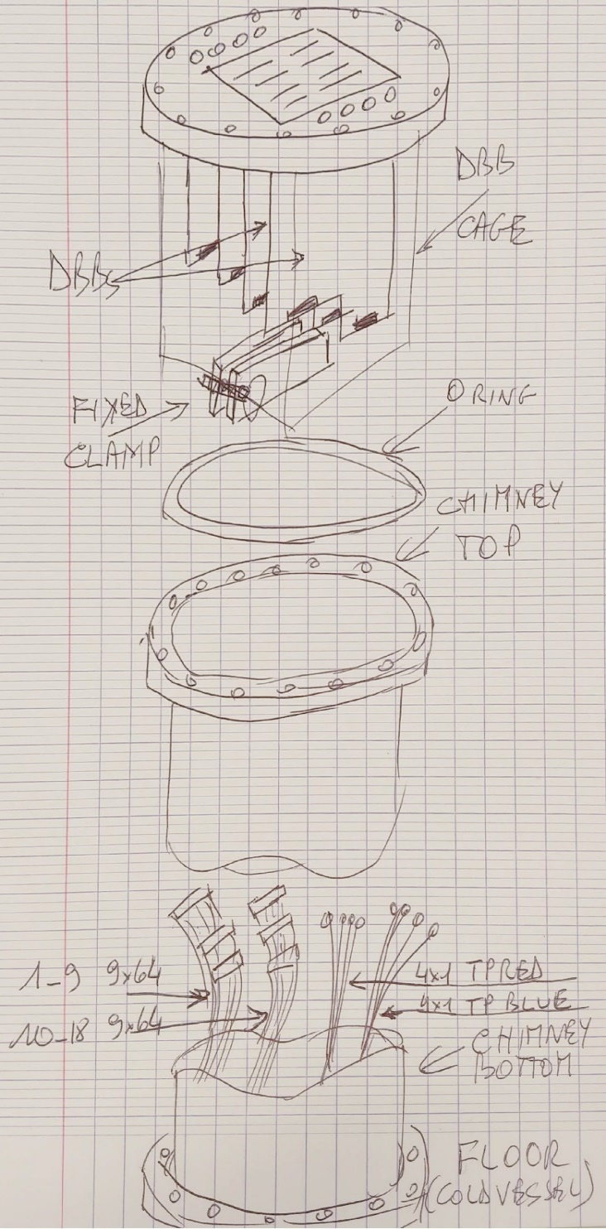
1. Installation protocol summary (9 steps)
Selection of ν_{e} events
O-ring: Place the copper O-ring on the chimney
Terminator: Put a 50 ohm term. on the BLUE TP cables
Extension: Extend the RED TP cables if needed by means of 24” RG316 SMA-SMA extension cables
Test Pulse: Connect the RED TP cables to the SMA connectors on the flange
Signal cables: Connect the flat cable bundles to the DBBs (#1-9 to HIGH side, #10-18 to LOW side)
Fixed Clamp: Leave a 5cm belly on the bundles and then tighten the fixed steel clamp around them
Mobile Clamp 1: Tighten the mobile epoxy clamp 20-30 cm below the fixed clamp
Mobile Clamp 2: Tie the mobile clamp to the DBB cage by means of cable ties; trim the tie so to leave a 10cm belly on the cable bundles
Put the flange in place: Place the flange on the chimney, hand tighten a couple of bolts

Slide 3
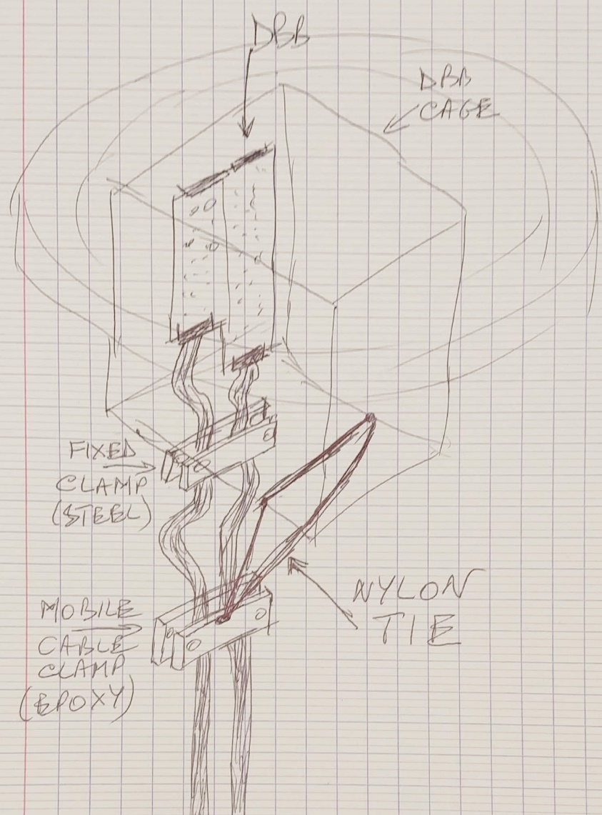
2. Guaranteeing the functional integrity of the cables
Selection of ν_{e} events
WHAT’s THE PROBLEM?
The ribbon cable bundles coming out from the chimney are made of 612 AWG 30 (7/38) wires.
The bundle portion hanging directly from the DBB cage is 2m long for the 72 top chimneys (less than 2m for the corner chimneys)
We have to ensure that:
The weight will not fall on the connectors
The weight is evenly distributed on the entire bundle, not only on the 4 corner wires of the bundle
Enough extra length is available to withstand the thermal contraction
THEREFORE: ➔ leave extra length between the DBB connectors and the clamps
➔ use wide clamps in order to reduce the pressure on the cable

Slide 4
3. Results
Selection of ν_{e} events
Installation of the flanges on the chimneys has been completed in 2 main rounds, from Nov.13th to Dec. 21st 2018 and from Feb. 20th to May 20th 2019
Except for the very first few flanges (3 or 4) which have shown some installation uncertainties due to the initial learning process, the installation of the flanges of both the top and the corner chimneys has proceeded flawlessly from the point of view of the cable connection
Extensive tests have been performed in order to check any variation in the geometry of the installation, i.e. to see if the cable clamps behaviour varies in time (if the clamps loosen up, if the cables slip, etc.)
No geometrical variation has been detected. The installation method and protocol have proved to be very reliable and have yielded a very stable mechanical status.
Next steps: What will happen during cooling down? Good question. Nothing should happen, as the cable bundles are thin enough and the clamps have been tightened up strongly enough so no clamp loosening should be observed as a result of the dimensional contraction of the cable bundles due to temperature drop.

Slide 5
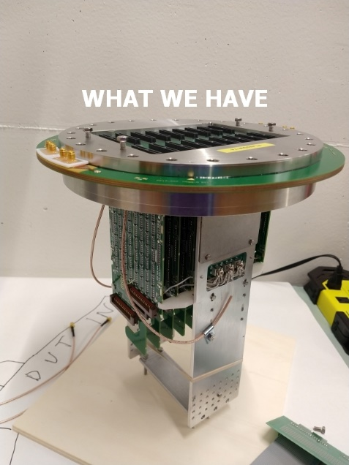
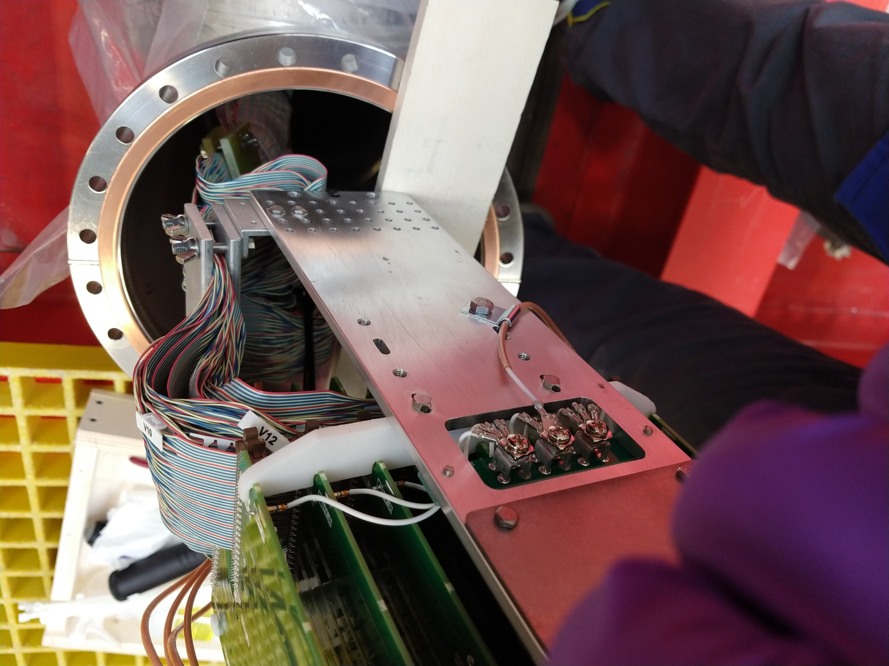
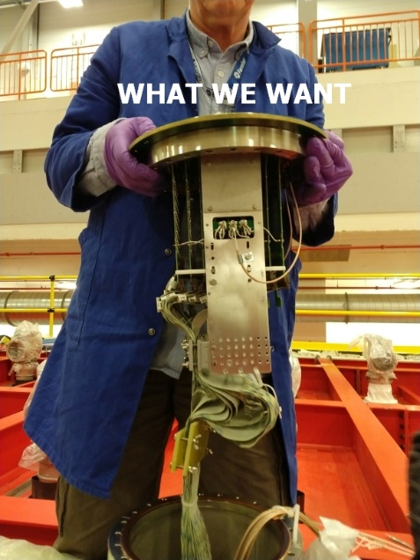
4. Pictures, pictures, pictures…
Selection of ν_{e} events

Slide 6
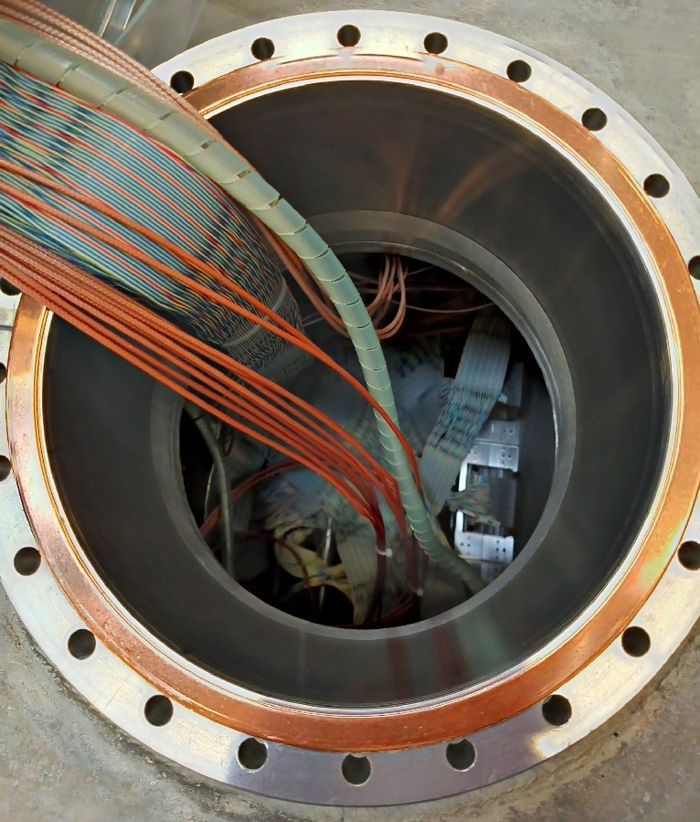
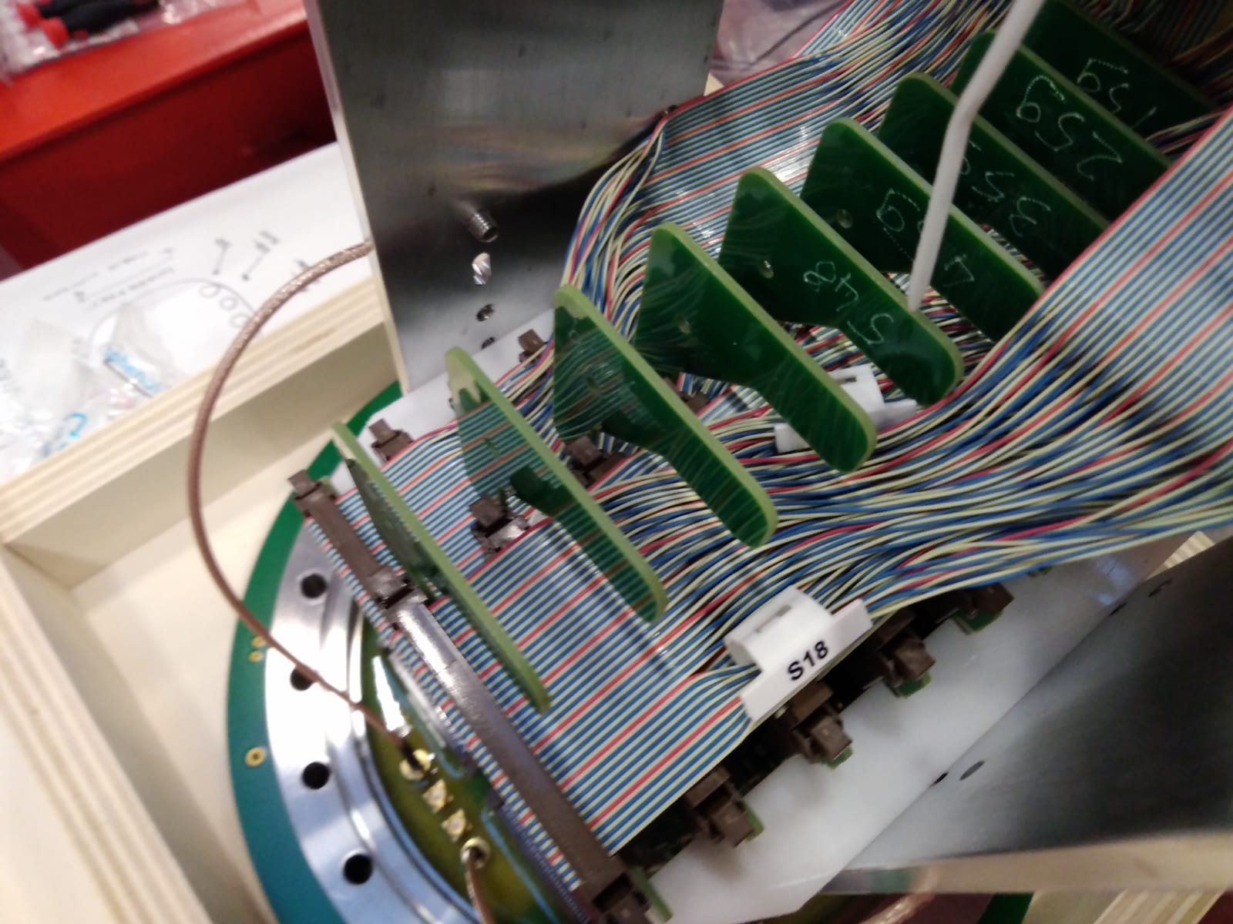
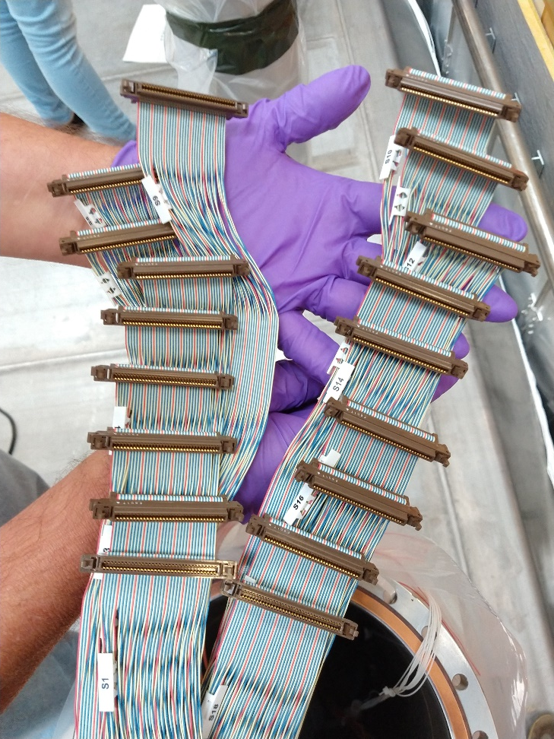
4. Pictures, pictures, pictures… (continued)
Selection of ν_{e} events

Slide 7
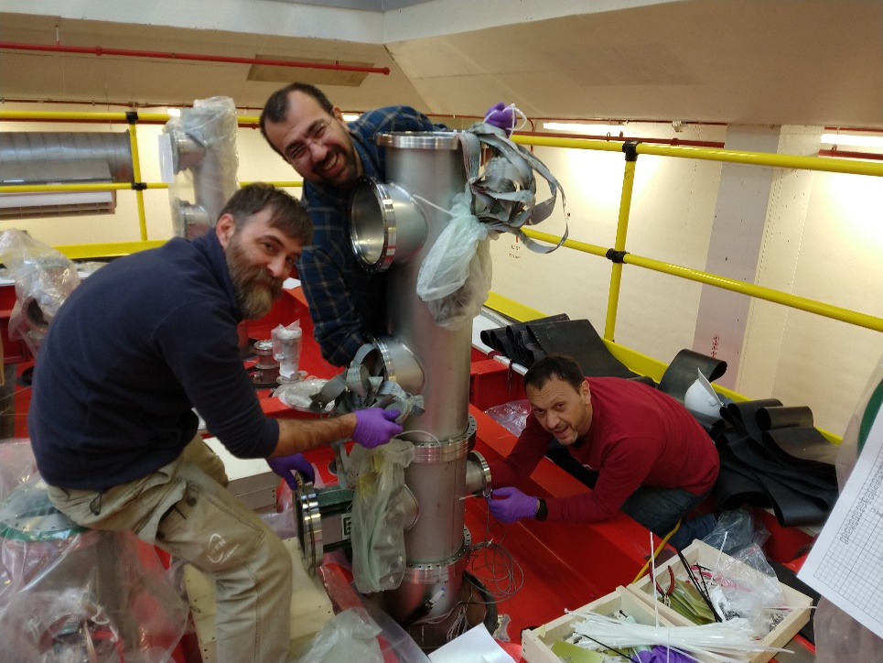
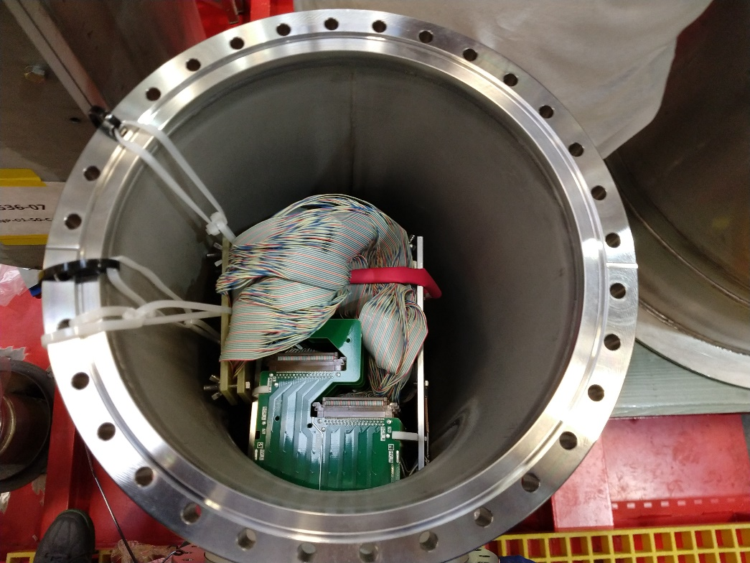
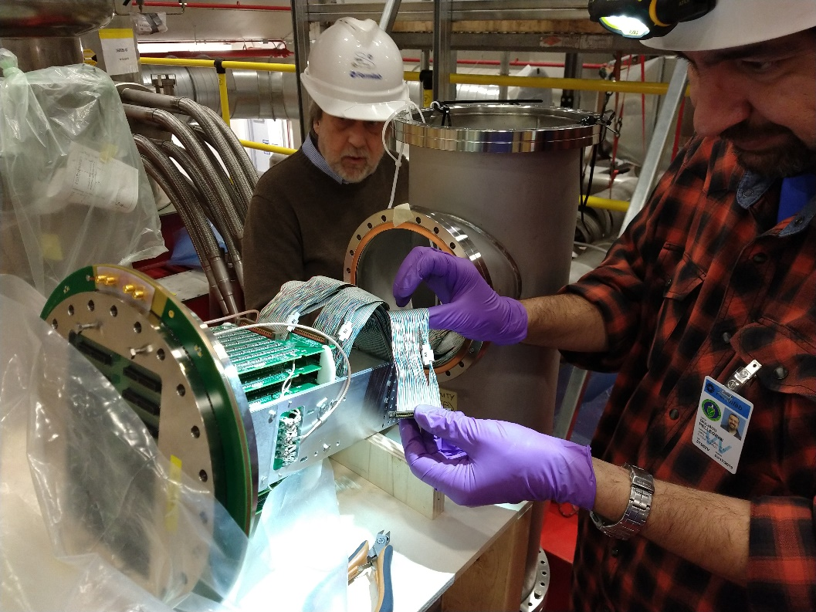
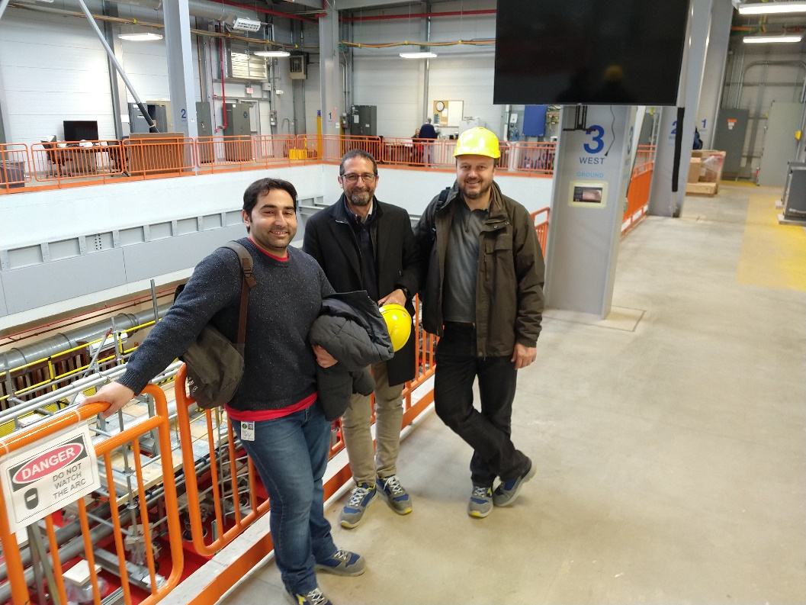
4. Pictures, pictures, pictures… (continued)
Selection of ν_{e} events

Slide 8
5. And now??
Selection of ν_{e} events
Still a lot of work to do, but for the time being…
THANK YOU INTENSE

