Slide 1
H2020, M. Sklodowska-Curie
R&I No. 822185 INTENSE
Tools for LAr purity measurement and for wire signal calibration in the ICARUS T600 detector
Liquid argon purity measurements
Calibration of the TPC wires
C. Farnese, INTENSE – WP2
Great improvements in the final development of these tools for the Calibration of T600 detector provided by the collaboration with FNAL colleagues, possible thanks to INTENSE
INTENSE General Meeting November 6^{th –} 7th 2019
Notes:
1

Slide 2
Purity measurement in ICARUS
Selection of ν_{e} events
The measurement of the free electron lifetime τ_{ele} is a fundamental feature that should be ready for the commissioning of the detector
for the monitoring of the Liquid Argon condition in the TPCs
for a precise measurement of the deposited energy in the events
Starting from the automatic procedure used during the Gran Sasso run, two complementary tools have been implemented:
A fast method, that provides the required monitoring in real time of the LAr condition
no sophisticated reconstructions, small number of events, few seconds for the full analysis of each event
An offline and more precise measurement for the final calibration of the detector
Full event reconstruction and larger number of events required
Both methods should be ready before the LAr filling, in order to be used as soon as the detector is completely filled

Slide 3
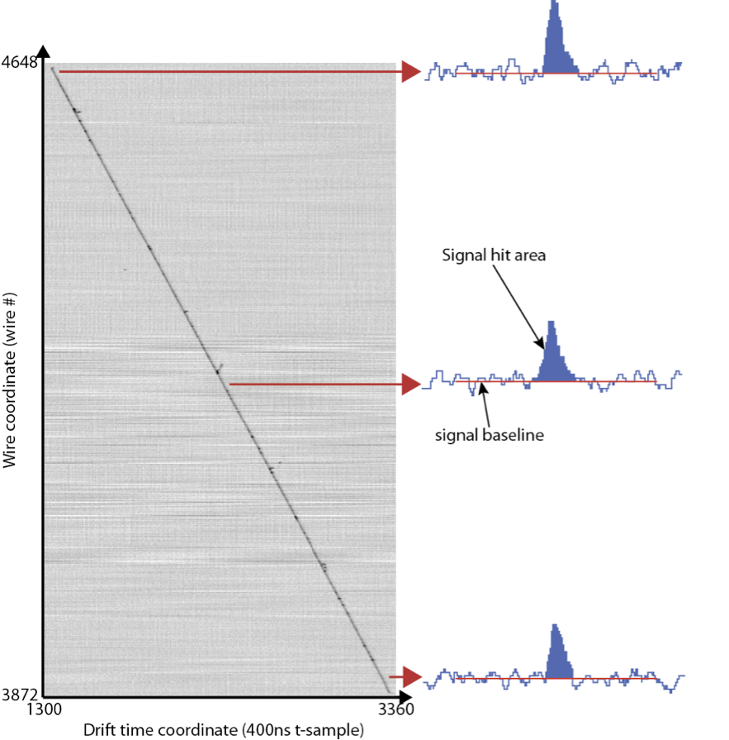
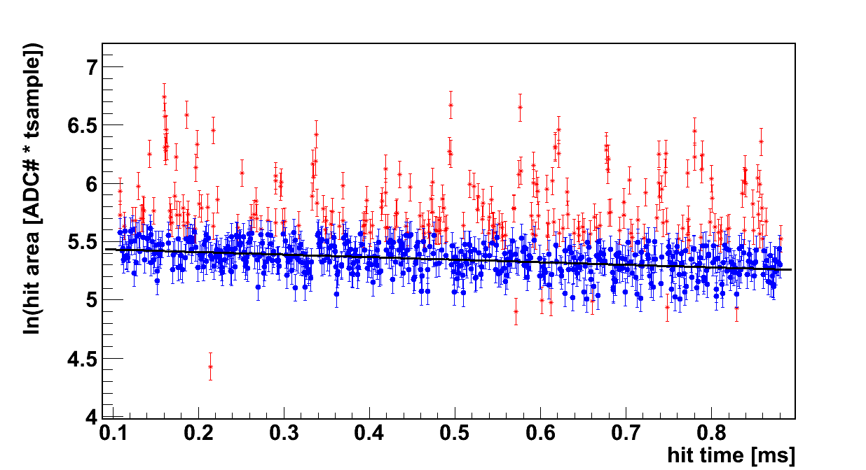
Purity measurement in the T600: methods description
Selection of ν_{e} events
The prepared tools are based on the same steps:
Automatic selection of through-going cosmic-ray muons with reduced e.m. activity (only Collection used, no 3D reco).
Rejection of residual δ-rays along the track
Survived hits Removed hits
Reduction of the fluctuations along the track due to the asymmetric Landau tail of the dE/dx
Study of the charge attenuation along each selected tracks
Final value λ = 1/τ obtained averaging over the identified tracks in a defined number of events;

Slide 4
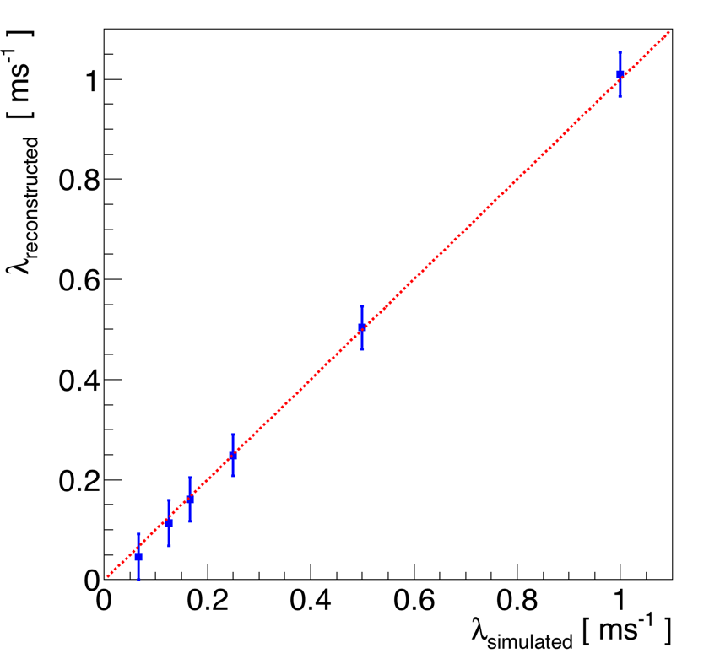
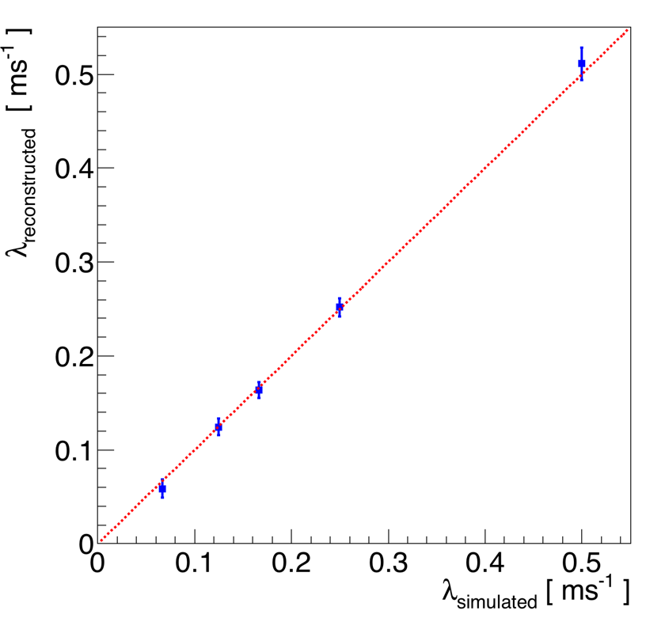
Purity measurement at FNAL: results
Selection of ν_{e} events
The online method is applied on 40 events;
The method is adequate for the required monitoring, providing information on when the purity is too low for the physics run;
These measurements can be uploaded on database and displayed in the online monitoring
ONLINE METHOD
2 ms
1 ms
8 ms
OFFLINE METHOD
4 ms
6 ms
2 ms
15 ms
4 ms
6 ms
The offline method is applied on 200 fully reconstructed events;
The online measurements are used as starting point for this analysis
Some residual bias still present, introducing a systematic effect on the energy measurement smaller than 1%
8 ms
15 ms

Slide 5
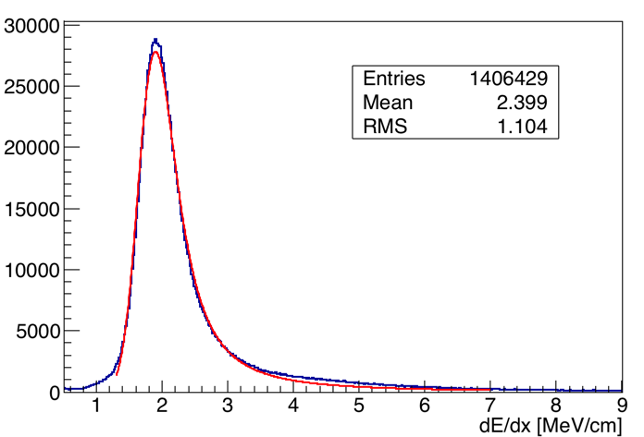
Calibration of ICARUS T600 TPC wires
Selection of ν_{e} events
The evaluation of the calibration constants for the TPC wire channels is required to obtain the deposited energy measurement and to guarantee the equalization of the channel responses;
These calibration constants can be obtained studying the dE/dx along cosmic μ tracks selected on a very large number of cosmic events:
Muon selection similar to the method used for the purity measurement
First preliminary test performed on 5000 MC cosmic events: on average
1-2 selected μ tracks per event
each Collection wire crossed by more than 300 tracks;
Accumulating the dE/dx signals in each channel, we can extract the MP value and from this the required calibration constant with a resolution ~1% for high purity level;
dE/dx MP value: 1,83 MeV/cm

