Slide 1
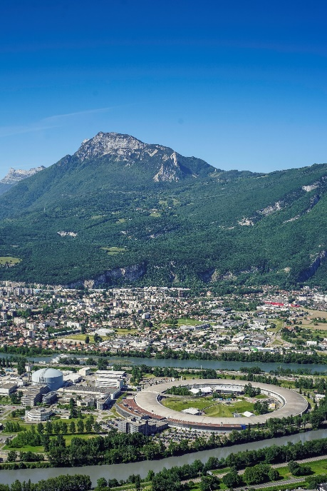

Anticipating the effect of electron radiation at ESRF-EBS using Fluka
Reine Versteegen
5th Fluka Advanced Course and Workshop
OECD / Nuclear Energy Agency
18-22 November 2019

Slide 2
outline
Introduction to the ESRF-EBS project
Protecting the Insertion Devices from radiation damage
Fluka simulations of the collimator irradiation

Slide 3
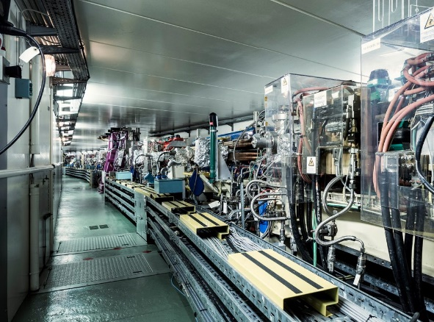
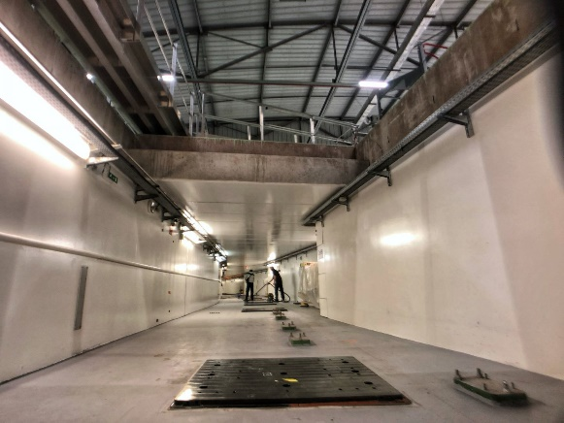
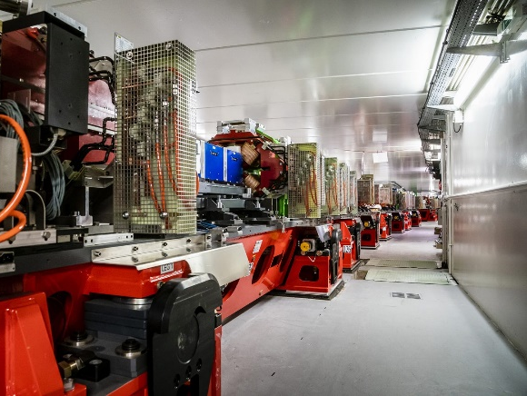
I. Introduction to the ESRF-EBS project
The European Synchrotron Light Source provides intense X-Ray beams to 44 experimental beam lines to explore materials and living matter,
The photons are produced by a 6 GeV electron beam stored in a 844m-long circular accelerator,
In 2019 the machine was shut down to be dismantled and replaced by a brand new storage ring aiming at pushing the electron beam parameters so as to further increase the X-ray performances.
View in the tunnel in December 2018 – Spring 2019 – Autumn 2019

Slide 4
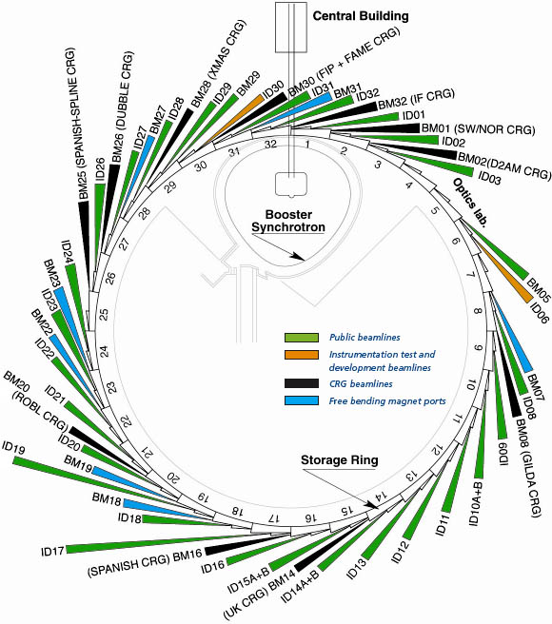
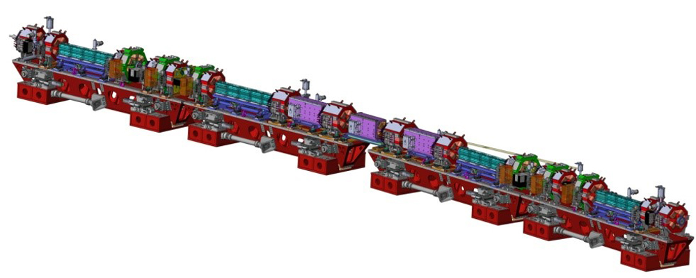
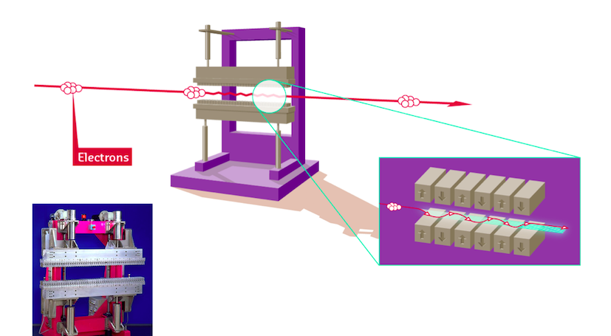
I. Introduction to the ESRF-EBS project
Composition of the storage ring (1/2)
The ring is made of a 32-periodic lattice of magnets separated by straight sections containing either the RF cavities, the injection system or Insertion Devices,
Photon are emitted in the IDs tangentially to the ring, constituting the experimental beam lines.

Slide 5
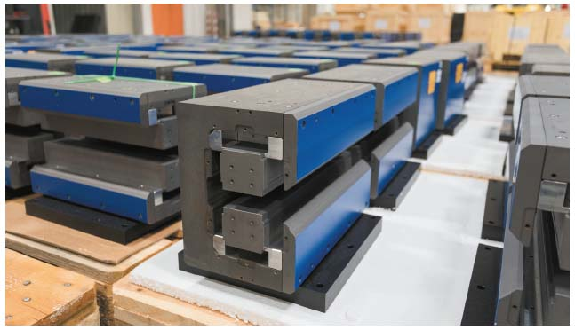
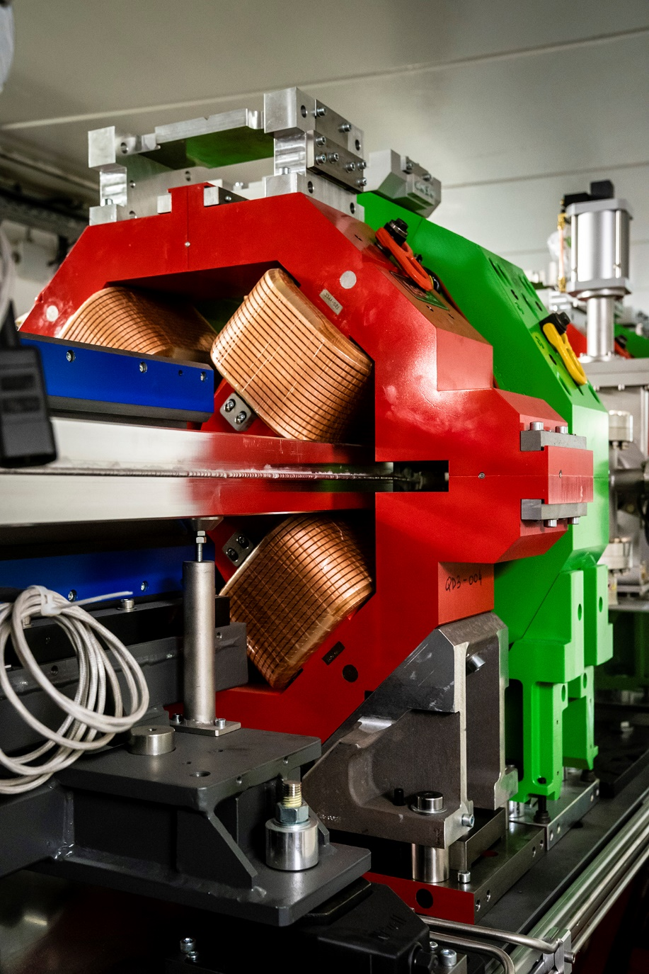
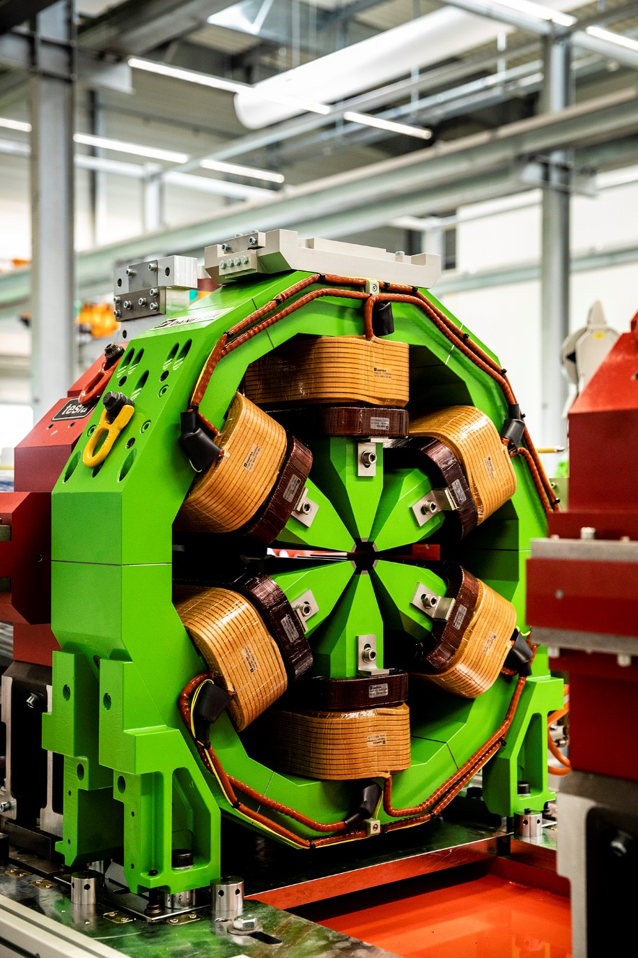
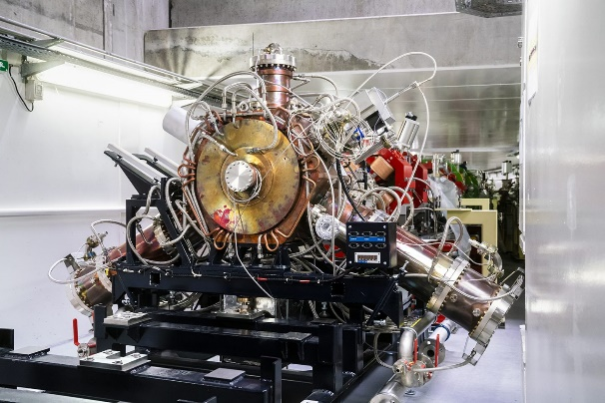
I. Introduction to the ESRF-EBS project
Composition of the storage ring (2/2)
Dipole magnets to deviate the beam
Quadrupole and sextupole magnets to focus the beam
Insertion devices to produce the photons
Radio-Frequency cavities to compensate for the energy loss (acceleration)

Slide 6
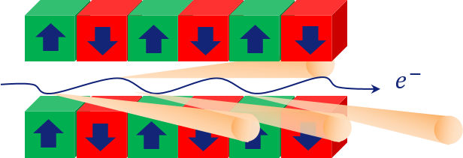
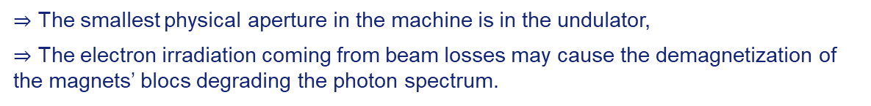
II. Protecting the Insertion Devices from radiation damage
X-rays are produced thanks to a periodic array of permanent magnet blocs (with or without interleaved soft iron poles) creating a vertical magnetic field forcing the electron beam to oscillate in the structure,
The peak field is directly correlated to the period and the magnetic gap of the undulator.
$⇒$ The smallest physical aperture in the machine is in the undulator,
$⇒$ The electron irradiation coming from beam losses may cause the demagnetization of the magnets’ blocs degrading the photon spectrum.

Slide 7
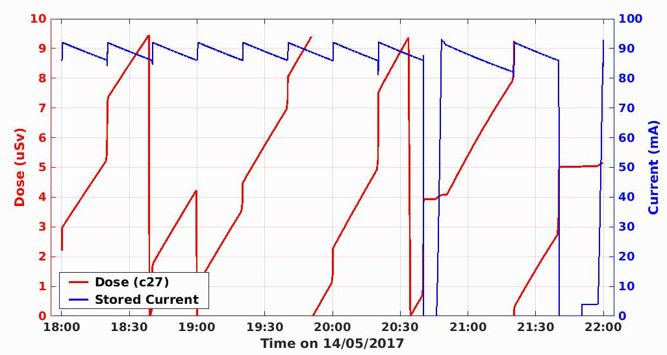
II. Protecting the Insertion Devices from radiation damage
Electron beam losses – example of typical operation
Beam injections
ID Gaps closed
Beam injection from 0 mA
Insertion Devices’ Gaps open
Accidental beam loss
…
…
…
…
The dose is measured by neutron monitors placed behind the undulators.
Beam decays
(random scattering)
(The unidos dose is automatically reset at 9.5 µSv and every 4hrs.)

Slide 8
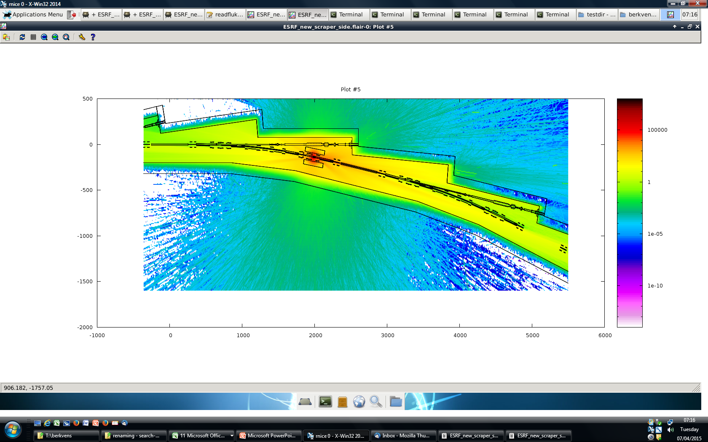
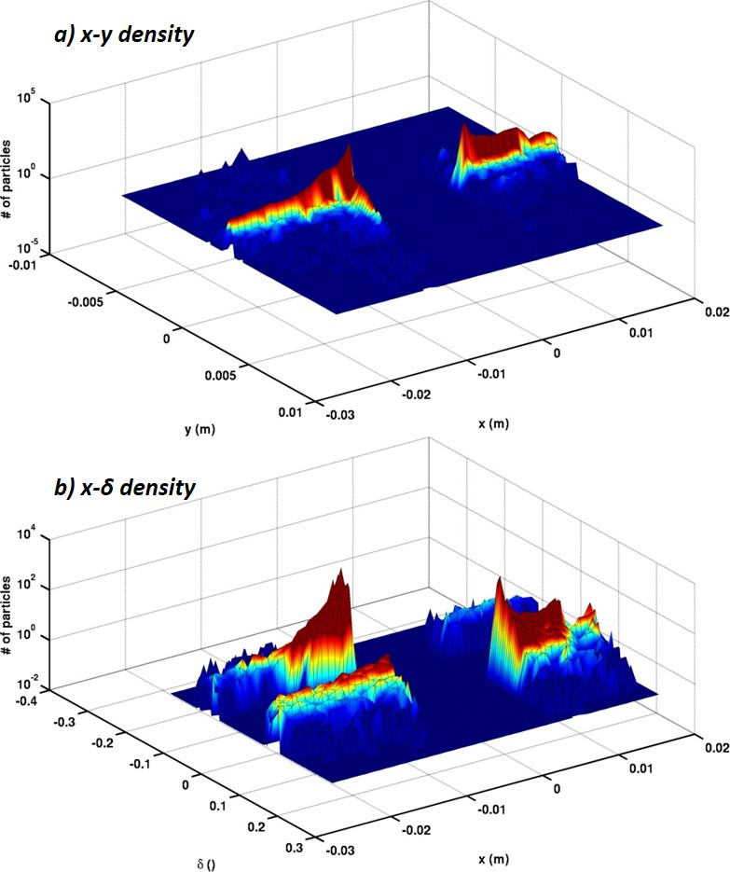
II. Protecting the Insertion Devices from radiation damage
In the new machine the beam lifetime will be reduced by a factor 3,
In order to maintain the experimental hall as a free access zone, a collimation system has been designed to localize the losses in 2 well shielded areas.
$⇒$ Fluka simulations were made by the safety group to design the collimators based on radiation dose estimation using realistic particle distributions (e- beam tracking),
Collimator: 30cm of tungsten, with 50cm-thick steel walls as shielding
0.5
1e-10 1e-5 1 1e5 µSv/h
Courtesy P. Berkvens
Transverse distribution of particles on one of the collimators’ jaws.
one EBS cell
one EBS cell

Slide 9
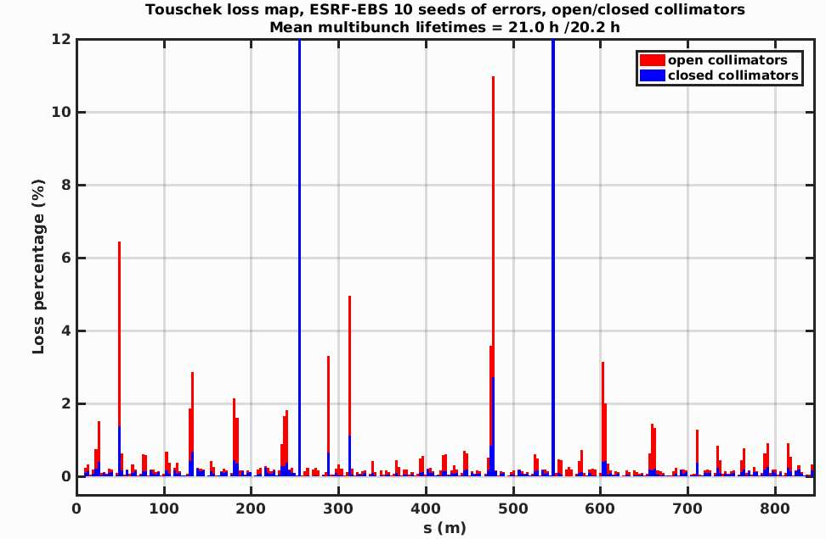
II. Protecting the Insertion Devices from radiation damage
Relocating the losses has the beneficial effect of putting the undulator’s aperture partly in the shadow of the collimators,
Thanks to Fluka simulations, combined with real beam distributions, we should be able to predict potential damage depending on the material, the gap and the collimators’ settings.
Firsts steps towards that goal are :
to reproduce the simulations for the collimators first in terms of dose to get experience with the code,
then generate data of energy deposition and potential damage to the jaws,
Then go for undulator’s geometry and materials.
Losses on collimators jaws

Slide 10
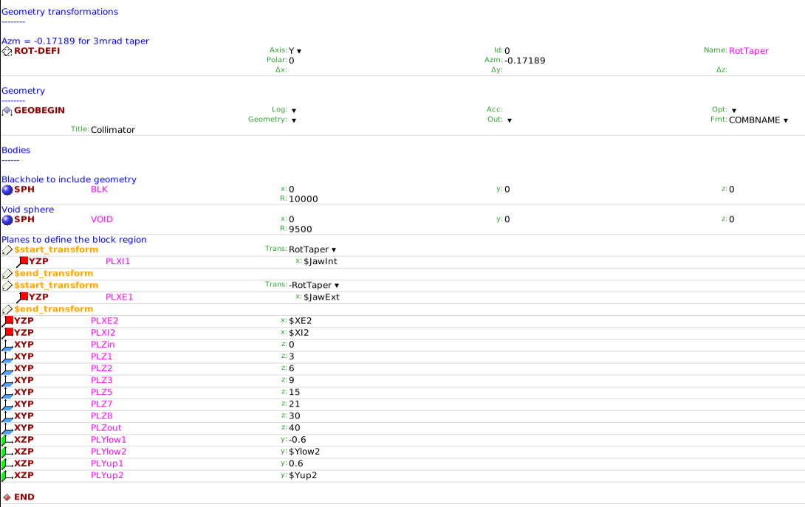
III. Fluka simulations of the collimator irradiation
Simplified ‘evolutive’ geometry :
a full bloc → a bloc with a hole → a hole with a taper to follow the beam convergence
Taper’s angle
Movable jaws
Variable bloc size
Slices for detectors

Slide 11
III. Fluka simulations of the collimator irradiation
Study of various materials using #if bloc:
Physics: photonuclear interactions and low-energy neutrons

Slide 12
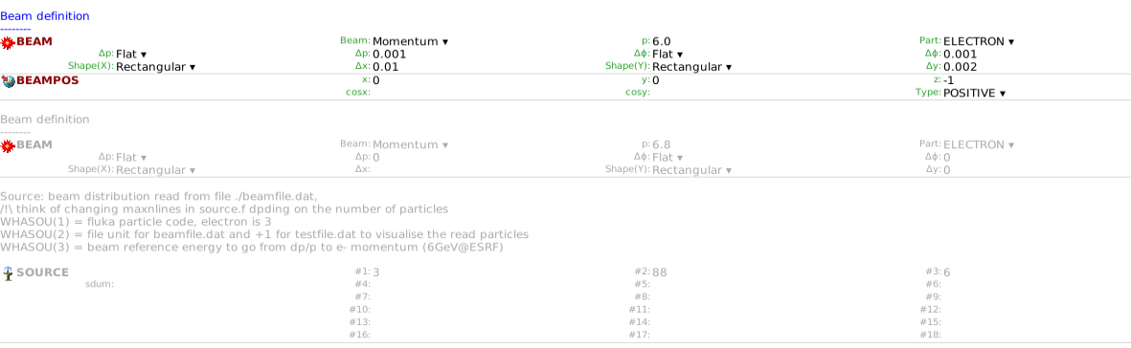
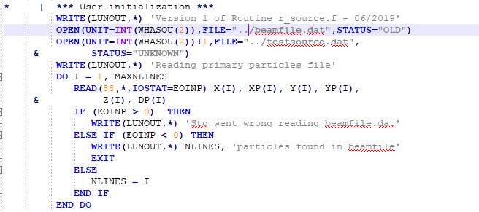
III. Fluka simulations of the collimator irradiation
Source from a user defined distribution: 6D phase space x x’ y y’ z dp/p
source.f

Slide 13
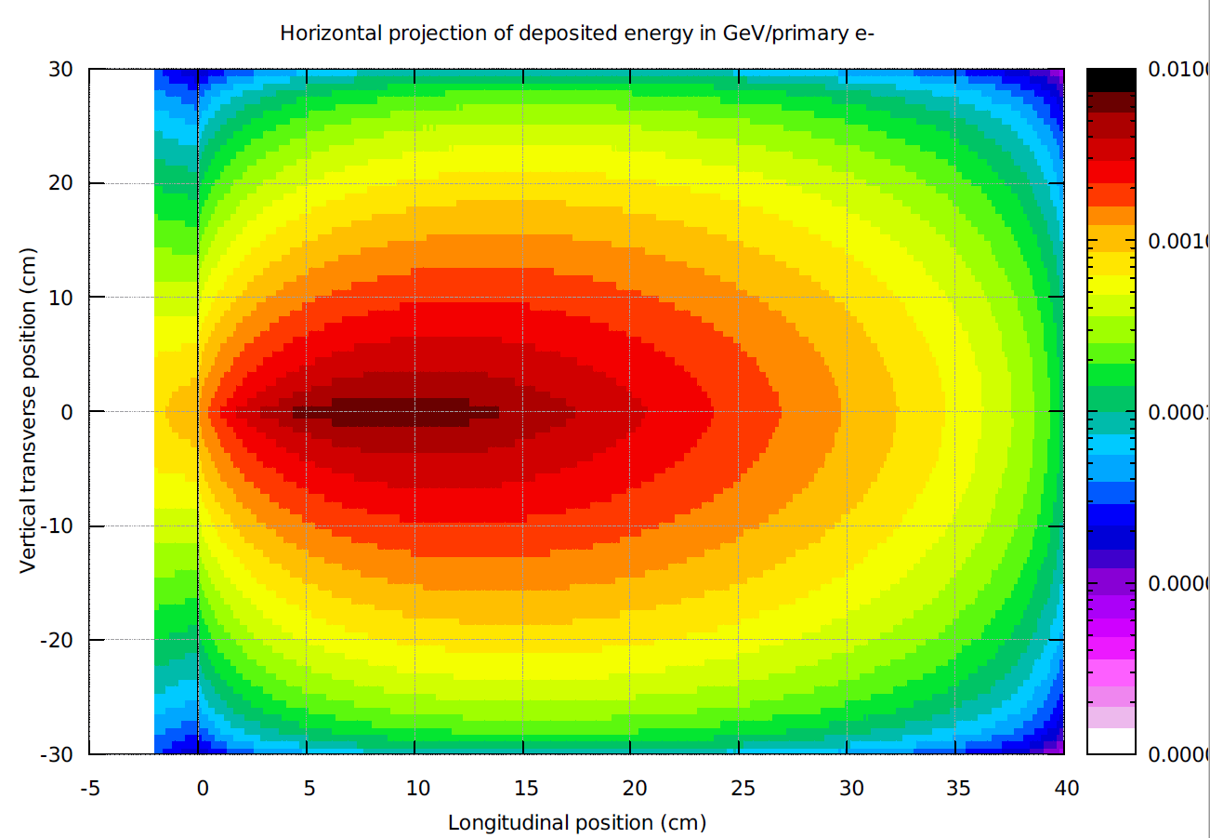
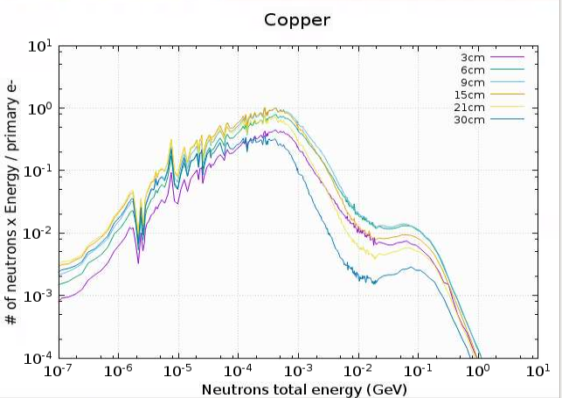
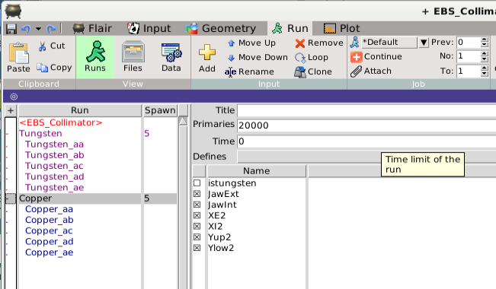
III. Fluka simulations of the collimator irradiation
First runs testing scoring photons and neutrons from one slice to the other
Done with 5 cycles split over 5 cores for each of the runs, to be optimized?
Next steps : link with temperature increase.

Slide 14
perspectives and future work
Optimization of runs and computing resources,
Getting more experience with flair and its plotting possibilities,
Work further on users defined sources to optimize the file creation and input to flair,
Going on with the study of a magnetic assembly:
→ defining my own materials,
→ create lattices,
→ and track in the resulting magnetic field.

