Slide 1
The FIERCE Mission Concept
Albert Y. Shih (NASA/GSFC)
on behalf of the FIERCE team
2020 Jul 8

Slide 2
Fundamentals of Impulsive Energy Release in the Corona Explorer (FIERCE)
Proposed Medium-class Explorer (MIDEX) concept for launch in mid-2025
PI: Albert Y. Shih (GSFC)
DPI: Lindsay Glesener (UMN)
PS: Säm Krucker (UCB)
DPS: Silvina Guidoni (AU)
Instrument PIs:
Steven Christe (GSFC)
Kathy Reeves (SAO)
Szymon Gburek (PAS), with U.S. lead Amir Caspi (SwRI)
Science goals
What are the physical origins of space-weather events?
How are particles accelerated at the Sun?
How is impulsively released energy transported throughout the solar atmosphere?
How is the solar corona heated?
Approach
X-ray imaging spectroscopy and extreme ultraviolet (EUV) imaging at high angular resolution, fast cadence, and high sensitivity

Slide 3
FIERCE instrument suite
Focusing Optics X-ray Solar Imager (FOXSI), led by GSFC
Observes accelerated electrons and plasmas ≳5 MK
First-ever solar-dedicated, direct-imaging hard X-ray spectroscopic imager
>10 times more sensitive and faster than RHESSI with better imaging dynamic range
Thermal and Dynamic Imager for the Sun (THADIS), led by SAO
Observes quickly evolving structures containing coronal plasma
High-angular-resolution EUV imager (two passbands) with fast cadence and very short exposure times
Spectrometer for Temperature and Composition (STC), led by PAS
Characterizes plasmas ≳1 MK
Soft X-ray spectrometer with high spectral resolution

Slide 4
FIERCE captures all elements of a solar eruptive event – flare and coronal mass ejection (CME)
FIERCE images EUV emission and faint X-ray sources in the corona even in the presence of bright X-ray footpoints

Slide 5
First FIERCE goal: What are the physical origins of space-weather events?

Slide 6
How are flares and CMEs initiated?
Different models of eruption initiation predict observationally differentiable timing and locations for the X-ray and EUV signatures of reconnection
FIERCE will definitively determine the dominant triggering mechanisms for flares and CMEs
Location of precursor emission varies with model

Slide 7
What are the solar origins of electrons escaping the Sun?
Electrons accelerated from the Sun into the heliosphere contribute to space weather
Missions such as Parker Solar Probe and Solar Orbiter observe these electrons in situ and via radio signatures after they have left the Sun
FIERCE observes where the electrons are accelerated and how they escape
FIERCE quantifies energetic electrons in the erupting flux ropes of CMEs

Slide 8
Second FIERCE goal: How are particles accelerated at the Sun?

Slide 9
Distinguishing between acceleration models
Location and sequence of X-ray and EUV signatures varies with model

Slide 10
Third FIERCE goal: How is impulsively released energy transported throughout the solar atmosphere?

Slide 11
Where do electrons lose their energy and how are hot plasmas produced?
FIERCE makes co-optimized X-ray and EUV observations, without saturation

Slide 12
Fourth FIERCE goal: How is the solar corona heated?

Slide 13
Is energy release in small flares fundamentally different from that in large flares?
FIERCE will measure much smaller flares than RHESSI and in much greater numbers than NuSTAR

Slide 14
What are the properties of unresolvable heating events that heat active regions?
FIERCE distinguishes between impulsive heating (e.g., nanoflares) and steady heating (e.g., waves) by observing high-temperature plasma

Slide 15
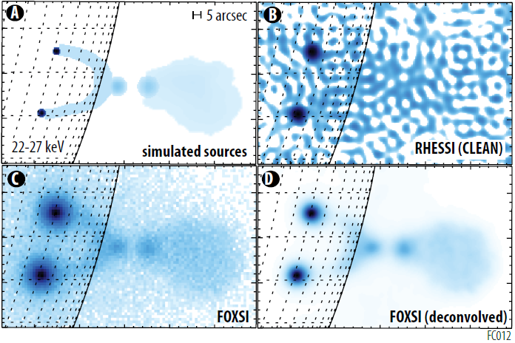
FOXSI X-ray imaging spectroscopy
FOXSI directly images hard X-rays to measure energetic electrons with high imaging dynamic range
Energy range: 3–55 keV
Energy resolution: 0.8 keV FWHM over the energy range
Angular resolution: 6.3” FWHM
Imaging effective time resolution: 0.1 second
Sensitivity: 0.2 photons/cm²
FOXSI utilizes:
Grazing-incidence optics
Fast, pixelated solid-state detectors
A deployable boom to achieve the 14-meter focal length
Heritage: FOXSI sounding rocket, HEROES balloon, RHESSI
FOXSI sees faint sources in the corona at the same time as the bright footpoints

Slide 16
THADIS EUV imaging
THADIS directly images EUV emission to reveal the structure of plasmas at temperatures with emission lines in the passbands
284 Å (peak at ∼2 MK)
133 Å (peak at ∼14 MK)
Angular resolution: 0.5” FWHM (twice as good as AIA)
Image cadence: 3 seconds, or 6 seconds in each passband (2–4 times as fast as AIA)
0.5-millisecond shortest exposure time for no image saturation during flares
Imaging dynamic range: 15,000:1
Heritage: Hi-C sounding rocket, IRIS, AIA, TRACE
Simulated image based on a Hi-C observation shows structures resolved by THADIS that are not resolved by AIA

Slide 17
STC soft X-ray spectroscopy
STC measures high-resolution spectra for temperature and composition diagnostics of coronal plasma that complement FOXSI and THADIS
Energy range: 0.8–15 keV
Energy resolution: 0.2 keV FWHM at 1.5 keV
Spectrum cadence: 0.5 second
Heritage: SphinX on CORONAS-PHOTON

Slide 18
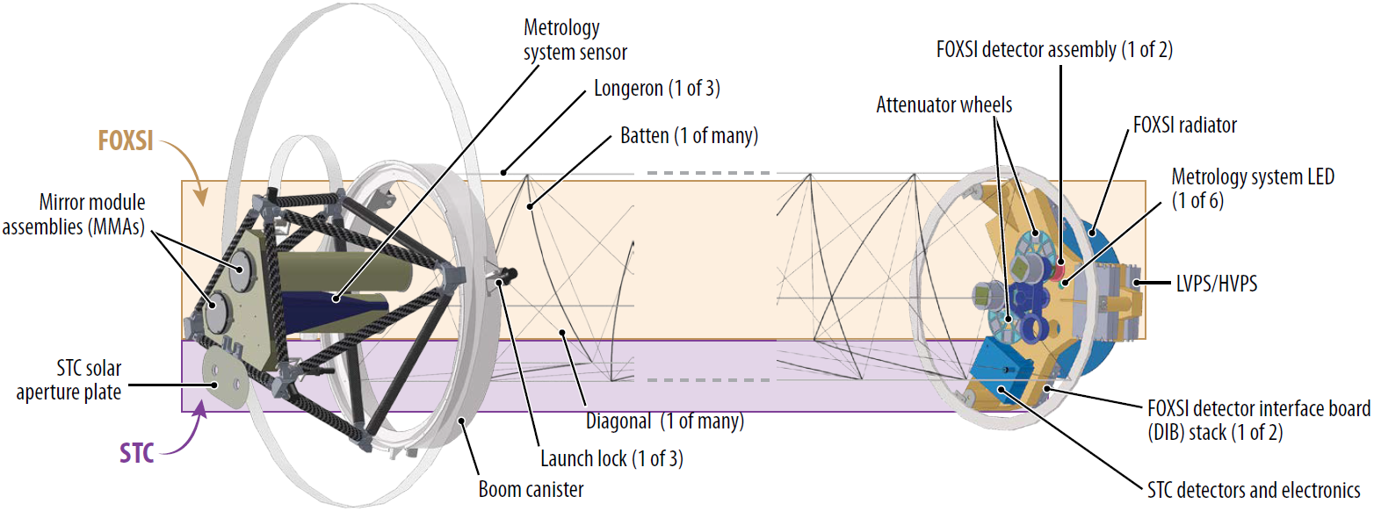
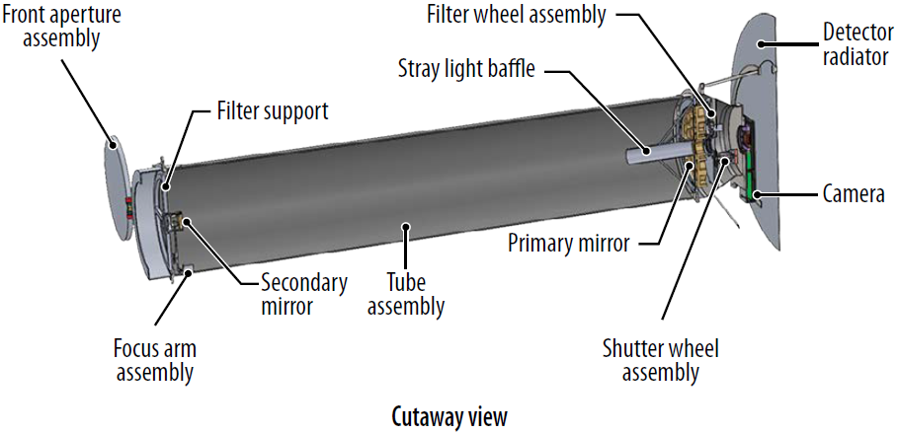
Instruments and observatory
FOXSI
STC
THADIS cutaway view
Fully deployed observatory

Slide 19
The FIERCE team is experienced and diverse
Science team
Hardware institutions
Alaoui, Meriem | Glesener, Lindsay | Kerr, Graham | Saint-Hilaire, Pascal
Allred, Joel | Golub, Leon | Klimchuk, Jim | Savage, Sabrina
Battaglia, Marina | Goetz, Keith | Krucker, Säm | Schwartz, Richard
Baumgartner, Wayne | Guidoni, Silvina | McKenzie, David | Seaton, Dan
Caspi, Amir | Hannah, Iain | Moore, Chris | Shih, Albert
Christe, Steven | Hayes, Laura | Musset, Sophie | Stęślicki, Marek
Dennis, Brian | Holman, Gordon | Reep, Jeff | Woods, Tom
Drake, Jim | Inglis, Andrew | Reeves, Kathy
Gburek, Szymon | Ireland, Jack | Ryan, Dan
Institution | Responsibilities
NASA/GSFC | Mission lead FOXSI lead
SAO | THADIS lead
PAS | STC lead
Ball Aerospace | Spacecraft
NASA/MSFC | FOXSI mirrors THADIS camera
UMN | Data processing units
SwRI | STC U.S. lead FOXSI power supplies
UCB | FOXSI forward bench
LASP | Sun Tracker
Data and tools will be open, so the broader community is welcome!

Slide 20
The time is now for FIERCE
Launch in mid-2025 is well timed with the ~11-year cycle of solar activity
Last opportunity to catch the next peak
Overlaps with perihelia of Parker Solar Probe and Solar Orbiter
Supports future human space exploration (e.g., Artemis program) through understanding space weather
Estimated event numbers
~3000 C-class flares, ~300 M-class flares, and ~20 X-class flares
~1500 CMEs (>500 km/s)
Solar activity estimated using the preceding cycle

Slide 21
Look forward to FIERCE!
FIERCE deduces how energy is suddenly released and transformed at the Sun
FIERCE makes next-generation X-ray and EUV observations at high angular resolution, fast cadence, and high sensitivity
FIERCE launches in mid-2025 for a two-year prime mission that aligns with the solar cycle and other programs

