Slide 2

eXTP enhanced X-ray Timing and Polarimetry mission
A flagship X-ray observatory mission, being developed by the Chinese Academy of Sciences, with a large contribution by a European Consortium inherited from the ESA-M3 LOFT mission study. ESA is studying a MoO participation.
Currently at the start of its Phase B. The launch date is planned in 2027, for a minimum mission lifetime of 5 years (goal 8 years).
eXTP is proposed as an observatory open to the worldwide scientific community. It is expected that the eXTP observing plan will be designed based on Core Program observations as well as on a Guest Investigator Program, through time allocation committees.

Slide 3


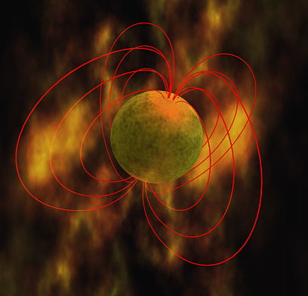
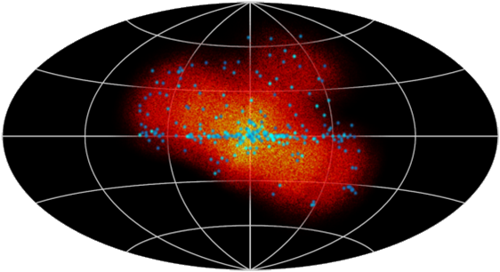
eXTP Science Drivers
Study of matter under extreme conditions of gravity, density and magnetism. Simultaneous, high-throughput spectral, timing and polarimetry observations.
Constrain the Equation of state of the supra-nuclear density matter in the interior of neutron stars.
Accretion physics in the strong-field regime of gravity and tests of General Relativity in neutron stars and black holes over the mass scale.
Physics of light and matter in the presence of ultra-strong magnetic fields in magnetars and X-ray pulsars.
Multi-purpose observatory and wide-field monitoring for transients (and e.m. counterparts of GWs). Rapid follow-up.

Slide 4

eXTP Science so far: WGs & White Papers
Five white papers for eXTP science case and mission:
Dense Matter
Strong Field Gravity
Strong Magnetism
Observatory Science
Instrument and mission

Slide 5
eXTP concept
Payload concept
  Short focal-length for multiple modules
  Deployable panel for collimated modules
  Polarimeter with imaging capability
  Wide field monitor

Slide 6

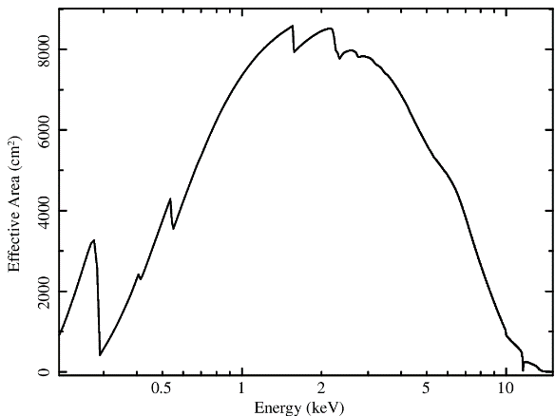
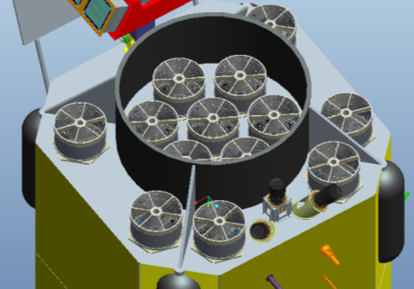
eXTP Scientific Payload
SFA – Spectroscopy Focusing Array
Large collecting area achieved by multiple optics with short focal length. Baseline: 9 optics with 5.25m FL
Total effective area: >0.7 m² @1 keV, 0.5 m² @6 keV
Non-imaging, PSF requirement 1 arcmin HPD, 12’ FoV
Multi-pixel SDD detector (to enable background subtraction). Single photon, <100µs
Energy band: 0.5-10 keV
Energy resolution: <180 eV FWHM @6 keV

Slide 7


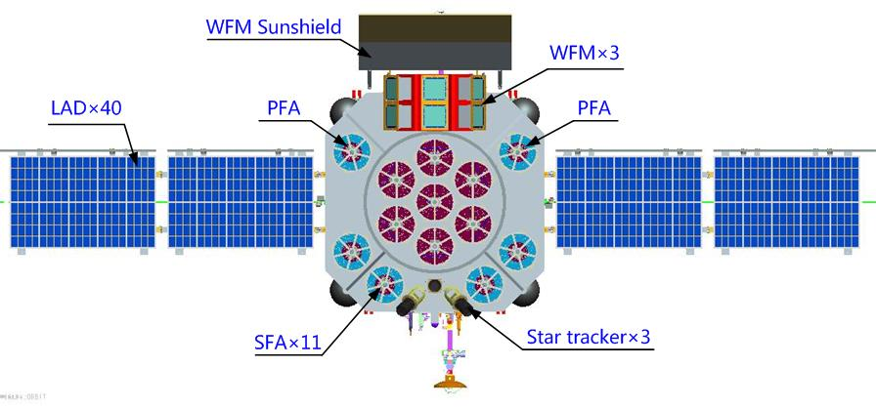
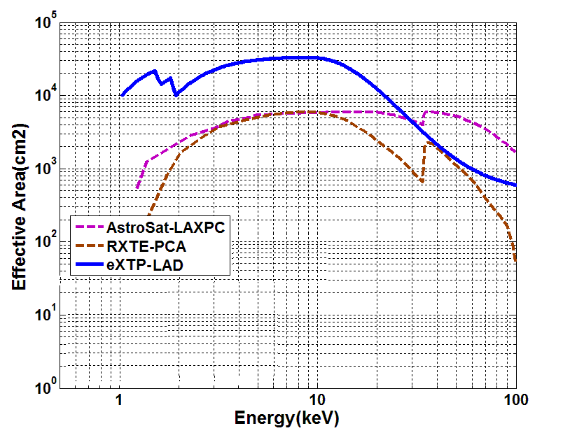
eXTP Scientific Payload
LAD – Large Area Detector
x4
Total effective area: 3.4 m² @8 keV
Energy band: 2-30 keV
Energy resolution: <240 eV FWHM @6 keV
Based on the LOFT/LAD design
40 Modules on 2 deployable panels
Collimated, large-area SDD detector. Single photon, <10µs

Slide 8
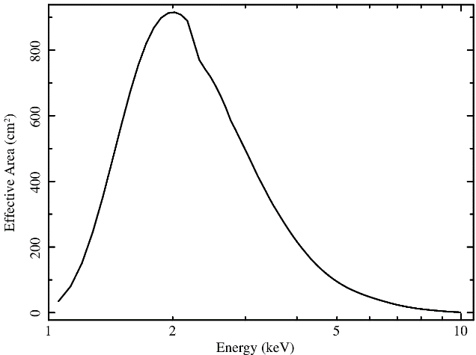
eXTP Scientific Payload
PFA – Polarimetry Focusing Array
Focal plane imaging polarimeter: 4 optics with 5.25m FL
Imaging, PSF 20 arcsec HPD
Total effective area: 900 cm² @2 keV (includes QE)
Gas Pixel Detector: single photon, <100µs
Energy band: 2-10 keV
Energy resolution: 20% FWHM @6 keV

Slide 9

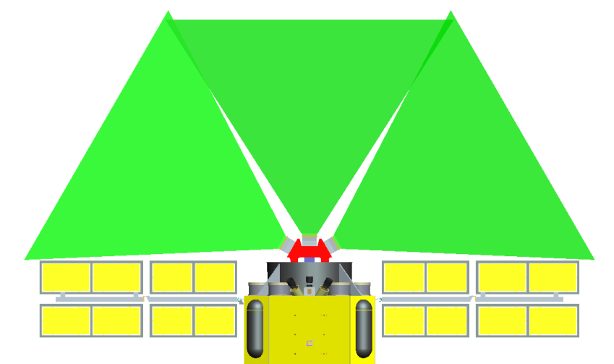
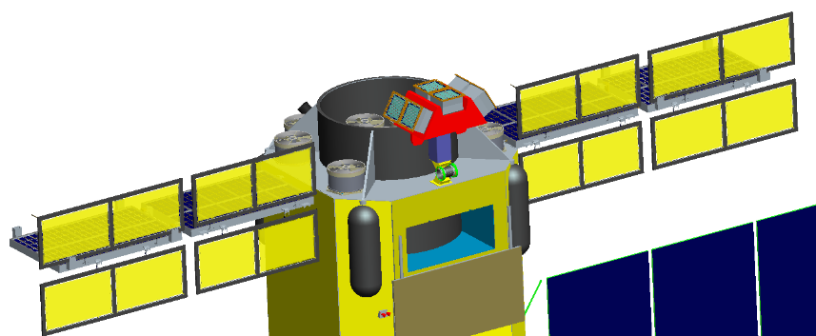
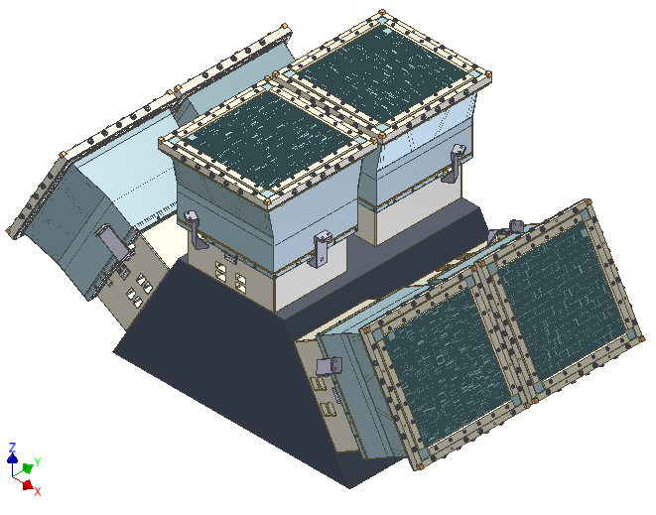
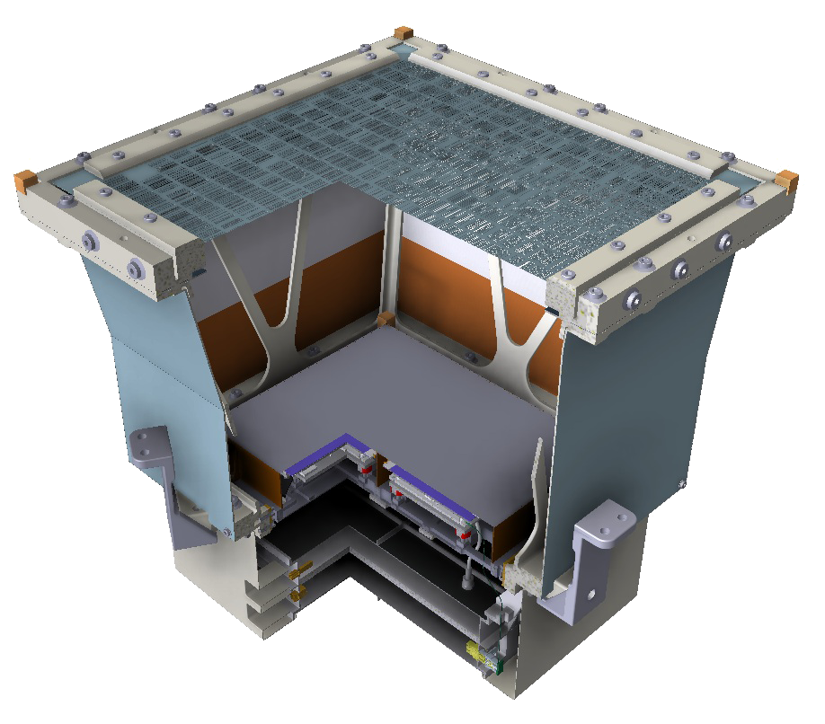
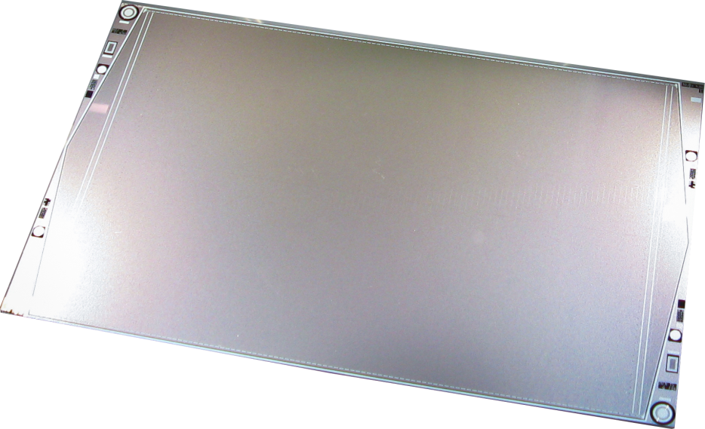
eXTP Scientific Payload
WFM – Wide Field Monitor
Field of View: 4 steradian (at 20% response)
Imaging, <5 arcmin angular resolution, 1 arcmin PSLA
Energy band: 2-50 keV
Energy resolution: 300 eV FWHM @6 keV
Effective area: 80 cm² @6 keV (1 unit, on axis)
Same design as LOFT/WFM, 3 units (6 cameras)
Same detectors as LAD (SDD). Single photon, <10µs

Slide 10
Key eXTP Performance
Effective Area of SFA and LAD
Simultaneous FoV of WFM
LAD: 6x RXTE/PCA, 35x XMM-Newton (but collimated!) + hard-X response
SFA: 8x XMM-Newton and 0.3-2x Athena/WFI (but multiple optics and large PSF!). Limiting sensitivity ∼10⁻¹⁴-10⁻¹⁵ erg cm⁻² s⁻¹
PFA: 5x IXPE. Sensitivity: 1% MDP in 50ks for a 100 mCrab source
WFM: Largest FoV ever, first time with 300 eV resolution. 3 mCrab in 50ks

Slide 11
Payload | Parameter | Specification
SFA | Energy range | 0.5-10 keV
 | Effective area | >7000 cm² @1 keV, >5000 cm² @6 keV
 | Energy resolution | <180 eV FWHM @6 keV
 | FoV/HPSD | 12 arcmin / 1 arcmin
 | Focal plane detector | Pixelated SDD (19 pixels)
LAD | Energy range | 2-30 keV (extended: 30-80 keV for out-FoV)
 | Effective area | 34000 cm²
 | Energy resolution | <240 eV FWHM @6 keV
 | FoV | 1° (FWHM)
 | Detector | Large area SDD (640 units, 40 Modules)
PFA | Energy range | 2-10 keV
 | Effective area | >900 cm² @2 keV (including QE)
 | Energy resolution | 1.2 keV FWHM @6 keV
 | FoV/HPD | 12 arcmin / 20 arcsec
 | Focal plane detector | GPD (4 units)
WFM | Energy range | 2-50 keV
 | Energy resolution | 300 eV FWHM @6keV
 | FoV | >4 sr (at 20% of peak response)
 | Angular resolution | <5 arcmin
 | Localization accuracy | <1 arcmin
 | Detector | Large area SDD
Soft Response
Large area
Polarization
Monitoring

Slide 12
Mission profile
Parameter | Value
Orbit | 550 km, <2.5° inclination
Launcher | Long-March CZ-7 + upper stage, from Wenchang
Mass | 4500 kg
Power | 3.6 kW
Telemetry | 3.2 Tb/day (X-band)
Ground Stations | Sanya, Malindi
Pointing | 3-axis stabilized, < 0.01° (3-sigma)
Sky visibility | 50% (goal 75%)
Mission Duration | 5 years (goal 8 years)
Launch date | 2027

Slide 13
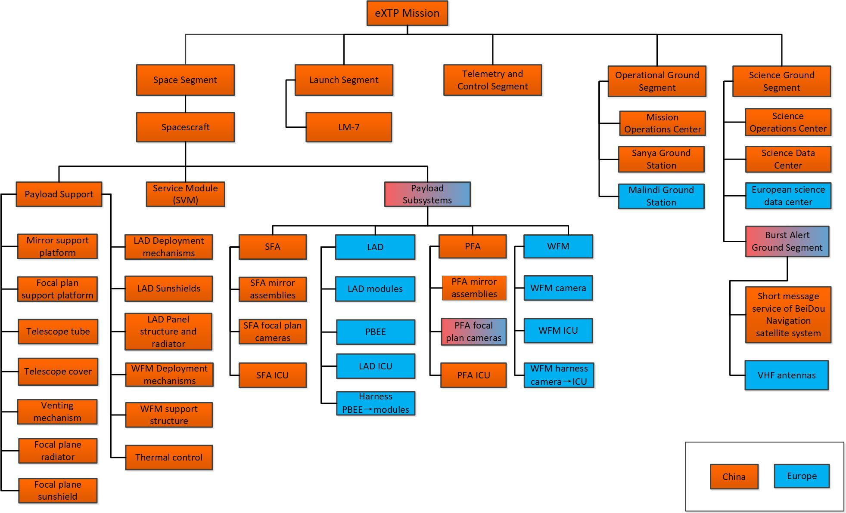
Who Does What
Direct INFN involvement

Slide 14




















The eXTP International Consortium
Italy:
Germany:
France:
Spain:
Switzerland:
Czech Republic:
Poland:
Denmark:
The Netherlands:
United Kingdom:
PI Institute: IHEP/CAS
CAS
CNSA
IHEP Beijing
Tsinghua University
Tongji University
CAST Beijing
Microsat Shanghai

Slide 15
Participating (H/S/W) Italian Institutes/Institutions
Institution | Institute | eXTP Subsystem | What
INAF | IAPS OAS OAPa OAB IASF-Mi OAR/SSDC | LAD/WFM LAD/WFM LAD SFA/PFA LAD/WFM SGS | PI, PO, AIVT, FEE, Calibrations AIVT, FEE, Calibrations, Simulations Optical filters Optics (design, integration and tests) FEE Science SW, Archive, User support
INFN | Trieste Trento Perugia Pisa Torino Roma2 Roma2/SSDC | LAD/WFM LAD/WFM LAD PFA PFA LAD/WFM SGS | Detectors, FEE, AIVT Detectors, AIVT AIVT GPD, BEE, Tests, Calibrations (TBD) GPD, BEE, Tests, Calibrations (TBD) Detectors, FEE, AIVT, PA Science SW, Archive, User support
FBK | MNF | LAD/WFM | Detectors
Universities | PoliMi UniPv | LAD/WFM LAD/WFM | FEE, Tests FEE, Tests
ASI | EOS SSDC Malindi | ALL SGS ALL | Management Science SW, Archive, User support TM Downlink

Slide 16
Programmatic Status Update
China - The mission has started its Phase B study in mid-2019, lasting until December 2021, when the Preliminary Design Review (PDR) is scheduled. This will be the key milestone for the mission adoption. The study is currently funded in China up to the end of Phase C1 (end-2022).
ESA and MS - CAS and the European Member States requested an ESA participation to the mission under a Mission of Opportunity. Although not formally approved yet, eXTP is included in the perspective plan for MoOs. ESA successfully reviewed the status of the LAD and WFM instruments in Summer 2019, assessing their readiness to (officially) enter Phase B. Meeting with MS planned on 30th Jan 2020. Most of the MS have already allocated funds for the Phase B study.
ASI - Funds for Phase B1 already approved: contract to be kicked off in Jan-Feb 2020. Plans for funding for the Phase B2/C1 are being developed jointly with ASI.
The formal decision/commitment on the mission adoption in Europe (both ESA and MS) will be taken after PDR (Dec 2021), when any potential export issues will be cleared out.

Slide 17
Technical Status Update
China - CAS has selected one single Prime Contractor for the spacecraft, the Microsat company/institute in Shanghai (the same as SVOM and SMILE). Interface activities have started in October 2019.
ESA - After the successful Phase A review ESA is expected to allocate a small study team at ESTEC to follow/support the Phase B study, in preparation to their official involvement in Phase C.
European MS - The LAD and WFM got organized as two independent instrument consortia, under the responsibility of Italy and Spain, respectively. Considering the large technical and programmatic overlap (detectors, analog and digital electronics, ..) the two teams work in tight connection.
Italy - The Italian participation involves ASI, INAF, INFN, Universities. The lead institute for the LAD is IAPS, hosting the Project Office. Next milestones are the Instrument System Requirements Review (I-SRR, June 2020) and the Instrument Preliminary Requirements Review (I-PDR, December 2021). These will be key milestones to define the configuration of the science instruments.

Slide 18
Expected Science Return
Observatory Type - eXTP is designed as an Observatory. The science program will include a Core Program and a Guest Observer Program. All data will become public after the proprietary period. Some data may go public immediately (WFM, TBC).
Europe vs China - The exact share between Europe and China will be defined at agency level at a later stage (MoU). However, the current understanding is in terms of a 40:60 share. The science return is expected to be proportional to that.
Italy vs Europe - Italy is leading the largest instrument and, in Europe, it has the largest share.
ESA - The ESA contribution is parallel to the contribution of the individual Member States. Overall, it will be in the range of 5-10%, that will give science access to a proportional fraction of the observing time. For Europe, this fraction adds on top of the science return of the individual MS.

Slide 19
Conclusions
eXTP is conceived as a powerful and general observatory for compact Galactic and bright extragalactic objects to date. It will offer for the first time the most complete diagnostics of compact sources: excellent spectral, timing and polarimetry sensitivity on a single payload.
The eXTP Team is open to contributions from the wide scientific community. More info at: http://www.isdc.unige.ch/extp/
Next eXTP Consortium meeting will be in the week 23-27 March 2020 in Nanjing. All Consortium members are welcome to attend.
References for the eXTP science and mission: special issue on
Science China, Volume 62, Issue 2, February 2019

Slide 20

Next eXTP Consortium Meeting
Nanjing, China, 23-27 March 2020

