Slide 1
eXTP key science goals – Luigi Stella (INAF-OAR)
behavior of matter and light under extreme conditions of density, gravity and magnetism
Dense Matter: which is the state of matter at supranuclear densities (i.e., in the neutron star’s interior)?
Exotic states of matter? Quark stars?
Strong Gravity: what are the properties of space-time under extreme gravity (i.e., in the vicinity of neutron stars and black holes)? Any deviations from Einstein’s General Relativity theory?
Strong Magnetism: which is the behavior of light in the presence of ultra-strong magnetic fields (e.g., in magnetars)? Are the predictions of the QED theory verified?
Observatory science: GW merging events involving neutron
star(s), TeV sources, neutrinos
Notes:
eXTP main cores is fundamental physics, and in particular three topics will be addressed by the mission.

Slide 2
eXTP Main Themes
Dense matter
Accretion in strong field gravity
Strong magnetism
Observatory science

Slide 3
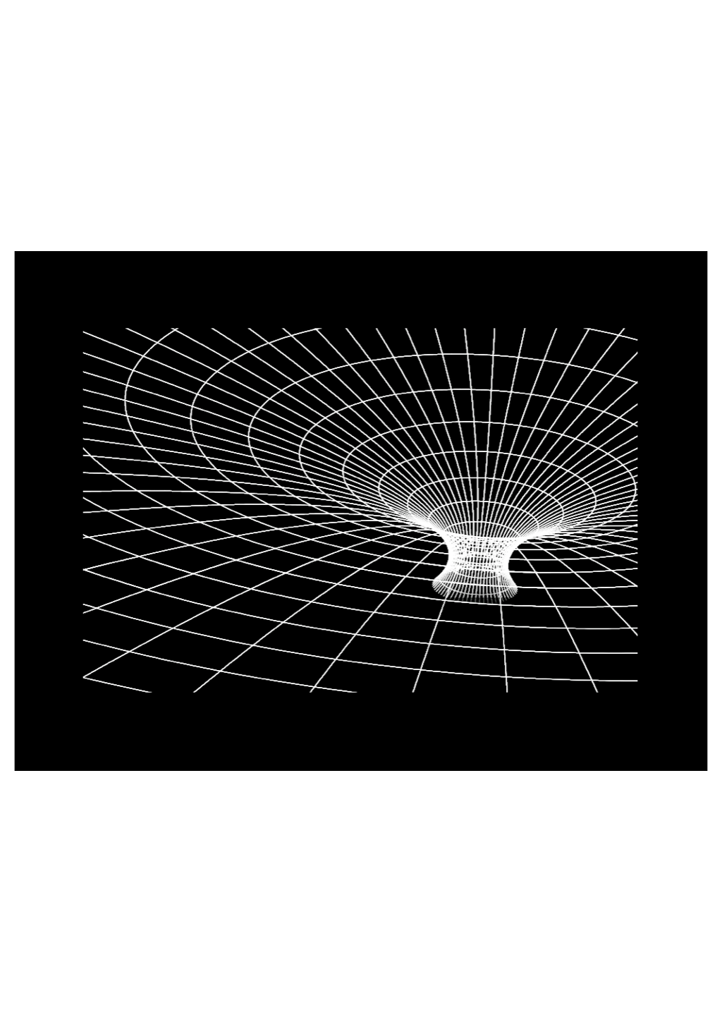
X-ray diagnostics:
  Strong field motions:
    orbital & epicyclic
  Spectral/timing/polarimetry
    Reverberation
    Doppler tomography
Strong Gravity in
stationary Spacetimes
(complementary to dynamical
spacetimes of GWs sources)
Astrophysics near black holes: strong field effects
  Innermost Stable Circular Orbit
  Orbital motion near ISCO
  Orbital and epicyclic frequencies
  Frame dragging, light deflection, Shapiro effect
Astrophysical impact
  Black hole masses and spins
  Accretion physics
  AGN feedback
  Relativistic jets
eXTP: near the event horizon
relativistic effects are large !
Factor 100,000 closer
to the black hole
Tests of General Relativity
with binary millisecond radiopulsars:
Relativistic effects are small perturbations

Slide 4
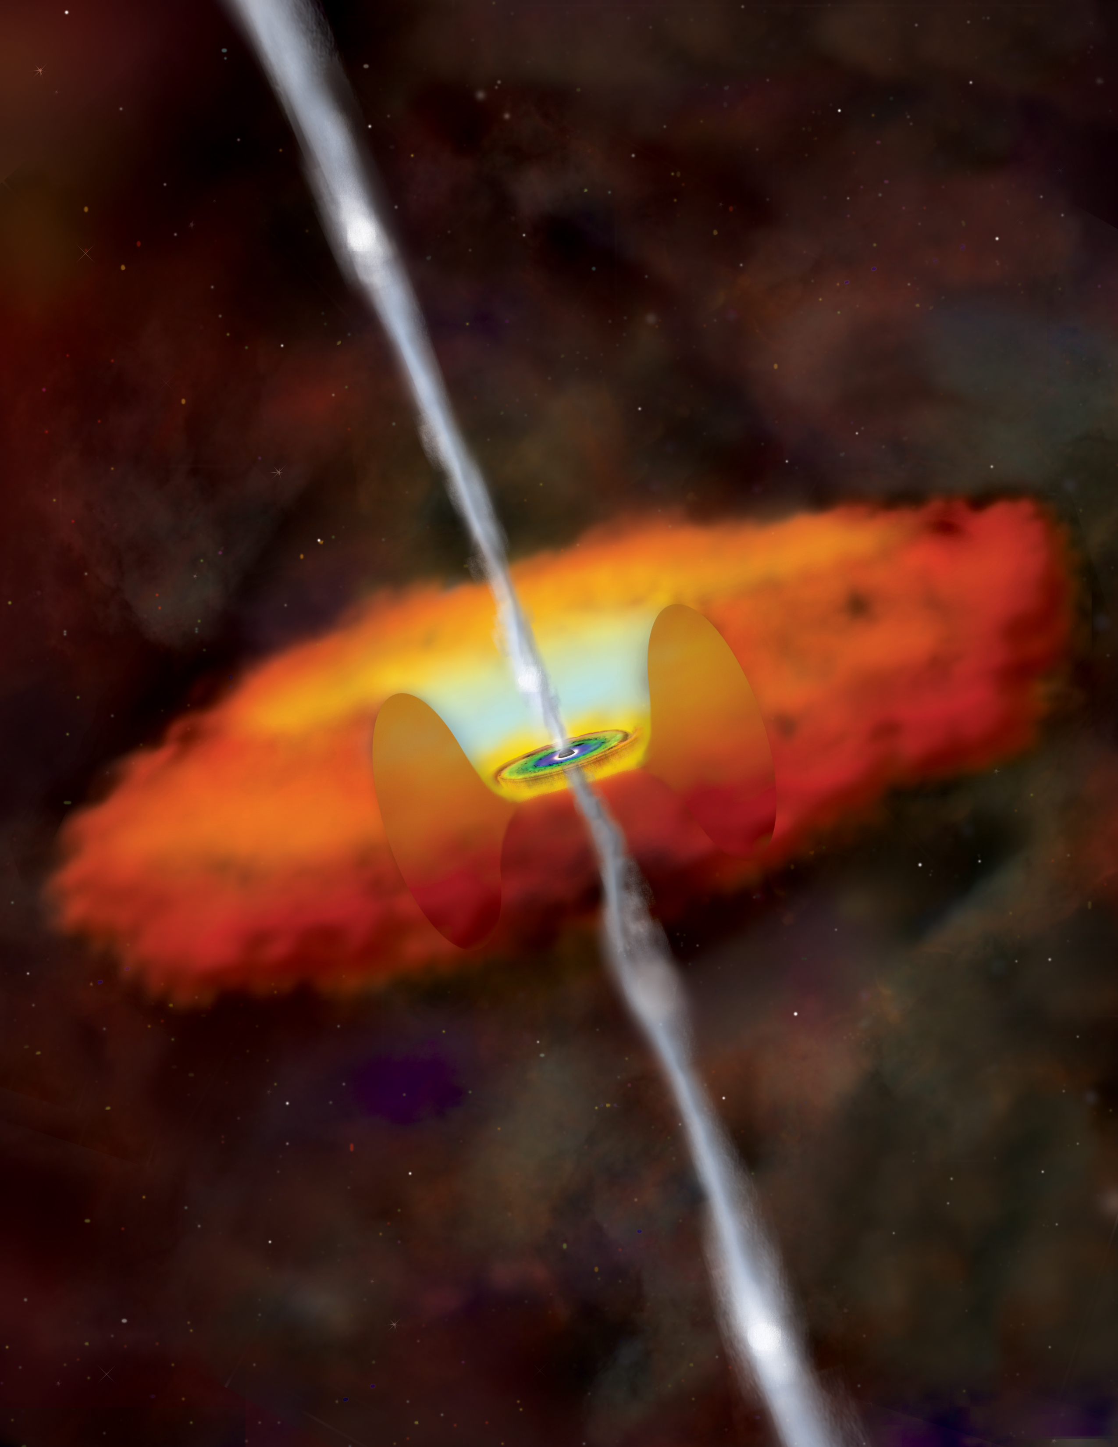
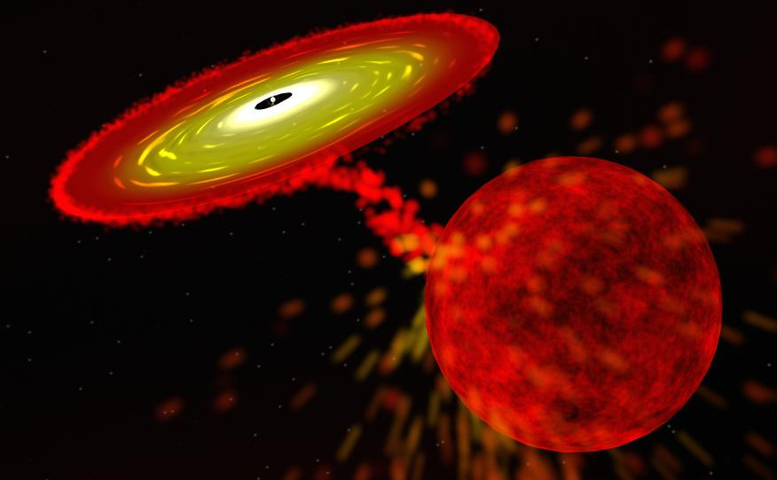
Accreting Black Holes
  Stellar mass Black Holes in X-ray binaries
  Supermassive Black Holes in nuclei
  of active Galaxies (AGN)
  - Accretion-released energy leads to powerful X ray emission
  from the innermost disk regions
  - X-ray flux is often very variable and spectra are complex

Slide 5
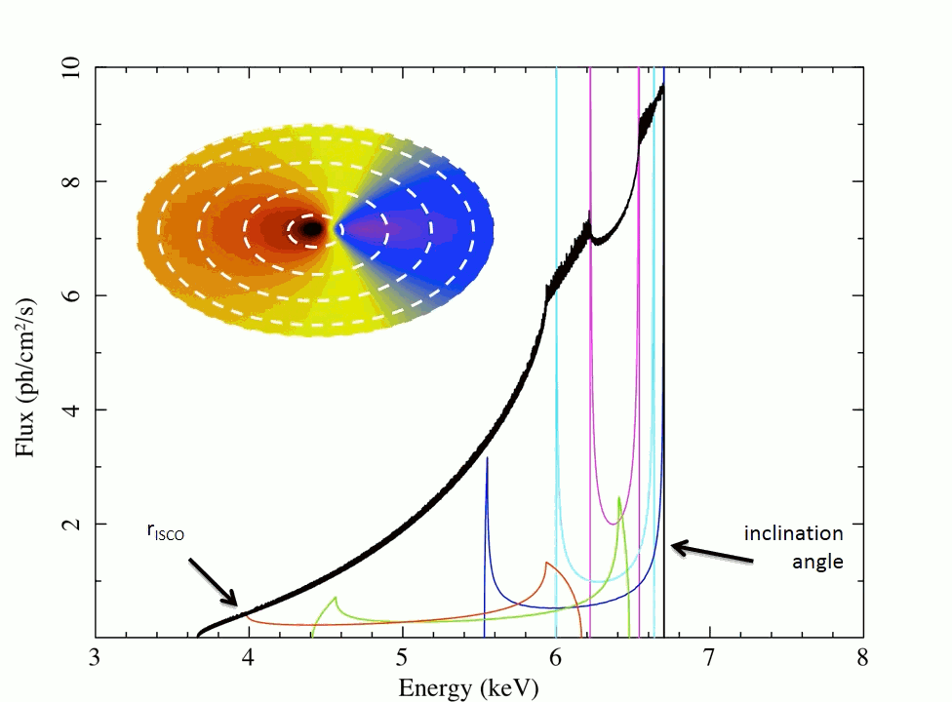
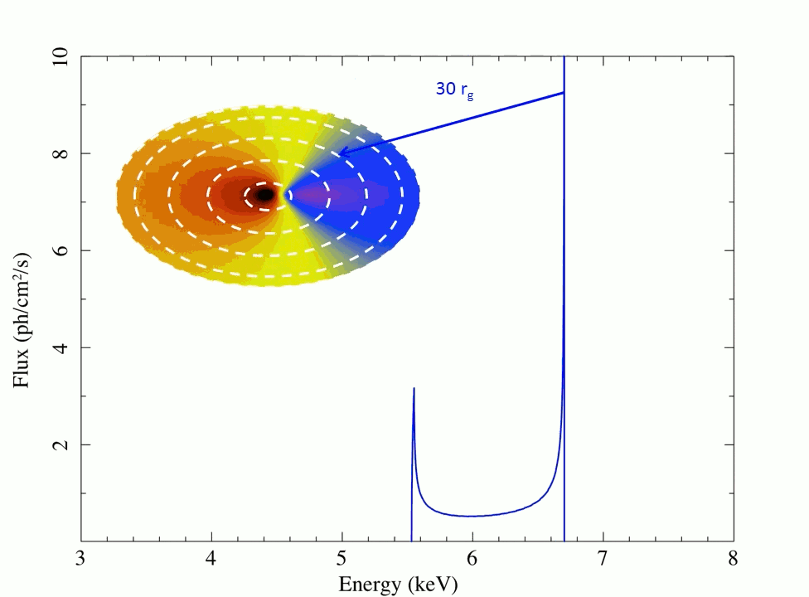
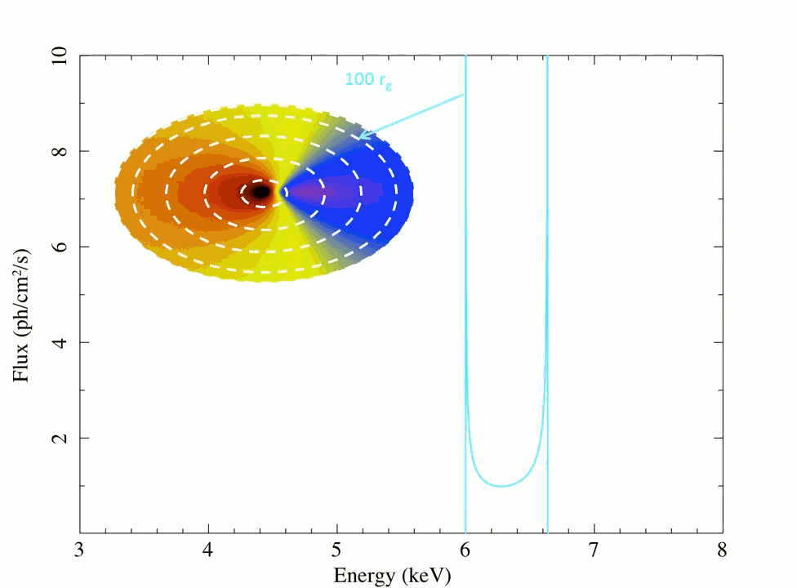
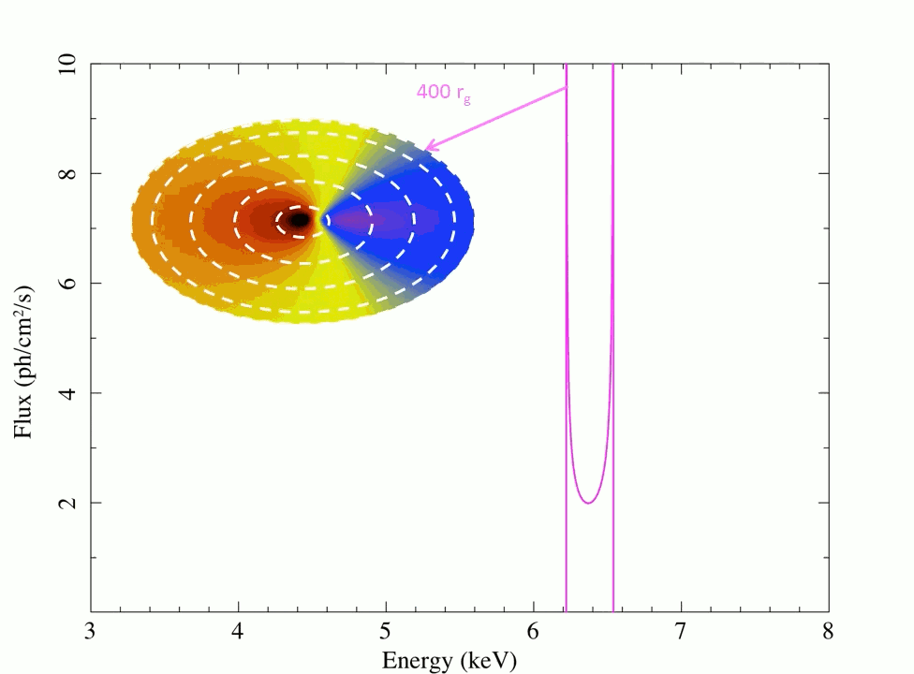

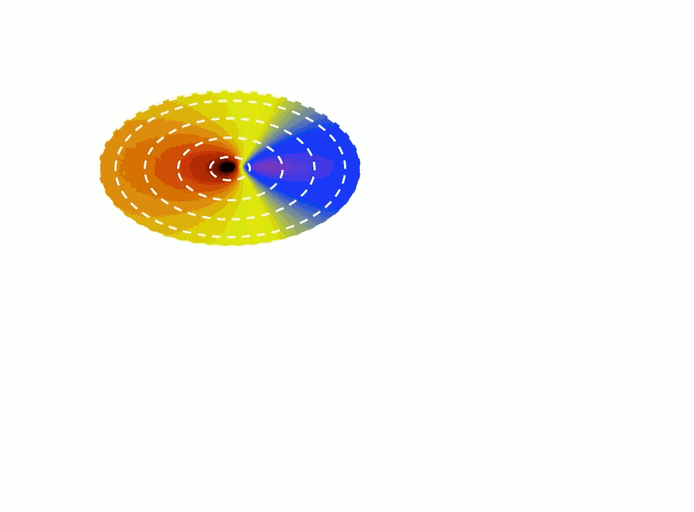
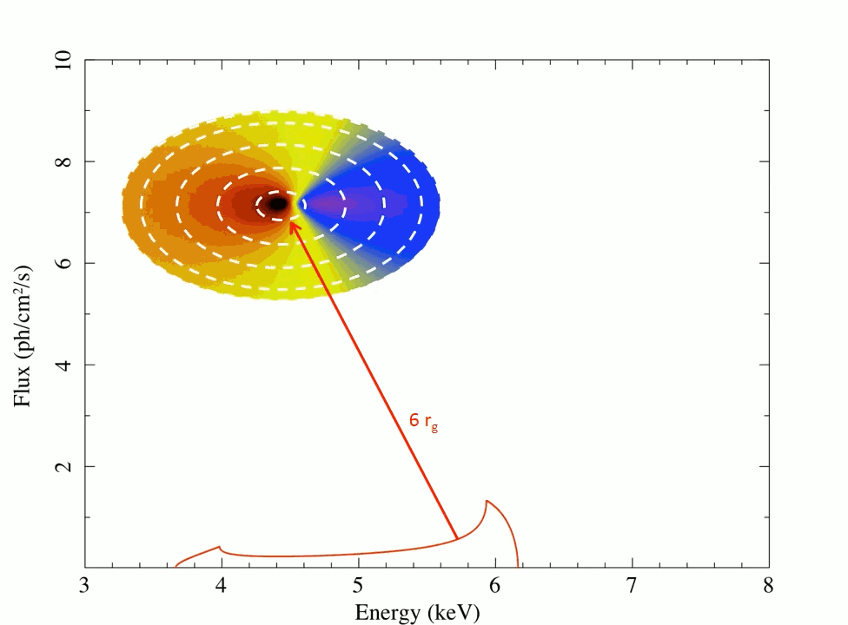
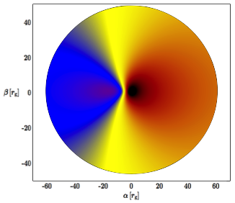
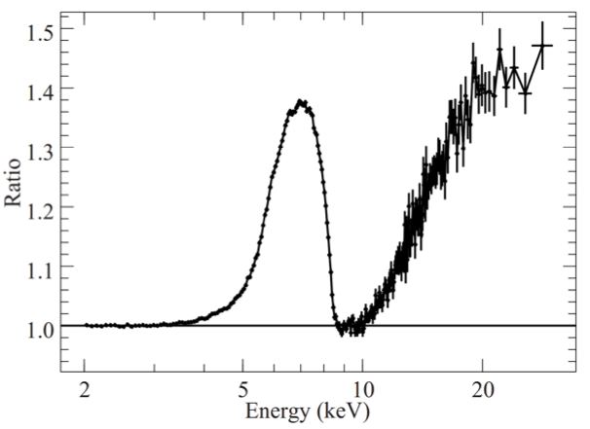
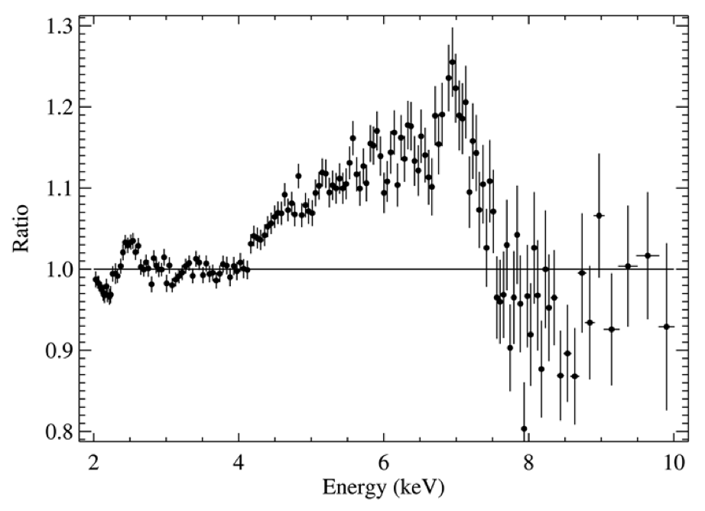
Fe-line diagnostics
Accreting stellar mass
Black Hole
eXTP-LAD simulation of black hole X-ray binary
1ks integration
a* = 0.967±0.003
General relativity predicted velocity and redshift map of the accretion disk
General relativity predicted velocity and redshift map of the accretion disk
Line profile integrated over entire flow encodes:
Strong field relativistic effect: Doppler shifts and boosting, gravitational redshift, strong field lensing, black hole spin
Observed in both Active Galactic Nuclei and X-ray binaries
Moreover: X-ray polarimetry diagnostics of accretion disk
De Rosa

Slide 6
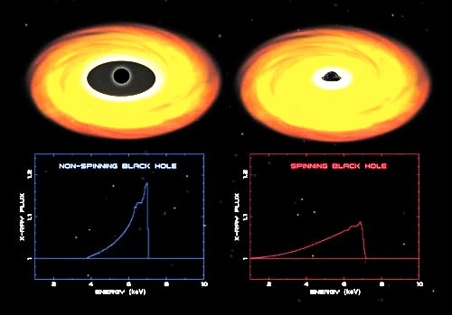
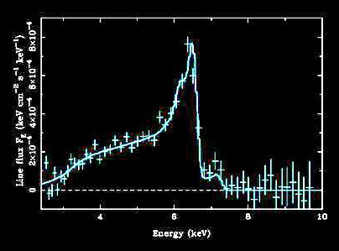
Fe-lines from accretion disks around supermassive black holes in AGNs
Strong field relativistic effect: Doppler shifts and boosting, gravitational redshift, strong field lensing
Observed in manyActive Galactic Nuclei and X-ray binaries
Line profile black hole spin
Probing of strong field effects
(~few Rs)
MCG 6-30-15:
- Kerr BH required to fit line profile
MGC 6-30-15 XMM
Notes:
Freccie per rotazione disco, animazione Reynolds

Slide 7
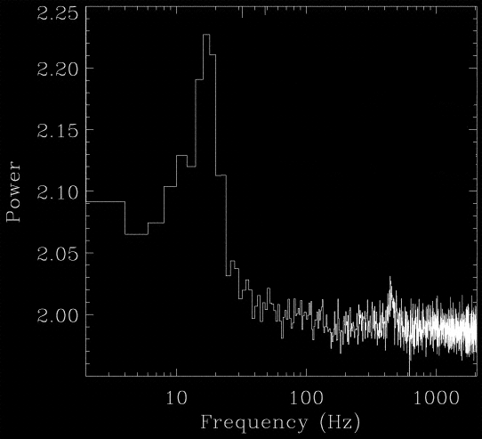
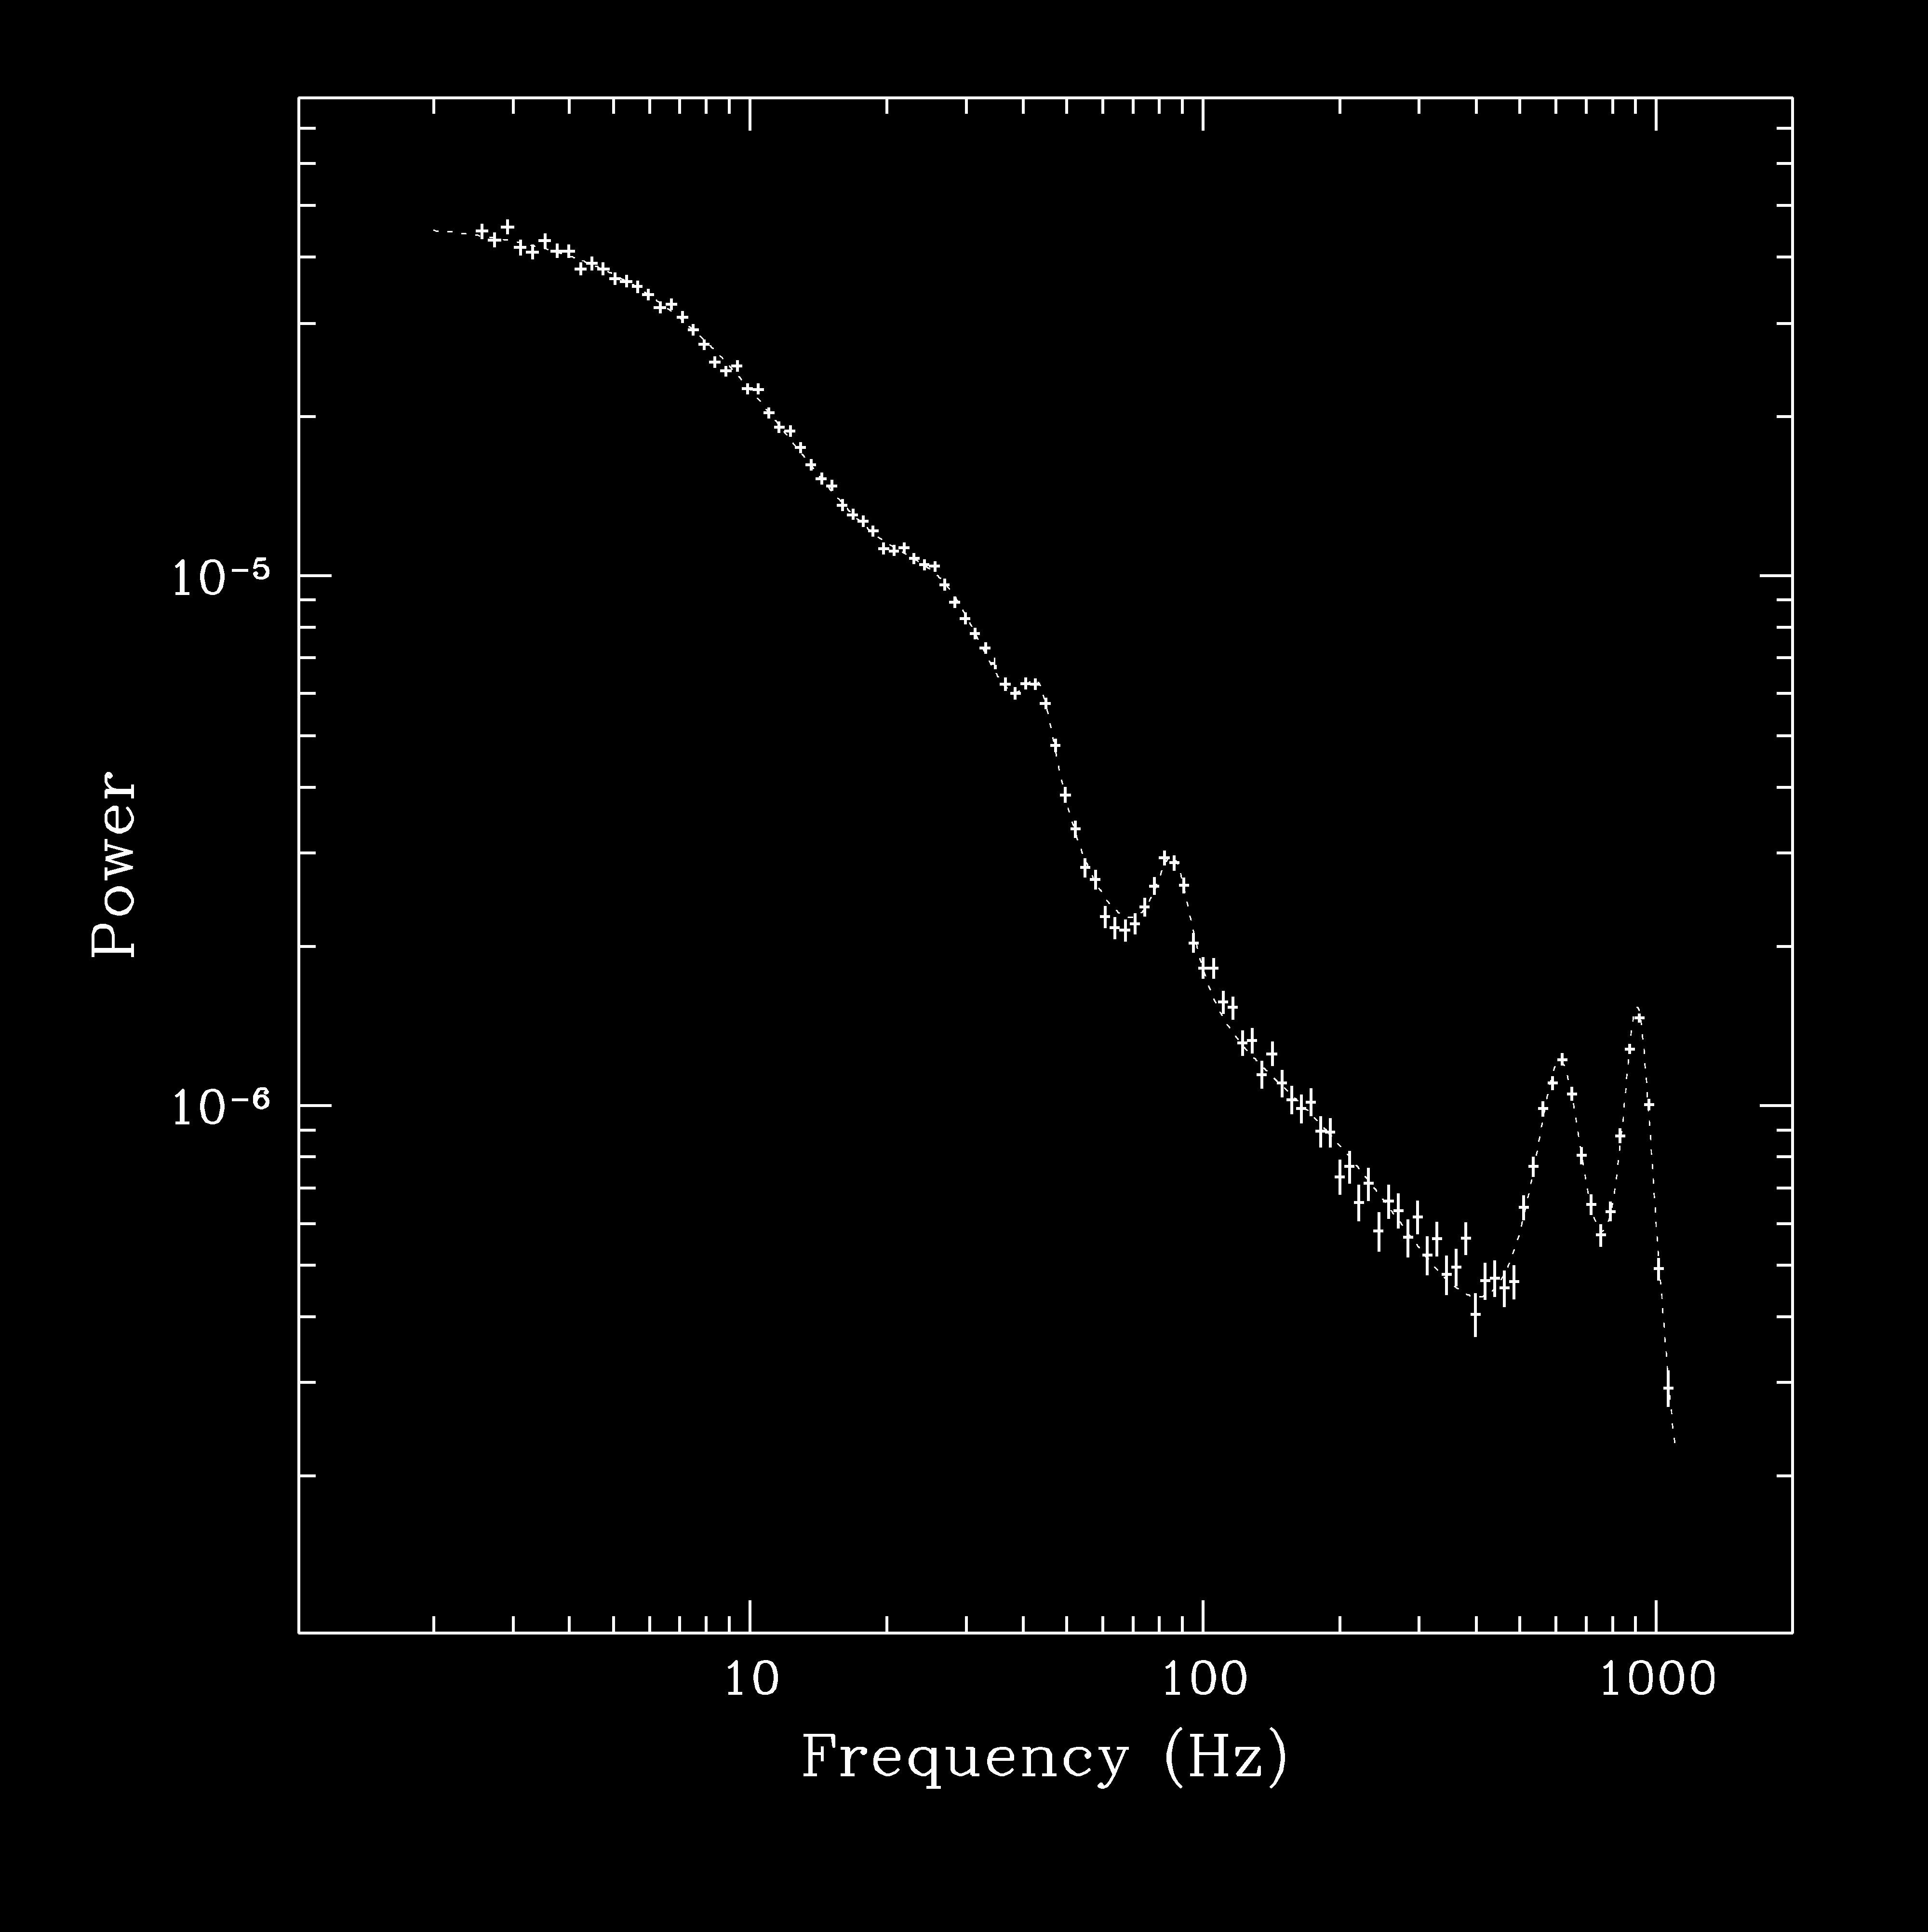
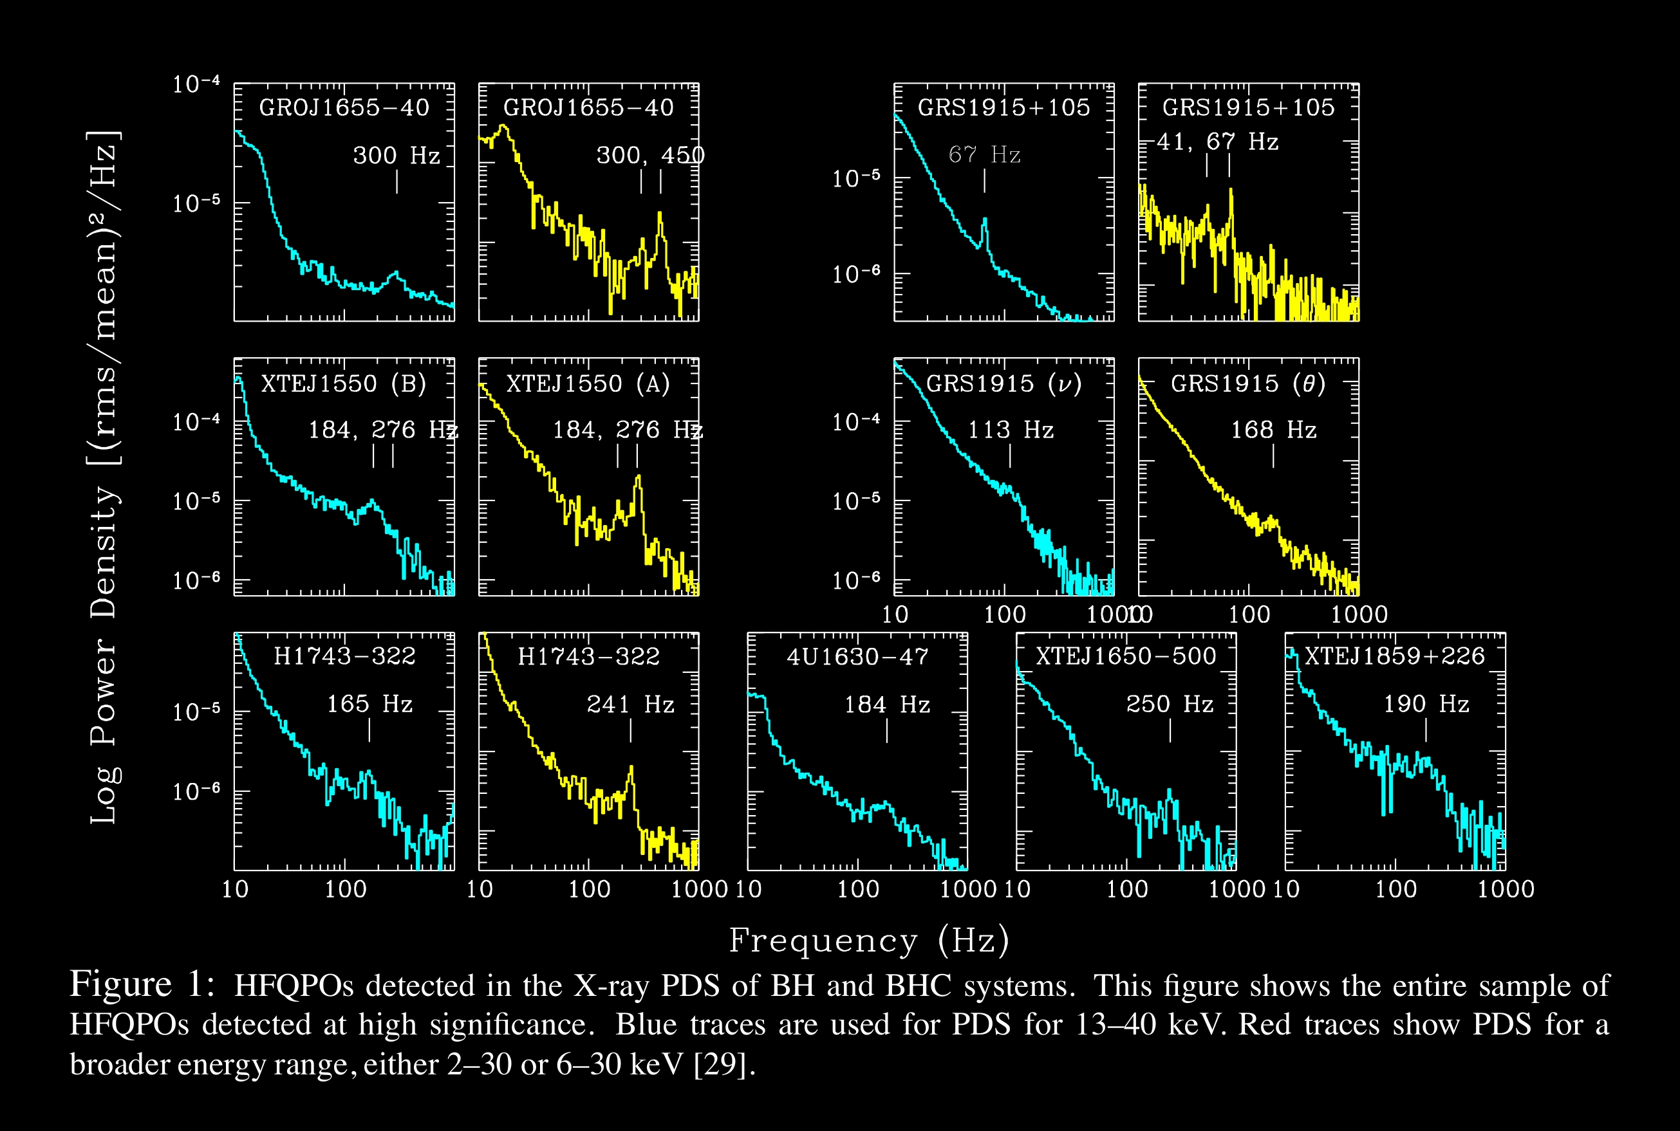
Probing strong gravitational fields with
Quasi Periodic Oscillations (QPOs)
Strong Field Diagnostic: Fast variability and
Quasi Periodic Oscillations
Accreting neutron stars Accreting black hole candidates
Sco X-1
10 100 1000
Frequency

Slide 8
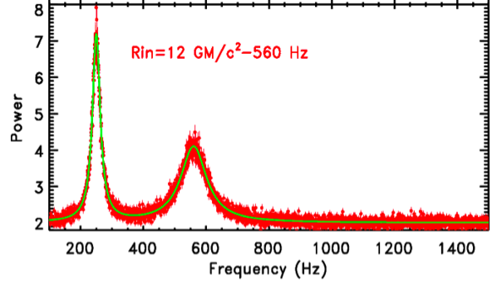
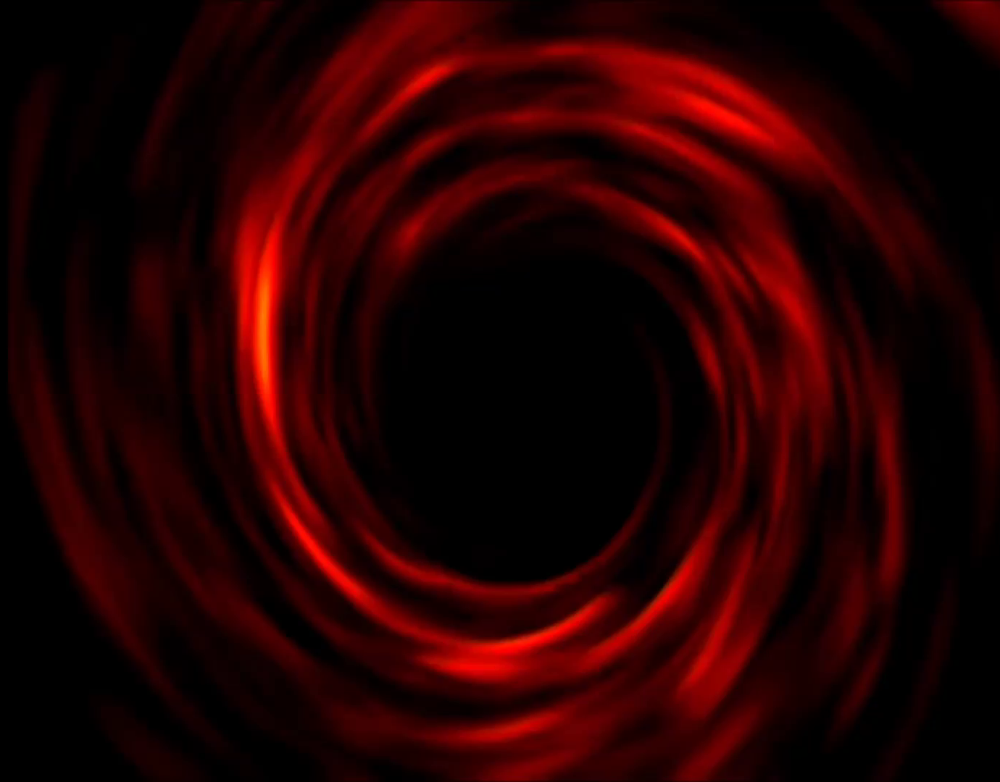
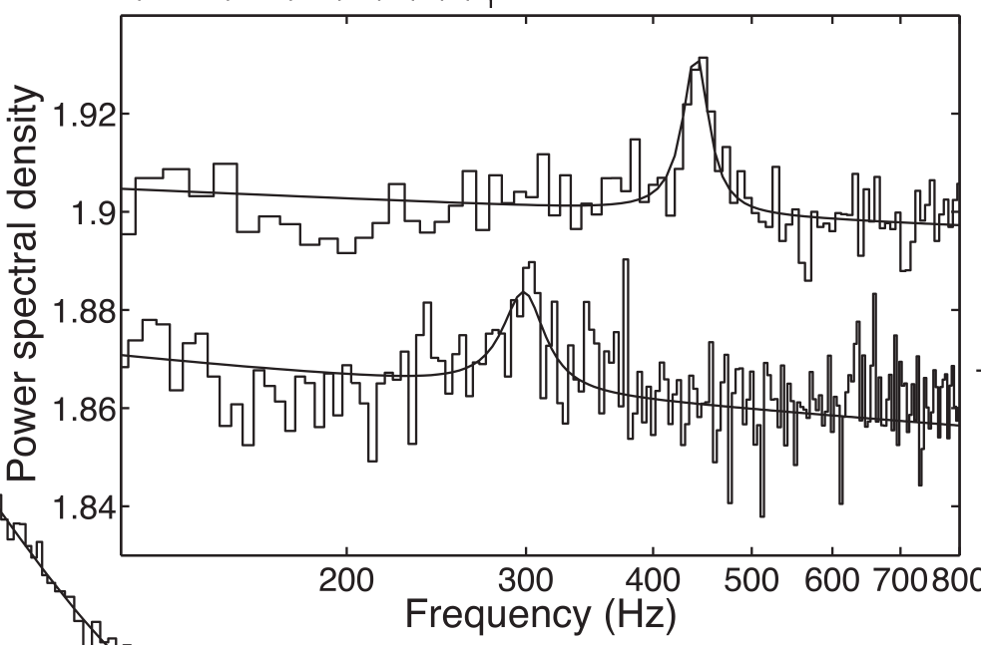
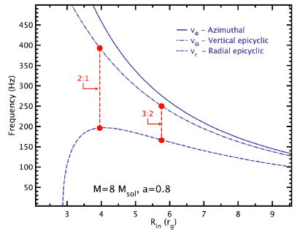
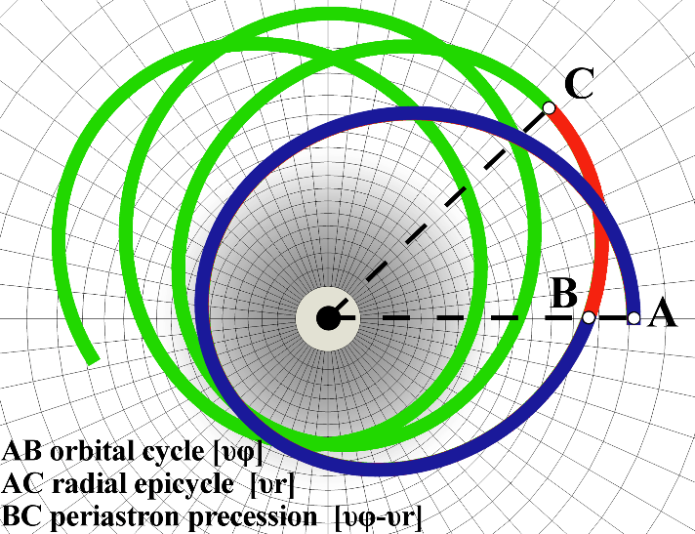
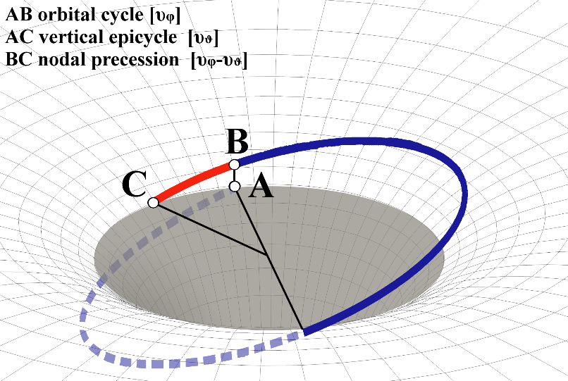
Strong field gravity diagnostics: Fundamental frequencies of motion
- Epicyclic Resonance (fixed r)
- Relativistic Precession: nodal and periastron
Frequencies of motion in strong gravity
Inhomogeneities in inner disk
eXTP:LAD 7 x S/N
BH in XRB / RXTE
GR orbital, epicyclic and precessional frequencies
Notes:
RXTE Motta was 1655, 5 PCUs on, 15 ksec
LOFT is Didier sim for 1608, 1 ksec

Slide 9
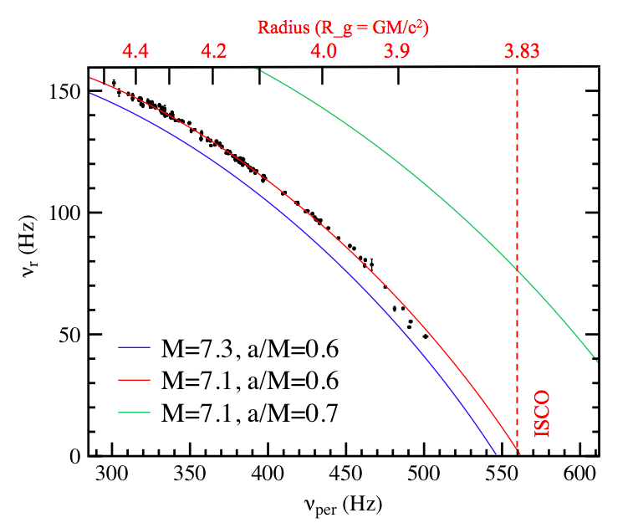
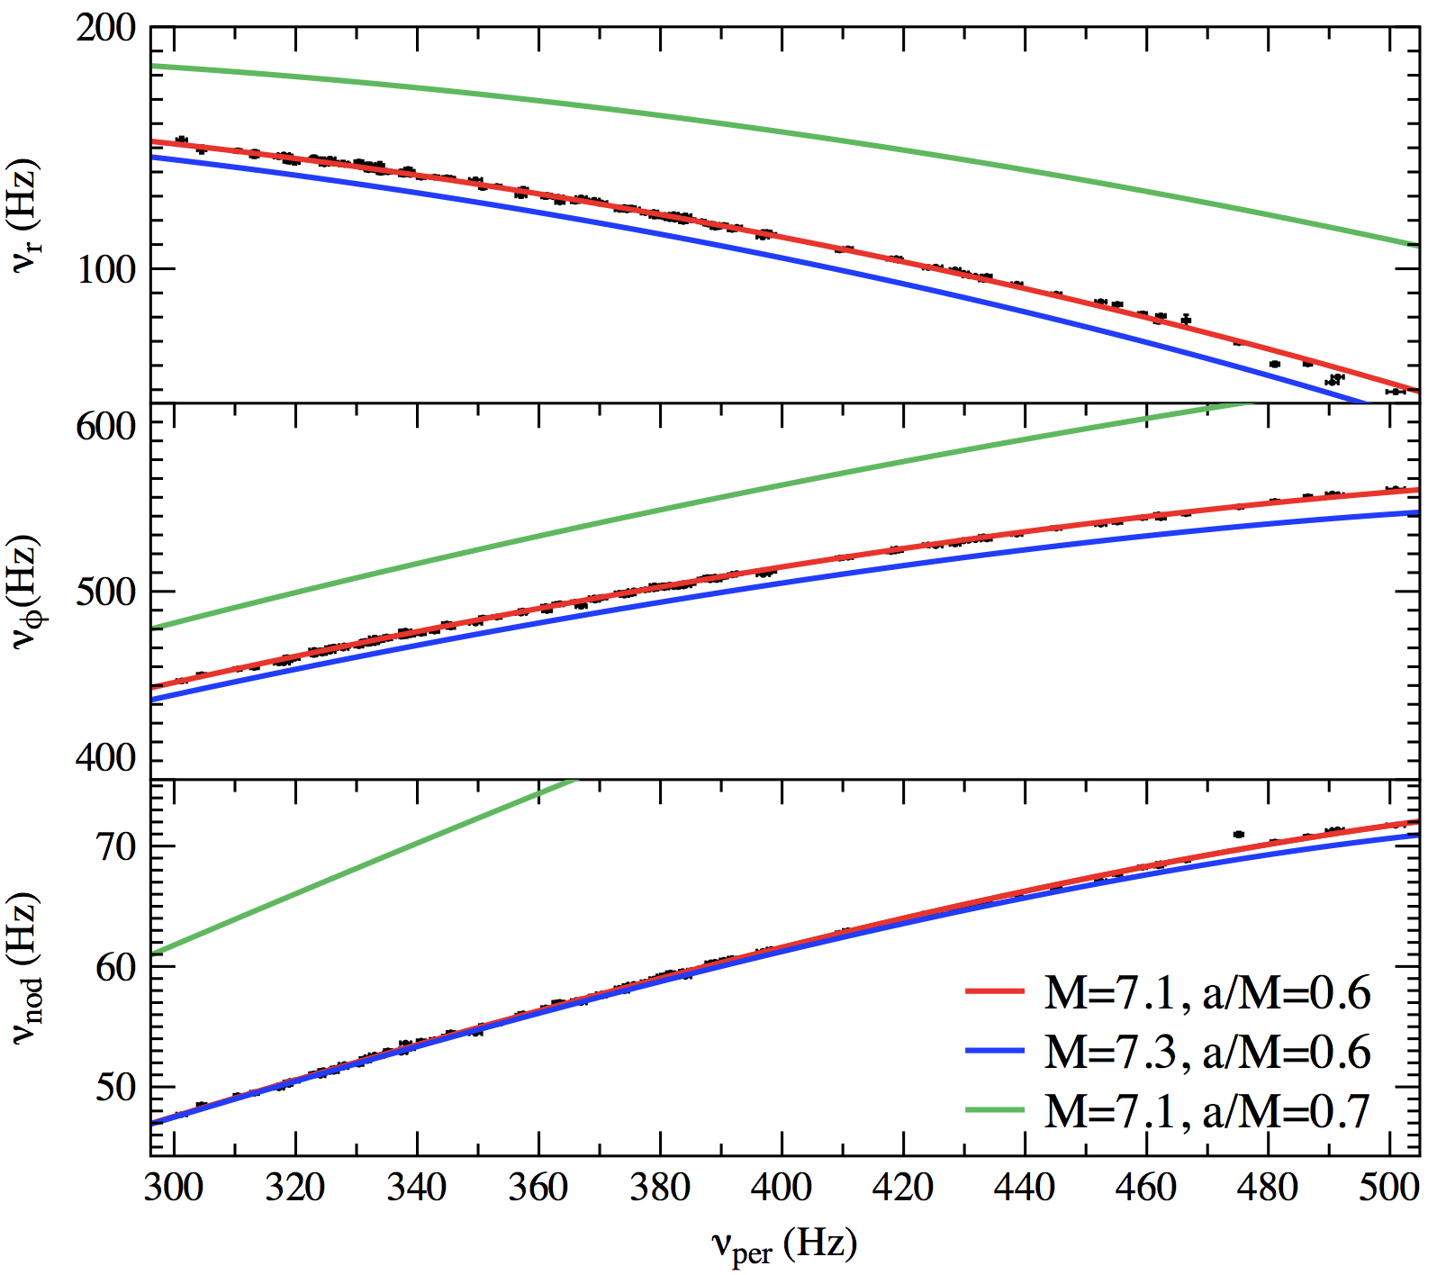
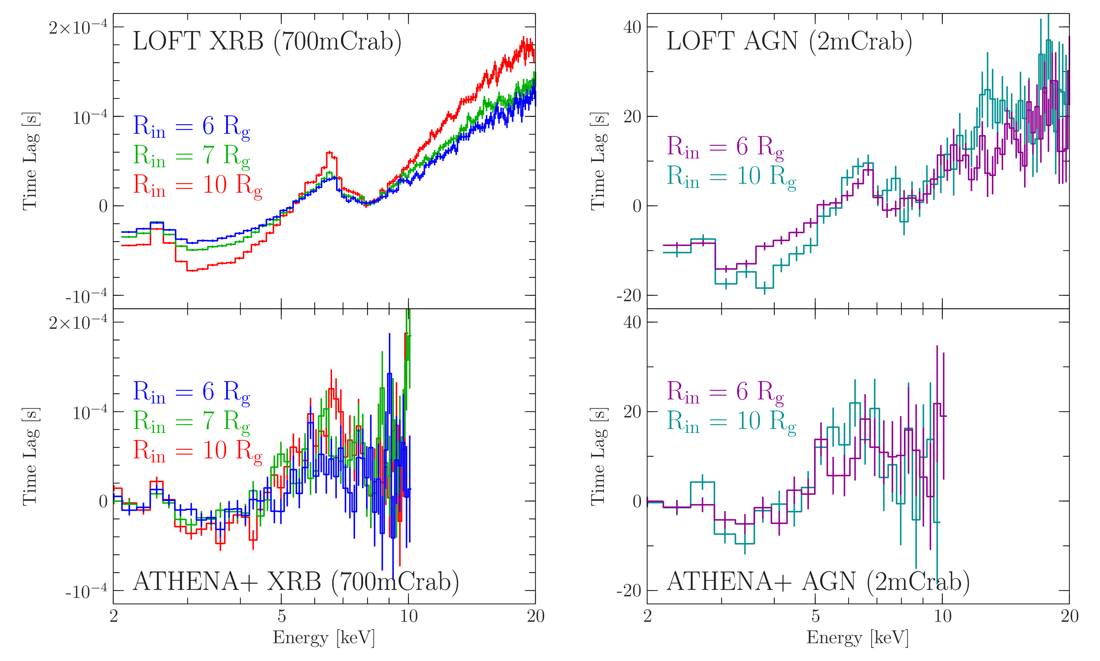
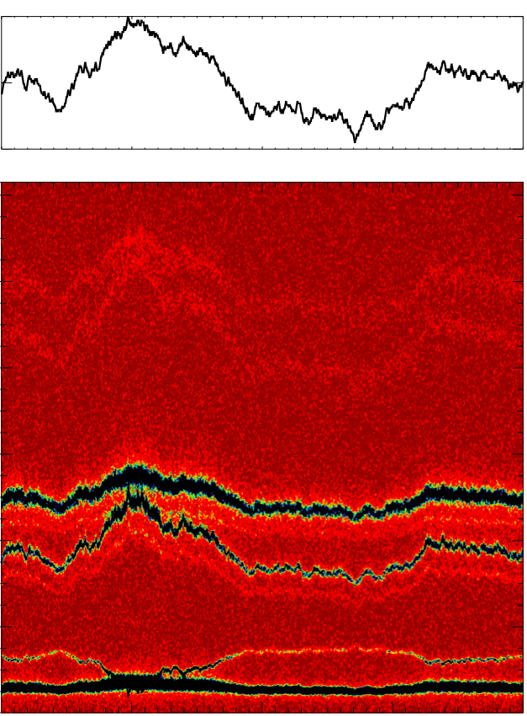
Timing diagnostics: relativistic epicyclic motion
1.1
600
X-ray flux (Crab)
Hz
Orbital frequency
a*=0.6
m = 7.1
1.0
0.9
a*=0.7
1200
Orbital and epicyclic frequencies
500
Hz
m = 7.3
800
400
300
400
500
Precisely measure orbital and epicyclic frequencies at each radius
Compare to GR predictions
Measure black hole mass and spin to < 0.3 % precision
400
0
0 1 2 3 4
TIME (ksec)

Slide 10
Polarimetry
Polarization degree
Polarization angle
Energy
150 ks exposure of GRS 1915+105 in the soft state. Blue and black curves show the expected dependencies of the polarization quantities on spin, while the black data points show the simulated data corresponding to the black curves.

Slide 11
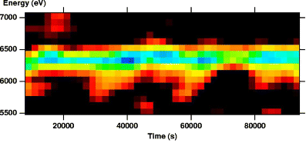
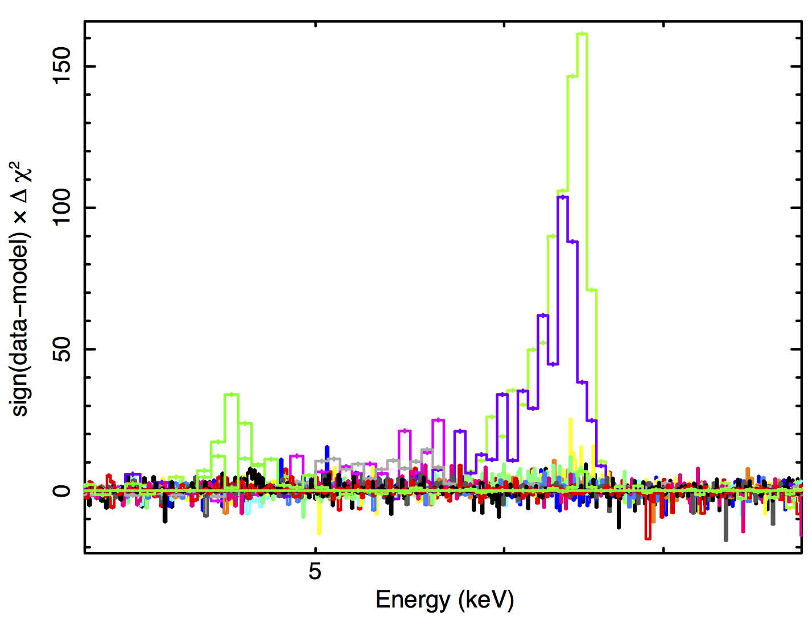
Spectral-Timing diagnostics
Doppler tomography: orbital motion in AGNs
Orbiting spot:
XMM observations of NGC3516
6 phases (1.5 ks each)
two cycles
r_{out}
r_{sp}
r_{in}
F=3mCrab, EW=30 eV, a=0.5, r_{in}=1r_{g}, r_{out}=100r_{g,}
M=3-4 10⁶ M_{sun}, a=0.4-0.6
De Rosa

Slide 12
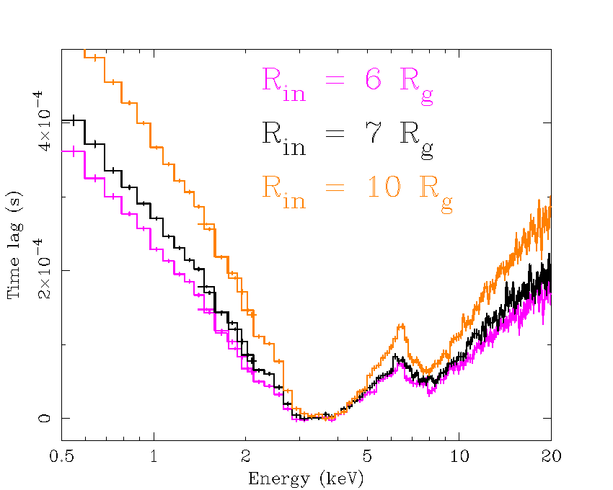
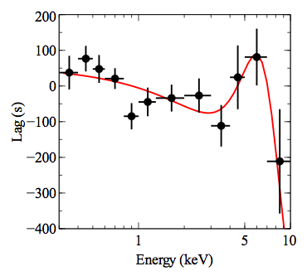
Spectral - Timing diagnostics
Reverberation: energy resolved light echoes
Probe disk velocity/redshift map as radiation fronts propagate over the disk
Relativistic effects as a function of absolute radius (e.g. km)
Disk reverberation
lags hot
continuum
to observer
Δt
variable (flux, geometry) hot continuum source
thermal disk
In addition to the iron line and reflection continuum, the absorbed flux is reradiated by the disc as thermal blackbody radiation
eXTP can study all three components simultaneously!
9 SFA + 40LAD
Uttley

Slide 13
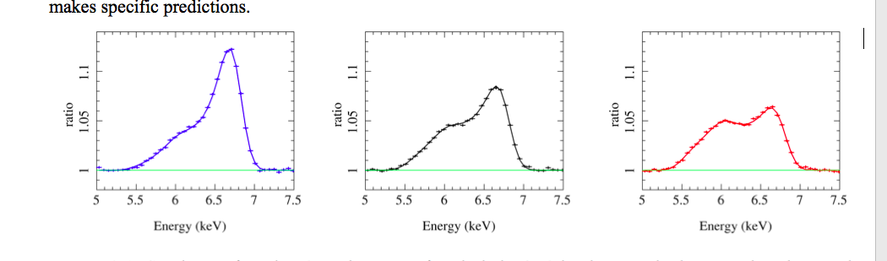
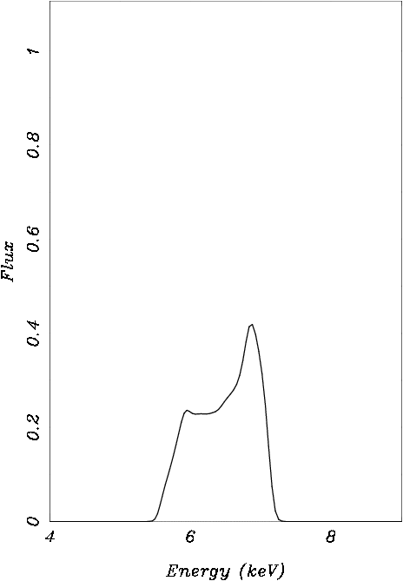
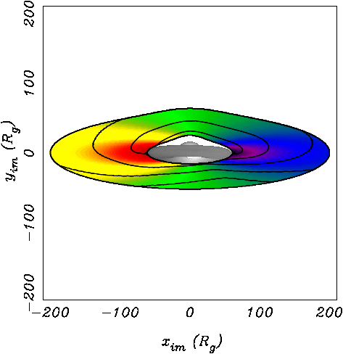
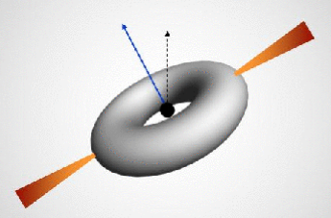
Frame dragging nodal precession
Precessing hot torus:
reverberation
Frame dragging: central hot torus precesses
Hard radiation sweeps around over disk
Reflection line profile varies periodically
eXTP tracks the line profile, probing the disk velocity and redshift map
Ingram & Done 2012

Slide 14
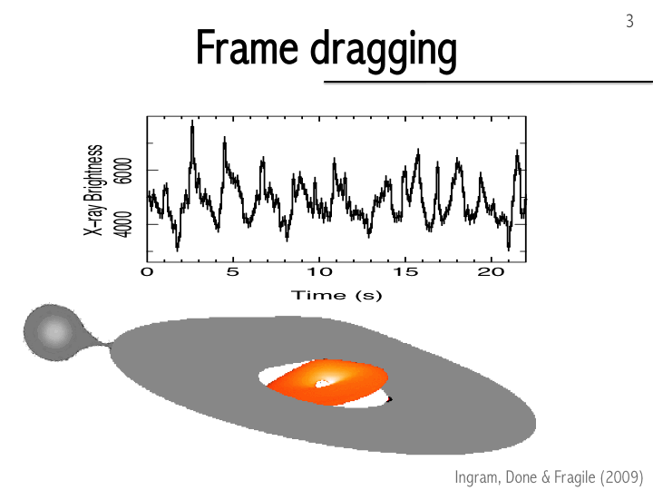

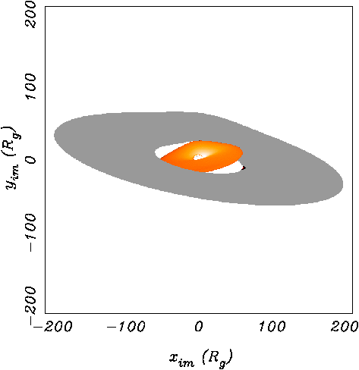
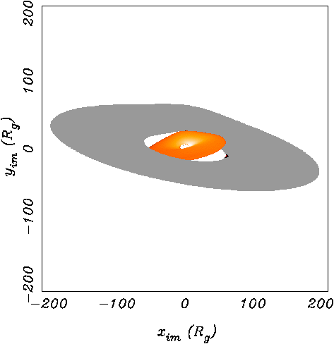
Frame dragging nodal precession:
timing (QPO) diagnostics
H 1743-322 – XMM
Ingram + 2017

Slide 15
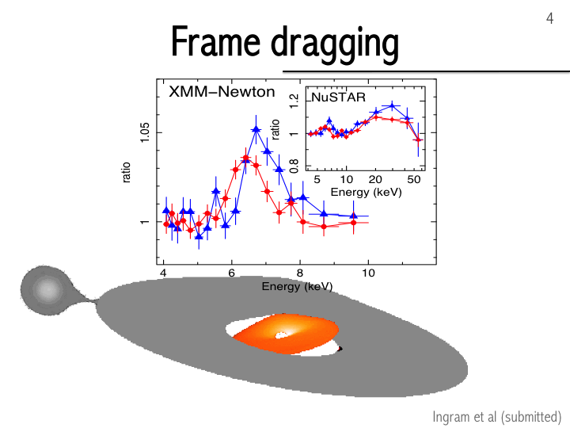
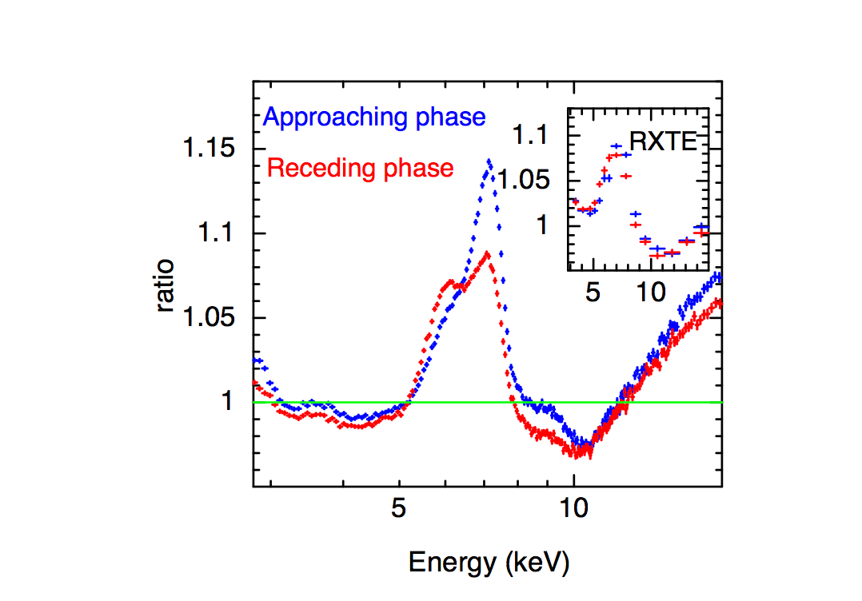
Frame dragging nodal precession:
timing-spectral (Fe-line) diagnostics
GRS 1915+105
H 1743-322
eXTP
Ingram

Slide 16
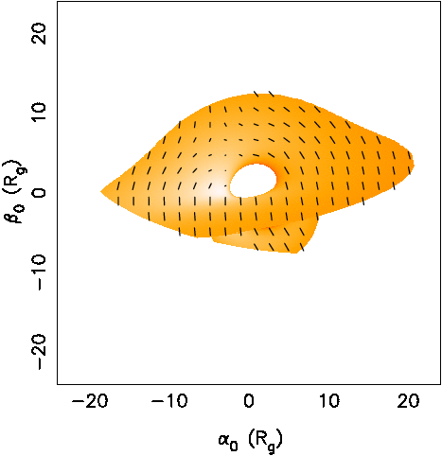
Frame Dragging: timing-polarisation diagnostics
Polarization of processing inner torus
R_{o}=20R_{g}, a=0.98
- polarization degree and angle affected by strong field light bending
- precession changes geometry and thus modulates polarization
Ingram + 2017

Slide 17
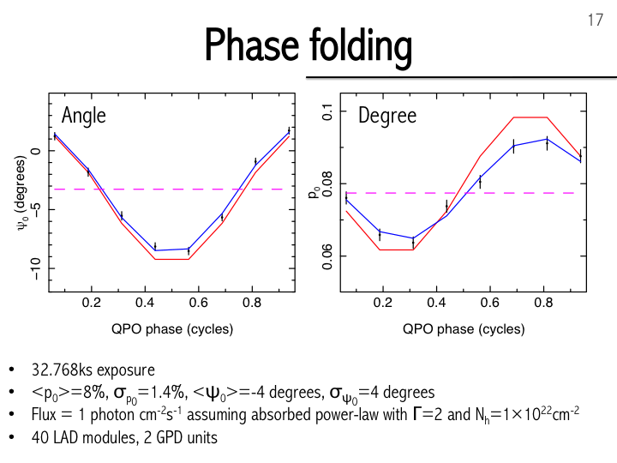
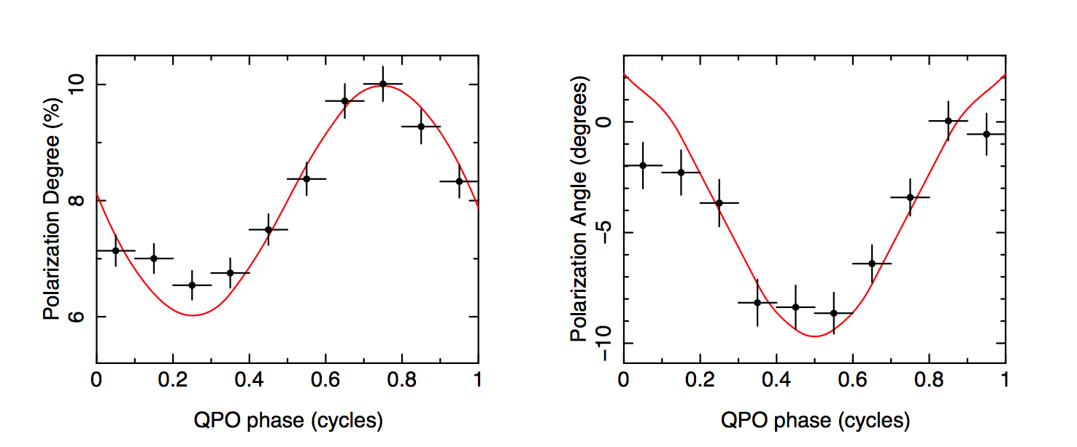
Frame dragging: eXTP polarization measurements
Only eXTP can study frame dragging through the combination of Timing-Spectral-Polarimetry
Ingram + 2017

Slide 18
Strong Field Gravity
Doppler Tomography
Iron Line (+reflection) Diagnostic
Reverberation Mapping
STRONG FIELD GRAVITY
Low Frequency QPOs
Spectral-Polarimetry
High Frequency QPOs
eXTP: variety of diagnostics to study gravity in the strong field regime.

Slide 19
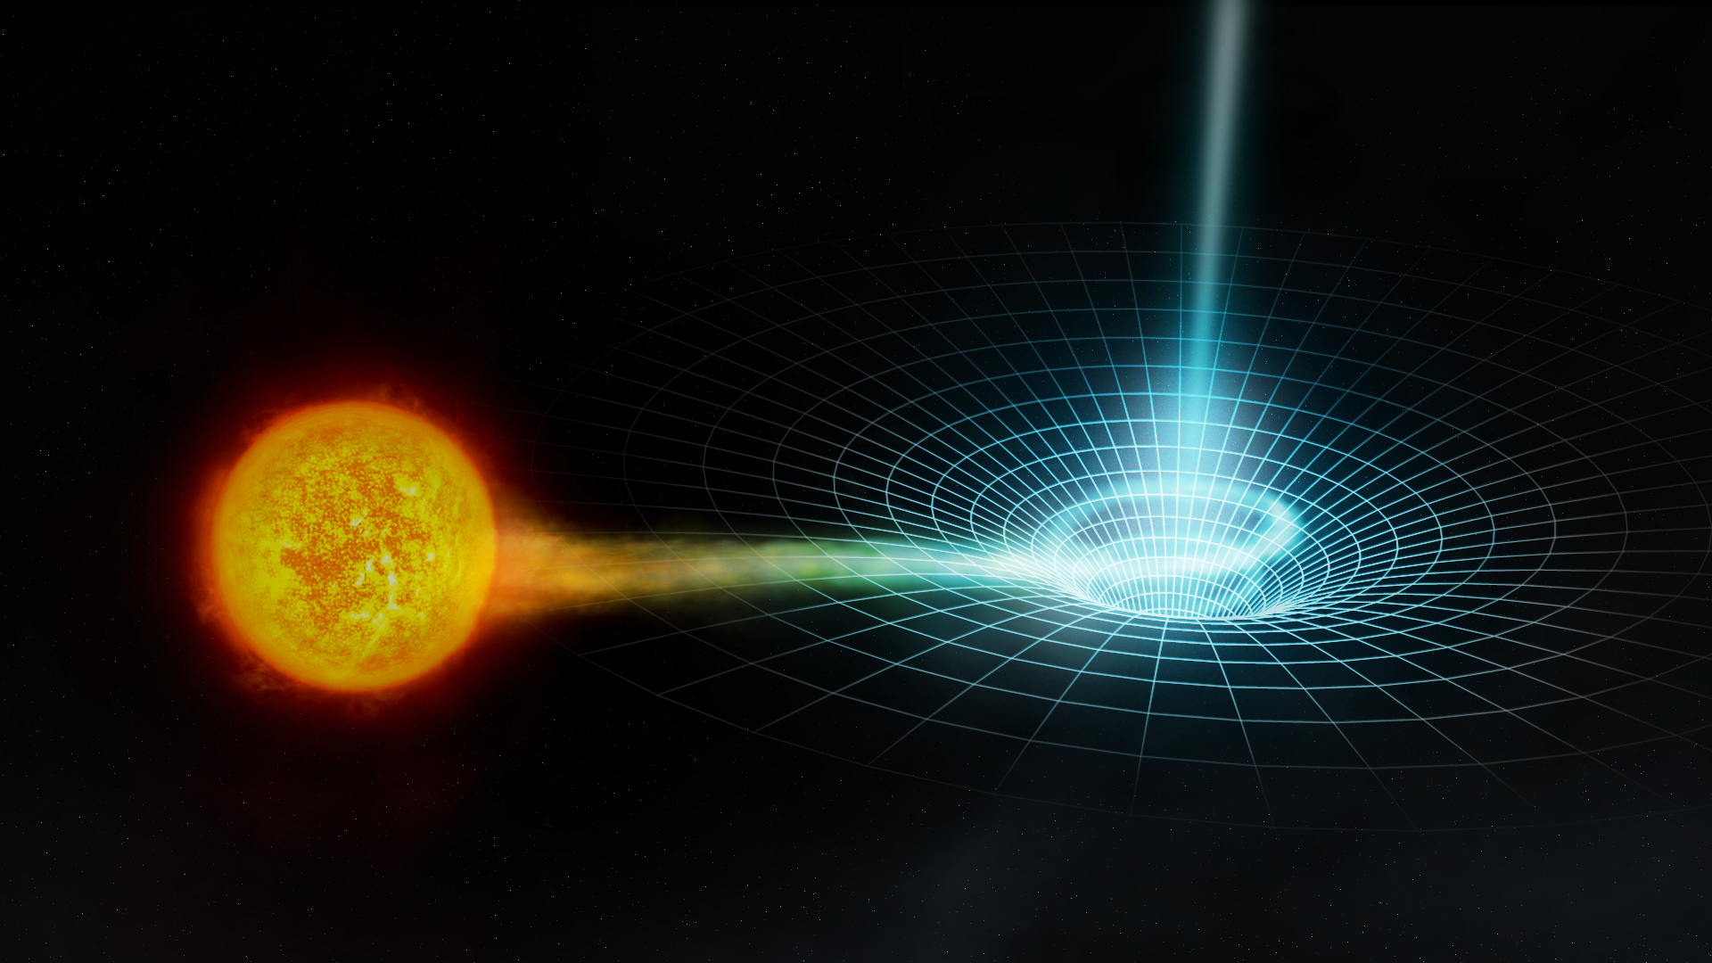
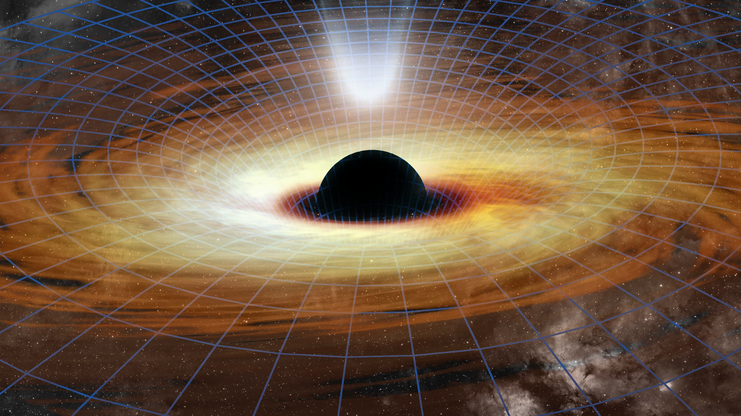
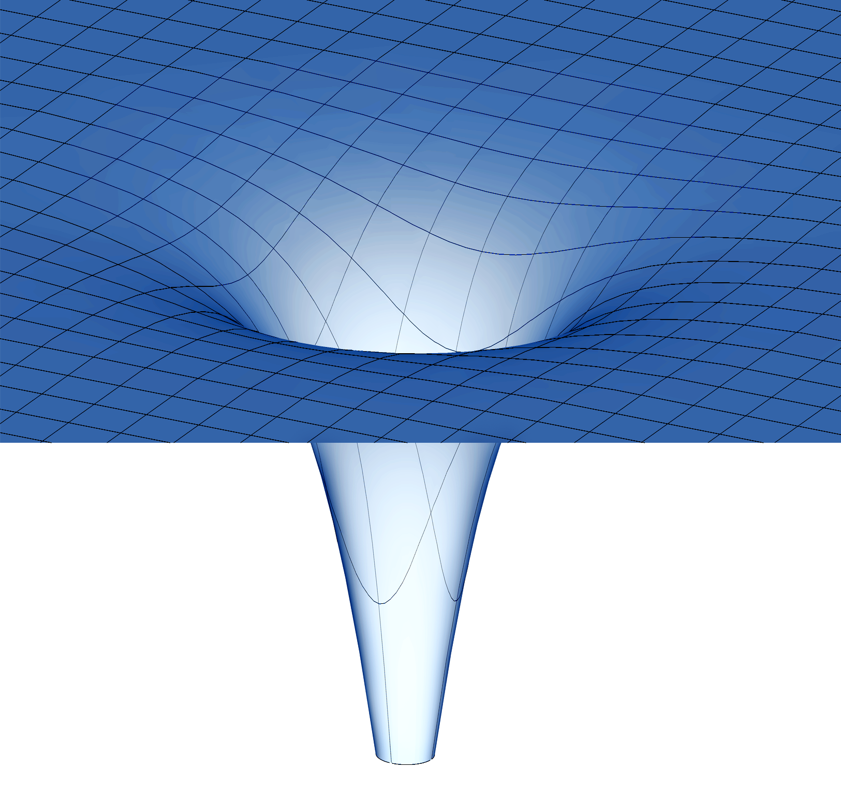
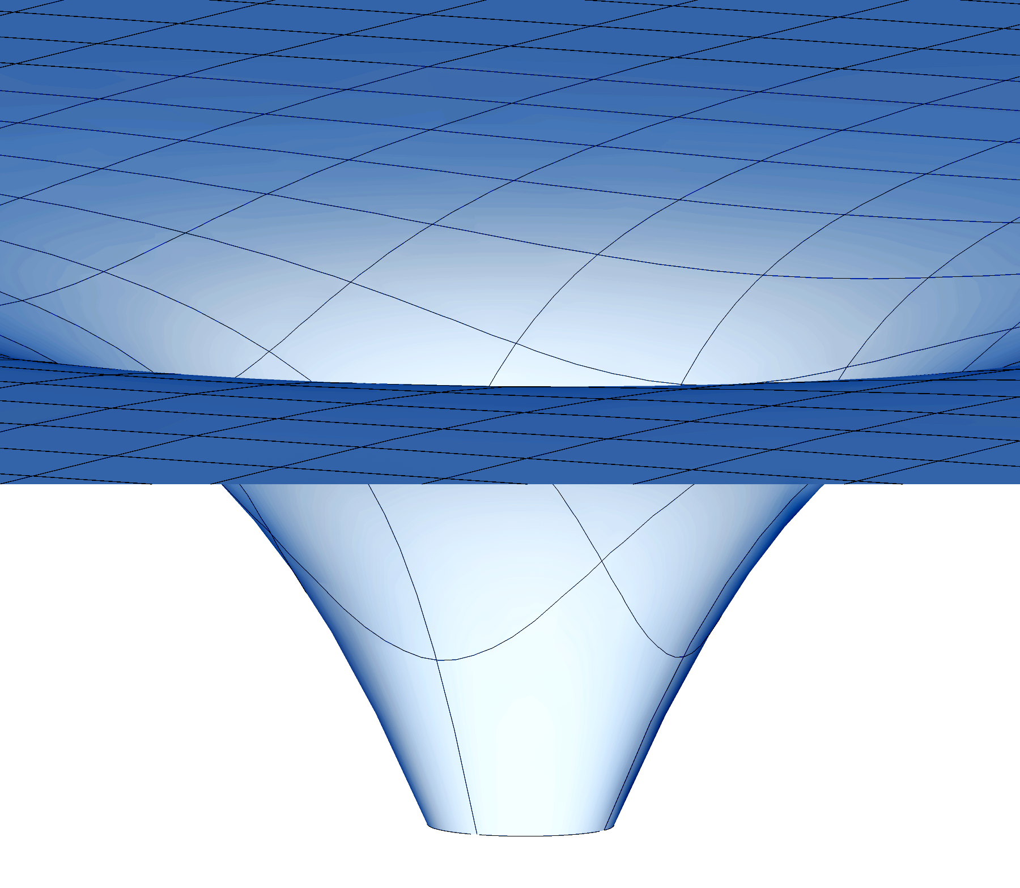
Accretion in strong field gravity: mass range
X-ray binary system
Active galactic nucleus
eXTP covers a very wide mass range in uniform setting
Stellar mass black hole
(or neutron star)
Strongly curved spacetime.
(10¹⁶ times Solar)
Supermassive black hole
Weakly curved spacetime
(~Solar)
Complementary to gravitational wave experiments:
eXTP probes stationary spacetimes

Slide 20
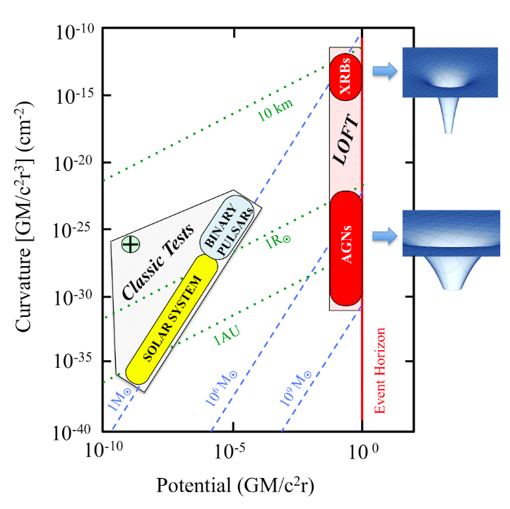
factor 10¹² in curvature
eXTP
Test/constrain alternative theories of gravity that differ from GR only in the strong field regime, through X-ray diagnostics like Fe-lines and QPOs
factor 10⁵ in field strength
Maselli
Notes:
GR SAYS CURVATURE DOESN’T MATTER – TEST THIS

Slide 21
ET
LIGO/Virgo
LISA
PTA
EHT

Slide 22


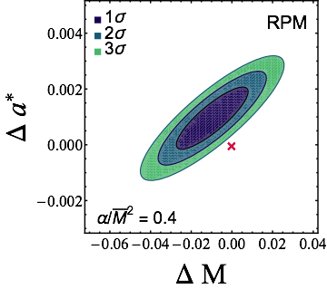



Test (or constrain) gravity theories that differ from GR in the strong field/high curvature regime”
  Bottom-up approach: parametrised spacetime (PPK-type) but in strong field
  Top-down approach: 1st principle modifications of GR
  (e.g. quadratic curvature term coupled to a scalar field)
  Fundamental frequencies in Einstein Dilaton Gauss Bonnet:
)
HF QPOs:
Bayesian MCMC analysis on a BH with
+
LF QPOs:
eXTP could detect values of
> 0.4
complementary to LIGO/Virgo constraints
Maselli + 2015, 2017

Slide 23
eXTP Themes
Dense matter
Accretion in strong field gravity
Strong magnetism
Observatory science

Slide 24
QCD diagram
FAIR (GSI), NICA (JNR), ASY-EoS(GSI-INFN)
LHC
eXTP
Neutron
Star
NSs access a unique region at T<<1 MeV, highest density

Slide 25
The interior of a NS
In the simplest picture: core is a uniform charge-neutral fluid of neutrons n, protons p, electrons e⁻, and muons μ⁻ (equilibrium with respect to the weak interaction, β-stable nuclear matter)
Anna L. Watts et al. Rev. Mod. Phys. 88, 021001 (2016)

Slide 26
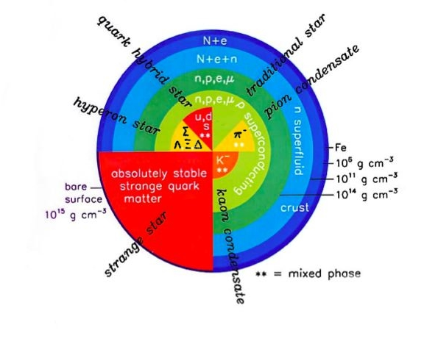
Dense Matter Diagnostic:
Neutron star structure and equation of state (EOS)
The behaviour of matter at densities above nuclear density
but at low temperature is not well understood.
Earth-based experiments like the Relativistic Heavy Ion Collider
(RHIC) provide information only about the very high T phase
Different hypotheses include
different particle species and
phases of matter in the core
Each of the possible equations
of state (EOS) provides different
predictions about the possible
masses and radii of NS.
Major goal of studying NS is to
make measurements that constrain
the EOS of dense matter.
Lattimer/Morsink

Slide 27

EOS
Nucleonic
The strong force determines the ‘stiffness’ of neutron star matter.
This is encoded in the
Equation of State.
Strange
cores
Chiral EFT models
Quark stars

Slide 28


Stellar structure equations
EOS
M-R
Must measure both M and R to high precision
(low statistical and systematic errors) for a range of M.

Slide 29

Pulse Profile Modelling
Spectrum
A Hotspot forms on the surface of the neutron star and radiates:
Relativistic effects: Light-bending, Gravitational & transverse redshift, Doppler shifts, aberration, local time dilation
→ encode information about mass M and radius R in the pulse profile.
Pulse profile
By fitting the pulse profiles we can reconstruct mass and radius…
Simulations (Hartle-Thorne spacetime) by Riley

Slide 30

Pulse Profile Modelling
Riley, Raaijmakers & Watts 2018; Raaijmakers, Riley & Watts 2018
Notes:
We illustrate the response of monochromatic pulse profiles to variation of the (circumferential) equatorial radius, whilst all other parameters are fixed at the values implemented in Figure 4. We use the realistic exterior spacetime described in Figure 4. The two synthetic stars shown are of equal gravitational mass and spin frequency, but have equatorial radii of 10 and 12 km; these stars require distinct EOS models to exist. The pulse profiles are clearly sensitive to the equatorial radius, and it is the need to detect such differences that drives the design requirements for eXTP.

Slide 31

ms spinning (rotation-powered) Radio Pulsars

Slide 32



ms spinning accreting neutron stars

Slide 33




Bursts and Bursts Oscillations
Spin axis
In some bursts anomalously bright patches form. There are known as burst oscillations.
Strohmayer et al., 1996.

Slide 34

Few per cents accuracy on both M and R!
Combining PPM modelling and polarimetry, and burst spectra
we get the orange solid spot!

Slide 35


Occultation of Fe-line profile by neutron star body
Occulted Fe-line profile:
Diagnostics of neutron star
R/M
La Placa + 2019

Slide 36

Searches for very fast spins
Neutron stars spin up via accretion.
Spin can be measured via pulsations, which are mostly weak/intermittent.
Spin rates constrain EOS, e.g.
via mass-shedding limit.
eXTP will allow full characterization of the
spin distribution of accreting neutron stars.

Slide 37



Magnetar Seismology
Starquakes on magnetars trigger global seismic vibrations.
At present we have data from only the rarest, most energetic events.
Seismic models depend on M and R. Frequencies constrain the EOS.
eXTP will be sensitive to seismic vibrations from smaller starquakes, driving the emerging field of neutron star asteroseismology.

Slide 38

These are not independent quantities: universal relations (Yagi & Yunes, Phys. Rept. 601, 1, 2017)
Quadrupole moment measurements
Measurements of the Love number from GW observations
Q - quadrupole moment
?
provides strong bounds, but very difficult to extract from GW
QPOs from accreting NS encode information of the stellar quadrupole moment
eXTP could be our best hope to measure Q and open a new window on the EoS
(Maselli et al., arXiv:1905.05616)

Slide 39


Monte Carlo Markov Chain analysis on QPOs data from
3 sources observed by RXTE:
4U1608-52, 4U0614+09, 4U1728-34
Consistency checks of QPO model
Preliminary measurements of
the source mass and spin
More accurate constraints on Q
are required: we need eXTP
Converting the quadrupole into the NS radius
Maselli + 2019

Slide 40
Dense matter (DM): synopsis
Pulse Profile modelling
Accretion flows in the disks of NS LMXRB
Combining techniques
Burst Oscillations
Relativistic Fe Line
Burst spectra + polarimetry
Dense Matter
Accreting millisecond pulsars
Kilohertz
and slow QPOs
Magnetar Seismology
Pulse Profile modelling

Slide 41


Equation of state with eXTP
measures both M and R.
minimises statistical error with its large effective area.
minimises systematic error with complementary methods and same source cross-checks.
relies only on known sources to deliver the required number of data points.
Different approach to EoS than NICER, SKA, LIGO/Virgo

Slide 42
Classes of Models
Two main classes of models for dense matter inside a compact star:
Models without a strong first order phase transition.
  Models with only nucleons
  Models with nucleons and hyperons(+ Hybrid Star [quarks in inner core])
Models in which there is a strong first order transition, typically to deconfined quark matter.
  Models in which quark matter occupies only the center of the star
  Models in which stars entirely made of strange quark matter can exist

Slide 43
Purely nucleonic stars: an example
Lonardoni, Lovato, Gandolfi, Pederiva; PRL 114 (2015) 092301
Very strongly repulsive three-body forces keep density low and increase the threashold of hyperon production.
The R_{1.4} is of about 13 km.
In this scheme even very massive are made only of nucleons.

Slide 44
Hyperonic stars: an example
Domenico Logoteta, Isaac Vidana and Ignazio Bombaci, EPJA (2019) 55: 207
Effect of the NNΛ nucleon-nucleon-lambda (NNΛ) three-body force recently derived within the framework of chiral effective field theory at next-to-next-to-leading order together with realistic nucleon-nucleon, nucleon-nucleon-nucleon and nucleon-hyperon interactions. The inclusion of the NNΛ force leads to an equation of state stiff enough that the resulting neutron star maximum mass is compatible with the largest currently measured (∼ 2 M) neutron star masses.
Hyperons can thus be present at least in the more massive compact stars. Their presence softens the EoS and allows for smaller radii

Slide 45
Models with a strong phase transition: the «twin stars» configurations
Small radii are possible if the sound velocity of quark matter is close to 1
Alford, Burgio, Han, Taranto, Zappalà, PRD92 (2015) 083002
Radii smaller than about 11.5 km for stars of M = 1.4 M_{s} are possible
ONLY if c² is close to 1 and for Disconnected configurations.

Slide 46
Models with a strong phase transition: two-families of compact stars
Stars made of hadrons co-exist with stars made of strange quark matter
G. Wiktorowicz, A.Drago, G. Pagliara, S. Popov; Astrophys. J. 846 (2017) 163
The existence of strange quark stars is based on the validity of the validity of the Witten’s hypothesis, telling that the absolute ground state of matter is made of a mix of deconfined up, down and strange quarks.
The velocity of sound in quark matter need not to be close to 1 in this scheme.
Massive stars have larger radii, at variance with models based on one family and with the twin stars scenario.

Slide 47
NEUMATT NEUtron star MATter Theory:
The equation of State of Nuclear Matter and Neutron Star Structure
The main goal of this research is to discover the composition of matter at supra-nuclear density, which, in turn, would allow us to map in a more complete way the phase diagram of matter under extreme conditions.
A few fundamental questions wait to be answered:
At which baryonic densities do quarks start to deconfine? Is there at all a deconfinement critical density?
Is Witten’s hypothesis about the absolute stability of strange quark matter realized in compact stars?
Are supernova explosions and gamma-ray bursts associated to phase transitions in dense matter?
These questions are deeply connected with another problem: at which densities can strange hadrons be produced and what is their impact on the equation of state of matter?

Slide 48
eXTP Themes
Dense matter
Accretion in strong field gravity
Strong magnetism
Observatory science

Slide 49


QED and Vacuum Birefringency
Is the propagation of light in vacuum modified by the magnetic field? Interaction of light with EM field
QED predictions:
Birefringence of the vacuum
Star magnetic field B
O-mode E field
X-mode E field
O-mode: E-field oscillates in the k-B plane
X-mode: E-field oscillates perp. to the k-B plane
Very small effect
Hard to measure on Earth
Effect is substantial in the vacuum near highly magnetic neutron stars

Slide 50


QED & vacuum birefringence
Reflective twisted-nematic liquid crystal display (LCD) Light reflected by surface (6) (or coming from a backlight) is horizontally polarized (5) and passes through the liquid-crystal modulator (3) sandwiched in between transparent layers (2, 4) containing electrodes. Horizontally polarized light is blocked by the vertically oriented polarizer (1), except where its polarization has been rotated by the liquid crystal (3), appearing bright to the viewer.
Where vacuum birefringence is active, the NS magnetic field “drags” light polarization
(as in a LCD “off”)
LCD OFF
LCD ON

Slide 51



Strong Magnetism
QED effect: vacuum birifringence in high B-fields
different index of refraction in O-mode and X-mode
- QED effects:
* Mode conversion in NS atmosphere
* Polarisation evolution in NS magnetosphere:
Polarisation fraction boost
⇒ First ever experimental confirmation that the light interacts with itself
Heyl, Lai, Zane, Turolla

Slide 52
eXTP Themes
Dense matter
Accretion in strong field gravity
Strong magnetism
Observatory science

Slide 53
Observatory Science subjects
Terrestrial Gamma-ray Flashes
Stellar flares
Cataclysmic variables
LMXBs
HMXBs
Accretion and ejection
Thermonuclear flashes on neutron stars
Pulsars
Tidal disruption events
Flares on AGN and Blazars
Gamma-ray bursts Supernova remnants
Galactic Center
eXTP synergy with other messengers:
Gravitational Waves, TeV, neutrinos

Slide 54
eXTP key science goals – Luigi Stella (INAF-OAR)
behavior of matter and light under extreme conditions of density, gravity and magnetism
Dense Matter: which is the state of matter at supranuclear densities (i.e., in the neutron star’s interior)?
Exotic states of matter? Quark stars?
Strong Gravity: what are the properties of space-time under extreme gravity (i.e., in the vicinity of neutron stars and black holes)? Any deviations from Einstein’s General Relativity theory?
Strong Magnetism: which is the behavior of light in the presence of ultra-strong magnetic fields (e.g., in magnetars)? Are the predictions of the QED theory verified?
Observatory science: GW merging events involving neutron
star(s), TeV sources, neutrinos
Notes:
eXTP main cores is fundamental physics, and in particular three topics will be addressed by the mission.

