Slide 1
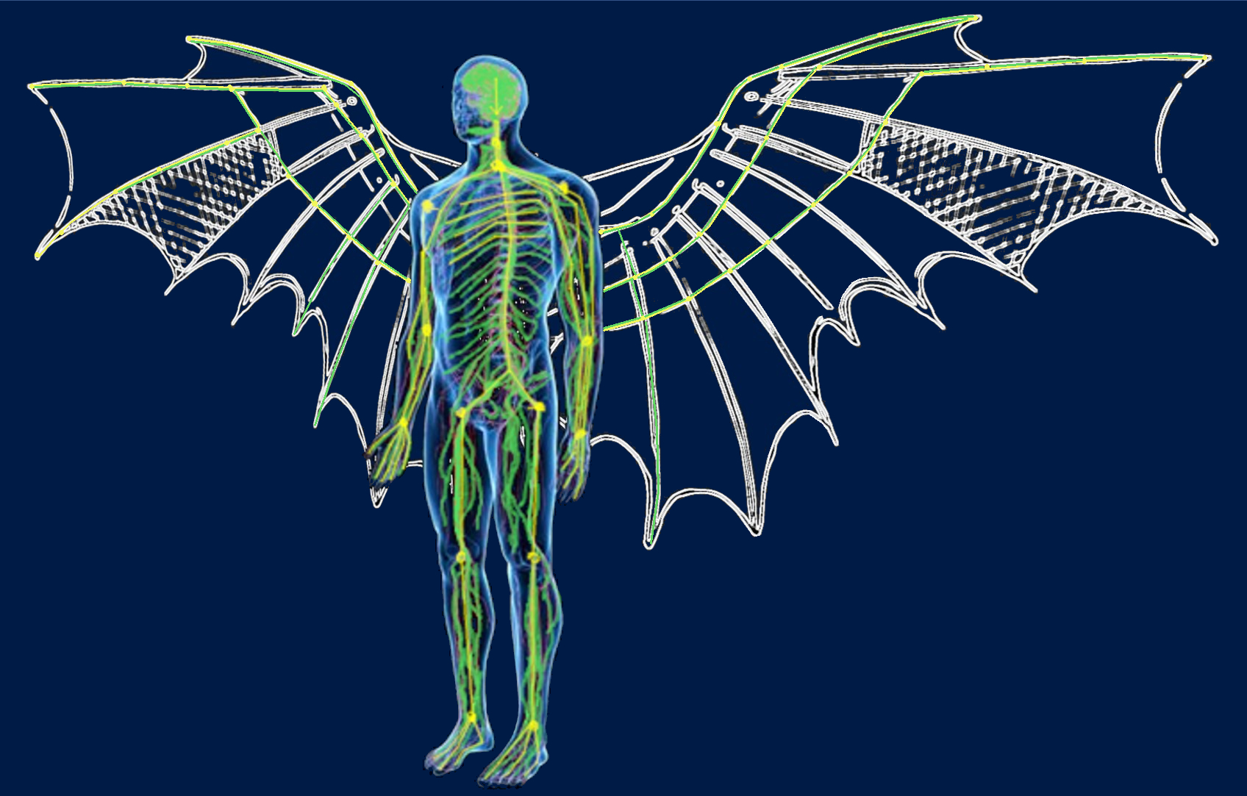

Mimic Nature, seeking for intelligent engineering system
Cristian Vendittozzi
vendittozzi@aerospace.unb.br
07 November 2019
INFN Frascati (Rm) - Italy

Slide 2
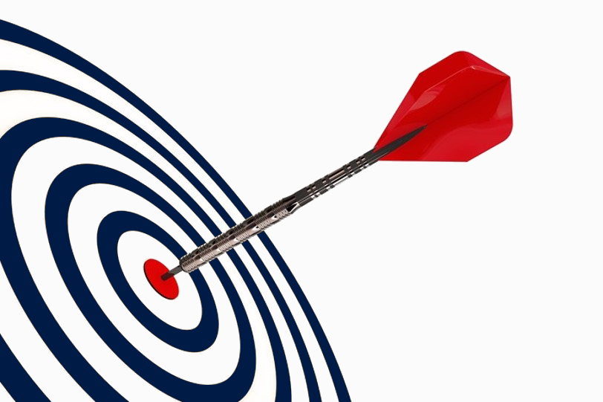

STRUCTURE
Introduction
Basic definitions
Biomimetic
Case studies
Aerospace applications
My interpretation and focus
07/11/2019 INFN, Frascati (Rm)
2

Slide 3
Few words about me …
I am associate professor at the Aerospace Engineering course at the University of Brasilia (Brazil).
I holds a Master degree in Aerospace Engineering, a Ph.D. in Materials and Raw Materials Engineering, both from Sapienza, Rome University (Italy).
Currently he I am dealing with the development of highly distributed optical fiber sensor systems for the monitoring of critical parameters in aerospace structures, the Intelligent monitoring of environmental disasters and the study and development of foldable systems that can be used for space applications.
For 2019, I am invited Scholar at CIRA (The Italian Aerospace Research Centre) to deepen concepts related to morphing and adaptive structures.
I have strong interest in biomimetic, trying to couple what I learned previously with the idea of developing a meta-material that can be printed (3D) and that can be able to change shape if properly stimulated (+ 1D). → A 4D material that is able to feel the changes taking place in the operating environment and to react by adapting itself (by morphing) to the new conditions.
https://fga.unb.br/cristian
http://lattes.cnpq.br/0016059435687196
https://orcid.org/0000-0003-0793-4052
07/11/2019 INFN, Frascati (Rm)

Slide 4
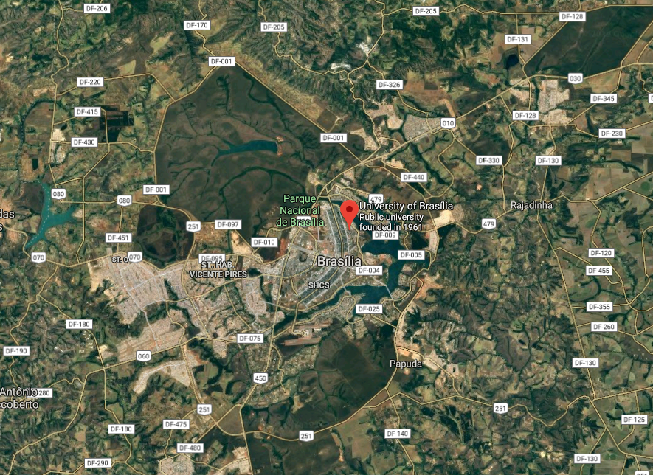
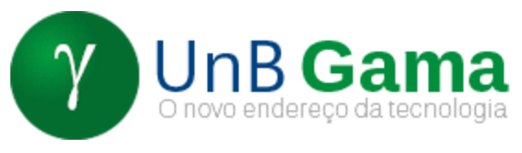
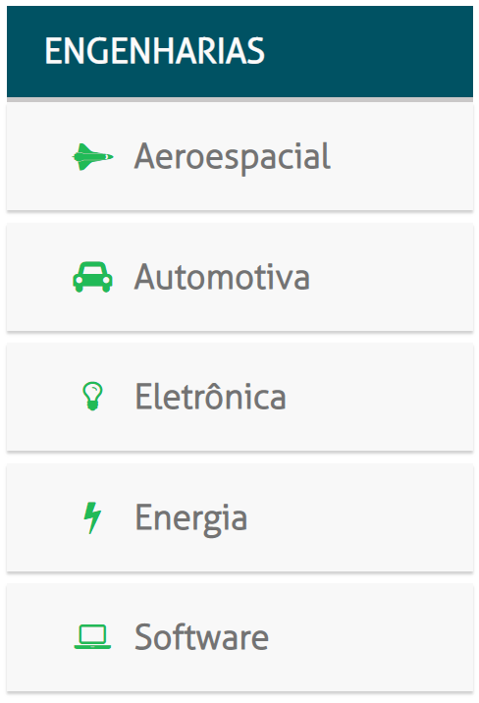
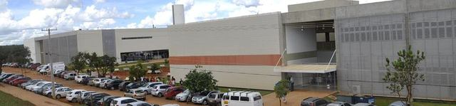
… and about my faculty.
FUP/UnB Campus in Planaltina (DF)
FGA/UnB Gama Faculty campus
http://fga.unb.br/
UnB main campus
«Darcy Ribeiro», Brasìlia (DF)
FCE/UnB Campus in Ceilândia (DF)
~35 km
07/11/2019 INFN, Frascati (Rm)

Slide 5
What is Biomimetic?
And, what does biomimicry mean?
British English Dictionary definition:
(of a human-made product) imitating nature or a natural process
Collins English Dictionary.
Copyright © HarperCollins Publishers
07/11/2019 INFN, Frascati (Rm)

Slide 6
What is Biomimetic?
And, what does biomimicry mean?
Biomimetic refers to an interdisciplinary field in which principles from engineering, physics, chemistry and biology are applied to the synthesis of materials, synthetic systems or machines ant to the definition of human processes that have functions that mimic biological systems and processes.
07/11/2019 INFN, Frascati (Rm)

Slide 7
What is Biomimetic?
And, what does biomimicry mean?
… it is, science inspired by nature!
Easier?
From an engineer’s point of view… it is a kind of reverse engineering about nature’s models and practices.
07/11/2019 INFN, Frascati (Rm)

Slide 8
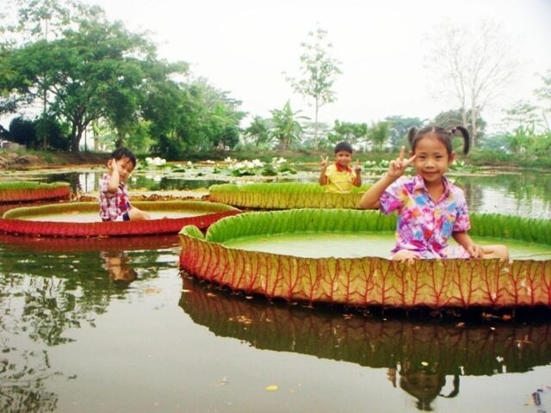
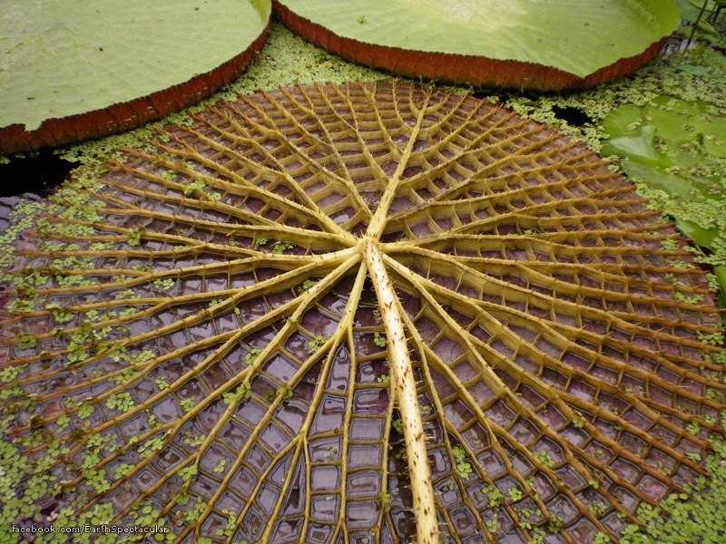
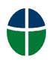
Giant Water Lily Lotus
Background texture of a Giant Amazon water Lily leaf (Victoria Amazonia)
Inspiration for topological optimization

Slide 9
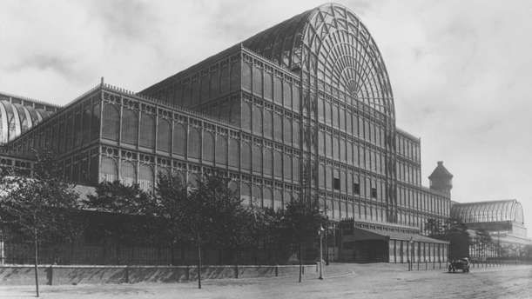
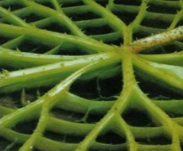
Crystal Palace
Crystal Palace, giant glass-and-iron exhibition hall designed by Sir Joseph Paxton, built in Hyde Park, London, that housed the Great Exhibition of 1851, it survived until 1936.
Giant Water Lily Lotus
07/11/2019 INFN, Frascati (Rm)

Slide 10
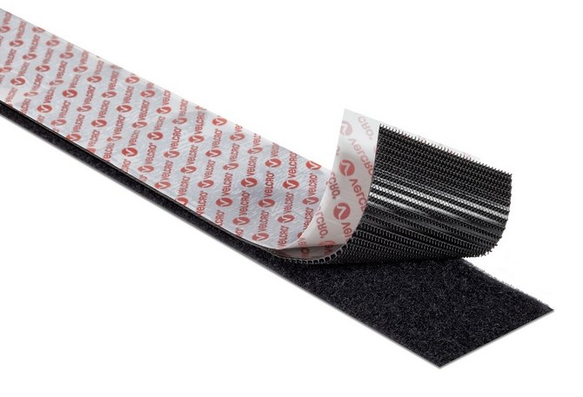
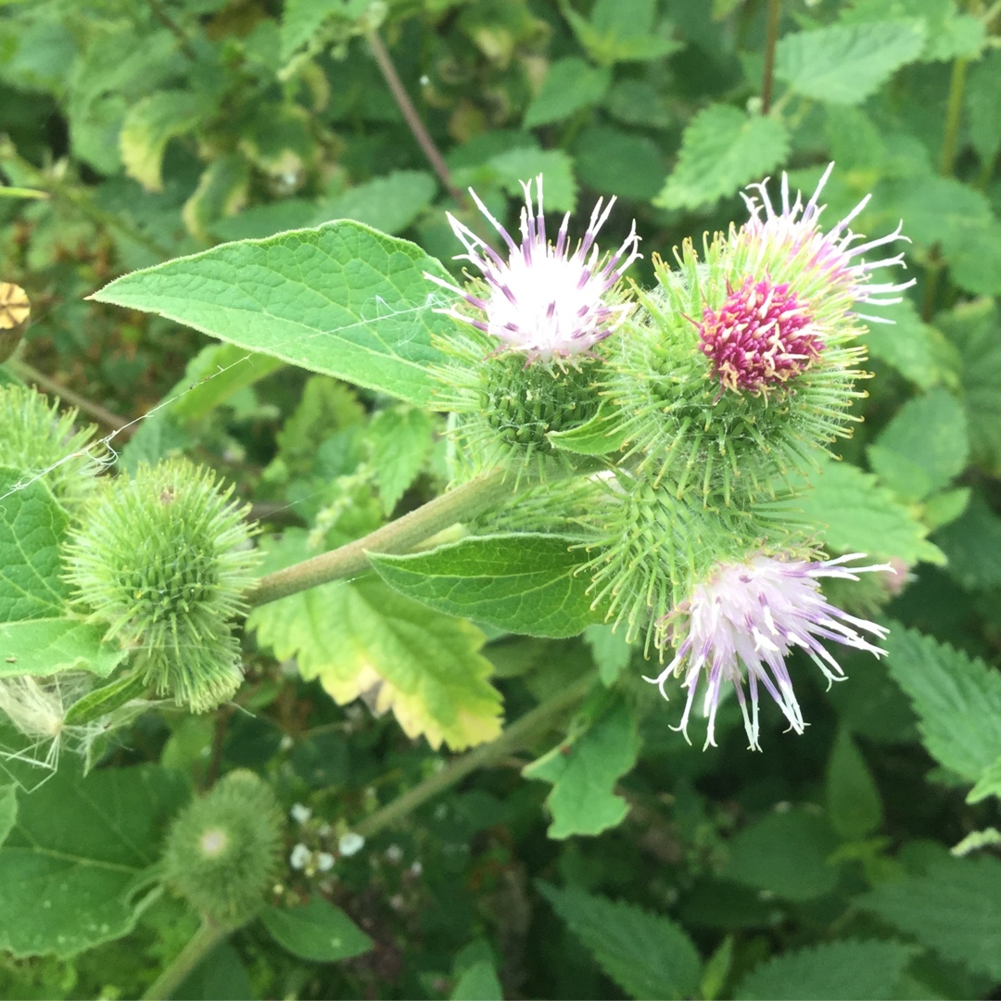
VELCRO
Hook-and-loop fastener
LOOPS
In 1941, the Swiss engineer George de Mestral coming back from a hunting trip noticed a lot of burdock seeds and flowers clung to his clothes and his dog’s fur.
HOOKS
He tried to reproduce the geometry to create a Hook-and-loop fastener, made of two strip of fabric, mimicking the burdock behavior.
In 1955 he patented his invention naming it as Velcro.
(combining velour – velvet - and crochet - hook)
BURDOCK/ARCTIUM LAPPA
07/11/2019 INFN, Frascati (Rm)

Slide 11
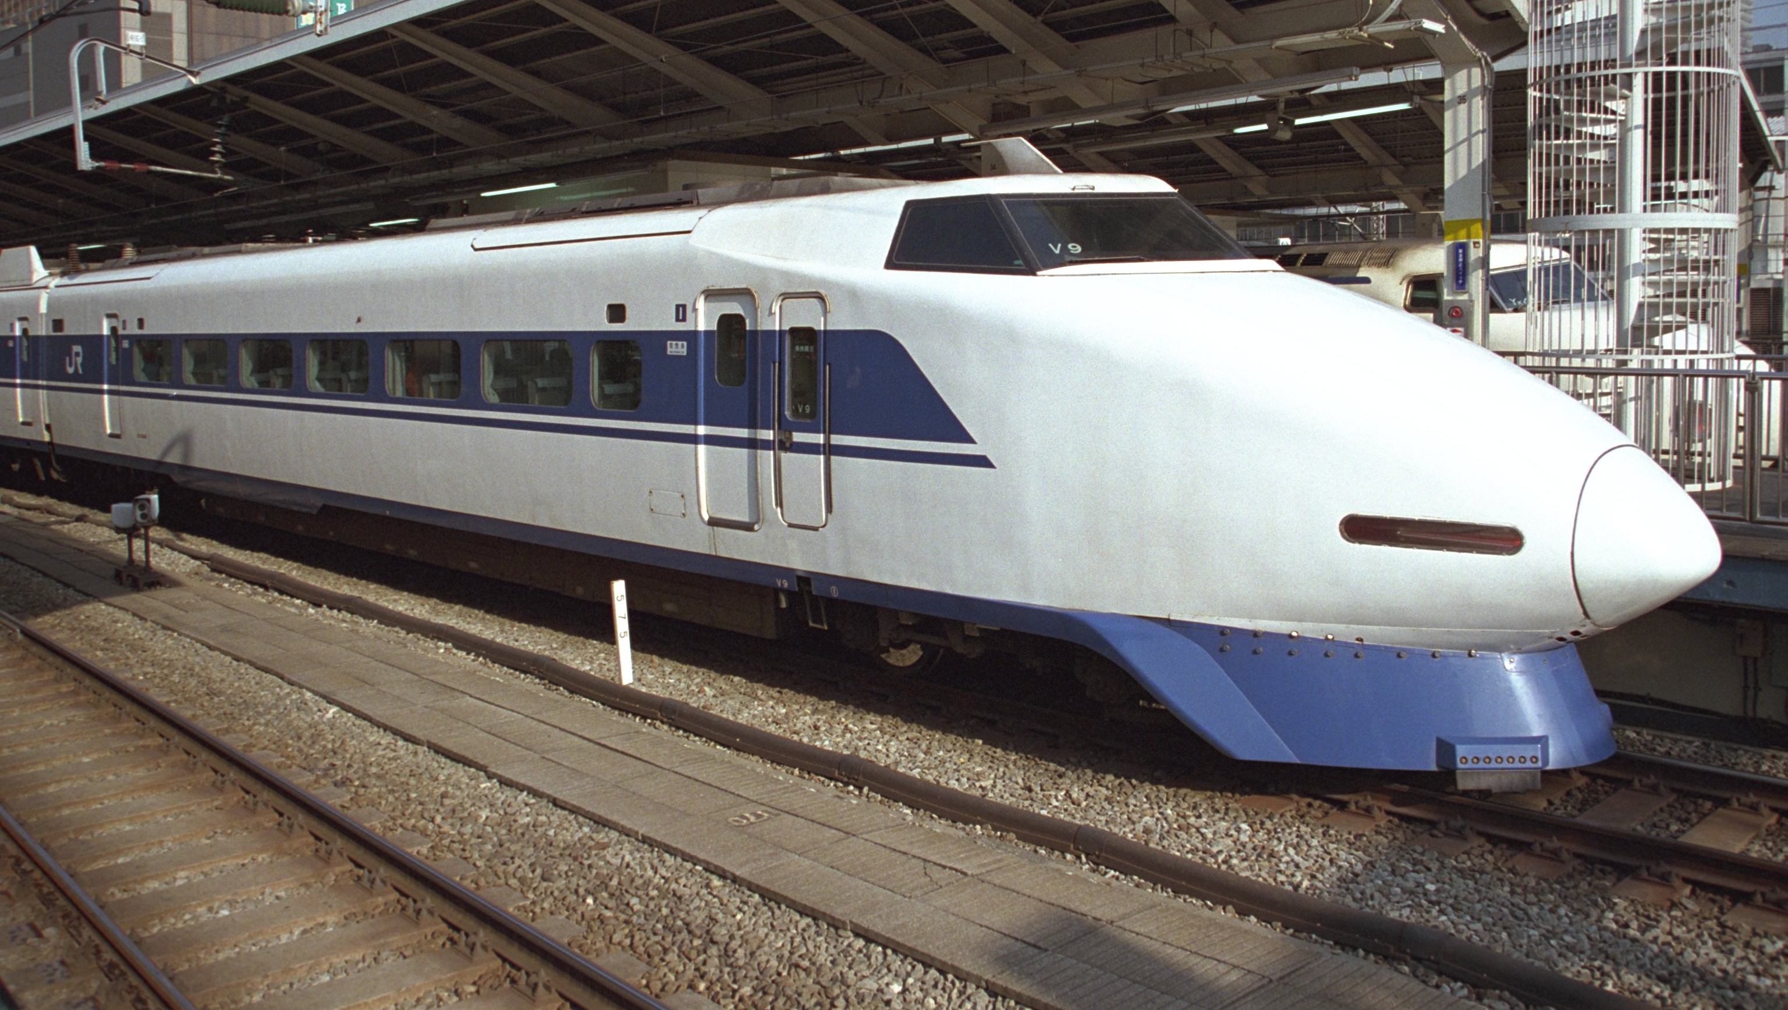
Shinkansen Series 500 “birdwatching” inspired design
1989 The San'yō Shinkansen
high-speed bullet train (Series 100)
170 mi/h (273,59 km/h)
Extremely noisy!
07/11/2019 INFN, Frascati (Rm)

Slide 12
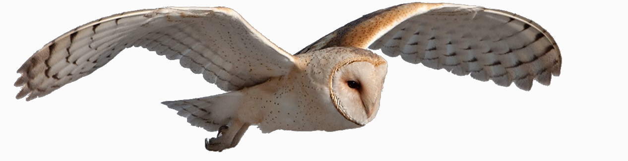
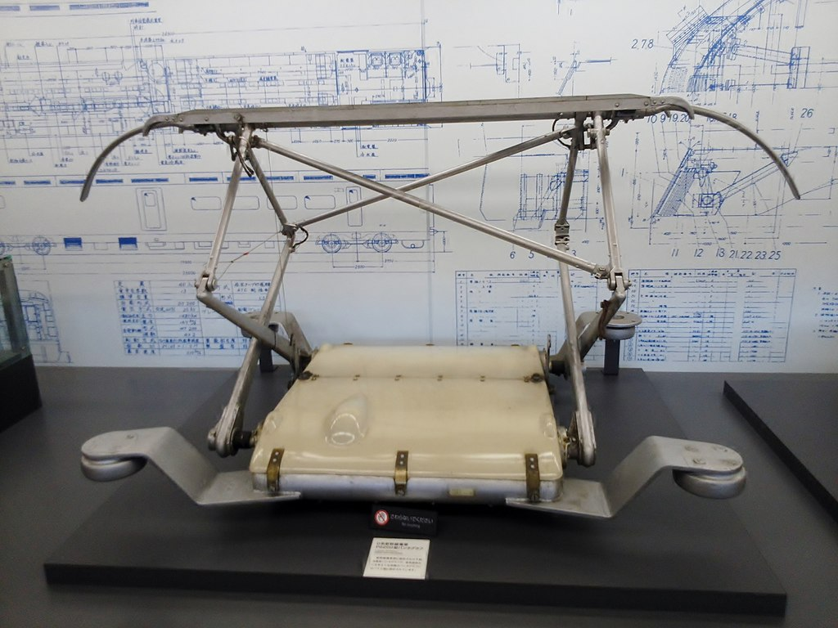
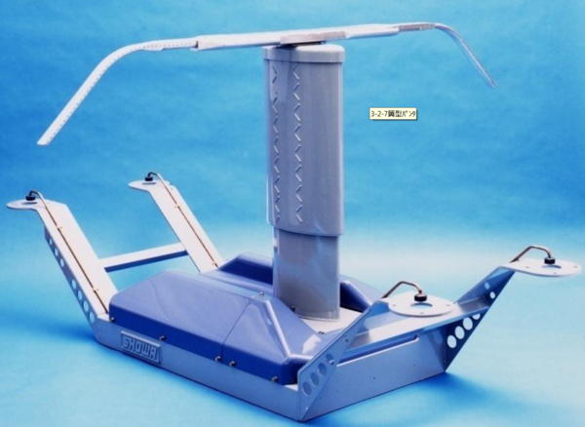
Tiny serrations on its primary feathers minimize the vortex generated by movement.
The owl has a concave face capable of absorbing sound. Its body has ample down to absorb fluttering sounds.
The pantograph was reshaped like an owl's wing
including small serrations,
which resulted in no vibrations and a quieter impact for residents near the tracks.
Shinkansen 100 pantograph
The pantograph, that connects the train to its power source, vibrated and made a loud noise.
Shinkansen 500 pantograph
07/11/2019 INFN, Frascati (Rm)

Slide 13
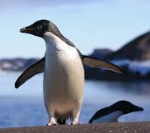
The body of the Adelie Penguin is shaped like a spindle which allows it to move effortlessly through water to catch fish.
The pantograph, that connects the train to its power source, vibrated and made a loud noise.
The pantograph's supporting shaft was reshaped like a penguin's body to lower its wind resistance.
Shinkansen 100 pantograph
Shinkansen 500 pantograph
The supporting frame for the pantograph had a high degree of wind resistance resulting in aerodynamic noise.
07/11/2019 INFN, Frascati (Rm)

Slide 14
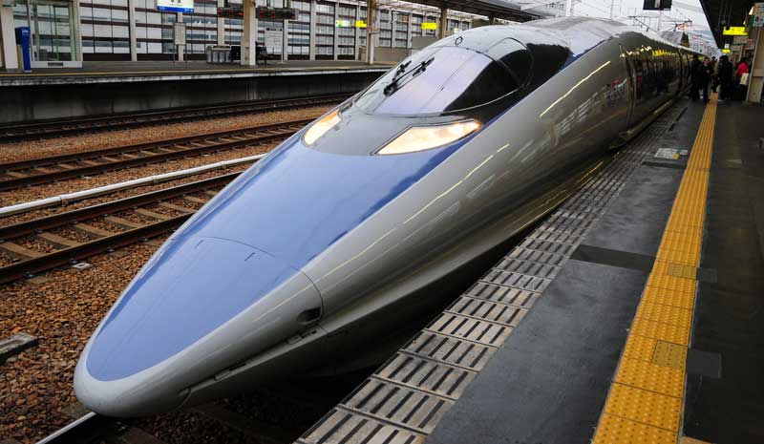
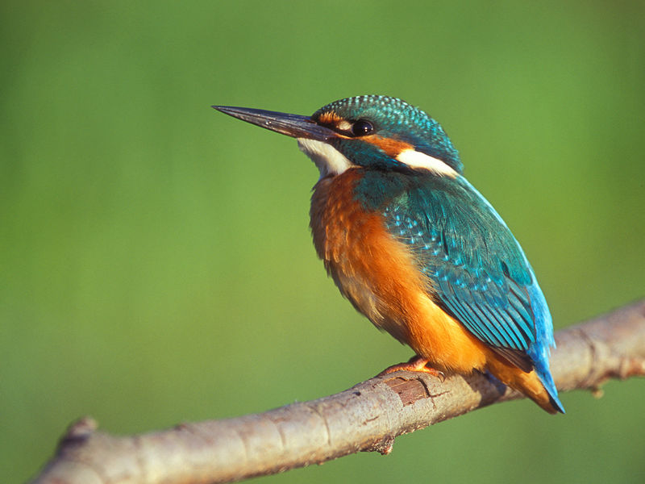
“Half of the entire Sanyo Shinkansen Line (from Osaka to Hakata) is made up of tunnel sections.
When a train rushes into a narrow tunnel at high speed, this generates atmospheric pressure waves that gradually grow into waves like tidal waves. These reach the tunnel exit at the speed of sound, generating low-frequency waves that produce a large boom and aerodynamic vibration so intense that residents 400 meters away have registered complaints.”
Tomohiro Kobayashi
(Project Coordination Director )
When the train would enter a tunnel, a loud bang would occur due to the fixed air volume of the tunnel and the sudden increase in pressure from the exiting train.
The nose of the Shinkansen train was reshaped in the form of the Kingfisher’s beak to eliminate the sudden pressure increase.
→ No more bang!
GOAL!
This shape has enabled the 500-series to reduce air pressure by 30%, electricity use by 15%, and allowing a more comfortable ride, even though speeds have increased by 10% over the former series.
The shape of the Kingfisher's head and beak allow it to glide through the air and precisely dive into water to snag fish.
It is considered the most efficient animal on earth to transition from low pressure (air) to high pressure (water).
07/11/2019 INFN, Frascati (Rm)

Slide 15
And … what about aerospace applications?
From the myth of Icarus to the wing of the Leonardo Da Vinci ornithopter, the yearning for flying was always - obviously - inspired by that of birds.
07/11/2019 INFN, Frascati (Rm)

Slide 16
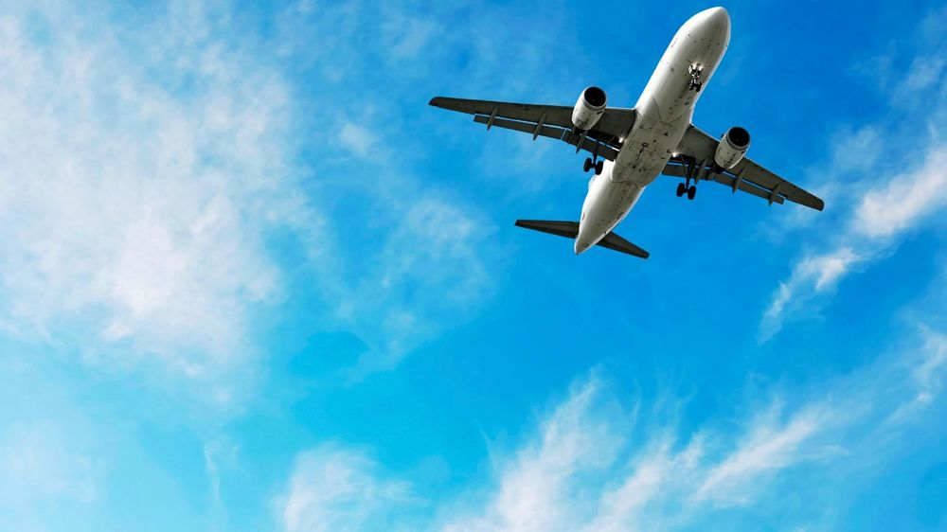
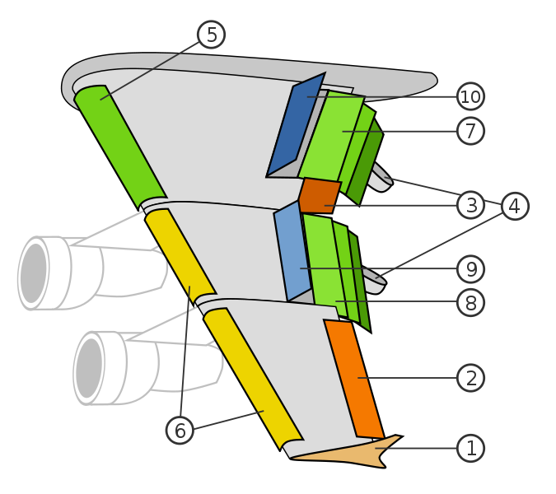
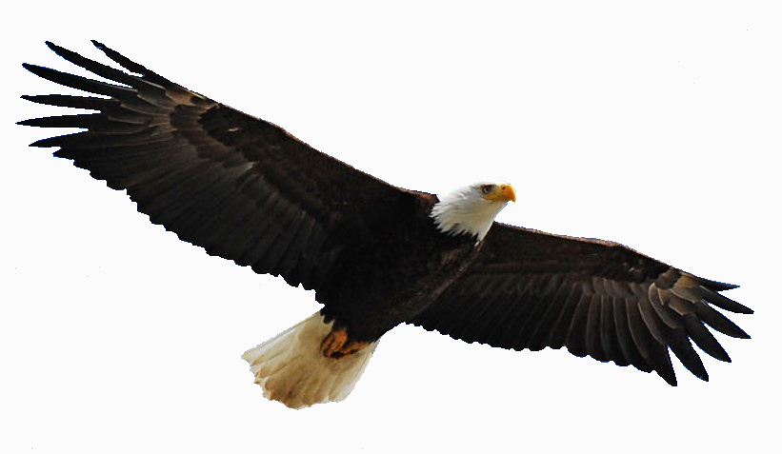
Flapping wing vs. fixed wing
Winglet
Low Speed Aileron
Hight Speed Aileron
Flap track fairing
Krüger flaps
Slats
Three slotted inner flaps
Three slotted outer flaps
Spoilers
Spoilers-Air brakes
The primary purpose of aircraft wings is to produce the required lift to maintain the aircraft in the air. As lift is related to the wet surface of the wing
07/11/2019 INFN, Frascati (Rm)

Slide 17
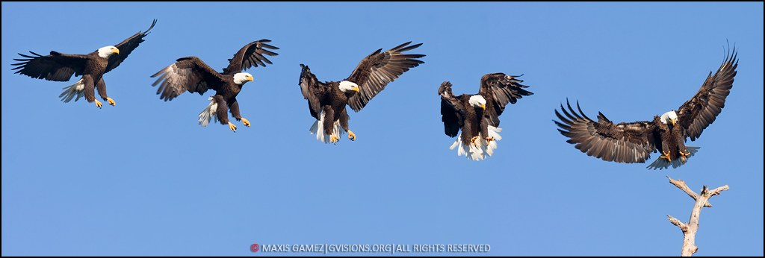

Landing
sequence
The fixed wing configuration is optimized for only one flight phase
APPROACH
ROUNDOUT
FLARE
TOUCH DOWN
07/11/2019 INFN, Frascati (Rm)
07/11/2019 INFN, Frascati (Rm)
17

Slide 18

Adaptive structures
Adaptive - Finger like - trailing edge
Seeking for morphing solutions for aerodynamic surfaces for:
the extension of the flight envelope and
the improvement of the performance at different regimes.
Source: Concilio A., et Al., “An Adaptive Trailing Edge”, pp.517-545, in Morphing Wing Technologies, edited by Concilio A., Dimino I., Lecce L., Pecora R., 2017, ISBN: 978-0-08-100964-2, 978 pages, Publisher: Butterworth-Heinemann (UK), DOI: 10.1016/B978-0-08-100964-2.00017-4.
a.concilio@cira.it
07/11/2019 INFN, Frascati (Rm)

Slide 19
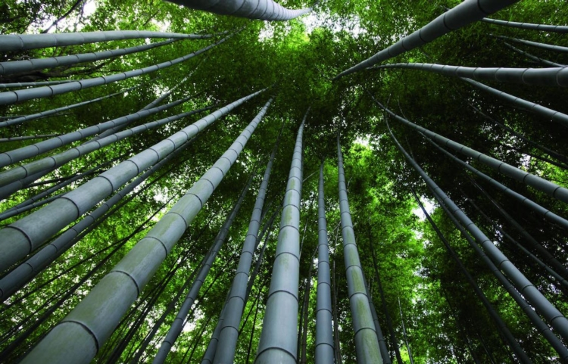
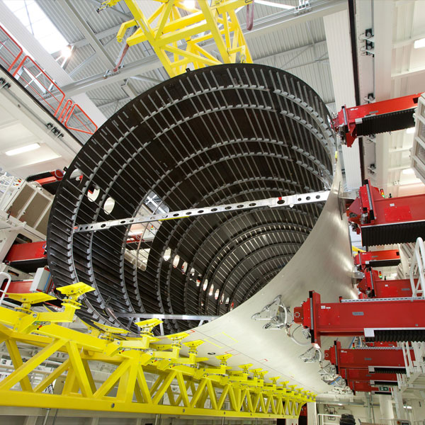
Bamboo groove.
Tall and thin stems
Nature has always been used as a source
of inspiration in aerospaceengineering applications.
Aircraft fuselage frames and formers
designed for reducing buckling risk
07/11/2019 INFN, Frascati (Rm)
Notes:
A former is a transverse structural component of the shell fuselage of an aircraft. Its function is to maintain the shape of the fuselage section, decrease the length of the stringers reducing buckling and to transfer, introduce and redistribute the internal and external loads. This is how aircraft engineers design aircraft fuselages, copying, more or less unconsciously, what nature has been doing for a few million years

Slide 20
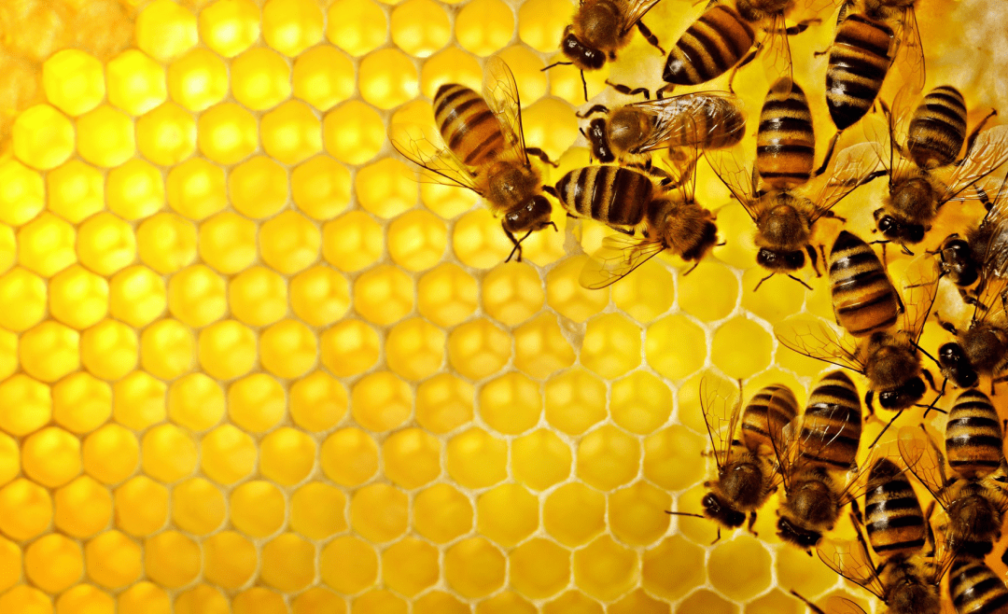
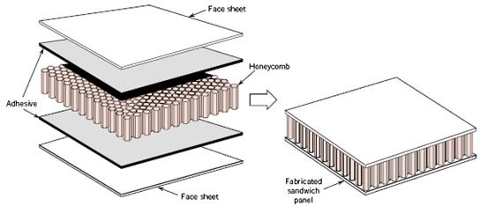
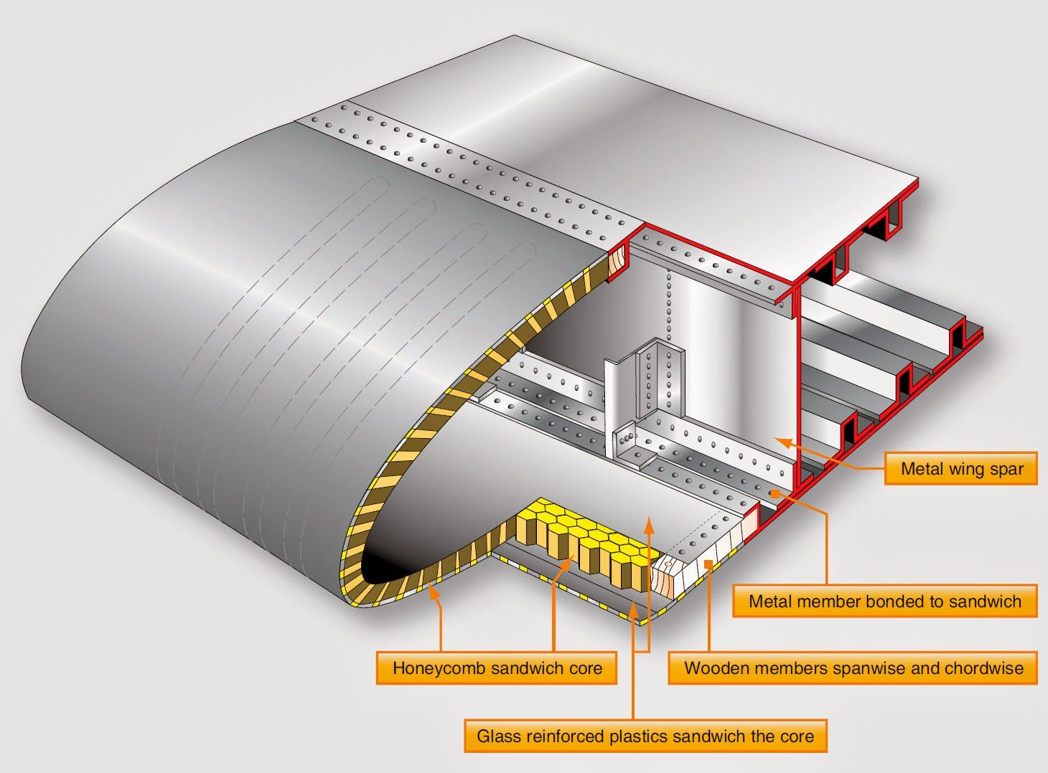
HONEYCOMB
Hexagons are the most efficient way to fill a space with the least amount of material.
Honeycomb structural materials are commonly made by layering a honeycomb material between two thin layers that provide strength in tension.
Honeycomb materials are widely used where flat or slightly curved surfaces are needed and their high specific strength is valuable.

Slide 21

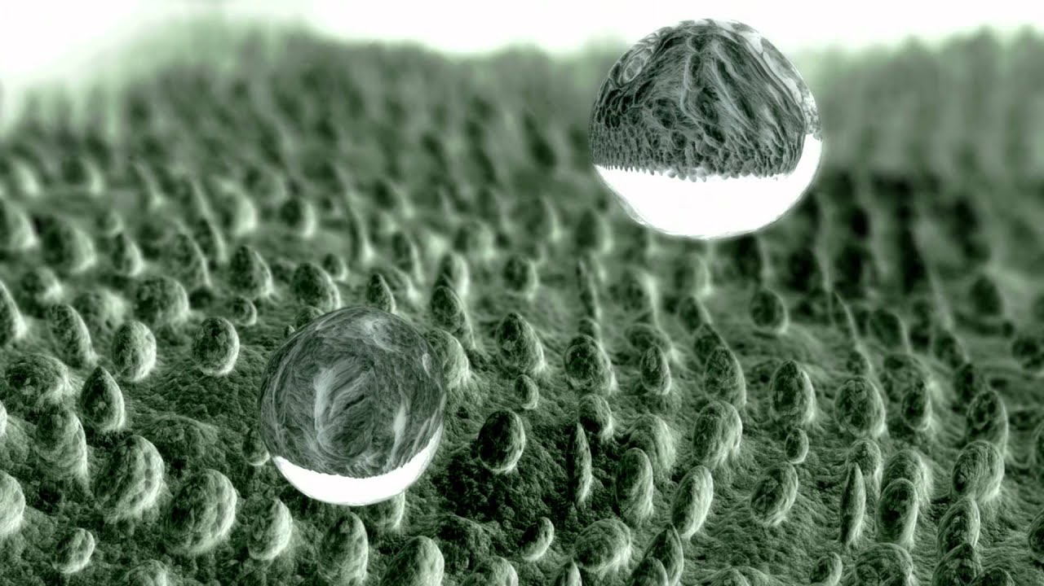
LOTUS EFFECT
From self-cleaning surfaces ...
Lotus leaves exhibit extreme water-repellent properties.
Their surfaces are Superhydrophobic and self-cleaning due to hierarchical roughness and the presence of wax tubules on the leaf surface.
This phenomenon is of interest in various applications, including self-cleaning windows, exterior paints for buildings, navigation ships, textiles, solar panels, and applications requiring antifouling and a reduction in fluid flow.
07/11/2019 INFN, Frascati (Rm)

Slide 22
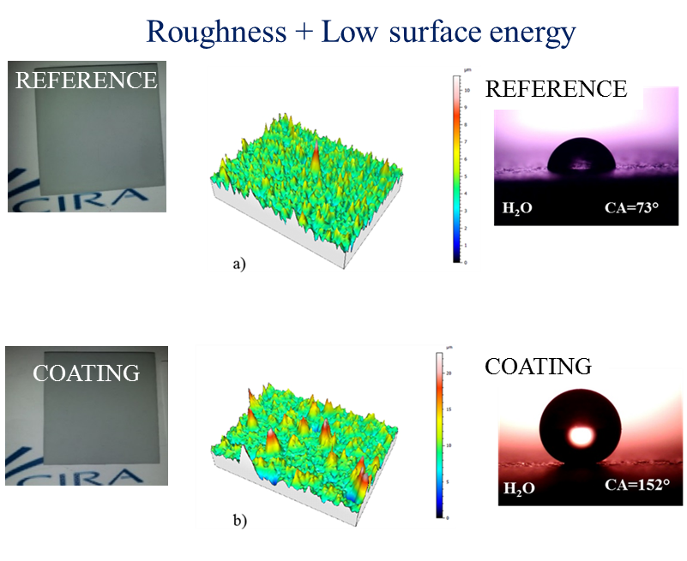
LOTUS EFFECT
… to anti icing systems
Ice accretion on aircraft leads to difficulties in aircraft flight control due to weight increase and change in weight distribution. Conventionally these difficulties are overcome using anti-icing or de-icing products, such as freezing depressants and heating devices.
A more cost effective way to solve these problems would be to use ice repellent surfaces (ice-phobic).
F. Piscitelli, et Al., On a simplified method to produce hydrophobic coatings for aeronautical applications, Applied Surface Science 472, 71–81, 2019.
DOI: 10.1016/j.apsusc.2018.04.062
f.piscitelli@cira.it
07/11/2019 INFN, Frascati (Rm)

Slide 23
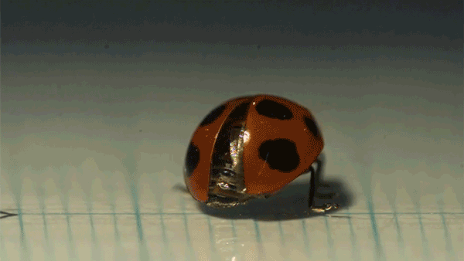
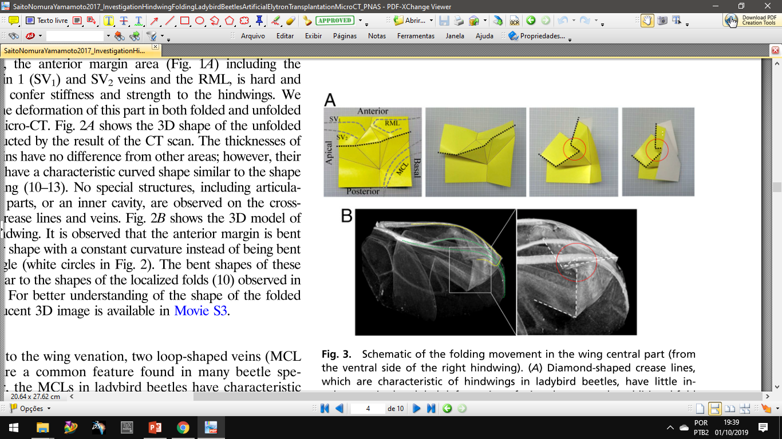
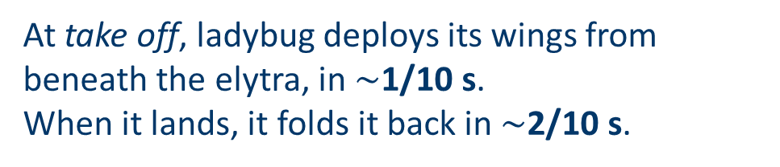
LADYBUG & ORIGAMI PATTERN
From Ladybugs to Origami-Like folding devices
At take off, ladybug deploys its wings from beneath the elytra, in $\sim$1/10 s.
When it lands, it folds it back in $\sim$2/10 s.
Images are courtesy of Prof. Kazuya Saito (Tokyo University),
Source: Investigation of hindwing folding in ladybird beetles by artiﬁcial elytron transplantation and microcomputed tomography.
DOI: 10.1073/pnas.1620612114
07/11/2019 INFN, Frascati (Rm)

Slide 24
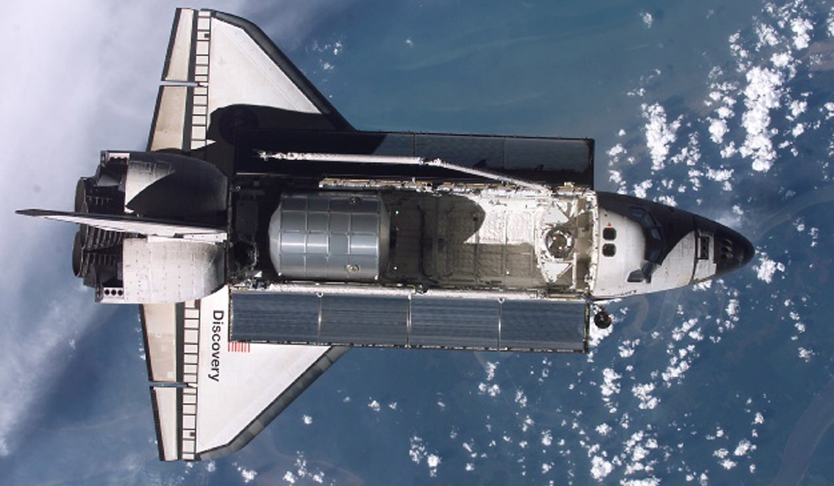
STOWING VOLUME LIMITATIONS
60 ft (18.3 m)
15 ft (4.6 m)
10.6 10³ ft³ (300 m³)
Since the beginning of the Space era, one of the major issues faced by space systems engineers has been mass and volume reduction due to launch vehicle storage limitations and for launch cost reduction.
07/11/2019 INFN, Frascati (Rm)

Slide 25
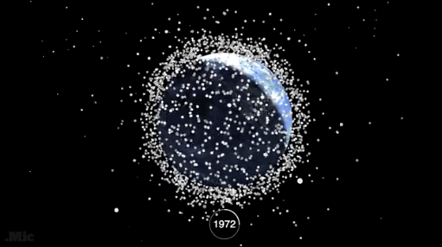
SPACE DEBRIS MITIGATION
LEO (Low Earth Orbits)
is the most densely populated orbital region
is the region that is seeing the fastest growth.
Ensuring orbit decay within 25 years.
(IADC Space Debris Mitigation Guidelines)

Slide 26
SPACE DEBRIS MITIGATION
Preliminary design of a Modular Deployable Deorbiting System (MDDS) based on an Origami Deployable Drag Sail (ODDS) to be used as a lightweight passive system in a 3U CubeSat platform.
The purpose is to obtain the lowest possible packaging volume given the sail surface extension that allows the orbital decay.
Reducing the volume of the stowed sail, designing a deployment system with a highest
Packing-Ratio (PR)
η=S/V
of deployed surface (S) to stowed volume (V)
Speeding up the sail deployment, minimizing the risk of failure during this phase
07/11/2019 INFN, Frascati (Rm)

Slide 27
Drag augmentation
Drag augmentation is an effective passive method for de-orbiting n LEO, exploiting the thin atmosphere that still exists below 1000 km.
Satellites in this orbit region will decay naturally regardless of mitigation strategy.
Drag augmentation is achieved by deploying a larger structure at the end of the satellite operations - to result in a larger drag surface area.
Resulting in a shorter Decay Time (DT)
07/11/2019 INFN, Frascati (Rm)

Slide 28
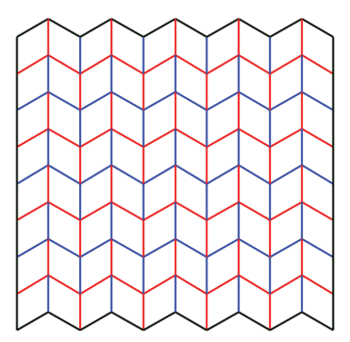
ORIGAMI PATTERN
Miura-Ori
Miura-ori is an example of an origami mosaic pattern
each parallelogram remains flat on top of each other during folding and unfolding.
its final compacted shape is limited only by the thickness of the sheet material.
It also found an application as a meta-material with unusual properties, such as a negative Poisson's ratio.
07/11/2019 INFN, Frascati (Rm)

Slide 29
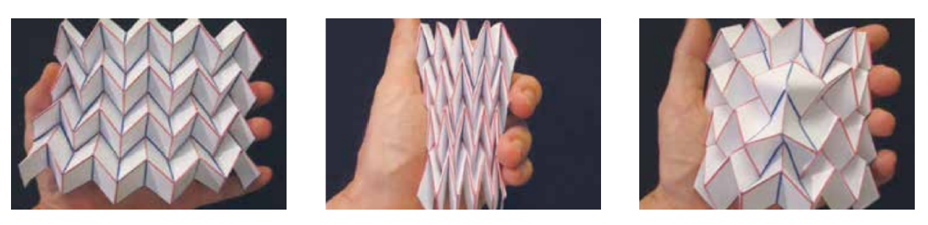
ORIGAMI PATTERN
Miura-Ori
Benefits:
It shows a high PR (η=S/V)
It has negative Poisson's ratio
Insert defects may increase material stiffness
Deployed
Folded (partially)
Reinforced by a defect
07/11/2019 INFN, Frascati (Rm)

Slide 30
ORIGAMI PATTERN
& SAIL SHAPE
Rabbit-ears pattern
Miura-ori
pattern
07/11/2019 INFN, Frascati (Rm)

Slide 31
ORIGAMI PATTERN
& SAIL SHAPE
With this particular fold configuration, there is only
one way to open/close it:
pulling one (1) corner it opens the whole sail with minimal effort.
The unfolding actuator is greatly simpliﬁed because
only one (1) input is required to deploy 4 sails.
07/11/2019 INFN, Frascati (Rm)

Slide 32
DEPLOYING ACTUATOR
07/11/2019 INFN, Frascati (Rm)

Slide 33
DEPLOYING ACTUATOR
The opening mechanism uses a thermally activated Shape Memory Alloy (SMA) actuator consisting of 4 C-shape clamps (C-Clamp), which keep the 2 Retention Plates (RP) locked, exploiting the shape-changing behavior.
→ Originally the clamp shape is a rectangular thin plate that is deformed, by two folds, in the shape of a C.
→ The plates remain coupled until the C-shaped clamps recover the original shape.
→ When a voltage is applied to the C-Clamp, local ohmic heating triggers a martensite-austenite phase change, recovering the annealed shape, opening the C-Clamp, freeing the RPs, thus deploying the sails.
07/11/2019 INFN, Frascati (Rm)

Slide 34
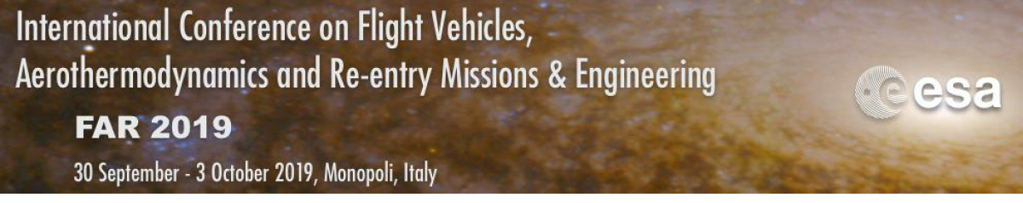
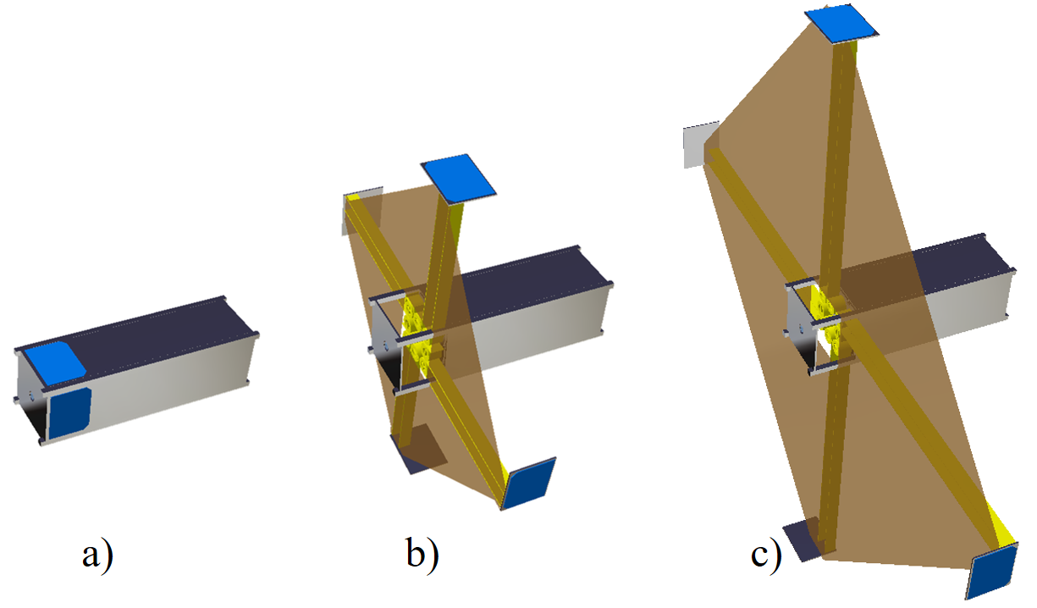




PRELIMINARY DESIGN OF AN ORIGAMI FOLDABLE DEORBITING SAIL FOR A 3U CUBESAT
C. Vendittozzi ^{A}, S. Colafranceschi ^{B}, S. Bianco ^{C},
G. Saviano ^{D}, L. S. L. Barros ^{A}, A. V. R. Dias ^{A}
A
B
C
D
07/11/2019 INFN, Frascati (Rm)

Slide 35
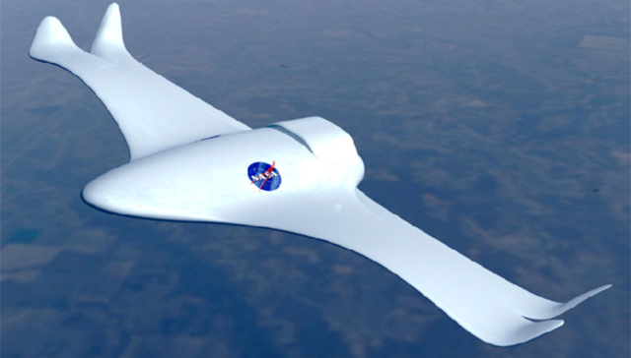
Mimic Nature, seeking for intelligent engineering system
Source:
https://www.nasa.gov/centers/langley/news/factsheets/21stcentury.html
Smart or Intelligent?
An intelligent structure is an adaptive structure, it is defined as a structure that is able to sense external stimuli such as pressure, velocity, density, or temperature change, etc. It can process the information and respond in a controlled manner in real time

Slide 36
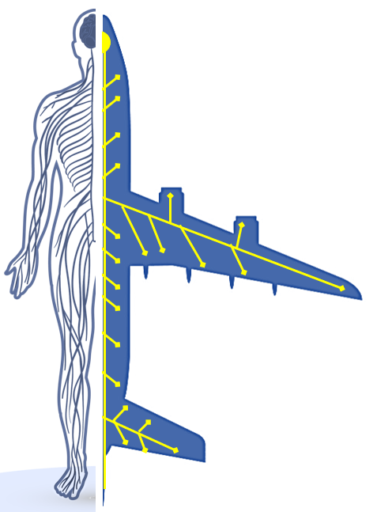
Mimic Nature, seeking for intelligent engineering system
The concept of biomimetics is applied in the sense of copying the “skeleton” of a
biological nervous system
Engineering
System
Biological
System
and
Reproducing it as an array of quasi distributed sensory points (sensors)
Allowing the engineering system to perceive variations in the operating environment and the consequent repercussions on the system.
07/11/2019 INFN, Frascati (Rm)

Slide 37
Mimic Nature, seeking for intelligent engineering system
Brain
Processing Unit
Spinal cord
Communication Bus
Nerve endings
Sensors
Smart Structures being able of
sensing their state in addition to
their surrounding environment
07/11/2019 INFN, Frascati (Rm)

Slide 38
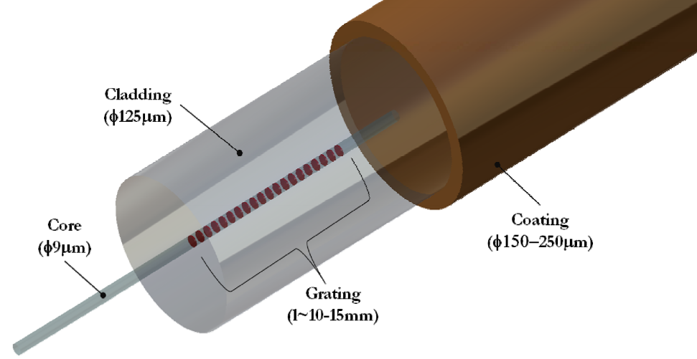
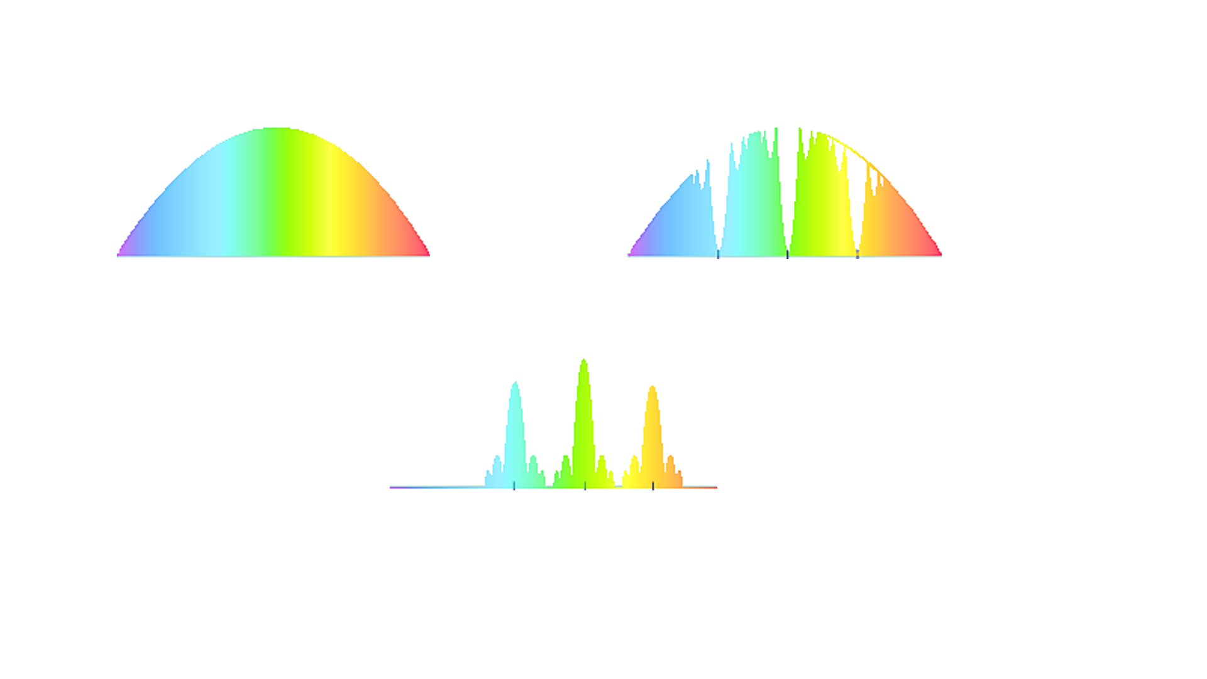
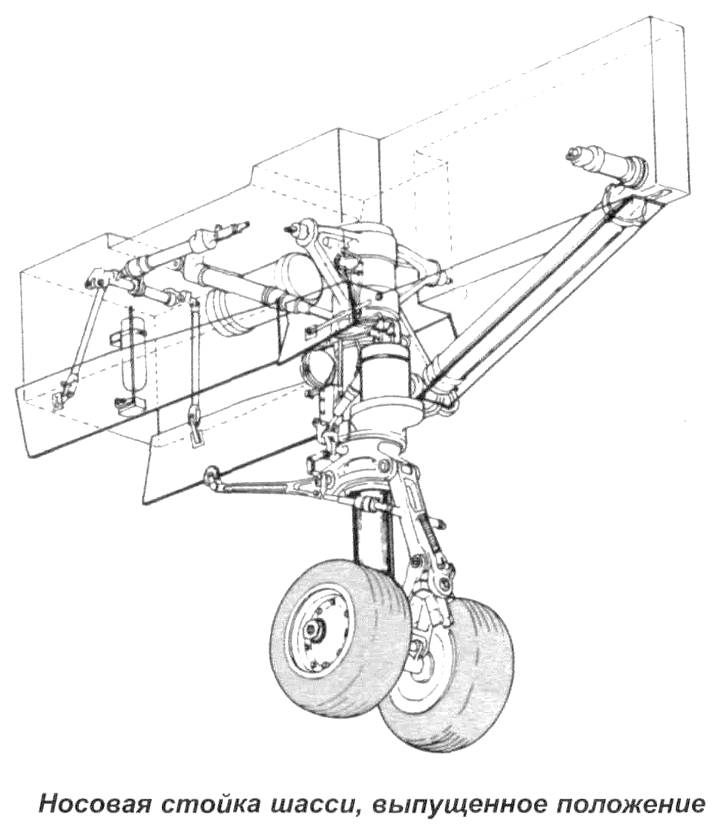

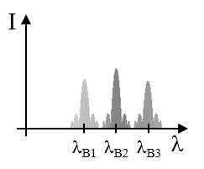
FBG Integrated System’s Architecture
Incident Spectrum
λ_{b}=2Λn
I
Optical Interrogator
FBGs Array
λ_{B3}
Broadband Light Source
(Tunable laser)
λ
Mono-mode
Optical Fiber
Data Acquisition
Optical Circulator
λ_{B2}
OSA
Optical Spectrum Analyser
λ_{B1}
Transmitted Spectrum
I
Ethernet Cable
I
Reflected Spectrum
l_{B1}
l_{B2}
l_{B3}
λ
l_{B1}
l_{B2}
l_{B3}
λ
… but embedding into the materials is tough!
PC
07/11/2019 INFN, Frascati (Rm)

Slide 39
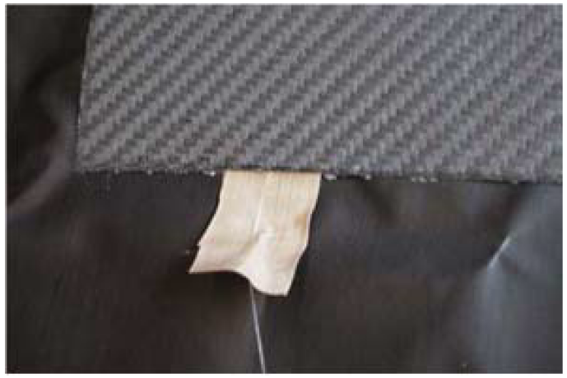
Main Issue - Exiting from CFRP parts
New magnetic connector for embedding of optical sensors in composite materials
Embedded optical fiber in a CFR laminate
Pig tail
Entry point
Pig tail
Exit point
CFRP Laminate
Embedded Fiber
FBG
Pigtail
Up to 76% of pigtail breaks, exiting the autoclave,
during laminate manufacturing.
07/11/2019 INFN, Frascati (Rm)

Slide 40
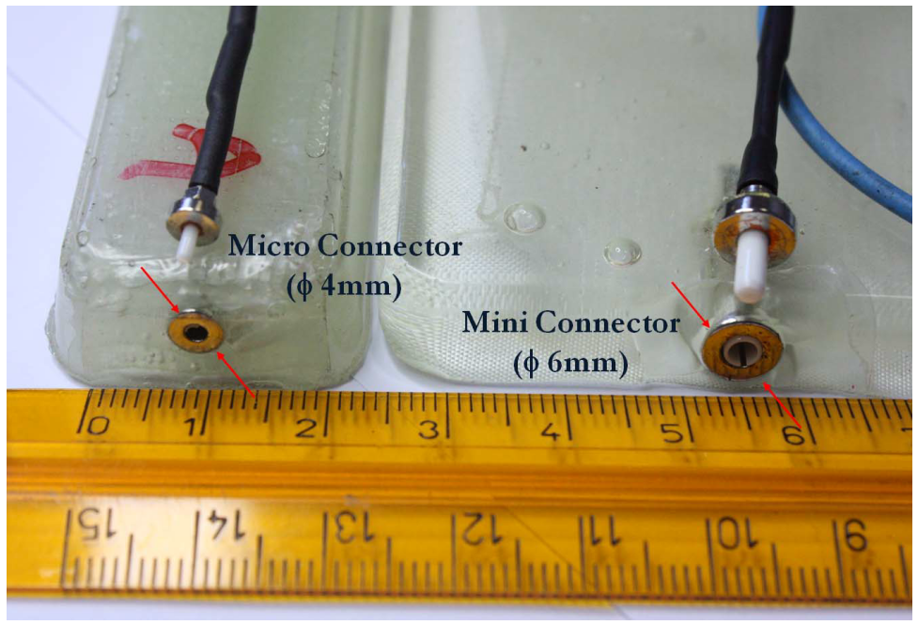
Exiting from CFRP parts
New magnetic connector for embedding of optical sensors in composite materials
DICMA
Department of Chemical, Materials and Environment Engineering
Prof. Ferdinando Felli
Dr. Andrea Brotzu
Source: 2011 Fifth International Conference on Sensing Technology (ICST):
New magnetic connector for embedding of optical sensors in composite materials
07/11/2019 INFN, Frascati (Rm)

Slide 41
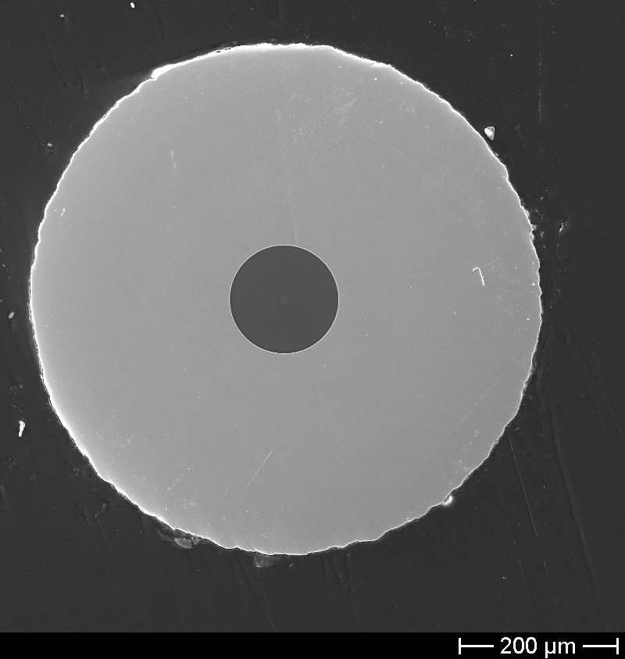
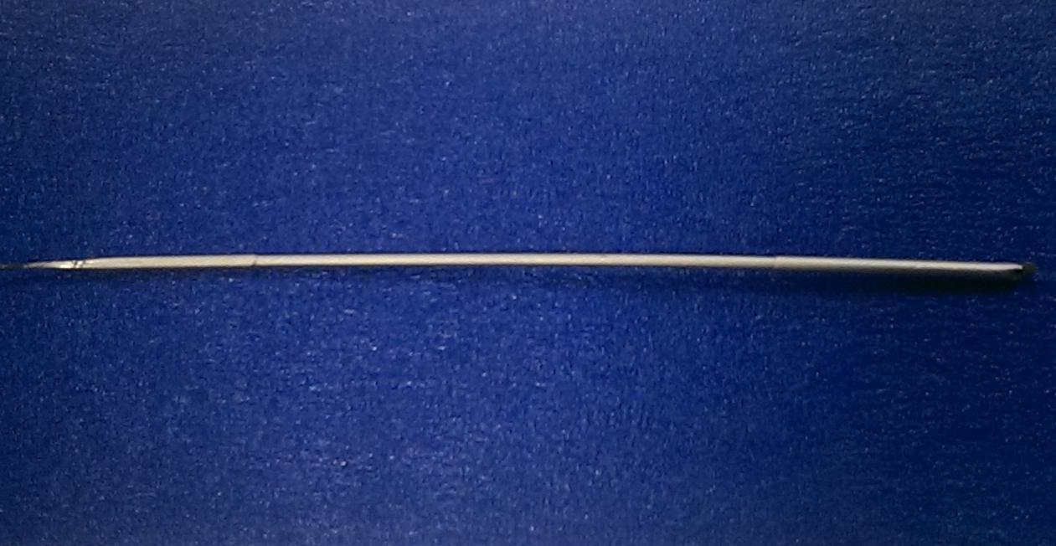

Extreme Temperatures Applications
Metal Electrodeposition for coating, working at High Temperature (HT)
Cu-Ni Coating
Prof. Ferdinando Felli
ferdinando.felli@uniroma1.it
Prof. Carla Lupi
carla.lupi@uniroma1.it
Dr. Michele A. Caponero
michele.caponero@ênea.it
07/11/2019 INFN, Frascati (Rm)

Slide 42


Extreme Temperatures Applications
Metal Electrodeposition for coating, working at High Temperature (HT)
Surface (aesthetic) issues
Dendrites on Cu ED-Coating
Micro-pitting on Ni ED-Coating
07/11/2019 INFN, Frascati (Rm)

Slide 43
Extreme Temperatures Applications
Metal Electrodeposition for coating, working at High Temperature (HT)
Internal (severe) issues
Cu-Ni Coating
HT Issues due to
Metal interdiffusion
phenomenum
Kirkendall Voids
generated over 700 °C
07/11/2019 INFN, Frascati (Rm)

Slide 44
Extreme Temperatures Applications
Metal Electrodeposition for coating, working at High Temperature (HT)
Cu-Ni Coating on
commercial FBG
reaching 1000 °C
07/11/2019 INFN, Frascati (Rm)

Slide 45
How to move from a smart structure to an intelligent one?
Biomimetics' suggestions
Embedded sensors array (FBG)
SHAPE MEMORY MATERIALS
Adaptive Structures
Compliant Mechanisms
Embedded Actuators
4D PRINTING
07/11/2019 INFN, Frascati (Rm)

Slide 46

Best is yet to come
FINAL REMARKS
The purpose is to integrate a sensors network into the engineering system, enabling the system to perceive the variations taking place in its operating environment.
This sensory array must be able to monitor:
in real time
simultaneously
during the entire lifetime of the system
in continuous
multiple physical quantities (T, P, RH%, etc.) and then send the information collected to the CPU.
This CPU will evaluate the collected information and send appropriate instructions to the network of actuators, also embedded in the materials, or consisting of the materials themselves (such as compliant mechanisms and/or shape memory materials), which will perform a reaction.
07/11/2019 INFN, Frascati (Rm)

Slide 47

Stay naturally inspired…
… stay foolish!
Keep in touch
vendittozzi@aerospace.unb.br

