Slide 1

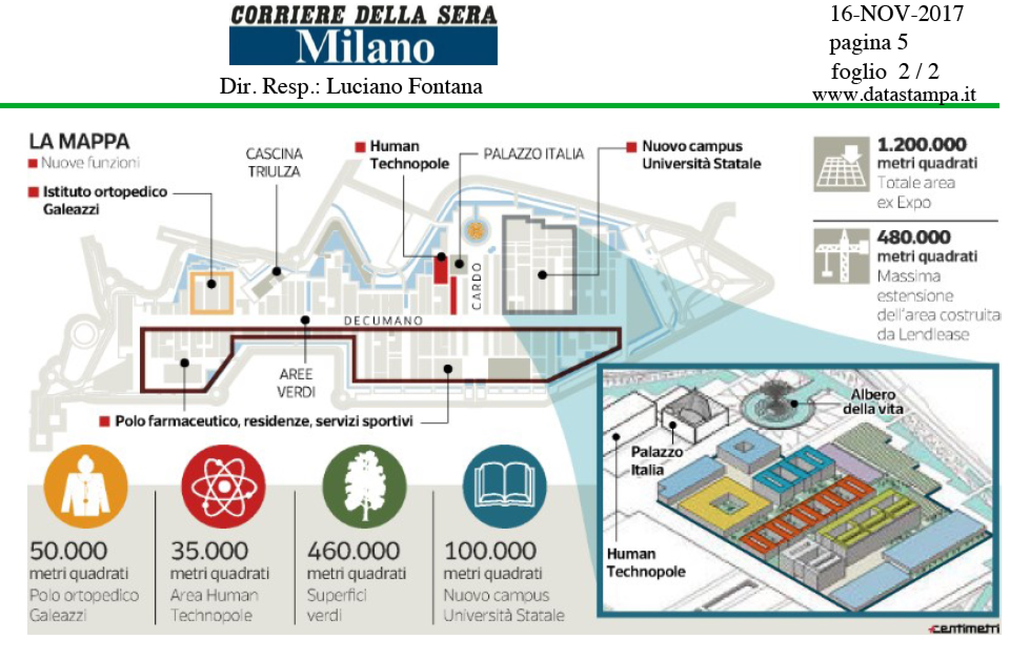
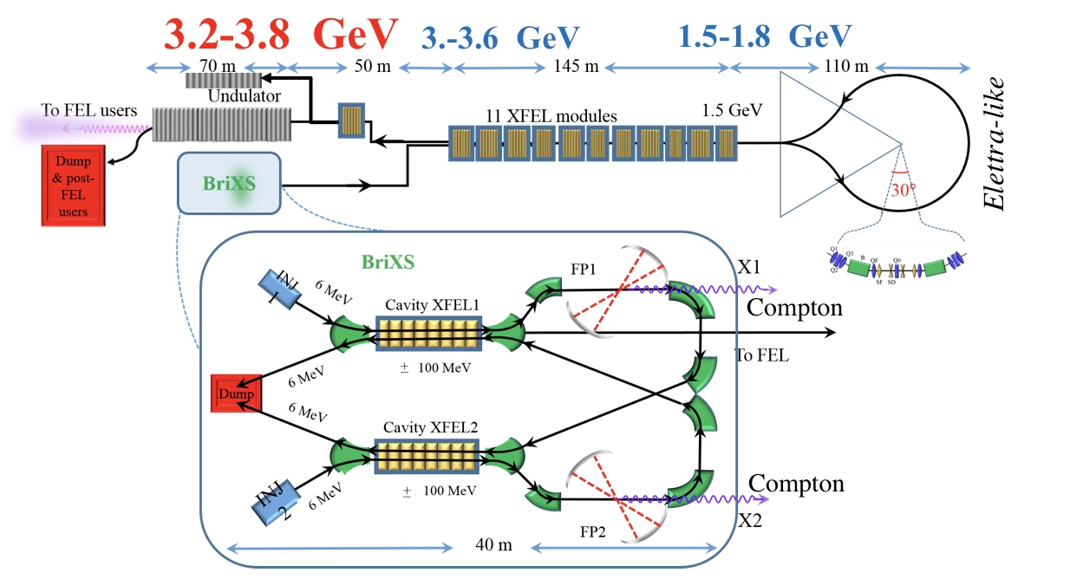
MariX: Conceptual Design Report of a Multi-disciplinary Advanced Research Infrastructure for the generation and application of X-rays
The Opportunity
Luca Serafini – INFN-Milan and University of Milan –
on behalf of MariX-C.D.R. Collaboration
The Challenge: sustainable CW coherent X-ray FEL & ICS
MariX Seminar – Laboratori Naz. del Sud - INFN - Nov. 13th, 2019

Slide 2

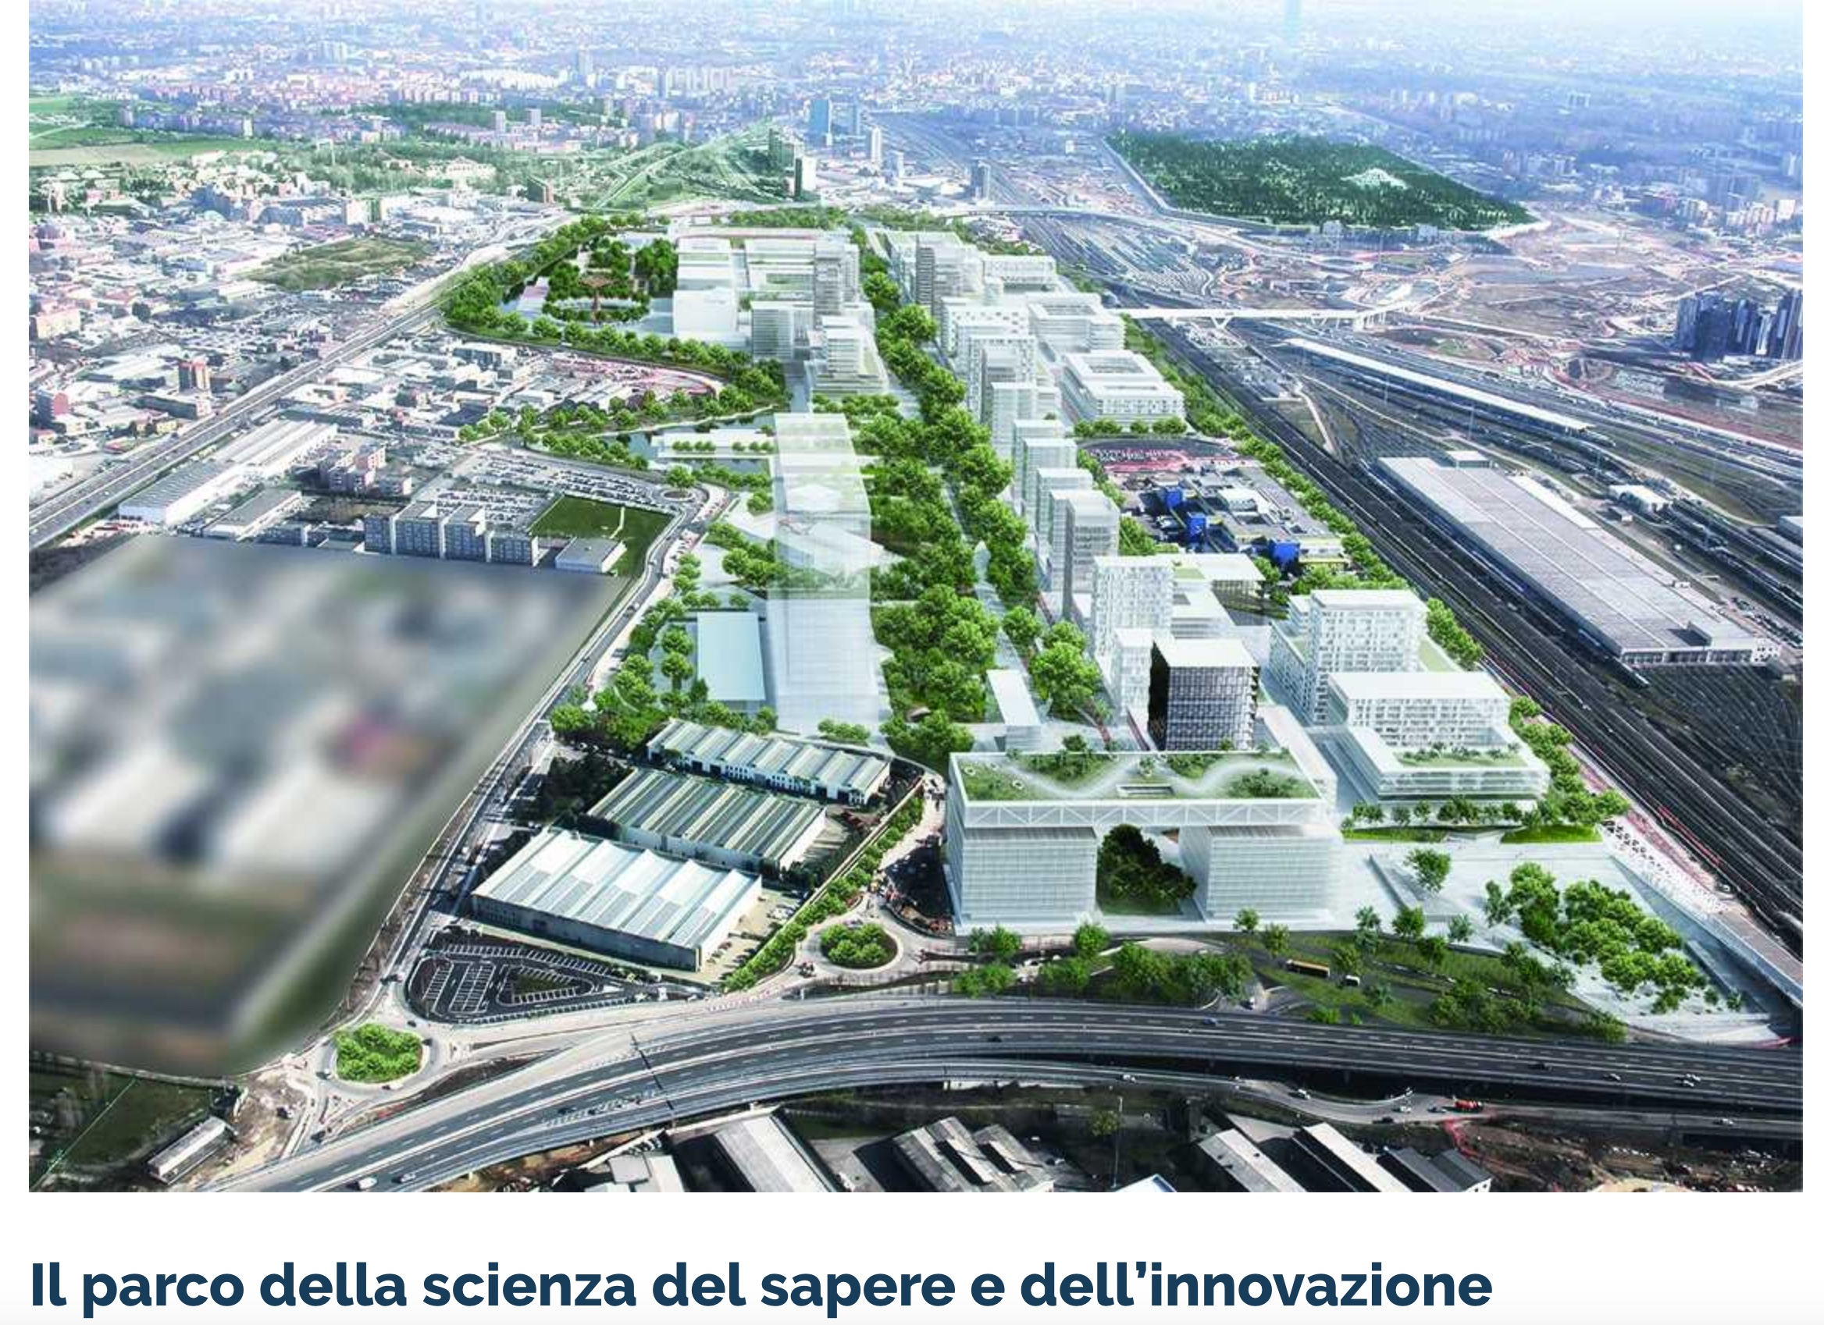


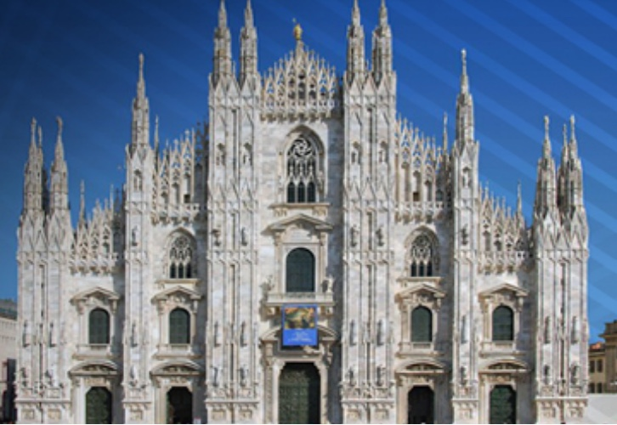
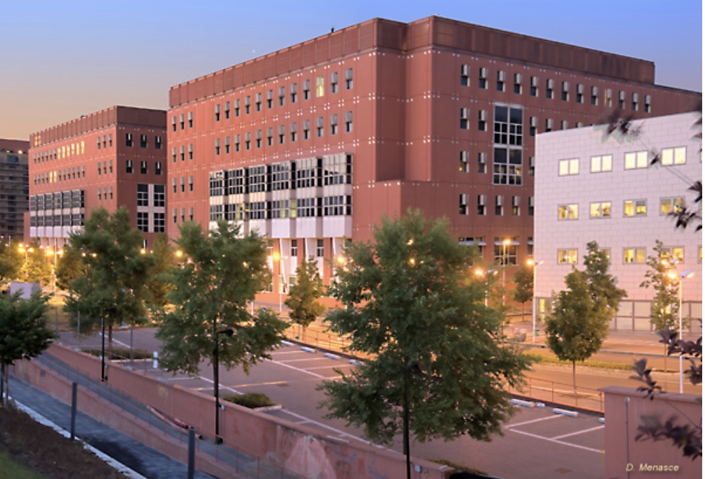

Autostrada A7 Como-Varese
MIND : Milan INnovation District
Linea ferroviaria Mi-Torino

Slide 3
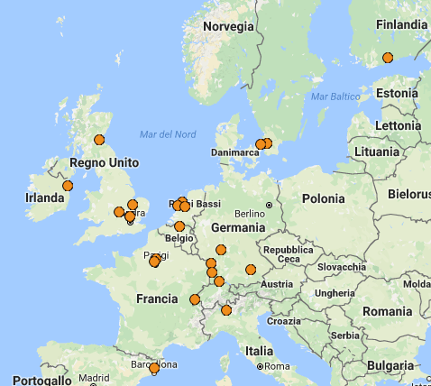
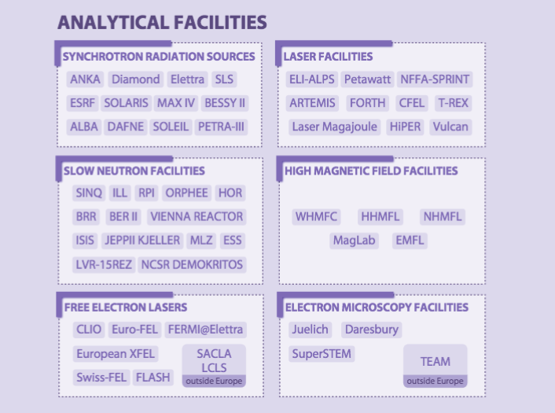

Infrastrutture di Ricerca Analitiche aperte
all’utenza internazionale che operano in Europa e sedi LERU
Analytical Machines as User Facilities in Europe and League of European Research Universities:
a 400 km void around Univ. of Milan
LERU members
MAX-Lab
ESS Neutron
PETRA-III
X-FEL, FLASH
DIAMOND
ISIS - CLF
MYRRHA
SOLARIS
SOLEIL
LLB
ANKA
SLS, SwissFEL
ESRF
ILL, LETI
Elettra FERMI
ALBA
SPARC DAFNE
Da PSE Landscape Analysis ESFRI Roadmap 2016
Courtesy Giorgio Rossi – former Chair ESFRI

Slide 4
Multi-disciplinary Advanced Research Infrastructure
for the generation and application of X-rays: MariX C.D.R.
Scientific Case for a low jitter CW FEL was conceived by Giorgio Rossi, Giacomo Ghiringhelli, Ezio Puppin, Francesco Stellato/Silvia Morante, Bruno Paroli, Martino Bolognesi: Linear Spectroscopy in 0.2-8 keV at femtosecond time scale
Clinical Case for ICS monochromatic X-ray Source delineated by metropolitan Milan Hospitals: San Raffaele, Niguarda, Istituto Naz. dei Tumori, in collaboration with Ferrara and Naples Univ.
Design of a High Sustainability CW combined FEL & ICS X-ray Source for UniMi Scientific Campus spanning 0.2-180 keV (delivering 200kW to 2 MW sustainable beam power to client, cfr. Fermi 100 W, LCLS 2 kW )

Slide 5
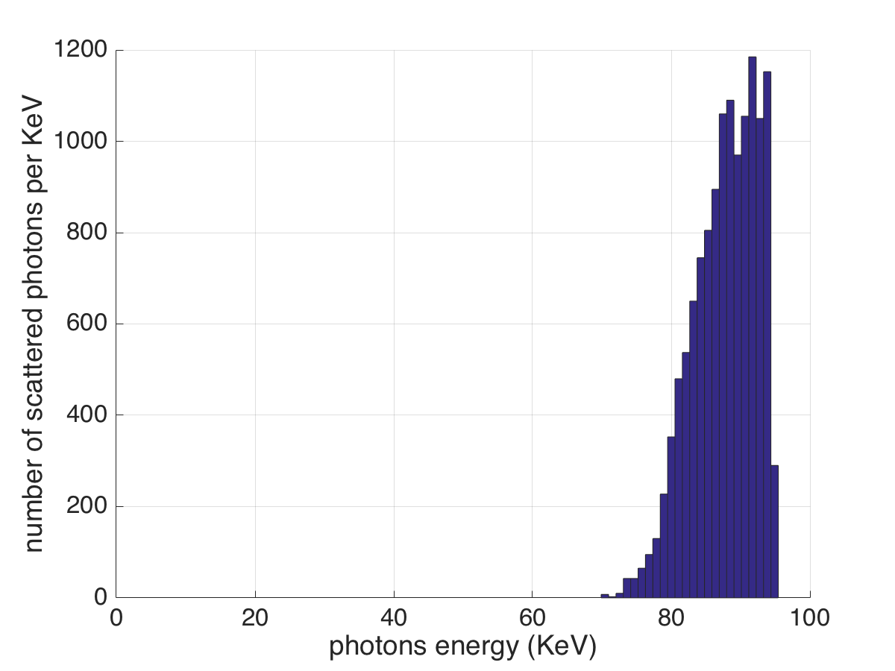
The Mission: coherent femto-second X-rays @ (0.2-8) keV, and ultra-high brilliance hard X-rays @ 20-180 keV
FEL fully coherent diffraction limited X-ray photon beam: 10⁸⁻¹⁰ hν/pulse @ 1 MHz
in 0.05% Δν/ν, 0.2-8 keV, σ_{t} < 50 fsec, 10¹⁶ hν/s
FEL Spectrum
2.5 GeV, λ_{w}=12 mm
LCLS, 1 Angstrom
15 GeV, λ_{w}=2.5 cm
Compton X-ray photon beam: 10¹² - 10¹³ hν/s (@ 100 MHz) in 5% Δν/ν, 20-180 keV, tunable, polarized, σ_{t} = 2 psec, 10 μm round source spot size, mrad divergence
Compton spectrum
FP @ 400 kW, 10 mA,
e⁻ beam 1 MW
2.6.10¹² photons/s

Slide 6
MariX Conceptual Design Report : Main Steps
Letter of Intent signed in July 2017 by University of Milan Rector (Prof. G. Vago) and INFN President (Prof. F. Ferroni)
The mandate to CDR collaboration team: Twin Source of FEL coherent X-rays in 0.2-8 keV range up to 10¹⁷ photons/s and ICS hard X-rays in 20-180 keV range up to 10¹³ photons/s
MariX CDR completed in March 2019 by 96 authors, belonging to INFN, University of Milan and 18 more Universities/Institutions (Politecnico di Milano - Sincrotrone Elettra), also thanks to INFN support for 3 fellowships and R&D funds for BriXSino
MariX Seminar – Laboratori Naz. del Sud - INFN - Nov. 13th, 2019

Slide 7

The Product: Conceptual Design Report
After 1 year of hard work...
CDR has been published and
available for download at
www.marix.eu

Slide 8
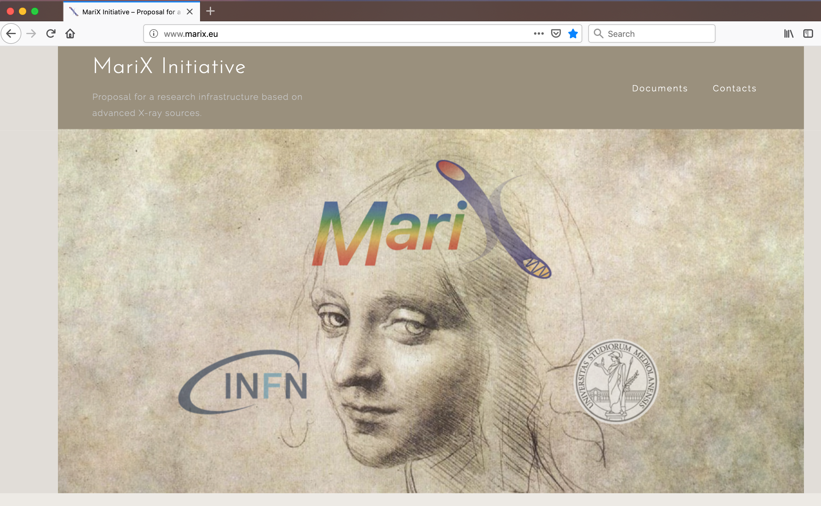

Slide 9
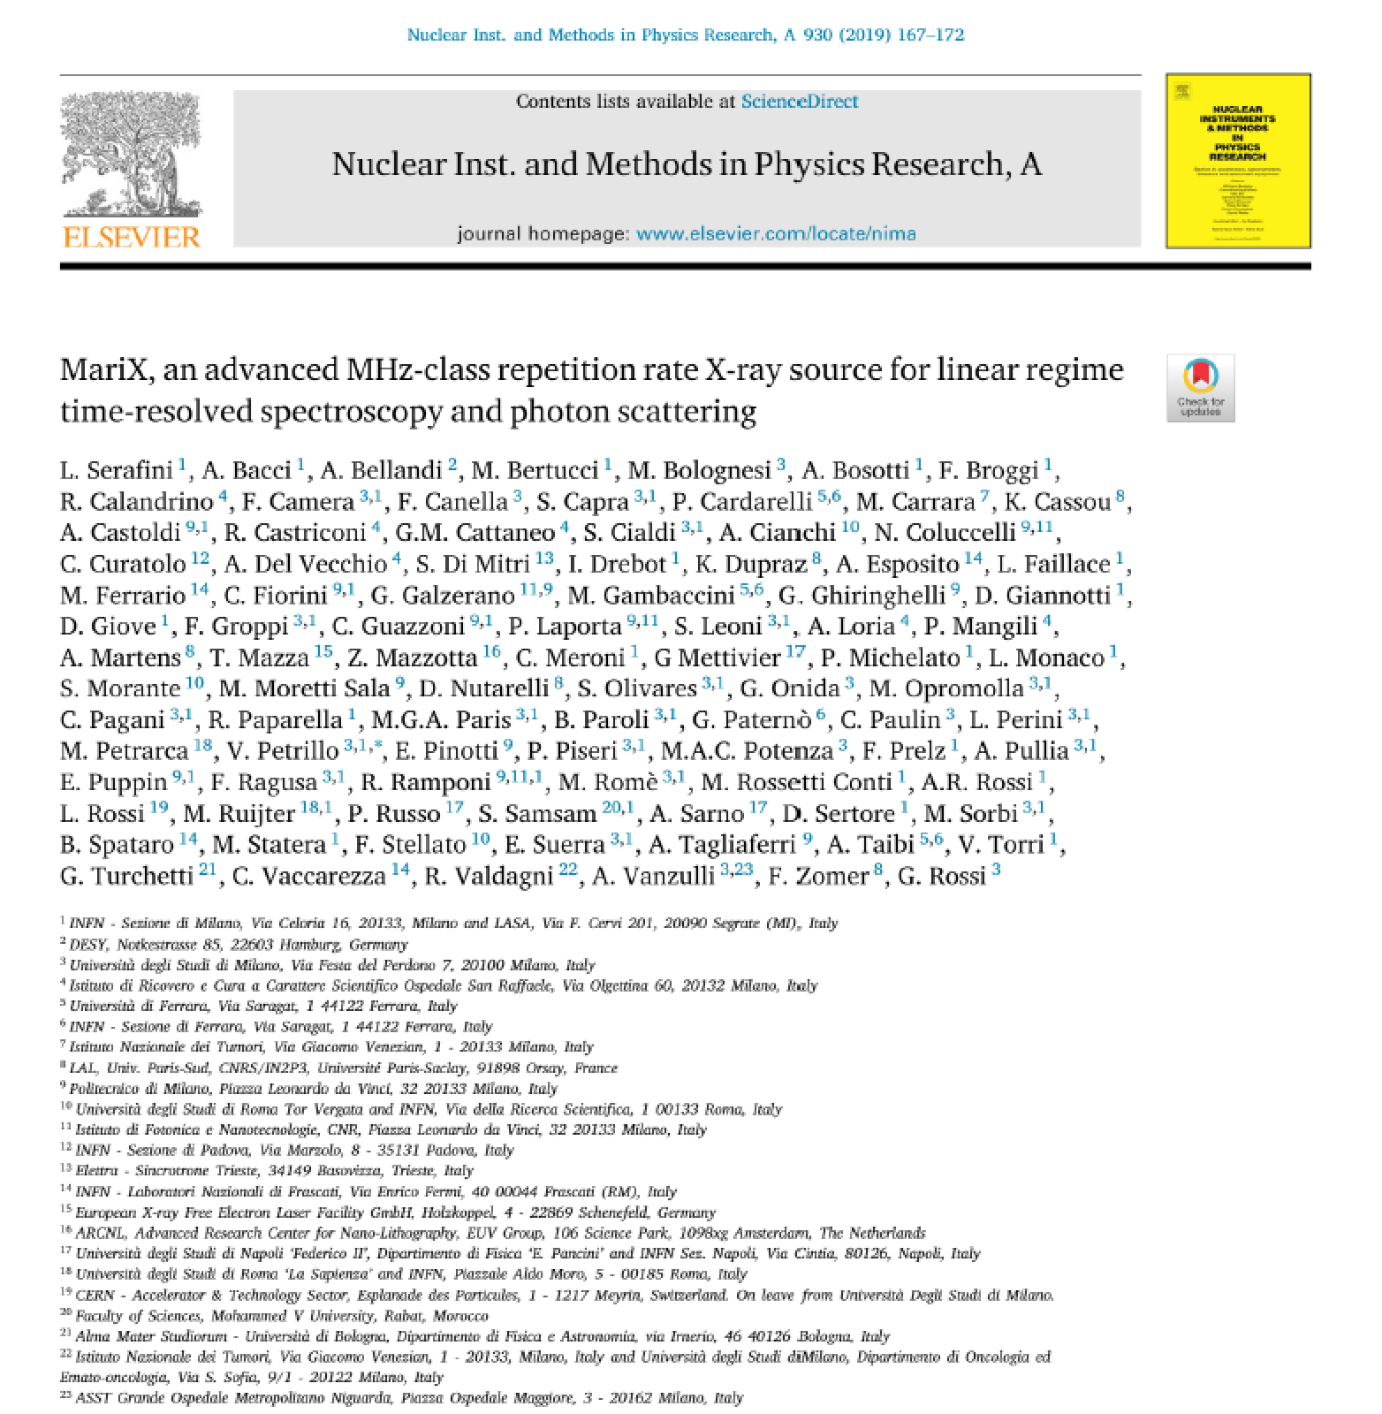
Executive Summary
published on NIM-A

Slide 10


Slide 11
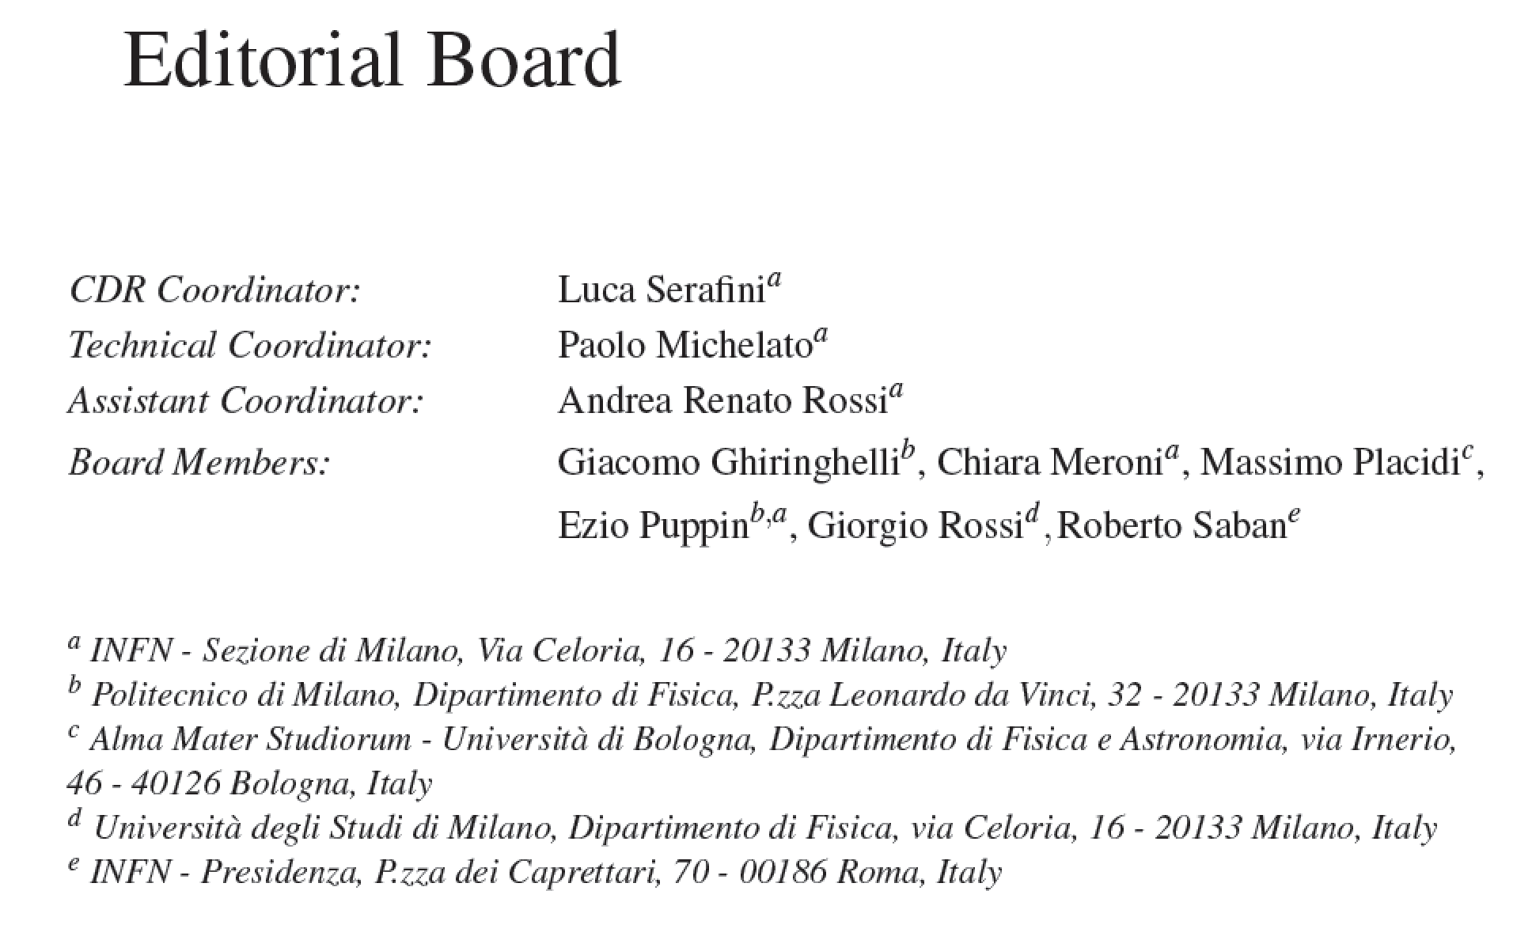
Machine Team: A. Bacci, A. Bosotti, F. Broggi, S. Cialdi, C. Curatolo (INFN-PD), S. DiMitri (ST),
I. Drebot, A. Esposito (LNF), D. Giove, G. Galzerano (PoliMi/CNR), P. Michelato, L. Monaco,
R. Paparella, V. Petrillo, F. Prelz, E. Pinotti (PoliMi), M. Placidi (Univ. BO), E. Puppin (PoliMi),
A.R. Rossi, D. Sertore, V. Torri
Fellows: D. Giannotti^{INFN}, L. Faillace^{INFN}, M. Rossetti Conti^{INFN}, S. Capra^{UniMi}
PhD/Master Students: F. Canella, M. Opromolla, C. Paulin, M. Ruijter^{INFN},
S. Samsam^{ICTP}, E. Suerra

Slide 12
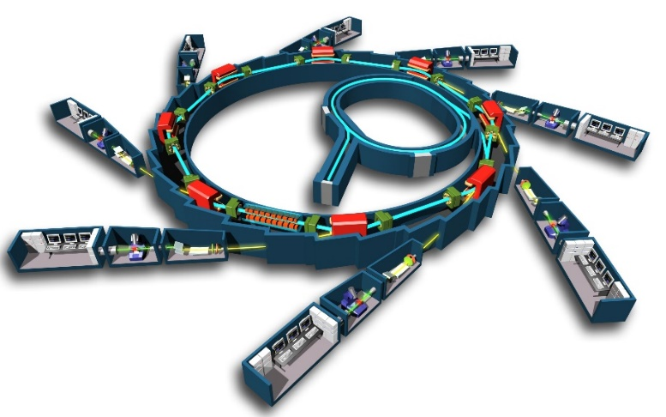
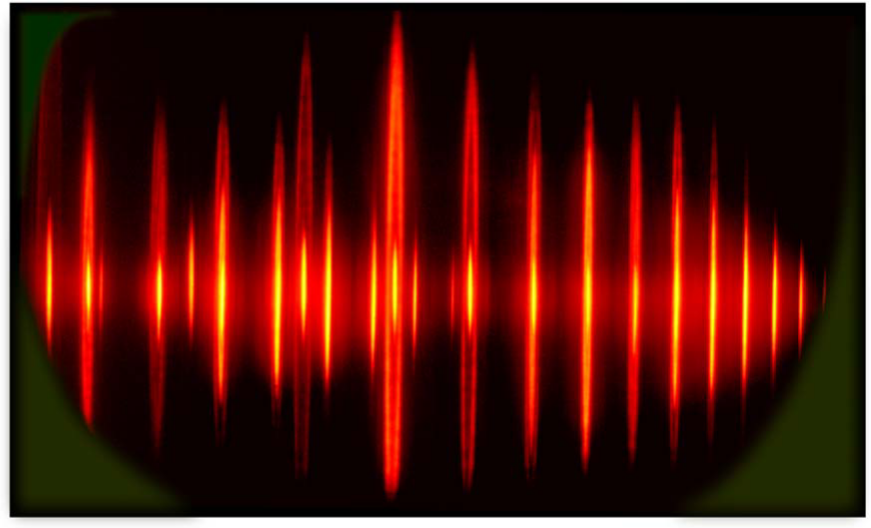
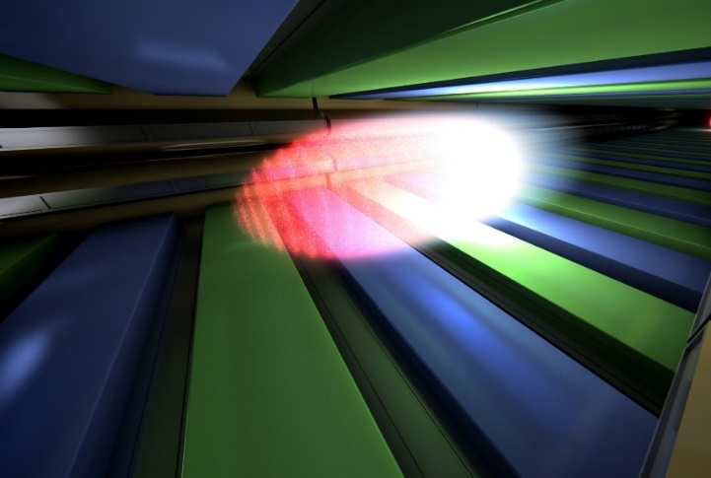

Laser-HHG UV-Soft X
Synchrotron Radiation sources
Free Electron Laser sources
500 MHz repetition
nJ pulse energy; ≈50ps
10⁵⁻⁶ photons x (5)x10⁸pulses
^{Linear response} ^{regime:}
^{Imaging} and spectroscopy (perturbation theory)
10Hz-27kHz repetition
mJ pulse energy; ≈50fs
10¹²⁻¹³ photons x
10¹⁻³⁻⁽⁶⁾pulses
Ultrafast Non-linear response regime
Imaging, flash+destroy
MARIX+FEL (10 keV)
1 MHz repetition
100nJ pulse energy; ≈50fs
10⁸⁻¹¹ photons x 10⁶pulses
Ultrafast Linear response
DLSR: vertical emittance 2-8 picorad,
horizontal emittance 200-300 picorad
MariX: vertical/horizontal
emittance 45 picorad
⇒ Round vs. Flat beams
Courtesy Giorgio Rossi

Slide 13
Scientific/Clinical Case: 2 Research Fields
enabled by MariX originality (Compton+FEL in CW)
High resolution low dose Radio-logical Imaging (<100 μm) with mono-chromatic X-rays up to 150 keV: mammography, 2 color angiography, radio-therapy with auger electrons on cis-platine, CAT 3D imaging of Cult.Herit./Archeological/Paleontological samples
Time resolved spectroscopy with fs coherent X-rays up to 8 keV @ 1 MHz rep rate: catalisys and chemistry in solvents, structure of nano-objects from coherent diffraction, bio-chemistry @ atomic and fs scale, pump&probe spectroscopy of strongly correlated materials, magnetism, superconductivity, topological materials, materials under strong spin-orbit interaction. Protein Crystallography with single-shot imaging (flash-and-destroy)

Slide 14
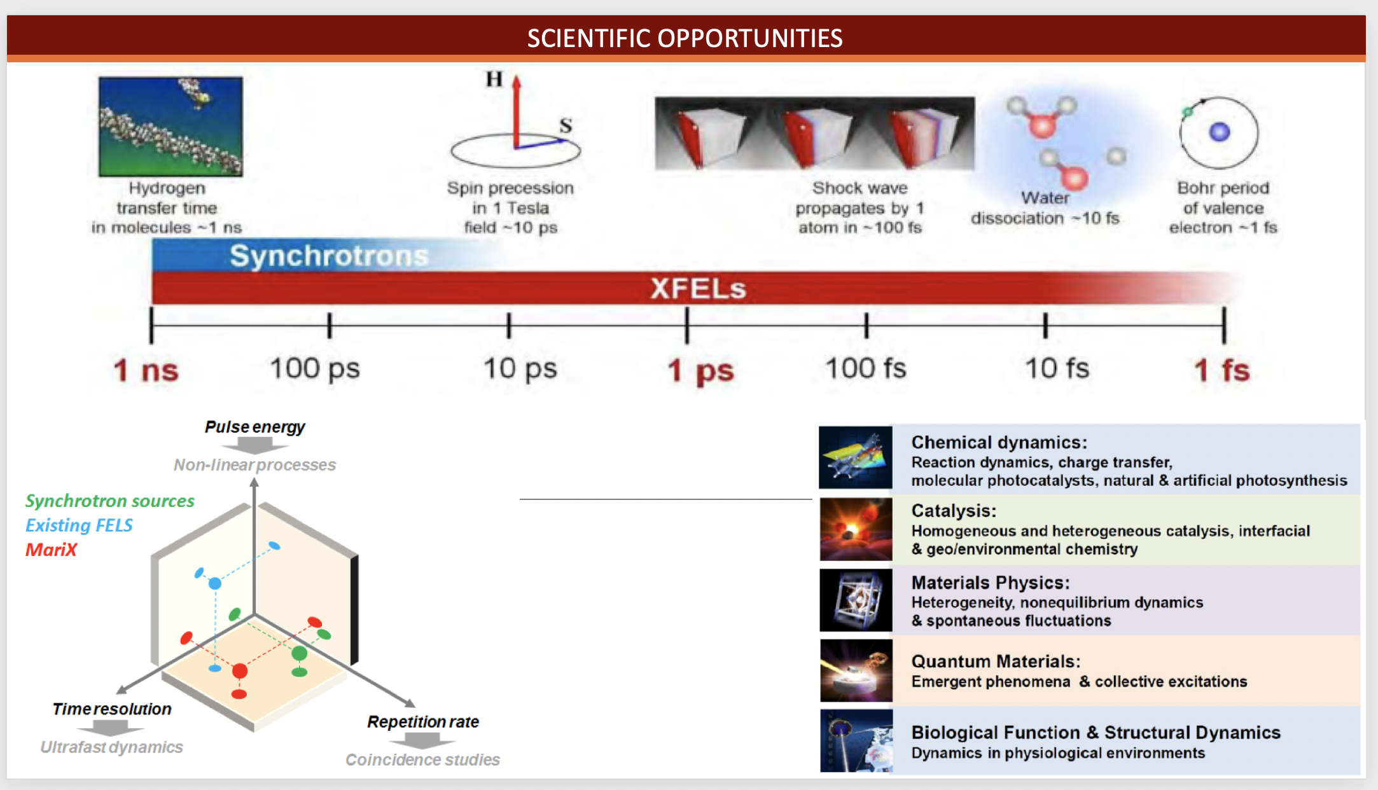
Courtesy Giorgio Rossi

Slide 15
Comparison between X-FELs
Electron Beam Energy to radiate at ~ Angstrom
λ_{R} = λ_{w} (1+a_{w}²)/ 2γ² , λ_{w} ÷ 1.2-3 cm
FEL | Radiation Wavelength (A) | Electron Beam Energy (GeV) | Linac Length (m)
LCLS | 0.5 | 14.3 | 1000.
PSI | 1.0 | 5.8 | 500.
EuXFEL | 0.15 | 17.5 | 1700.
LCLS II | 2.4 | 4.0 | 650.
MariX | 1.5 | 3.8 | ???? < 200

Slide 16
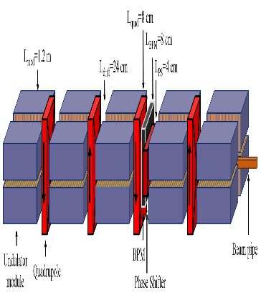
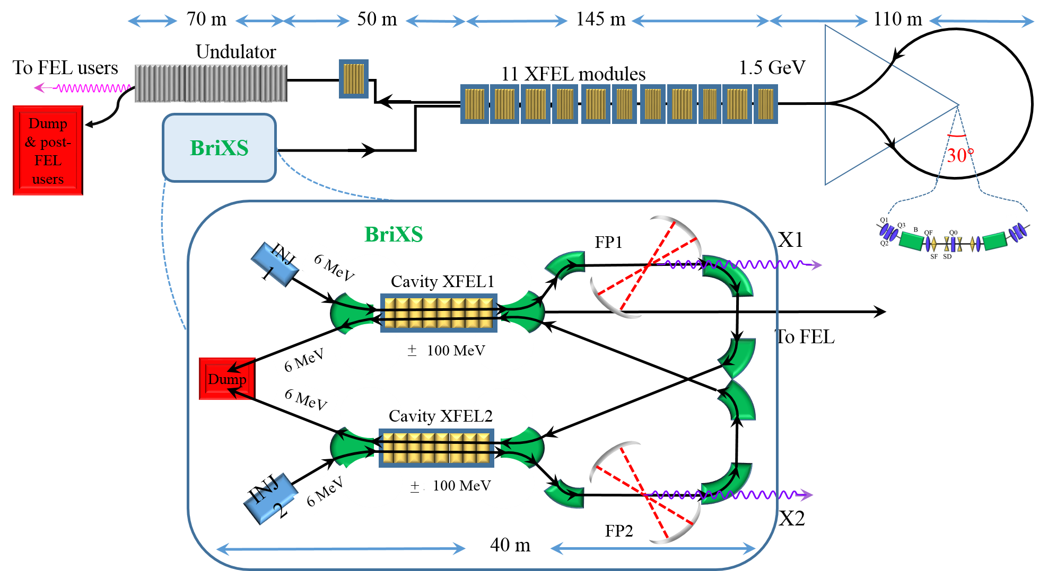

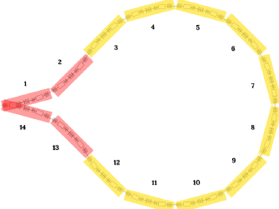
In quest of High Sustainability we had to conceive a new kind of machine:
the Two-Way Linac (TWL)
All Accelerators are one way – the beam propagates in one direction (ERL too)
MariX uses the CW Linac twice – forward and backward
Superconductiong Linac: 13 XFEL crio-modules Compr Undulator
Traditional
FEL layout
Injector
dV/dz=17 MV/m
100 MeV 1.6-1.8 GeV
λ=7 Ang
0
100m
200m
300m
400m
500m
Linac2
Linac1: 11 XFEL crio-modules
Arc
compr
MariX
layout
λ=1.5 Ang
Injector
3.4-3.8 GeV 2.8-3.2 GeV 1.4- 1.6 GeV
Only Standing Wave RF Cavities can accelerate particles in both directions!

Slide 17
Acceleration in opposite directions through a Linac
(two-way acceleration)
is possible if:
RF fields can accelerate in both directions
(Standing Waves can do it)
2) Focusing effective in both directions and weakly energy dependent
(RF focusing and/or solenoids)
3) No bunch crossing –> Twice the Linac Length < Bunch separation
4) RF fields must be on for a time longer than
bunch back-and-forth travel time (CW recommended)
5) Orbit position must not be dependent on magnetic rigidity
(no two-way through dipoles, except bifurcations)
MariX Seminar – Laboratori Naz. del Sud - INFN - Nov. 13th, 2019

Slide 18
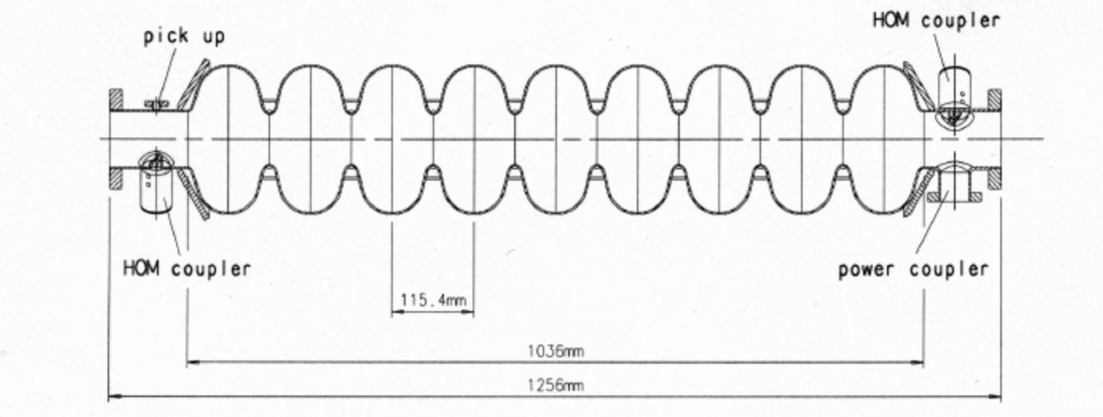
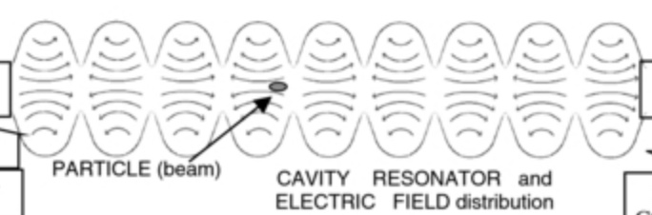
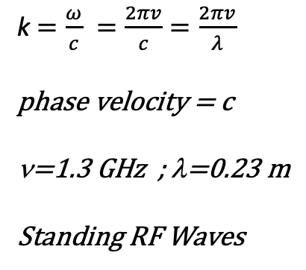
Modo risonante TM_{010-π} ad Onda Stazionaria
k$=\frac{ω}{c} =\frac{2πv}{c}=\frac{2πv}{λ}$
phase velocity = c
ν=1.3 GHz ; λ=0.23 m
Standing RF Waves
9 celle = 4.5 λ = 1.04 m

Slide 19
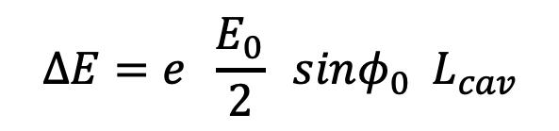
standing wave
E₀ sin(kz)cos(ωt-φ₀) =
(1/2) E₀ sin(kz-ωt+φ₀) + (1/2) E₀ sin(kz+ωt-φ₀)
forward traveling wave,
synchronous to z = ct
backward traveling wave,
synchronous to z = -ct
ampiezza della componente
di onda viaggiante sincrona
rispetto all’elettrone
$$ΔE=e \frac{E_{0}}{2} sinφ_{0}{ L}_{cav}$$

Slide 20
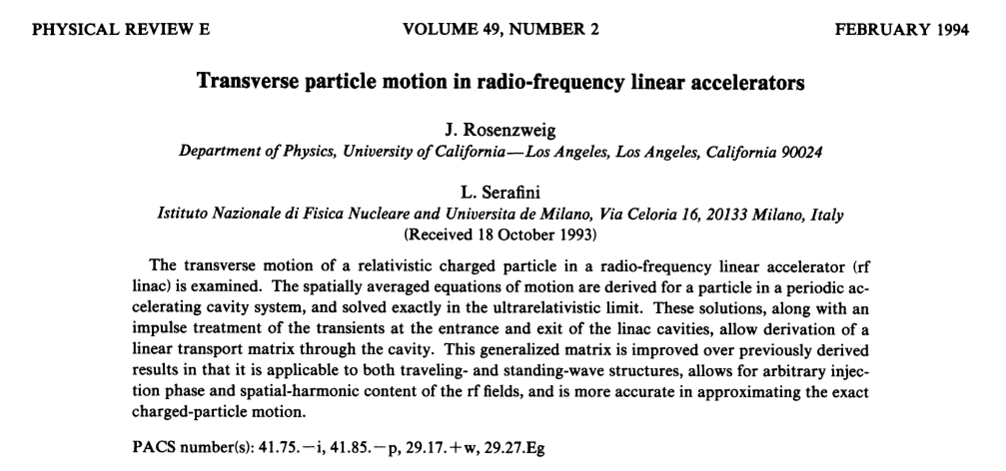
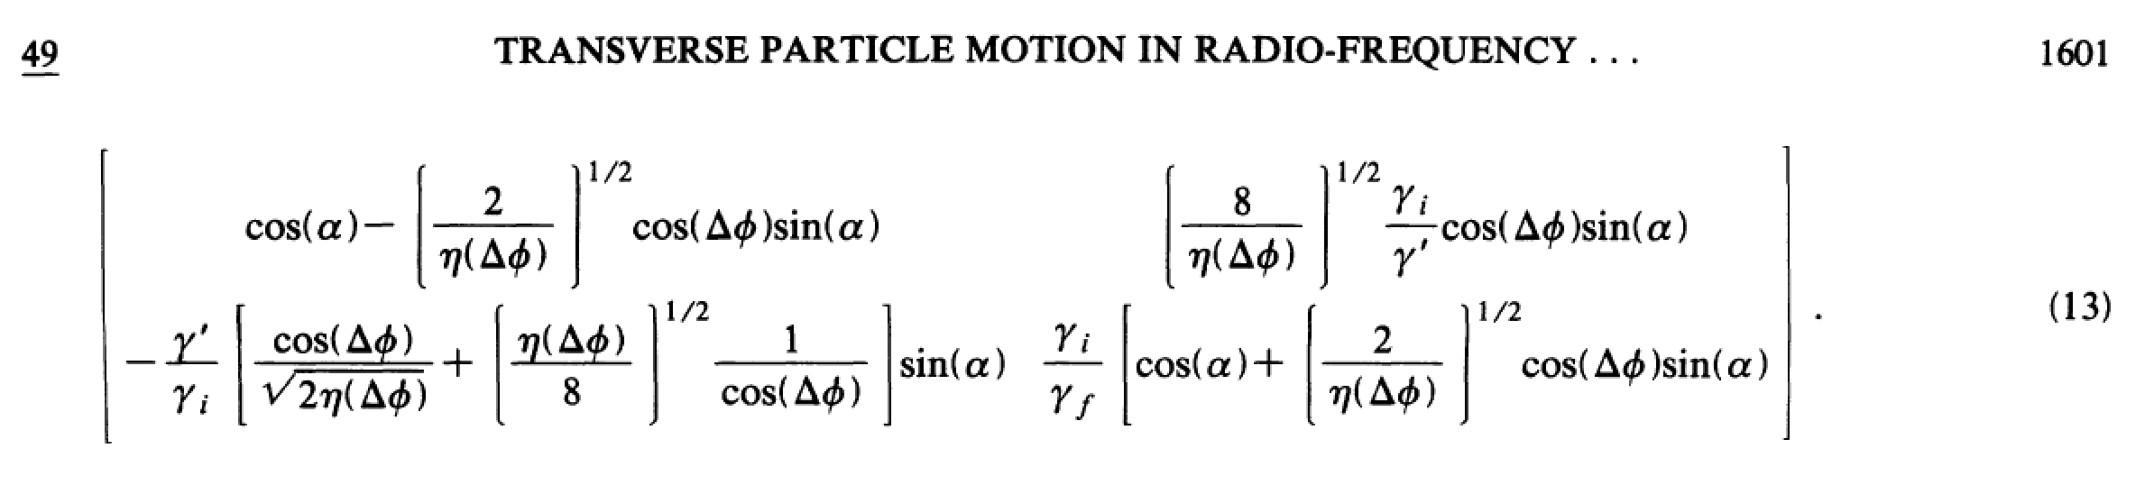
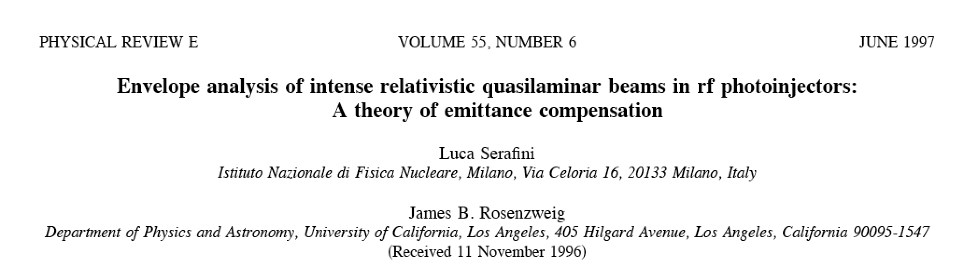
RF Focusing effective only in Standing Wave RF Cavities
a lesson we learned long time ago
RF transport matrix

Slide 21
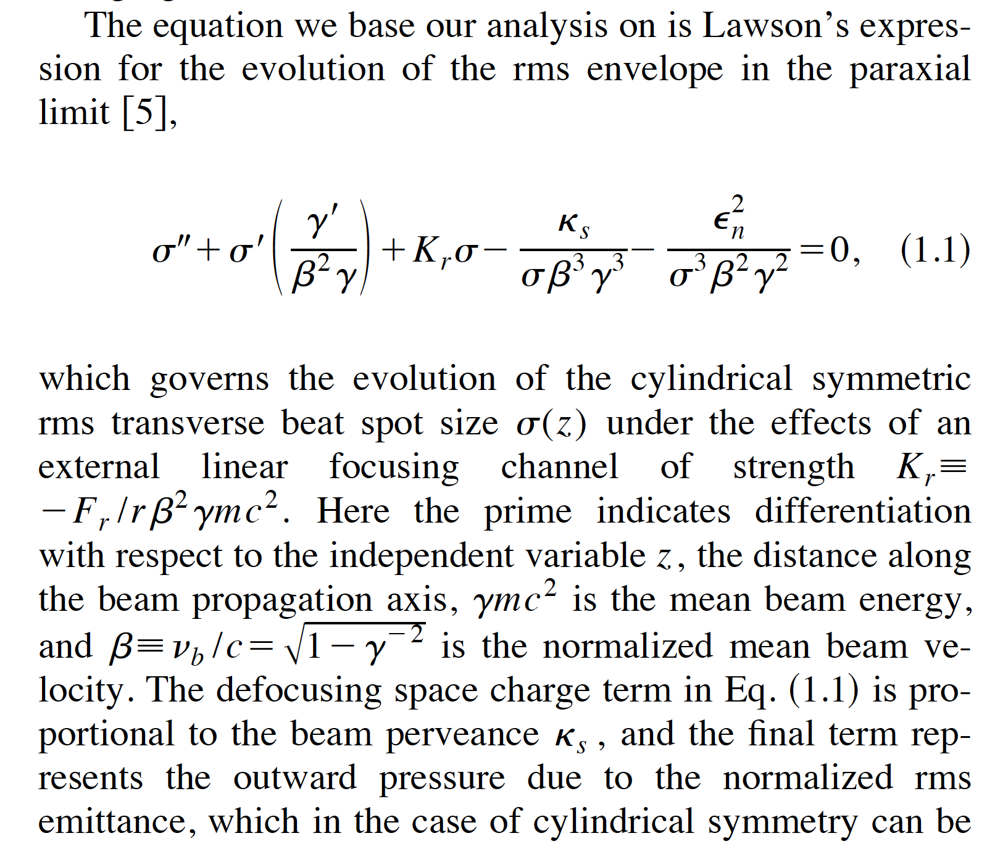
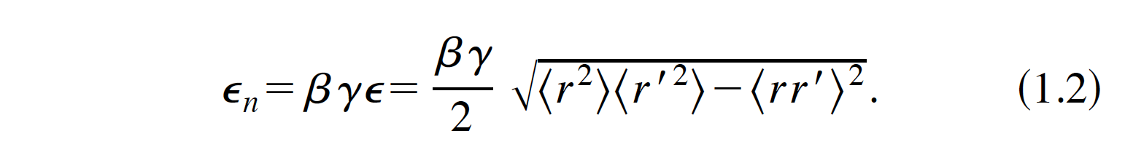
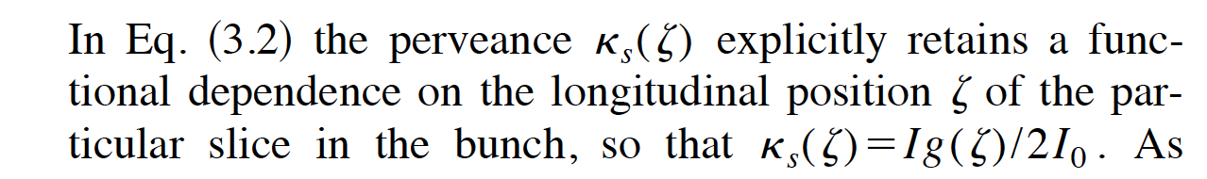
RMS Envelope Equation for laminar beams: a path towards the Invariant
Envelope Theory for High Brightness el. beams (1997, L.S and J.Rosenzweig)
1.1

Slide 22
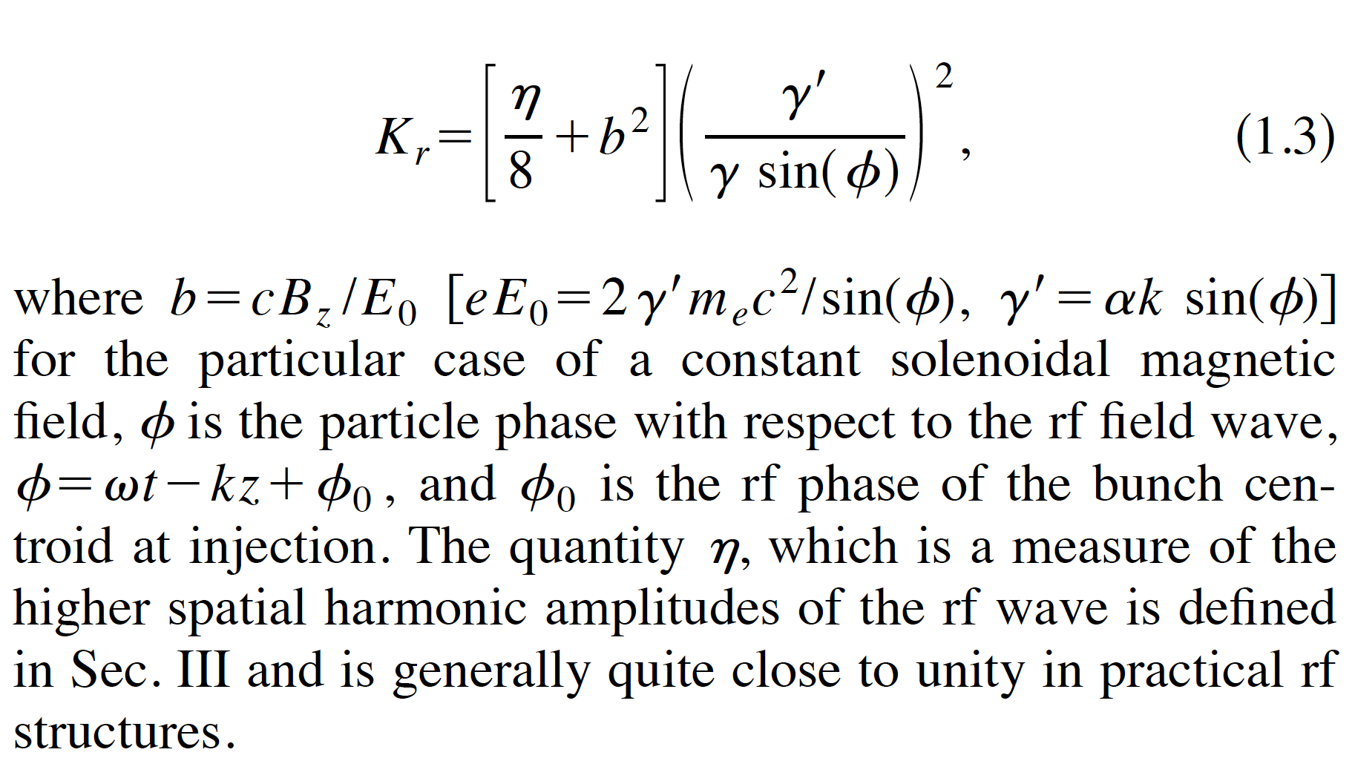
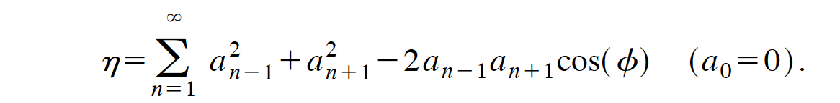
RF (ponderomotive) Focusing
~ 1 Standing
~ 0 Traveling

Slide 23
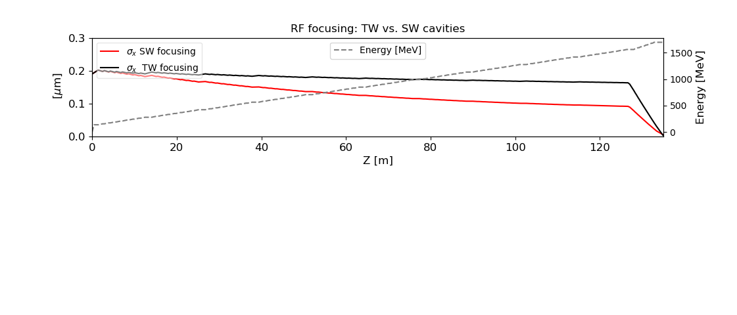

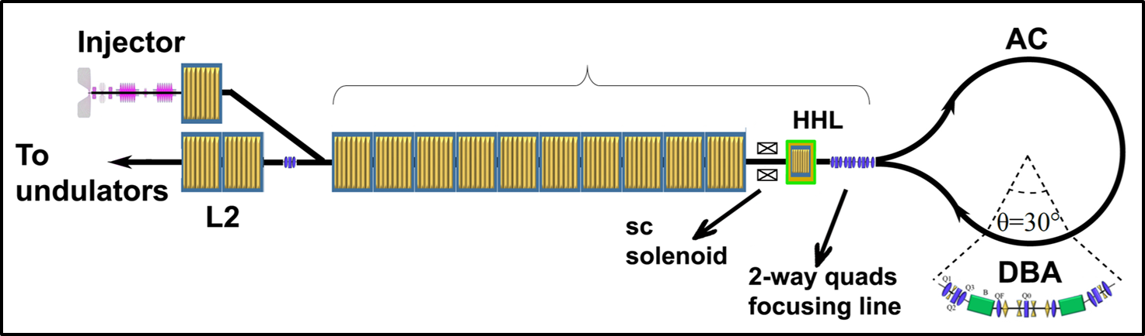
The Super Conductive Main Linac
Ten Tesla like cryomodules: max grad 16 MV/m, 8 cavity per cryomodules
Chirp for AC-compression is given injecting @ + 6° from RF crest.
We rely only on second order focusing, symmetric back-and-forth: Rf focusing and solenoid foc.
5 T solenoid
Two-pass 2-way region
Notes:
Adiabatic focsing

Slide 24
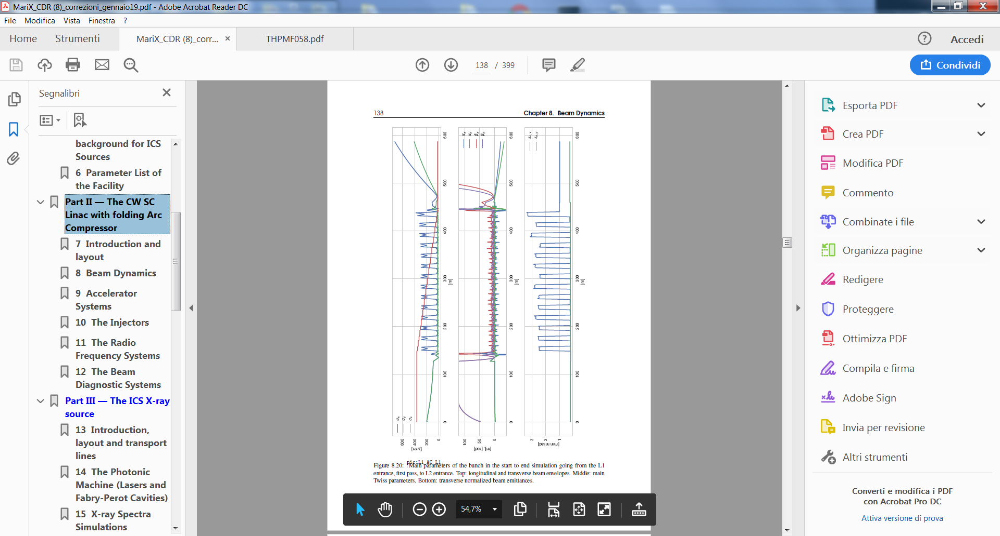
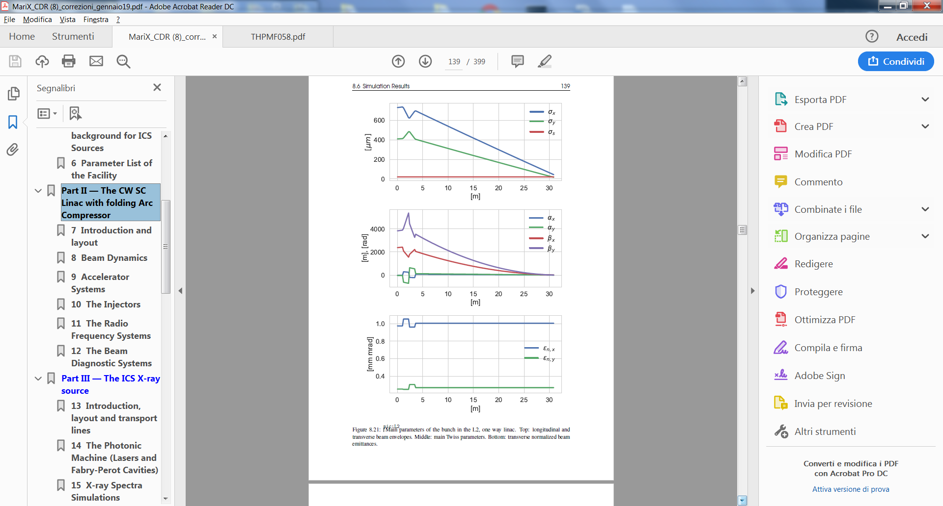
The beam dynamics
All the beam dynamics simulations have been done with ELEGANT by
Alberto Bacci and Marcello Rossetti Conti
Envelopes
Linac 1 1st pass TL Arc compressor TL Linac 1 2nd pass Linac2
Emittances
MariX Seminar – Laboratori Naz. del Sud - INFN - Nov. 13th, 2019

Slide 25

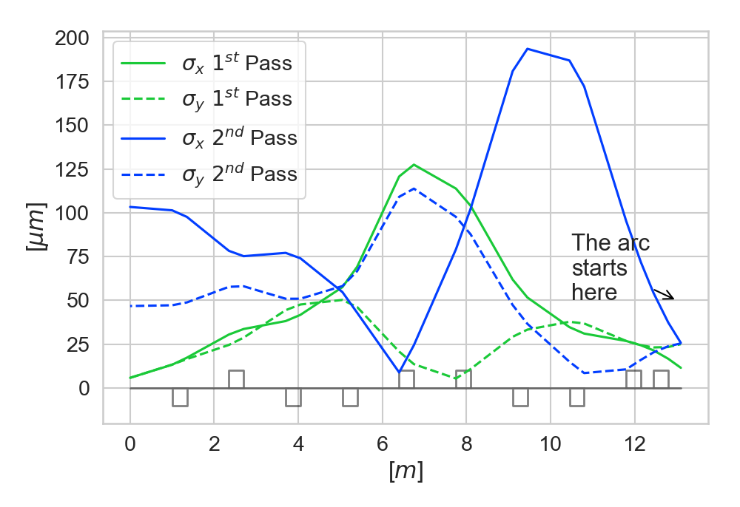
AC – matching line
Not trivial 10 quads matching line with 2 SOLUTIONS
SOL. 1: «going bunch» match perfectly at the DIPOLE entrance
SOL. 2: «the coming back bunch» control bunch envelopes avoiding disastrous emit degradation by chromatic aberrations @ the 5T SOLENOID
going
coming

Slide 26

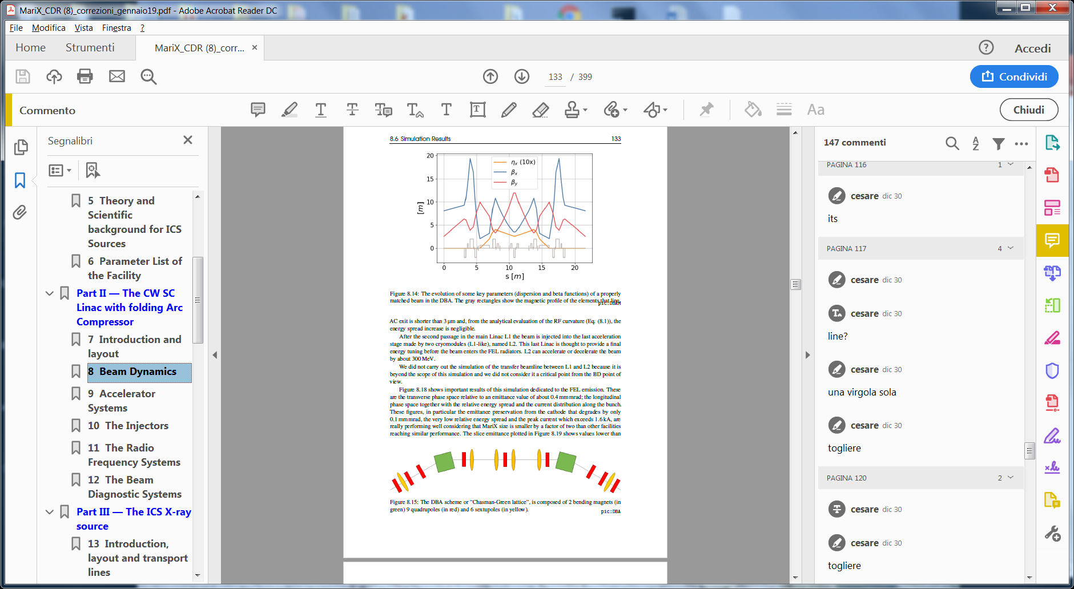
Source layout 5:
The arc compressor
14 Double Bending Achromats Elettra-like
dipole
One DBA
quad
R₅₆=35 mm
30°
sextupole
R=41 m
Study of the arc compressor done by
M. Rossetti Conti
MariX Seminar – Laboratori Naz. del Sud - INFN - Nov. 13th, 2019

Slide 27
Beam dynamics 1: before the arc, Q=50 pC
here
Beam dynamic study made by A. Bacci
I_{peak}=16 A
σ_{x}=6 μm
σ_{z}=360 μm
<E>=1.5 GeV
ε_{nx,y}=0.2 μm
ΔE/<E>=7 10⁻⁴
Longitudinal phase space
Transverse phase space
MariX Seminar - Univ. of Pisa - Dept.of Physics – Sept. 25th, 2019

Slide 28
Beam dynamics 2: after the arc, Q=50 pC
here
I_{peak}=1600 A
σ_{x}=52μm
σ_{z}=20 μm
ΔE/<E>=3.6 10⁻⁴
ε_{n,x}=1 μm
σ_{y}=14.5 μm
Longitudinal phase space
Transverse phase space
ε_{n,y}=0.2 μm
Centro Brasileiro de Pesquisas Fisicas, Rio de Janeiro, May 2nd, 2019

Slide 29
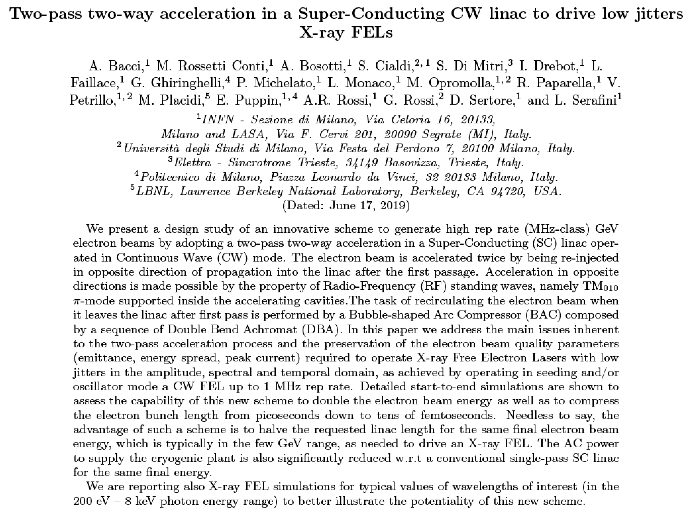
In Publication on Phys. Rev. AB

Slide 30
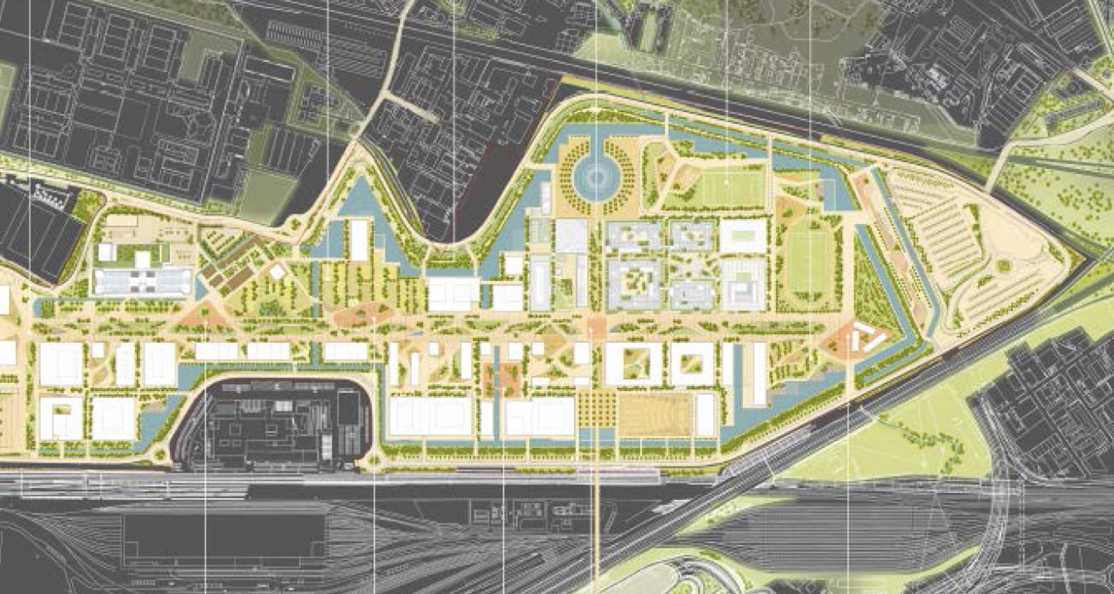
500 m
Next generation CW FELs like LCLS-II are km-long: not enough space in new UniMi Campus

Slide 31
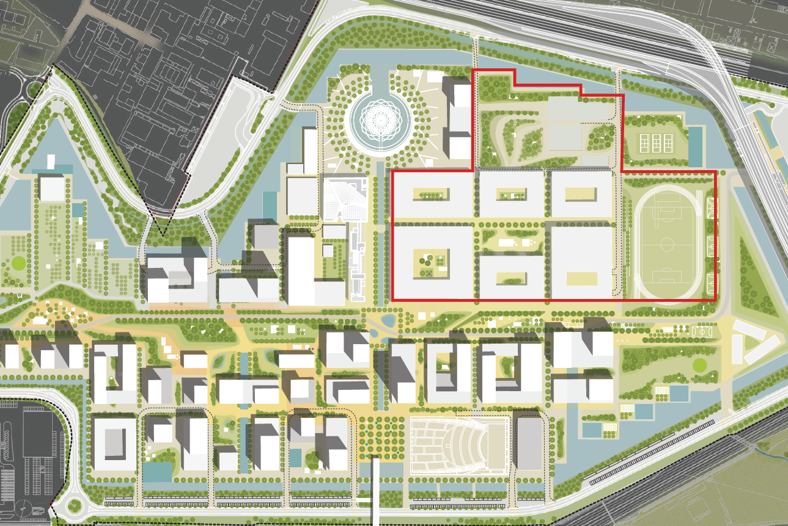
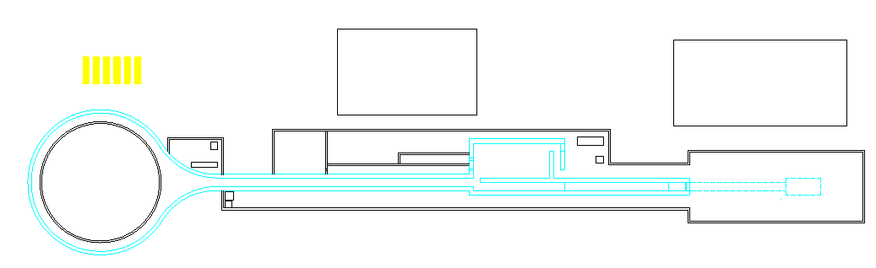
100
200
300
400
m

Slide 32
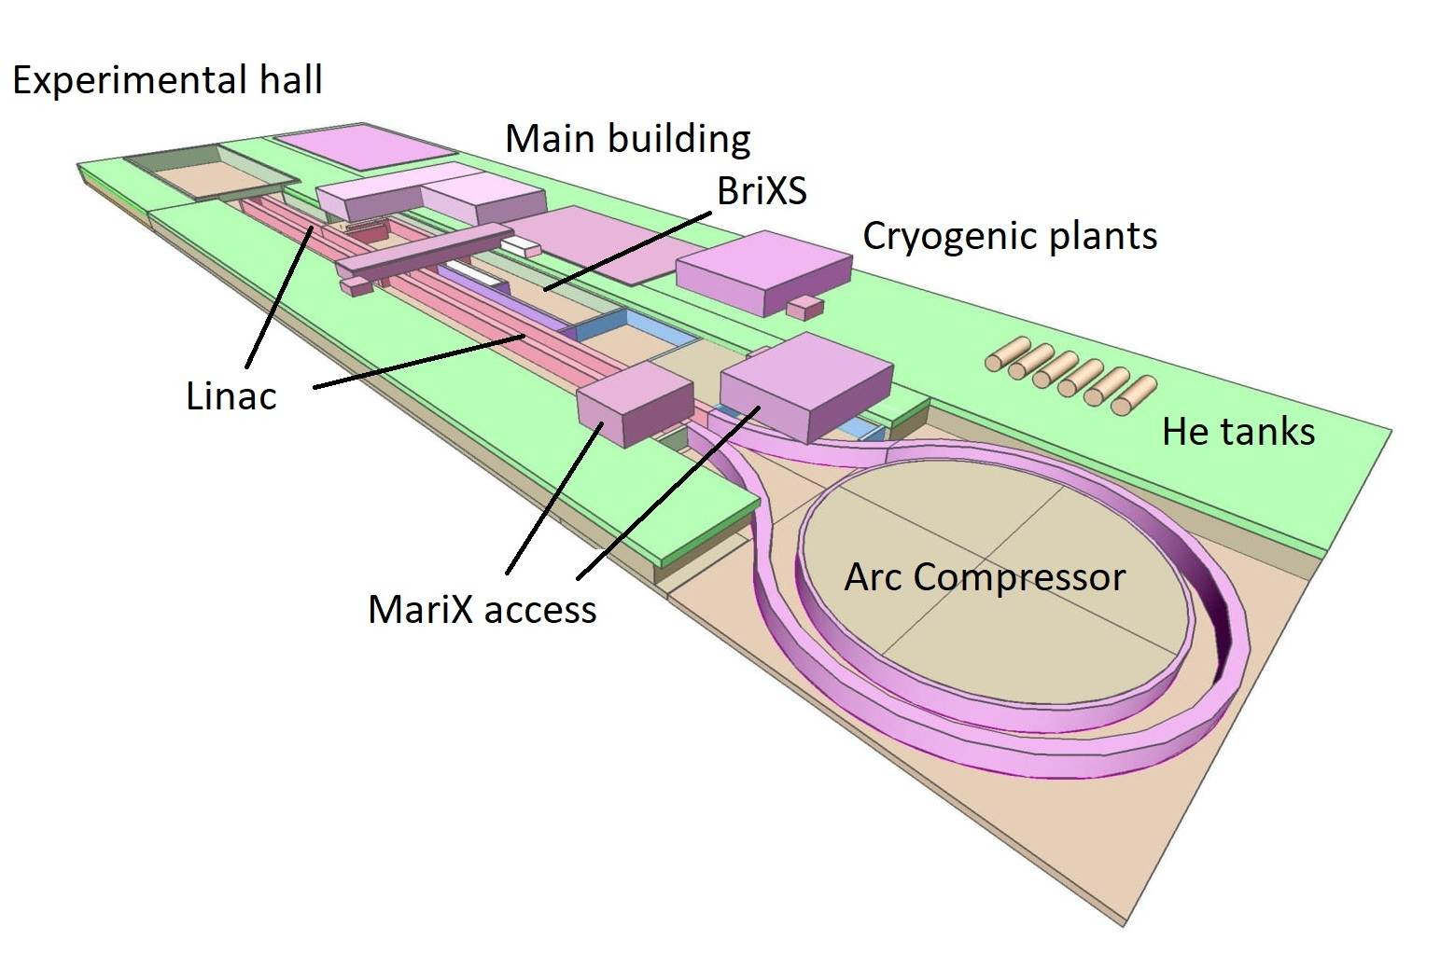
Ezio Puppin – CDR convener for Civil Engineering and
Infrastructure Systems

Slide 33
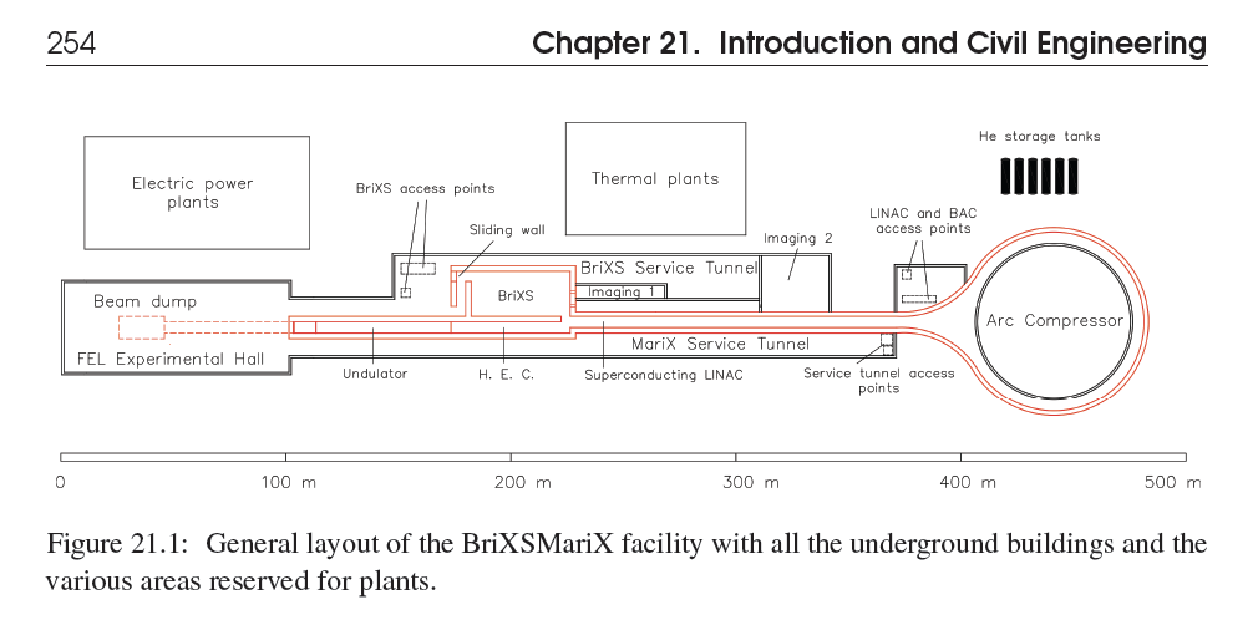
200 kW underground beam dump @ 3.8 GeV

Slide 34
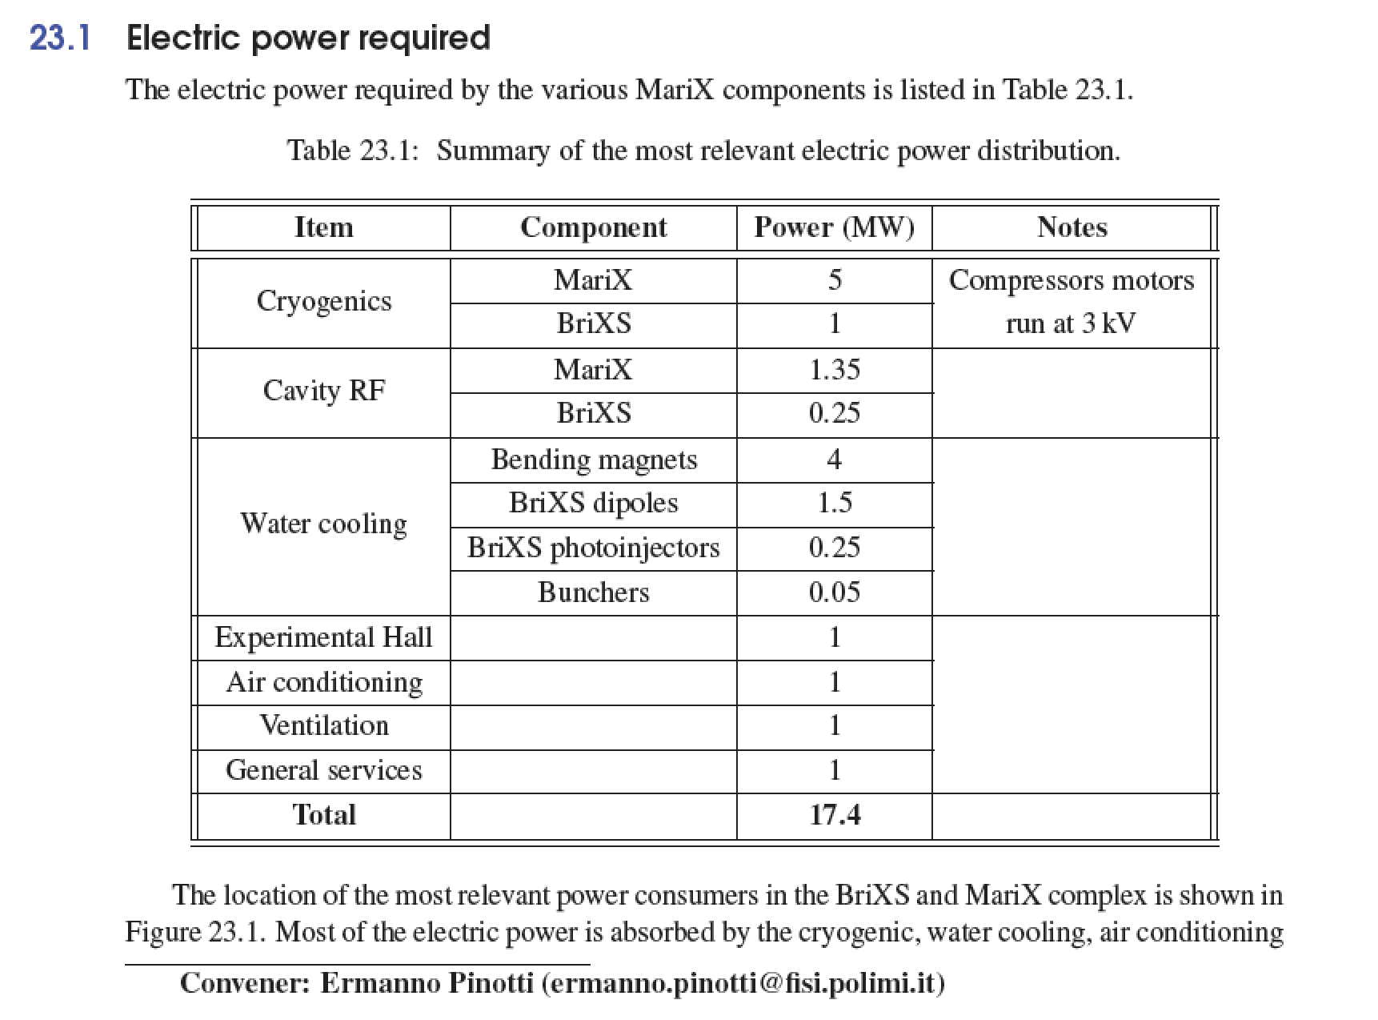

Slide 35
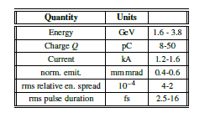
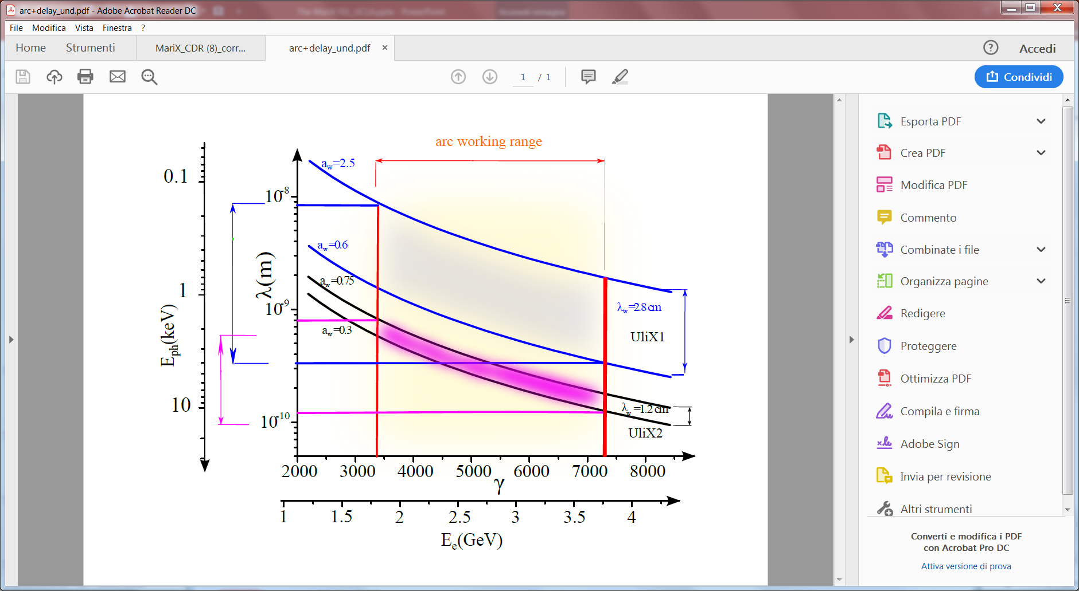

General considerations on MariX FEL
1) For emitting with continuity from 100 eV to 8 KeV:
Nominal electron beam
L_{quad}=20 cm
L_{mod}=2.8 m
L_{drift}=56 cm
Undulator
module
Quadrupole
BPM
Beam
pipe
Phase Shifter
ULIX1
UliX1 λ=2.8 cm a_{w}<2.5
from 100 eV to 4KeV
L_{mod}=1.2 m
L_{drift}=24 cm
L_{quad}=8 cm
ULIX2
UliX2 λ=1.2 cm a_{w}<0.8
from 2 KeV to 8 KeV
Undulator
module
BPM
Beam pipe
Quadrupole
Phase Shifter

Slide 36
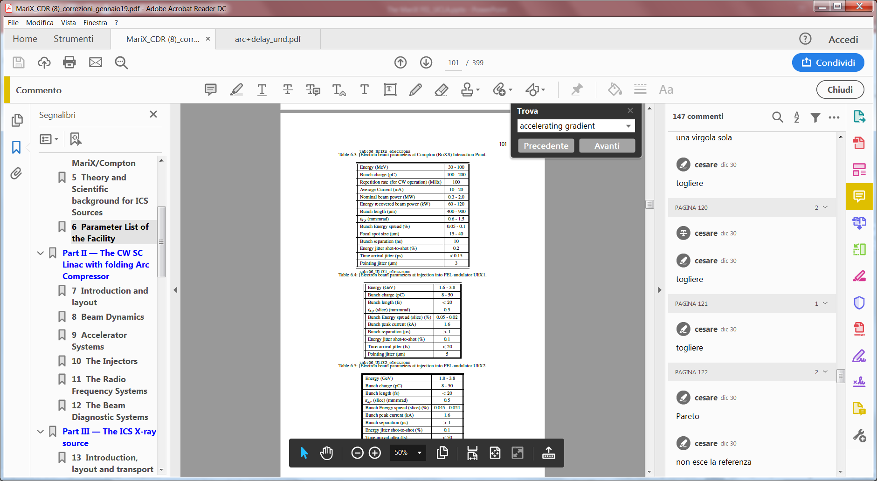
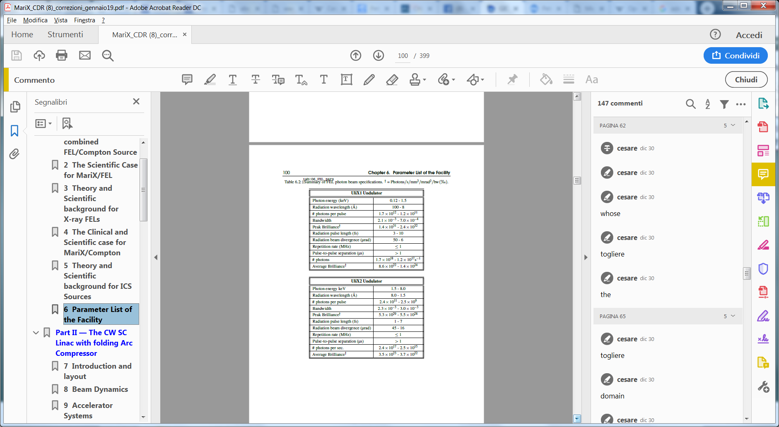
FEL simulations
With ELEGANT simulations we obtained
an electron beam with parameters very
similar to the nominal ones
0.5-0.35
Sirius like, ESRF-upgrade like

Slide 37
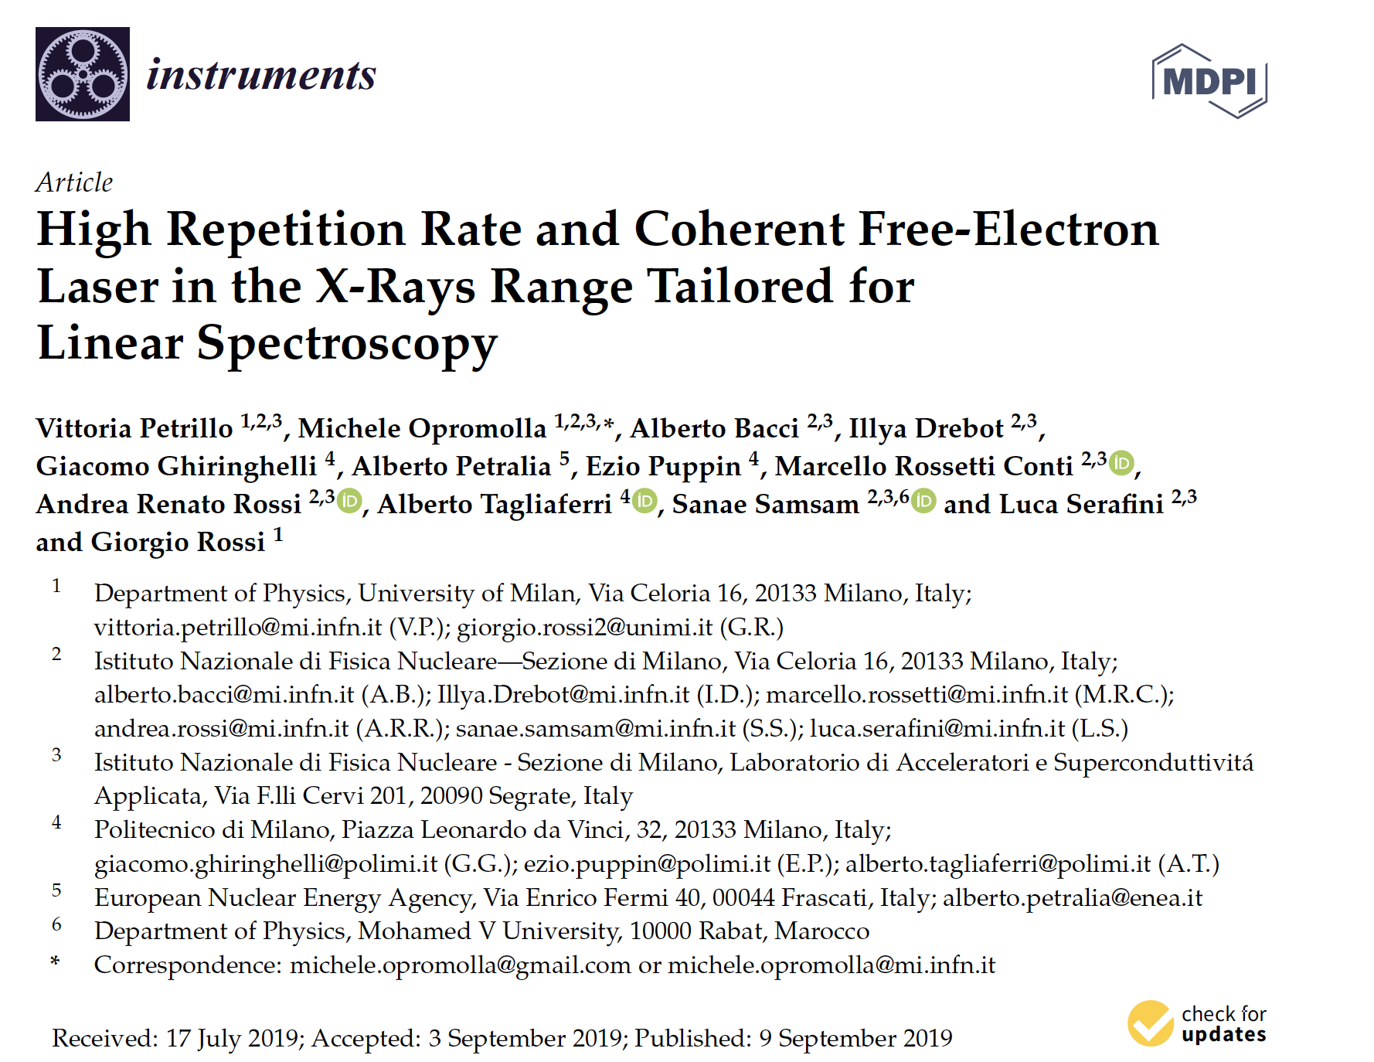

Slide 38
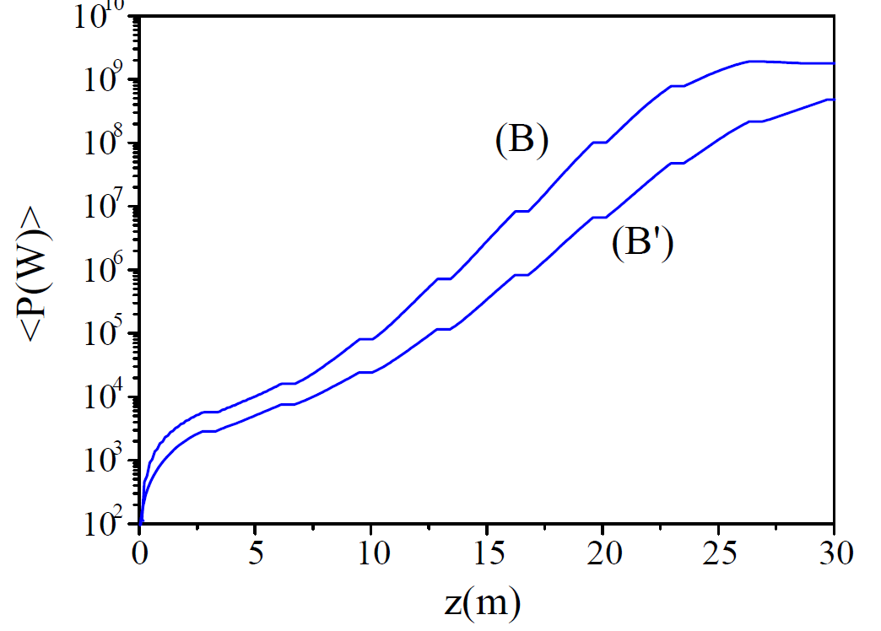
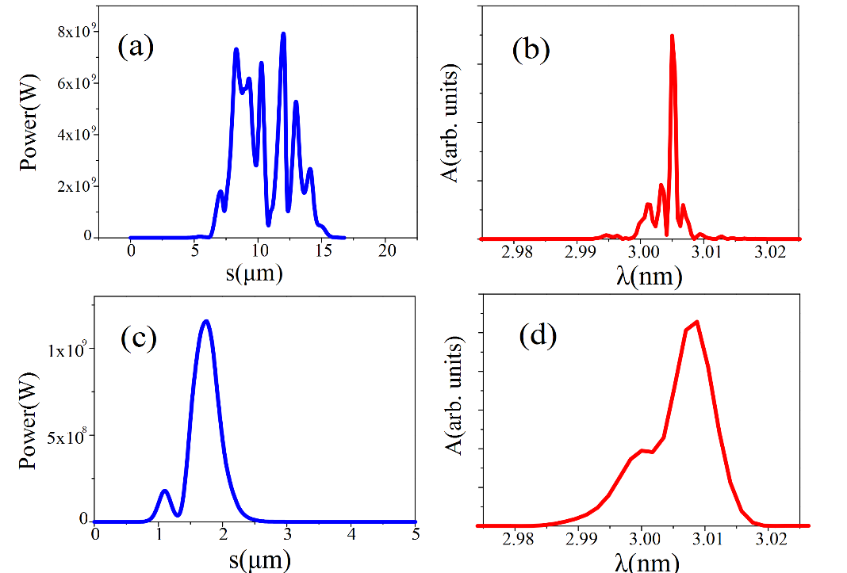
SASE1: water window (2.77 nm) ULIX1, λ_{w}=2.8 cm
 | 16pC | 50 pC
e-En (GeV) | 3.2 | 3.2
Und l_w, L(cm,m) | 3 , 25 | 5, 25
Ph-en (keV) | 0.45 (2.8nm) | 0.45 (2.8nm)
Rep rate | 1 MHz | 1 MHz
Energy | 21 μJ | 156 μJ
Numb per shot | 3 10¹¹ | 2.2 10¹²
Bandwidth (%) | 0.1 | 0.15
Pulse duration (fs) | 3 | 10
N/ s (s⁻¹) | 3 10¹⁷ | 2.2 10¹⁸
S dens(N/shot/%bw) | 1.7 10¹² | 1.5 10¹³
Radiation size mm | 0.15 | 0.07
Divergence mrad | 2.5 10⁻² | 1.810⁻²
Tot. S. d. (N/s/%bw) | 1.7 10¹⁸ | 1.5 10¹⁹
Coherence | Single Spike | SASE
Growth
I=1.5 kA
emit=0.35 um
ΔE/E=3.6 10⁻⁴
a_{w}=2.5
dt=10-3 fs
Q=50 pC
Q=16 pC
Q=50 pC
SASE
Power
30 m
Spectrum
30 m
Q=16 pC
Single Spike

Slide 39



SASE2: linear spectroscopy (4.17 Å), ULIX2, 1.2 cm
 | 50 pC | 8 pC
e-En (GeV) | 3 | 3
Und λw, L(cm,m) | 1.2 60 | 1.2 60
Ph-en (keV) | 3 | 3
Rep rate (MHz) | 1 | 1
Energy (μJ) | 42 | 2.5
Numb per shot | 8.75 10¹⁰ | 5.4 10⁹
Bandwidth (%) | 0.45 | 0.8
Pulse duration (fs) | 6.6 | 1.2
N/ s (s-1) | 8.75 10¹⁶ | 5.4 10¹⁵
S dens(N/shot/%bw) | 1.94 10¹⁰ | 6.7 10⁸
Tot. spect dens. | 1.94 10¹⁶ | 6.7 10¹⁴
Radiation size mm | 0.135 | 0.14
Divergence mrad | 4 10⁻² | 4.3 10⁻²
Coherence | SASE | Single Spike
I=1.5 kA
emit=0.35 um
ΔE/E=3.6 10⁻⁴
a_{w}=0.6
dt=10-3 fs
Q=50pC
Q=8pC
Growth
Q=50pC
SASE
Power
60 m
Spectrum
60 m
Spectrum
60 m
Q=8pC
Quasi Single spike
50 pC
16 pC
50 pC
16 pC

Slide 40



SASE3: single shot imaging (1.5 Å), ULIX2, 1.2 cm
e-En (GeV) | 3.8
Und (cm,m) | 1.2 60
Ph-en (keV) | 9.25
Rep rate | 1 MHz
Energy | 3.3 uJ
Numb per shot | 2.5 10⁹
Bandwidth (%) | 0.3
N/ s (s-1) | 2.5 10 ¹⁵
Spectral dens(N/shot/1%bw) | 0.8 10⁹
Radiation size mm | 0.1
Divergence mrad | 15 10⁻³
Tot. spect dens. (N/s/1%bw) | 8 10^14
Coherence | SASE
Q=50 pC, SASE
I=1.5 kA
emit=0.35 um
ΔE/E=3.6 10⁻⁴
a_{w}=0.64
dt=10 fs
Growth
Power
60 m
Spectrum
60 m
SASE spikes undersampled
in the graph (but not in the calculus)

Slide 41



Seeded pulses for linear spectroscopy (3-6 Ang):
three options
Multi-Cascade Seeded by HHG in gas at 13 nm
Possible only at low repetition rate
Multi-Cascade seesed by a FEL Oscillator at 13 nm, MoSi mirrors
Possible at 0.5 MHz
Regenerative Amplifier with diamond mirrors
1 MHz, Optical line by Alberto Tagliaferri

Slide 42





1st option: Cascade with HGG in gas at 13.6 nm; 5x3 at 9 Ang
Seed needed:
15 nJ@13.6 nm
Final
spectrum
SASE/seed
competition
$$E_{seed}∼{10}^{3}E_{sn}$$
maximum
coherence
E(mJ)
0.9 nm
after ∼ 10 m
Final
temp. distr.
2.7 nm
0.9 nm

Slide 43



2nd option: Cascade with Oscillator at 13.6 nm
The oscillator
The Mo/Si mirrors, quasi normal incidence
At the exit of the oscillator
Temp. Distr.
Spectrum
Undulator length: best value 4.4 m

Slide 44

2° option: Cascade 5x5 (5.4 Ang) with Oscillator at 13.6 nm
Temp distr
Spectrum
Temp distr
Spectrum
E (J)
z (m)

Slide 45

3rd option: Regenerative amplifier at 4 Ang with Diamond mirrors
3 Diamond mirrors, 1 beam splitter,
quasi normal incidence @ 3 KeV
Fluctuations are due to the different electron microscopy
from shot to shot
Photon number/shot
Round trip number

Slide 46




3° option: Regenerative amplifier at 4 Ang with Diamond mirrors
SASE
Reg. amplifier
Spectrum
λ(nm)
Temp. distr.
s(μm)
Round trip number
Round trip number

Slide 47

λ_{R} = λ_{u} / 2γ²
Comparison between X FELs, photons per second,
Electron Beam Energy to radiate at ~ Angstrom
FEL | Pulse per second
LCLS | 120 Hz
SACLA | 30-60 Hz
FERMI | 10-50 Hz
PAL | 30-60 Hz
PSI | 100 Hz
EuXFEL | 27 kHz
LCLS II | 1 MHz
MariX | 1MHz
MariX Seminar – Laboratori Naz. del Sud - INFN - Nov. 13th, 2019

Slide 48

BriXS: an example of high sustainability. High power 2 MW beam delivered to user with only 200 kW power consumption/dissipation with outstanding beam quality (larger than storage rings, same current)

Slide 49


Slide 50

Inverse Compton Sources rivaling in Average Brightness with Synchrotron Light Sources at photon energies above 80-100 keV
ELI-NP-GBS
STAR
I.C.S.

Slide 51






BriXS Compton Source
Clinical/Scientific Case
enrolling
Ercolano’s
papyri
Fonte dei grafici: SwissFEL Science Case

Slide 52


Slide 53

MariX-RAD CSN5-INFN (FE, MI, NA)
Resp. Naz. Paolo Cardarelli - Univ. di Ferrara and INFN-FE

Slide 54




Slide 55

20 mA, 100 MHz, 10 MeV
> 60% energy recovery
6 M€, TDR within 2019

Slide 56

Bdw = 5% , Flux = 4.10¹² ph/s

Slide 57

MariX 2-Phases (M€)
BriXS 82.5
MariX-FEL 685.3
cmp. LCLS-II > 1 G€
XFEL > 1 G€

Slide 58
Operational Costs (M€/year) Footprint (m²) (€/kwh)
MariX 45.5 (18 A/C) 35.000 0.234
LCLS 110
XFEL 120
SIRIUS 35 68.000 0.11
MariX Seminar – Laboratori Naz. del Sud - INFN - Nov. 13th, 2019

Slide 59
MariX efficiency in transforming electron beam power into radiation
FEL @ 7.4 keV - beam 50 pC @ 3.8 GeV, N_{ph} = 8.5.10¹⁵ s⁻¹ ,
efficiency = 5.3 .10⁻⁵
2) FEL @ 1.6 keV - beam 50 pC @ 1.8 GeV, N_{ph} = 2.4.10¹⁷ s⁻¹ ,
efficiency = 6.8 .10⁻⁴
3) ICS @ 180 keV - beam 200 pC @ 100 MeV, 95% recovery, N_{ph} = 5 .10¹² s⁻¹, efficiency = 1.4.10⁻⁶
MariX Seminar – Laboratori Naz. del Sud - INFN - Nov. 13th, 2019

Slide 60
conclusions
MariX/BriXS/BriXSino – the Italian way towards sustainable high power e⁻ (e⁺) accelerators (MW and multi-MW class)
A new genetic line in accelerator zoology (2-way 2-pass)
Both are strategic motivations for INFN (BriXSino aims at filling an Italian void in this field)
Why Milano: unique overlap among expertise in accelerator & laser physics and technology, like High Brightness Beams/FEL/ICS Physics - SC/RF technology - High QE photocathodes - High Power Optical FP cavities, and a qualified User Community in Synchro-tron Light and FELs, with the endorsement in MariX-CDR and BriXS-EoI from IRCCS San Raffaele, Niguarda, Istituto Nazionale dei Tumori

Slide 61
MariX Seminar – Laboratori Naz. del Sud - INFN - Nov. 13th, 2019

Slide 62

800 kW
150 kW

Slide 64


Slide 65


Slide 66


MariX-RAD CSN5-INFN - Resp. Naz. Paolo Cardarelli - Univ. di Ferrara

Slide 68
Comparison between X FELs, photons per second
FEL | Pulse per second
LCLS | 120 Hz
SACLA | 30-60 Hz
FERMI | 10-50 Hz
PAL | 30-60 Hz
PSI | 100 Hz
EuXFEL | 27 kHz
LCLS II | 1 MHz
MariX | 1MHz
Super conducting
Normal conducting
MariX Seminar – Elettra - Trieste - July 12th, 2019

Slide 69
Comparison between X FELs, photons per second
FEL | Pulse per second
LCLS | 120 Hz
SACLA | 30-60 Hz
FERMI | 10-50 Hz
PAL | 30-60 Hz
PSI | 100 Hz
EuXFEL | 27 kHz
LCLS II | 1 MHz
MariX | 1MHz
MariX Seminar - Univ. of Padova - Dept.of Physics - July 17th, 2019

Slide 70

Temporal pulse structure
FEL | Pulse per second
LCLS | 120 Hz
SACLA | 30-60 Hz
FERMI | 10-50 Hz
PAL | 30-60 Hz
PSI | 100 Hz
EuXFEL | 27 kHz
LCLS II | 1 MHz
MariX | 1MHz
Room
temperature
linacs
MariX
Superconducting
linacs
MariX Seminar – Elettra - Trieste - July 12th, 2019

Slide 71


Citta’ Studi
Ateneo
Centro Brasileiro de Pesquisas Fisicas, Rio de Janeiro, May 2nd, 2019

Slide 72

MariX Free Electron Laser Scientific Case
Fonte dei grafici: SwissFEL Science Case
La scala sub-nanometrica (piccole molecole), la scala 1-10 nm (proteine e complessi), la scala 10-100 nm (organelle, virus), la scala micrometrica (cellule) sono suscettibili di imaging con la diffrazione coerente con λ=0.2 nm)
Coherent diffraction imaging with 2 Angstrom (6 keV) X-rays is ideal for proteins (1-10 nm) and viruses (100 nm)
Centro Brasileiro de Pesquisas Fisicas, Rio de Janeiro, May 2nd, 2019

Slide 73


MariX Free Electron Laser Scientific Case
Coherent Diffraction Imaging di nanoscristalli e macromolecole
Centro Brasileiro de Pesquisas Fisicas, Rio de Janeiro, May 2nd, 2019

Slide 74




Research areas and techniques: photon energy, number and time
Research areas (yellow)
and techniques (blue)
mapped onto
(photon energy-
photon number)
Courtesy of G. Rossi
Processes
vs
(photon number
-time duration)
Fine analysis of matter at/under the nanometer scale
relies on X-rays produced by
Synchrotrons
or
FELs.
Centro Brasileiro de Pesquisas Fisicas, Rio de Janeiro, May 2nd, 2019

Slide 75
A source for bridging the gap between Synchrotrons and FELs
Research areas (yellow)
and techniques (blue)
mapped onto
(photon energy-
photon number)
Courtesy of G. Rossi
Region of the
linear spectroscopy
There is the need of a source:
Low cost, contained dimension
Reaching 8 keV
Low flux/shot: 10⁷-10⁹ ph per shot
Large rep rate: up to 1 MHz
Possibly large coherence degree.
Centro Brasileiro de Pesquisas Fisicas, Rio de Janeiro, May 2nd, 2019

Slide 76
TOTAL LENGTH BUDGET FOR MariX
3.8 GeV electron energy to FEL-radiate at 8 keV (1.5 Angstrom) with 1.2 cm undulator period
Super-conducting RF Cavities at TESLA frequency (1.3 GHz) can safely operate up to 17 MV/m
accelerating gradient in CW (continuous wave) mode (to be compared with 25 MV/m of
XFEL in pulsed mode)
This means 3.8 / 0.017 = 224 m active RF Cavity length. Typical filling factor of SC Linacs is 0.5, implying toal effective legnth of about 450 m just for the main SC Linac. Let’s add spaces for
Injectors (30 m), transfer lines (20 m), magnetic compressors (50 m), matching line (20 m), undulator (80 m), photon beam lines (100 m), it rounds up to about 800 m. As a matter of fact LCLS-II is a km long.
How can we fit the whole FEL source into a
500 m long Campus available footprint ??
Centro Brasileiro de Pesquisas Fisicas, Rio de Janeiro, May 2nd, 2019

Slide 77
General considerations
To achieve continuous tunability from 100 eV to 8 KeV
we need two undulators
2) All components must operate up to 1 MHz repetition rate
Max 50 pC bunch charge - beam dump constraints at 3.8 GeV
(50 microampere, about 200 kW average beam power)
Beam optics in two-way section at arc-entrance-exit must operate in
both directions - second order optics adopted (RF-solenoid, no quads!)
Lengths have been chosen to avoid collisions between bunches
  (1 MHz – 1 microsec – 300 m bunch separation)
Centro Brasileiro de Pesquisas Fisicas, Rio de Janeiro, May 2nd, 2019

Slide 78
Some general considerations
For emitting up to 8 KeV we need such an electron beam:
-0.3
Centro Brasileiro de Pesquisas Fisicas, Rio de Janeiro, May 2nd, 2019

Slide 79


The two-way Linac II passage
5 T solenoid
Two-pass 2-way region
Notes:
Simulation done with Elegant

Slide 80

Last energy adjustment LINAC-2
Focusing triplet
Two-pass 2-way region

Slide 81
Beam dynamics 3: at the undulator, 30 pC
here
1500
σ_{x}=34.5 μm
I_{peak}=1500 A
Collimator
σ_{z}=20.6 μm
<E>=3.2 GeV
ε_{n,x}=0.33 μm
ΔE/<E>=3.6 10⁻⁴
σ_{y}=14.5 μm
Longitudinal phase space
Transverse phase space
ε_{n,y}=0.2 μm
Centro Brasileiro de Pesquisas Fisicas, Rio de Janeiro, May 2nd, 2019

Slide 82


FEL seeding: search for coherence and stability
The single spike regime leads to an
increase of coherence of the single
shot, but gives no improvement in
stability.
This last is achieved only with seeding
techinques.
Direct seeding impossible.
Among all the seeding techniques we have individuated only those with quite
short installations.
We selected three different methods for producing truly coherent X rays pulses:
a harmonic cascade seeded by the harmonics in gas of a IR laser;
a similar cascade but seeded by a FEL oscillator
a regenerative amplifier in the X-rays.
Centro Brasileiro de Pesquisas Fisicas, Rio de Janeiro, May 2nd, 2019

Slide 83


Cascaded case: which wavelength, how much energy?
Seed wavelength:
λ_{rad}=4-10 Ang= λ_{seed} /n
n=15-30
λ_{seed}= 12 nm
Seed energy:
$$\frac{P_{seed}}{P_{sn}}≈{10}^{2}−{10}^{4}$$
with the power associated to the shot noise level:
Seed level
10-20 nJ
Centro Brasileiro de Pesquisas Fisicas, Rio de Janeiro, May 2nd, 2019

Slide 84


1) Cascade with High Harmonic Generation
A consistent spectral power is needed to overcome the shot noise level at lowering wavelengths
From M. E. Couprie et al., Seeding FEL with high harmonics in gas, Nanobeam 35° ICFA (2005)
Radiation at around 13nm (H59-63), starting from a Ti:Sa laser at 800nm, has been obtained with two methods at Riken, based on the interaction with a Ne gas
From M. Artioli et al., EuPRAXIA@SPARC Lab CDR (2017)
Centro Brasileiro de Pesquisas Fisicas, Rio de Janeiro, May 2nd, 2019

Slide 85


1) Cascaded operation with HGG as seed, fresh bunch
1° Mod
2° Mod
Radiator
Seed
A delay line between the modules shifts each stage output to a fresh portion of the e-beam (fresh bunch injection)
λ = 12.7-13.6nm (H59-63)
E = 10-15nJ
σ ∼ 2µm (rms)
Pmax = 1-1.5MW
Duration ∼ 30fs (rms)
Examples of possible HGHG up-shift frequency conversions
Centro Brasileiro de Pesquisas Fisicas, Rio de Janeiro, May 2nd, 2019

Slide 86




Cascade 5x3
Seed at λ = 13.6nm
after ∼ 10m
$$E_{seed}∼{10}^{3}E_{sn}$$
after ∼20m
after ∼ 10m
SASE/seed
competition !
Centro Brasileiro de Pesquisas Fisicas, Rio de Janeiro, May 2nd, 2019

Slide 87

Cascade 5x3 at 9 Ang
SASE/seed
competition
maximum
coherence
$$E_{seed}∼{10}^{3}E_{sn}$$
0.9 nm
2.7 nm
0.9 nm
after ∼ 10m
Centro Brasileiro de Pesquisas Fisicas, Rio de Janeiro, May 2nd, 2019

Slide 88


with the real MariX beam
Centro Brasileiro de Pesquisas Fisicas, Rio de Janeiro, May 2nd, 2019

Slide 89



Cascade performances to be compared with its SASE counterpart
Q=50pC
Q=8pC
τc∼13fs=10 τc,SASE
Quasi-Gaussian temporal profile, with increased shot-to-shot stability
Degree of temporal coherence increased by one order of magnitude
Natural synchronization with the laser
Number of photons per pulse reduced by one order of magnitude
Competition SASE -seeded
Lower Repetition Rate (100 kHz? Determined by the HGG device)
Advantages:
Problems:
Centro Brasileiro de Pesquisas Fisicas, Rio de Janeiro, May 2nd, 2019

Slide 90



2) Cascade with a FEL oscillator as seed
λ = 13.6nm (H59)
E = 10-20nJ
σ ∼ 2µm (rms)
div = 55µrad
size = 100µm
From Q. Huang et al., High efficiency structured EUV multilayer mirror for spectral filtering of long wavelengths, Optical Society of America (2014)
After twelve rounds
Developments in EUV multi-layer coatings allow the use of Mo/Si-like mirrors at λ = 13.6 nm with reflectivities up to 75%, depending on the angle of incidence and polarization.
Centro Brasileiro de Pesquisas Fisicas, Rio de Janeiro, May 2nd, 2019

Slide 91


Results of the 5x3 cascade compared …
Courtesy of Michele Opromolla,
See Master Thesis published on www.marix.eu
Higher shot-to-shot stability
Lower SASE effect
Higher coherence
Centro Brasileiro de Pesquisas Fisicas, Rio de Janeiro, May 2nd, 2019

Slide 92

3) Regenerative amplifier
Diamond
mirror
Diamond
mirror
λ=4,16 Ang
Beam splitter
Diamond
mirror
Incidence angle 3.092° from normal
$\frac{\int{d}λ \text{S}\text{(}\text{l}\text{)}\text{R}\text{(}\text{l}\text{) }}{\int{d}λ \text{S}\text{(}\text{l}\text{)}}$=3%
E_{SASE}(25m)=6μJ
E_{seed}=180 nJ
3 diamonds mirrors and 1 beam splitter
Beam intradistance 300 m
SASE growth
SASE Spectrum
at 25 m
Centro Brasileiro de Pesquisas Fisicas, Rio de Janeiro, May 2nd, 2019

Slide 93
Cascades with harmonics in gas
Centro Brasileiro de Pesquisas Fisicas, Rio de Janeiro, May 2nd, 2019

Slide 94

Cascades with Oscillator
Centro Brasileiro de Pesquisas Fisicas, Rio de Janeiro, May 2nd, 2019

Slide 95

Comparison between X FELs, photons per shot
SASE
Self seeding
Single spike
seeded
Centro Brasileiro de Pesquisas Fisicas, Rio de Janeiro, May 2nd, 2019

Slide 96
Comparison between X FELs, photons per shot
SASE
Self seeding
Single spike
seeded
MariX
MariX
seeded
Centro Brasileiro de Pesquisas Fisicas, Rio de Janeiro, May 2nd, 2019

Slide 97

MariX with bubble arc compressor
3.2-3.8 GeV
3.-3.6 GeV
1.5-1.8 GeV
Dump& post FEL users
Intra-bunch time separation : 1 micro-second, 300 m
Beam time structure: 1 MHz repetition rate, single bunch CW

Slide 98
BriXS & MariX FEL based on bubble arc compressor:
we use twice the same 1.5 GeV SC CW Linac
A relativistic-doppler antenna
3.2-3.8 GeV
3.-3.6 GeV
1.5-1.8 GeV
Elettra-like
Compton
A boosted e-γ
Collider
Compton
BriXS: 20-180 keV mono-chromatic X-rays
up to 5.10¹² photons/sec in 5% bdw

Slide 99
BriXS: MariX Compton Source
3.2-3.8 GeV
3.-3.6 GeV
1.5-1.8 GeV
Elettra-like
Compton
Compton
A boosted Collider
e-γ as I.C.S.
(in regime Thomson)
BriXS: 20-180 keV mono-chromatic X-rays
up to 5.10¹² photons/sec in 5% bdw

Slide 100

Centro Brasileiro de Pesquisas Fisicas, Rio de Janeiro, May 2nd, 2019

Slide 101

Centro Brasileiro de Pesquisas Fisicas, Rio de Janeiro, May 2nd, 2019

Slide 102

A quite complex machine from BD point of view
Centro Brasileiro de Pesquisas Fisicas, Rio de Janeiro, May 2nd, 2019

Slide 103






The common beamline or BriXs linac layout
Centro Brasileiro de Pesquisas Fisicas, Rio de Janeiro, May 2nd, 2019

Slide 104

One Wing of BriXS WP – NO remarkable open questions
Compton Interaction Point
22.5 m
30 m
Energy Recovery Linac exit: acceleration
10 m
15 m
Energy Recovery Linac re-injection: deceleration or recovery mode
Centro Brasileiro de Pesquisas Fisicas, Rio de Janeiro, May 2nd, 2019
Notes:
Mettere le dimensioni della stanza

Slide 105

We are planning to build a small scale BriXS demonstrator at INFN-Milano LASA: BriXsino
Centro Brasileiro de Pesquisas Fisicas, Rio de Janeiro, May 2nd, 2019

Slide 106
Obrigado pela vossa Atenção
Thanks for your Attention!
luca.serafini@mi.infn.it
Centro Brasileiro de Pesquisas Fisicas, Rio de Janeiro, May 2nd, 2019

Slide 107
Centro Brasileiro de Pesquisas Fisicas, Rio de Janeiro, May 2nd, 2019

Slide 108
Centro Brasileiro de Pesquisas Fisicas, Rio de Janeiro, May 2nd, 2019

Slide 109



Slide 110

The compressor performances (output emittance= 0.5 um)
σ_{s} = 3.96μm
(C_{f} ≈ 64.9)
Peak current evaluation
(C_{f} ≈ 64.9) x (I_{p}=25A) = 1650 A

Slide 112

Apex MARIX & BriXS working points
T_{Exit} [KeV] | Qb [pC] | T_{laser} [ps] (plateau) | σ_{x_laser} [mm] | ε_{n,t} /σ_{x} [µm/1mm] | σ_{z} [um] | ε_{n} [µm] | Δγ [KeV] | T [MeV]
BriXS |  |  |  |  | Inj. exit
830 | 200 | 48 | 420 | 0.5 | 1000 | 0.85 | 5 | 6.7
MARIX |  |  |  |  | Inj. exit
830 | 50 | 40 | 200 | 0.5 | 460 | 0.36 | 7.0 | 6.4
GUN Parameters
@ injector exit
booster-I & compressor 1.3 GHz
booster-II 1.3 GHz
APEX
lCLS-II
buncher 1.3 GHz
High harmonic
cavity 3.9 GHz
total length 4.0 m
L. Faillace map scheme

Slide 113


Apex MARIX & BriXS injector dynamics
Very good performances for
the both Working Points
@ 6.5 MeV

Slide 114


Dogleg & ERL WP @ 200 pC. GIOTTO optimization
Fully restored in cylindrical symmetry
GIOTTO Genetic Algorithm optimization
Emittance oscillation tuning
Bunch Longitudinal compression
Full energy spread compensation
100MeV target energy

Slide 115
Most of the story began with BriXS E.o.I. (2015)
BriXS-EoI-2.3.pdf (Oct. 2016)
downloadable at
https://www.researchgate.net/publication/308793009_BriXS_BRIght_and_compact_X-ray_Source_Expression_of_Interest_1

Slide 116
Firmatari

Slide 117

CALA
ELI-NP
HigS
STAR
Le Sorgenti Thomson/Compton sono gli “acceleratori di fotoni” piu’ efficaci
“4γ² boost effect”
Courtesy A. Variola

Slide 118

The Classical E.M. view (Maxwell eq.): Thomson Sources as synchrotron radiation sources with electro-magnetic undulator
FEL’s and Thomson/Compton Sources common mechanism:
collision between a relativistic electron and a (pseudo)electromagnetic wave
3 km
cm und. period λ_{u}
1-25 GeV
electrons
100-0.5 Å
photons
20-150 MeV electrons
0.8 μm laser λ
20-500 keV
photons
20 m

Slide 121


Slide 122

macchina compatta 10x10 m²
In operazione dai primi del 2015

Slide 123

measured
Righe spettrali
mono-cromatiche
e accordabili
Flusso misurato
1.5.10¹⁰ fotoni/s con 10 mA

Slide 124
Imaging a Contrasto di Fase (risoluzione spaziale < 80 μm)

Slide 126



ESEMPIO NOTEVOLE DI IMAGING PER SCREENING DI MASSA: MAMMOGRAFIA
Sorgente Convenzionale per Mammografia: tubo RX.
Risoluzione spaziale richiesta ~100 μm Alto Flusso ~10⁷ γ/(mm²s) equivalente a ~5.10¹¹ γ/s su un’area di 20x20 cm².
Assente nello
spettro X
delle Sorgenti
Thomson!
65 cm
Parte di bassa energia dello spettro di fotoni X che viene assorbita dai tessuti ed aumenta il rischio secondario di indurre tumori, abbassando il rapporto rischio-beneficio dello screening di massa sulla popolazione femminile > 40 anni

Slide 127



La Mammografia con Raggi X Mono-cromatici a 20 keV e’ gia’ stata dimostrata
essere di gran lunga superiore nel rapporto Segnale-Rumore rispetto ai tubi
Mammografici convenzionali, con una dose di radiazione ai tessuti di gran lunga inferiore (esperimenti alle facilities di Luce di Sincrotrone)
a) SR digital image
Energy 17 keV
Scan step 100 mm
MGD 1 mGy
Conventional
X-ray tube 26 kVp
MGD 1 mGy
b) SR digital image
Energy 20 keV
Scan step 100 mm
MGD 0.33 mGy
3 cm thick in vitro human breast tissue

Slide 128
Basso rate di pazienti diagnosticati al Sincrotrone, in pratica solo i dubbi falsi positivi
vengono indirizzati al Sincrotrone a valle della diagnostica con strumenti convenzionali
Portare i pazienti in Ospedale non al Sincrotrone…
realizzare un Sincrotrone-equivalente (Sorgente Thomson)
che possa funzionare all’interno dell’Ospedale

Slide 129


Slide 130




K Edge imaging per Beni Culturali, XRF, realizzato a ESRF
Courtesy A. Variola

Slide 131
Courtesy R. Agostino

Slide 132

Courtesy R. Agostino

Slide 133

Courtesy R. Agostino

Slide 134






Slide 135











Inverse kinematics of a relativistic (massive) particle
E_{p} = γM_{p}c² (γ >>1) colliding quasi head-on (θ ≈π ) with a photon E_{L}=hν_{L}
$$M_{p}:\left\{\begin{aligned}p \\ e^{−} \\ ion…\end{aligned}\right.$$
Recall some Basics
$$E_{p}$$
$$θ$$
$$E_{L}$$
lab ref. frame
Assumptions: $E_{p}{≫E}_{L} ; γ≫1 ⇒highly asymmetric collider$
‘ = particle rest ref. frame
$${E_{p}^{′}=M}_{p}c^{2} .$$
$$E_{L}^{′}=γ(1−cosθ)E_{L}≅2γE_{L}$$
$$X≡\frac{4γE_{L}}{M_{p}c^{2}}$$
$$γ_{cm}=\frac{γ}{1+X}$$
c.m. ref.
frame
$$E_{cm}≅M_{p}c^{2}\sqrt{1+X}$$
X: particle recoil
$$E_{p}^{cm}=M_{p}c^{2}\frac{2+X}{2\sqrt{1+X}}$$

Slide 136







Example: Inverse Compton scattering
X=0 electron: relativ. mirror
(Thomson regime)
X>>1 symmetric collider
$$\left\{\begin{aligned}E_{cm}\overset{→}{X→0}m_{e}c^{2} \\ \\ E_{cm}\overset{→}{X→∞}2\sqrt{γm_{e}c^{2}hν_{L}}=2\sqrt{E_{e}E_{L}}\end{aligned}\right.$$
E_{ph} = energy of scattered photons as function of scattering angle θ∗
in c.m. ref. frame
$$E_{ph}=\frac{2γ^{2}hν_{L}}{1+X}\left[1+\sqrt{1−\frac{1+X}{γ^{2}}}\text{cos}θ^{∗}\right]$$
$$4γ^{2}hν_{L}$$
0 momentum
exchange
$$E_{ph−max}=\frac{4γ^{2}hν_{L}}{1+X}=4γ_{cm}^{2}hν_{L}$$
$$X→0$$
Compton edge
$$X→∞$$
full momentum
exchange
$$γm_{e}c^{2}$$

Slide 137





$$E_{ph−max}=\frac{4γ^{2}hν_{L}}{1+X}=4γ_{cm}^{2}hν_{L}$$
$$E_{ph−max}^{Thomson}=4γ^{2}hν_{L}$$
γ−γ Colliders
X/γ
[MeV]
Polarized
Positrons
FELs (pure γ²)
Nuclear
Photonics
X
X
$$σ_{Compton}=σ_{Thomson}(1−X)$$
$$\frac{σ_{Compton}}{σ_{Thomson}}$$
Thomson
X-rays
1 GeV
T_{e} [MeV]
1 TeV
0.511
E_{cm} [MeV]
1.533

Slide 138









Example: Inverse Compton scattering
$$E_{ph}=\frac{2γ^{2}hν_{L}}{1+X}\left[1+\sqrt{1−\frac{1+X}{γ^{2}}}\text{cos}θ^{∗}\right]$$
cos$θ^{∗}=\frac{\sqrt{1+\tan^{2}θ}−{γ_{cm}tan}^{2}θ\sqrt{γ_{cm}^{2}−1}}{1+γ_{cm}^{2}\tan^{2}θ}$
example 250 MeV electrons against hν_{L}=1.2 eV photons
$$γ=490.$$
$$X=0.0046$$
$$γ_{cm}=488.88$$
$$E_{ph}(eV)$$
$$E_{ph}(eV)$$
High sensitivity of Lorentz Boost to scattering angle θ is the origin
of secondary beam phase space dilution (emittance, en. spread)
$$θ$$
$θ=1/γ$ ${; E}_{ph}\left(θ=\frac{1}{γ}\right)=\frac{1}{2}E_{ph}\left(θ=0\right)$

Slide 139


From particle-particle to
beam-beam collisions
negligible diffraction
0 crossing angle
electrons
laser
Laser pulse length matched to focus size (Rayleigh length).
Laser pulse too long for small focus size.
courtesy of
D. Moncton

Slide 140

Single electron-photon spectra
What happens when we scatter beams of electron against beams of photons?

Slide 141

Electron beam emittance and energy spread spread out the c.m. propagation so to generate a “beam” of c.m. ref. frames
See C. Curatolo, PhD Thesis, Univ. of Milan, 2016 (and references therein)

Slide 142

Electron-photon Collider Spectra

Slide 143

Courtesy C. Barty - LLNL

Slide 144


Slide 145


Bandwidth due to collection angle, laser and electron beam phase space distribution
$$ν_{X}=\frac{2γ^{2}hν_{L}}{1+X}\left[1+\sqrt{1−\frac{1+X}{γ^{2}}}\text{cos}θ^{∗}\right]$$
cos$θ^{∗}=\frac{\sqrt{1+\tan^{2}θ}−{γ_{cm}tan}^{2}θ\sqrt{γ_{cm}^{2}−1}}{1+γ_{cm}^{2}\tan^{2}θ}$
;
;
etc
angular spread due to scattering angle and angular spread due to single electron incoming angle (emittance) are treated symmetrically

Slide 146


4th order variational expansion over rms phase space
distribution of two colliding beams
(assumed gaussian, spectral distribution of scattered photon treated exactly)
$$reduced rms transverse momentum \overline{P}$$
scales like ε_{n} in low recoil regime,
while it scales like ε_{n}/X^{1/2} in high recoil regime
broad-band lasers/photon beams
are acceptable in high recoil regime

Slide 152


Collisore elettrone-fotone altamente
asimmetrico e compatto* (cfr. LHC)
*10 m, 10 M$
Fascio secondario di fotoni prodotto grazie al grande boost di Lorentz del sistema di riferimento del centro di massa elettrone-fotone (cfr. LHC, simmetrico, zero boost di Lorentz)
Nuova Generazione
Elettroni con energia nel range 10-100 MeV collidono contro fotoni laser con energia nel range 1-3 eV

Slide 153


Slide 154


Slide 155


Slide 156

Radio-terapia con raggi X monocromatici del glioblastoma cerebrale, basato su attivazione Auger di cisplatino nelle cellule tumorali. Gli elettroni Auger attivati mediante K-edge dai fotoni X depositano radiazione solo all’interno del tumore.
Per una review omni-comprensiva delle applicazioni delle sorgenti Thomson/Compton si veda la present. di A. Variola (INFN-LNF) al PAHBB-2016 Workshop (https://conferences.pa.ucla.edu/hbb/index.html)

Slide 157

Brilliance of Lasers and X-ray sources
ELI
12.4
1.24
0.124
λ (nm)
BELLA
FLASH
Thomson/Compton Sources
Outstanding X/γ photon beams
for Exotic Colliders

Slide 158

Rivaling with Synchr. Light Sources for energies above 50 keV

Slide 159



BriXsinO
3 MeV
3 MeV
+ 6~8 MeV
Dump

Slide 160


BriXsinO
3 MeV
3 MeV
+ 6~8 MeV
Dump

Slide 161



BriXsinO
3 MeV
3 MeV
+ 6~8 MeV
Dump
L=1m;
V=5 MV;
f=1.3 GHz;

Slide 162
Variant with Pac-Man 180⁰ bending
~8 MeV
RF
Optical table
Dumping
2 MeV
Gun
Such bending magnets are using in the medical linacs

Slide 163
THz CW FEL for biological imaging
Kurchatov interest in collaboration

Slide 164



Slide 165


Slide 166
Acceleration in opposite directions through a Linac
(two-way acceleration)
is possible if:
RF fields can accelerate in both directions
(Standing Waves can do it)
2 ) Focusing must be effective in both directions and weakly energy dependent (RF focusing and/or solenoids)
3) No bunch crossing –> Twice the Linac Length < Bunch separation
4) RF fields must be on > back-and-forth bunch travel time
(CW recommended)

