Slide 1
Single shot diagnostics for plasma accelerated beams
Matteo Cesarini
Ph.D. in accelerator physics, 2nd year thesis report presentation, Sapienza, 16/10/2019

Slide 2
Introduction
The plasma acceleration
OTR based diagnostics
OTR: theory and diagnostic applications
Angular distributions measurement
Divergence resolution
Emittance measurement
A new innovative scheme
The micro-lenses array
The experimental setup
Developments
Data analysis algorithm
Ongoing work
Conclusions

Slide 3
Introduction
The plasma acceleration
OTR based diagnostics
OTR: theory and diagnostic applications
Angular distributions measurement
Divergence resolution
Emittance measurement
A new innovative scheme
The micro-lenses array
The experimental setup
Developments
Data analysis algorithm
Ongoing work
Conclusions

Slide 4
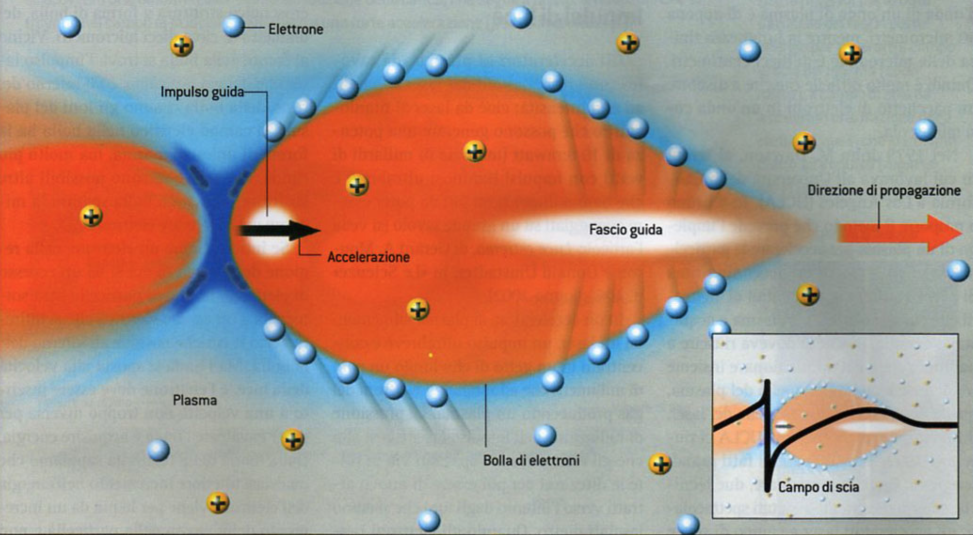
The plasma acceleration

Slide 5
Introduction
The plasma acceleration
OTR based diagnostics
OTR: theory and diagnostic applications
Angular distributions measurement
Divergence resolution
Emittance measurement
A new innovative scheme
The micro-lenses array
The experimental setup
Developments
Data analysis algorithm
Ongoing work
Conclusions

Slide 6
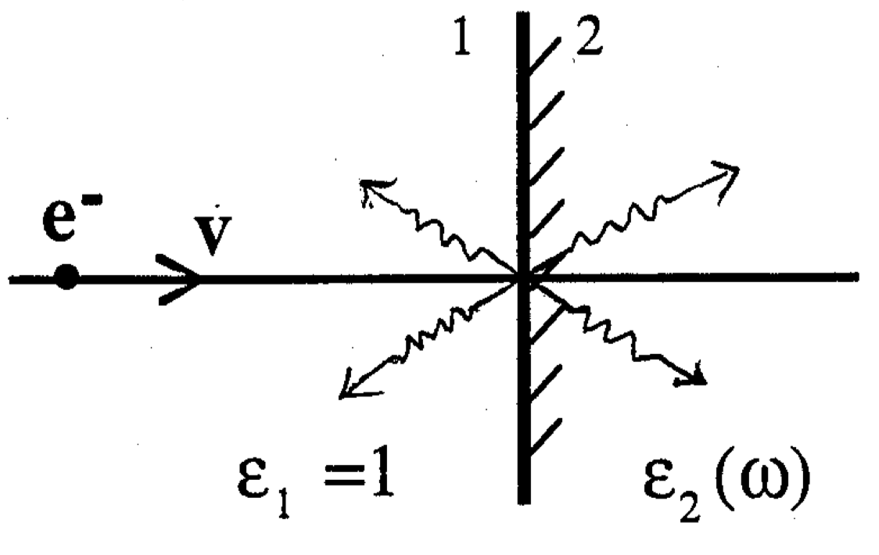
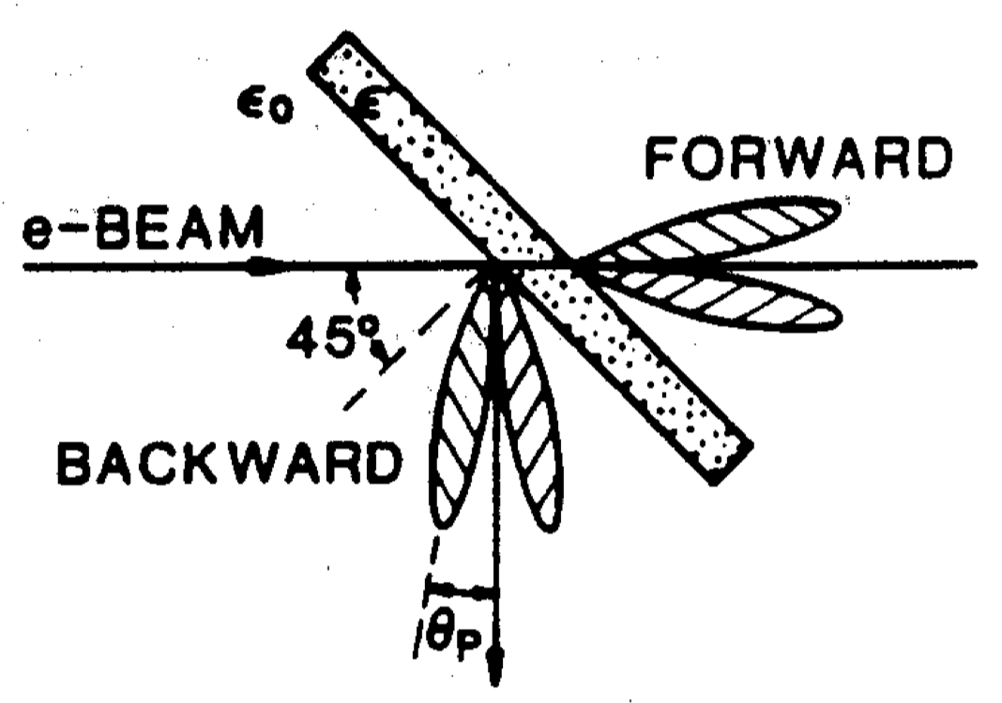
OTR: theory and diagnostic applications
A charged particle passing through the boundary between two media with different optical properties generates transition radiation. For beam diagnostics purposes, only the visible part of the radiation is used.
The backward radiation, produced by a thin metallic foil is normally used to measure the beam spot, by means of an imaging system.
The main advantage of OTR is the instantaneous emission process which makes it suitable for single shot diagnostic measurements.
The main drawback is the low radiation intensity, with respect for example to the scintillator screens, widely used for the beam spot measurement.

Slide 7
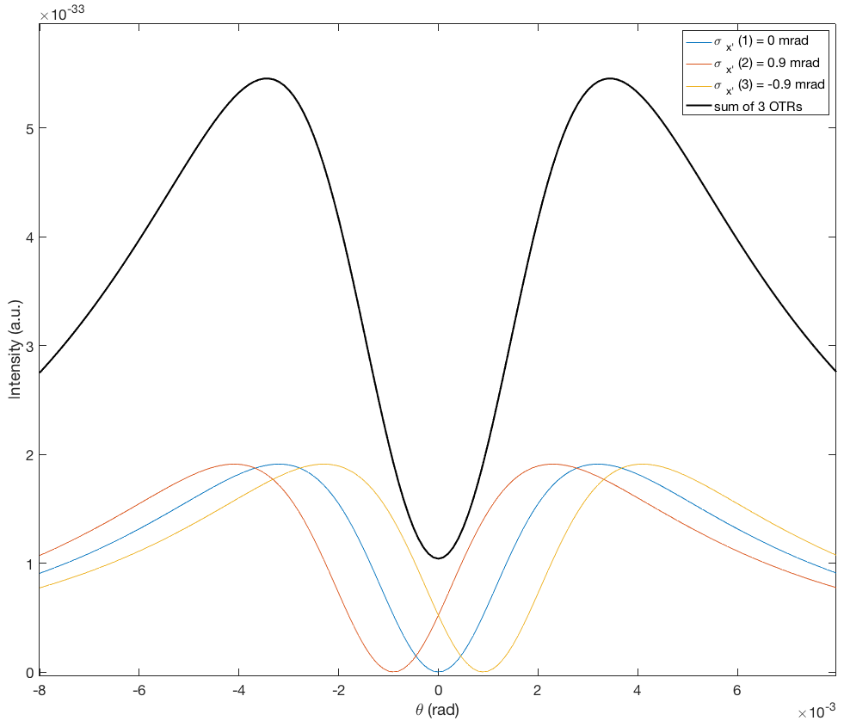
Angular distributions measurement
The angular distribution of a single particle can be expressed in the relativistic limit as:
$\frac{d^{2}I}{dω dΩ}≅\frac{e^{2}}{π^{2}c} \frac{θ^{2}}{{{[θ}^{2}+γ^{−2}]}^{2}}$
In a beam, each particle emits radiation at a different angle.
The overall angular distribution is the sum of these different radiations; the resultant distribution loses the properties of the singl particle one.
The central minimum is no more null; actually the minimum raising contain information about the beam divergence. It can be retrieved evaluating this increase.
The overall distribution is well described by the following formula, i.e. the convolution of the OTR angular distributions and a gaussian beam profile:
$$I=\frac{e^{2}β^{2}}{π^{2}c} \left\{\frac{\sqrt{π} μ}{ν} ℜe\left[Θ\left(z\right) \left(\frac{1}{2}+μνz\right)\right]−μ^{2}\right\} ,{ }_{with }\left\{\begin{aligned}z=μ(ν+iθ) \\ μ=1/(\sqrt{2} σ) \\ ν=γ^{−1}\end{aligned}\right.$$

Slide 8
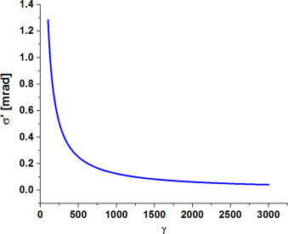
Divergence resolution
SPARC_LAB limit
An essential issue of the measurement is the resolution limit of the angular divergence.
The measurement is very efficient for high energy beam, but it can be carried out as well for low energy beam, with a particular attention on the divergence resolution.
At low energy (i.e. low $γ$) it worsens and the divergence has to be higher and higher to be measured.
At SPARC_LAB, the energy can reach energies up to ~ 160 MeV ($γ$ ~ 315); hence the beam divergence has to be at least ~ 0.45 mrad .
Angular divergence resolution as function of the relativistic $γ$

Slide 9
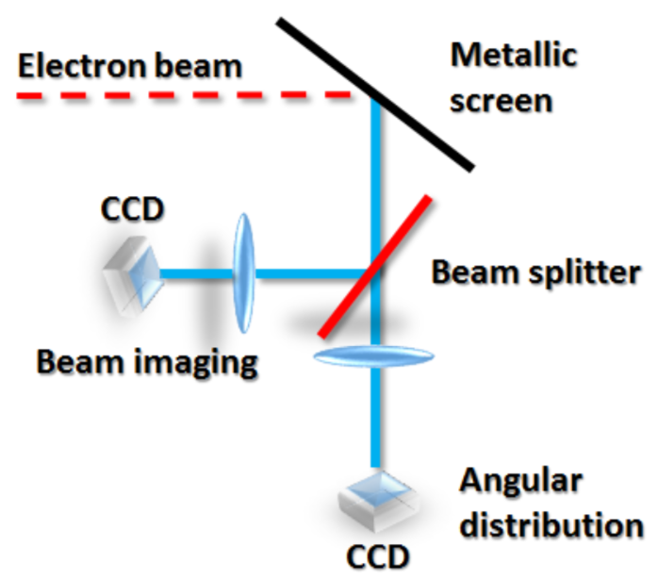
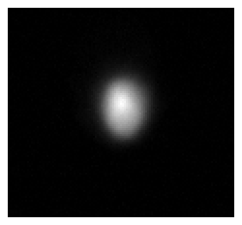
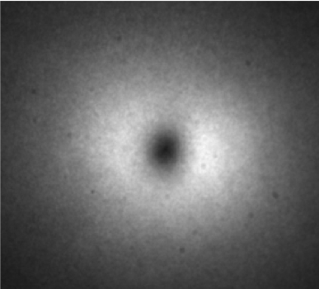
Emittance measurement
The geometrical r.m.s. emittance is expressed as:
$$ε_{rms}= \sqrt{\left\langle x^{2}\right\rangle \left\langle {x^{′}}^{2}\right\rangle − {\left\langle xx^{′}\right\rangle }^{2}}$$
When the beam emits OTR in its waist, the correlation term is null. Thus measuring spot and angular distribution provides an emittance measurement.
Experimentally, the spot is measured by the detector in the image plane of a lens. Whereas the angular distribution can be observed placing the camera in the lens focal plane.
Beam spot
OTR angular distribution

Slide 10
Introduction
The plasma acceleration
OTR based diagnostics
OTR: theory and diagnostic applications
Angular distributions measurement
Divergence resolution
Emittance measurement
A new innovative scheme
The micro-lenses array
The experimental setup
Developments
Data analysis algorithm
Ongoing work
Conclusions

Slide 11
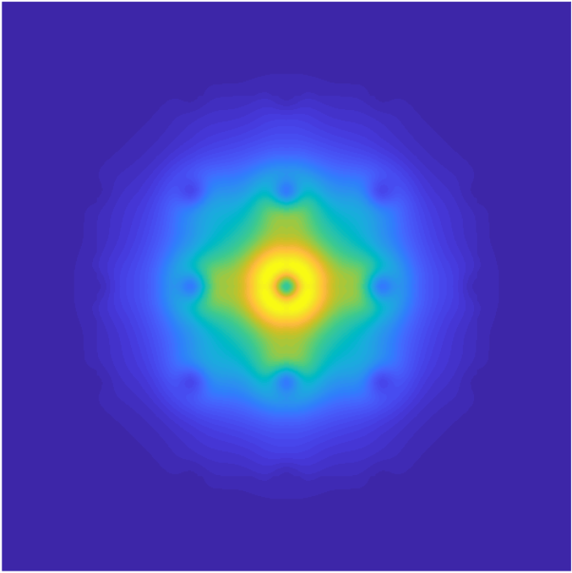
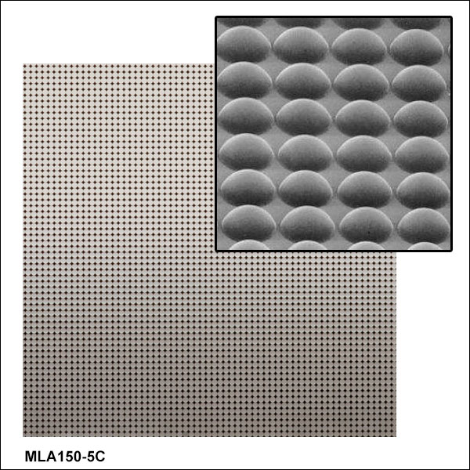
The micro-lenses array
To compute the correlation term, the idea is to measure the divergence in different transverse positions of the beam.
It can be accomplished by a micro-lenses array: Each lens provides an angular distribution of the light from different transverse parts is directed on it.
The overall distribution is the overlap of the single micro-lens distribution.
An image of the beam OTR on the micro-lenses array is created by using a lens.

Slide 12
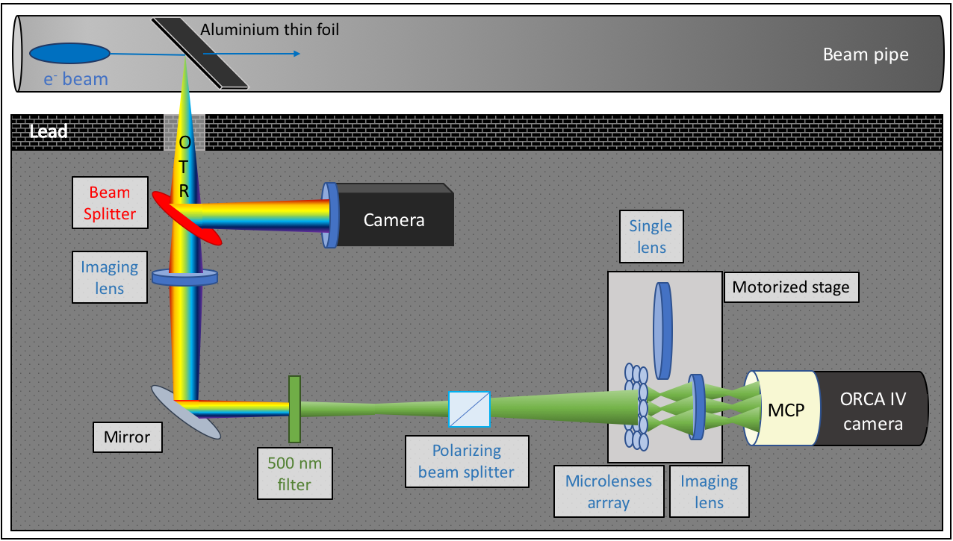
The experimental setup

Slide 13
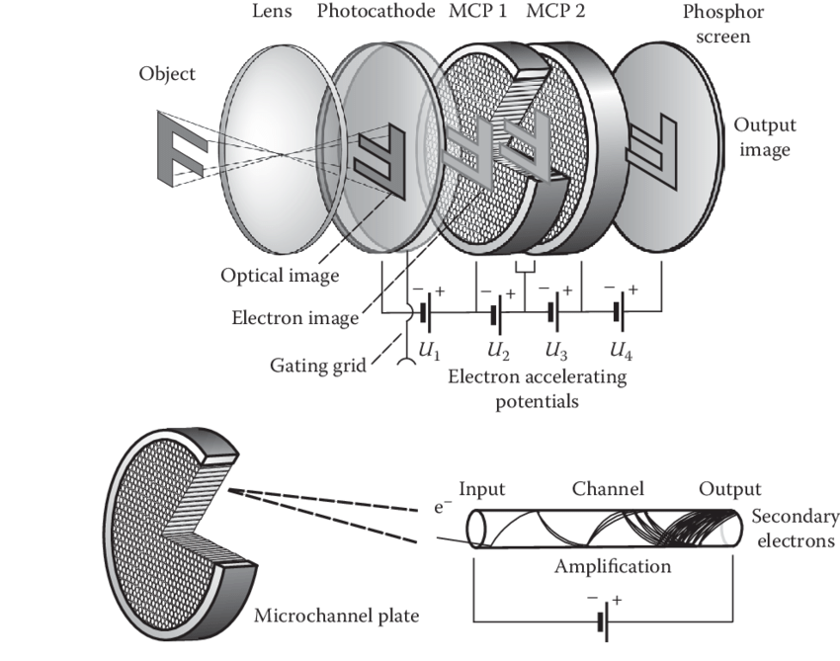
The experimental setup
The detector is a CMOS based camera, but the signal is too low.
A double stage Micro Channel Plate is used to amplifies the signal and not to lose spatial information.
The micro-lenses focal length of only 13 mm constrains the use an addictionary lens to have the focal plane at the detector position.

Slide 14
Introduction
The plasma acceleration
OTR based diagnostics
OTR: theory and diagnostic applications
Angular distributions measurement
Divergence resolution
Emittance measurement
A new innovative scheme
The micro-lenses array
The experimental setup
Developments
Data analysis algorithm
Ongoing work
Conclusions

Slide 15
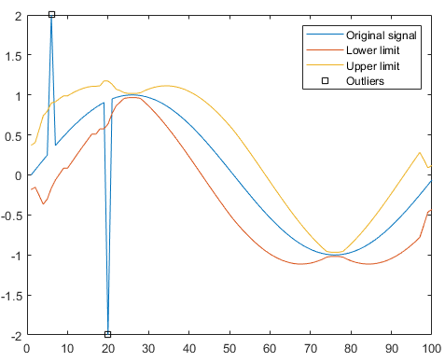
Data analysis algorithm
To remove the X-ray spikes on the acquired picture, an hampel filter is used.
It checks and remove maximums over 3 $σ$ over the close pixels avarage.
Before hampel filter
After hampel filter

Slide 16
Data analysis algorithm
Data extrapolation

Slide 17
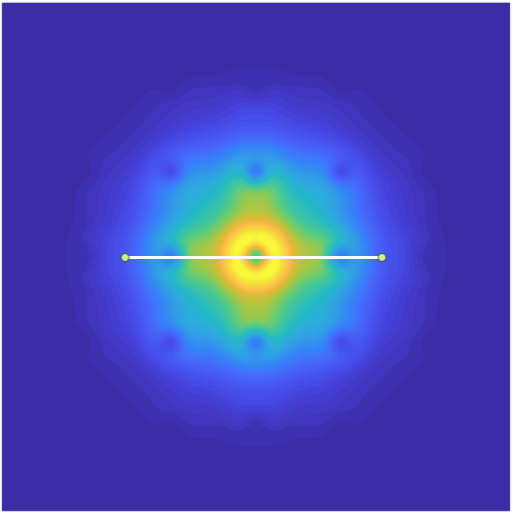
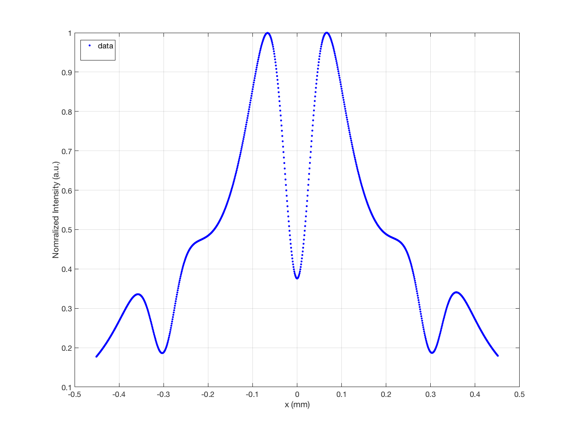
Data analysis algorithm
Data extrapolation
Data fit

Slide 18
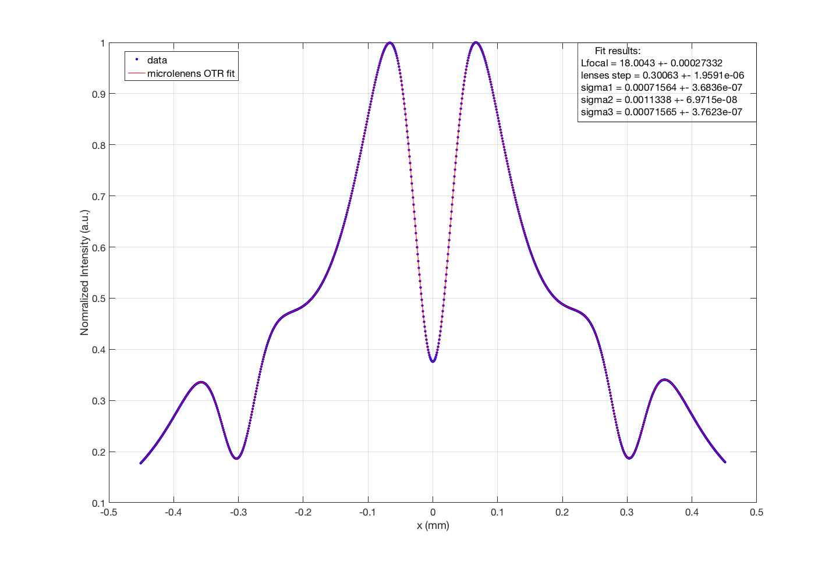
Data analysis algorithm
Data extrapolation
Data fit

Slide 19
Ongoing work
I am working on a start-to-end simulation inside the SPARC_LAB linac.
By means of General Particle Tracer (GPT) simulation tool, I am creating a reproducible working point that simulate a beam from the photocathode to the metallic foil whereby OTR is produced by the beam.
Zemax OpticStudio tool allows to simulate the light transport inside the optical elements of the setup, taking in account possible aberrations or second order effects, too.
Finally the algorithm will compute the emittance of the obtained configuration, to be compared with the simulation value.

Slide 20
Introduction
The plasma acceleration
OTR based diagnostics
OTR: theory and diagnostic applications
Angular distributions measurement
Divergence resolution
Emittance measurement
A new innovative scheme
The micro-lenses array
The experimental setup
Developments
Data analysis algorithm
Ongoing work
Conclusions

Slide 21
Conclusions
The main aim of the thesis work is the single shot emittance measurement, by means of an innovative OTR based scheme.
A start-to-end simulation is still in progress to create a reproducible working point.
In the next months a data acquisition campaign will be conducted.

Slide 22
References
M Litos, E Adli, W An, et al. High-efficiency acceleration of an electron beam in a plasma wakefield accelerator. Nature, 515(7525):92, 2014.
Beth Gitter. Optical transition radiation. CAA-Tech-Note Internal, 24, 1992.
Alessandro Cianchi. Observations and diagnostics in high brightness beams. CERN Yellow Reports: School Proceedings, 3:229, 2017.
VL Ginzburg and Io M Frank. Radiation from a uniformly moving electron passing from one medium to another. Journ. of Experimental and Theoretical Physics (JETP) V, 16:15–26, 1946.
A Cianchi, MP Anania, M Bellaveglia, et al. Transverse emittance diagnostics for high brightness electron beams. Nuclear Instruments and Methods in Physics Research A, 865:63–66, 2017.

