Slide 1
W→τν Note & Tau candidates in first data
Lidia e Attilio
ATLASMi – 22nd December 2009

Slide 2
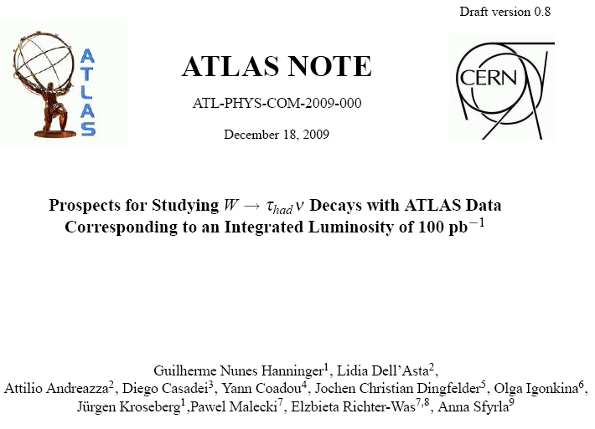
W→τν Note
Prospects for Studying W→τ_{had}ν Decays with ATLAS Data corresponding to an Integrated Luminosity of 100 pb⁻¹
it should be submitted as COM today
will ask for INT approval at the beginning of January
I studied the QCD di-jet background.
The full simulated QCD background samples available are not enough to evaluate the contribution to the analysis from this background.
On the other side, the fast simulated samples have two problems:
no trigger information is available
the missing Et spectrum in fast and full simulation is different.
I studied how to:
correct the fast samples for the trigger efficiency
correct the missing Et spectrum

Slide 3
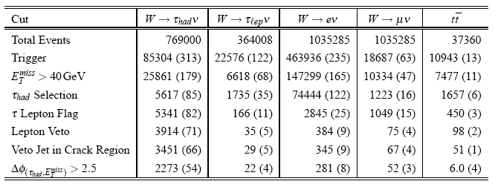
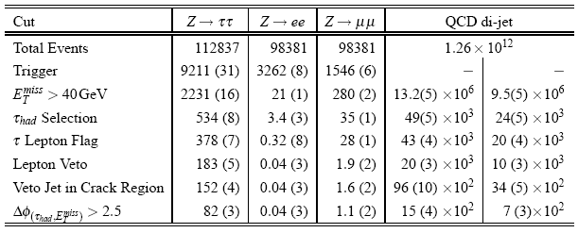
W→τν Note – Event Selection
it is important to estimate QCD background from data.

Slide 4
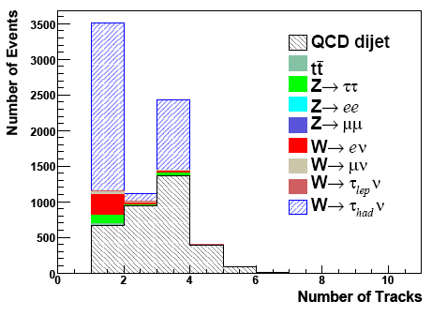
Extracting QCD from data

Slide 5
Samples
MonteCarlo:
mc09_900GeV.105001.pythia_minbias.merge.AOD.e466_s604_s582_r871_r879 (day1 conditions)
mc09_900GeV.105001.pythia_minbias.merge.AOD.e466_s604_s582_r873_r879 (day100 conditions)
Data(*): only some LumiBlocks from
data09_900GeV.00142383.physics_MinBias.merge.DESD_COLLCAND.f190_m311
data09_900GeV.00142195.physics_MinBias.merge.DESD_COLLCAND.f189_m305
data09_900GeV.00142193.physics_MinBias.merge.DESD_COLLCAND.f195_m326
data09_900GeV.00142191.physics_MinBias.merge.DESD_COLLCAND.f189_m305
data09_900GeV.00142189.physics_MinBias.merge.DESD_COLLCAND.f189_m305
data09_900GeV.00142174.physics_MinBias.merge.DESD_COLLCAND.f189_m305
data09_900GeV.00142171.physics_MinBias.merge.DESD_COLLCAND.f189_m305
data09_900GeV.00142166.physics_MinBias.merge.DESD_COLLCAND.f189_m305
data09_900GeV.00142165.physics_MinBias.merge.DESD_COLLCAND.f189_m305
data09_900GeV.00142154.physics_MinBias.merge.DESD_COLLCAND.f188_m305
data09_900GeV.00142149.physics_MinBias.merge.DESD_COLLCAND.f188_m305
data09_900GeV.00141811.physics_MinBias.merge.DESD_COLLCAND.f187_m305
data09_900GeV.00141749.physics_MinBias.merge.DESD_COLLCAND.f187_m305
(*) good data has been selected using the AtlasRunQuery
Release 15.6.1 + some packages for D3PD production (see backup)

Slide 6
GoodRunList
decide a list of good runs (→atlas-runquery →GoodRunList)
Pixel and SCT ON
Solenoid ON
data at 900 GeV
run on DESD_COLLCAND to produce D3PD
run the same code on MonteCarlo to produce D3PD
D3PD produced privately
we are in touch with D3PD developers, to add all the variables we need
then D3PD will be produced centrally
will produce new D3PD after Christmas reprocessing

Slide 7
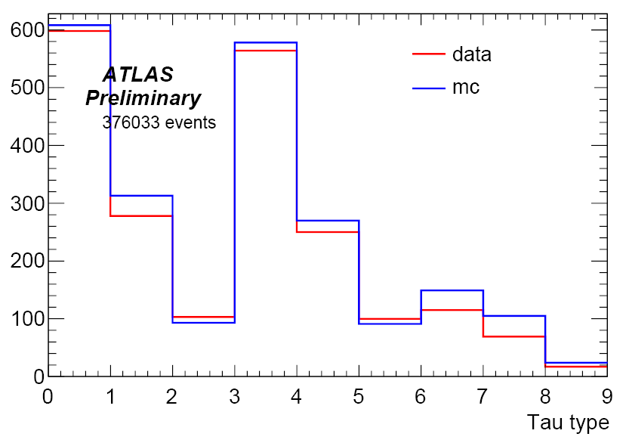
Some very preliminary plots…
number of reconstructed taus for different identification levels
(→ Note ATL-PHYS-INT-2009-082)
“SafeCalo“ variables based on calorimetric variables
“Safe“ variables based on calorimetric and tracking variables
quite good agreement, except for “Safe” variables…
Loose
Medium
Tight
SafeTight
SafeLoose
SafeCaloLoose
SafeCaloTight
SafeMedium
SafeCaloMedium

Slide 8
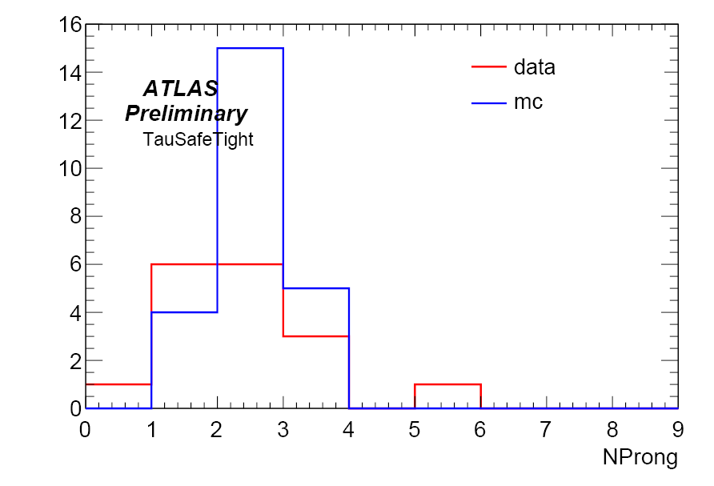
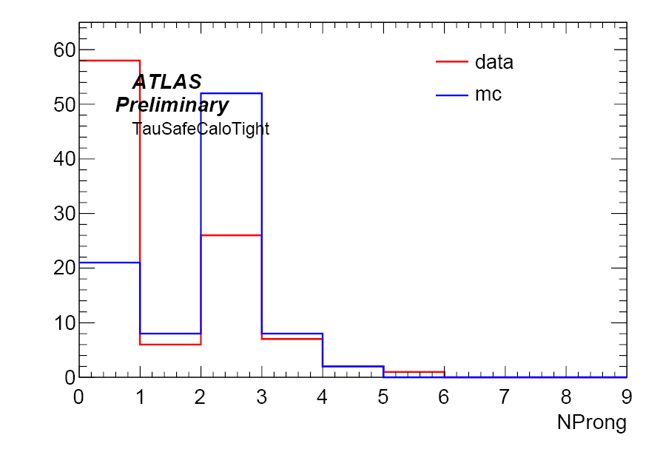
Tau Nprong for different identifications
reconstructed taus
no cuts applied
different number of reconstructed taus in Data and MC on the same number of events

Slide 9
Backup

Slide 10
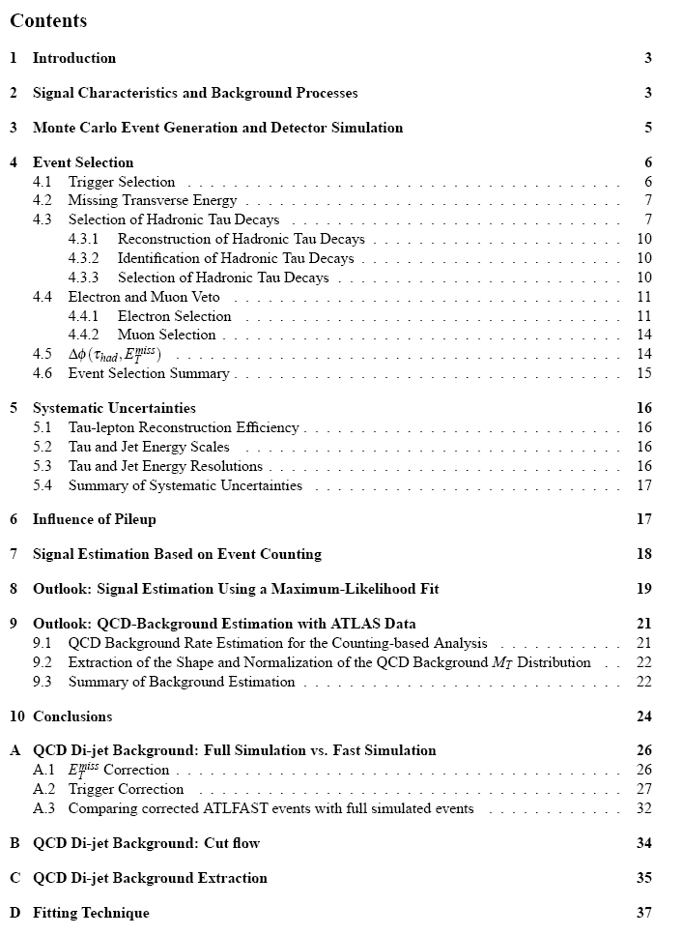
W→τν Note - Index

Slide 11
W→τν Note - Index

Slide 12
D3PD – technical details
to produce D3PD, check out and compile:
JetD3PDMaker-r252088
MinBiasD3PDMaker-00-00-05
MissingETD3PDMaker-00-03-02
TauD3PDMaker-r254873
TrackD3PDMaker-00-01-03
MissingETGoodness-00-00-09
MissingETPerformance-00-05-34
DATA
EventDetails (EventNumber, lbn...)
electrons, photons, muons (StacoMuonCollection)
jets (Cone4H1TopoJets, Cone4H1TowerJets, AntiKt4H1TopoJets…)
missingET (RefFinal, Final, Topo, Base…)
taus (TauRecContainer)
tracks and vertexes (primary, conversions)
MC: DATA + ...
missingET: truth
no trigger info for the moment
all the other truth information have just been added in the D3PDMaker package

Slide 13
Atlas Run Query
make your selection:
time
run duration
number of events collected
data type (900GeV or 2(!)TeV)
beam conditions (stable beam, number of bunches, beam energy, fill number...)
magnets
detectors in the data taking
data quality
trigger
...
AtlasRunQuery gives a list of runs (and lumi block) with the selected conditions
It is possible to download “GoodRunList” as an xml file to be used by the analysis

Slide 14
Atlas Run Query
http://atlas-runquery.cern.ch/
Tool to:
look for all the useful information about runs and data quality
define a GoodRunList
My selection:
time: from 24 Nov 2009
data@900GeV
solenoid ON
DataQuality for pixels and SCT green
N.B. In the pixel dq green flag there is no request that the preamplifiers are not killed (with no stable beam HV is OFF and preamplifiers killed), so some data may not be optimal anyway, due to transition...

Slide 15
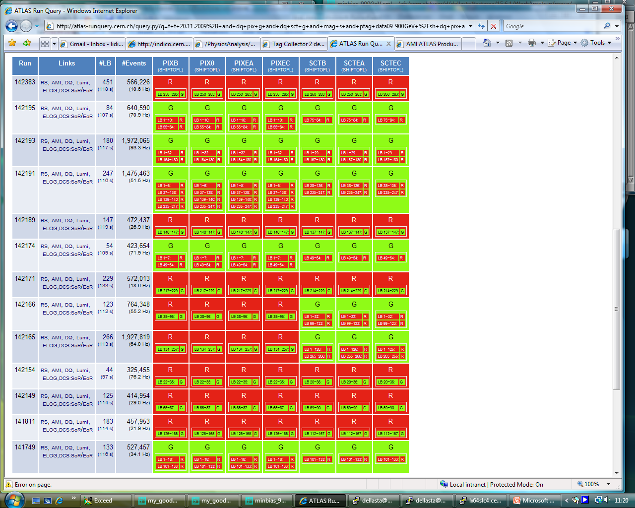
Atlas Run Query
xml file

Slide 16
NTau
DATA
Events with Taus 2120
Taus 2395
Taus CutLoose 598
Taus CutMedium 278
Taus CutTight 103
Taus CutSafeCaloLoose 564
Taus CutSafeCaloMedium 250
Taus CutSafeCaloTight 100
Taus CutSafeLoose 115
Taus CutSafeMedium 69
Taus CutSafeTight 17
MC
Events with Taus 1502
Taus 1734
Taus CutLoose 608
Taus CutMedium 313
Taus CutTight 93
Taus CutSafeCaloLoose 578
Taus CutSafeCaloMedium 270
Taus CutSafeCaloTight 91
Taus CutSafeLoose 149
Taus CutSafeMedium 105
Taus CutSafeTight 24

Slide 17
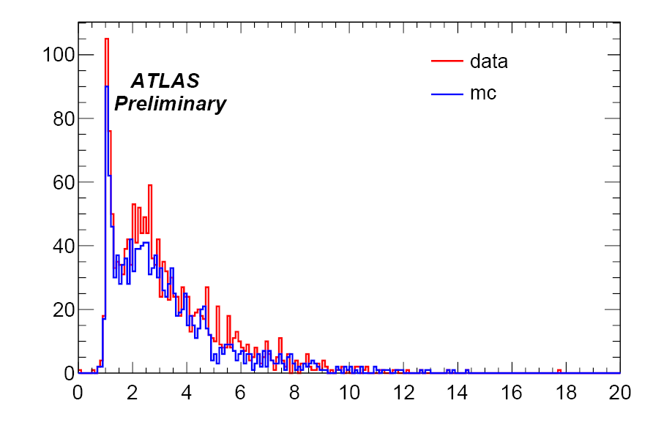
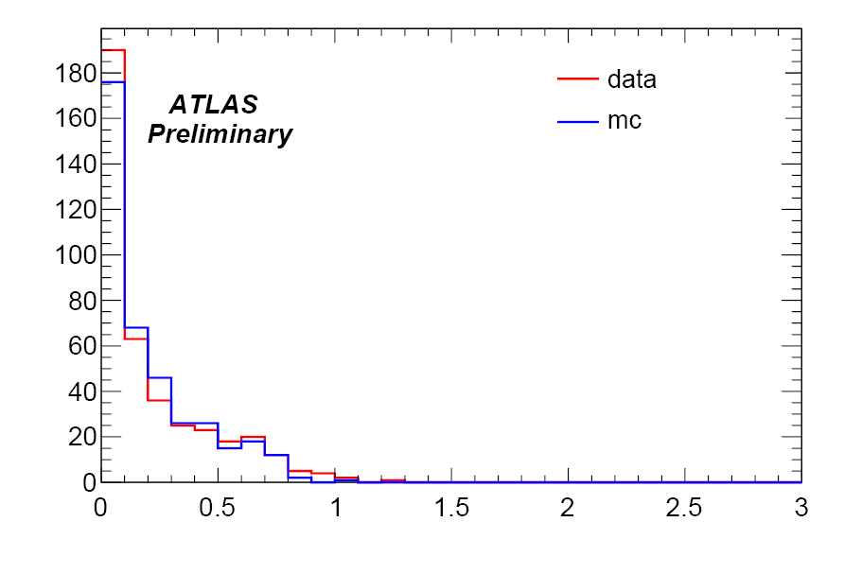
Tracking variables for SafeTaus
reconstructed taus
no cuts applied
different number of reconstructed taus in Data and MC on the same number of events
Tau_etOverPtLeadTrk
Tau_EtHadsumpT

