Slide 1
Ricostruzione dell’energia di elettroni e fotoni in ECal
Due metodi di calibrazione :
Calibration Hits (CH): ATL-ARG-PUB-2007-012,2007; ATL-LARG-INT-2008-001,2008
Longitudinal Weights (LW): Expected performance of the ATLAS experiment-I Performance
N.B. Entrambi I metodi sono stati elaborati per energie >20 GeV
Le performance sono state applicate anche a 5 e 10 GeV
Entrambi I metodi sono disponibili in Athena. CH e’ il default.
Attivita’:
Nota congiunta sulle Performace (98% ok)
Studio dell’ effetto di un aumento di X0 davanti al criostato (tracker)
In attesa dei files
(??)Ottimizzazione performance 5-20 GeV. Energie inferiori (???)
Richiede nuove simulazioni (Es: 15, 12.5, 7.5)
(??)Estensione dei CH al crack ( 1.425-1.55)
(??)Nuovi coefficienti ( dipendera’ dai risultati)

Slide 2
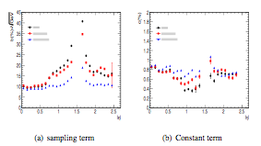
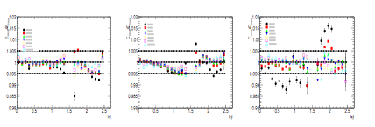
electtroni
Fotoni non convertiti
Fotoni convertiti

Slide 3
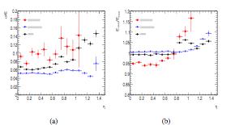
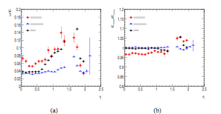
5 GeV
10 GeV

Slide 4
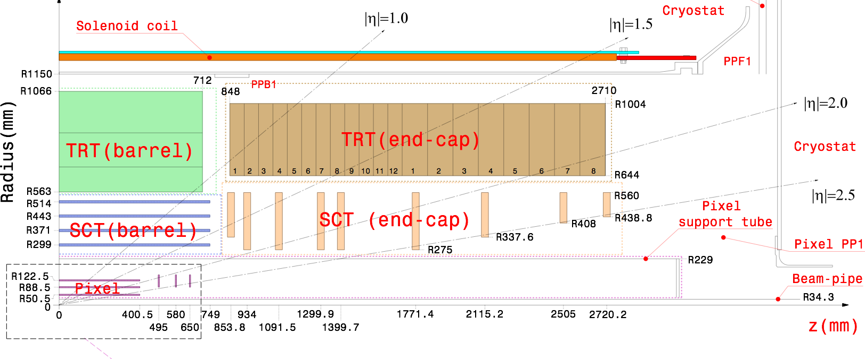
Proposed new geometry tag
SCT services
2.5 - 5 - 7.5 %
TRT Barrel - TRT EC
3 - 6 - 10%
η=0.7
η=1.3
SCT Barrel
1→3%
2→6%
4→12%
v
Pixel EC service
0.6→1.2%
1.2→2.4%
2.4→4.8%
Pixel Barrel 1-2-4%
Pixel Barrel-EC
1-3-4%
η | 1/sin(Θ) | 1/cos(Θ)
0.7 | 1.25 | 1.65
1.3 | 1.97 | 1.16
2.0 | 3.76 | 1.04

Slide 5
Summary of the proposed new simulations
η | E | Position | ΔX0 | Additional tags
0.7 | 25; 50 GeV | Pixel Barrel | 1, 2, 4% | 3
 |  | SCT Barrel Cone of increasing material along z | 1-3, 2-6, 4-12 % | 3
 |  | TRT Barrel-TRT EC (constant z) | 3, 6, 10% | 3
1.3 | 25; 50 GeV | Pixel Barrel | 1, 2, 4% | 3
 |  | SCT services at R=55cm | 2.5, 5.0; 7.5% | 3
2.0 | 50; 100 GeV | Pixel Barrel-EC (constant z) | 1, 3, 4% | 3
 |  | Pixel EC services. Cone increasing material along z . | 0.6-1.2, 1.2-2.4, 2.4-4.8 | 3
 |  | SCT services at R=55cm | 1, 2.5, 5% | 3
Each tag with:
Δη= 0.1, Δφ =π/2
no vertex spread
2 Energies
80k events
Ideal geometry sample will be simulated for reference
Total runs: 2Ex(8x4) Tag=64 jobs
The aim is to obtain a relation δE vs δX₀ and decide what to do given δX₀.and to study the effect of material on shapes (IsEM) and compute selection efficiencies.
New simulations with additional material in the cryostat (ΔX0=0.1 & 0.2%) are ongoing.

