Slide 1
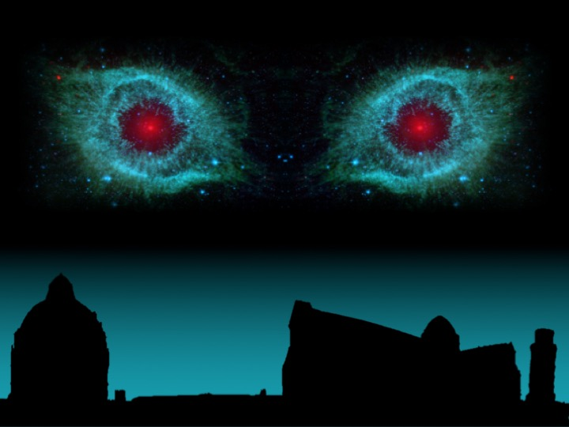


LSW experiments in the microwaves
16TH PATRAS WORKSHOP
June 15, 2021
Paolo SPAGNOLO
INFN – Pisa - Italy

Slide 2
Outline
Experimental overview
LSW experimental scheme
MW experiment design
Magnets, detectors and cavities
MW potential in the experimental landscape
Conclusions

Slide 3
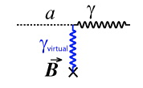
Axions Experiments
3 classes of experiments: Haloscopic, Helioscopic, Laboratory (LSW)
ma < 3x10⁻³ eV from SN1987
Axion, like neutral pion couples to
two photons via Primakoff effect)
Detected in a magnetic field H
  Haloscopic: cavity like ADMX
  Are the only experiments hitting
  the Peccei-Quin region
  Helioscopic: depend on stellar models
  CAST (best limit at the moment) withLHC dipoles
  IAXO (next Helio. exp.)
Yellow band represent theoretical predictions from DFSZ and KSVZ axion models
<E> ~4.2 KeV

Slide 4
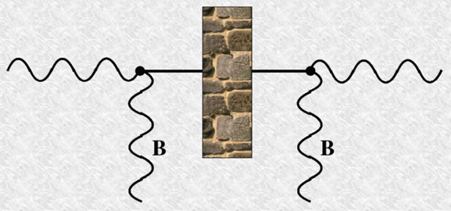
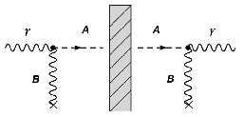
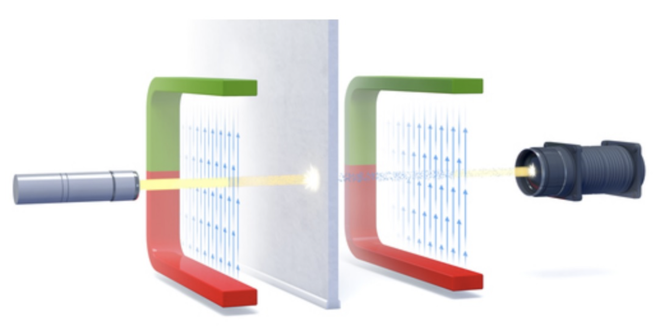
Light Shining through a Wall Experiments
P. Sikivie, Phys. Rev. Lett. 51, 1415 (1983)
LAB experiment
Laser Source
Higher Luminosity
Double process
Rate ~ G⁴
Sensitivity on G linear with L and H, quartic root of luminosity (not depending on E_{γ})
10¹⁹ photons hitting the wall
1 single photon beyond the wall
Notes:
You know exactly when and how expecting photons – Energy is defined

Slide 5
Phys. Dark Univ. 12, 37 (2016)
Presented at ICHEP16

Slide 6
Optimization attempt of LSW scheme
Gyro-Klystrom Source
Highest Luminosity
Sensitivity on G linear with L and H, quartic root of luminosity (not depending on E_{γ})
The key points are:
- High Luminosity ( gyrotrons in the SubTHz region)
- intense H ~ 11 Tesla with L ~ 150 cm dipole
- Sub-THz single photon detector using TES
Optimal Working Point ~ 30-100 GHz (microwaves)

Slide 7
High Luminosity Photon Sources
photon-axion conversion probability depends on luminosity, not energy
⇒ Lumi = P(ω)/E(ω)
Reference:
30 GHz ~ 120 μeV ~ 1 cm
Micro-waves domain
Klystrons and gyrotrons sources in the 30-100 GHz range.
Power exceeding 1 MW in this frequency range
Luminosity up to 10²⁸-10²⁹ γ/s in CW
Lasers commonly used in LSW experiments ~ 10¹⁹ γ/s

Slide 8
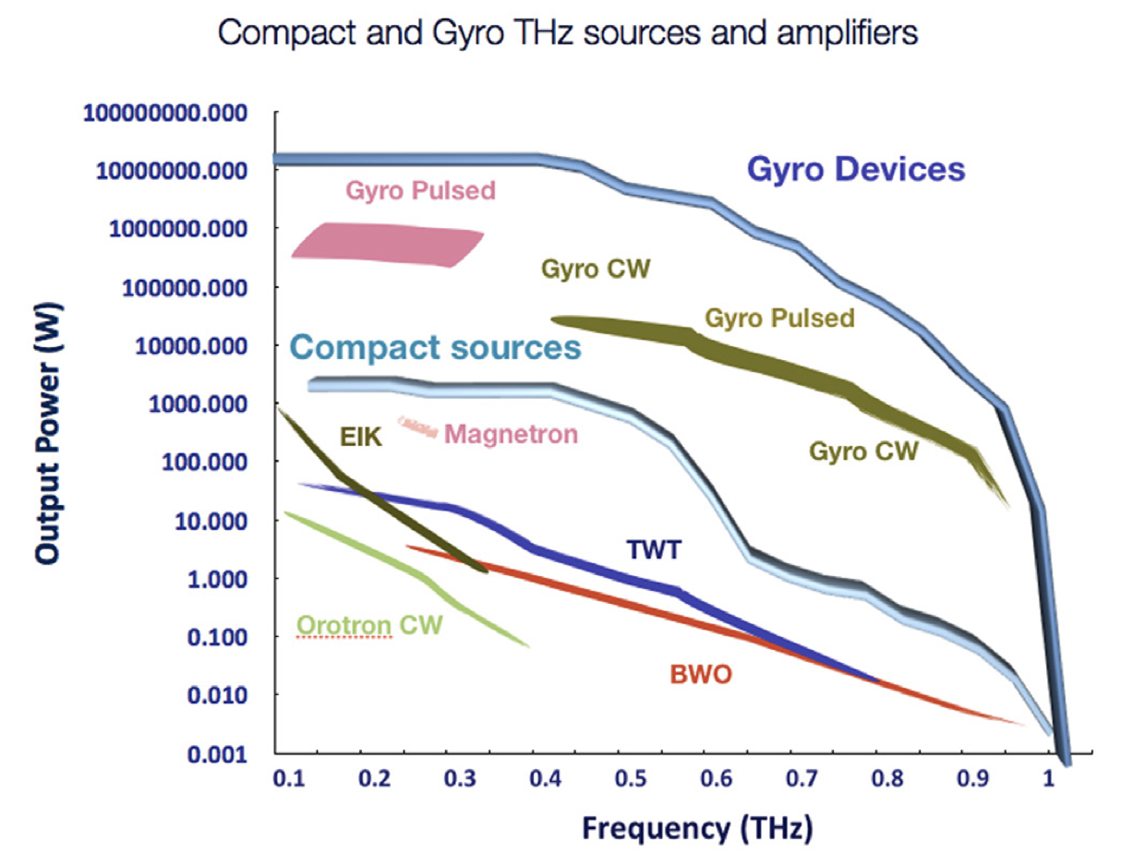
High Luminosity Photon Sources
photon-axion conversion probability depends on luminosity, not energy
⇒ Lumi = P(ω)/E(ω)
Reference:
30 GHz ~ 120 μeV ~ 1 cm
Micro-waves domain
Klystrons and gyrotrons sources in the 30-100 GHz range.
Power exceeding 1 MW in this frequency range
Luminosity up to 10²⁸-10²⁹ γ/s in CW
Lasers commonly used in LSW experiments up to 10¹⁹ γ/s

Slide 9
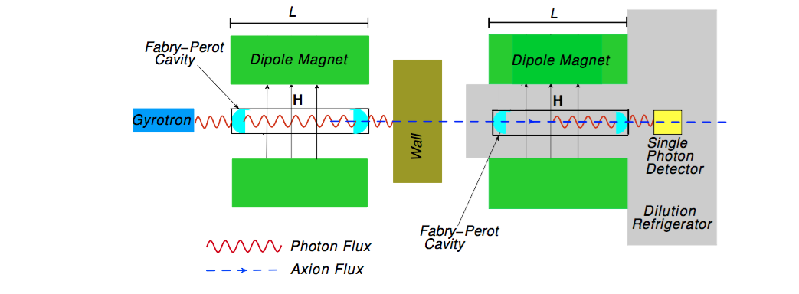
Micro-Wave Experimental scheme
Magnetic field: H = 11 T, L = 1.5 m
Source: gyrotron; P ≈ 100 kW, Φ_{γ} = 10²⁷ s⁻¹, ε_{γ} = 120 μeV (ν ≈ 30 GHz)
Fabry-Perot cavity: finesse Q ≈ 10⁴
Sub-THz single-photon detection based on TES technology, η ≈ 1
Possible second FP cavity behind the wall to enhance axion-photon conversion rate
P. Sikivie, D.B. Tanner and K. Van Bibber, Phys. Rev. Lett. 98, 172002 (2007)

Slide 10
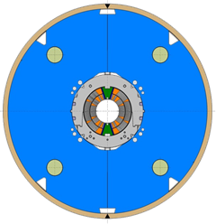
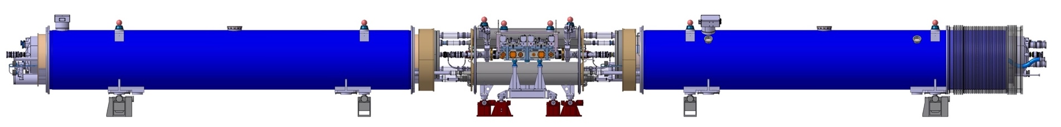
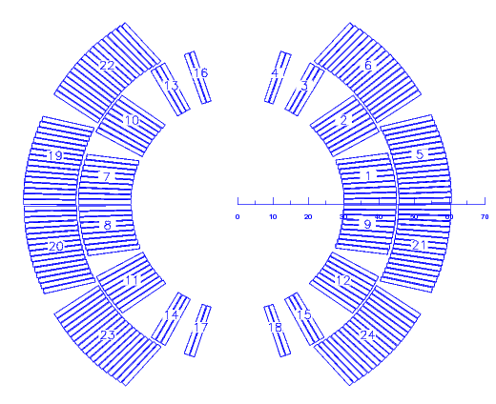
11T CERN dipole magnets
The HL-LHC Project implies beams of larger intensity
  Additional collimators are needed
Two collimators to be installed on either side of interaction point 7
  Replace a standard Main Dipole by a pair of shorter 11 T Dipoles
5 single aperture short models fabricated and tested by CERN TE-MSC team
  Bore field ranging from 10 to 12 T
  60 mm coil aperture
  ~1.5 m magnetic length
Included in the PBC CERN document for EU strategy

Slide 11
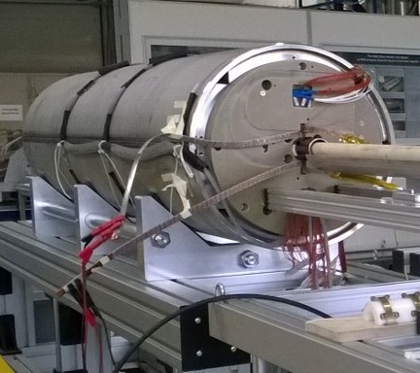
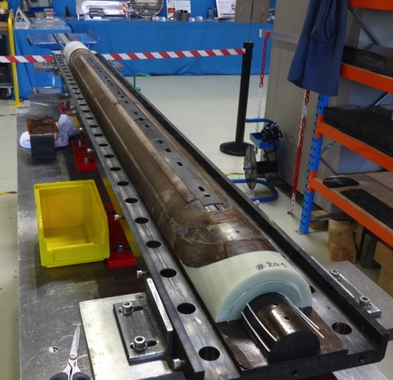
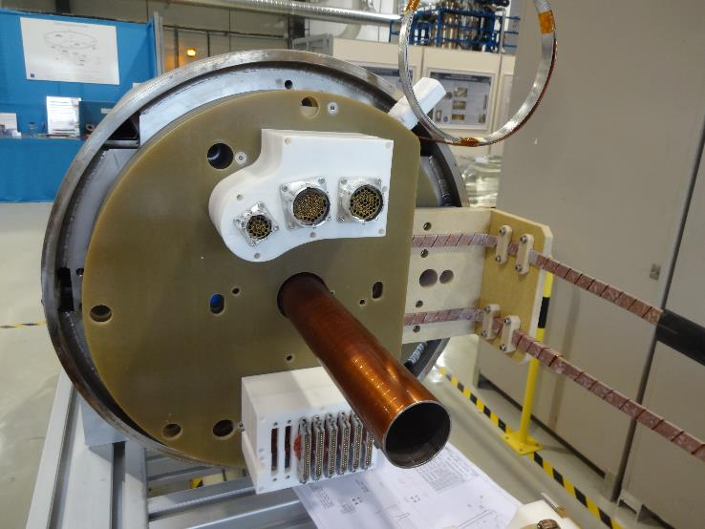
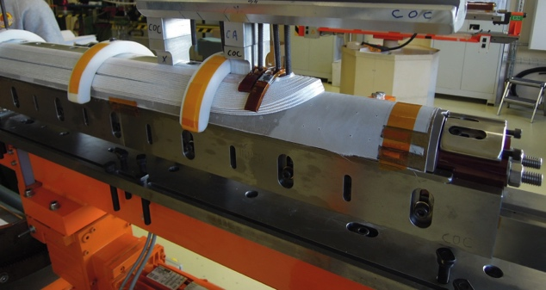
11T CERN dipole magnets

Slide 12
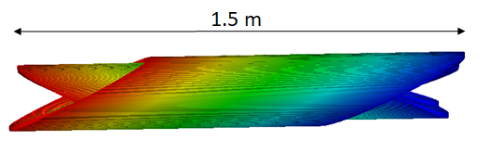
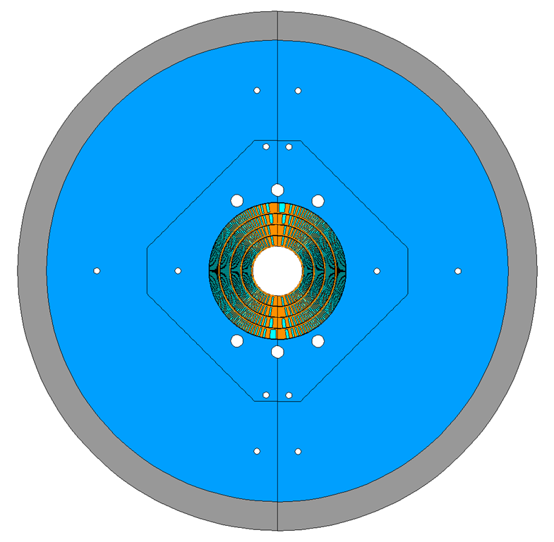
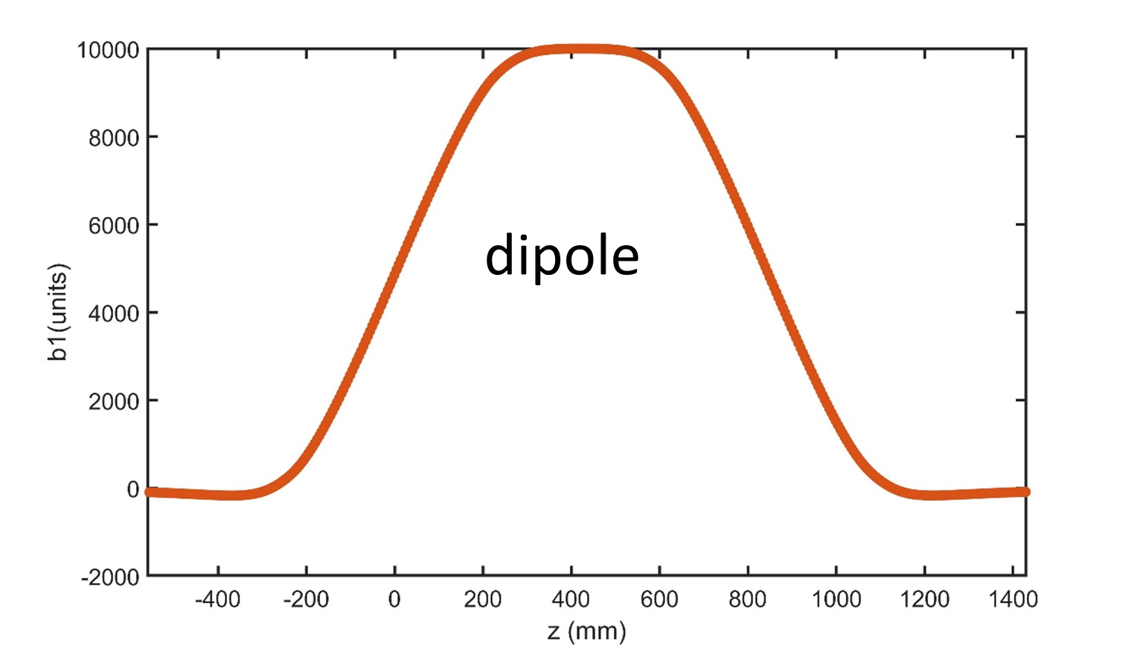
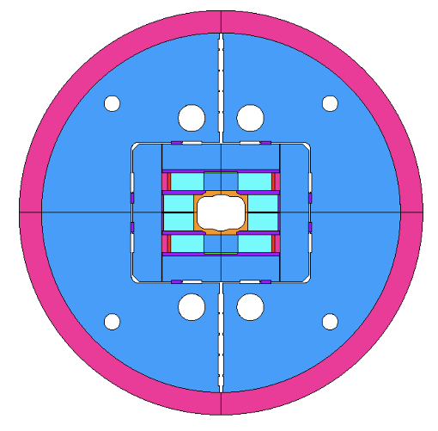
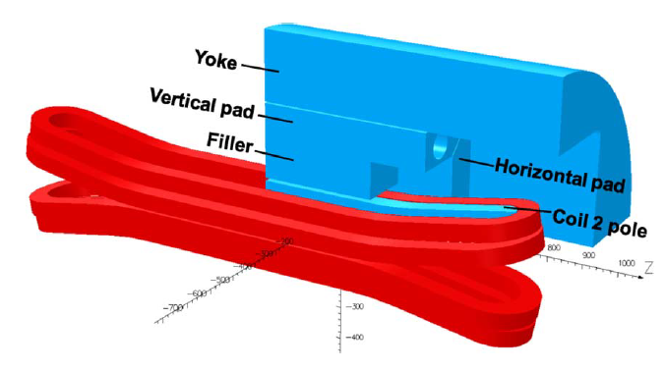
Berkley - CCT6 and TFD
Canted Cos-Theta CCT6
  Goal: Nb₃Sn magnet for testing HTS coils
  Round aperture with 120 mm diameter
  Target field: 12 T at 4.2 K over 200 mm length
  Design in progress; fabrication at LBNL expected in 2022-2023
  Funded by DoE HEP as part of the LBNL Magnet Development Program
Test Facility Dipole TDF
  Goal: Nb₃Sn magnet for testing superconducting cables
  Rectangular aperture: 150x100 mm diameter
  Target field: 14-15 T at 4.2 K over ~800 mm length
  Design in progress; fabrication at LBNL expected in 2022-2024
  Funded by DoE HEP and FES (Fusion Energy Science)

Slide 13
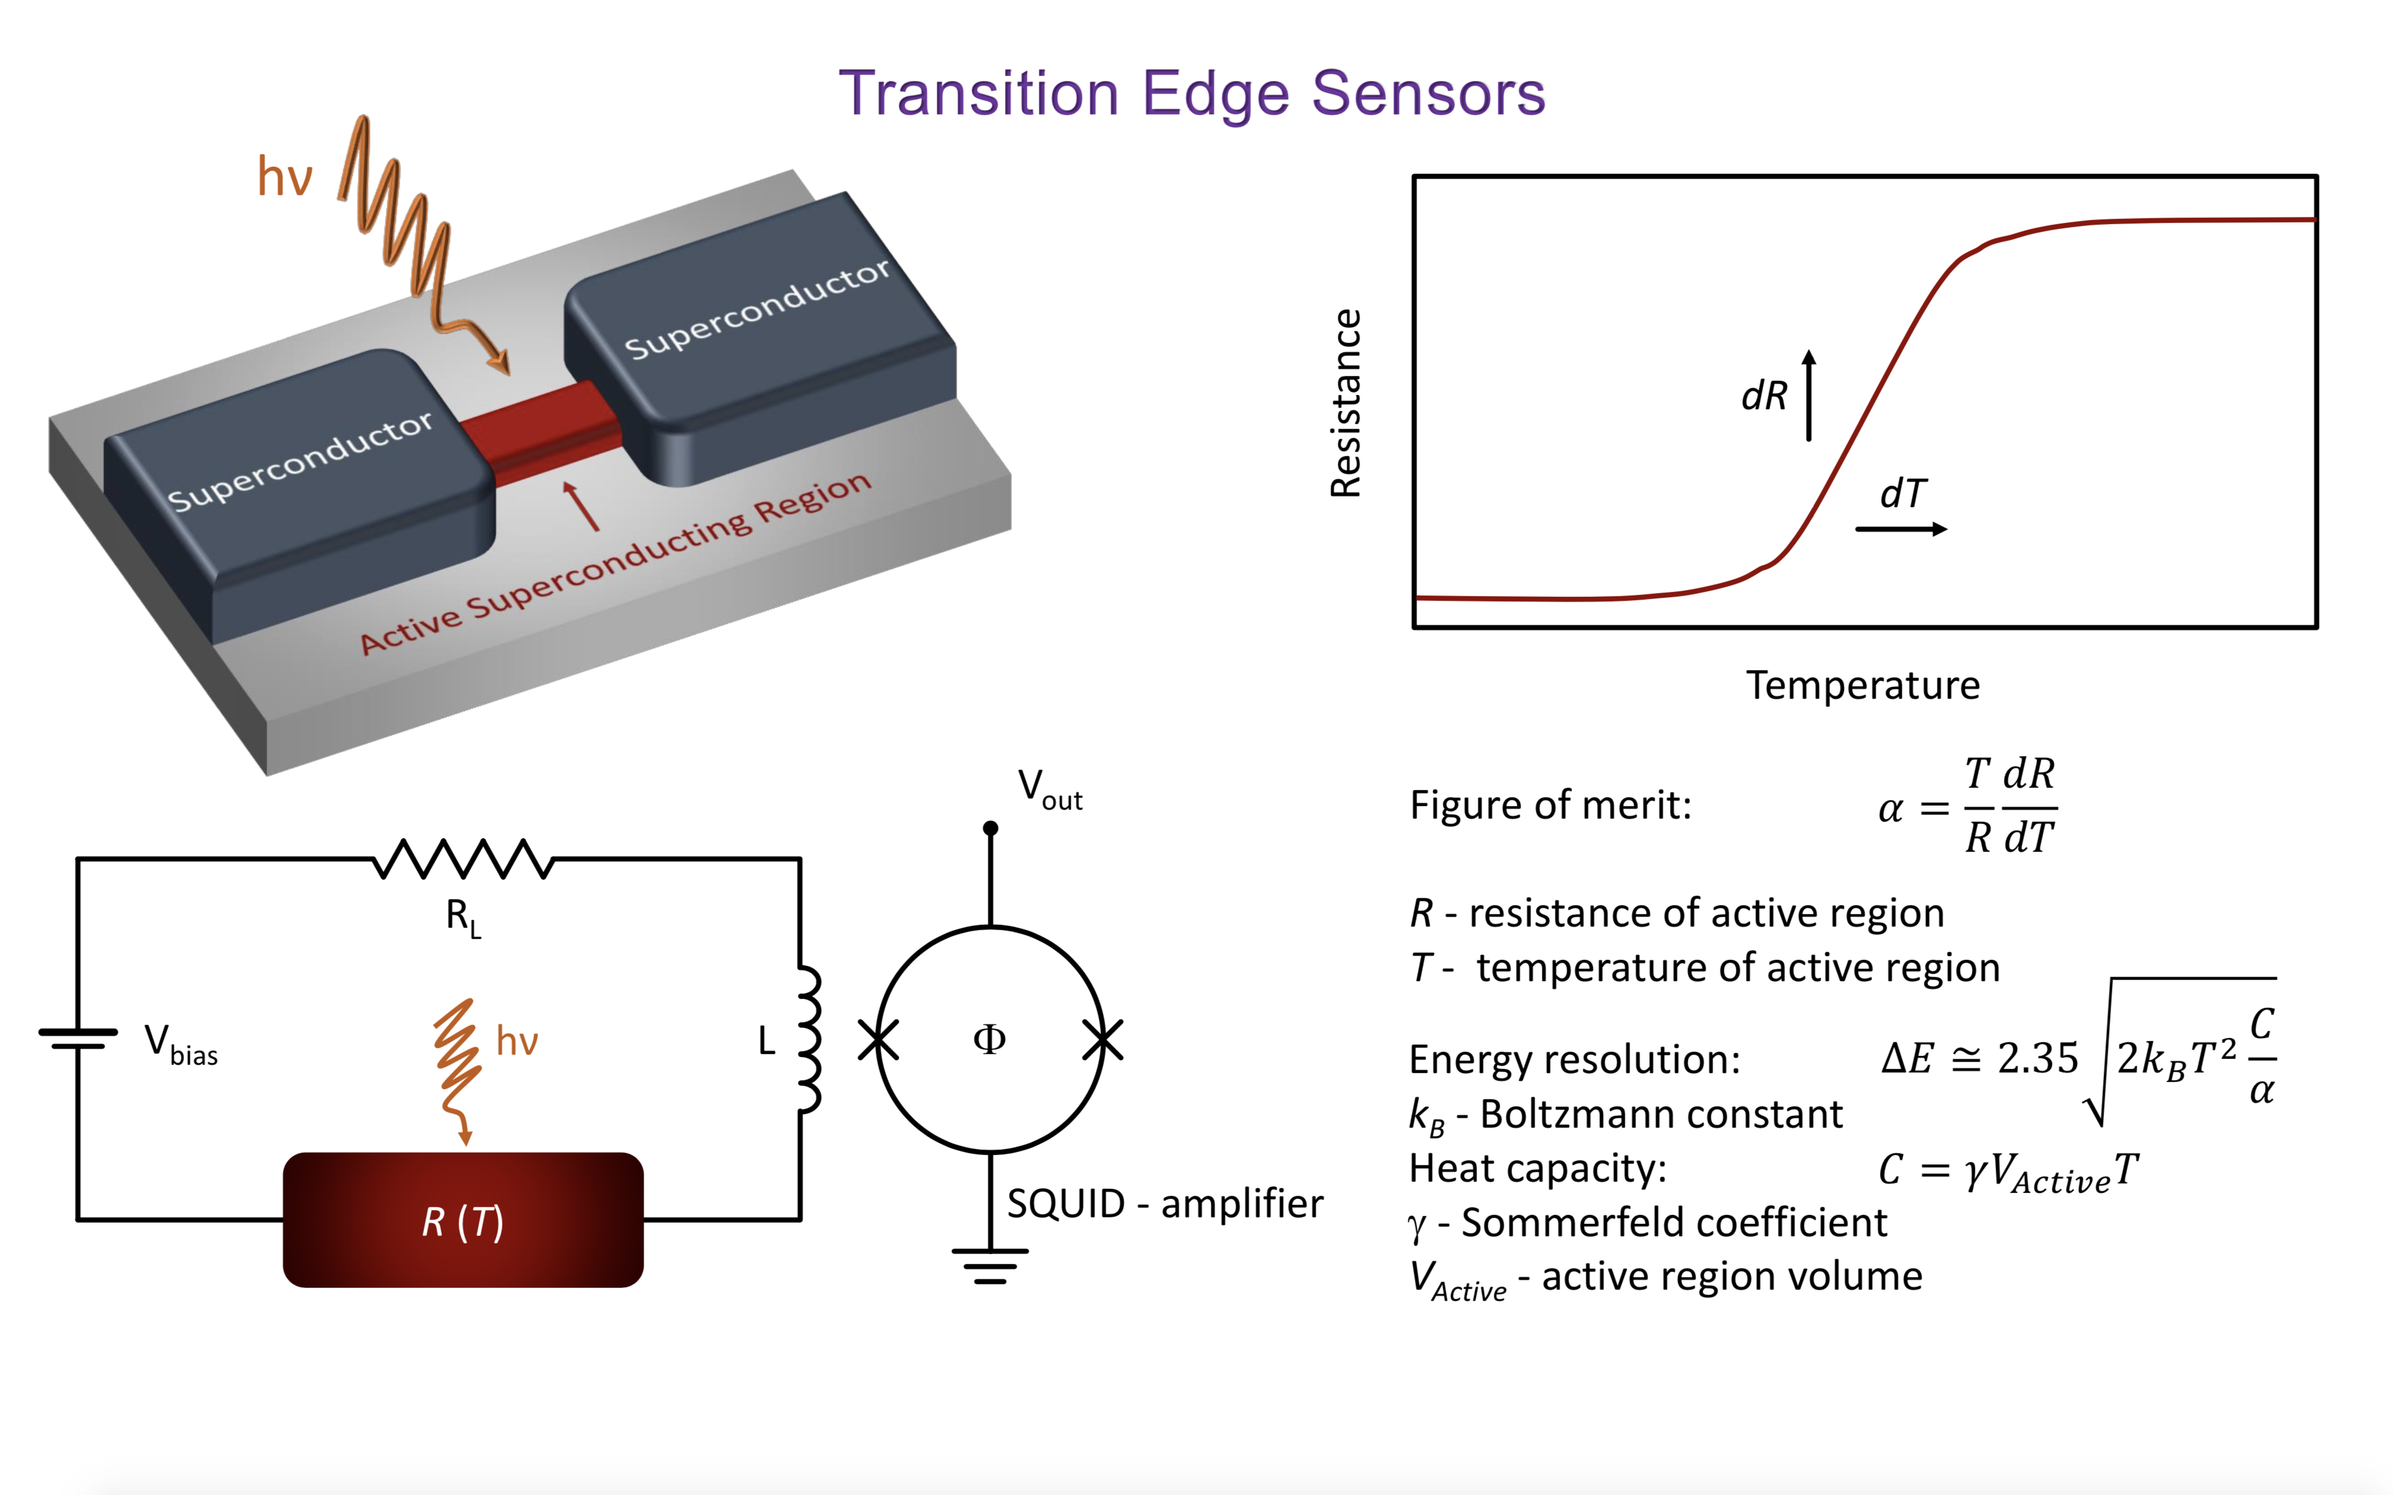
Transition Edge Sensor
TES operates within its superconducting transition. DC bias voltage applied.
When TES absorbs an incoming photon, it heats up above critical temperature Tc.
Change of resistance and current flowing in the circuit, measured by a SQUID

Slide 14
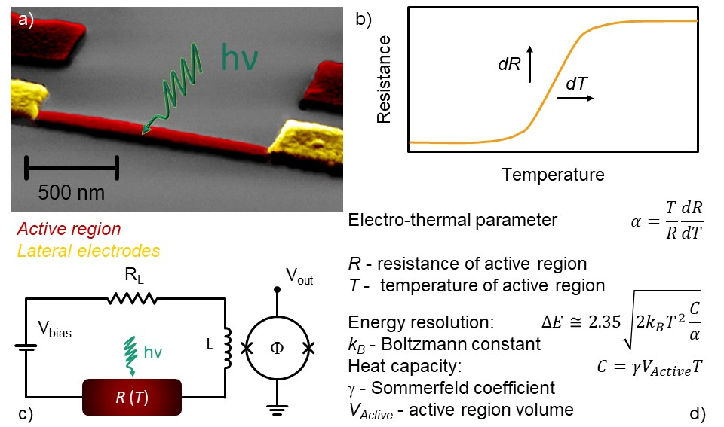
Transition Edge Sensor
TES operates within its superconducting transition. DC bias voltage applied.
When TES absorbs an incoming photon, it heats up above critical temperature Tc.
Change of resistance and current flowing in the circuit, measured by a SQUID

Slide 15
TES detectors
Sub-THz single photon detector
Transition Edge Sensor TES: ultra-low critical temperature superconductor bridge between two superconducting electrodes. TES coupled to a log periodic antenna.
Goal: Energy resolution below 10%
Tailoring active volume to reduce thermal capacitance (V~ 300x40x20 nm ³ < 10⁻³μm³ ) Material: choice of a Superconductor with low critical temperature (Tc ≈ 30 - 50 mK) to have a good energy resolution bilayer Ti-Au, Al-Cu or Ti-Cu
TES bridge Ti-Cu (gap ~20 μeV), superconducting electrodes Nb (gap ~ 1 meV)
Very high efficiency
Ultra low background/dark count

Slide 16
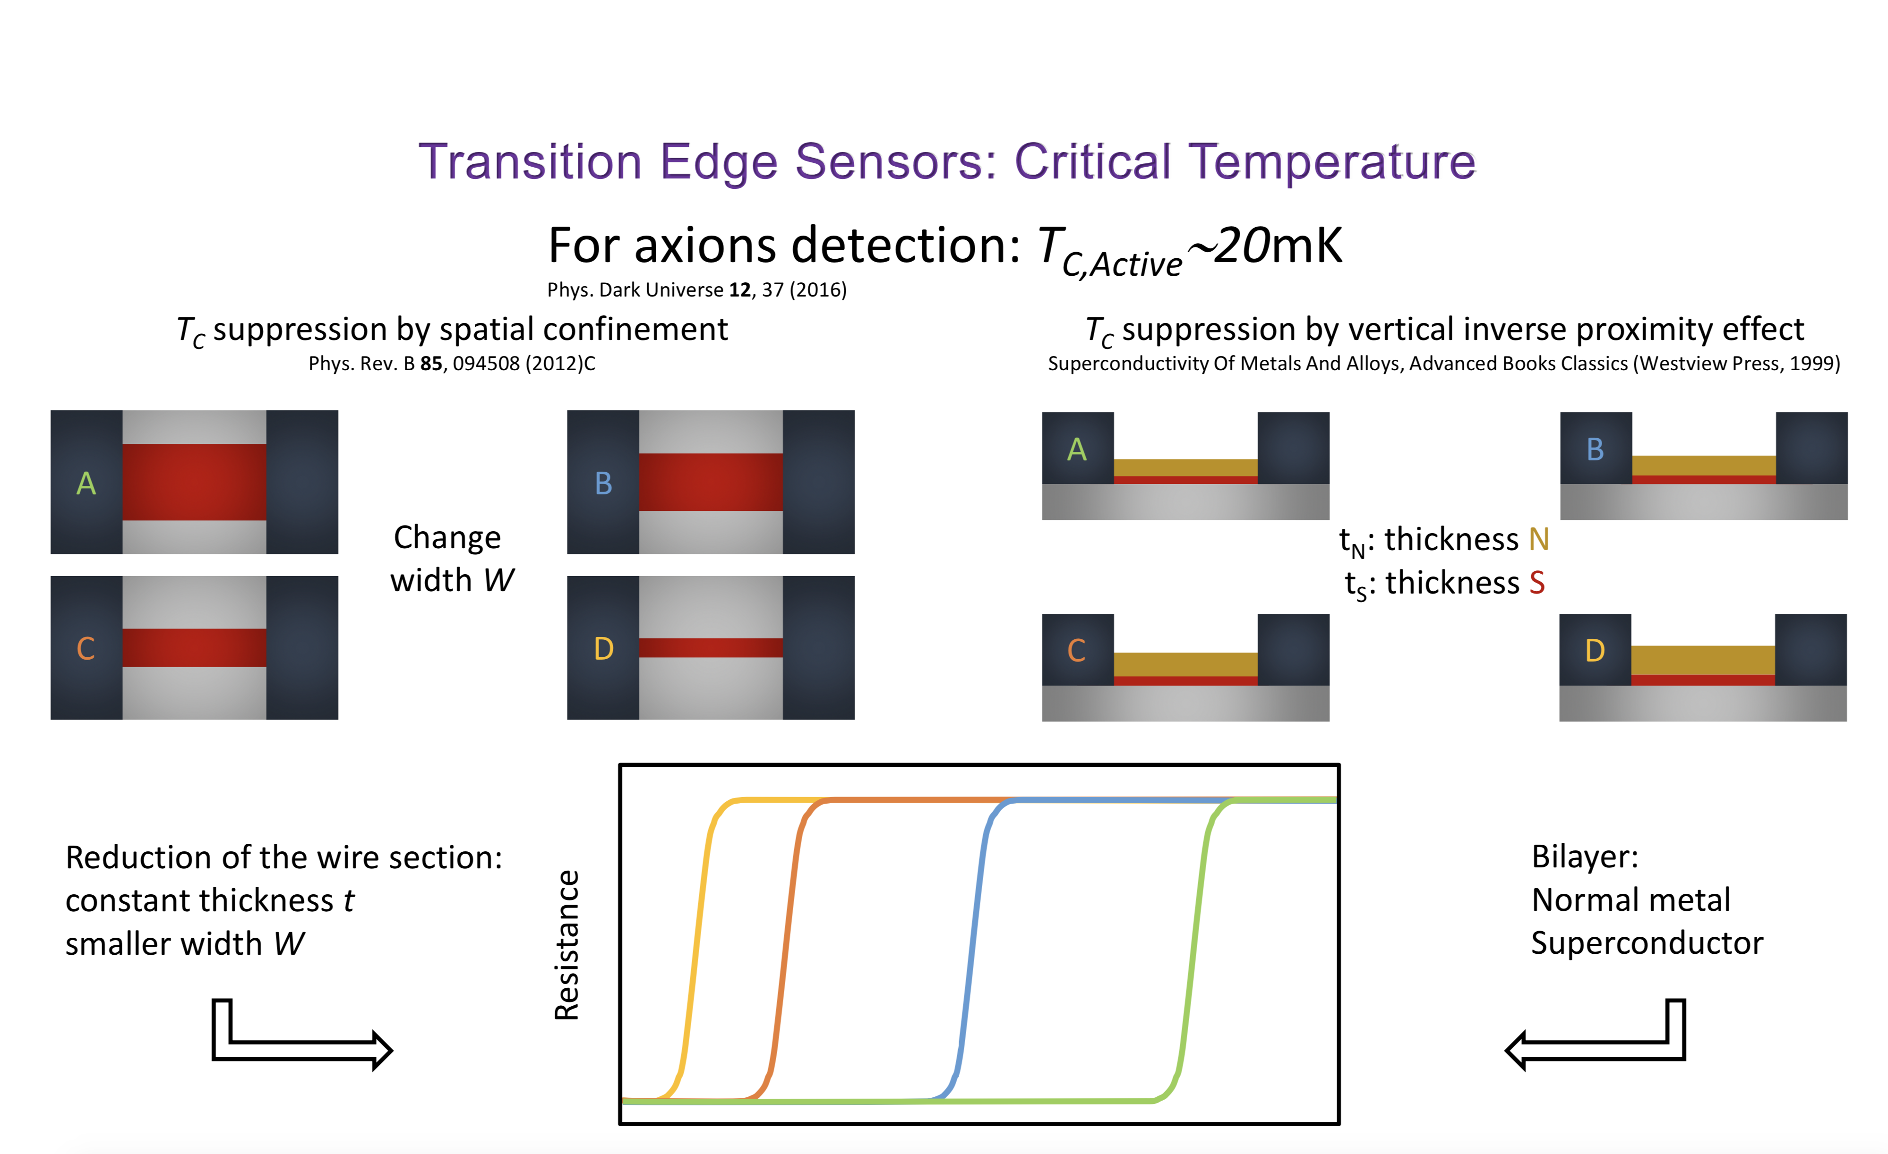
Cu-Al bi-layers
Tc

Slide 17
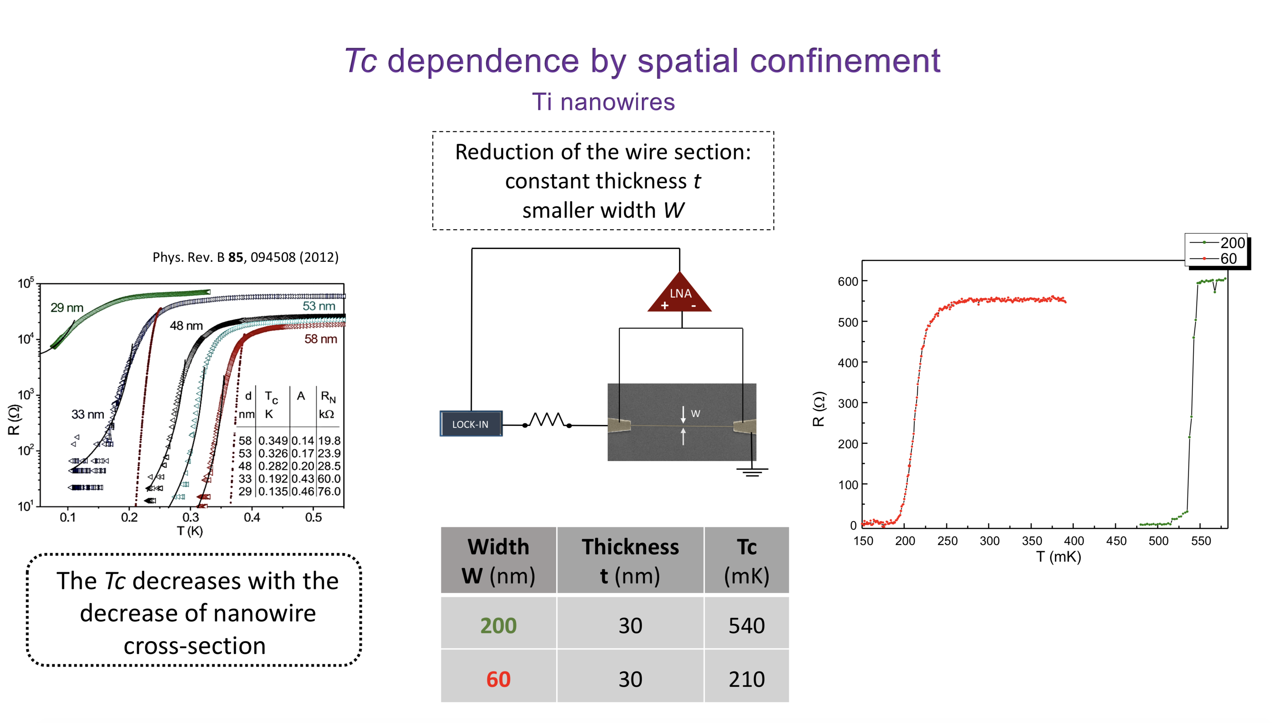

Slide 18
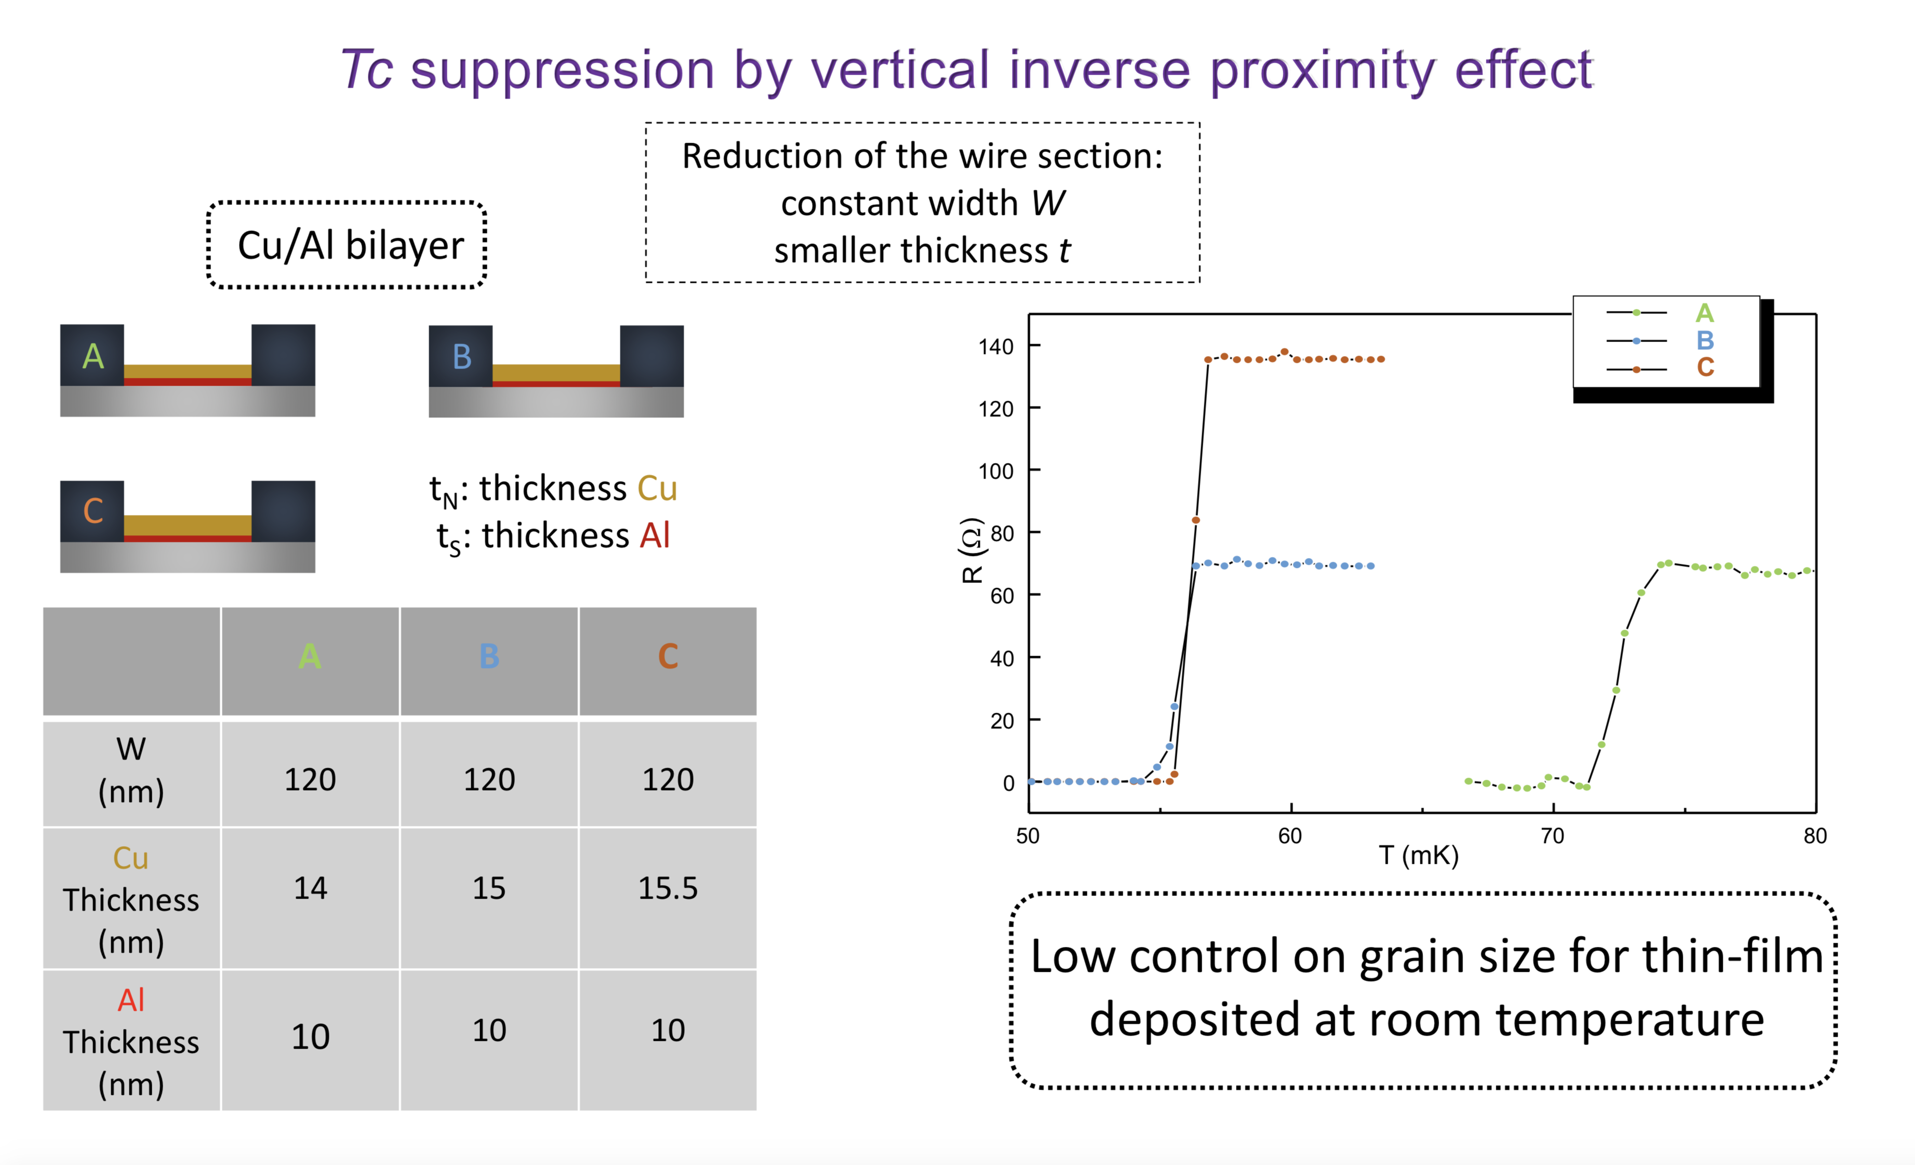
Tc ~ 55mK

Slide 19
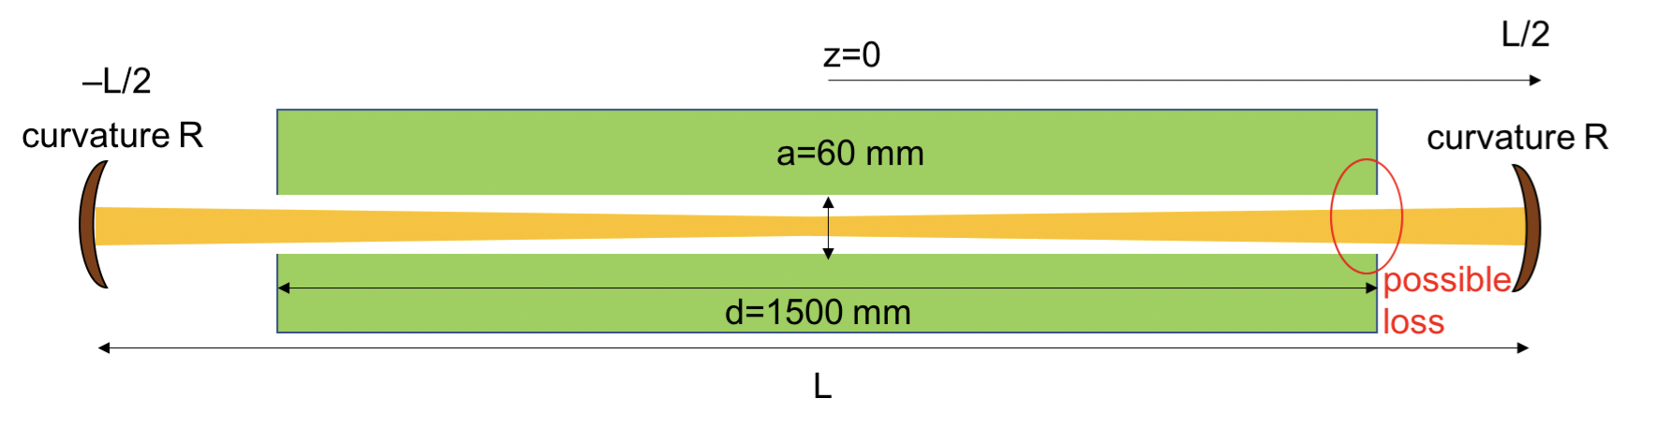
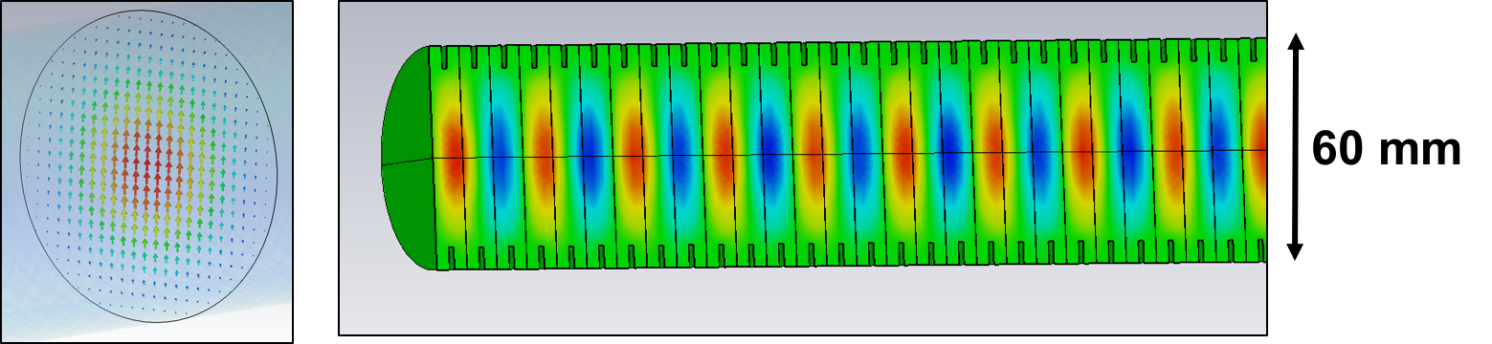
Generation and the Regeneration Cavities
Finesse of about 10⁴ is expected
A classic Fabry Perot, in the range 30-100 GHz could bring to the beam confinement problem
The waist of the photon beam should be of few cm in order to have a total cavity length of 1.5 m to be fully inserted into the dipole magnet
A valid alternative could be a corrugated waveguide structure to confine millimetre waves in a linearly polarized HE11 mode
In high power applications it minimizes the power loss at the waveguide wall
Need to investigate a set of materials suitable for application in high magnetic fields
Courtesy of Akira Myazaki (his talk later today)
Notes:
N

Slide 20
Next Steps…
Cu/Ti down to Tc ~ 20-30 mK (via a cold deposition)
Coupling with a SQUID read-out
Test with a 30-100 GHz photon source
R&D of the Fabry Perot
Design of the log periodic antenna
Notes:
Cu/Ti in place of Cu/Al Tc(Ti) = 0.39 K Tc(Al) = 1,2 K Cu conduttore normale fino a 0 K

Slide 21
Alternative choices to boost the experiment
Work with a new concept Fabry Perot after the wall to enhance the finesse Q
An upgrade in Q translates into the need of a lower power of the source P/Q²
Fabry Perot with Q’ exceeding 10¹⁰ have been recently developed with superconducting cavities or wispering galleries resonator
Material choice need to be shaped to work in this particular environment
  Low temp
  High B field
High Q and lower P can drive the use of other (more refined and easier to handle) photon sources than gyrotrons (klystrons?)
x QxQ’

Slide 22
STAX
STAX2

Slide 23
CONCLUSIONS
A new optimized version of the LSW experiments is proposed
The ambitious goal is to push limit on the photon-axion coupling g beyond stellar experiments (CAST) exclusion
Development of Fabry-Perot and TES detectors could lead to a new generation of experiments in the field
Important R&D need to be addressed to the scope
Nanotech detectors could drive Searches of Light Dark Matter

Slide 24
BACK UP SLIDES

Slide 25
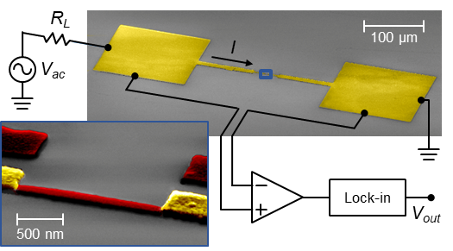
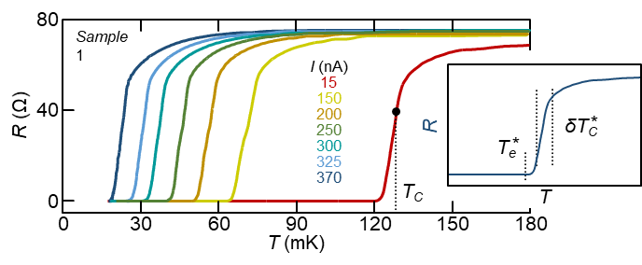
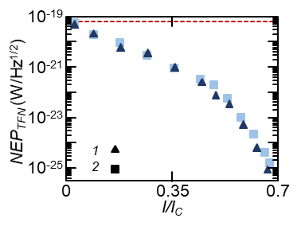
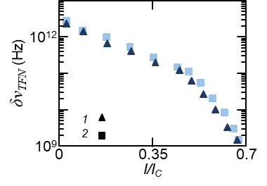
Josephson Escape Sensor (JES)
J. Appl. Phys. 128, 194502 (2020); https://doi.org/10.1063/5.0021996
NEP:
1x10⁻²⁵ W/Hz^{1/2}
Frequency resolution:
2 GHz

Slide 26
Gyrotrons (often used for military-purpose/radar)
Now beyond 1 MW power
High-Power Cyclotron Autoresonance Maser (CARM)
Up to 10-15 MW with 10-50 GHz

Slide 27
Scheme of the temperatures in the experimental dilution cryostat set-up

Slide 28
STAX detector
Tailoring TES active volume to reduce thermal capacitance (V ~10⁻³-10⁻⁴ μm³)
C = γ V T V ~ 300x40x20 nm ³
low-noise SQUID readout electronics optimization (operating at 80 mK)
Sensitivity thermalization

Slide 29
Noise
Dark count rate (phonon noise) < 6x10 ⁻¹⁰ s⁻¹
Black Body: at 10mK peaked around 0.6 GHz with a negligible rate of 10 ⁻³⁰ m⁻² s⁻¹ photons irradiated
Cosmic bkg: 1μ/cm⁻²/min with 10 eV released in 10nm of material saturates the TES, bkg. under control translated in a negligible dead time of the TES ~ 0.1%
dark count bkg rate
single photon quantum efficiency

Slide 30
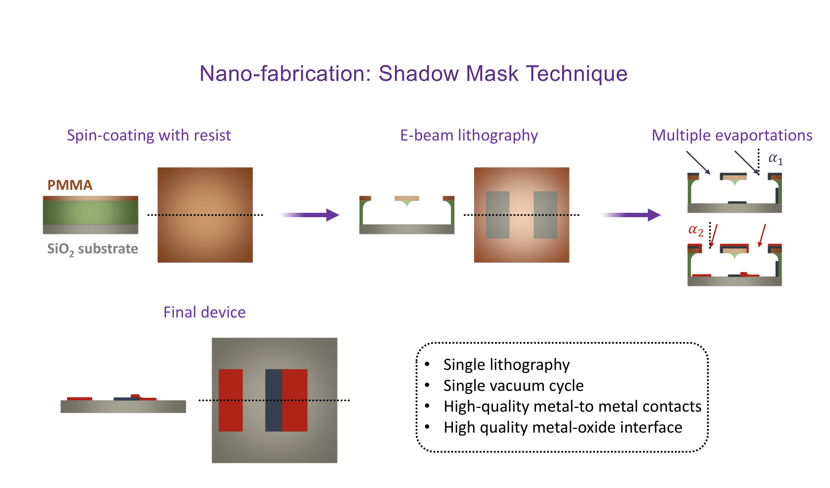

Slide 31
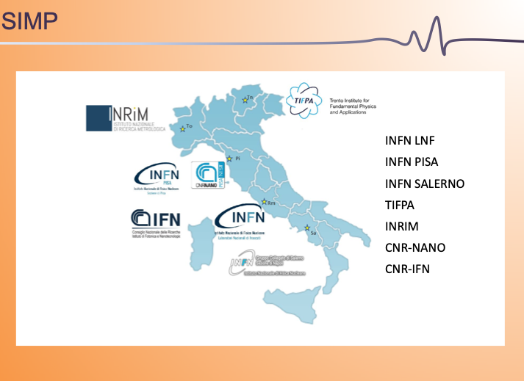

Slide 32
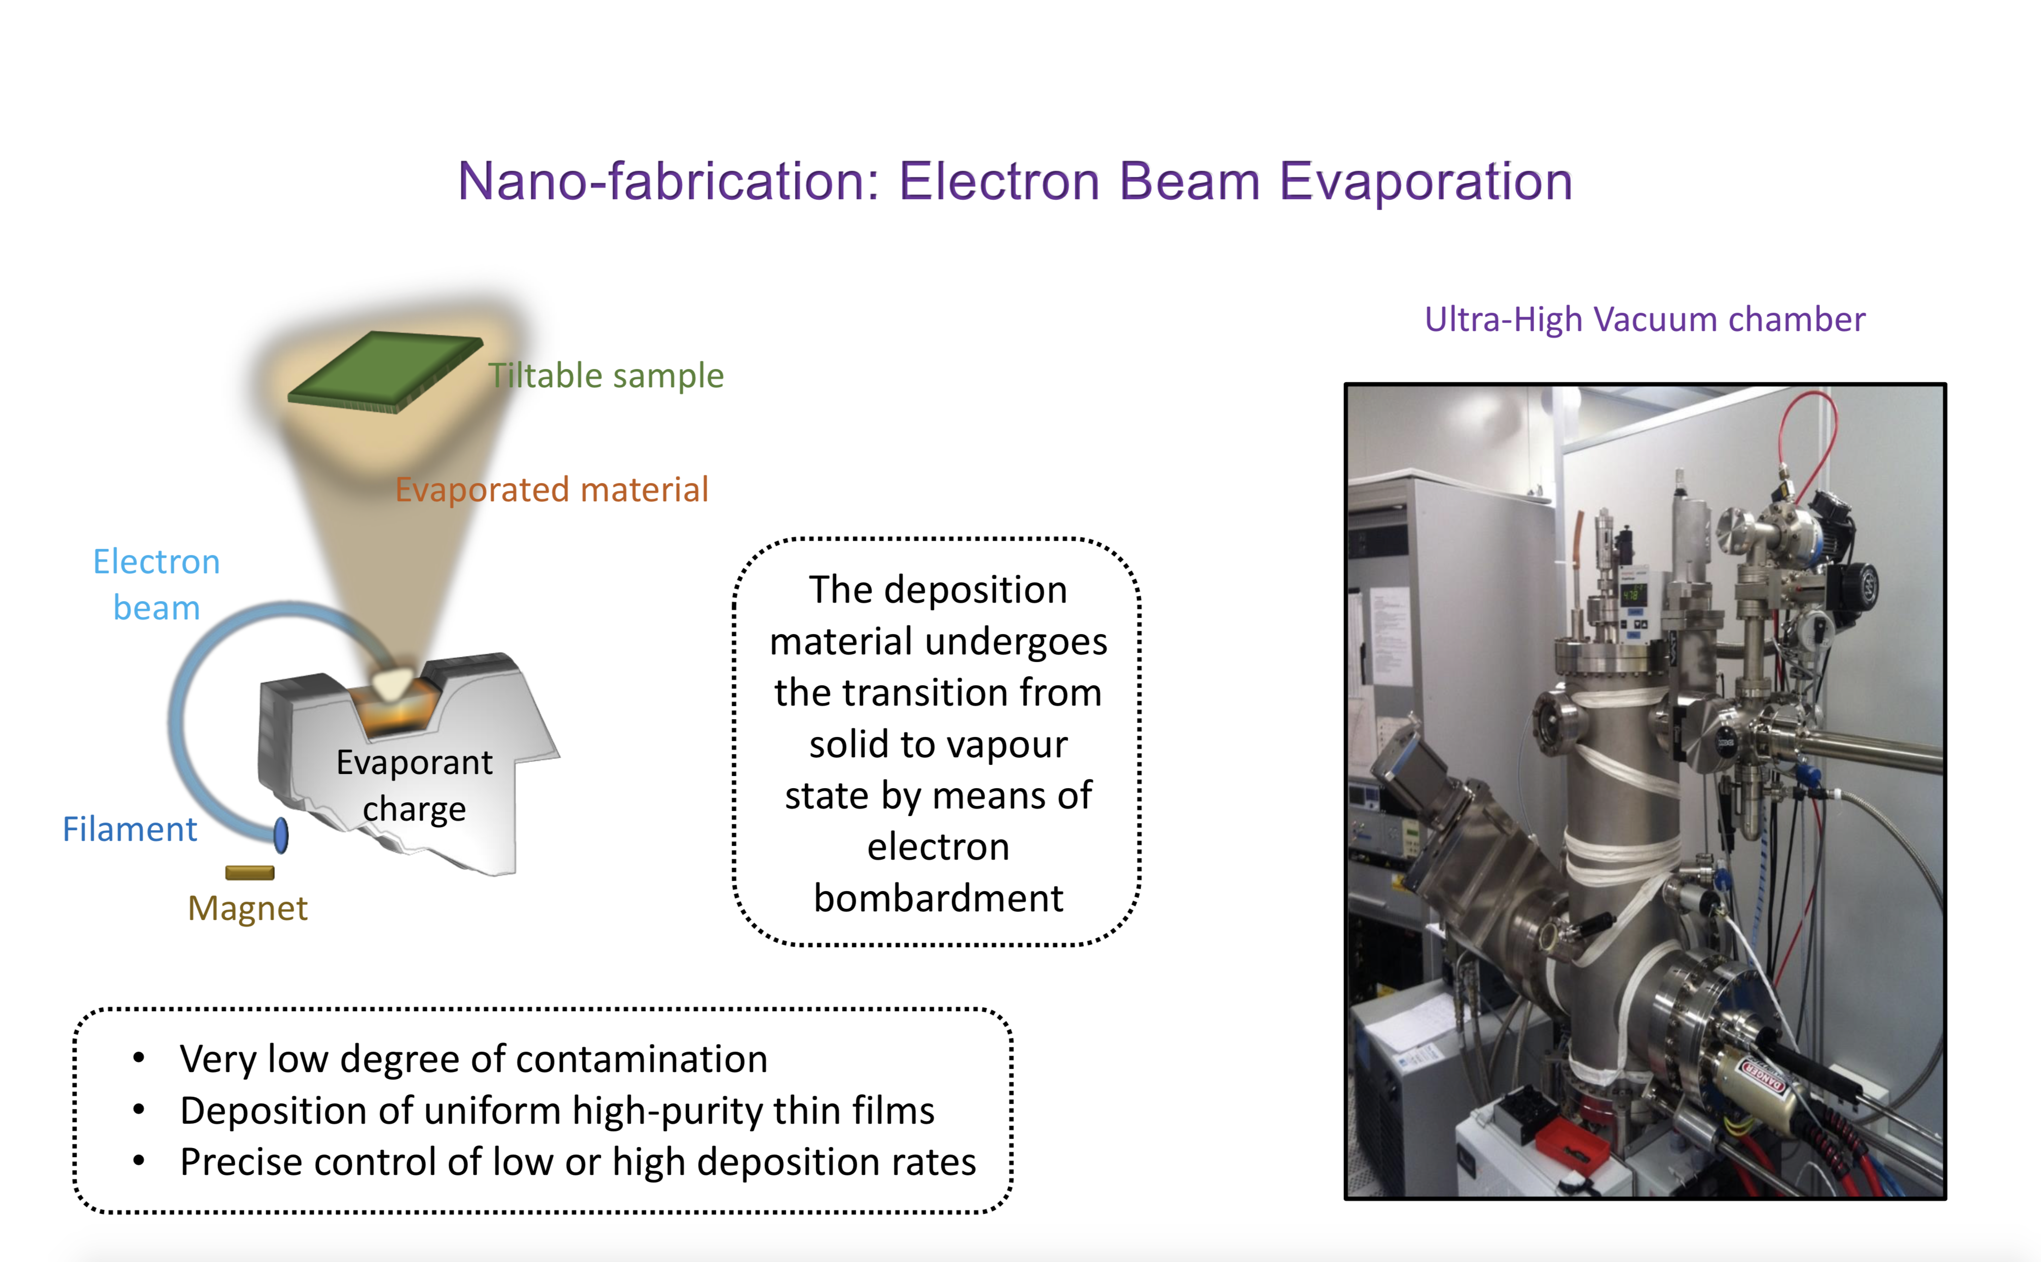

Slide 33
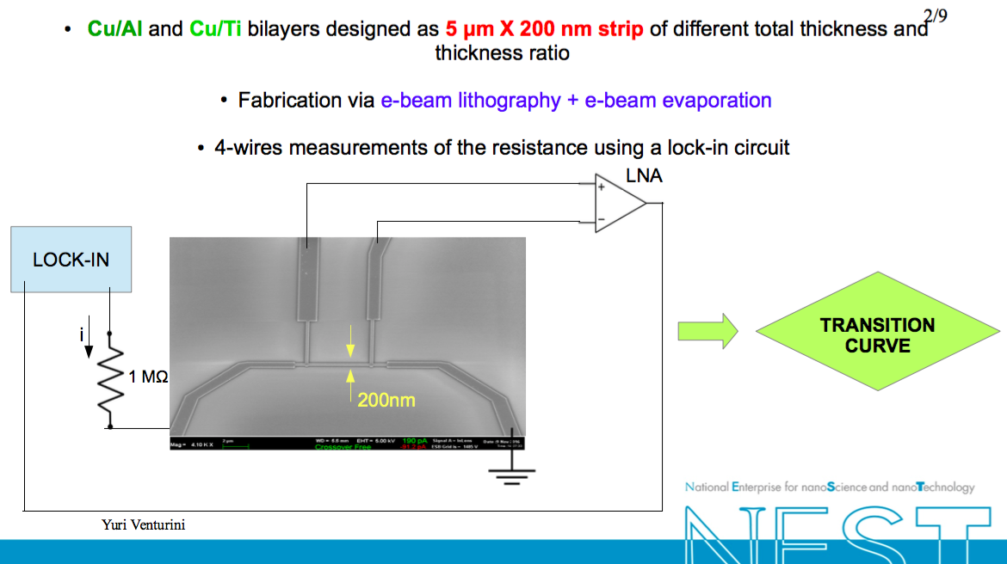

Slide 34
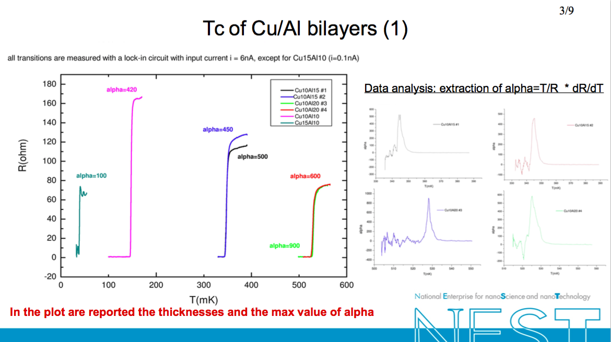

Slide 36

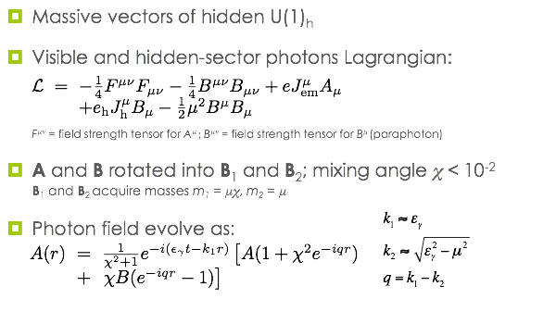

Slide 37
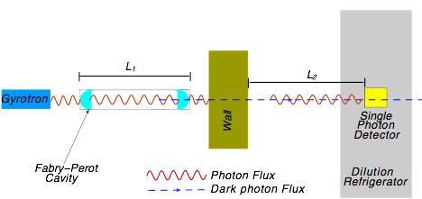
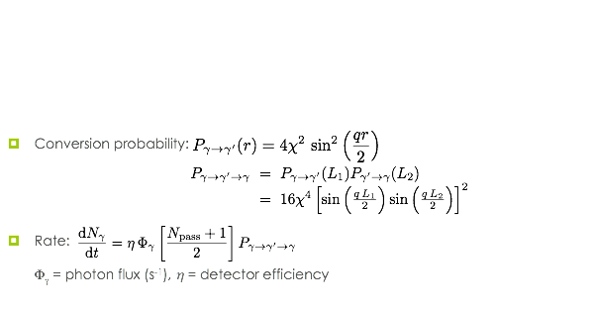

Slide 38
Search for dark photons at STAX L.M. Capparelli et al., Phys. Dark Univ. 12, 37 (2016)
Exclusion limits STAX may achieve in case of null result
STAX limits compared to
  ALPS LSW results Phys. Lett. B 689, 149 (2010)
  CROWS results Phys. Rev. D 88, 075014 (2013)
  Spring-8 results Phys. Lett. B 722, 301 (2013)
  XENON10 results Phys. Lett. B 689, 149 (2010)
  Constraints on dark photons from measurements of the CMB Astrophys. J. 473, 576 (1996)
  Searches for modifications of Coulomb’s Law Phys. Rev. Lett. 61, 2285 (1988)

