Slide 1
Some perspectives of PANDORA beyond
s-processes: plasma opacities and other issues
Marco La Cognata

Slide 2
Outline
1. Very few words about the r-process
2. Kilonovae and nucleosynthesis
3. Studying the opacity of a plasma made up of lanthanides (nuclear methods and atomic physics)

Slide 3
1. Very few words about the r-process

Slide 4
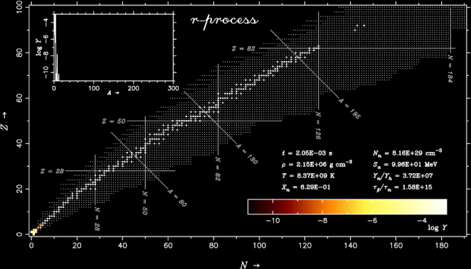
r process nucleosynthesis
- It produces ~50% of the stable isotopes heavier than Fe
- Candidate site: neutron star mergers (cold r-process)
- Nuclear physics input:
Masses, shell structure, half lives, fission parameter, P_{n} values (probability of neutron emission following 𝛽-decay)
https://fr.cdn.v5.futura-sciences.com/sources/images/dossier/rte/18FuturaSciences.gif
Example: animation of the coalescence of two neutron stars with masses 1.4 and 1.5 M☉
Nuclear physics input
Observations (GW, e.m. radiations, neutrinos)
Stellar modelling
Some review papers:
Annu. Rev. Nucl. Part. Sci. 67 (2017) 253
Prog. Part. Nucl. Phys. 86 (2016) 86
Prog. Part. Nucl. Phys. 66 (2011) 346
Multimessenger
astronomy
http://compact-merger.astro.su.se/Movies1/ns14_ns15_6mio_3D_density_v5.mov

Slide 5
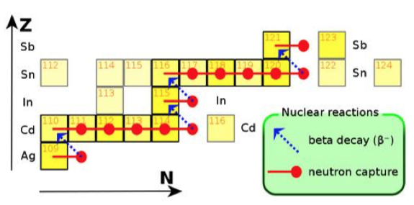
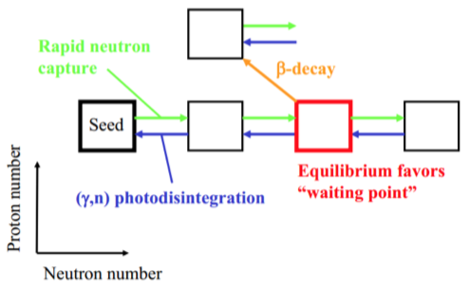
r process nucleosynthesis
Temperatures 10⁹ K (cold r-process → NS mergers)
(hot r-rpocess → CC supernova)
Neutron densities 10²² n/cm³
Timescale < ms
Neutrons can be absorbed until the neutron separation energy is less than or equal to zero (drip line)
→ 𝛽-decay and new sequence of neutron captures
Photodisintegration can play an important role in the r-process path owing to the high temperatures
(n,γ) - (γ,n) equilibrium (less important for NS mergers)
At shell closure (n,γ) rates decrease and right beyond (γ,n) rates are very large.
→ As a result of the r process path waiting at shell closures the abundance of nuclei in the corresponding mass range is increased

Slide 6
2. Kilonovae and nucleosynthesis

Slide 7
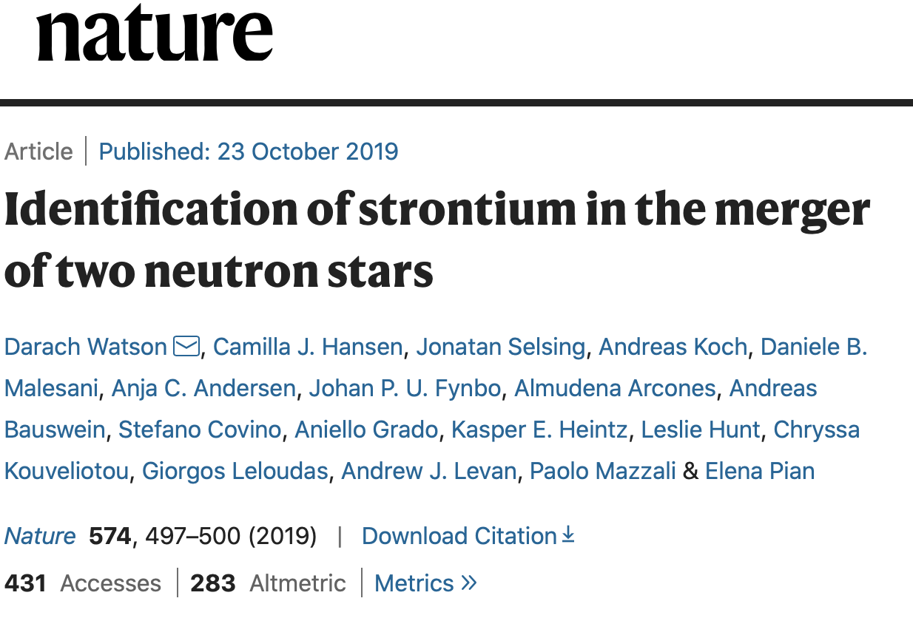
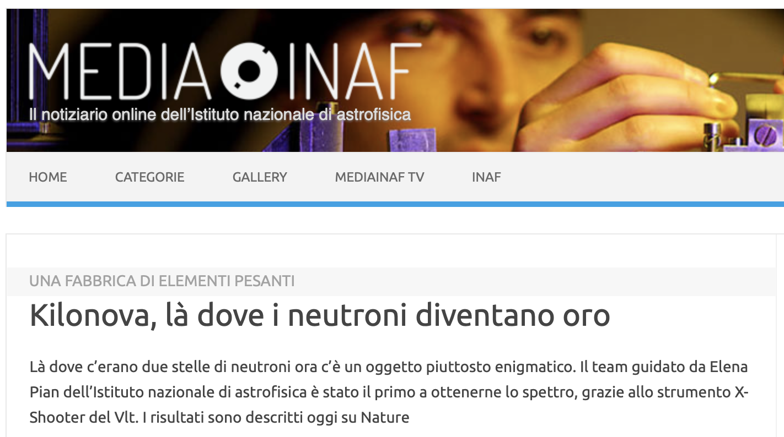
Kilonovae and nucleosynthesis
Nuclei freshly synthesized by the r-process are radioactive. As this expanding matter decays back to stability, the energy released via β decays and fission can power a thermal transient lasting days to weeks, commonly known as a kilonova
A quickly developing field: from hints on nucleosynthesis of heavy elements to spectroscopy
Don’t forget this reference:

Slide 8
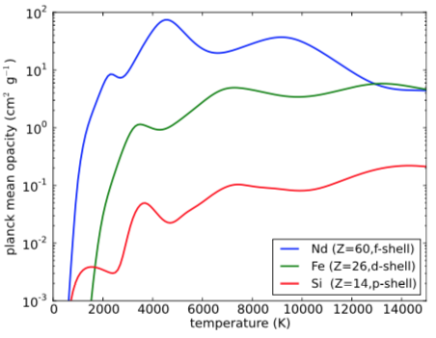
Atomic physics: measurement of opacities
Neutron star merger
Kilonova
Gravitational waves
What is opacity? Photon cross section per unit mass of absorbing material
→ ∝ to the number of atomic transition in the heated matter
→ ∝ to the square of number of atomic levels
The opacity of matter containing a small fraction of lanthanides is orders of magnitude larger than one containing iron peak elements
Powered by radioactive nuclei decays
Peak luminosity: proportional to their quantity
When is it reached?
Observed using LIGO/VIRGO
The Astrophysical Journal 774 (2013) 25
Where:
𝜅 → opacity
M_{ej}, v_{ej} → mass and speed
of the ejected matter

Slide 9
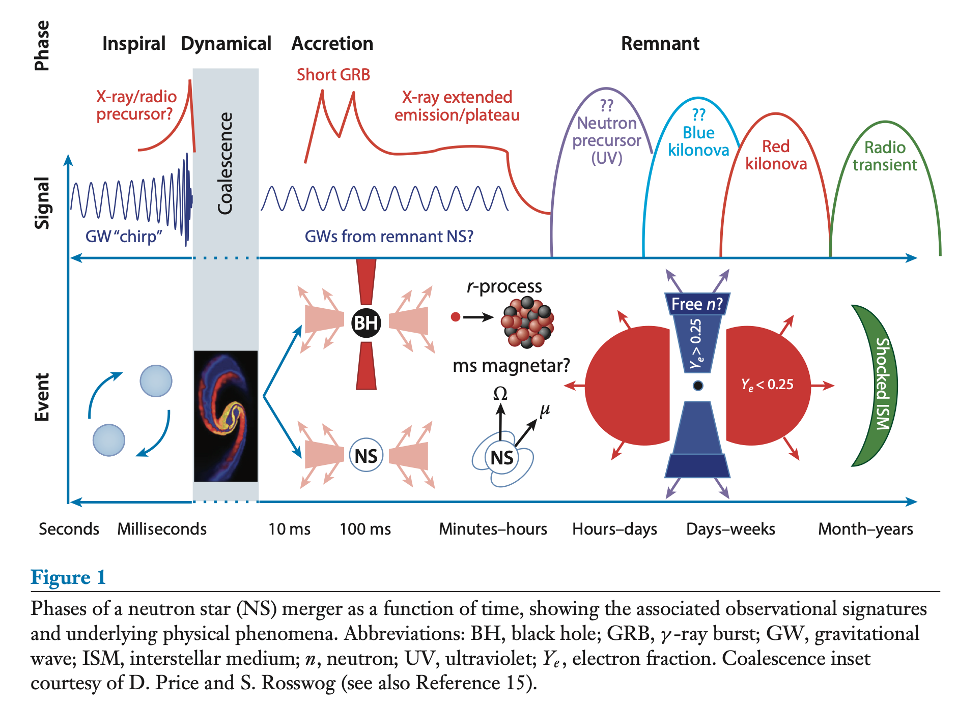
Kilonovae and nucleosynthesis
Annu. Rev. Nucl. Part. Sci. 2016. 66:23–45

Slide 10
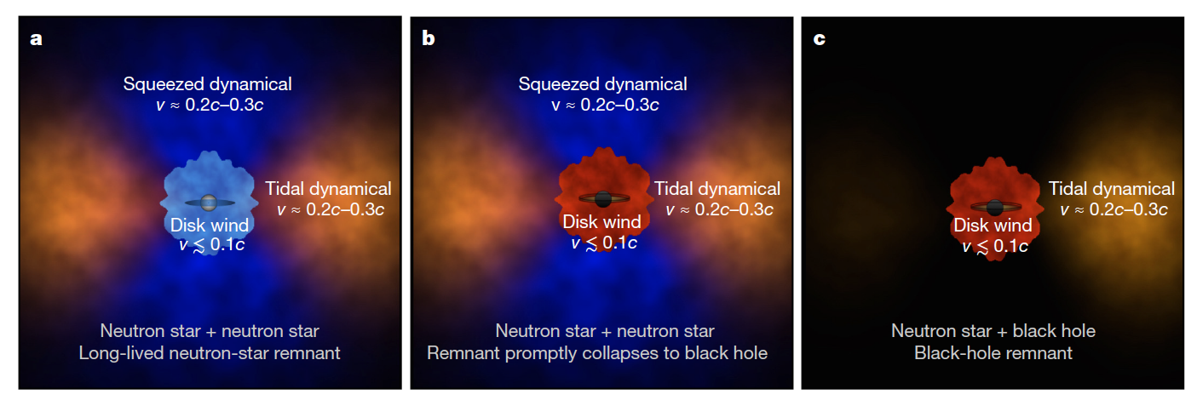
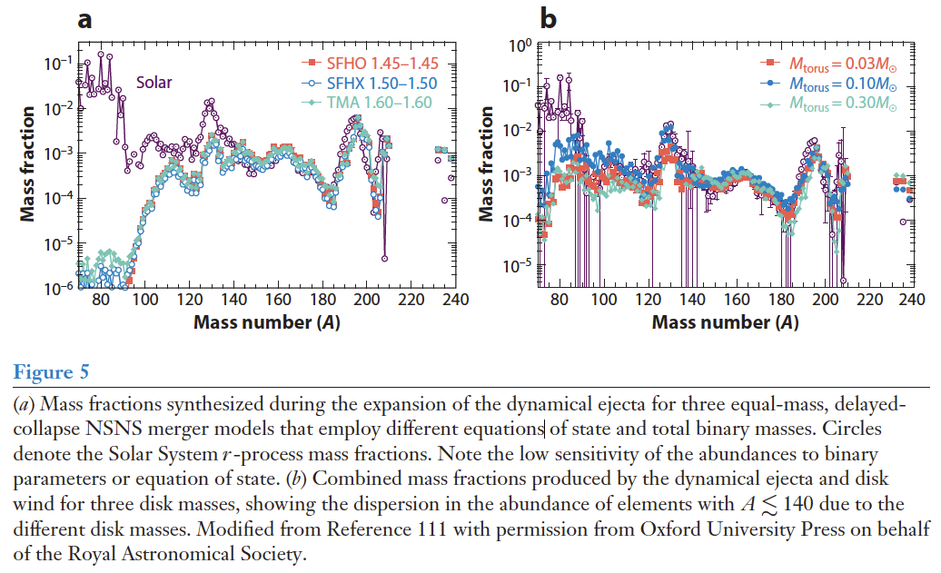
Constraining the dynamics?
Dynamical eject vs. Disk winds: different Y_{e} and different nucleosynthesis yields
Schematic illustration of the components of matter ejected from neutron-star mergers.
- Red colours denote regions of heavy r-process elements, which radiate red/infrared light.
- Blue colours denote regions of light r-process elements which radiate blue/optical light.
Annu. Rev. Nucl. Part. Sci. 2016. 66:23–45
Nature 2017 551:80.
Notes:
During the merger, tidal forces peel off tails of matter, forming a torus of heavy r-process ejecta in the plane of the binary. Material squeezed into the
polar regions during the stellar collision can form a cone of light r-process material. Roughly spherical winds from a remnant accretion disk can also
contribute, and are sensitive to the fate of the central merger remnant.
a, If the remnant survives as a hot neutron star for tens of milliseconds, its
neutrino irradiation lowers the neutron fraction and produces a blue wind.
b, If the remnant collapses promptly to a black hole, neutrino irradiation
is suppressed and the winds may be red.
c, In the merger of a neutron star
and a black hole, only a single tidal tail is ejected and the disk winds are
more likely to be red.

Slide 11
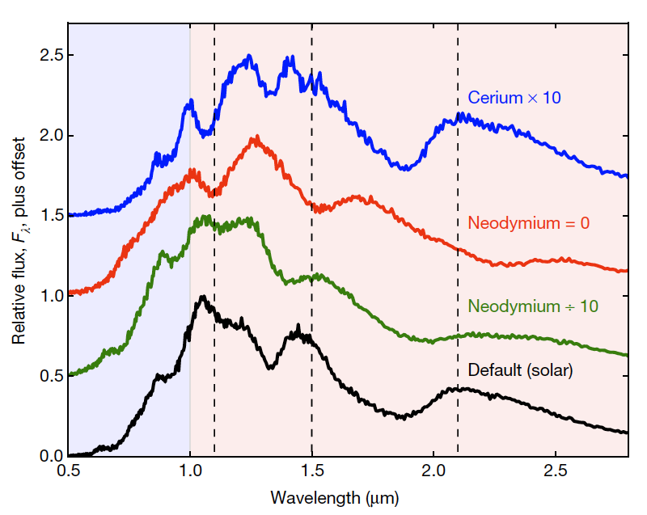
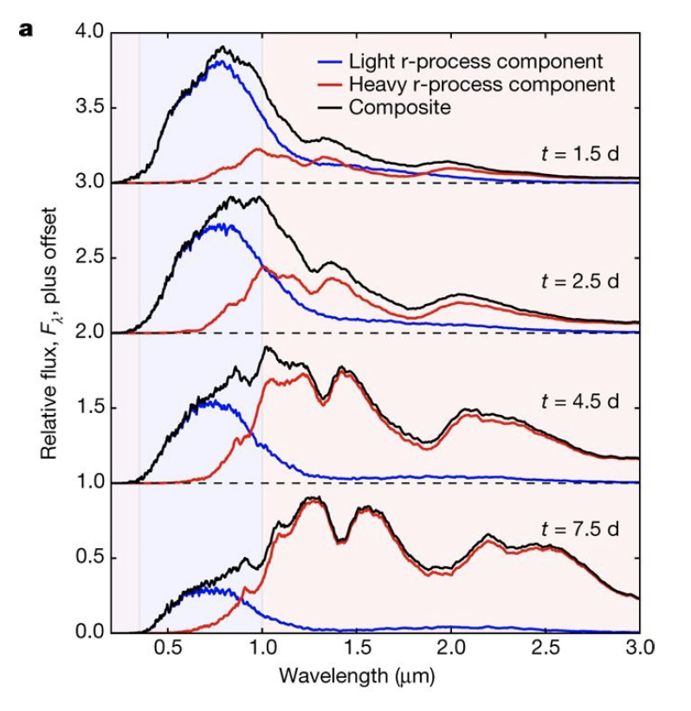
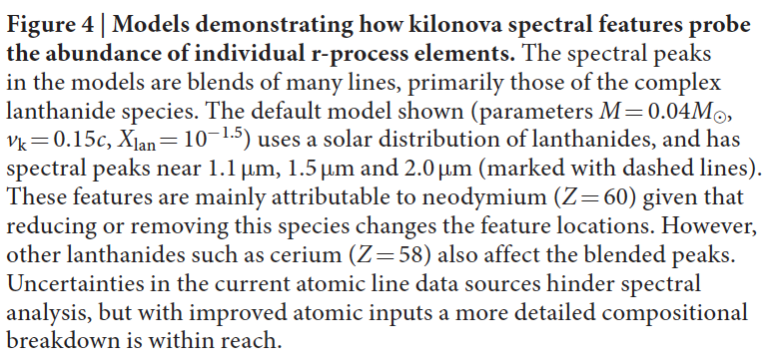
Constraining r-process abundances
Two-component model for the observed GW170817 light curve from Nature 2017 551:80.

Slide 12
3. Studying the opacity of a plasma made up of lanthanides.

Slide 13
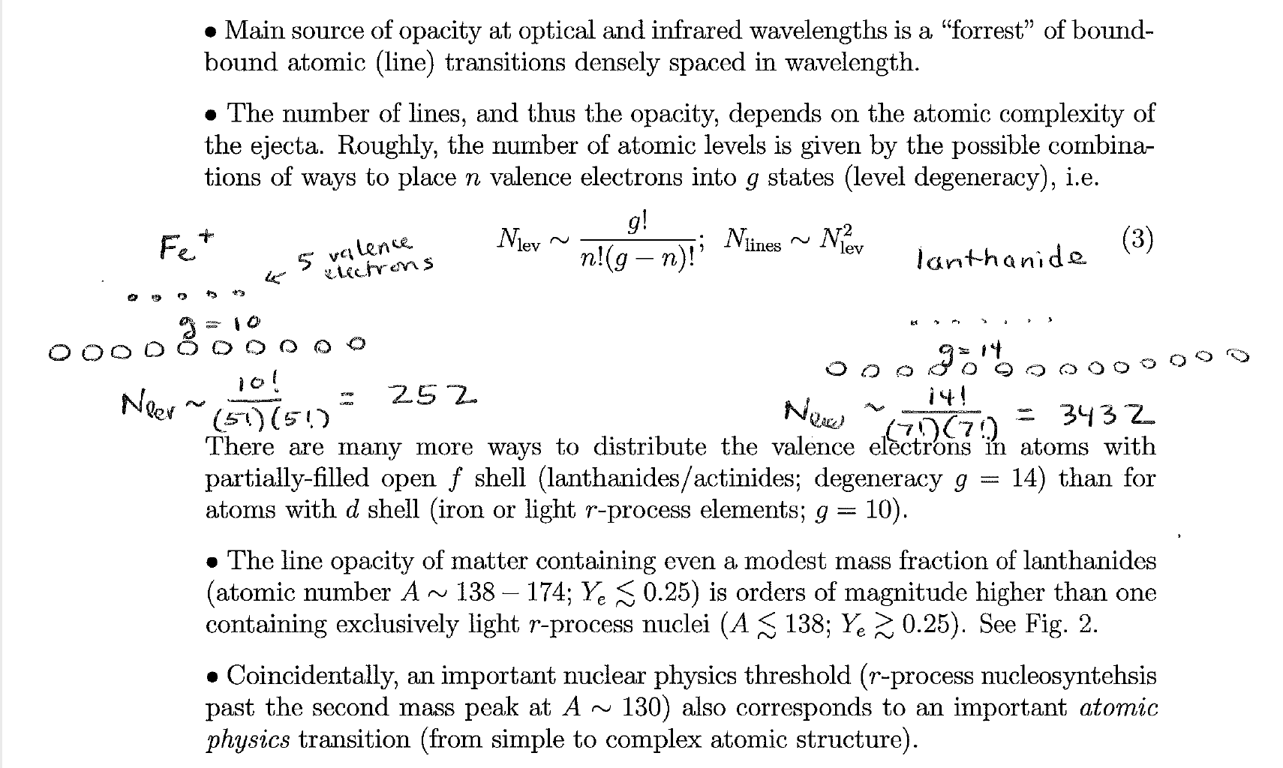
Let’s focus on the physical problem
Taken from B. Metzger FRIB summer school Lecture on kilonovae
May 16-18, 2018 @ MSU

Slide 14
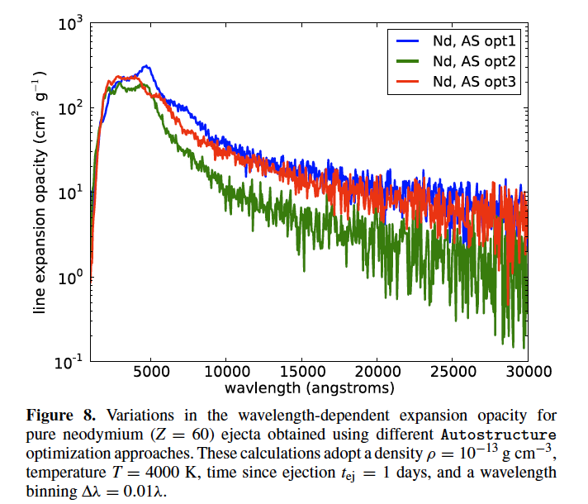
Available data
A detailed discussion on opacities for kilonovae can be found in The Astrophysical Journal, 774:25 (13pp), 2013 September 1
An improved solution was found (opt3) which reproduced the ground and first two excited level energies almost exactly. Further iterations could presumably improve the result, but this sort of manual alignment is time consuming, and more of an art than science
Kurucz calculation fails to reproduce every observed spectral feature in SNe, even if they are optimized for A<30
Autostructure model energies do not exactly match the experimental values, especially for high-Z elements
The pseudo-continuum opacities depend only on the statistical distribution of lines and are fairly robust, although our numerical experiments indicate uncertainties at the factor of ∼2 level.
Another more important uncertainty is that the radiative data for one species (Nd, Z = 60) is used to represent all lanthanides.
Kasen et al. therefore suspect that our current opacities underestimate the true values for an r-process mixture where Gd is present at the ∼1% level.
Same code, different level of reproduction of the lines
Significant differences!

Slide 15
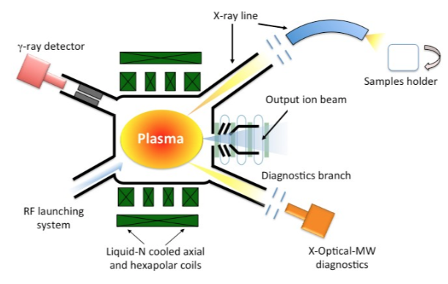
Possible measurement at PANDORA?
Pandora @ LNS
Production of controlled plasma at the same densities of kilonovae ejecta at peak luminosity
→ Measurement of opacities of different mixtures of atomic species
→ Accurate predictions of kilonovae light curves
→ Constraining r-process yields and kilonovae energetics
Eur. Phys. J. A 53 (2017) 145
Ion temperatures of the plasma well below 20 eV
Densities of the order of 10¹⁰ ions/cm³
To be compared with ejecta physical conditions:
T~10⁵ K
𝜌~10⁻¹³ g/cm³
1 day after ejection.
Unique possibility to perform measurements at the physical conditions of interest
The ejecta of NSMs consists of heavy elements in rapid differential expansion
Perhaps the largest remaining uncertainty in our understanding of r-process SNe has concerned the opacity of the ejected debris
The Astrophysical Journal 774 (2013) 25

Slide 16
Summary
1. r-process, multimessenger astronomy and atomic physics are strongly bound and a common effort is necessary to achieve discovery power
2. Many effort have been poured in modelling, yet the connection with models and observations requires additional, uncertain atomic models
3. Studying the opacity of a plasma made up of lanthanides in a controlled enviroments, where physical conditions similar to the ones in the ejecta can be produced.
THANKS for your attention!

Slide 17
In fact, not all lanthanides are equal
the ions whose valence f-shell is nearly open (e.g., La, Z = 56) or closed (Yb, Z = 70) are considerably less complex, and should have correspondingly lower opacities.
On the other hand, gadolinium (Gd, Z = 64) has a nearly half-filled f-shell, and is one of the most complex species on the periodic table. Simple counting arguments (Figure 1) suggest that Gd may have an opacity 10 times that of Nd.

Slide 18
The opacity of bound–bound transitions is significantly enhanced by the high expansion velocities found in SN and NSM ejecta (Karp et al. 1977). We discuss here the “expansion opacity” formalism which wavelength averages the contribution of multiple lines and treats the line radiative transfer in the Sobolev approximation. As a photon propagates through the differentially expanding medium, its wavelength is constantly Doppler shifted with respect to the comoving frame. For a homologous (Hubble-like) expansion, this Doppler shift is always to the red, and proportional to the distance traveled. The photon will interact with a line when its comoving frame wavelength is redshifted into resonance with the line rest wavelength. The spatial extant of this interaction, or resonance, region is set by the intrinsic width of the line profile.

