Slide 1
Design of PANDORA MAGNETIC Trap
Luigi CELONA
Istituto Nazionale di Fisica Nucleare – Laboratori Nazionali del Sud
Via S. Sofia 62, 95123 Catania, ITALY
PANDORA MEETING 30-10-19, Perugia

Slide 2
TRAP DEFINTION

Slide 3
POSSIBLE ROADMAP
Bologna 31/01/2019
Instead of a single cryostat for the source coils, two separated cryostats may be used for the solenoids (symmetrical structure) to leave in the middle the radial access. Higher cost!
To achieve the radial access through the hexapole different strategies may be used depending from the chosen technology:
If the field is achieved through PM the degradation of the radial field due to the empty space must be estimated.
If the field is achieved through a coil based hexapole the space between the conductors may be used
In any case it is better to keep the chamber separated from the radial magnetic system.

Slide 4
GEANT4

Slide 5
First Hypothesis
STATUS
Identified company: CRYOGENIC (SIGMAPHI rejected) to realize the axial coils and budgetary quote received;
Company not identified for the realization of the RT copper hexapole: CRYOGENIC rejected, SIGMAPHI after a couple of interactions rejected too for the complex shape of the structure and mainly because the too high current density needed.
Two choices: PM magnets and fully SC magnet with multiple port cryostat.

Slide 6
TRAP Choices#1 Fully SC Lhe FREE
Trap is feasible, but the 350 mm warm bore implies conductors of 300 H with stored energy of 1 MJ circa.
If three separate cryostats are used, the force containement will be much more complex than putting all together within the same cryostat. Cost of ancillary equipment is also higher.
A possible idea would be to put all the magnetic system in the same cryostat, keeping the lines of sight requested.
Such solution implies the use of windows at the two ends od the line (inner and outer radii). May this affect the detection?
If so, pipes should cross the cryostat together with the insulation. Much more complex and expensive to do but still possible.

Slide 7
TRAP Choices#1 Fully SC Lhe FREE
Hexapole should be longer than the 800mm to avoid that the maximum field due to solenoids is in coincidence with the hex bends.
A possible solution to mitigate force on hexapole is to decrease the radius of the coil that means a reduction of warm bore. A resaobale value proposed by CRYOGENIC is 300 mm.
DETAILED STUDY IS NEEDED BEFORE TO START THE CONSTRUCTION.
Actually the estimation is 1.5-1-7 M€ for the entire system with 350 mm bore and 20% savings with 300 mm bore.
The goal is to have the trap design for half 2020.

Slide 8
TRAP Choices#2
Same configuration of trap#1, but with permanent magnets instead of SC hexapole.
The idea would be the insertion of the magnets inside the cryostat. Compounds able to work at cryogenic regimes are available from VACUUMSCHMELZE.
Cost of the realization of the hexapole should be 900 k€ circa (for a warm bore of 350 mm)
Integration inside the cryostat possible.
Interfaces needed to be well studied

Slide 9
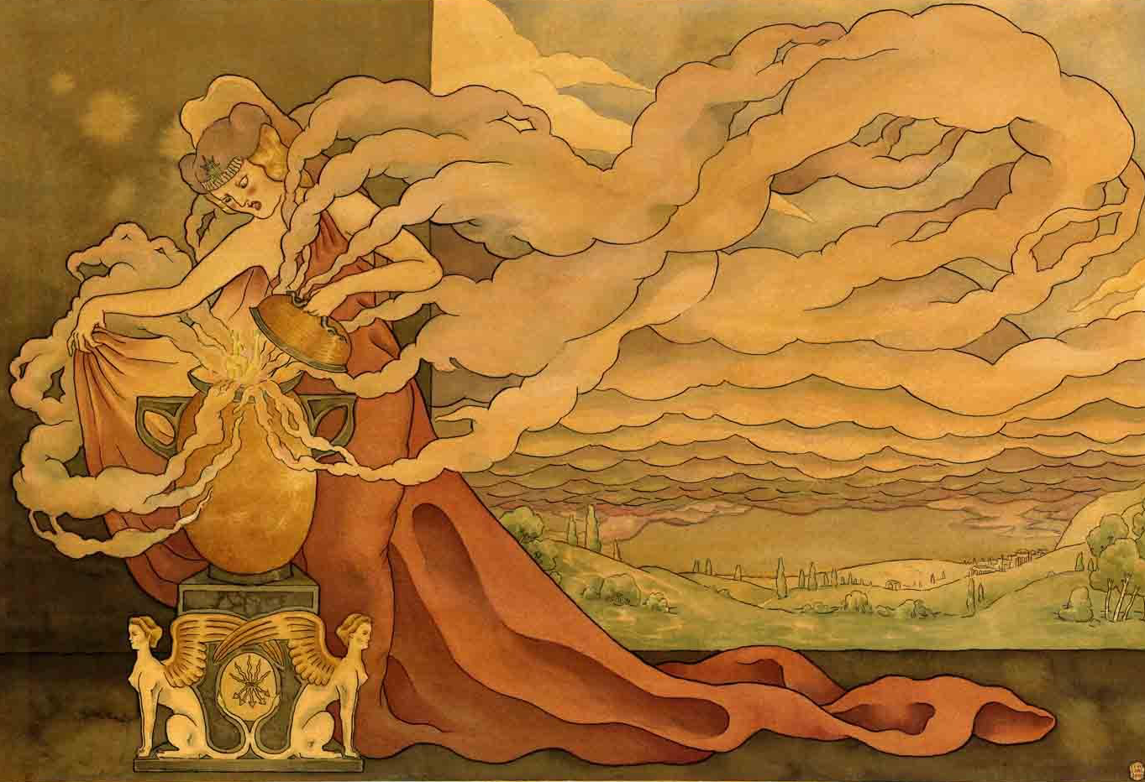
NEXT STEPS
Cost and complexity of the trap strongly depends from warm bore radius
A detailed cryogenic design is needed to define the trap both if PM or SC coils will be employed for the hexapole.
Administrative issues
Trap design is expected for 06/2020

Slide 10
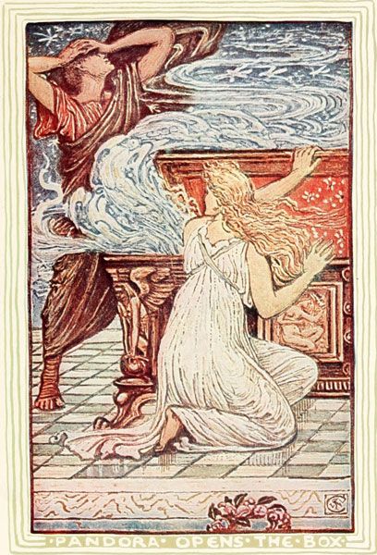
What inside Pandora Jar…???
THANKS FOR YOUR ATTENTION!!!

