Slide 1
PLASMA MODELLING
A. Galatà on behalf of the PANDORA collaboration
PANDORA: measuring beta-decays in plasmas, Perugia 3o/10/2019

Slide 2
DIFFERENT ASPECTS
ION DYNAMICS WITH COLLISIONS AND IONIZATIONS
ELCTRON HEATING WITH COULOMB COLLISIONS
ECR PLASMAS DESCRIPTION
ELECTROMAGNETIC CALCULATIONS
Perugia, 2019-10-30
Alessio Galatà
PANDORA: measuring beta-decays in plasmas

Slide 3
THE NUMERICAL CODE
INFN SIMULATION TOOLS
Fully 3D tracking code for ions and electrons
Precise electromagnetic calculations (Comsol+Matlab)
Plasma fine structure is automatically obtained
Can creates distribution maps of any physical quantity
Can be used to evaluate plasma heating by an injected beam
Atomic process can be easily implemented
Very good agreement with experiments of charge breeding
Can demonstrates the frequency tuning effect
Perugia, 2019-10-30
Alessio Galatà
PANDORA: measuring beta-decays in plasmas

Slide 4
DIFFERENT APPROACHES
ION DYNAMICS WITH COLLISIONS AND IONIZATIONS
ECR HEATING WITH COULOMB COLLISIONS
PLASMA DESCRIPTION
ELECTROMAGNETIC CALCULATIONS
Perugia, 2019-10-30
Alessio Galatà
PANDORA: measuring beta-decays in plasmas

Slide 5
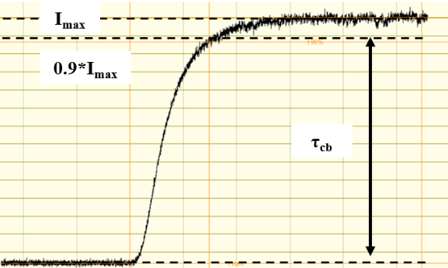
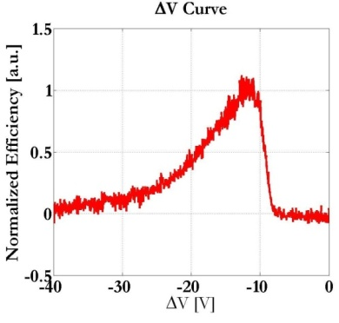
CHARGE BREEDING PROCESS
E₁₊=1*V keV
V_{CB} = +(V + ΔV) kV
Focusing
Deceleration
ΔV
Capture by the CB
τ_{CB} (half life)
<q+> (energy)
Efficiency (Intensity)
$$ε_{q^{+}}=\frac{I_{q_{}^{+}}}{q∗I_{1^{+}}}$$
ΔV<0
$$ε_{tot}=\sum_{i}{ε_{q_{i}^{+}}}$$
FUNDAMENTAL PARAMETER!
Perugia, 2019-10-30
Alessio Galatà
PANDORA: measuring beta-decays in plasmas
Notes:
ECR-CB used in ISOL facilities to boost the charge states of RIB allowing post acceleration
Charatteristics: tau_CB, eps, <q>
Important parameter: deltaV

Slide 6
ECR-BASED CHARGE BREEDERS
ECR resonance
Magnetic Trapping
Charge creation and destruction
IN COMMON WITH ECR SOURCES
E₁₊=1*V keV
V_{CB} = +(V + ΔV) kV
ΔV
Particles are injected as 1+ ions
Focusing
Deceleration (reflection)
Coulomb collisions lead to thermalization and capture
PECULIARITY IMPLEMENTED IN THE CODE
Perugia, 2019-10-30
Alessio Galatà
PANDORA: measuring beta-decays in plasmas

Slide 7
THEORY
INTERACTION OF AN ION BEAM WITH A PLASMA
plasma
Plasma ions following a M-B distribution
Cumulative small angle collisions dominate
Motion deduced from a “test particle”
THERMAL EQUILIBRIUM REACHED FOR ANY INITIAL DISTRIBUTION
Perugia, 2019-10-30
Alessio Galatà
PANDORA: measuring beta-decays in plasmas

Slide 8
THEORY
THE FOKKER-PLANK EQUATION
Dynamical Friction
Perp. Diffusion D⊥
Par. diffusion D//
Independent variable
Perugia, 2019-10-30
Alessio Galatà
PANDORA: measuring beta-decays in plasmas

Slide 9
THEORY
TRENDS OF THE COEFFICIENTS
Similar to ΔV
Always increasing
Maximum @ x=1
Φ-G
G
v→0: no friction; isotropic diffusion
v→∞: transversal diffusion
Heavy particles dominated by friction
Perugia, 2019-10-30
Alessio Galatà
PANDORA: measuring beta-decays in plasmas

Slide 10
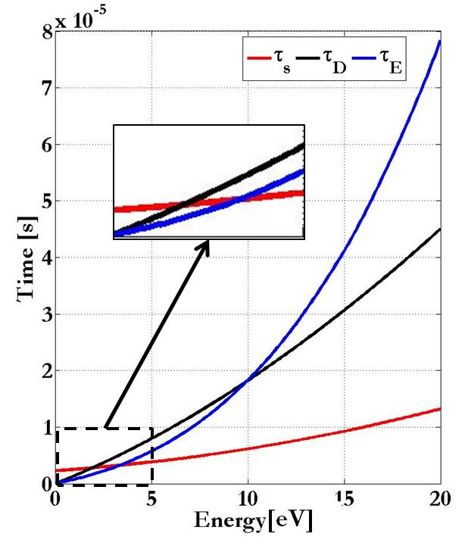
THEORY
CHARACTERISTIC TIMES
⁸⁵Rb¹⁺in oxygen plasma
Slowing down time τ_{s}
90° Diffusion time τ_{D}
x=1
Energy equilibrium time τ_{E}
n_{e}=2.6*10⁺¹⁸ m⁻³, KT=1 eV, <z>=3
Perugia, 2019-10-30
Alessio Galatà
PANDORA: measuring beta-decays in plasmas

Slide 11
THE NUMERICAL CODE
IMPLEMENTATION OF COULOMB COLLISIONS
Forward Difference method
v(t+1)=v(t) + a*T_{step} → x(t+1)=x(t)+ v(t+1)*T_{step}
Collisions implemented through the Langevin Equation*
Δv_{Lang}= v(t+1)-v(t)= - ν_{s}v(t)*T_{step}+v^{rand}
SLOWING DOWN
DIFFUSION
*Journal of Comp. Phys. 138, 563-584 (1997)
Perugia, 2019-10-30
Alessio Galatà
PANDORA: measuring beta-decays in plasmas

Slide 12
THE NUMERICAL CODE
LANGEVIN EQUATION
Δv_{Lang}= v(t+1)-v(t)= - ν_{s}v(t)*T_{step}+v^{rand}
Friction: a=- ν_{s}v
Random vector v^{rand}
1
2
Distribution of random kicks
3 // v while 1,2 ⊥ v
change at each iteration
Calculated for each particle from the F-P eq.
Perugia, 2019-10-30
Alessio Galatà
PANDORA: measuring beta-decays in plasmas

Slide 13
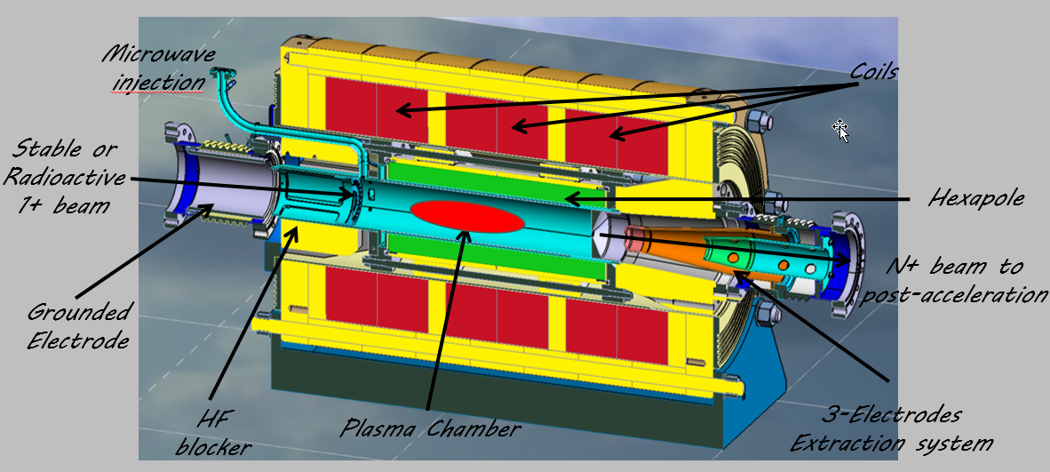
SIMULATION DOMAIN
SPES CHARGE BREEDER
B_{max} at injextion
Cylinder:
r = 36 mm
l =288 mm
Extraction hole
Perugia, 2019-10-30
Alessio Galatà
PANDORA: measuring beta-decays in plasmas

Slide 14
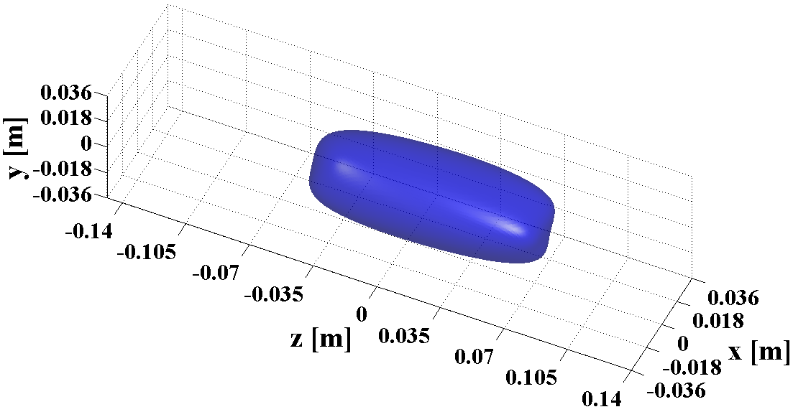
STEP-WISE PLASMA MODEL
PLASMOID/HALO STRUCTURE
n_{plasmoid}=100*n_{halo}
Boris method for B motion
Potential Dip
Ionizations
T_{e}(plasmoid)=1 keV
T_{e}(halo)=0.1*T_{e}(plasmoid)
n_{halo}
n_{plasmoid}
B_{ECR}
LOTZ FORMULA
MC Technique
v(t+1)=v(t) - ν_{s}*v(t)*T_{step}+v^{rand} + q[E+ v(t)xB]
Perugia, 2019-10-30
Alessio Galatà
PANDORA: measuring beta-decays in plasmas

Slide 15
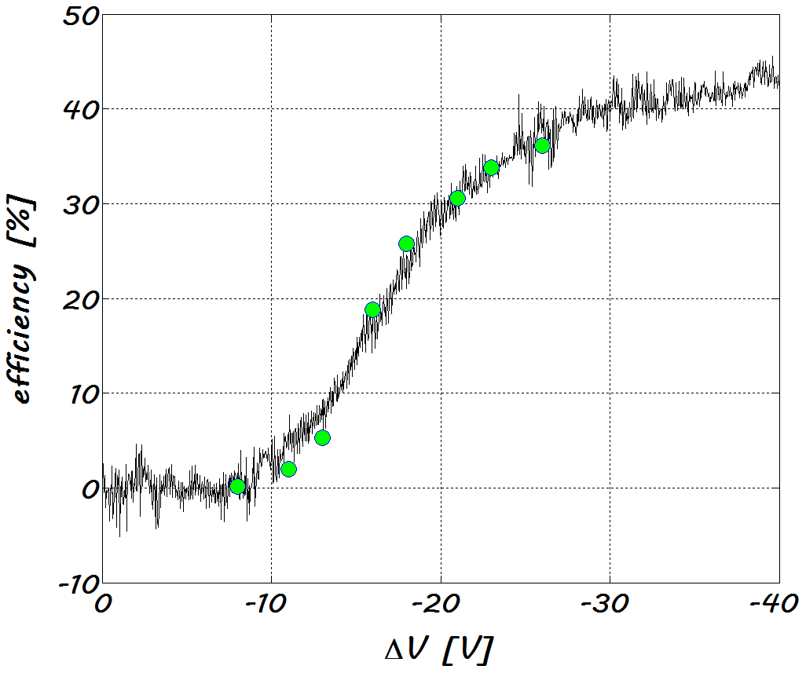
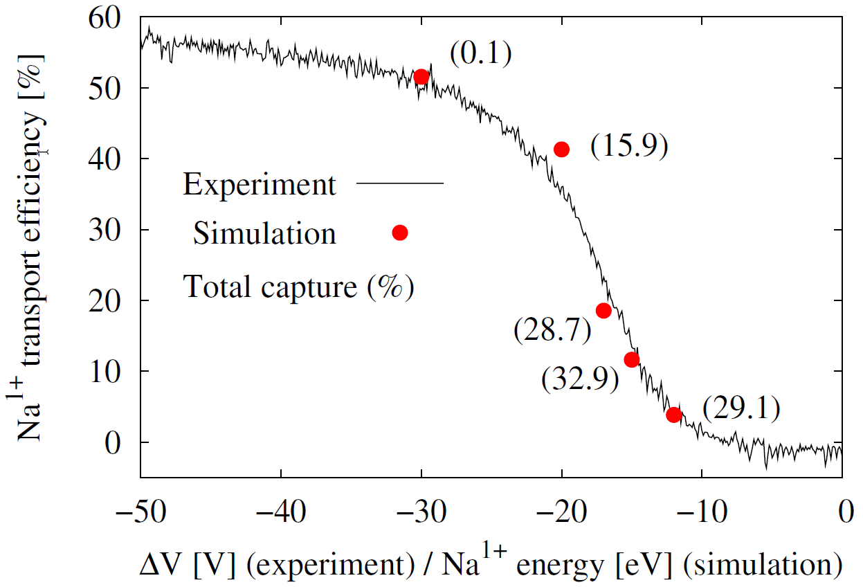
STEP-WISE PLASMA RESULTS
AGREEMENT WITH EXPERIMENTS!
n=2*10¹⁷ m⁻³
KT_{i}=0.3 eV
n=4.4*10¹⁷ m⁻³
KT_{i}=0.5 eV
Na**
Rb*
Shift: -4 V
Shift: -9 V
Einj [eV] | Captures [%] | ε1+ [%] | ΔVsim [V]
7 | 47.64 | 0.80 | -11
10 | 39.51 | 9.28 | -14
*A. Galatà et al., Plasma Sources Sci. Technol. 25 04500
**O. Tarvainen et al, Phys. Rev. Accel. Beams 19, 053402
Perugia, 2019-10-30
Alessio Galatà
PANDORA: measuring beta-decays in plasmas

Slide 16
STEP-WISE PLASMA RESULTS
BEAM-PLASMA INTERACTION
BALLISTIC OF THE PROCESS
ENERGY RELEASED IN THE PLASMA
Perugia, 2019-10-30
Alessio Galatà
PANDORA: measuring beta-decays in plasmas

Slide 17
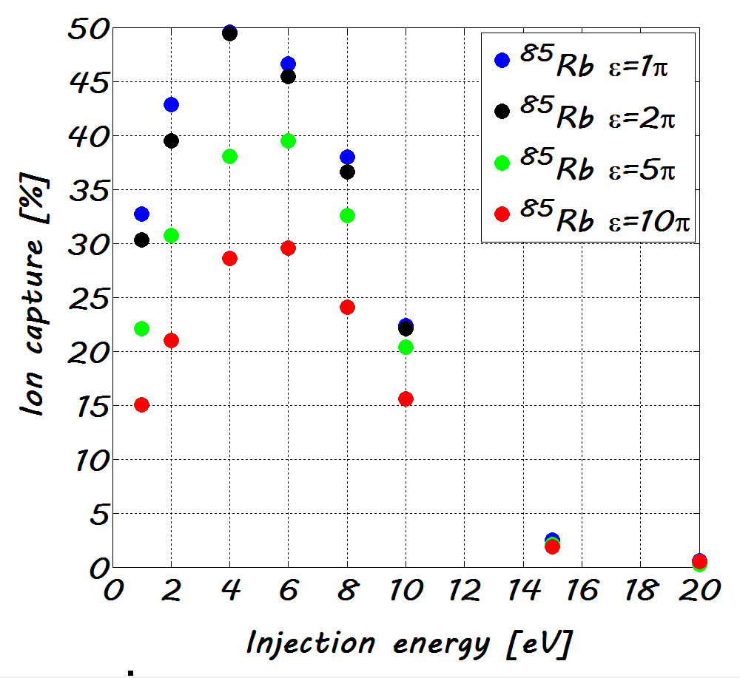
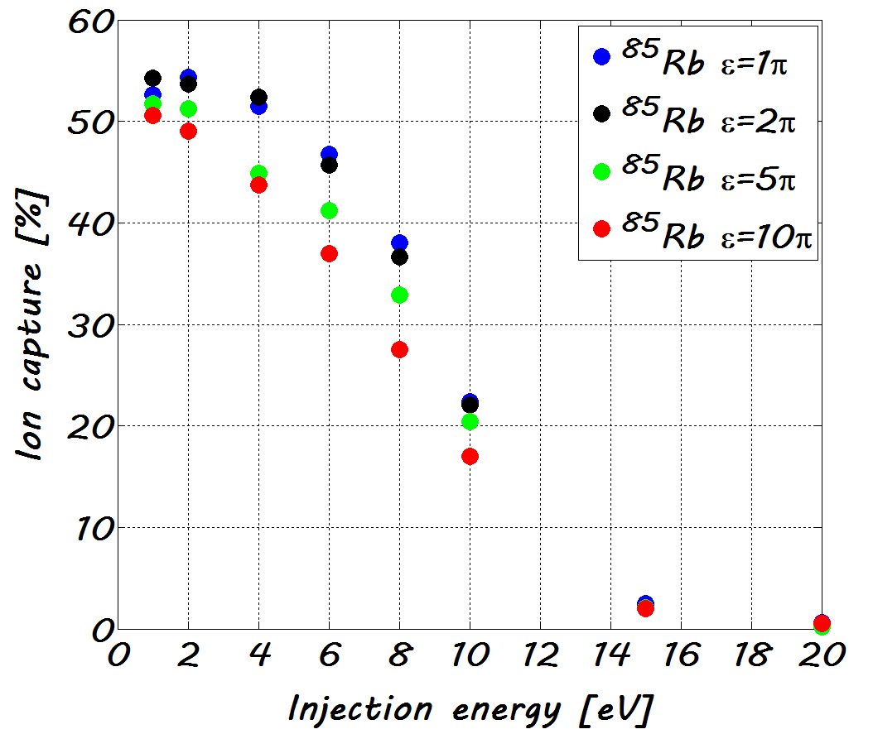
STEP-WISE PLASMA RESULTS
INFLUENCE OF BEAM EMITTACE*
Injected particles
Transmitted particles
E(x=1)= 1.6 eV for Rb with KT_{i}=0.3 eV
Slight shift of the optimum energy
Curves are very close to each other
EMITTANCE IS MORE INVOLVED IN THE INJECTION THAN THE CAPTURE PROCESS
*A. Galatà et al., Phys. Rev. Accel. Beams 20, 063401
Perugia, 2019-10-30
Alessio Galatà
PANDORA: measuring beta-decays in plasmas

Slide 18
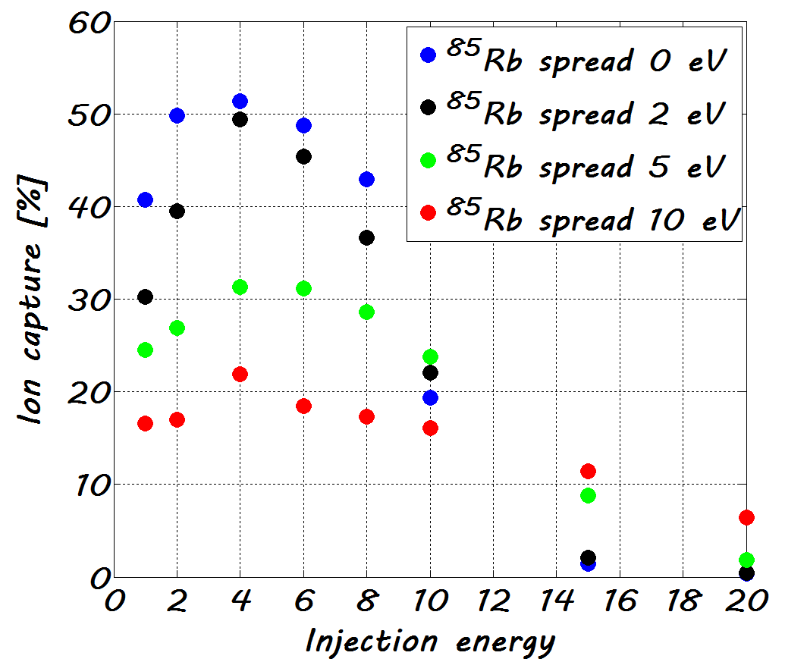
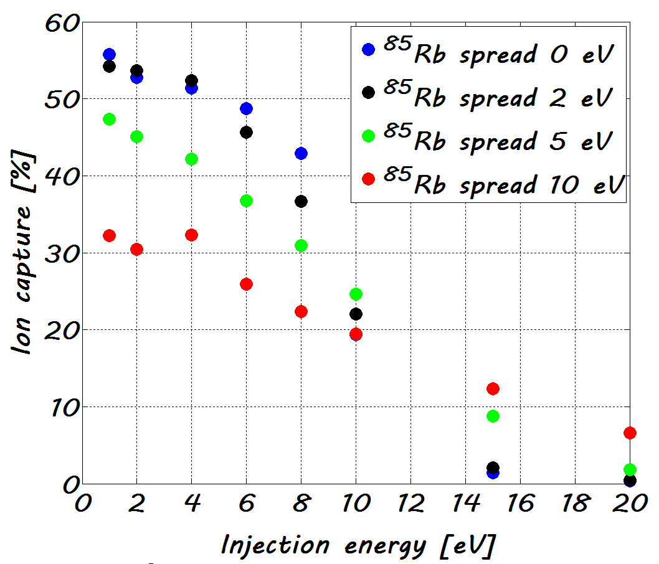
STEP-WISE PLASMA RESULTS
INFLUENCE OF BEAM ENERGY SPREAD*
Injected particles
Transmitted particles
Same optimum energy
ENERGY SPREAD ALWAYS CAUSES A MISMATCH IN THE CAPTURE PROCESS
*A. Galatà et al., Phys. Rev. Accel. Beams 20, 063401
Perugia, 2019-10-30
Alessio Galatà
PANDORA: measuring beta-decays in plasmas

Slide 19
DIFFERENT APPROACHES
ION DYNAMICS WITH COLLISIONS AND IONIZATIONS
ECR HEATING WITH COULOMB COLLISIONS
PLASMA DESCRIPTION
ELECTROMAGNETIC CALCULATIONS
Perugia, 2019-10-30
Alessio Galatà
PANDORA: measuring beta-decays in plasmas

Slide 20
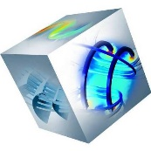
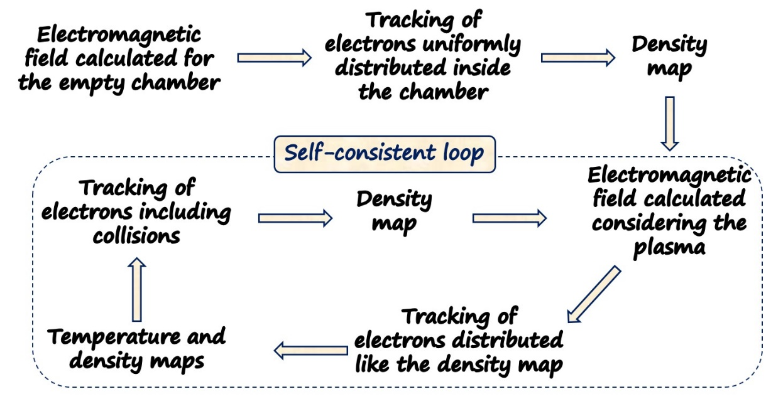
APPROACH TO SELF-CONSISTENCY
THE ELECTROMAGNETIC FIELD DISTRIBUTION AND THE PLASMA INFLUENCE EACH OTHER IN A CLOSED LOOP
TRACKING
Same approach as ion dynamics
T_{step}=10⁻¹² s
T_{span}=40 µs
N=40000 electrons
Perugia, 2019-10-30
Alessio Galatà
PANDORA: measuring beta-decays in plasmas

Slide 21
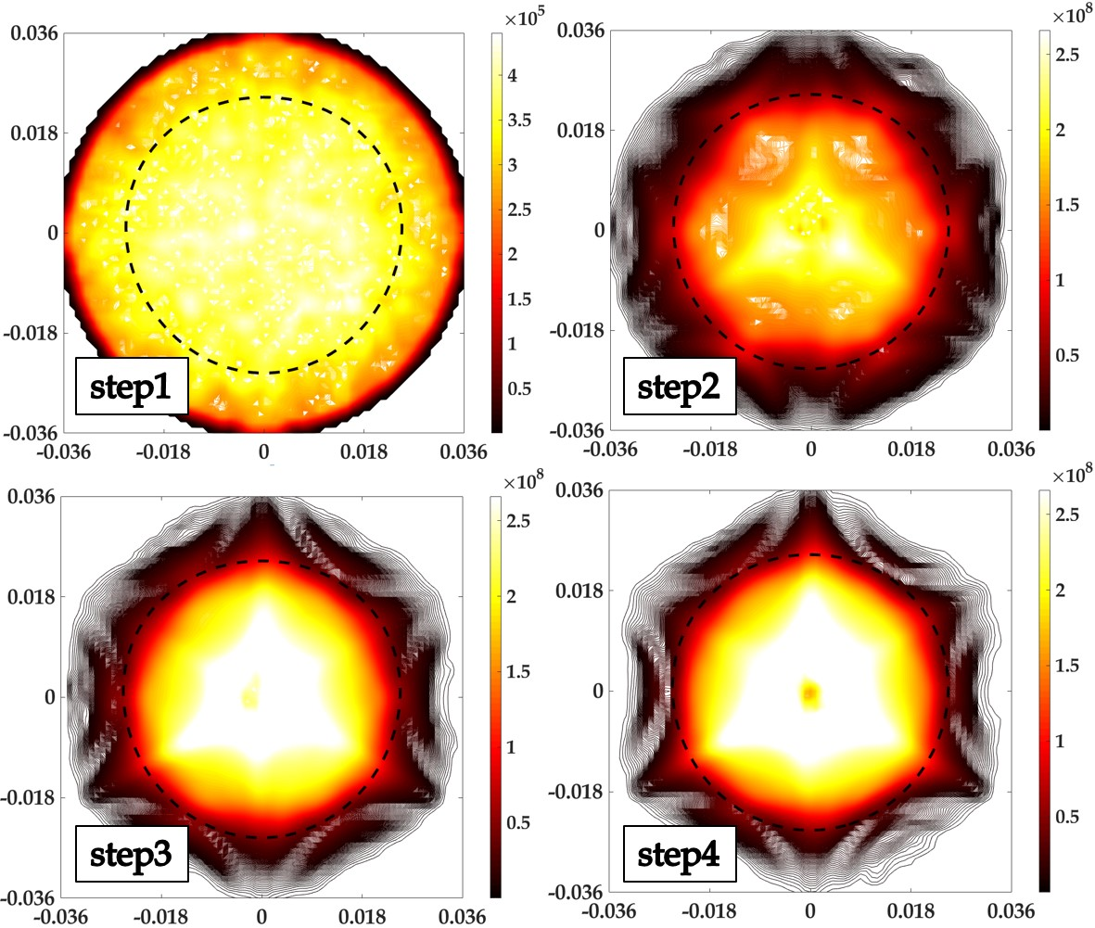
SELF-CONSISTENT RESULTS
OCCUPATION MAPS @ 14.521 GHz
The plasma concentrates inside the resonance surface
The plasmoid halo structure is automatically formed
The plasmoid has an its own structure
Perugia, 2019-10-30
Alessio Galatà
PANDORA: measuring beta-decays in plasmas

Slide 22
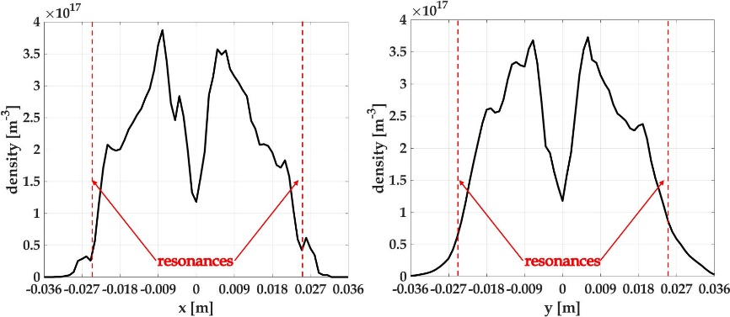
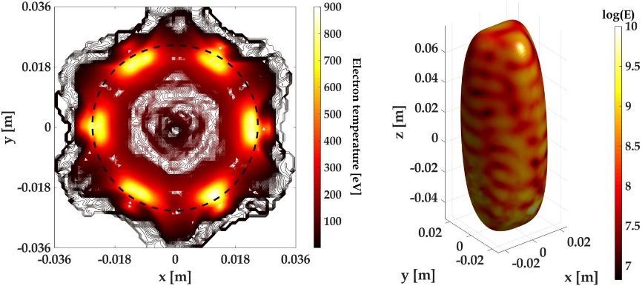
SELF-CONSISTENT RESULTS
DENSITY AND TEMPERTURE PROFILES @ 14.521 GHz
The maximum density exceeds the constant value of the step-wise case
The plasma is hollow
Step-wise
Step-wise
The maximum temperature is localized on the resonance surface
The distribution reflects that of the electromagnetic field
Perugia, 2019-10-30
Alessio Galatà
PANDORA: measuring beta-decays in plasmas

Slide 23
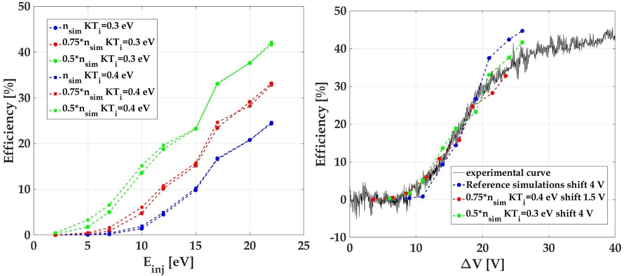
SELF-CONSISTENT RESULTS
INFLUENCE OF PLASMA PARAMETERS
The ion temperature affects mostly the global capture, not the extraction of 1+ ions
The plasma density influence the amount of 1+ ions that escape the plasma
BY SLIGHTLY VARYING THE PLASMA PARAMETERS THE SELF-CONSISTENT MODEL PERFECTLY MATCHES EXPERIMENTAL RESULTS
Perugia, 2019-10-30
Alessio Galatà
PANDORA: measuring beta-decays in plasmas

Slide 24
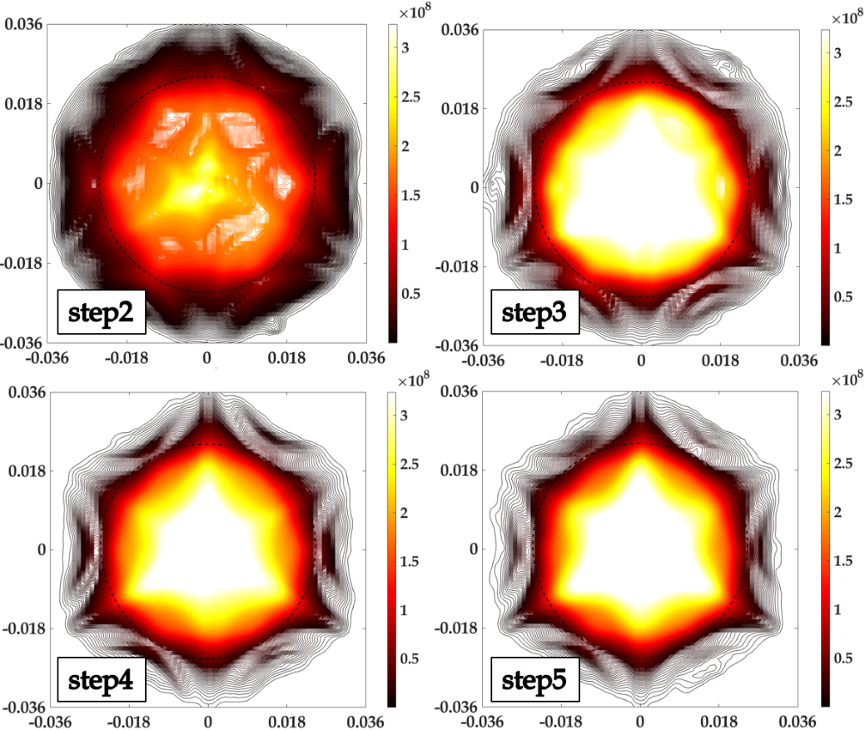
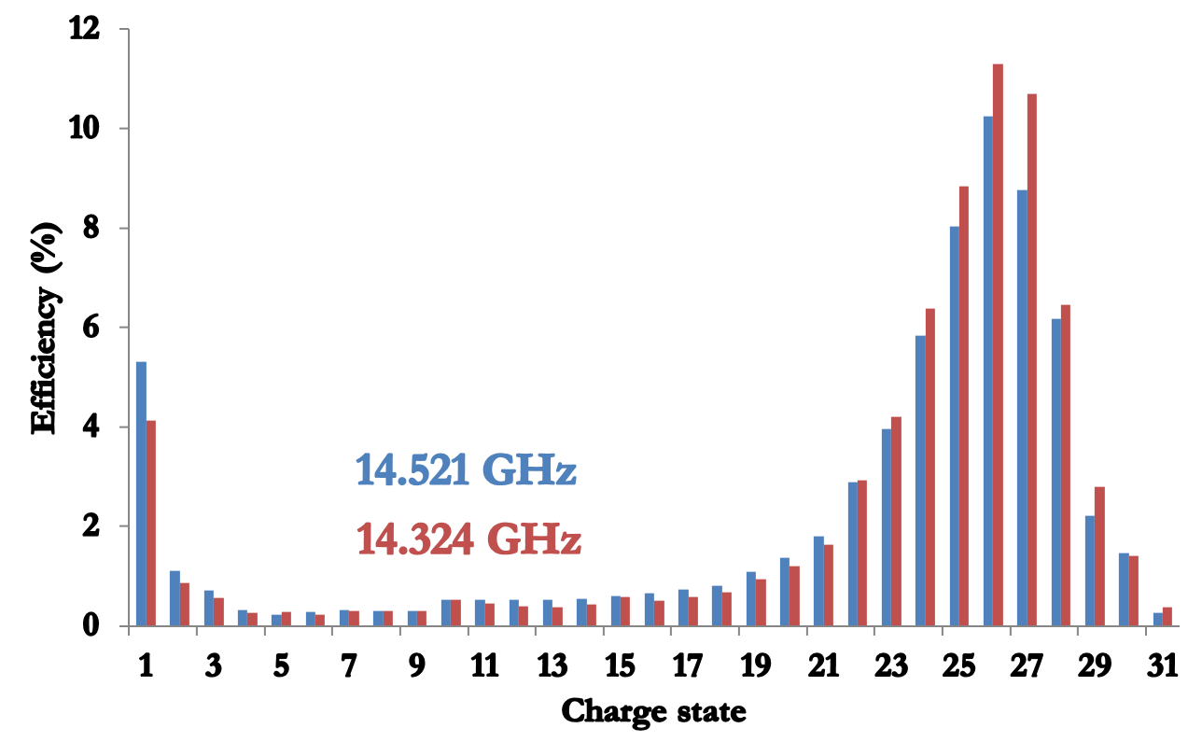
SELF-CONSISTENT RESULTS
FREQUENCY TUNING EFFECT: 14.324 GHz
Cesium fine frequency tuning during the acceptance tests of the SPES-CB
Cs
AGAIN THE PLASMOID/HALO STRUCTURE IS AUTOMATICALLY FORMED
Perugia, 2019-10-30
Alessio Galatà
PANDORA: measuring beta-decays in plasmas

Slide 25
14.521 GHz Vs 14.324 GHz
COMPARISON OF OCCUPATION MAPS
14.521 GHz
14.324 GHz
THE NEW FREQUENCY CREATES A MUCH DENSER PLASMA FOR THE SAME SIMULATED MICROWAVE POWER
Perugia, 2019-10-30
Alessio Galatà
PANDORA: measuring beta-decays in plasmas

Slide 26
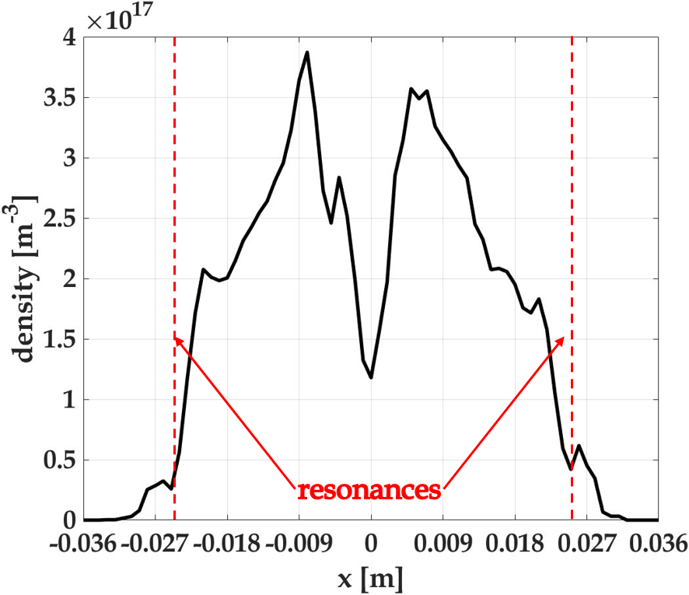
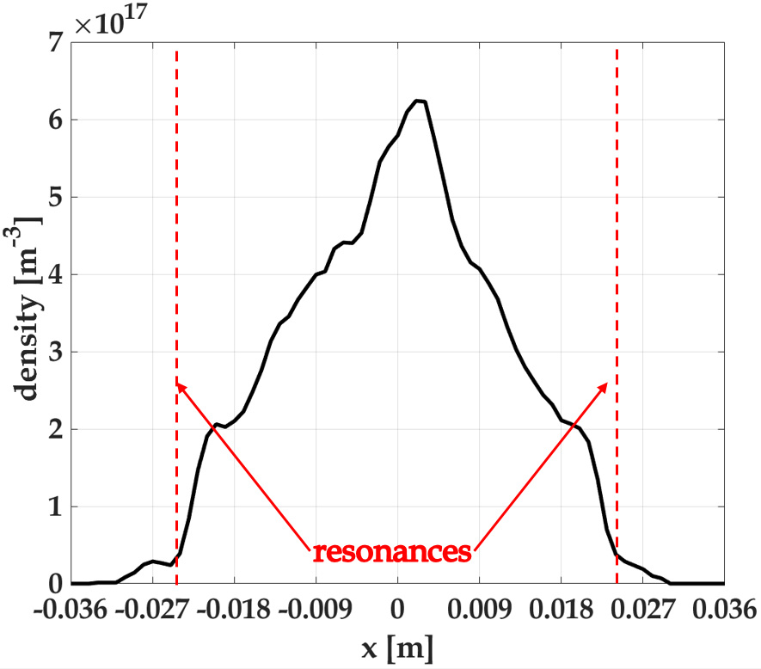
14.521 GHz Vs 14.324 GHz
COMPARISON OF DENSITY PROFILES*
14.521 GHz
14.324 GHz
BY CHANGING THE FREQUENCY THE FINE STRUCTURE OF THE PLASMOID CHANGES FROM HOLLOW TO PEAKED AT THE CENTER
*A similar effect observed in Celona et al, Review of Scientific Instruments 79, 023305 (2008)
Perugia, 2019-10-30
Alessio Galatà
PANDORA: measuring beta-decays in plasmas

Slide 27
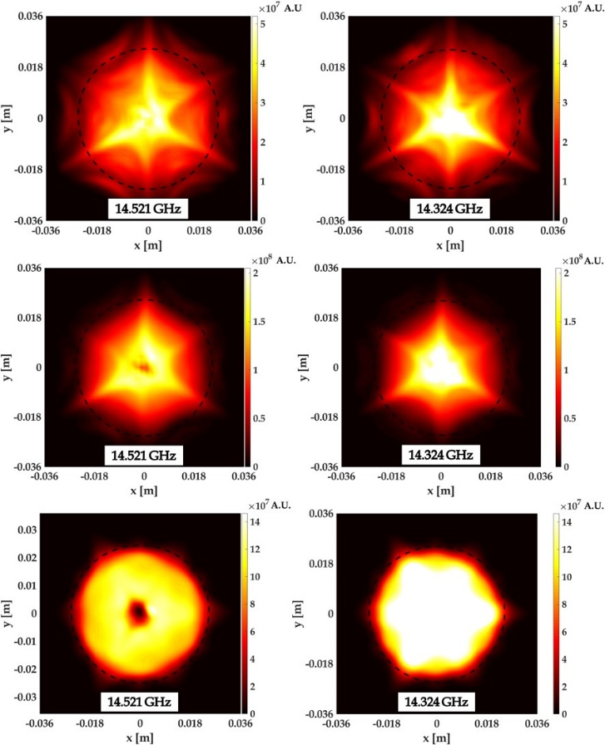
14.521 GHz Vs 14.324 GHz
OCCUPATION MAPS IN DIFFERENT ENERGY RANGES
IT IS POSSIBLE TO OBTAIN OCCUPATION MAPS IN ANY ENERGY RANGE!
0-10 eV
10-100 eV
THE FREQUENCY AFFECTS THE ELECTRONS DENSITY AND ENERGY DISTRIBUTIONS
100-10000 eV
Perugia, 2019-10-30
Alessio Galatà
PANDORA: measuring beta-decays in plasmas

Slide 28
ELECTROMAGNTIC SIMULATIONS
FROM VACUUM TO ANISOTROPIC PLASMA
Calculations in vacuum
Calculations with a plasma: plasmoid-holo scheme
n_{halo}
n_{plasmoid}
B_{ECR}
ISOTROPIC PLASMA
Single-value Dielectric Constant*
ANISOTROPIC MAGNETIZED PLASMA FULL 3D DIELECTRIC TENSOR
*Evstatiev et al. RSI 85, 02A503 (2014)
Perugia, 2019-10-30
Alessio Galatà
PANDORA: measuring beta-decays in plasmas

Slide 29
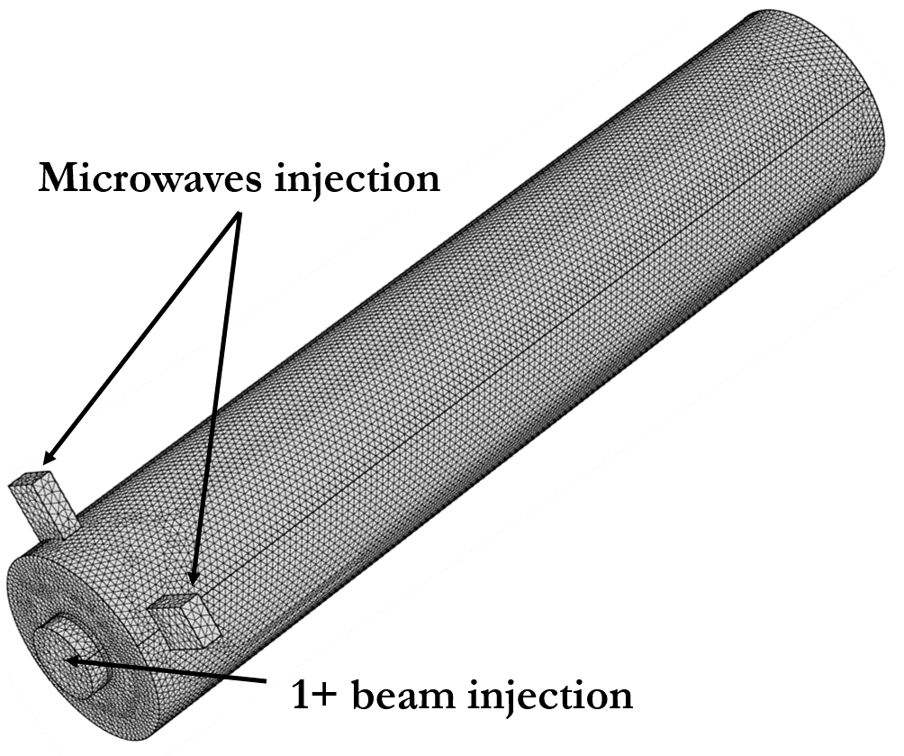
ELECTROMAGNTIC SIMULATIONS
FREQUENCY DOMAIN
TWO SPECIFIC FREQUENCIES:
14.521 GHz (operating)
14.324 GHz (SPES-CB acc. tests).
Real geometry (waveguides, holes)
Boundaries: PML, IBC, port & port-off
Magnetic field
Interaction COMSOL-MATLAB
Adaptive mesh
Extraction hole
Perugia, 2019-10-30
Alessio Galatà
PANDORA: measuring beta-decays in plasmas

Slide 30
ELECTROMAGNTIC SIMULATIONS
FREQUENCY DOMAIN
ANISOTROPIC PLASMA
STEP-WISE PLASMOID/HALO STRUCTURE
 | 14.324 GHz | 14.521 GHz
P_{input} [W] | 100 | 100
P_{f} [W] | 92.6 | 68.4
P_{hole} [W] | 14.5 | 41.3
P_{w2} [W] | 0.8 | 3.0
P_{plasma} [W/%] | 74.5/80.4 | 16.6/24.4
NUMERICAL EVIDENCE OF THE FREQUENCY TUNING EFFECT !
*A. Galatà et al, RSI 87, 02B505 (2016)
Perugia, 2019-10-30
Alessio Galatà
PANDORA: measuring beta-decays in plasmas

Slide 31
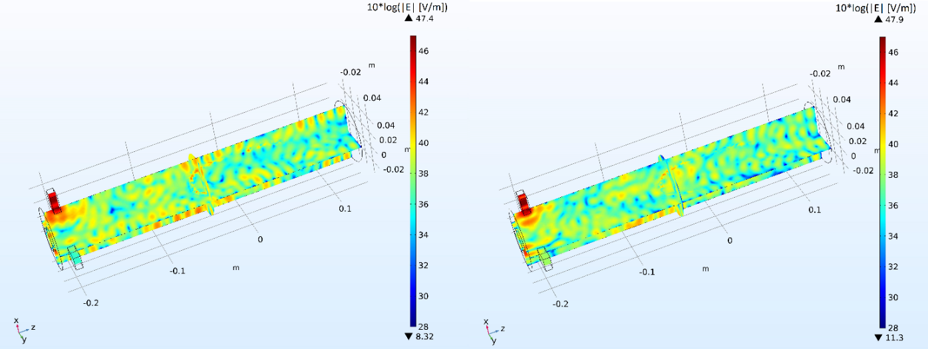
ELECTROMAGNTIC SIMULATIONS
FREQUENCY DOMAIN: SELF-CONSISTENT PLASMA
ELECTROMAGNETIC FIELD FOR THE EMPTY CHAMBER
14.324 GHz
14.521 GHz
ELECTROMAGNETIC FIELD DURING THE SELF-CONSISTENT LOOP
14.324 GHz
14.521 GHz
Perugia, 2019-10-30
Alessio Galatà
PANDORA: measuring beta-decays in plasmas

Slide 32
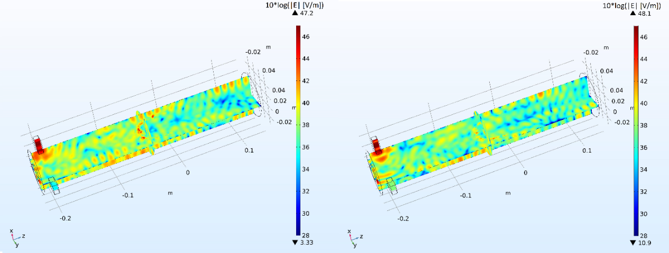
ELECTROMAGNTIC SIMULATIONS
FREQUENCY DOMAIN: SELF-CONSISTENT PLASMA
14.324 GHz
14.521 GHz
ELECTROMAGNETIC FIELD AT THE END OF THE SELF-CONSISTENT LOOP
INTENSIFICATION OF THE ELECTRIC FIELD AT THE RESONANCE
_{32 kV/m}
_{12 kV/m}
Perugia, 2019-10-30
Alessio Galatà
PANDORA: measuring beta-decays in plasmas

Slide 33
CONCLUSIONS
The code is able to describe ion dynamics, even for PANDORA full scale (1+ beam injection)
Electron dynamics: Comsol+MatLab
Plasmoid/halo formation
Plasmoid fine structure
Effect of the frequency
Energy distribution
Density and energy maps (in any range) can be exported
Benchmark with experimental results
Predictive tool for the PANDORA plasma description
Perugia, 2019-10-30
Alessio Galatà
PANDORA: measuring beta-decays in plasmas

Slide 34
THANK YOU FOR YOUR ATTENTION

